Slide 1


Slide 2


Slide 3

Notes:
Introduce yourself

Slide 4

Notes:
Have teachers write their goals on a post it note and share
Review our goals in the next slide

Slide 5


Slide 6

Notes:
I share my rule of the socks:
They have never been on my feet
They are not a souvenir of the workshop
Put your cellphones away in the sock (model with your own)

Slide 7

Notes:
Ask the teachers to discuss with the person next to them and then share.

Slide 8

Notes:
Ask the teachers to discuss with the person next to them and then share.

Slide 9

Notes:
This is the premise of the workshop, you have to plan for discussions in your classroom. You are going to share steps to make that happen.

Slide 10
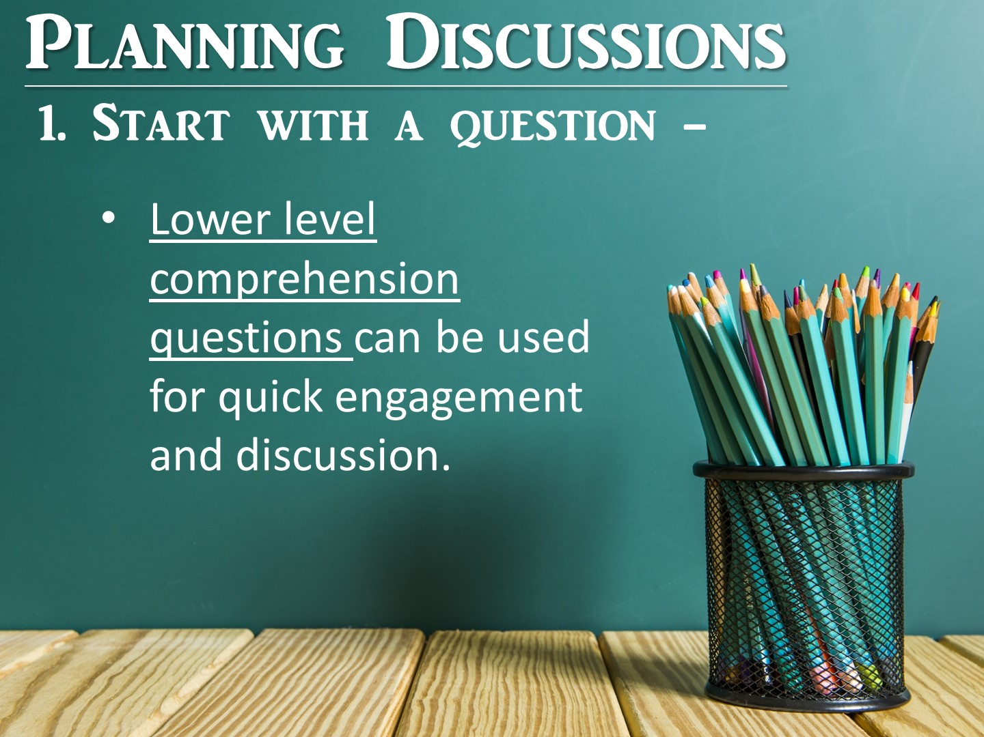
Notes:
The first step in planning for discussion seems obvious, but it is often overlooked. Planning your questions. When you plan your questions, you are also planning the intent of the discussion, because the intent of the discussion will help you craft your questions.
Let me explain. If you are planning on having a quick discussion to check for comprehension or to build student engagement, you will plan lower level questions. These short discussions can provide brain breaks for your students and help them process the information. These questions will be easier for you to write and will be based directly on the content you teach.

Slide 11
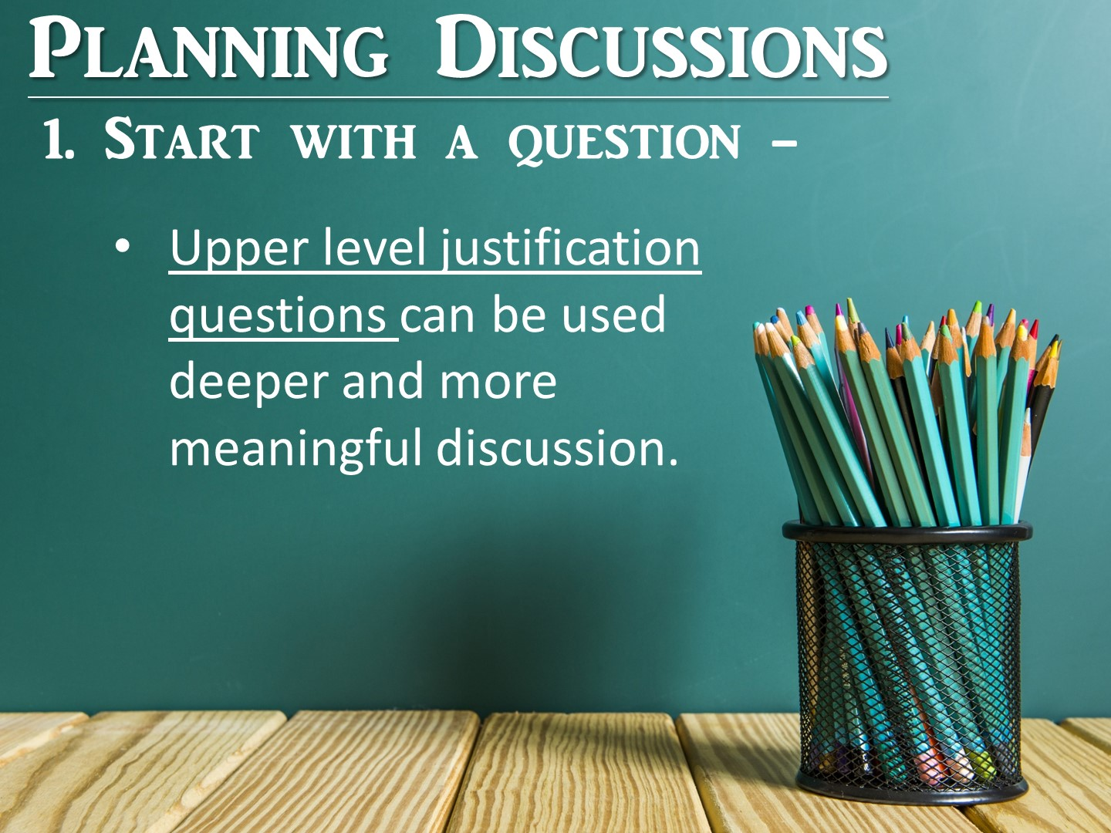
Notes:
If your goal is a deeper and more meaningful discussion, you need higher level questions. These are the questions that take place at the end of the class or unit as students process all of the information they have learned. The best type of upper level questions are essential questions.
Essential questions are questions that focus on the big ideas in Social Studies. They often tie back to important concepts in Social Studies as well as the content you are teaching. Essential questions Have no simple “right” answer; they are meant to be argued, and as such, lead to powerful classroom discussions.
I have included more information on crafting essential questions in your Discussion Strategies Manual.

Slide 12

Notes:
This next step seems obvious also, but too often we don’t provide our students enough information prior to leading a discussion. How can students discuss a topic they know nothing about.

Slide 13

Notes:
Providing background information needs to be more than a lecture. Students need to interact with the content before they can discuss it. Background information needs to increase student interest on the topic, so you can use resources such as songs, primary sources and even a high interest reading.

Slide 14
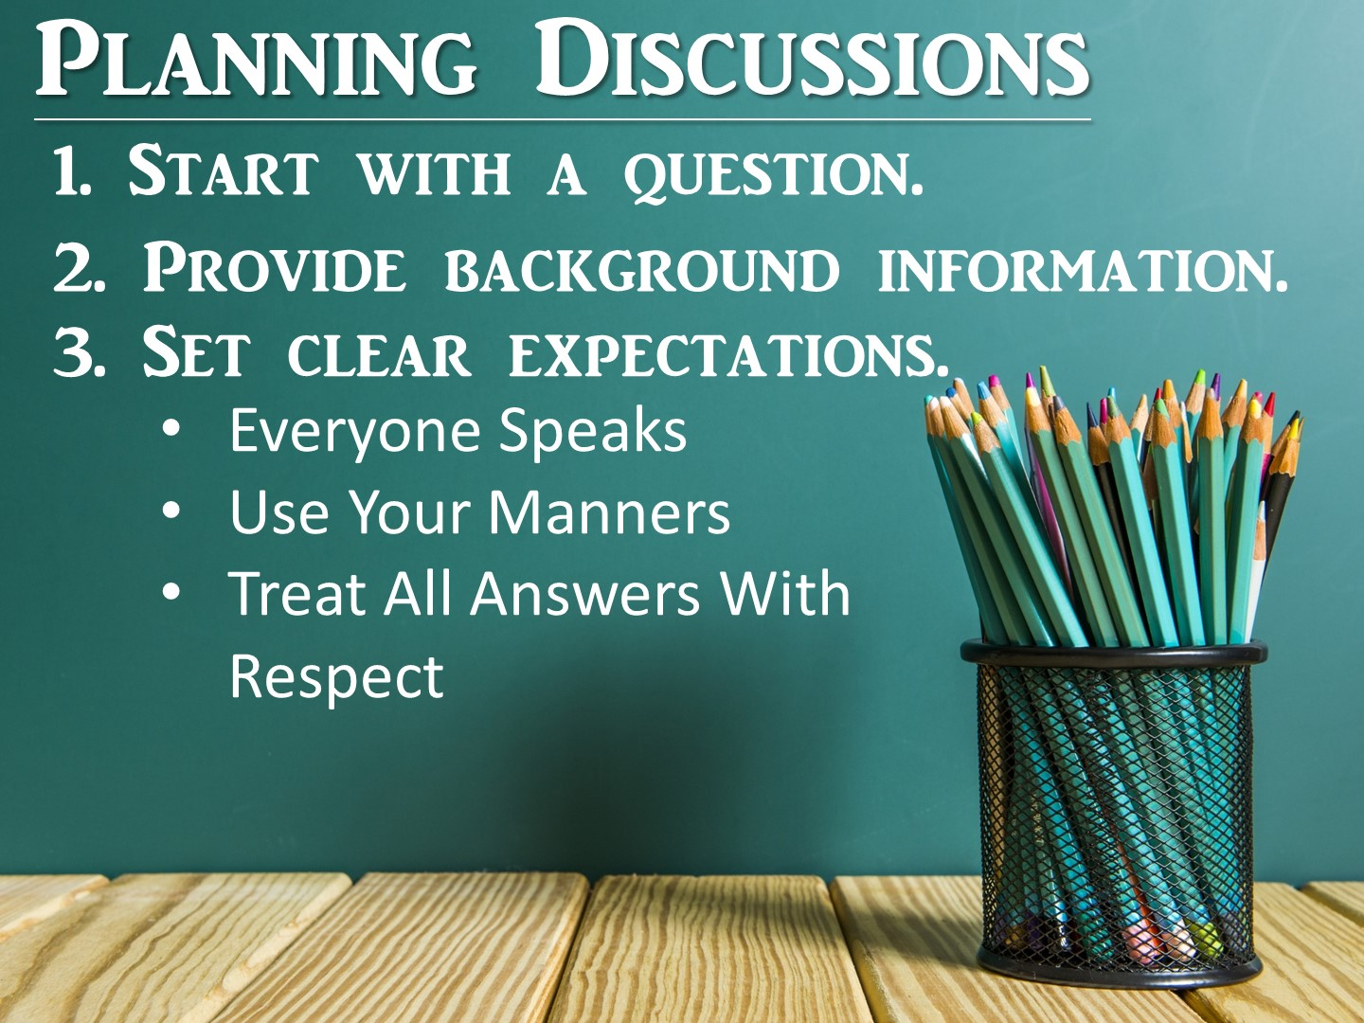
Notes:
Step Three needs to be used prior to every discussion. What are your expectations for the discussion? Do your students know these expectations? How do you teach them? Was it modeled? Is it on an anchor chart that you review? This important step needs to be thought out in advance and include instruction on it’s own.

Slide 15

Notes:
The final step is to actually choose the strategy you want to use. The strategy should match your goal in step one. Each of these strategies I am going to share with you can be used in whole groups, small groups and even with a partner. In addition to these strategies, you will receive more in your Discussion Strategy Manual.

Slide 16

Notes:
Give teachers time to discuss with a partner, then use popsicle people to randomly call on teachers
16

Slide 17

Notes:
Give teachers time to discuss with a partner, then use popsicle people to randomly call on teachers

Slide 18

Notes:
The first series of discussion strategies are going to focus on whole class discussions.

Slide 19
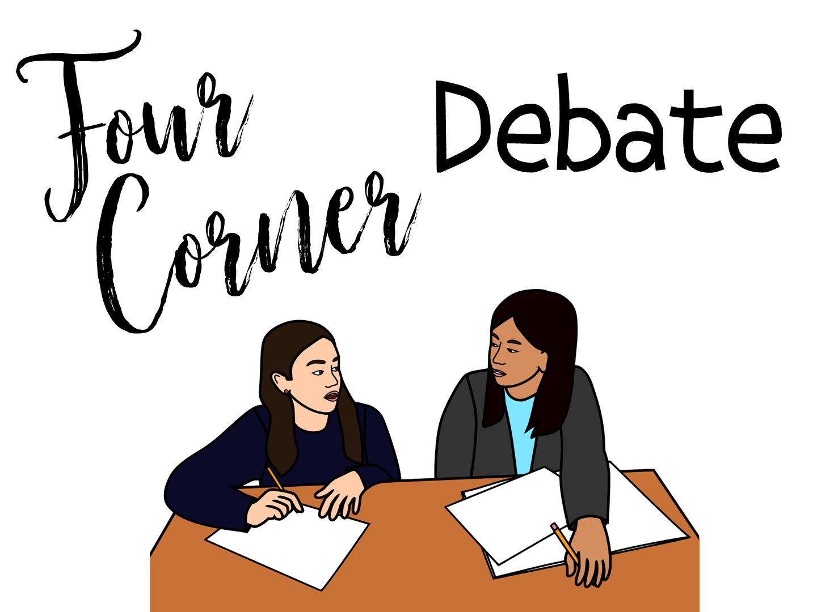
Notes:
Four corner debate is a strategy you can use to create a discussion in your class as well as include movement. This strategy works well as a preview when you start class, but can also be used to summarize and draw conclusions at the end.

Slide 20

Notes:
This is an example of how you can use a four corner debate. You post a provocative statement that can be answered in multiple ways with a variety of responses. Hang the 4 corner cards up in your room in 4 different spaces. Give each student an index card. Before they move to their corner, have the students write a response on their card. This provides students wait and think time – and also just prevents them from going to the corner with their friends. Once a few minutes have passed, allow students to stand up and move into the corner that corresponds with their answer. Ask a few debrief questions like: where is the majority of the class standing? Which response has the least students? Then have the students in the 4 corners organize themselves into smaller groups of 3-4 students. Have them read their index card with their response to the smaller group. Once everyone has had a chance to speak in their group, randomly call on one person from each of the 4 corners to share their response. Encourage them to pull in other answers they have heard in their small group discussion.

Slide 21

Notes:
Here are some examples of 4 corner debate questions. In order for a four-corner debate to be effective, you must create a statement that can be viewed from multiple perspectives and is controversial. Take essential questions and turn them into provocative statements.
A tip for four corner activities is to have your students write their answers on an index card, then move to the corner to debate.

Slide 22

Notes:
You can also use 4 Corners with Questions and Answers – Instead of posting the Agree/Disagree signs, just post the numbers 1-4 in your room. Your students can move to the number that corresponds with the answer choice they choose. Once again they will need to explain their thinking to other students that have created similar responses.

Slide 23

Notes:
A twist on 4 Corners is to actually create a Human Bar Graph. Instead of just bunching up in front of a sign, have your students create a bar graph out of their bodies. You can then debrief by having the students look around the room to see which topic received the most responses, the least, and ask a few questions before you have your students discuss it in their smaller group.

Slide 24
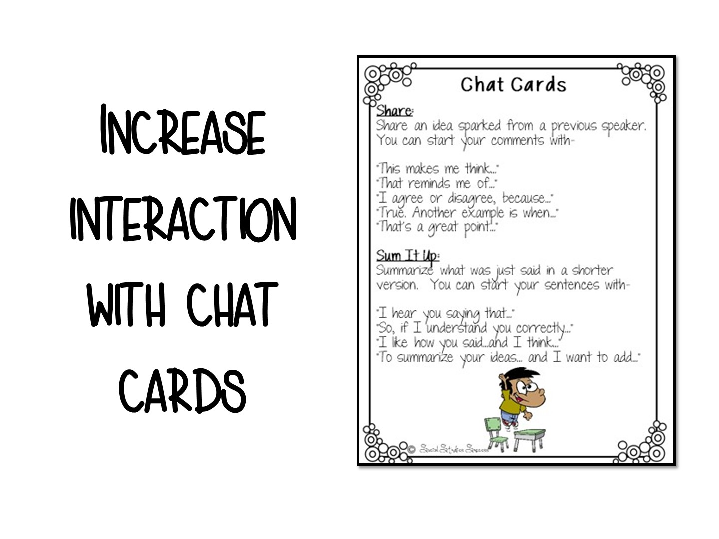
Notes:
A modification to the 4 Corner Discussion is to use chat cards. Chat cards are a great strategy for structuring a discussion with sentence starters. These work well with ELL students who may need extra support structuring their sentences or for a group of students who may need instruction in civil discourse.
Pass out these cards prior to a discussion. Give your students time to read the sentence starters. When you start your discussion, give guidelines to your students, such as – “You must use a statement from the “Share” category” or “You must use a statement from the “Sum It Up Category”. When you finish your discussion, make sure you acknowledge who used these cards correctly.

Slide 25
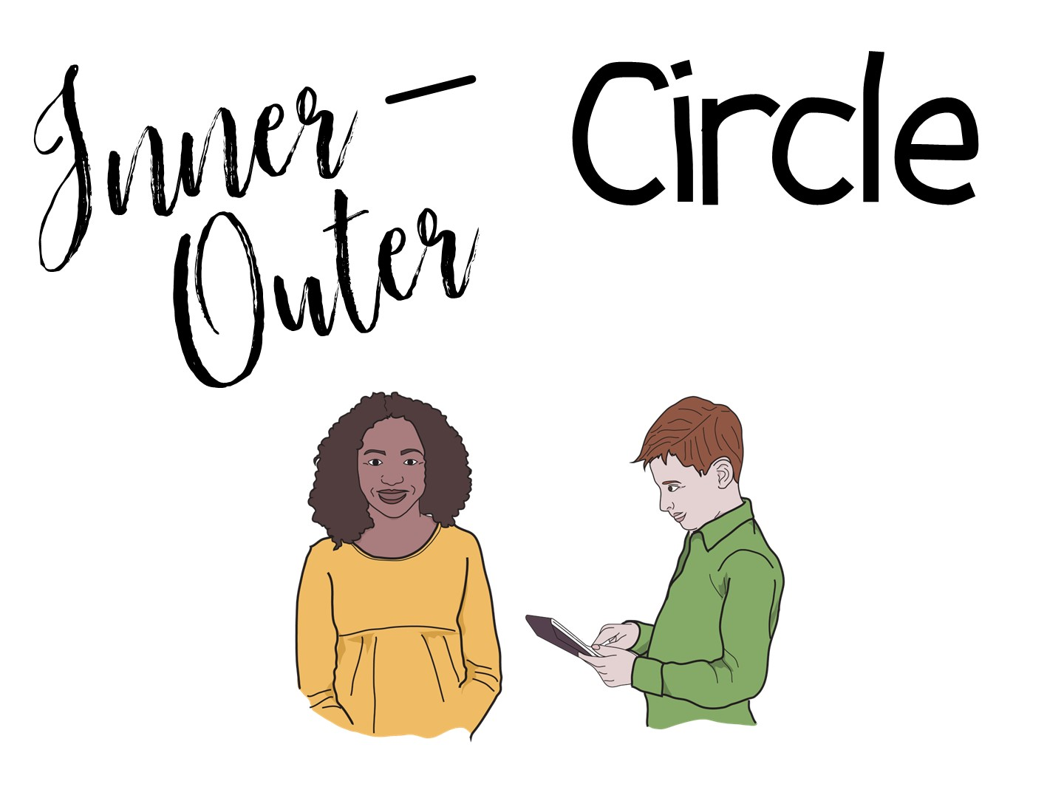
Notes:
Inner – Outer circle is another strategy that will include your entire class and incorporate movement as well. This is a great strategy for involving all of the students in your class in a low-steaks discussion.
The inner – outer circle strategy is great when you want to check for understanding and have a brief discussion. For this strategy to work, you need to provide students background information and a few questions that spiral from easy to more complex. Give your students time to answer the questions and prepare for the inner-outer circle.

Slide 26
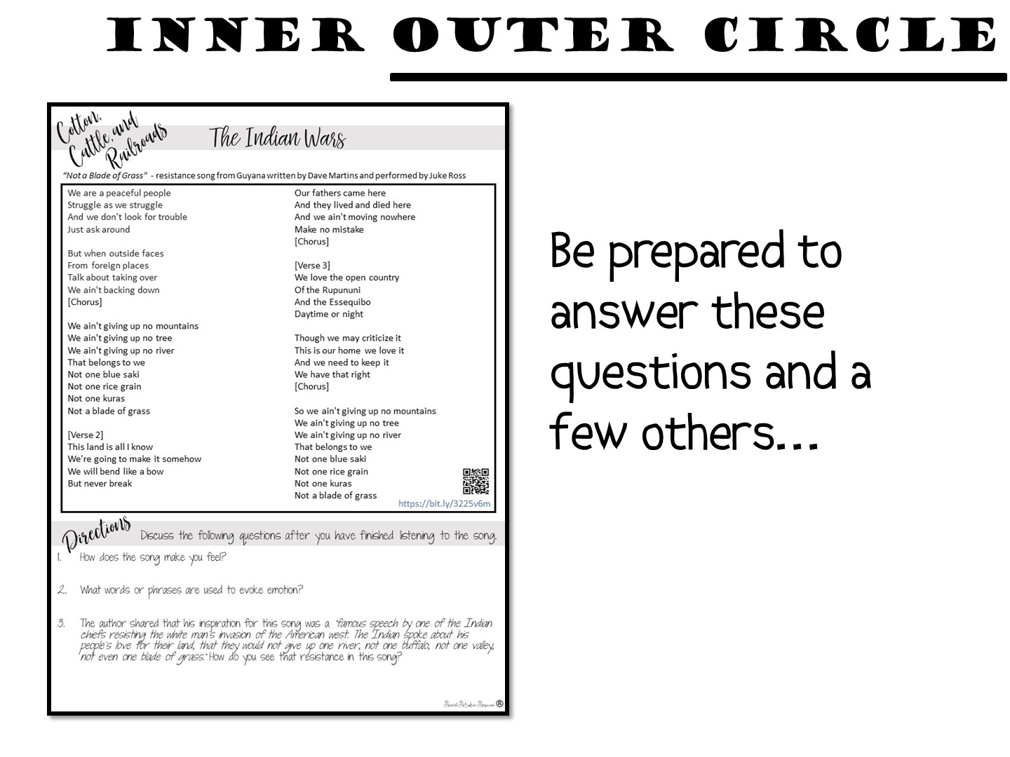
Notes:
We are going to build a little background knowledge on the Indian Wars in Texas History – let’s start by listening to a song and discussing the questions before we learn the content (not really – you are just modeling this strategy). Download the song onto your Iphone and play to the teachers to prep.

Slide 27

Notes:
You will need space for the next step – get your students out of their desks and have them create a circle around you. You will need to stay in the center of the circle so that you can monitor the discussion.

Slide 28
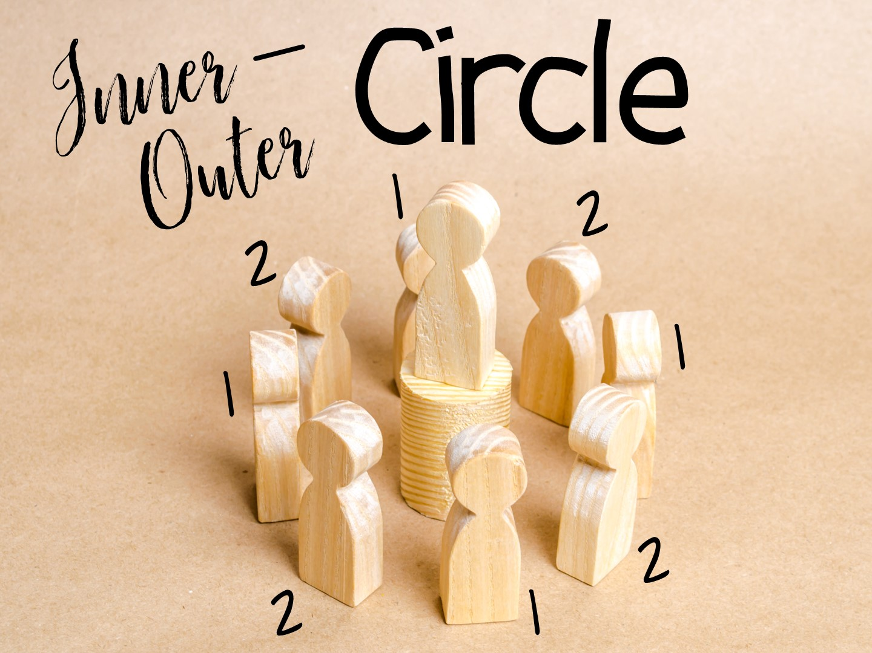
Notes:
Starting with any student, go around the circle and number the students off, 1,2, 1, 2, until you have assigned numbers to all of the students. The students who are number one need to stay in their position. The number two students will take one step forward and then turn around, facing the number one student who is next to them. I always have the students shake hands and say hello, but a fist bump will work as well.

Slide 29
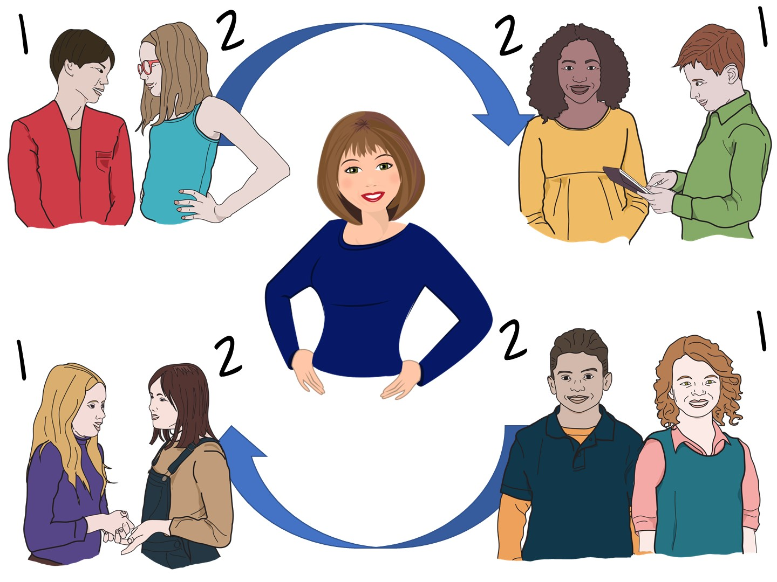
Notes:
Once the students are grouped in two circles facing each other (Inner and Outer Circle). I will read the first question out loud. In the first round, student number 1 will repeat the question to student number two, who will then answer it. After a minute or so, get the students attention (I recommend a bell), and have the number two student on the inside take a step to their left. This will place them with a new partner. Once again, shake hands and say hello.
In this round, I will ask a question, and student number 2 will repeat the question to their new partner. Student number one is responsible for answering the question.
Repeat the process for 3 to 4 rounds, giving every student a chance to both ask a question and answer a question. After every question, rotate the inner circle.
After you have completed the rounds, debrief with your class. Share what you heard when you were standing inside the circle and praise those with especially thoughtful responses.

Slide 30

Notes:
What did you learn about whole class discussions?

Slide 31

Notes:
Next we are going to take a look at strategies for smaller group discussions. This will include strategies for groups of 4, 3, and 2 students. I am going to model a lesson for you with discussion strategies embedded throughout the session.

Slide 32
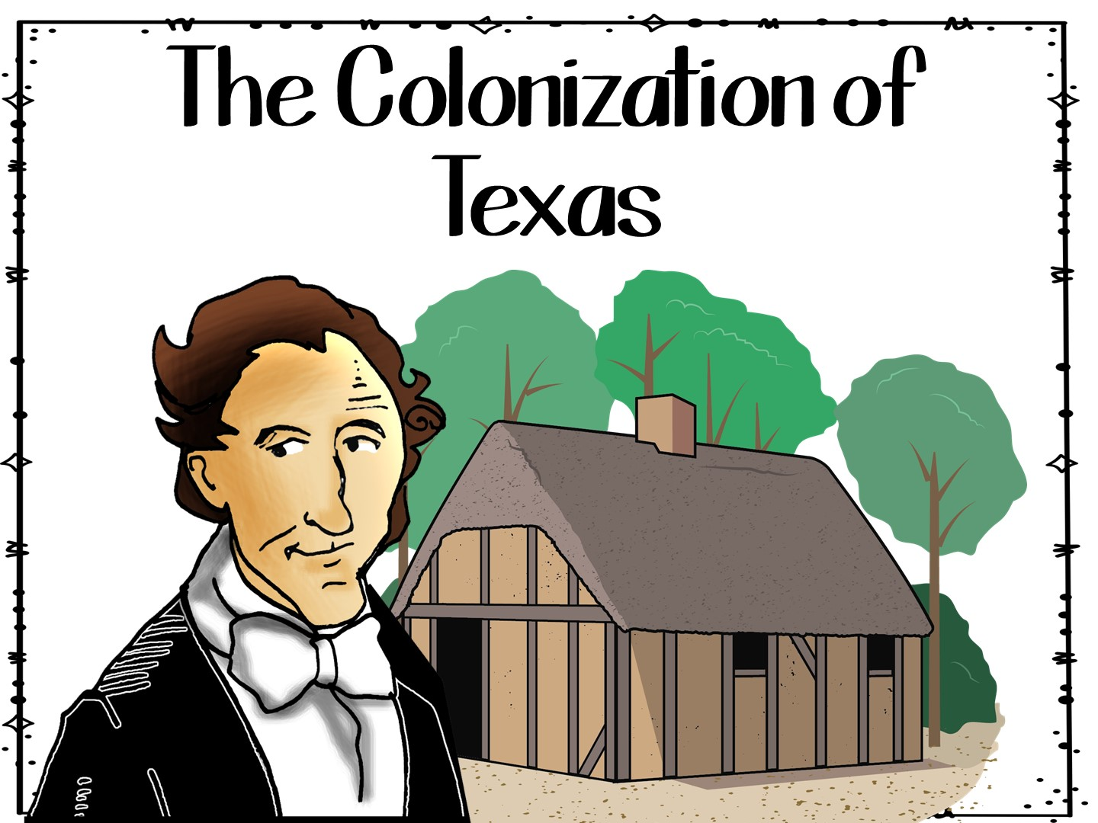
Notes:
You are going to model a lesson for the teachers – the content will be on the colonization of Texas. Tell teachers to focus on the strategies for discussion that you use.

Slide 33
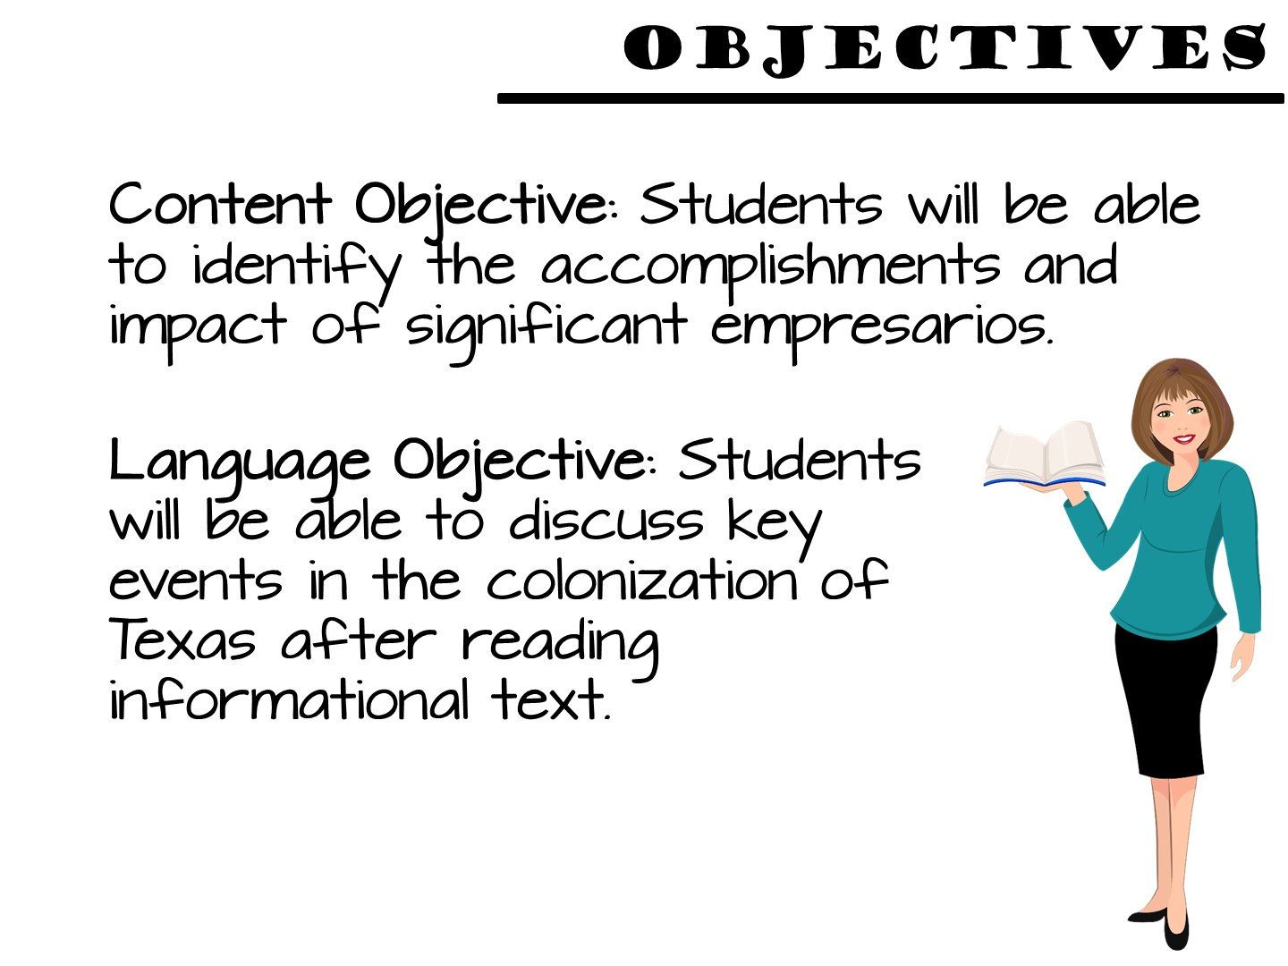

Slide 34

Notes:
Share that the strategy you will be modeling is a structured discussion

Slide 35

Notes:
Pronounce all of the vocabulary terms for the teachers on the word wall

Slide 36
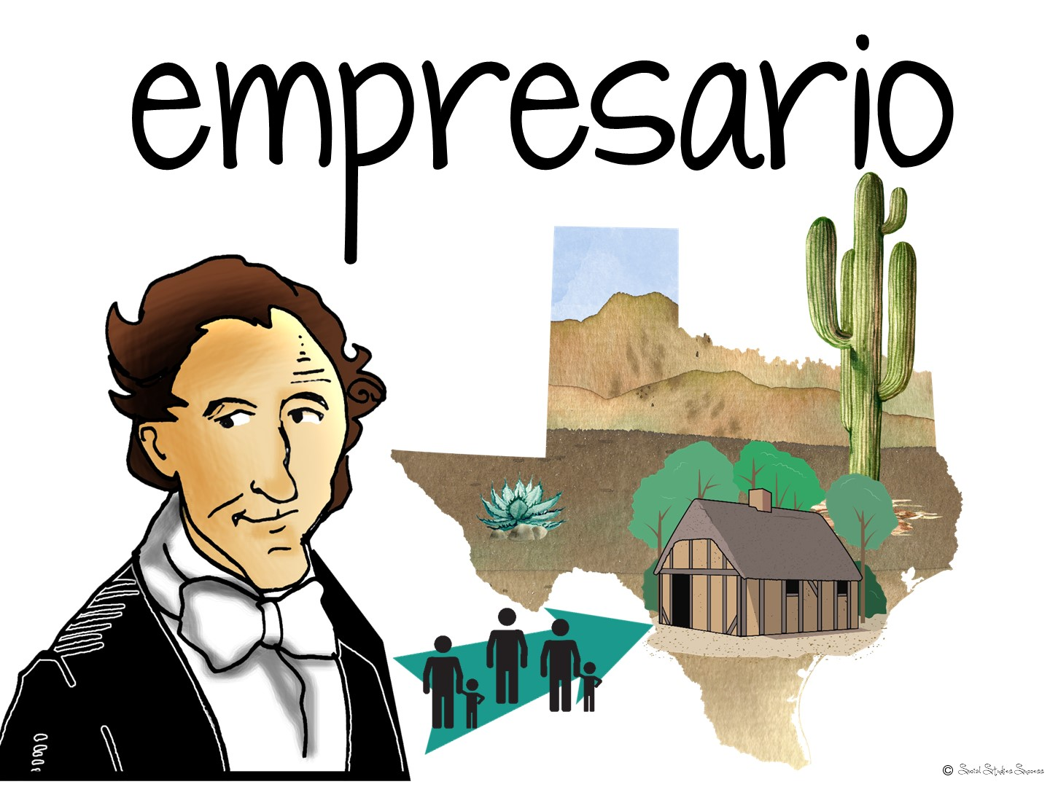

Slide 37


Slide 38


Slide 39


Slide 40

Notes:
– give each group a number card (1-3)

Slide 41
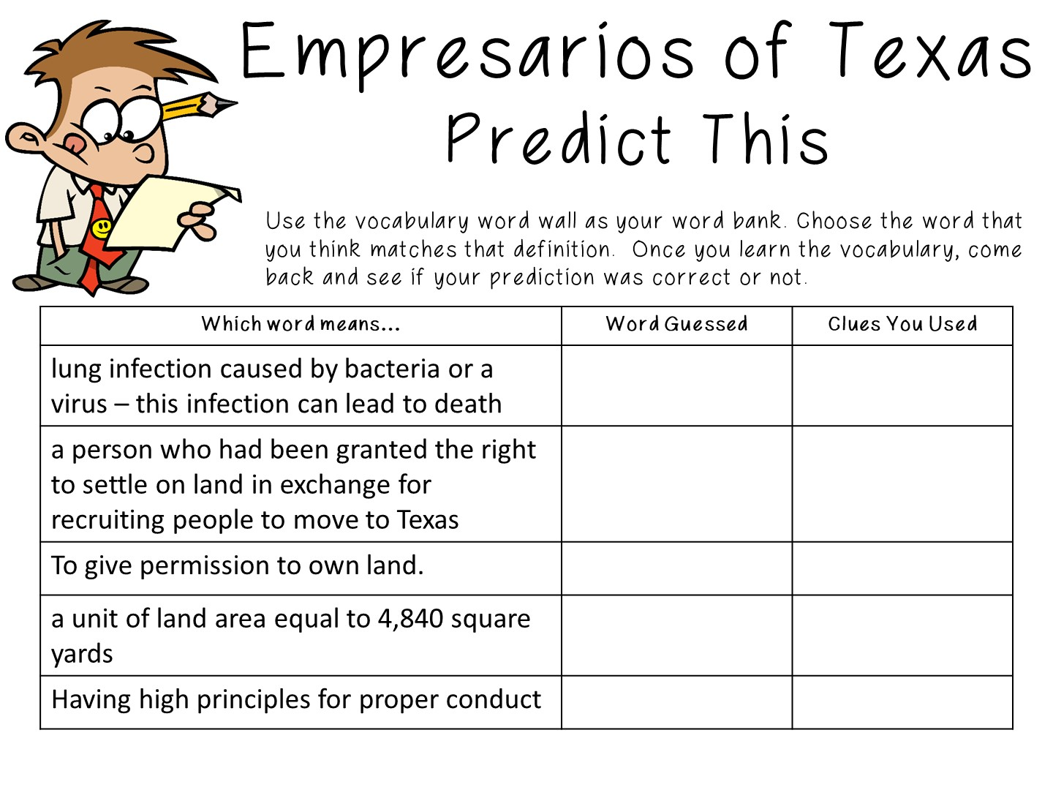
Notes:
Use the predict this activity to go over the vocabulary

Slide 42
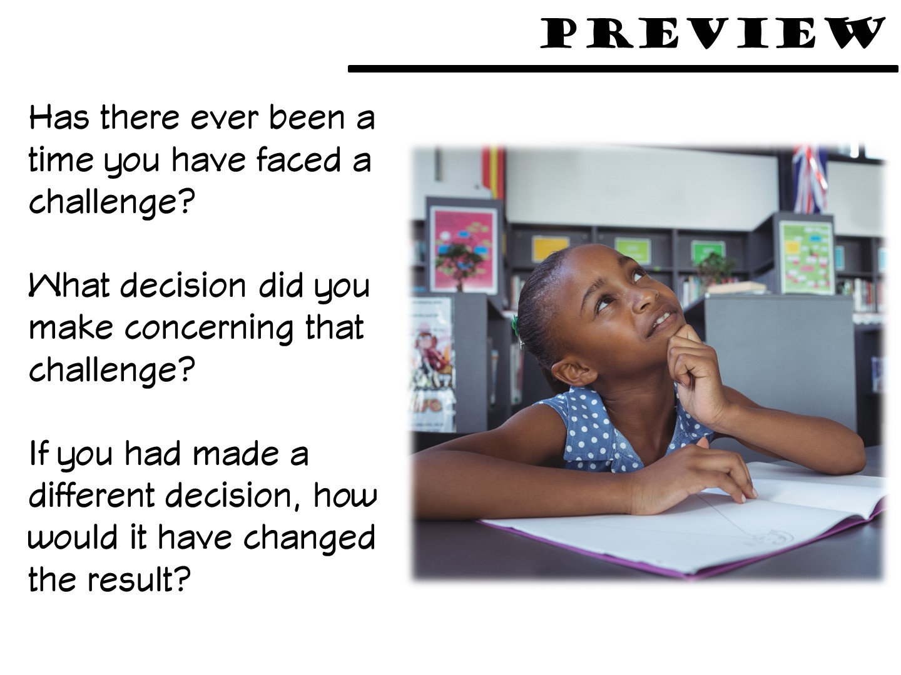
Notes:
Teachers should discuss these questions in their small group.

Slide 43
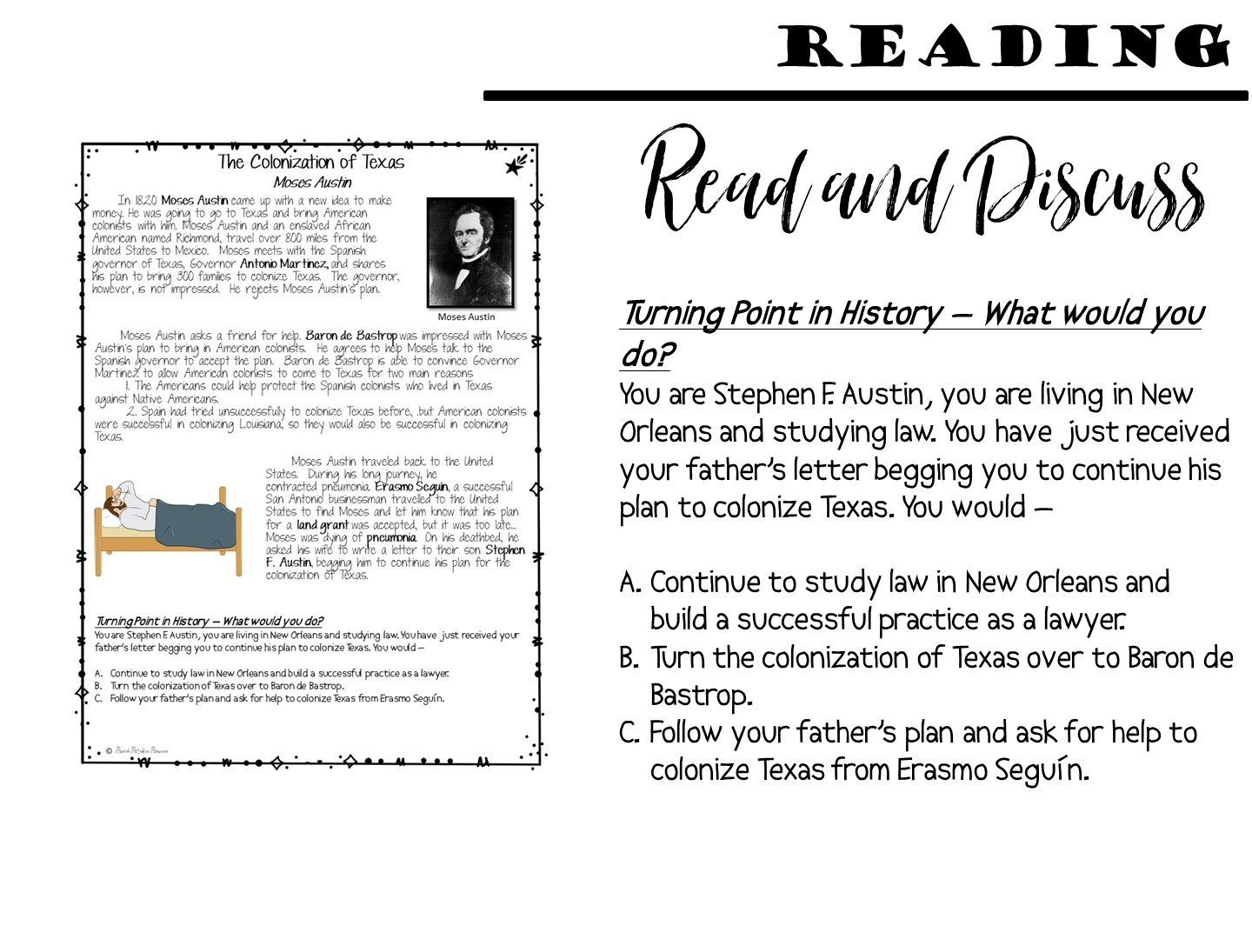
Notes:
Pass out the first page of the reading on the colonization of Texas. Have the teachers read as a group and discuss which option they would choose.

Slide 44
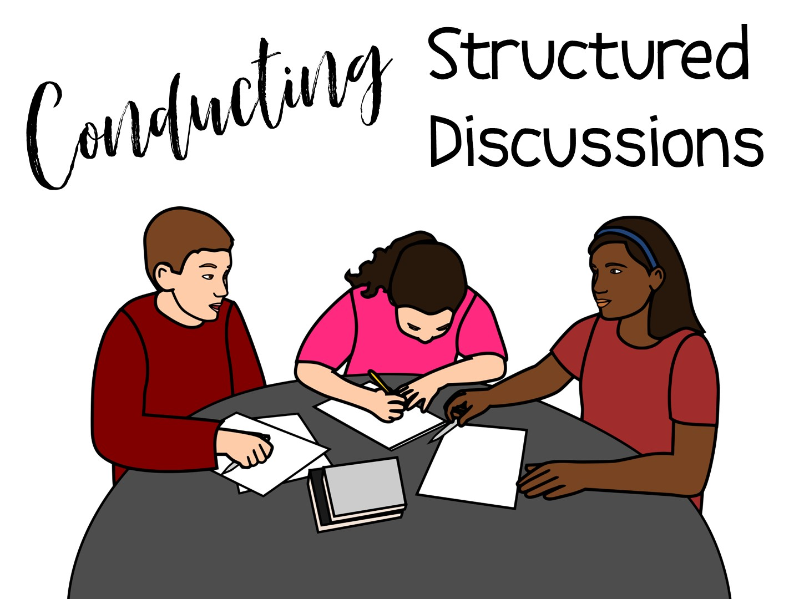
Notes:
This is the same as a response group

Slide 45
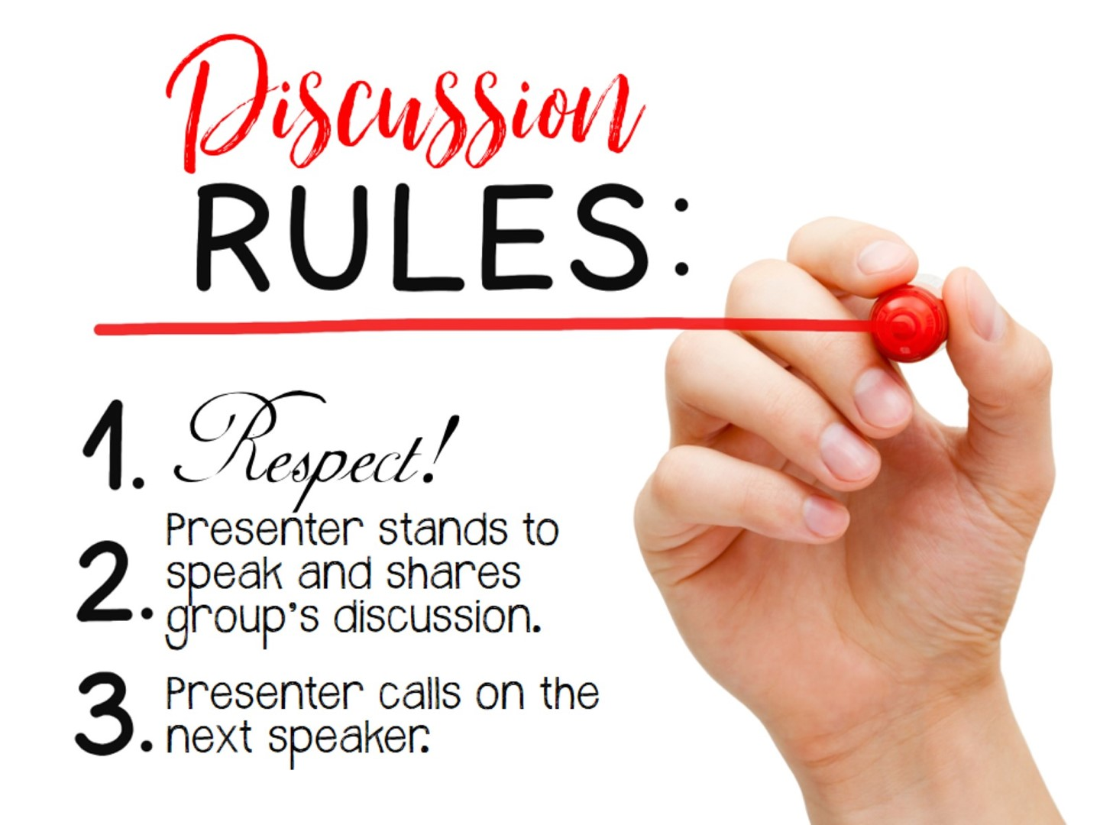
Notes:
Conduct a structured discussion with 2-3 different groups.

Slide 46
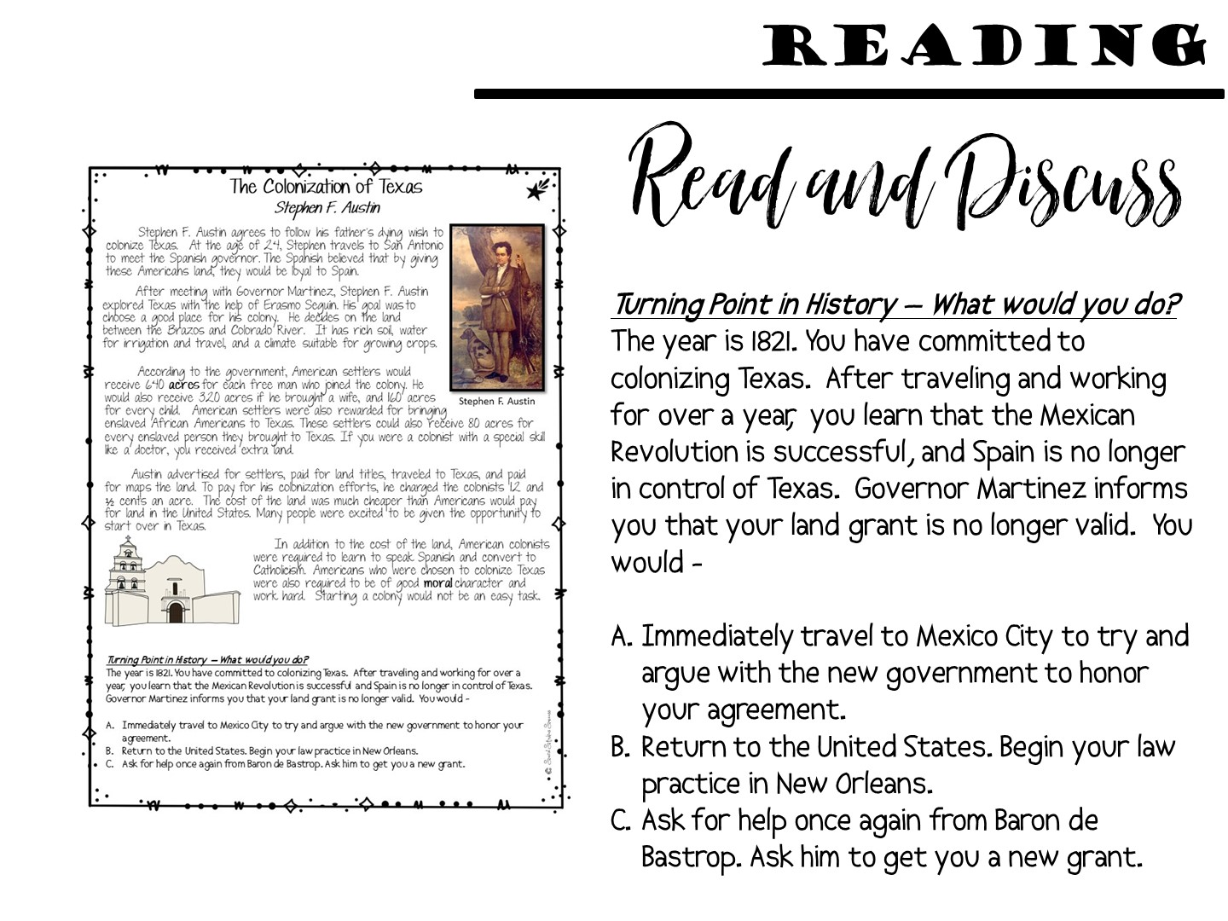
Notes:
Pass out the next reading and have them discuss.

Slide 47
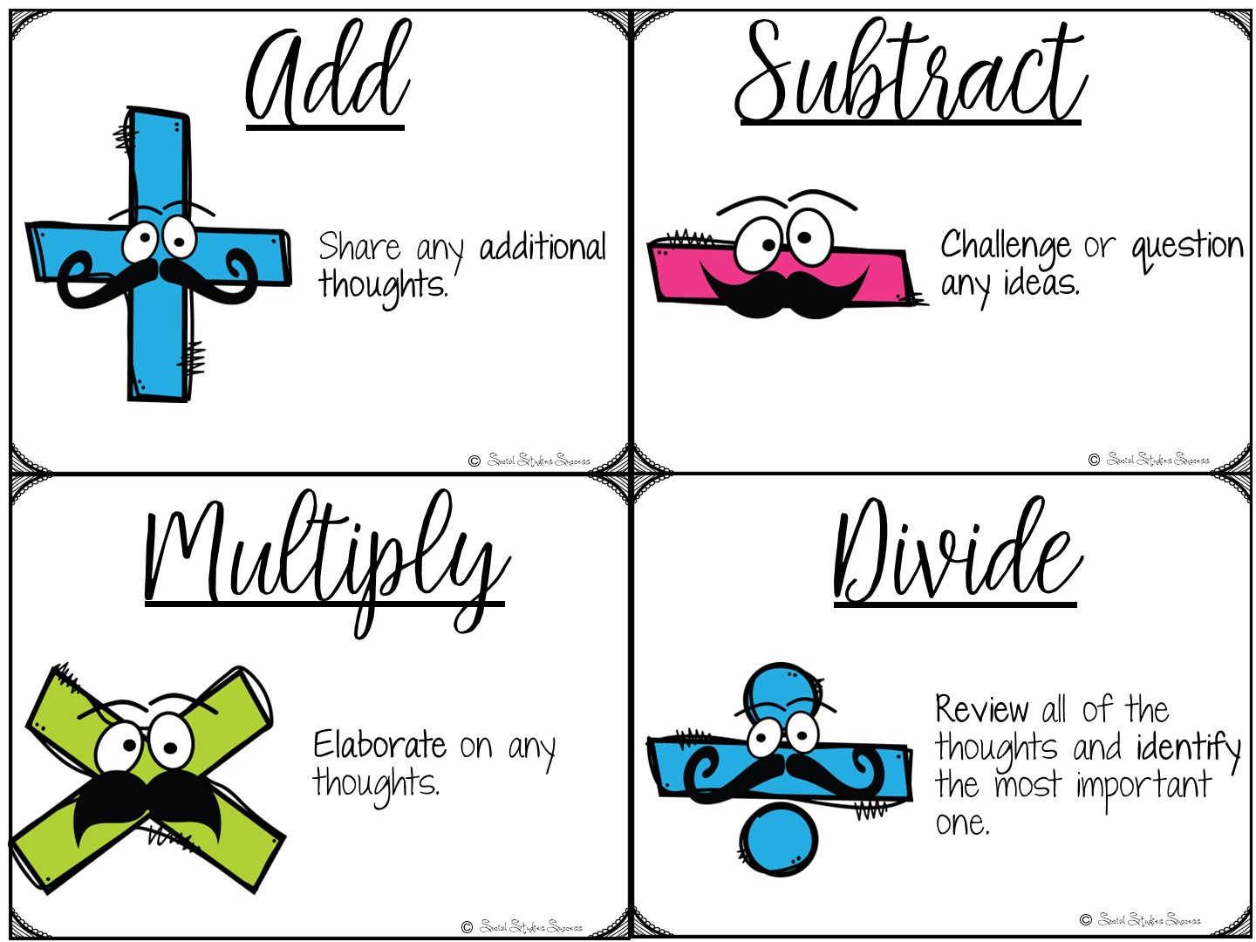
Notes:
In this round you can introduce the add, subtract, multiply and divide cards if you want.

Slide 48
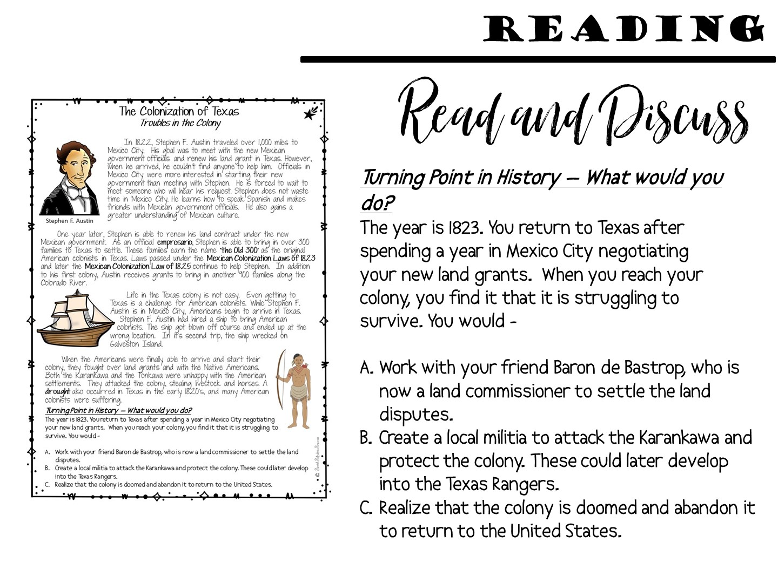
Notes:
Share that there is more to the activity, but you do not have to do this round if you don’t want

Slide 49

Notes:
How did you see each of these different elements of a discussion embedded into the activity?

Slide 50


Slide 51

Notes:
Prep for the next lesson model during the break:
Hang up the word wall vocabulary terms for immigration

Slide 52
Notes:
I am now going to model a different strategy for small group discussions

Slide 53
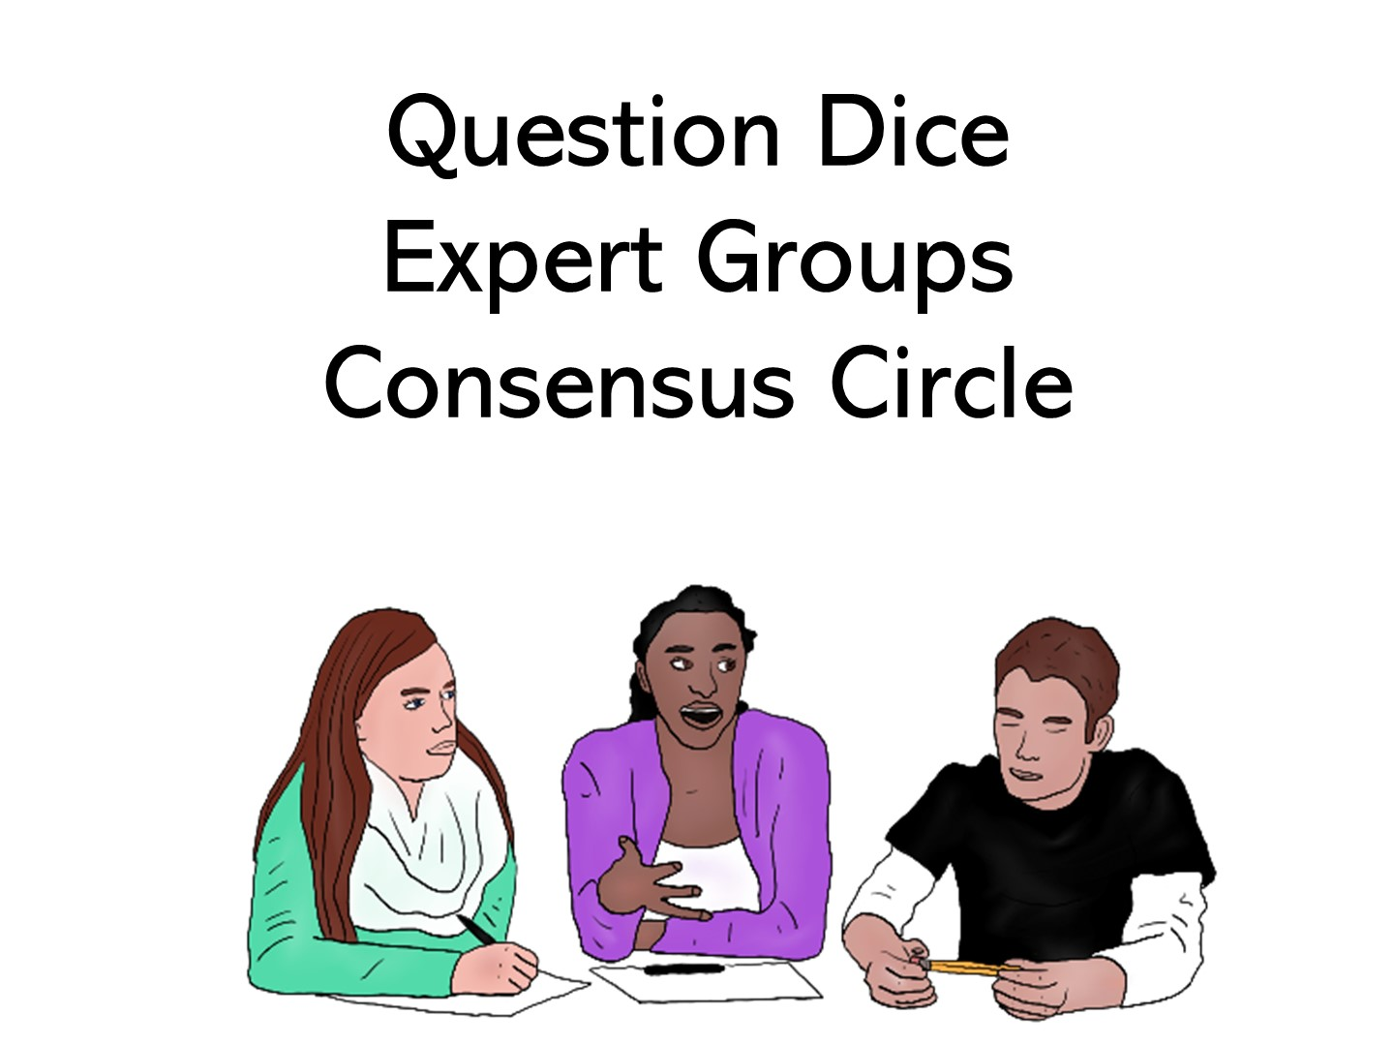
Notes:
We are going to look at multiple strategies in this lesson model.

Slide 54

Notes:
Provide your students different pieces of background information. Each group should have a different topic or different piece of research on a topic.
I think Expert Groups is a great way to analyze primary sources, because it provides a peer support system to the primary source analysis. Prepare for your lesson by finding 3 different primary sources to examine with the background information.

Slide 55
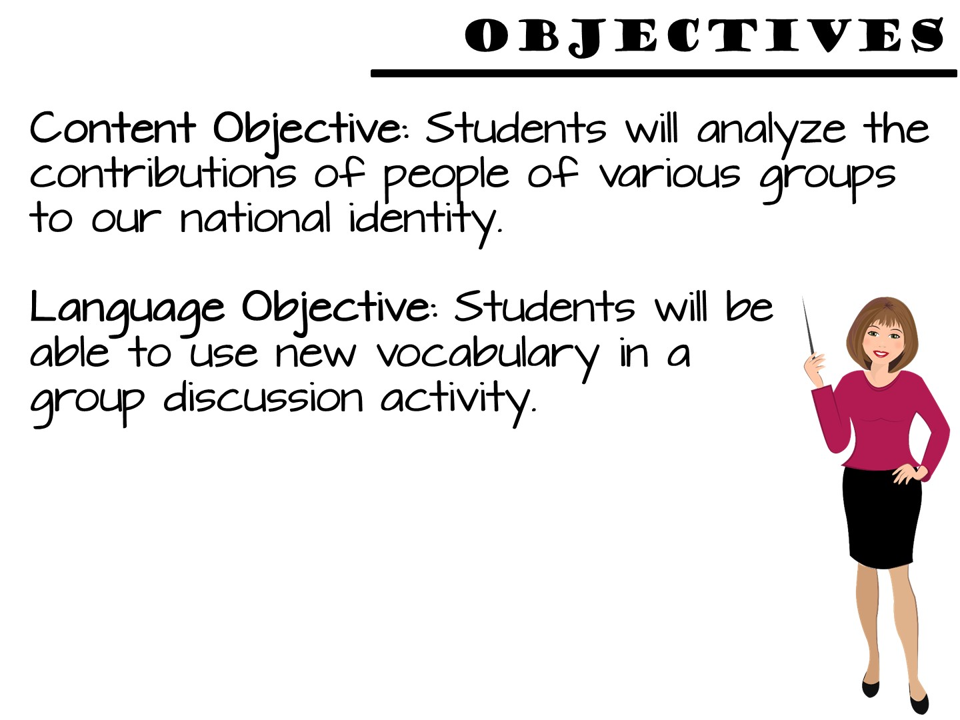
Notes:
Just read

Slide 56
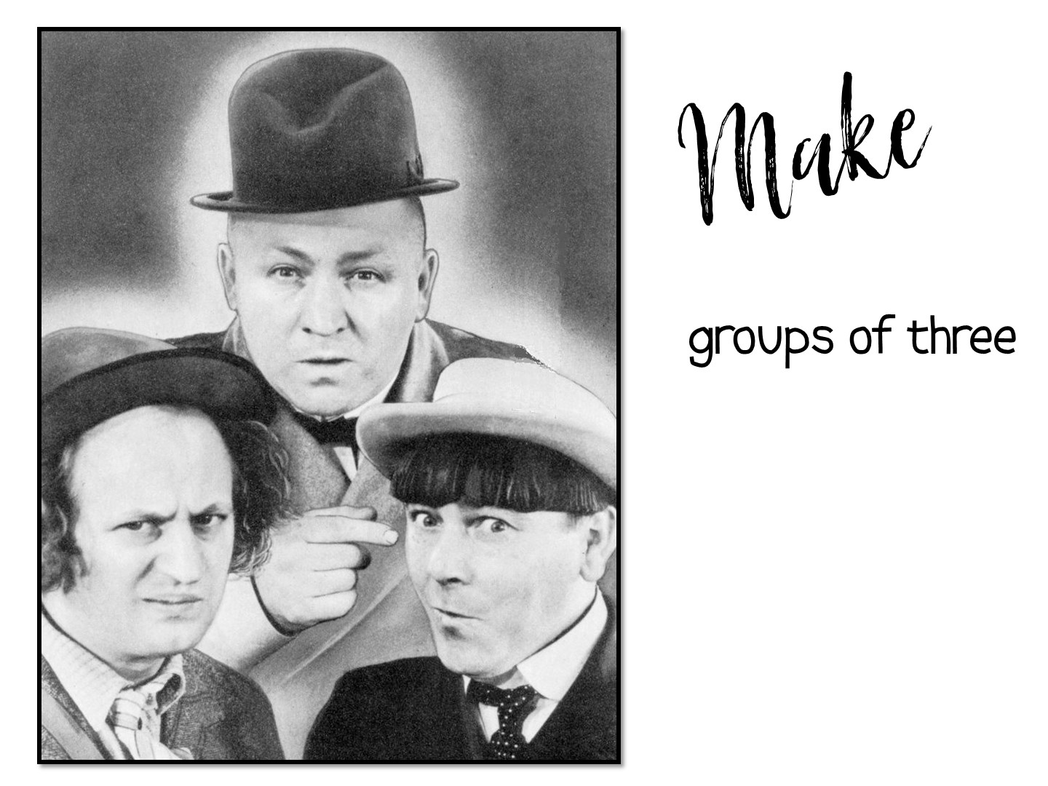
Notes:
Put into new groups of 3

Slide 57
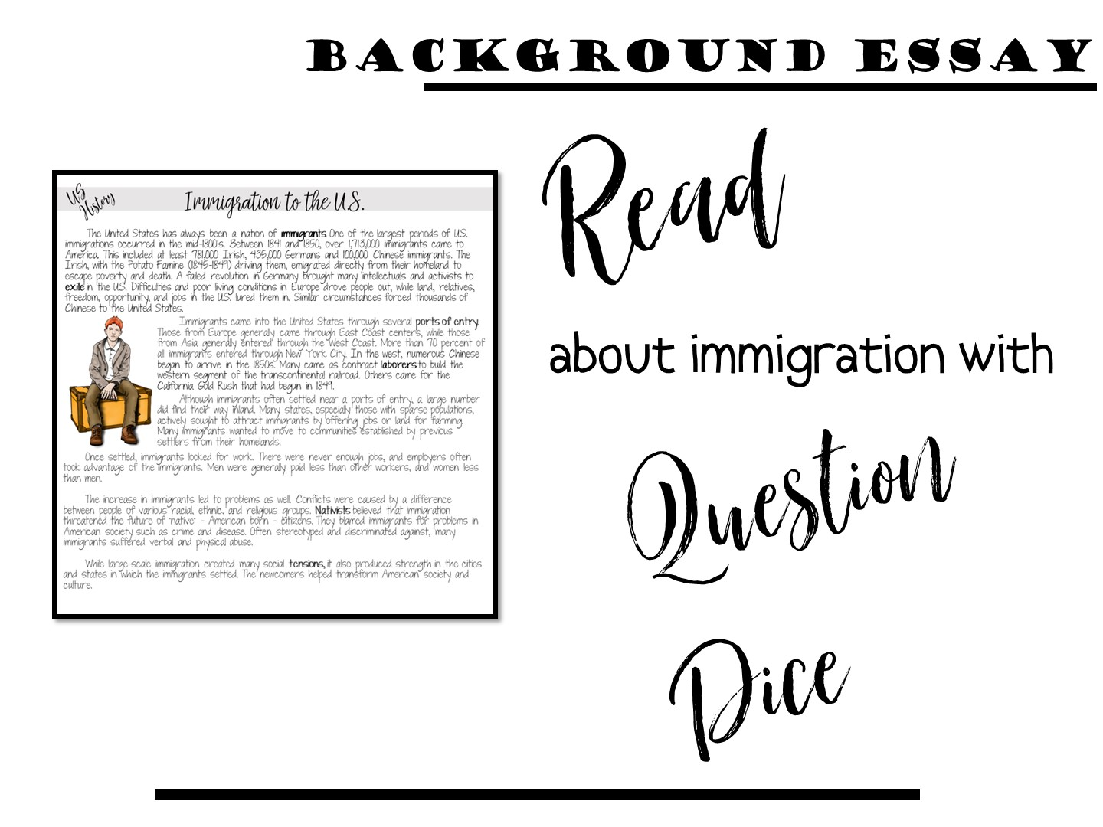

Slide 58
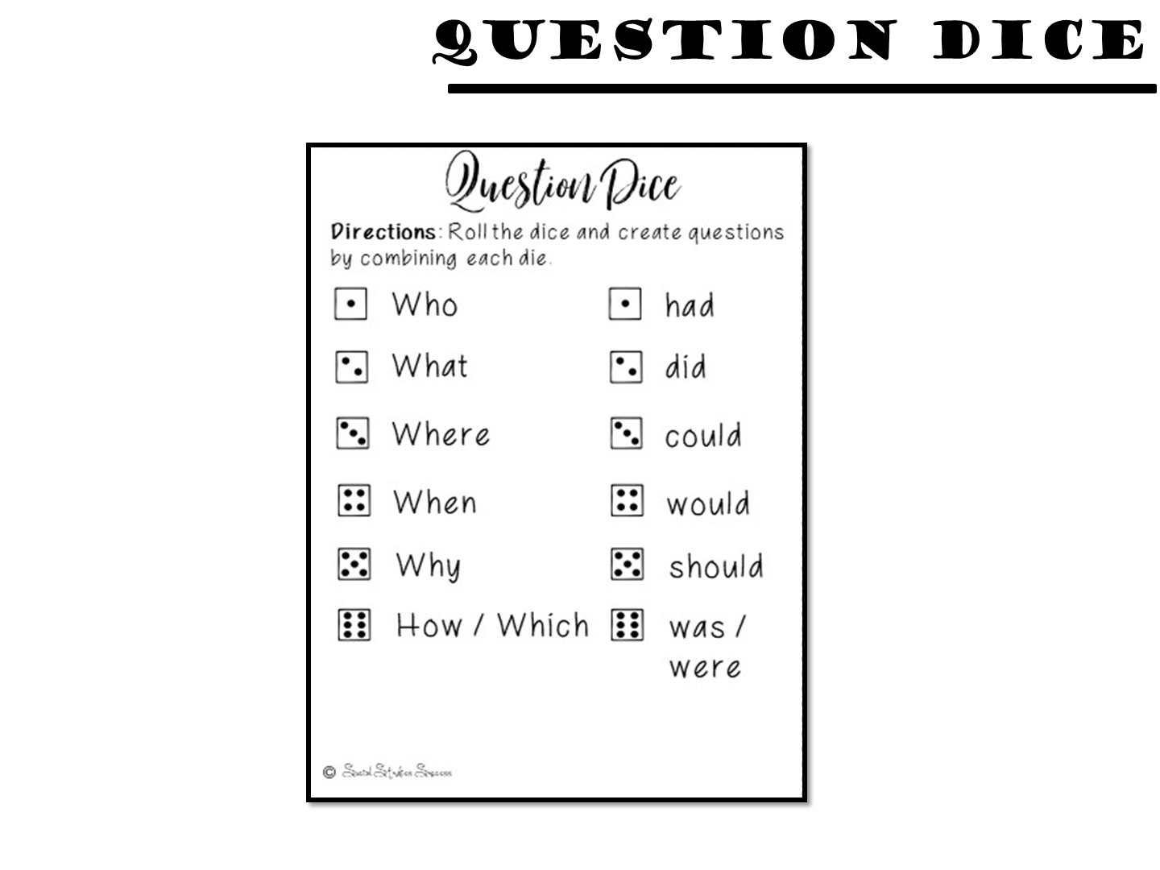
Notes:
Project so they can see if they can’t read the tiny cards in the boxes.

Slide 59
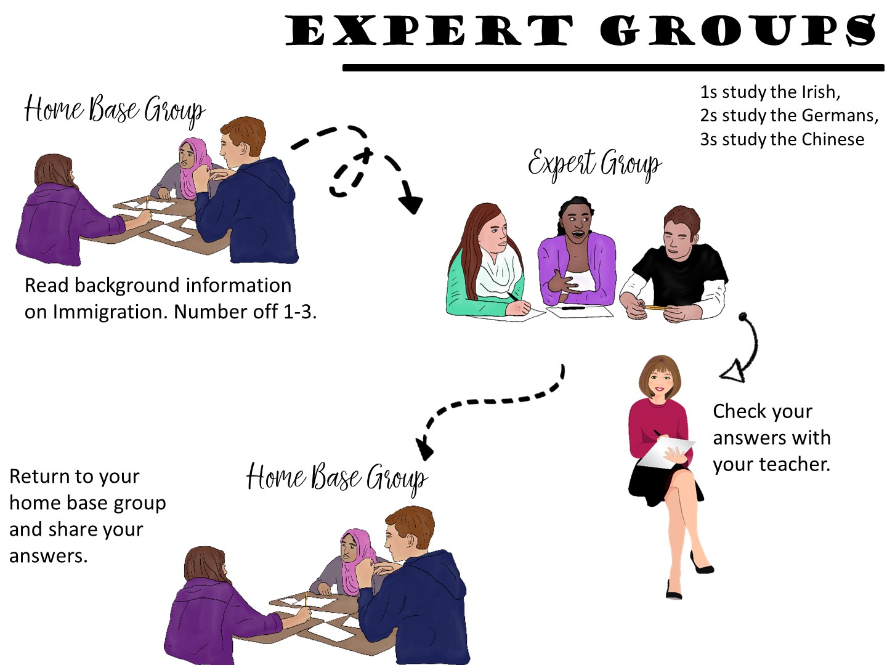
Notes:
Once they have finished the background reading, it is time to set up the expert groups.

Slide 60
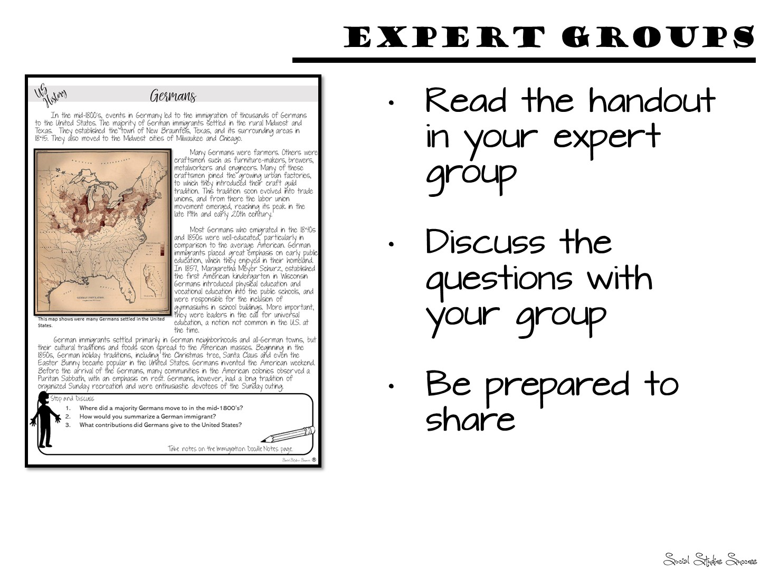

Slide 61
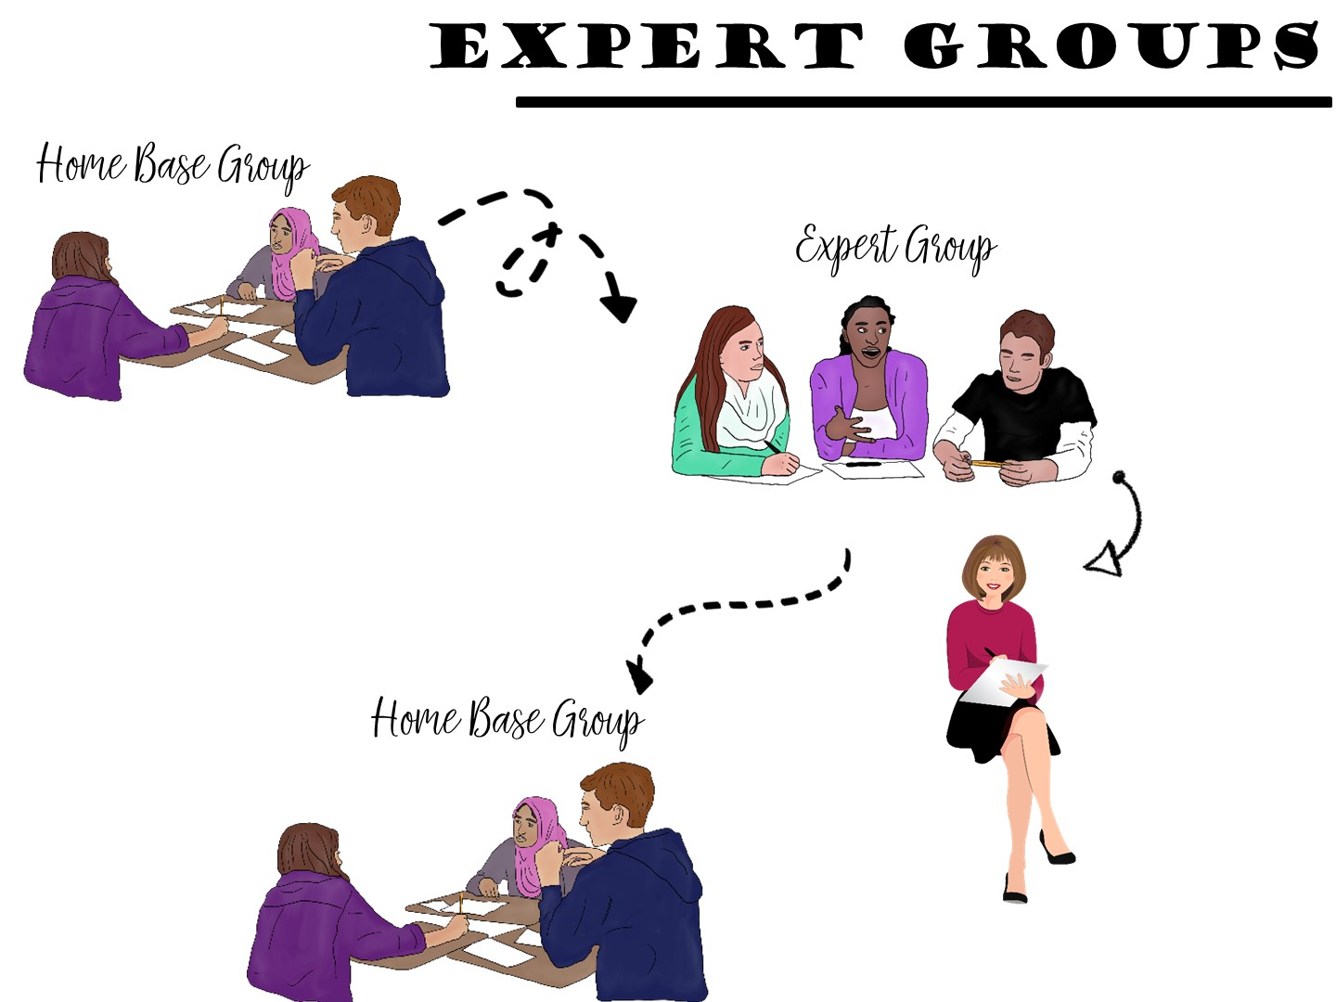

Slide 62
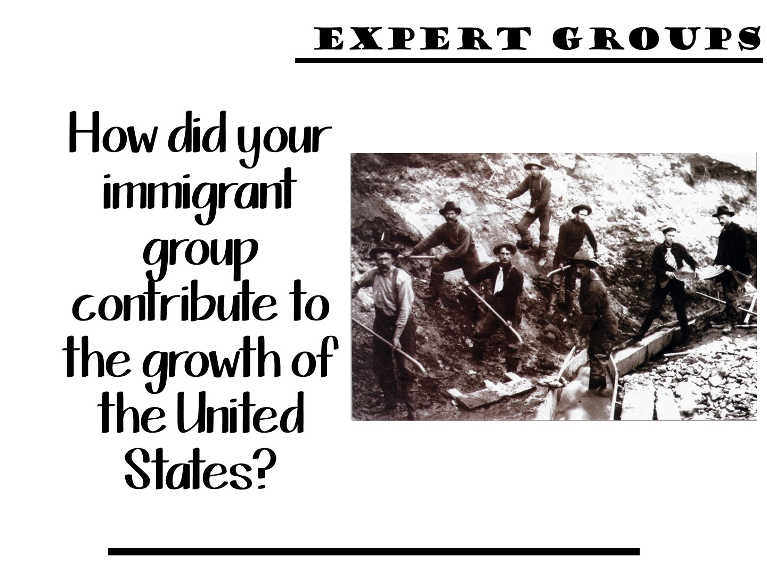

Slide 63

Notes:
Training will include:
Immediate application of content learned by the creation of a complete unit – from beginning to end.
Time to work on each step of the unit plan
Collaboration from each other.
63

Slide 64


Slide 65
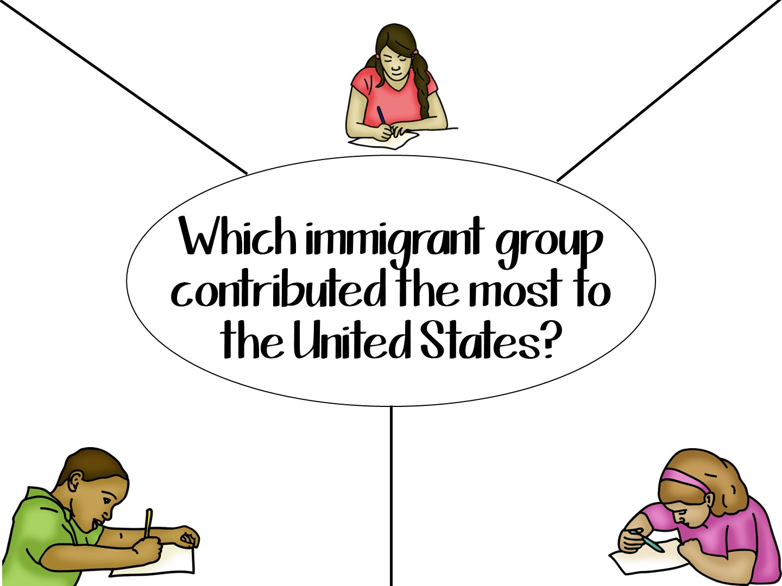
Notes:
Prepare for this activity with chart paper. Divide your students into groups of 3 or 4. Have your students write the discussion question in the center of the paper, draw a circle around it, and then create space for each of the students to write their answers. Give your students about 5 minutes to write the answer to the question.

Slide 66
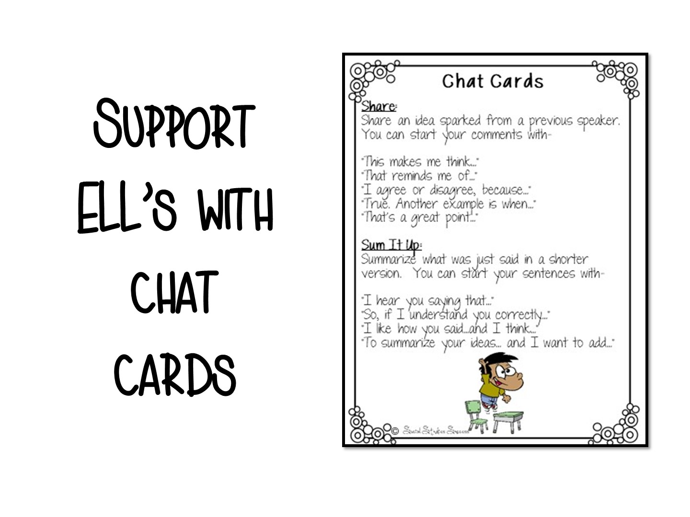

Slide 67

Notes:
It is now time for you to make your own lesson play that includes a discussion strategy. Take a look at the Discussion Strategy manual that comes with this workshop. The second page of your Doodle Notes handout is a lesson planning template. Use this to help guide your thought process when you are planning for a discussion. I hope you have enjoyed this training and I look forward to working with you again!

Slide 68
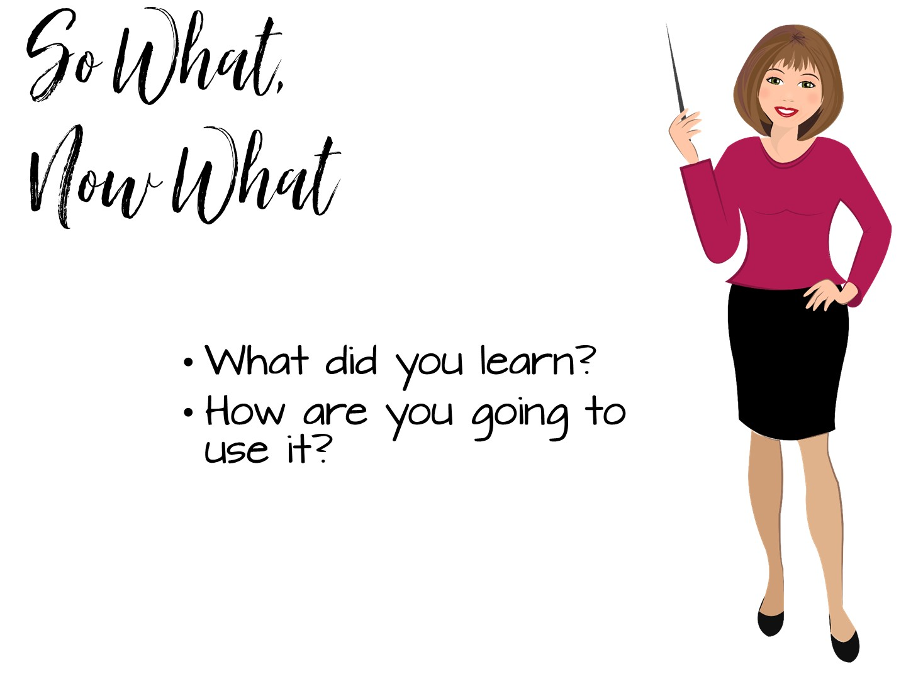

Slide 69


