Slide 22
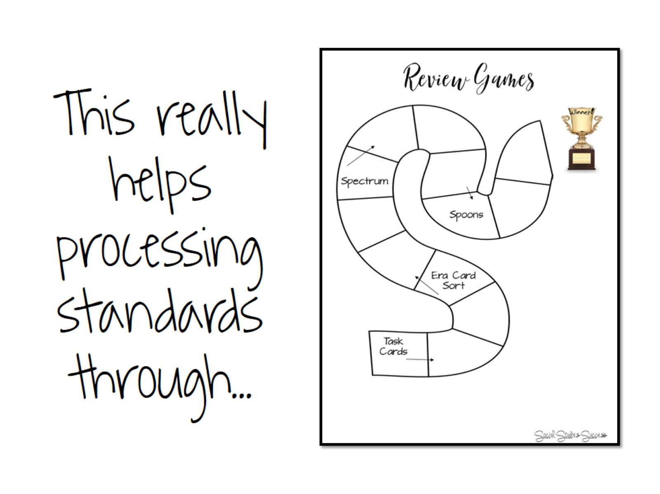

Slide 27
So What, Now What

