Slide 1


Slide 2


Slide 3

Notes:
Introduce yourself

Slide 4

Notes:
These slides need to be changed to reflect what you believe about social studies instruction

Slide 5


Slide 6
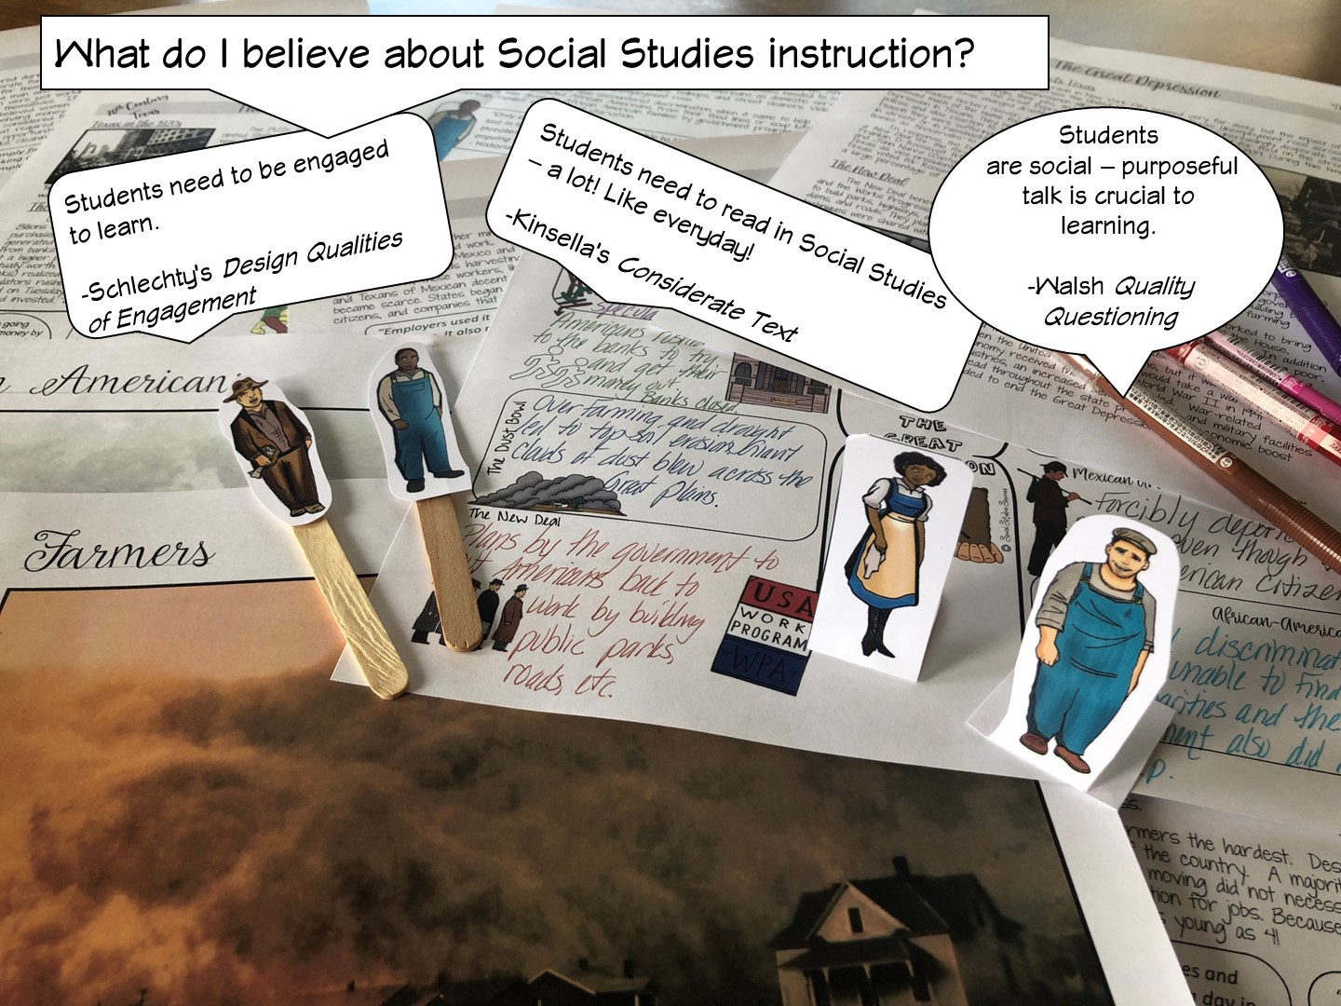

Slide 7
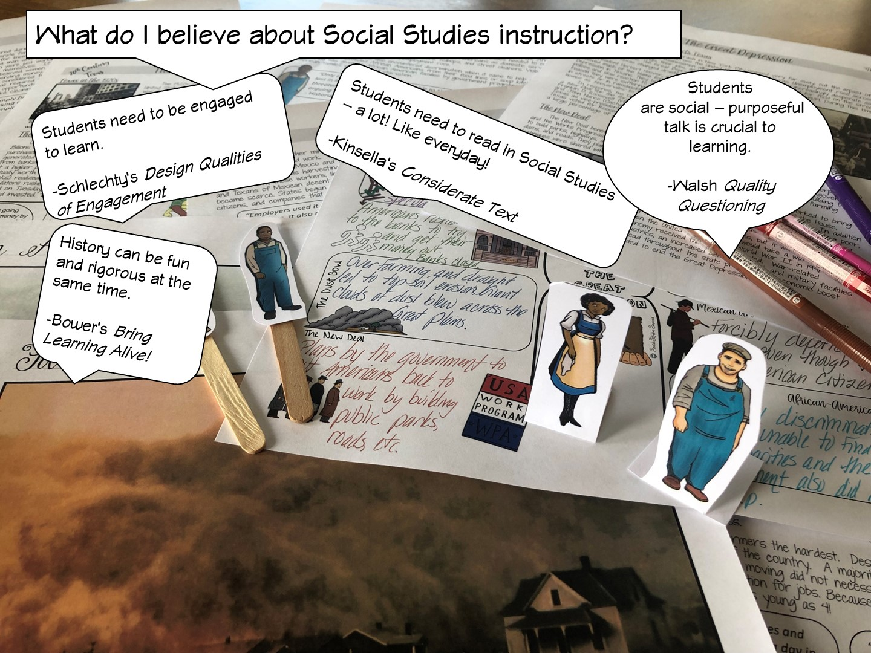

Slide 8


Slide 9
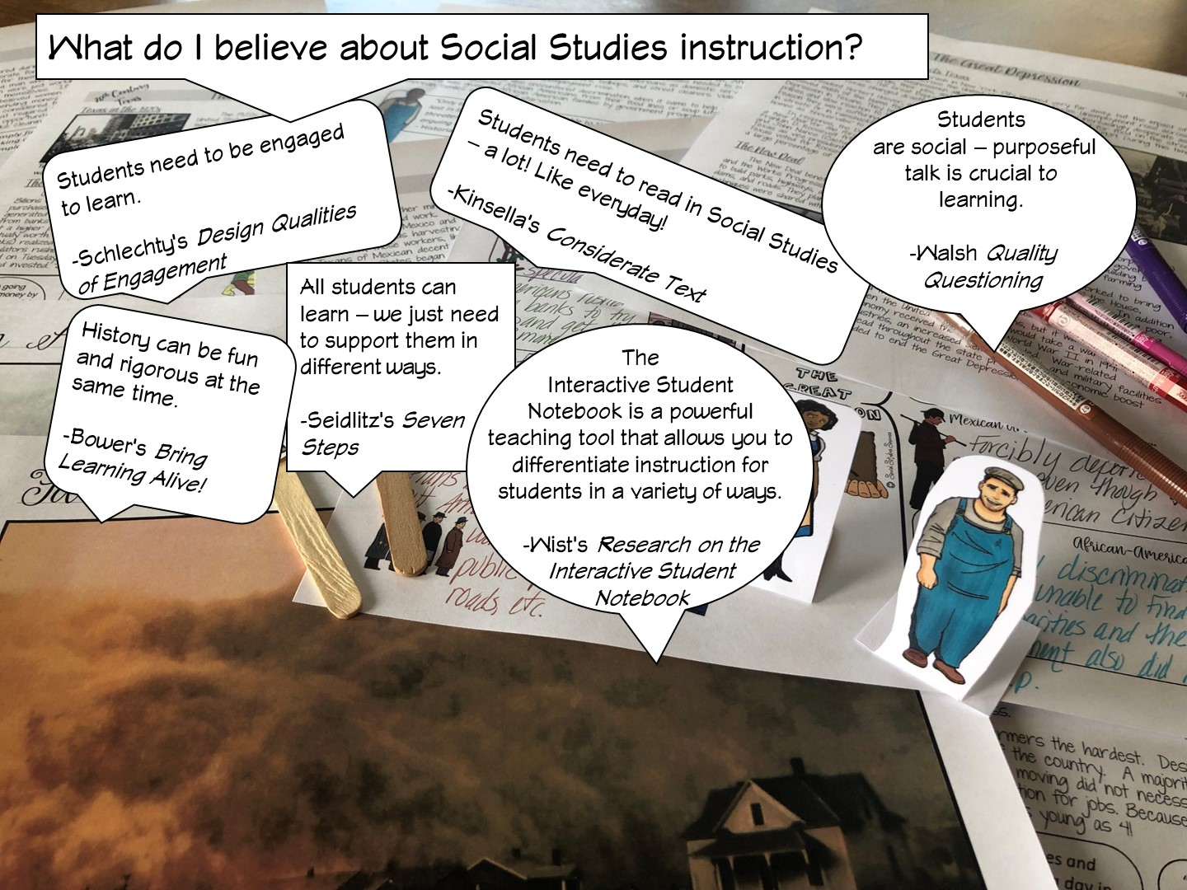

Slide 10
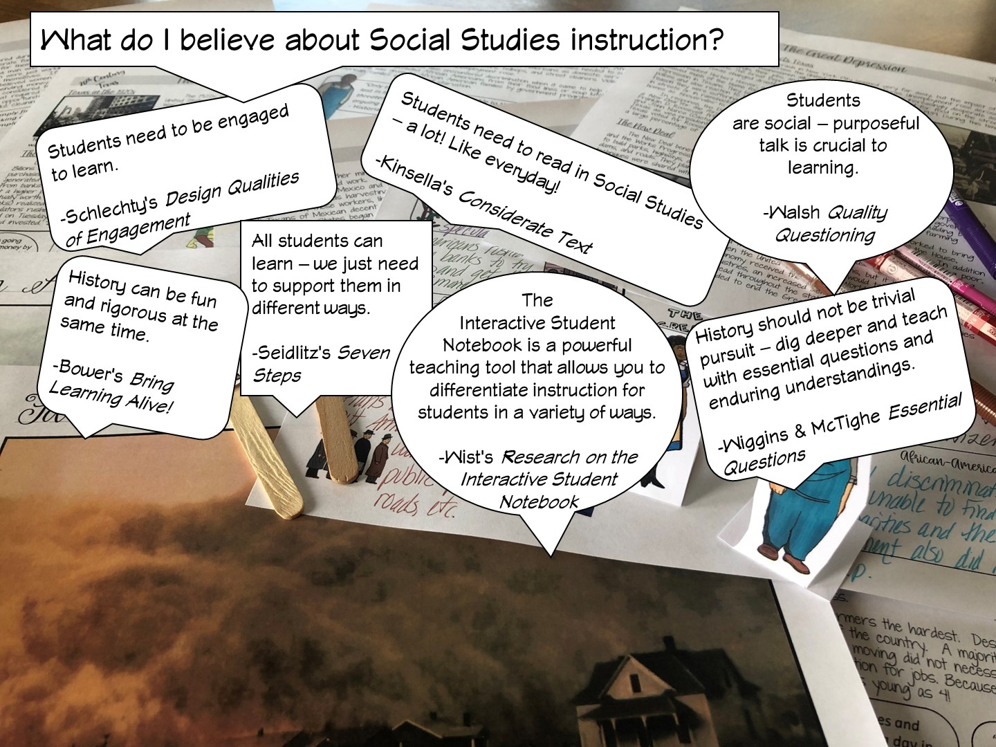

Slide 11
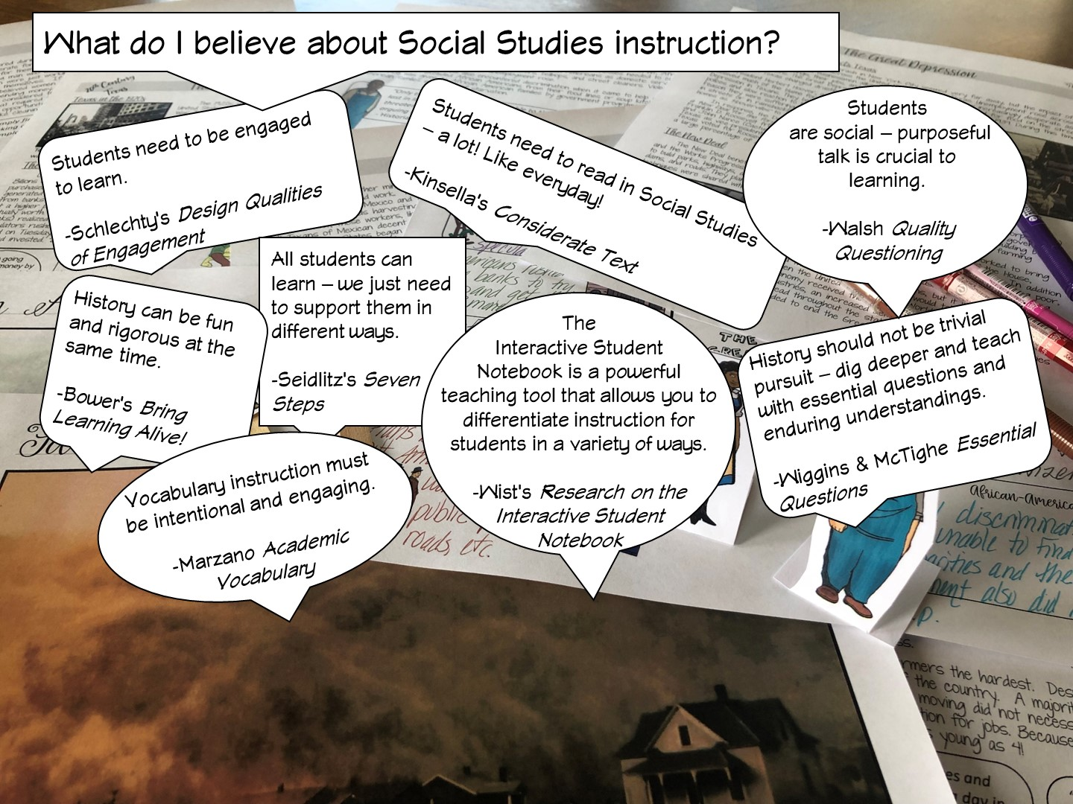

Slide 12
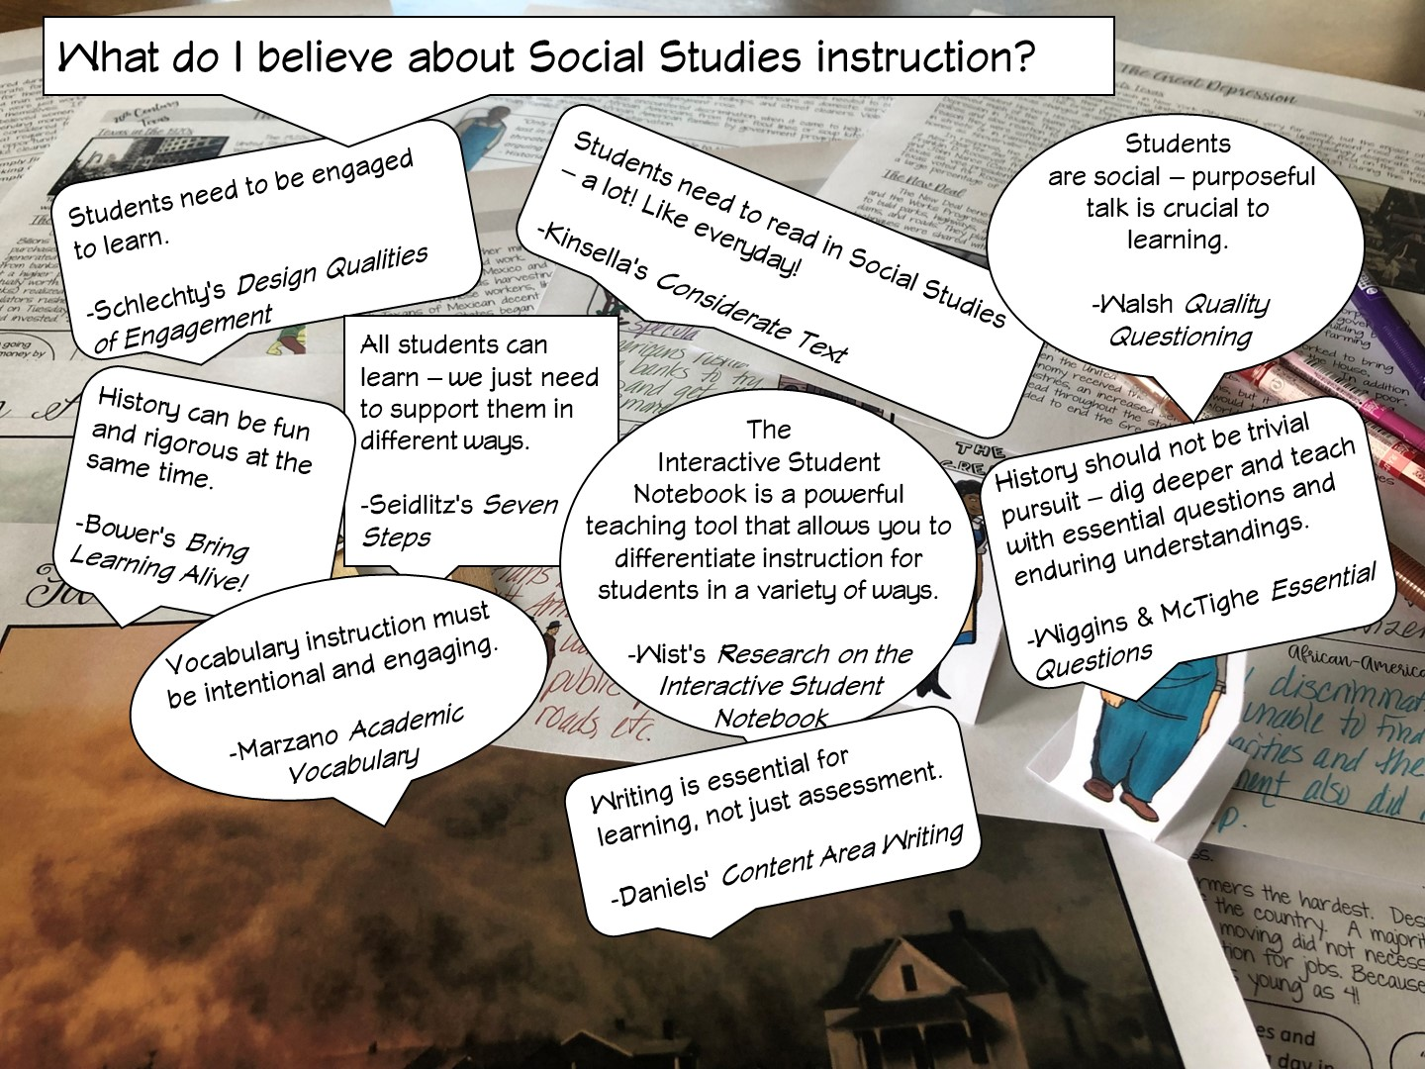

Slide 13
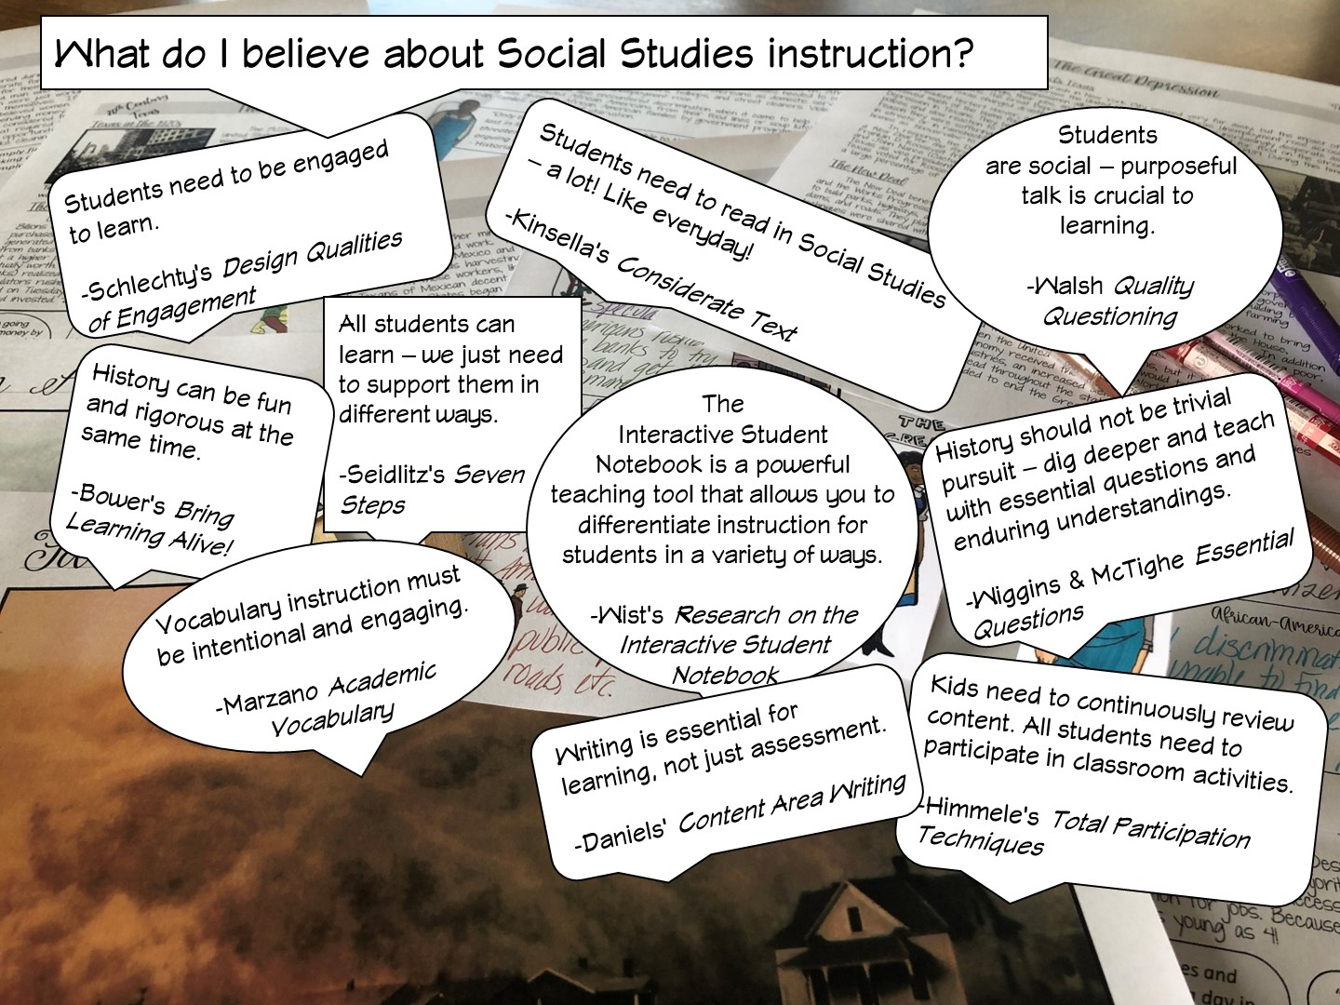

Slide 14
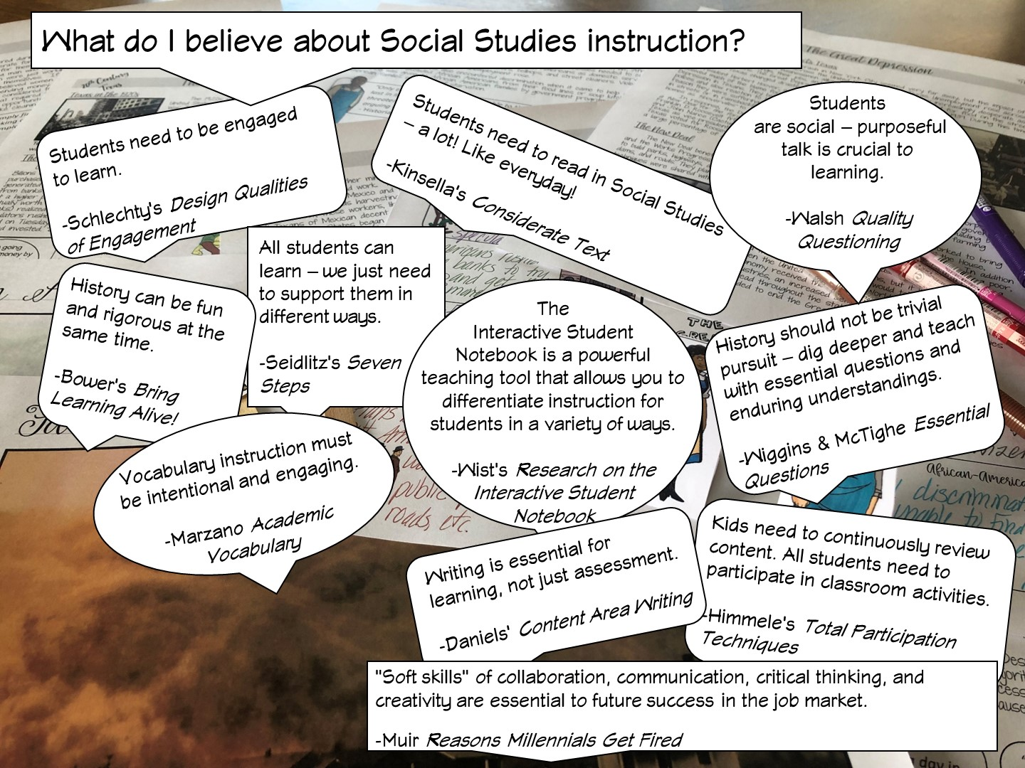

Slide 15
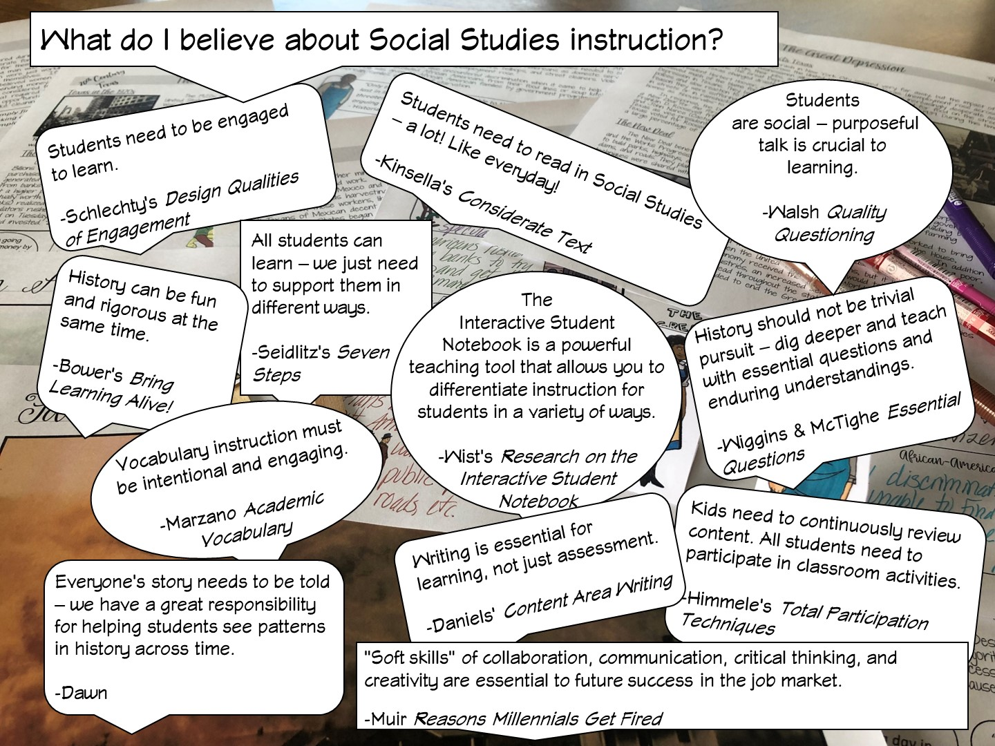

Slide 16

Notes:
My number 1 belief!

Slide 17

Notes:
Have teachers write their goals on a post it note and share
Review our goals in the next slide

Slide 18


Slide 19

Notes:
I share my rule of the socks:
They have never been on my feet
They are not a souvenir of the workshop
Put your cellphones away in the sock (model with your own)

Slide 20
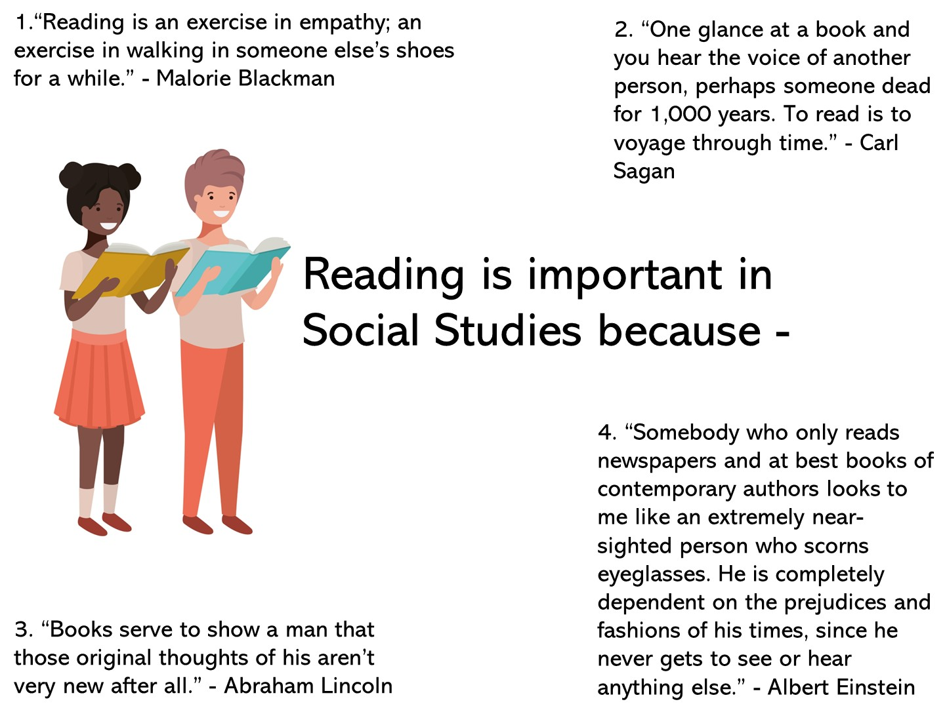
Notes:
Let’s start with what you think about writing in the classroom with this 4 –Corner strategy. Take a look at these different statements regarding writing – which one do you agree with the most and why? Conduct a 4 Corner Activity
https://www.edweek.org/teaching-learning/opinion-response-ways-to-integrate-writing-in-social-studies-classes/2019/04

Slide 21


Slide 22

Notes:
Share that you are going to model a lesson based on the reading cycle – teachers need to look for what you do before, during, and after reading.

Slide 23


Slide 24
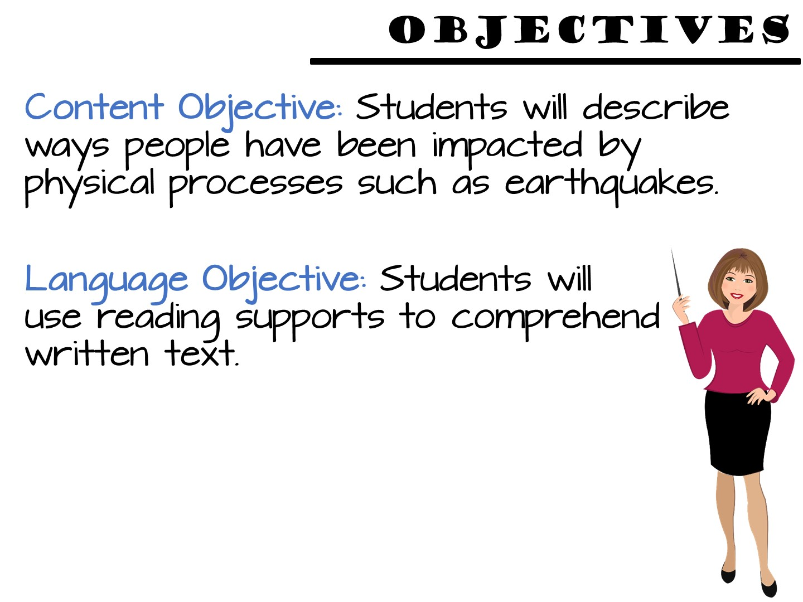
Notes:
Just read

Slide 25
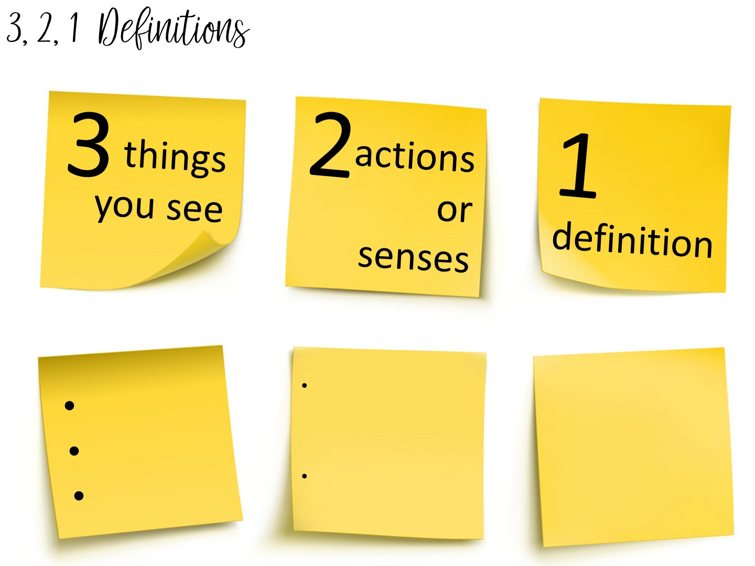
Notes:
Another method to teach vocabulary with images is the 3, 2, 1 Definitions – Allow students time to analyze an image to build their understanding of an image.
Allow them to pick a term with a partner and complete the 3, 2, 1 definition. I always bring the teachers close to word wall to get them out of their seats.

Slide 26


Slide 27


Slide 28
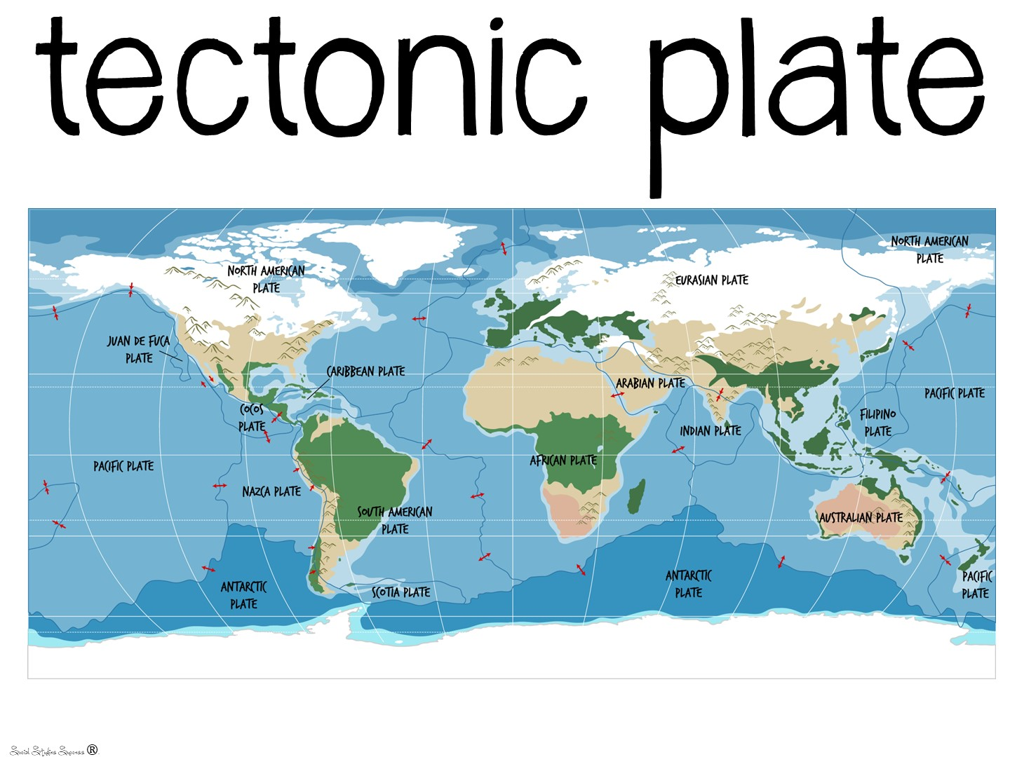

Slide 29
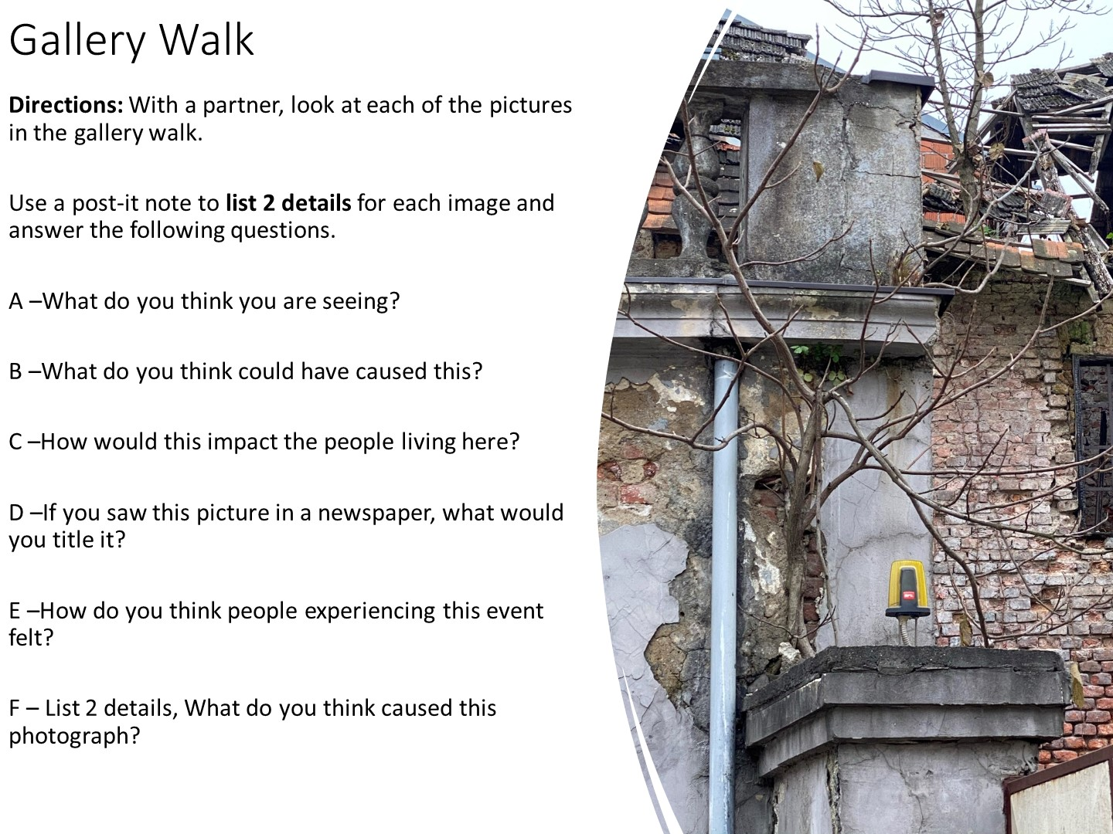
Notes:
Post the pictures of the earthquake damage and have them do a gallery walk – as they walk around, they add their thoughts to each of the images based on these questions. You don’t have to do all to get them to see what to do.

Slide 30
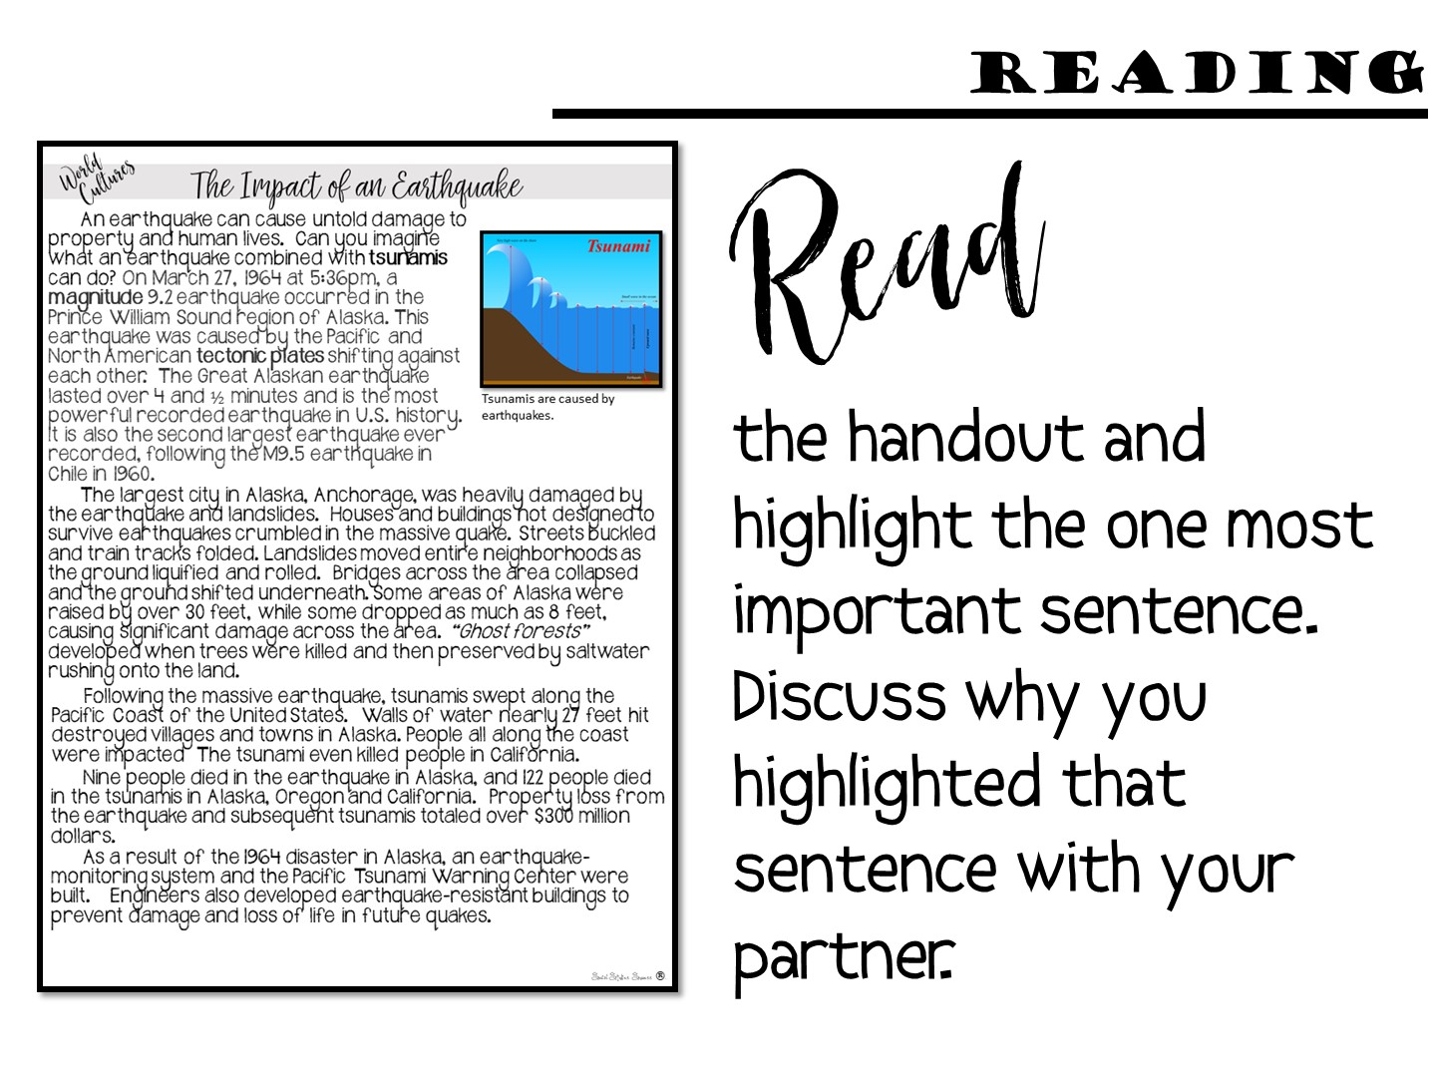

Slide 31
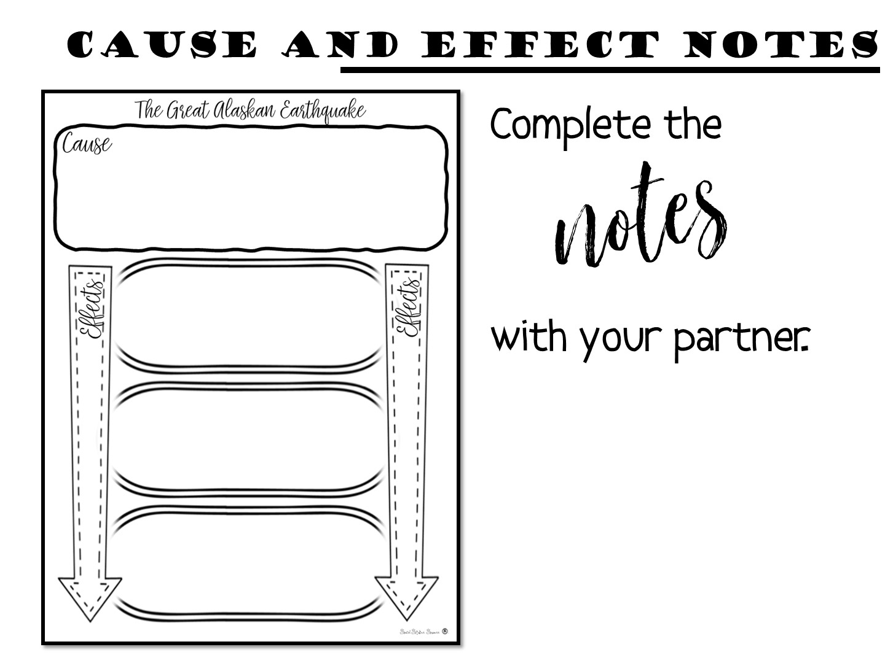
Notes:
Just give them a few minutes to do.

Slide 32
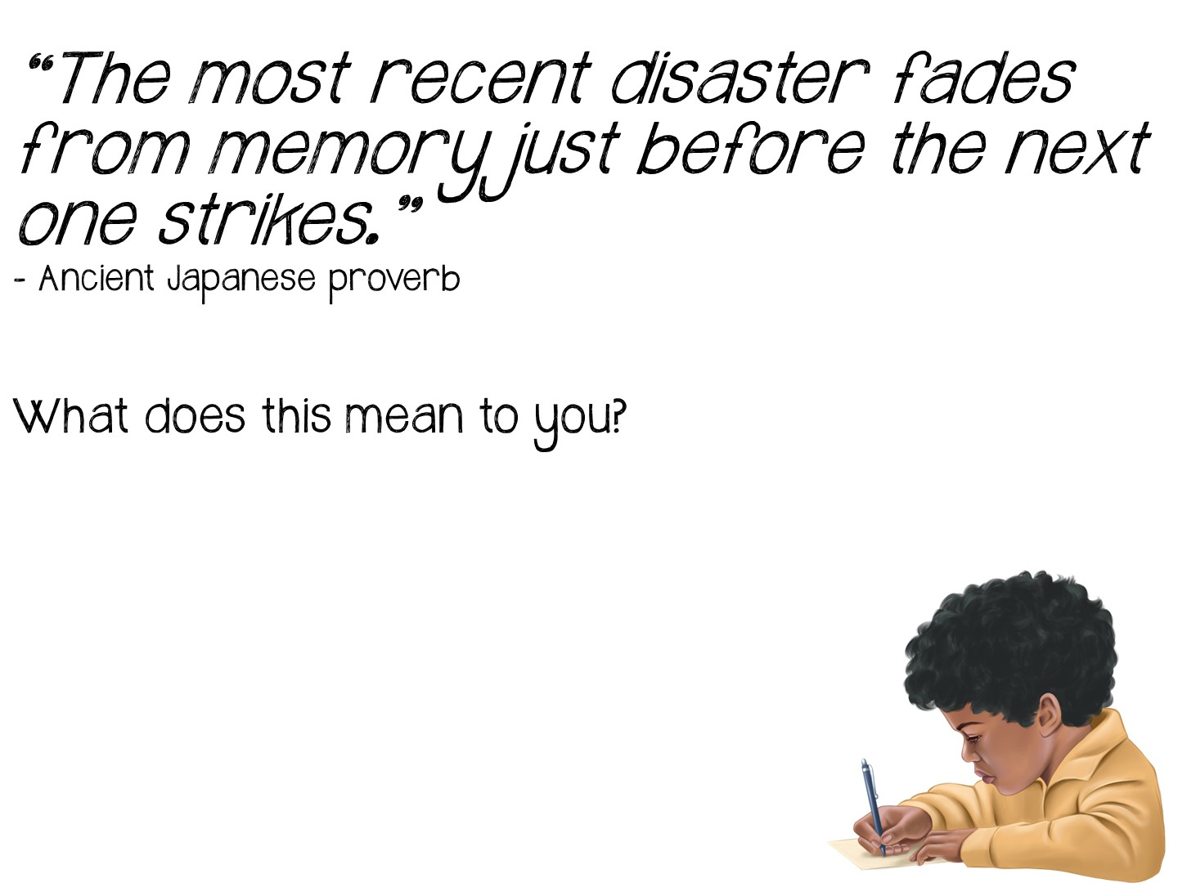
Notes:
Pass out and debrief after they write.

Slide 33


Slide 34

Notes:
Give them 5 minutes to write down reflections on their Doodle Notes

Slide 35


Slide 36
Notes:
Now you are going to review the reading cycle more in depth.

Slide 37


Slide 38
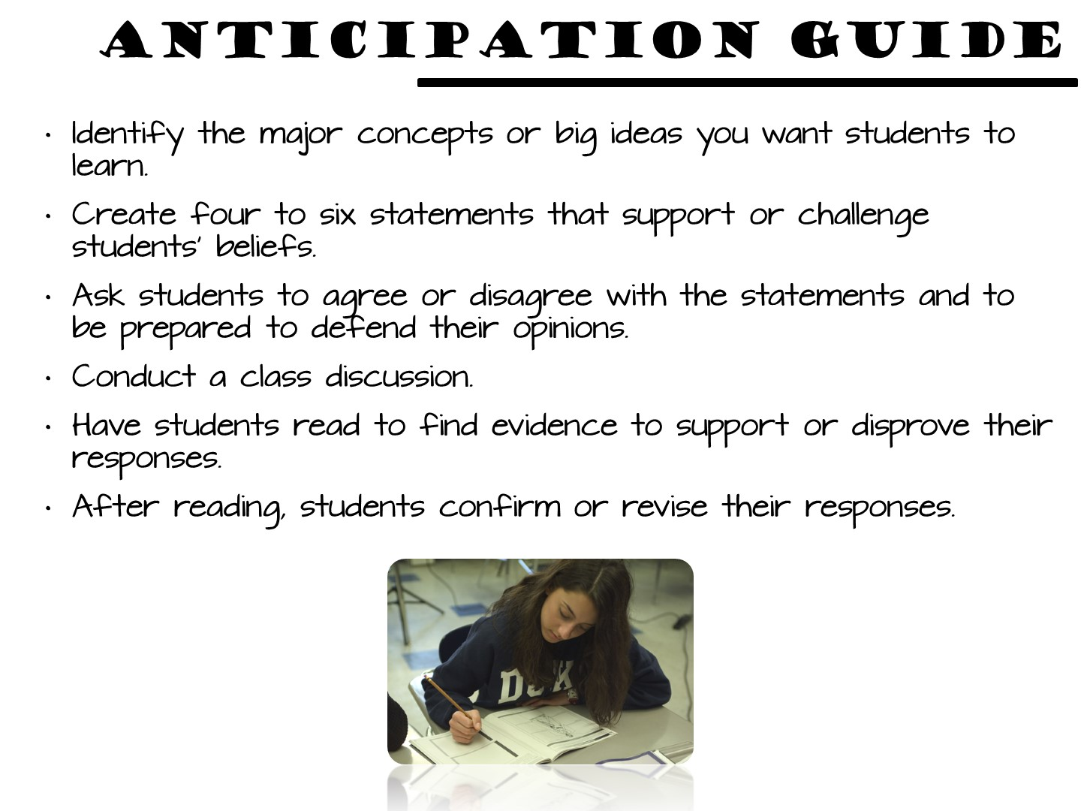
Notes:
When skillful readers pick up a new book, their minds go into "anticipation mode;" they have developed a set of strategies that help them get ready to read. They examine such things as: the cover and its art work, the book flaps, excerpts from the reviews, the writer's biography, the number of pages and print size; often these readers will open to several points in the text to sample the style and voice of the writer. Struggling readers will often skip all of these strategies as possible ways to approach a text; therefore, if we can design activities that will help them to anticipate "the big ideas" that will be revealed, it may provide an initial "hook" that draws them into the text
The Anticipation/Reaction Guide helps students activate and evaluate prior knowledge. Students make predictions based upon background knowledge and evaluate these predictions after exposure to new information. (H.L. Herber, 1978)

Slide 39
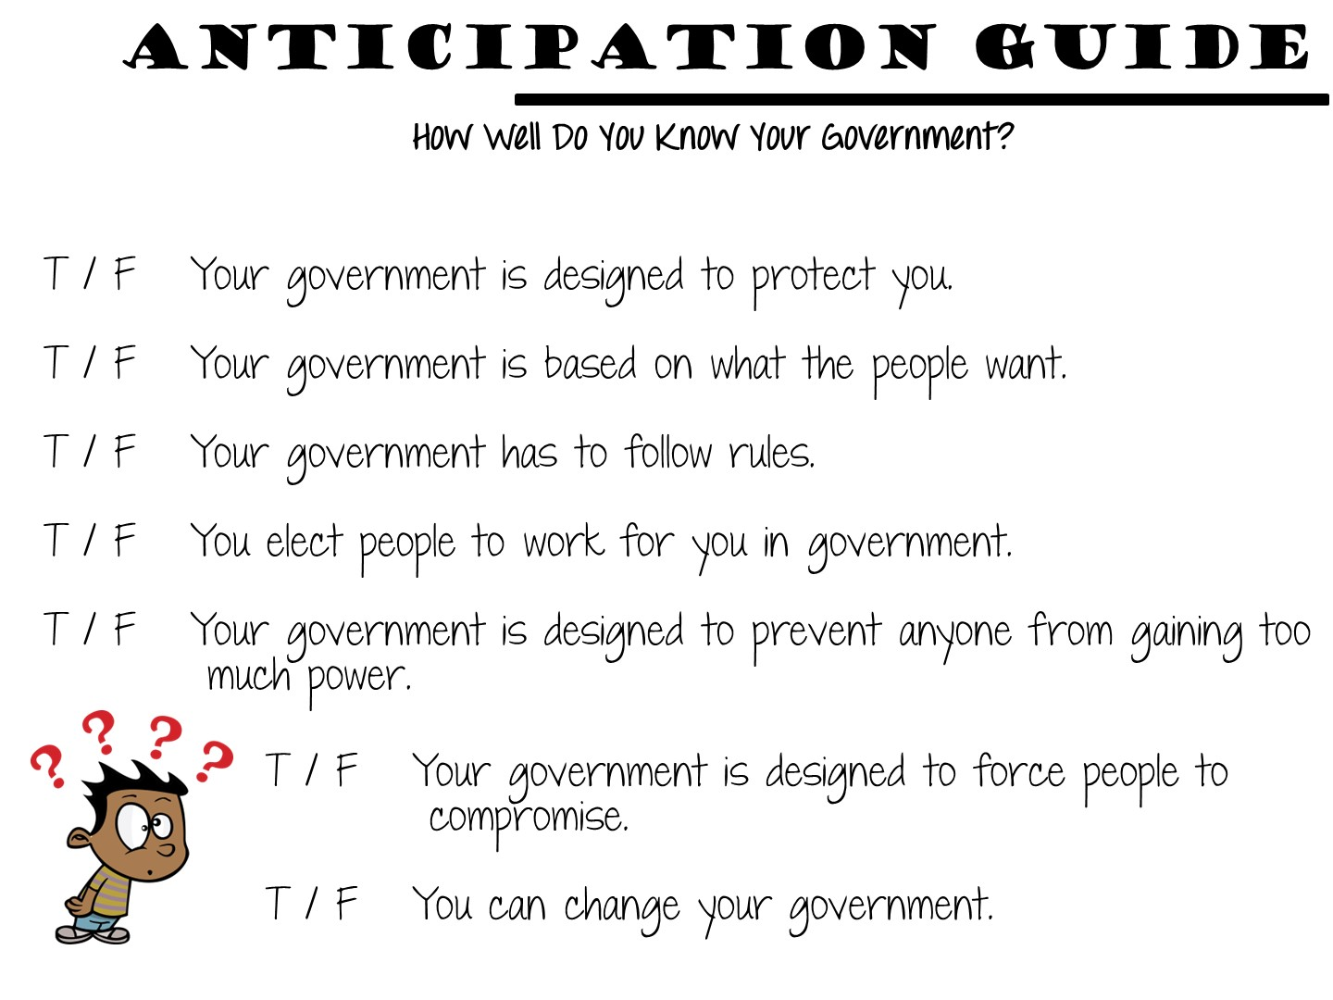
Notes:
Here is an example of one for the principles of government

Slide 40
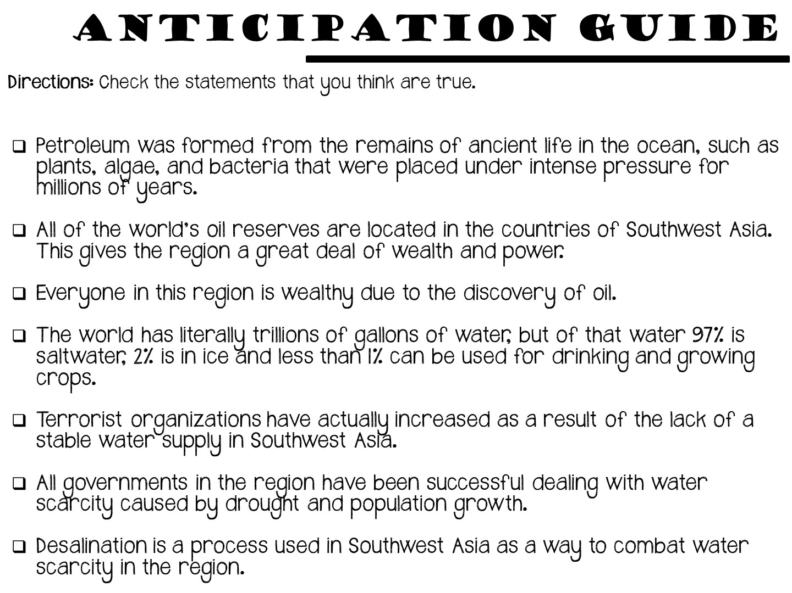
Notes:
Another anticipation guide strategy is to provide your students a series of statements from the reading – some of which are true and some that are not. After reading the selection of text, your students can then come back and correct the false statements.

Slide 41
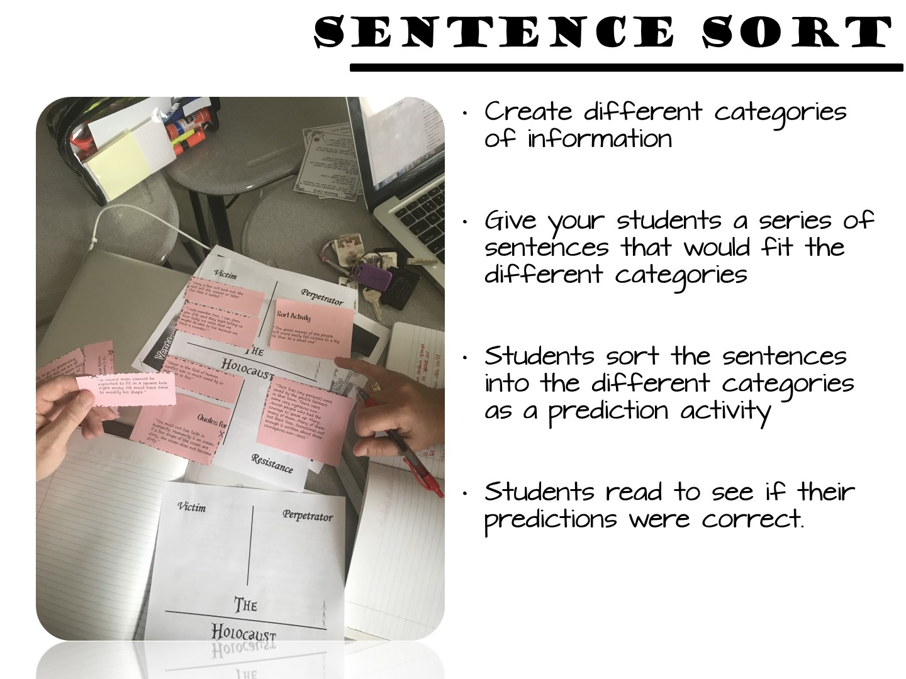

Slide 42


Slide 43


Slide 44
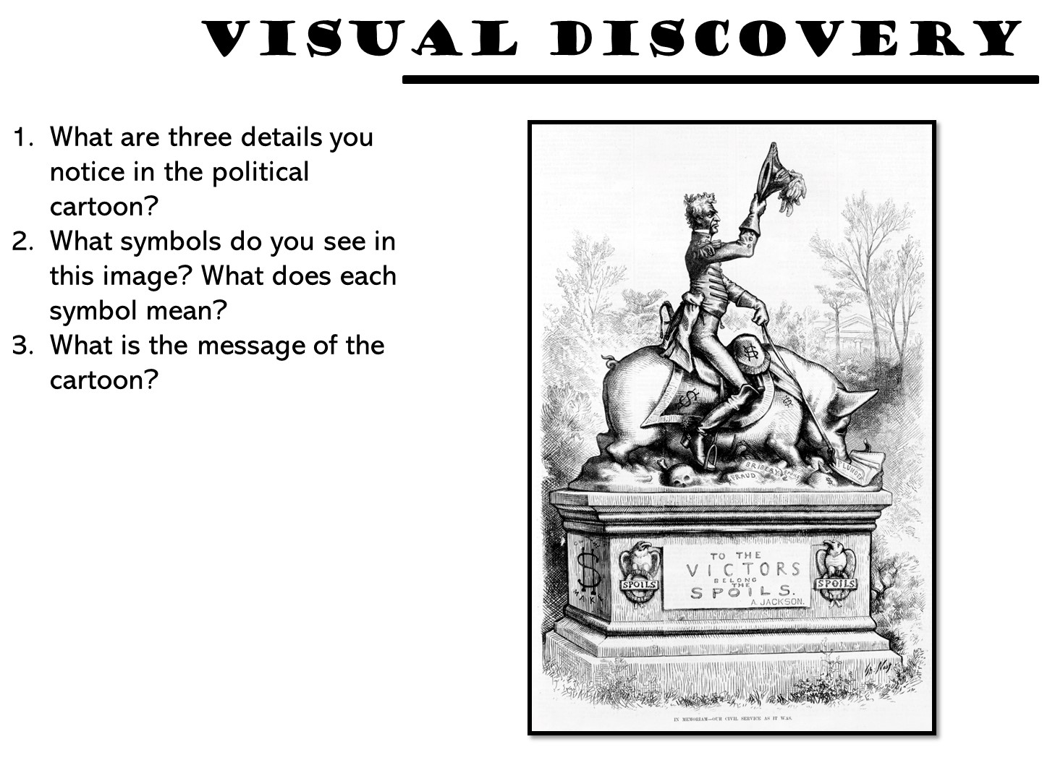

Slide 45
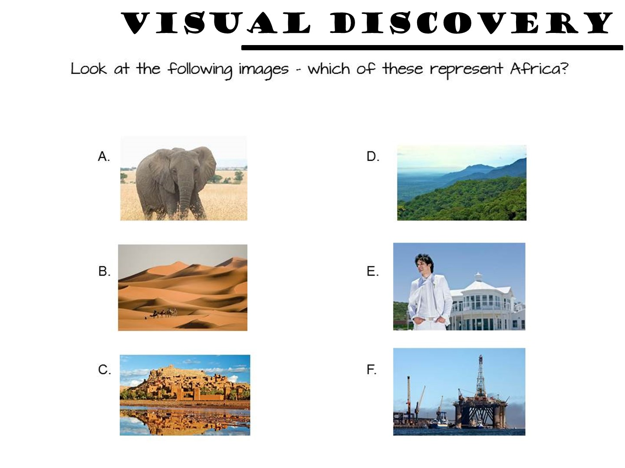

Slide 46
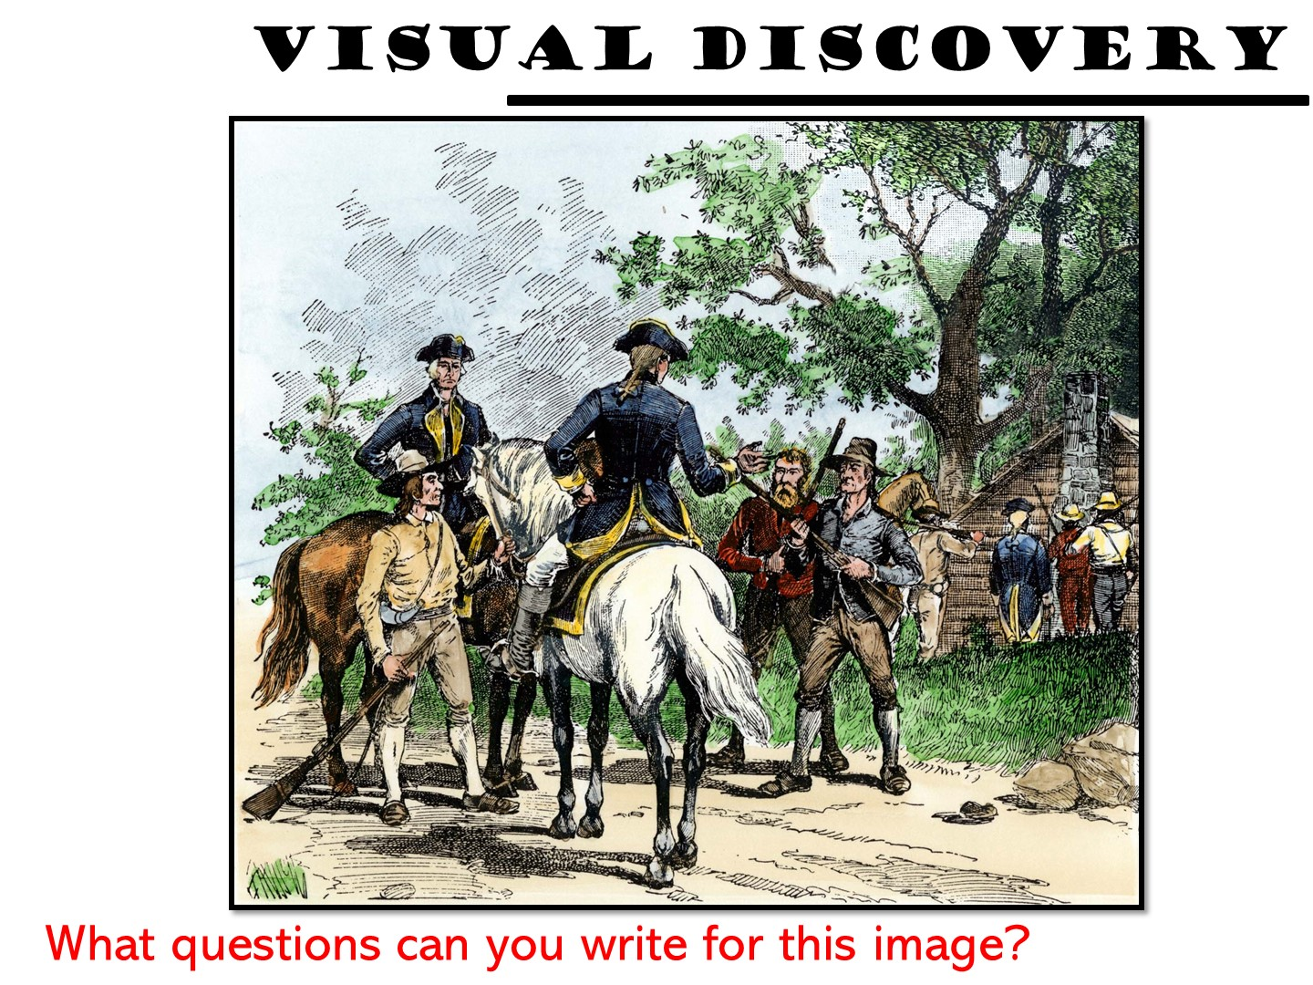

Slide 47
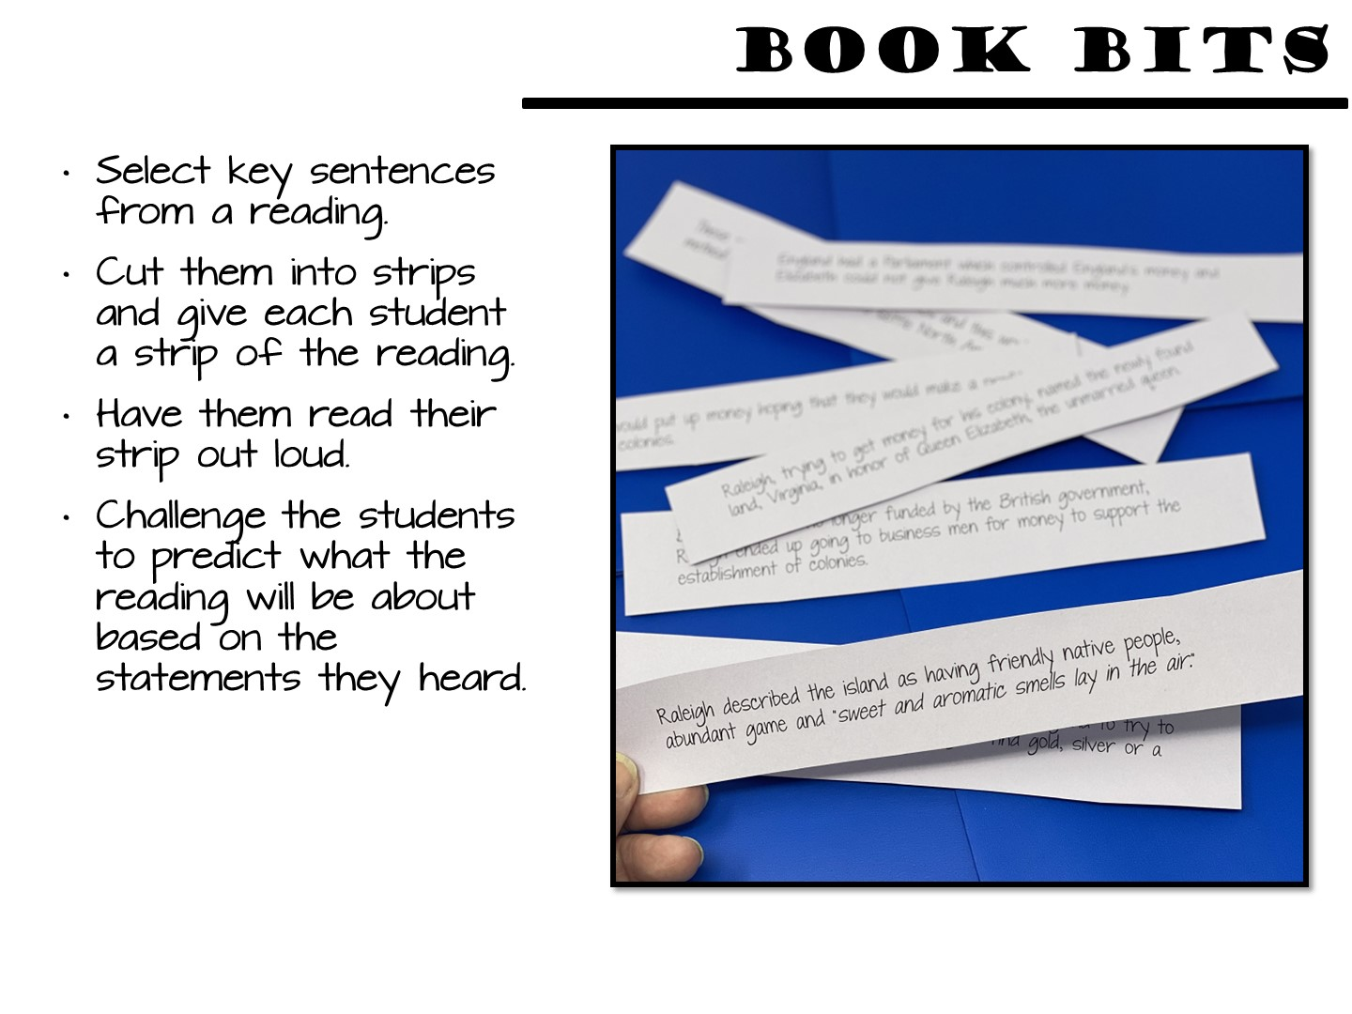
Notes:
Select key phrases or sentences that are significant to the text. These book bits should reveal enough to help students begin to think along the lines that support text understanding, but not so revealing that they limit thinking.
Write each book bit on a strip of paper. There should be as many book bits as there are students in the group.
Give each student a book bit. Ask each student to read his/her book bit and think about how it might be connected to the text.
After the students have read their book bit, they move about the room and read their book bit to others. No discussion occurs during this sharing – only the reading of the book bits to one another. (Consider dividing class into two equal groups. Form two parallel lines having students facing each other. Students facing each other read the book bits to one another. Then tell one of the lines to shift down one space. The student at the end of the row goes to the beginning for a new partner. Keep shifting until all book bits have been read aloud.)
Once students have had the opportunity to hear most of their peers’ book bits, they return to their seat and do a quick write about the impressions they now have about the text. They might address what they think the selection is about or what they know about the characters or topic.
After completing the quick write, students discuss their ideas with one another.

Slide 48
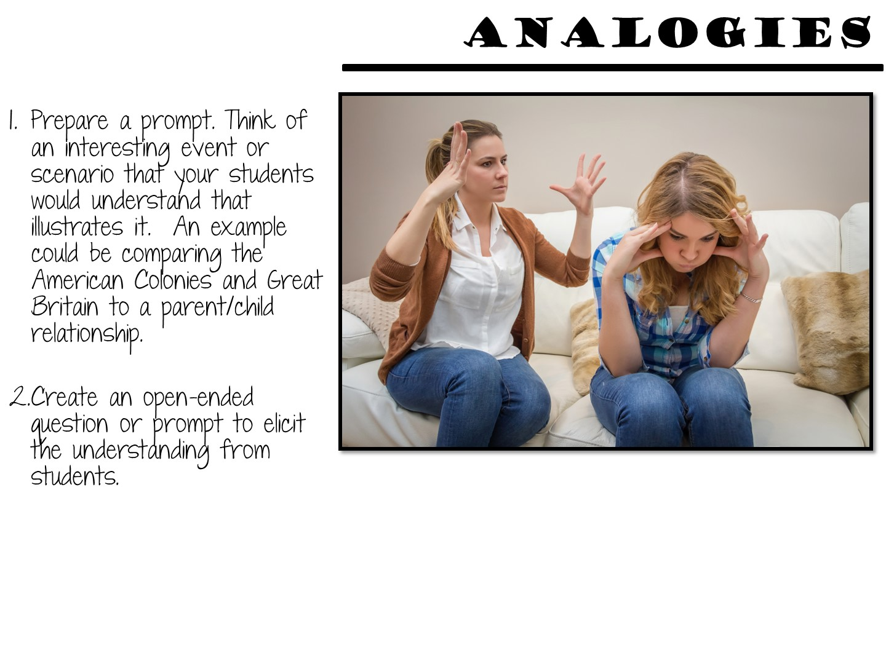

Slide 49
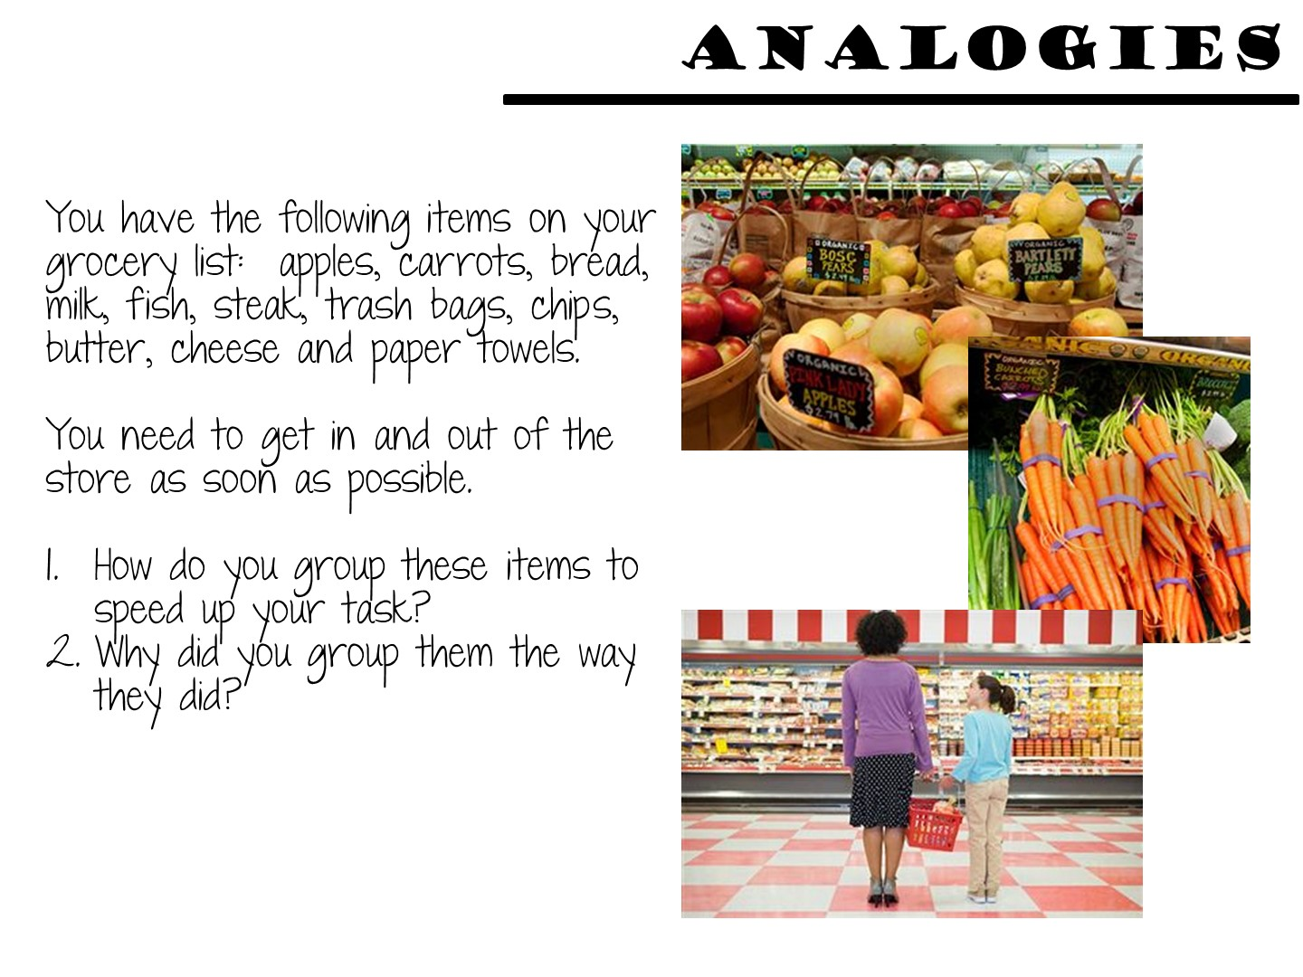
Notes:
Tie this preview into the concept of regions. People organize places into regions so they make more sense.

Slide 50

Notes:
Pass out the literacy strategy manual.

Slide 51

Notes:
Pat yourself on your back, then give me 5 new things you have learned so far

Slide 52
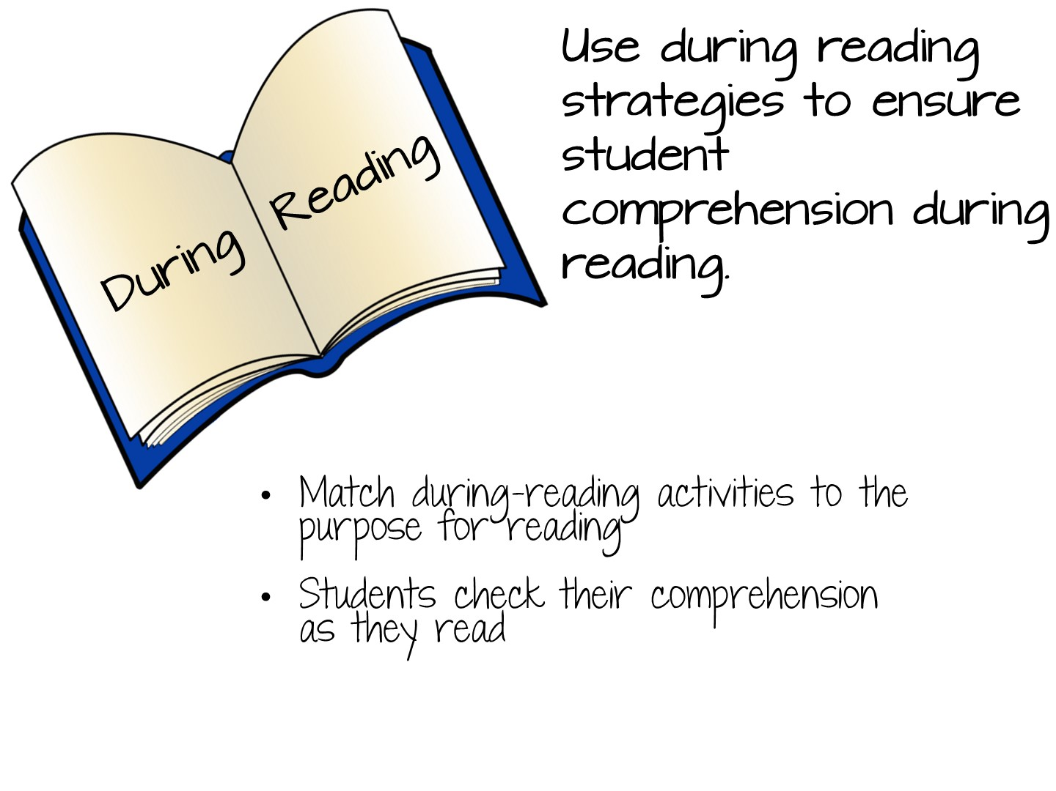

Slide 53
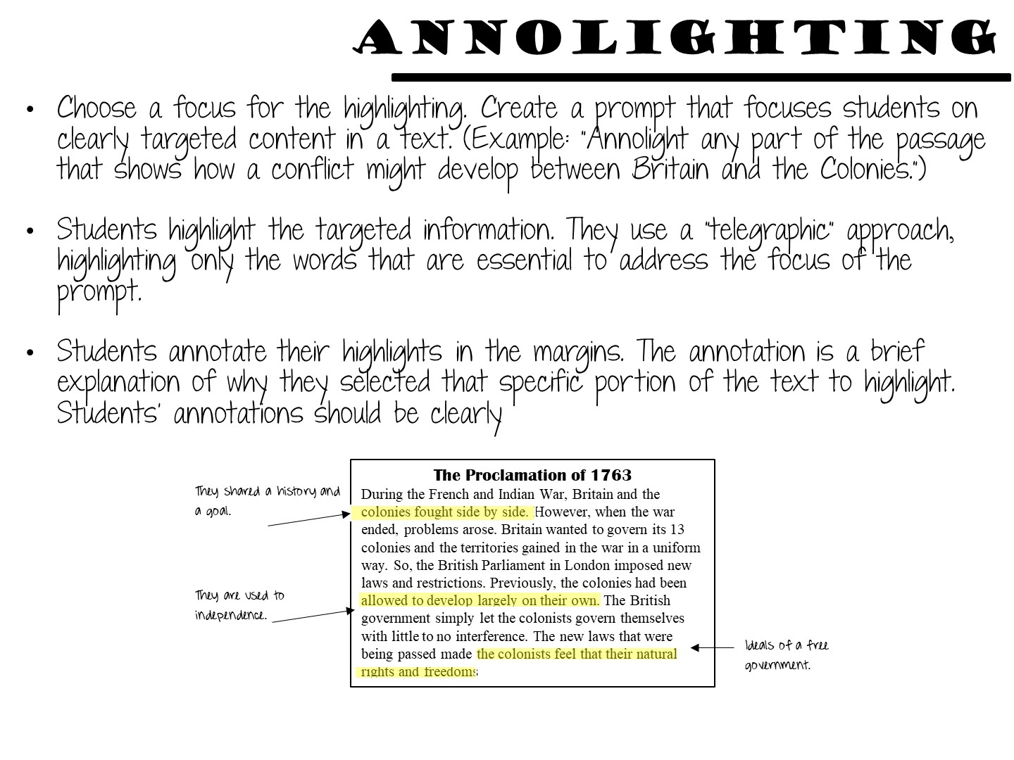

Slide 54


Slide 55
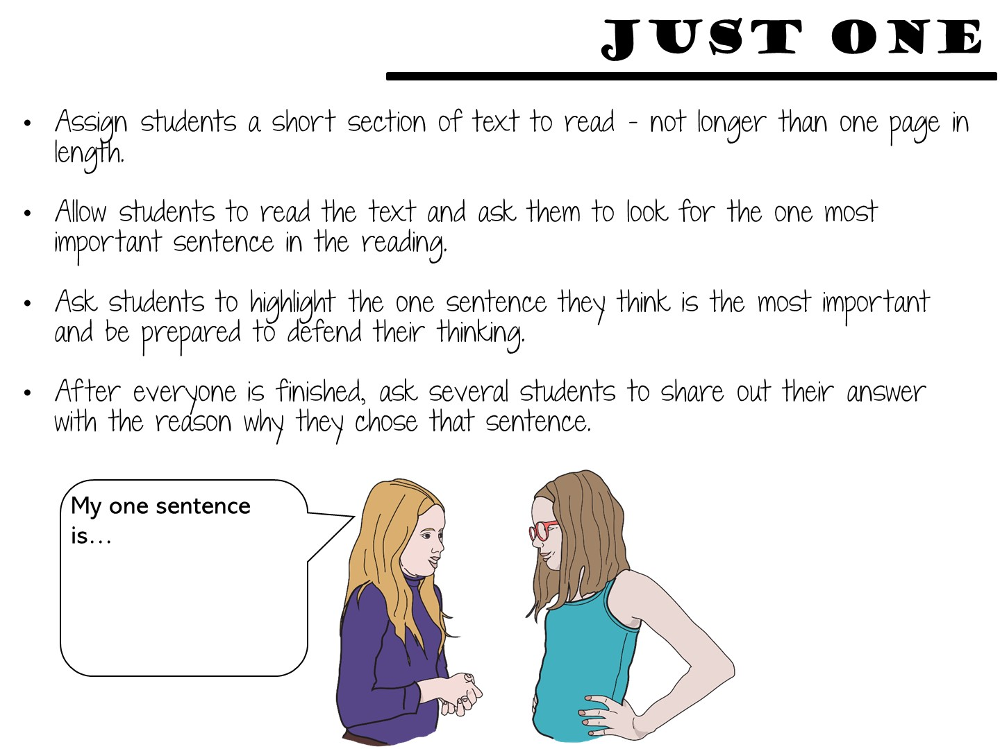

Slide 56
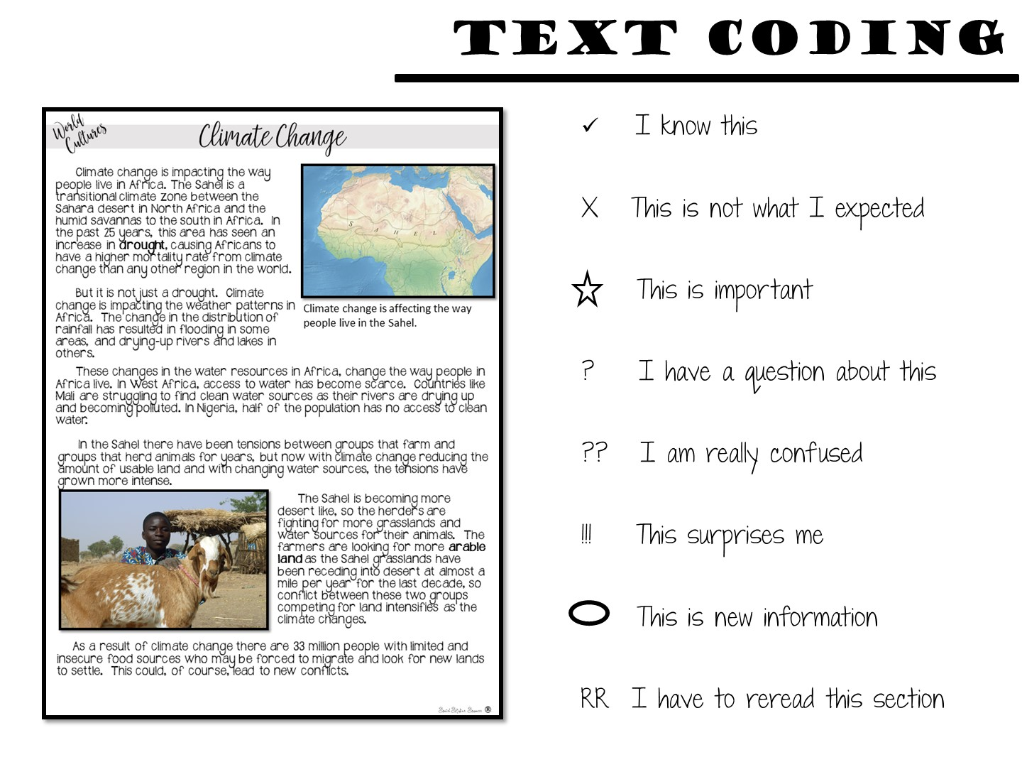
Notes:
Text coding is another strategy to help students focus on their reading while they are reading. Hand students cards with these codes on them (you can find these in your strategy manual). Tell your students that you are going to focus on one code at a time like what they already know (checkmark). Read the first paragraph with your students and have them place a checkmark next to information they already know. You can continue the process with the next few paragraphs. When they are done, go back with another symbol. You do not have to use all of the symbols all of the time.

Slide 57


Slide 58


Slide 59
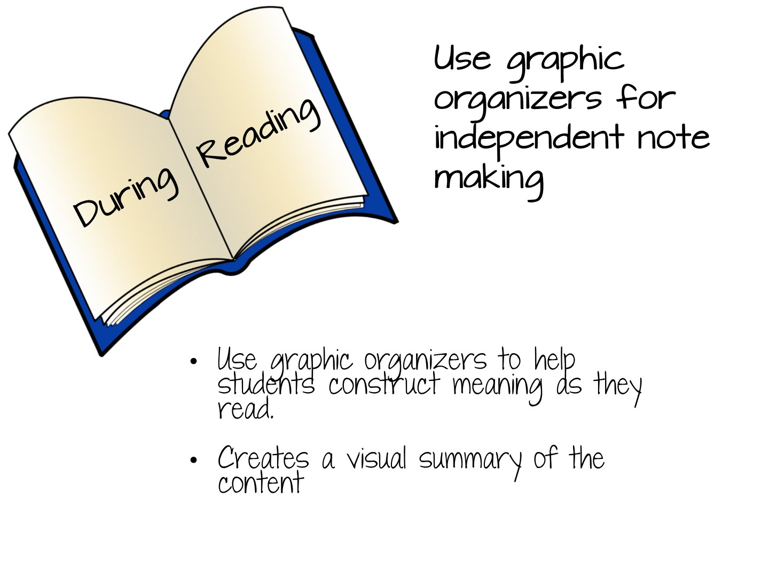

Slide 60
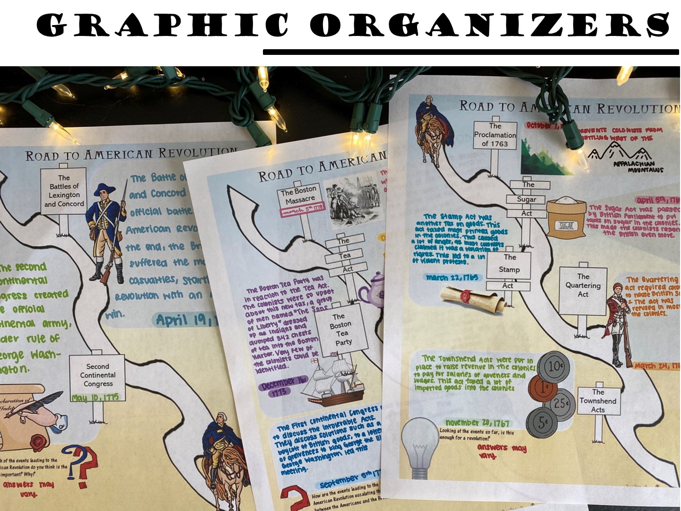
Notes:
Let’s take a look at the variety of graphic organizers for note making you can use with your students.

Slide 61
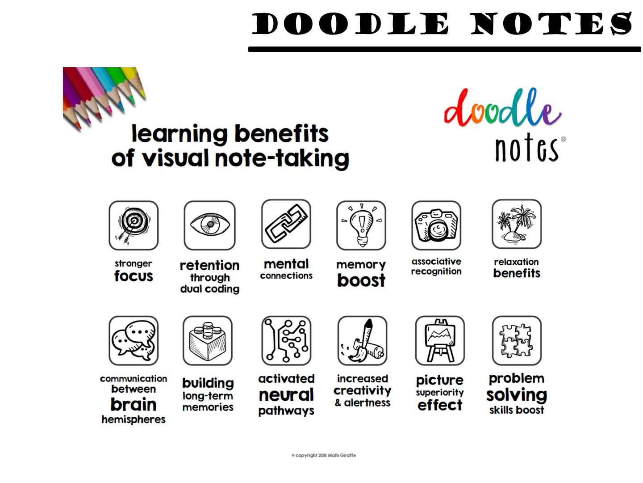
Notes:
Let’s start with my favorite note taking strategy – Doodle Notes developed by Brigid Danziger and Kate Wright. I want to take a little bit of time to discuss Doodle Notes as a method of graphic note taking for the During Reading stage. First take a look at the benefits of Doodle Notes. Read this slide and jot down 2 benefits that connect with you on your notetaking page.

Slide 62
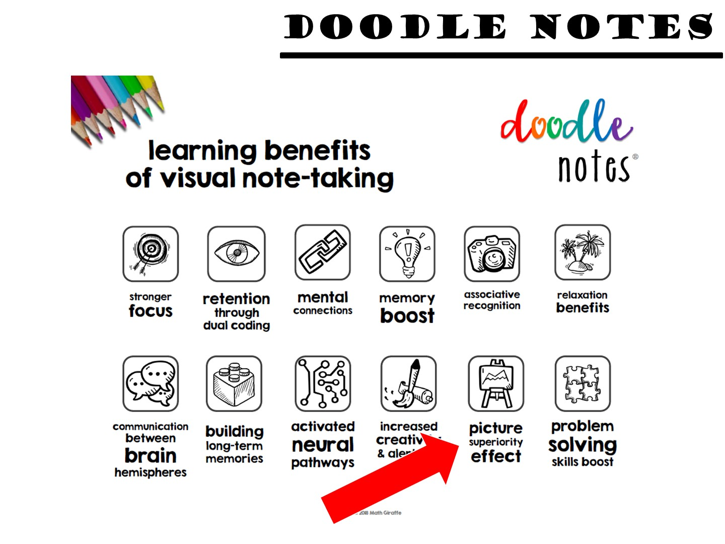
Notes:
Let me share with you the one benefit that connects with me the most - The picture superiority effect. The picture superiority effect refers to the phenomenon in which pictures and images are more likely to be remembered than words. When you close your eyes and think of a graphic organizer with pictures, you are more likely to remember the information than if you are just trying to remember fill-in-the-blank notes or an outline.

Slide 63
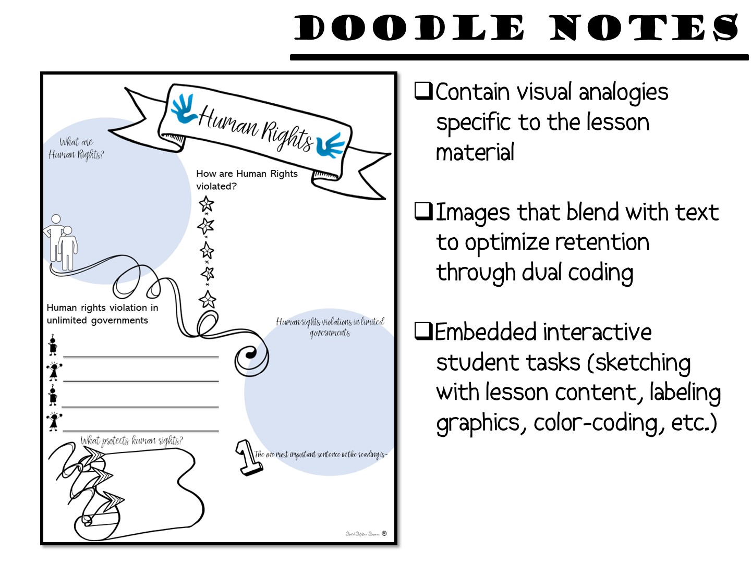
Notes:
There are many different types of Doodle Notes – from the simple to the more complex. But they all have similar elements.

Slide 64
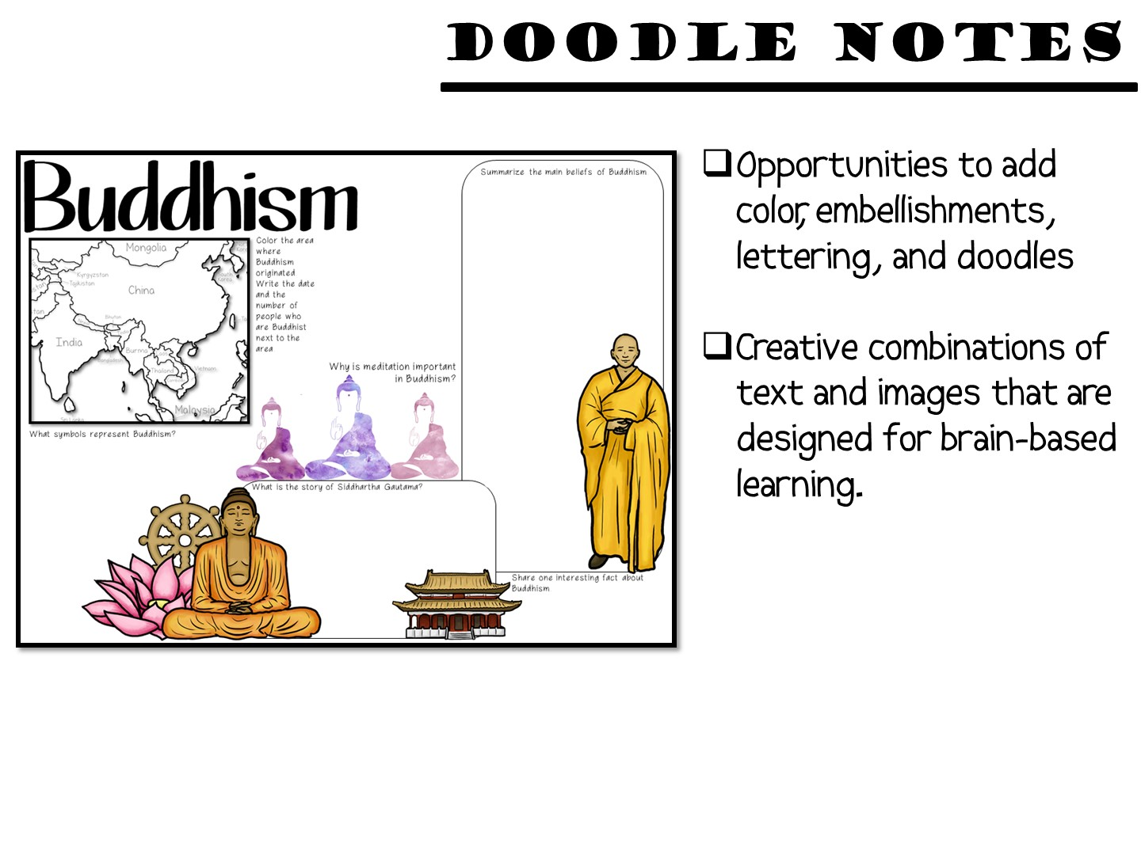
Notes:
More guidelines include

Slide 65
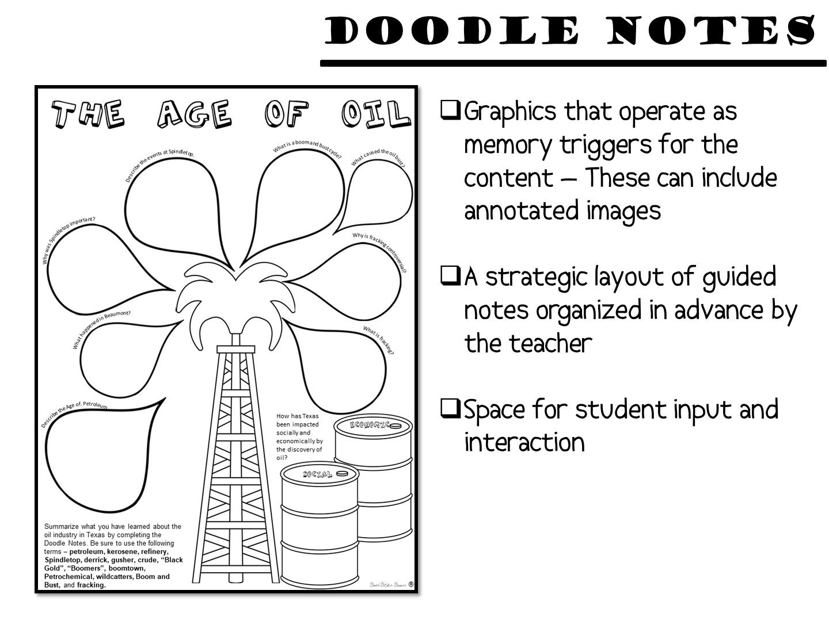

Slide 66
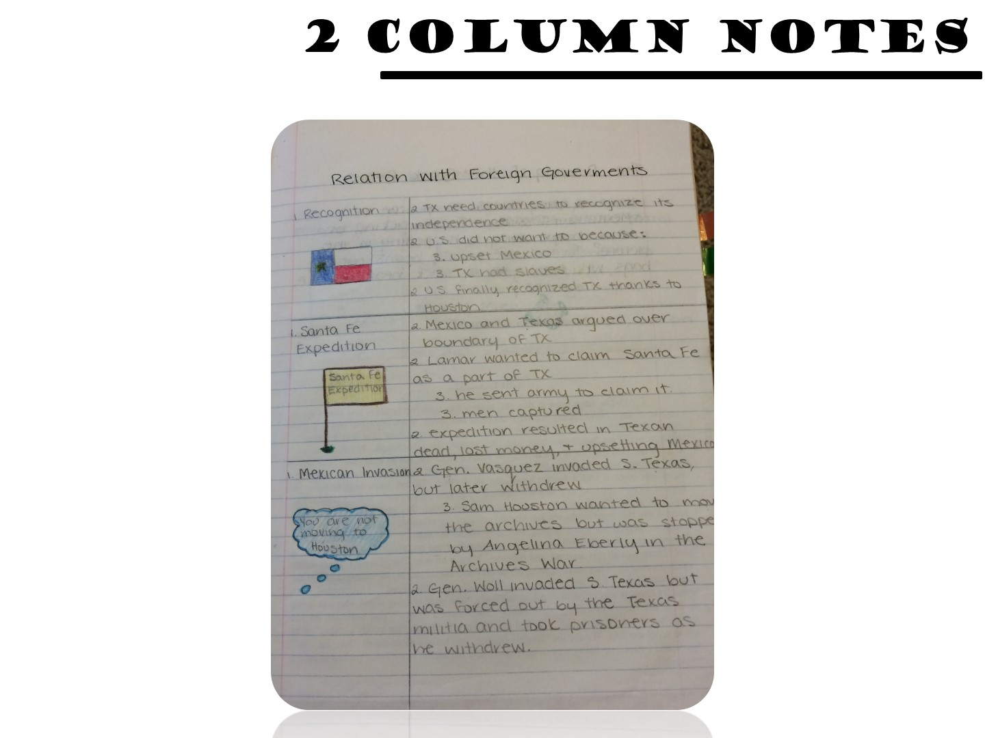
Notes:
Other types of Graphic Notes

Slide 67
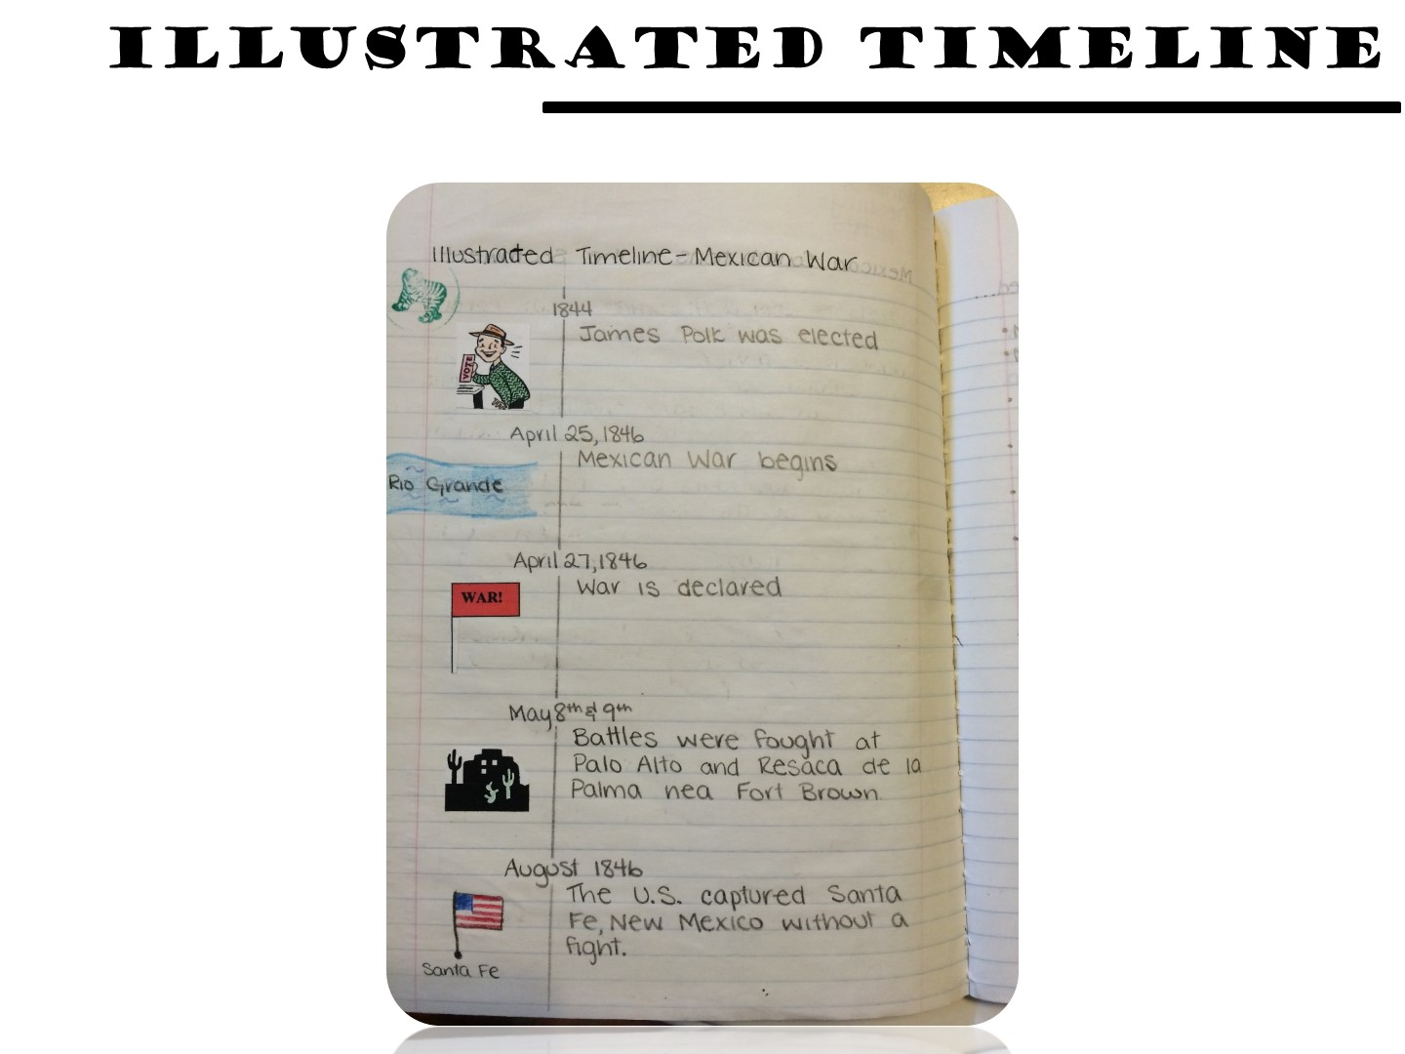
Notes:
Other types of Graphic Notes

Slide 68
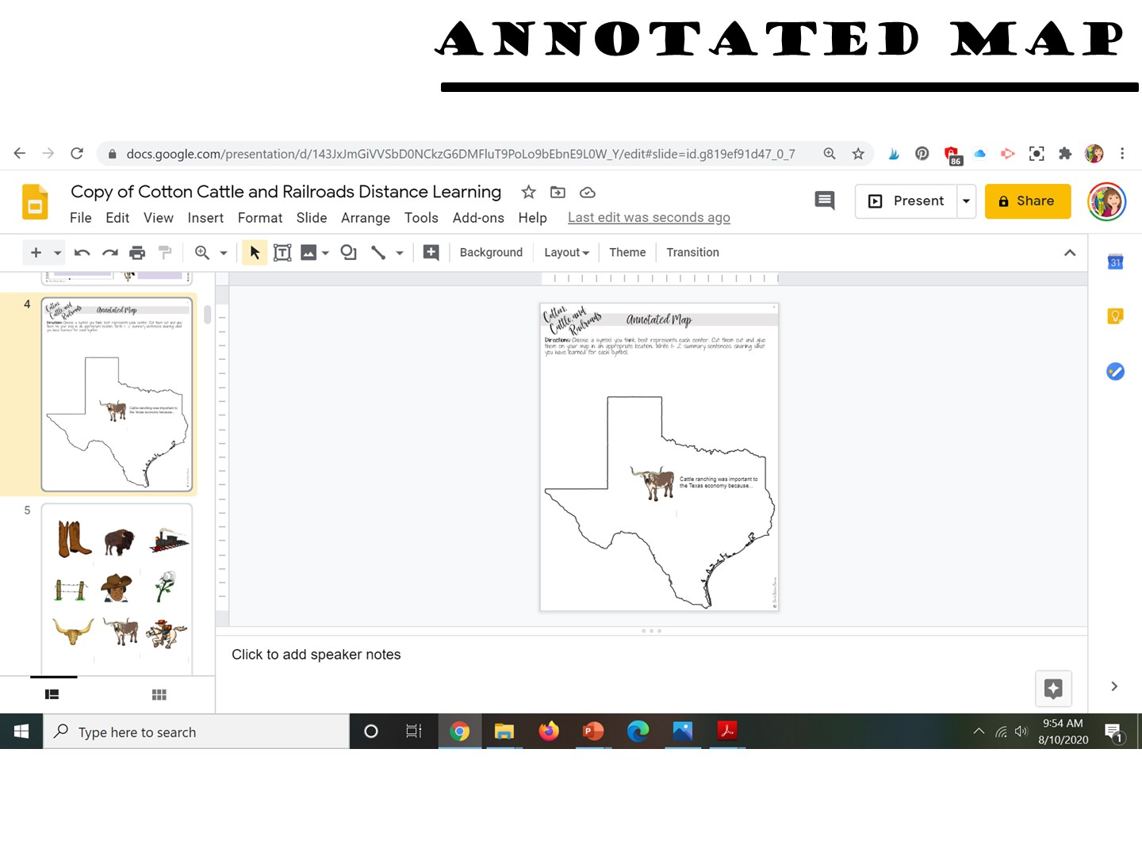
Notes:
Other types of Graphic Notes

Slide 69
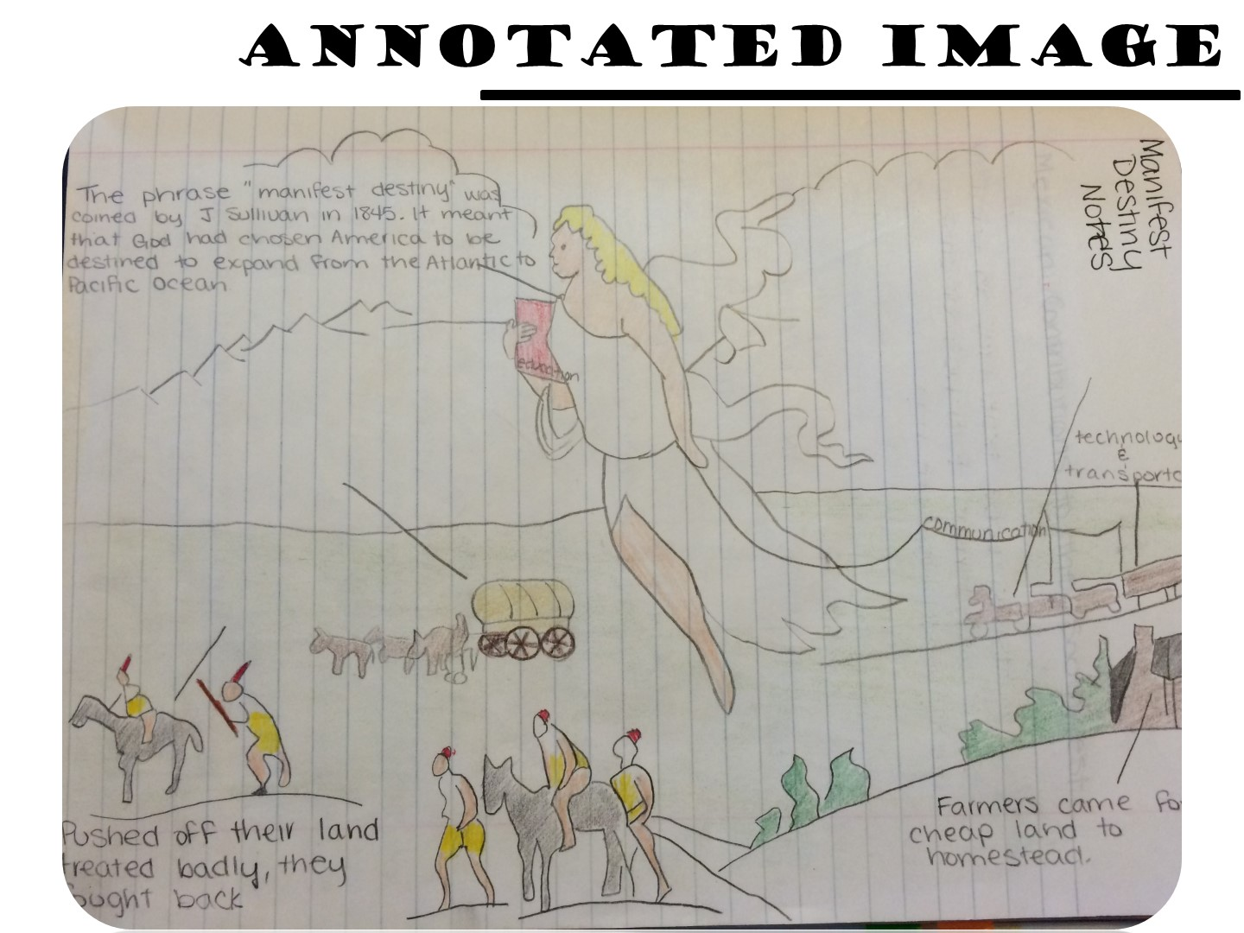

Slide 70
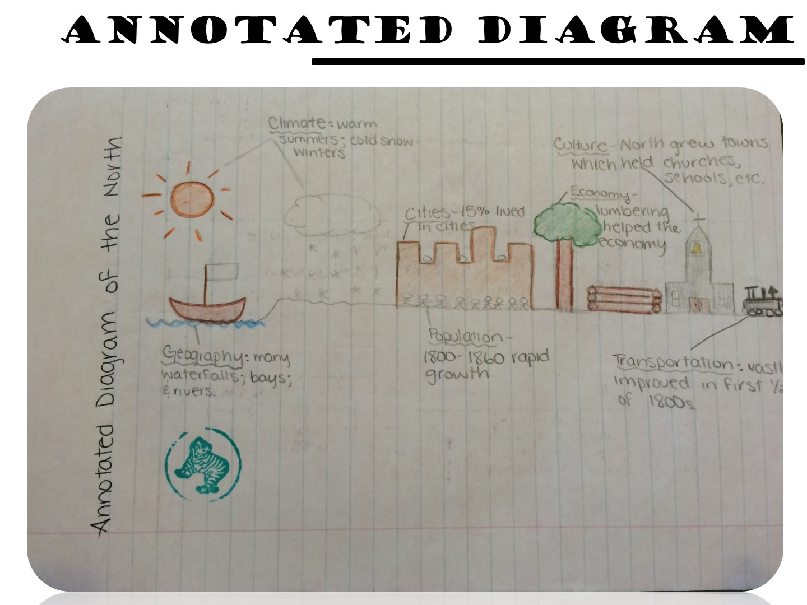

Slide 71
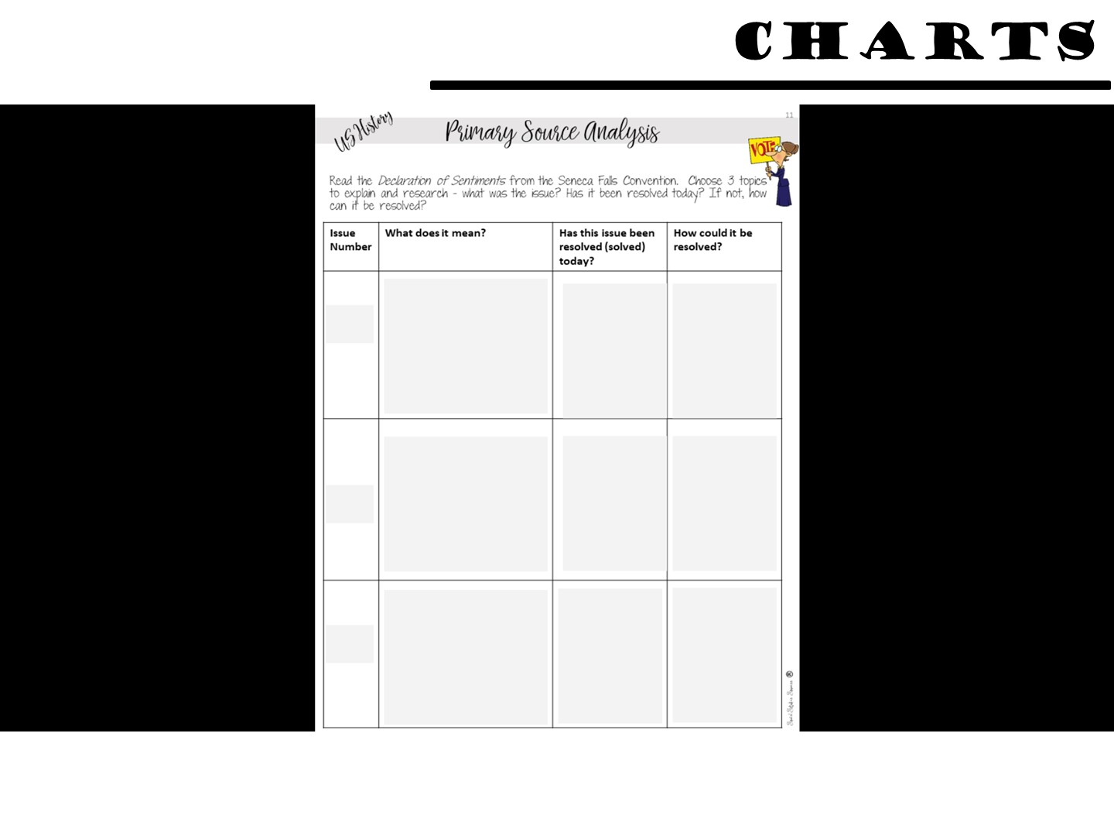

Slide 72
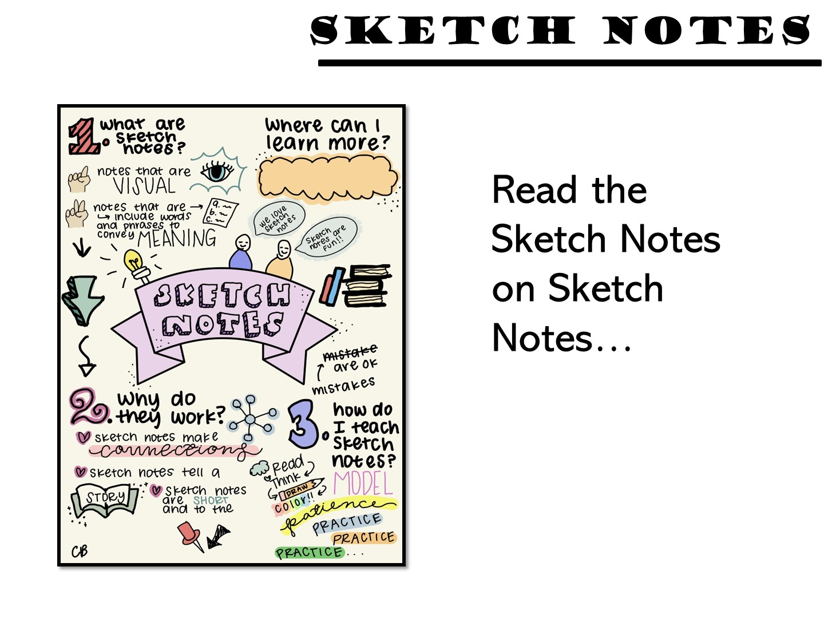
Notes:
Other types of Graphic Notes is called Sketch Notes. These too are graphic and help students summarize the key information in a reading. Have them read the sketch notes examples.

Slide 73

Notes:
Stand on one foot and summarize what you have learned so far

Slide 74


Slide 75
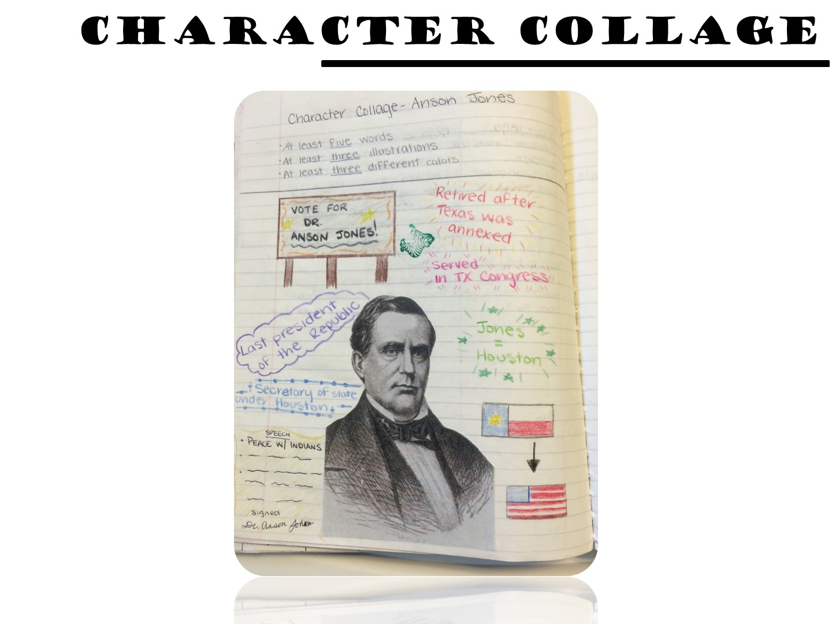

Slide 76
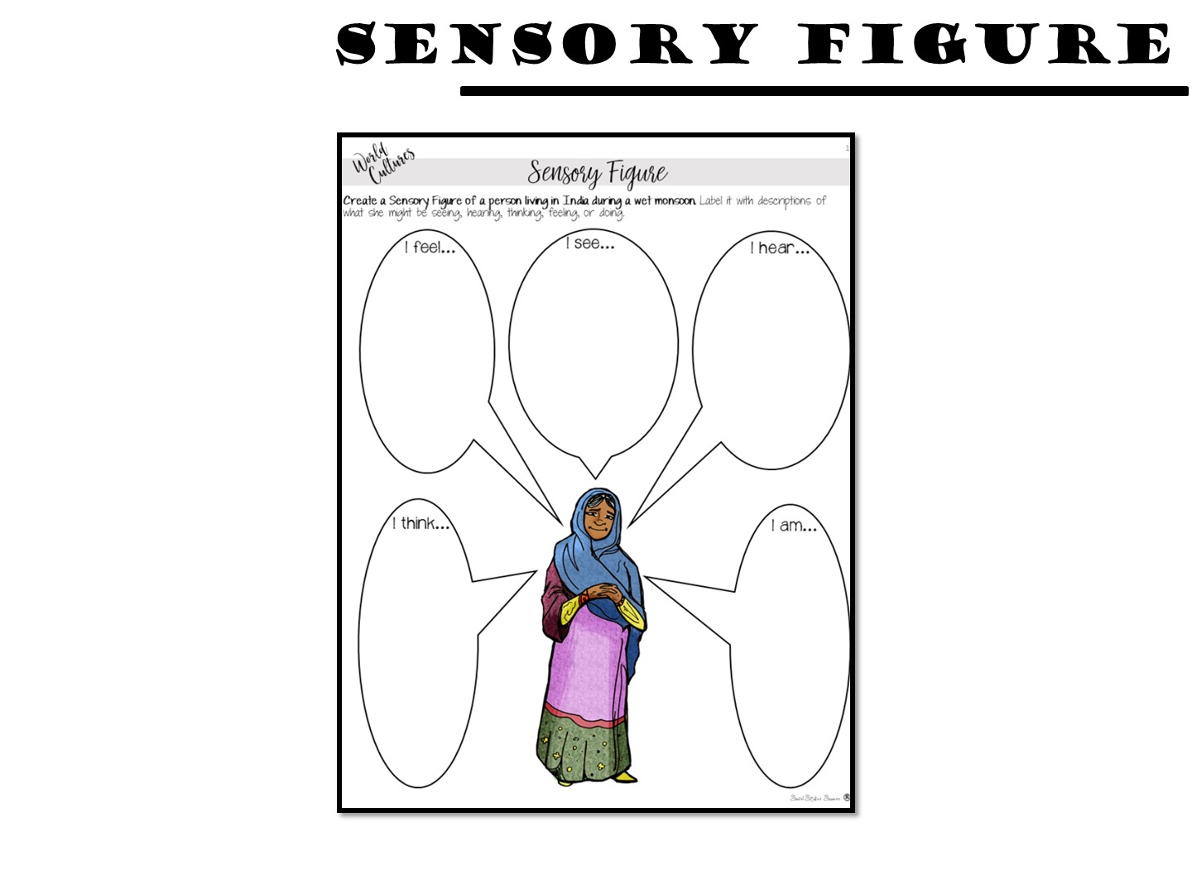

Slide 77
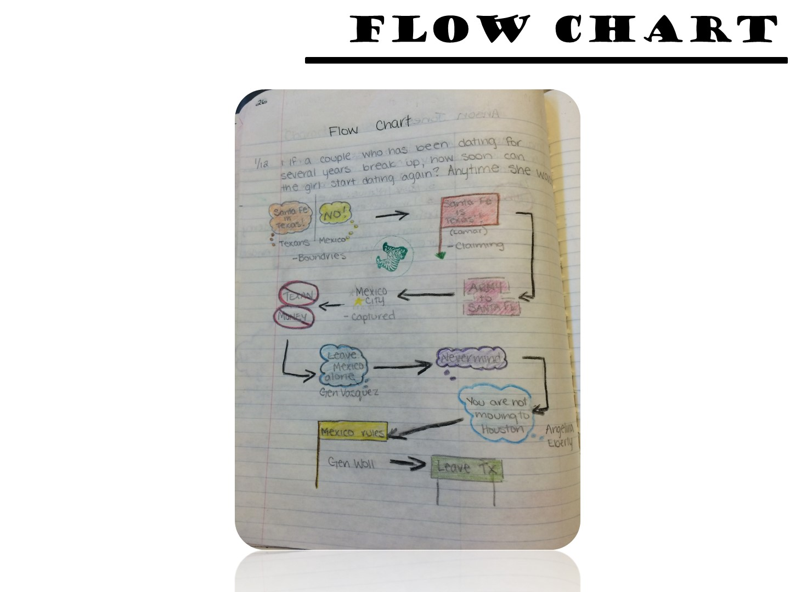

Slide 78
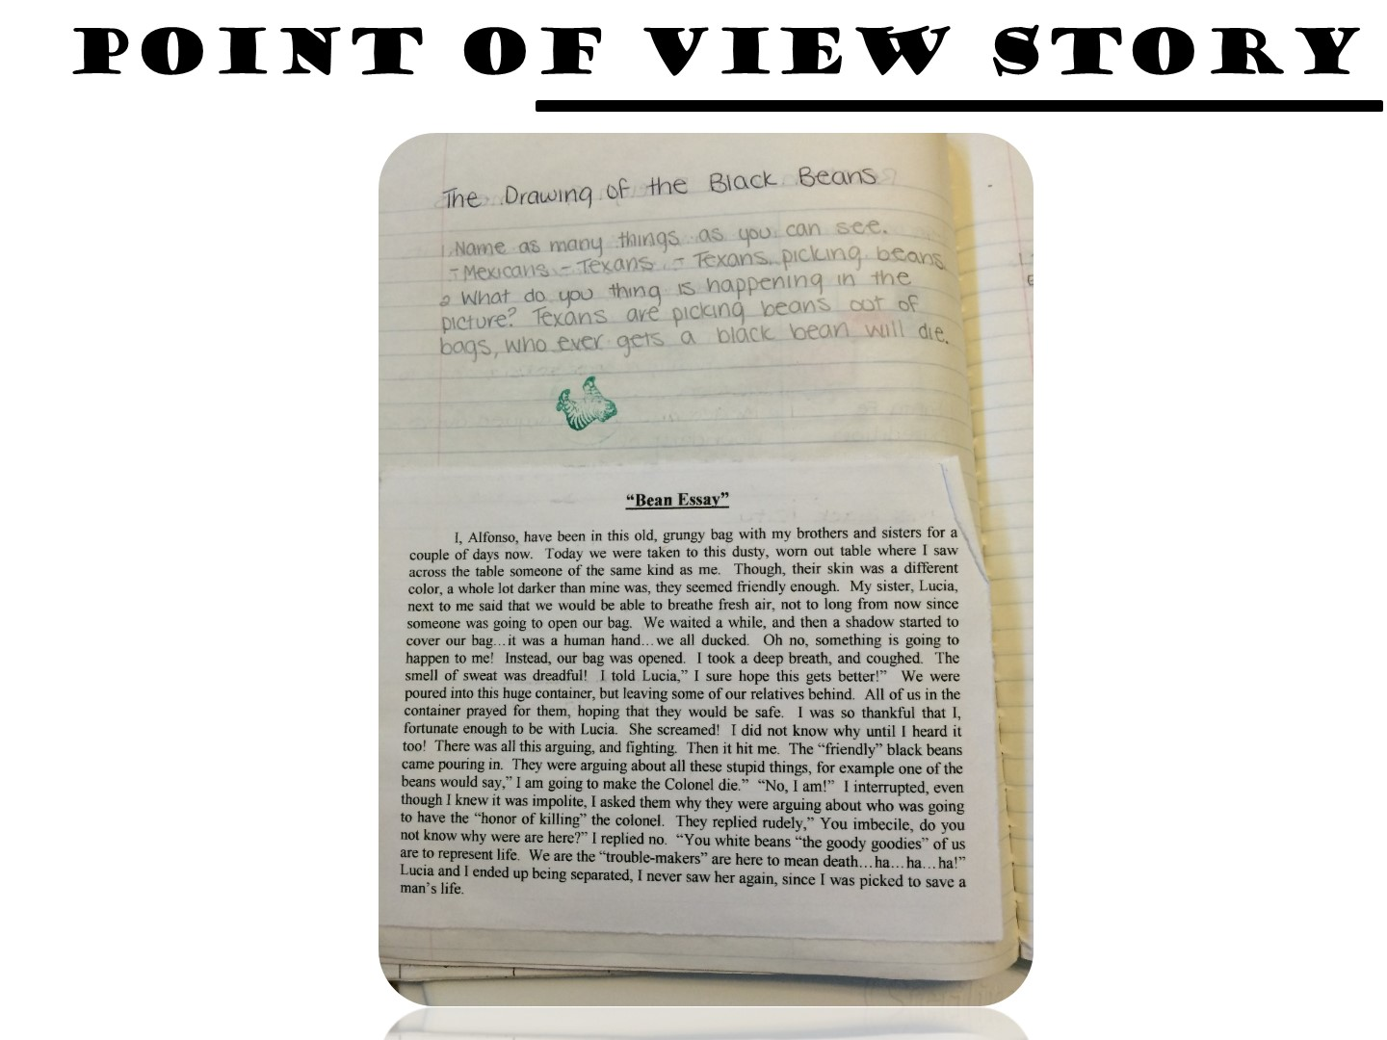

Slide 79
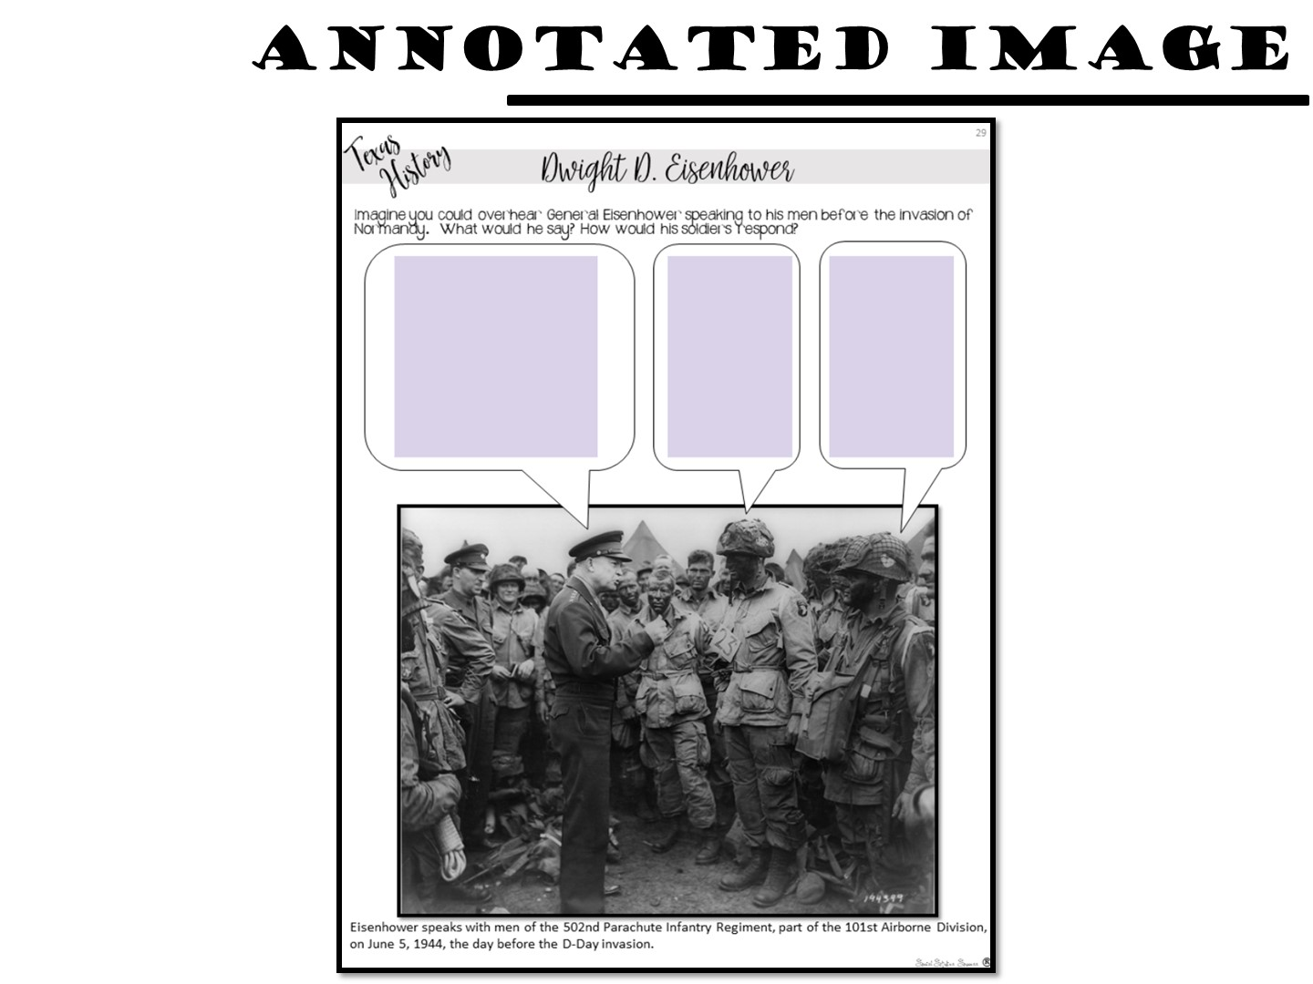

Slide 80


Slide 81


Slide 82


Slide 83

Notes:
Students write or draw what they would see beyond the picture frame.

Slide 84


Slide 85


Slide 86


Slide 88

Notes:
We will be practicing some of these strategies – be sure to have a pen and paper handy.

Slide 89

Notes:
Let’s start with what you think about writing in the classroom with this 4 –Corner strategy. Take a look at these different statements regarding writing – which one do you agree with the most and why? Raise your hand to show with your fingers the answer.

Slide 90

Notes:
Why is writing important? The Program for the International Assessment of Adult Competencies (PIACC) does a widespread study of literacy every ten years, with updates to the data coming in more frequently. The most recent data come from 2014. The results are staggering.
More than 50% of American adults read and write at or below a fourth/fifth-grade level. A shocking 17% read and write at below a third-grade level. Only 13% of American adults can read and write at a high school level or higher.
Perhaps the most sobering statistic is that 4% do not have enough literacy to function in our society. If that seems low, think of it like this: in a room of 100 random people, four could not read and write well enough to perform basic tasks in our society. We are putting our students at a disadvantage if we do not write in our classroom.

Slide 91

Notes:
Let me show you an example – as a teacher I would assign writing as an assessment – usually on a test.
91

Slide 92

Notes:
And this is the results I would get! Do your students turn in writing similar to this example? I lacked a methodology and strategies for teaching writing – I want you to avoid the same fate as me.
92

Slide 93

Notes:
As one expert has said - David Labaree: “Learning to write is extraordinarily difficult, and teaching people how to write is just as hard.

Slide 94

Notes:
The purpose of this session is to share different strategies on writing in Social Studies – so we will look at ways you can help your students learn to write in a social Studies course as well as ways to cement learning through writing in your class. We are going to start with the difference between learning to write strategies and writing to learn strategies.

Slide 95

Notes:
There are three basic steps of writing - prewriting, composing, and revising. These steps have to be taught explicitly. Students need to know that while writing involves these steps, the process of writing is also circular. As students start writing, they may need to loop back and gather more information and do more work at each of the steps. We are going to examine strategies to help in each of these stages of writing.

Slide 96

Notes:
If prewriting is what you do before writing – what strategies do you have in place right now that actually help students prepare for writing? Answer in the chat box of what you do in your class to help your students prepare to write.

Slide 97

Notes:
Before I start with different strategies for writing instruction, I want to acknowledge the importance of vocabulary. Just like solid vocabulary instruction improves reading, so too does vocabulary instruction improve writing. You can support students use of vocabulary by providing word banks or lists of terms you would want included in a writing assignment. And don’t just think word lists need to include academic vocabulary. Transition terms can be just as helpful to your students who are writing in your classroom.

Slide 98

Notes:
The first stage of the writing process involves prewriting. Prewriting can include many different stages – brainstorming ideas of what students will need to write, organizing ideas students have generated, and even providing structures to support writing and working together to complete them. Let’s take a look at some effective prewriting strategies.

Slide 99

Notes:
The first strategy I want to share with you is Character Quotes – Character quotes are great to get students thinking about a biographical figure.
Explain how character quotes work

Slide 100

Notes:
Character quotes can lead into a paragraph about a person.

Slide 101

Notes:
Rapid writing is another prewriting strategy – it can be used to activate information about a topic.
(Read directions)

Slide 102

Notes:
Ideas like this can lead to a deeper understanding of the topic.

Slide 103

Notes:
Have teachers share the answers to this with each other.

Slide 104

Notes:
The next step in the writing process is composing the writing. There are several different ways we can support students in this step.

Slide 105

Notes:
The first strategy seems simple, but it takes quite a bit of preparation and reflection on your part – you need to model writing for your students. If you are going to introduce a writing assignment, think through the different steps it would require for the students to complete the assignment… and then model how to do it. Model writing can also include providing writing samples that you would want your students to emulate.

Slide 106

Notes:
One common strategy for helping students compose their writing is to provide acronyms to help students structure their writing. Acronyms teach your students to use self-monitoring checklists while they write. The self-monitoring checklists might be mnemonic devices in which the first letter of each word spells out a memorable catch-phrase.

Slide 107

Notes:
TREE to: (a) develop a Topic sentence; (b) list Reasons to support; (c) Examine the quality of reasons; and (d) provide an Ending

Slide 108

Notes:
explain

Slide 109

Notes:
explain

Slide 110


Slide 111

Notes:
Another strategy is to use templates to provide structure for writing.

Slide 112

Notes:
These templates can include ideas like a double bubble to compare and contrast two different ideas -

Slide 113

Notes:
A problem solution, to help students structure a writing assignment like – How do countries in Southwest Asia solve their water crises?

Slide 114

Notes:
A Somebody Wanted is a great template to help students summarize the main ideas of an issue in Social Studies.

Slide 115


Slide 116

Notes:
The final stage in the writing process is revision – this is an essential step for students to grow from the writing process.

Slide 117

Notes:
Feedback is essential for students! It would be easy to circle errors in red pen, write a few comments, and return papers with a letter grade, but most teachers don’t do that—the amount of time we spend on grading student writing is staggering. And much of this feedback is not improving their writing.
Dedicate time to conference with each student to offer them personalized feedback they can immediately use. Checklists can also support students in this stage.

Slide 118

Notes:
One strategy you can use for providing peer feedback is rainbow revisions. (explain)

Slide 119


Slide 120
Notes:
Next we are going to take a look at the difference between learning to write and writing to learn.

Slide 121

Notes:
A writing-to-learn strategy is one that teachers uses throughout a unit or at the end of a lesson to engage students and develop big ideas and concepts.
WRITING TO LEARN IS:
a catalyst for further learning – a way to activate prior knowledge, recall newly learned information, make connections to other concepts and promote reflective questioning
a process in which writers discover what they know and do not know about their topics, and their ability to communicate with specific audiences. For example, the prompt: “Explain the bombing of Hiroshima to your younger brother or sister.” requires that the student consider their prior knowledge and how to best convey that and their new knowledge in writing.
a way for teachers to check students’ understanding of the content and to plan future instruction.
a chance for students to record data and thoughts that they can use later for essays or class assignments
a way for content area teachers to focus on their content & yet sneak some writing into their curriculum.
WRITING TO LEARN IS NOT:
a process piece that will go through multiple refinements
writing with full attention to grammar & mechanics of writing
WHY USE W.T.L.
Students need to ACT on information in order to UNDERSTAND, REMEMBER, & USE IT…Hence Writing to Learn.
Lecture notes and end-of-the-chapter questions are essentially forms of transcription, of writing down other people’s words. They don’t ask enough of learners
WHEN TO USE W.T.L.
BEFORE a unit of study:
To surface prior knowledge
To identify misconceptions
to activate thinking
to set class and individual goals for an upcoming unit
DURING a unit of study:
to help students stop and collect thoughts
to sort out ideas
to notice and hold thinking
to review and readjust goals & get ready to move ahead
AFTER a unit of study:
To synthesize what has been learned
To connect with others
To compare notes
To plan projects or outlets for learning
SOURCES:
Daniels, Harvey; Steineke, Nancy; Zemelman, Steven. Content-Area Writing: Every Teacher’s Guide. Heinemann. Portsmouth, NH. 2007.
Fisher, Douglas & Frey, Nancy. Improving Adolescent Literacy: Content Area Strategies at Work. . Pearson Education Inc. Upper Saddle River, New Jersey. 2008

Slide 122


Slide 123

Notes:
(read slide)

Slide 124

Notes:
The writing to learn strategies we are going to look at are actually one of the most important for Social Studies – summarization. Just like in any other skill, summarization will need to be taught to your students. Let’s take a look at some of the steps to help students summarize.

Slide 125

Notes:
When teaching students to summarize, use a process. This can include - Read slide

Slide 126

Notes:
Read slide

Slide 127

Notes:
Read slide

Slide 128

Notes:
Pass out handout

Slide 129

Notes:
Now let’s take a look at different summarization strategies

Slide 130

Notes:
Implement GIST. Explain that the "gist" of something is the main idea. Help them understand that they do not need to remember all of the details in order to get the gist of the material. Draw twenty word-size blanks on the chalkboard or transparency and explain that, after reading, they will try to write a sentence (or two) of no more than twenty words that captures the gist of the selection. The students read a short section--no more than three paragraphs--then work with the teacher as a class to record the gist of what they've read. Students take turns telling the teacher part of what to write. In no case will the teacher write a twenty-first word. Students must revise their statement until it describes the essence of the article in twenty blanks or fewer.
: GIST- Generating Interactions between Schemata and Texts

Slide 131

Notes:
Reread the Earthquake handout. When you are finished reading, write a gist summary – have them draw the boxes on a sheet of white paper.

Slide 132

Notes:
A summarization star is another strategy to help students focus on the main points of a topic. (Read) – You can model this if you have time.

Slide 133

Notes:
Read slide and give example question like Why Study History?

Slide 134

Notes:
The "First Then Finally" technique helps students summarize events in chronological order. The three words represent the beginning, main action, and conclusion of a story, respectively:
Read slide

Slide 135

Notes:
Another strategy is -

Slide 136


Slide 137


Slide 138

Notes:
Point out my blog on social studies success if they want to learn more.

