Slide 1


Slide 2


Slide 3

Notes:
Introduce yourself

Slide 4

Notes:
Differentiated instruction is ensuring that learning happens in an accessible way for the student. ISNs allow the students to format their thoughts however they find suitable, thus, differentiating by learning styles — someone who loves writing can love in the notebooks, another student who would rather draw is free to express his/her ideas through diagrams, charts and pictures.

Slide 5

Notes:
Differentiated instruction is ensuring that learning happens in an accessible way for the student. ISNs allow the students to format their thoughts however they find suitable, thus, differentiating by learning styles — someone who loves writing can love in the notebooks, another student who would rather draw is free to express his/her ideas through diagrams, charts and pictures.

Slide 6
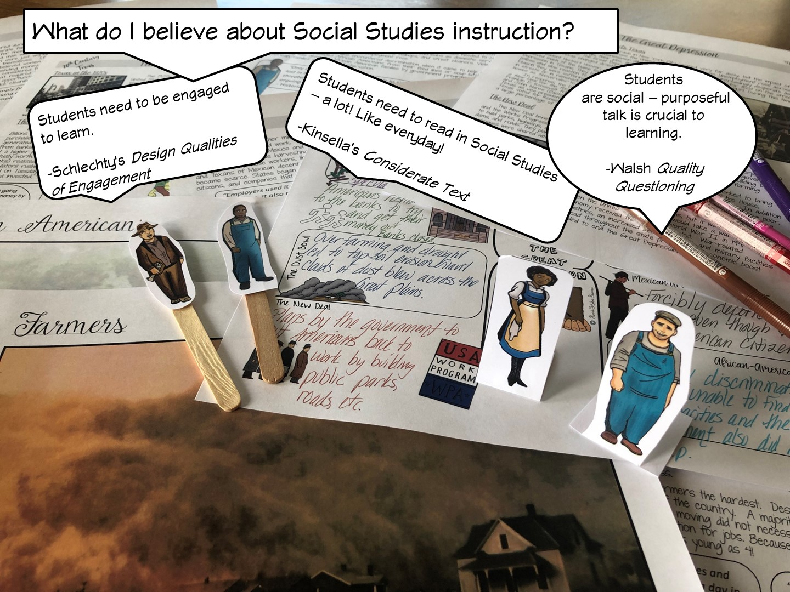
Notes:
Differentiated instruction is ensuring that learning happens in an accessible way for the student. ISNs allow the students to format their thoughts however they find suitable, thus, differentiating by learning styles — someone who loves writing can love in the notebooks, another student who would rather draw is free to express his/her ideas through diagrams, charts and pictures.

Slide 7
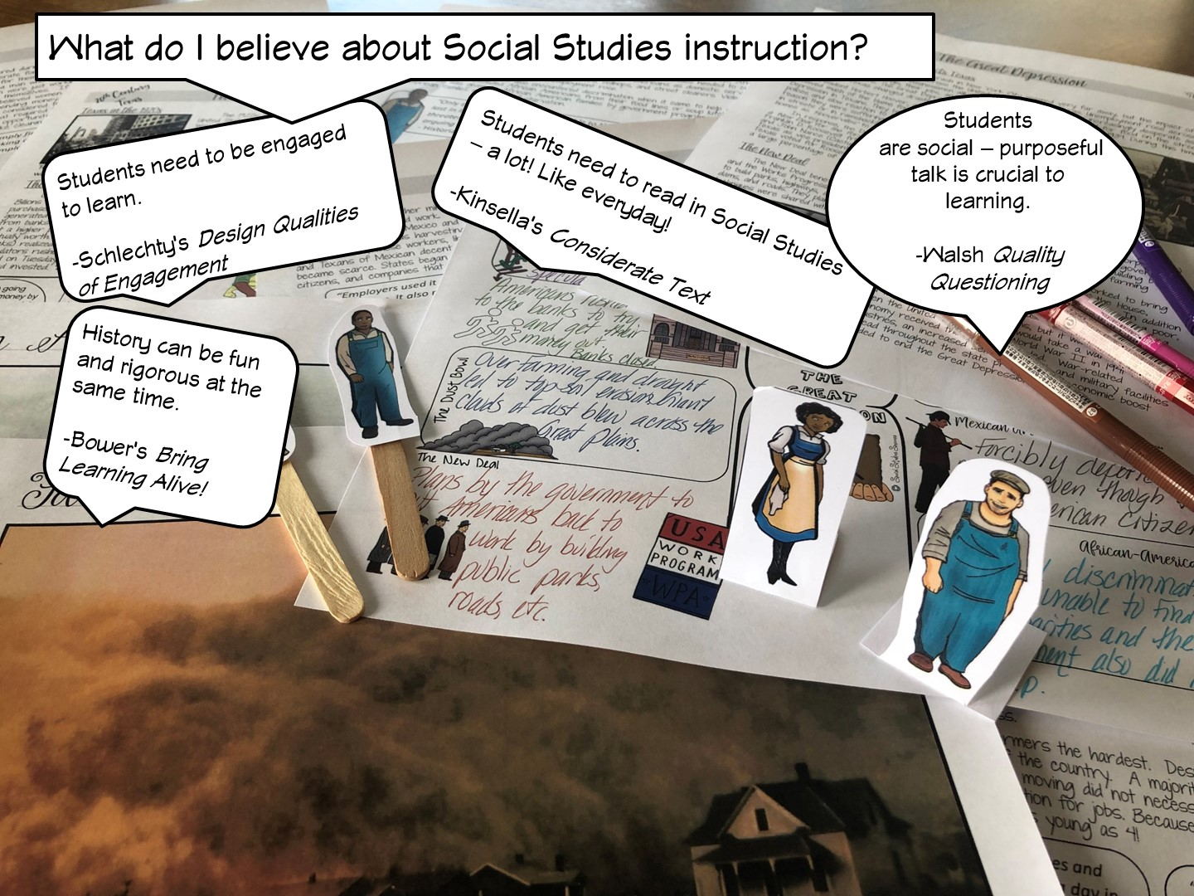
Notes:
Differentiated instruction is ensuring that learning happens in an accessible way for the student. ISNs allow the students to format their thoughts however they find suitable, thus, differentiating by learning styles — someone who loves writing can love in the notebooks, another student who would rather draw is free to express his/her ideas through diagrams, charts and pictures.

Slide 8

Notes:
Differentiated instruction is ensuring that learning happens in an accessible way for the student. ISNs allow the students to format their thoughts however they find suitable, thus, differentiating by learning styles — someone who loves writing can love in the notebooks, another student who would rather draw is free to express his/her ideas through diagrams, charts and pictures.

Slide 9

Notes:
Differentiated instruction is ensuring that learning happens in an accessible way for the student. ISNs allow the students to format their thoughts however they find suitable, thus, differentiating by learning styles — someone who loves writing can love in the notebooks, another student who would rather draw is free to express his/her ideas through diagrams, charts and pictures.

Slide 10

Notes:
Differentiated instruction is ensuring that learning happens in an accessible way for the student. ISNs allow the students to format their thoughts however they find suitable, thus, differentiating by learning styles — someone who loves writing can love in the notebooks, another student who would rather draw is free to express his/her ideas through diagrams, charts and pictures.

Slide 11

Notes:
Differentiated instruction is ensuring that learning happens in an accessible way for the student. ISNs allow the students to format their thoughts however they find suitable, thus, differentiating by learning styles — someone who loves writing can love in the notebooks, another student who would rather draw is free to express his/her ideas through diagrams, charts and pictures.

Slide 12

Notes:
Differentiated instruction is ensuring that learning happens in an accessible way for the student. ISNs allow the students to format their thoughts however they find suitable, thus, differentiating by learning styles — someone who loves writing can love in the notebooks, another student who would rather draw is free to express his/her ideas through diagrams, charts and pictures.

Slide 13

Notes:
Differentiated instruction is ensuring that learning happens in an accessible way for the student. ISNs allow the students to format their thoughts however they find suitable, thus, differentiating by learning styles — someone who loves writing can love in the notebooks, another student who would rather draw is free to express his/her ideas through diagrams, charts and pictures.

Slide 14
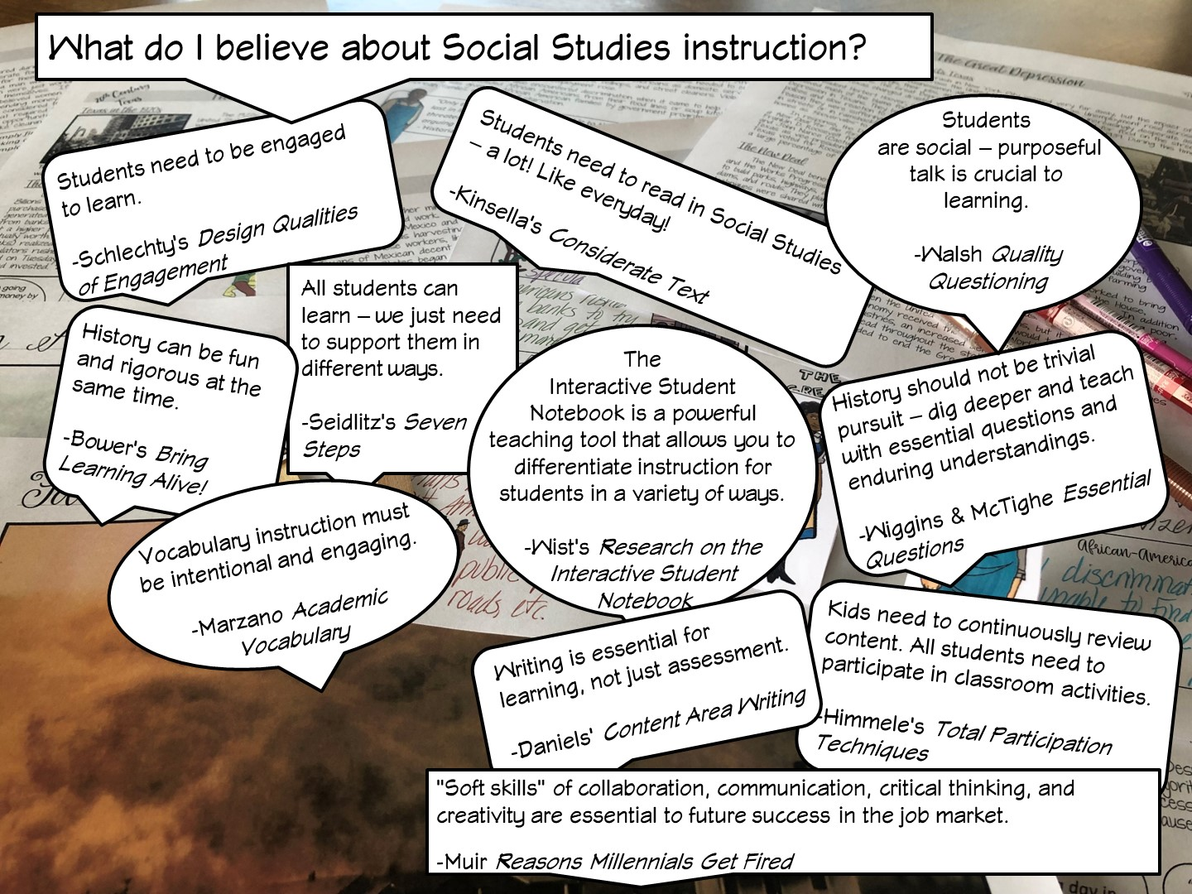
Notes:
Differentiated instruction is ensuring that learning happens in an accessible way for the student. ISNs allow the students to format their thoughts however they find suitable, thus, differentiating by learning styles — someone who loves writing can love in the notebooks, another student who would rather draw is free to express his/her ideas through diagrams, charts and pictures.

Slide 15
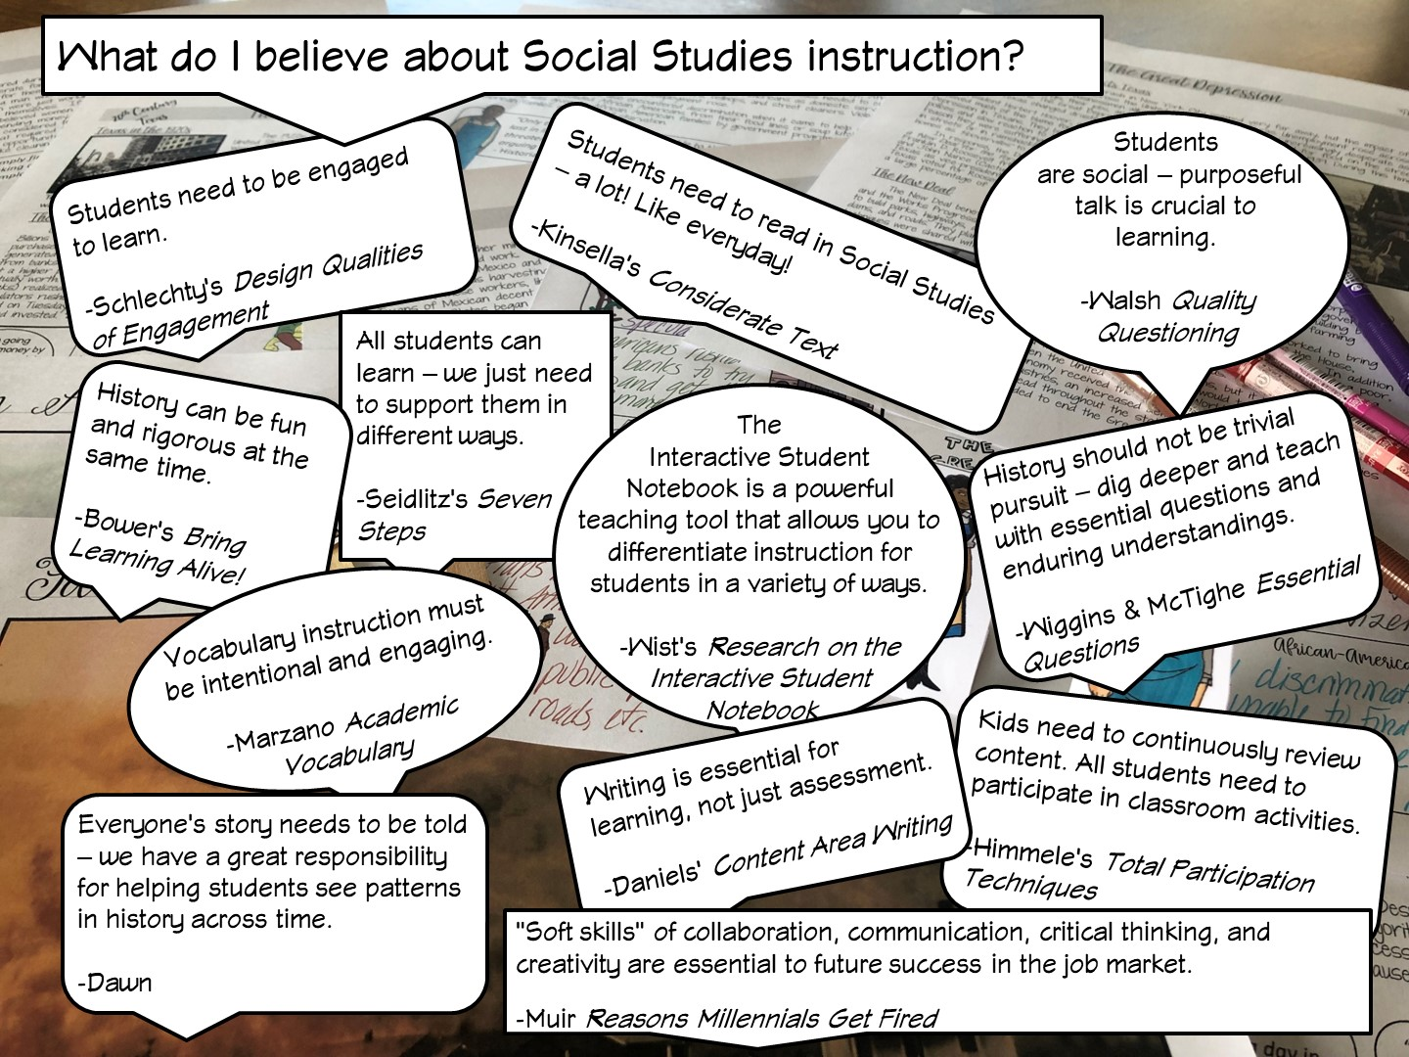
Notes:
Differentiated instruction is ensuring that learning happens in an accessible way for the student. ISNs allow the students to format their thoughts however they find suitable, thus, differentiating by learning styles — someone who loves writing can love in the notebooks, another student who would rather draw is free to express his/her ideas through diagrams, charts and pictures.

Slide 16

Notes:
History teachers are the guardians of democracy

Slide 17


Slide 18


Slide 19


Slide 20

Notes:
Create a t-chart out of post it notes

Slide 21
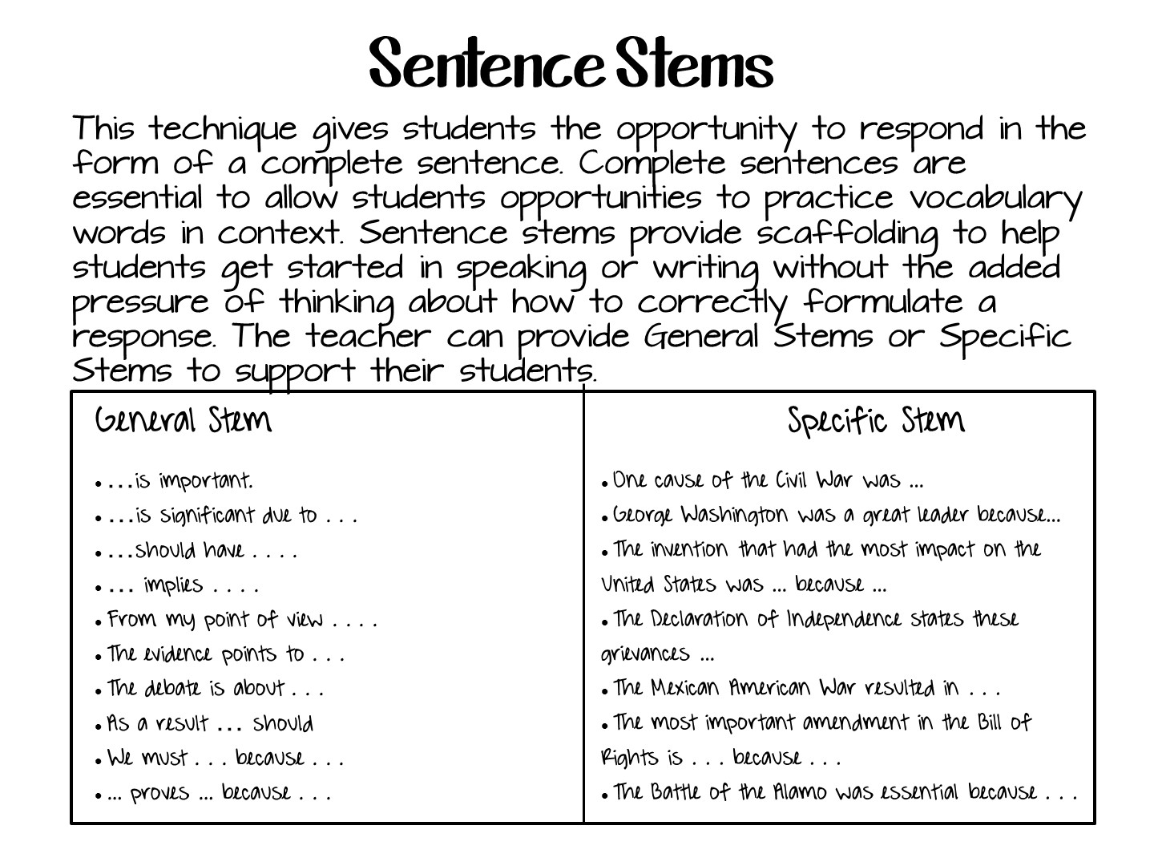
Notes:
1. CreateCreate a list of sentence stems that are appropriate to the discussion or task you are setting the students. Be sure to provide stems that use academic language or sentence structure that is difficult for the students.
2. ModelReview stems with students and provide some examples of how to complete the sentence stems.
3. PracticePose questions or a set a writing task for students. In pairs or independently, have students use sentence stems to respond.
4. ReviewAsk students to share their sentences. Add any clarification where needed.
When to Use
Use Sentence Stems at any point in the lesson to structure meaningful conversation.
Before introducing new material to tap into prior knowledge (Example stems: I understand that ….; I already know that…)
When trying to work through a problem. (Examples: It would be easier if….; First, I…)
After reading a short text to begin a discussion (Examples: The main points were….; I read that…)
Responding to a peer discussion (Examples: My partner pointed out ….; I agree because…)
When re-enforcing the use of academic language (Example: The text structure is ….; I use the denominator of …)

Slide 22
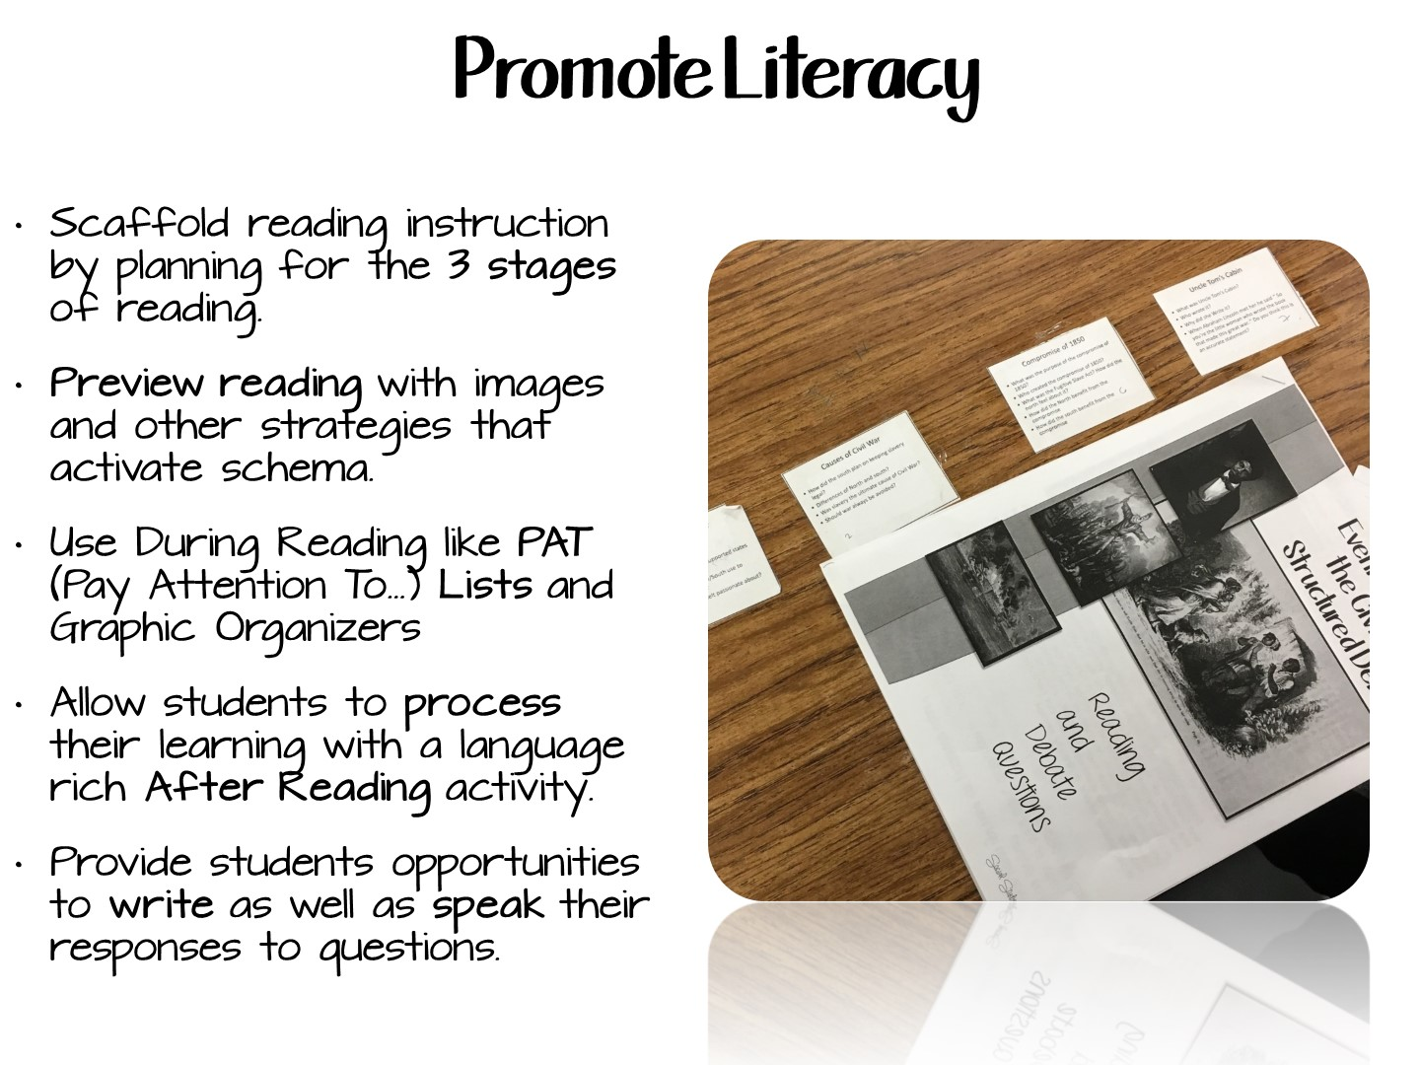
Notes:
English language learners need support to make the text meaningful. Pairing text with charts and pictures is extremely helpful.
Often English language learners benefit if a picture is used to lead students to text.
Perhaps due to the advent of video games, the visual modality is one of the strongest to tap for students to remember information.

Slide 23
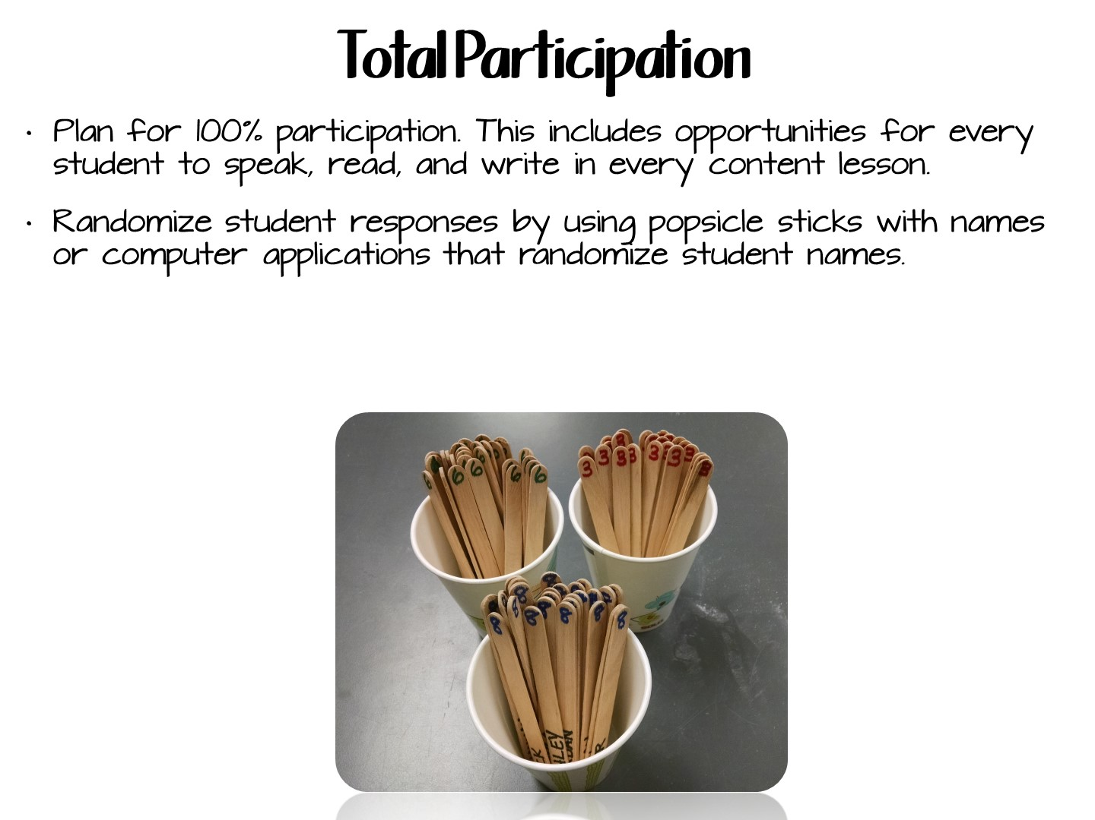
Notes:
Try to be considerate of the language issues in the home by sending home information in more than one language.
Arrange meeting times that might fit the parent’s work schedule.
Realize there may be literacy issues in the home which impact the literacy support provided to the students..

Slide 24

Notes:
Try to be considerate of the language issues in the home by sending home information in more than one language.
Arrange meeting times that might fit the parent’s work schedule.
Realize there may be literacy issues in the home which impact the literacy support provided to the students..

Slide 25
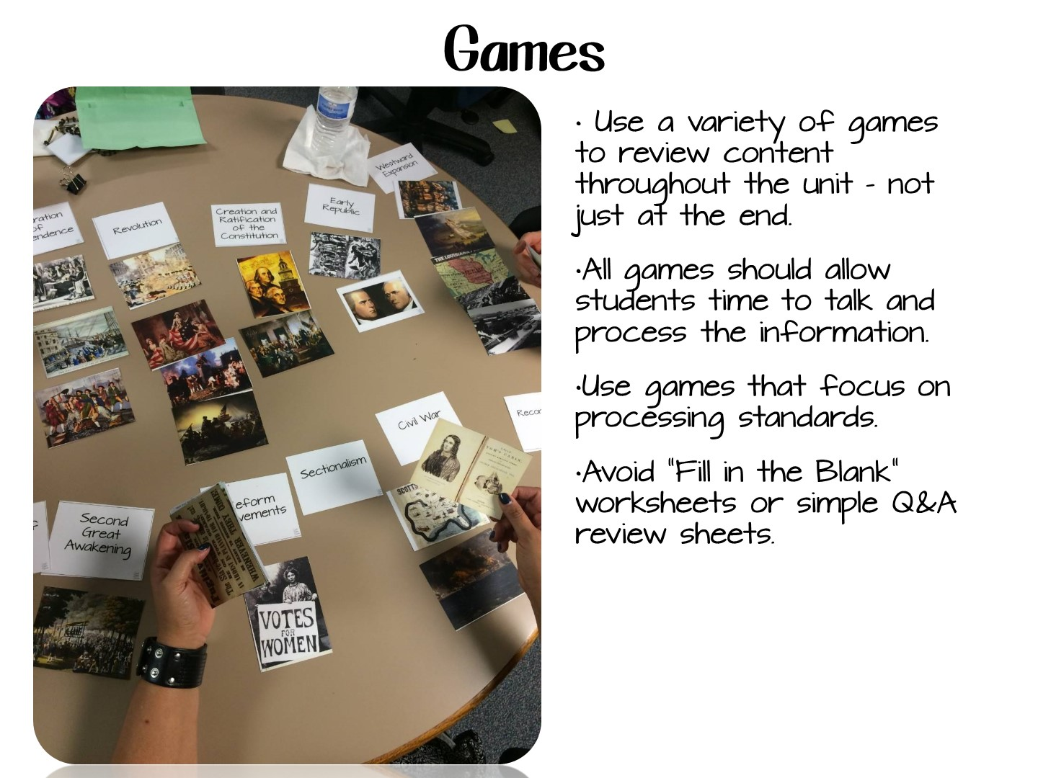

Slide 26
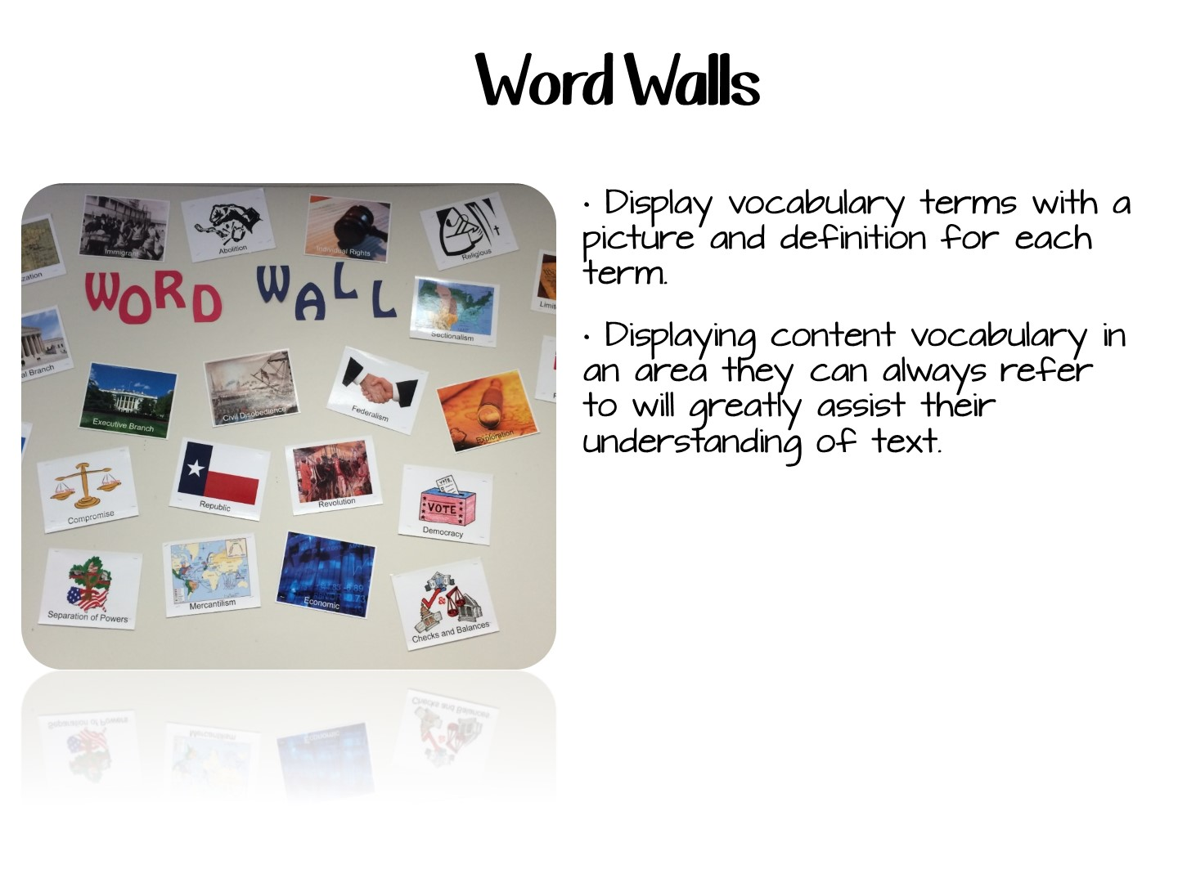
Notes:
Vocabulary is often the stumbling block for English language learners. Displaying content vocabulary in an area they can always refer to will greatly assist their understanding of text.
In addition to content vocabulary, consider displaying in another area academic vocabulary to help students decode academic tasks (i.e. characterize, diagram, hypothesize).
Some teachers find it necessary to categorize the word wall to help them organize the content presented.
Often, the word wall that is set up for English language learners is used by all the students in the class.

Slide 27
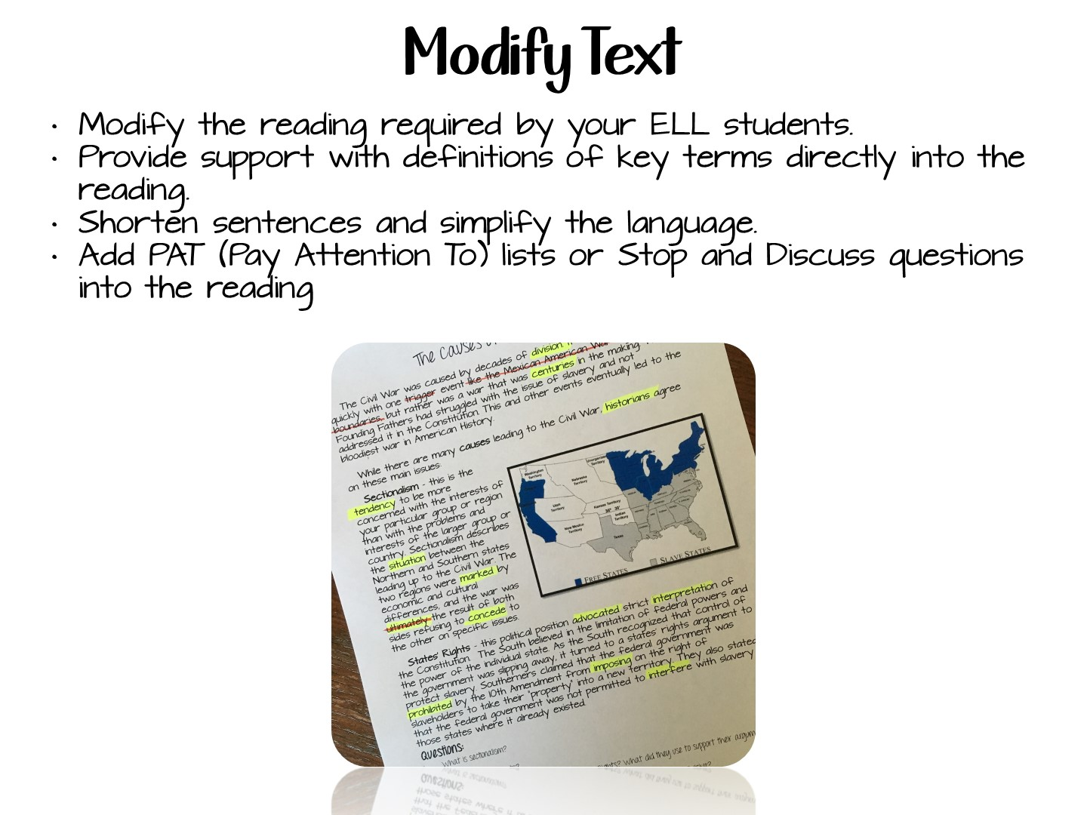
Notes:
English language learners should have the opportunity to see a representative sampling of cultures in the materials they use.

Slide 28
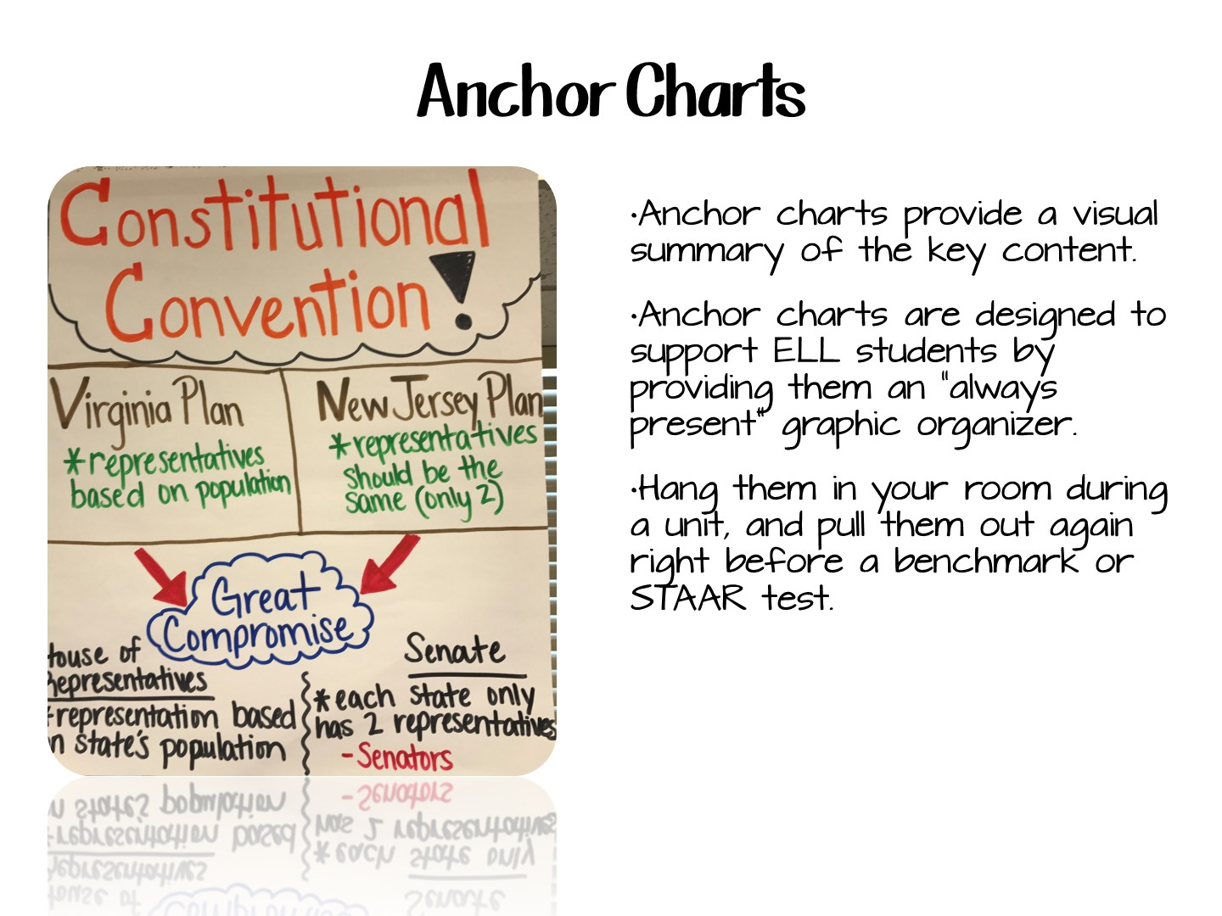

Slide 29


Slide 30

Notes:
When a textbook is difficult to read, the use of other reading materials helps students understand content.

Slide 31
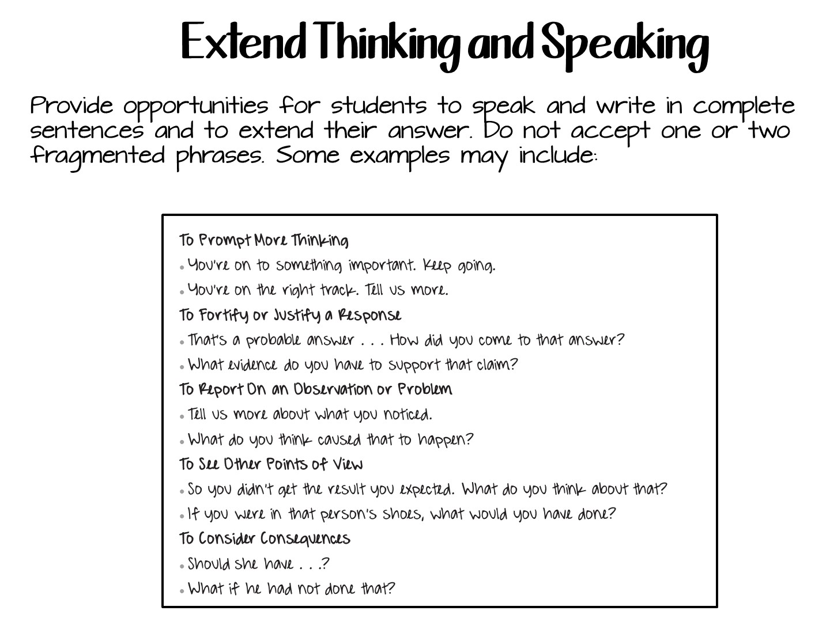

Slide 32


Slide 33
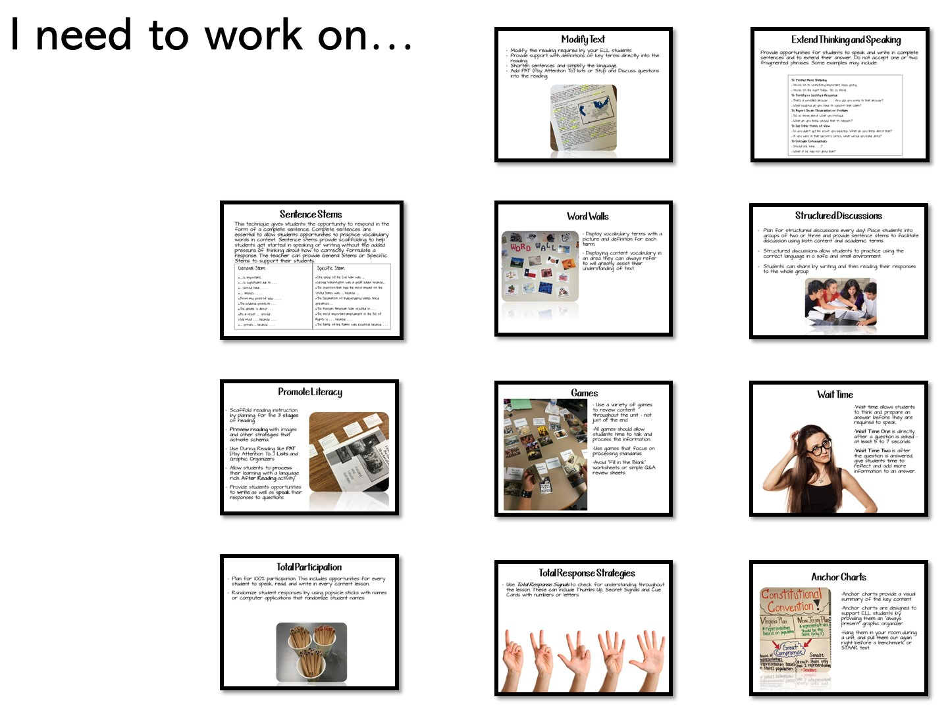
Notes:
Have the teachers share their answers.

Slide 34


Slide 35
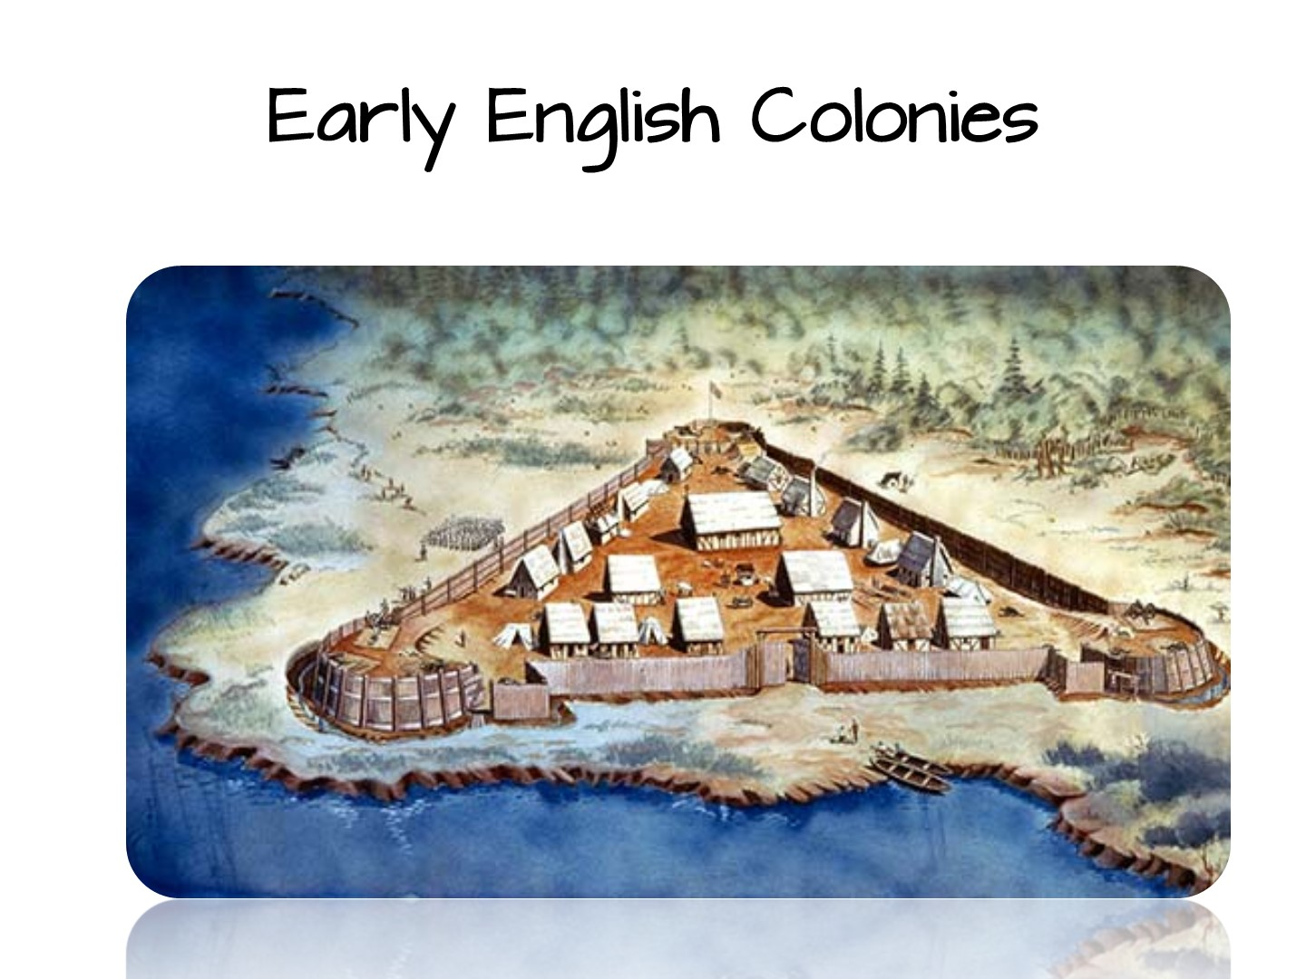

Slide 36
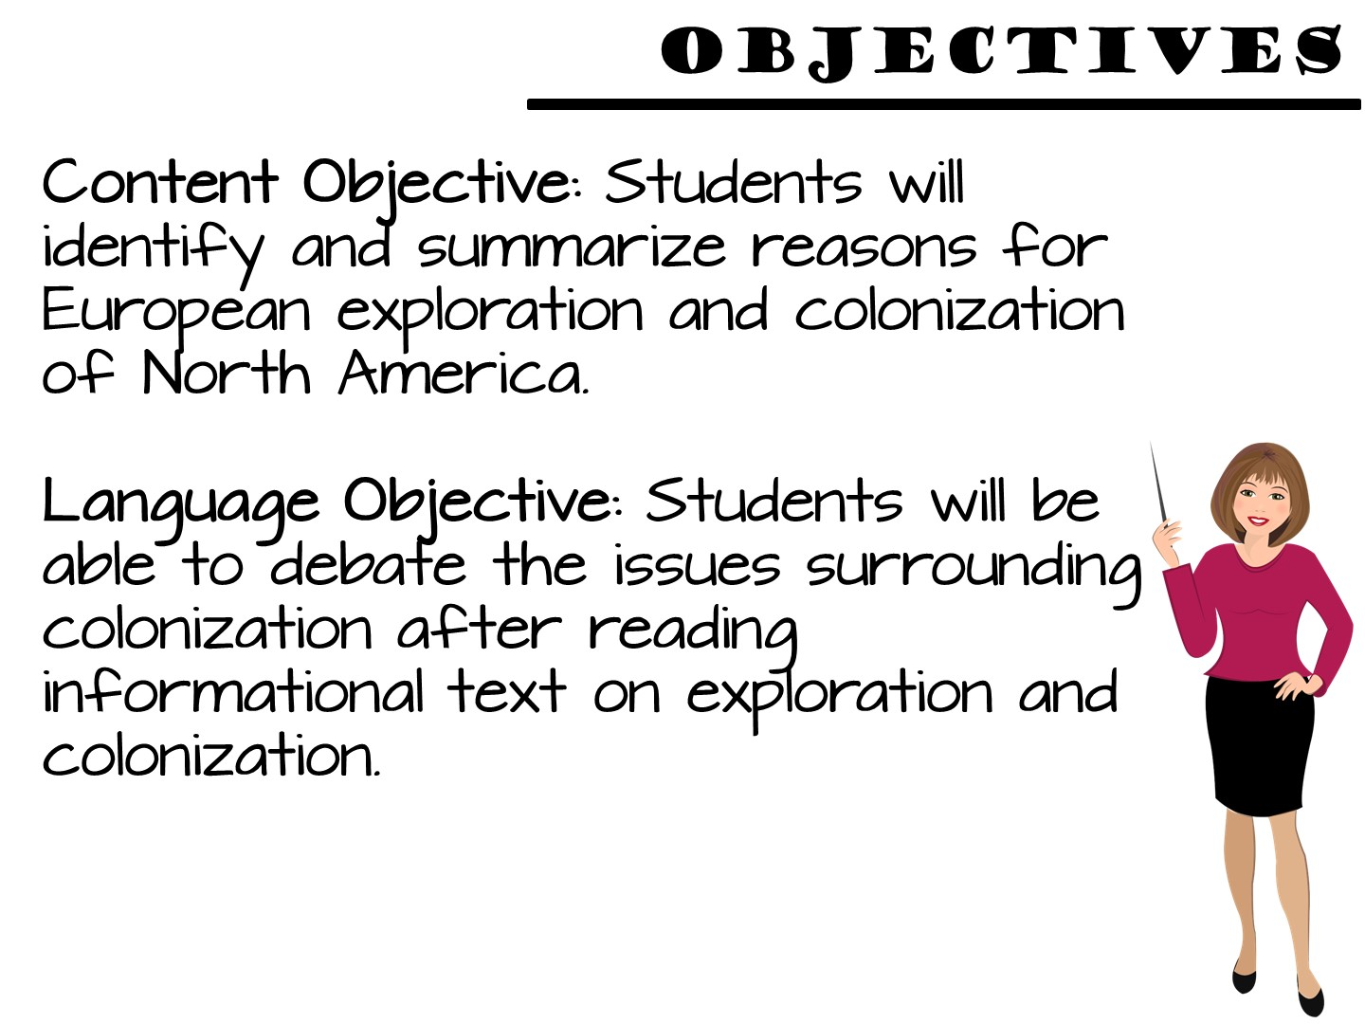
Notes:
Students use critical-thinking skills and a variety of primary and secondary source material to explain and apply different methods that historians use to understand and interpret the past, including multiple points of view and historical context.

Slide 37
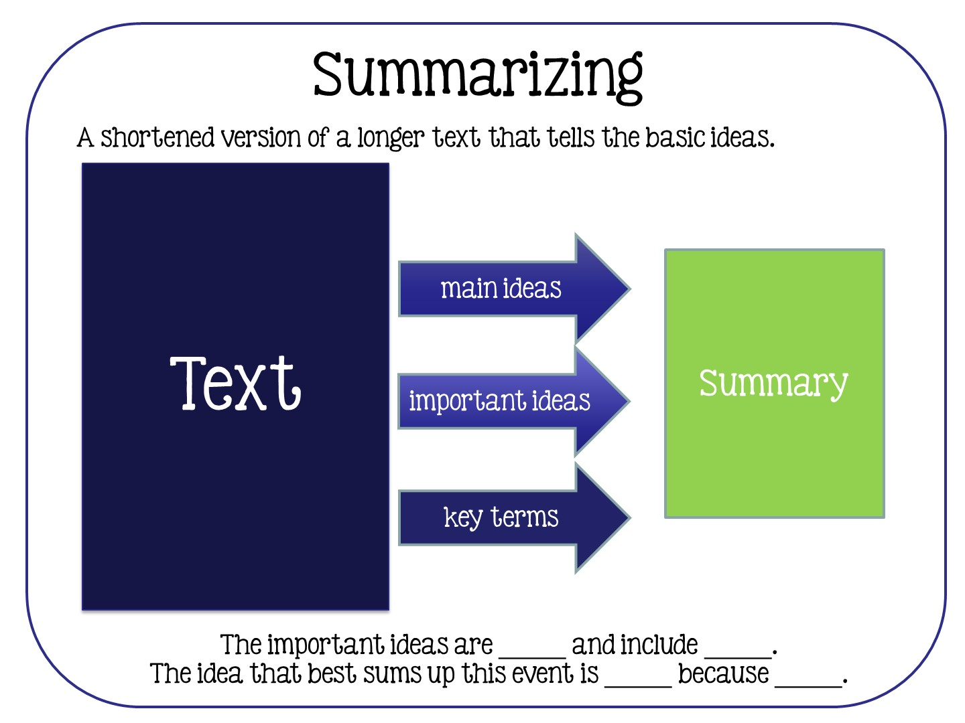
Notes:
The text said _____ and I know that _____ so I can conclude_____
What the evidence tells me
What I already know
My conclusion
Use evidence from text and what you already know to draw a conclusion about history.

Slide 38
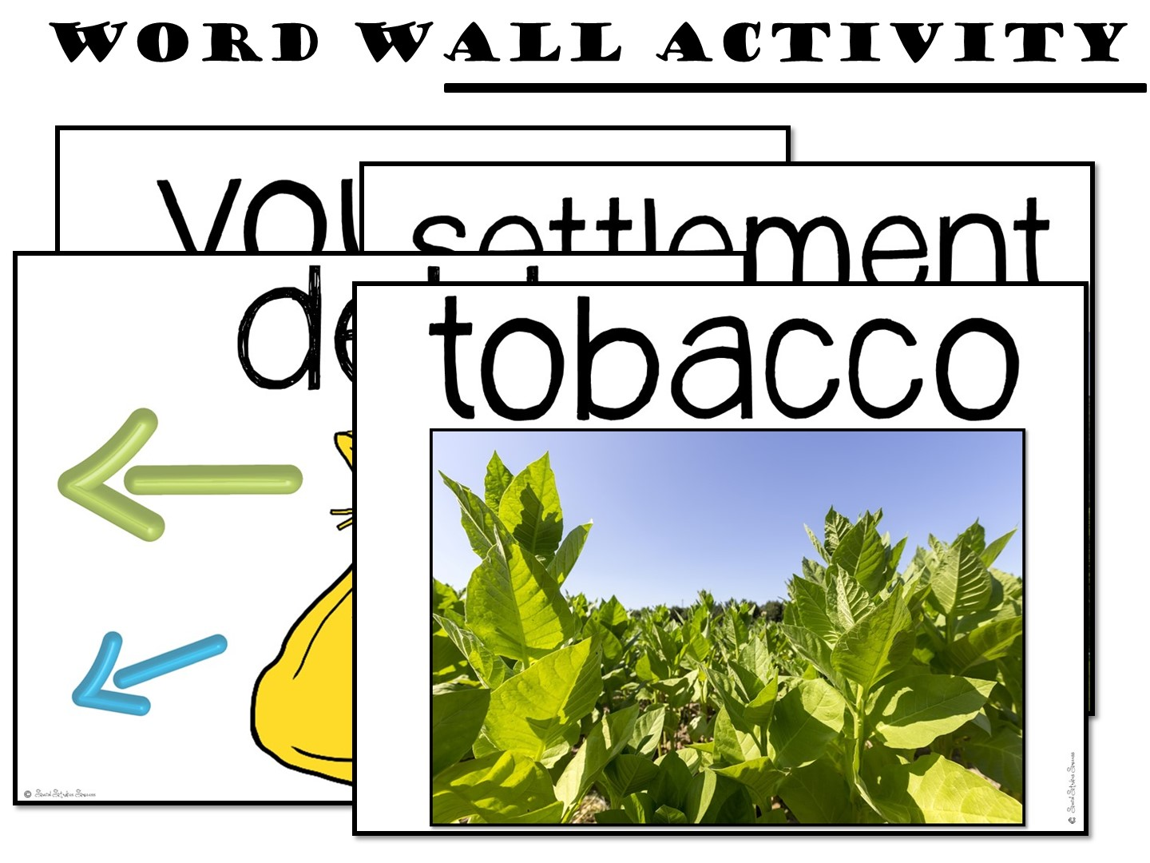
Notes:
Students use critical-thinking skills and a variety of primary and secondary source material to explain and apply different methods that historians use to understand and interpret the past, including multiple points of view and historical context.

Slide 39
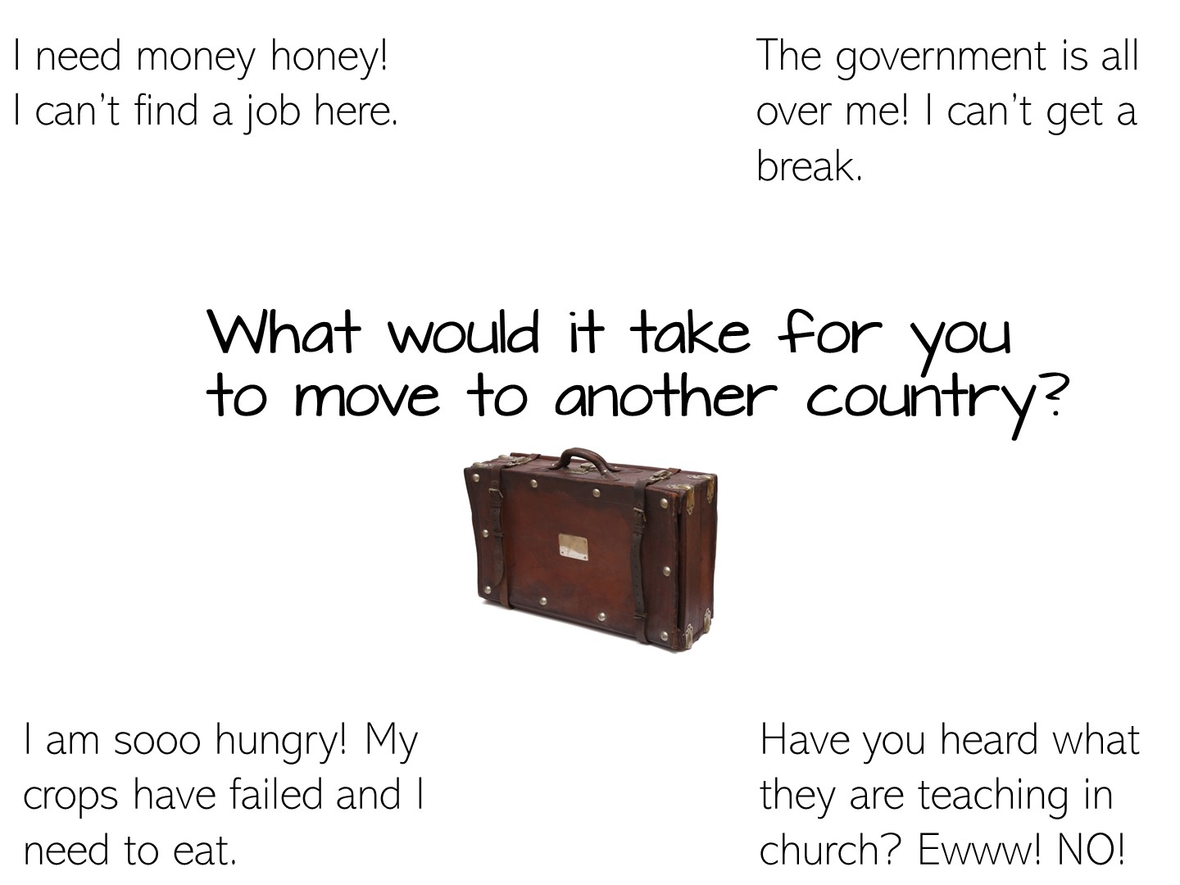
Notes:
Preview the lesson with this question.

Slide 40


Slide 41
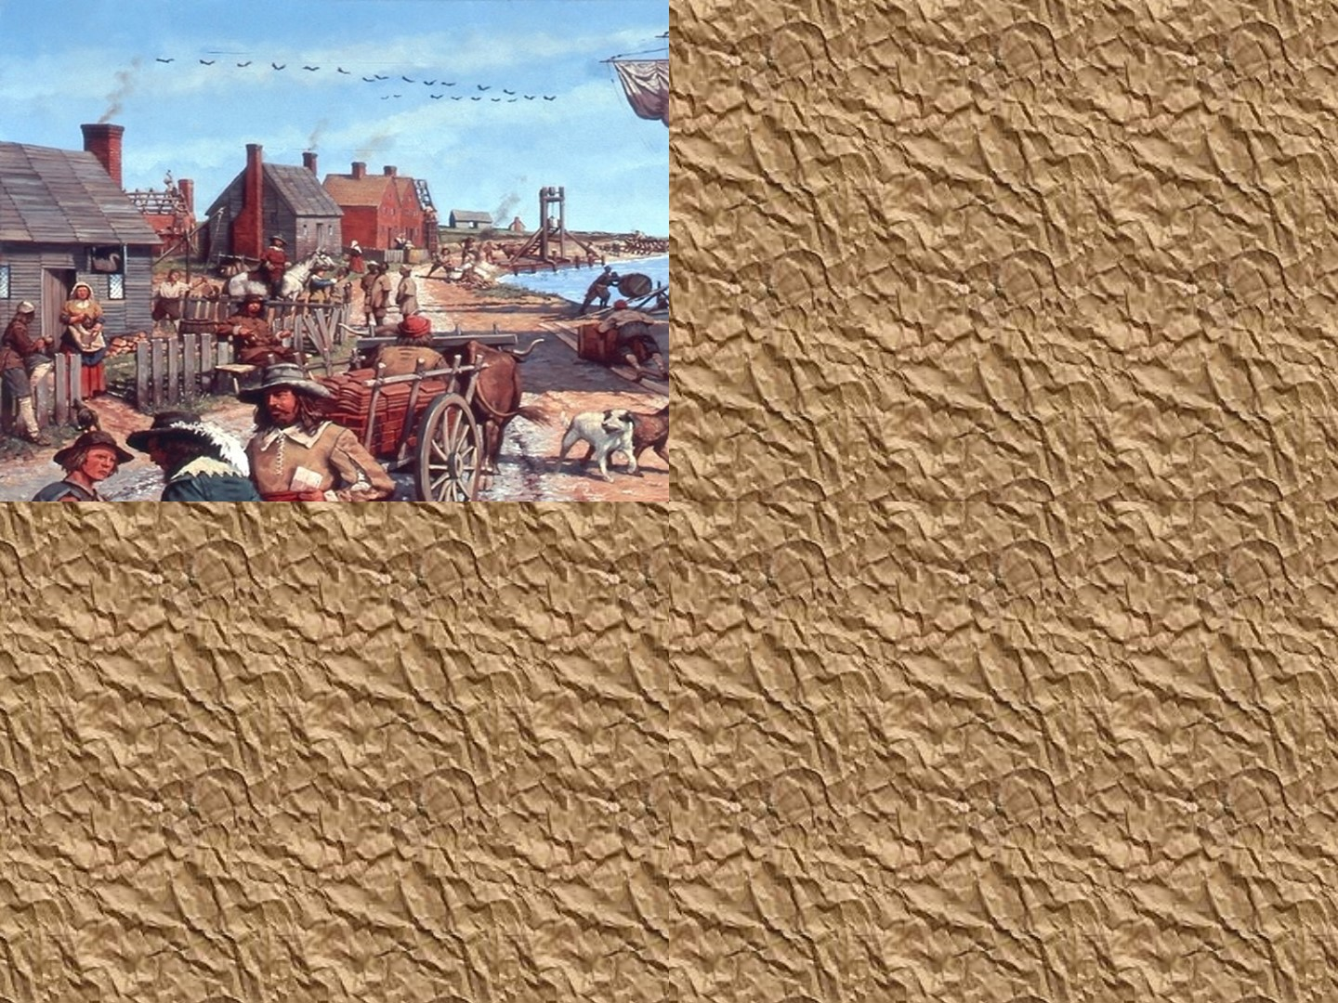

Slide 42
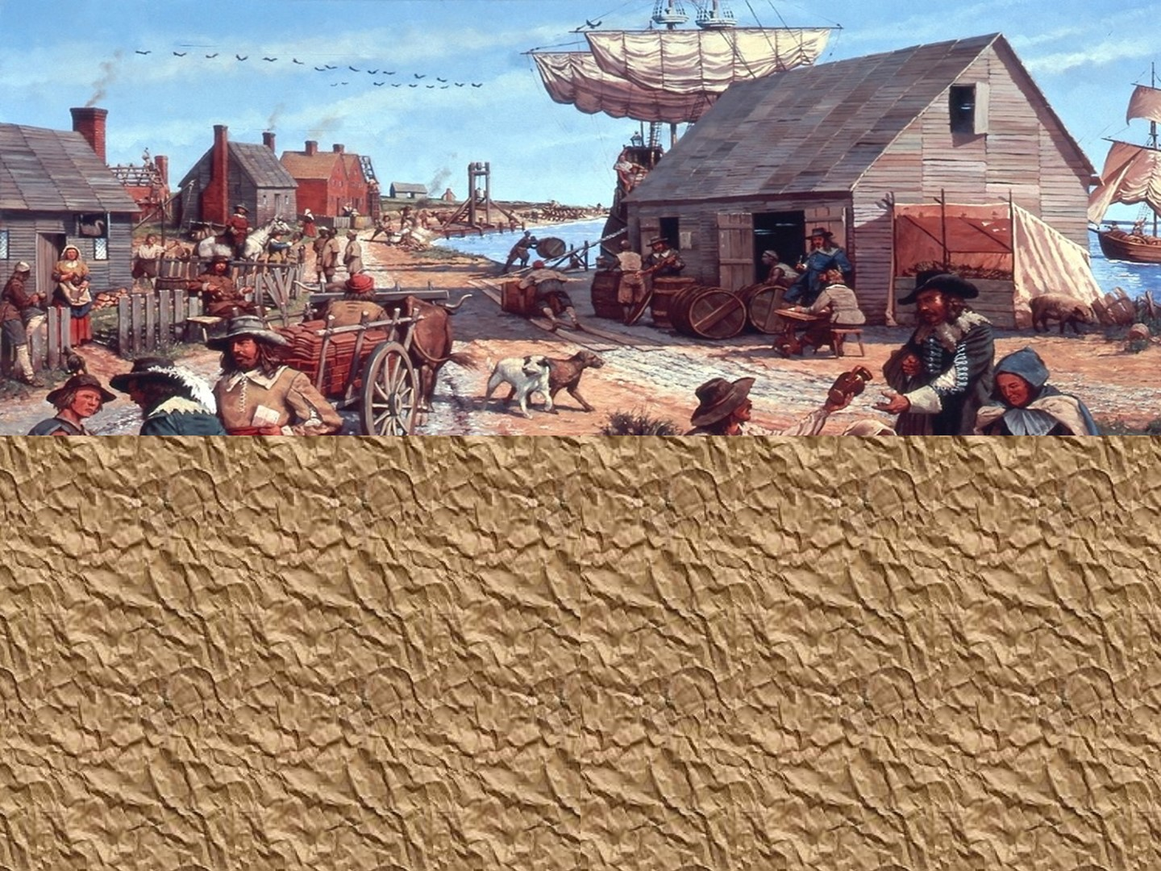

Slide 43
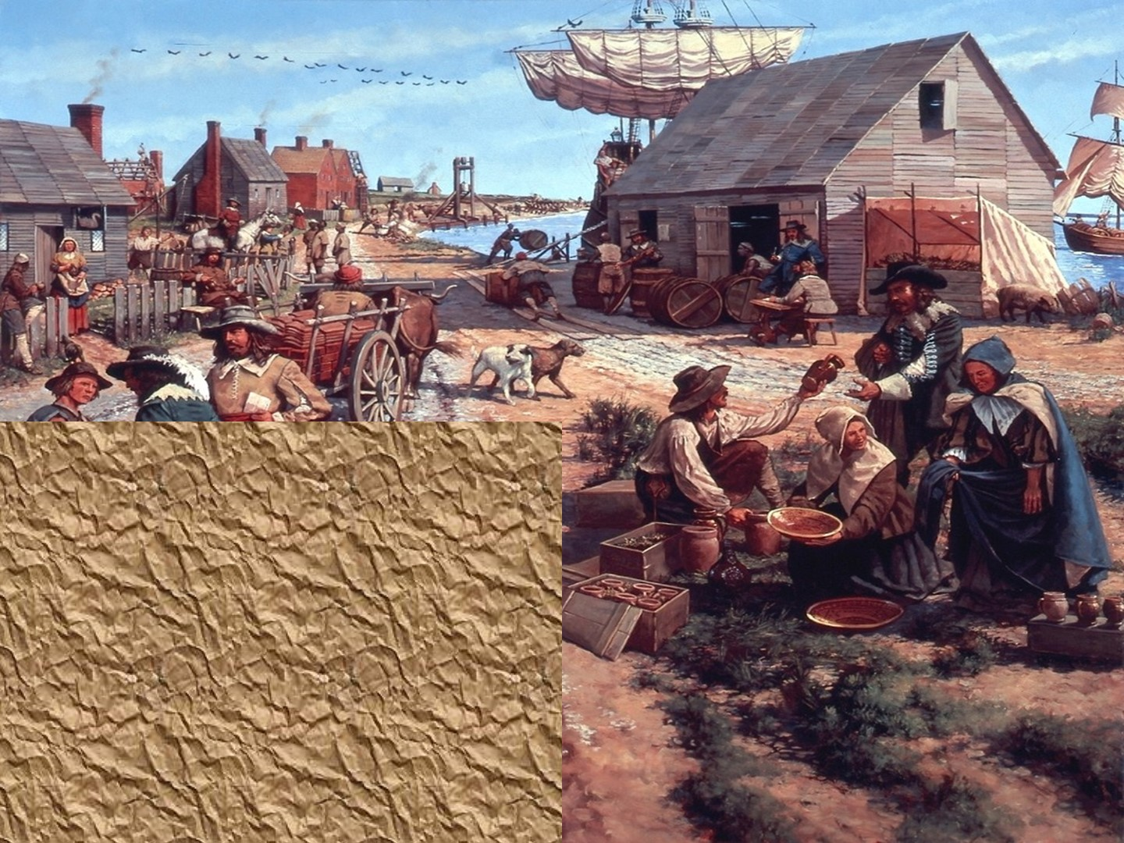

Slide 44
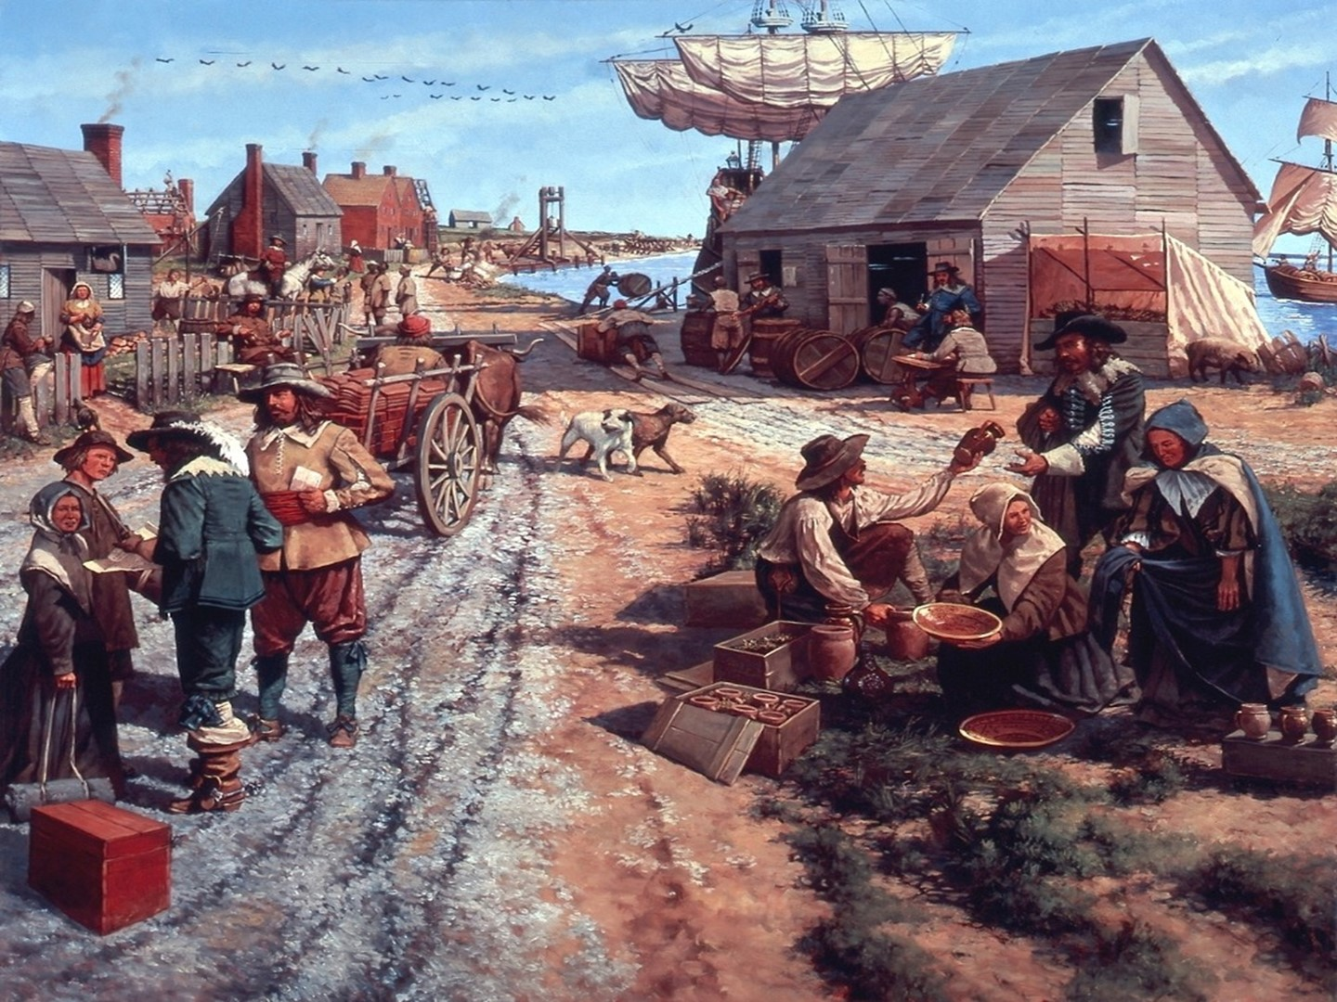
Notes:
Use this image for the act-it-out

Slide 45
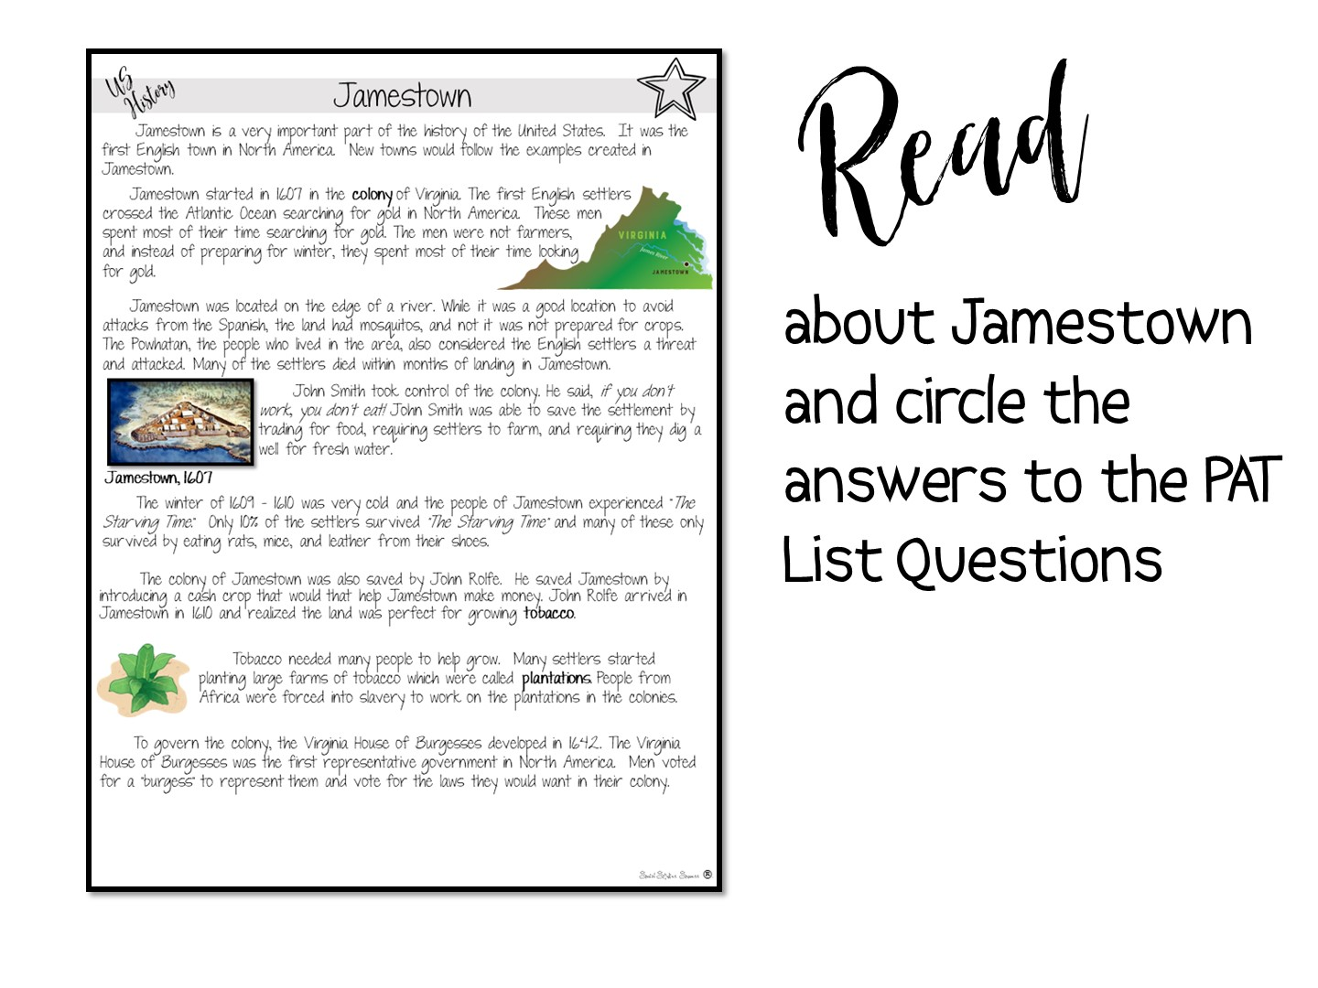

Slide 46
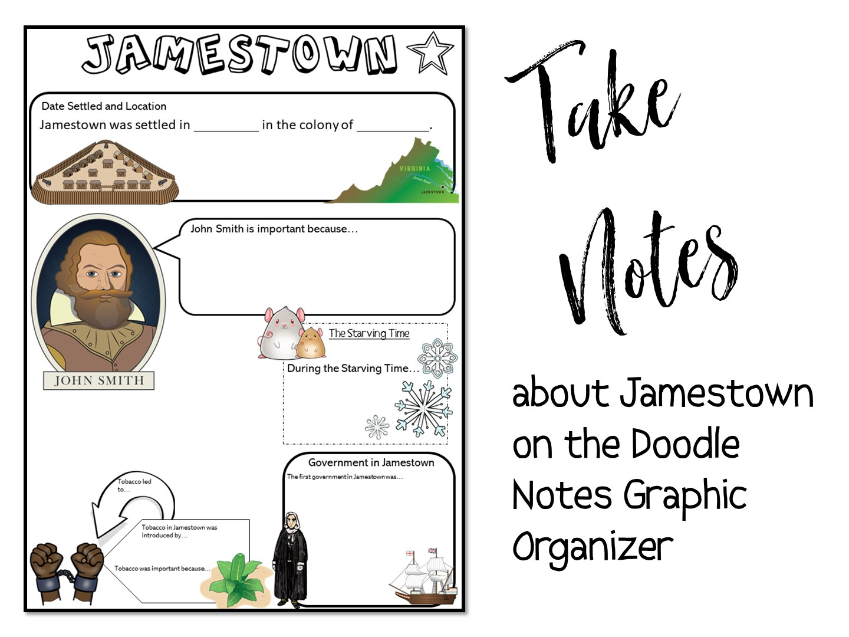

Slide 47
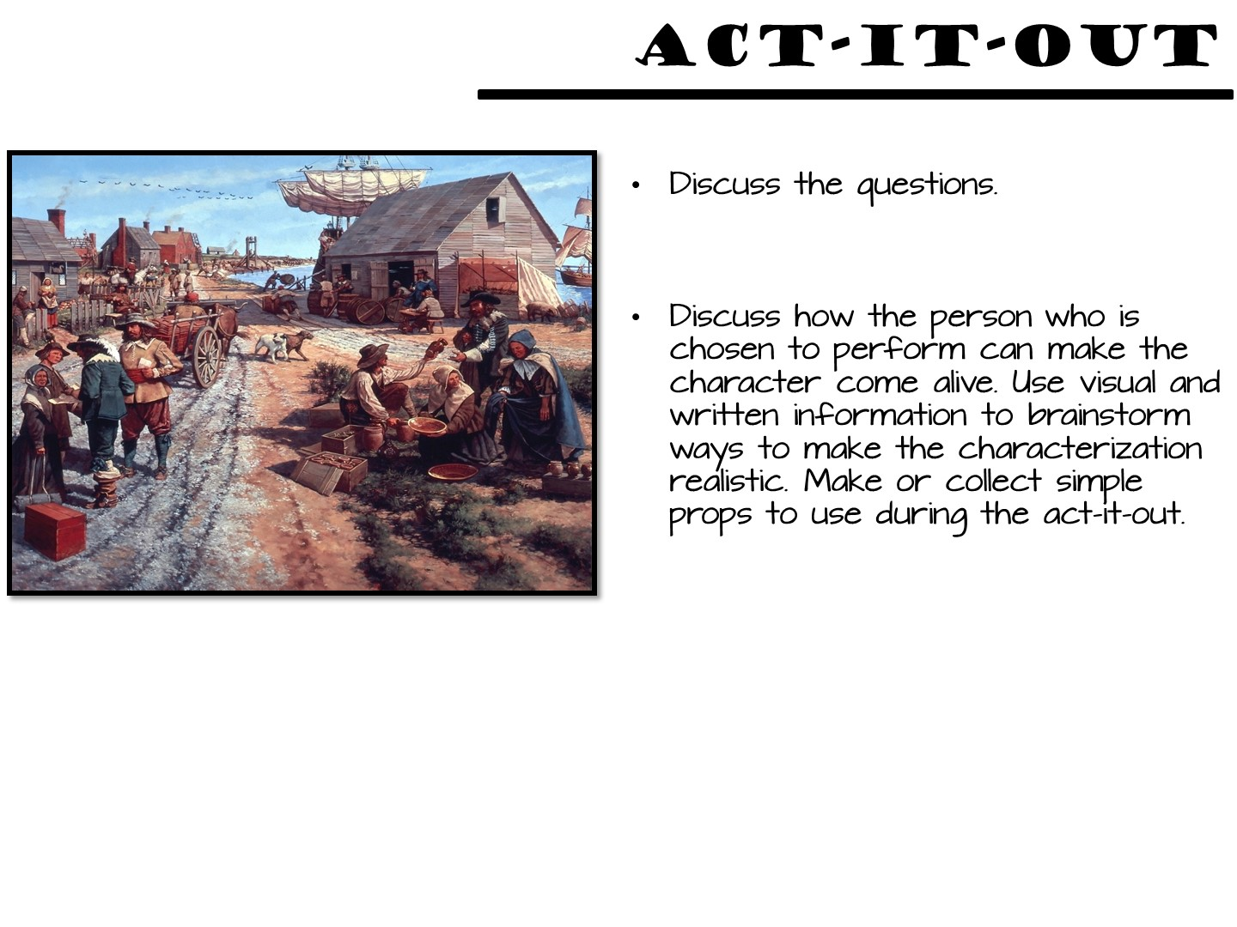

Slide 48
Notes:
Use this image for the act-it-out

Slide 49
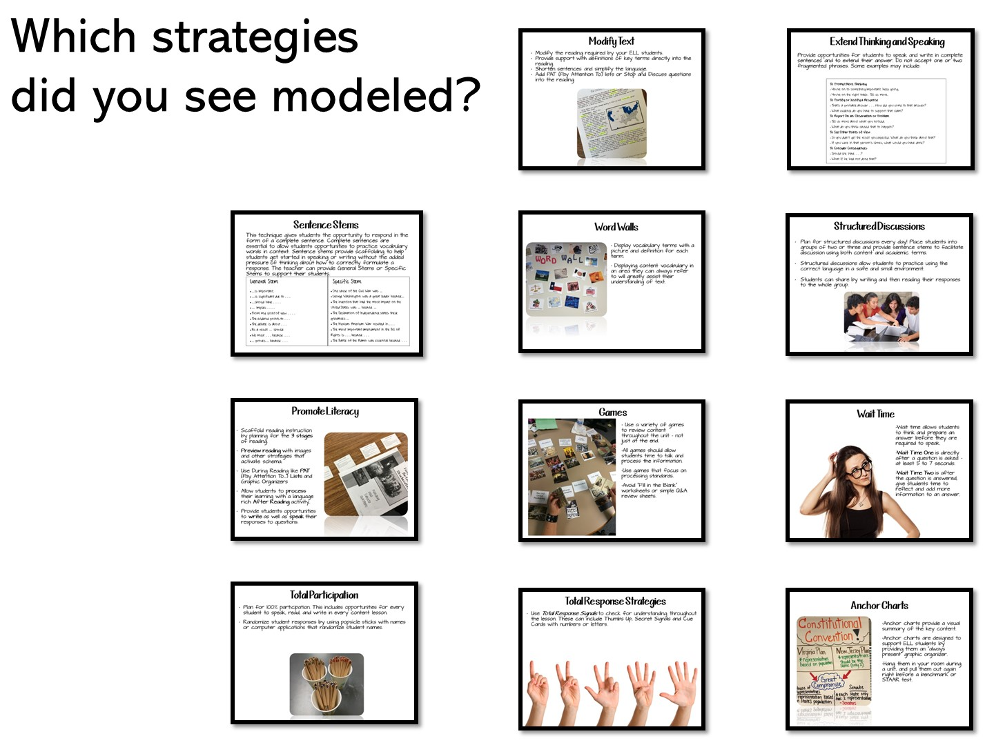
Notes:
Have the teachers share their answers.

Slide 50

Notes:
Rotating Trios
Using the number on your popsicle stick (0,1 or 2), make a “trio”. Each trio should contain a 0, 1, and 2. Give the trio 1-2 minutes to discuss the question. Then choose one or two groups to share their responses.
DI Notes: MI – Kinesthetic, Verbal/Linguistic and Intra-Personal
50

Slide 51


Slide 52


Slide 53


Slide 54
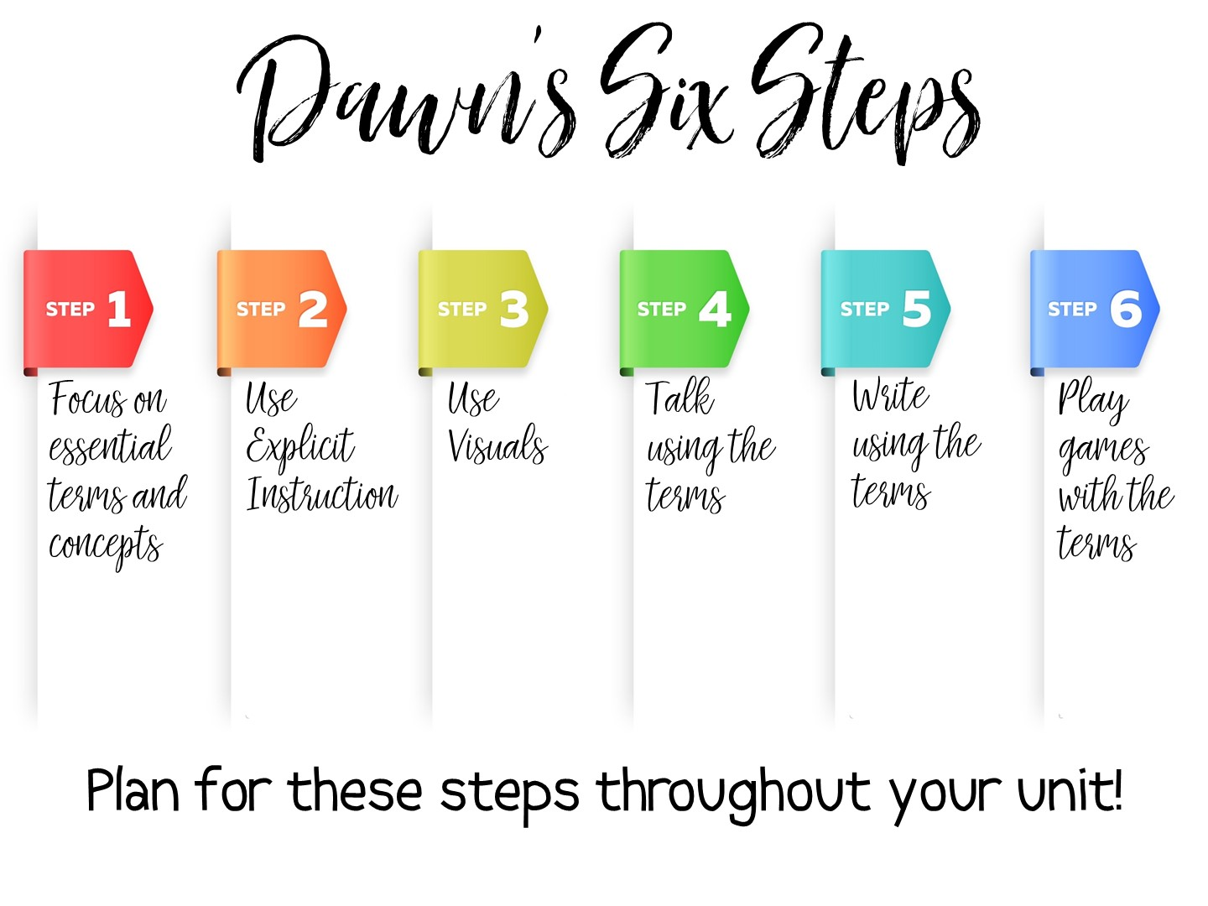
Notes:
I have taken the research and created my own 6 steps for practical vocabulary instruction. We will examine each of these steps in this workshop. Steps one and two need to be done in order, but the rest of the steps can be done at any point in the unit.
Some key points to remember:
Vocabulary instruction must be intentional, not just the initial instruction on the definition of the term, but included deliberately in subsequent lesson plans throughout the unit.
Vocabulary must be taught directly – students need to see the term, hear the term, and say the term in order to build their understanding of key content vocabulary.
Students need to encounter the vocabulary term in a meaningful way at least six times throughout the unit before it can be understood and applied.
One of the best ways for students to learn vocabulary is to associate an image with the term.
Students must participate in engaging activities for long term retention.

Slide 55

Notes:
Step One actually seems obvious – you need to know the terms that you will be teaching. In the discipline of Social Studies there are more than 26,000 terms – more than math, Language Arts, and Science combined. Social Studies vocabulary is actually the vocabulary needed most in college.
But there is actually more to just teaching a list of terms out of the textbook. What are the specific vocabulary terms students will need to master your daily lesson? The unit? You cannot teach too many vocabulary terms in one setting and expect immediate mastery. You need to carefully examine the terms you are given or you find for each unit and decide – is this a term that is essential for this lesson? For this unit? Can this term be introduced and master at a later point? Or does it need mastery now? Is this a term that has already been taught and just needs a refresher? Thougtful planning needs to happen before instruction.

Slide 56

Notes:
Stop the video now and read the handout on Tips for Selecting Vocabulary Terms. When you have finished reading the Tips – jot down 1-2 new learnings or thoughts on your Doodle Notes before you start the video again.

Slide 57


Slide 58
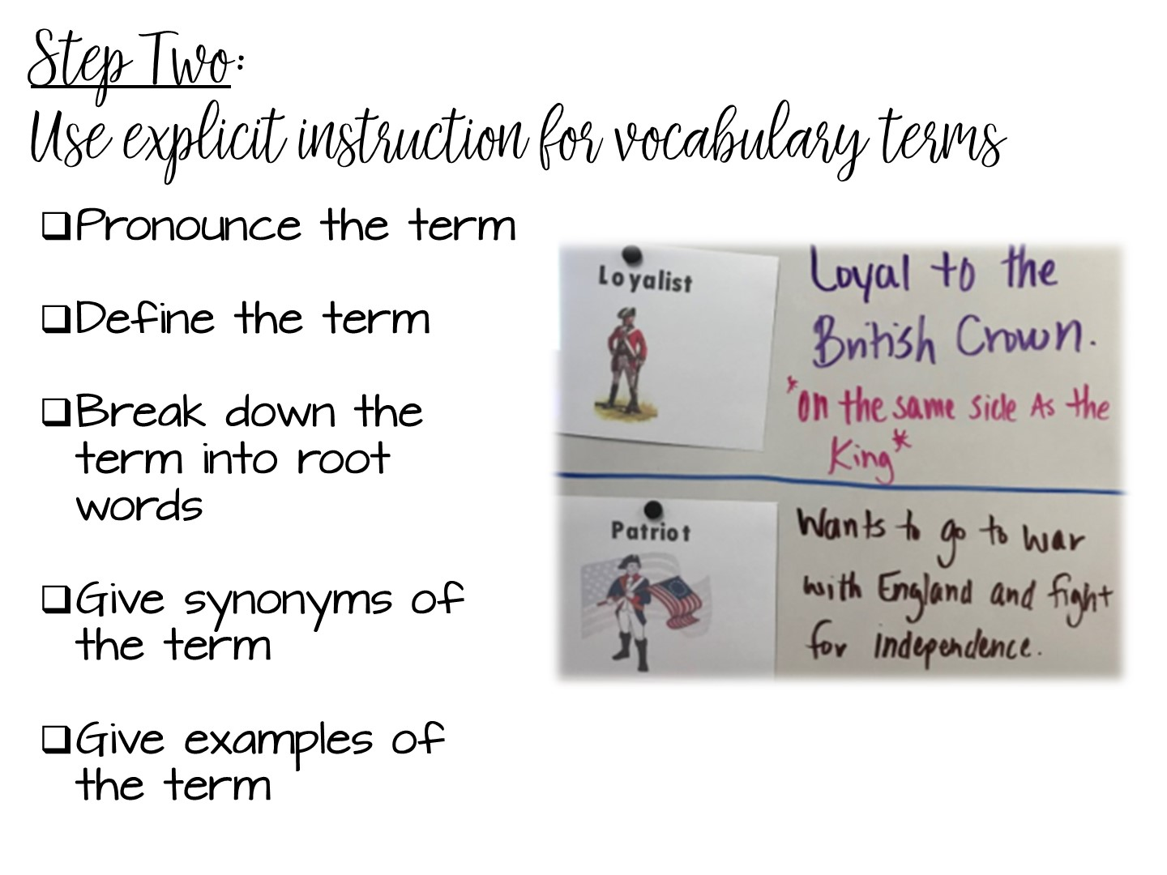
Notes:
Vocabulary instruction is active, it is not a passive activity to fill time. Assigning vocabulary out of the back of the book and having students copy the definition does not work. Just like you would plan for a lesson on teaching content, you need to plan how you will teach vocabulary.
The 2nd step involves explicit instruction. Pronounce the vocabulary terms to your students. Students must hear the word out loud to help build their understanding of the term. Many time students will understand a term more if they hear it first. Think of the term militia – the way it is pronounced and the way it is spelled can be confusing to your students. But if you pronounce the term first, they may already know the word, just not have experienced it in text.
The rest of the vocabulary instruction can differ depending on the term, but these activities are recommended when you are teaching vocabulary.
Define it, or help your students define the term. There is nothing more dangerous than asking kids to just “google” the definition. They will usually just choose the first definition rather than correct one.
Help students make connections to any root terms. This is important for transfer of knowledge – if they understand the root, they can understand the term.
Help students make connections with synonyms – many times, vocabulary on an assessment is actually a synonym of a term they were taught.
And finally, give concrete SOCIAL STUDIES examples of the term.

Slide 59
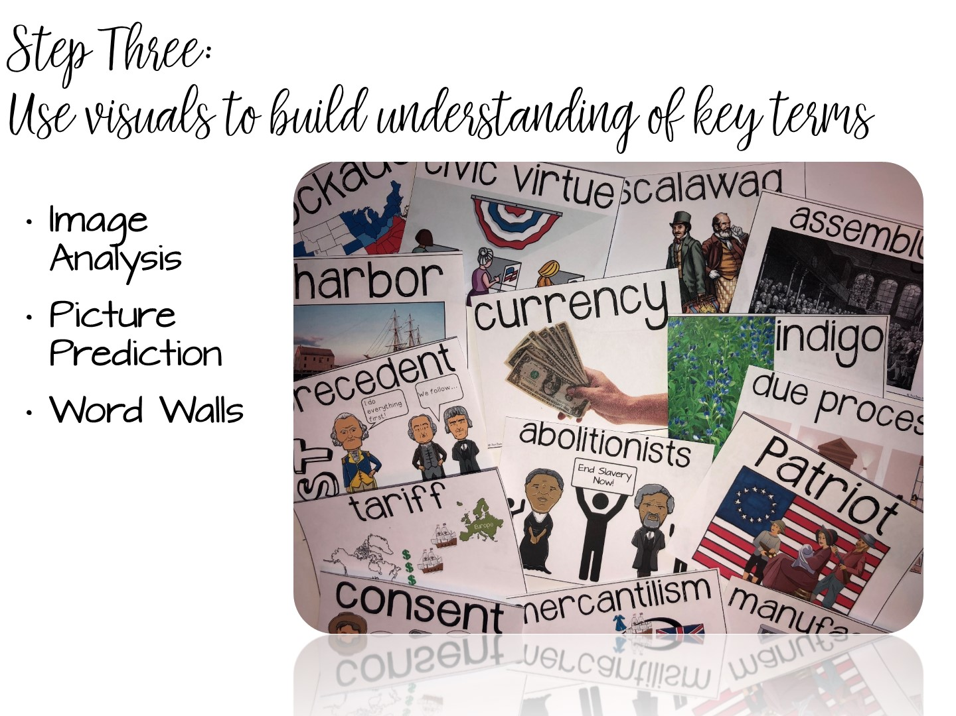

Slide 60
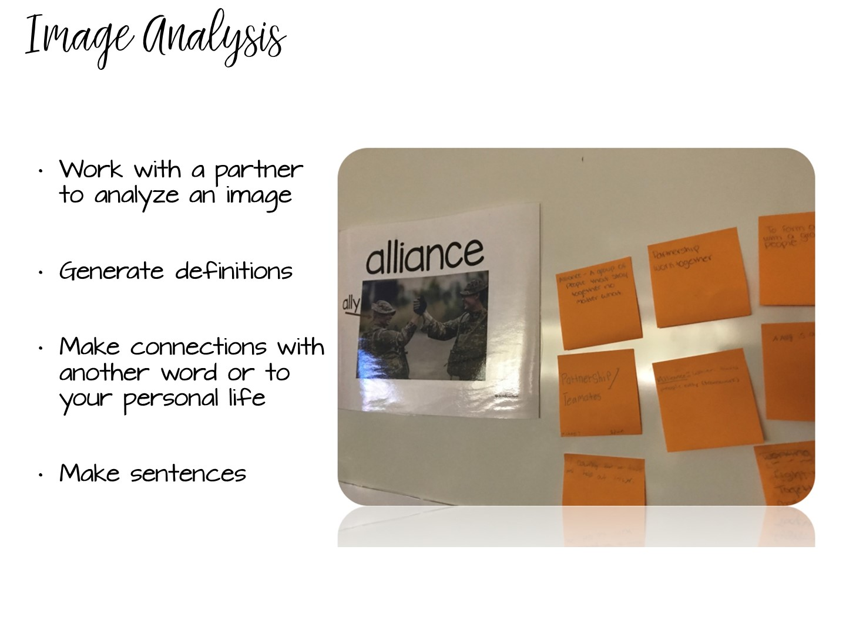
Notes:
One strategy for explicit instruction involves using planned visuals of the definition. Let’s look at a content example of this – I have created visuals to help support terms for a lesson on Westward Expansion. As you look at these visuals, think about what the definition of each term might be…

Slide 61
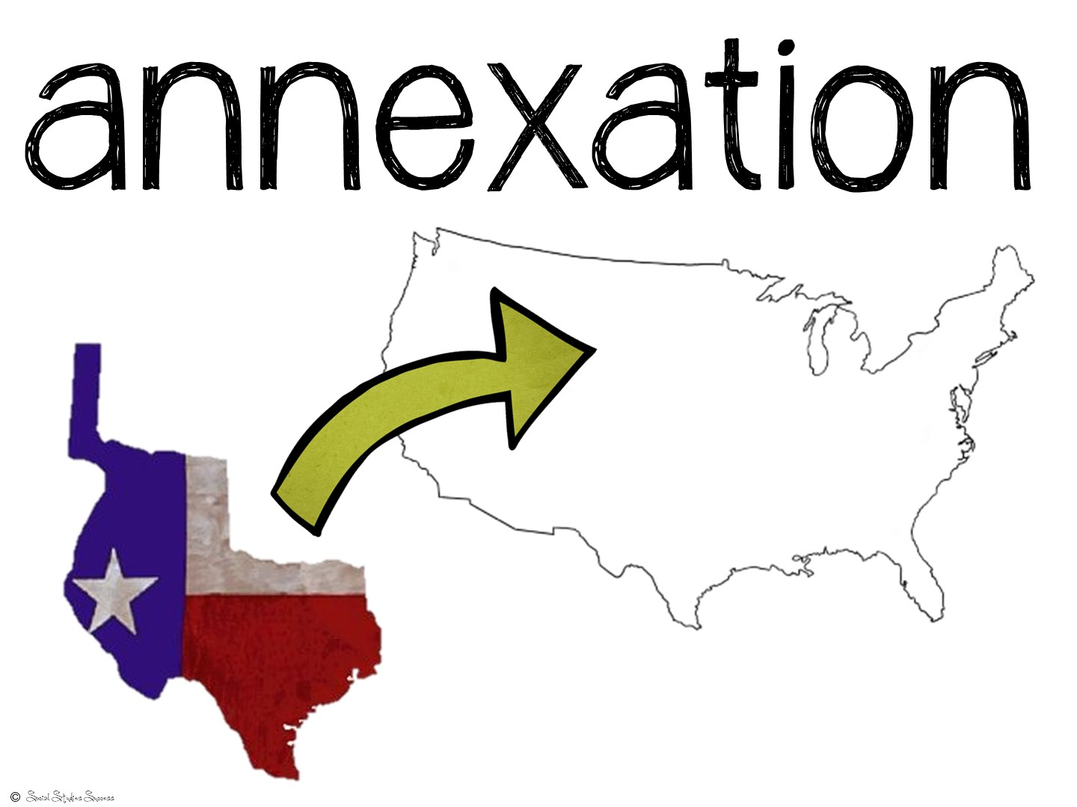

Slide 62


Slide 63


Slide 64
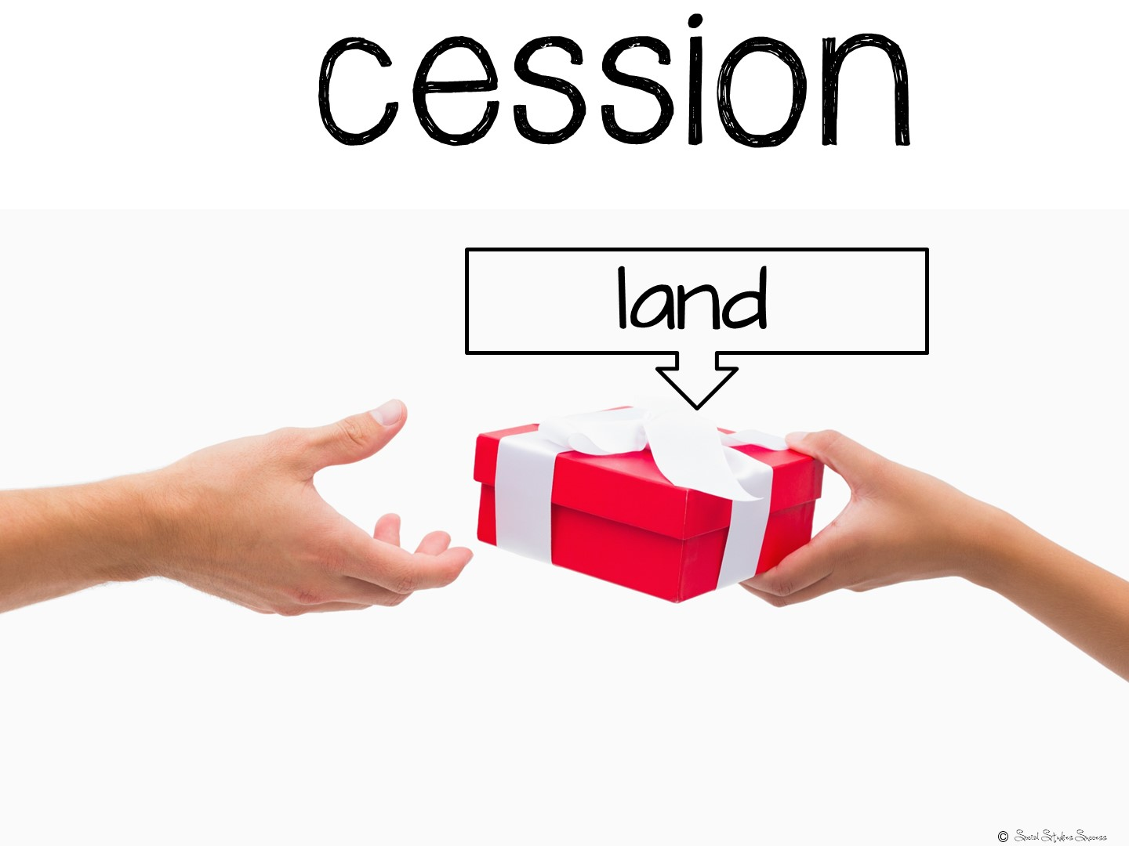

Slide 65


Slide 66


Slide 67


Slide 68
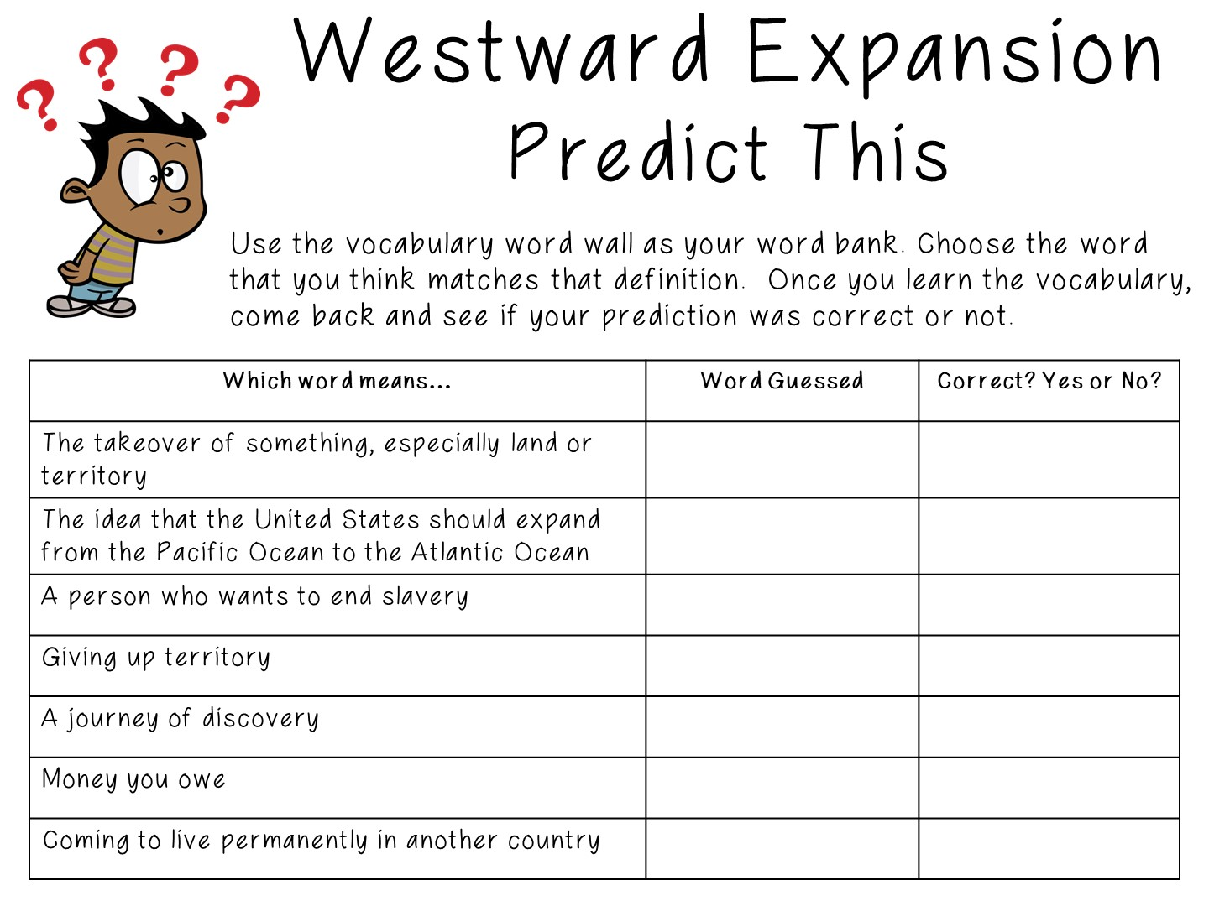
Notes:
The visuals you just saw would be perfect for your word wall – you can use the Predict this strategy to help the students build an understanding of these terms.

Slide 69
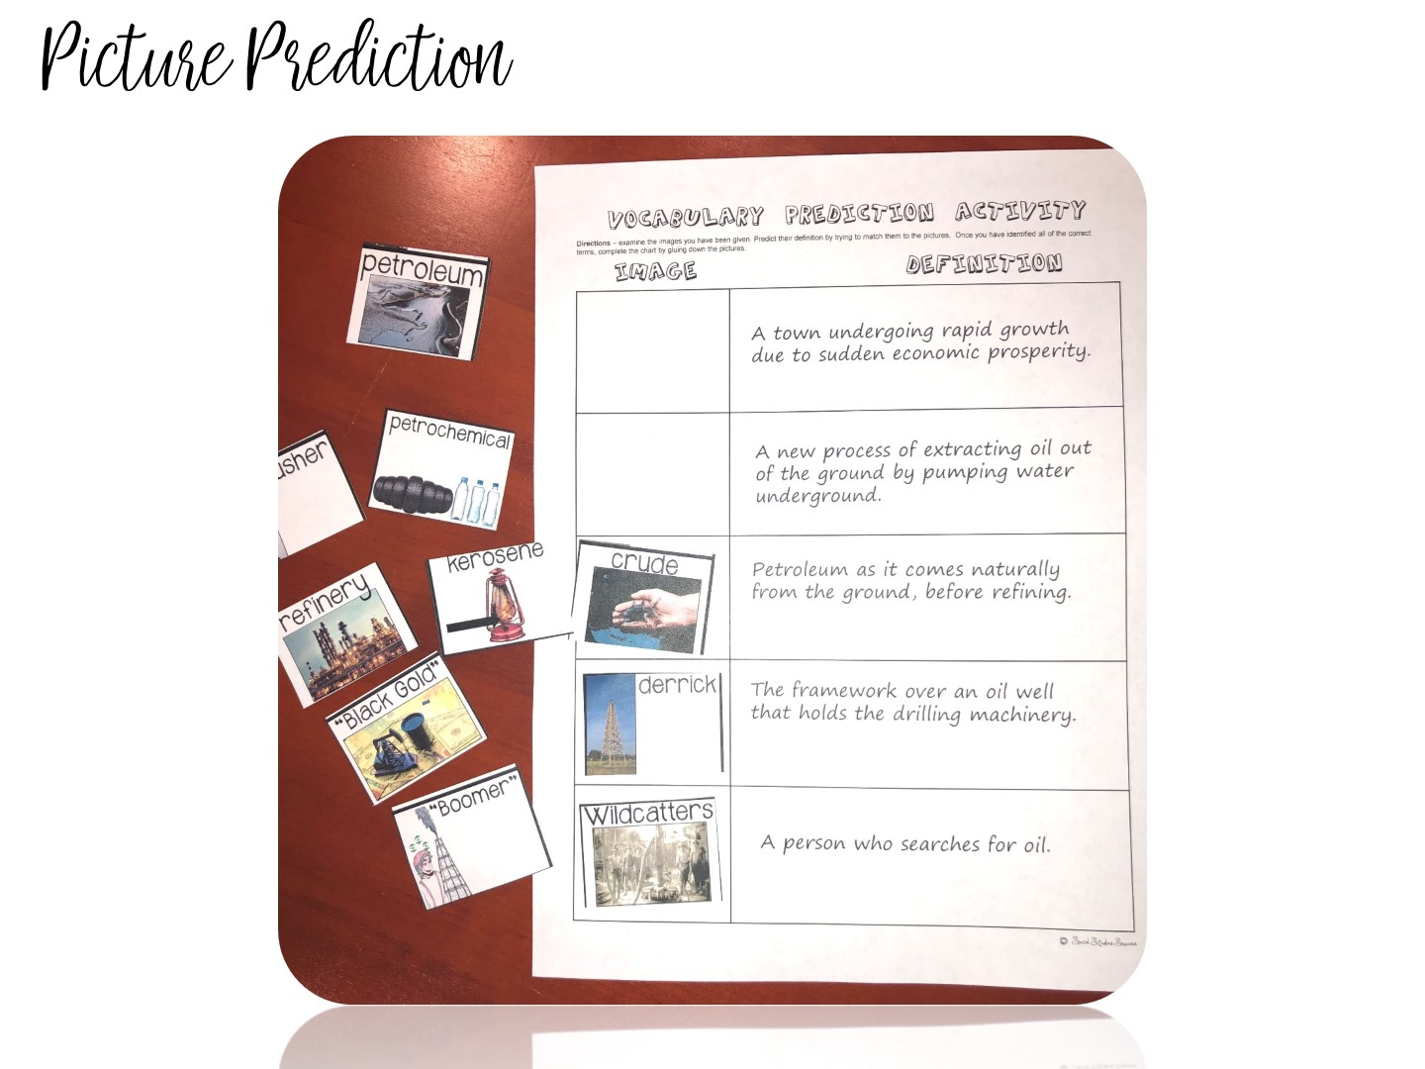
Notes:
A twist on this activity could be to give your students mini- word wall terms. They would again try to match the terms with the definition, but on a smaller scale.

Slide 70

Notes:
While you are learning about visuals to support vocabulary instruction – I want to take a quick time out to discuss Word Walls.

Slide 71

Notes:
Have you had instruction on how to use Word Walls, or was it just a district initiative you were told to follow? Let me tell you my own story with word walls….

Slide 72
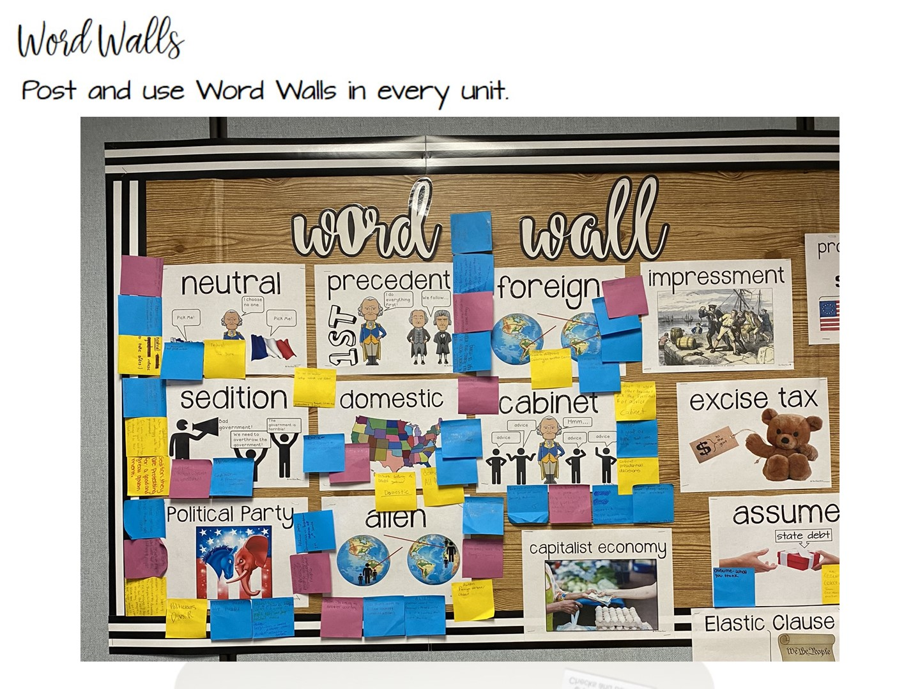
Notes:
Word walls work because of episodic memory. Students begin to associate a specific location and memory with vocabulary terms. It is important that you put your current word wall in the focal point of your room – near where you teach.

Slide 73
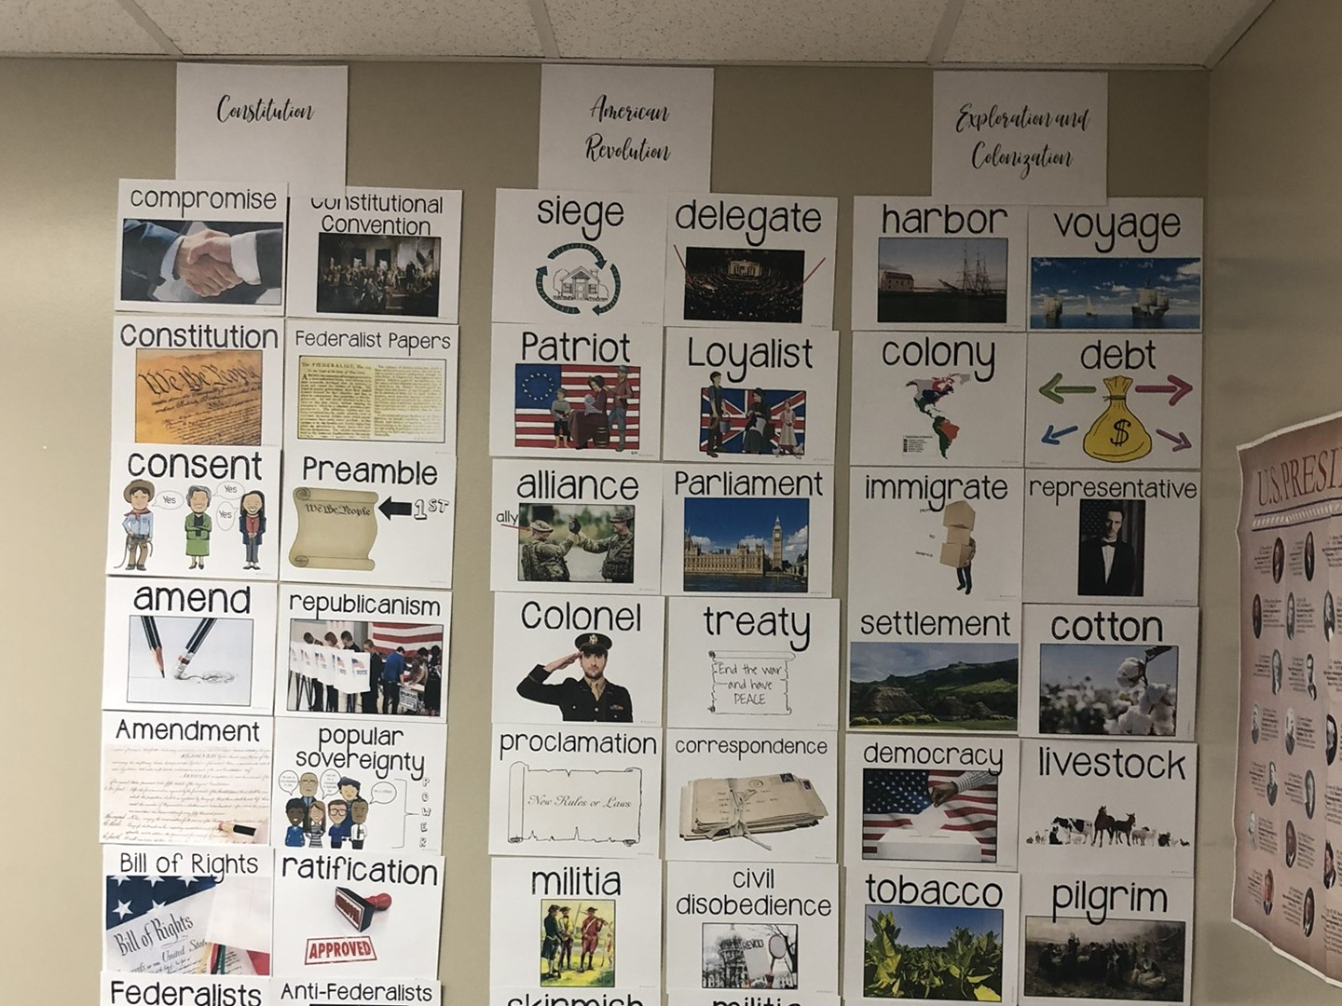
Notes:
When you finish with a unit, you can always take your word wall terms and put them in the back of the room.

Slide 74

Notes:
Here are some tips for word walls

Slide 75
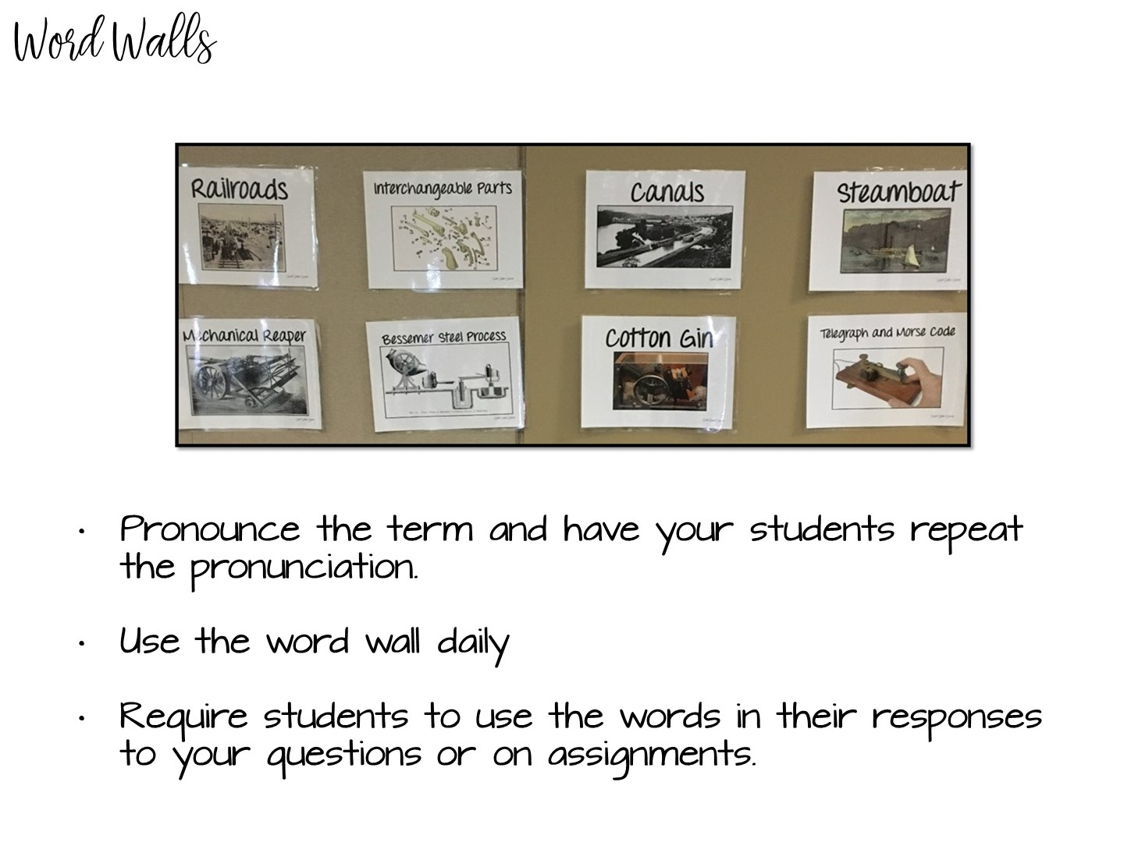
Notes:
See above

Slide 76
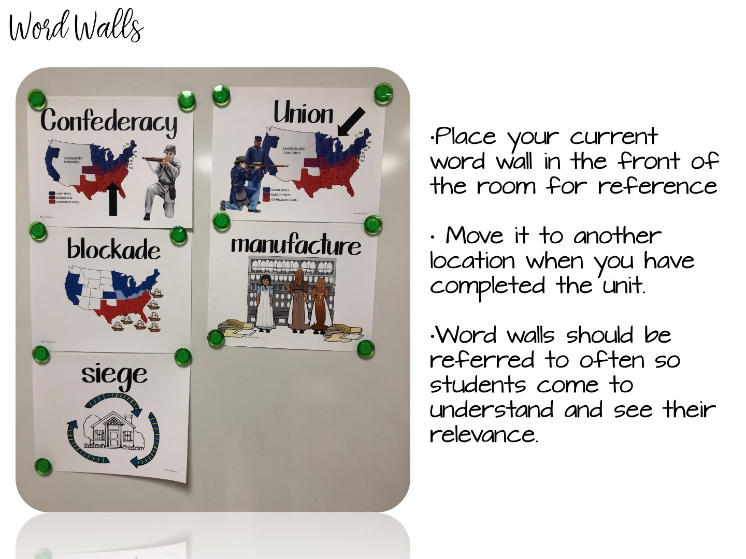
Notes:
See above

Slide 77

Notes:
Stop the video and read the handout on word walls – when you have finished reading, add to your Doodle Notes.

Slide 78
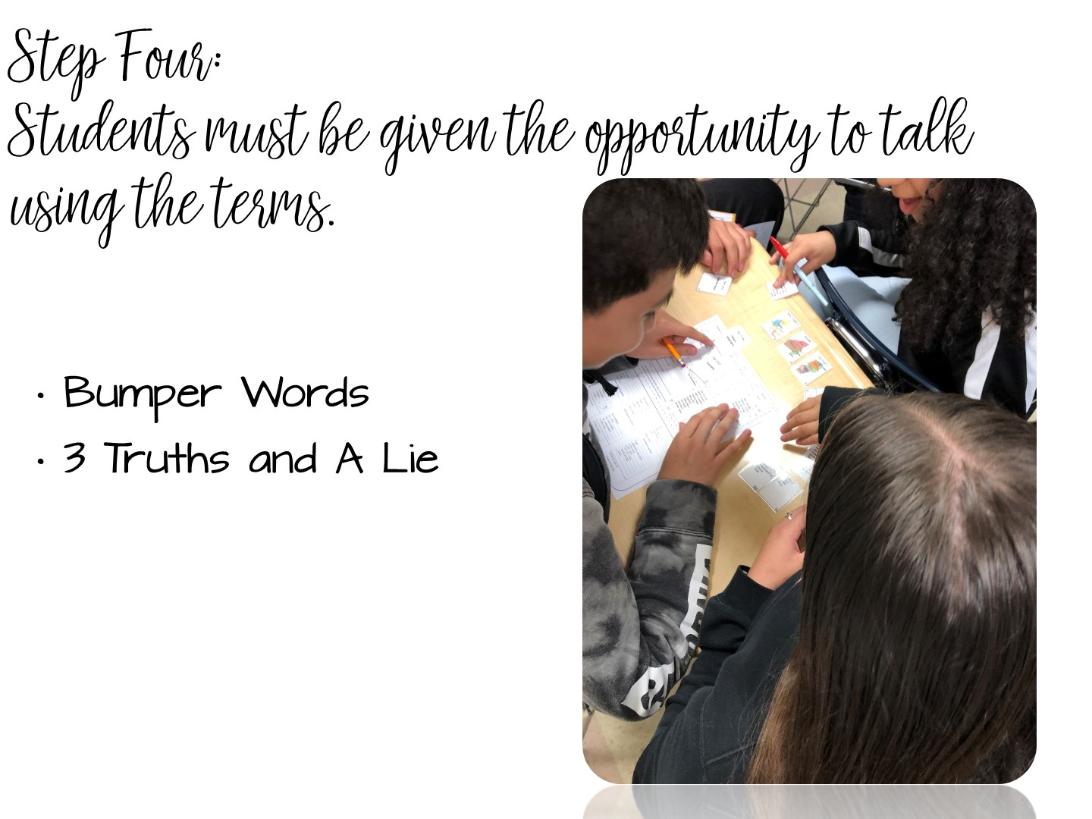
Notes:
See above

Slide 79
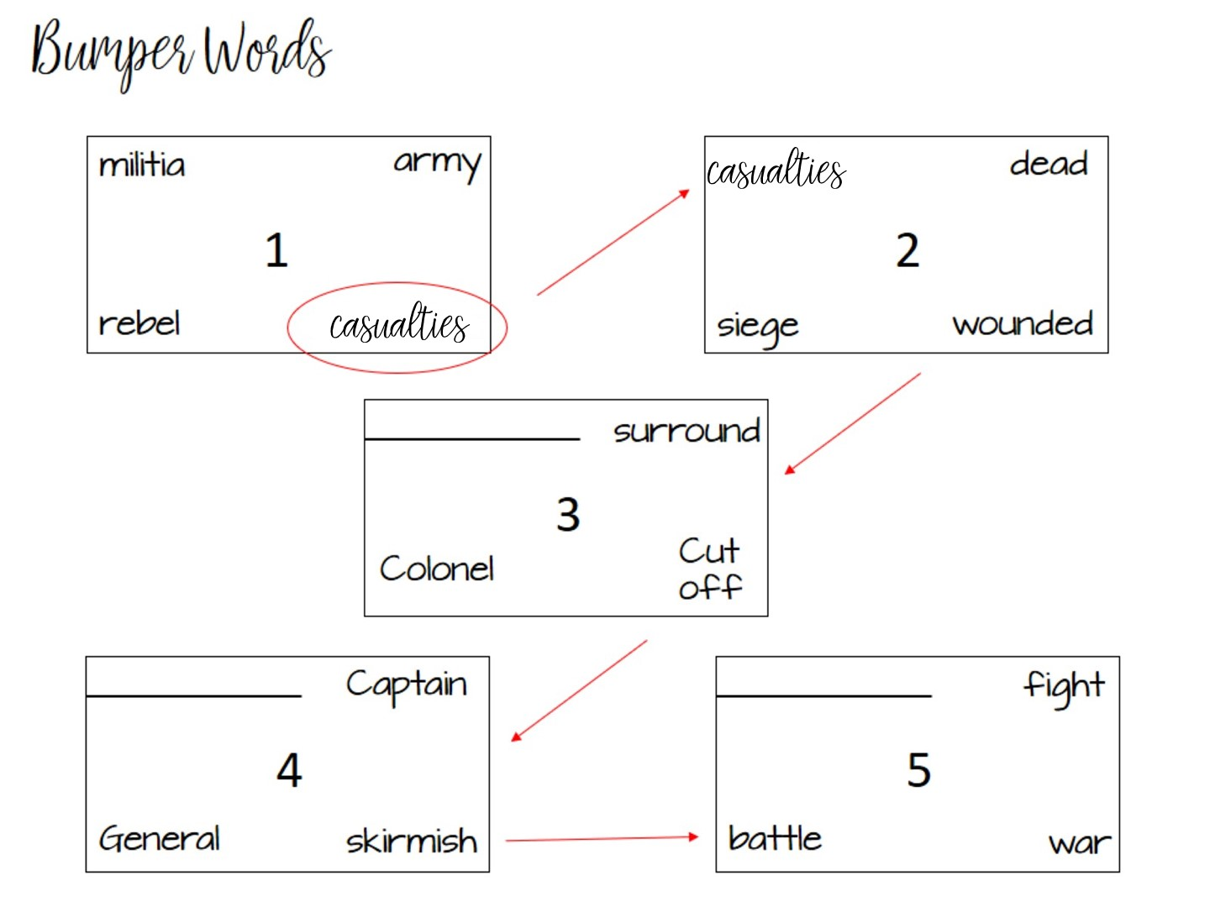
Notes:
Bumper words is a vocabulary strategy that is based on synonyms. In each box, you have a vocabulary term with synonyms. The student has to talk to a partner to determine which term does not fit. It gets bumped to the next box causing one of those terms to not fit. At the end, all of the terms in the box will go together.
Go over pattern

Slide 80
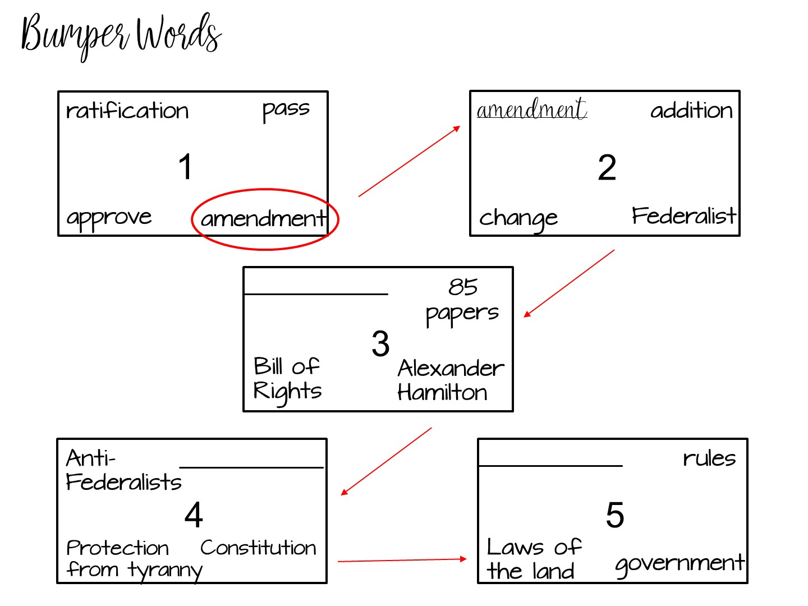
Notes:
Here is another example using both content and vocabulary terms.

Slide 81
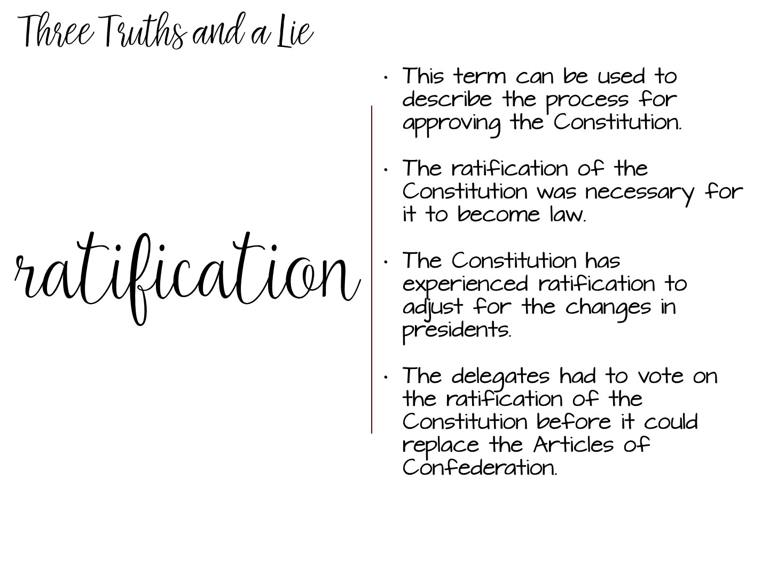
Notes:
Three Truths and a Lie is a game where you put up the vocabulary term with 3 correct statements and one incorrect statement. The students need to talk to each other to determine which statement is the lie.

Slide 82


Slide 83
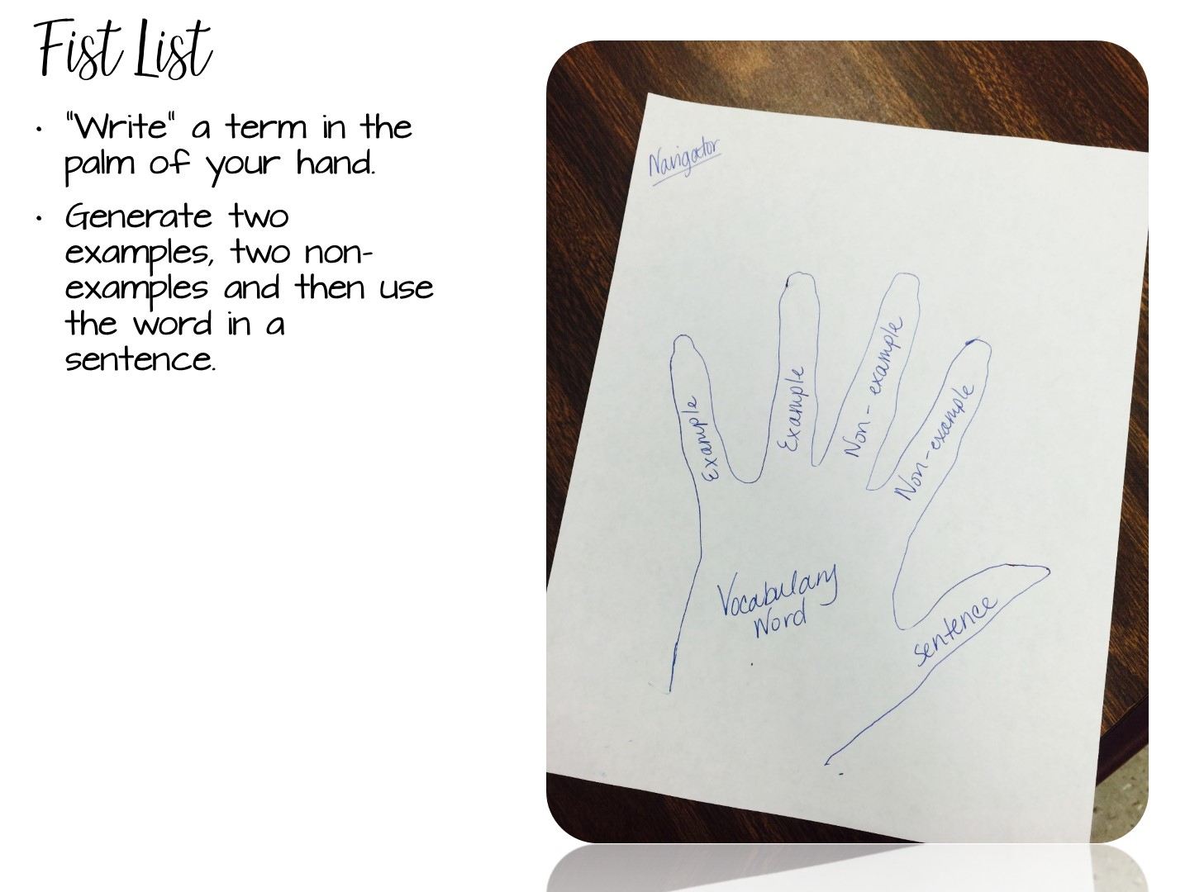
Notes:
5 minutes
Tell the participants to use the back of their pen to “write” the term in the palm of their hand or write the term on a slip of paper and put it into their closed fist.
Two of their fingers will be used for examples of the word, and two for non-examples. Their thumb would represent the word in a sentence.
5 minutes
An alternate way of doing this activity is for students to trace their hand on a sheet of paper. They then fill out the information on paper. Students can then cut the hands out & you can hang them up around the room.
EX:
Pretty
Examples – a flower, a model
Non examples – trash, pollution
Sentence – the girl wore a pretty dress to prom.

Slide 84
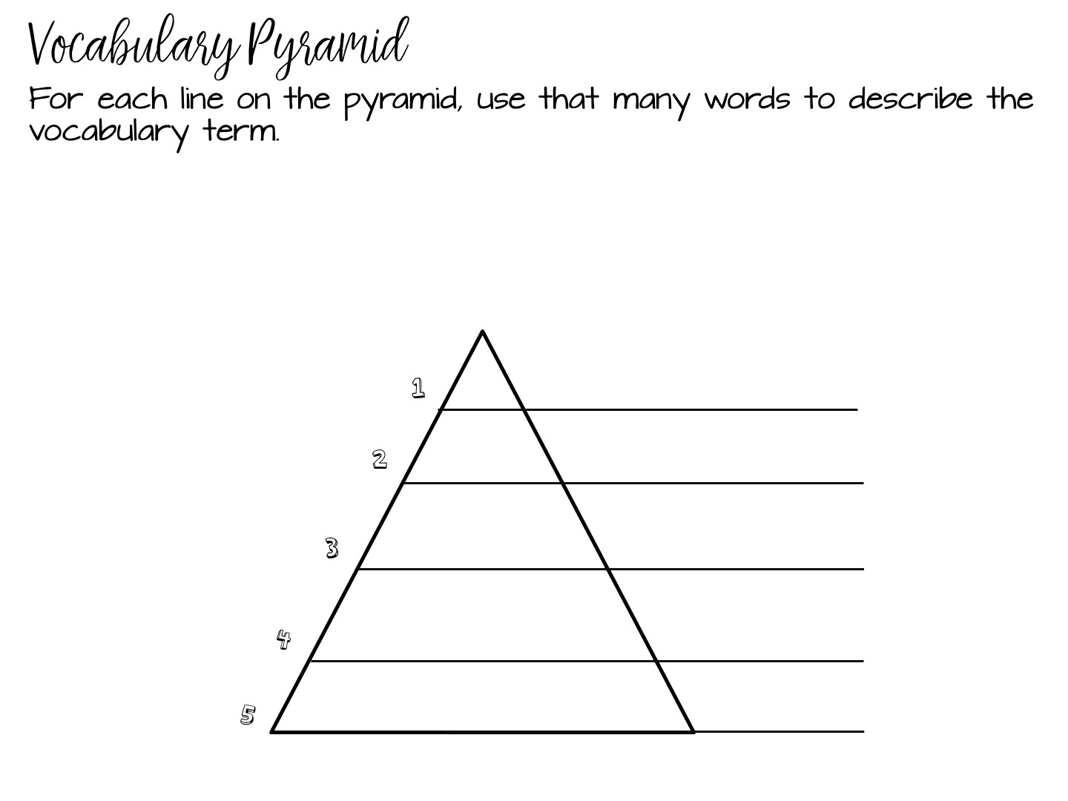

Slide 85
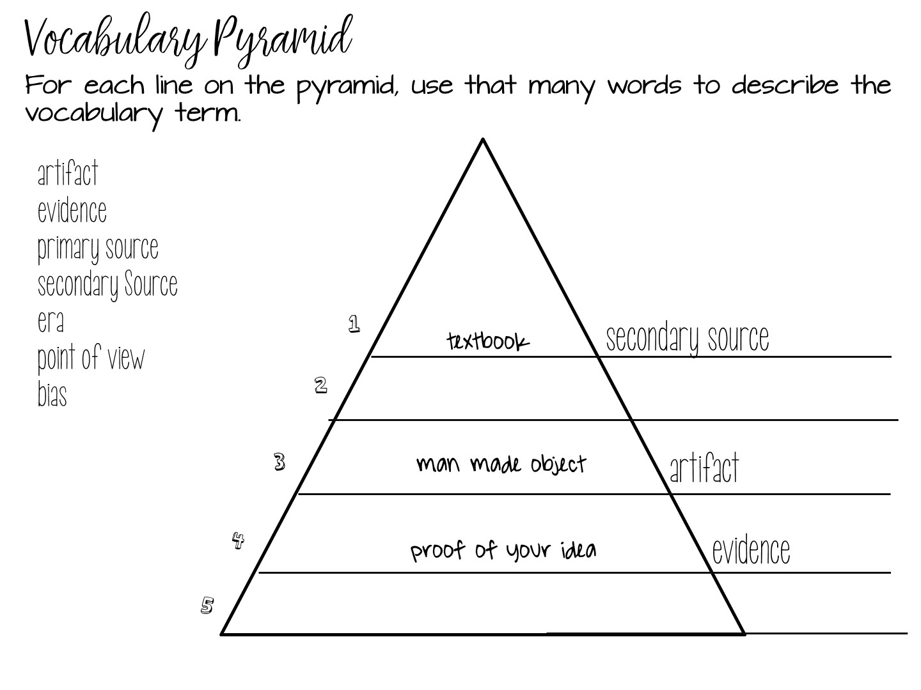
Notes:
Explain example

Slide 86
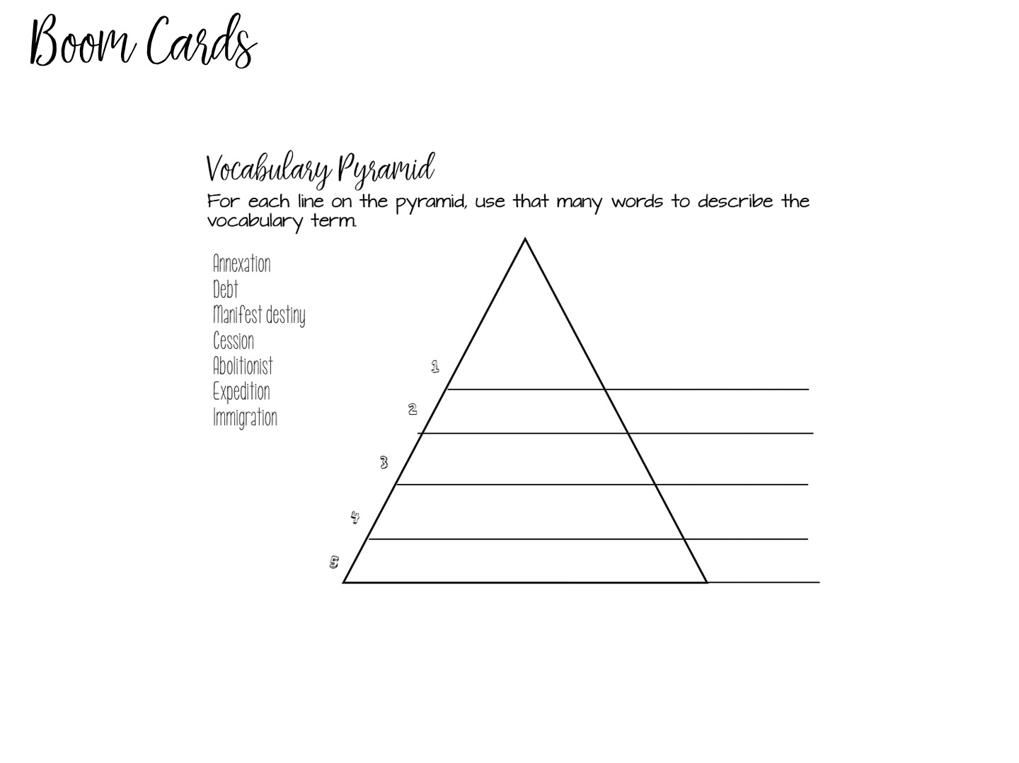

Slide 87
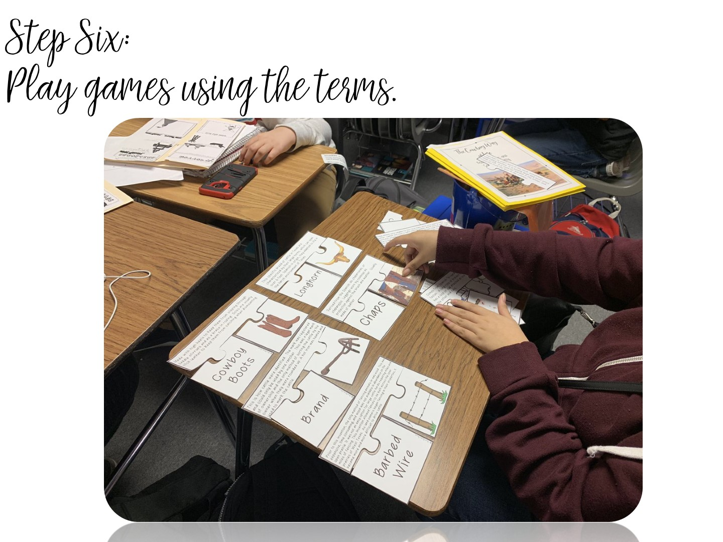
Notes:
Students LOVE games – I would like to share several different strategies for games with you.

Slide 88
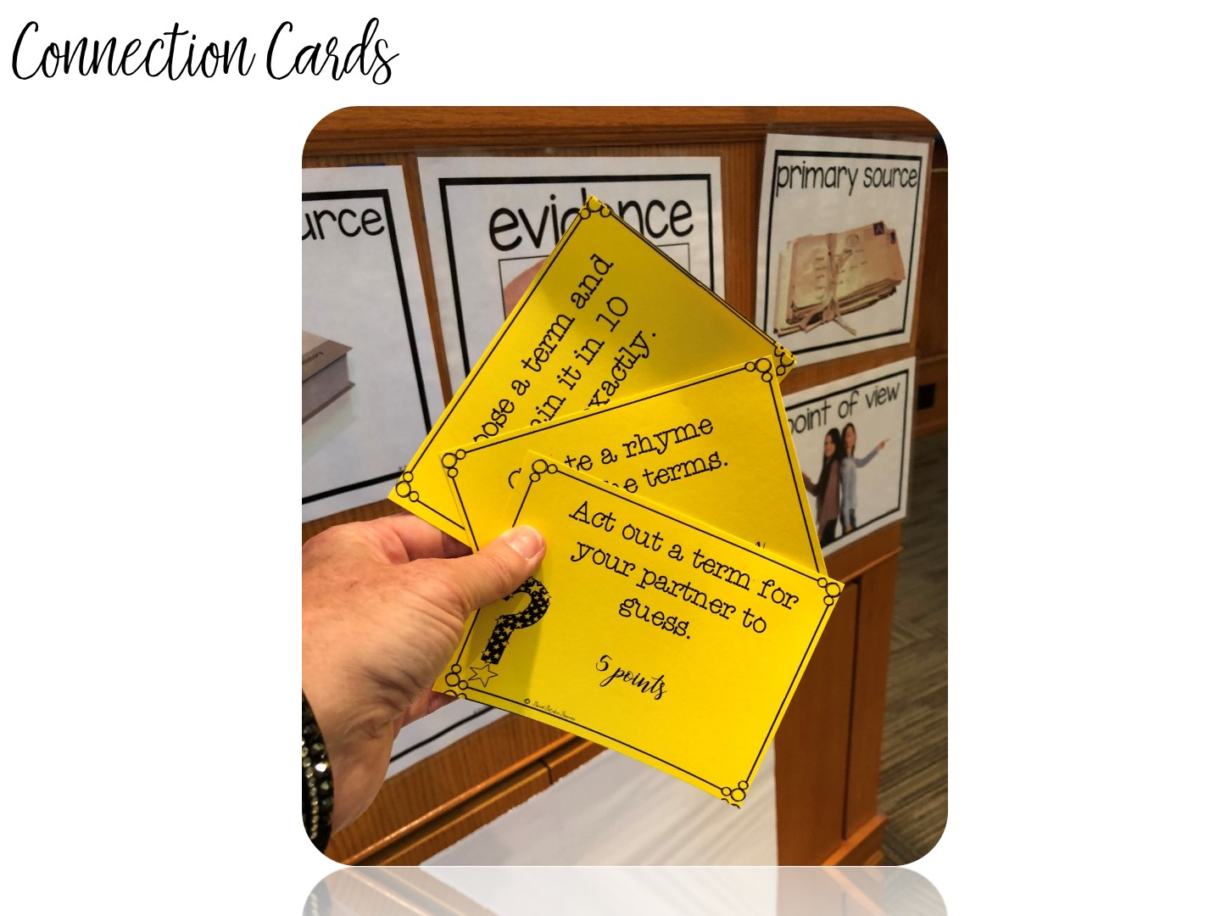
Notes:
explain

Slide 89

Notes:
With all those specific strategies you learned, there is only one addition – your students must read!

Slide 90


Slide 91
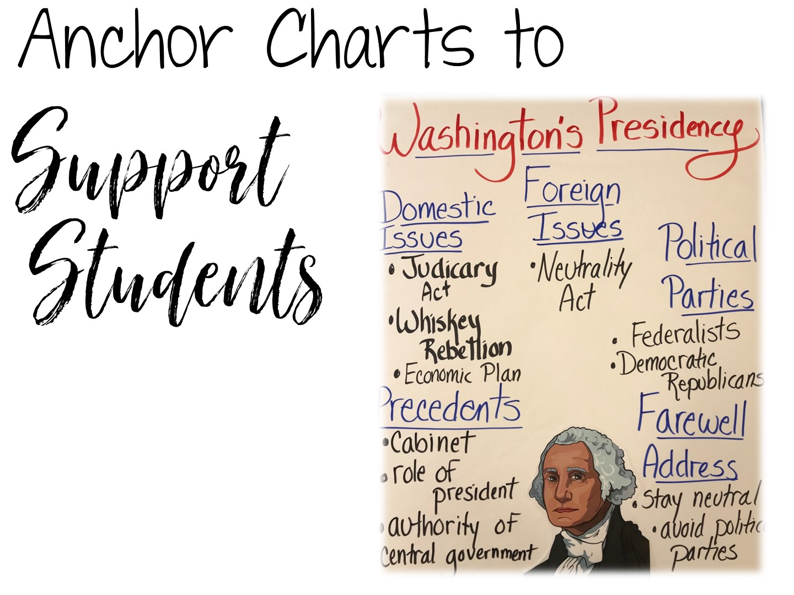
Notes:
Hello, This is Dawn with Social Studies Success, and I would like to welcome you to this session on using anchor charts in secondary Social Studies.

Slide 92


Slide 93

Notes:
Obviously we are going to start with what makes the most sense – what is an anchor chart.
Let me tell you my own personal story about using anchor charts in Social Studies. I first heard of them in a meeting where we were discussing differentiated instruction. I can vividly remember thinking, well that may work for you (it was an elementary math teacher talking at the time), but I have no idea how it would work in Secondary Social Studies. The premise was that you would create an anchor chart every day with your class – and it would really work best if you made it with your students every time. I really couldn’t see how that would work in secondary Social Studies. I had 6 classes – over 130 students, if I attempted that, I would spend all day, every day, creating anchor charts and nothing else would happen in class. Nope – not doing that! I dismissed the idea as great for elementary, but wouldn’t work for me.

Slide 94
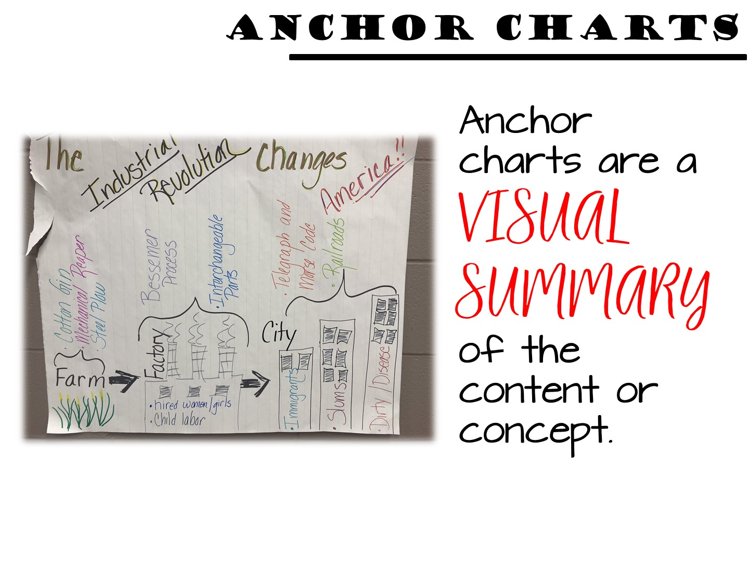
Notes:
It wasn’t until I actually saw anchor charts being used by a secondary social studies teacher, that I had my epiphany. Anchor charts in secondary social studies are VISUAL SUMMARIES of important content or concepts. You create anchor charts for the big ideas or difficult concepts you want students to remember. It is not an everyday, with every student in every class thing. Anchor charts can be manageable for secondary teachers, and more importantly are essential in supporting our ELL and SPED students.

Slide 95

Notes:
So how do anchor charts benefit our students? Why would teachers spend time making them? I knew I needed to do more research to see if anchor charts really are worth our time. But when I researched anchor charts in secondary social studies, I came up against a blank wall – I could find plenty of research for the effectiveness in elementary school, but nothing for secondary. I then started to do my own research based on classroom observations. For the past 5 years I have worked with teachers across Texas. I observed their teaching, and more importantly their students reactions to anchor charts. This workshop is based on the research I have compiled in the past 5 years watching secondary social studies teachers use anchor charts in their classroom. The examples you see are shared with permission from these teachers. Some I have created on my own as I work with different teams of teachers. All are great examples for you to see and use.

Slide 96

Notes:
How do anchor charts support our ELL and SPED students? Because of what they are – visual summaries of important content. Too often our ELL and SPED students struggle with difficult text or teacher lectures. But anchor charts help students focus on the key points of a lesson. An anchor chart lets students know what is really important about a topic – what do they need to walk away knowing about the topic.

Slide 97

Notes:
When you hang your anchor chart in your classroom and USE IT – point to it, require questions to be answered from it, base exit ticket or entrance ticket questions on it - students develop episodic memory around the anchor chart. They can visualize it in their mind and use it as a reference point. Students will even look at a blank wall where an anchor chart hung as they recall information.
One of my favorite memories of an anchor chart was when I saw students using it during a class debate – one student got up, went to the anchor chart and pointed out certain features to reinforce his argument. I was thrilled to see how he had incorporated it into his learning. It was evident that the teacher had been using the anchor chart throughout her instructional unit.

Slide 98

Notes:
Students are notoriously weak in their geographic skills – especially mental mapping. Creating a anchor chart that incorporates a map can be beneficial in so many ways. While this anchor chart can be posted during your colonial unit, revisiting it during your unit on sectionalism can help cement the idea that geographic differences and the economy and history of the colonies helped lead to the Civil War.

Slide 99

Notes:
In addition to mental mapping, anchor charts can help reinforce chronological events or the concept of an era. Anchor charts can be created as timelines or can even be used to …

Slide 100

Notes:
reinforce cause and effect relationships. An idea that can be used for an anchor chart like this is to leave the information in it blank. Then give your students cards with the different cause and effect events on them. As you learn about the content, your students can add the cards to the anchor charts. When you are done with the unit, you can glue the cards down to complete the anchor chart.

Slide 101

Notes:
Anchor charts are also great for reinforcing an essential questions. With any good essential question, you introduce it at the beginning of a unit. Then teach to the essential question throughout the unit. As student learn about the content – Was the Great Storm Galveston’s Greatest Tragedy or Triumph – they can share their answers to build this chart. Instead of making one for every class period – make one and add answers on post-it notes.

Slide 102

Notes:
At the end of the unit, you can have students summarize their learning on a class anchor chart

Slide 103

Notes:
Anchor charts are also great for Social Studies Skills and Processes. These can easily be made ahead of instruction and kept up for the entire year. When you embed or focus on a skill, quickly reteach it with an anchor chart. These can also help your SPED students focus on the thinking that is required in their lesson for the day.

Slide 104

Notes:
Anchor charts can also provide sentence starters for your ELL students. In addition to a visual summary of the skill, sentence starters are beneficial to ELL students moving along the language spectrum from listening to speaking to reading to writing.

Slide 105

Notes:
Anchor charts make thinking visible. Making connections across time is difficult for students to see sometimes – they lack the content knowledge that allows them to see connections between events. An anchor chart that models this process can help your students.

Slide 106

Notes:
One example of developing connections between historical events over time has to do with the documents that influenced the US Constitution. While this is not a cause and effect relationship, each of these documents influenced the thinking behind the American Constitution. An anchor chart can make this series of relationships visible to students.

Slide 107


Slide 108

Notes:
Next we are going to look at the different ways to make anchor charts.

Slide 109

Notes:
Anchor charts do not have to just be posters in your classroom. In fact, I highly recommend against that. In order for anchor charts to become a part of episodic memory, students must interact with anchor charts. There are a variety of ways to do that.

Slide 110

Notes:
Anchor charts can be used as part of a classroom activity. Let’s take a look at the unit on Andrew Jackson. Many teachers use this unit for a point of view lesson. Was Andrew Jackson a hero or a villain? Anchor charts can be used to explore that essential question.

Slide 111

Notes:
Use an anchor chart to evaluate the events that occurred during his presidency. Should Andrew Jackson be praised or condemned for his actions during each of these events? As students post images on the anchor chart, it can help them develop and defend their ideas. The visual element of using pictures as the content can also help cement the learning.
Students refer to the charts and use them as tools as they answer questions, expand ideas, or contribute to discussions and problem-solving in class.

Slide 112

Notes:
Do you have a visual that you always use for a lesson? You can turn that into an anchor chart.

Slide 113

Notes:
Require your students to copy important anchor charts into their interactive student notebook for reference.

Slide 114

Notes:
Create a simple anchor chart to use as part of your instruction cycle. Anchor charts can be used at the end of a lesson or unit to check for understanding. Did your kids understand the key content or concepts? Anchor charts like these increase engagement and help students check their own understanding as well.

Slide 115

Notes:
You can turn almost anything into an interactive anchor chart.

Slide 116

Notes:
Anchor charts can also be made after a formative assessment using the game you just played!

Slide 117

Notes:
Students can use anchor charts to compare ideas or people. Give students a simple post it note with key content and allow them to create categories of the information.

Slide 118

Notes:
Once categories of content have been created, you can make a simple anchor charts summarizing the student’s information.

Slide 119

Notes:
You can also create informal anchor charts to help teach the eras of your course. I love the way the arrow helps students visualize where they are in history.

Slide 120

Notes:
Stop the video now to reflect on your learning and take any notes you wish.

Slide 121

Notes:
Let’s talk about planning your anchor charts.

Slide 122

Notes:
Anchor charts work best when they are planned in advance to provide a visual summary for students. In fact, anchor charts can even help in your planning process. When you plan a unit, think of the key content you want your students to walk away with. What is so essential, so important, that you want your students to know it next week, at the end of the year, and into adulthood? Create an anchor chart on that!

Slide 123

Notes:
Talk with your team about the important content you want to include in your unit. Discuss ways you can visually represent the content. Sketch a few ideas, some will work and some won’t. For example, when I first started making anchor charts, I tried to include ABSOLUTELY EVERYTHING into an anchor chart. This is not a visual summary, it is almost a textbook! Students will have a hard time visualizing this in their heads!

Slide 124

Notes:
Here are a few more examples to explain what I mean when I talked about planning out an anchor chart. In this image, you can see all of the ideas I wanted to incorporate into my anchor chart on the Industrial Revolution.

Slide 125

Notes:
And here is the completed process – it has more of a visual element to the organization of information.

Slide 126

Notes:
Once you develop those ideas into your anchor chart, discuss how you would plan instruction around it. An anchor chart is not just another poster to decorate your room, so how will you use it in your instruction? Will it serve as a word bank? Concept chart? Formative assessment? Will students copy it into their notebook? Play games with it?
Plan for the different ways you can reinforce your key content throughout the unit with your anchor chart.

Slide 127

Notes:
Let’s take a look at some helpful tips for creating anchor charts.

Slide 128

Notes:
Your handwriting is your voice and is important – you train kids all year long to pay attention to your handwriting – what is written on the board, what is written on their papers - be sure to use your own handwriting when creating anchor charts. It is tempting to have students or other teachers make your anchor chart for you – but if you do, you are missing out on a connection with your students. They know what you say is important, it might not have the same effect in another person’s handwriting.

Slide 129

Notes:
With that being said, there is nothing wrong with some good clip art or images to help the visual aspect of your anchor chart.

Slide 130

Notes:
The supplies that you use for your anchor charts is obvious – markers, crayons, highlighters, but here are another few options that can make a difference when you are creating anchor charts.
A good calligraphy pen – I love the way it makes my handwriting look elegant (or at least better!)

Slide 131

Notes:
Symbols are essential for a visual summary. They can be “read” quickly and help convey meaning. How are you going to incorporate different symbols into your anchor chart?

Slide 132

Notes:
Grab a pair of cheap hula hoops at the Dollar Store – these are great for making Venn Diagrams on chart paper.

Slide 133

Notes:
Are you going to use one shape over and over and over again? See if you can make or purchase a hard template to trace. I decorated this Texas at a painting event, but I love it even more when I discovered I can use it for anchor charts. Consider doing the same for the shape of the United States. Project a map onto the wall, trace it onto tag board and then cut it out. You now have a template to use for the rest of the year.

Slide 134

Notes:
How do you store your anchor charts is always a question I get. You could laminate them, roll them up tight, write on the end what the title is and store them in a large trash size container. Or you can hang your anchor charts on pant hangers.

Slide 135

Notes:
Or you can hang your anchor charts on pant hangers.

Slide 136

Notes:
And keep up as many as you can as long as they are relevant.

Slide 137

Notes:
There are several different ways you can make your anchor charts “fancy”. Take a look at this image to see some of your different options.

Slide 138

Notes:
You can also add different types of borders for emphasis. Dots and dashes, S’s and Dots, slashes, curly cues and even just crayons can make nice borders.

Slide 139


Slide 140


Slide 141


Slide 142


Slide 143


