Slide 1

Notes:
Use presenter checklist to prepare your room and supply list.

Slide 2


Slide 3

Notes:
Have teachers write their goals on a post it note and share with their table mates.
Review our goals in the next slide

Slide 4


Slide 5
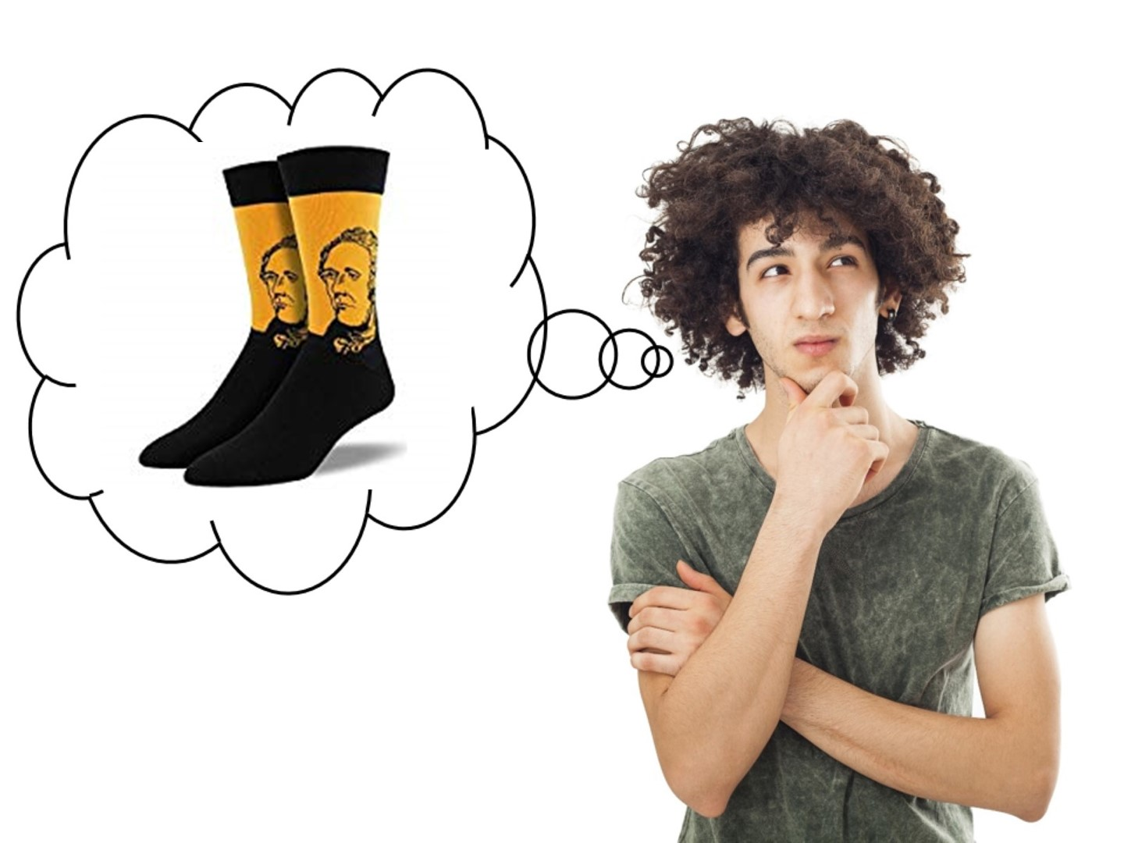
Notes:
I share my rule of the socks:
They have never been on my feet
They are not a souvenir of the workshop
Put your cellphones away in the sock (model with your own)

Slide 6

Notes:
Pass out Engagement Doodle Notes
Ask this question and have them respond on the Engagement Doodle Notes handout – list 3 reasons. When they have finished, have them share their responses with their tablemates.

Slide 7
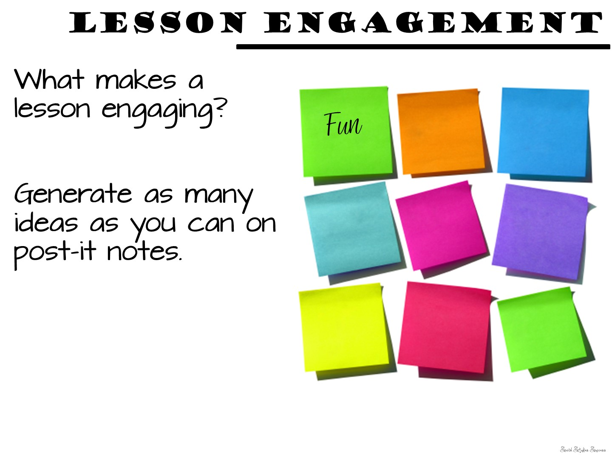
Notes:
Now put them with a partner or a small group of 3 and have them come up with 10 ideas – each idea on its own post it note (give them one color of post it note for this portion). Their goal is to have 10 separate post-it notes with engaging ideas written on them.

Slide 8
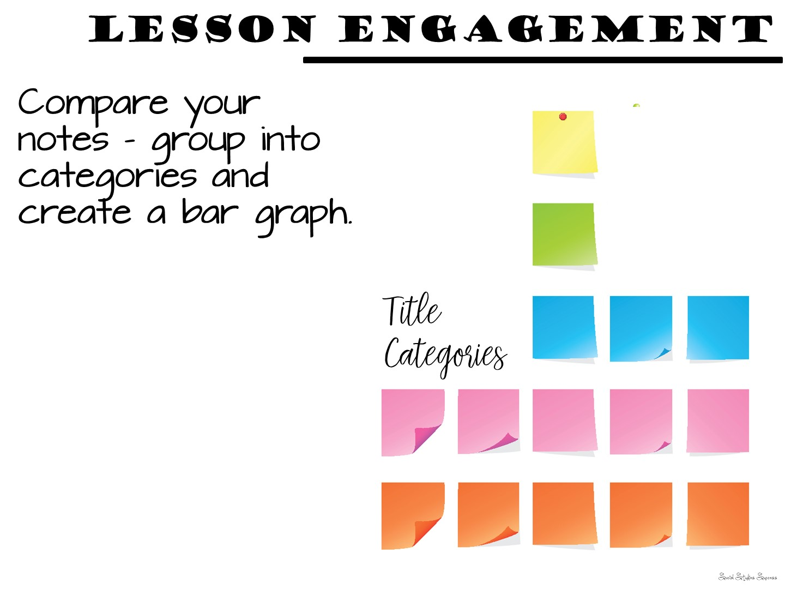
Notes:
Have them rearrange their post-it notes to create categories (example technology if they mention kahoot, quizlet, etc.) Give them a different color post it note for the title of their categories.
Once they have created their categories – get them up to do a forced march around each others post it notes. What did they see that was similar? What was different?
Debrief

Slide 9
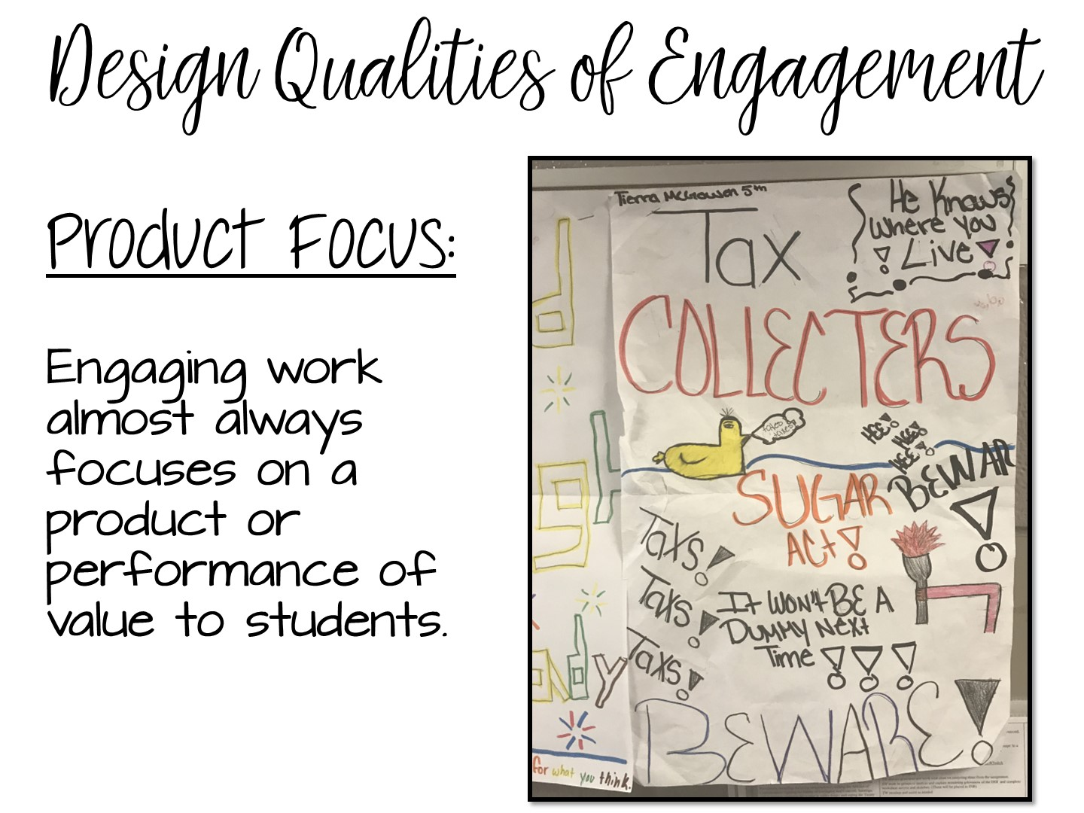
Notes:
Now share the official research from Philip Schlechty and his book – Working on the Work. Just read the next few slides to the teachers. Add any personal examples of things you have done for each slide. Allow them to take notes if they wish on their Engagement Doodle Notes.
Product focus – students are making a product or a project.
Schlechty’s Design Qualities of Engagement

Slide 10
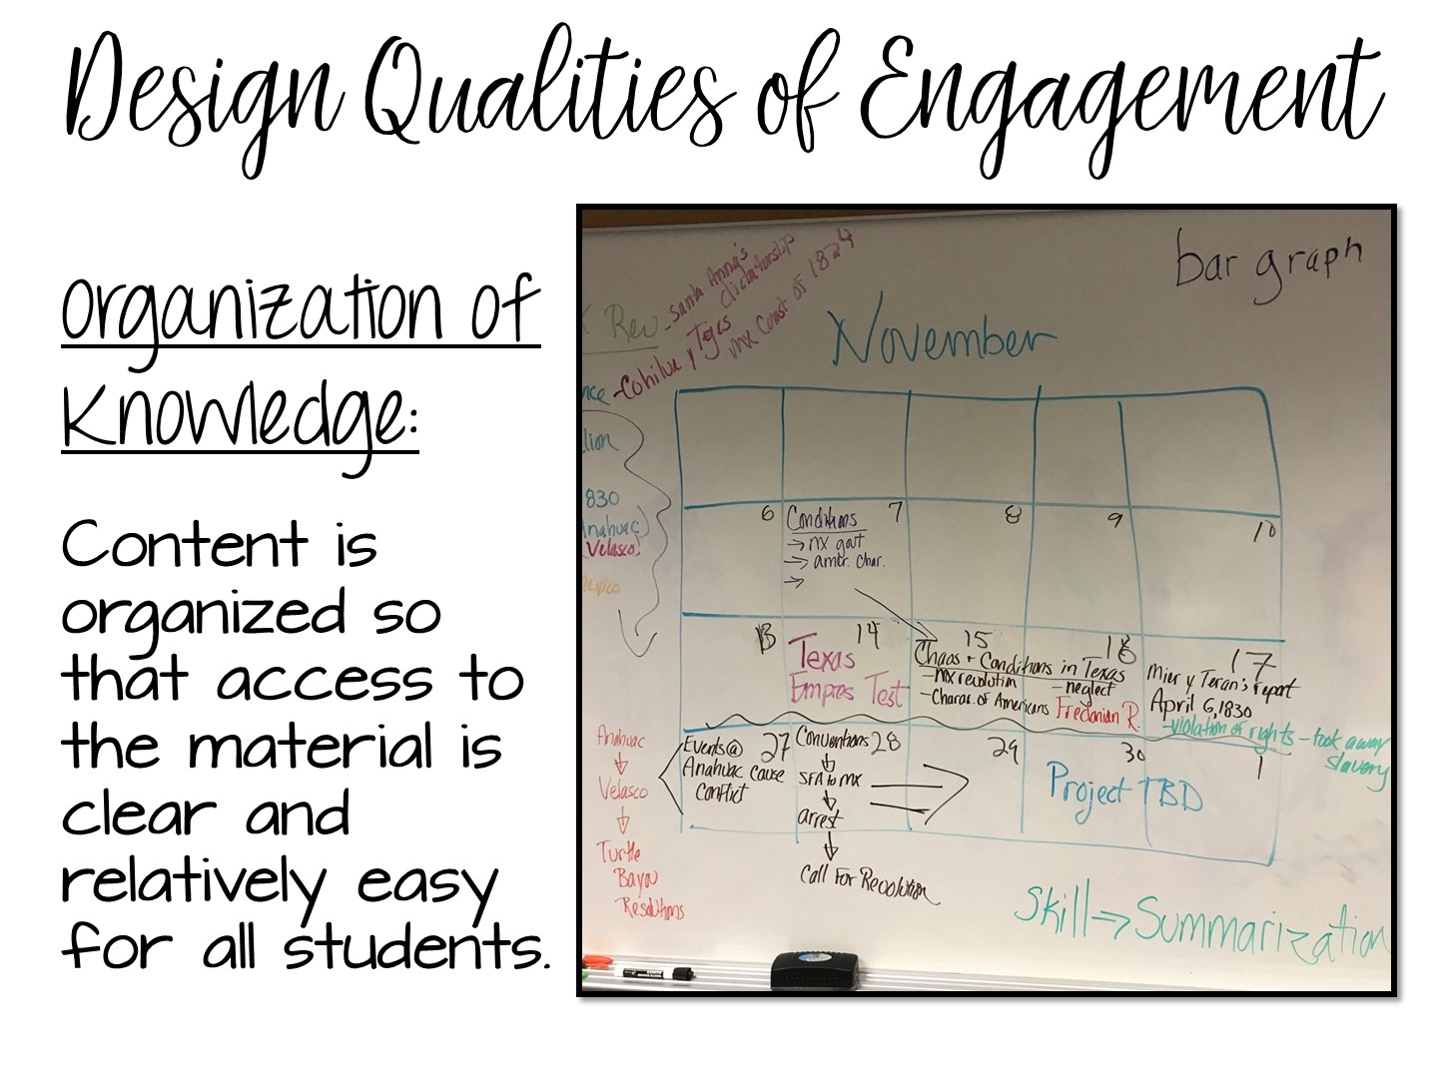

Slide 11
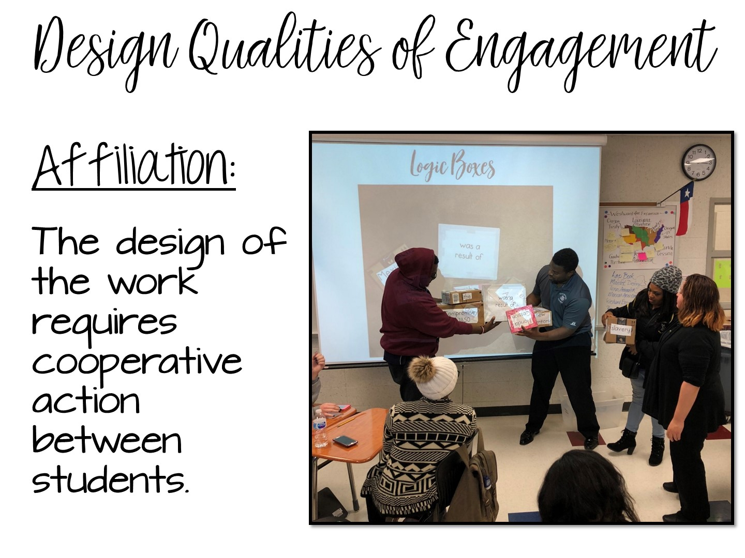
Notes:
Affiliation – students are working together to complete a task, not just splitting an assignment in ½ and each doing a portion, but cooperatively engaged with each other.

Slide 12
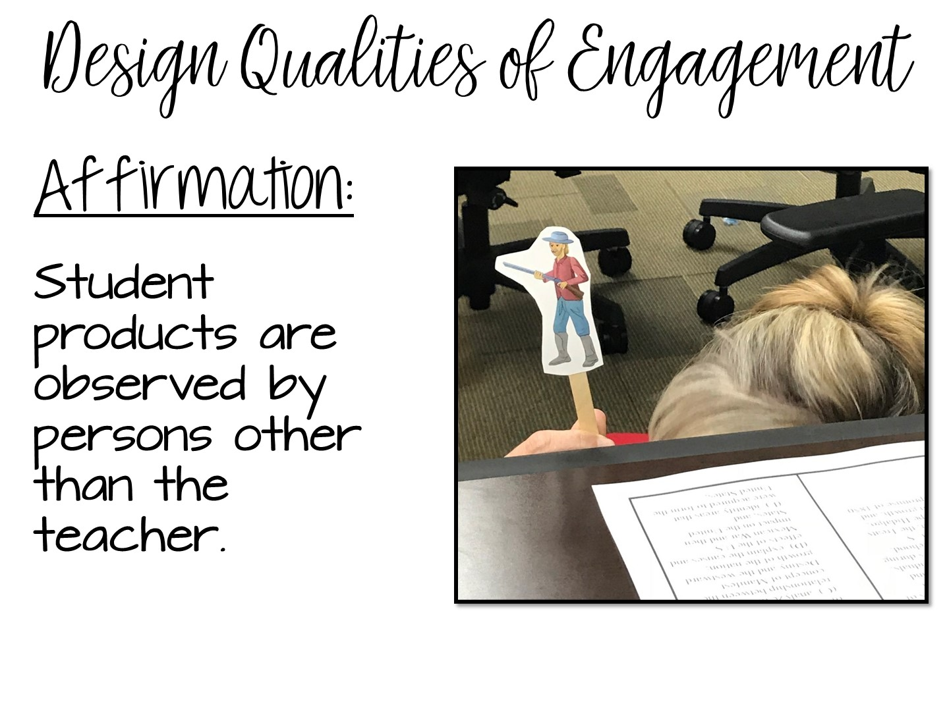
Notes:
Examples include hanging products in the hallway, display in the library, other classes come observe, share with other classes.

Slide 13
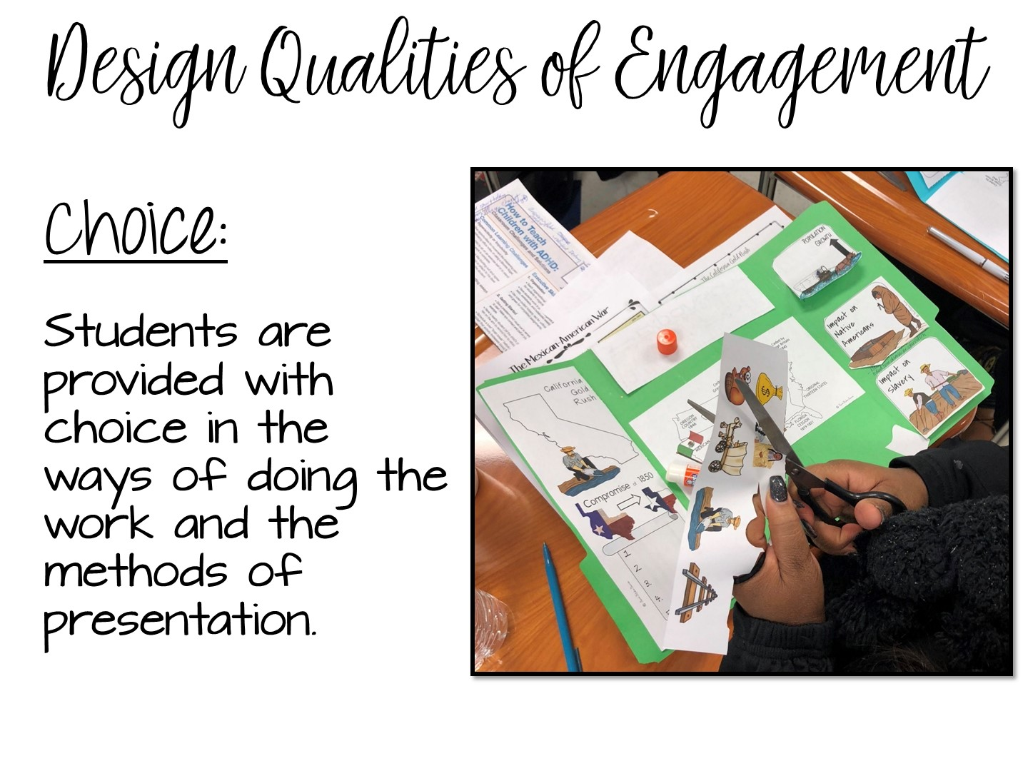
Notes:
PERCEPTION OF CHOICE is the key – it doesn’t just mean a choice board. Any choice students have increases engagement.

Slide 14
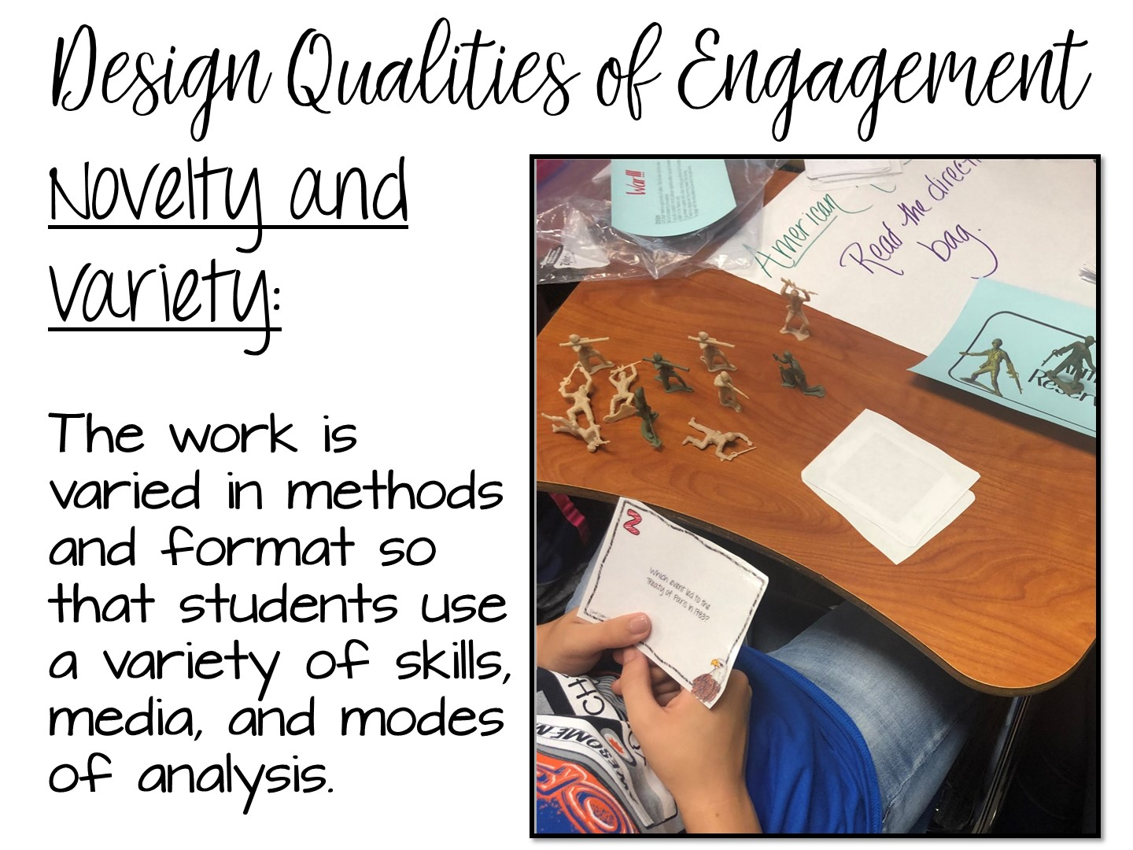
Notes:
New and different. What is new at the beginning of the year, is not new at the end. What is different (like Kahoot) is no longer different if everyone in every class is doing it.

Slide 15
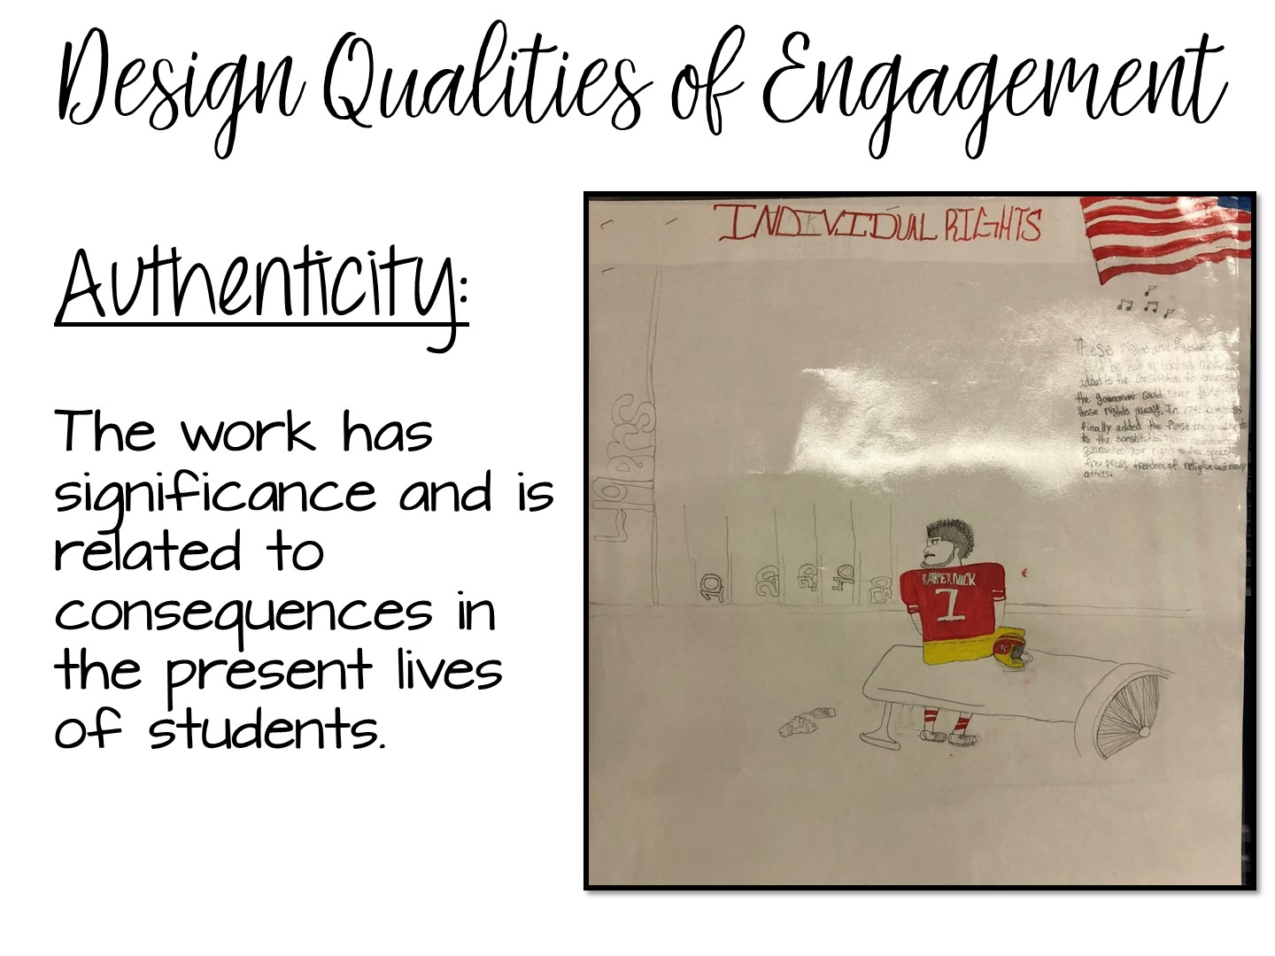
Notes:
Needs to have real world connections or a project that has a real world application.

Slide 16
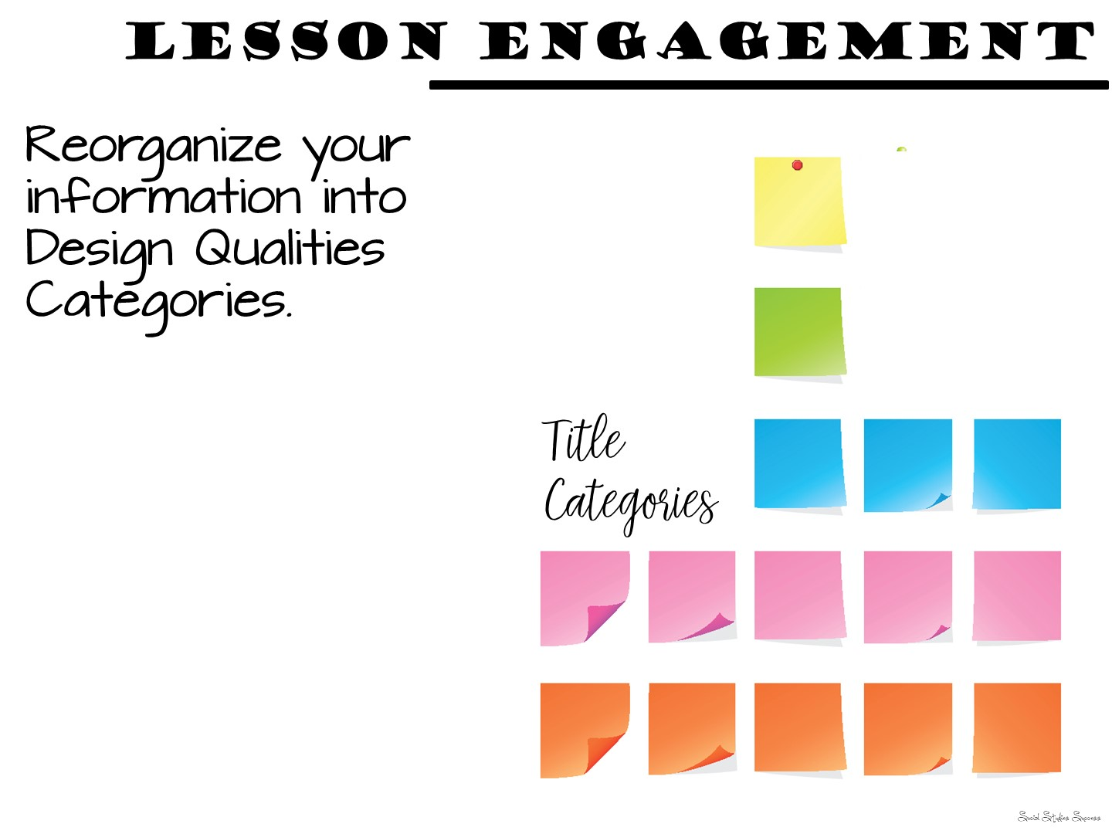
Notes:
Now have them use the official terms from the design qualities of engagement. Create new category titles based on the design qualities of engagment and move their post it notes into the new categories. The purpose of this is to show them they already know a lot about engagement, this workshop is to help them come up with new ideas and focus for engagement in Social Studies.

Slide 17

Notes:
What did they just see you model? What design qualities – example: affiliation (working in a group)
Use popsicle people to randomly call on teachers.

Slide 18

Notes:
Use popsicle people to randomly call on teachers
18

Slide 19
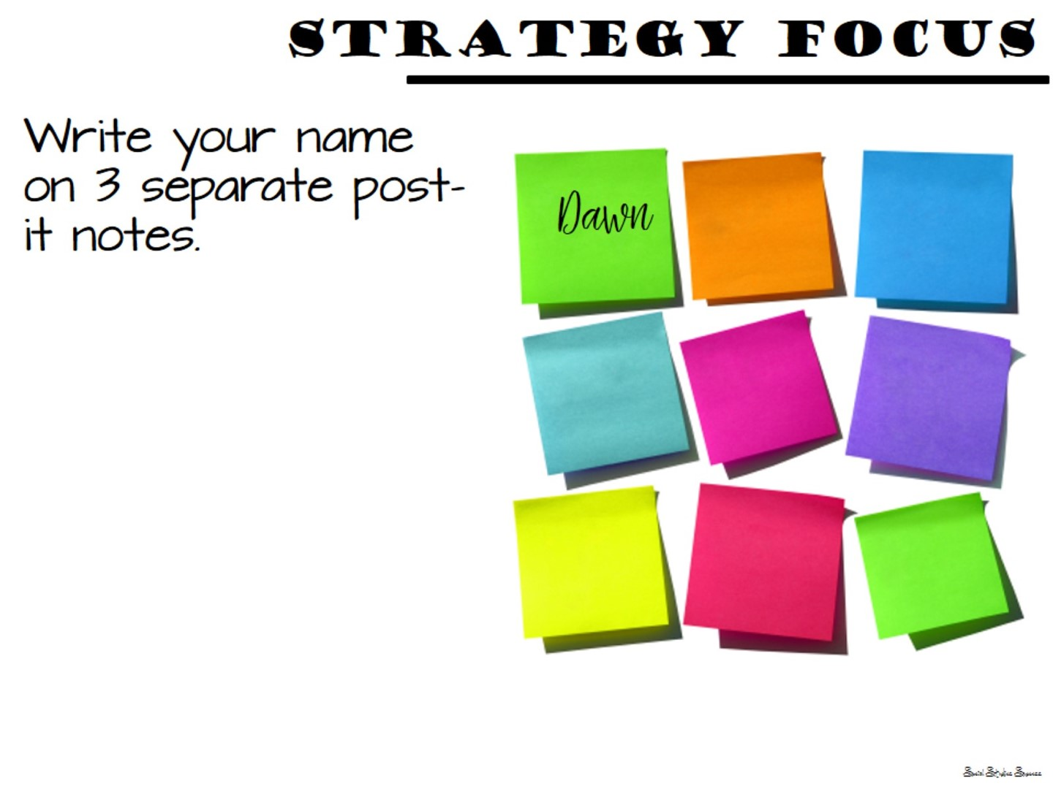

Slide 20
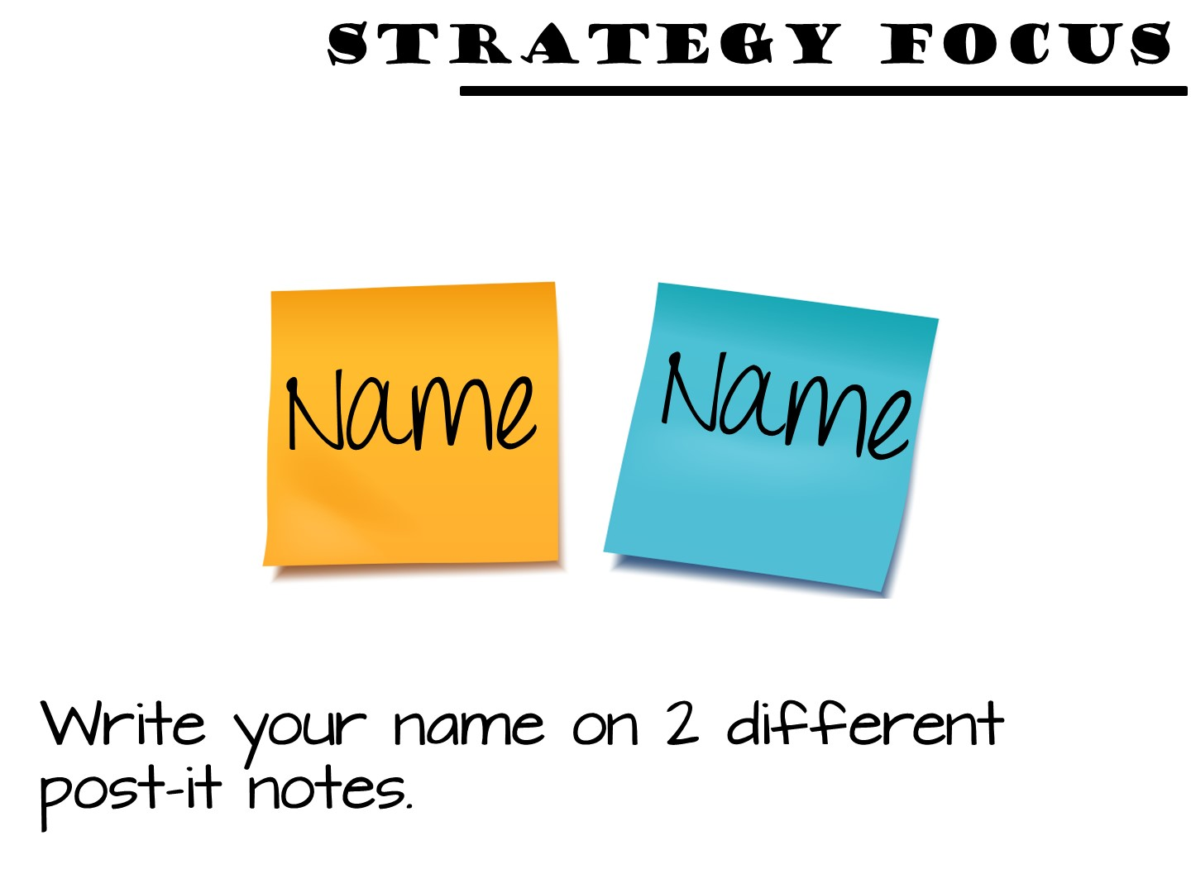
Notes:
Have the teacher participants write their name on two different post-it notes.

Slide 21
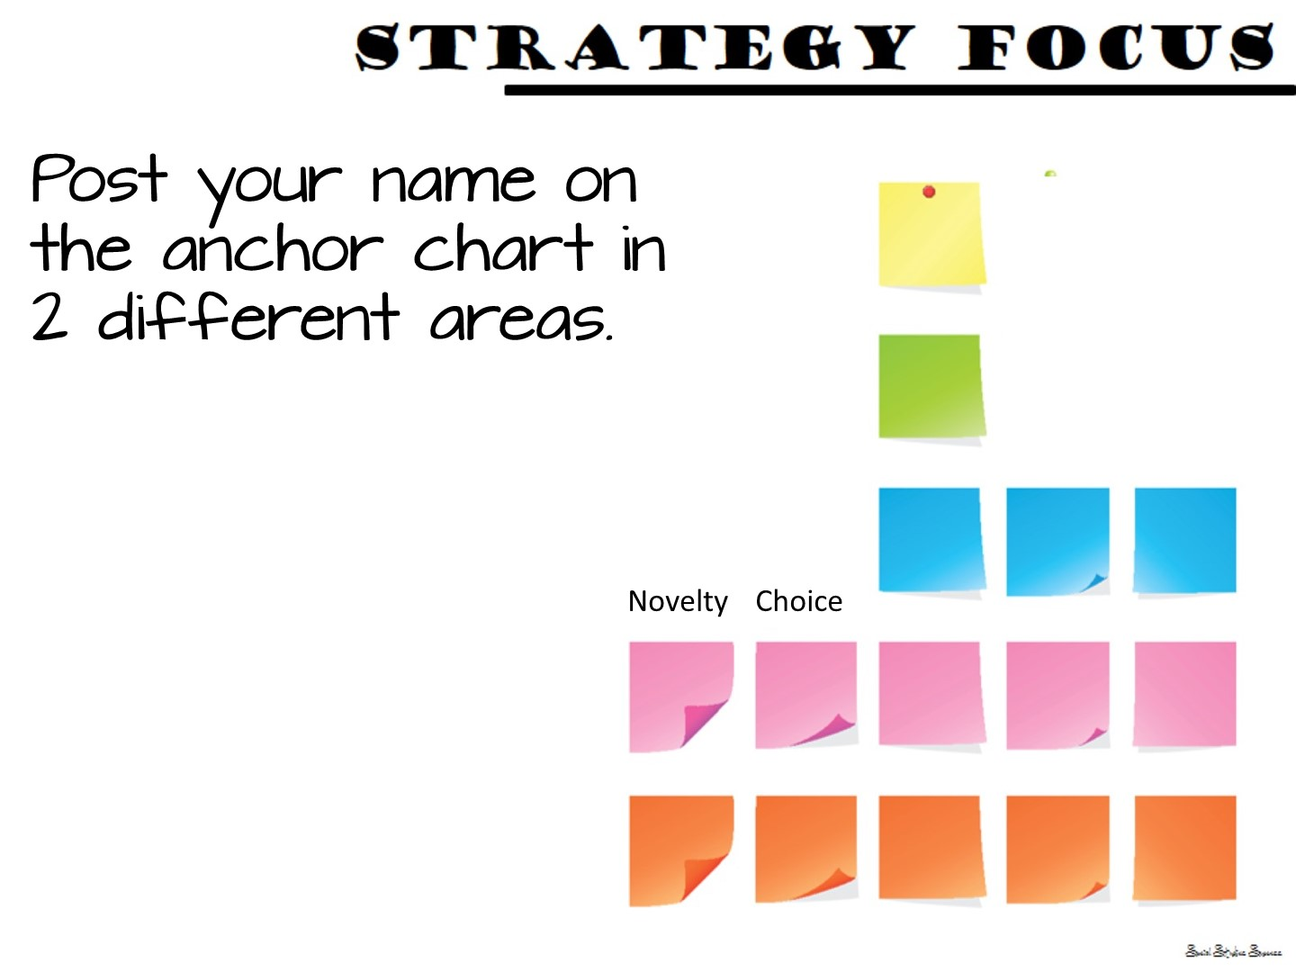
Notes:
Ask them which design quality of engagement they themselves need to work on. They will put their name post-it note on the anchor chart next to 2 different design qualities of engagement. This will be their focus for the day. You can then ask them throughout the day – “Johnny, where did you see x” by pulling his name off the chart.

Slide 22


Slide 23

Notes:
We are now going to model a lesson focusing on a different design quality of engagement – authenticity. But be on the lookout for more!

Slide 24

Notes:
This is a great lesson for the beginning of the year! Use within the first week if possible.

Slide 25
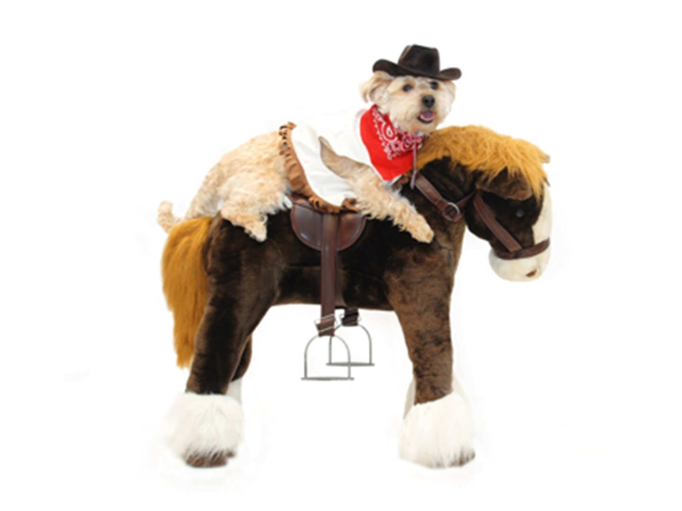
Notes:
This lesson is a dog and pony show as you will be modeling as many different strategies as you can. The lesson in their own classroom will be much simpler.

Slide 26

Notes:
Just read

Slide 27

Notes:
This is the essential question. They will need to be thinking about why we study history.

Slide 28

Notes:
Four Corner Activity
Ask the teachers to think about the answer and then stand in each one of the 4 corners that represent their response. Once they are in their corner, talk with each other to see why they all have similar response, then share out.

Slide 29

Notes:
These are the vocabulary terms we are going to learn. Point to each term on the word wall and pronounce them for the teachers.

Slide 30

Notes:
Pass out Predict This
Give each teacher one of these and place them with a partner. Have them all come up to the word wall and discuss with their partner to see what they think the correct answer is. Debrief.

Slide 31

Notes:
Use the following slides to debrief the answers

Slide 32


Slide 33


Slide 34


Slide 35


Slide 36


Slide 37
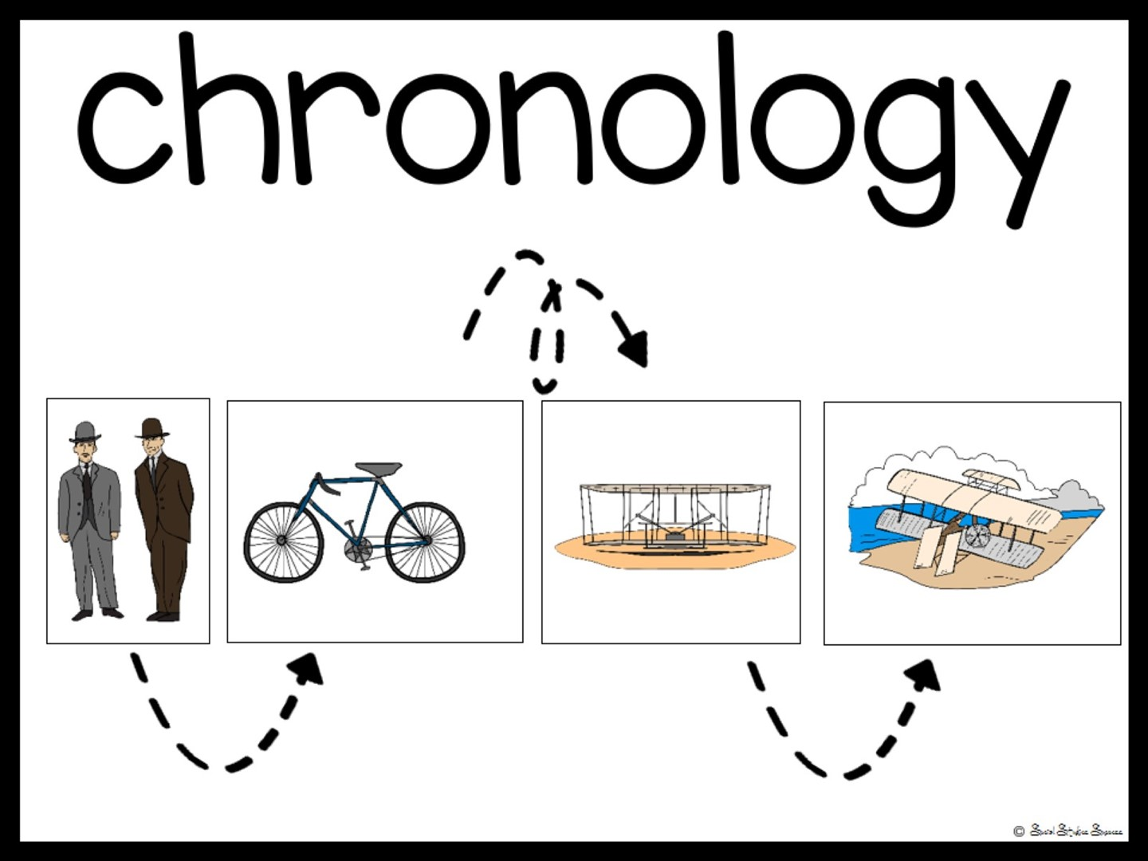

Slide 38


Slide 39

Notes:
Now pass out your own artifacts in an envelope. Do not tell the teachers that these are your own personal artifacts. In their groups, have them examine the artifacts to see if they can answer any of these questions.

Slide 40
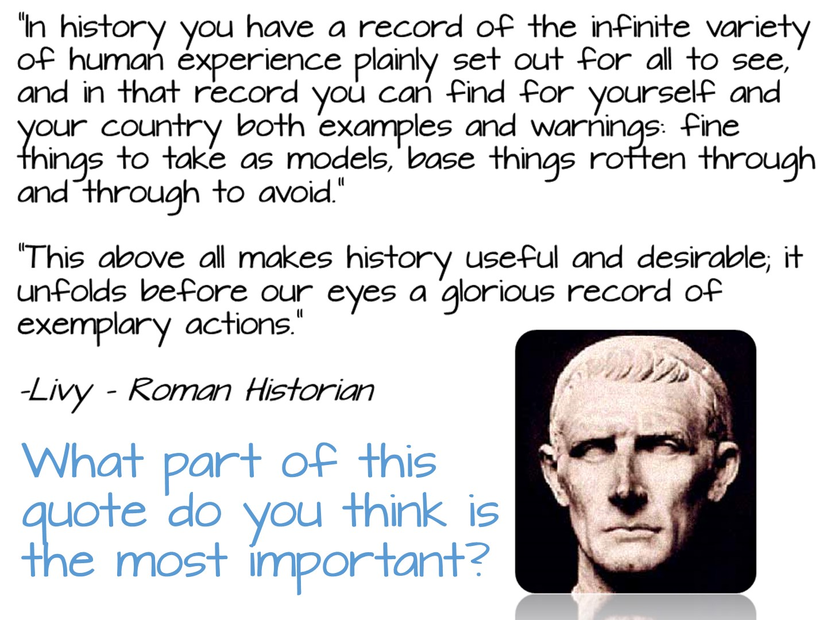
Notes:
Read to group and discuss the question.

Slide 41

Notes:
Pass out the first page of the reading. Follow directions on the slide.

Slide 42

Notes:
Pass out the second reading and model how to read with pick a card. After they have read, give them one of the pick a cards to use as a sentence starter with the whole group.

Slide 43

Notes:
Pass out Doodle Notes and just do for about 5 minutes

Slide 44

Notes:
Pass out spectrum and have them read and discuss.

Slide 45

Notes:
Debrief the lesson by asking them to use specific design qualities of engagement terminology to identify different parts of the lesson that increase engagement.

Slide 46


Slide 47

Notes:
Give them 5 minutes to write down reflections on their notes (on the back)

Slide 48

Notes:
Prep for the next lesson model during the break:
Hang up the word wall vocabulary terms for colonization

Slide 49

Notes:
Check for any questions from the first part of the session before you begin. If no questions, have them tell their partner 1 thing they learned.

Slide 50

Notes:
The next lesson you are going to model is for World History.

Slide 51
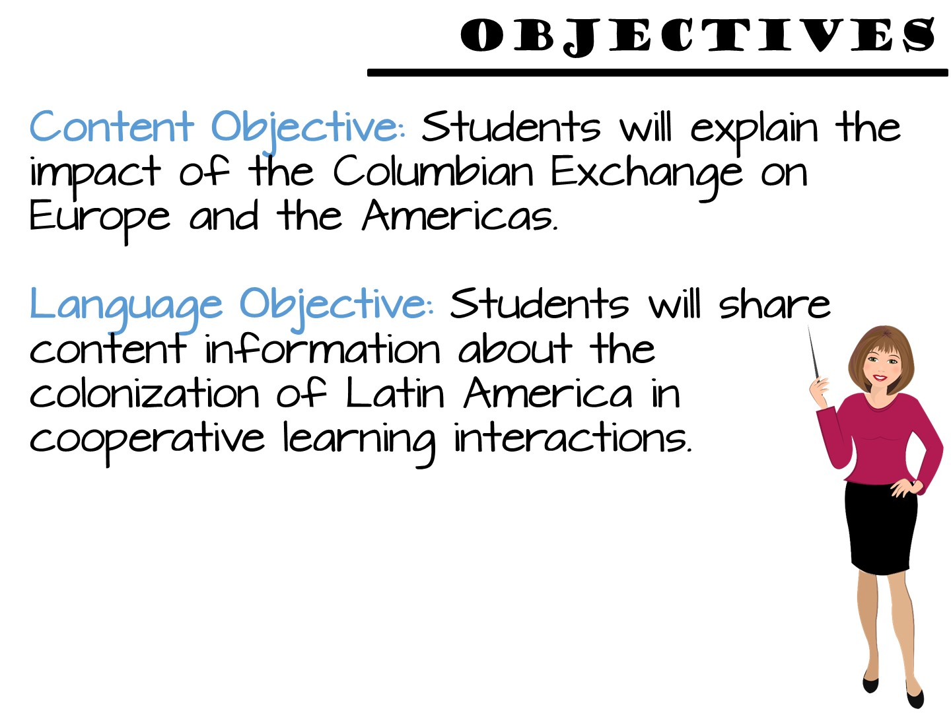
Notes:
Just read.

Slide 52

Notes:
Place teachers with a new partner.

Slide 53

Notes:
Point to the word wall and read each of the terms – tell the teachers we are going to do a 3, 2, 1 definition to learn the terms. They will need post-it notes for the activity.

Slide 54
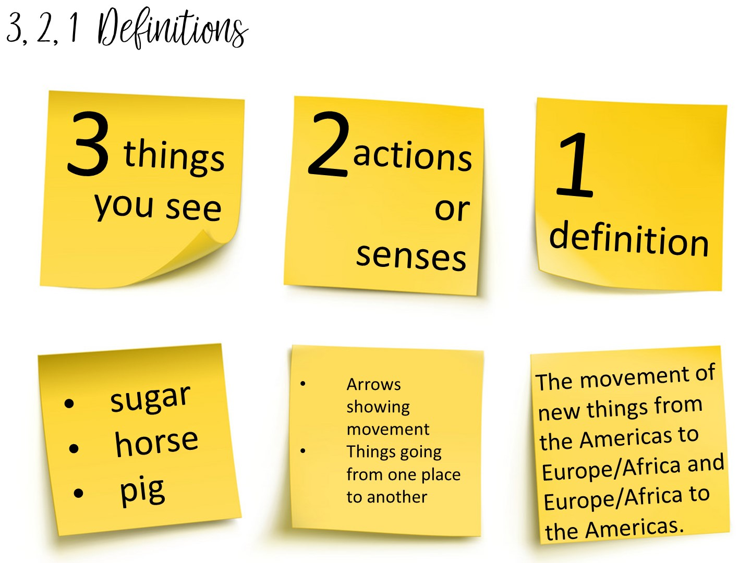
Notes:
Another method to teach vocabulary with images is the 3, 2, 1 Definitions – Allow students time to analyze an image to build their understanding of an image.
Model this with the word Columbian Exchange
Allow them to pick a term with a partner and complete the 3, 2, 1 definition. I always bring the teachers close to word wall to get them out of their seats.

Slide 55
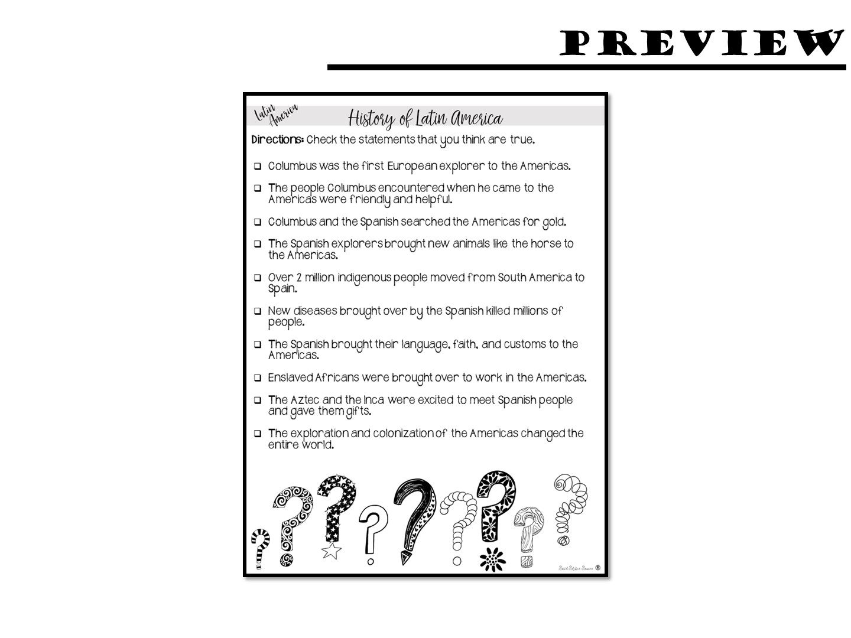
Notes:
Pass out anticipation guide - do for just a few minutes.

Slide 56

Notes:
Do a thumbs up/thumbs down debrief. Put your thumbs up if the answer is true, thumbs down if they answer is false.

Slide 57
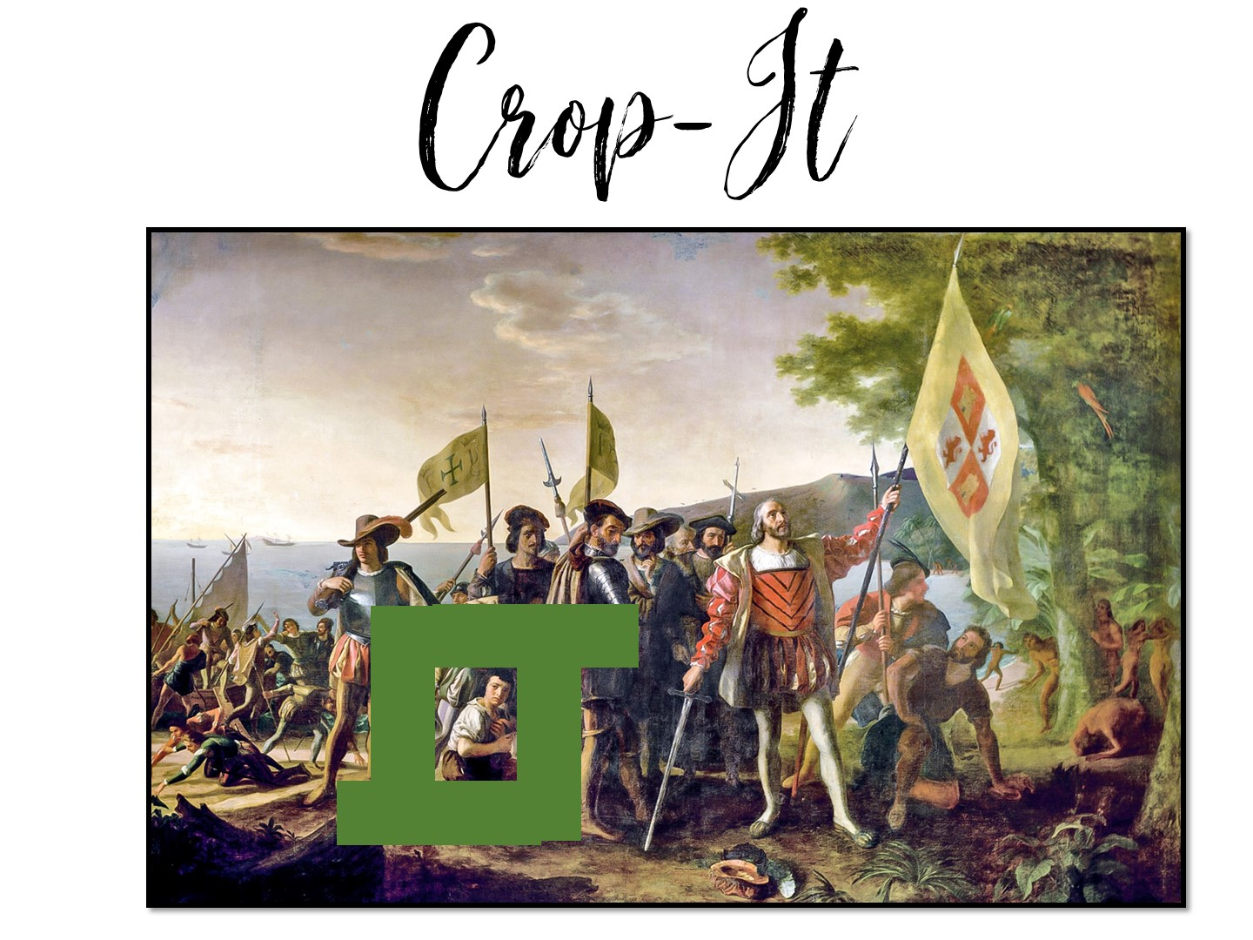
Notes:
Pass out the crop-it tools and the Columbus images. Use the handout with questions to ask questions for the teachers to answer using the tool.

Slide 58

Notes:
Give each group a copy of the first page of the reading (Spanish Exploration) and conduct the reading.

Slide 59
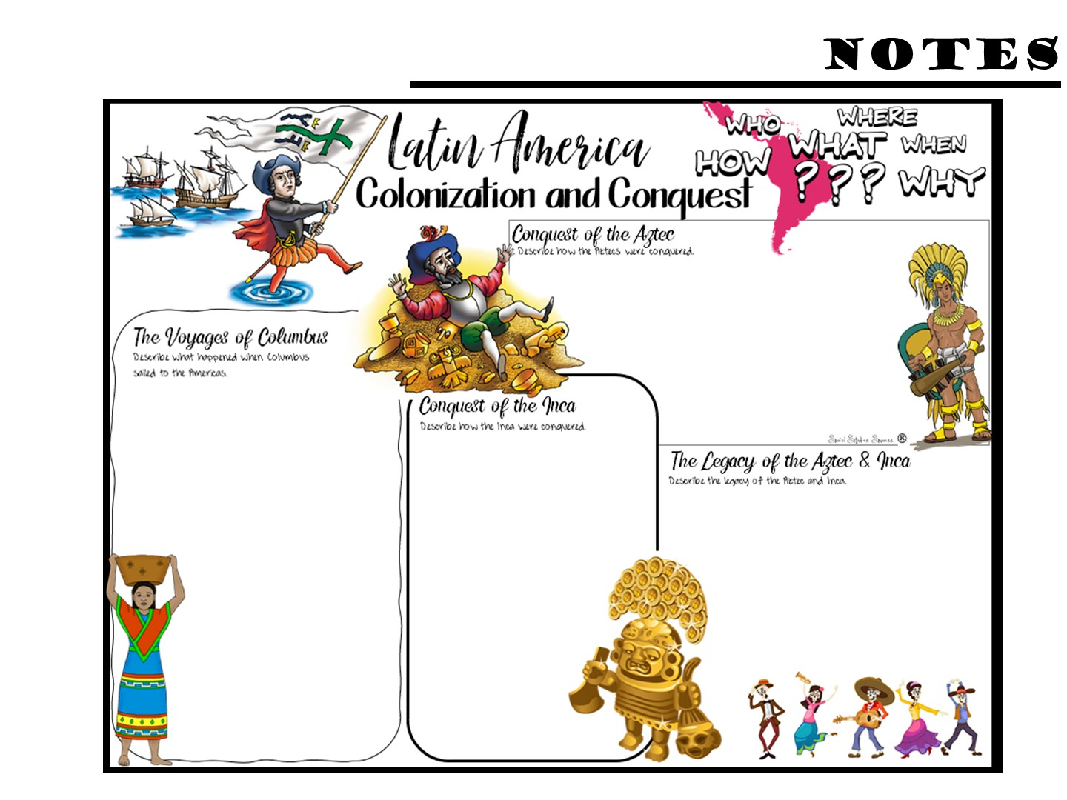
Notes:
Pass out the Doodle Notes and have them complete what they can with the first page of reading – not all of the info comes from the first page.

Slide 60
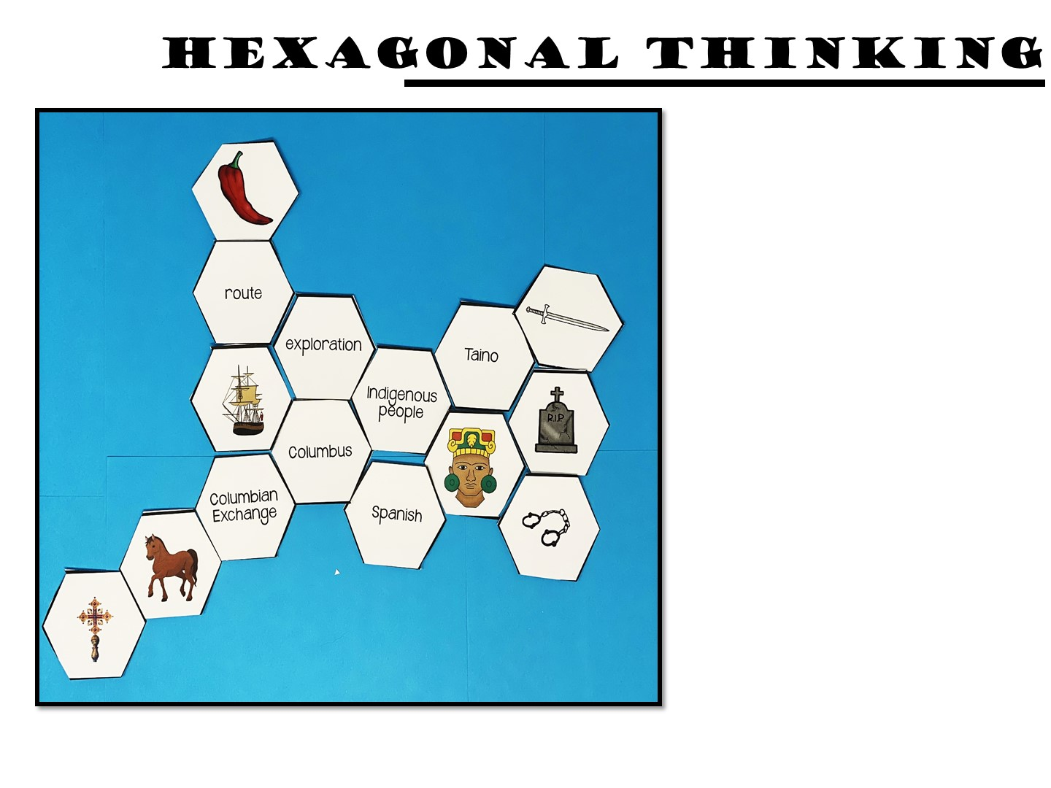
Make connections between the hexagon shapes.
Notes:
Pass out the first round of the hexagons. Make connections between the hexagon shapes. For every connection they make, they earn 1 point. For example, the indigenous people shape is connected on 5 sides, exploration, Columbus, Spanish, person figure and Taino. A student should be able to explain how all of these are connected. If they can, they earn 5 points. You can ask them to annotate their connections with post it notes
Once you have finished the directions, go to the next slide before you start – you don’t want them to just copy your example.

Slide 61

Play
Notes:
Give them time to make connections with the hexagons. Do not clean up the hexagons, they need to stay out for the next round.

Slide 62

Notes:
You may not want to do round two or three, depends on your time. You can just tell them what they would do next, how they add hexagons everytime so that it grows.

Slide 63
Notes:
Pass out the Doodle Notes and have them complete what they can with the second page of reading

Slide 64
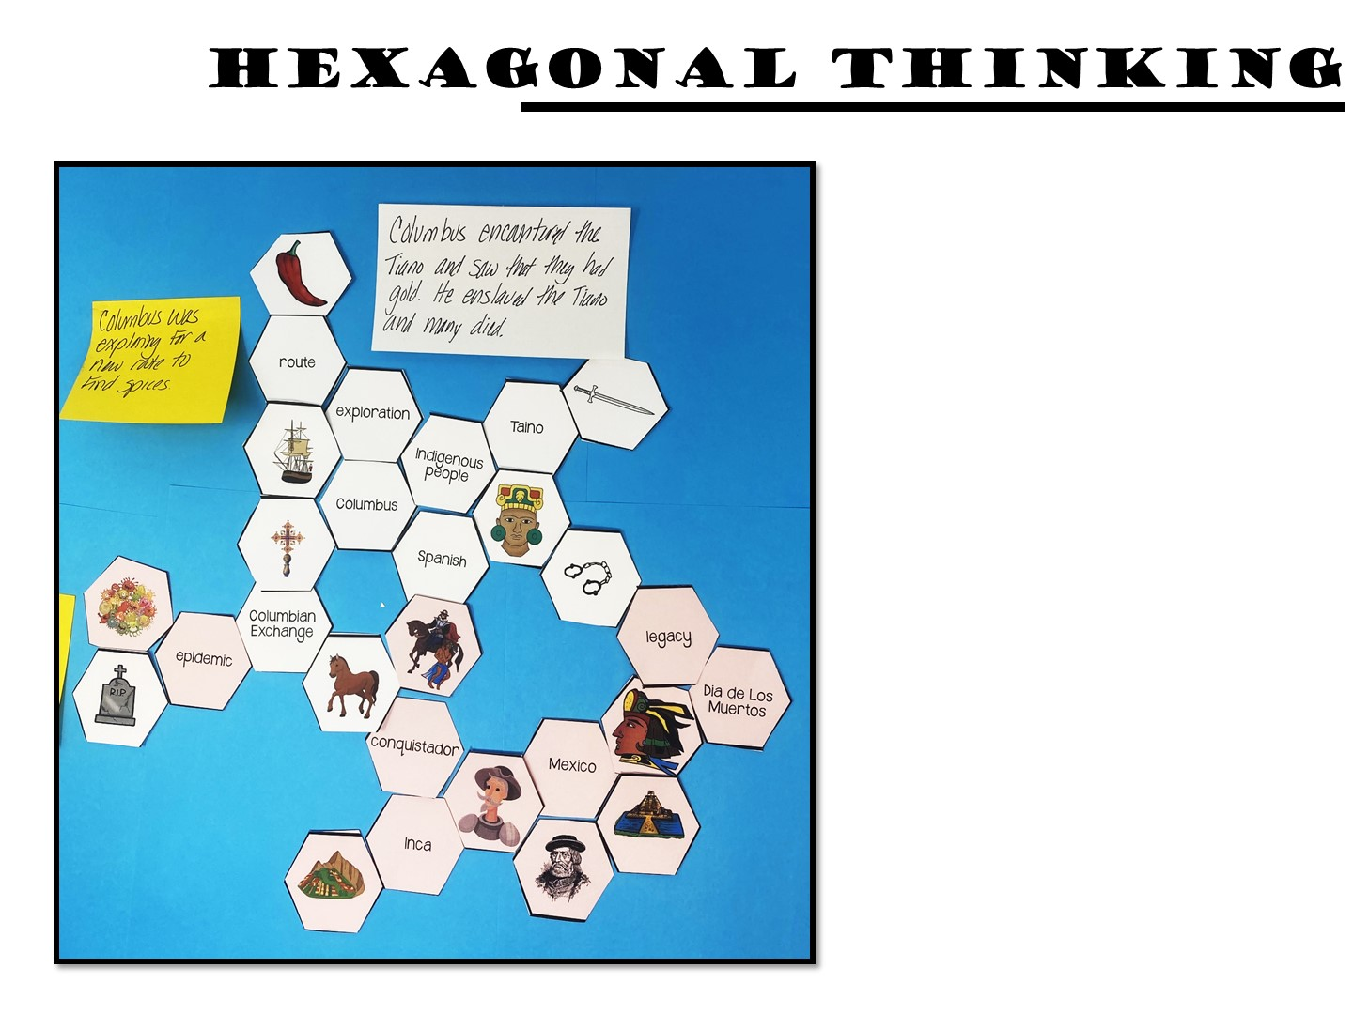
Make connections between the hexagon shapes.
Notes:
Pass out the next set of hexagons, they will then add to their first set.

Slide 65
Play

Slide 66
Notes:
Debrief the lesson by asking them to use specific design qualities of engagement terminology to identify different parts of the lesson that increase engagement.

Slide 67

Notes:
Share with a partner.

Slide 69
Notes:
Give them 5 minutes to write down reflections on their notes (on the back)

Slide 70
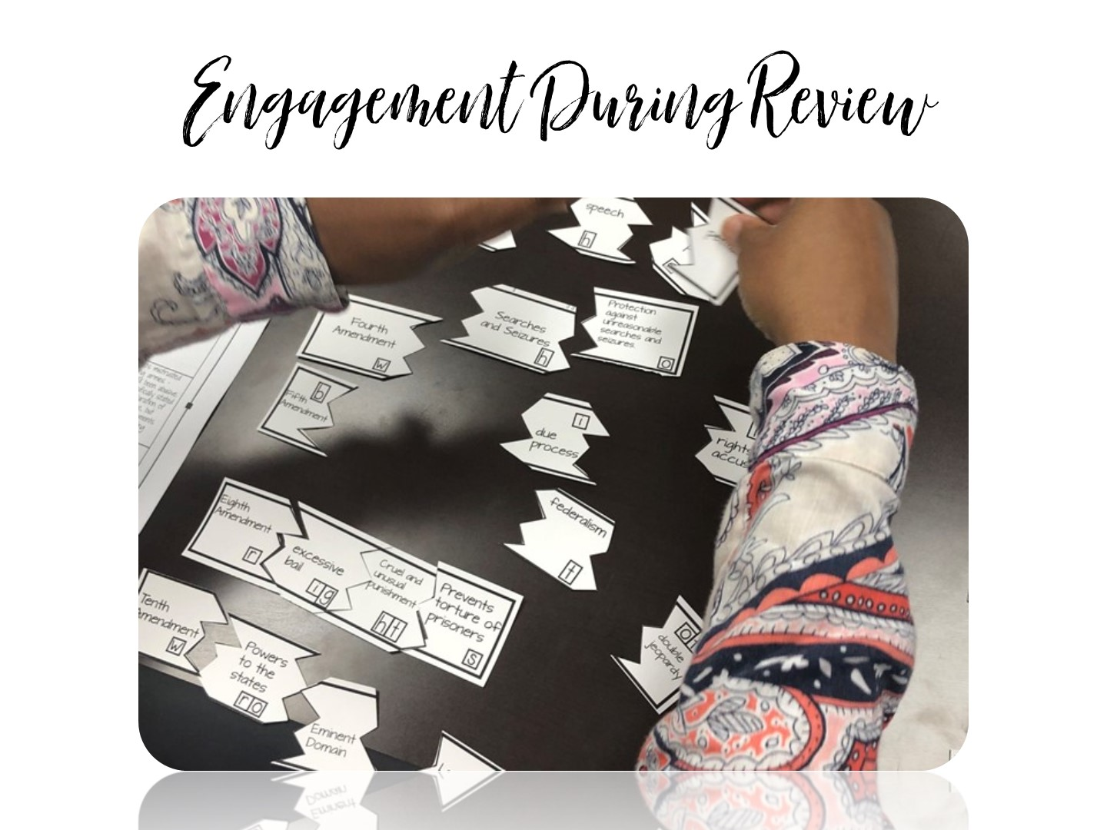
Notes:
We are now going to look at how to build engagement during review sessions.

Slide 71
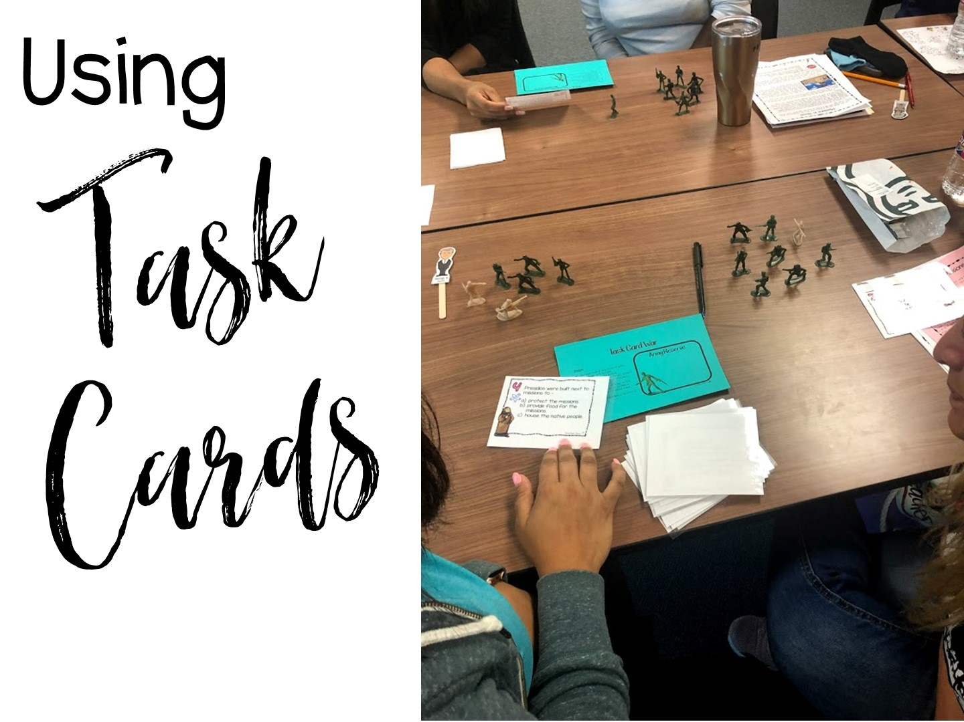

Slide 72
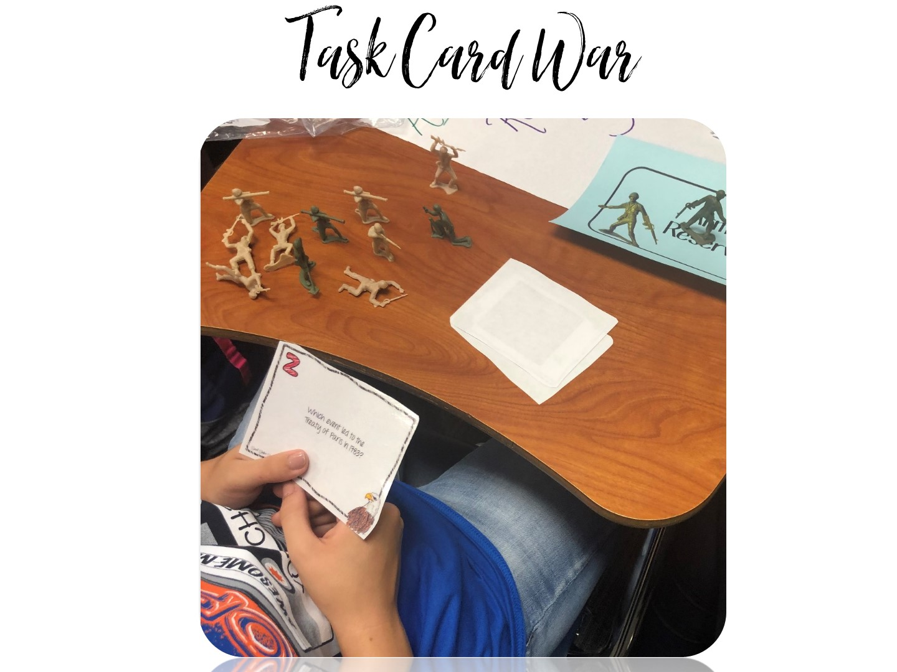
Notes:
Pass out army soldiers – each person gets about 10 soldiers. Directions are on the next slide.

Slide 73
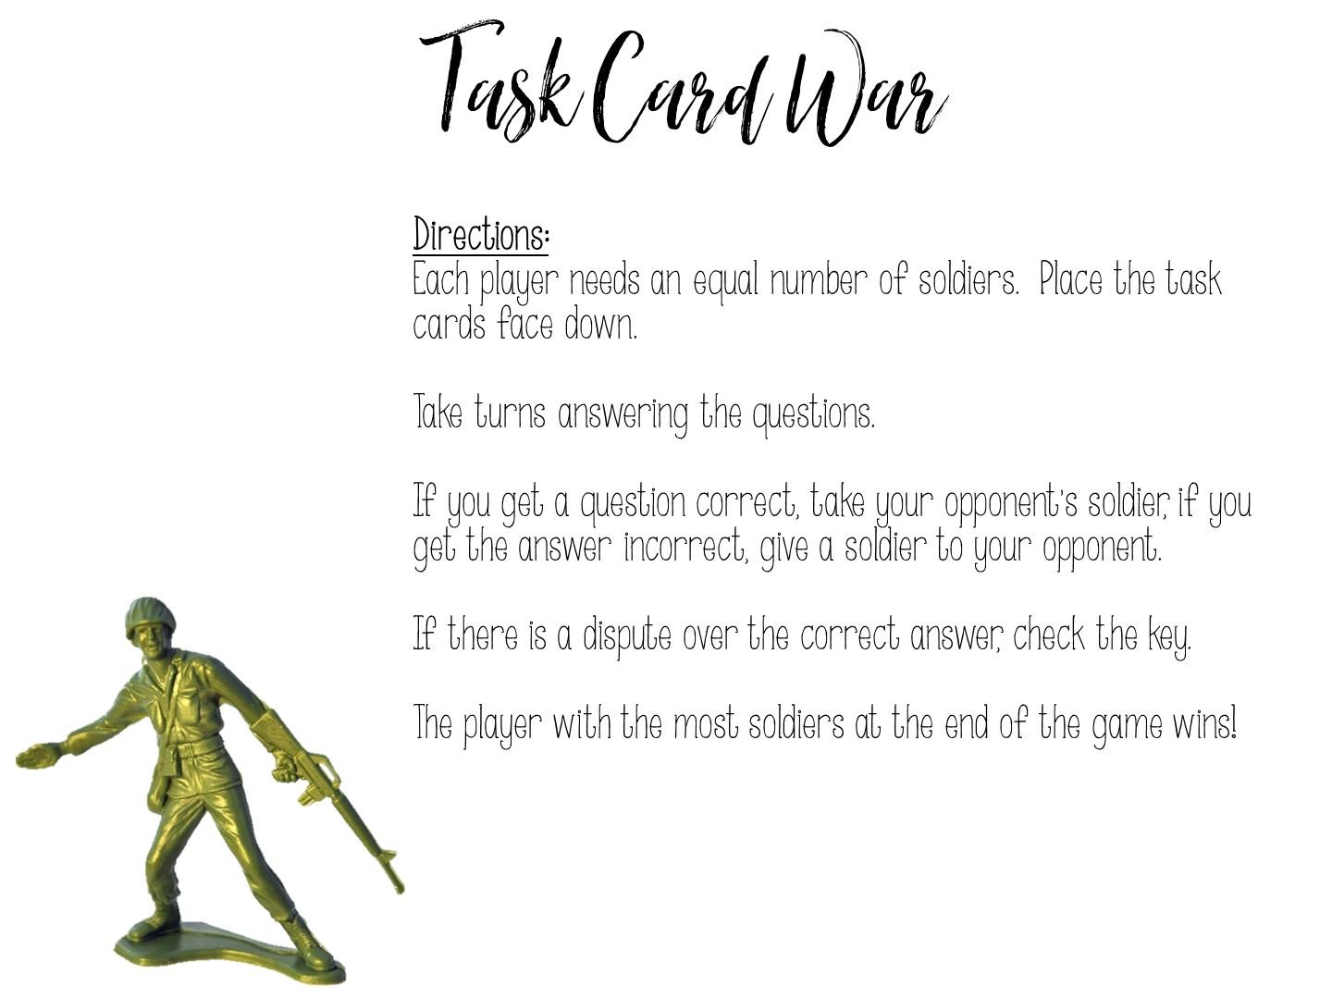
Notes:
Play ☺

Slide 74
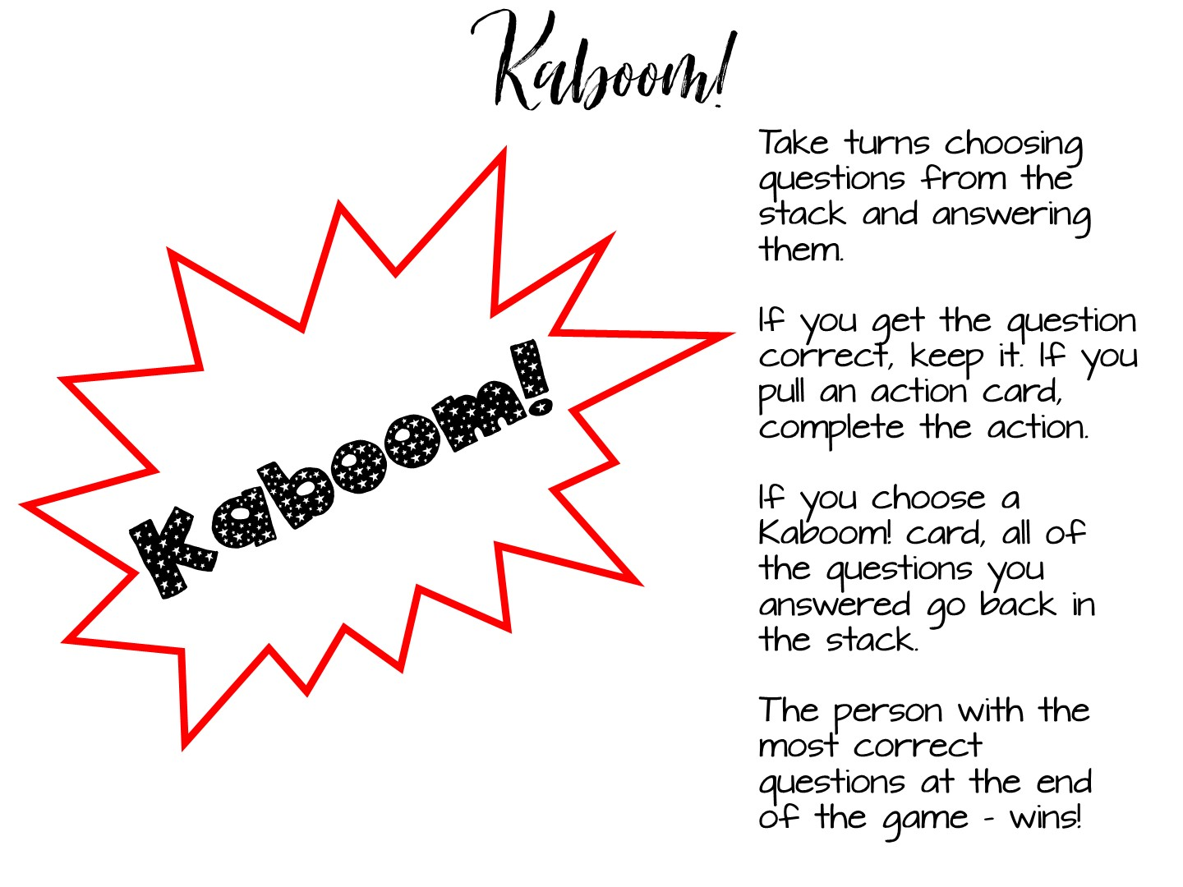
Notes:
Add a few of the kaboom cards to each set. Play like UNO.

Slide 76
Notes:
Give them 5 minutes to write down reflections on their notes (on the back)

Slide 77


