Slide 1

Notes:
Refer to the session checklist to prepare materials.

Slide 2


Slide 3

Notes:
Add your own information to this slide to introduce yourself.

Slide 4

Notes:
The following slides list the research that goes into my workshops. I quickly share all of the research, and on the last slide I ask, “Which of these do you agree with?” and share the answer with a partner.

Slide 5


Slide 6
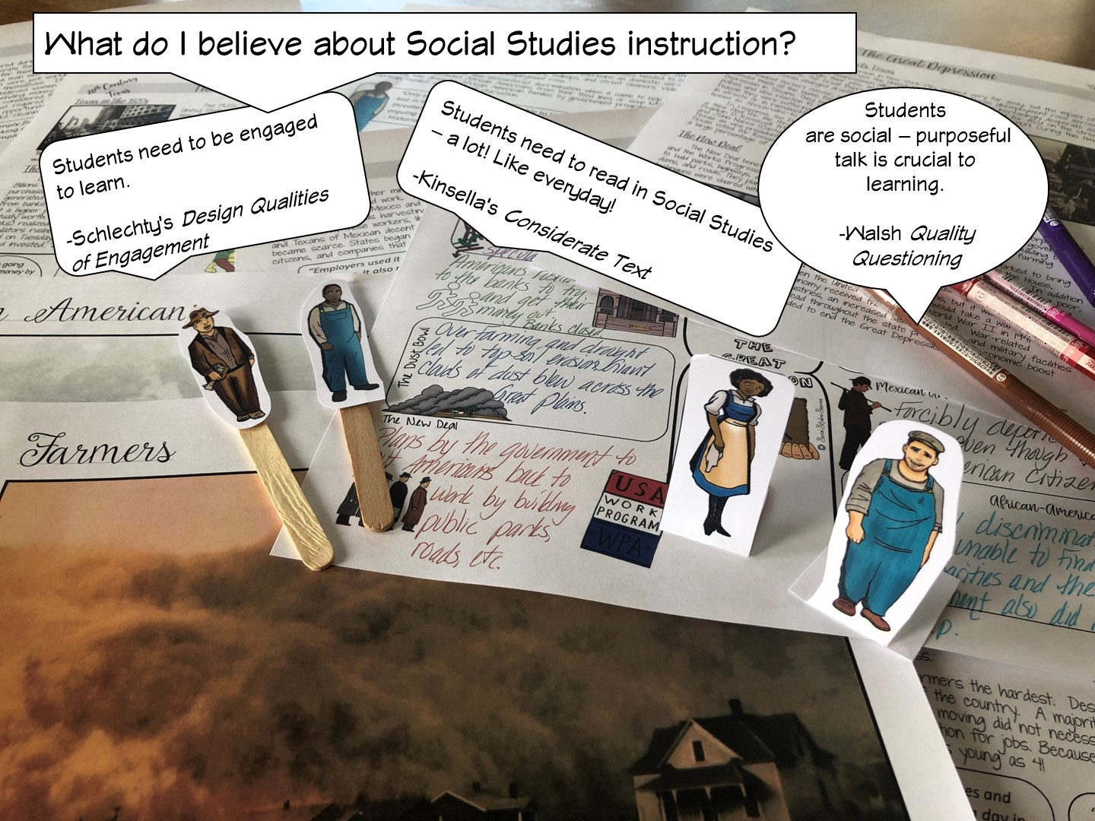

Slide 7
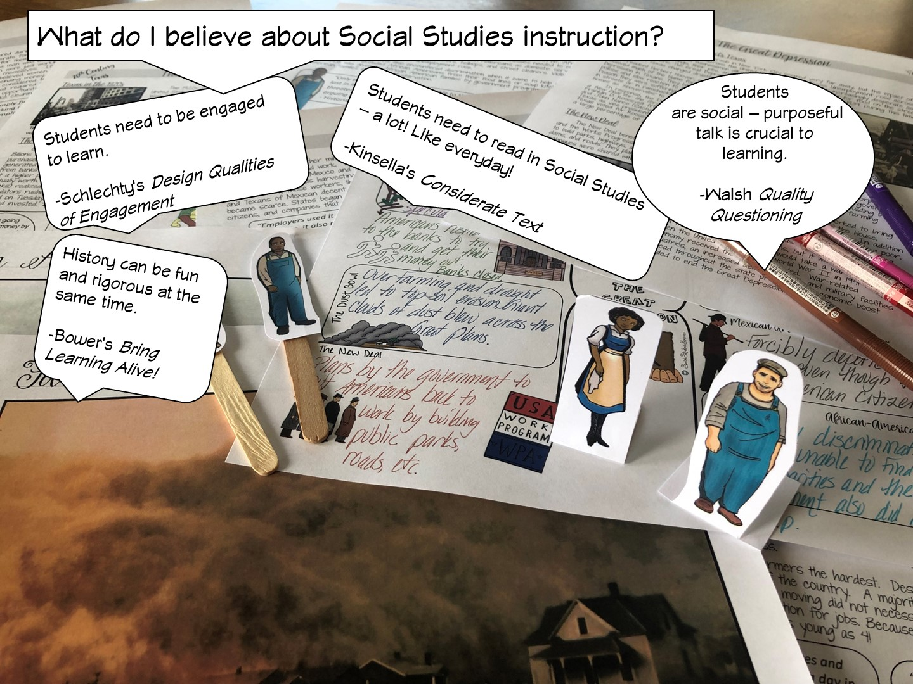

Slide 8


Slide 9
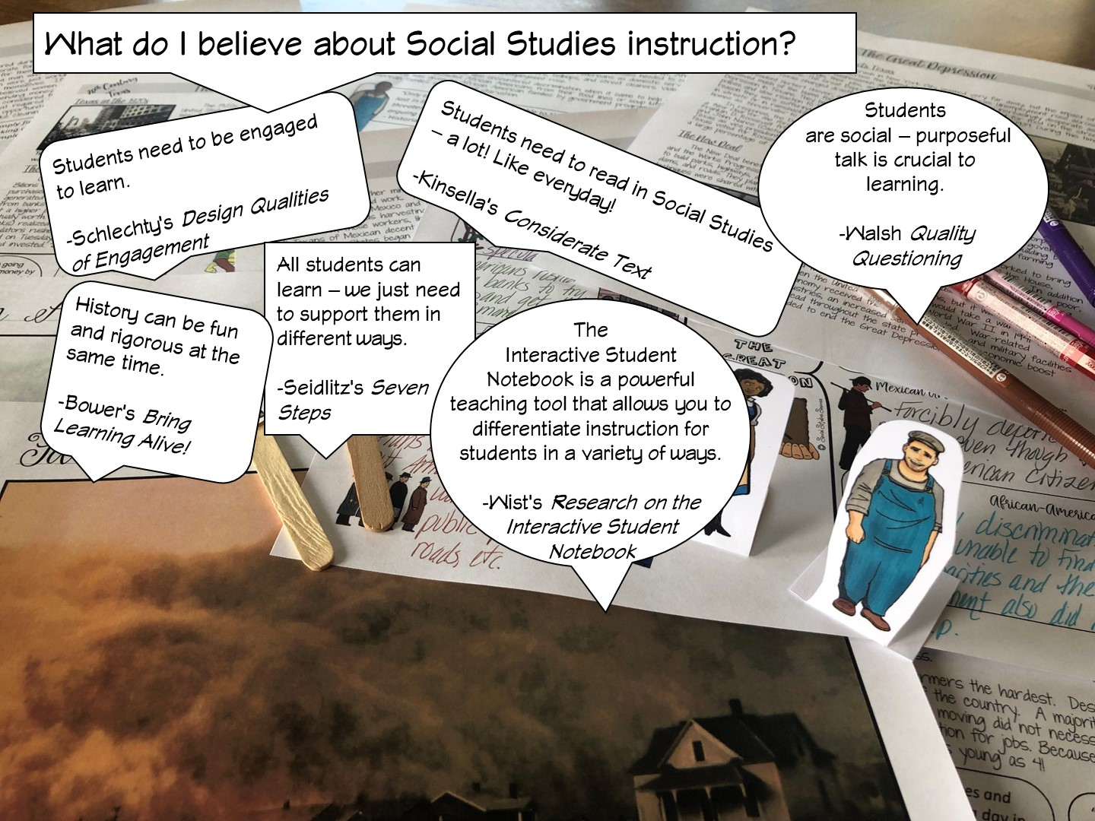

Slide 10
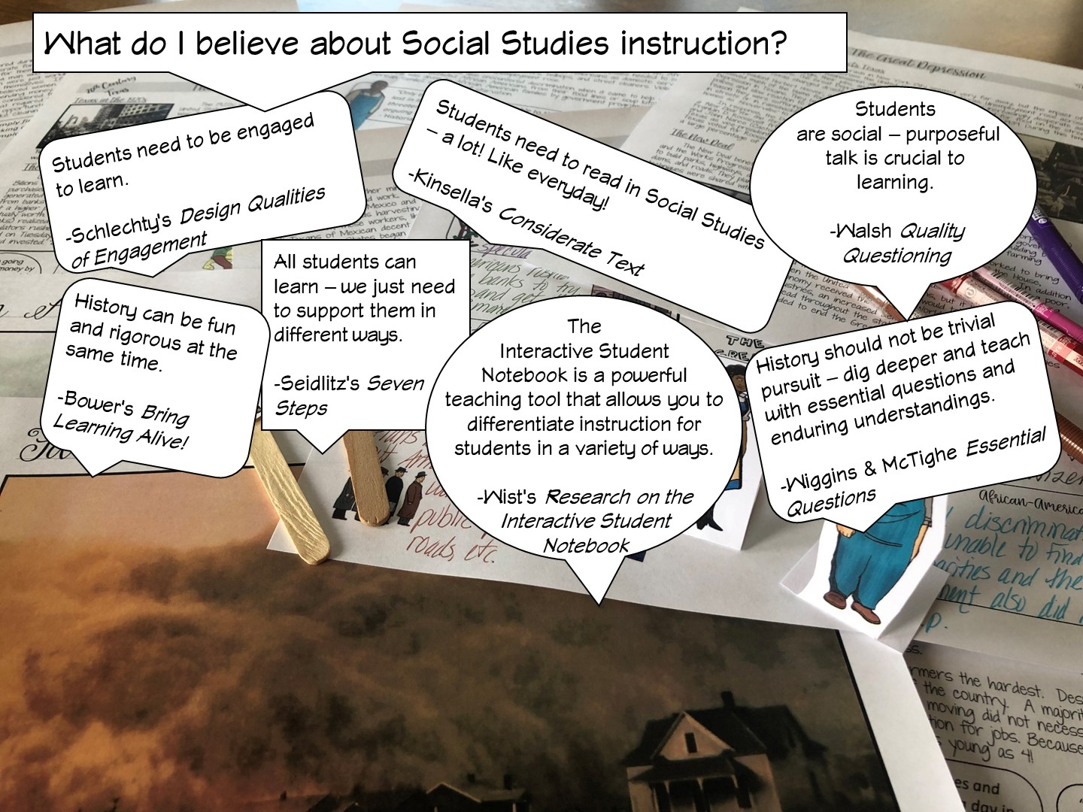

Slide 11
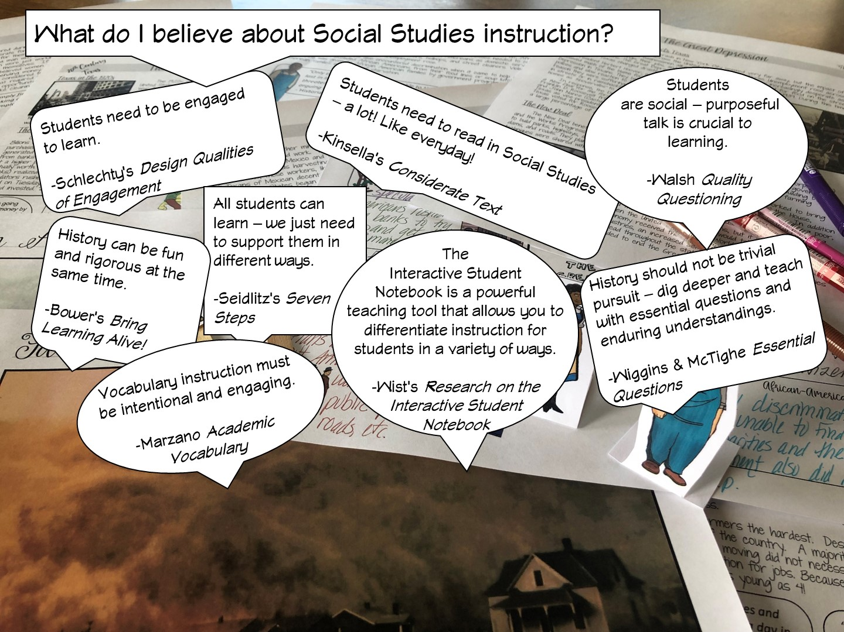

Slide 12
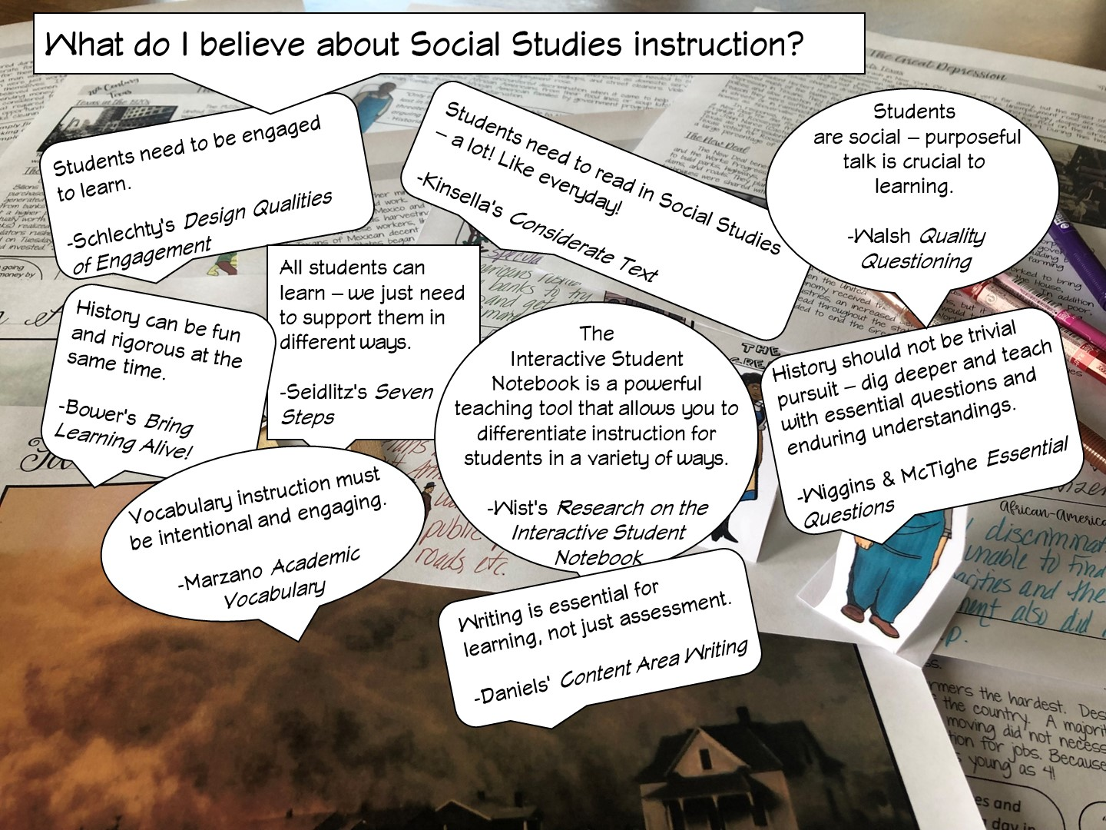

Slide 13
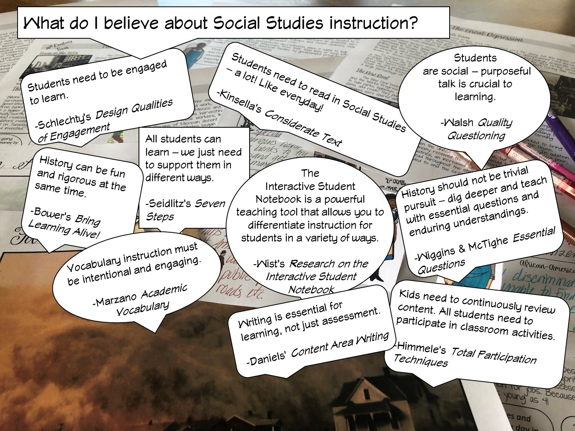

Slide 14
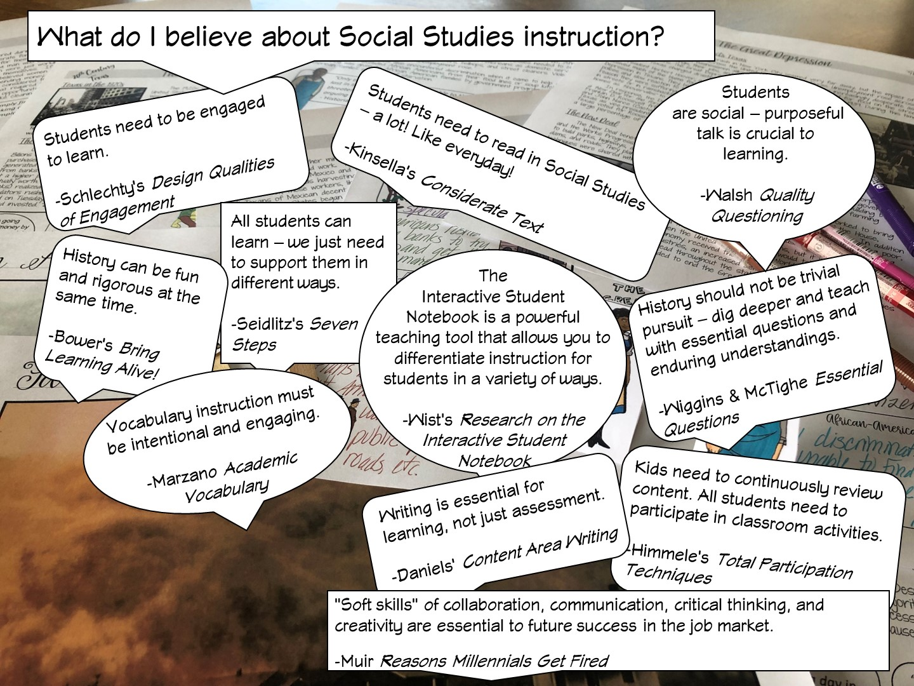

Slide 15
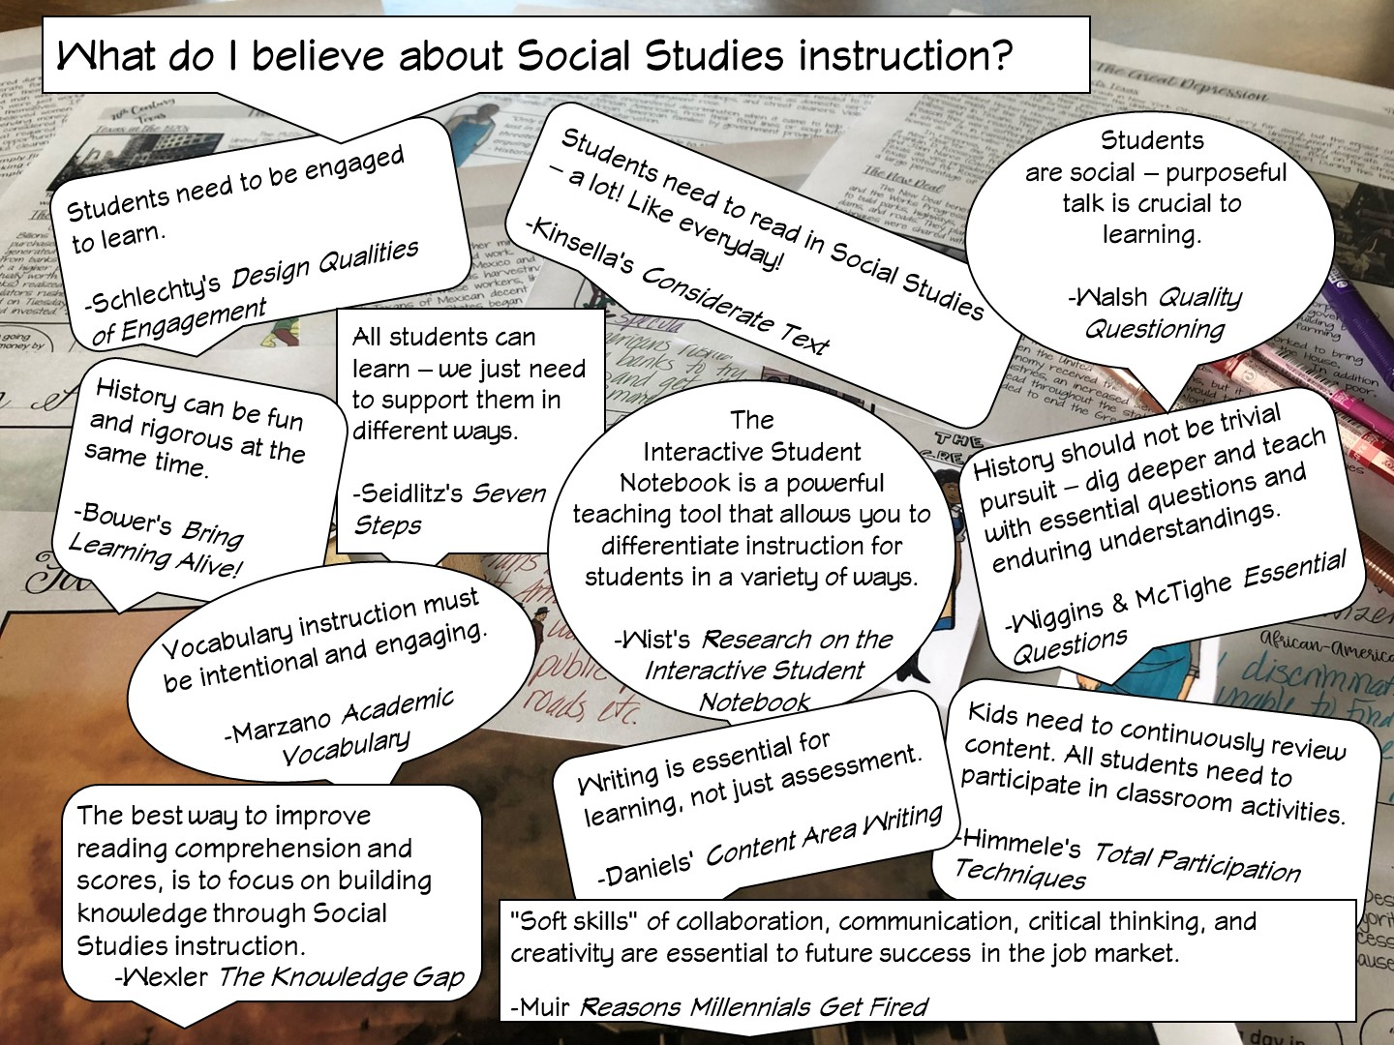
Notes:
After I have reviewed the different research – I ask the teachers, which one they agree with and why – have them talk to their table or partner.

Slide 16

Notes:
We are going to be focusing on literacy in this session – mainly reading and how we can structure our lesson to support reading.

Slide 17

Notes:
I share my rule of the socks:
They have never been on my feet
They are not a souvenir of the workshop
Put your cellphones away in the sock (model with your own)

Slide 18

Notes:
This is a spectrum to break up the teacher cliques – they line up from most experienced to brand new, then fold the spectrum to put them with a partner. This allows me to identify who my novice teachers are, and I can provide them more assistance as needed.

Slide 19

Notes:
First we must start with the research. There are multiple books and articles written on how to teach vocabulary – but here are the key parts…

Slide 20
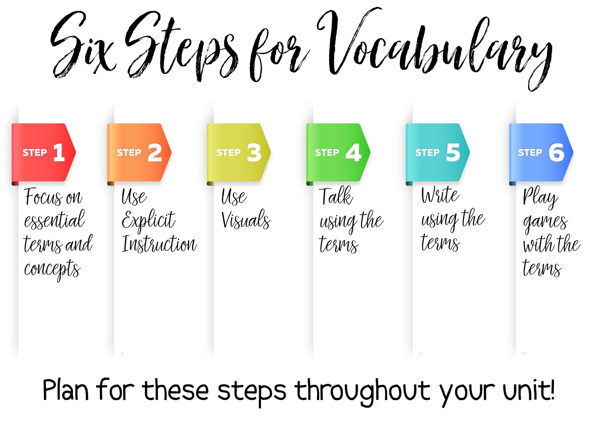
Notes:
I have taken the research and created my own 6 steps for practical vocabulary instruction. We will examine each of these steps in this workshop. Steps one and two need to be done in order, but the rest of the steps can be done at any point in the unit.
Some key points to remember:
Vocabulary instruction must be intentional, not just the initial instruction on the definition of the term but included deliberately in subsequent lesson plans throughout the unit.
Vocabulary must be taught directly – students need to see the term, hear the term, and say the term in order to build their understanding of key content vocabulary.
Students need to encounter the vocabulary term in a meaningful way at least six times throughout the unit before it can be understood and applied.
One of the best ways for students to learn vocabulary is to associate an image with the term.
Students must participate in engaging activities for long term retention.

Slide 21

Notes:
Step One actually seems obvious – you need to know the terms that you will be teaching. In the discipline of Social Studies there are more than 26,000 terms – more than math, Language Arts, and Science combined. Social Studies vocabulary is actually the vocabulary needed most in college.
But there is actually more to just teaching a list of terms out of the textbook. What are the specific vocabulary terms students will need to master your daily lesson? The unit? You cannot teach too many vocabulary terms in one setting and expect immediate mastery. You need to carefully examine the terms you are given, or you find for each unit and decide – is this a term that is essential for this lesson? For this unit? Can this term be introduced and master at a later point? Or does it need mastery now? Is this a term that has already been taught and just needs a refresher? Thoughtful planning needs to happen before instruction.

Slide 22

Notes:
Read the handout on Tips for Selecting Vocabulary Terms. When you have finished reading the Tips – share your thoughts with your partner.

Slide 23
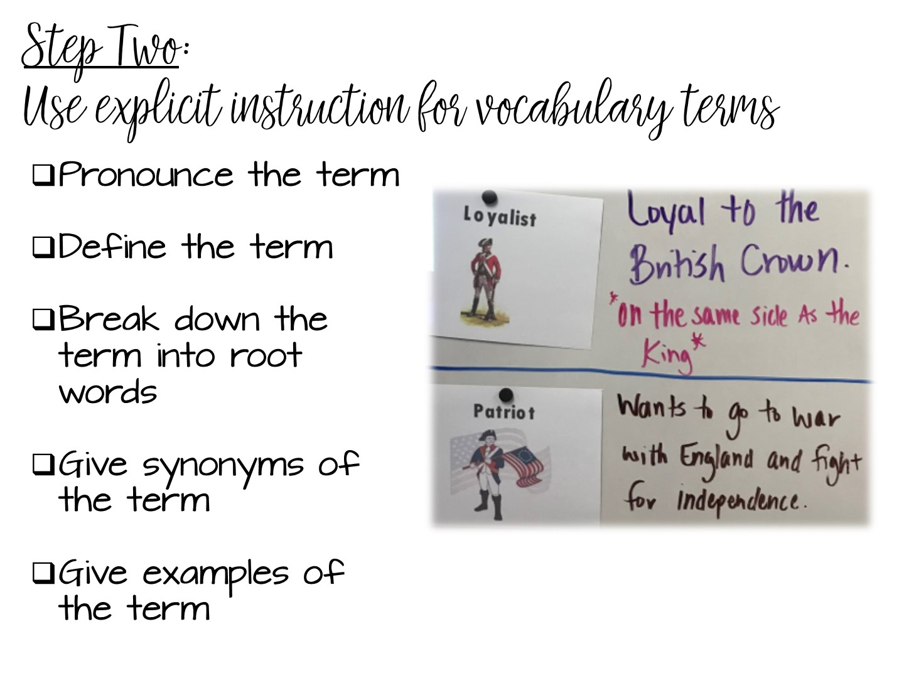
Notes:
Vocabulary instruction is active, it is not a passive activity to fill time. Assigning vocabulary out of the back of the book and having students copy the definition does not work. Just like you would plan for a lesson on teaching content, you need to plan how you will teach vocabulary.
The 2nd step involves explicit instruction. Pronounce the vocabulary terms to your students. Students must hear the word out loud to help build their understanding of the term. Many time students will understand a term more if they hear it first. Think of the term militia – the way it is pronounced and the way it is spelled can be confusing to your students. But if you pronounce the term first, they may already know the word, just not have experienced it in text.
The rest of the vocabulary instruction can differ depending on the term, but these activities are recommended when you are teaching vocabulary.
Define it, or help your students define the term. There is nothing more dangerous than asking kids to just “google” the definition. They will usually just choose the first definition rather than correct one.
Help students make connections to any root terms. This is important for transfer of knowledge – if they understand the root, they can understand the term.
Help students make connections with synonyms – many times, vocabulary on an assessment is actually a synonym of a term they were taught.
And finally, give concrete SOCIAL STUDIES examples of the term.

Slide 24
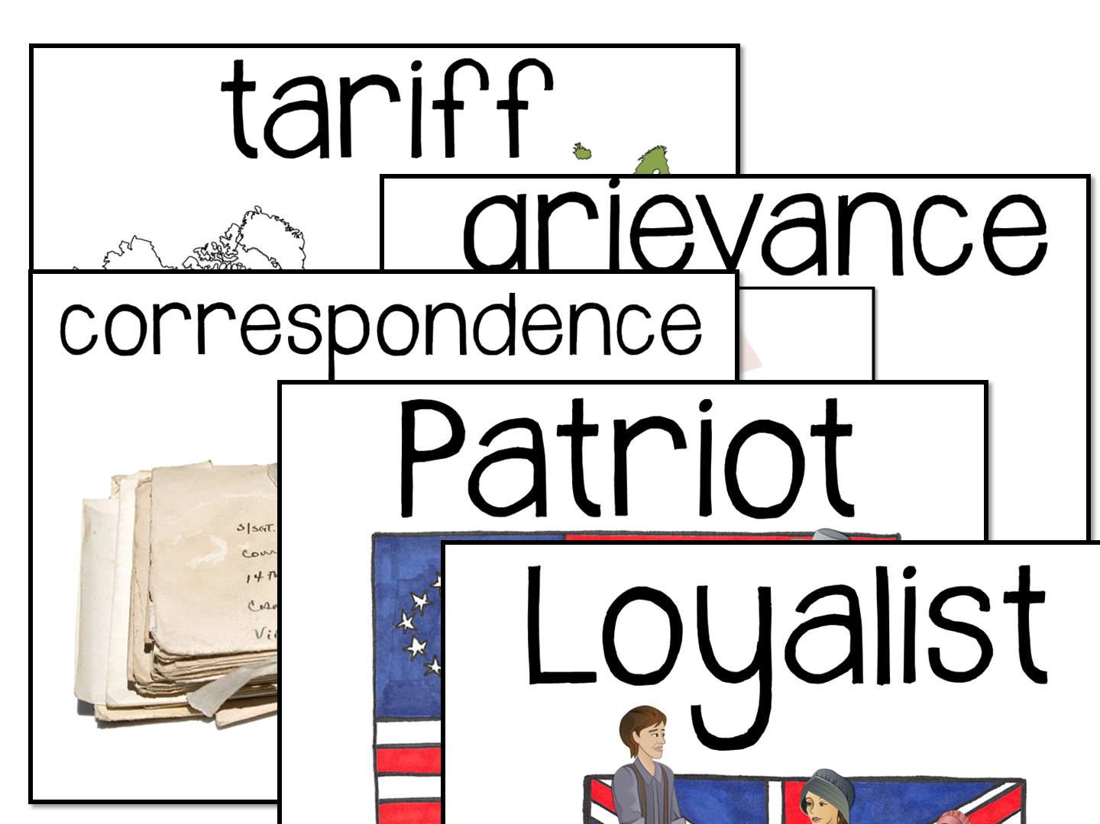
Notes:
This is your visual clue to go to the word wall you posted and read the terms to the teachers. Have them repeat the terms when they have finished.

Slide 25
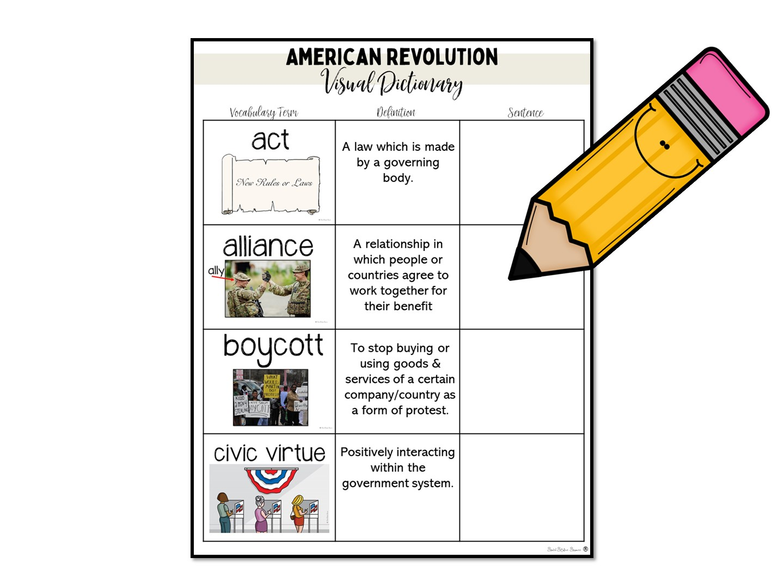
Notes:
You don’t have to do anything here except tell the teachers they could pass out a worksheet and have their students complete the sentence. The key is to not waste time looking up terms in a dictionary or on Google.
Depending on time, you can model this resource or just talk about it.

Slide 26
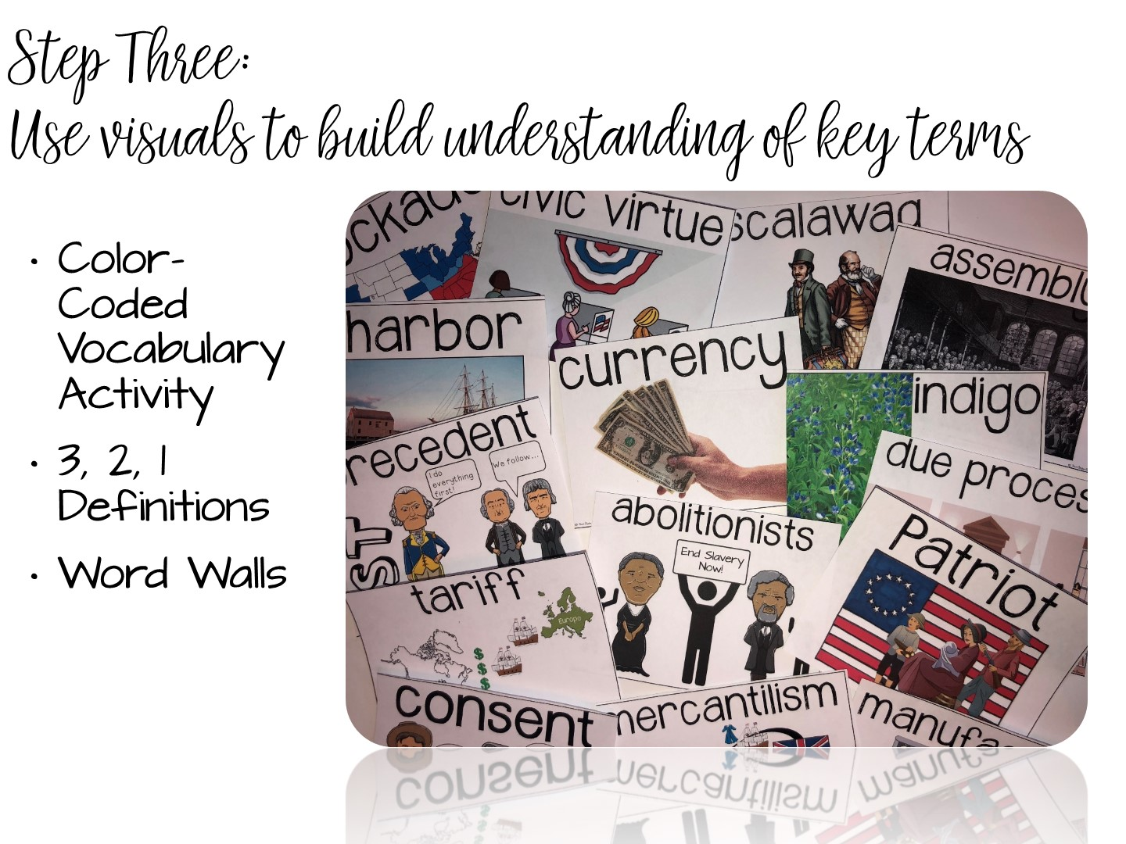
Notes:
Based on the research, visuals support learning vocabulary instruction. We are now going to look at a variety of strategies to focus on using visuals.

Slide 27
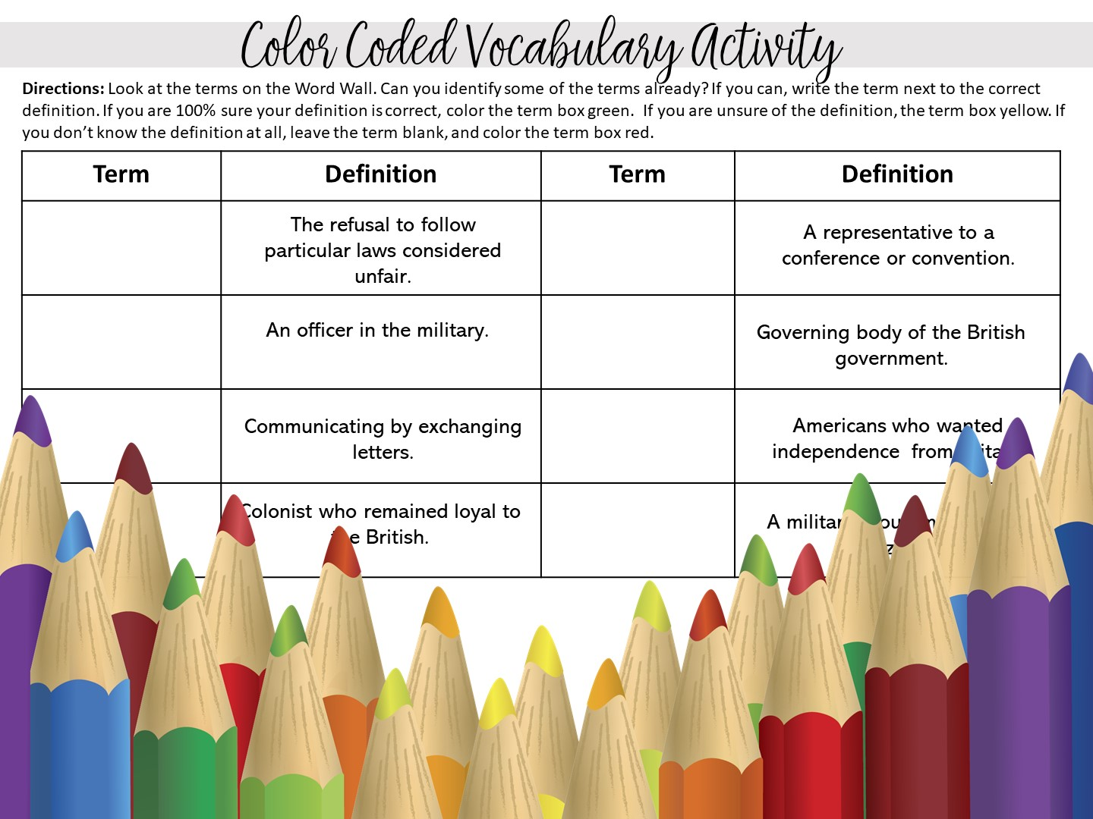
Notes:
Do the color – coded vocabulary activity
Pass out the handout and red-, green-, and yellow-colored pencils. Give teachers time to look at the word wall and complete the activity.
Model walking around and checking students answers while they are color-coding. When the teachers are finished, share that you can look at the colors as a type of formative assessment prior to more instruction on vocabulary.

Slide 28
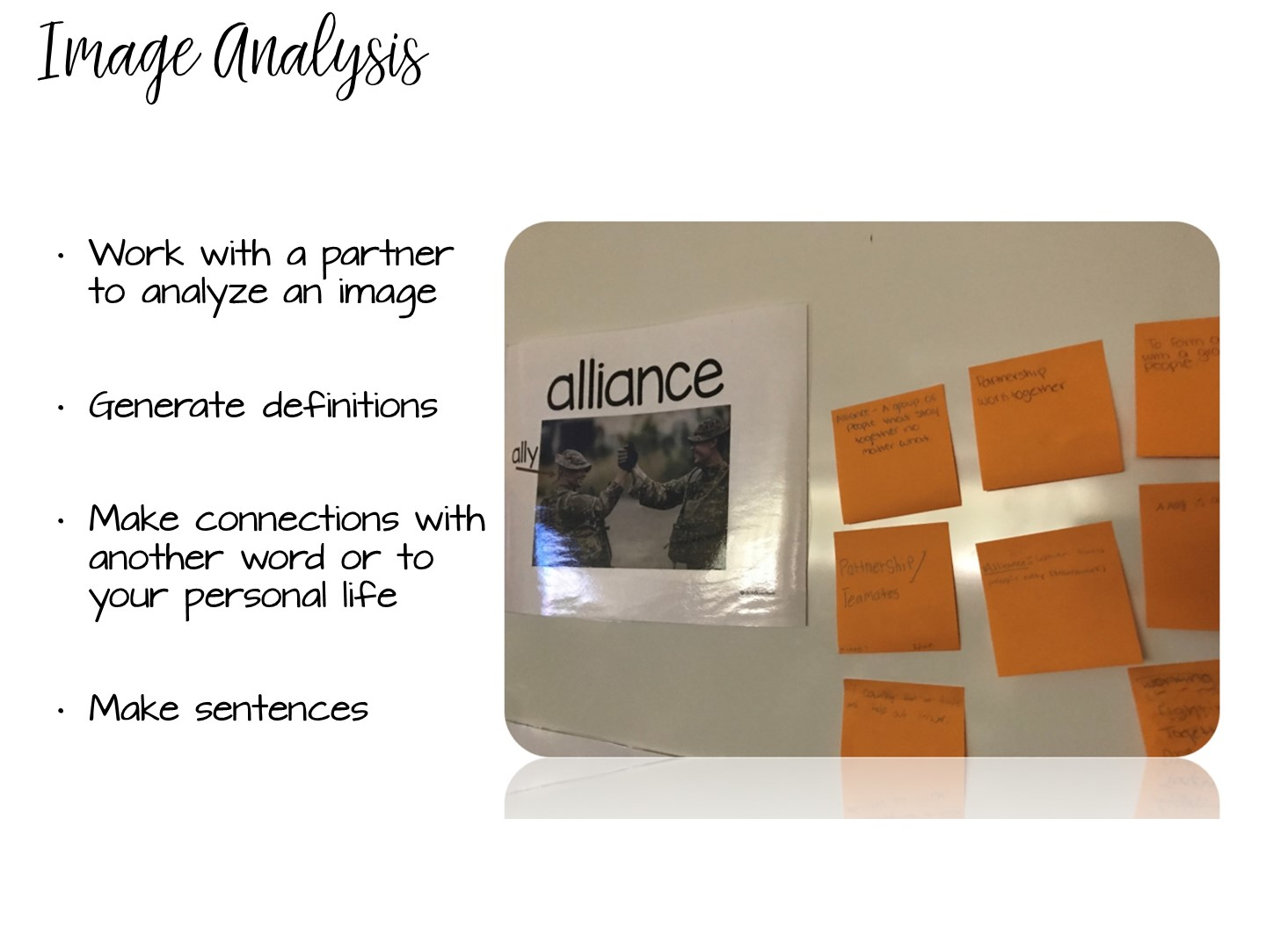
Notes:
One strategy for explicit instruction involves using planned visuals of the definition.

Slide 29

Notes:
Take a quick look at this image -

Slide 30
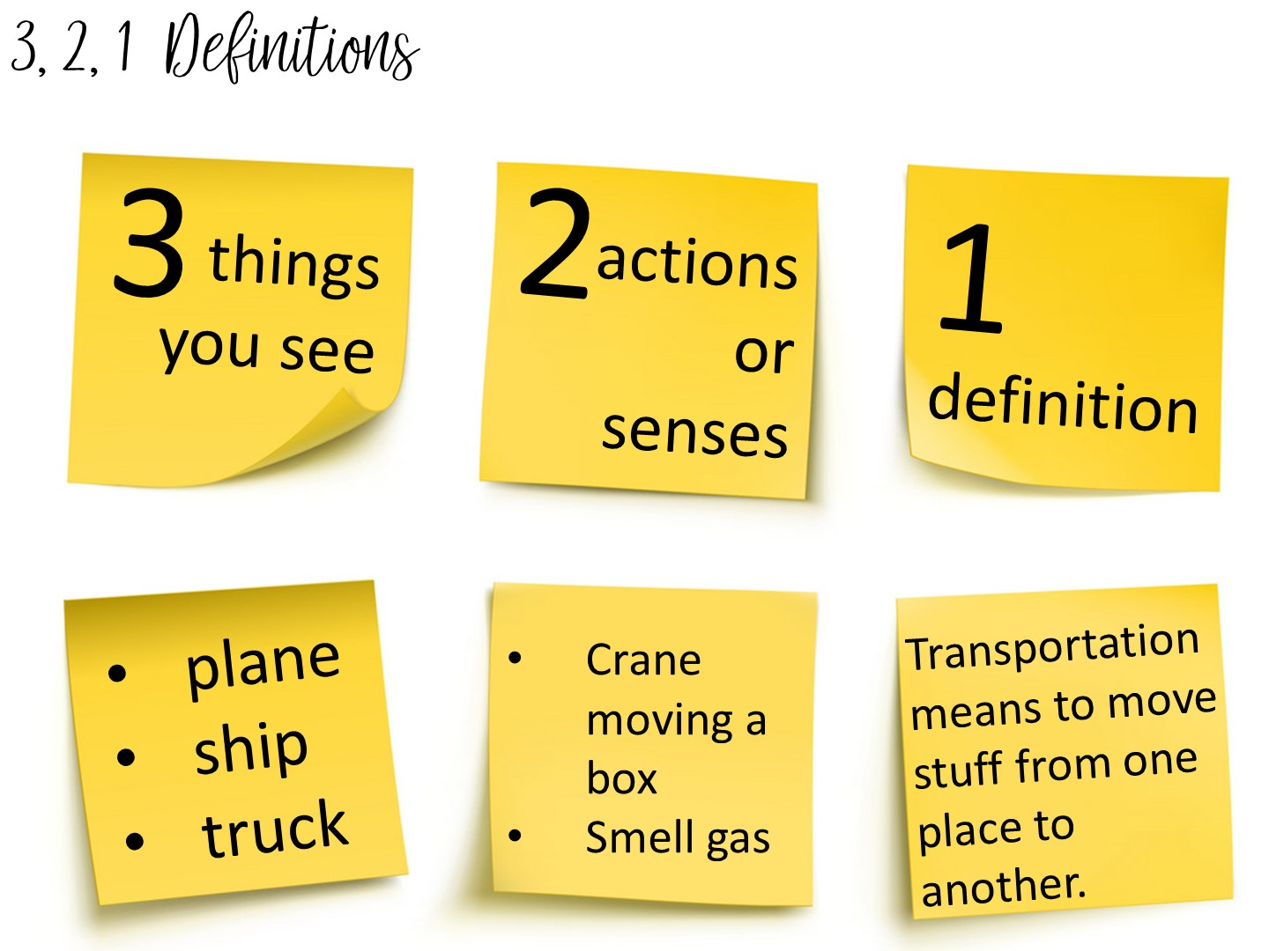
Notes:
Another method to teach vocabulary with images is the 3, 2, 1 Definitions – Allow students time to analyze an image to build their understanding of an image.

Slide 31
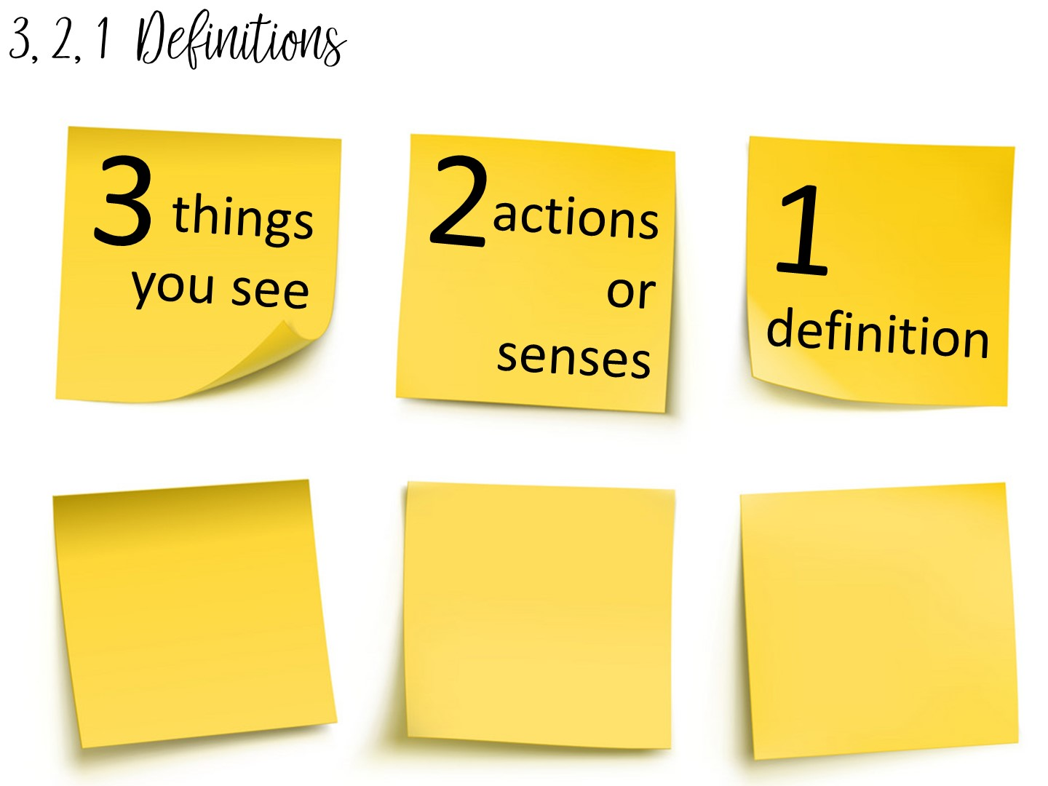
Notes:
Another method to teach vocabulary with images is the 3, 2, 1 Definitions – Allow students time to analyze an image to build their understanding of an image.

Slide 32
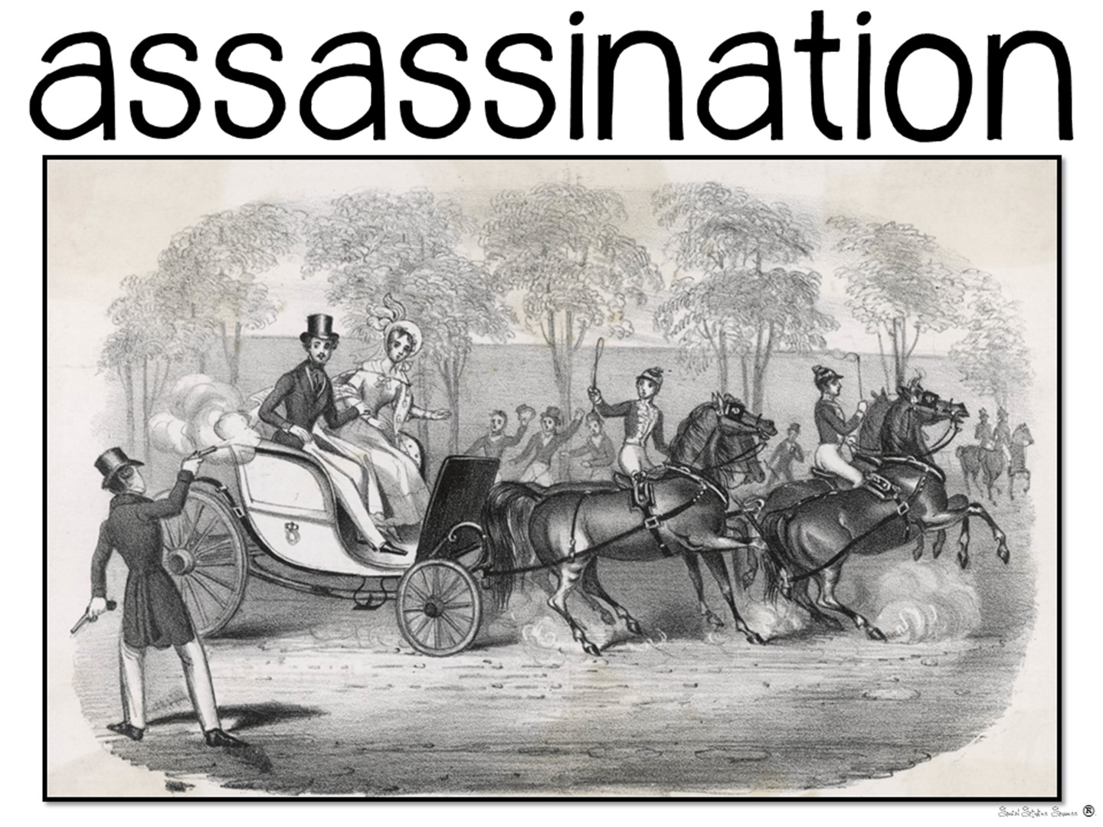
Notes:
Have them create a 3, 2, 1 definition on this image

Slide 33

Notes:
Have them discuss the following two questions with a partner

Slide 34

Notes:
Discuss with a partner

Slide 35
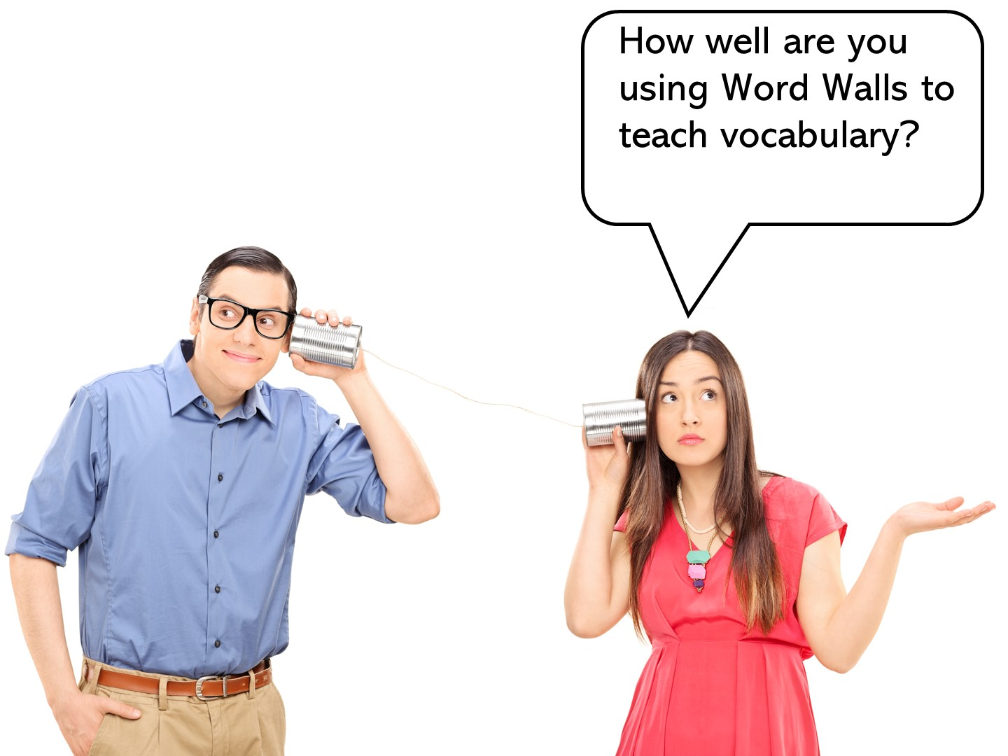
Notes:
Share out when teachers are done

Slide 36

Notes:
Have you had instruction on how to use Word Walls, or was it just a district initiative you were told to follow? Let’s take a look on why word walls work.

Slide 37

Notes:
Word Walls work because of several different reasons – the first of which is episodic memory. Students begin to associate a certain space in your room with vocabulary terms, and if you have taken the time to teach the terms, they will associate the space with learning.
It is important that you put your current word wall in the focal point of your room – near where you teach.

Slide 38

Notes:
Word walls reinforce sight-word acquisition. When students recognize the terms on sight, their fluency increases. When their fluency increases, their comprehension increases. The goal is to build content literacy across grades and disciplines.

Slide 39
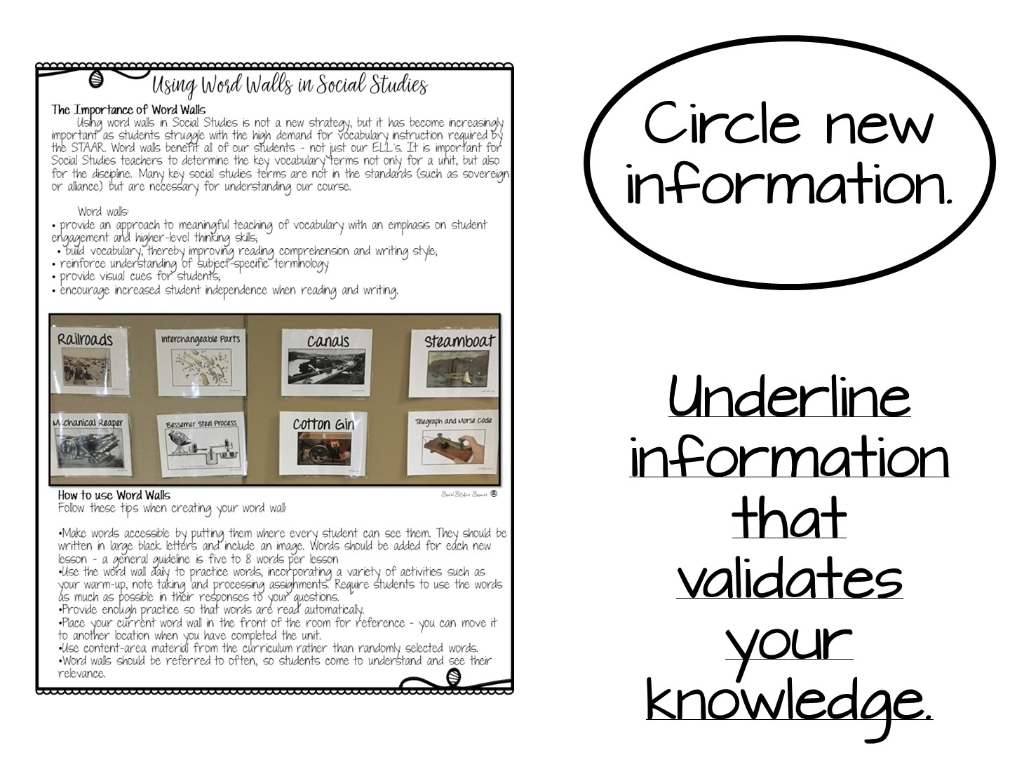
Notes:
Pass out this handout and have them read it. Discuss what they circled or underlined with their partner.

Slide 40

Notes:
Now you are going to share tips for making word walls work in the classroom.

Slide 41
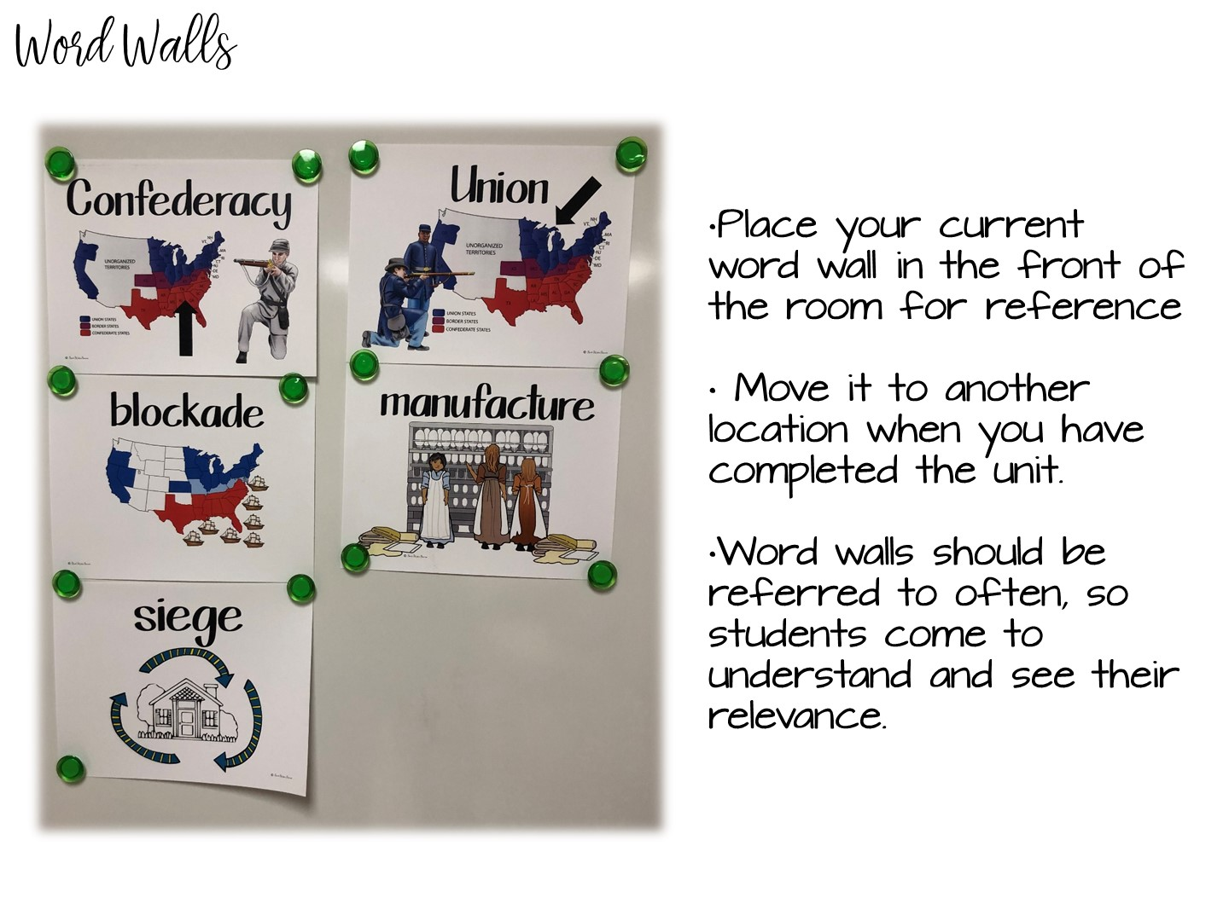
Notes:
See above

Slide 42
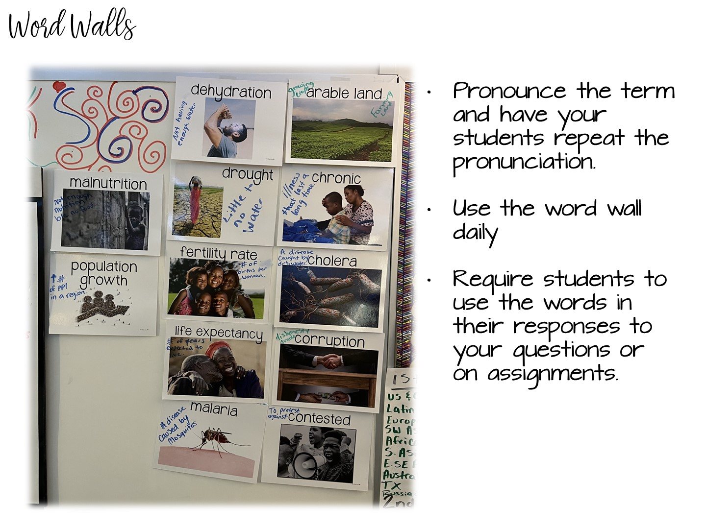
Notes:
See above

Slide 43
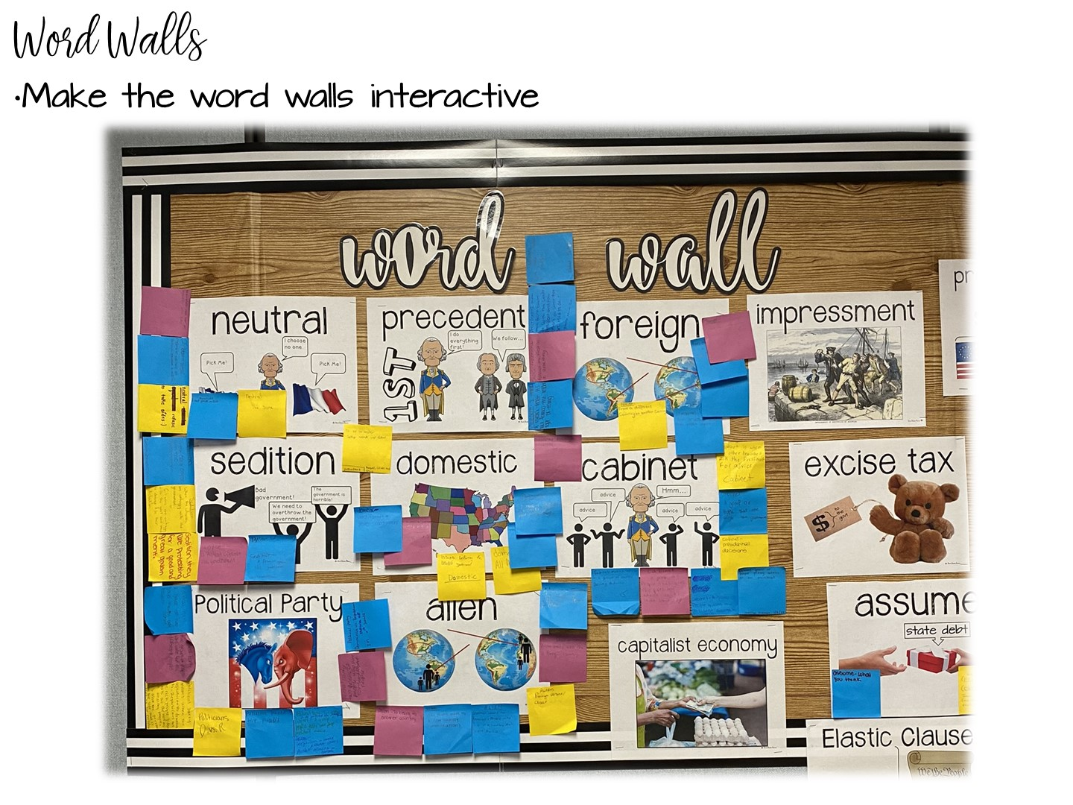
Notes:
You can use post-it notes to interact with the word walls.

Slide 44
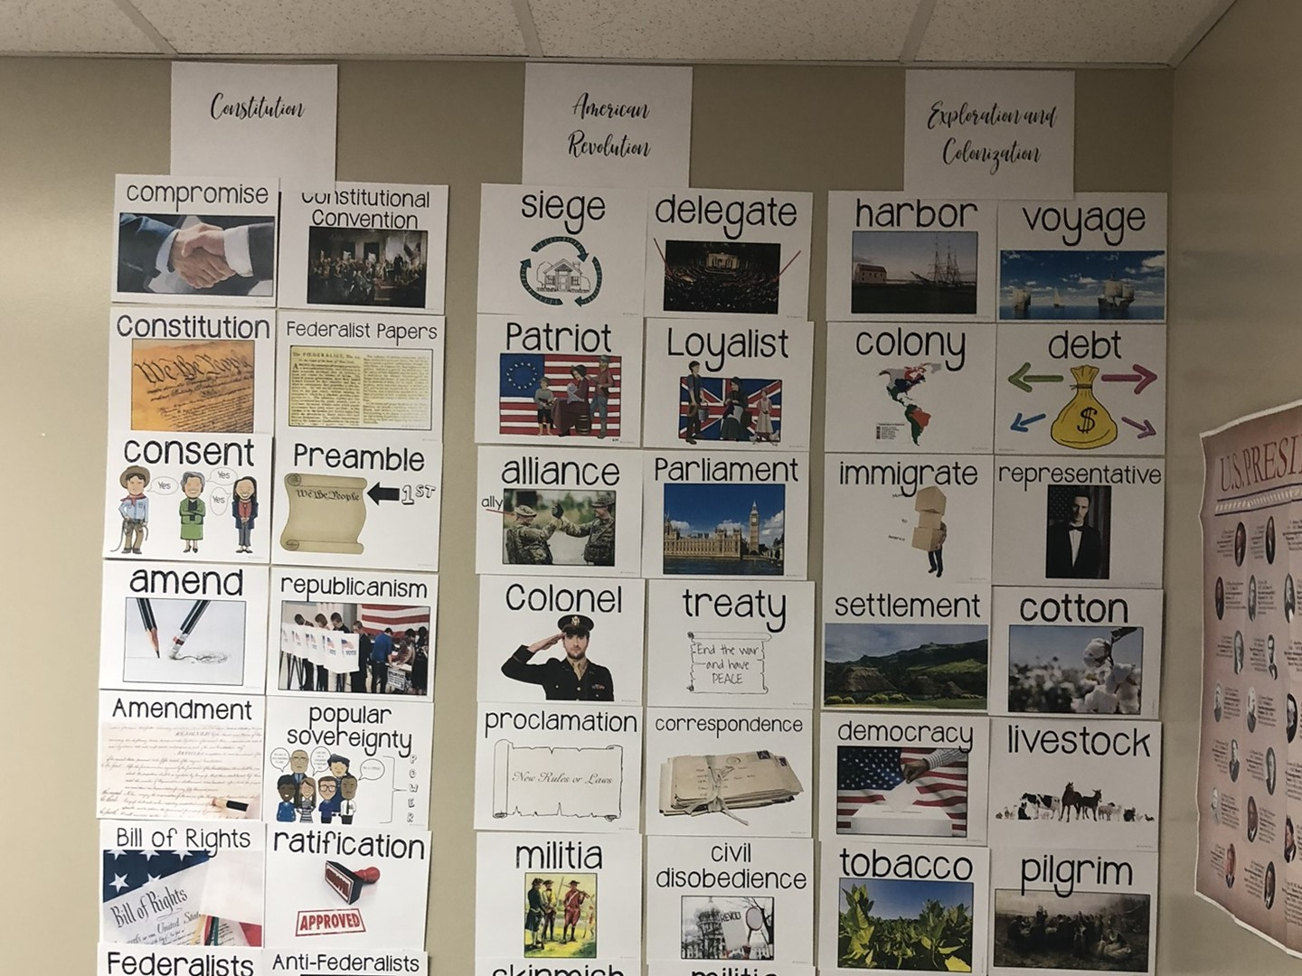
Notes:
When you finish with a unit, you can always take your word wall terms and put them in the back of the room. I recommend this for tested content areas.

Slide 45

Notes:
How to make your own word walls.

Slide 46

Notes:
Have them sum up what they have learned so far in just one word – then explain it.

Slide 47
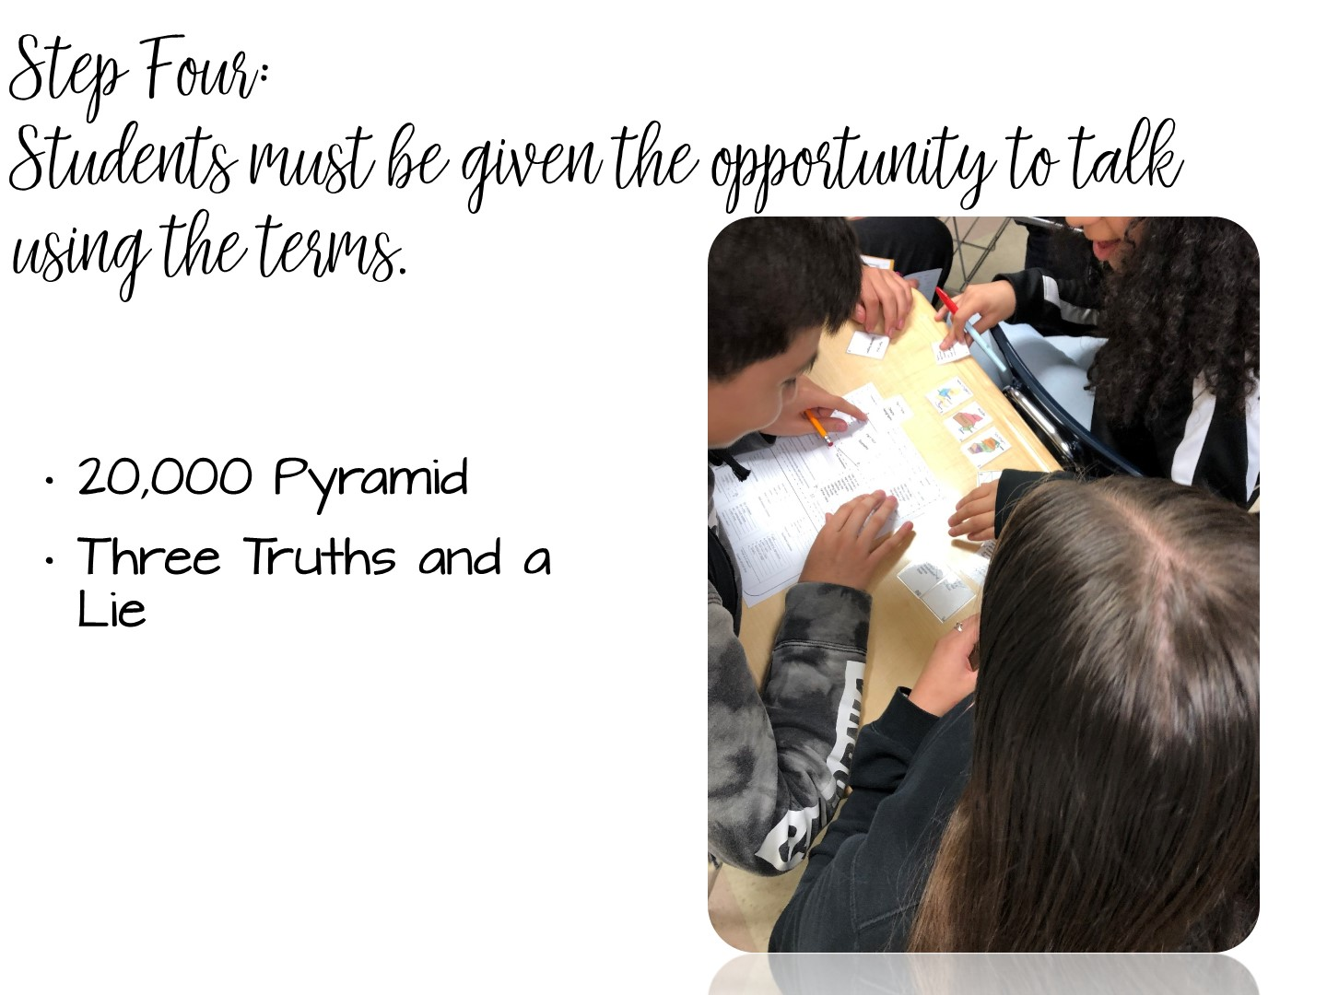
Notes:
Now we are going to look at strategies for students to talk more with the terms.

Slide 48
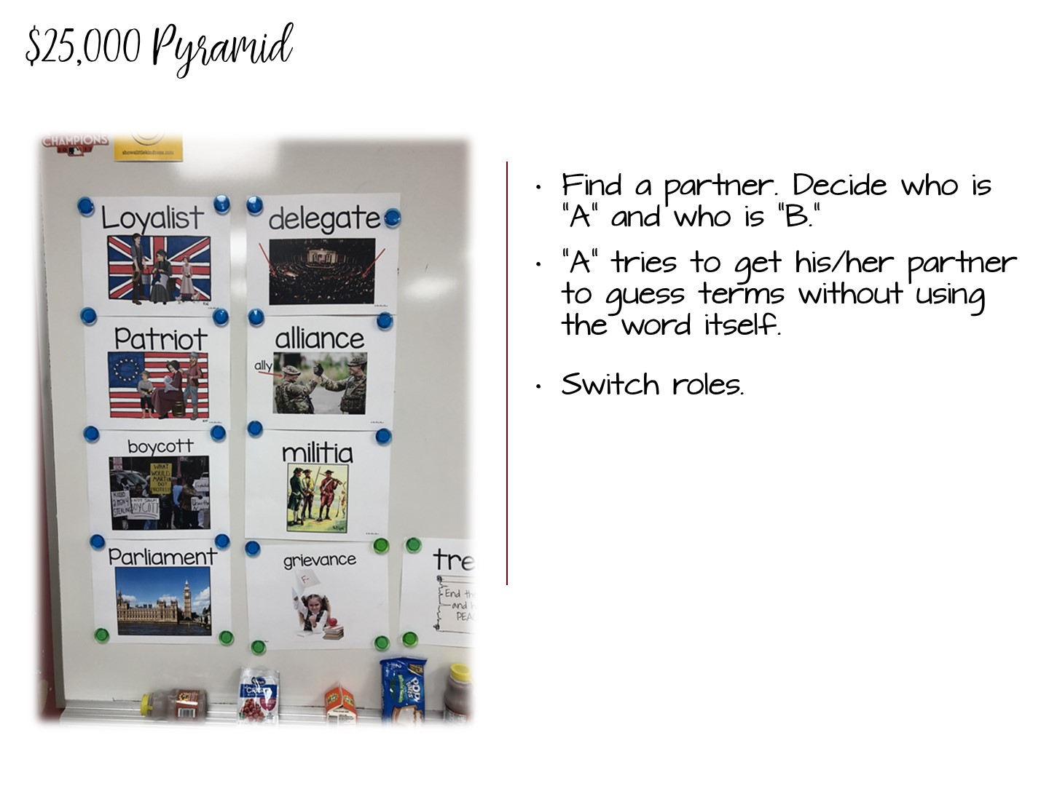
Notes:
Partner everyone – one person from each partner group needs to have their back to the screen (Partner B)
Put post it notes on certain terms – have partner A use definitions to try & get partner B to guess the term
Once all of the partner groups have finished – have the partners switch seats & duplicate the activity

Slide 49
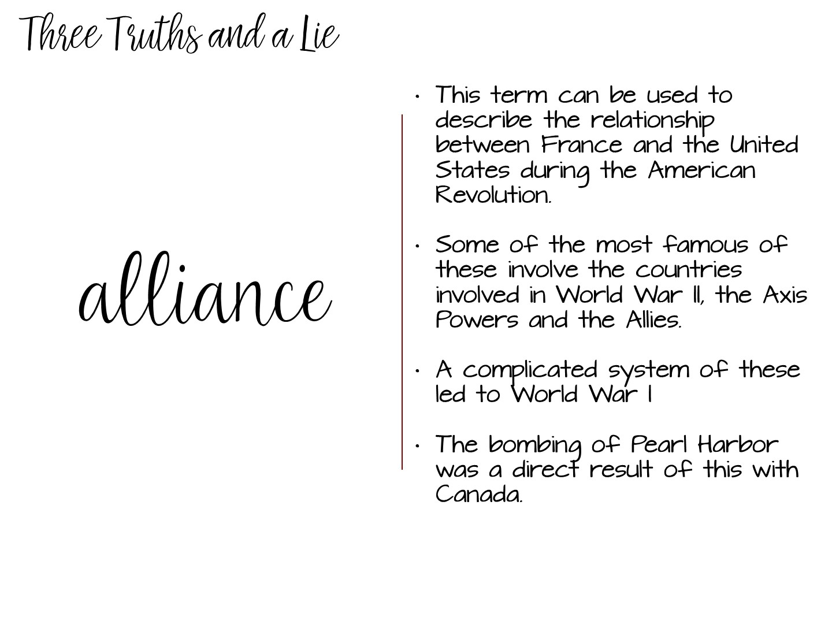
Notes:
Three Truths and a Lie is a game where you put up the vocabulary term with 3 correct statements and one incorrect statement. The students need to talk to each other to determine which statement is the lie.
The fourth option is the lie.

Slide 50
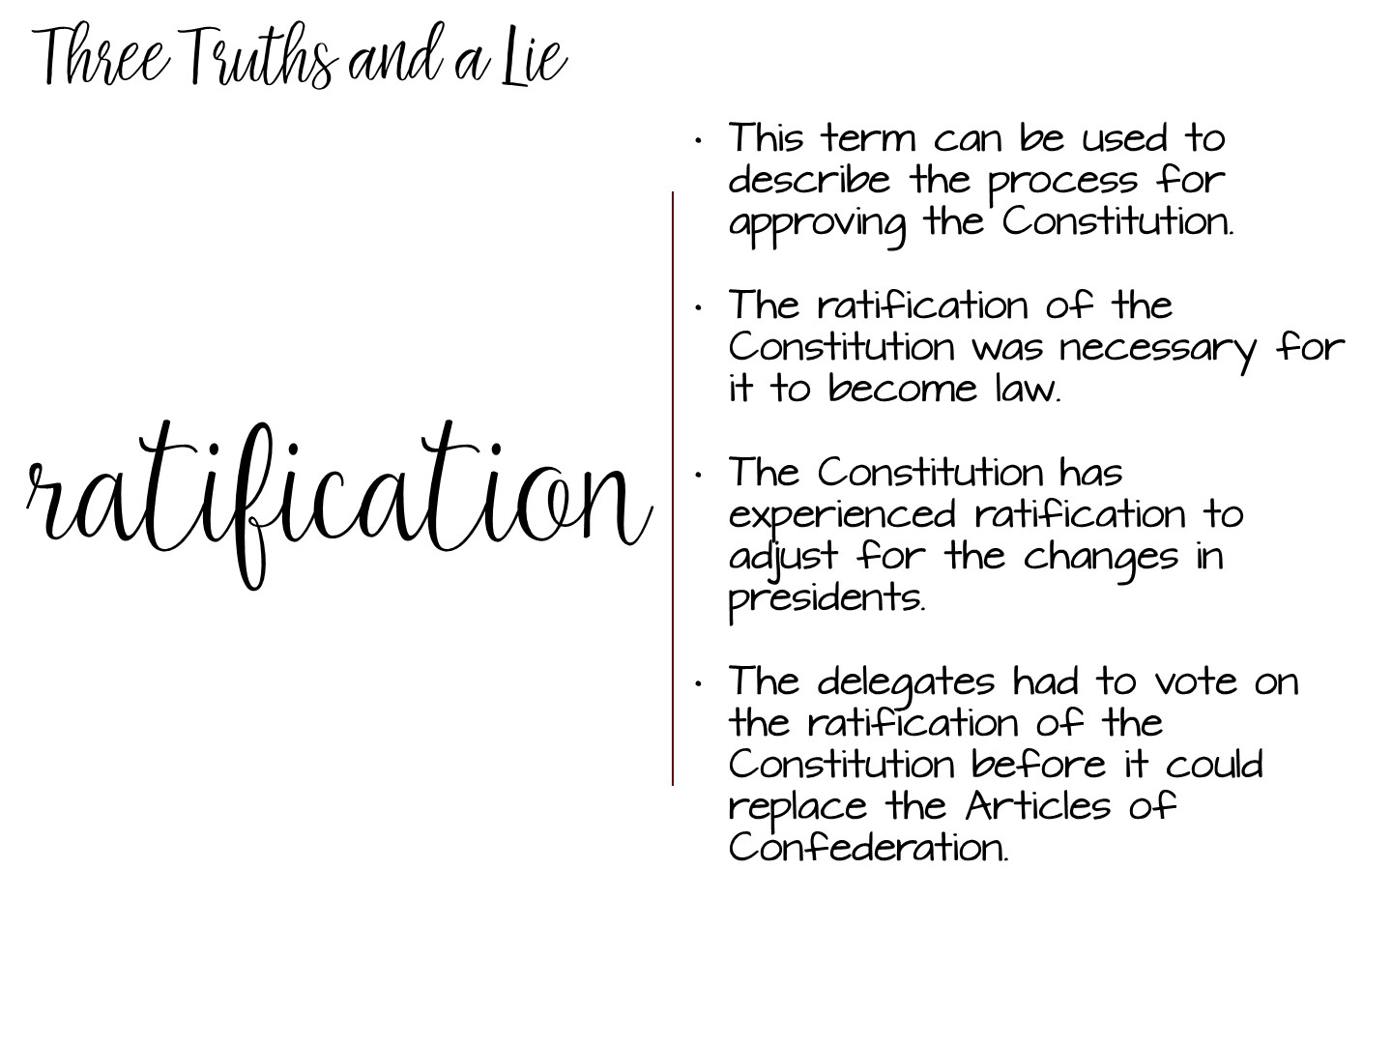
Notes:
The third option is the lie.

Slide 51
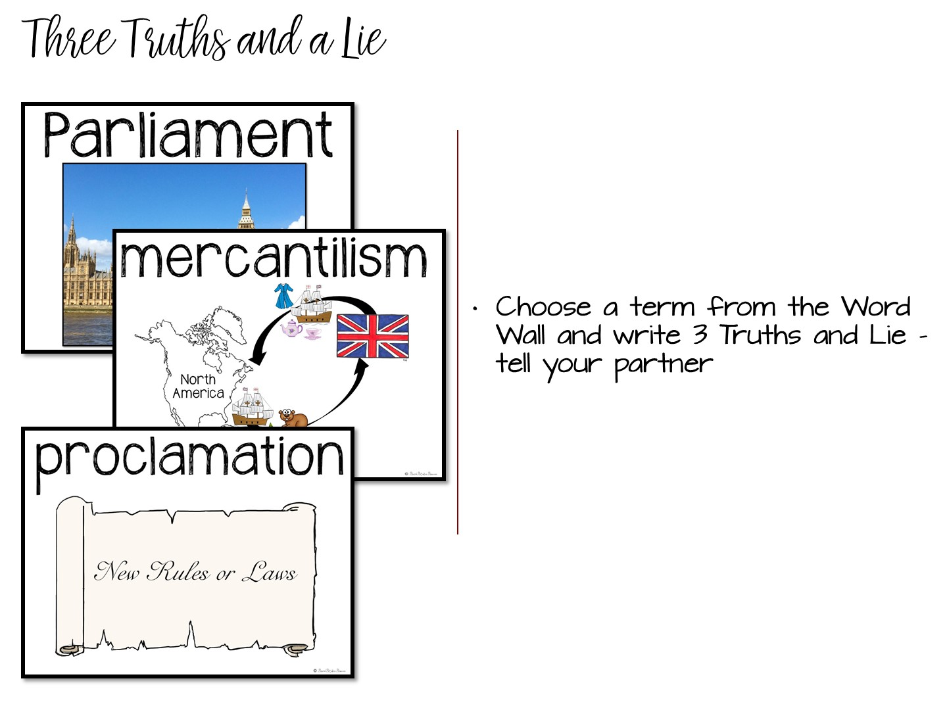
Notes:
Three Truths and a Lie is a game where you put up the vocabulary term with 3 correct statements and one incorrect statement. The students need to talk to each other to determine which statement is the lie.

Slide 52


Slide 53
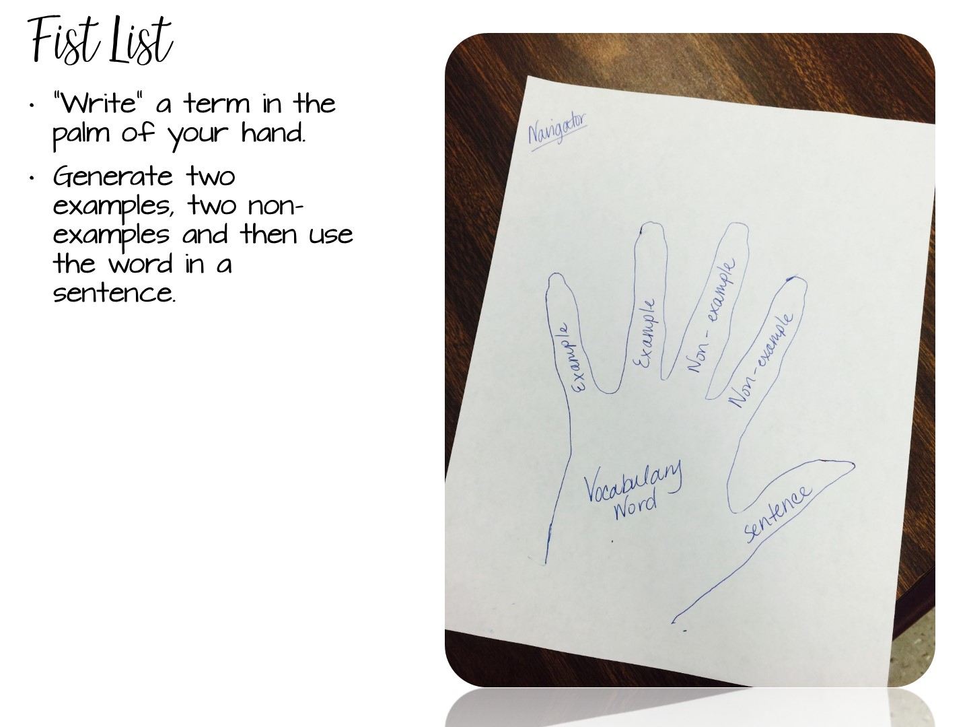
Notes:
Tell the participants to use the back of their pen to “write” the term in the palm of their hand or write the term on a slip of paper and put it into their closed fist.
Two of their fingers will be used for examples of the word, and two for non-examples. Their thumb would represent the word in a sentence.
An alternate way of doing this activity is for students to trace their hand on a sheet of paper. They then fill out the information on paper. Students can then cut the hands out & you can hang them up around the room.
EX:
Pretty
Examples – a flower, a model
Non examples – trash, pollution
Sentence – the girl wore a pretty dress to prom.

Slide 54
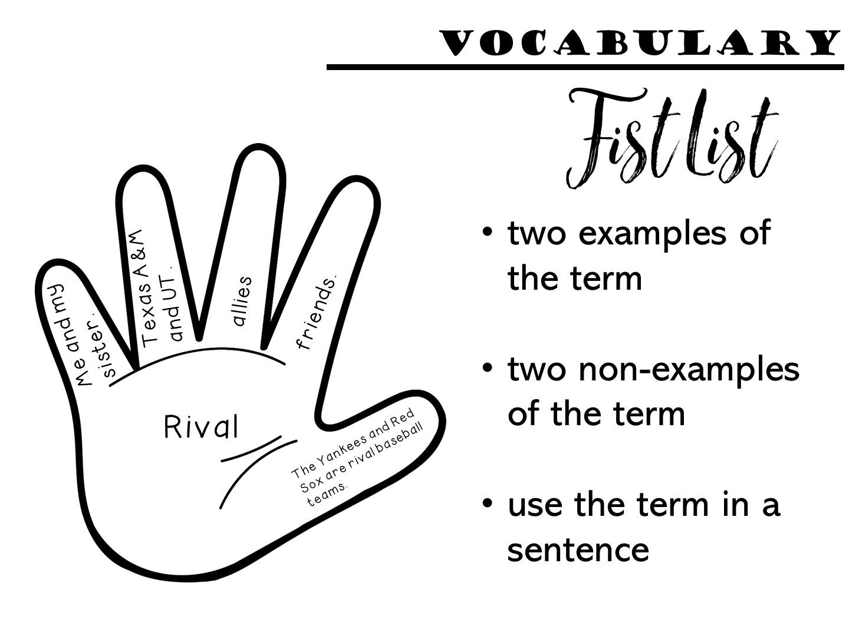
Notes:
Have the teachers choose a term off of the word wall and create a fist list with it.

Slide 55

Notes:
Another option you can use to allow students to write with the term is a choice board

Slide 56
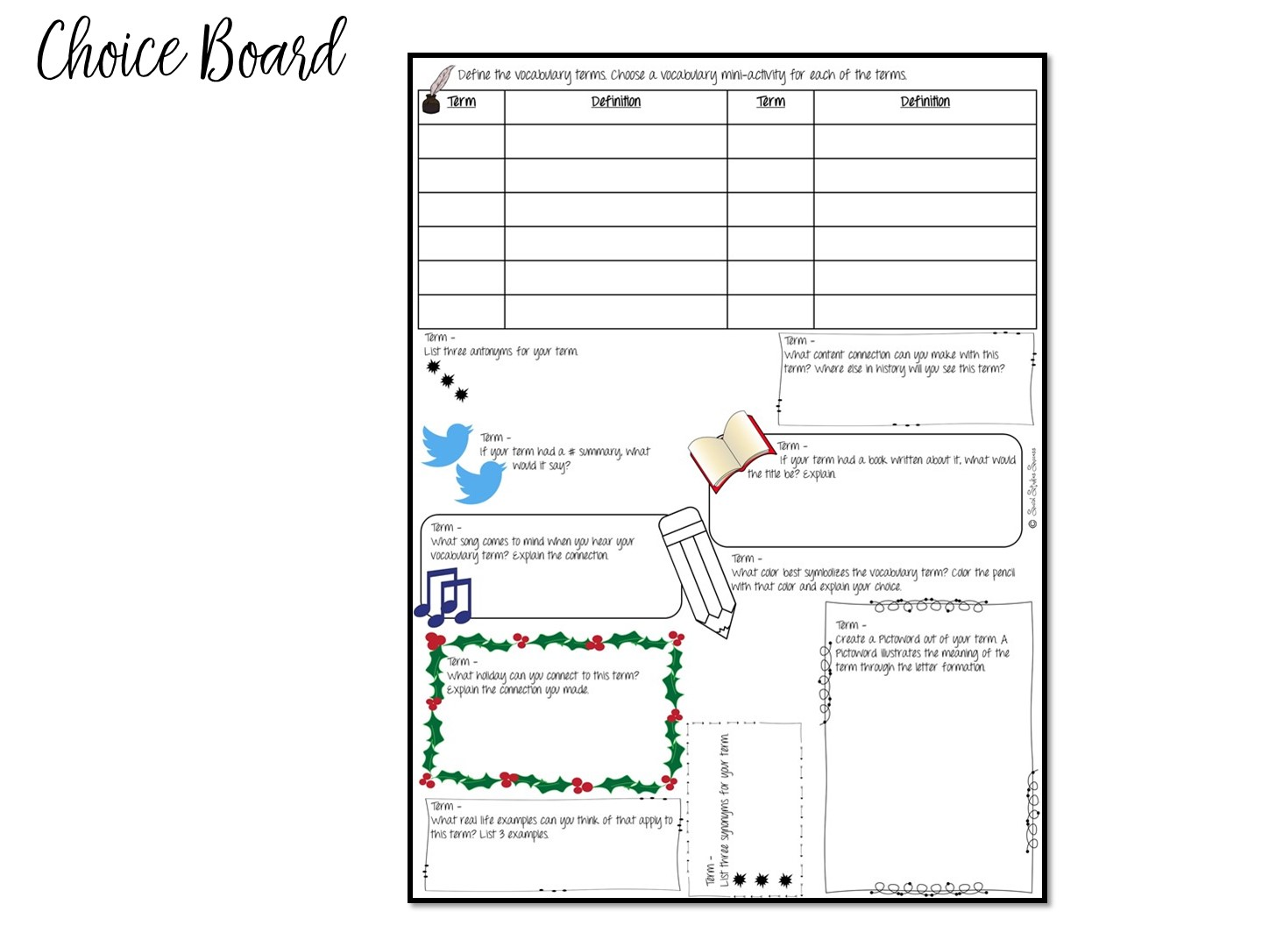
Notes:
This choice board allows students multiple opportunities to both write with the term and think of the term in different ways. Just show them and tell them that it is in the manual that they will receive.

Slide 57
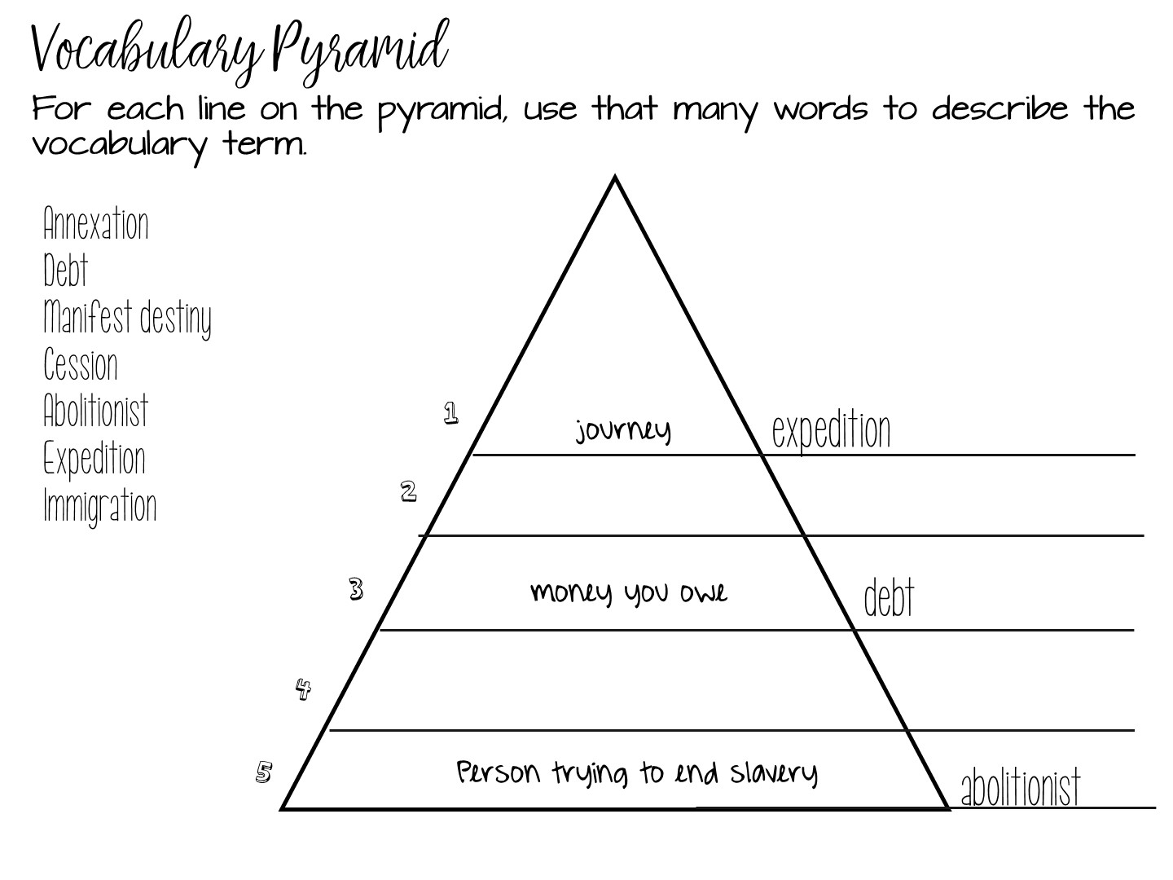
Notes:
The next strategy is of a vocabulary pyramid. Students would choose which words to use off of the word wall, and define it in one word, 2 words, and so on.

Slide 58
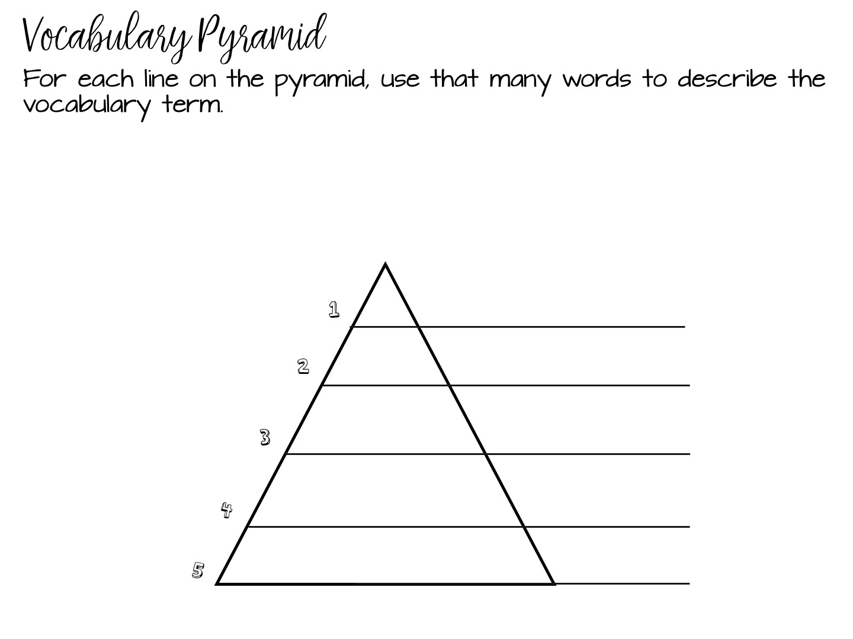
Notes:
Have them complete this activity with words from the word wall.

Slide 59
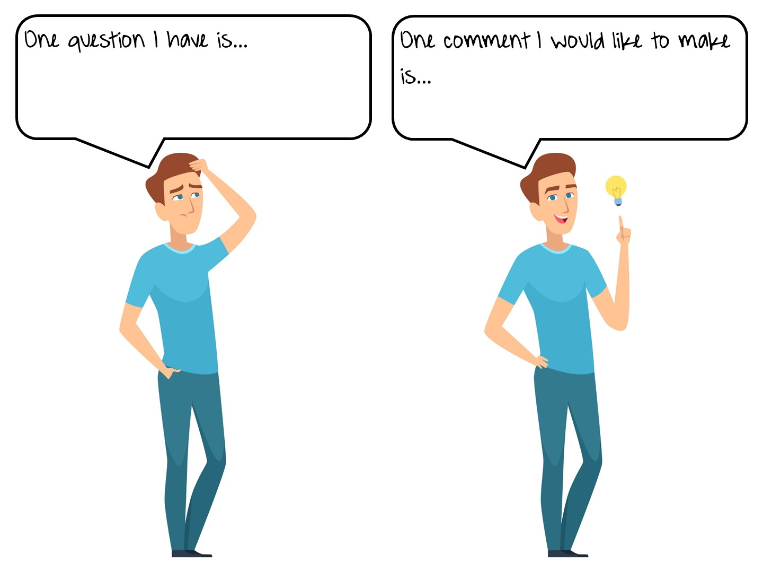
Notes:
Discuss one question this information suggests and one comment you would want to share with a colleague.

Slide 60
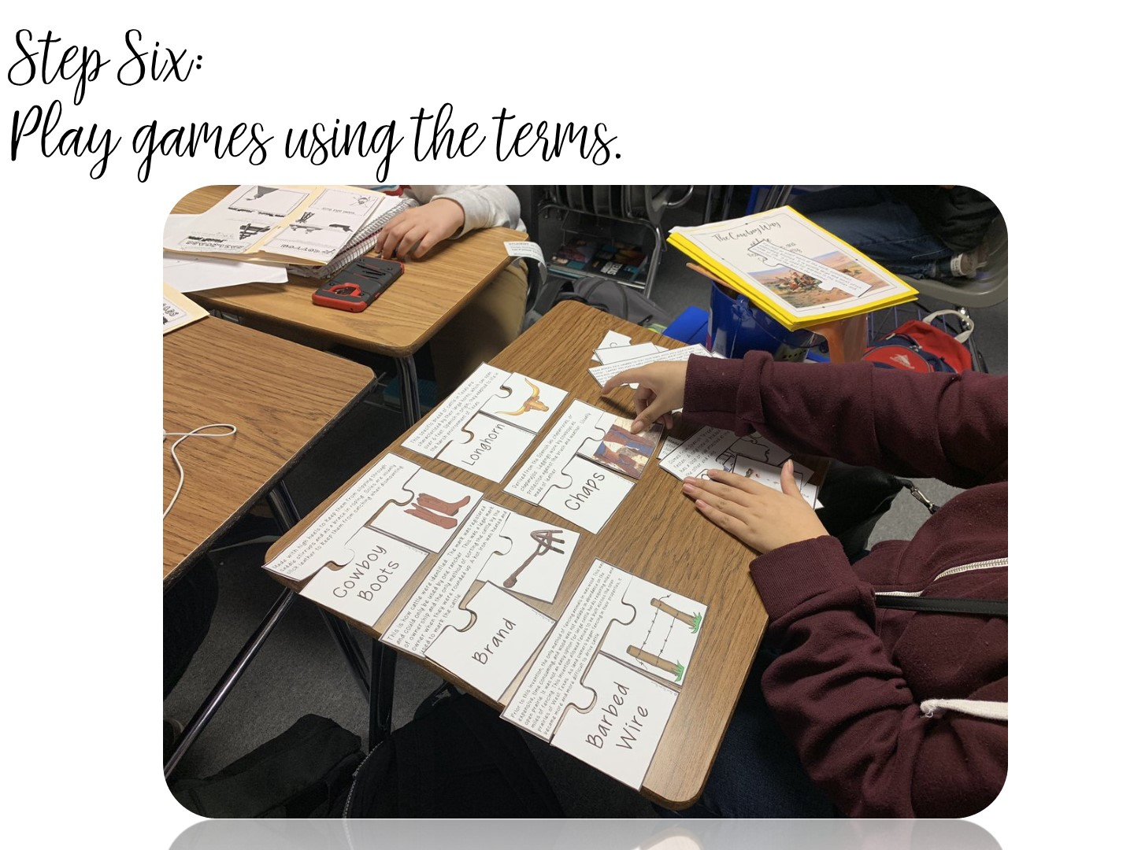
Notes:
Students LOVE games – I would like to share several different strategies for games with you.

Slide 61
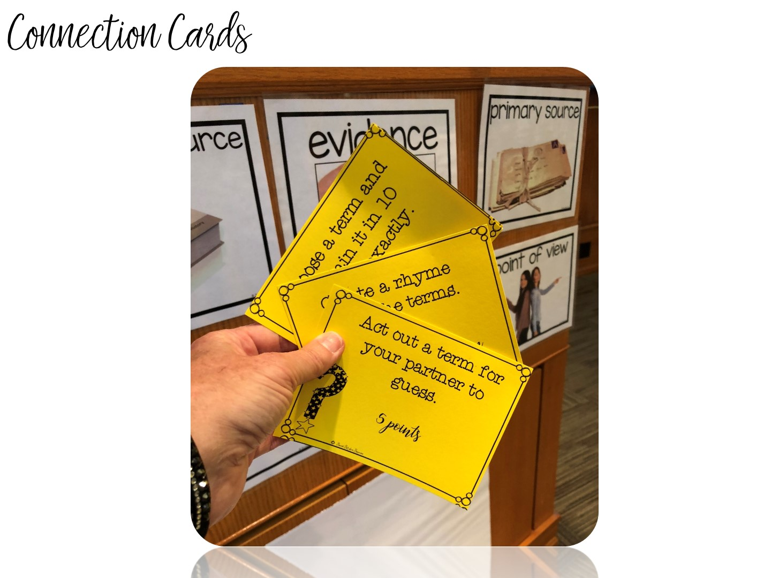
Notes:
Put teachers in a small group. Give each group a set of connection cards.

Slide 62
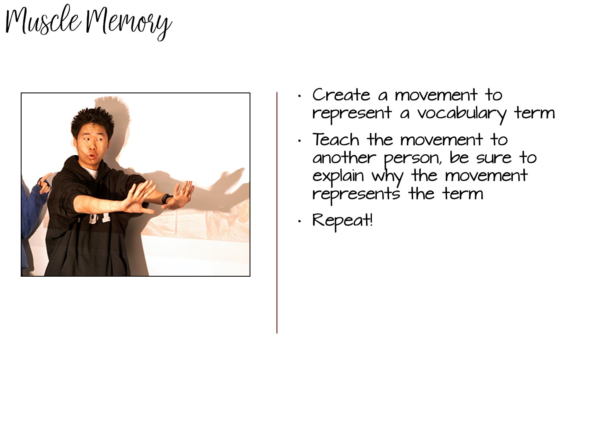
Notes:
Have each group member act out or create a movement of the definition of the word – other group members guess the terms.

Slide 63

Notes:
With all those specific strategies you learned, there is only one addition – your students must read!

Slide 64

Notes:
Have teachers talk to a partner and discuss

Slide 65

Notes:
This is where you can end a session or give a 15 minute break.

Slide 66
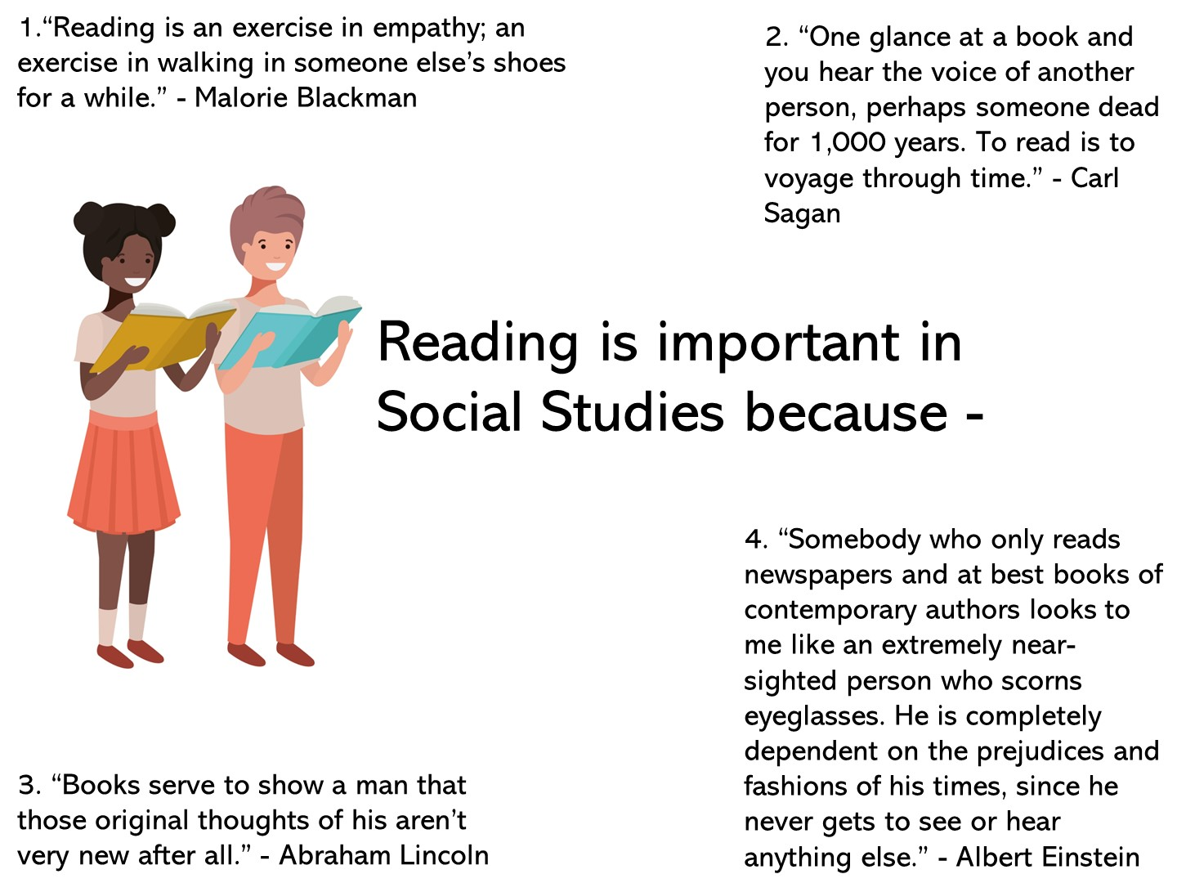
Notes:
4 Corner activity – ask the teachers to stand in the corner that best represents their point of view. Once they are in the corner, they need to share with others why they choose that quote. Call on one teacher from each corner to share their thoughts.

Slide 67

Notes:
Discuss with partner and debrief

Slide 68

Notes:
The reading cycle has been designed to support informational text like in Social Studies. Share that you are going to model a lesson based on the reading cycle – teachers need to look for what you do before, during, and after reading.

Slide 69

Notes:
Explain that you are going to model a lesson for high school on the Persian War.

Slide 70
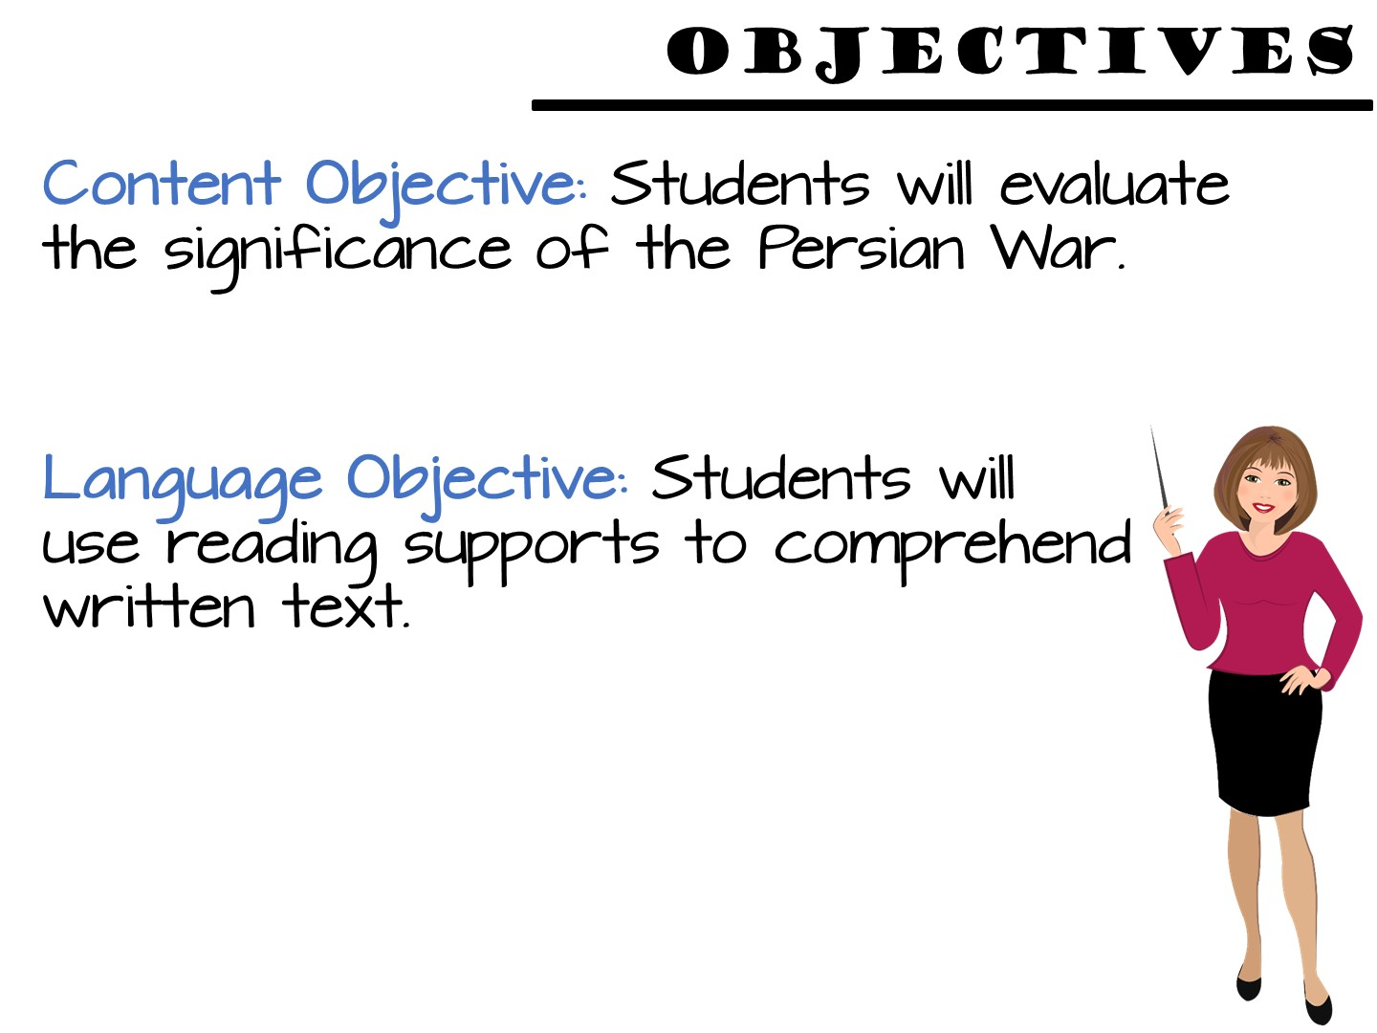
Notes:
Read the objectives for the lesson. This lesson is designed for high school World History.

Slide 71
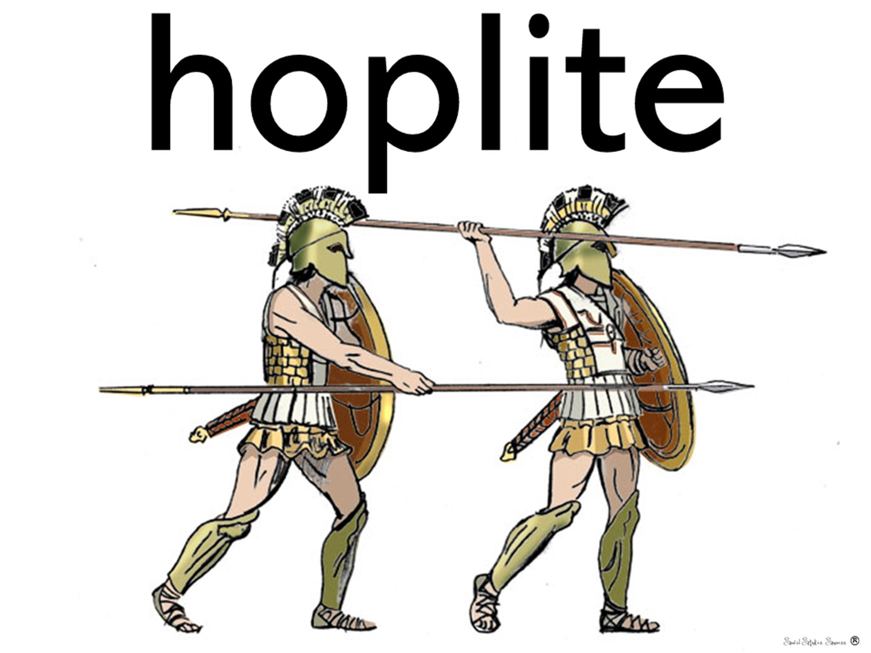
Notes:
Hoplites were citizen-soldiers of Ancient Greek city-states who were primarily armed with spears and shields.

Slide 72
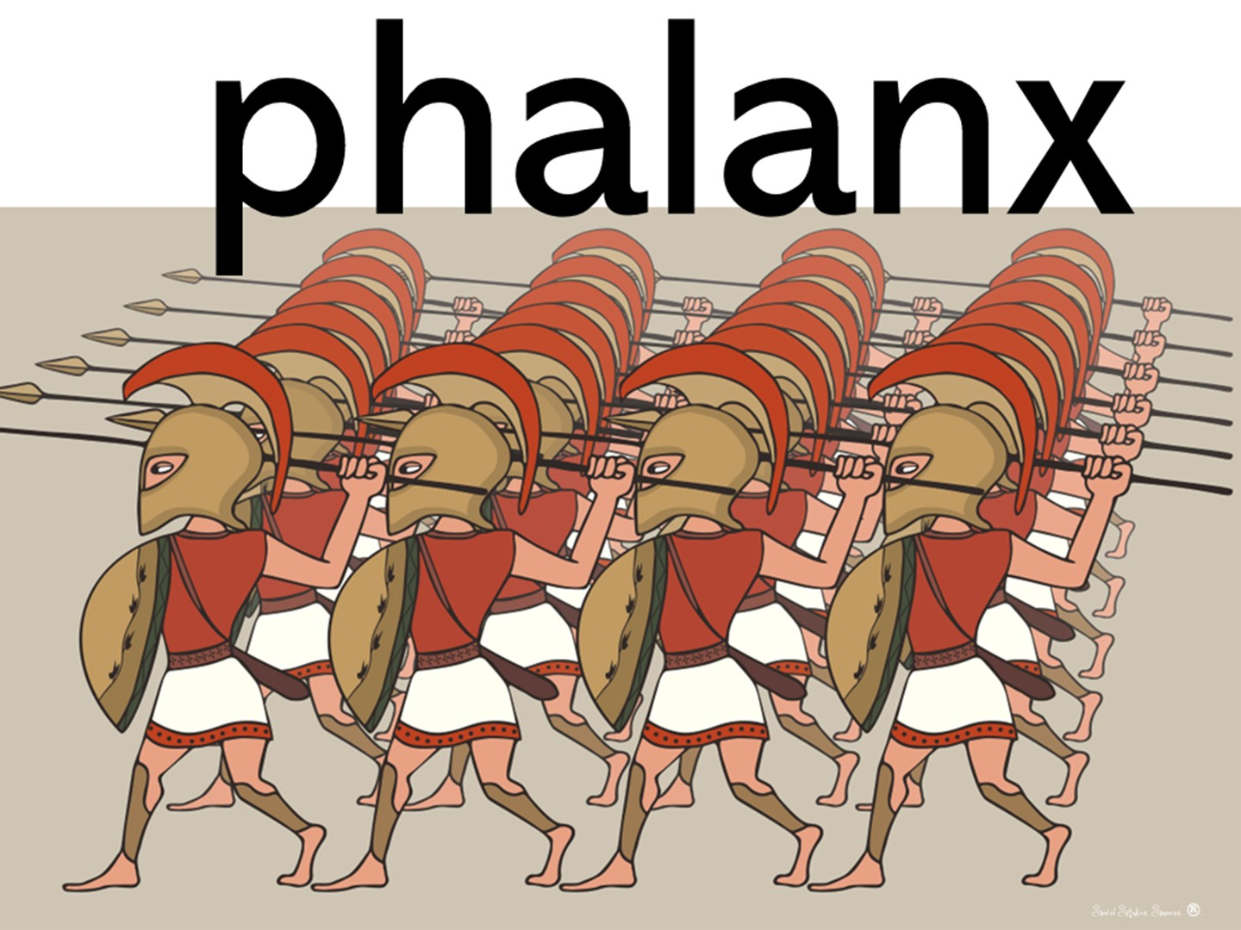
Notes:
A phalanx is a military formation, usually composed entirely of soldiers armed with spears, or similar pole weapons.

Slide 73
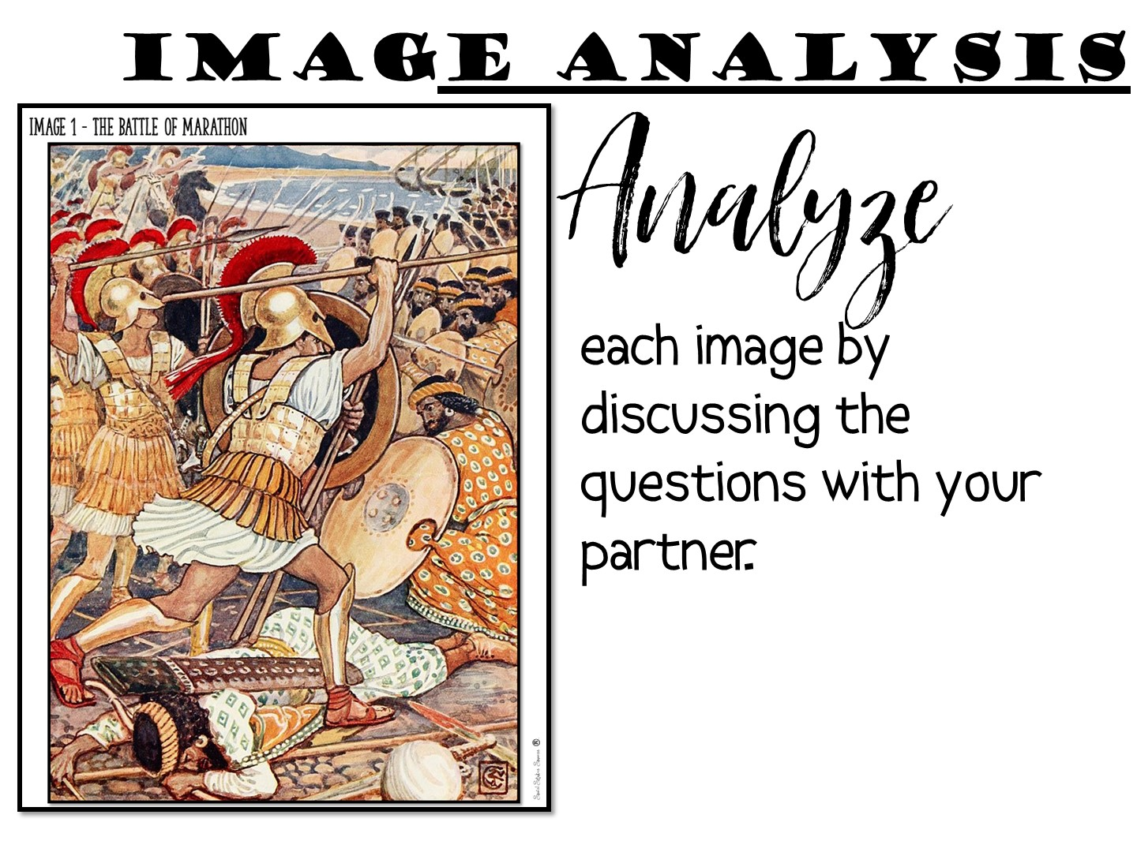
Notes:
Pass out the images and have participants discuss questions with partner.

Slide 74

Notes:
Pass out highlighters and have them read the two pages on the Persian Wars. Model highlighting with the first paragraph.

Slide 75
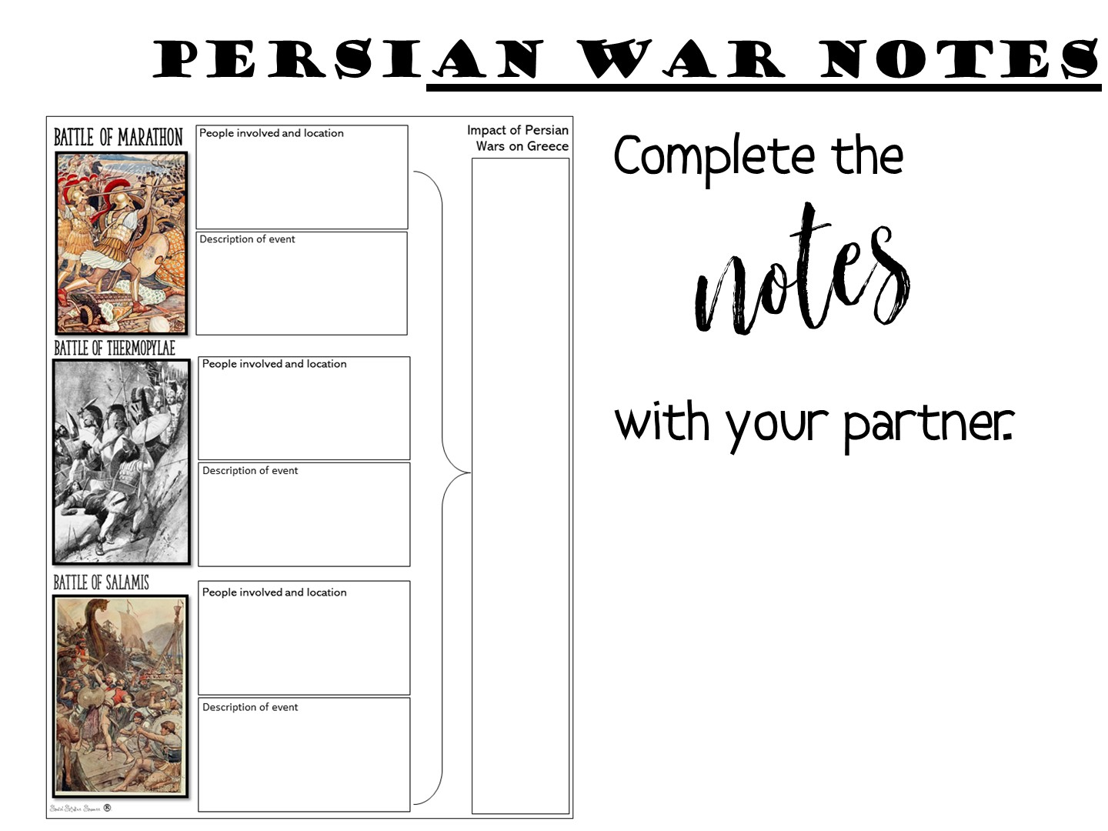
Notes:
Just give them a few minutes to do.

Slide 76
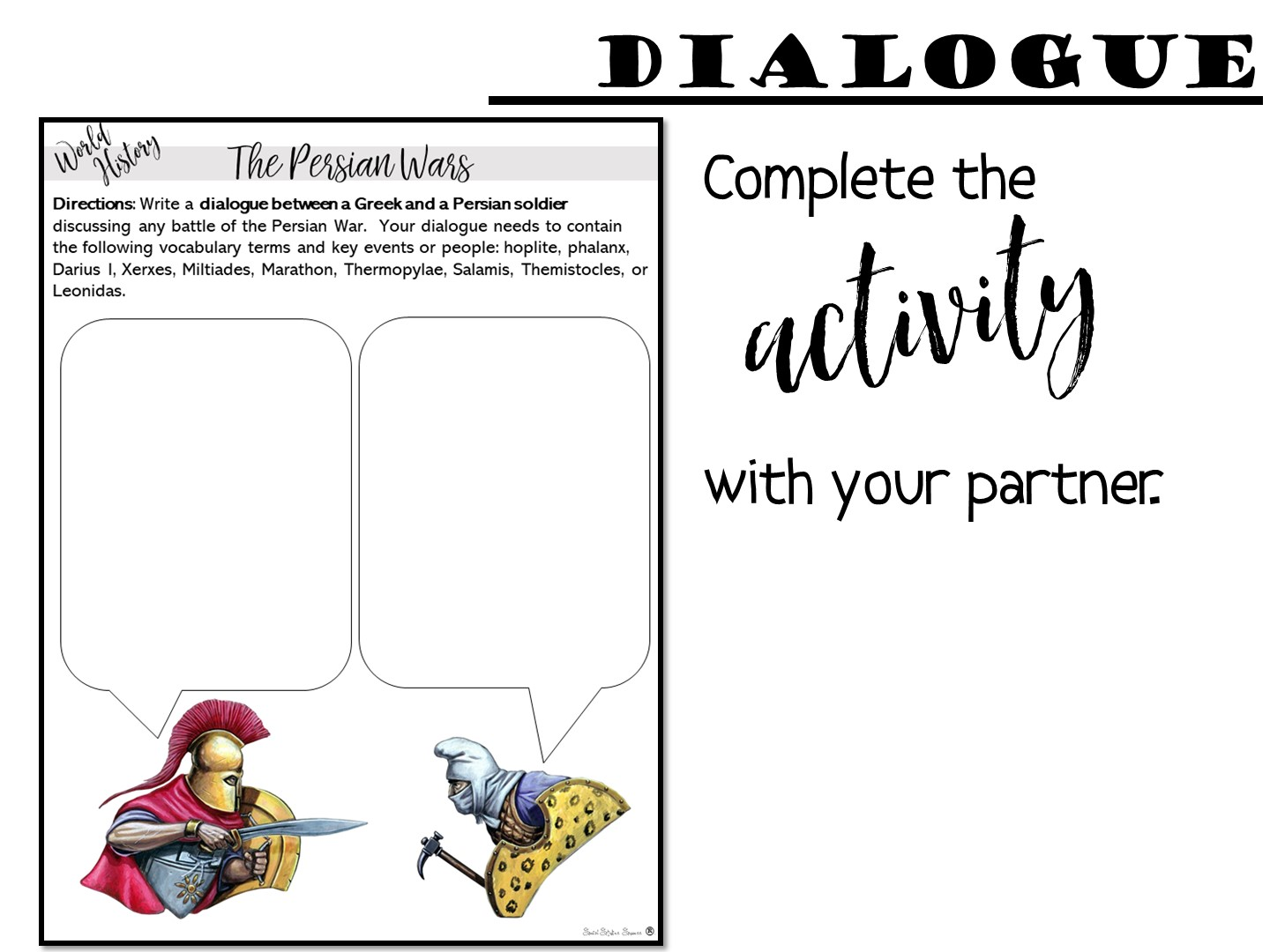
Notes:
Just give them a few minutes to do.

Slide 77

Notes:
Have teachers discuss with each other.

Slide 78
Notes:
Now you are going to review the reading cycle more in depth. Have the Literacy Strategy Manuals ready to pass out.

Slide 79

Notes:
Before Reading or PreReading prepares the student to read.

Slide 80
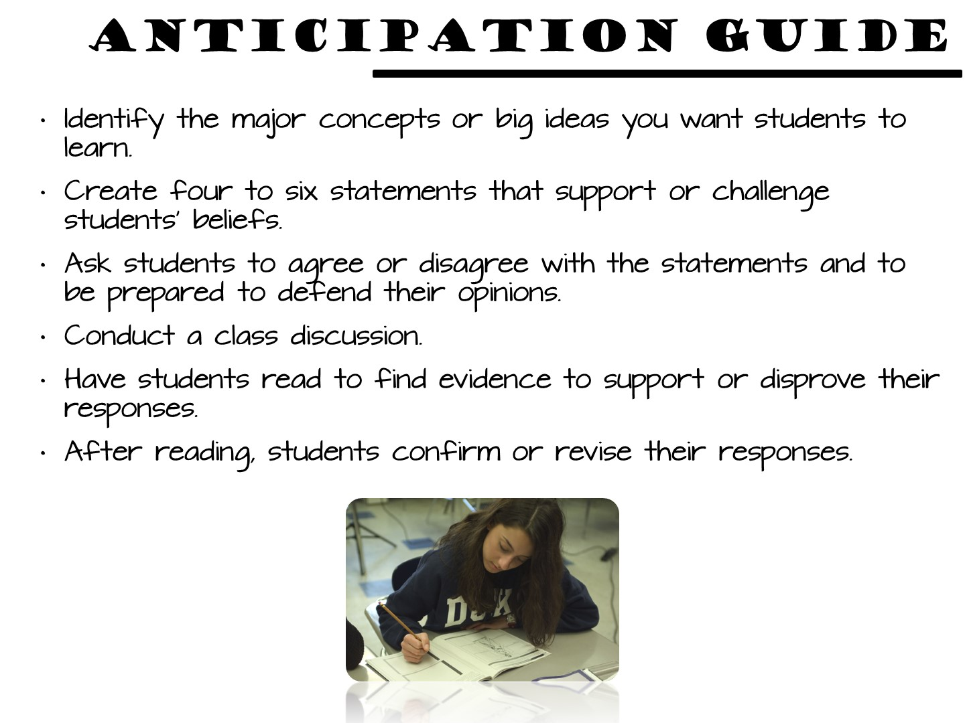
Notes:
Struggling readers will often skip all of these strategies as possible ways to approach a text; therefore, if we can design activities that will help them to anticipate "the big ideas" that will be revealed, it may provide an initial "hook" that draws them into the text
The Anticipation Guide helps students activate and evaluate prior knowledge. Students make predictions based upon background knowledge and evaluate these predictions after exposure to new information.

Slide 81
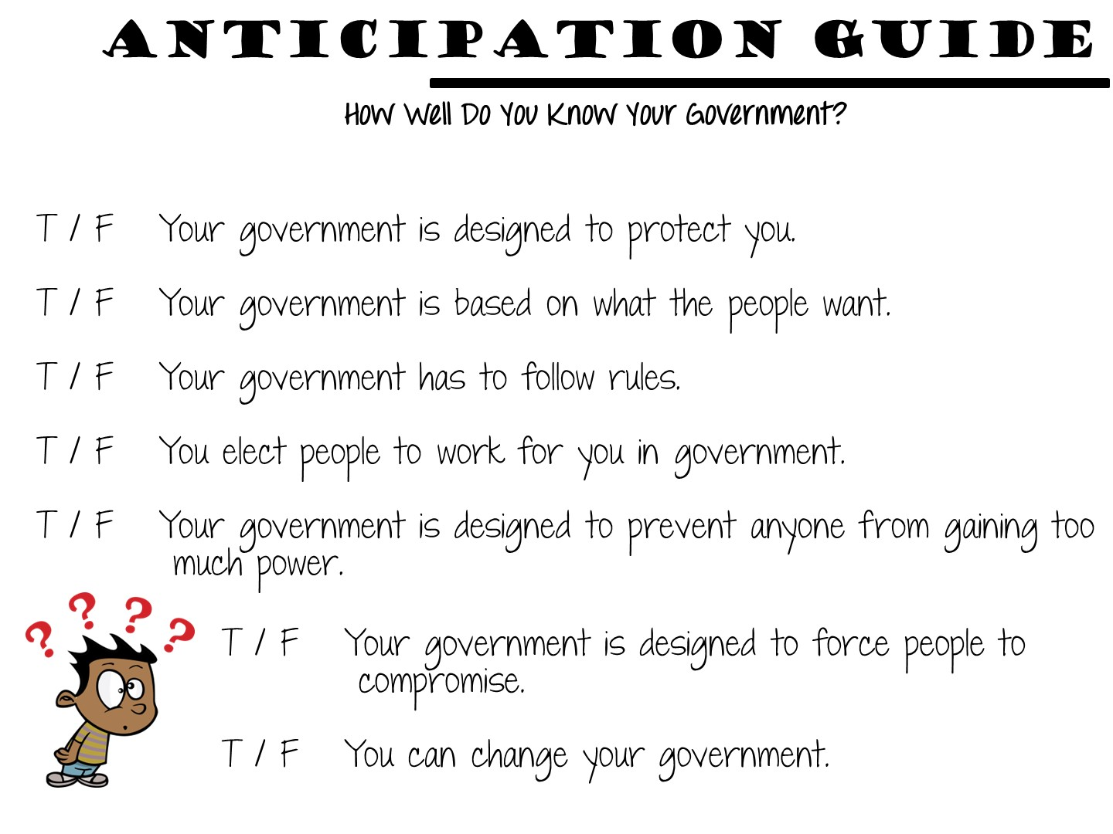
Notes:
Here is an example of one for the principles of government.

Slide 82
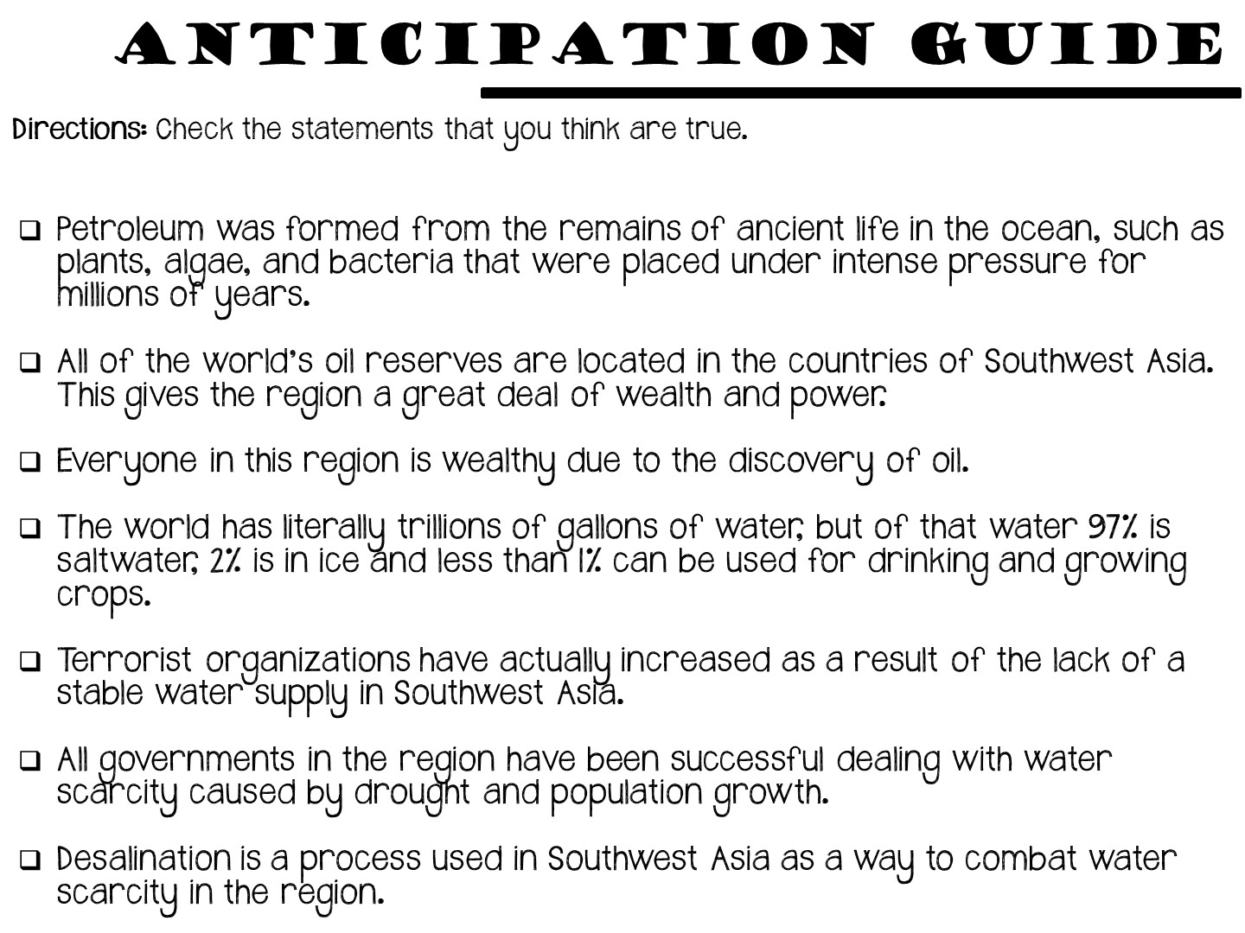
Notes:
Another anticipation guide strategy is to provide your students a series of statements from the reading – some of which are true and some that are not. After reading the selection of text, your students can then come back and correct the false statements.

Slide 83
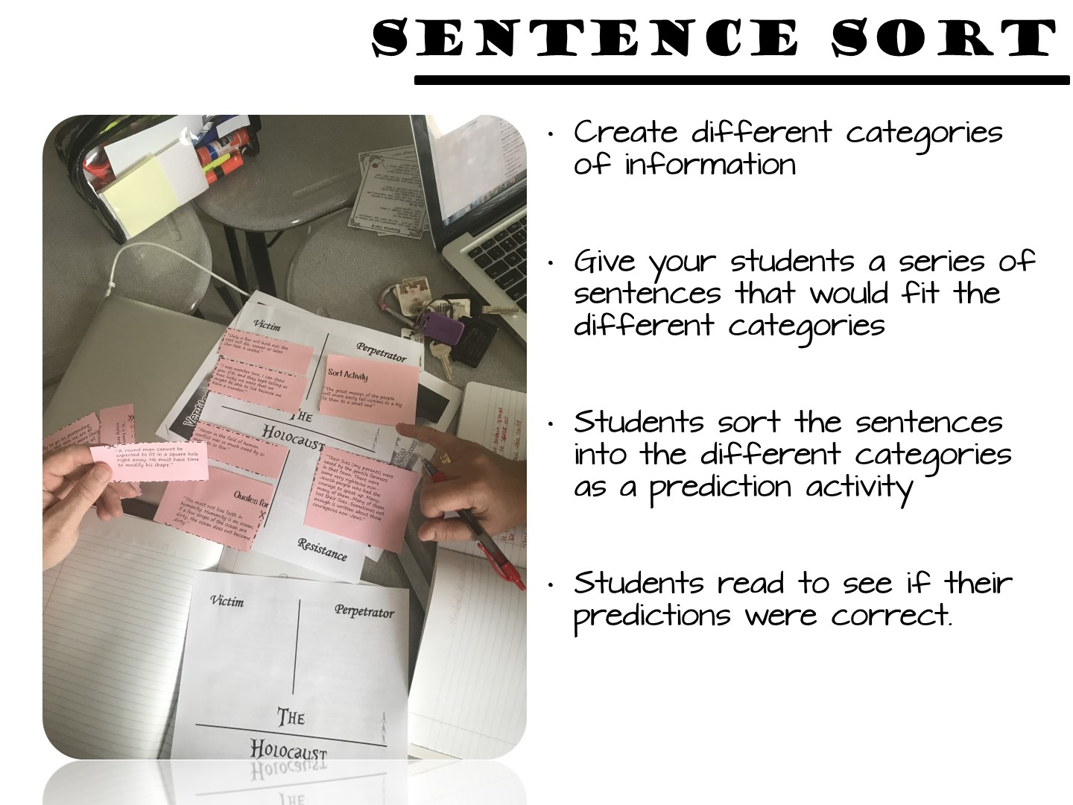
Notes:
Another strategy is a sentence sort.

Slide 84

Notes:
Here is an additional example on the government of Japan.

Slide 85

Notes:
A visual discovery or image analysis is a great way to prepare readers for informational text.

Slide 86

Notes:
This is an example for monsoons in India.

Slide 87

Notes:
This is an example for Jacksonian Democracy.

Slide 88

Notes:
This is an example for Africa, it uses a series of images.

Slide 89

Notes:
Pass out image analysis handout to guide question writing.

Slide 90

Notes:
Select key phrases or sentences that are significant to the text. These book bits should reveal enough to help students begin to think along the lines that support text understanding, but not so revealing that they limit thinking.
Write each book bit on a strip of paper. There should be as many book bits as there are students in the group.
Give each student a book bit. Ask each student to read his/her book bit and think about how it might be connected to the text.
After the students have read their book bit, they move about the room and read their book bit to others. No discussion occurs during this sharing – only the reading of the book bits to one another. (Consider dividing class into two equal groups. Form two parallel lines having students facing each other. Students facing each other read the book bits to one another. Then tell one of the lines to shift down one space. The student at the end of the row goes to the beginning for a new partner. Keep shifting until all book bits have been read aloud.)
Once students have had the opportunity to hear most of their peers’ book bits, they return to their seat and do a quick write about the impressions they now have about the text. They might address what they think the selection is about or what they know about the characters or topic.
After completing the quick write, students discuss their ideas with one another.

Slide 91

Notes:
Place teachers into a small group. Pass out the literacy strategy manual and conduct this activity

Slide 92

Notes:
Give your partner a high 5, then give me 5 new things you have learned so far

Slide 93

Notes:
The next are a series of strategies designed to support readers during the reading process.

Slide 94

Notes:
Prep for this portion of the activity by taping different reading strategies on chart paper. Post the reading strategies around the room. Give teachers different colored markers and allow the teachers to visit and then write their thoughts on a post-it note next to each strategy.

Slide 95

Notes:
Debrief after chalk talk

Slide 96

Notes:
Just review these types of strategies.

Slide 97

Notes:
Graphic Organizers come in a variety of forms.

Slide 98

Notes:
Other types of Graphic Notes include 2 –Column notes, with the topic and a summary.

Slide 99

Notes:
Sketch notes are created by students while they are reading.

Slide 100


Slide 101


Slide 102


Slide 103

Notes:
Lap books can also be used as graphic organizers.

Slide 104

Notes:
The goal of graphic organizers are to move note taking from a passive to an active process by combining Social Studies skills with content in the note making process.

Slide 105


Slide 106

Notes:
After reading allows students to process what they have learned.

Slide 107

Notes:
Character collages allow students to process information about historical figures by adding images and quotes.

Slide 108

Notes:
Sensory figures process by inferencing senses.

Slide 109

Notes:
Flow charts show the movement of an idea.

Slide 110

Notes:
Point of view stories are great for inferencing as well.

Slide 111

Notes:
Students bring to life images by adding text.

Slide 112

Notes:
A mosaic is great for showing the parts of a topic.

Slide 113

Notes:
Challenge students to create summaries for the topic with Alpha Boxes.

Slide 114

Notes:
Explain an acrostic poem.

Slide 115

Notes:
Students write or draw what they would see beyond the picture frame.

Slide 116

Notes:
Students rank the importance of certain events.

Slide 117

Notes:
Allow the groups to review the different strategies and choose one for the Persian War.

Slide 118

Notes:
This is a time filler debrief if you need it – if not, use the next slide.

Slide 119

Notes:
They can write this on an index card.

Slide 120

Notes:
120

Slide 121


