Slide 1
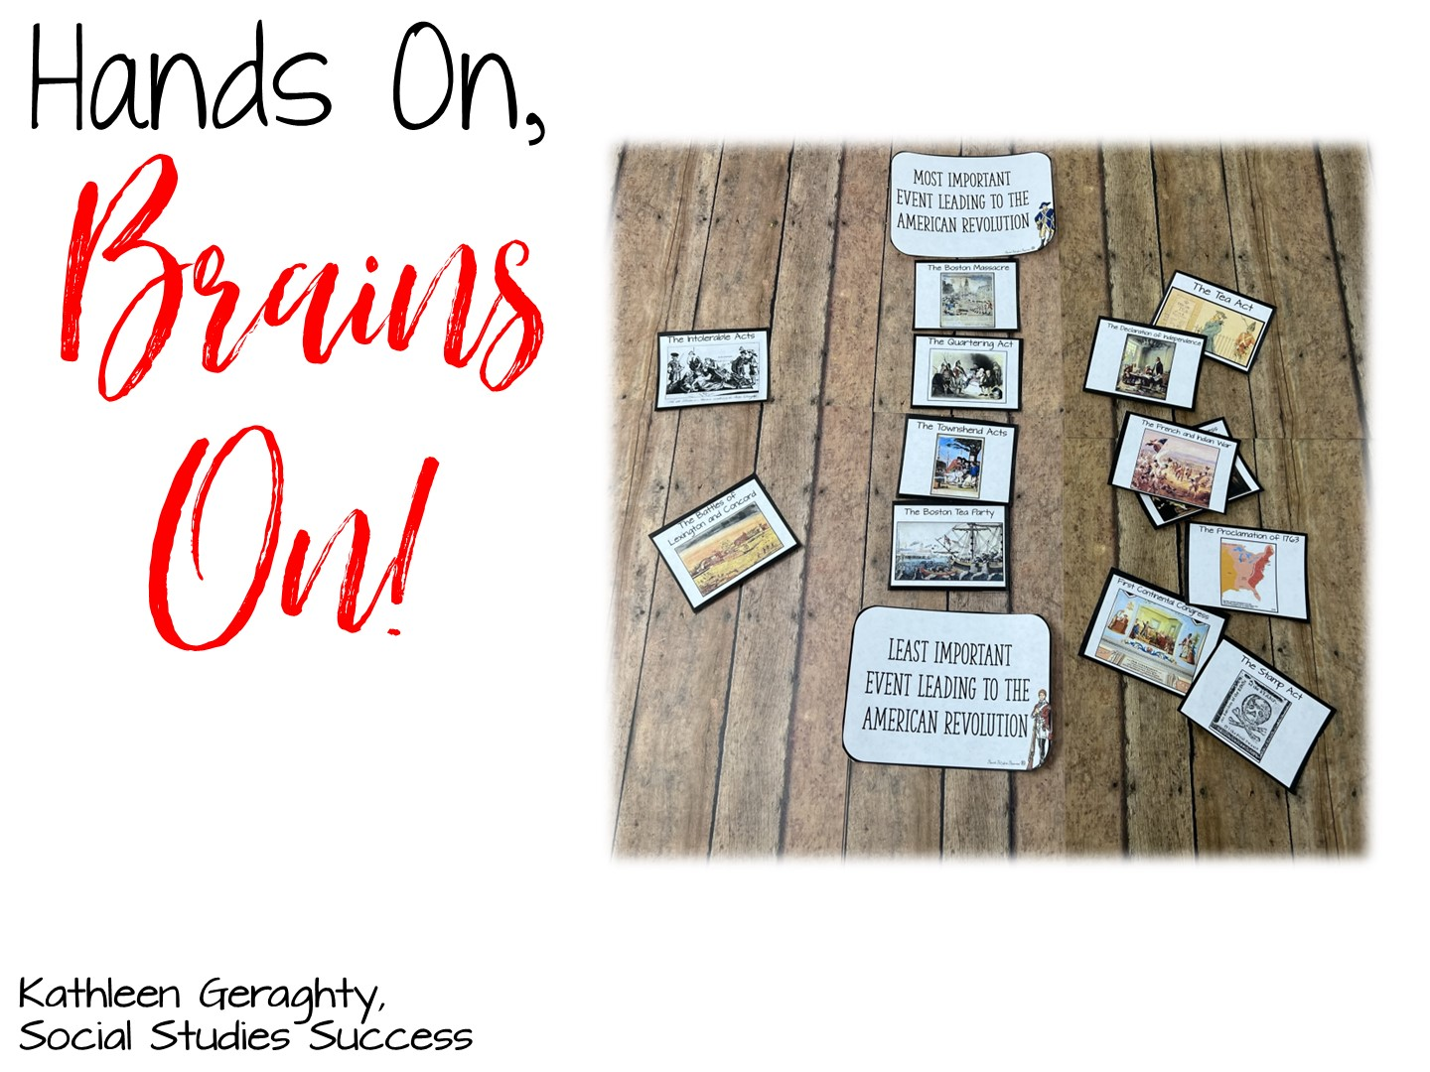

Slide 2


Slide 3

Notes:
Introduce yourself

Slide 4

Notes:
Differentiated instruction is ensuring that learning happens in an accessible way for the student. ISNs allow the students to format their thoughts however they find suitable, thus, differentiating by learning styles — someone who loves writing can love in the notebooks, another student who would rather draw is free to express his/her ideas through diagrams, charts and pictures.

Slide 5

Notes:
Differentiated instruction is ensuring that learning happens in an accessible way for the student. ISNs allow the students to format their thoughts however they find suitable, thus, differentiating by learning styles — someone who loves writing can love in the notebooks, another student who would rather draw is free to express his/her ideas through diagrams, charts and pictures.

Slide 6
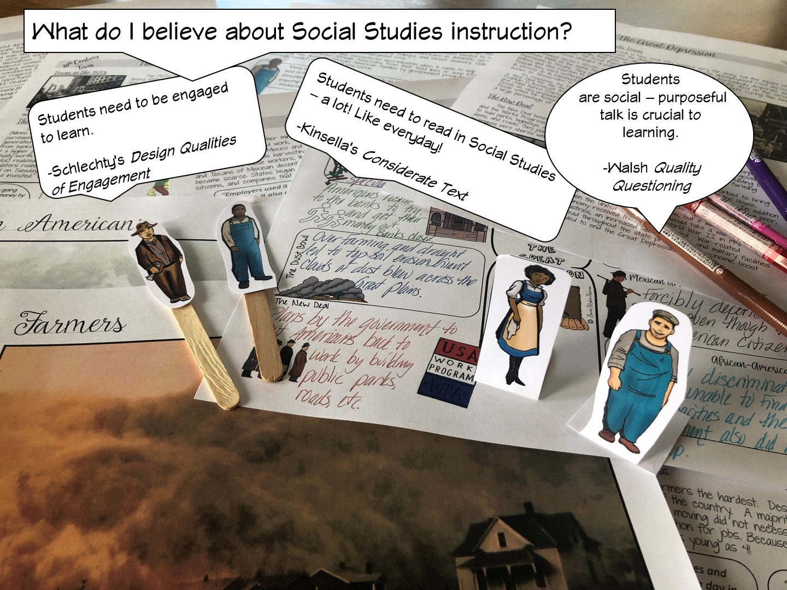
Notes:
Differentiated instruction is ensuring that learning happens in an accessible way for the student. ISNs allow the students to format their thoughts however they find suitable, thus, differentiating by learning styles — someone who loves writing can love in the notebooks, another student who would rather draw is free to express his/her ideas through diagrams, charts and pictures.

Slide 7
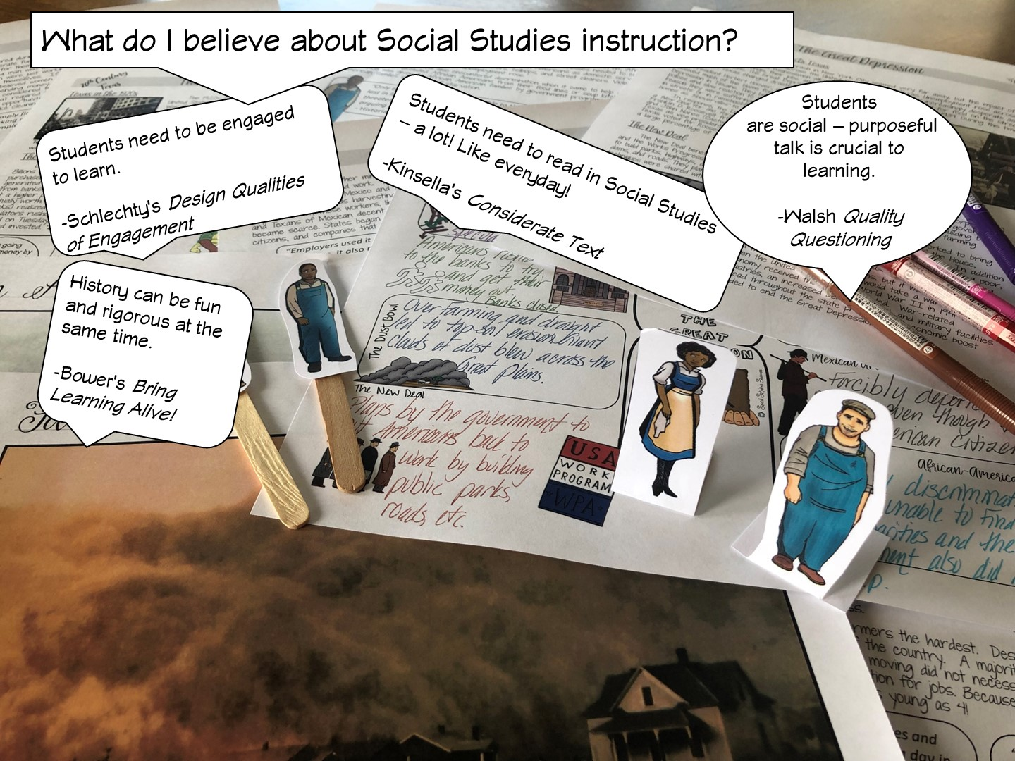
Notes:
Differentiated instruction is ensuring that learning happens in an accessible way for the student. ISNs allow the students to format their thoughts however they find suitable, thus, differentiating by learning styles — someone who loves writing can love in the notebooks, another student who would rather draw is free to express his/her ideas through diagrams, charts and pictures.

Slide 8

Notes:
Differentiated instruction is ensuring that learning happens in an accessible way for the student. ISNs allow the students to format their thoughts however they find suitable, thus, differentiating by learning styles — someone who loves writing can love in the notebooks, another student who would rather draw is free to express his/her ideas through diagrams, charts and pictures.

Slide 9
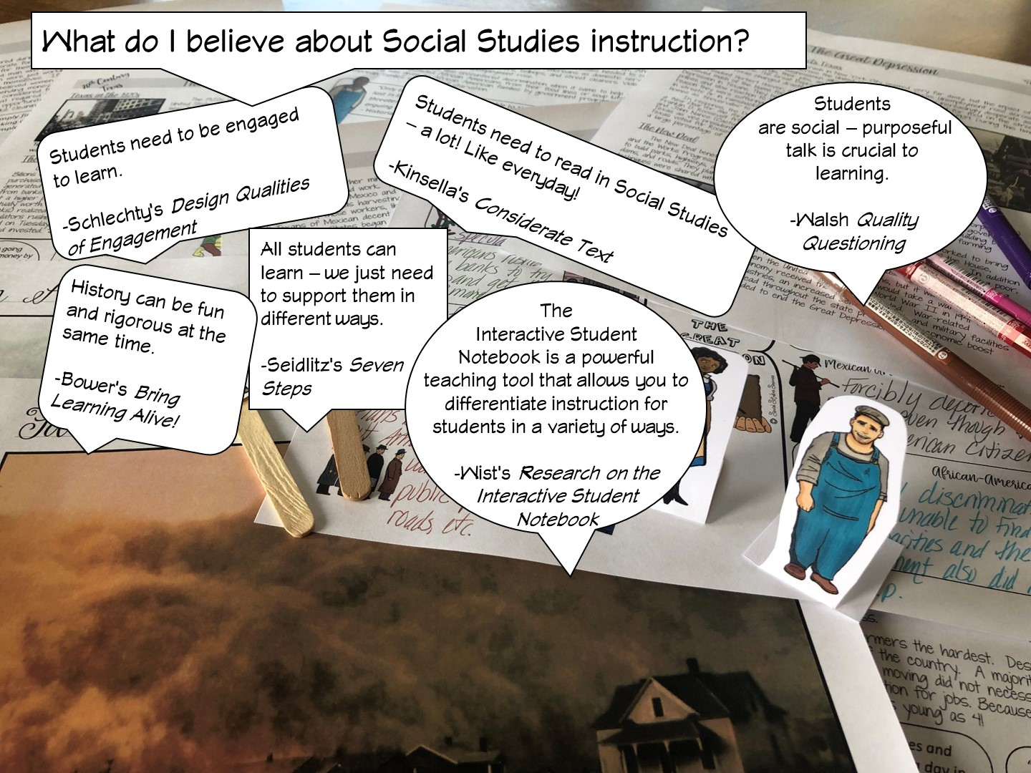
Notes:
Differentiated instruction is ensuring that learning happens in an accessible way for the student. ISNs allow the students to format their thoughts however they find suitable, thus, differentiating by learning styles — someone who loves writing can love in the notebooks, another student who would rather draw is free to express his/her ideas through diagrams, charts and pictures.

Slide 10
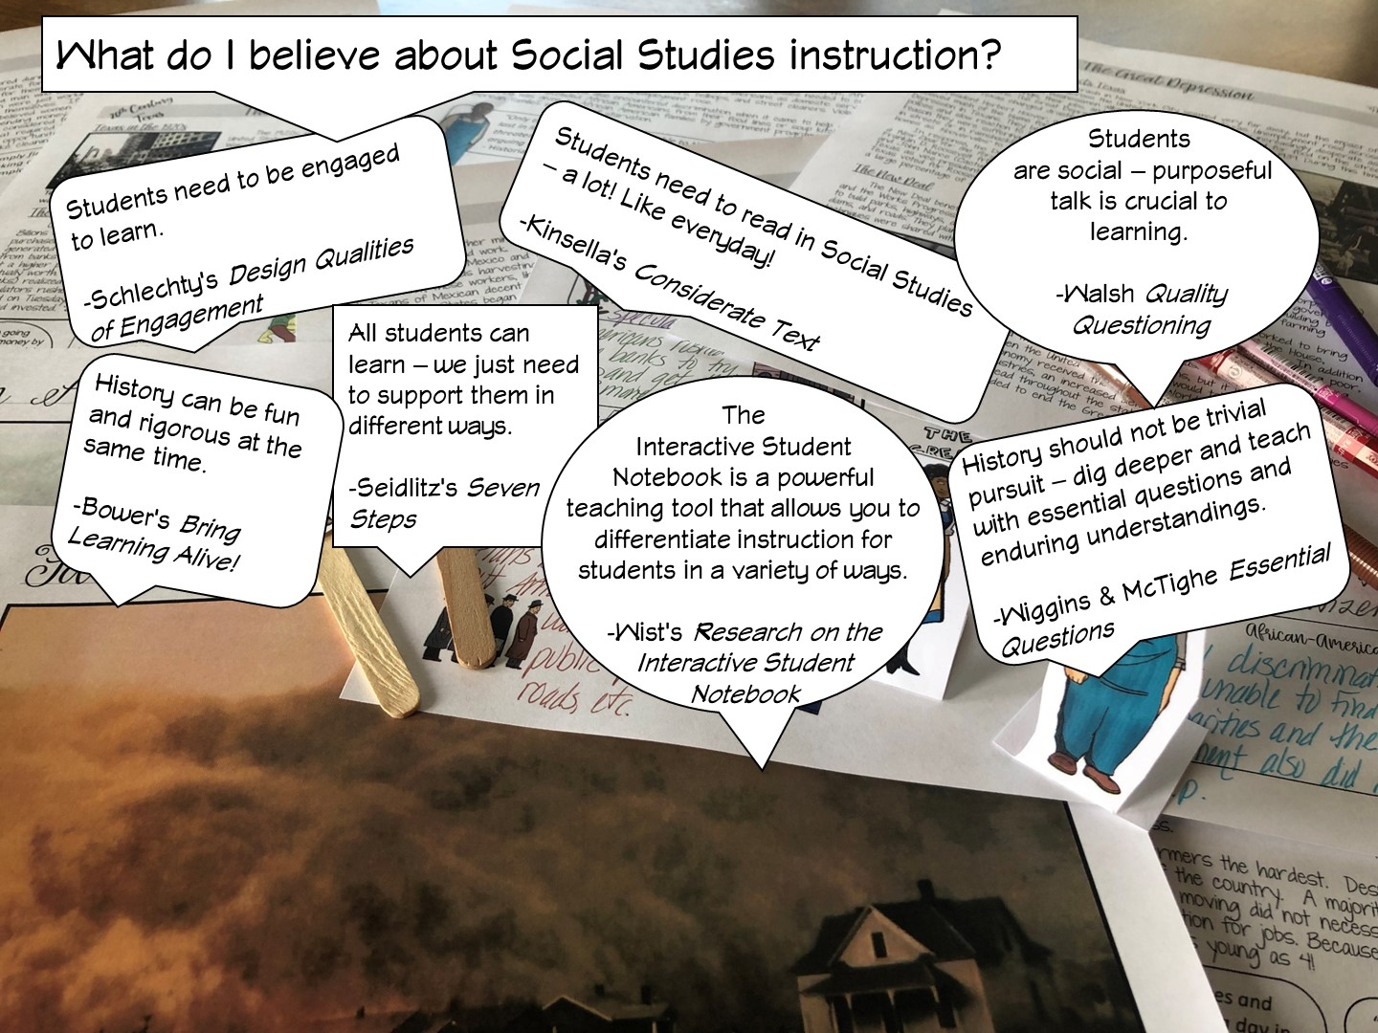
Notes:
Differentiated instruction is ensuring that learning happens in an accessible way for the student. ISNs allow the students to format their thoughts however they find suitable, thus, differentiating by learning styles — someone who loves writing can love in the notebooks, another student who would rather draw is free to express his/her ideas through diagrams, charts and pictures.

Slide 11
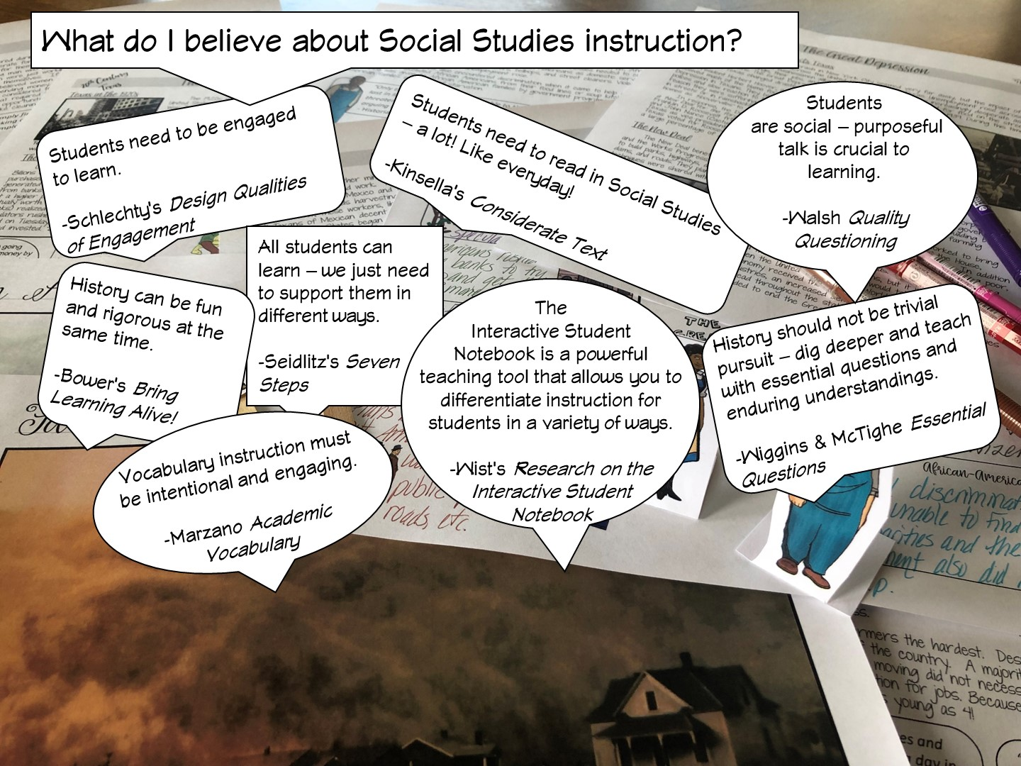
Notes:
Differentiated instruction is ensuring that learning happens in an accessible way for the student. ISNs allow the students to format their thoughts however they find suitable, thus, differentiating by learning styles — someone who loves writing can love in the notebooks, another student who would rather draw is free to express his/her ideas through diagrams, charts and pictures.

Slide 12
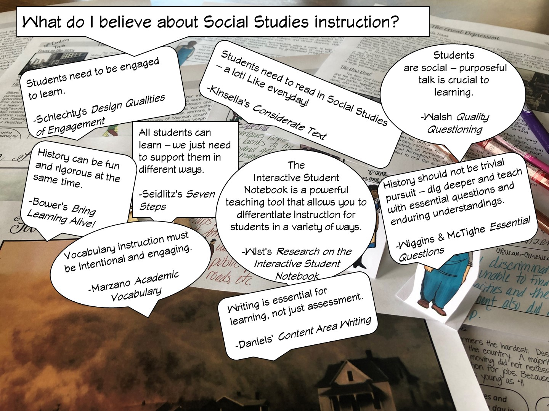
Notes:
Differentiated instruction is ensuring that learning happens in an accessible way for the student. ISNs allow the students to format their thoughts however they find suitable, thus, differentiating by learning styles — someone who loves writing can love in the notebooks, another student who would rather draw is free to express his/her ideas through diagrams, charts and pictures.

Slide 13
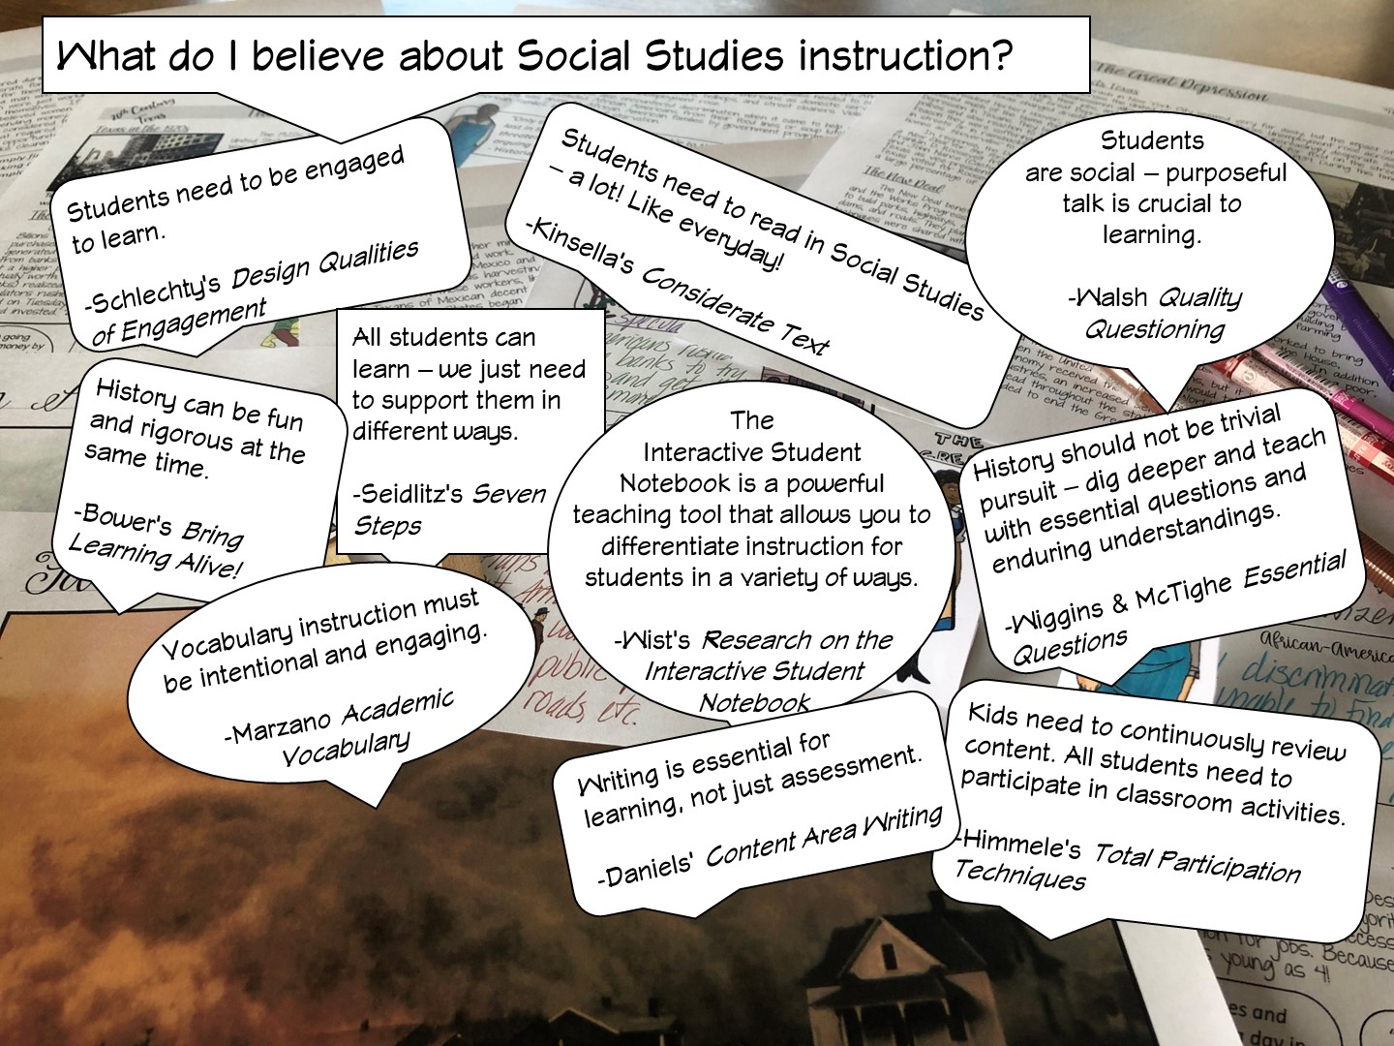
Notes:
Differentiated instruction is ensuring that learning happens in an accessible way for the student. ISNs allow the students to format their thoughts however they find suitable, thus, differentiating by learning styles — someone who loves writing can love in the notebooks, another student who would rather draw is free to express his/her ideas through diagrams, charts and pictures.

Slide 14
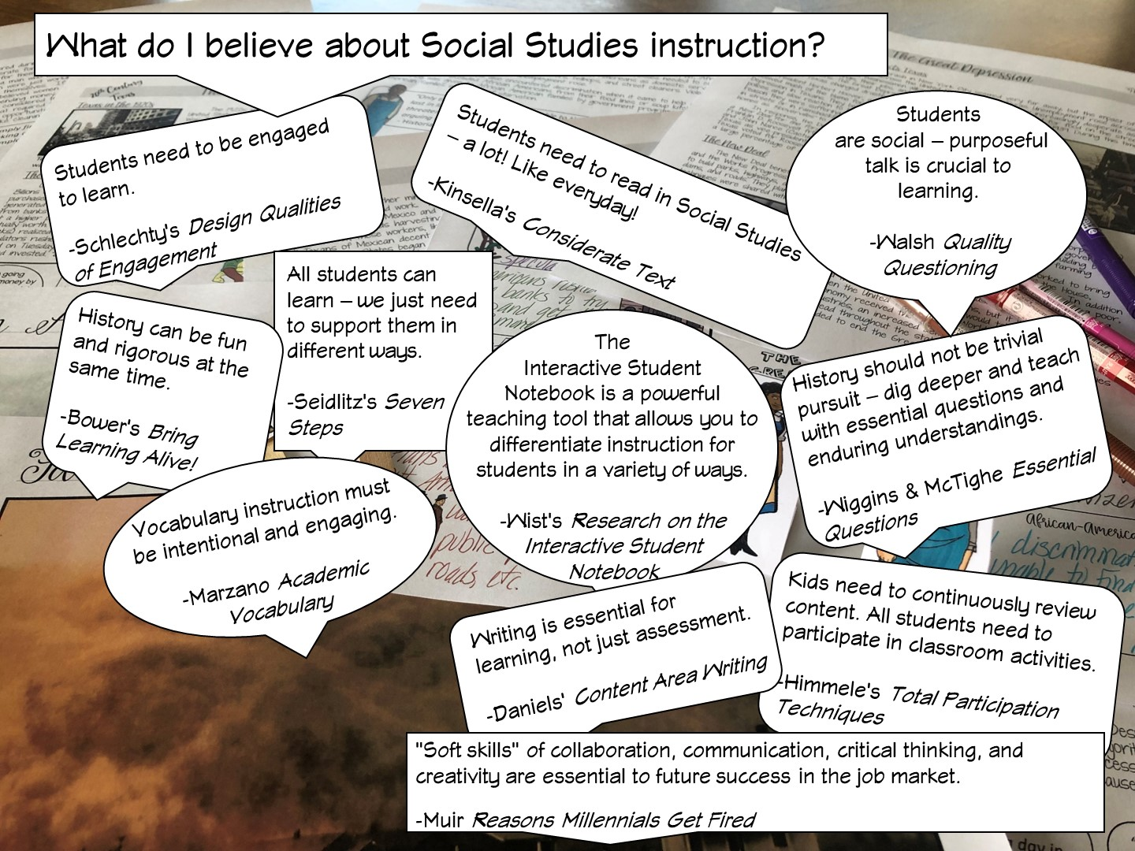
Notes:
Differentiated instruction is ensuring that learning happens in an accessible way for the student. ISNs allow the students to format their thoughts however they find suitable, thus, differentiating by learning styles — someone who loves writing can love in the notebooks, another student who would rather draw is free to express his/her ideas through diagrams, charts and pictures.

Slide 15
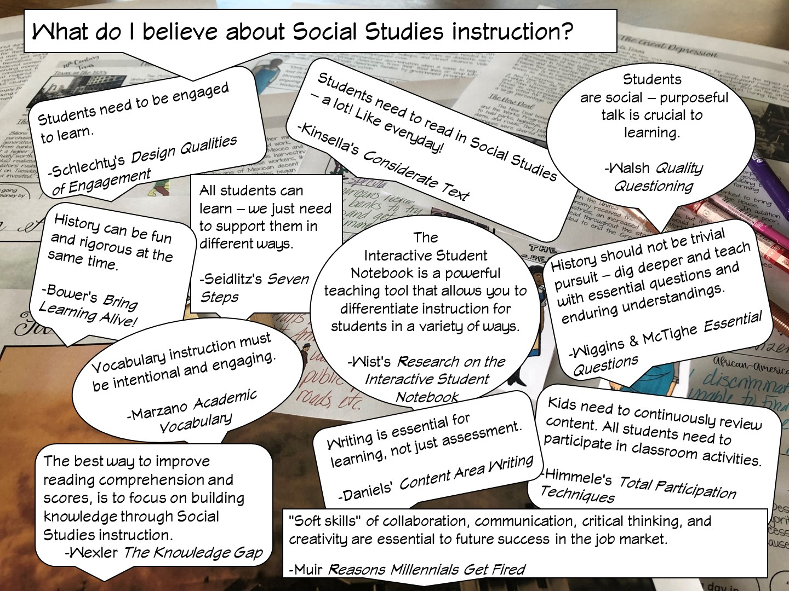
Notes:
Differentiated instruction is ensuring that learning happens in an accessible way for the student. ISNs allow the students to format their thoughts however they find suitable, thus, differentiating by learning styles — someone who loves writing can love in the notebooks, another student who would rather draw is free to express his/her ideas through diagrams, charts and pictures.

Slide 16

Notes:
History teachers are the guardians of democracy

Slide 17


Slide 18

Notes:
Have teachers write their goals on a post it note and share
Review our goals

Slide 19
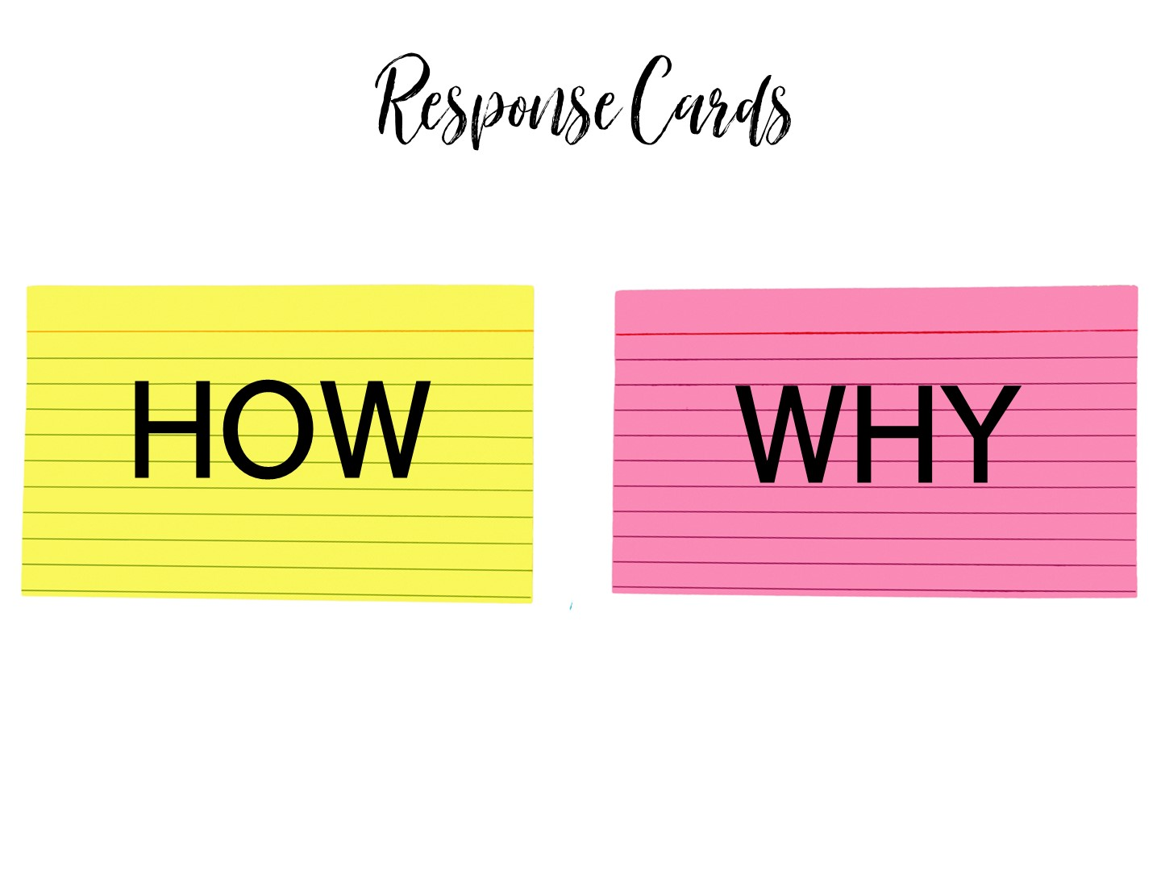
Notes:
Pass out pink and yellow index cards. Each person should have one of each. As you ask the following questions, they will need to hold up a card to represent their answer.

Slide 20
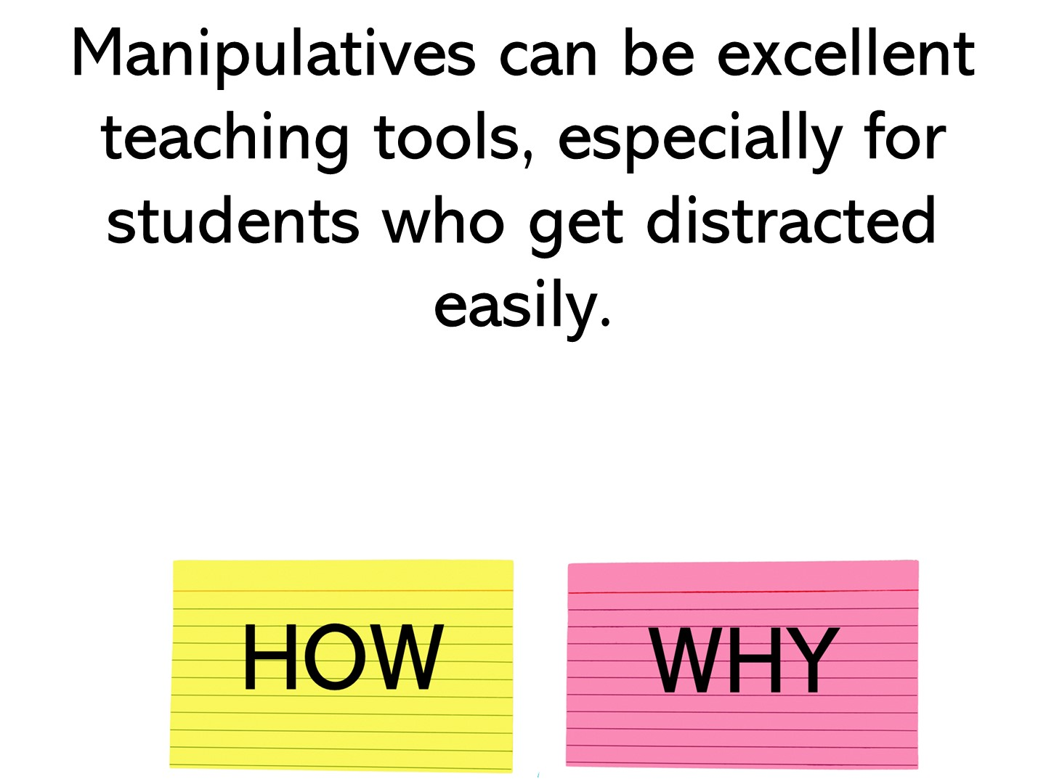
Notes:
This is a why

Slide 21
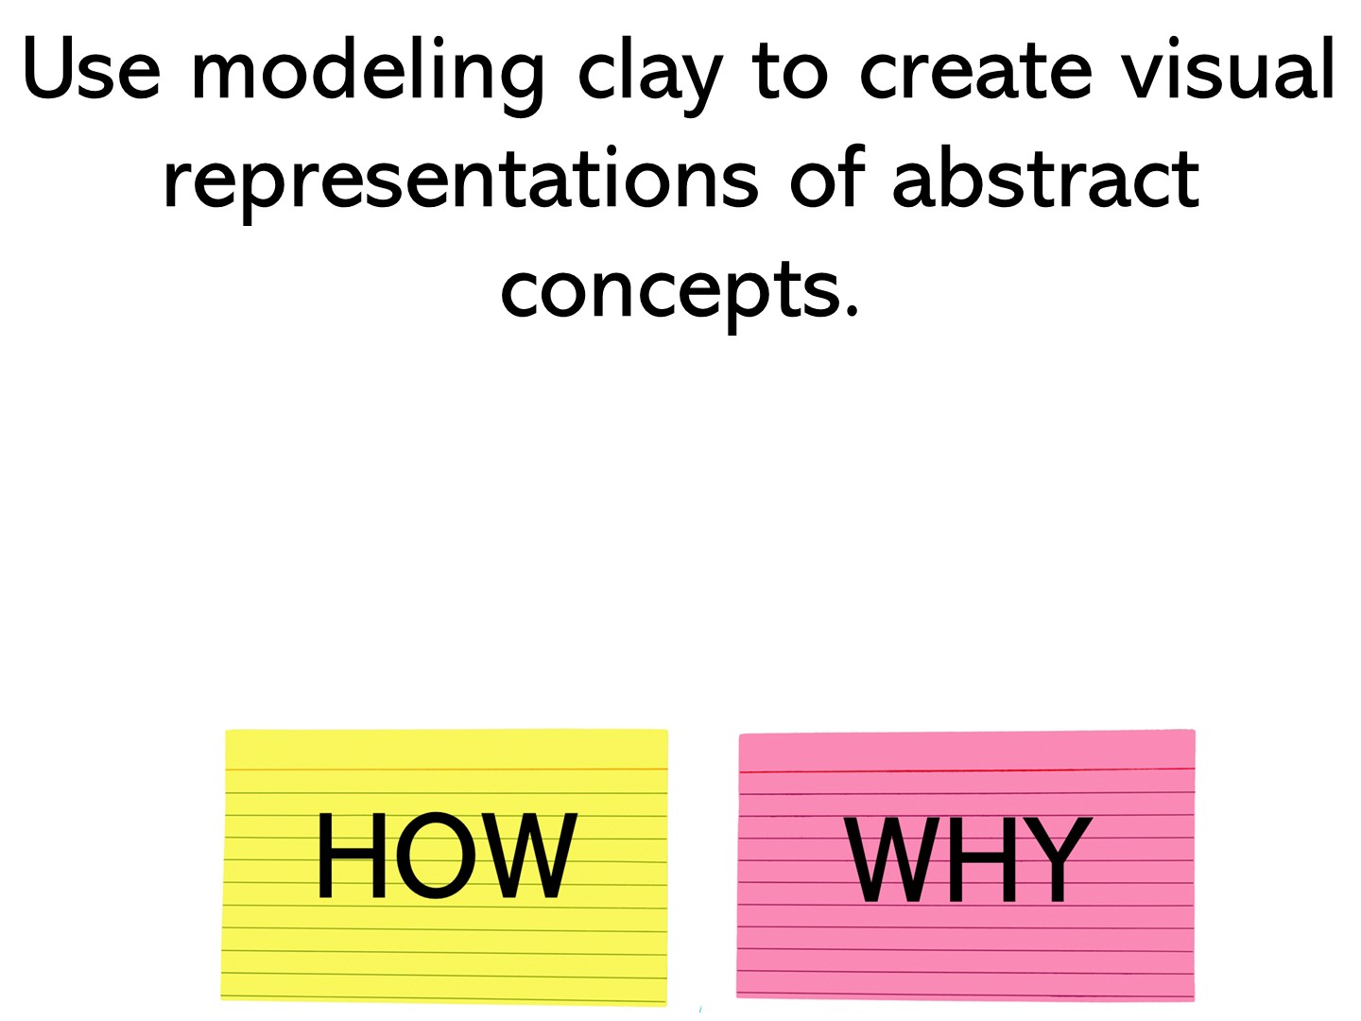
Notes:
how

Slide 22
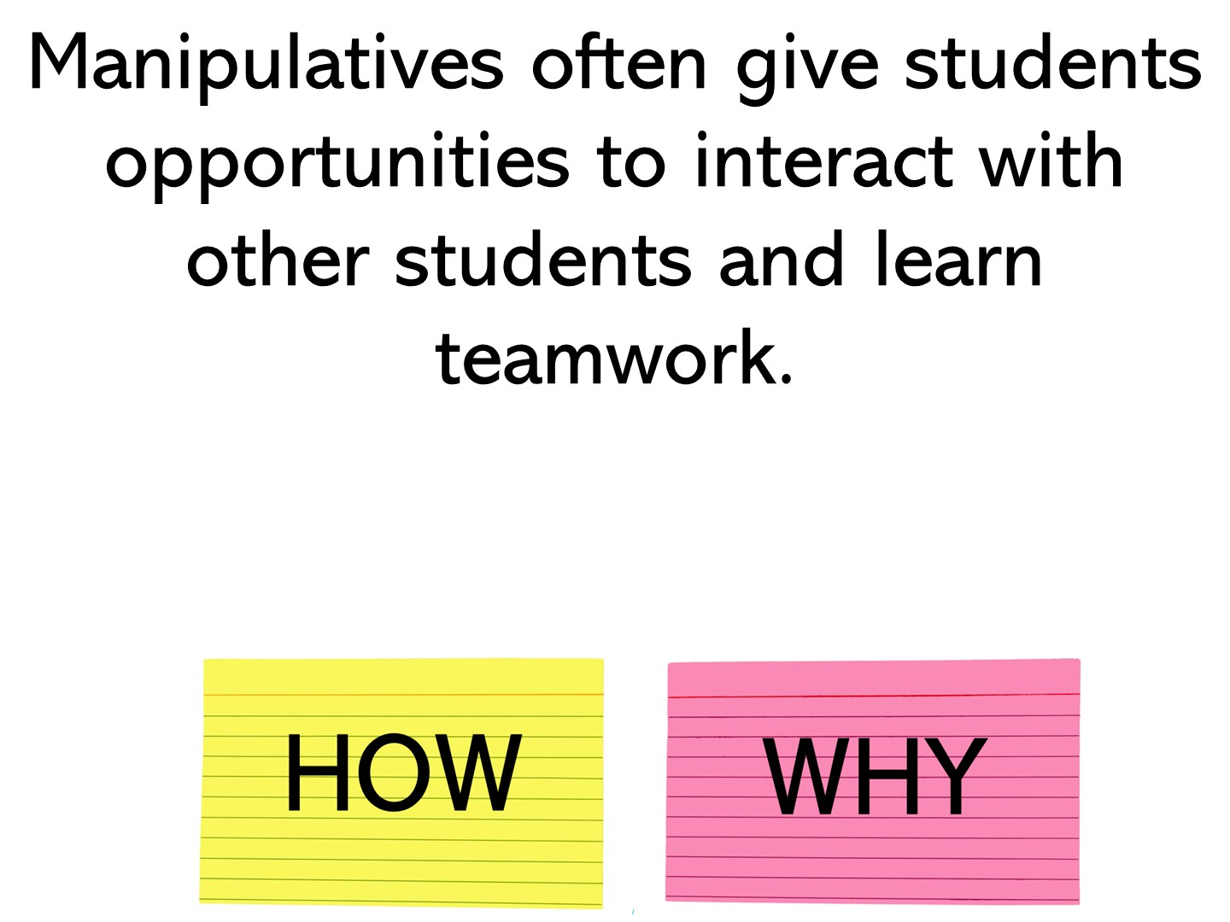
Notes:
why

Slide 23
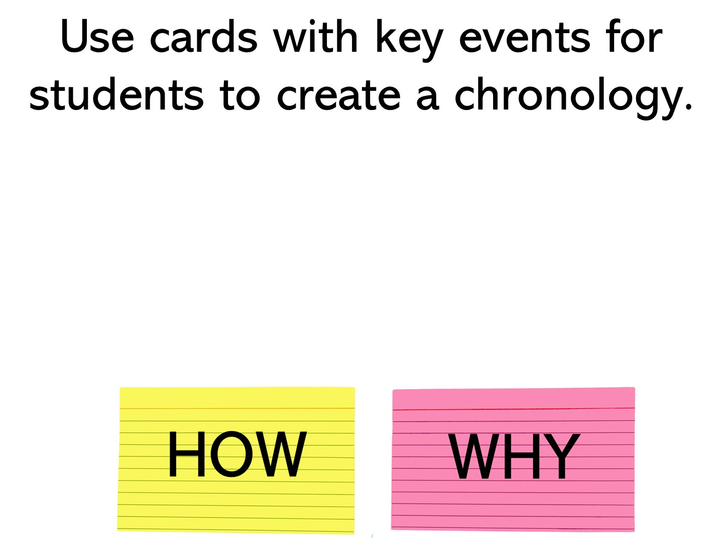
Notes:
how

Slide 24
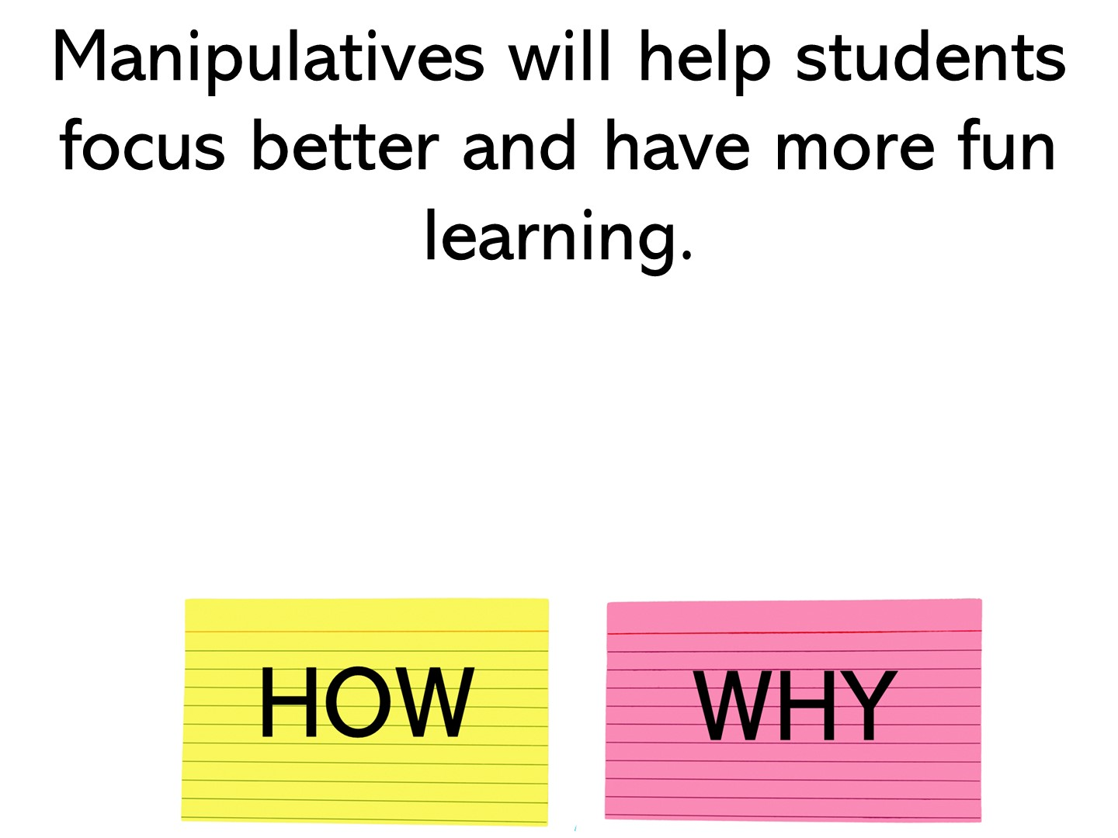
Notes:
why

Slide 25
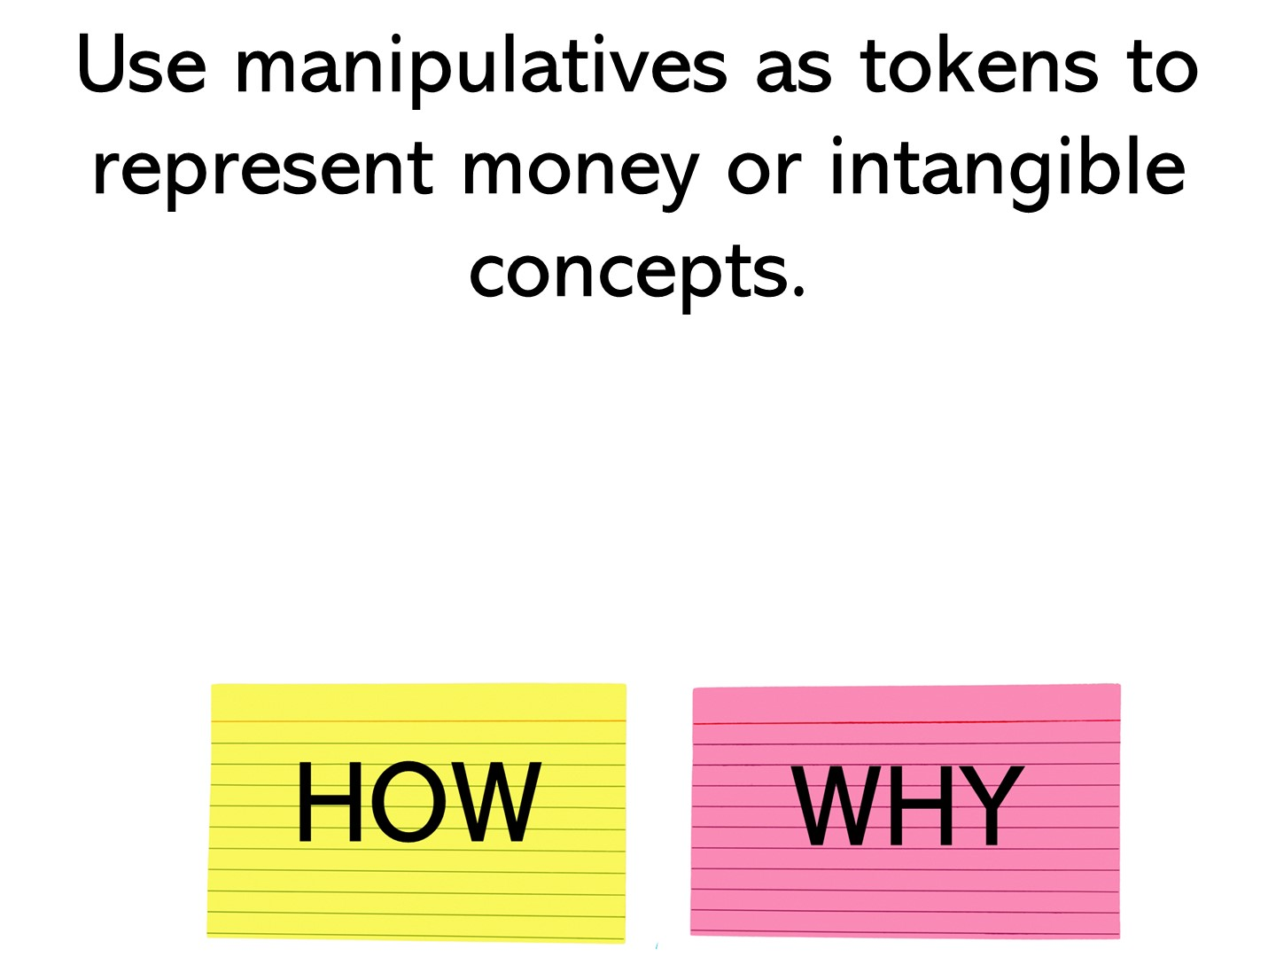
Notes:
how

Slide 26
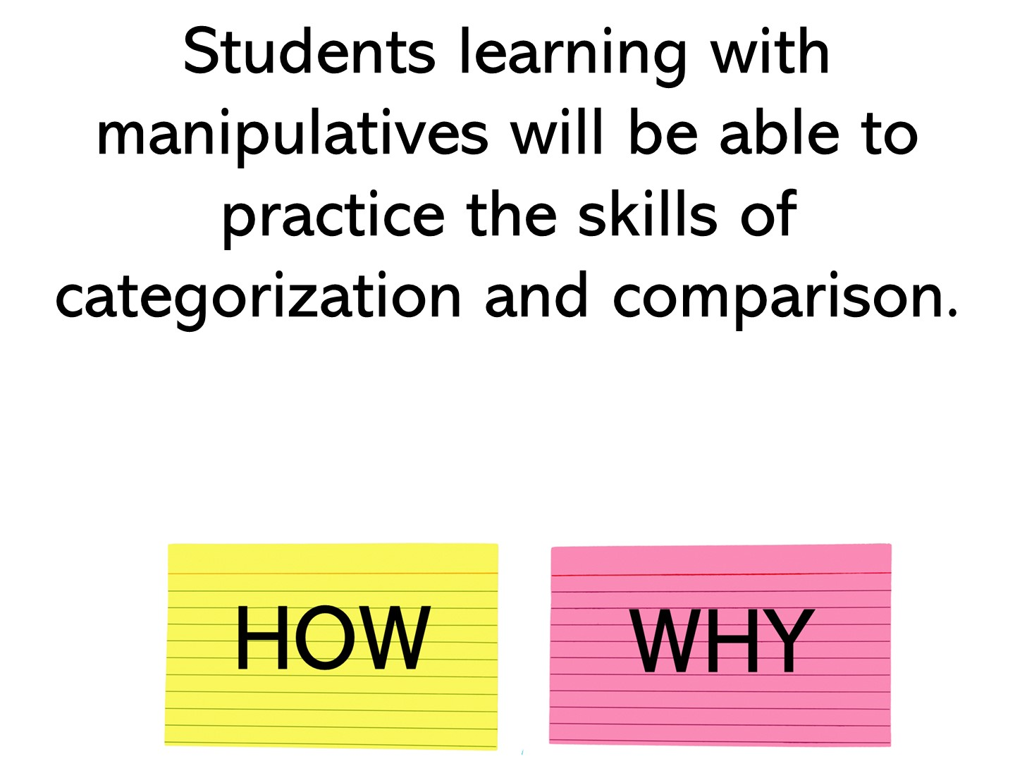
Notes:
why

Slide 27
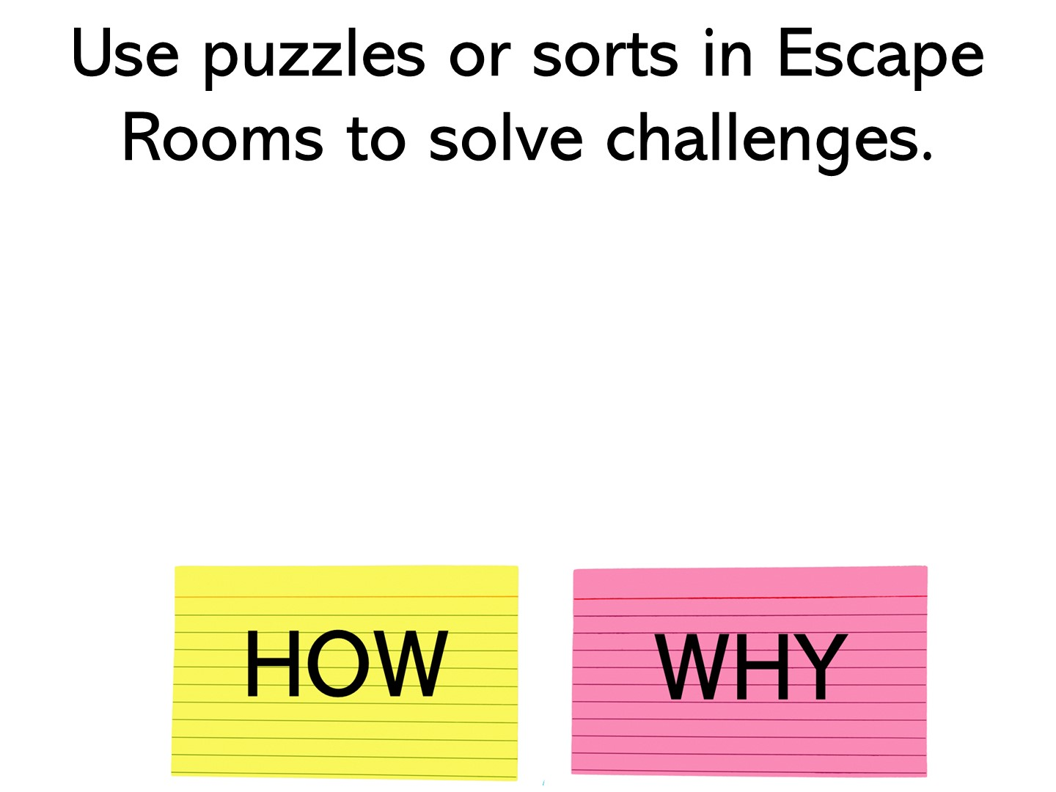
Notes:
how

Slide 28

Notes:
Share one of your stories here

Slide 29

Notes:
Organization – it keeps your kids organized – everything they need for a unit is in one place
Student Centered – Once your students make their lap books, they are responsible for completing the information as they learn the information
Engagement – it is novel for the students, and they made it themselves, so it also builds student ownership

Slide 30
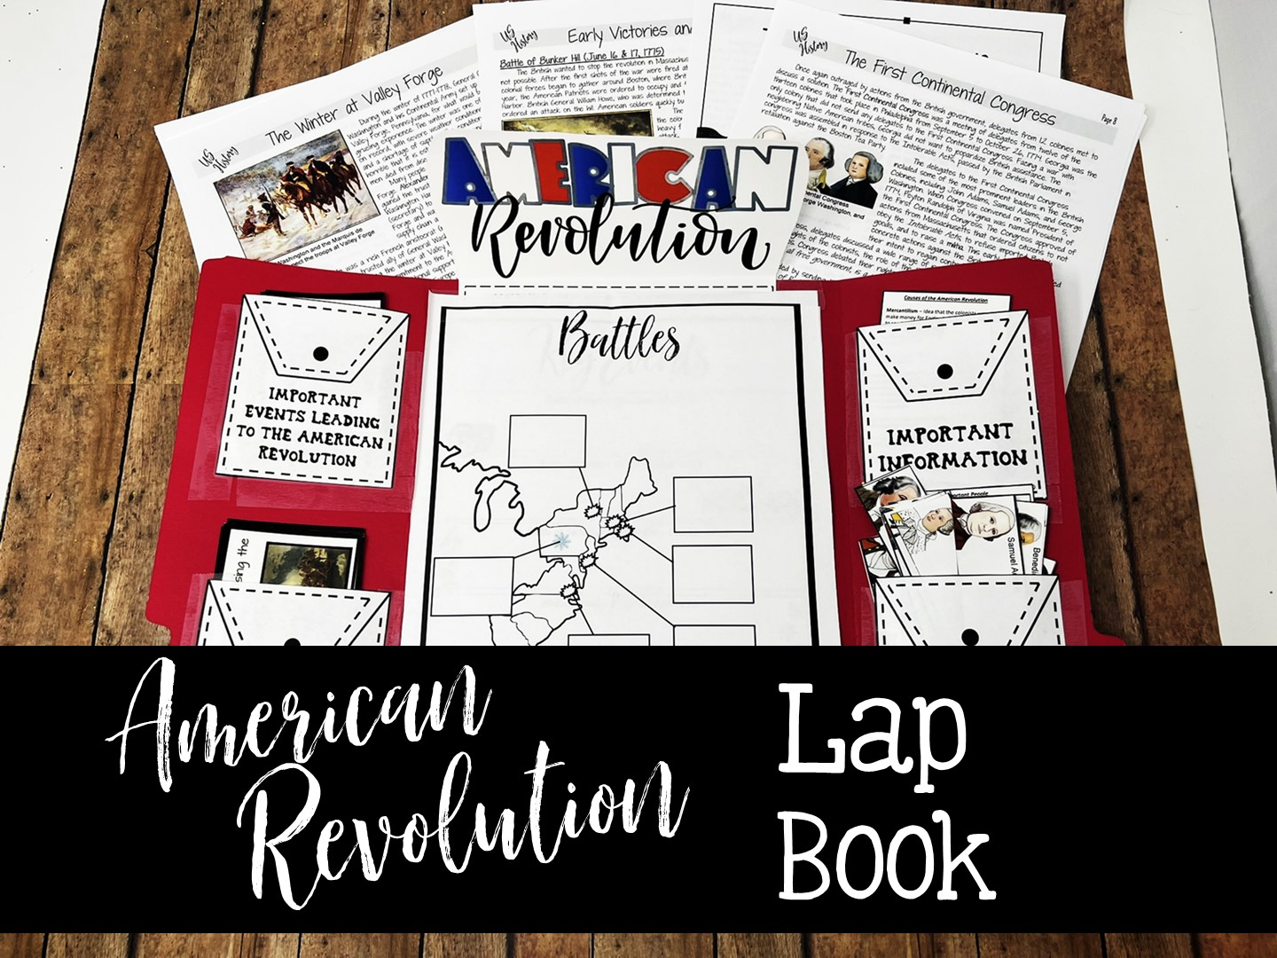
Notes:
Pass out the folders with the templates. Tell them this is one of my most time-consuming lap books to make, simply because it has so many parts, but it is a COMPREHENSIVE resource for all things American Revolution, and when they are done, it will contain games to review! This template has been designed for 8th grade as it is too comprehensive for 5th.

Slide 31
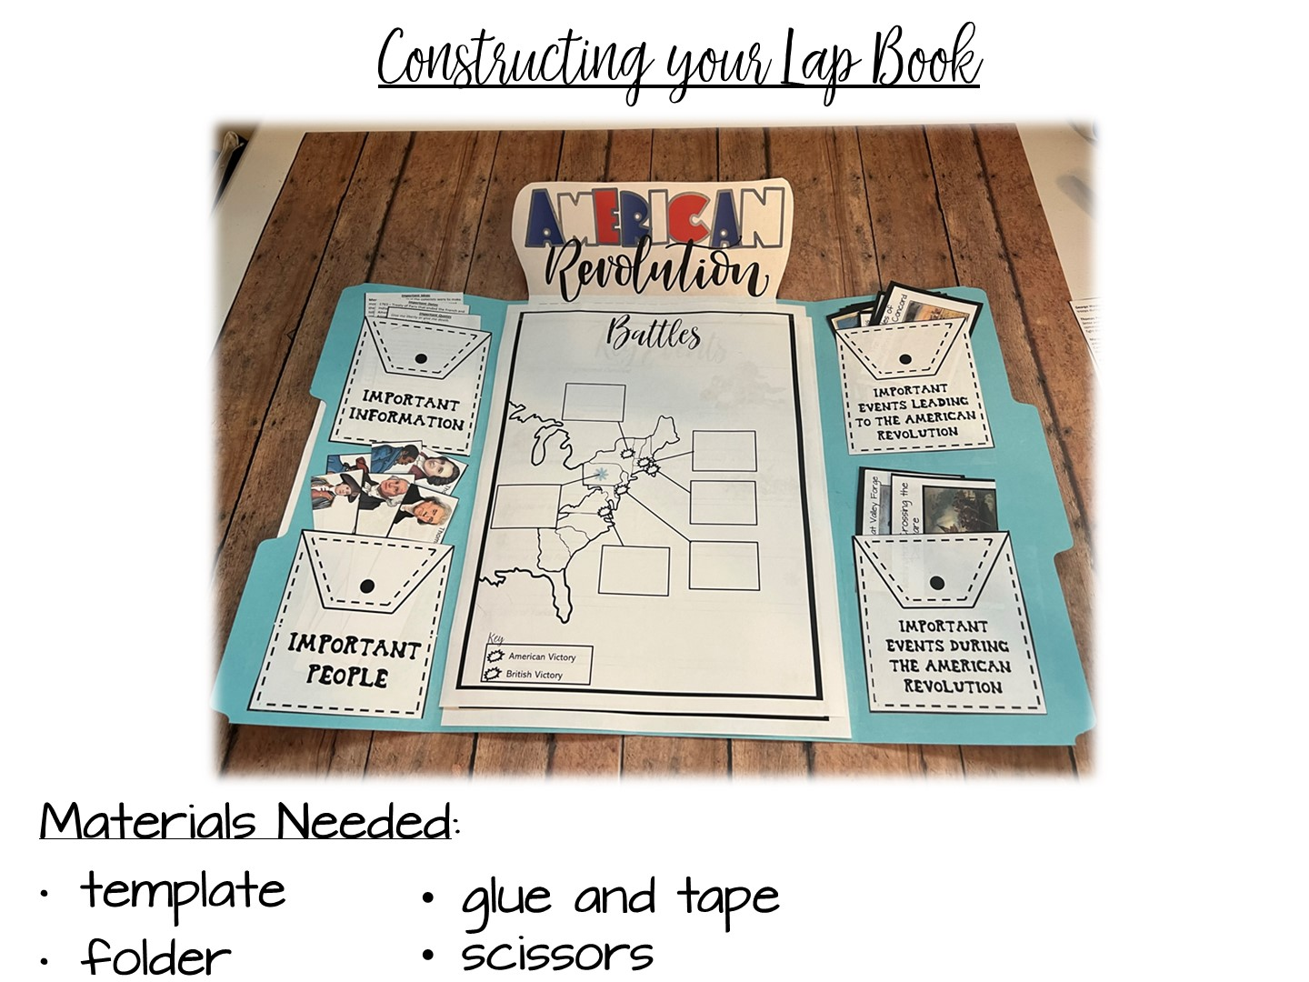
Notes:
Make sure everyone has resources that they need to make lap book.

Slide 32
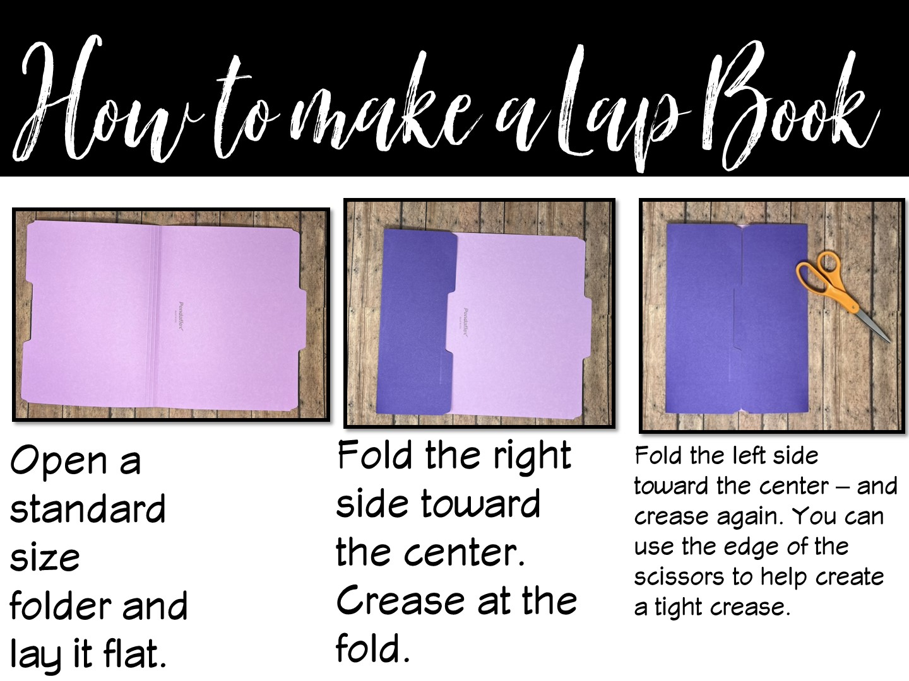
Notes:
Model how to make lap book – you should make one before the training to show them a completed model.

Slide 33
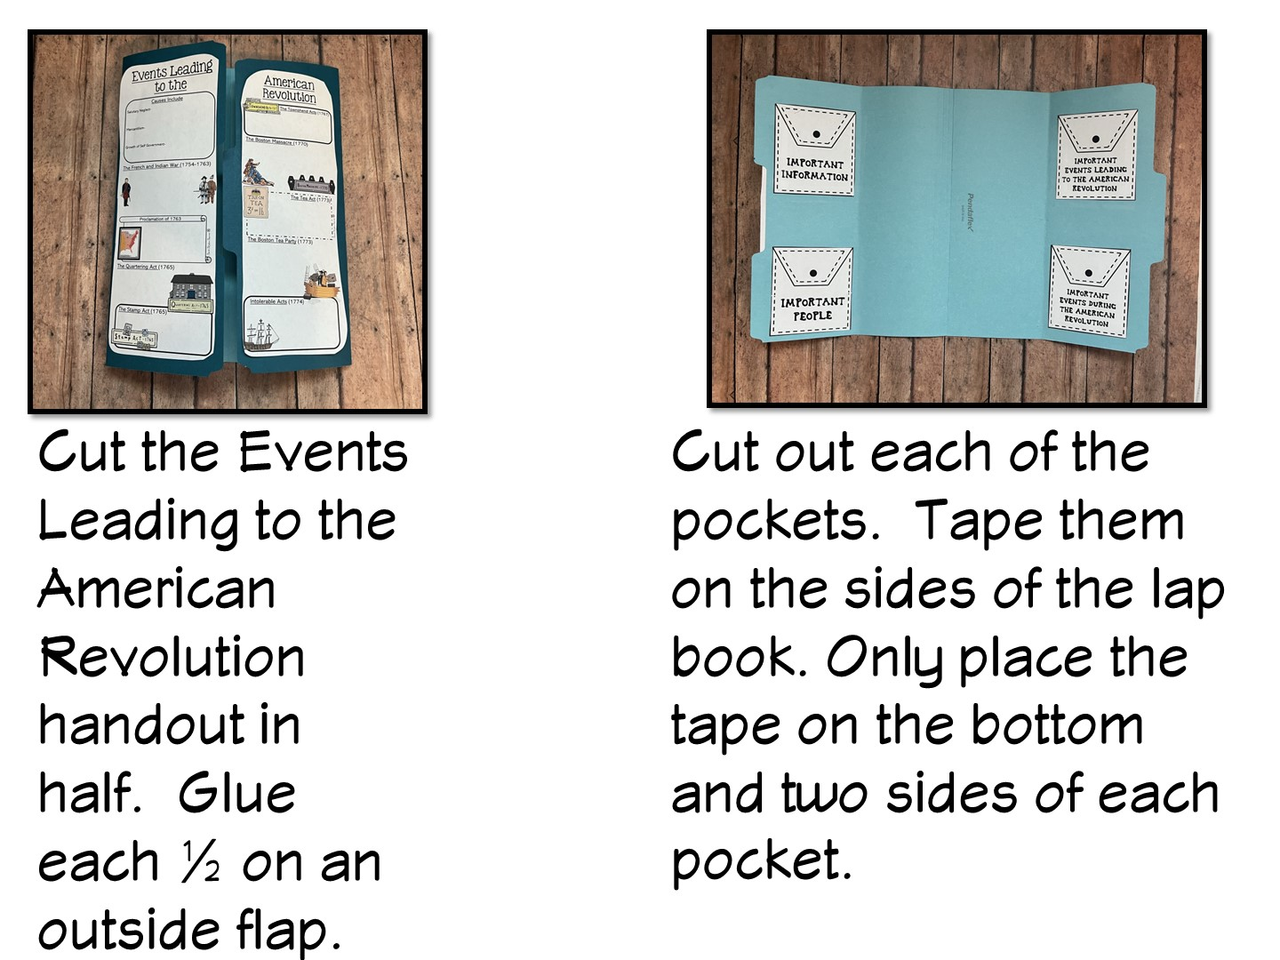

Slide 34
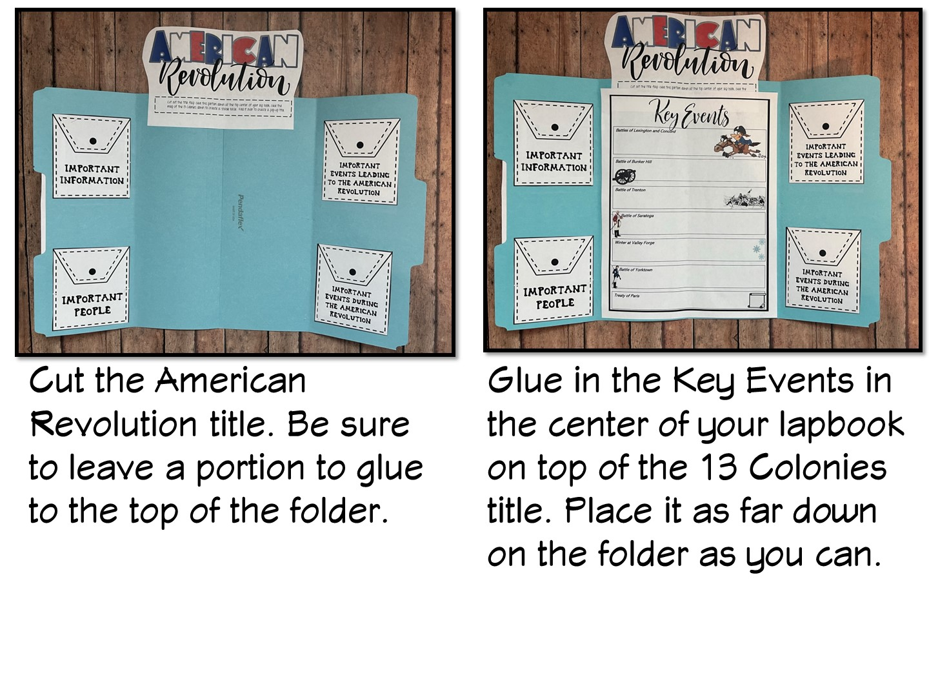

Slide 35
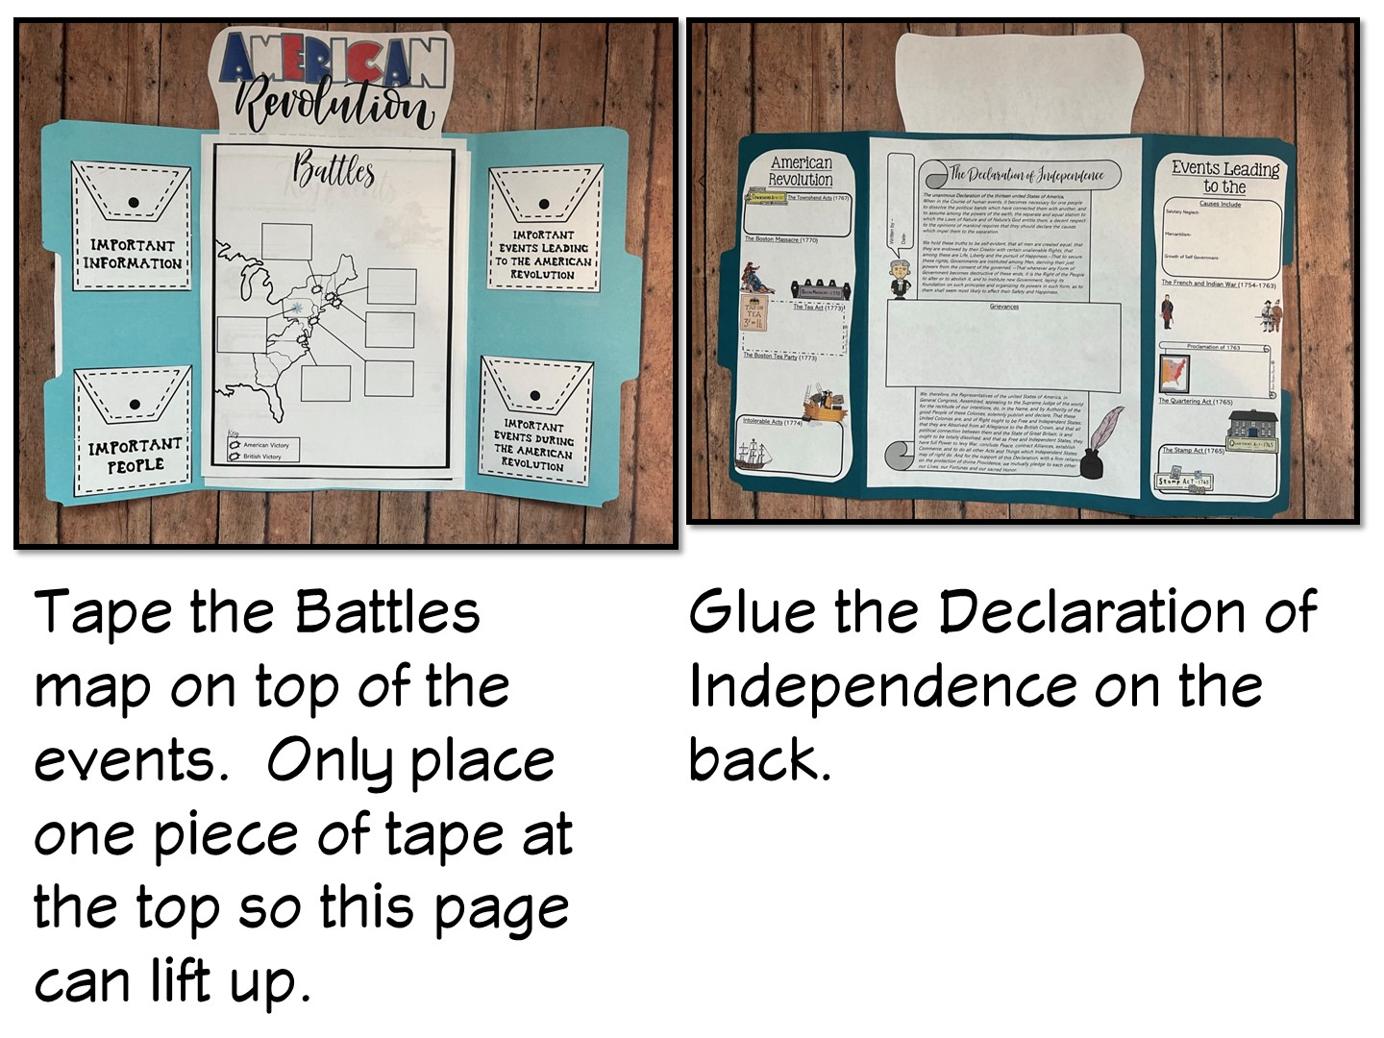

Slide 36
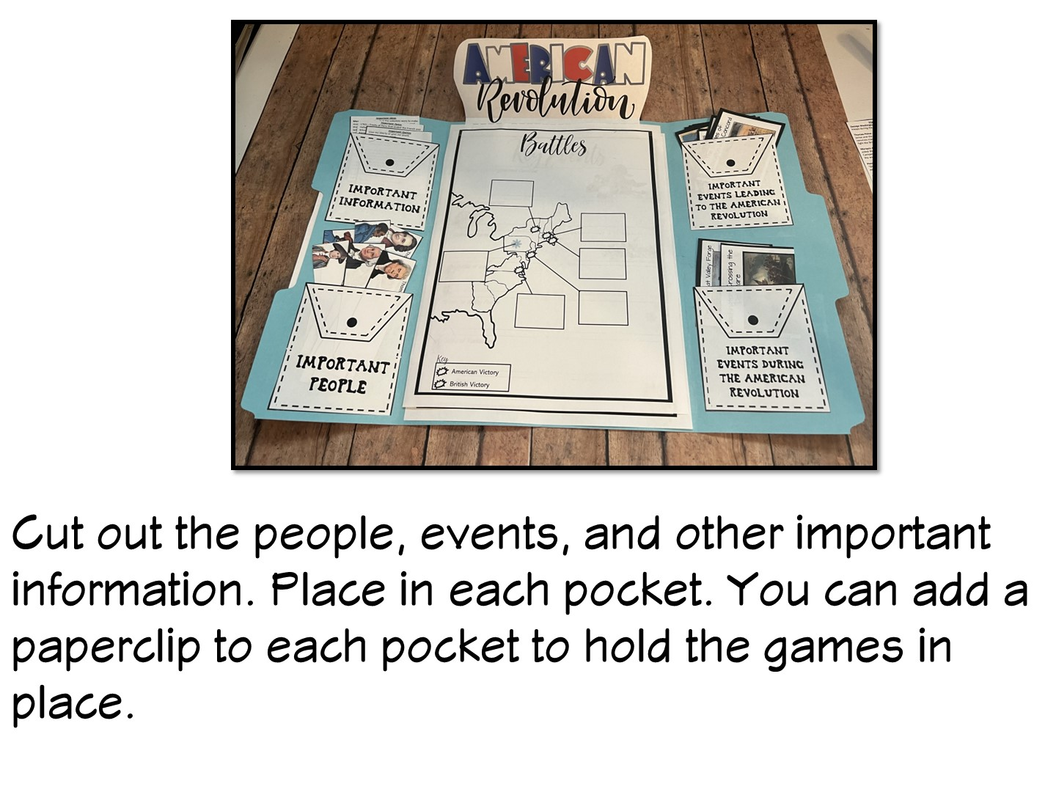
Notes:
These have been run off on card stock to increase the durability of the games.

Slide 37

Notes:
Share any classroom tips for making lap books – like organizing resources before and having several already made for absent students.
37

Slide 38

Notes:
Give teachers time to discuss with a partner, then use popsicle people to randomly call on teachers. Tell the teachers we will be coming back to the lap book during the training to show them the games and parts of the template.

Slide 39
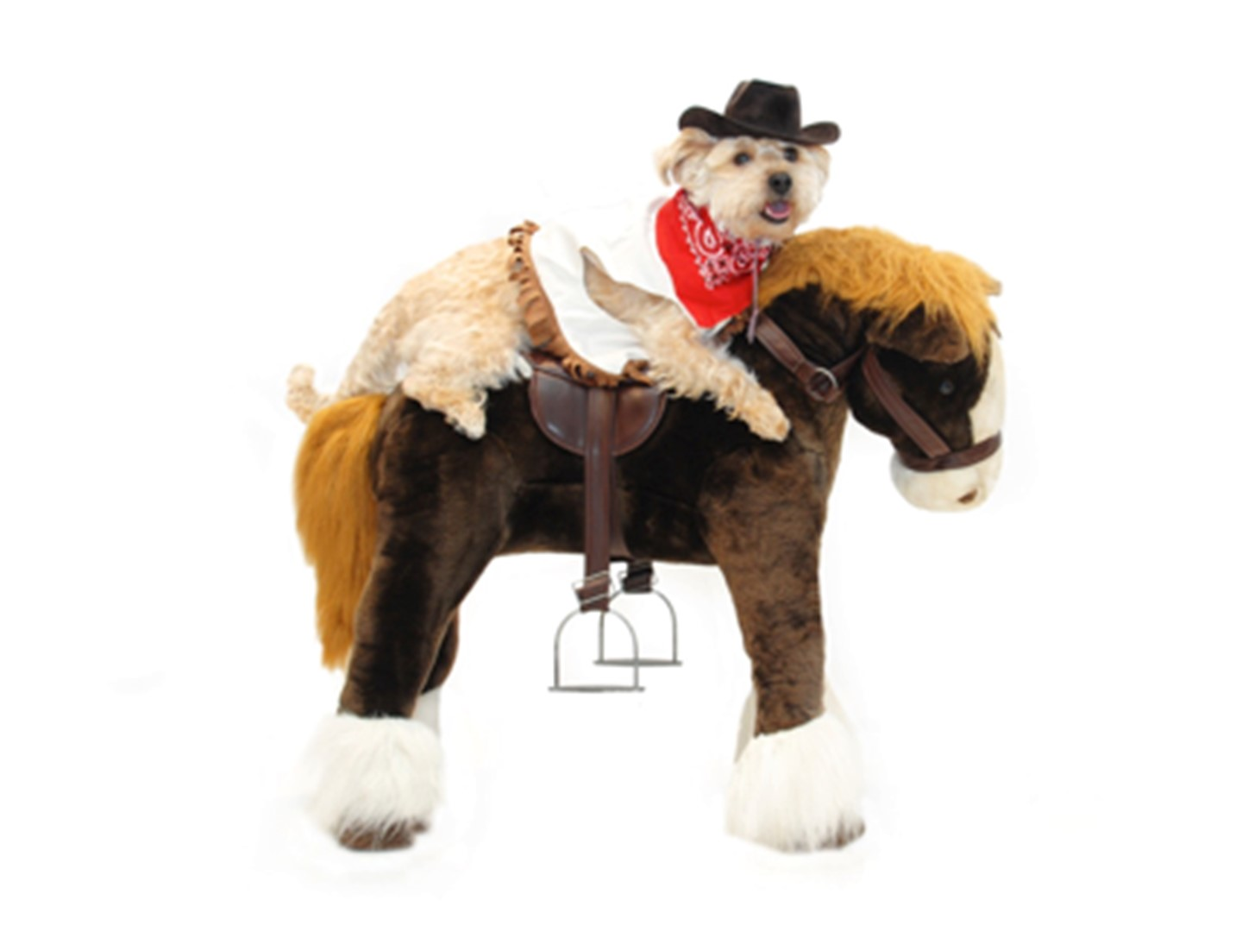
Notes:
State that these next series of lessons are “dog and pony” shows. You won’t have time to implement as seen, but it is designed to show you a variety of ways you can teach a topic with more hands-on resources.

Slide 40
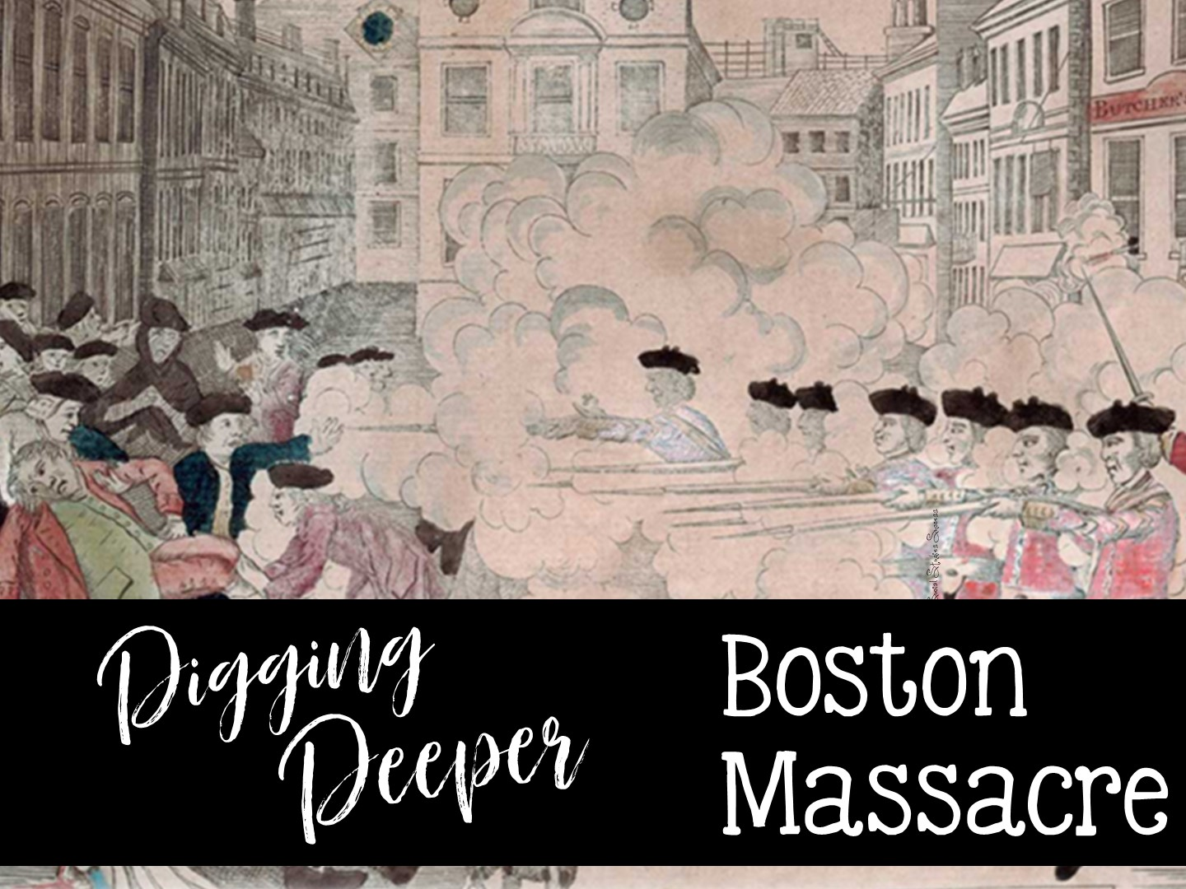
Notes:
This is one of my new 5th grade resources – Deborah said there will be elementary teachers in the training.

Slide 41
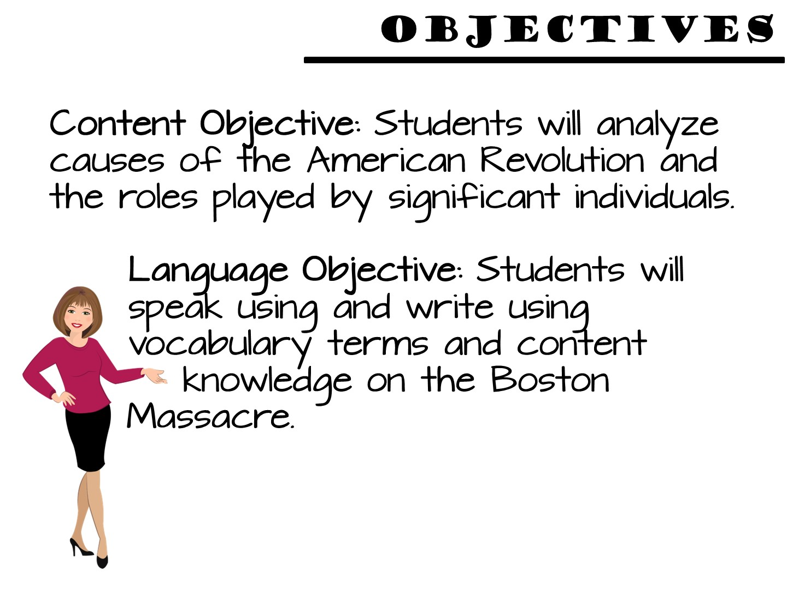
Notes:
These are 5th grade objectives.

Slide 42
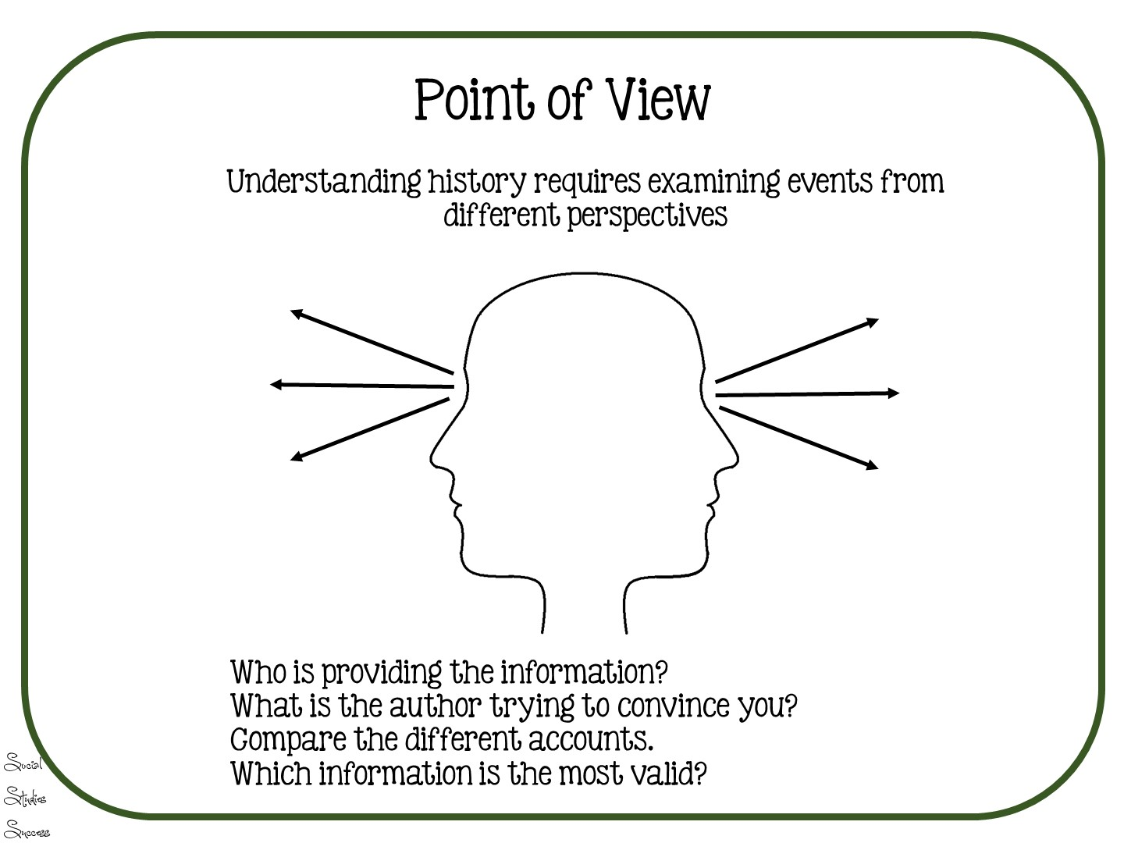
Notes:
This is the skill that will be taught in addition to the content.

Slide 43


Slide 44

Notes:
Post the word wall and pronounce the terms

Slide 45
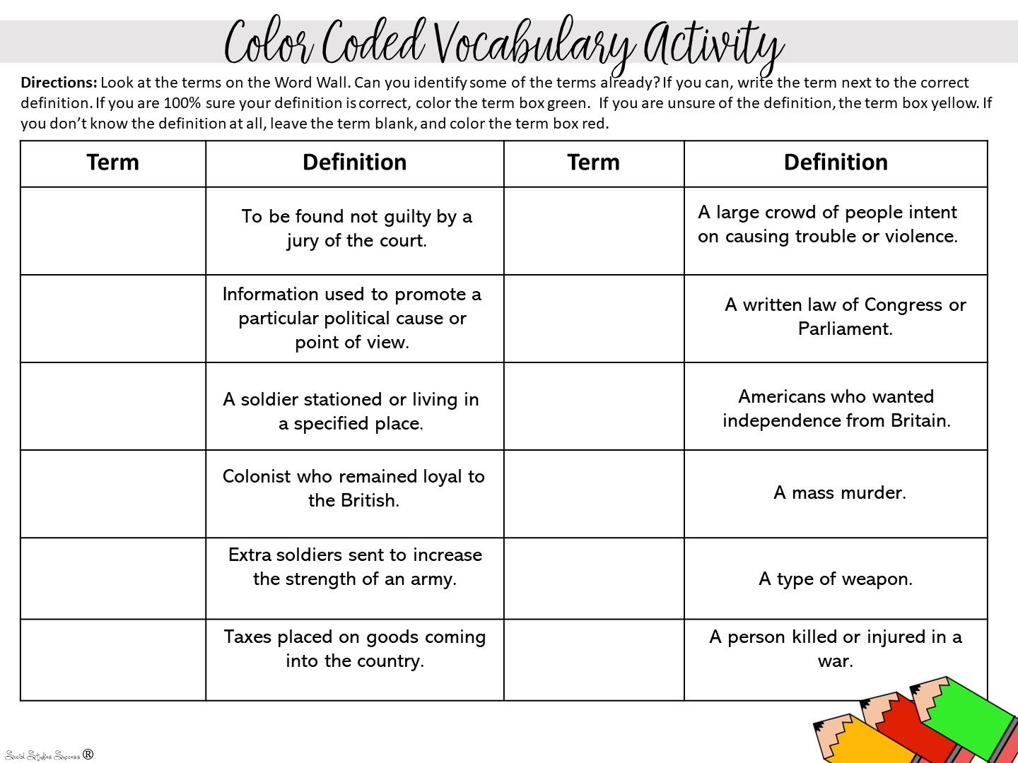
Notes:
Pass out colored pencils and have the teachers do about 5 terms.

Slide 46
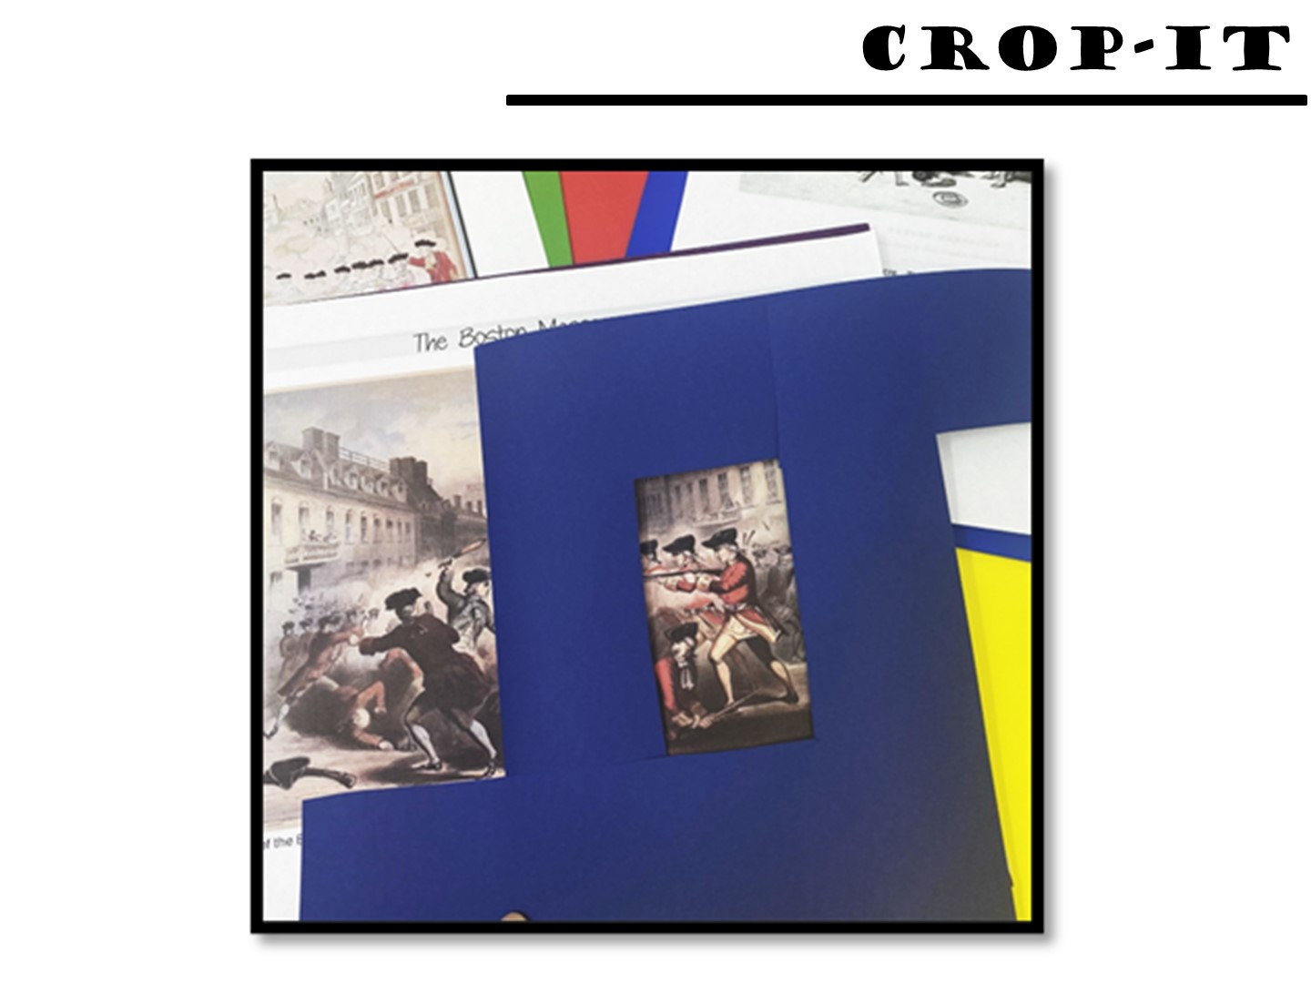
Notes:
Pass out the crop-it tool and the Boston Massacre images. Give the teachers a few minutes to just examine the image using the tool. Hand out the Questions for Image Analysis as a teacher freebie when you are done.

Slide 47
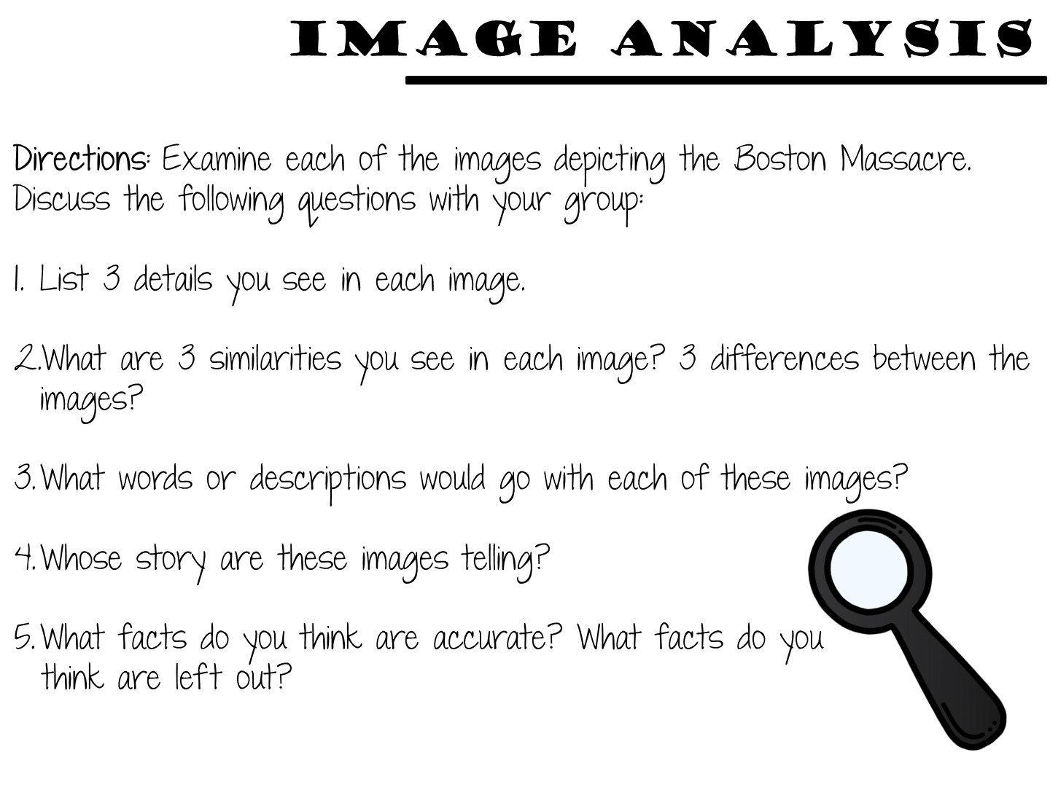
Notes:
Use the crop-it tool to answer as many of the questions as you can.

Slide 48
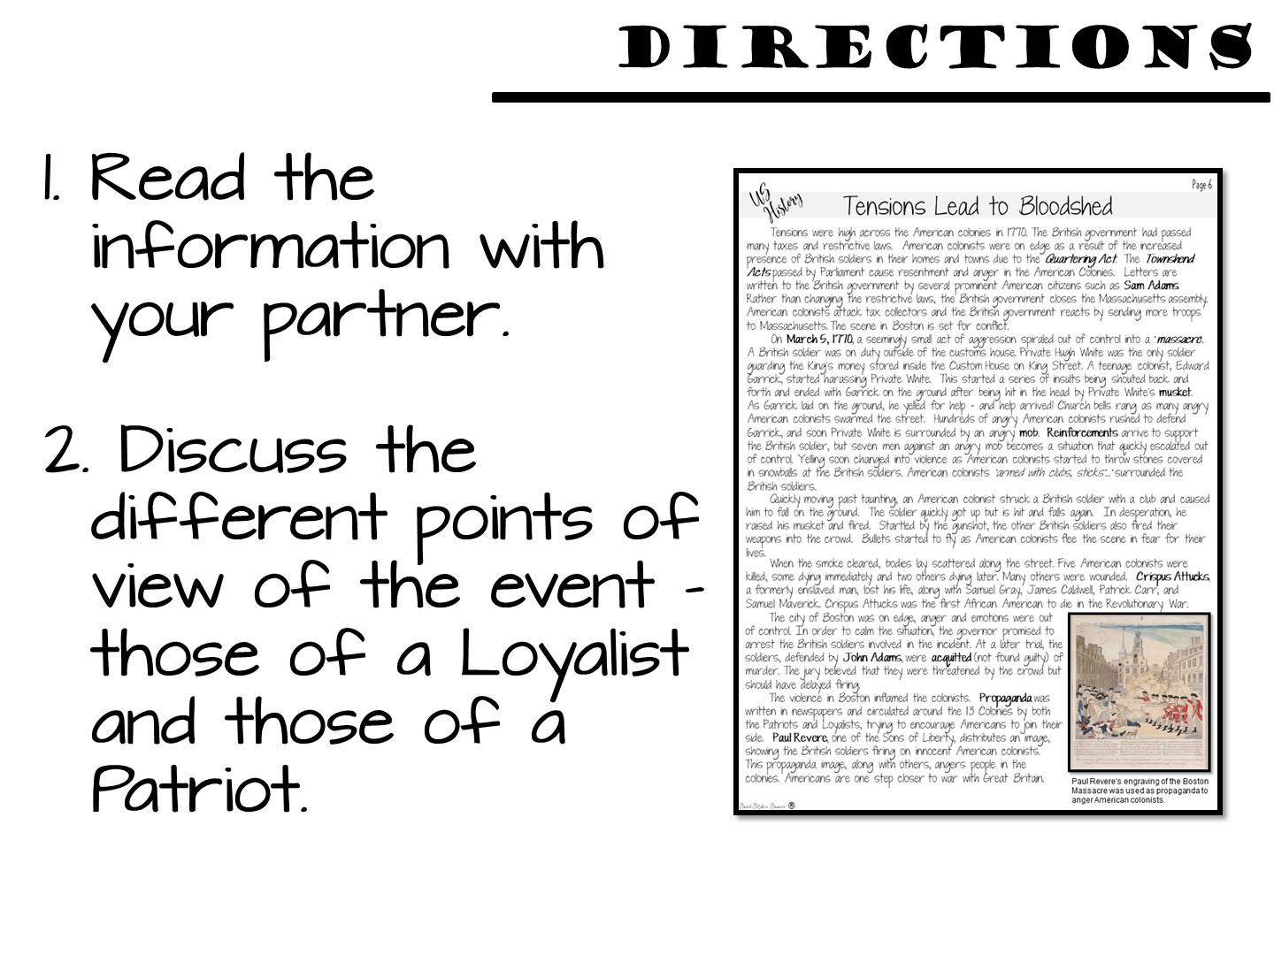
Notes:
Pass out the reading and the graphic organizer.

Slide 49
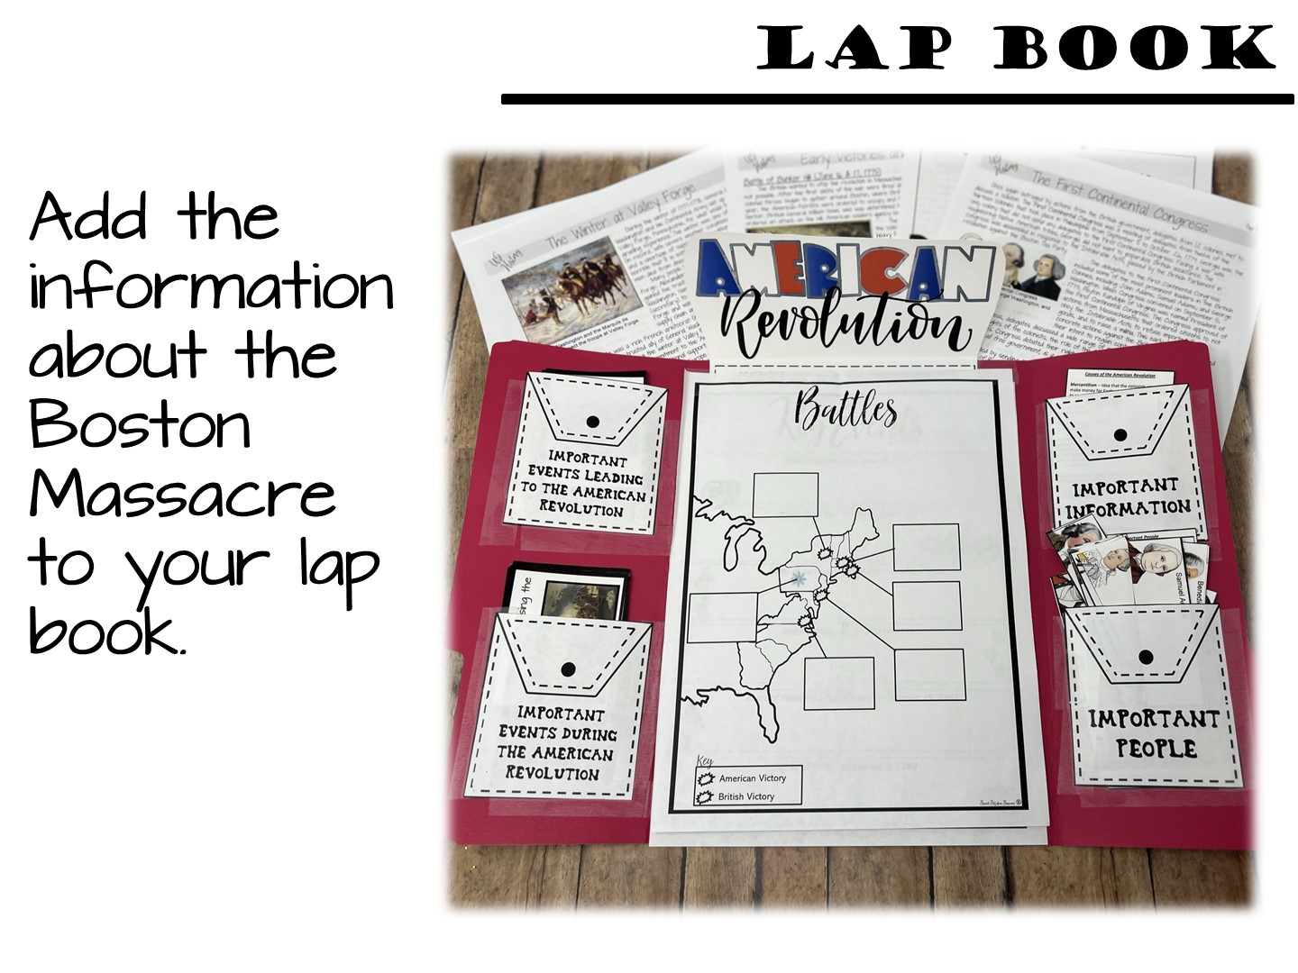

Slide 50
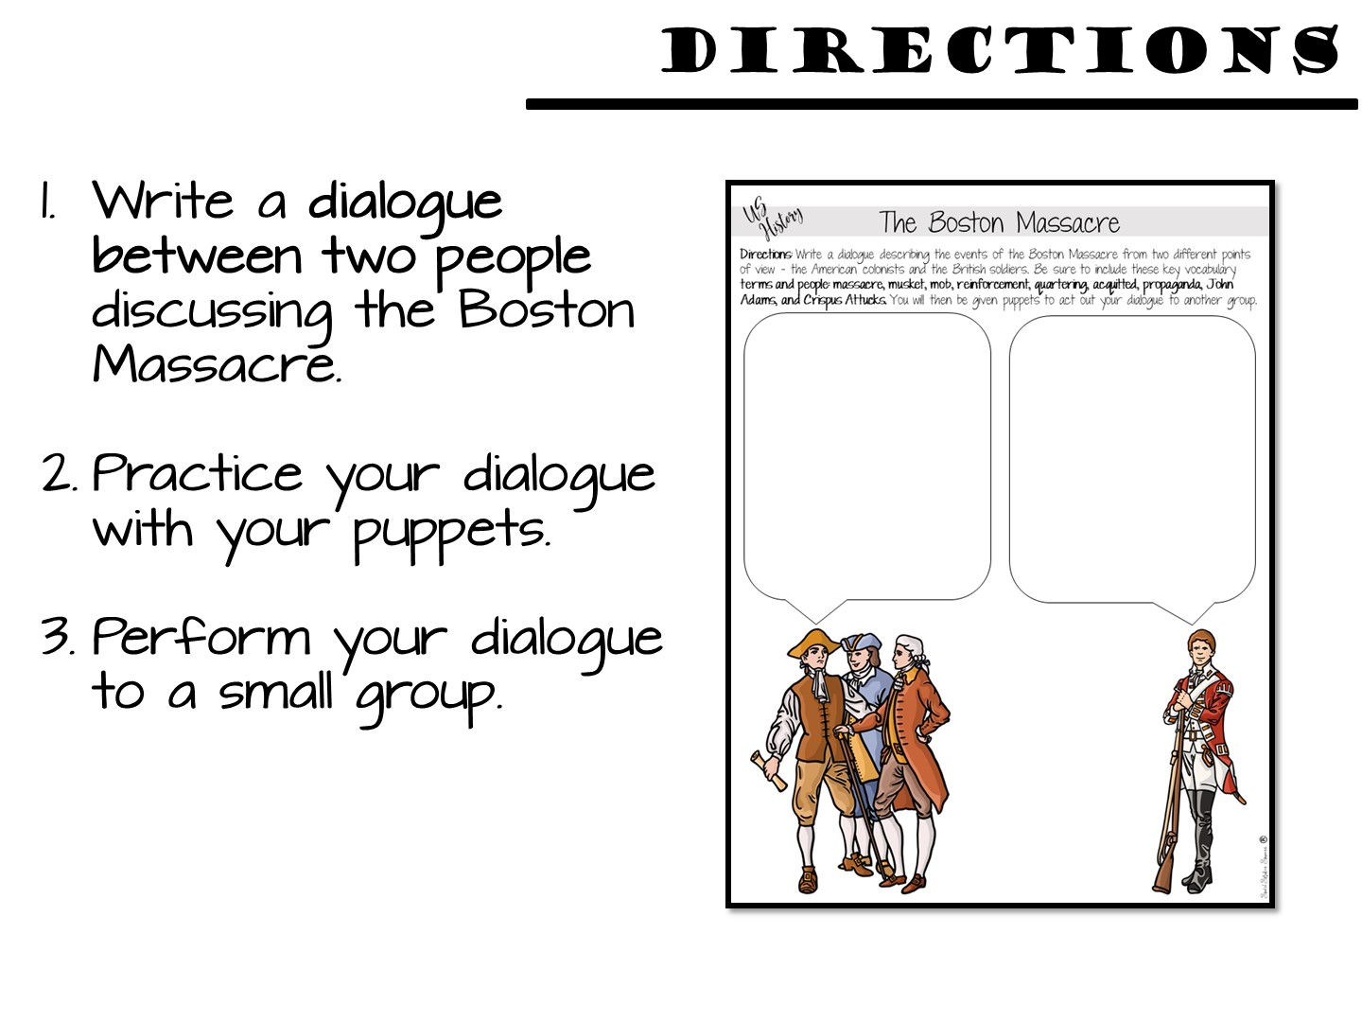

Slide 51
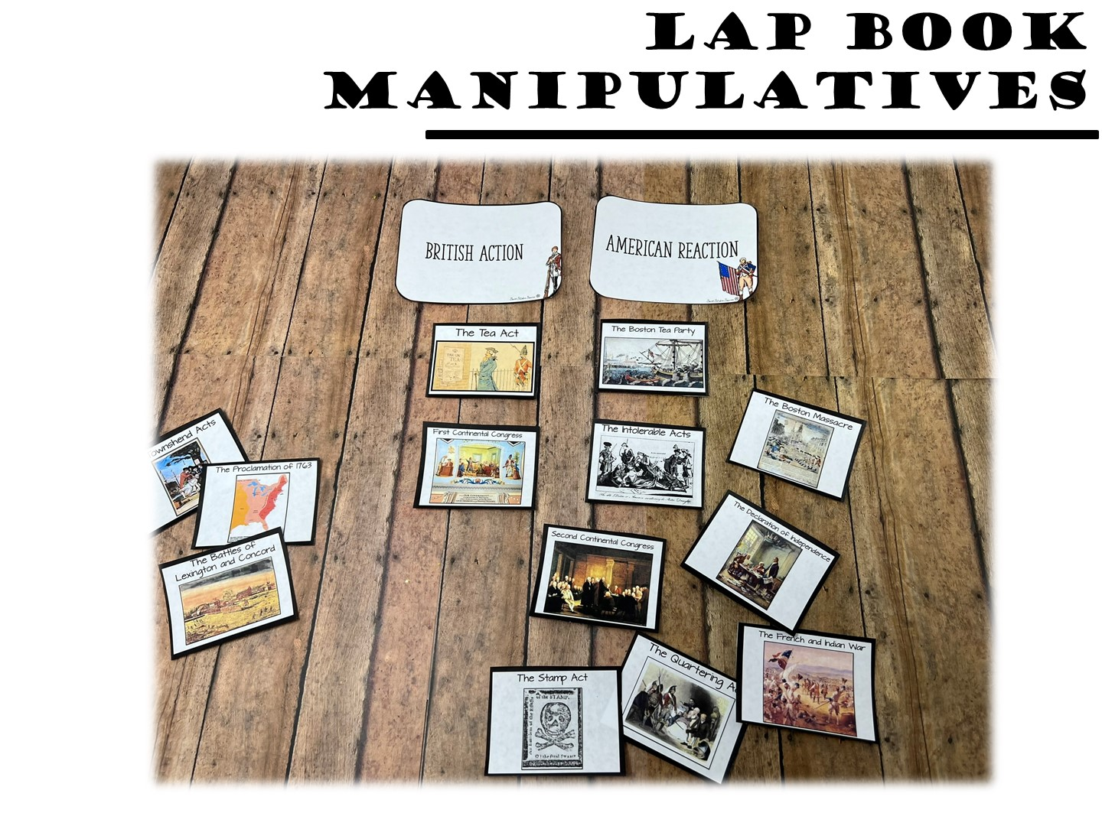
Notes:
Use the manipulatives in the lap book to model.
There will be several rounds – have them do events by date, British Action, American Reaction, match people to events, and then a spectrum

Slide 52


Slide 53
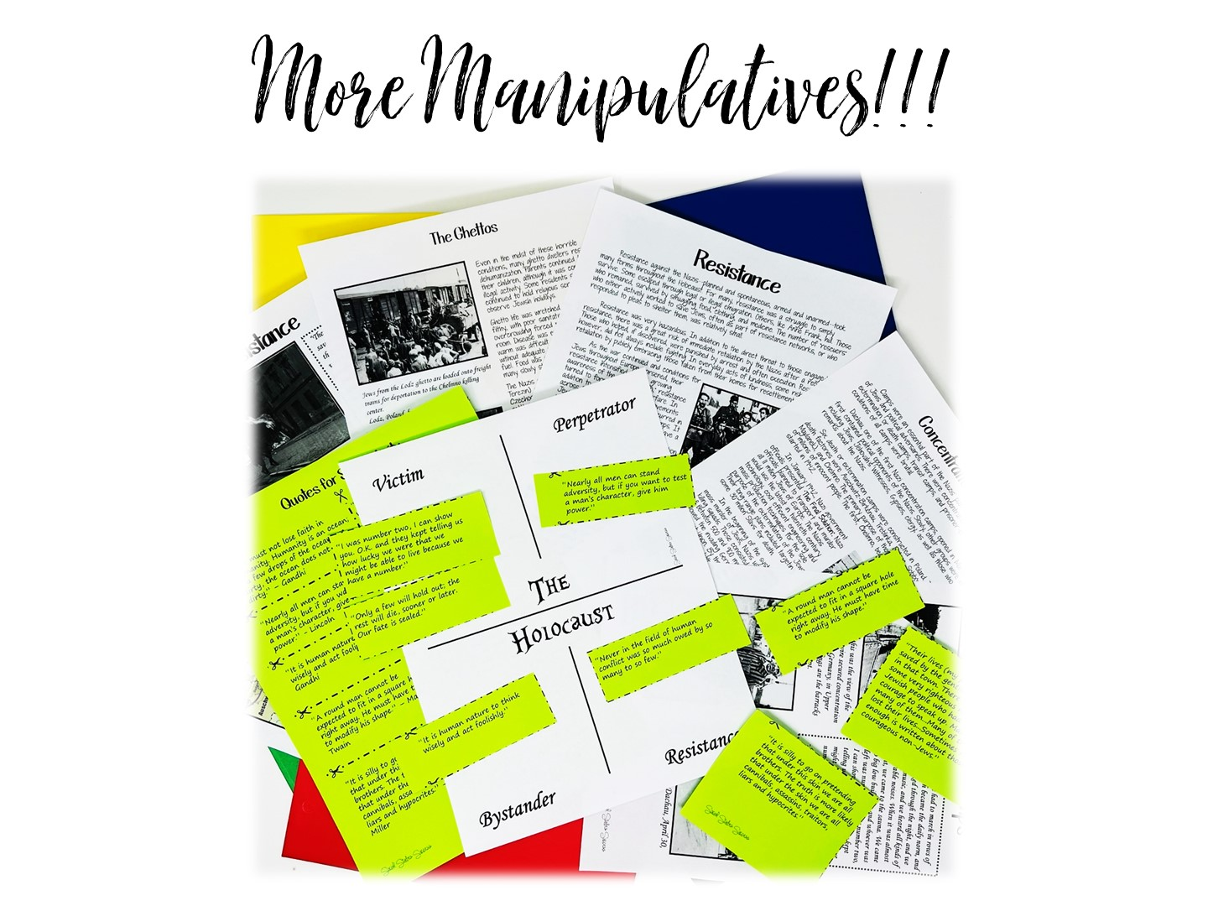
Notes:
Now you are going to show them a variety of manipulatives for instruction and review.

Slide 54
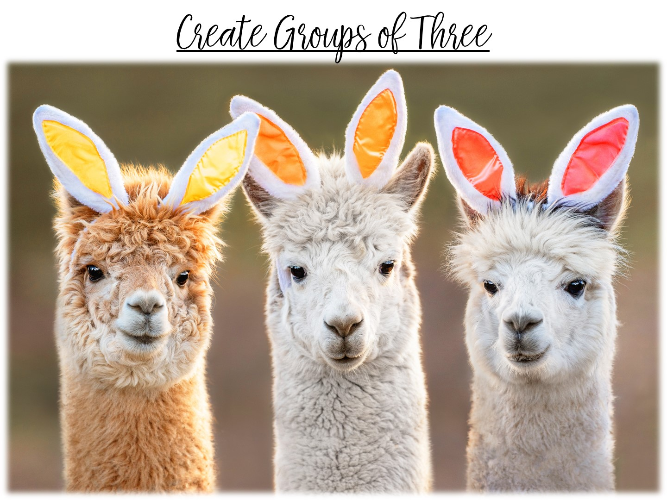

Slide 55
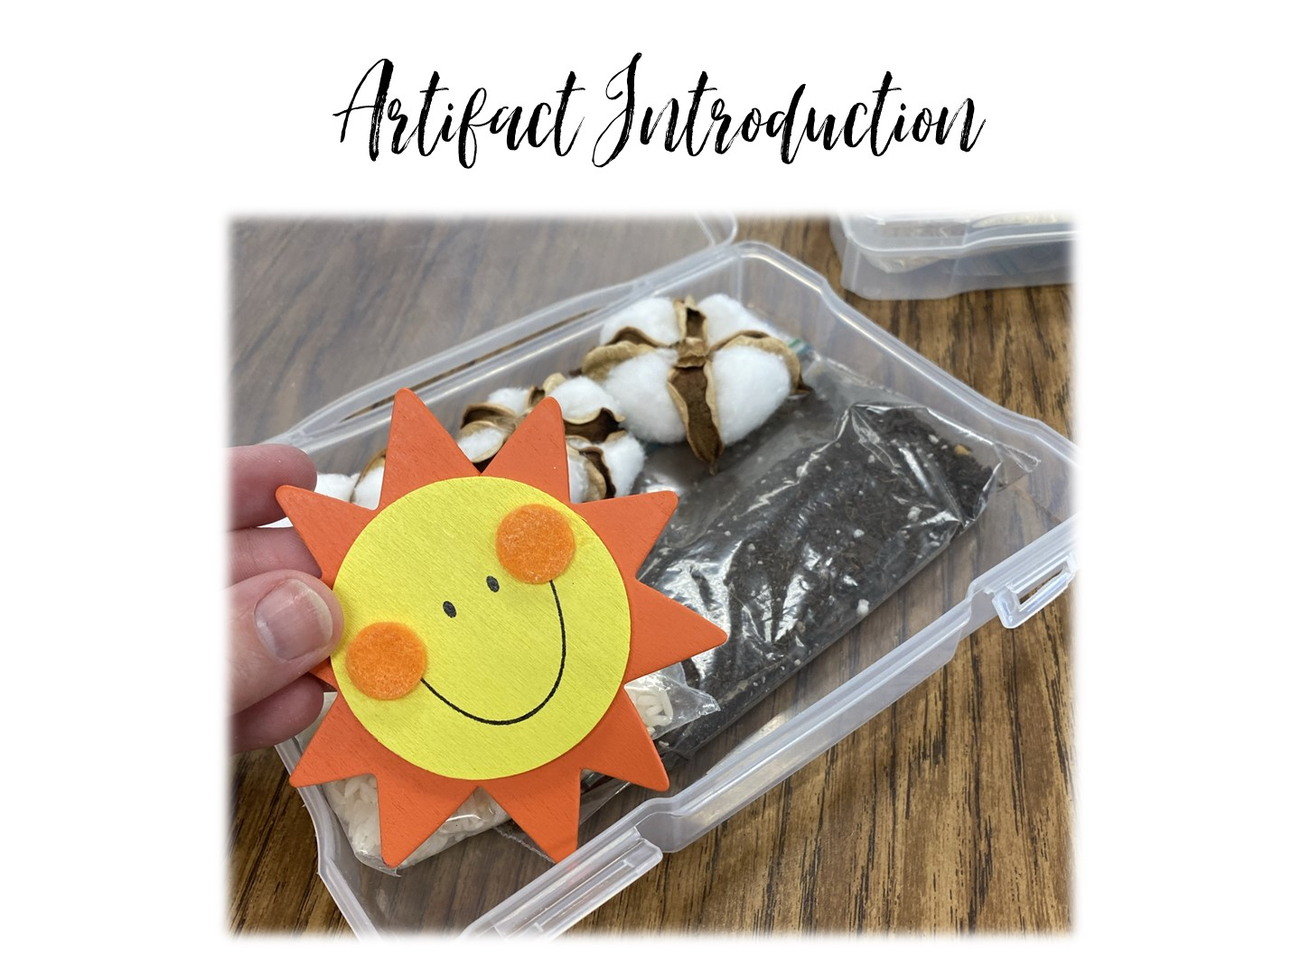
Notes:
These can be used as an initial instruction or a review at the end of the unit.
The boxes you will be passing out have to deal with the Cotton, Cattle, and Railroads era in Texas History – DON’T TELL THEM THAT UNTIL THE END.

Slide 56
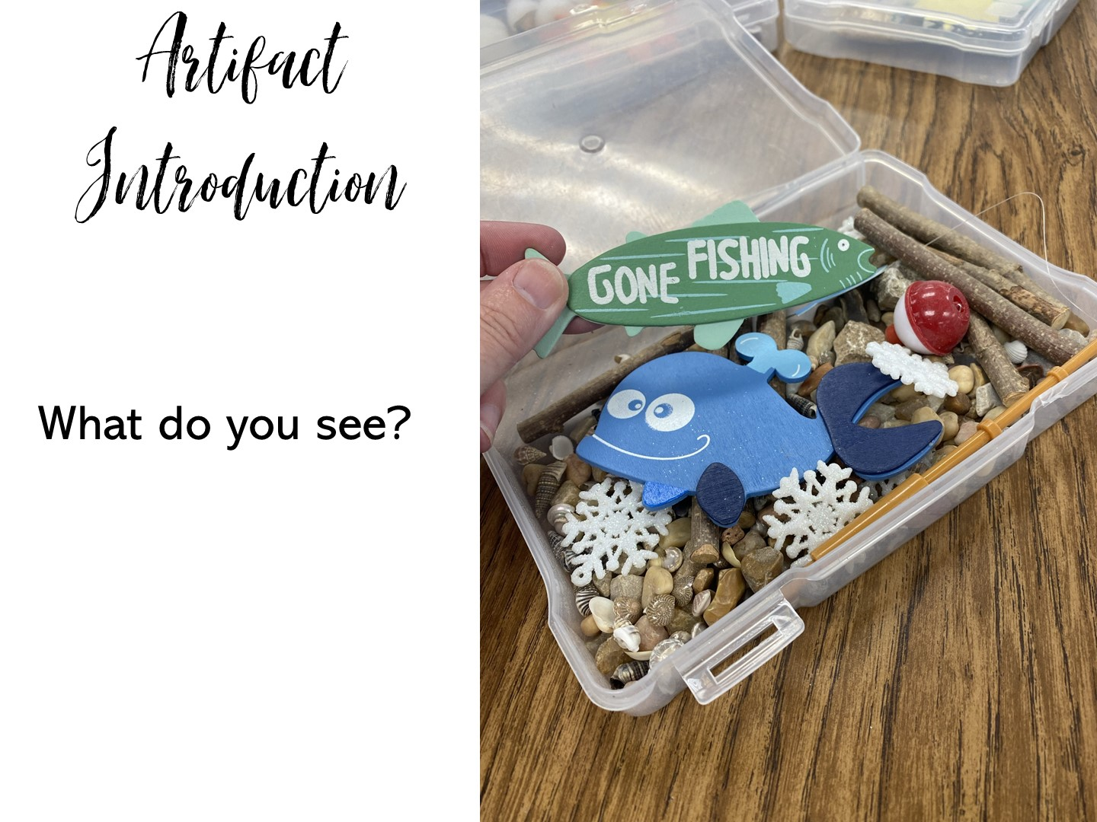
Notes:
Pass out the Cowboy boxes and ask the questions.

Slide 57
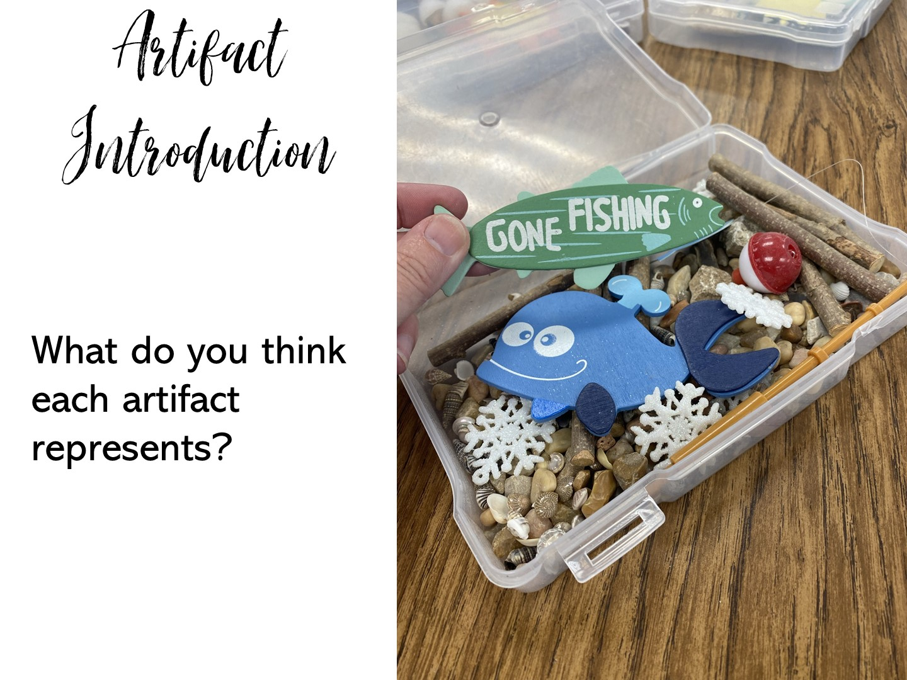

Slide 58
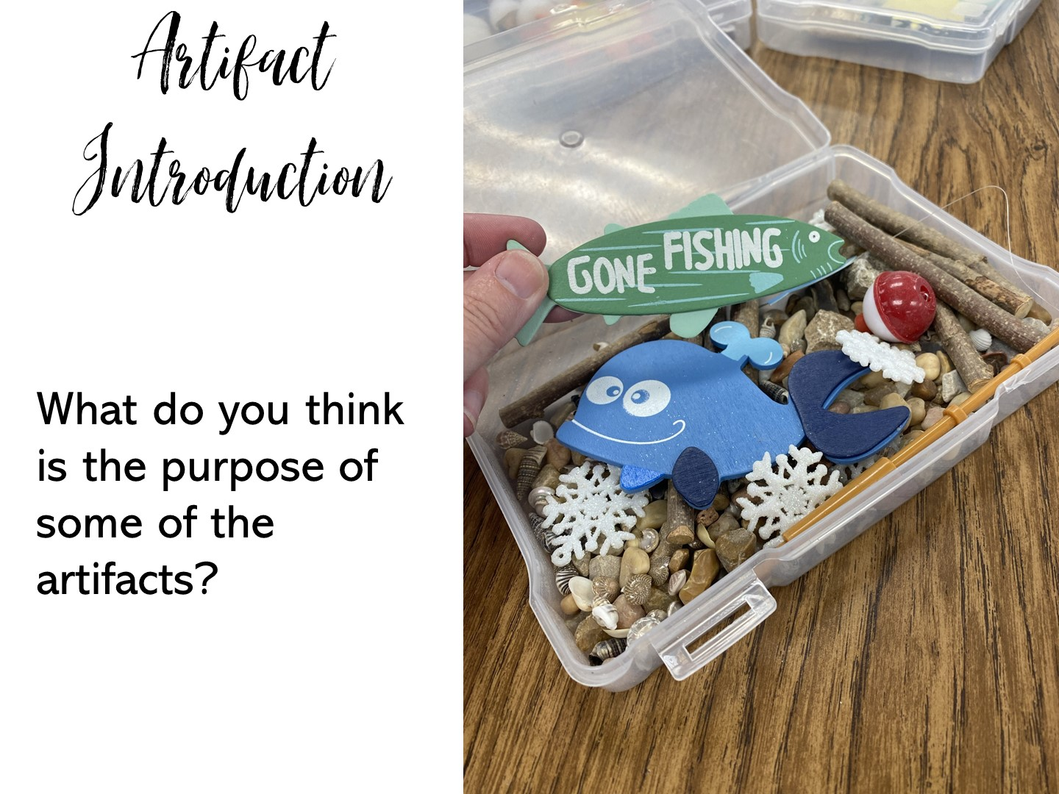

Slide 59
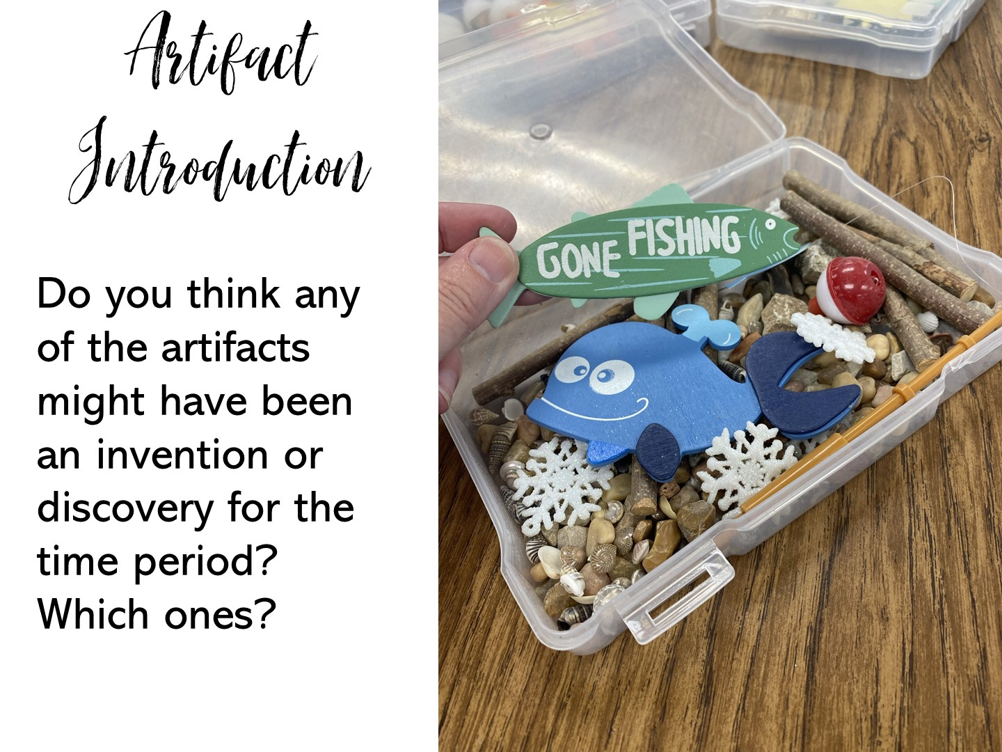

Slide 60
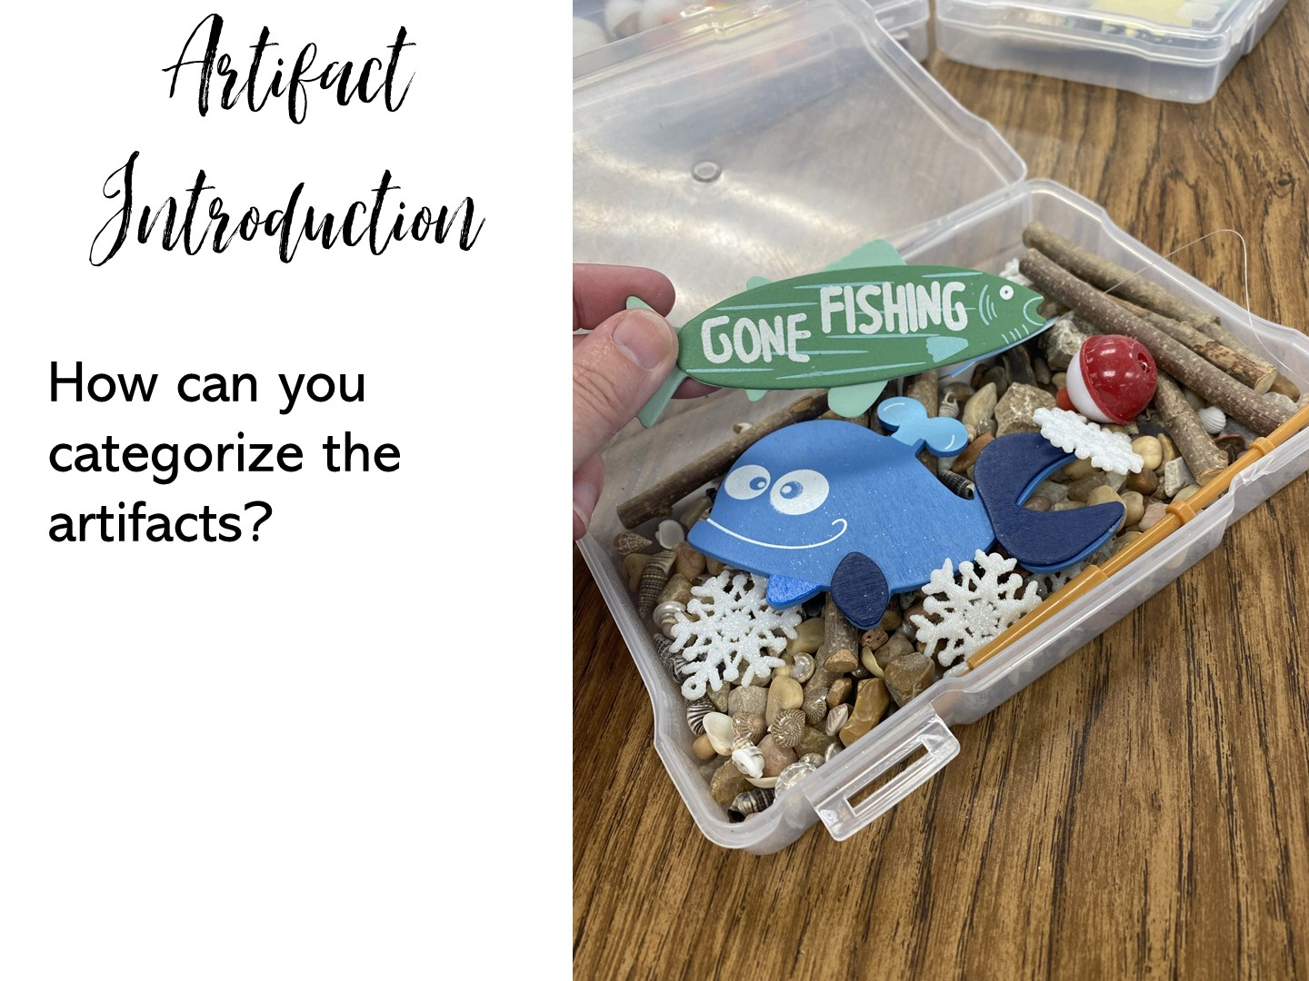

Slide 61
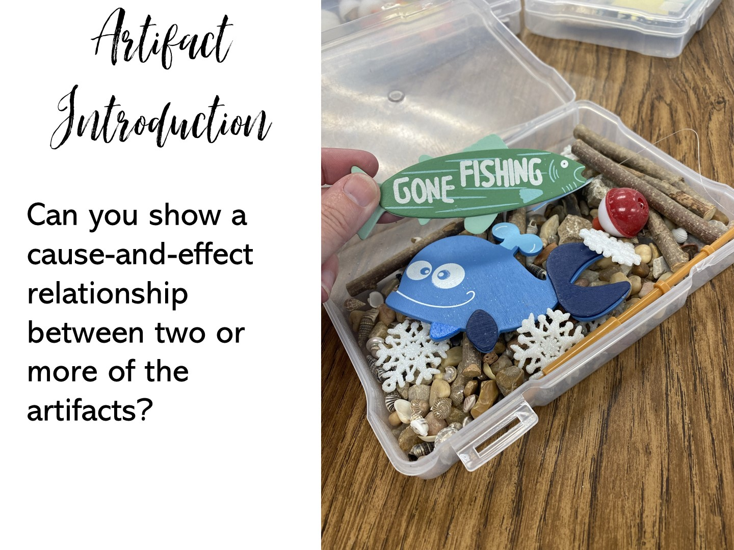

Slide 62
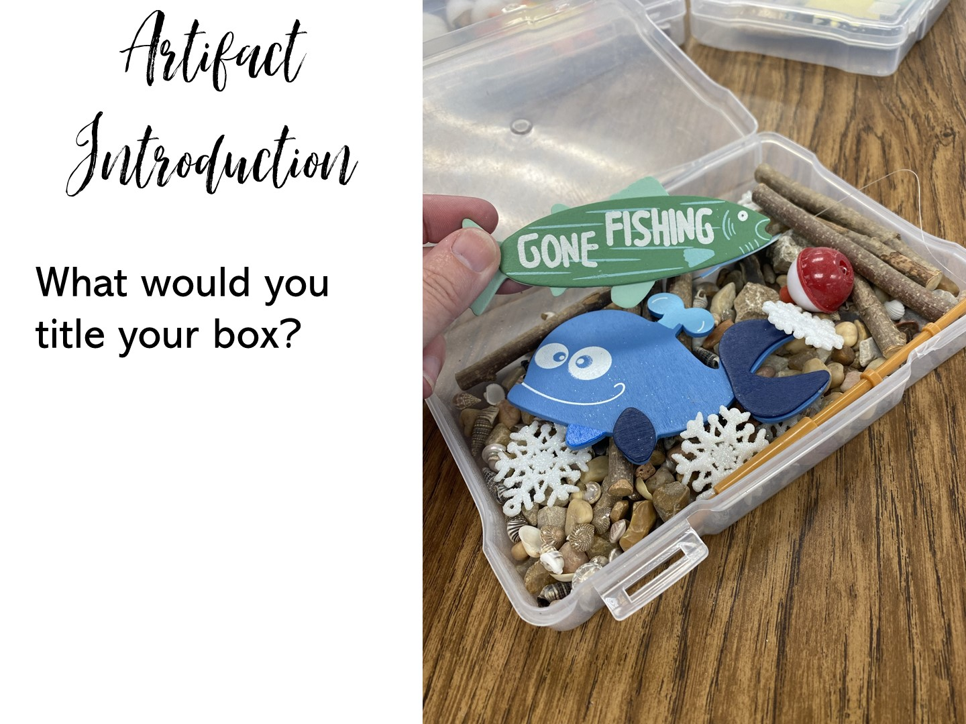

Slide 63
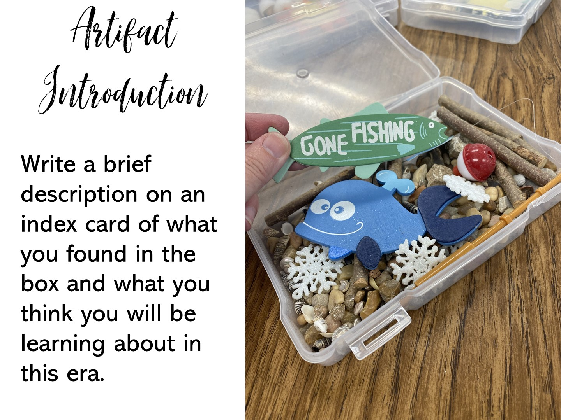

Slide 64

Notes:
Have them turn and talk.

Slide 65

Notes:
Do not create artifact boxes on these controversial topics.
BTW, I purchased all of these items on Amazon, but you can purchase in dollar stores, garage sales, etc.

Slide 66
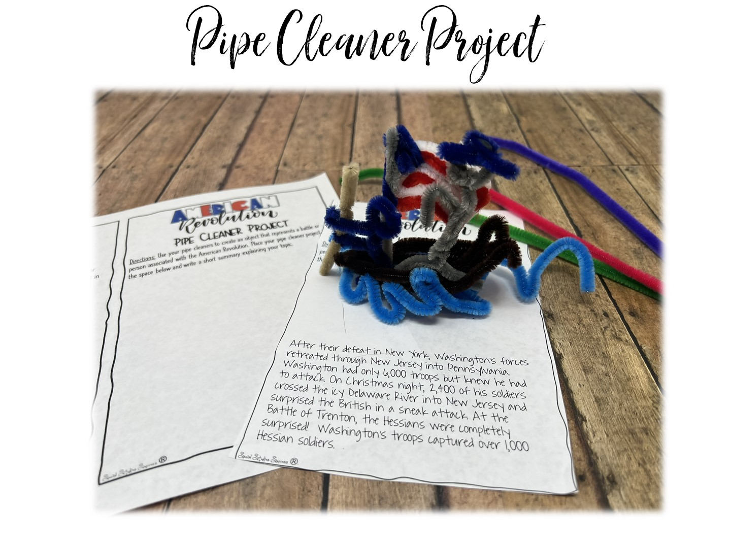
Notes:
Challenge the teachers to make a pipe cleaner object to represent the Boston Massacre.

Slide 67
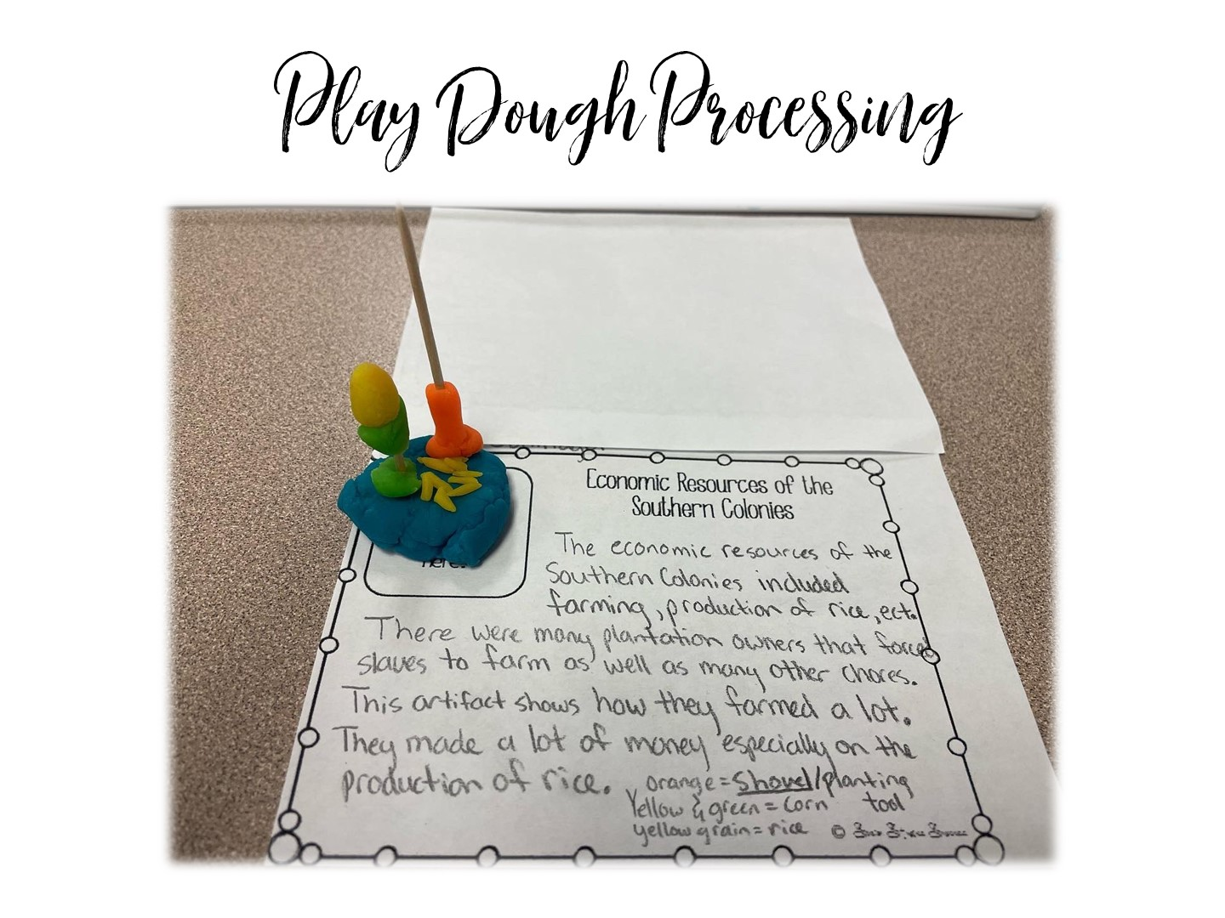
Notes:
You are not going to do, just show the slide and pass out the extra play-dough as a gift.

Slide 68

Notes:
Scavenger Hunts can be fun because you can turn question cards or clue cards into an activity.

Slide 69

Notes:
You are going to model the Vietnam Scavenger Hunt. Pass out 3 cards to each participant, they need to look at the placards posted around the room to find the answer. Model one question with them.

Slide 70

Notes:
Turn and Talk

Slide 71

Notes:
Pass out the handout on Review Games

Slide 72

Notes:
Pass out and conduct Hexagonal Thinking on American Revolution

Slide 73

Notes:
Pass out army soldiers – each person gets about 10 soldiers. Directions are on the next slide.

Slide 74

Notes:
Play ☺

Slide 75

Notes:
75

Slide 76


Slide 77


