Slide 1
Building Engagement in
Social Studies
Notes:
Use presenter checklist to prepare your room and supply list.

Slide 3
Goals
What
are your
for this session?
goals
Notes:
Have teachers write their goals on a post it note and share with their table mates.
Review our goals in the next slide

Slide 4
Explore the elements of engagement.
See model lessons in action.

Slide 5
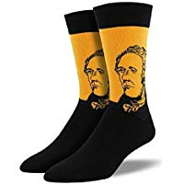
Notes:
I share my rule of the socks:
They have never been on my feet
They are not a souvenir of the workshop
Put your cellphones away in the sock (model with your own)

Slide 6
What makes a lesson engaging?
Notes:
Pass out Engagement Doodle Notes
Ask this question and have them respond on the Engagement Doodle Notes handout – list 3 reasons. When they have finished, have them share their responses with their tablemates.

Slide 7
Lesson Engagement
What makes a lesson engaging?
Generate as many ideas as you can on post-it notes.
Fun
Social Studies Success
Notes:
Now put them with a partner or a small group of 3 and have them come up with 10 ideas – each idea on its own post it note (give them one color of post it note for this portion). Their goal is to have 10 separate post-it notes with engaging ideas written on them.

Slide 8
Lesson Engagement
Compare your notes – group into categories and create a bar graph.
Title
Categories
Social Studies Success
Notes:
Have them rearrange their post-it notes to create categories (example technology if they mention kahoot, quizlet, etc.) Give them a different color post it note for the title of their categories.
Once they have created their categories – get them up to do a forced march around each others post it notes. What did they see that was similar? What was different?
Debrief

Slide 9
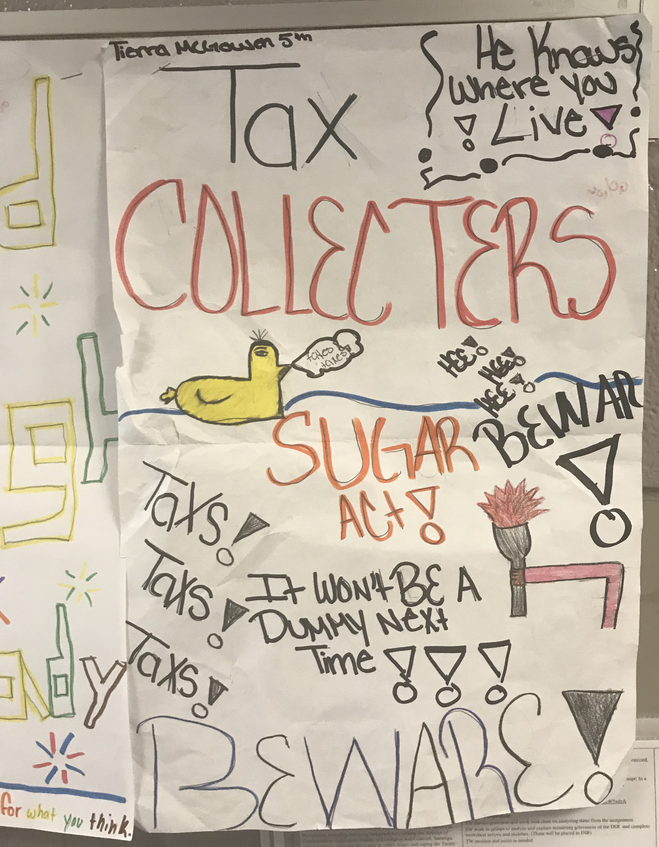
Design Qualities of Engagement
Product Focus:
Engaging work almost always focuses on a product or performance of value to students.
Notes:
Now share the official research from Philip Schlechty and his book – Working on the Work. Just read the next few slides to the teachers. Add any personal examples of things you have done for each slide. Allow them to take notes if they wish on their Engagement Doodle Notes.
Product focus – students are making a product or a project.
Schlechty’s Design Qualities of Engagement

Slide 10
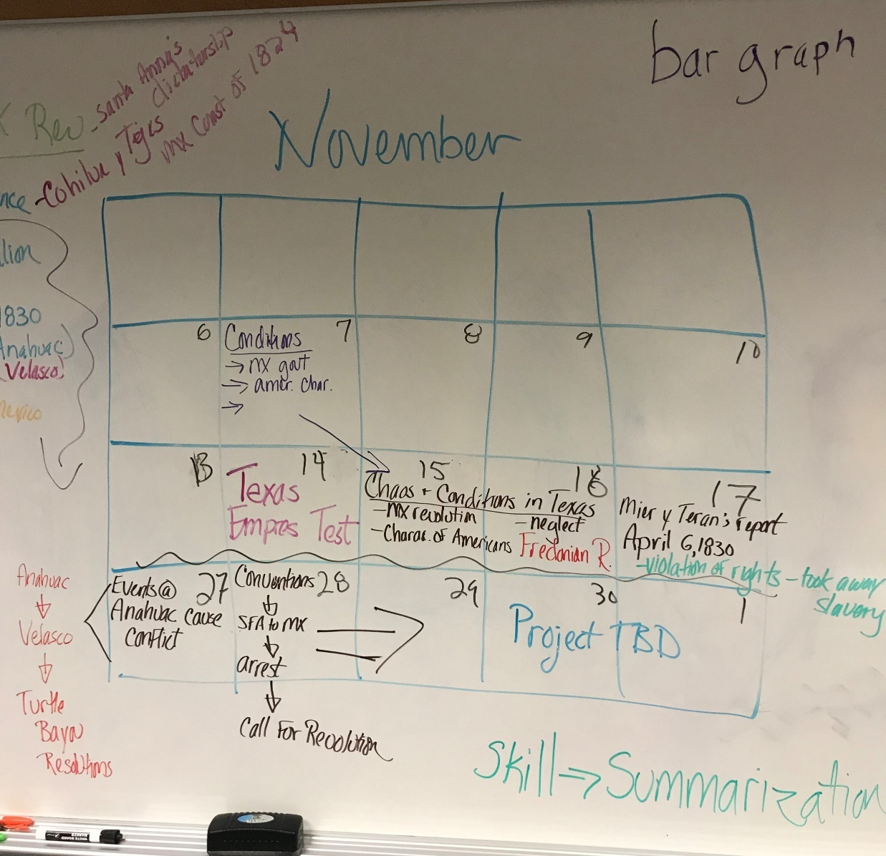
Design Qualities of Engagement
Organization of Knowledge:
Content is organized so that access to the material is clear and relatively easy for all students.

Slide 11
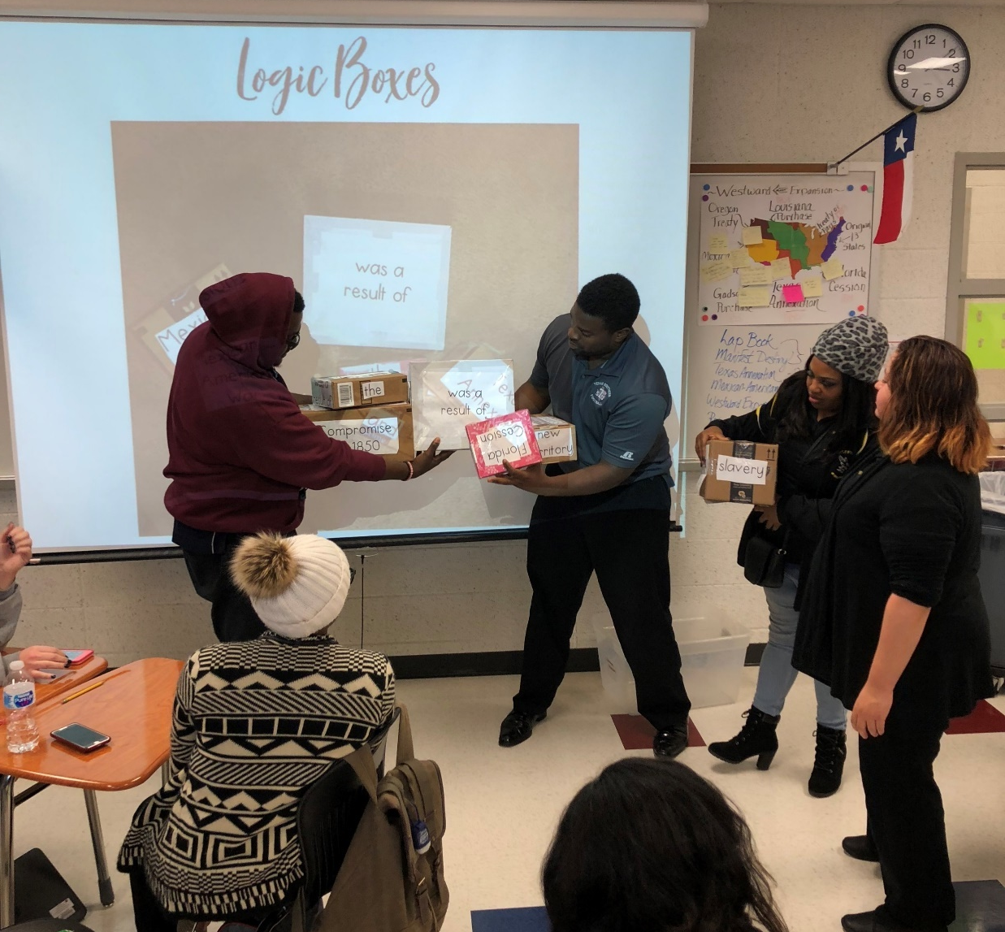
Design Qualities of Engagement
Affiliation:
The design of the work requires cooperative action between students.
Notes:
Affiliation – students are working together to complete a task, not just splitting an assignment in ½ and each doing a portion, but cooperatively engaged with each other.

Slide 12
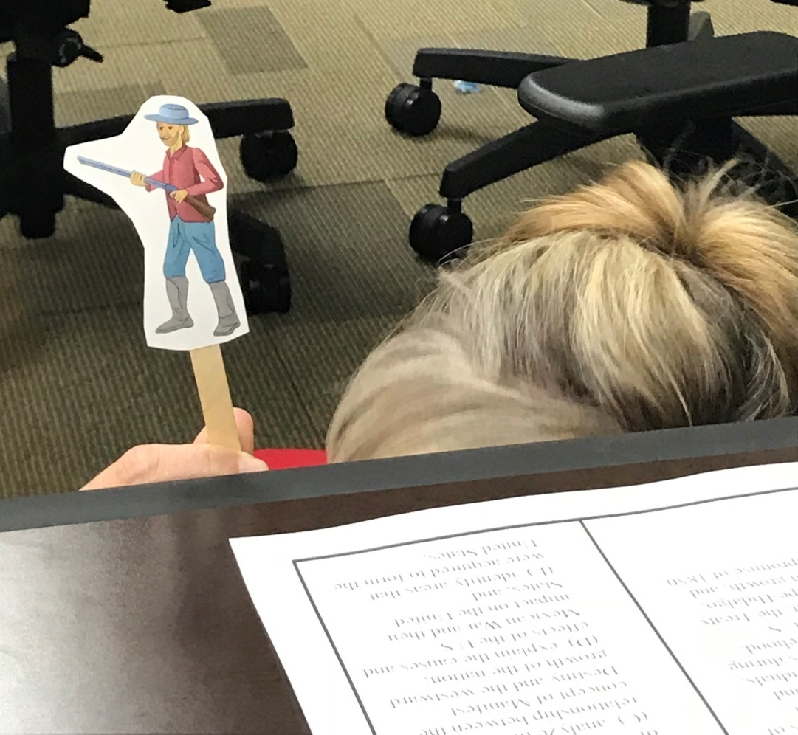
Design Qualities of Engagement
Affirmation:
Student products are observed by persons other than the teacher.
Notes:
Examples include hanging products in the hallway, display in the library, other classes come observe, share with other classes.

Slide 13
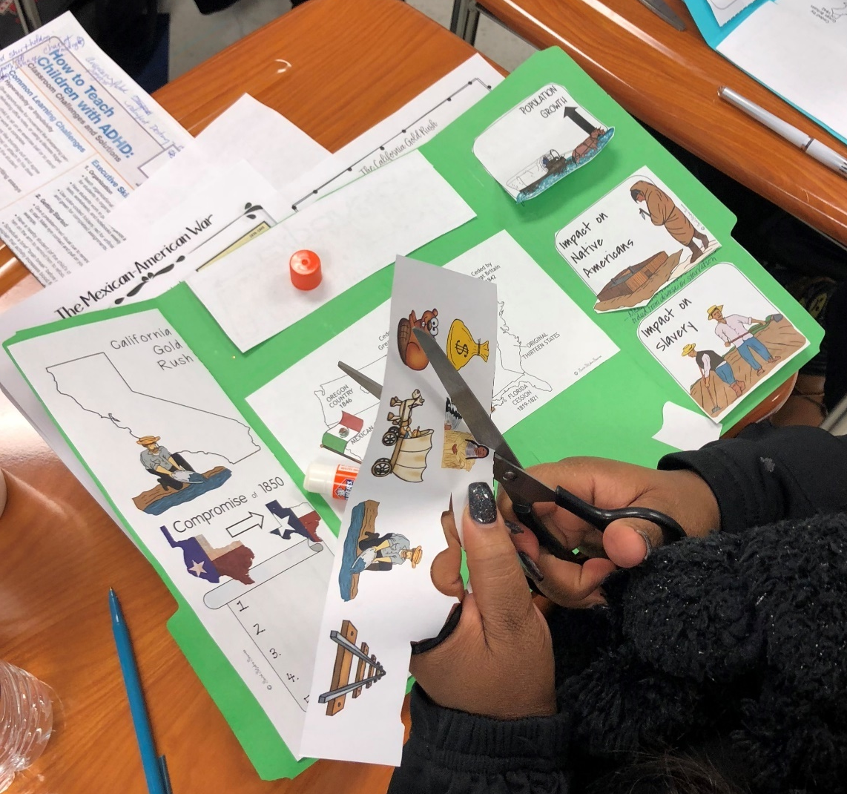
Design Qualities of Engagement
Choice:
Students are provided with choice in the ways of doing the work and the methods of presentation.
Notes:
PERCEPTION OF CHOICE is the key – it doesn’t just mean a choice board. Any choice students have increases engagement.

Slide 14
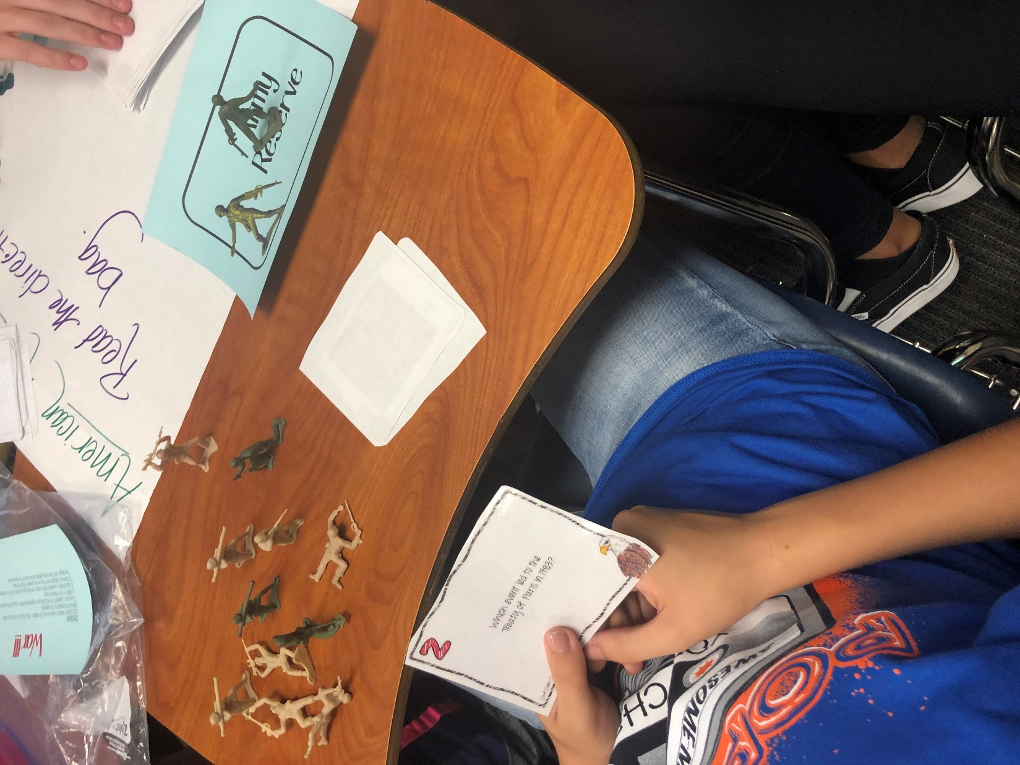
Design Qualities of Engagement
Novelty and Variety:
The work is varied in methods and format so that students use a variety of skills,
media, and modes of analysis.
Notes:
New and different. What is new at the beginning of the year, is not new at the end. What is different (like Kahoot) is no longer different if everyone in every class is doing it.

Slide 15
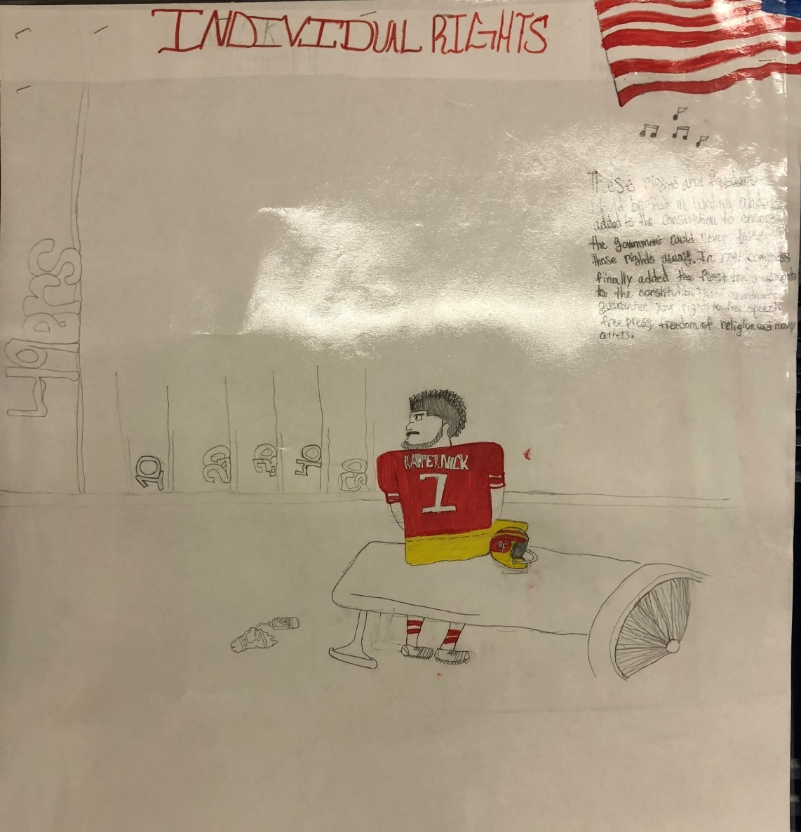
Design Qualities of Engagement
Authenticity:
The work has significance and is related to consequences in the present lives of students.
Notes:
Needs to have real world connections or a project that has a real world application.

Slide 16
Lesson Engagement
Reorganize your information into Design Qualities Categories.
Title
Categories
Social Studies Success
Notes:
Now have them use the official terms from the design qualities of engagement. Create new category titles based on the design qualities of engagment and move their post it notes into the new categories. The purpose of this is to show them they already know a lot about engagement, this workshop is to help them come up with new ideas and focus for engagement in Social Studies.

Slide 17
Where have you already seen these elements today?
Notes:
What did they just see you model? What design qualities – example: affiliation (working in a group)
Use popsicle people to randomly call on teachers.

Slide 18
How does this information either confirm or challenge what you already know?
Notes:
Use popsicle people to randomly call on teachers
18

Slide 20
Strategy Focus
Name
Name
Write your name on 2 different post-it notes.
Notes:
Have the teacher participants write their name on two different post-it notes.

Slide 21
Post your name on the anchor chart in 2 different areas.
Novelty
Choice
Notes:
Ask them which design quality of engagement they themselves need to work on. They will put their name post-it note on the anchor chart next to 2 different design qualities of engagement. This will be their focus for the day. You can then ask them throughout the day – “Johnny, where did you see x” by pulling his name off the chart.

Slide 22
Questions?

Slide 23
Focus on
Authenticity
Notes:
We are now going to model a lesson focusing on a different design quality of engagement – authenticity. But be on the lookout for more!

Slide 24
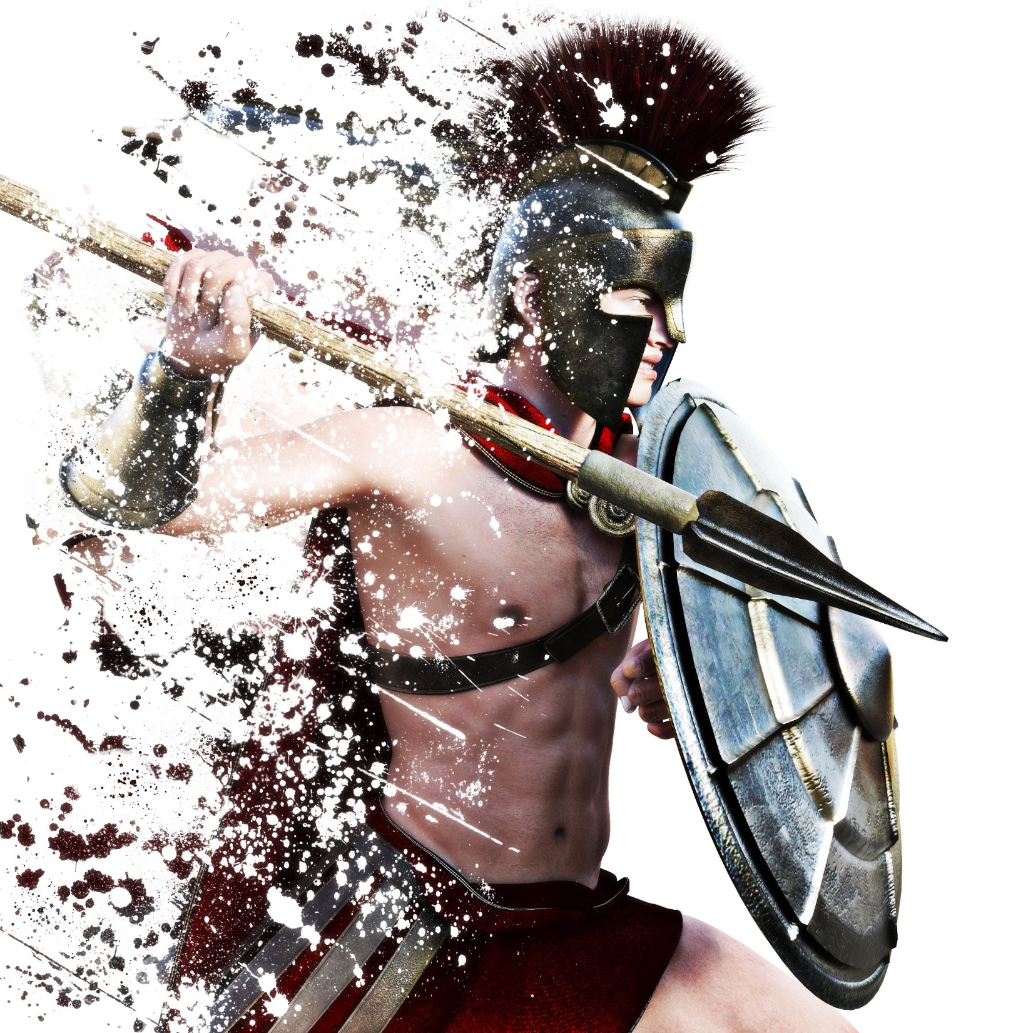
Why Study History?
Notes:
This is a great lesson for the beginning of the year! Use within the first week if possible.

Slide 25
Notes:
This lesson is a dog and pony show as you will be modeling as many different strategies as you can. The lesson in their own classroom will be much simpler.

Slide 26
Objectives
Content Objective: Students will use critically examine primary and secondary sources to draw inferences and conclusions on the study of history.
Language Objective: Students will be
able to use new vocabulary focusing
on historical skills.
Notes:
Just read

Slide 27
Why do we study history in school?
Social Studies Success
Notes:
This is the essential question. They will need to be thinking about why we study history.

Slide 28
Preview
Which of these sentences do you agree with the most? Why?
Studying history teaches that people change and still always stay the same.
History helps us understand the way we live now.
History teaches us that actions have consequences.
History teaches you to ask questions and challenge ideas.
Social Studies Success
Notes:
Four Corner Activity
Ask the teachers to think about the answer and then stand in each one of the 4 corners that represent their response. Once they are in their corner, talk with each other to see why they all have similar response, then share out.

Slide 29
Vocabulary Terms
evidence
artifact
bias
primary source
secondary source
point of view
chronology
era
Notes:
These are the vocabulary terms we are going to learn. Point to each term on the word wall and pronounce them for the teachers.

Slide 30
Why Study History?
Predict This
Use the vocabulary word wall as your word bank. Choose the word that you think matches that definition. Once you learn the vocabulary, come back and see if your prediction was correct or not.
Which word means… | Word Guessed | Clues You Used
A human made object.
A way of looking at something, may be shaped by many things, such as the person’s age, religion, job, or political views.
The sequence of events in time.
Information that can be used to prove a statement or support a conclusion.
A document or other record of past events created by people who were present at that time.
Anything that might change a person’s observations. It can make a source less than trustworthy.
Information written after the time period by an expert or historian.
A long and distinct period of history with a particular feature of characteristic.
Social Studies Success ®.
Notes:
Pass out Predict This
Give each teacher one of these and place them with a partner. Have them all come up to the word wall and discuss with their partner to see what they think the correct answer is. Debrief.

Slide 31
Notes:
Use the following slides to debrief the answers

Slide 38
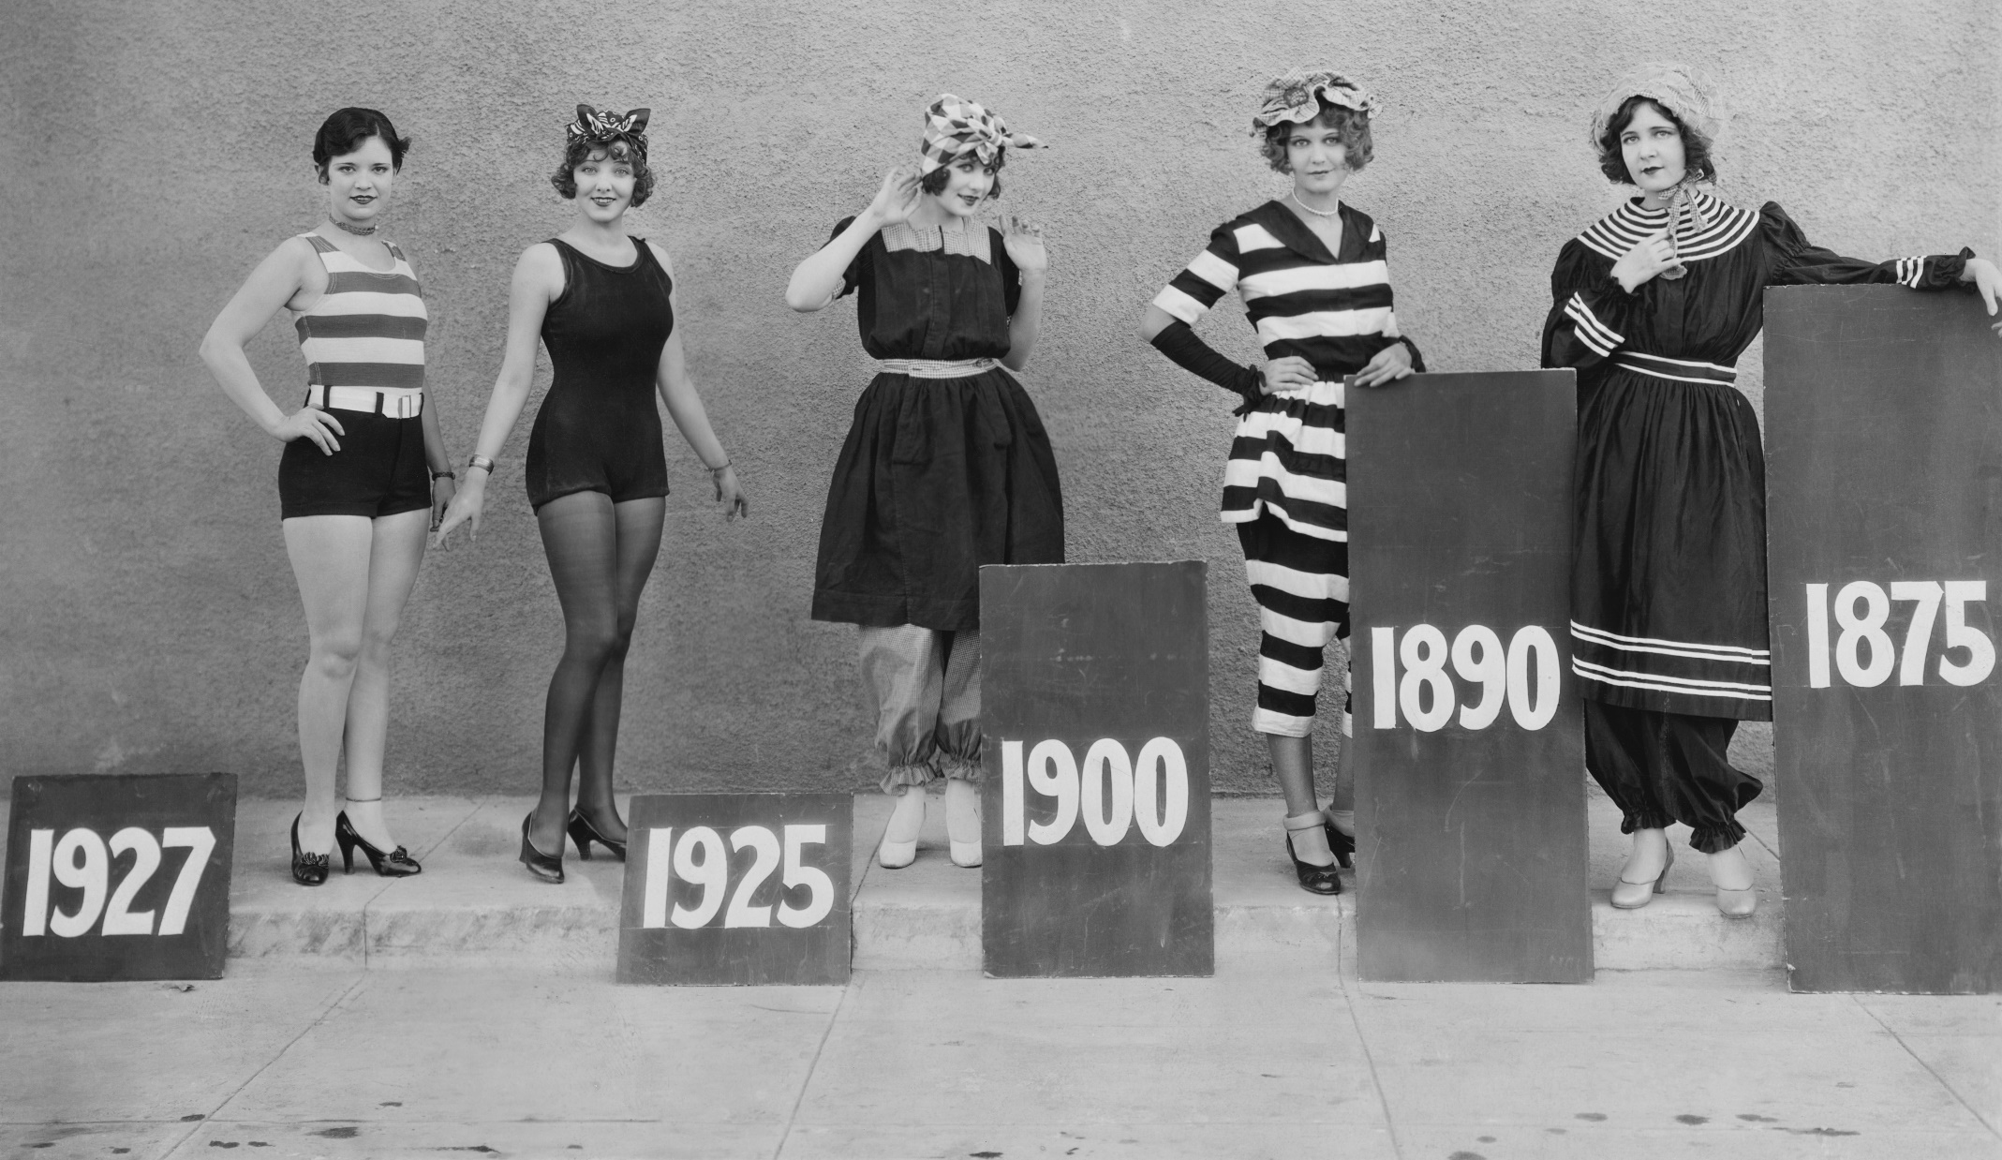
era
Social Studies Success

Slide 39
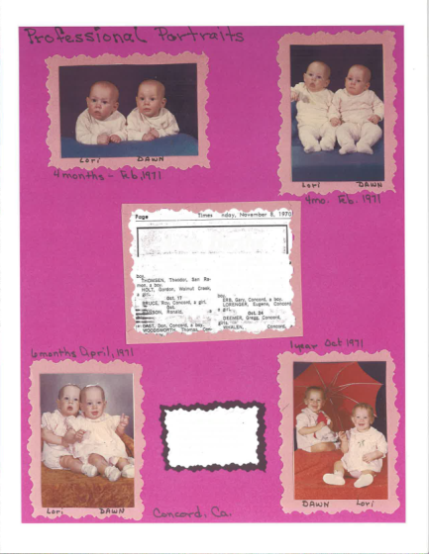
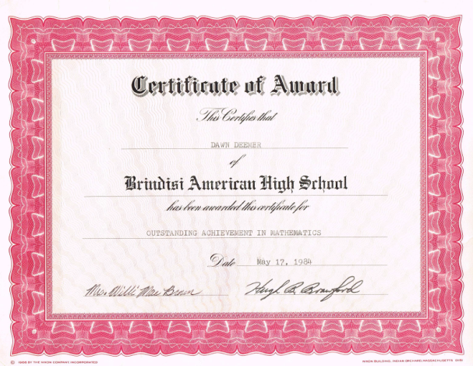
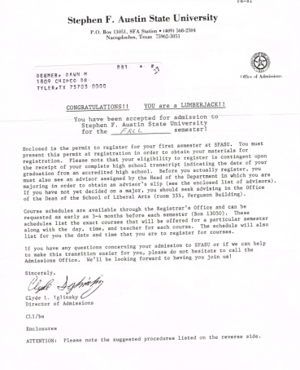
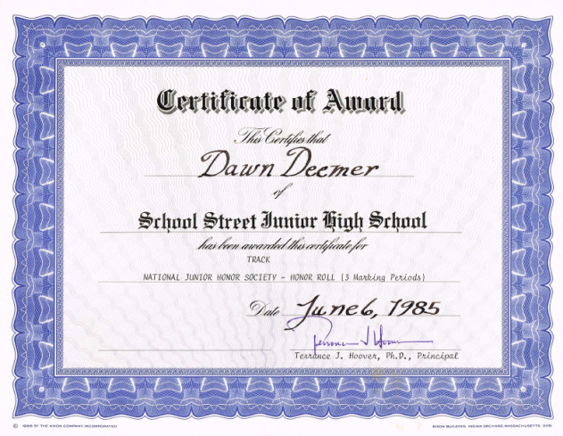
Artifact Study
What facts can you idenfify about this person?
What inferences can you make from the facts?
What is important to this person? How do you know?
Do you see any patterns in their life?
How are you similar to this person? Different?
Notes:
Now pass out your own artifacts in an envelope. Do not tell the teachers that these are your own personal artifacts. In their groups, have them examine the artifacts to see if they can answer any of these questions.

Slide 40
What part of this quote do you think is the most important?
Notes:
Read to group and discuss the question.

Slide 41
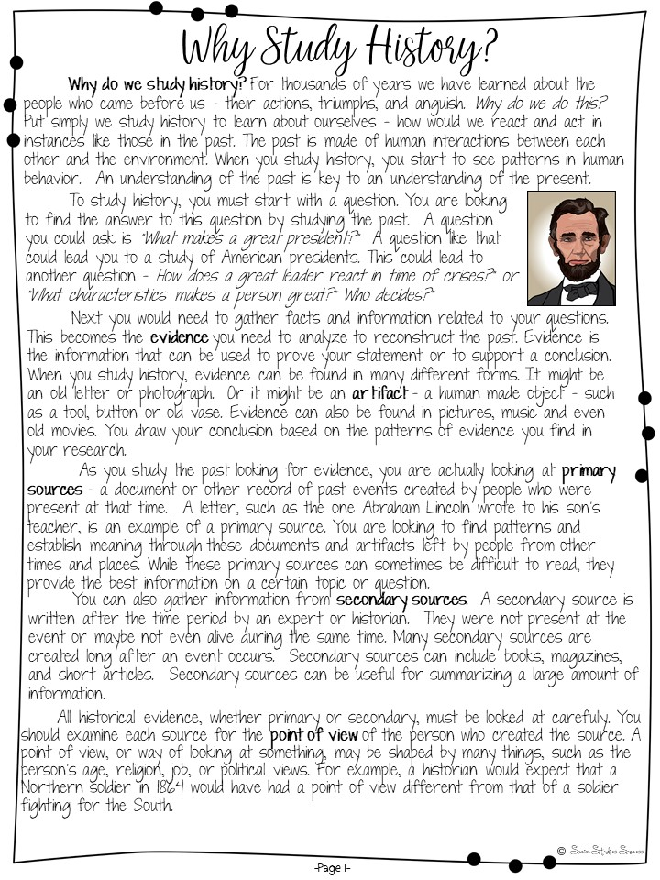
Why study history?
Read
the handout, then highlight the one most important sentence on the page. Be prepared to share.
Notes:
Pass out the first page of the reading. Follow directions on the slide.

Slide 42
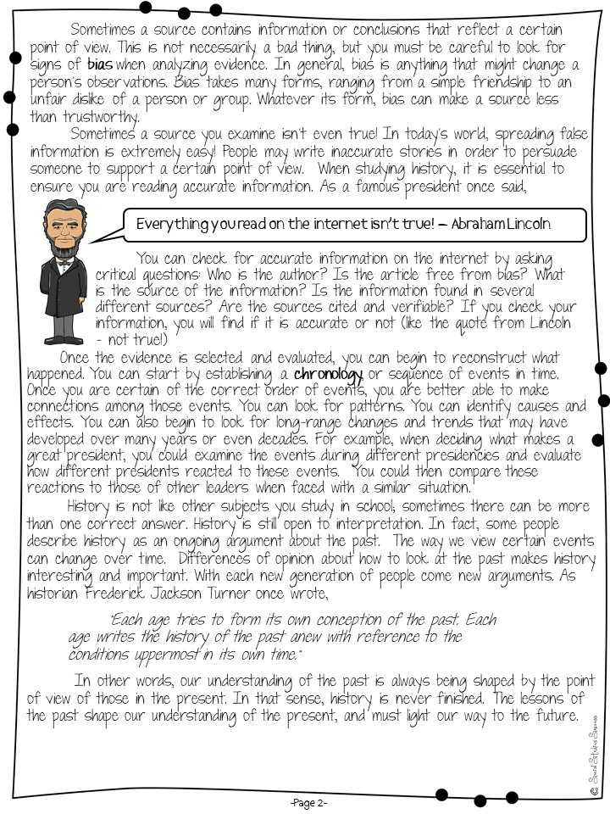
Why study history?
Read
the second page and be prepared to discuss with
Pick a
Card
Social Studies Success
Notes:
Pass out the second reading and model how to read with pick a card. After they have read, give them one of the pick a cards to use as a sentence starter with the whole group.

Slide 43
Why study history?
Complete the Doodle Notes.
Social Studies Success
Notes:
Pass out Doodle Notes and just do for about 5 minutes

Slide 44
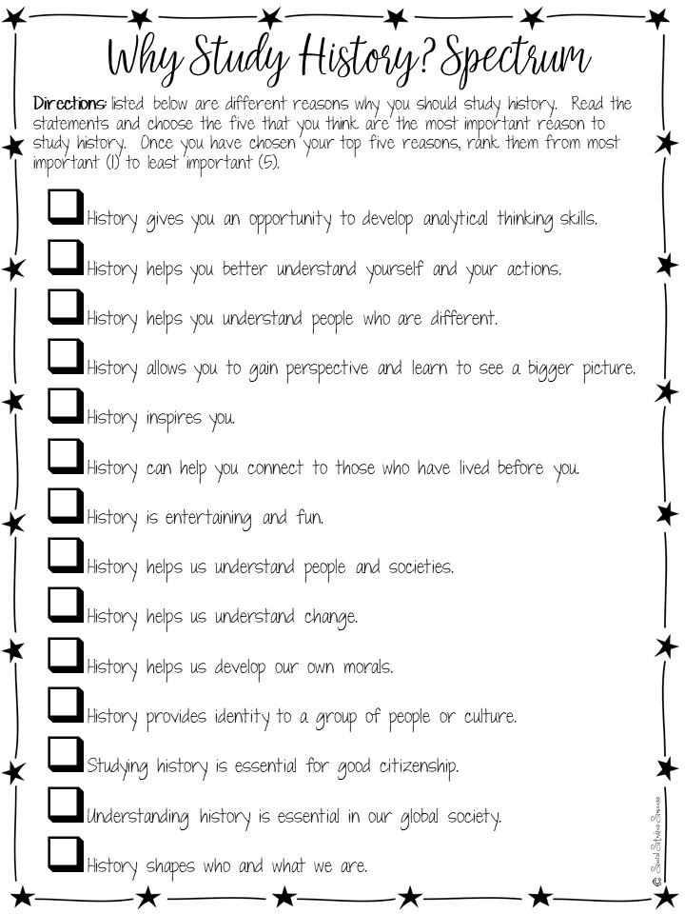
Why study history?
Notes:
Pass out spectrum and have them read and discuss.

Slide 45
What Design Qualities of Engagement did you observe?
Notes:
Debrief the lesson by asking them to use specific design qualities of engagement terminology to identify different parts of the lesson that increase engagement.

Slide 46
What
Questions
have I created?

Slide 47
Reflection
Notes:
Give them 5 minutes to write down reflections on their notes (on the back)

Slide 48
Take a 15 minute
Break!
Notes:
Prep for the next lesson model during the break:
Hang up the word wall vocabulary terms for colonization

Slide 49
Questions?
Notes:
Check for any questions from the first part of the session before you begin. If no questions, have them tell their partner 1 thing they learned.

Slide 50
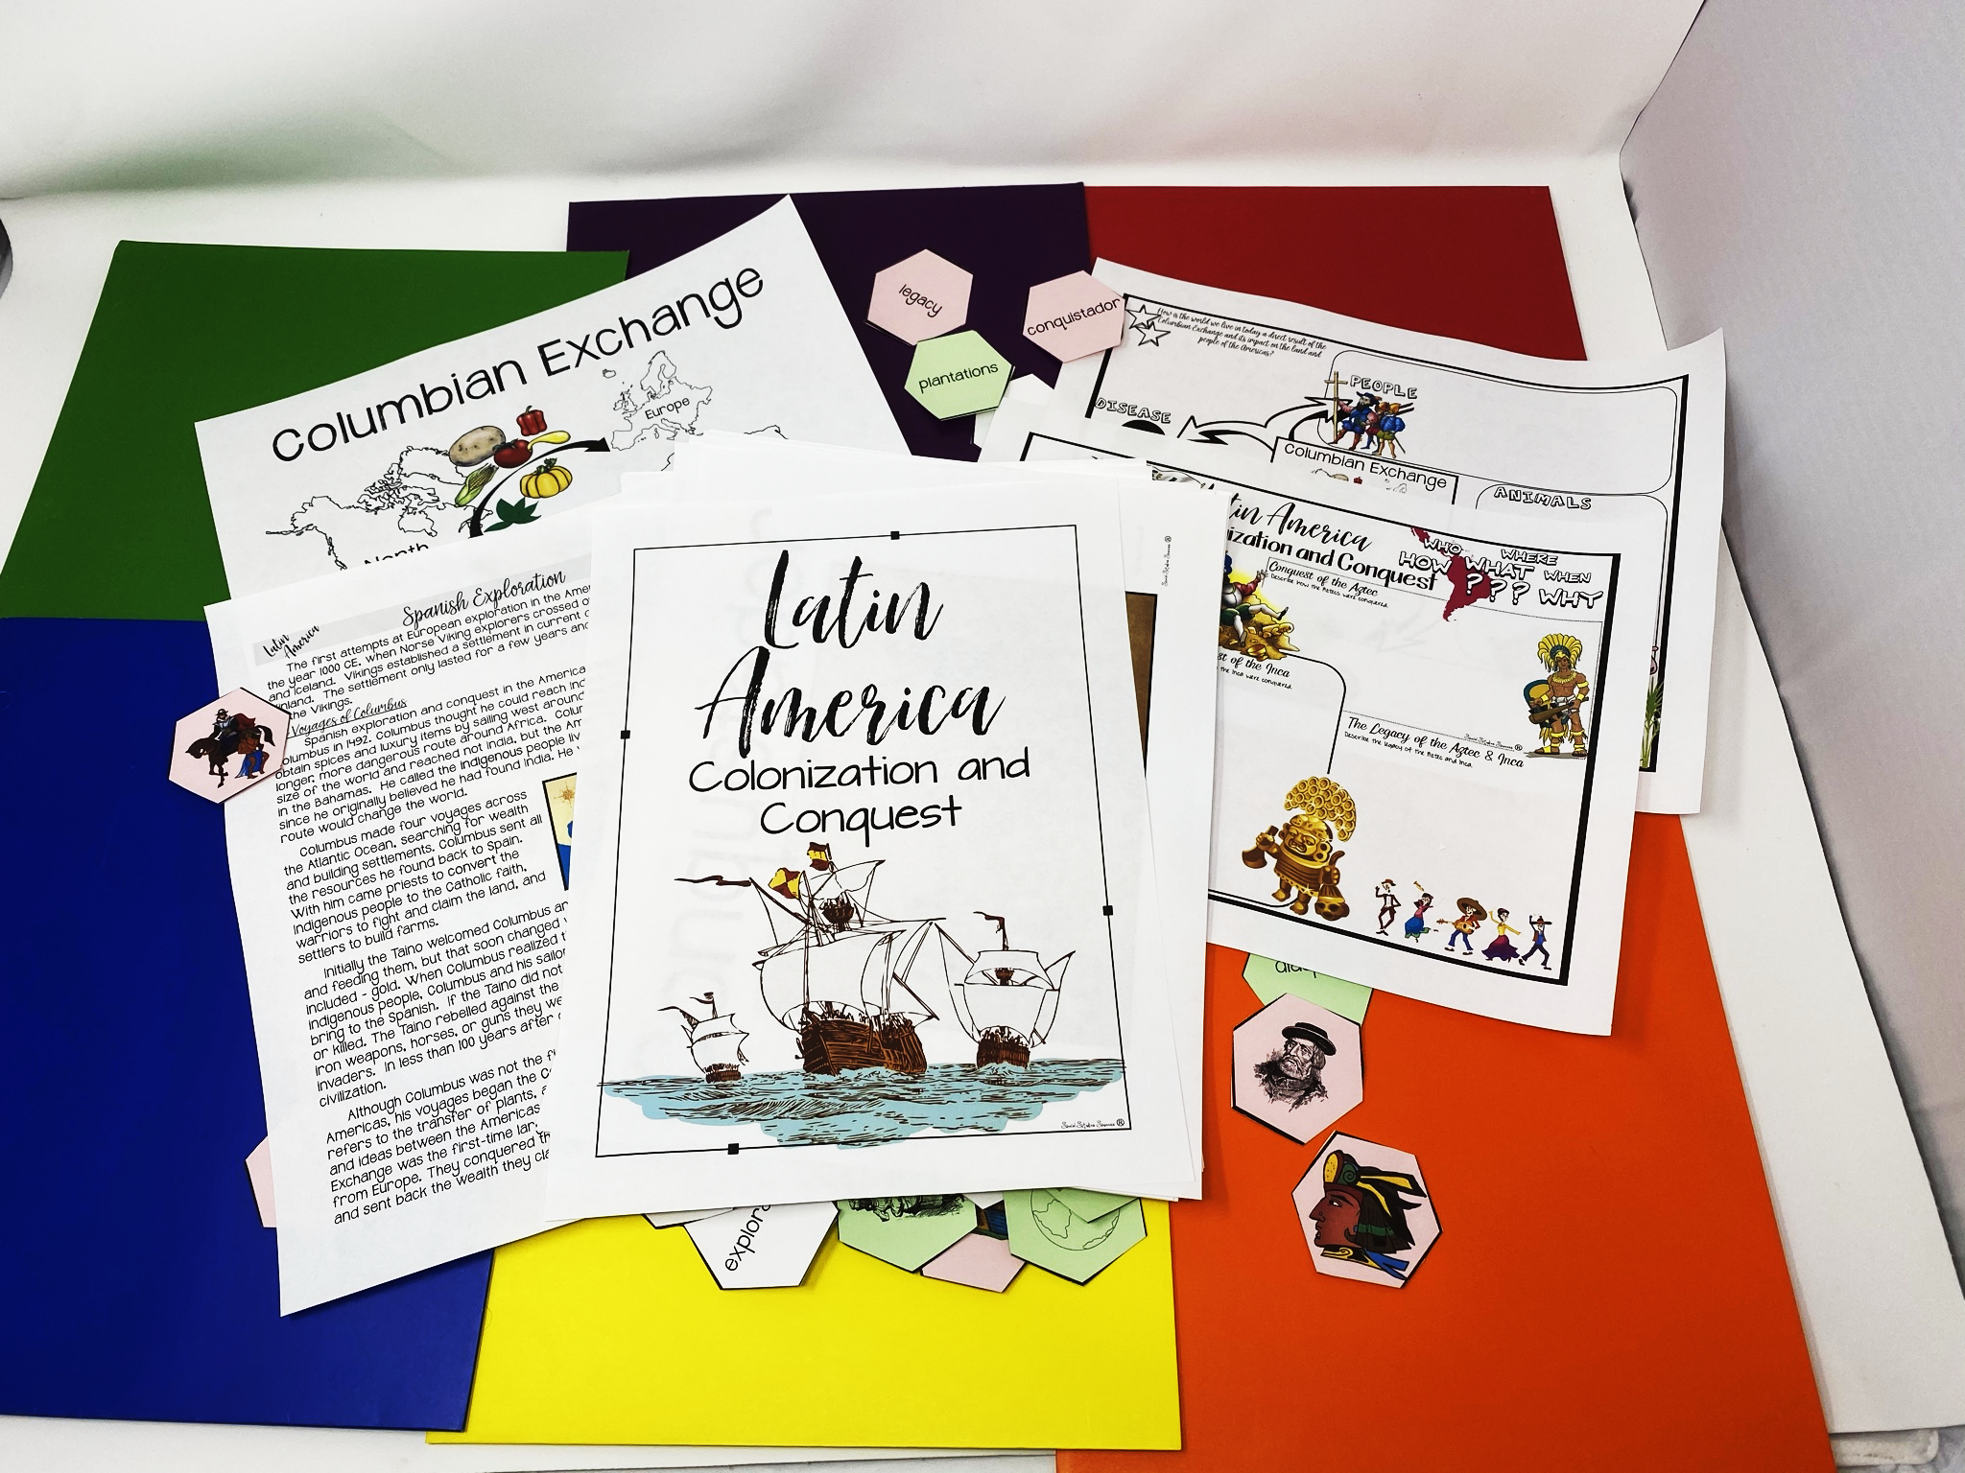
Latin America
Columbus, Conquest &
Colonization
Notes:
The next lesson you are going to model is for World History.

Slide 51
Objectives
Content Objective: Students will explain the impact of the Columbian Exchange on Europe and the Americas.
Language Objective: Students will share content information about the colonization of Latin America in cooperative learning interactions.
Notes:
Just read.

Slide 52
Find
a partner
Notes:
Place teachers with a new partner.

Slide 53
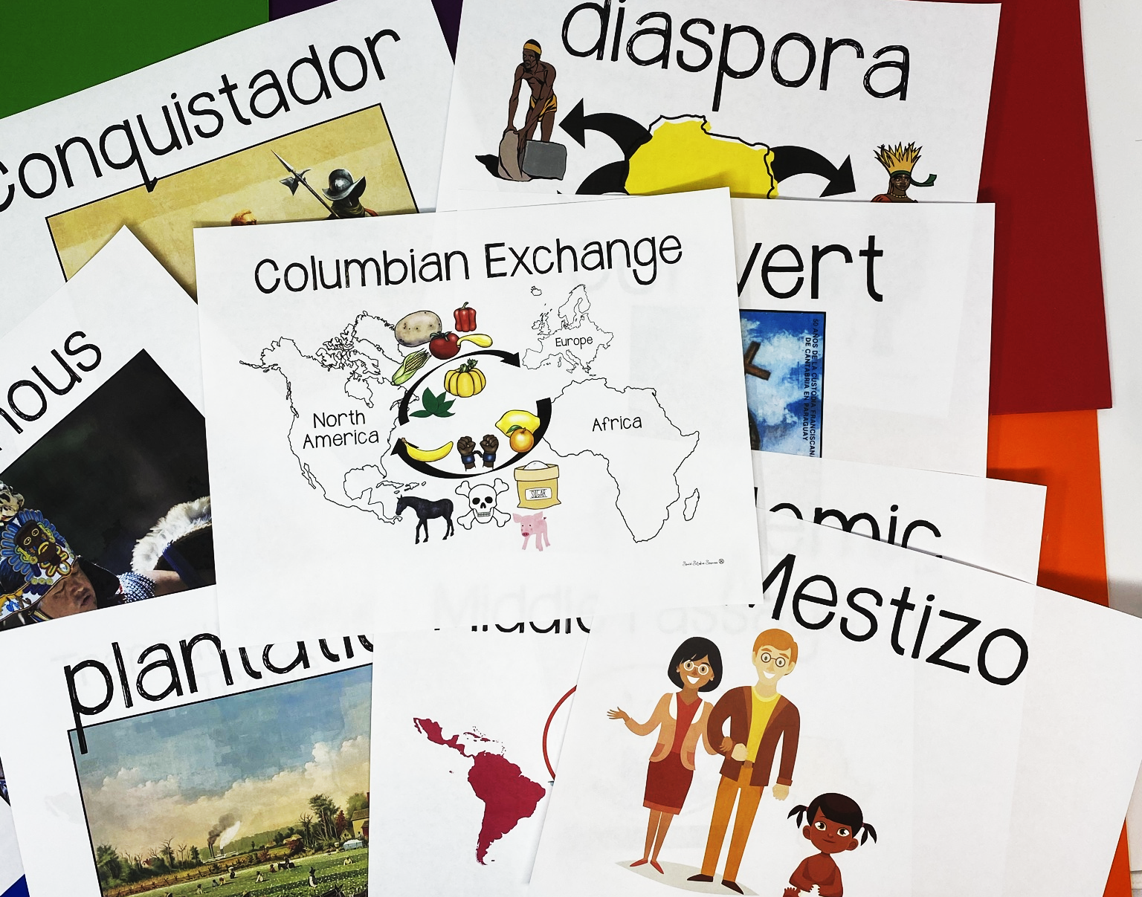
Notes:
Point to the word wall and read each of the terms – tell the teachers we are going to do a 3, 2, 1 definition to learn the terms. They will need post-it notes for the activity.

Slide 54
3, 2, 1 Definitions
3
2
1
things you see
actions or
senses
definition
Arrows showing movement
Things going from one place to another
The movement of new things from the Americas to Europe/Africa and Europe/Africa to the Americas.
sugar
horse
pig
Notes:
Another method to teach vocabulary with images is the 3, 2, 1 Definitions – Allow students time to analyze an image to build their understanding of an image.
Model this with the word Columbian Exchange
Allow them to pick a term with a partner and complete the 3, 2, 1 definition. I always bring the teachers close to word wall to get them out of their seats.

Slide 55
Preview
Notes:
Pass out anticipation guide - do for just a few minutes.

Slide 56
True
False
Notes:
Do a thumbs up/thumbs down debrief. Put your thumbs up if the answer is true, thumbs down if they answer is false.

Slide 57
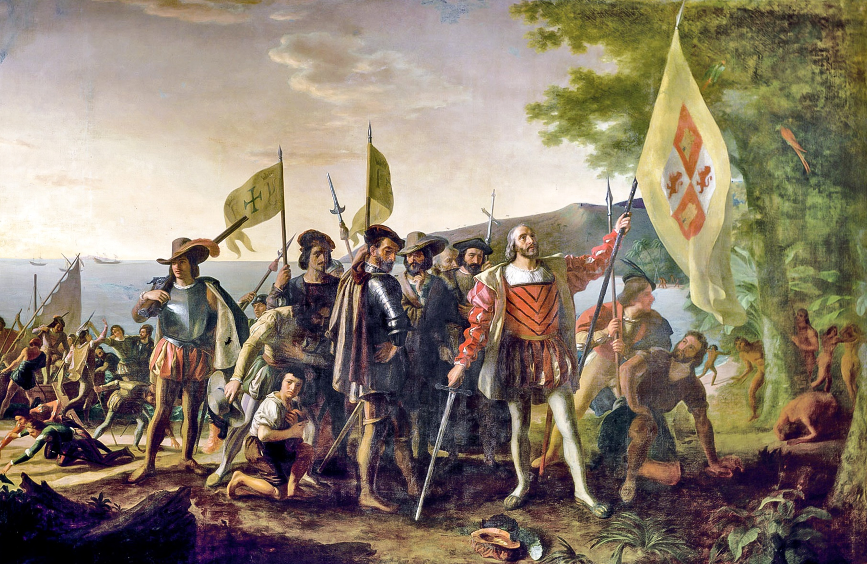
Crop-It
Notes:
Pass out the crop-it tools and the Columbus images. Use the handout with questions to ask questions for the teachers to answer using the tool.

Slide 58
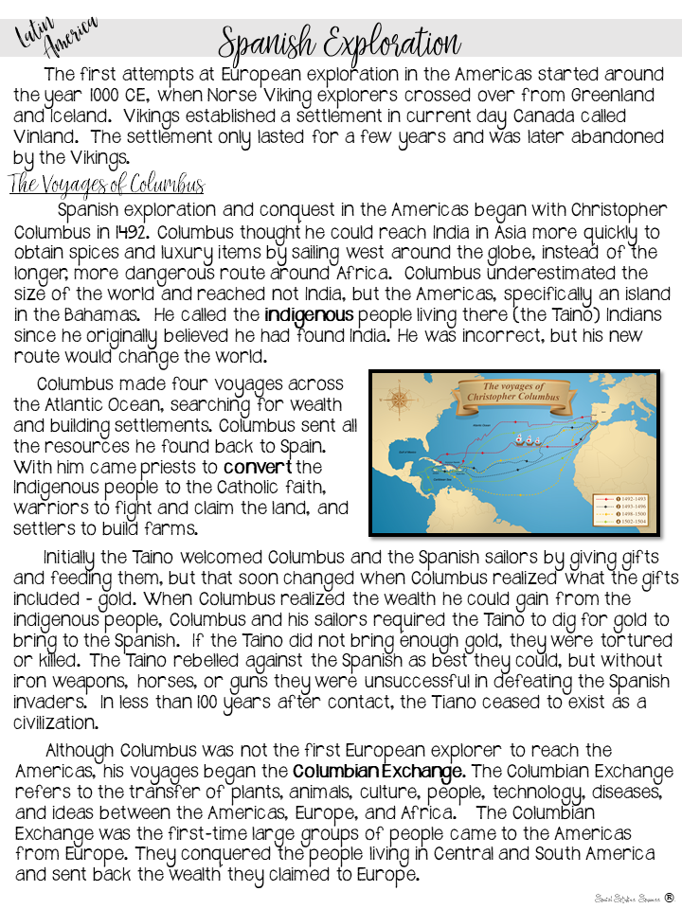
Reading
Read
the handout.
Underline new information.
Check facts you already know.
Notes:
Give each group a copy of the first page of the reading (Spanish Exploration) and conduct the reading.

Slide 59
Notes
Notes:
Pass out the Doodle Notes and have them complete what they can with the first page of reading – not all of the info comes from the first page.

Slide 60
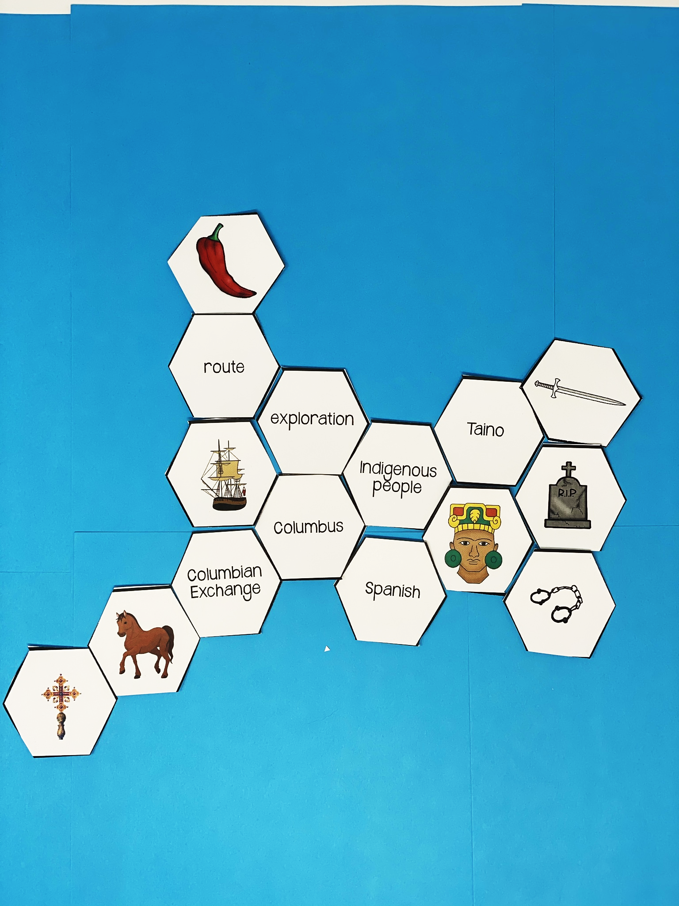
Hexagonal Thinking
Make connections between the hexagon shapes.
Notes:
Pass out the first round of the hexagons. Make connections between the hexagon shapes. For every connection they make, they earn 1 point. For example, the indigenous people shape is connected on 5 sides, exploration, Columbus, Spanish, person figure and Taino. A student should be able to explain how all of these are connected. If they can, they earn 5 points. You can ask them to annotate their connections with post it notes
Once you have finished the directions, go to the next slide before you start – you don’t want them to just copy your example.

Slide 61
Play
Notes:
Give them time to make connections with the hexagons. Do not clean up the hexagons, they need to stay out for the next round.

Slide 62
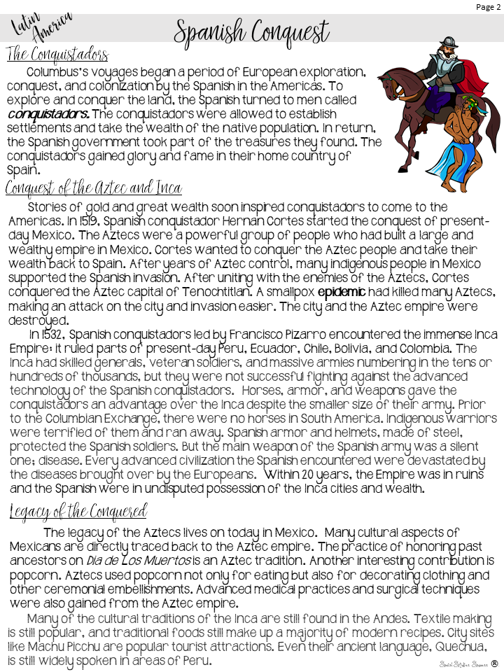
Reading
Read
the handout.
Underline new information.
Check facts you already know.
Notes:
You may not want to do round two or three, depends on your time. You can just tell them what they would do next, how they add hexagons everytime so that it grows.

Slide 63
Notes
Notes:
Pass out the Doodle Notes and have them complete what they can with the second page of reading

Slide 64
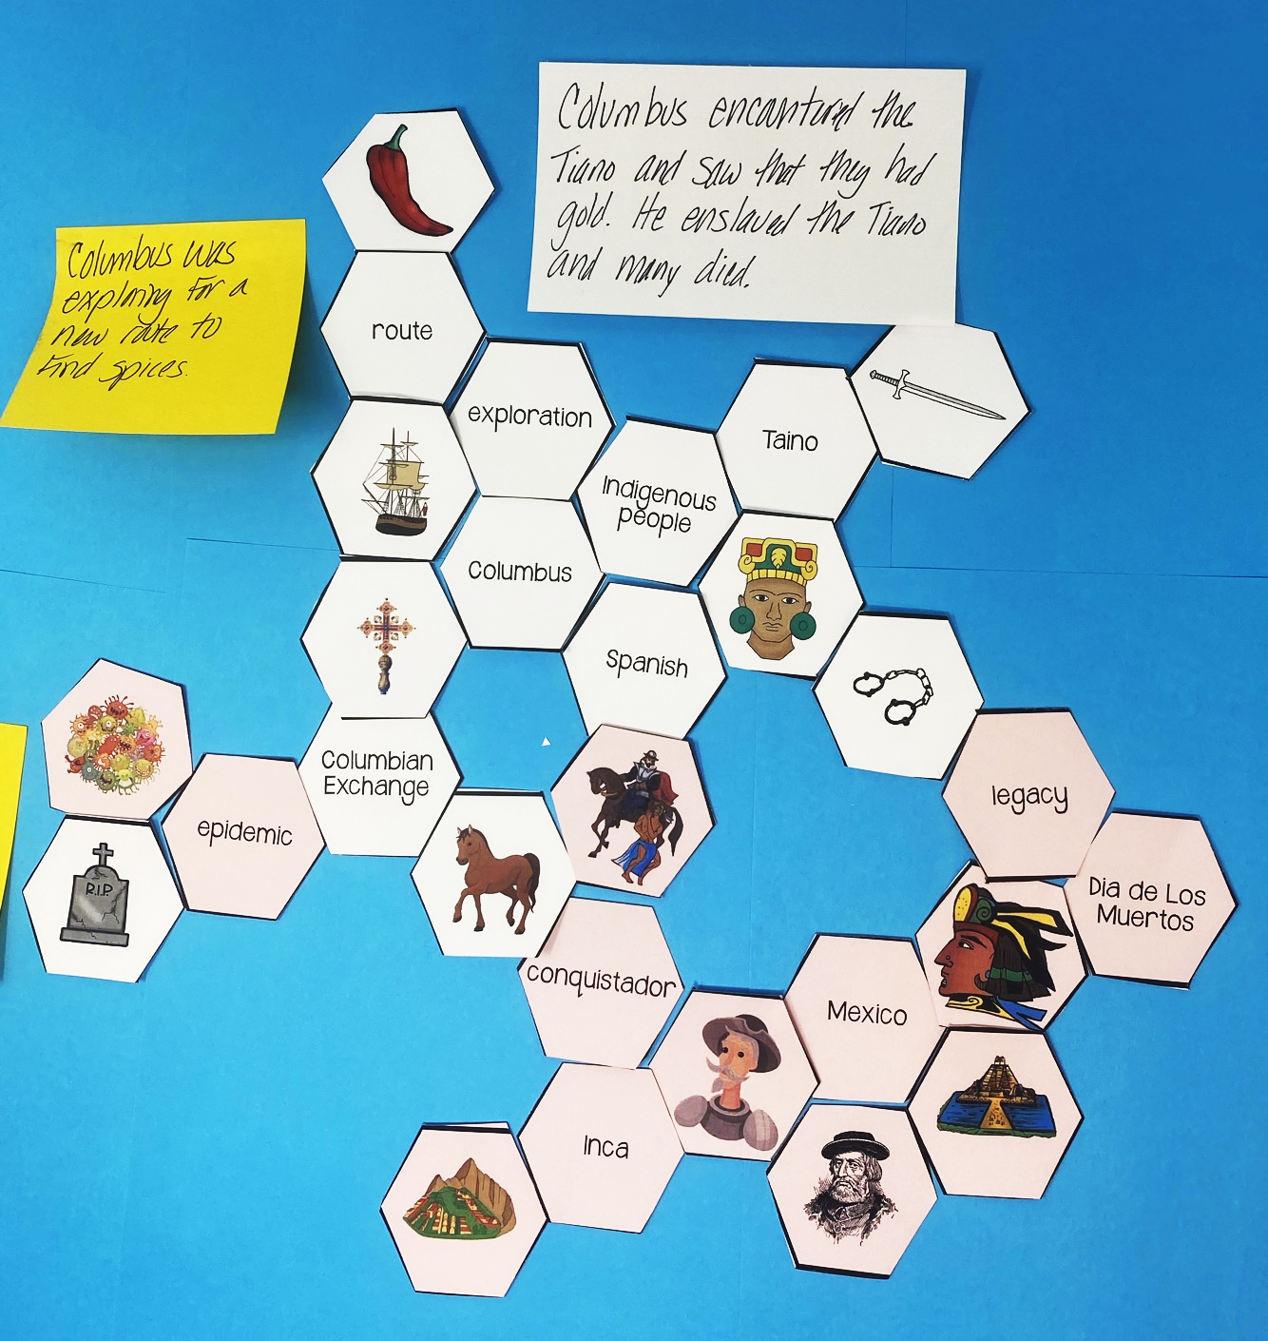
Hexagonal Thinking
Make connections between the hexagon shapes.
Notes:
Pass out the next set of hexagons, they will then add to their first set.

Slide 65
Play

Slide 66
What Design Qualities of Engagement did you observe?
Notes:
Debrief the lesson by asking them to use specific design qualities of engagement terminology to identify different parts of the lesson that increase engagement.

Slide 67
What have you learned about engagement?
Notes:
Share with a partner.

Slide 68
What
Questions
have I created?

Slide 69
Reflection
Notes:
Give them 5 minutes to write down reflections on their notes (on the back)

Slide 70
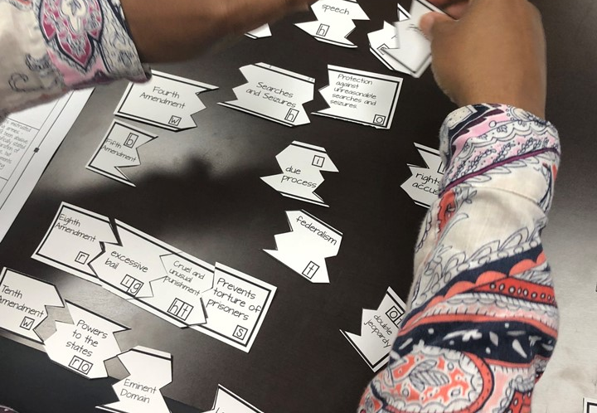
Engagement During Review
Notes:
We are now going to look at how to build engagement during review sessions.

Slide 71
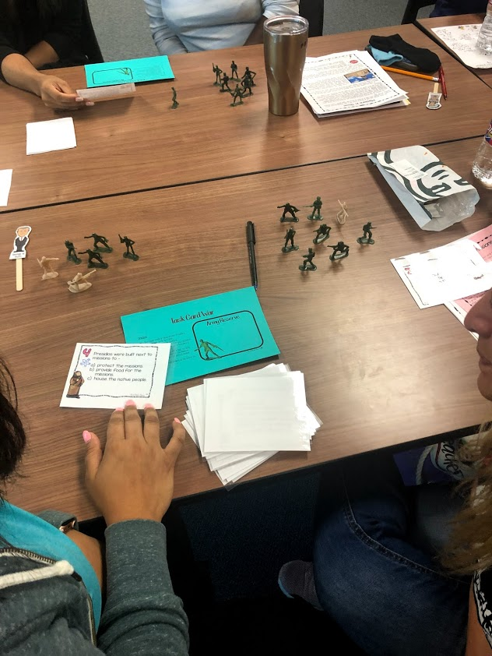
Using
Task
Cards

Slide 72
Task Card War
Progressive Era Task Cards
Notes:
Pass out army soldiers – each person gets about 10 soldiers. Directions are on the next slide.

Slide 73
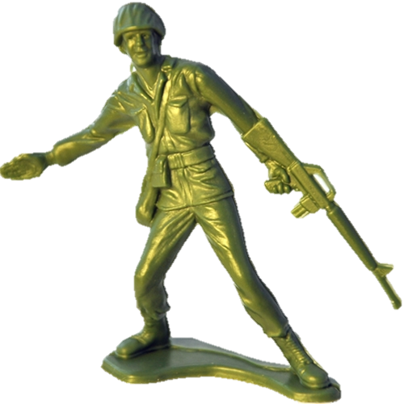
Task Card War
Directions:
Each player needs an equal number of soldiers. Place the task cards face down.
Take turns answering the questions.
If you get a question correct, take your opponent’s soldier, if you get the answer incorrect, give a soldier to your opponent.
If there is a dispute over the correct answer, check the key.
The player with the most soldiers at the end of the game wins!
Fix directions
Add kaboom
Notes:
Play ☺

Slide 74
Kaboom!
Take turns choosing questions from the stack and answering them.
If you get the question correct, keep it. If you pull an action card, complete the action.
If you choose a Kaboom! card, all of the questions you answered go back in the stack.
The person with the most correct questions at the end of the game – wins!
Kaboom!
Notes:
Add a few of the kaboom cards to each set. Play like UNO.

Slide 75
What Design Qualities of Engagement did you observe?

Slide 76
Reflection
Notes:
Give them 5 minutes to write down reflections on their notes (on the back)

