Slide 1
Questioning Strategies for
Social Studies

Slide 2
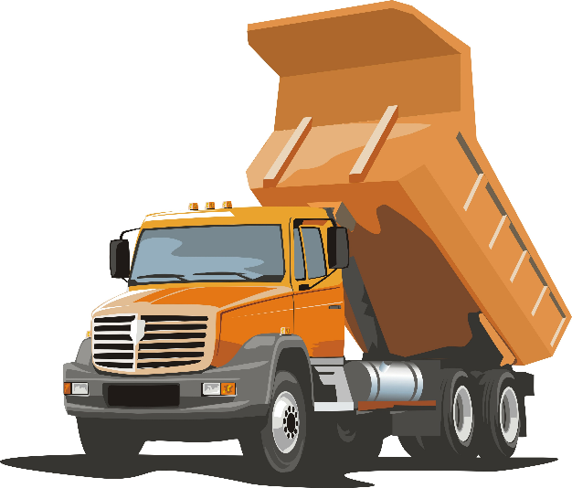
Brain Dump
Write everything you remember from the last session on an index card – you have one minute.
Share your ideas on the index card with 2 other people in the room.
Notes:
Pass out index card and give the teachers 1 minute to complete the activity. Then allow them to walk around the room and share what they remember as a warm-up to the presentation.

Slide 3
Examine essential questions.
Learn how to create activities based on discussion strategies.
Notes:
We are going to look at questioning strategies in two different scenarios – essential questions and how to use them in discussions

Slide 4
Find a Partner
Notes:
Place the teachers with a partner.

Slide 5
It is not the answer that enlightens, but the question. – Eugene Ionesco
Notes:
Read this quote to the teachers and ask them to think about it for 30 seconds.

Slide 6
It is not the answer that enlightens, but the question. – Eugene Ionesco
How does this quote reflect your teaching?
Why do we ask questions as teachers?
Notes:
Ask teachers to talk about this quote, then share.

Slide 7
Question Match Up
Notes:
Pass out the envelopes with the Question and Answer Match Up activity. Give your teachers time to read the questions and match up the answers. Then ask them to categorize the questions – for example, all those dealing with wait-time.

Slide 8
What did you already know about questioning?
What did you learn about questioning?
Notes:
Ask the teachers to discuss these questions.

Slide 9
Essential
Questions
Notes:
We are going to start by focusing on essential questions.

Slide 10
Criteria for Creating Essential Questions
is clearly connected to a state standard/essential understanding
is provocative
is stated simply and clearly
is arguable from different points of view
allows/makes students synthesize and evaluate historical information
deals with issues to which students have direct access—and interest
Notes:
Take a minute to read the handout on Essential Questions

Slide 11
Evaluating Essential Questions
The Civil Rights Movement
A. What made the Civil Rights Movement successful?
The Roman Empire
B. Why did the Roman Empire fall?
The Roots of Western Civilization: Hebrews, Greeks, and Romans
C What is the best set of rules for people to live by?
The Industrial Revolution and the Progressives
D. Is what’s good for business also good for America?
Imperial China and Feudal Japan
E. In what ways were Imperial China and Feudal Japan similar and different?
Notes:
Give teachers time to rank the questions, then discuss which questions are good essential questions and which ones need more work.
Question A is not very provocative and is not evaluative. The teacher has already decided that the Civil Rights Movement was successful and the students simply go find the answer. A more evaluative question might be: Was the Civil Rights Movement successful?
Question B is not very provocative and not very evaluative. A more provocative question might be: Did the Roman Empire really fall?
Question C matches all the criteria. In addition, this question also makes it easy to make a complicated ancient history relevant to students’ lives by talking about rules to live by.
Question D matches all the criteria.
Question E is neither provocative nor evaluative and it encourages students to regurgitate a laundry list of facts.

Slide 12
Practice Writing Essential Questions
Examine the different readings.
Generate two or three essential questions.
Notes:
Pass out various readings – have teachers discuss and create essential questions.

Slide 13
1 Foot Summary
Notes:
Stand on one foot and summarize what you have learned so far to your partner.

Slide 14
Take a 15 minute
Break!
Notes:
I am putting in an early break because it is after lunch – feel free to move it where you need it.

Slide 15
What does
look like in your classroom?
discussion
Notes:
Now we are going to look at questioning within discussion strategies – you will add your own personal story here.
I want to share with you some of my own experiences with “classroom discussion”. I can remember writing that in my lesson plan (because it looked good), but not having any purposeful strategy or plan beyond writing it down. I would ask a question in class, and Travis – thank goodness for Travis – would raise his hand and answer my question. The two of use would have an amazing discussion about my topic, I would think it was a success, and then I would move on. The problem was, I didn’t have Travis in all of my classes, so sometimes, I would ask a question, tell the students to discuss and nothing would happen. Students would talk, but it sure wouldn’t be about my question! I would quickly get frustrated and move on. I didn’t have any particular strategies I could use to improve student discussion in my classroom.

Slide 16
What
do you already use?
discussion
strategies
Notes:
The first question I want to ask you is – what discussion strategies do you already use? Teachers know that purposeful talk is important in social studies. It is important for our students to learn and process the ideas the receive in your class. Many teacher use turn and talk and Socratic seminars successfully already. We are going to explore more ways you can embed discussion into your lesson plan to both increase engagement and to improve learning.
Give teachers a minute to discuss.

Slide 17
Powerful discussions don’t just happen… they are
planned!
Notes:
Yes, sometimes you can have some amazing unplanned discussions in your classrooms, but do you want to find a method where you have amazing classroom discussions in your classroom all the times? It takes planning.

Slide 18
Planning Discussions
1. Start with a question -
Lower level comprehension questions can be used for quick engagement and discussion.
Notes:
The first step in planning for discussion seems obvious, but it is often overlooked. Planning your questions. When you plan your questions, you are also planning the intent of the discussion, because the intent of the discussion will help you craft your questions.
Let me explain. If you are planning on having a quick discussion to check for comprehension or to build student engagement, you will plan lower level questions. These short discussions can provide brain breaks for your students and help them process the information. These questions will be easier for you to write and will be based directly on the content you teach.

Slide 19
Planning Discussions
1. Start with a question -
Upper level justification questions can be used deeper and more meaningful discussion.
Notes:
If your goal is a deeper and more meaningful discussion, you need higher level questions. These are the questions that take place at the end of the class or unit as students process all of the information they have learned. The best type of upper-level questions are essential questions.
Essential questions are questions that focus on the big ideas in Social Studies. They often tie back to important concepts in Social Studies as well as the content you are teaching. Essential questions Have no simple “right” answer; they are meant to be argued, and as such, lead to powerful classroom discussions.

Slide 20
Planning Discussions
1. Start with a question.
2. Provide background information.
Notes:
This next step seems obvious also, but too often we don’t provide our students enough information prior to leading a discussion. How can students discuss a topic they know nothing about.

Slide 21
Planning Discussions
1. Start with a question.
2. Provide Background information.
Songs
Primary Sources
Content Readings
Notes:
Providing background information needs to be more than a lecture. Students need to interact with the content before they can discuss it. Background information needs to increase student interest on the topic, so you can use resources such as songs, primary sources and even a high interest reading.

Slide 22
Planning Discussions
1. Start with a question.
2. Provide background information.
3. Set clear expectations.
Everyone Speaks
Use Your Manners
Treat All Answers With Respect
Notes:
Step Three needs to be used prior to every discussion. What are your expectations for the discussion? Do your students know these expectations? How do you teach them? Was it modeled? Is it on an anchor chart that you review? This important step needs to be thought out in advance and include instruction on its own.

Slide 23
Planning Discussions
1. Start with a question.
2. Provide background information.
3. Set clear expectations.
4. Choose a strategy
4 Corner Debate
Chat Cards
Inner-Outer Circle
Expert Groups
Question Dice
Roving Reporter & More
Notes:
The final step is to actually choose the strategy you want to use. The strategy should match your goal in step one. Each of these strategies I am going to share with you can be used in whole groups, small groups and even with a partner. In addition to these strategies, you will receive more in your Discussion Strategy Manual.

Slide 24
Strategies
for Whole Class Discussions
Notes:
The first series of discussion strategies are going to focus on whole class discussions.

Slide 25
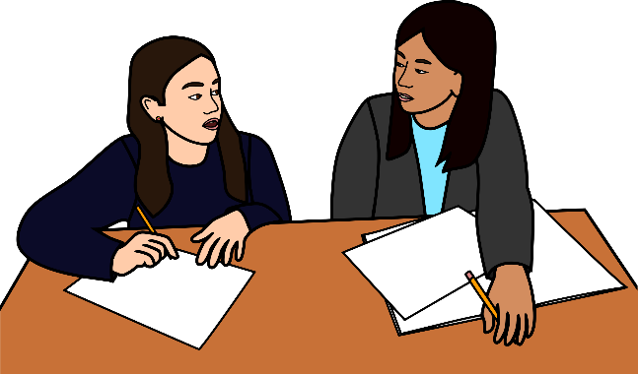
Four
Debate
Corner
Notes:
Four corner debate is a strategy you can use to create a discussion in your class as well as include movement. This strategy works well as a preview when you start class but can also be used to summarize and draw conclusions at the end.

Slide 26
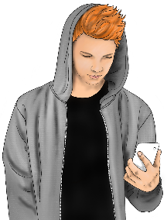
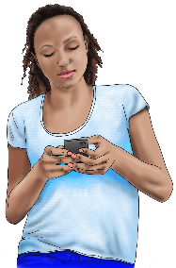
Strongly Agree
Mildly Agree
Technology is essential for teaching social studies
Mildly Disagree
Strongly Disagree
Notes:
This is an example of how you can use a four-corner debate. You post a provocative statement that can be answered in multiple ways with a variety of responses. Hang the 4 corner cards up in your room in 4 different spaces. Give each student an index card. Before they move to their corner, have the students write a response on their card. This provides students wait and think time – and also just prevents them from going to the corner with their friends. Once a few minutes have passed, allow students to stand up and move into the corner that corresponds with their answer. Ask a few debrief questions like: where is the majority of the class standing? Which response has the least students? Then have the students in the 4 corners organize themselves into smaller groups of 3-4 students. Have them read their index card with their response to the smaller group. Once everyone has had a chance to speak in their group, randomly call on one person from each of the 4 corners to share their response. Encourage them to pull in other answers they have heard in their small group discussion.

Slide 27
Preview
Which of these sentences do you agree with the most? Why?
Studying history teaches that people change and still always stay the same.
History helps us understand the way we live now.
History teaches us that actions have consequences.
History teaches you to ask questions and challenge ideas.
Social Studies Success
Notes:
You can also use 4 Corners with Questions and Answers – Instead of posting the Agree/Disagree signs, just post the numbers 1-4 in your room. Your students can move to the number that corresponds with the answer choice they choose. Once again, they will need to explain their thinking to other students that have created similar responses.

Slide 28
Notes:
A twist on 4 Corners is to create a Human Bar Graph. Instead of just bunching up in front of a sign, have your students create a bar graph out of their bodies. You can then debrief by having the students look around the room to see which topic received the most responses, the least, and ask a few questions before you have your students discuss it in their smaller group.

Slide 29
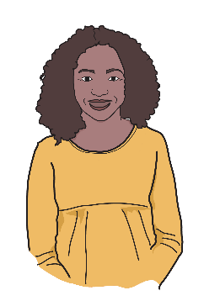
Inner –
Circle
Outer
Notes:
Inner – Outer circle is another strategy that will include your entire class and incorporate movement as well. This is a great strategy for involving all of the students in your class in a low-steaks discussion.

Slide 30
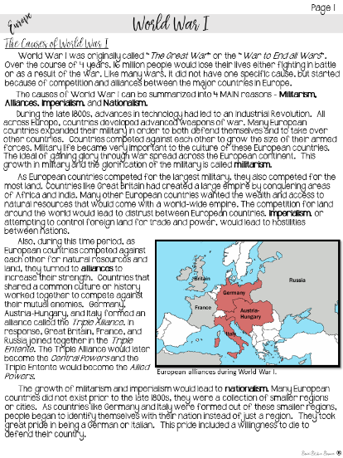
Inner outer circle
Be prepared to discuss this topic by creating two questions about the reading on index cards.
Notes:
The inner – outer circle strategy is great when you want to check for understanding and have a brief discussion. For this strategy to work, you need to provide students background information and a few questions that spiral from easy to more complex. Give your students time to answer the questions and prepare for the inner-outer circle.
Since we have already read this handout, I am just going to give you a few moments to review it before we start our activity.

Slide 31
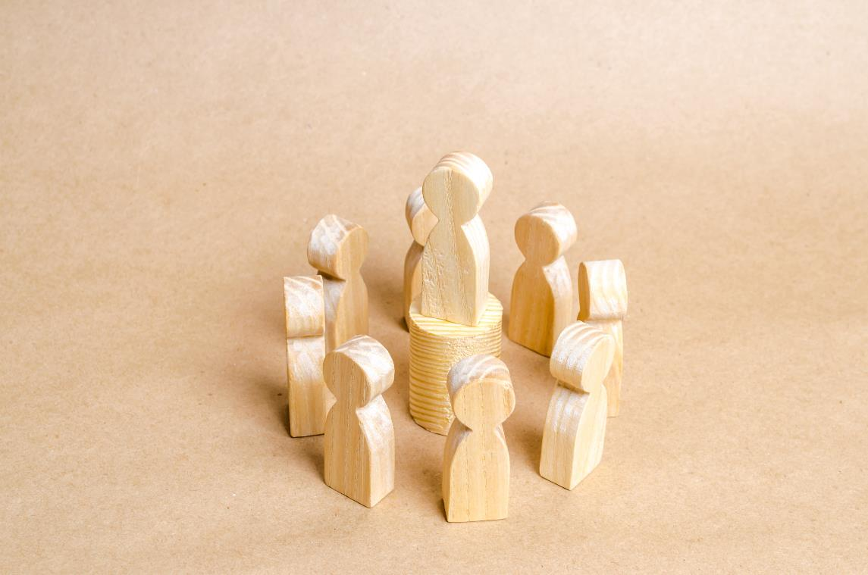
Circle
Inner outer circle
Inner –
Outer
How does this song make you feel? Why do you think it makes you feel that way?
What words or phrases are used to evoke emotion?
How does this song reflect resistance?
What other connections can you make with this song?
Notes:
You will need space for the next step – get your students out of their desks and have them create a circle around you. You will need to stay in the center of the circle so that you can monitor the discussion.
Directions:
Divide your class in half. One half will create an inner circle; the other half will make up the outer circle.
Students in the outer circle can ask a question of the students in the inner circle. These questions can be self-selected by the students, or you can make your own question(s).
After a set period of time, the teacher signals, and the inner circle rotates and pairs up with a new student.
Once the group has completed a full rotation, the inside and outside circle trade positions and repeat the above steps.
Benefits:
♥ Listening and Speaking Practice: This activity allows students to practice active speaking and listening skills.
♥ Active Engagement: Students are constantly moving and/or switching roles. This variety keeps students engaged and on task.
♥ Safe/Comfortable: Talking one-on-one with each other is far less intimidating than talking to a small group or to the whole class. This is a great activity to help build confidence in students who are reserved or afraid to speak in front of others (ELLs).
♥ Ownership: One option for this activity is to have students create their own questions (which they LOVE doing). They really take this task seriously and become entirely invested in the process.

Slide 32
Circle
Inner outer circle
Inner –
Outer
1
2
2
1
1
How does this song make you feel? Why do you think it makes you feel that way?
What words or phrases are used to evoke emotion?
How does this song reflect resistance?
What other connections can you make with this song?
2
2
1
Notes:
Starting with any student, go around the circle and number the students off, 1,2, 1, 2, until you have assigned numbers to all of the students. The students who are number one need to stay in their position. The number two students will take one step forward and then turn around, facing the number one student who is next to them. I always have the students shake hands and say hello, but a fist bump will work as well.

Slide 33
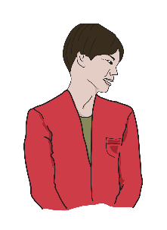
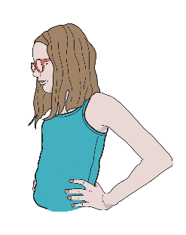
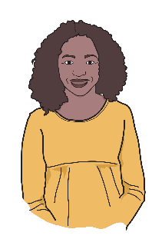
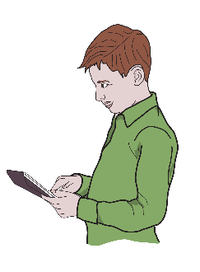
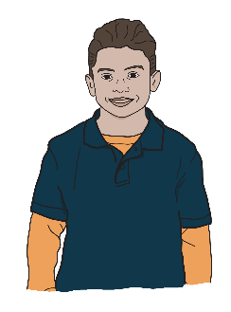
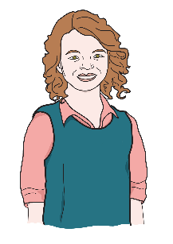
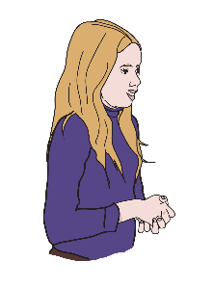
1
2
2
1
2
1
1
2
Notes:
Once the students are grouped in two circles facing each other (Inner and Outer Circle). I will read the first question out loud. In the first round, student number 1 will repeat the question to student number two, who will then answer it. After a minute or so, get the students attention (I recommend a bell), and have the number two student on the inside take a step to their left. This will place them with a new partner. Once again, shake hands and say hello.
In this round, I will ask a question, and student number 2 will repeat the question to their new partner. Student number one is responsible for answering the question.
Repeat the process for 3 to 4 rounds, giving every student a chance to both ask a question and answer a question. After every question, rotate the inner circle.
After you have completed the rounds, debrief with your class. Share what you heard when you were standing inside the circle and praise those with especially thoughtful responses.
Some additional questions on World War I you can ask are:
What were the four causes of World War I?
Which countries made up the Central Powers? Which countries made up the Allied Powers?
The United States did not immediately join World War I. Which side do you think it will join? Why?
The teenager who killed Franz Ferdinand was named Gavrilo Princip. He was part of a terrorist group called the Black Hand. He was captured immediately after the assassination and brought to trial. He only received a prison sentence of 20 years for his crime. Would you call his actions a turning point in history? Why or why not?

Slide 34
Fishbowl Discussion
Notes:
The Fishbowl is a formative assessment strategy that allows the teacher to assess whether a student can justify a stand or decision. Three to five students are selected to be in the "fishbowl", sitting together in a cluster or in the front of the room. The rest of the students evaluate the conversation by completing a rubric on the discussion or creating their own questions to ask members of the "fishbowl". The conversation is a response to a prompt in which the students think aloud - discussing and defending their ideas.

Slide 35
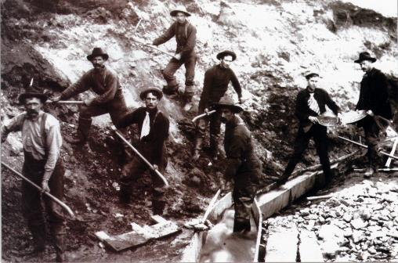
How did immigrants contribute to the growth of the United States?
Immigration
Germans
Irish
Chinese
Social Studies Success
Notes:
Provide your students different pieces of background information. Each partner group should have a different topic or different piece of research on a topic.

Slide 36
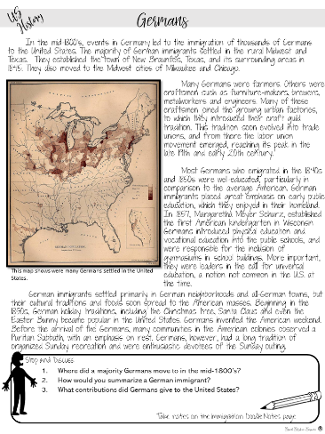
Fishbowl discussion
Read the handout with your partner
Discuss the questions with your partner
Be prepared to share in a discussion
Notes:
Give teachers time to read the handouts and discuss the questions with their partner.

Slide 37
Fishbowl discussion
How did immigrants contribute to the growth of the United States?
Notes:
Put the teachers into the fishbowl. Designate one person to start and conduct a discussion based on this question. The teacher outside of the fishbowl needs to take notes on their discussion partner with the rubric.

Slide 38
Fishbowl discussion
Which immigrant group contributed the most to the United States?
Notes:
Switch teachers and discuss this next question.

Slide 39
Share your observations
Notes:
Give teachers time to share their observations about the discussion with each other.

Slide 40
What did you learn about discussions?
Notes:
Give teachers time to share what they have learned so far about discussions.

Slide 41
Strategies
for Small Group Discussions
Notes:
Next, we are going to experience strategies for smaller group discussions. This will include strategies for groups of 4, 3, and 2 students.

Slide 42
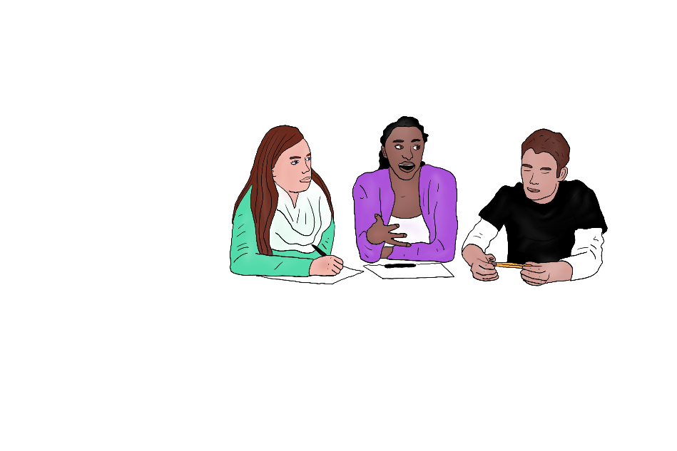
Expert
Groups
Notes:
Another great way to embed discussion into your lesson is with Expert Groups. In this strategy, you want to choose content that can be examined from many different lenses or from different points of view. Prepare for this lesson by creating multiple “Home Base Groups” – each group should have 3 (or close to 3) students.

Slide 43
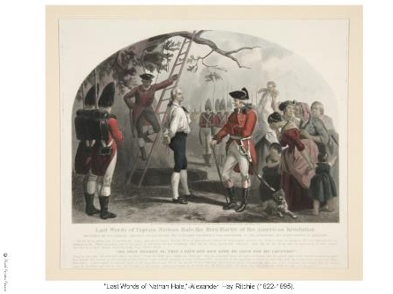
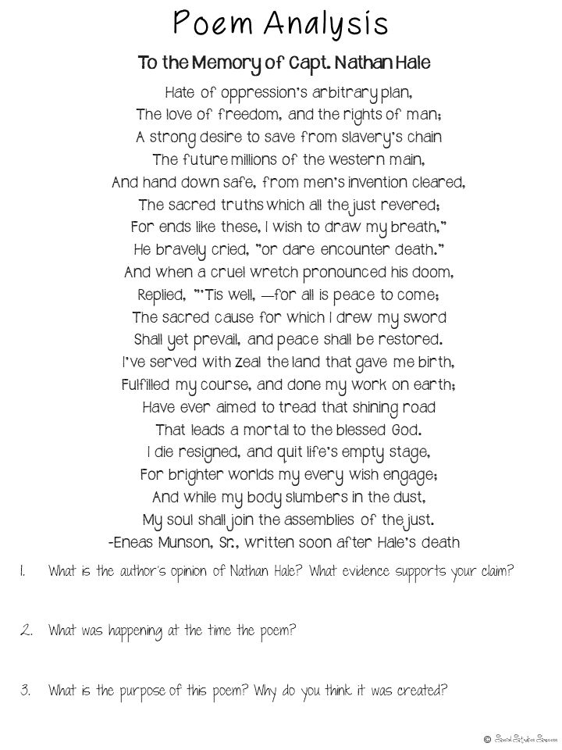
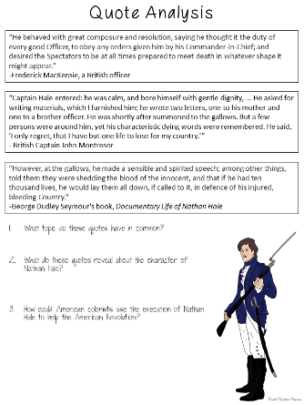
Analyze
primary sources with
Expert
Groups
Notes:
Provide your students different pieces of background information. Each group should have a different topic or different piece of research on a topic.
I think Expert Groups is a great way to analyze primary sources, because it provides a peer support system to the primary source analysis. Prepare for your lesson by finding 3 different primary sources to examine – in this example, I am using quotes, a poem and an image of the Hanging of Nathan Hale. Each of these primary sources will have questions that will lead to a discussion with a small group.

Slide 44
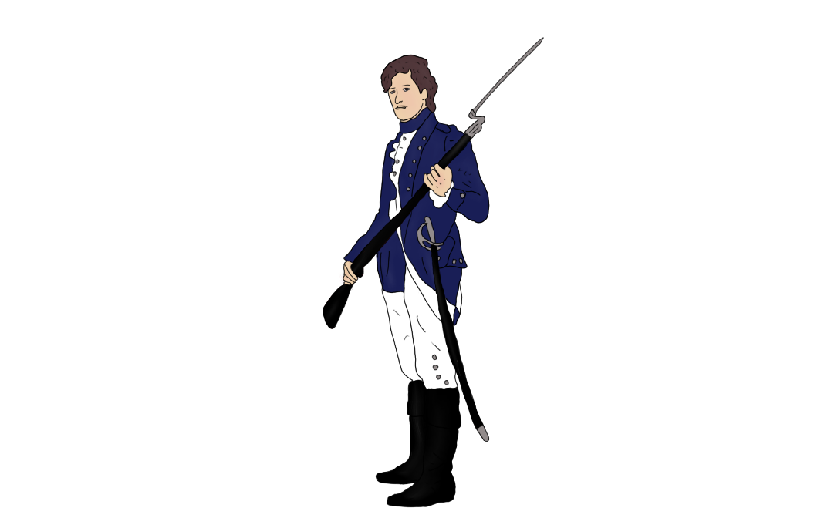
Why should Nathan Hale be remembered today?
Nathan Hale joined the Continental army and became a captain. In August and September of 1776, Nathan Hale volunteered to spy on the British in New York. His experience as a school teacher gave him the perfect cover. He spied on the British while he was teaching school. Unfortunately he was captured and killed.
Notes:
Place your students into their home base groups. Set up the discussion with background information prior to the expert group discussion. You will want to share the essential question (Why should Nathan Hale be remembered today) as well as a brief story or lecture with historical content for your students prior to the primary source analysis.

Slide 45
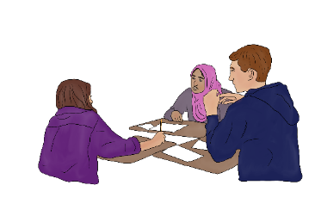
Expert Groups
Home Base Group
3
2
Expert Group
1
1
1
1
Home Base Group
Notes:
Once you have shared the background information with the Home Base Group – you will number your students off “1, 2, 3” . Then you will group all of the like numbers together – keeping in mind that you don’t want your groups to be too big, so you many have several new number 1 groups, several number 2 groups and so on.
The expert group will then be given a primary source – make sure all of the numbers get the same primary source. To facilitate this process, I usually create folders with the resources and just number the folders, 1, 2, and 3. Tell these new “Expert Groups” that their job is to analyze the primary source together, and be prepared to teach the information to their home base group. Monitor their work and assist as needed.
One important step is for each group to CHECK WITH YOU before they can return to their home base group to share. This will ensure accuracy of information and raise their level of concern when discussing the information with their expert group.
The next step is for you to allow the students to return to their home base group to share what they have learned.

Slide 46
Why should Nathan Hale be remembered today?
Notes:
Once the expert groups have shared what they learned from the expert groups, it is time to give the final discussion question. Your students should then discuss this question with their home base groups. You can then transition into a writing assignment or have each group share out their discussion.

Slide 47
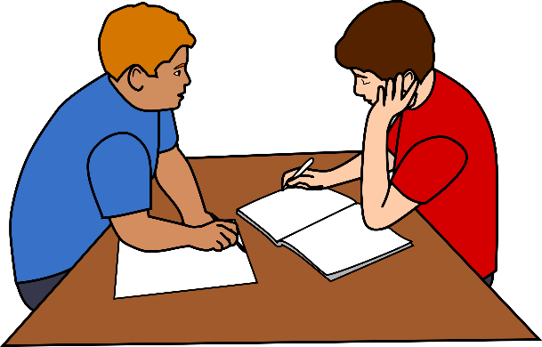
Question
Dice
Notes:
Question dice are a great “instant discussion and engagement” tool. They do require a little bit of prep before hand, but you can use them easily throughout the year.

Slide 48
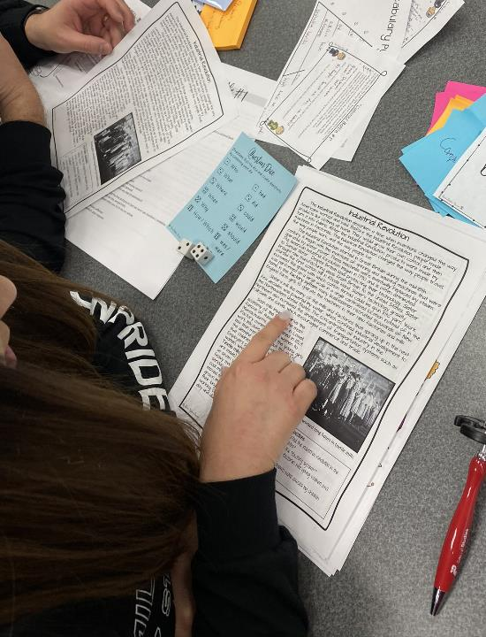
Use
Question
Dice
for small group discussions during a reading.
Notes:
Students use question dice to ask each other questions during a reading. Place the students with a partner or in a small group of 3. Give each group a set of dice and a question dice card. Students will take turns reading the content out loud to each other. At the end of every paragraph, 1 student will roll the dice and create a question based off of the content they read. At first, they will only ask questions regarding the first paragraph, but as the reading continues, students can ask questions off of any of the content that has been read aloud.
If you want to practice this strategy with question boxes, use the Industrial Revolution Reading.

Slide 49
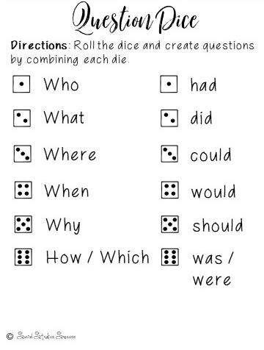
Question Dice
Notes:
You will need to model how to use question dice before you allow your students to use it. They can use the dice in any order that makes sense. If they roll the dice and they can’t create a question, just have them roll again.

Slide 50
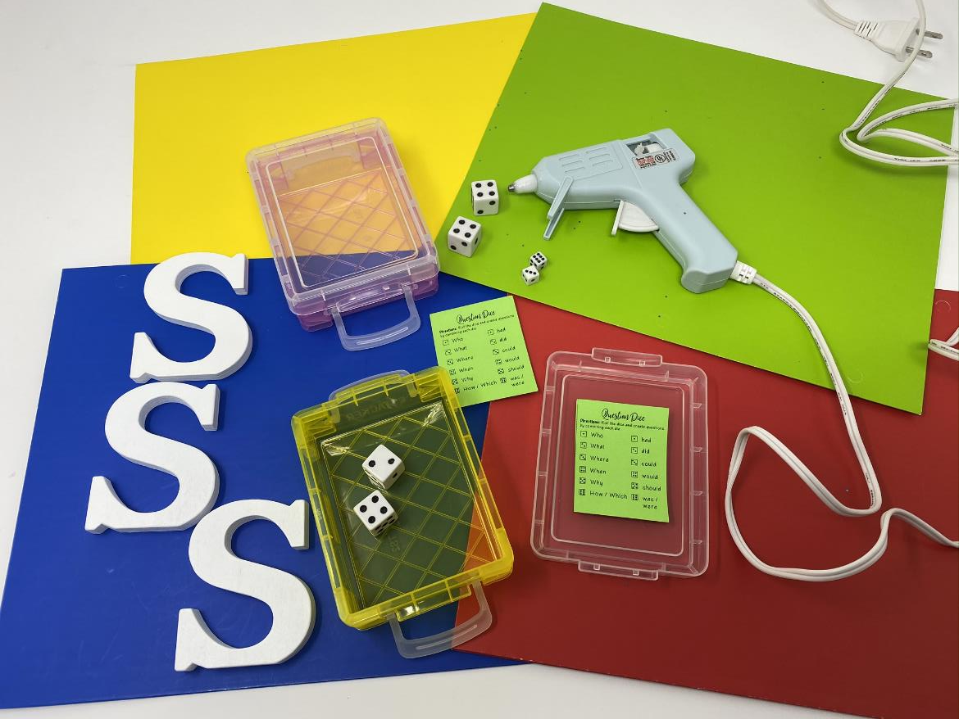
Notes:
Are you afraid of allowing dice in your classroom? Here is a neat teacher hack. Print the questions cards at 50% or smaller. Take your dice and the Question Dice Card and put them in a crayon box. You can then glue the top shut so that students can’t access the dice. The box will still allow the dice to roll and you can store them neatly on a bookshelf or in a closet. If you buy all different colored crayon boxes, you can even spot checks groups by saying “The group with the pink box – read one of your questions and answer it”.

Slide 51
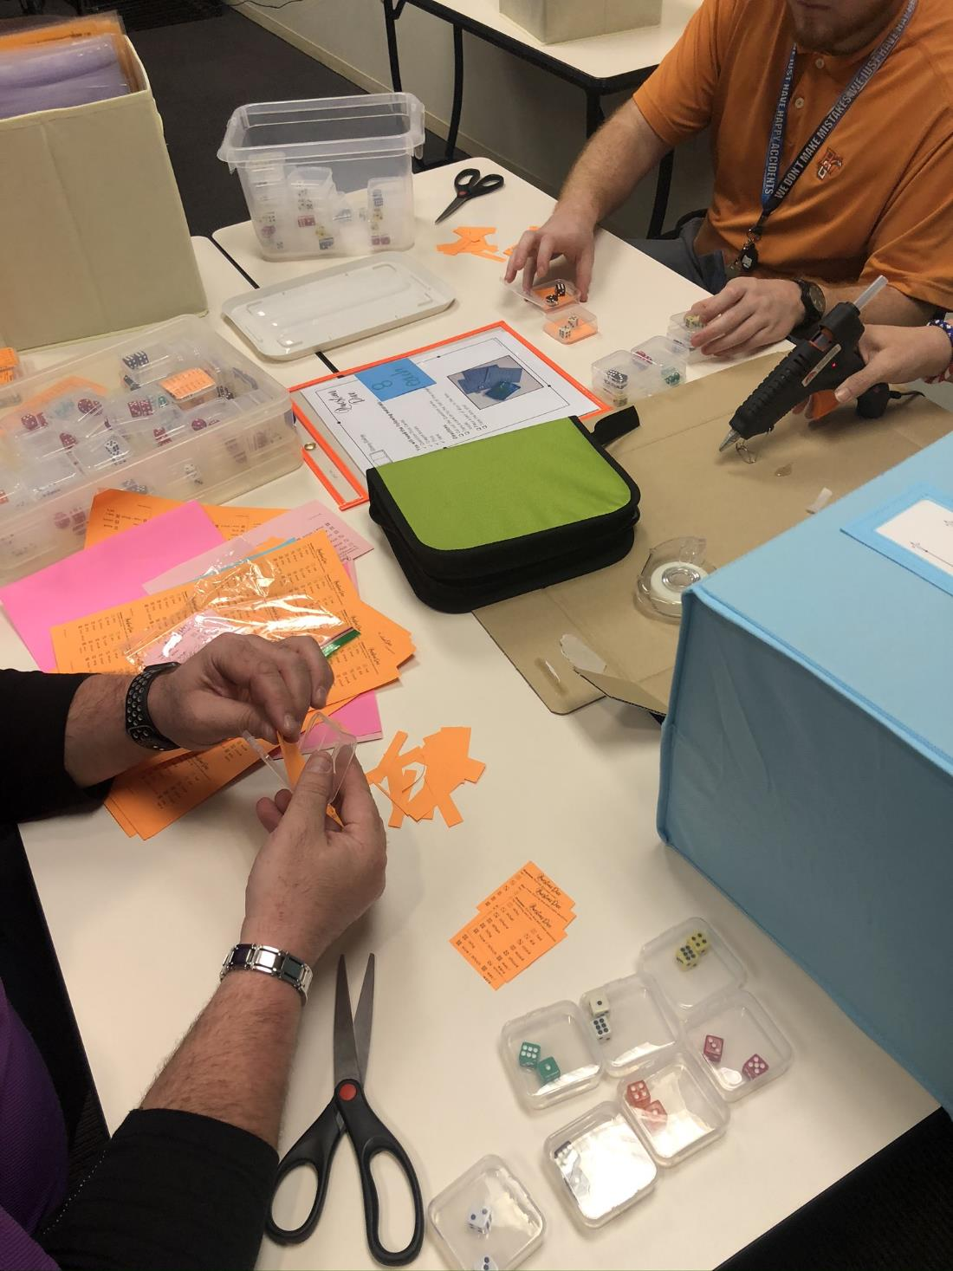
Notes:
If you can’t find crayon boxes – small jewelry boxes like these can be purchase on Amazon in bulk. You can even buy tiny die to fit in the tiny boxes!

Slide 52
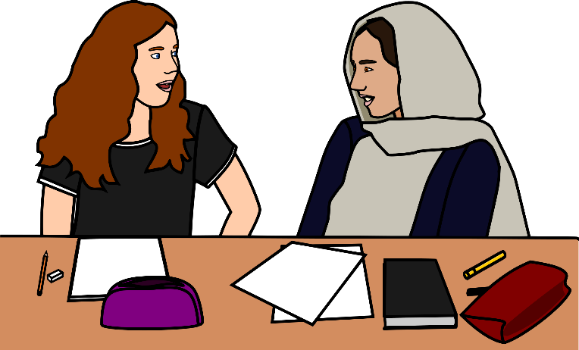
Reporter
Roving
Notes:
The Roving Reporter is another discussion strategy for partners, but also includes movement. This strategy works best when you want to focus on the human element of the history you are teaching.

Slide 53
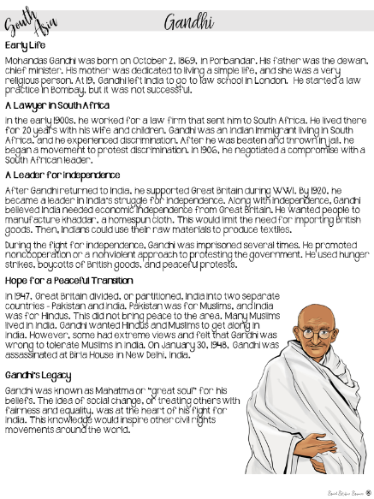
Read
the background information and create
questions.
Roving
Reporter
Notes:
Students start first by reading content with a partner. They are then challenged to create questions they could ask that person if they could travel back in time. In this example, they need to read the handout to prepare to ask questions about Gandhi.

Slide 54
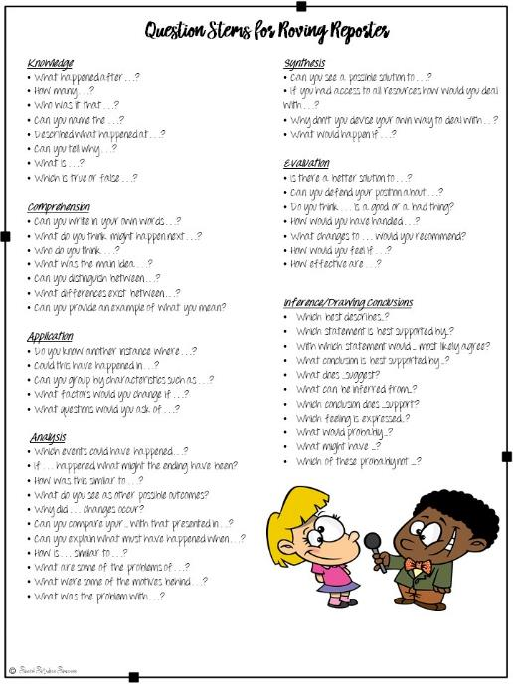
Use
Question
Stems
to support students.
Notes:
To help students prepare for their interview, I give them this handout with question stems. Included with this handout are the guidelines that students must create questions from all levels of Blooms Taxonomy. Students think deeply about the content as they craft specific questions to ask a historical figure. They need to focus on point of view and personal aspects of the historical figures.

Slide 55
Notes:
To create a more authentic experience, I create tiny notepads out of lined paper for my students. This helps students assume their roles as reporters.

Slide 56
Notes:
You can also purchase a few cheap microphones to use as props for the reporters. If you don’t have microphones, scissors turned upside down can also simulate microphone and enhance the experience.

Slide 57
Roving Reporter
One partner will be a reporter.
One partner will be Gandhi.
Notes:
Once the students have prepared for the interview, split the partner group – with one student role playing the reporter, and one student role playing the historical figure like Gandhi. Tell your students that now is the opportunity for them to travel back in time and interview an important historical figure. I would also prep the class with a few “rules” before we started. The students role playing Gandhi must act like him and answer questions from his point of view. The students role playing reporters must act like reporters of that time period – no shoving or shouting out questions, but respectful.
The students will then get up and go to interview different Gandhi’s by asking them their questions. I usually limit the reporters to 1-2 questions per interview, but then they need to interview another student.

Slide 58
Roving Reporter
Switch roles and then
write about it!
Notes:
After a few minutes, I allow the students to switch roles so that everyone has a chance to be the reporter and Gandhi. When they have finished their interviews, they can write a brief news story about what they learned about Gandhi.

Slide 59
What did you learn about discussions?
Notes:
Give teachers time to share what they have learned so far about discussions.

Slide 60
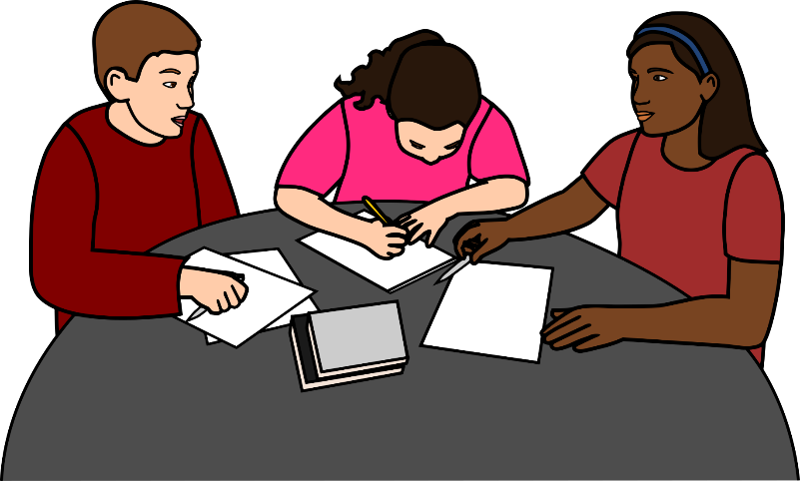
Silent Discussions
Conducting
Notes:
Another easy method for group discussion is actually a silent discussion. A silent discussion allows students to prepare their thoughts prior to a group discussion.

Slide 61
Write Around
Write on the assigned topic until you are told to stop.
Pass your paper to the person on your left.
Read what they have written and respond – either by extending their answer or contradicting it. Use facts from the lesson to support your answer.
Notes:
One method of silent discussions is called a write around. In this strategy, you place students into groups of 4. Tell each student to put their name on the top of a piece of paper and copy the silent discussion question. Your silent discussion questions work best if they are your essential questions for your unit. Questions like “Did the South really lose the Civil War” or “Was World War II America’s last “Good” War” will elicit a variety of responses.
Once students have written down the question, start a timer (usually 2 minutes) and have your students write everything they can about the topic. After the timer goes off, have them pass their paper to the person on their left. That person needs to write their name in the margin of the paper, read what was already written and respond – either by agreeing and adding more facts, or disagreeing and stating the opposite point of view. As this activity continues, give your students a little bit more time in each round, as they will need to read previous responses in addition to writing their answer.
When the original paper is back with the owner. Allow your students to have a discussion about what was written. They need to either compliment or critique the responses to their original answer.

Slide 62
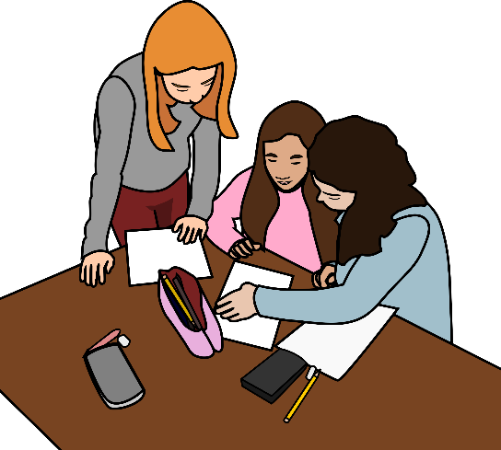
Circle
Consensus
Notes:
The Consensus Circle is another great strategy that involves a silent writing component and then speaking. We are going to model this with our prior reading on the Industrial Revolution.

Slide 63
Was the Industrial Revolution a blessing or a curse?
Notes:
Prepare for this activity with chart paper. Divide your students into groups of 3 or 4. Have your students write the discussion question in the center of the paper, draw a circle around it, and then create space for each of the students to write their answers. Give your students about 5 minutes to write the answer to the question. This is also a great opportunity to bring back in your essential question.

Slide 64
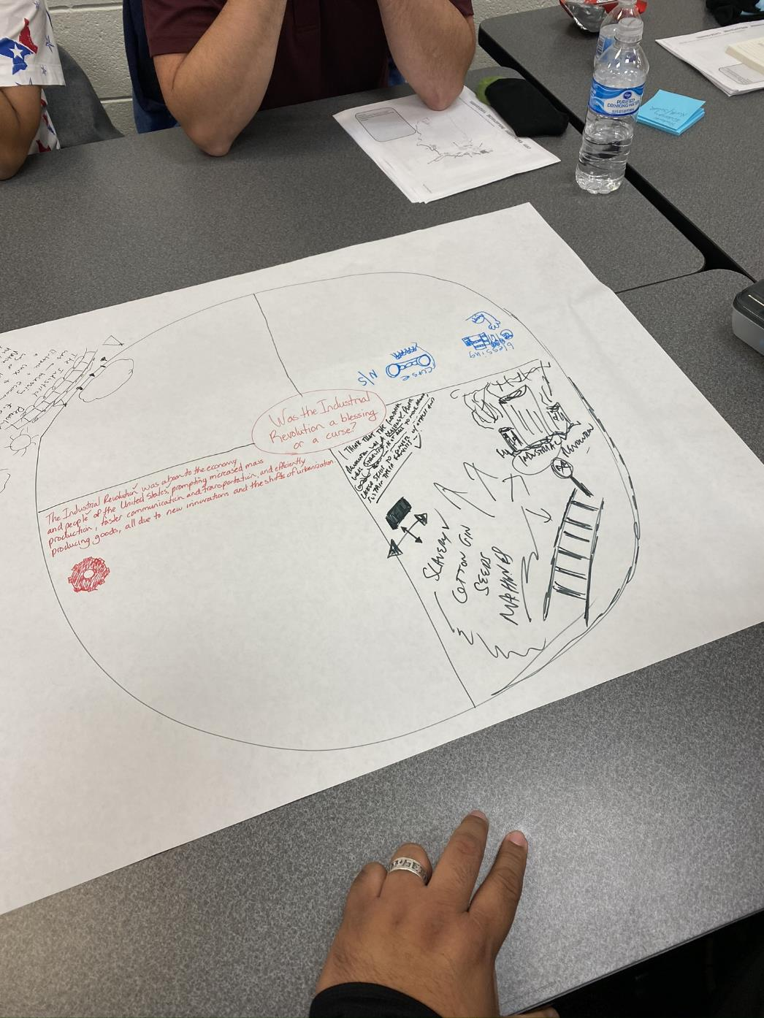
Notes:
Your students do not have to write in complete sentences, or even write to answer the question – they can doodle or draw if they wish.

Slide 65
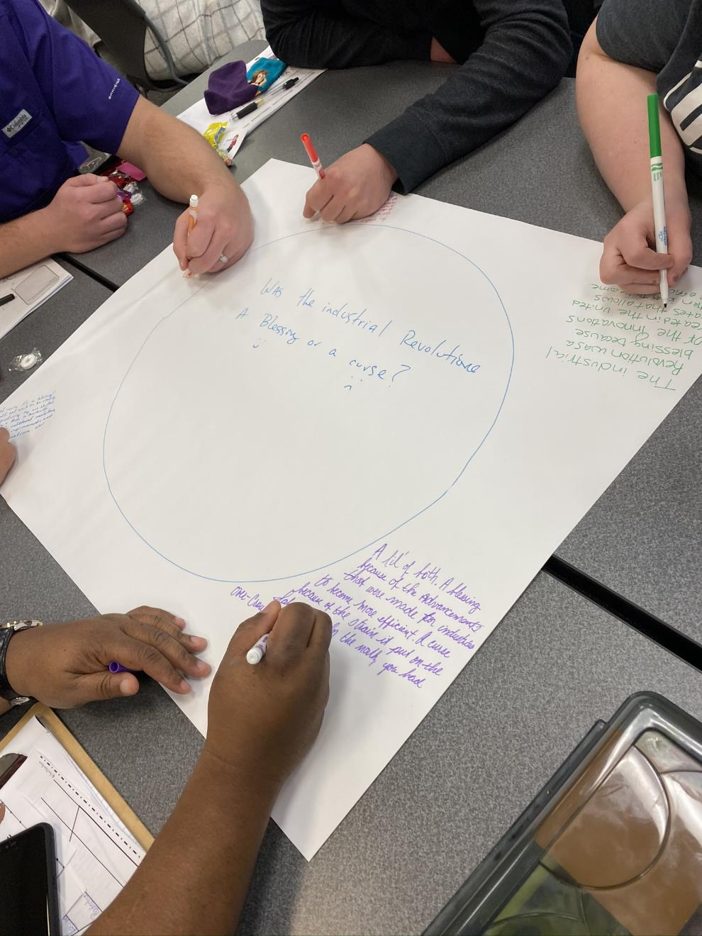
Notes:
After students have written their response, it is time for the discussion. Students go around the circle and share their responses. Once everyone has shared, have the students generate a team response that combines everyone’s answer. They can present their answer to the rest of the class.

Slide 66
Structured
Discussions
Conducting
Notes:
The final discussion strategy I want to share with you is my favorite. The structured discussion is a great strategy for you to use when you want to discuss controversial topics in your classroom in a controlled way.

Slide 67
Create Groups of Three

Slide 68
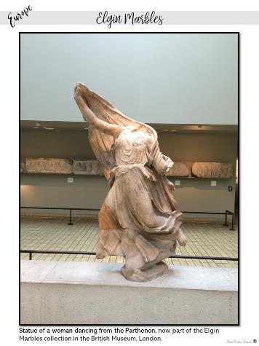
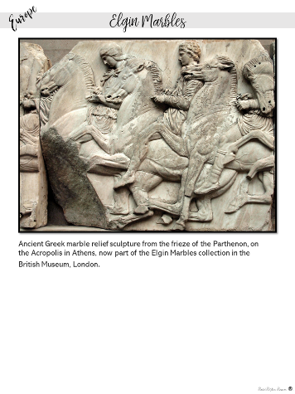
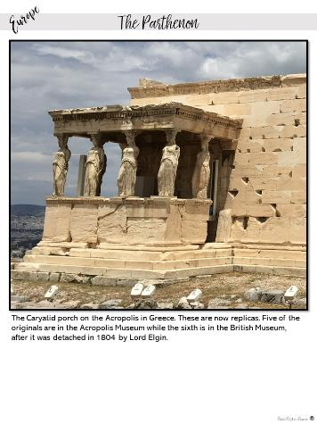
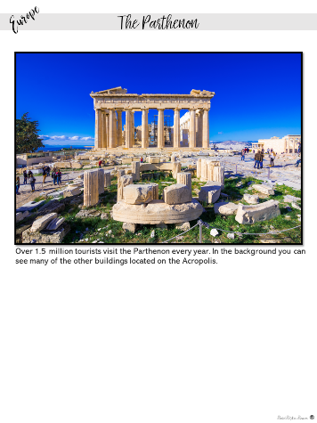
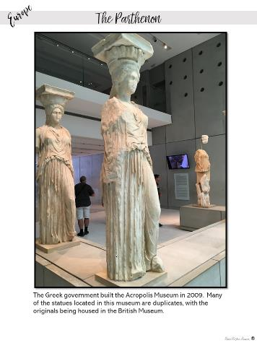
Preview
Examine the images given to your group.
For each image, identify 3 things you notice and write it on a post-it note.
Notes:
Teachers should discuss these questions in their small group.

Slide 69
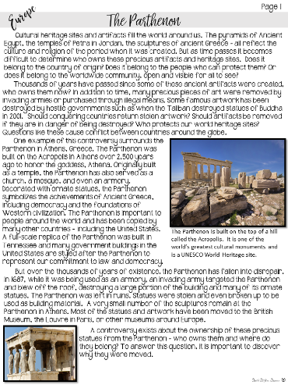
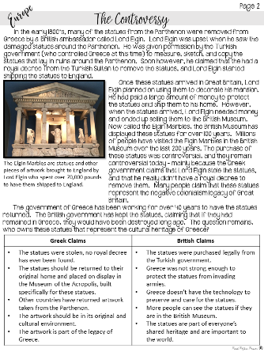
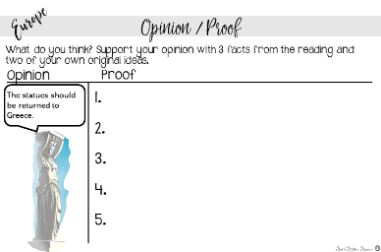
Reading and Notes
Read the handouts with your group and defend your assigned point of view.
Notes:
Teachers should discuss these questions in their small group.

Slide 70
Structured
Discussions
Conducting
Notes:
Next I am going to show you how to conduct a structured discussion.
Place your students into groups of 3. This size group is critical, because people have a tendency to want to agree with another person – if you have a group of 3, it will allow more students the opportunity to share their point of view.
Provide your students with background information on the topic you want to discuss. You want to encourage your students to research a topic before they debate – an essential life skill! The example I am using here is a current events topic on the ownership of cultural heritage.
Provide your students the discussion questions you will be asking the whole group. This allows students the opportunity to practice their answers before they speak in a large group. Prepare several questions on the same topic – you want your questions to spiral in difficulty from the comprehension level to the more complex essential question. Give your students time to read the background information and discuss the questions in their small group before you move on to the next step in the process.

Slide 71
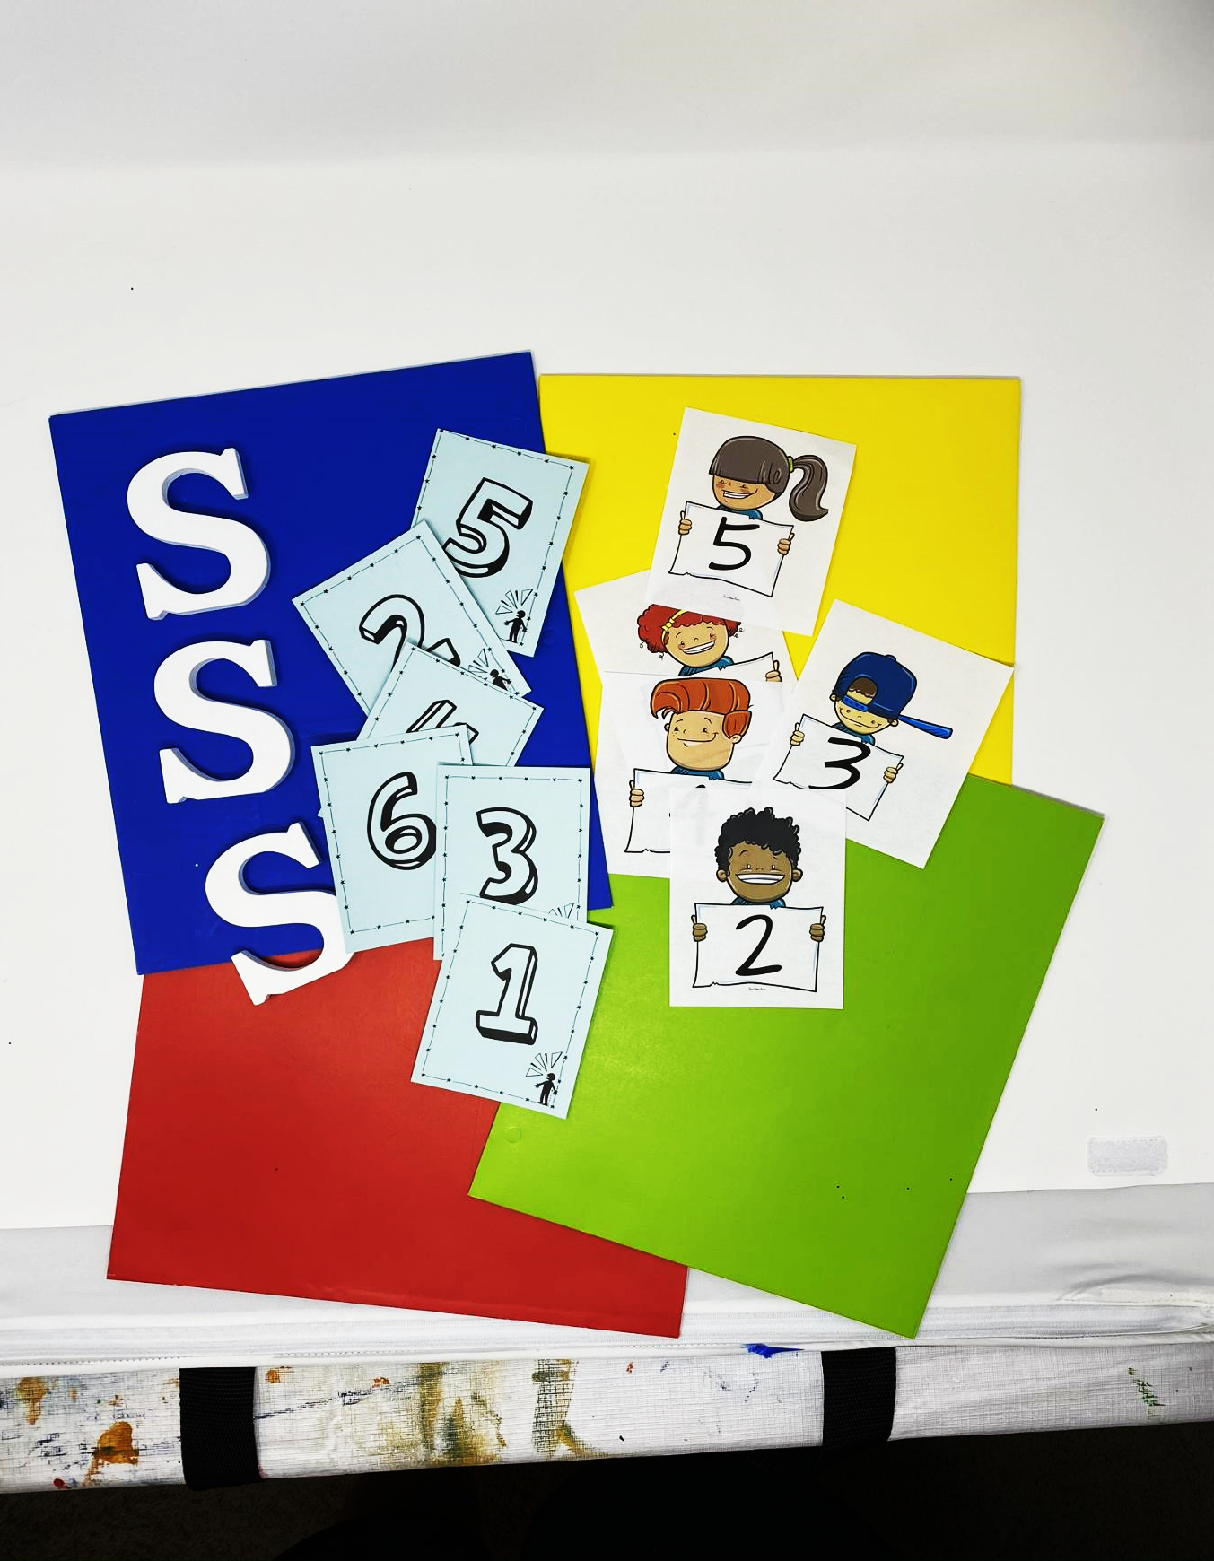
Notes:
Prepare for the structured discussion by assigning each group a number and giving them a large numbered card. They will need to hold up their card to indicate they wish to speak when it is their turn. Only a person holding the card will have permission to speak. Have each group choose a student to be their first speaker. Everyone will have a chance to speak by handing the numbered card to another student in their group between rounds.

Slide 72
Notes:
Review the rules for the discussion. You will call on the first group. Their speaker will stand up and face the class to share their group’s answer to the first question. Tell your students to face the class and not you – you are not the audience, their classmates are their audience. Your students will want to talk to you, but keep reminding them to face their audience. They do not have to come up to the front of the room, they just need to face the other students. I would often sit in an out of the way spot in the room so they weren’t tempted to try and talk to me.
Once the first student has finished speaking, (and you might want to hold them to a time limit) they get to call on the next speaker. Ask all of the groups to hold up their number, and let the previous student choose a speaker.

Slide 73
*I heard you say…
*My group agrees/ disagrees because…
Notes:
All of the following speakers will need to use the following phrases in their response –
I heard you say (and summarize their response)…
My Group agrees or disagrees with your group because…
Once they have finished speaking, they call on the next speaker allowing every group to share. After each of the groups have finished sharing, have them choose a new speaker and pass over the number card. You will then ask the next question, call on the first speaker, and repeat the process.
If you find students interrupting each other or being disrespectful, stop the discussion and remind them of the rules.

Slide 74
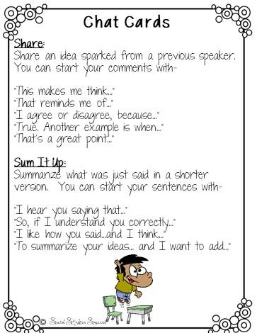
Support Students with chat cards
Notes:
Chat cards are a great strategy for structuring a discussion with sentence starters. These work well with ELL students who may need extra support structuring their sentences or for a group of students who may need instruction in civil discourse.
Pass out these cards prior to a discussion. Give your students time to read the sentence starters.

Slide 75
Who should own the statues from the Parthenon?
Notes:
Give each group a number. Choose a speaker for each group. Have them stand and share their group’s answer. They should then call on the next speaker by calling out their number. Allow several, but not necessarily all groups to speak. They will have the chance to speak on the next round.

Slide 76
Should all museums return artwork to their country of origin?
Notes:
Rotate the role of the speaker and call on different groups.

Slide 77
What should be done to protect shared heritage sites?
Notes:
Rotate the role of the speaker and call on different groups.

Slide 78
So What, Now What
What did you learn?
How are you going to use it?

