Slide 1
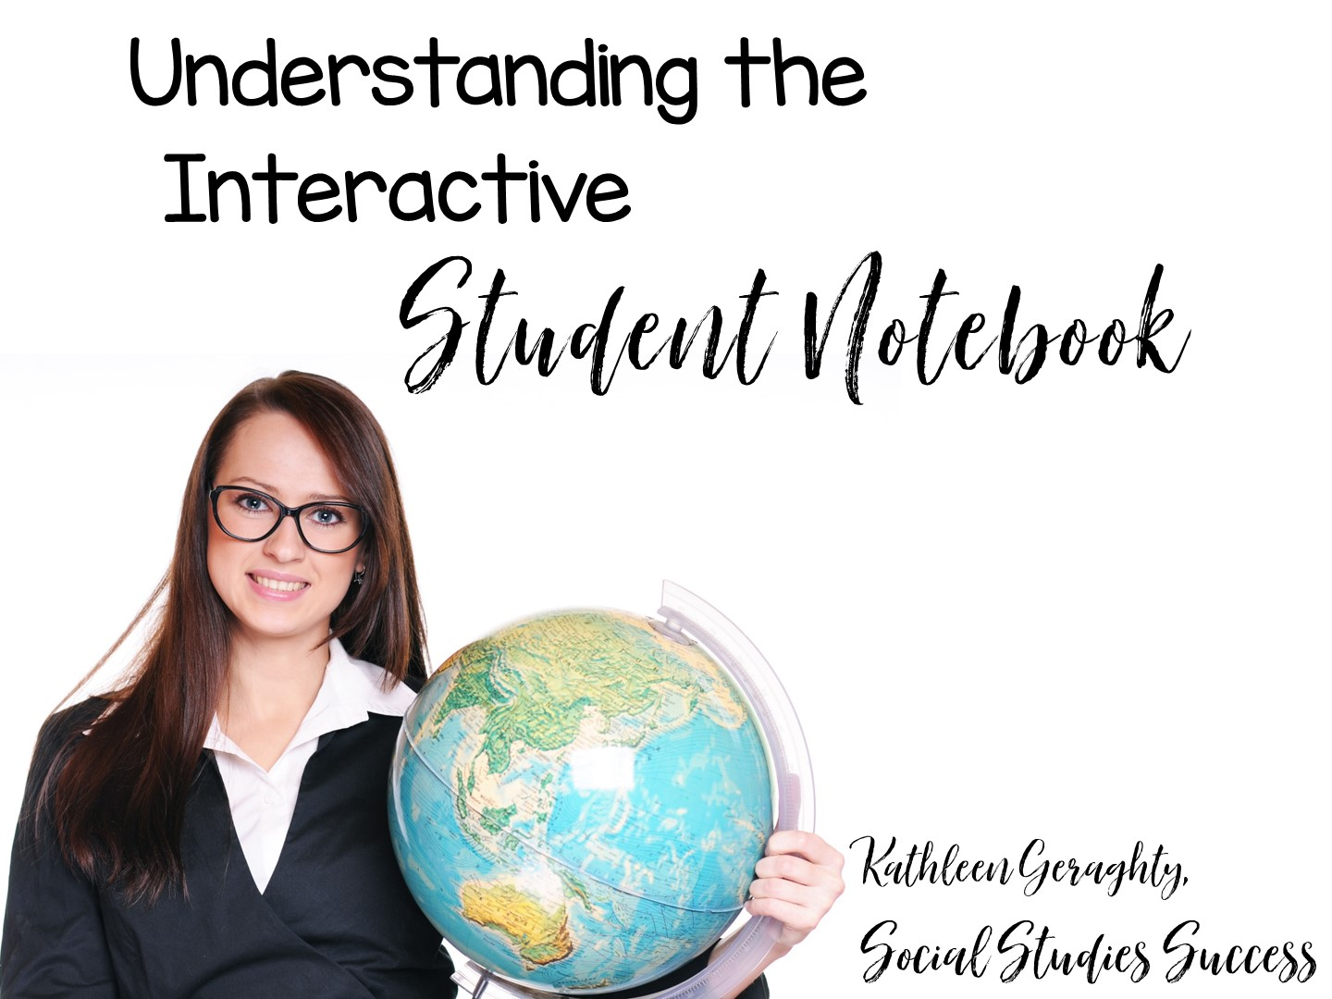

Slide 2


Slide 3

Notes:
Introduce yourself

Slide 4


Slide 5


Slide 6
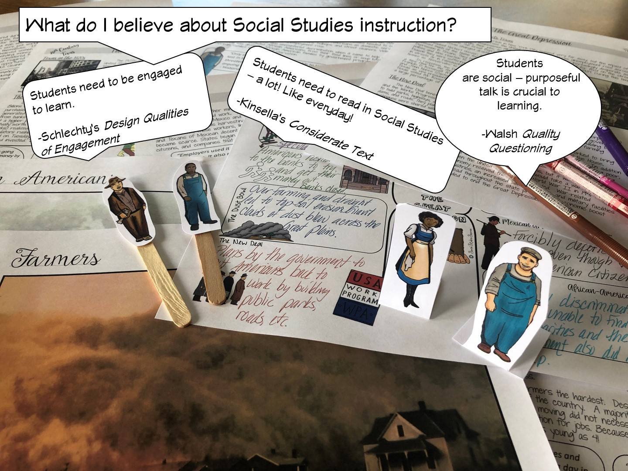

Slide 7
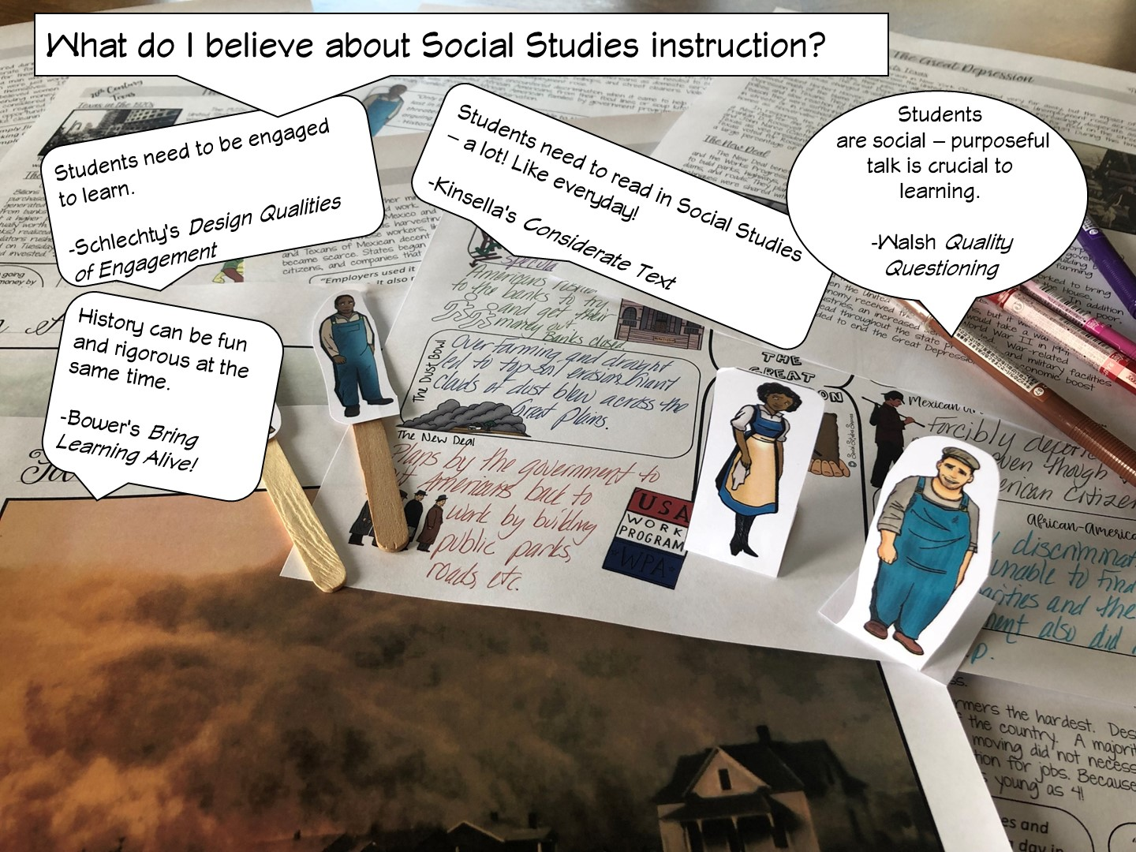
Notes:
.

Slide 8


Slide 9
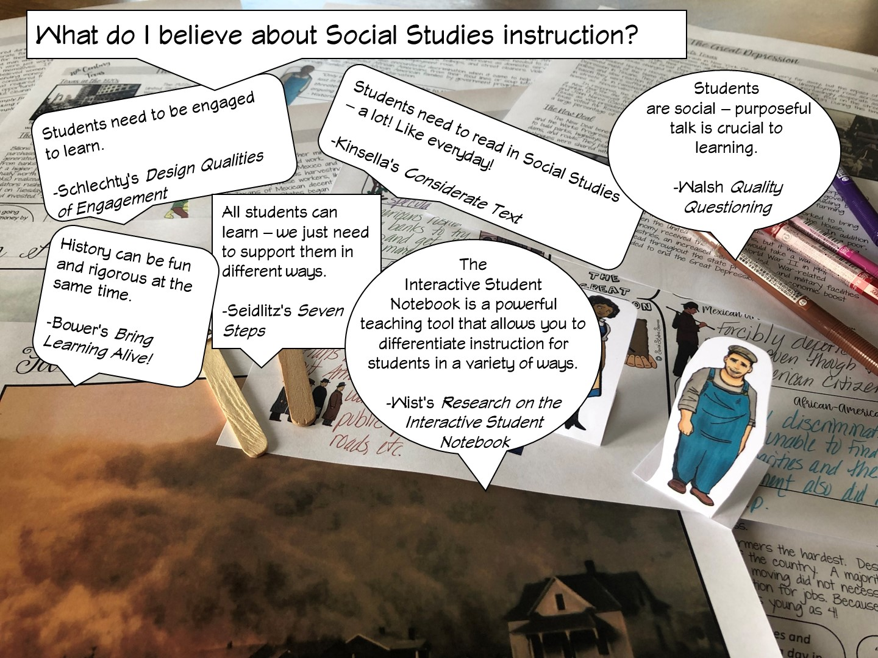
Notes:
Differentiated instruction is ensuring that learning happens in an accessible way for the student. ISNs allow the students to format their thoughts however they find suitable, thus, differentiating by learning styles — someone who loves writing can love in the notebooks, another student who would rather draw is free to express his/her ideas through diagrams, charts and pictures.

Slide 10
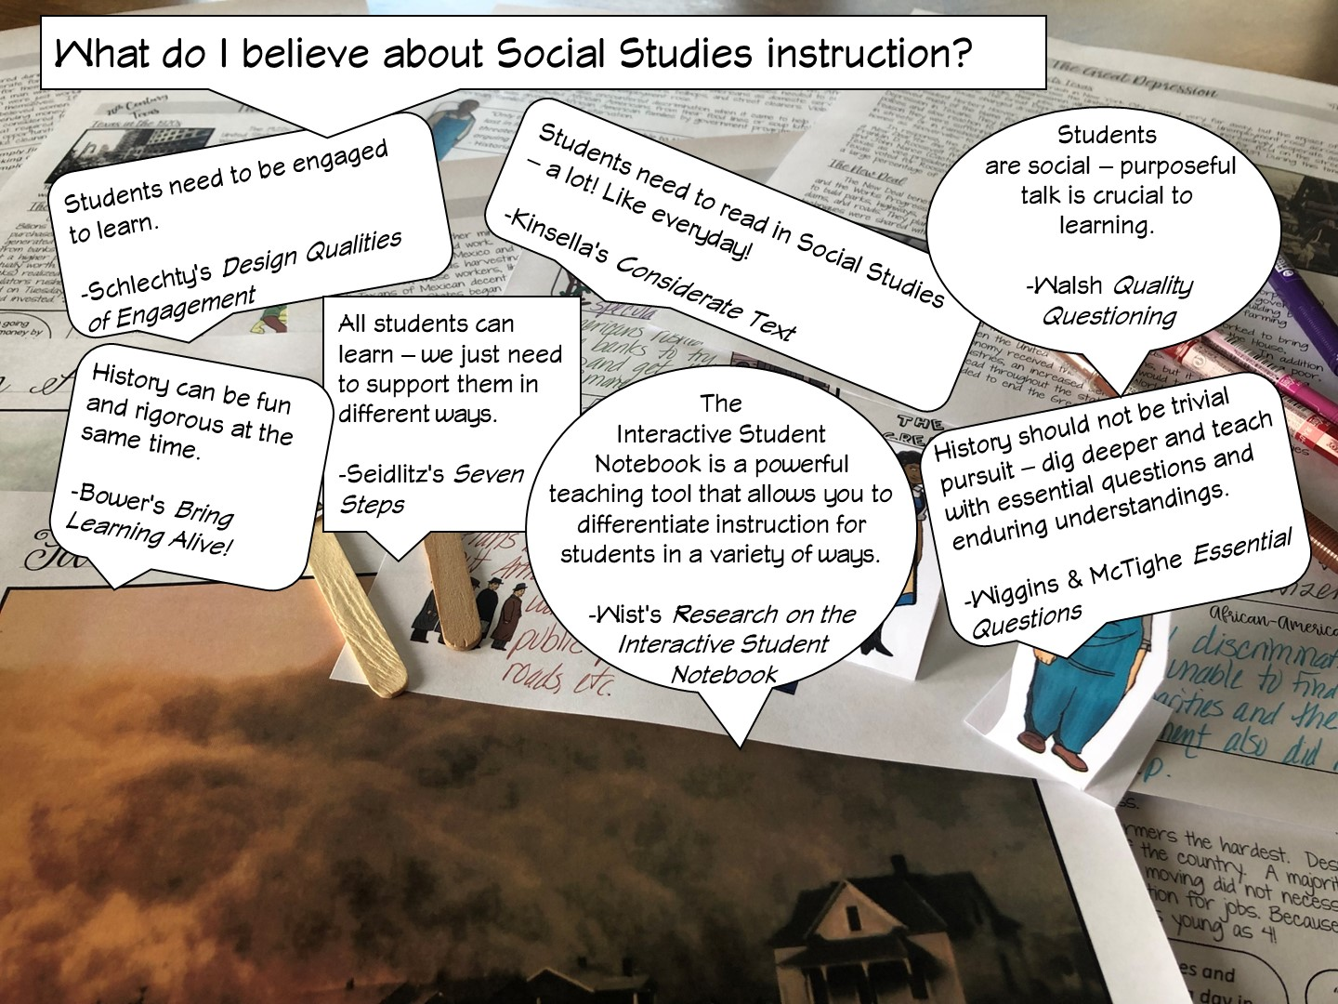

Slide 11
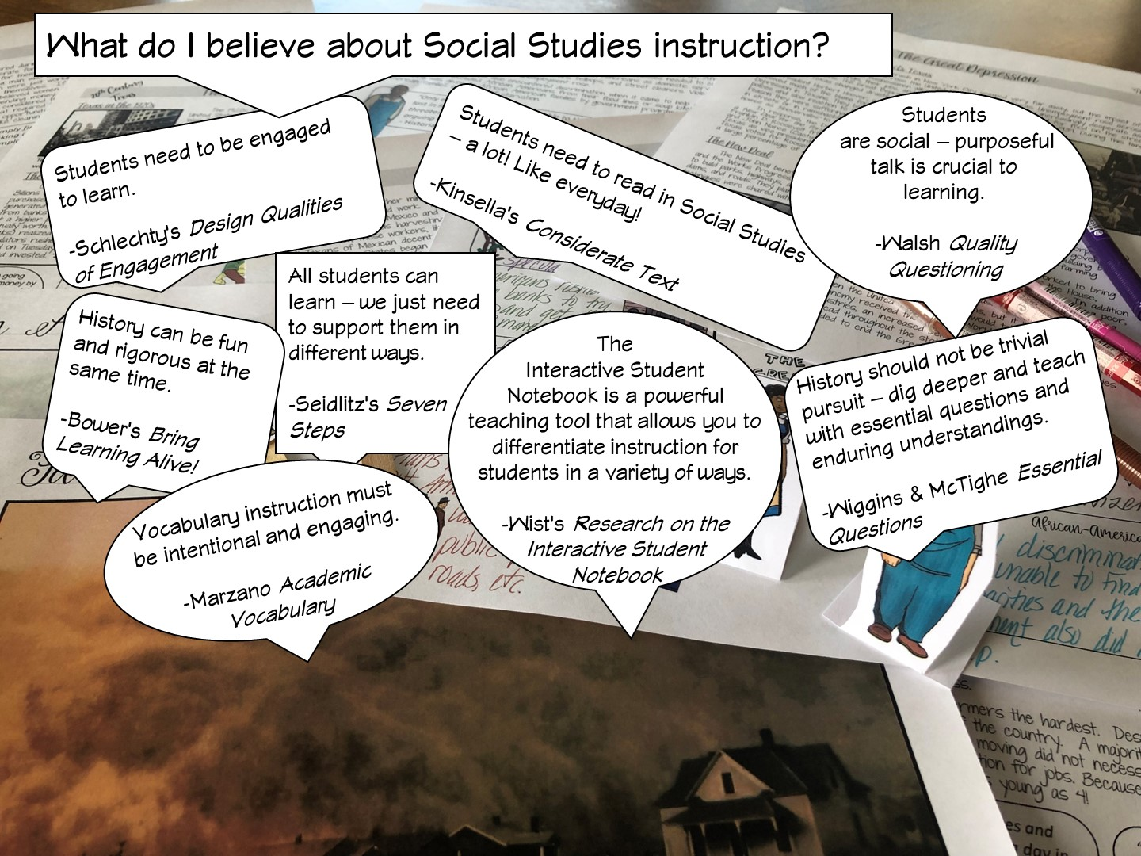

Slide 12
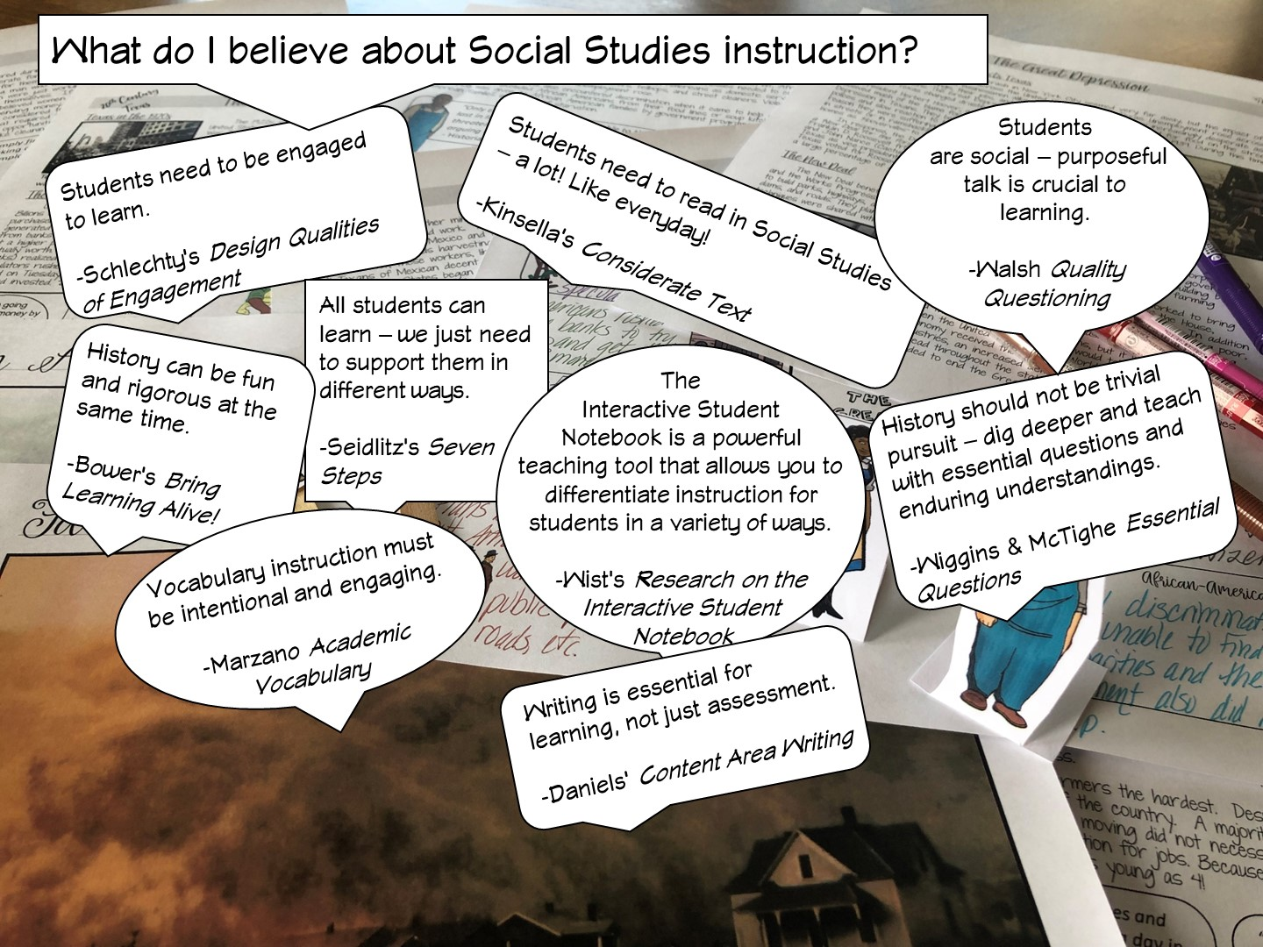

Slide 13
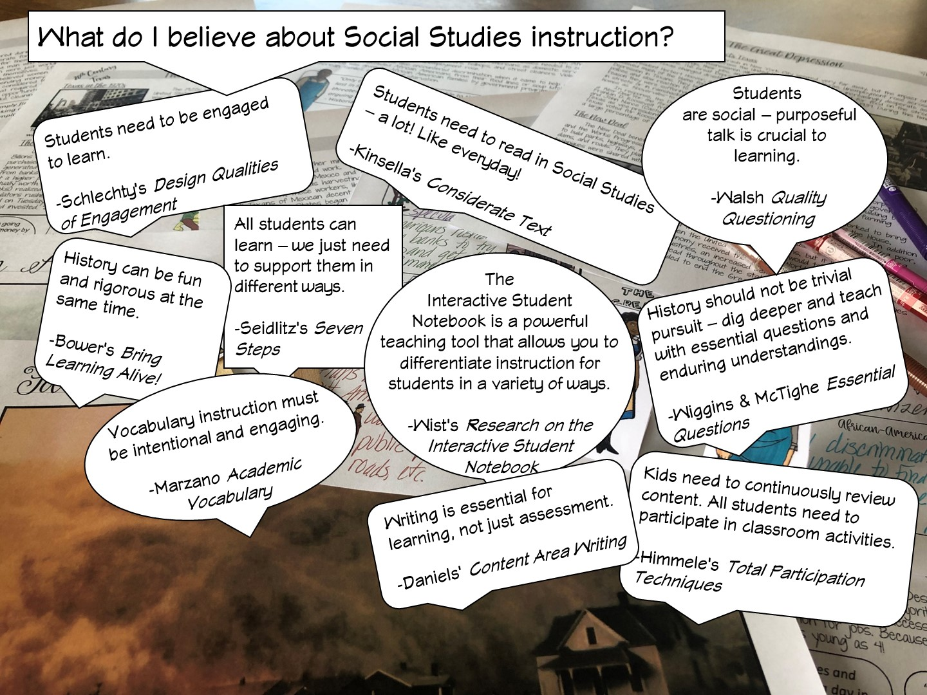

Slide 14
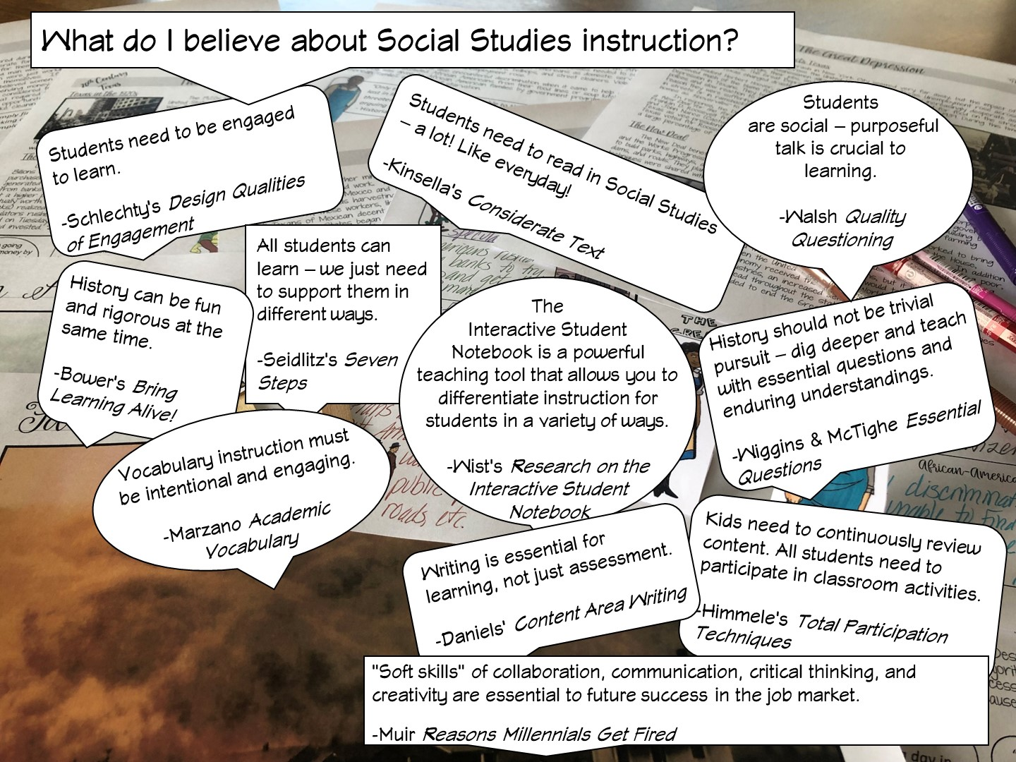

Slide 15
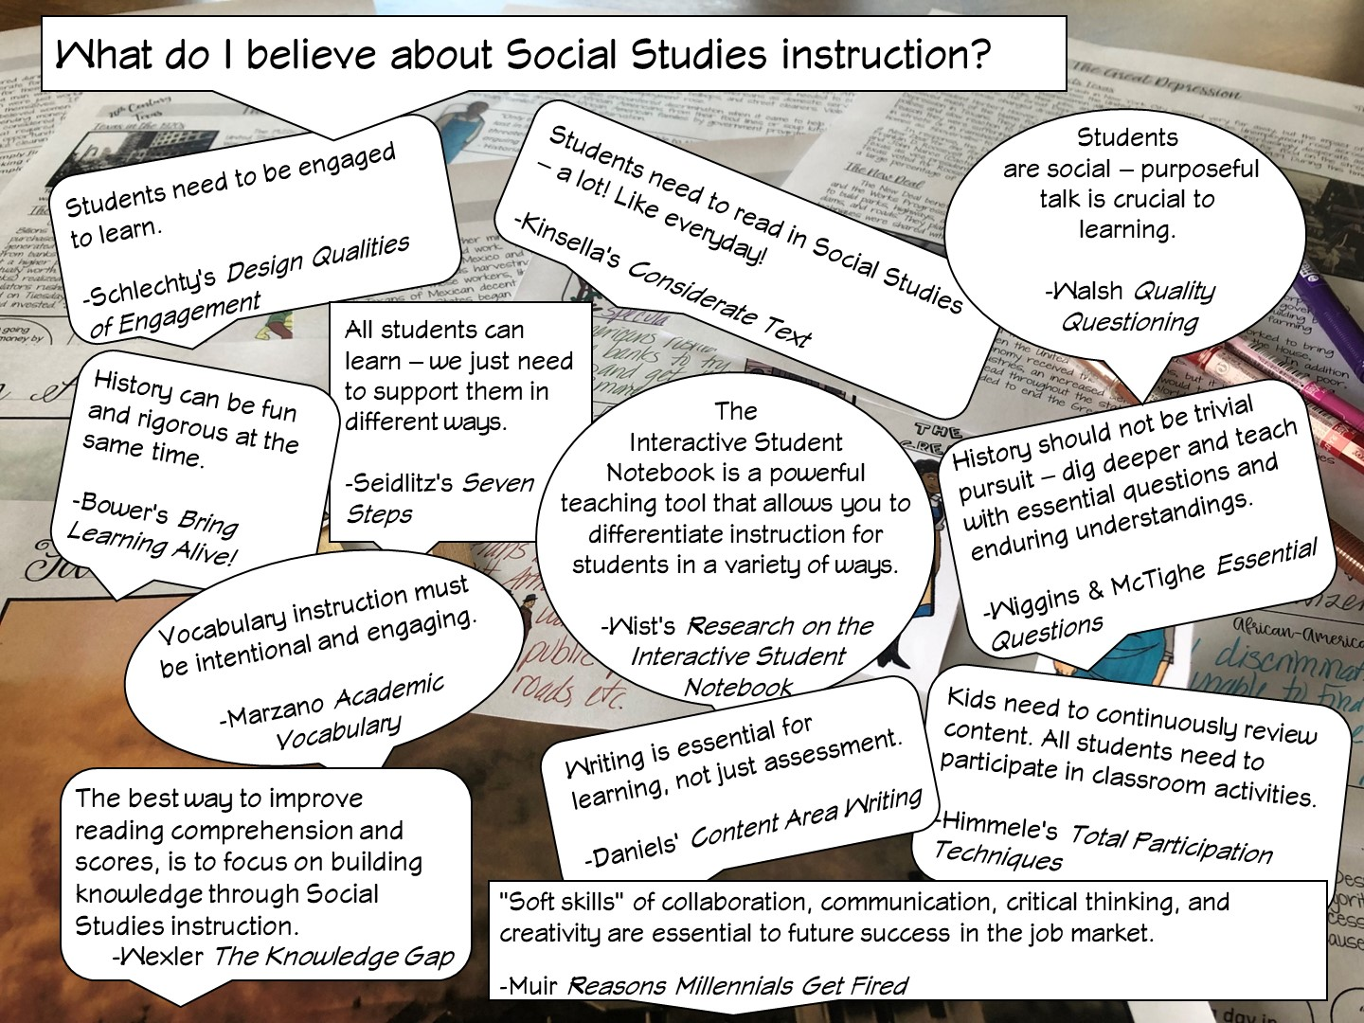

Slide 16


Slide 17

Notes:
Have teachers discuss

Slide 18


Slide 19

Notes:
I share my rule of the socks:
They have never been on my feet
They are not a souvenir of the workshop
Put your cellphones away in the sock (model with your own)

Slide 20
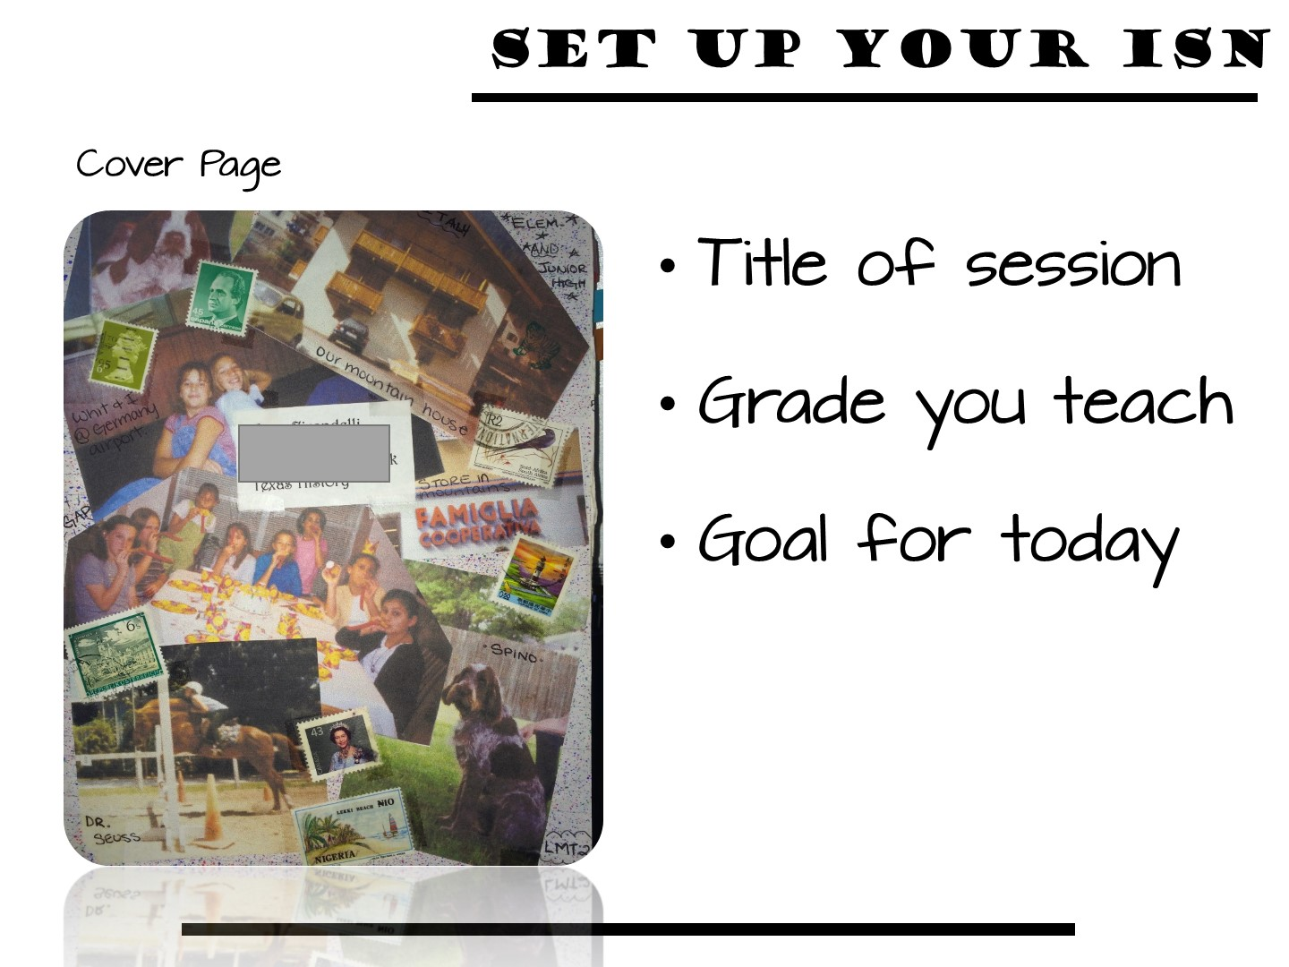
Notes:
If you provide teachers notebooks, use the next two slides. If not, delete.

Slide 21
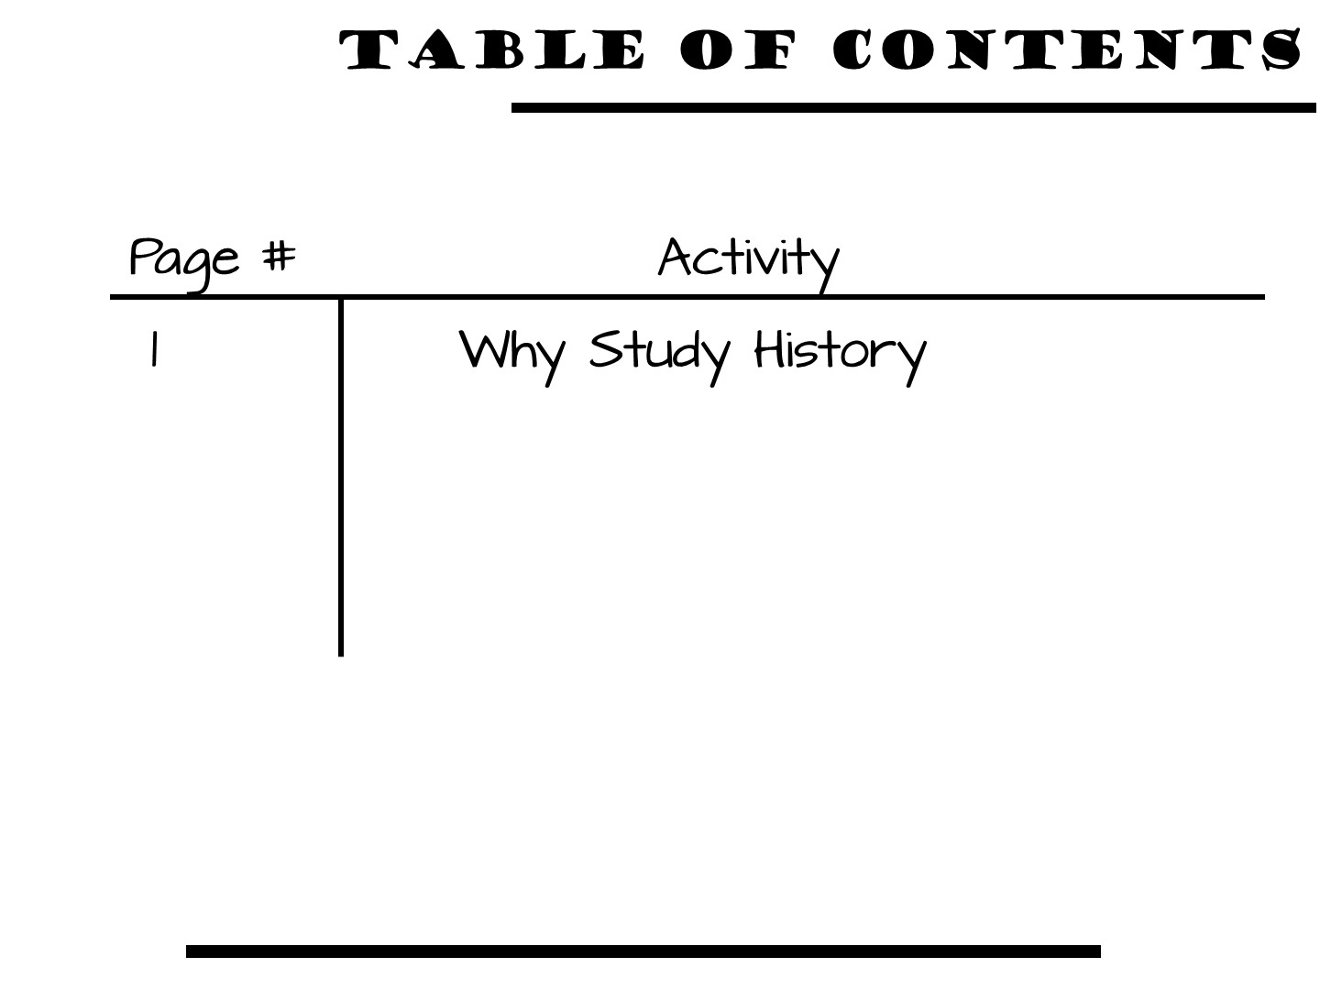
Notes:
21
If you want to use a TOC

Slide 22

Notes:
This is a great lesson for the beginning of the year! Use within the first week if possible.
Let them know they all have a subscription to Social Studies Success and to reach out to me via the website if they do not yet have access.

Slide 23

Notes:
This lesson is a dog and pony show as you will be modeling as many different strategies as you can. The lesson in their own classroom will be much simpler.

Slide 24
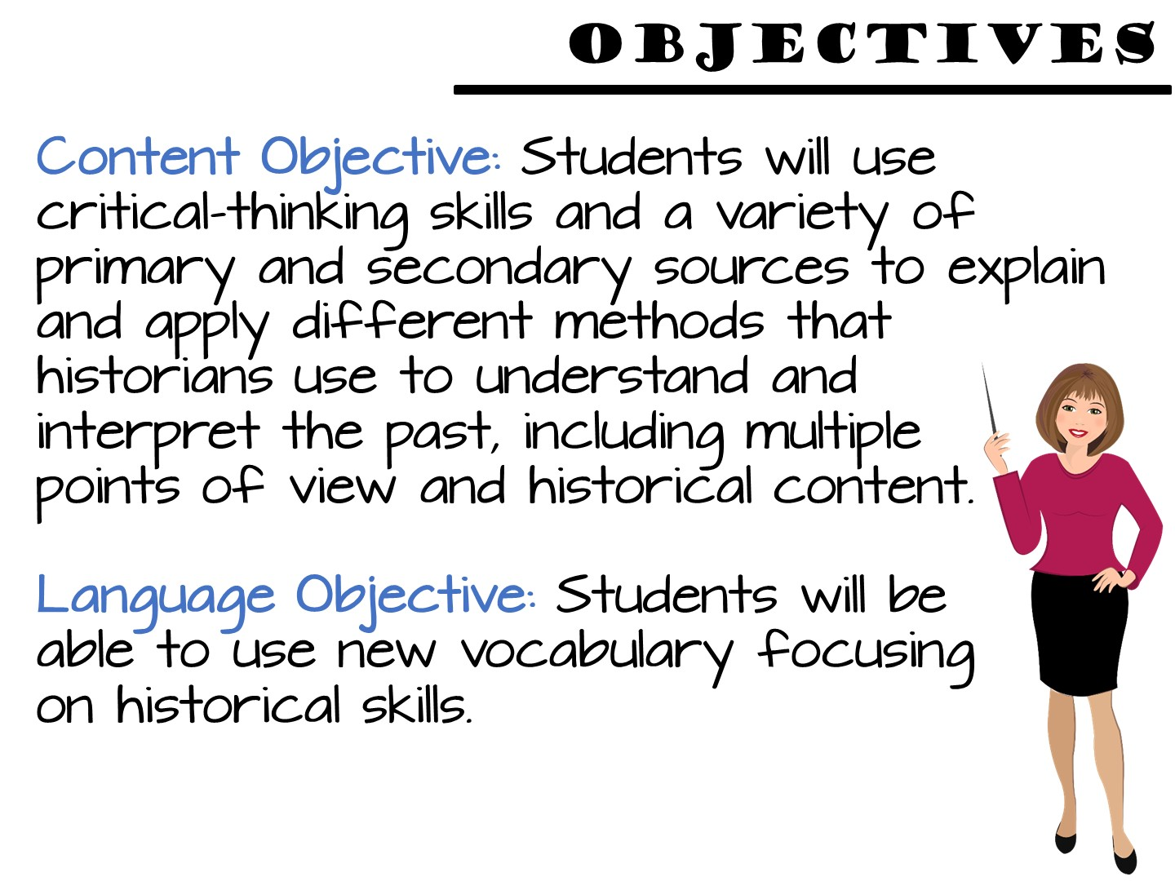
Notes:
Just read

Slide 25
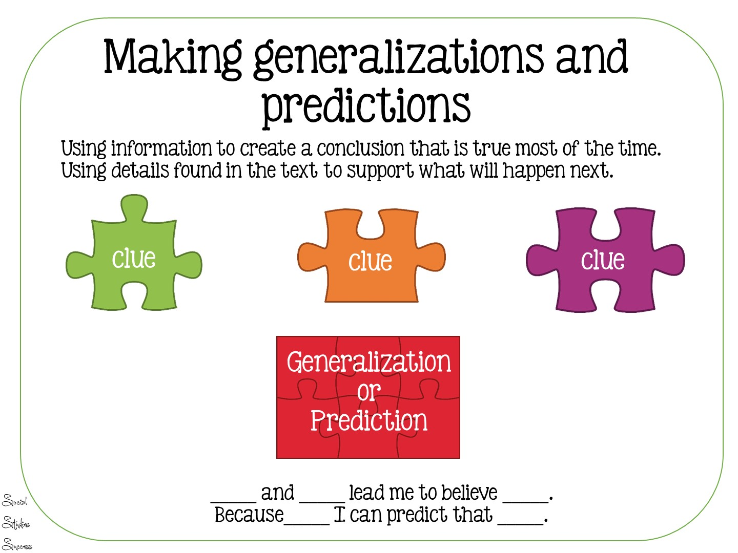
Notes:
Just read – this is the skill the students will be using in the lesson.

Slide 26

Notes:
This is the essential question

Slide 27
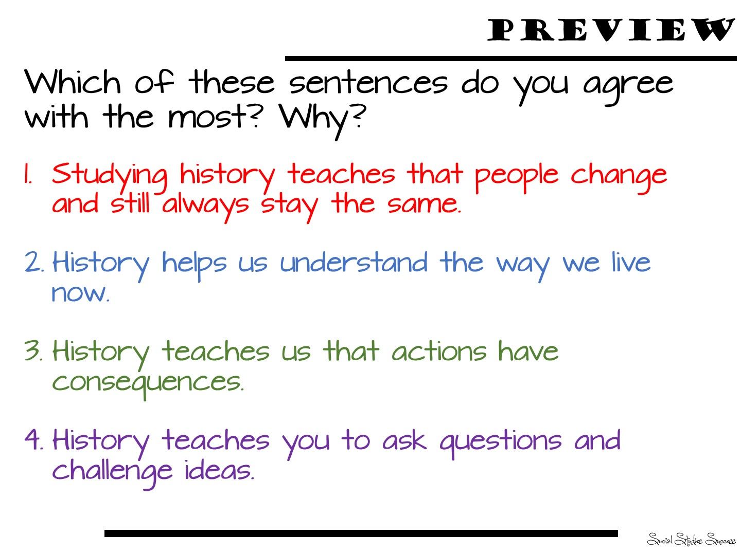
Notes:
This is the preview question – have them put into their ISN.

Slide 28

Notes:
These are the vocabulary terms we are going to learn

Slide 29

Notes:
Pass out Predict This
Give each teacher one of these and place them with a partner. Have them all come up to the word wall and discuss with their partner to see what they think the correct answer is.

Slide 30

Notes:
Use the following slides to debrief the answers

Slide 31


Slide 32


Slide 33


Slide 34


Slide 35


Slide 36
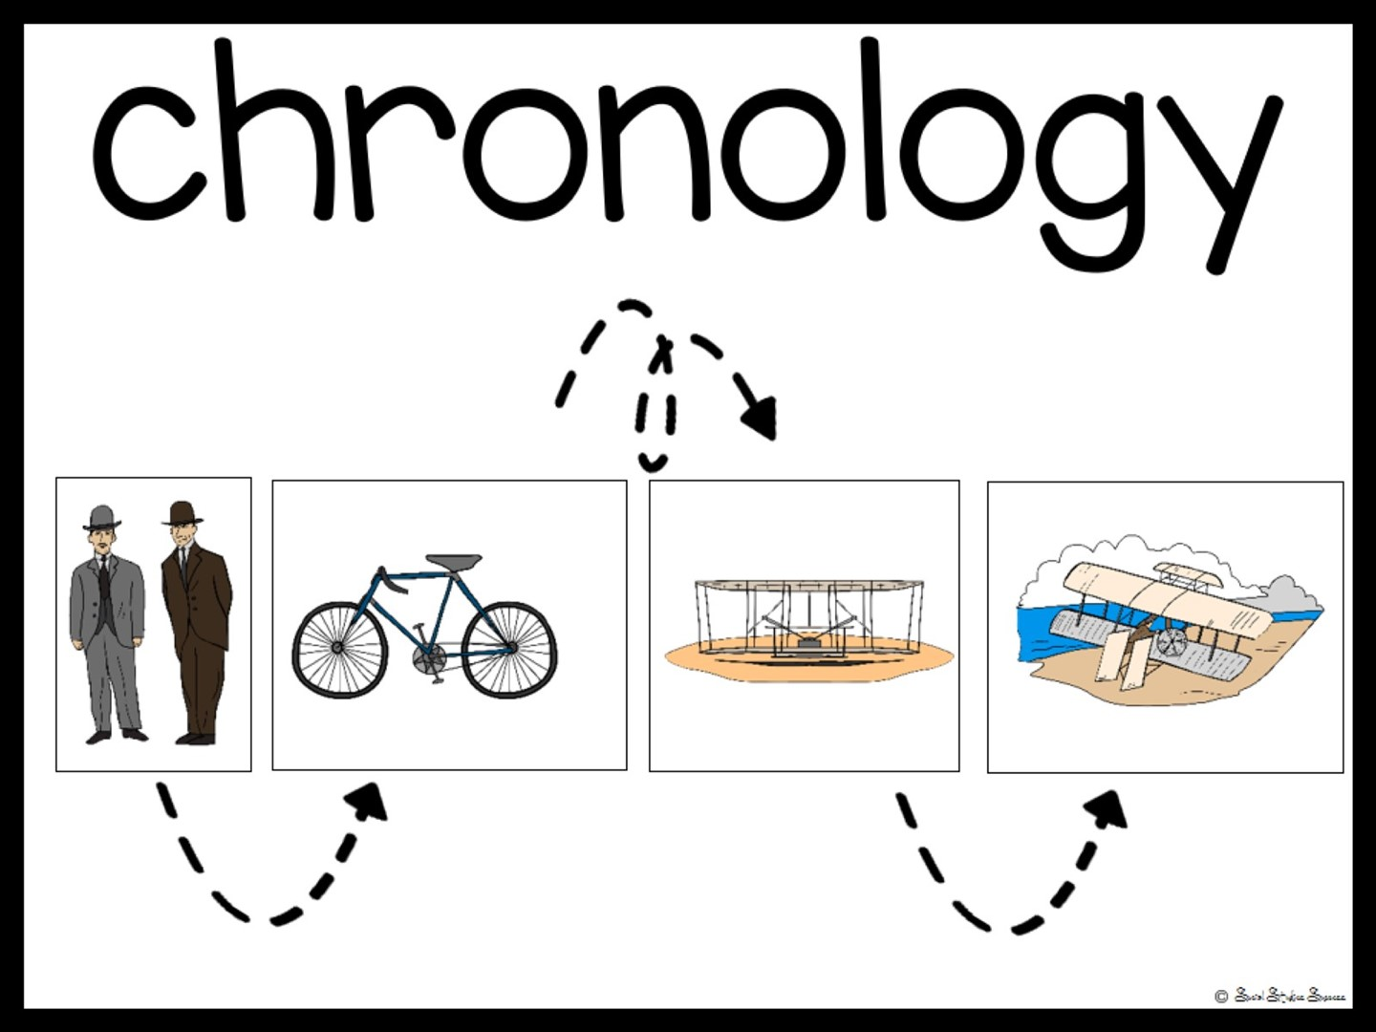

Slide 37


Slide 38

Notes:
Now pass out your own artifacts in an envelope. In their groups, have them examine the artifacts to see if they can answer any of thee questions.

Slide 39

Notes:
You can discuss or have them add to their ISN under the other preview.

Slide 40

Notes:
Pass out the first page of the reading. Follow the directions on the slide.

Slide 41


Slide 42
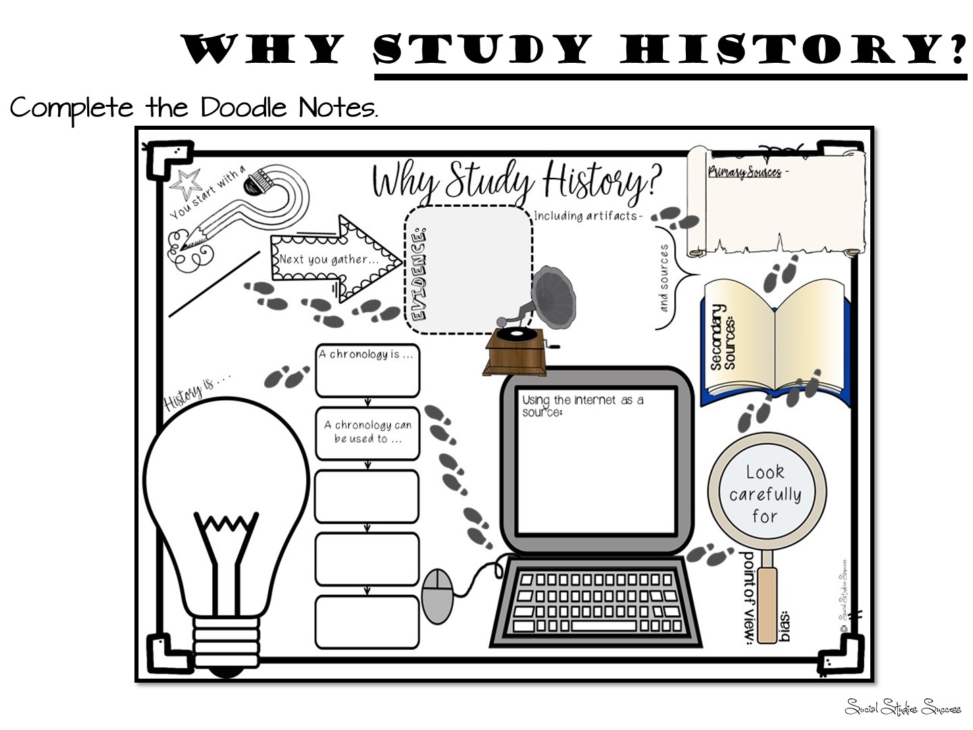
Notes:
Pass out Doodle Notes and just do for about 5 minutes. Glue into ISN

Slide 43

Notes:
Pass out spectrum and have them read and discuss. Write their top 3 responses into their interactive student notebook with an explanation.

Slide 44


Slide 45


Slide 46

Notes:
Give them 5 minutes to write down reflections on their Doodle Notes.

Slide 47


Slide 48


Slide 49
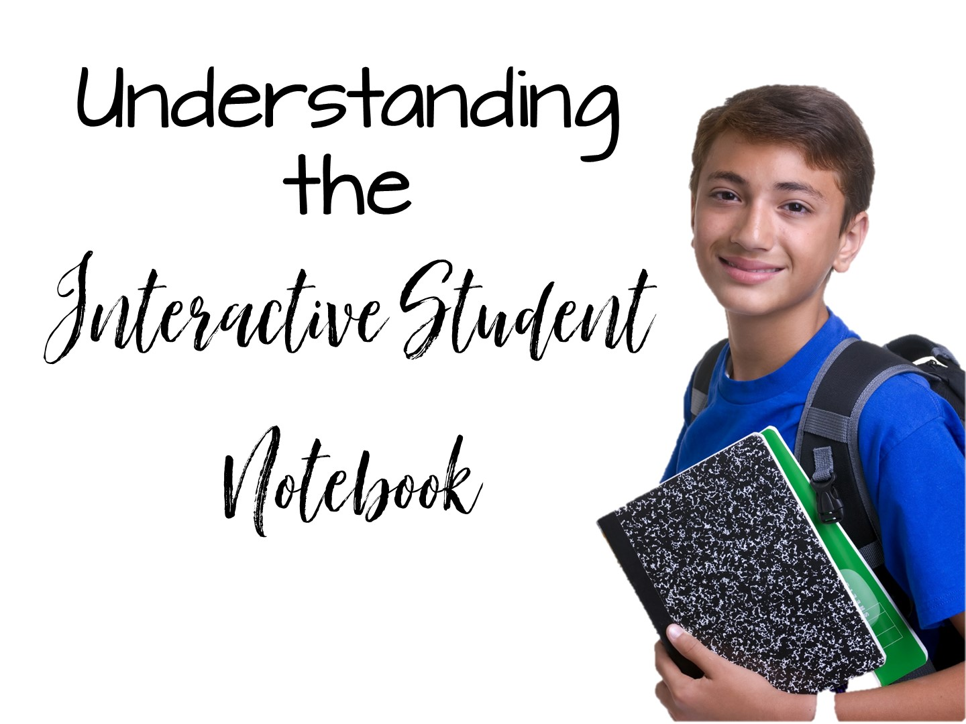

Slide 50
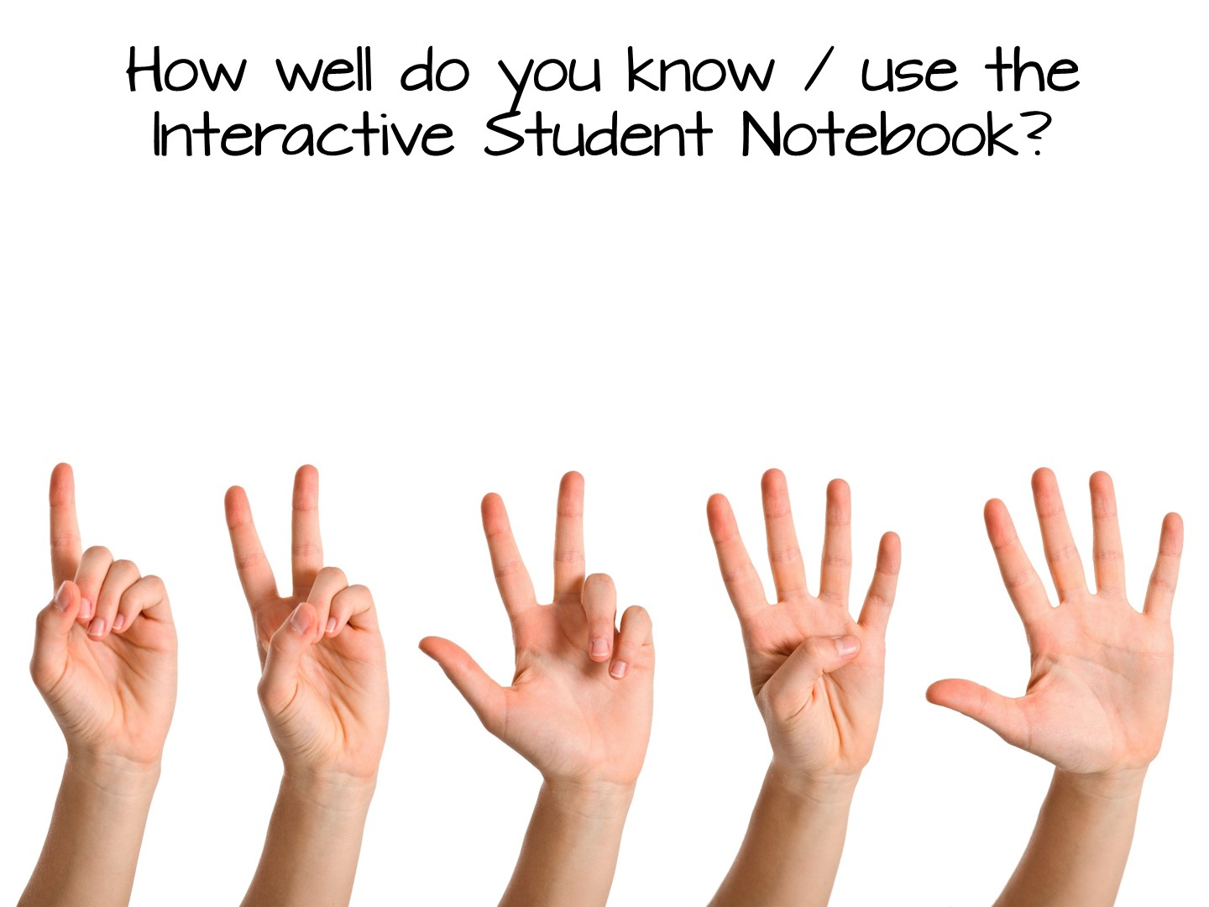
Notes:
Have them respond 1-Don’t know anything, 5 – close to an expert

Slide 51

Notes:
We are going to look at what makes an ISN – Structure
and how we can personalize it in our classroom - Style

Slide 52


Slide 53
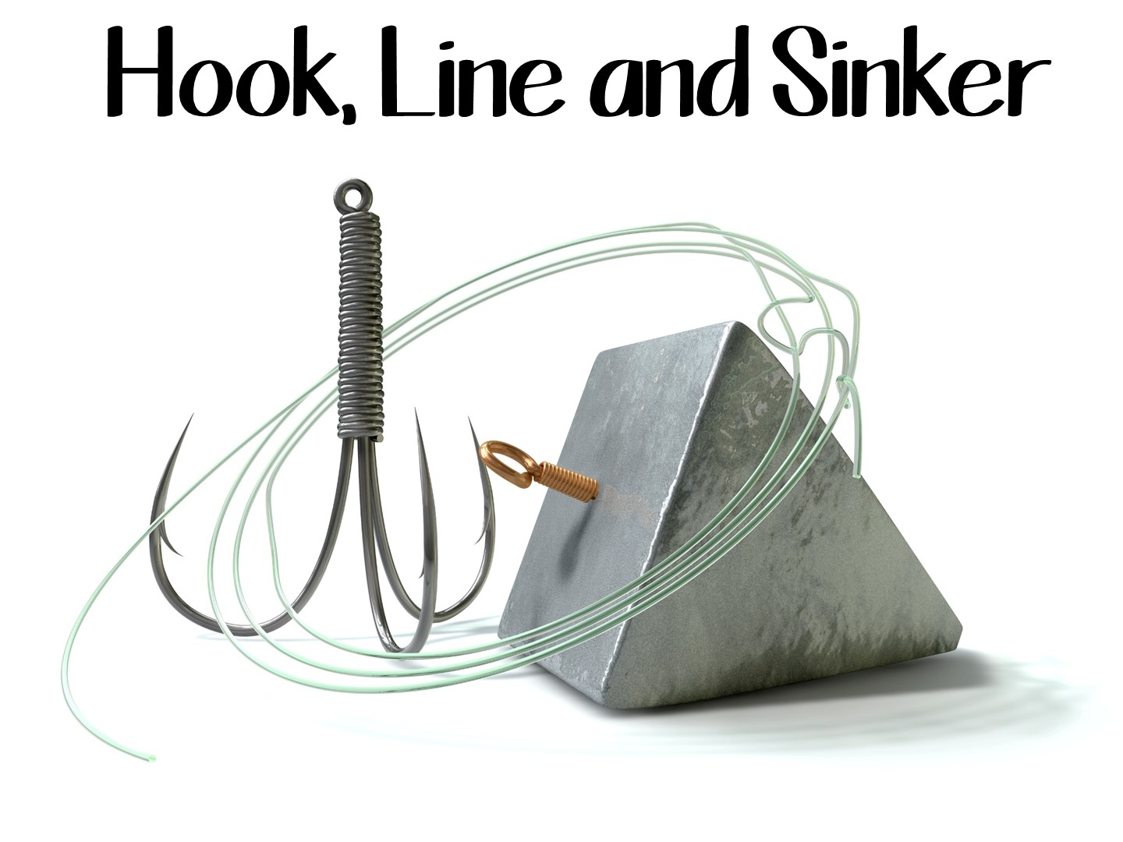
Notes:
This is the analogy we use for the ISN.

Slide 54
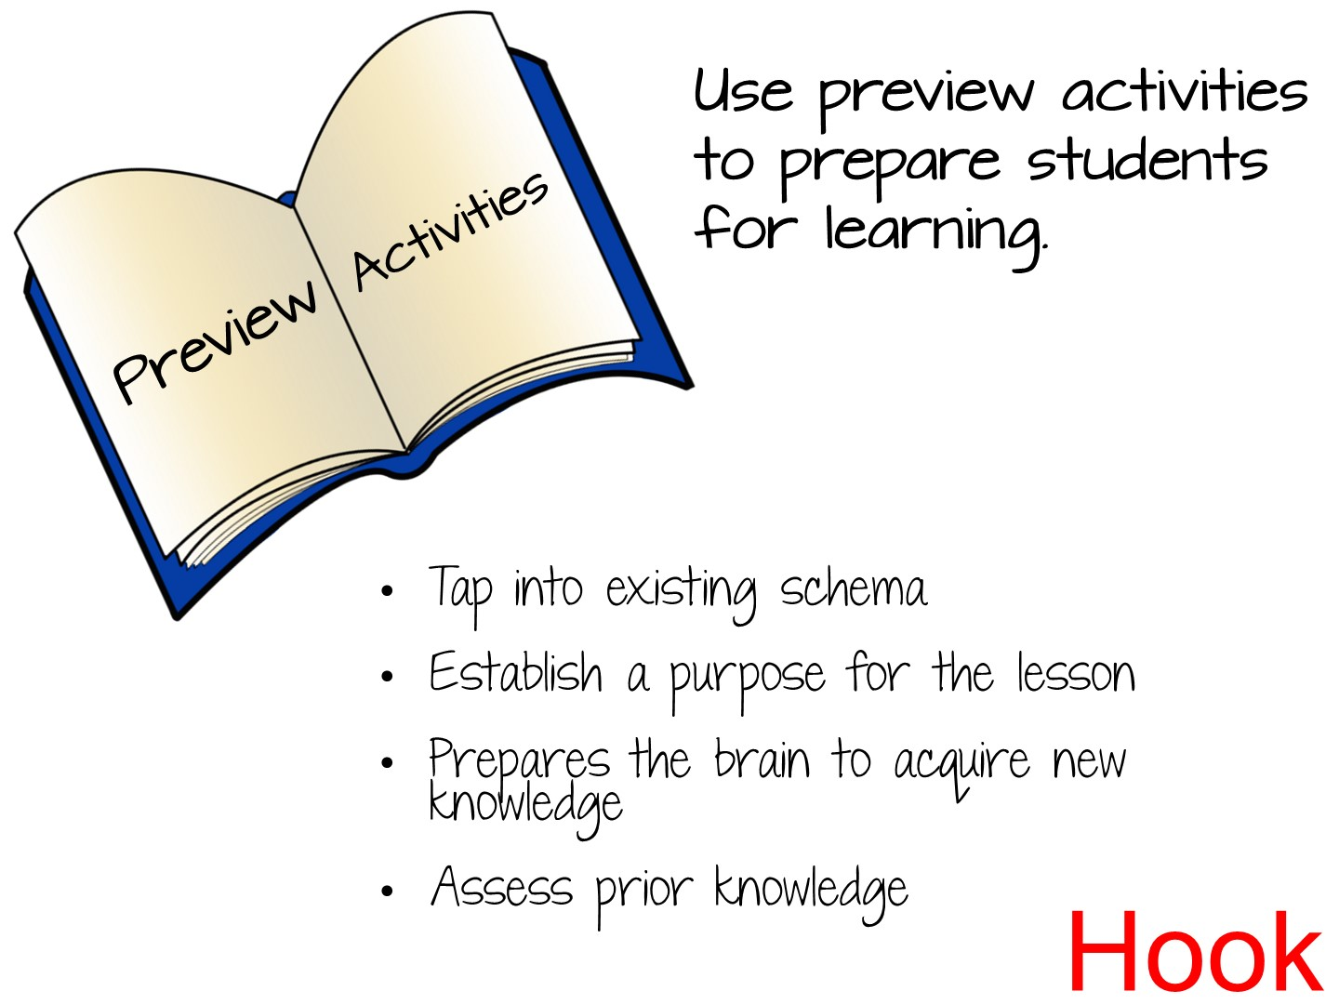

Slide 55
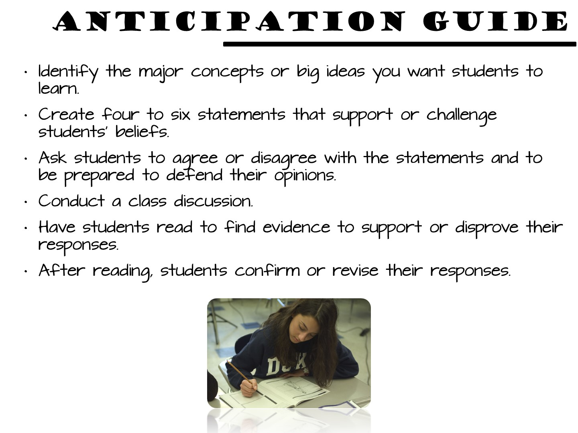

Slide 56
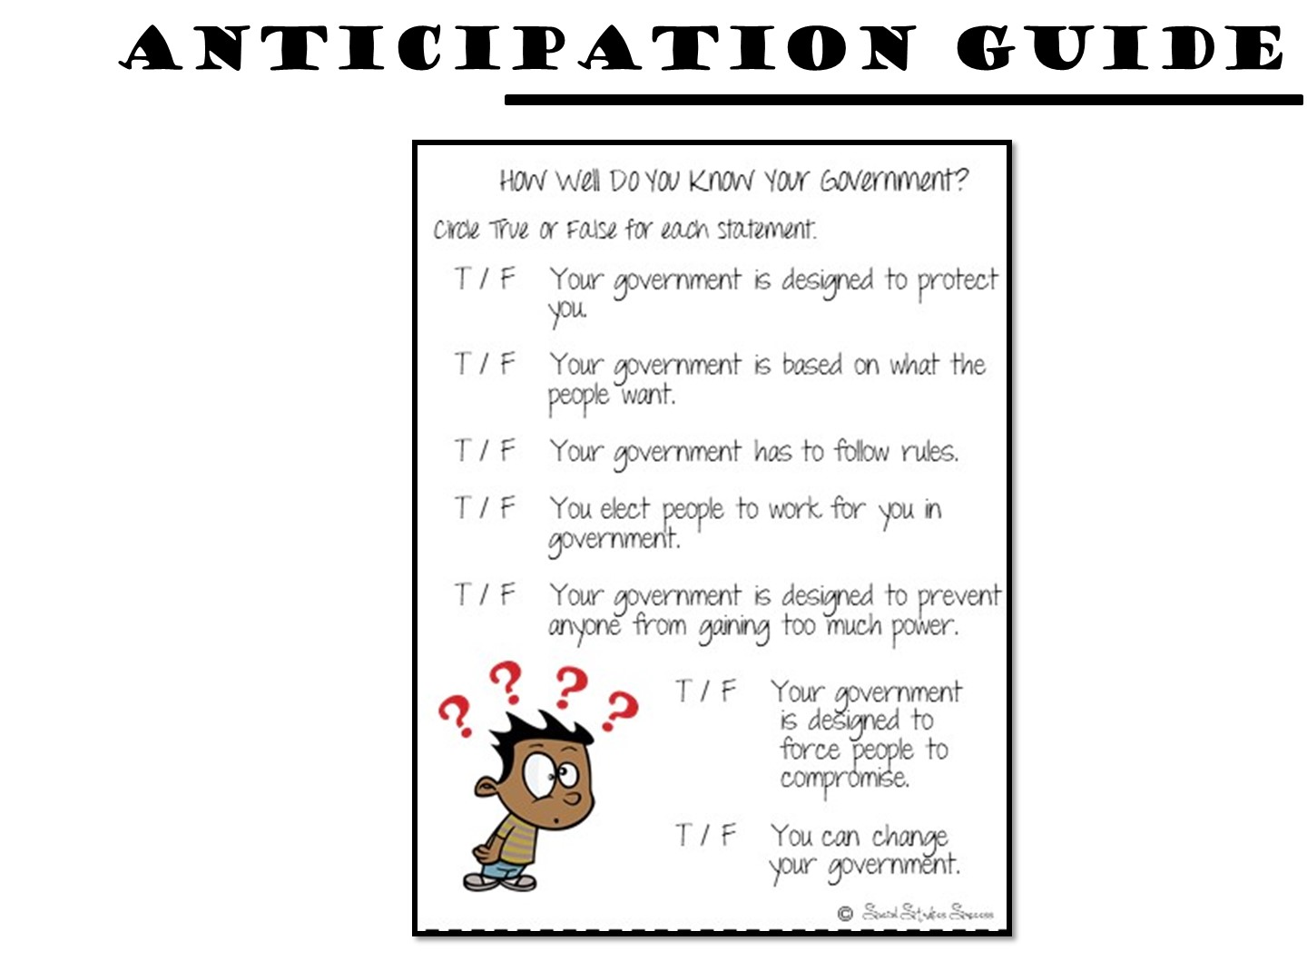
Notes:
Sample for the 7 Principles of Government

Slide 57


Slide 58
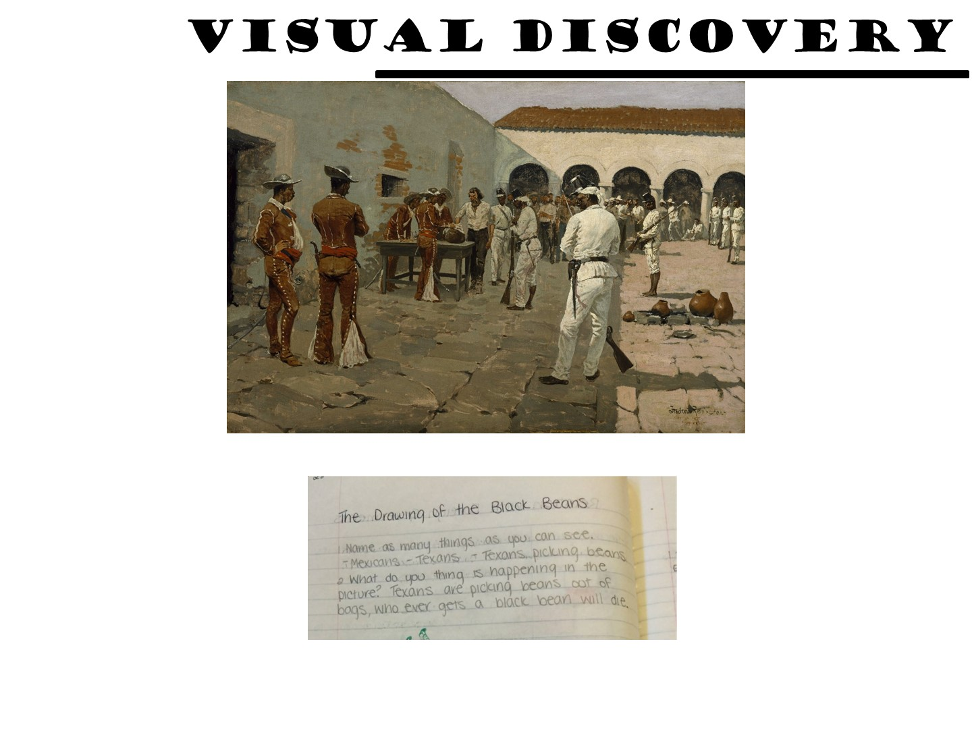
Notes:
Example for Texas History

Slide 59

Notes:
Example for World History

Slide 60
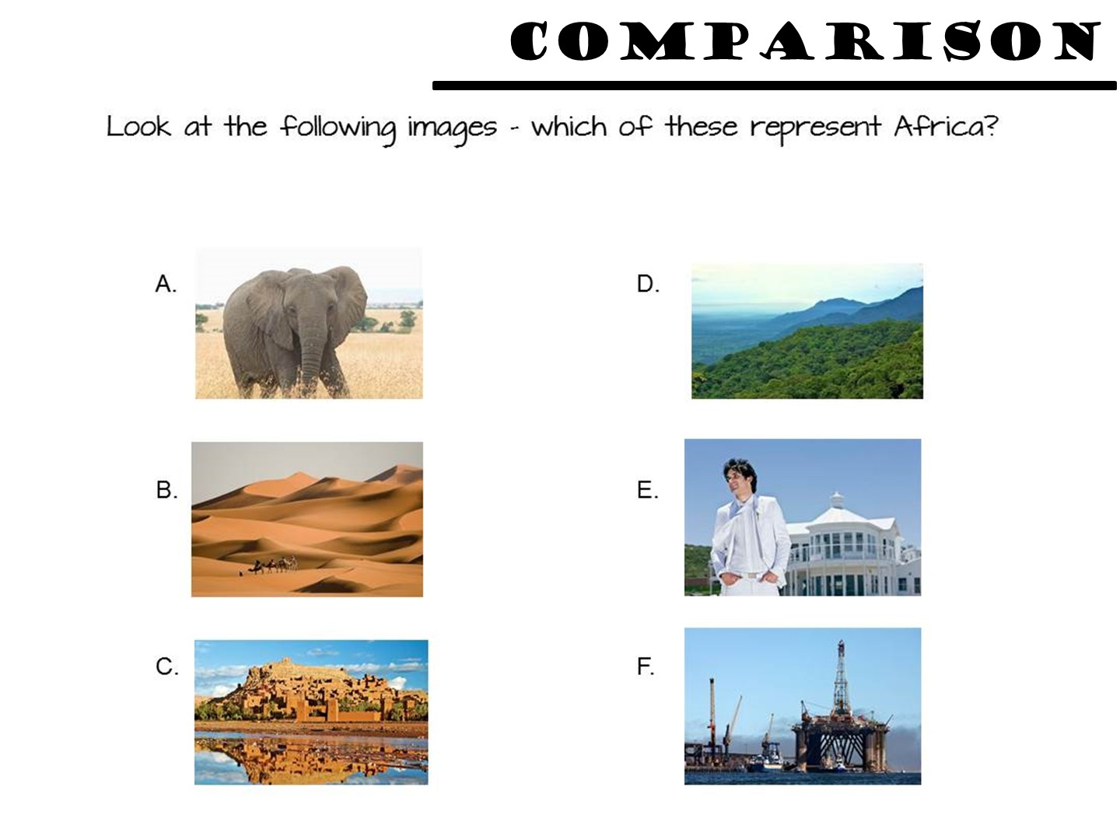
Notes:
Example for Geography

Slide 61
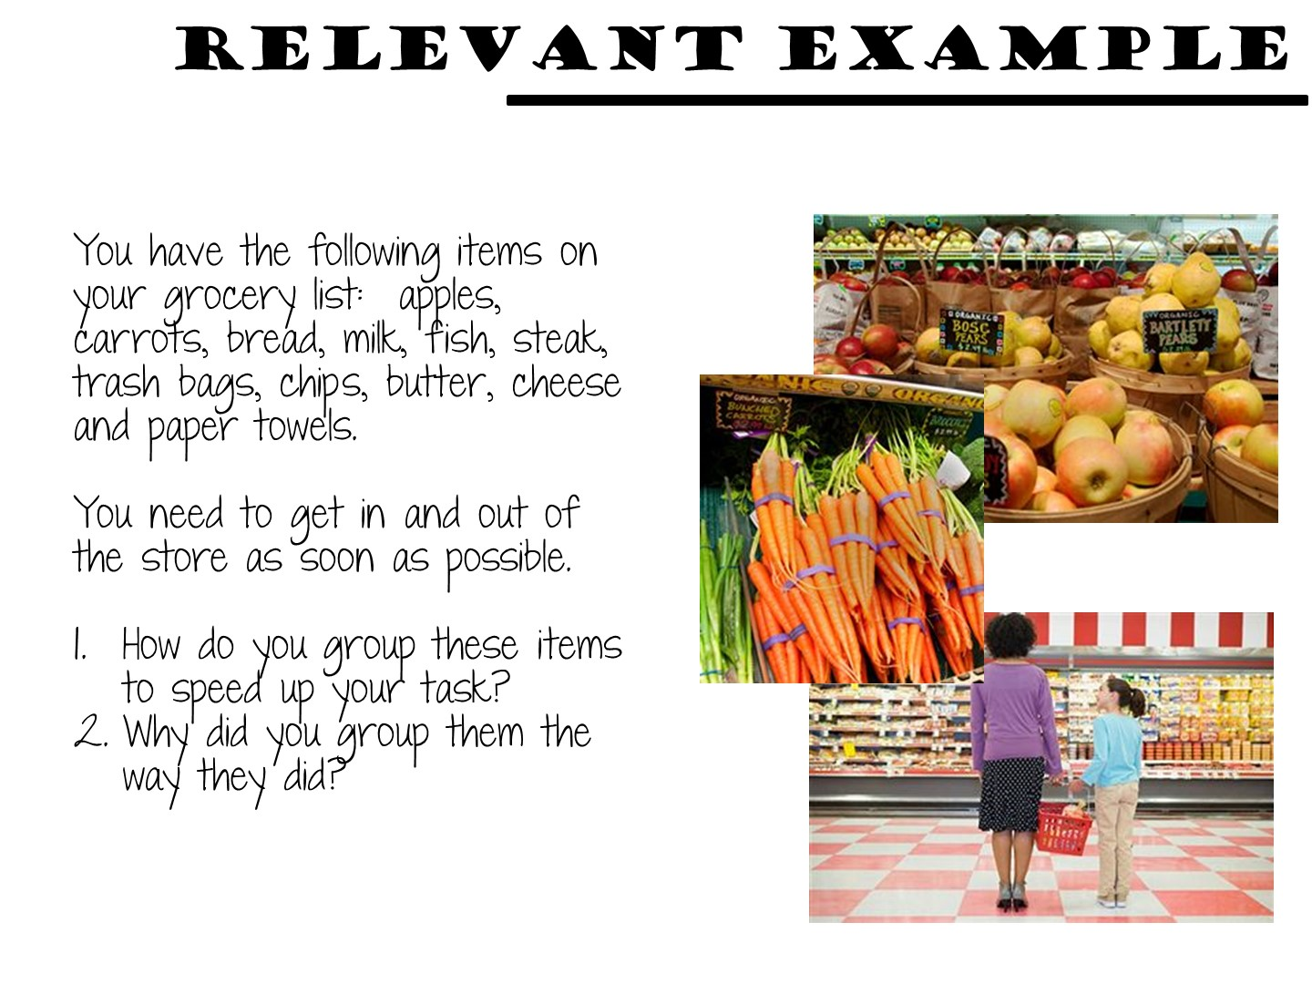
Notes:
Geography

Slide 62

Notes:
Place teachers into a small group. Pass out the literacy strategy manual and conduct this activity. They can be found by looking at the table of contents.

Slide 63

Notes:
Debrief after chalk talk

Slide 64
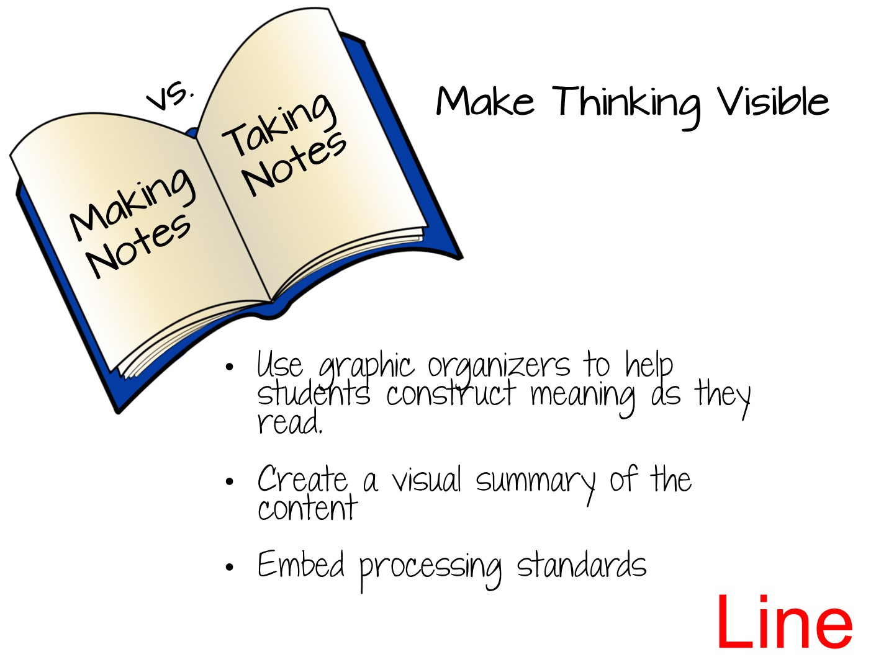

Slide 65
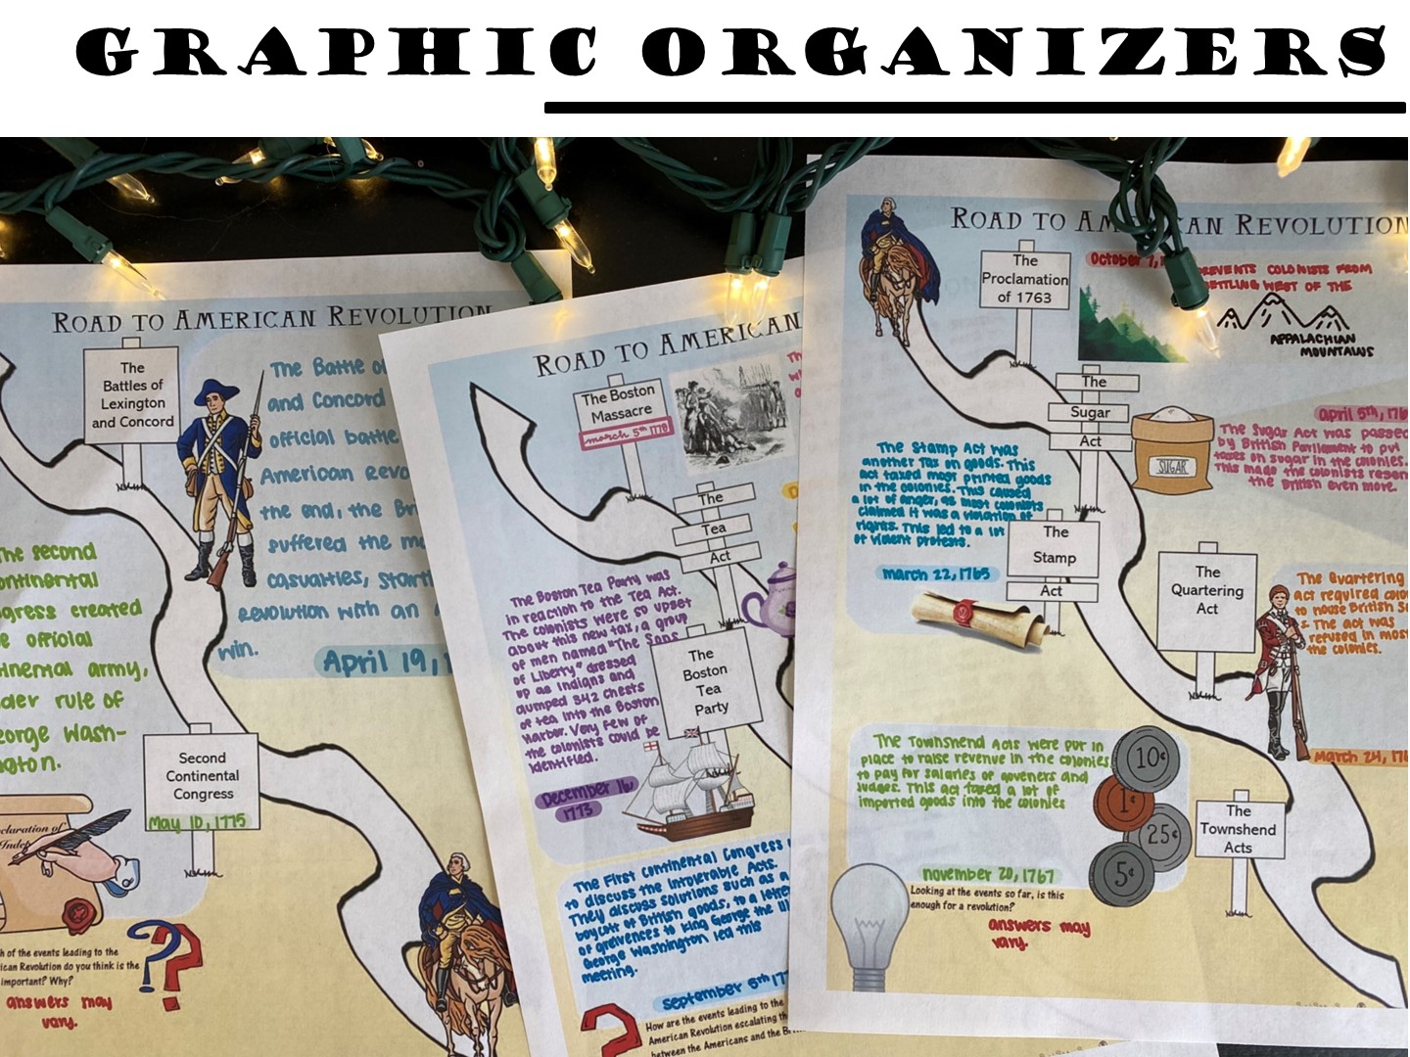
Notes:
Graphic Organizers come in a variety of forms.

Slide 66
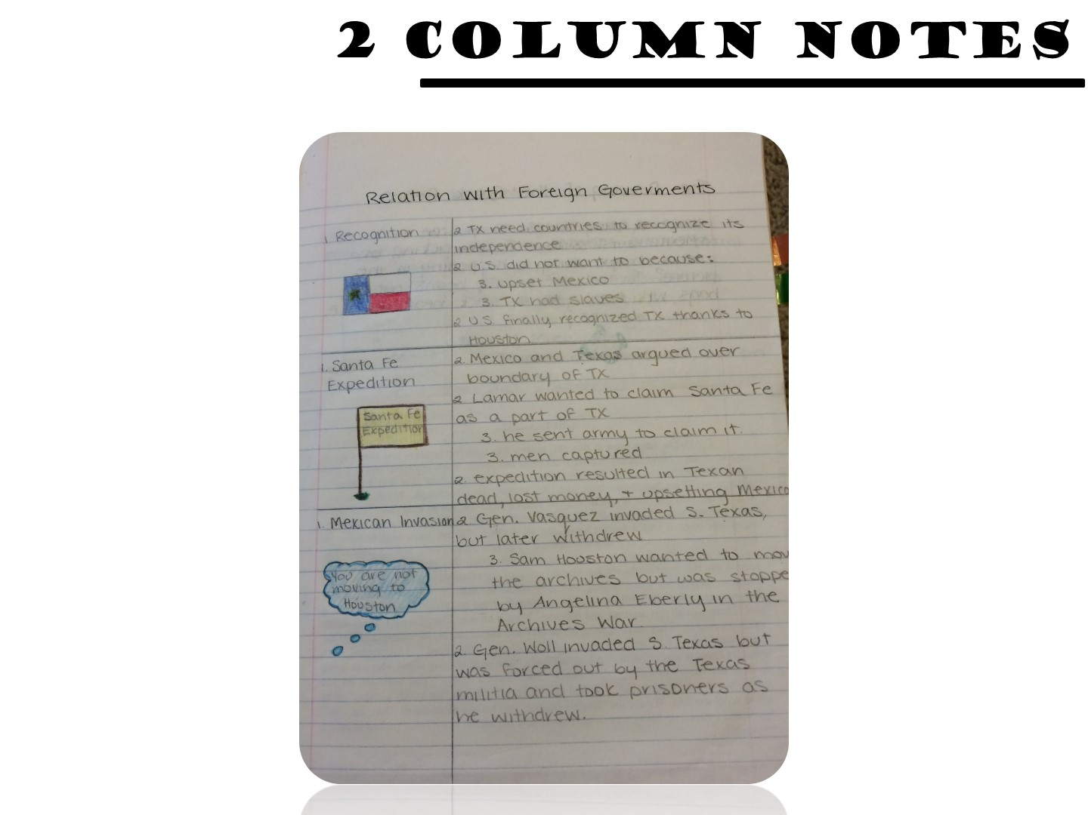
Notes:
Other types of Graphic Notes include 2 –Column notes, with the topic and a summary.

Slide 67
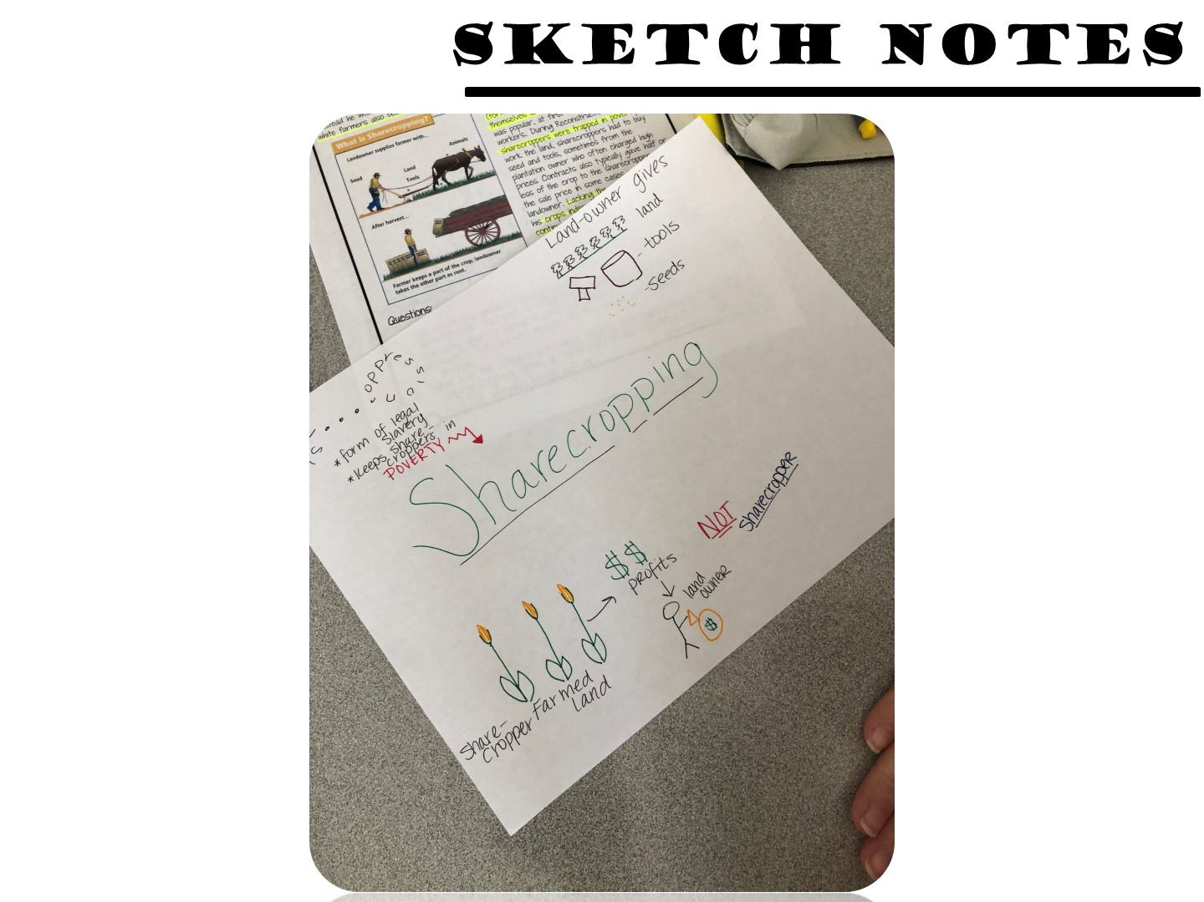
Notes:
Sketch notes are created by students while they are reading.

Slide 68
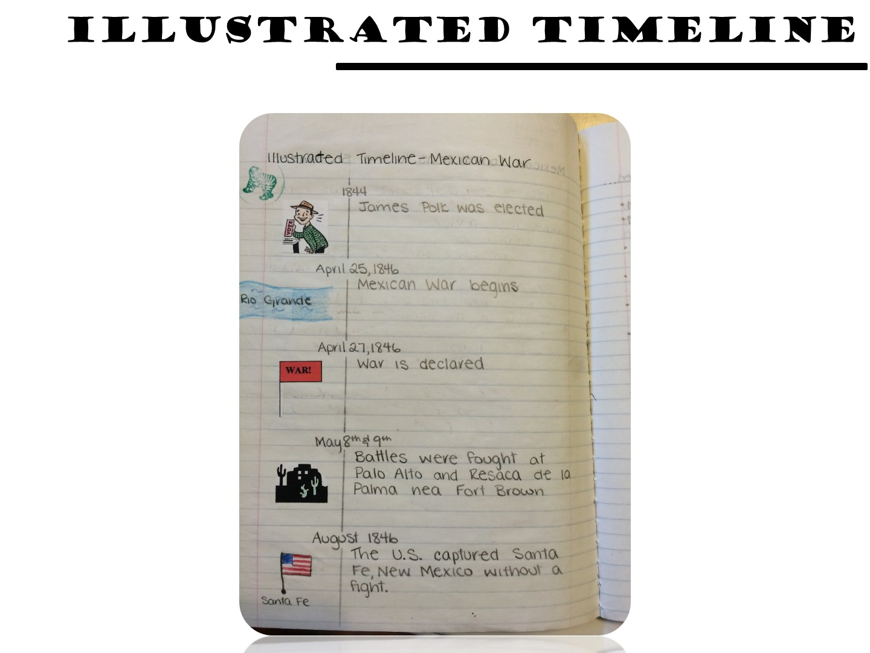

Slide 69
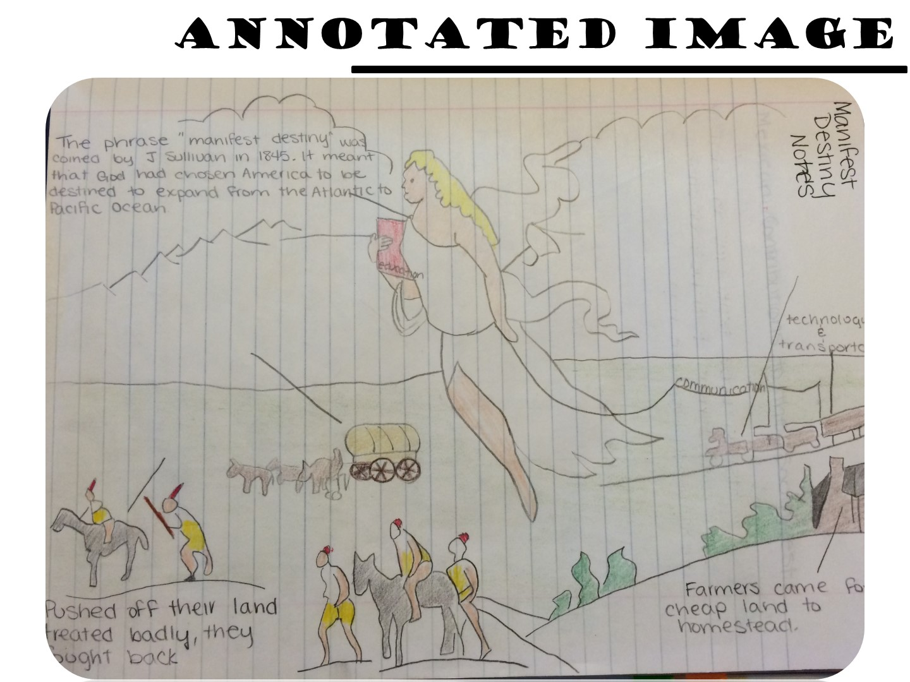

Slide 70
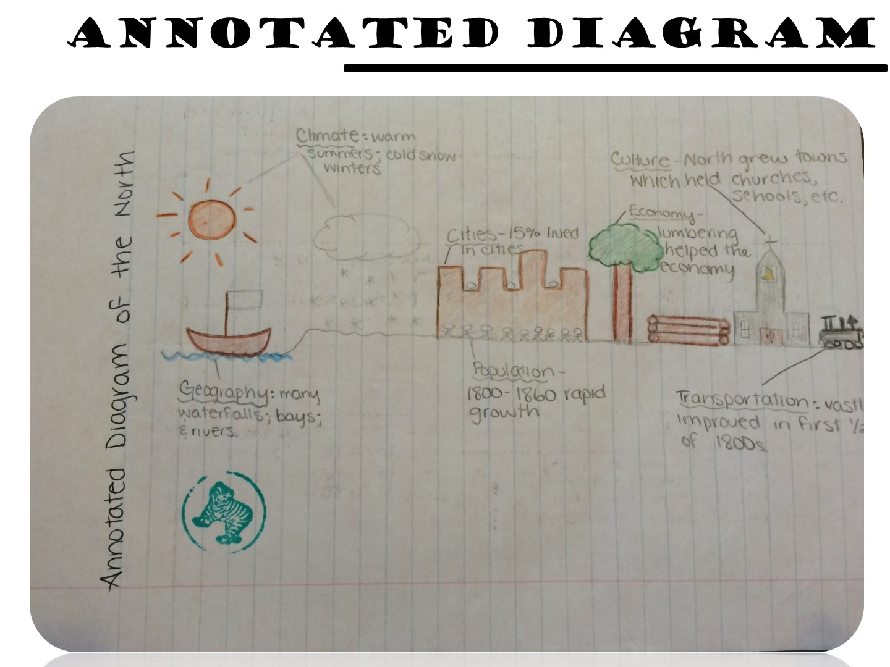

Slide 71
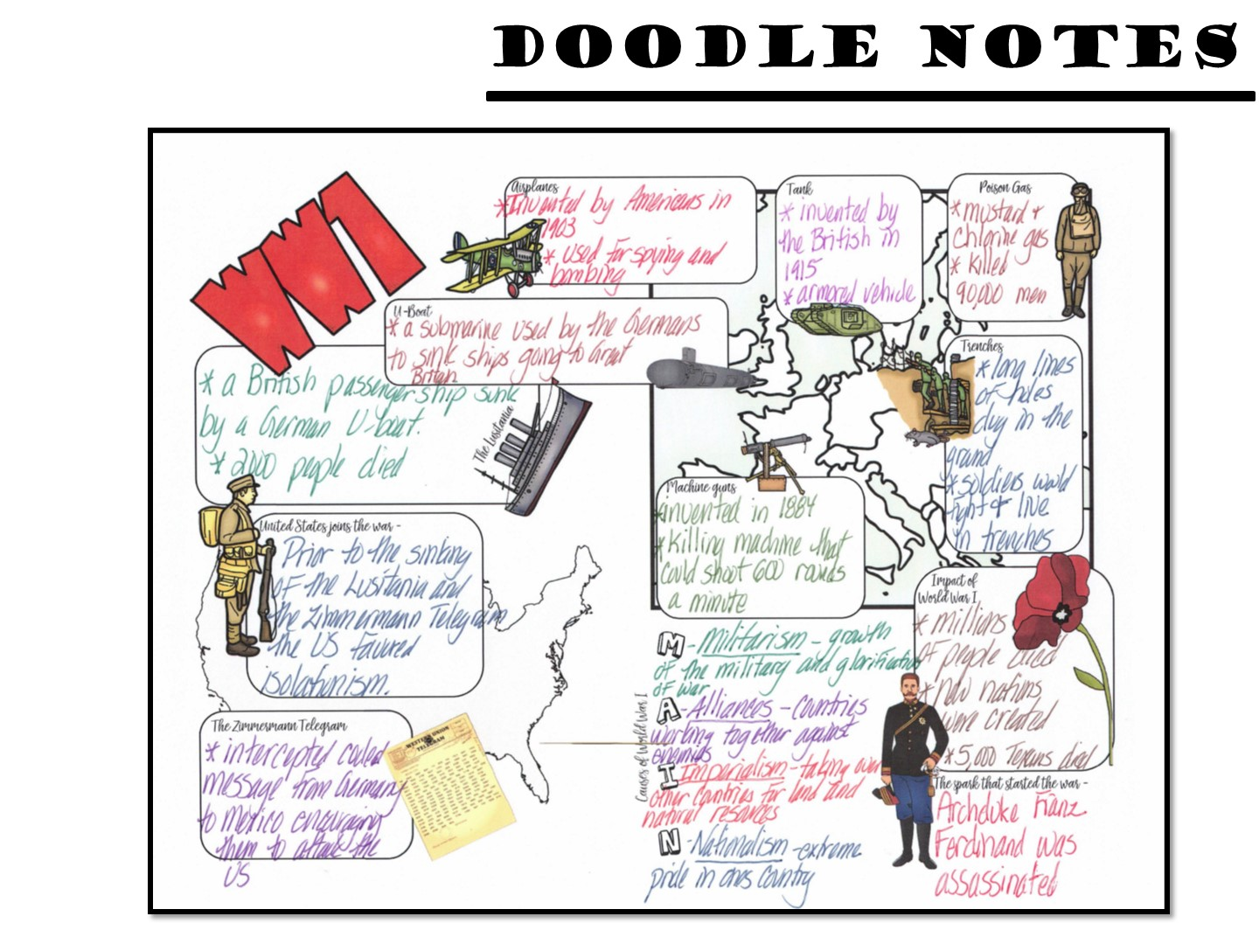

Slide 72

Notes:
You will need to indicate which pages these are on – just flip through to find them.

Slide 73


Slide 74
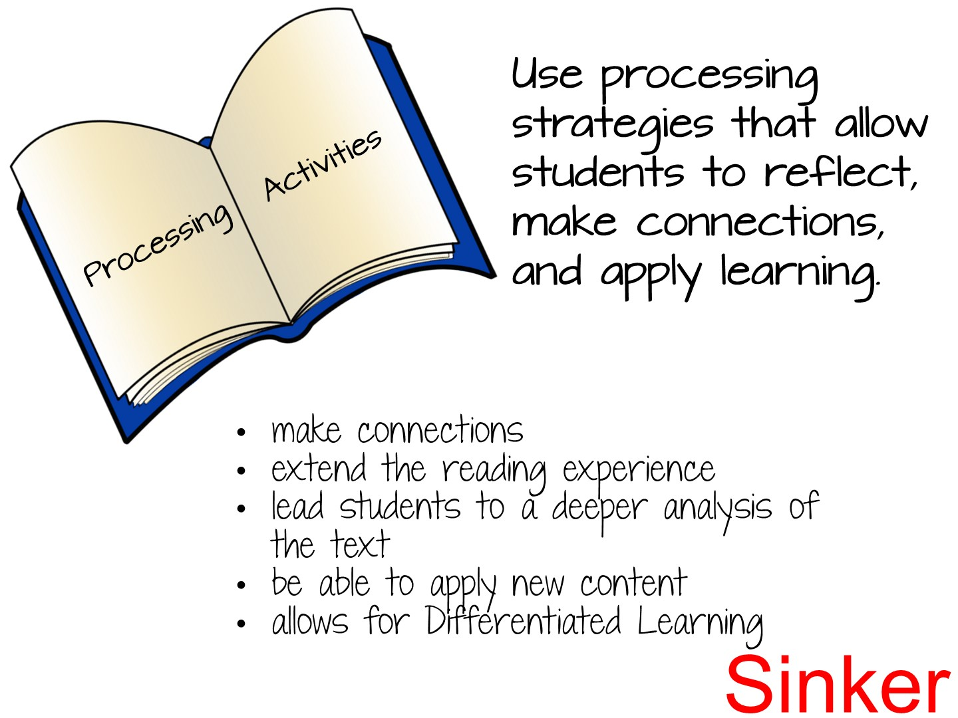
Notes:
Handouts: Before Reading Activities packet
More background knowledge
2.1 Tap into existing schema with activities
2.2 Establish a purpose for reading
2.3 Prepares the brain to acquire new knowledge
Construct the reading activity around a purpose that has significance for the students
Make sure students understand what the purpose for reading is: to get the main idea, obtain specific information, understand most or all of the message, enjoy a story, or decide whether or not to read more. Recognizing the purpose for reading will help students select appropriate reading strategies.
Use pre-reading activities to prepare students for reading
The activities you use during pre-reading may serve as preparation in several ways. During pre-reading you may:
Assess students' background knowledge of the topic and linguistic content of the text
Give students the background knowledge necessary for comprehension of the text, or activate the existing knowledge that the students possess
Clarify any cultural information which may be necessary to comprehend the passage
Make students aware of the type of text they will be reading and the purpose(s) for reading
Provide opportunities for group or collaborative work and for class discussion activities
Sample pre-reading activities:
Using the title, subtitles, and divisions within the text to predict content and organization or sequence of information
Looking at pictures, maps, diagrams, or graphs and their captions
Talking about the author's background, writing style, and usual topics
Skimming to find the theme or main idea and eliciting related prior knowledge
Reviewing vocabulary or grammatical structures
Reading over the comprehension questions to focus attention on finding that information while reading
Constructing semantic webs (a graphic arrangement of concepts or words showing how they are related)
Doing guided practice with guessing meaning from context or checking comprehension while reading
Pre-reading activities are most important at lower levels of language proficiency and at earlier stages of reading instruction. As students become more proficient at using reading strategies, you will be able to reduce the amount of guided pre-reading and allow students to do these activities themselves.

Slide 75
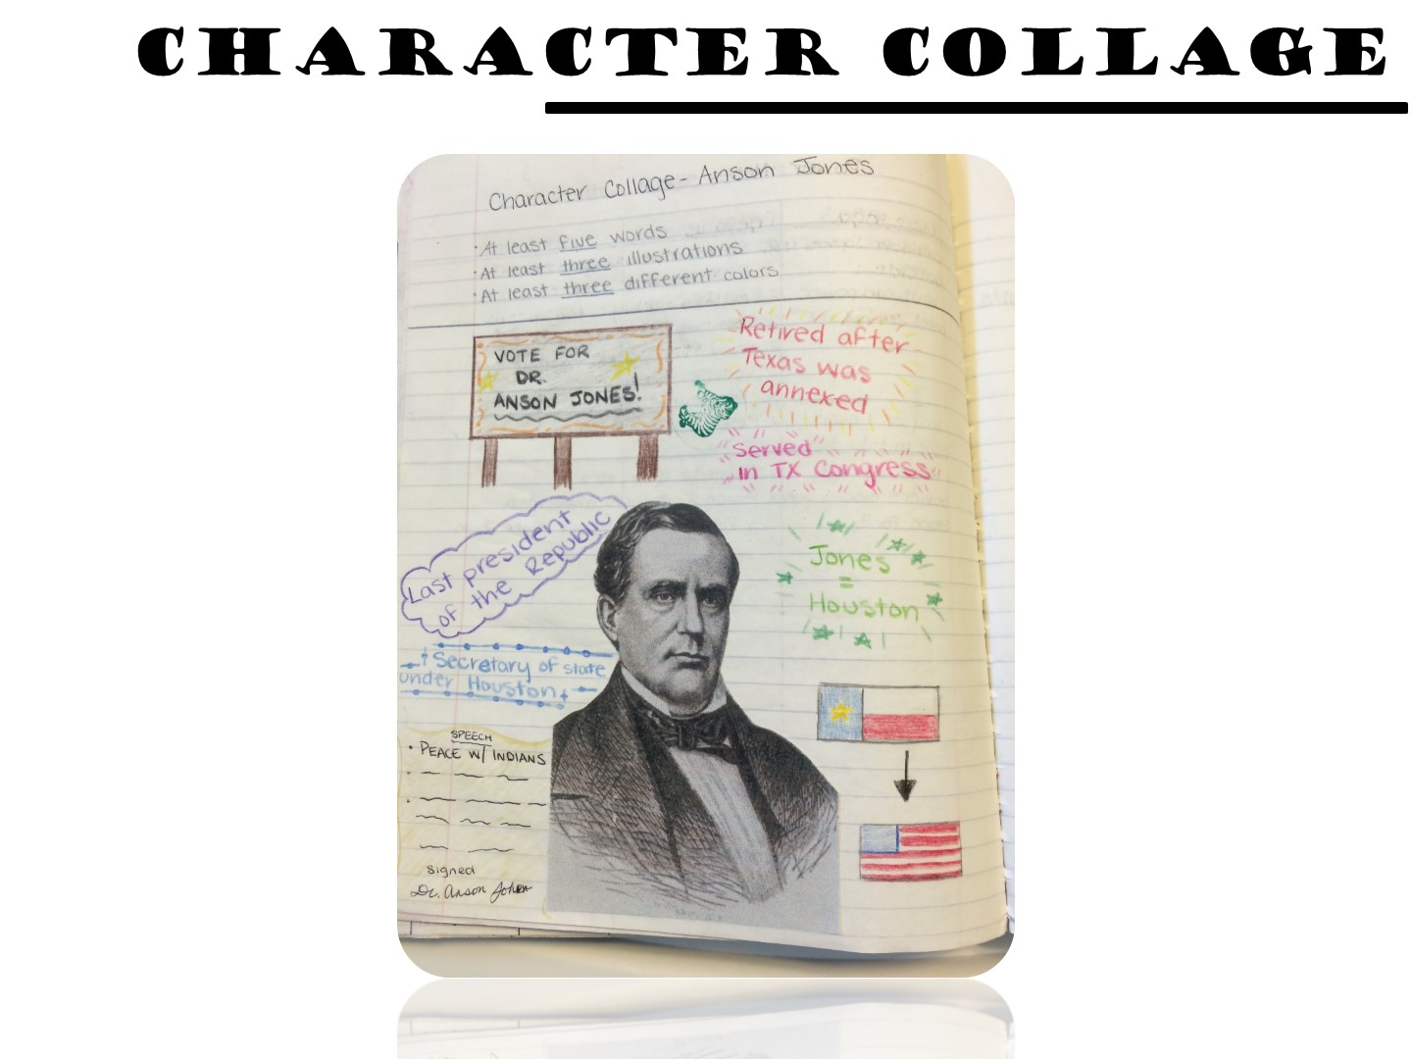
Notes:
Character collages allow students to process information about historical figures by adding images and quotes.

Slide 76
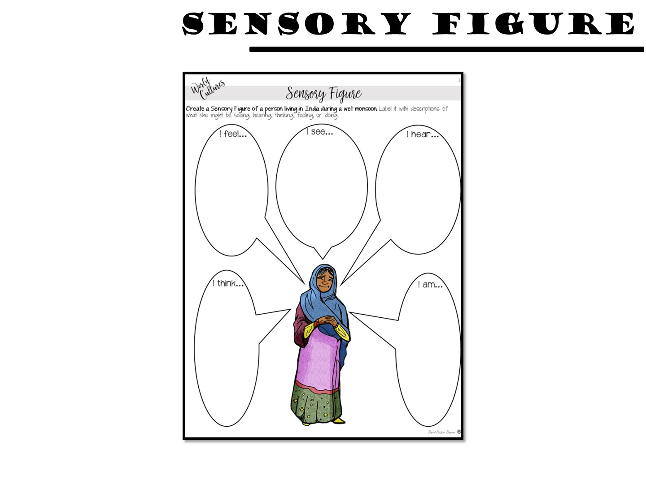
Notes:
Sensory figures process by inferencing senses.

Slide 77
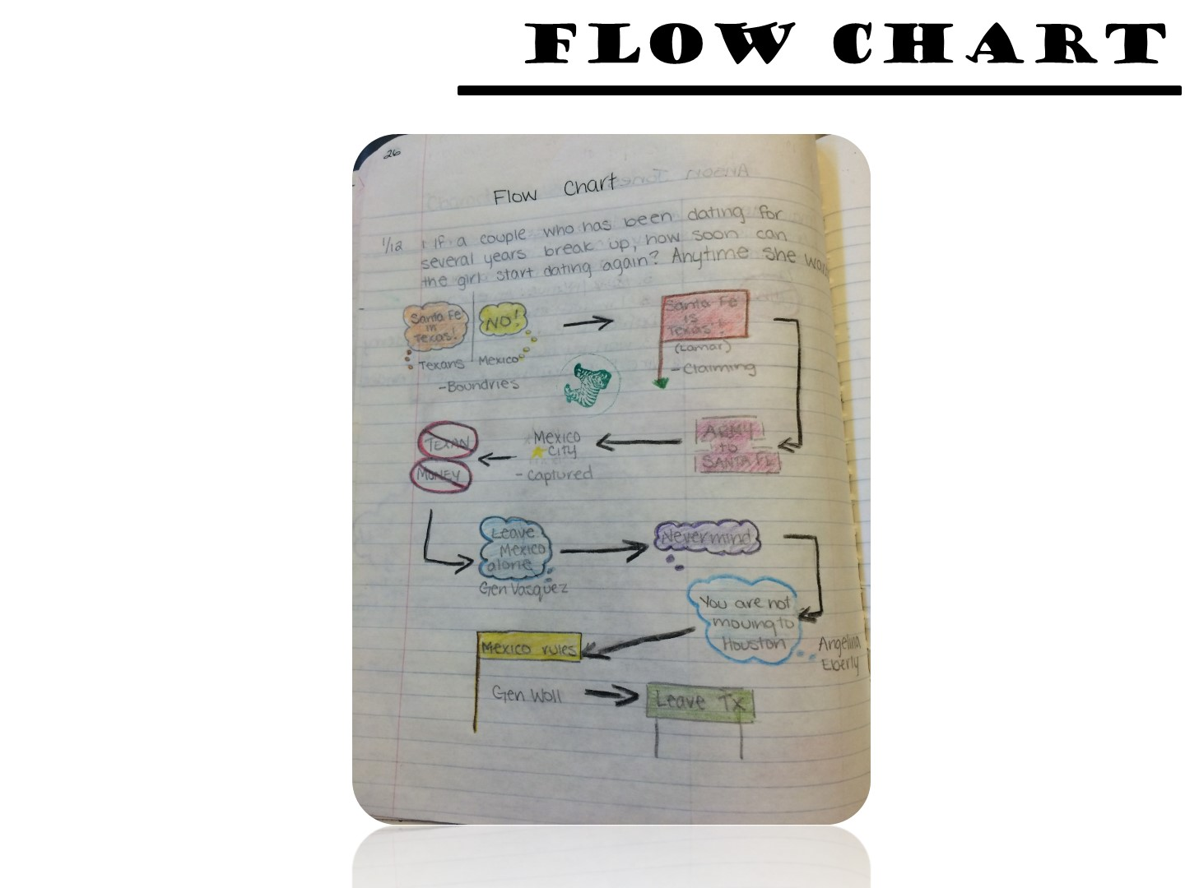
Notes:
Flow charts show the movement of an idea.

Slide 78
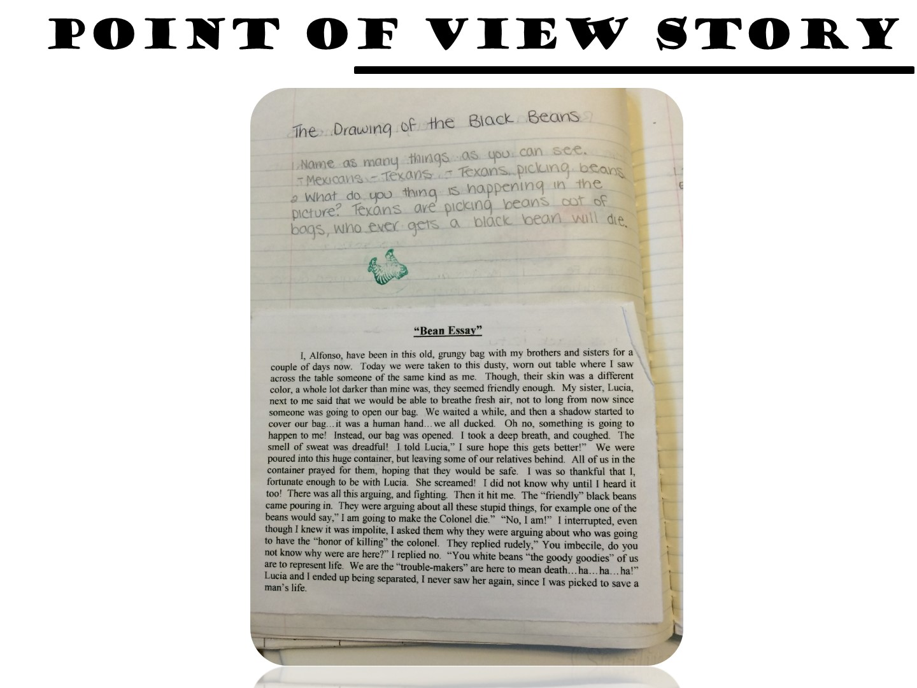
Notes:
Point of view stories are great for inferencing as well.

Slide 79
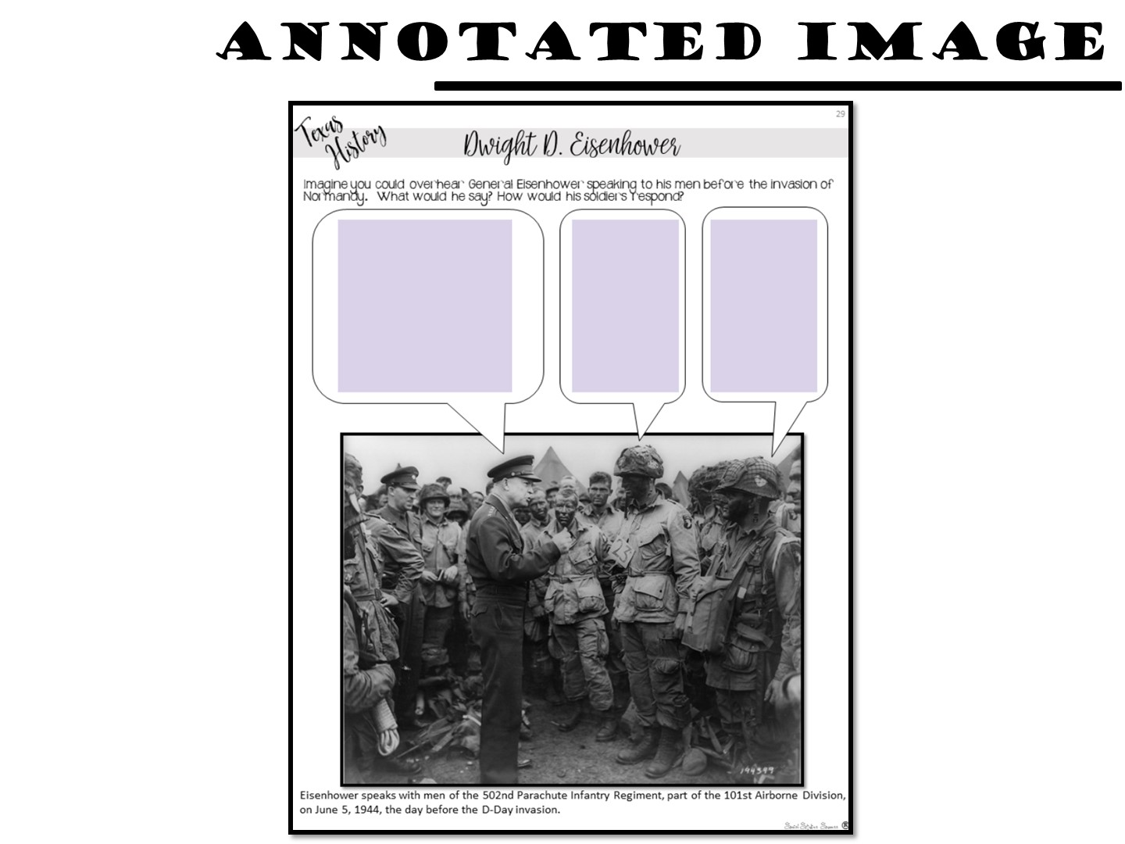
Notes:
Students bring to life images by adding text.

Slide 80
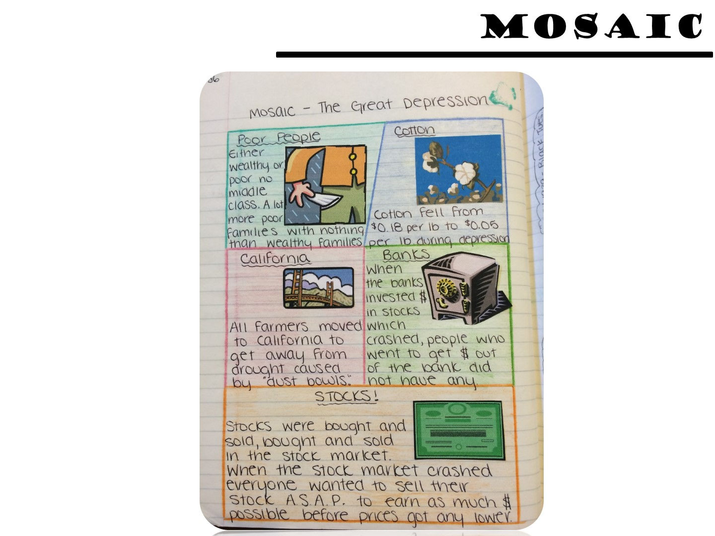
Notes:
A mosaic is great for showing the parts of a topic.

Slide 81
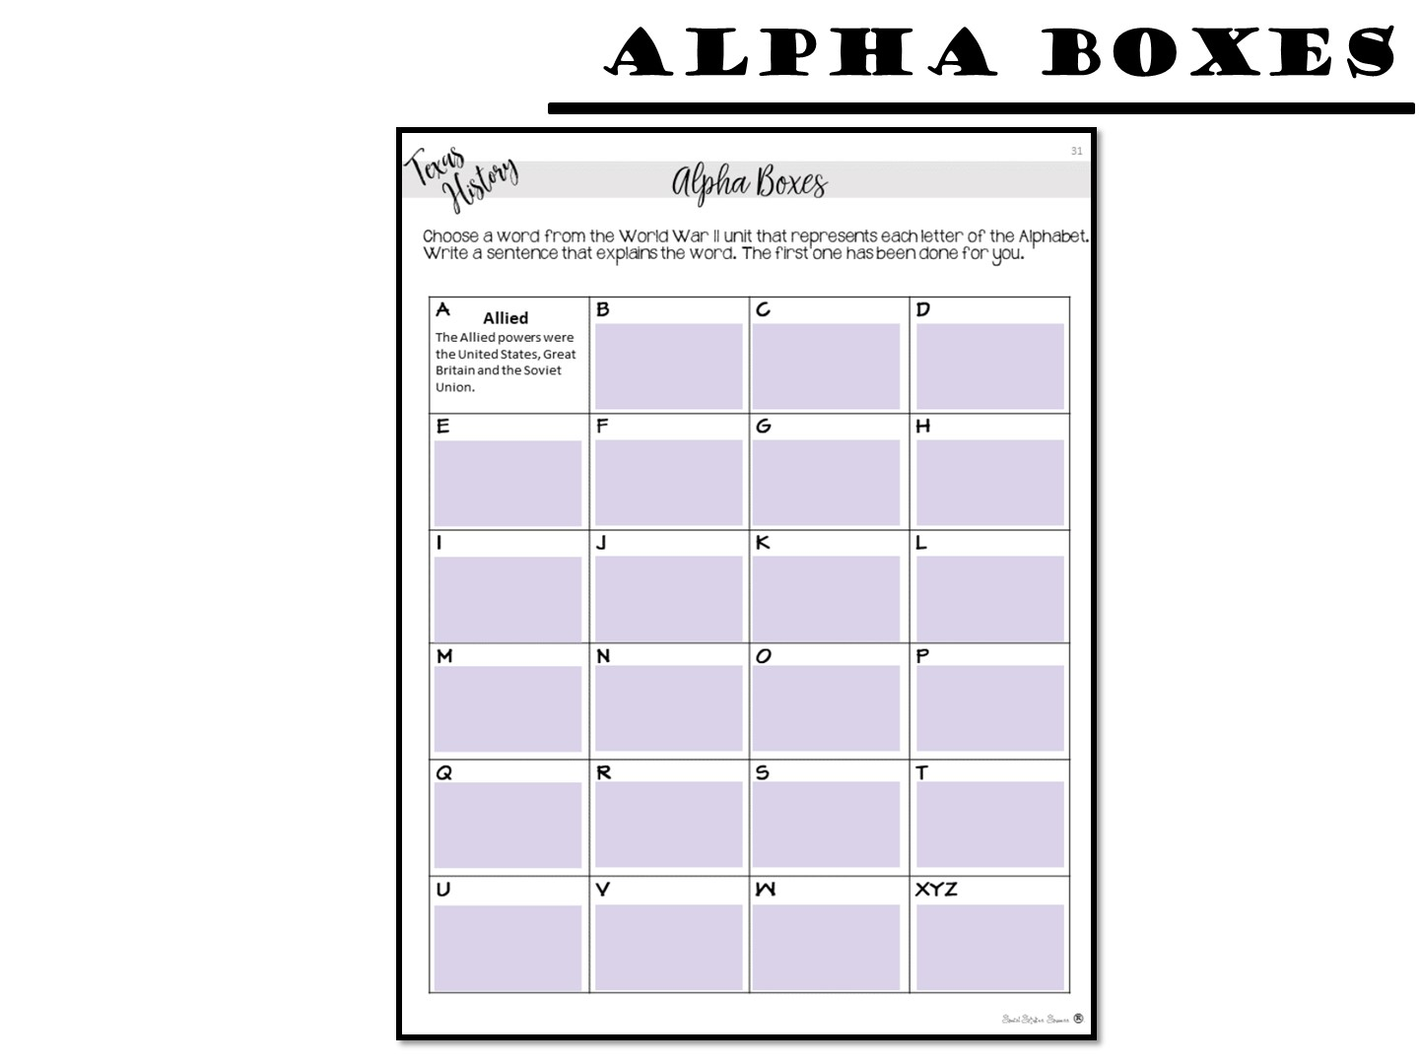
Notes:
Challenge students to create summaries for the topic with Alpha Boxes.

Slide 82
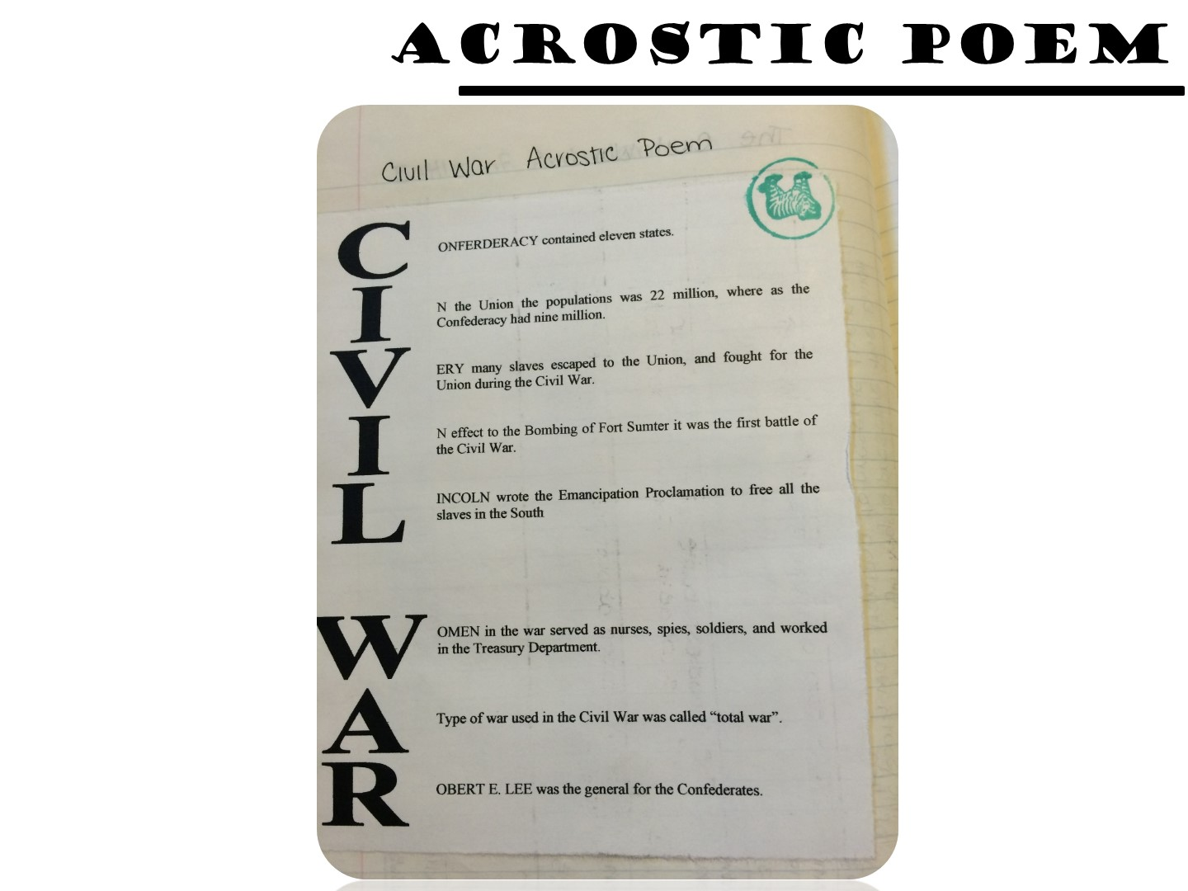
Notes:
Explain an acrostic poem.

Slide 83
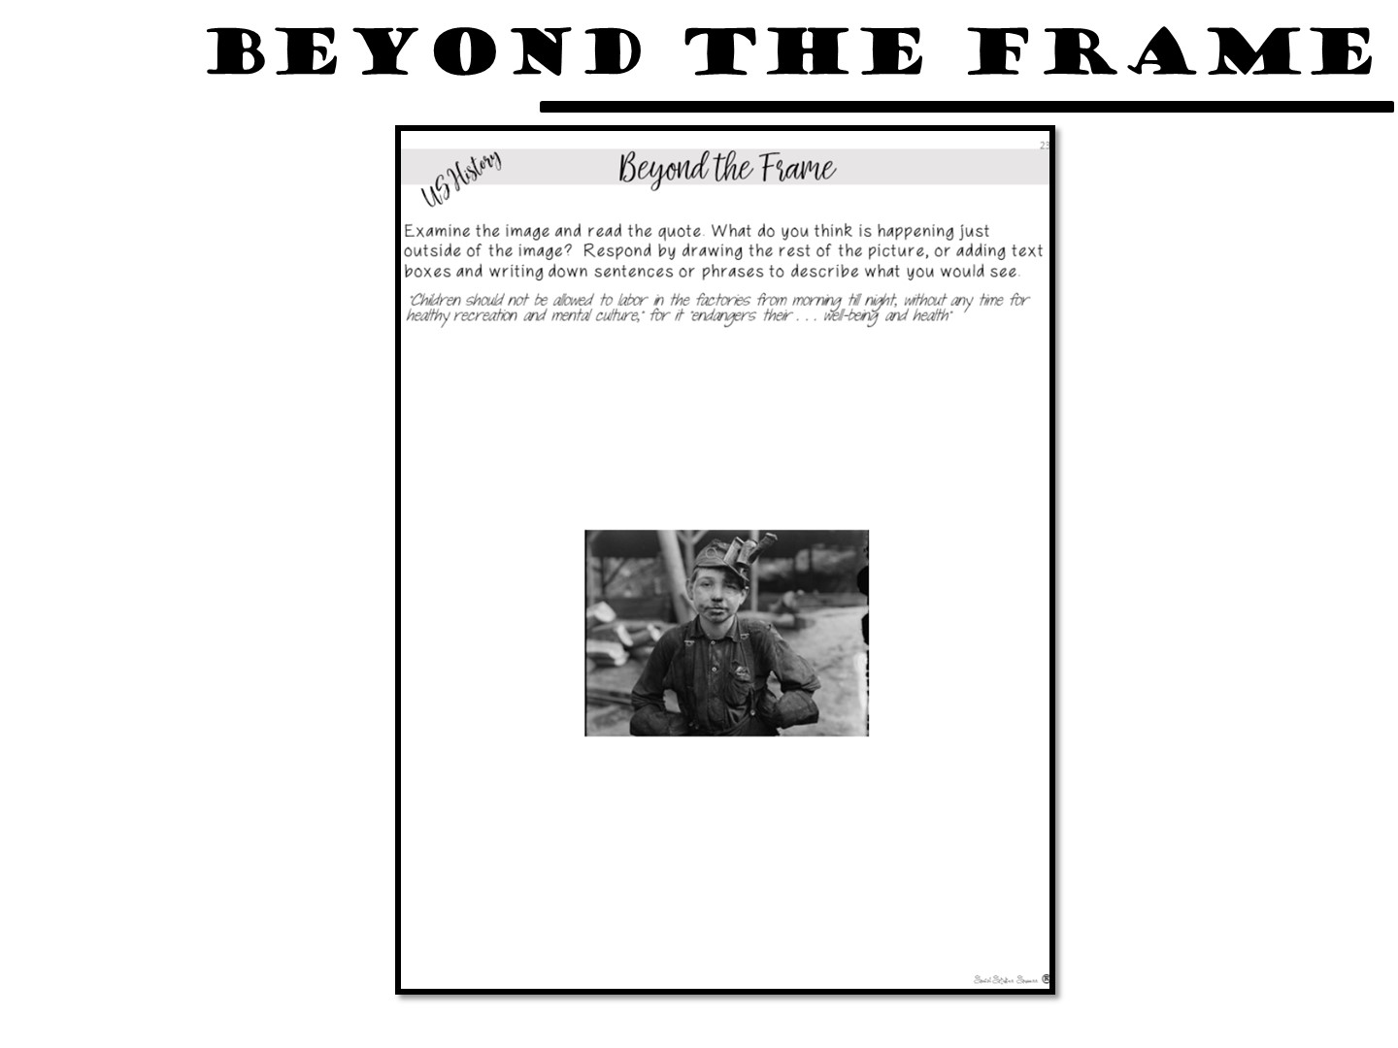
Notes:
Students write or draw what they would see beyond the picture frame.

Slide 84
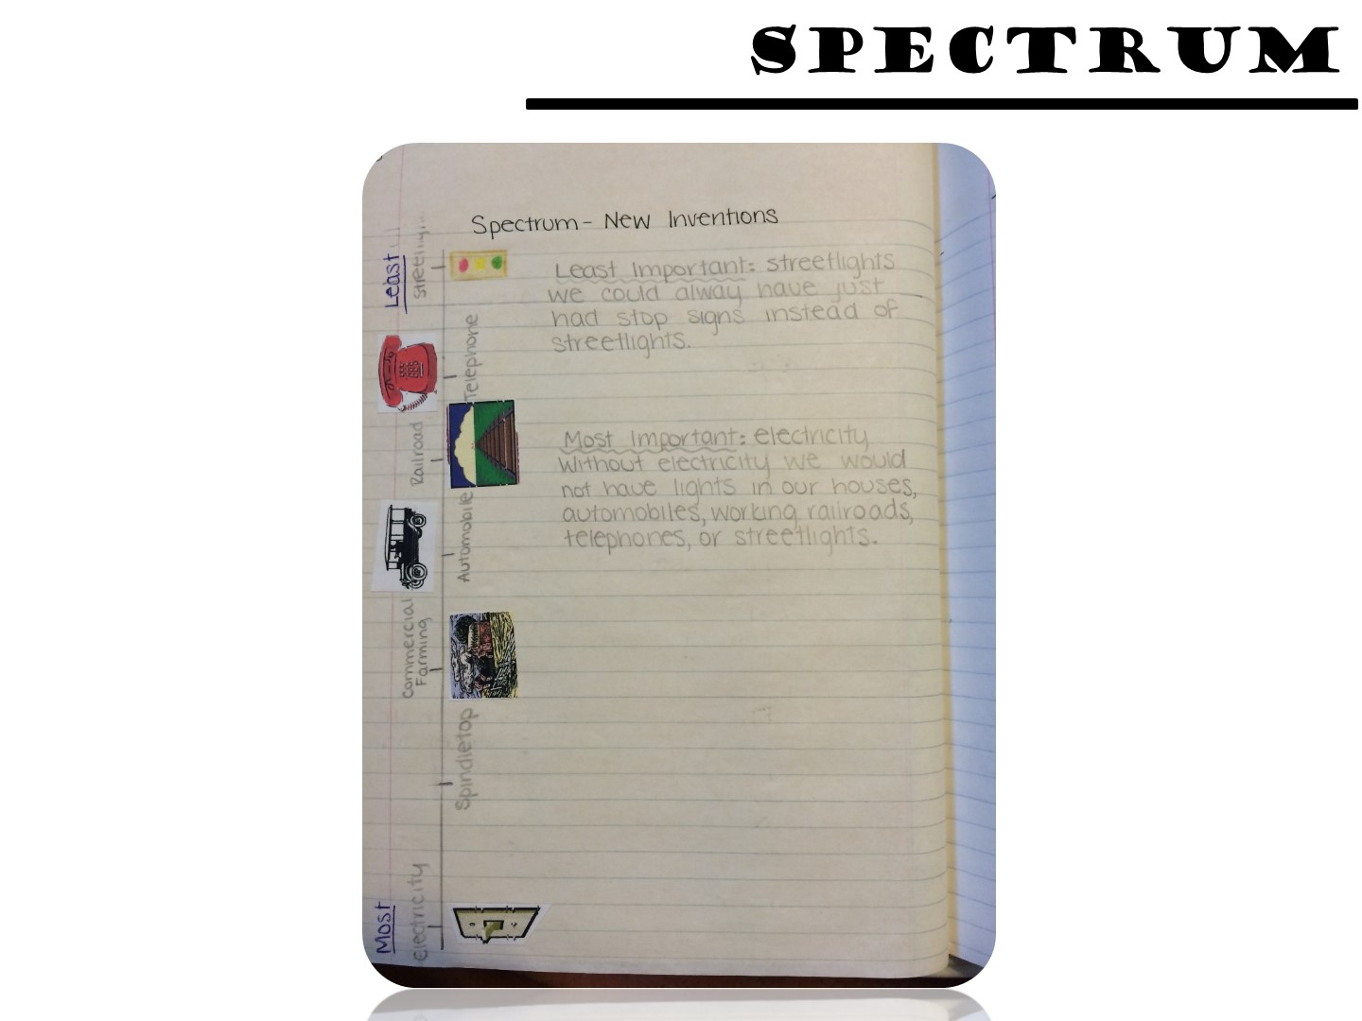
Notes:
Students rank the importance of certain events.

Slide 85
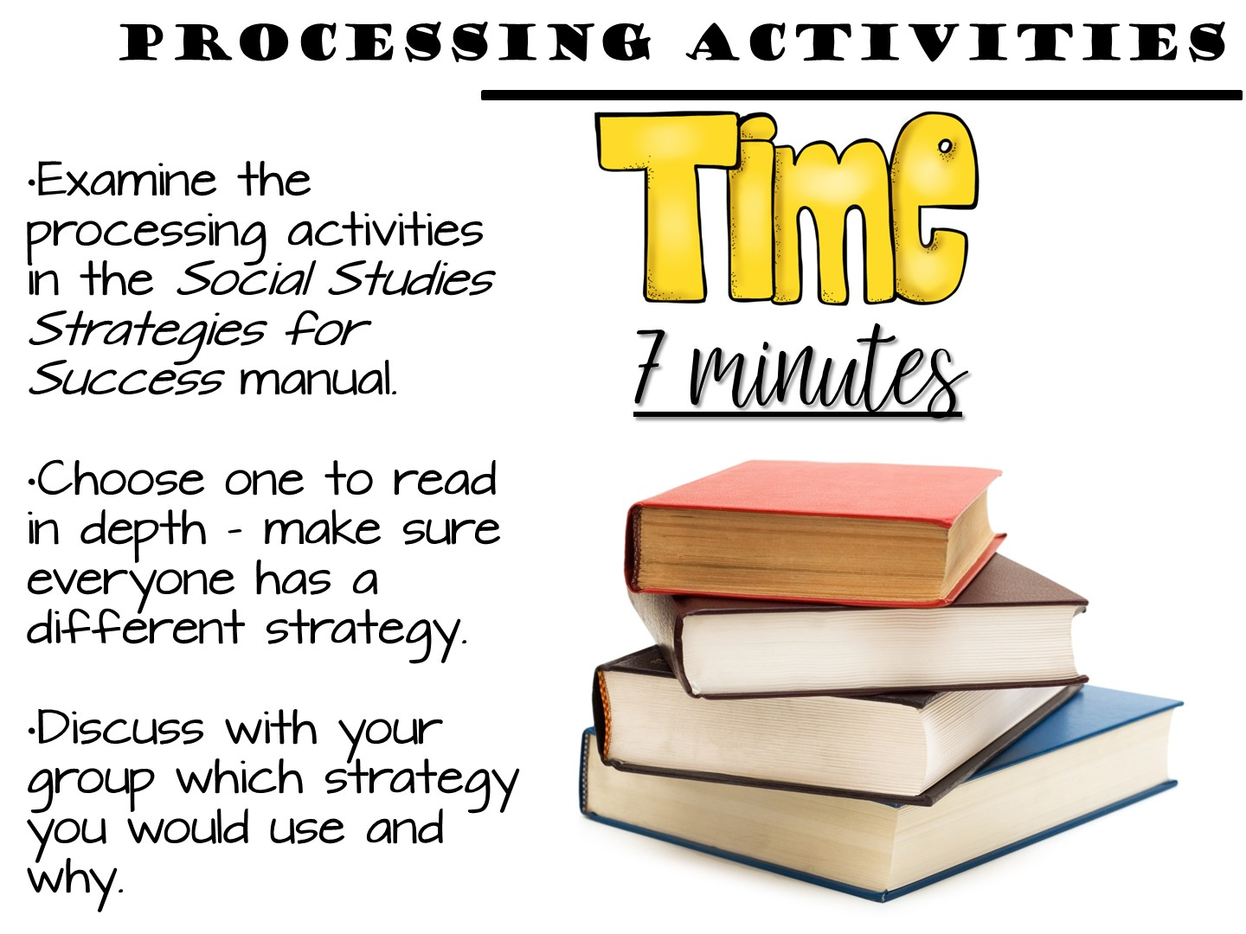
Notes:
These can be found in the table of contents.

Slide 86

Notes:
Have participants hold up their hands in a “gimmie five”. Then for each finger up they have to say one thing they learned. For their thumb, they need to say one question they still have.

Slide 87
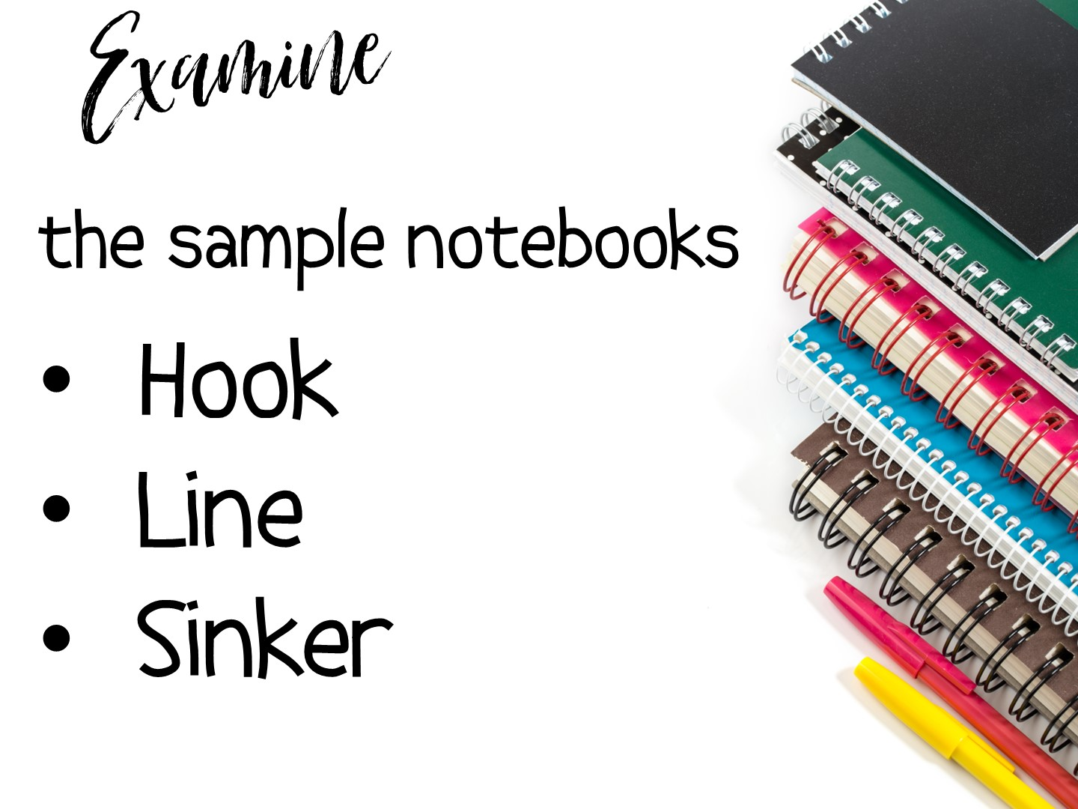
Notes:
Now examine at the sample notebooks you brought to look for these parts in the notebook.

Slide 88


Slide 89

Notes:
This is your personal choice in the classroom (share all your tips in this section).

Slide 90
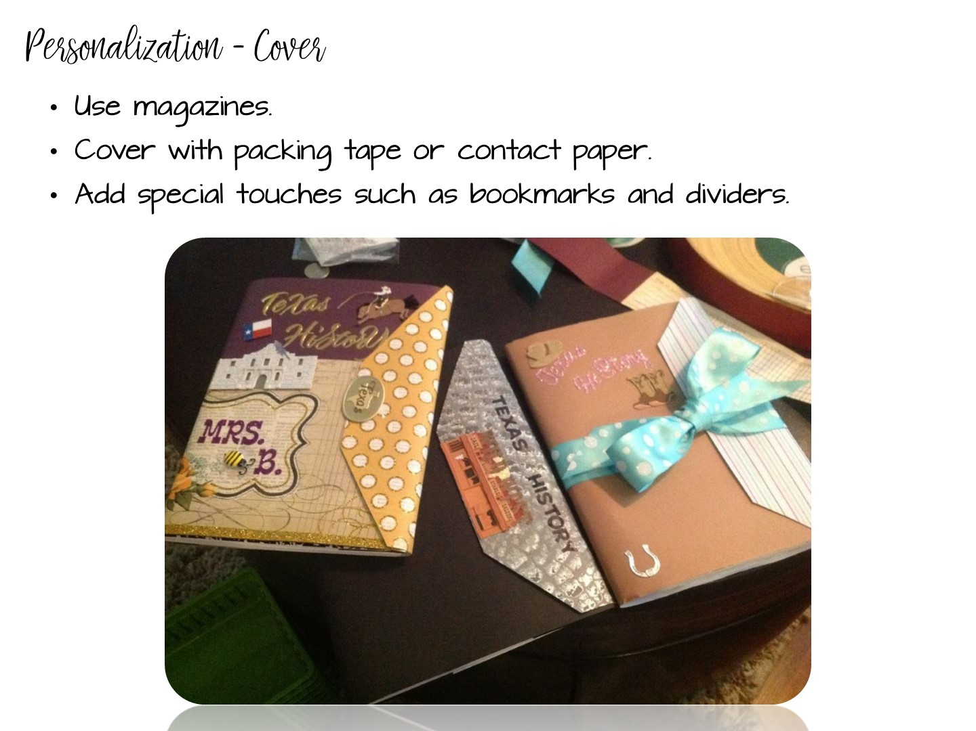
Notes:
There are also things that you can do to individualize them. As you go over these, give your tips and experiences using notebooks.
For reduce the number of lost notebooks explain that the students have invested their time and personality into them, so they now have value to the kids.

Slide 91
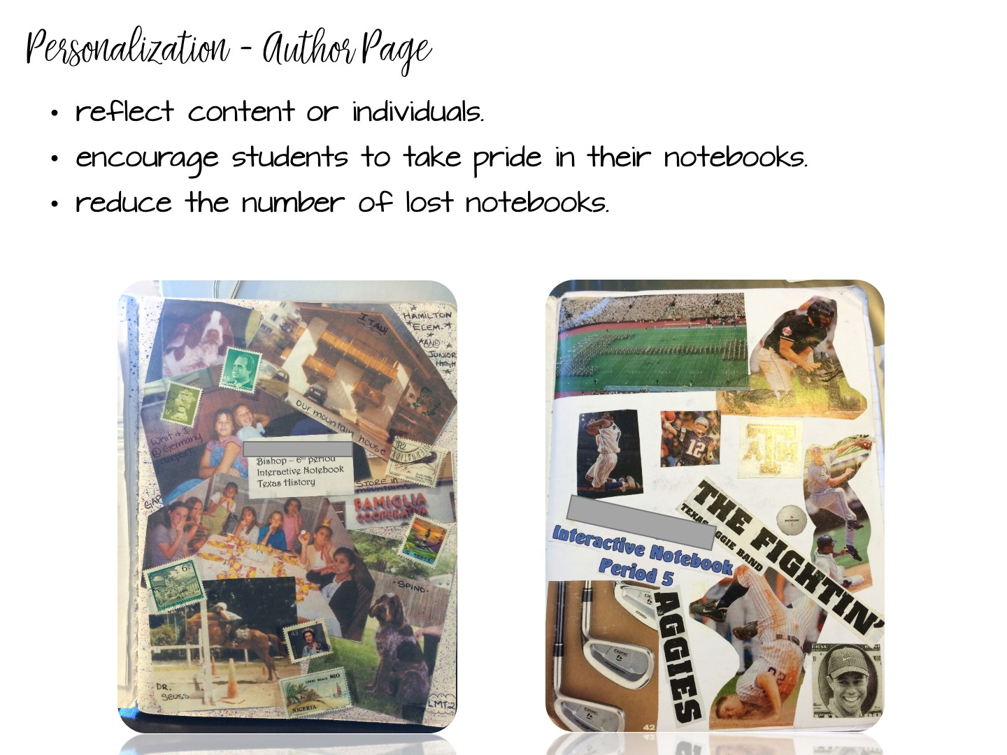
Notes:
There are also things that you can do to individualize them. As you go over these, give your tips and experiences using notebooks.
For reduce the number of lost notebooks explain that the students have invested their time and personality into them, so they now have value to the kids.

Slide 92
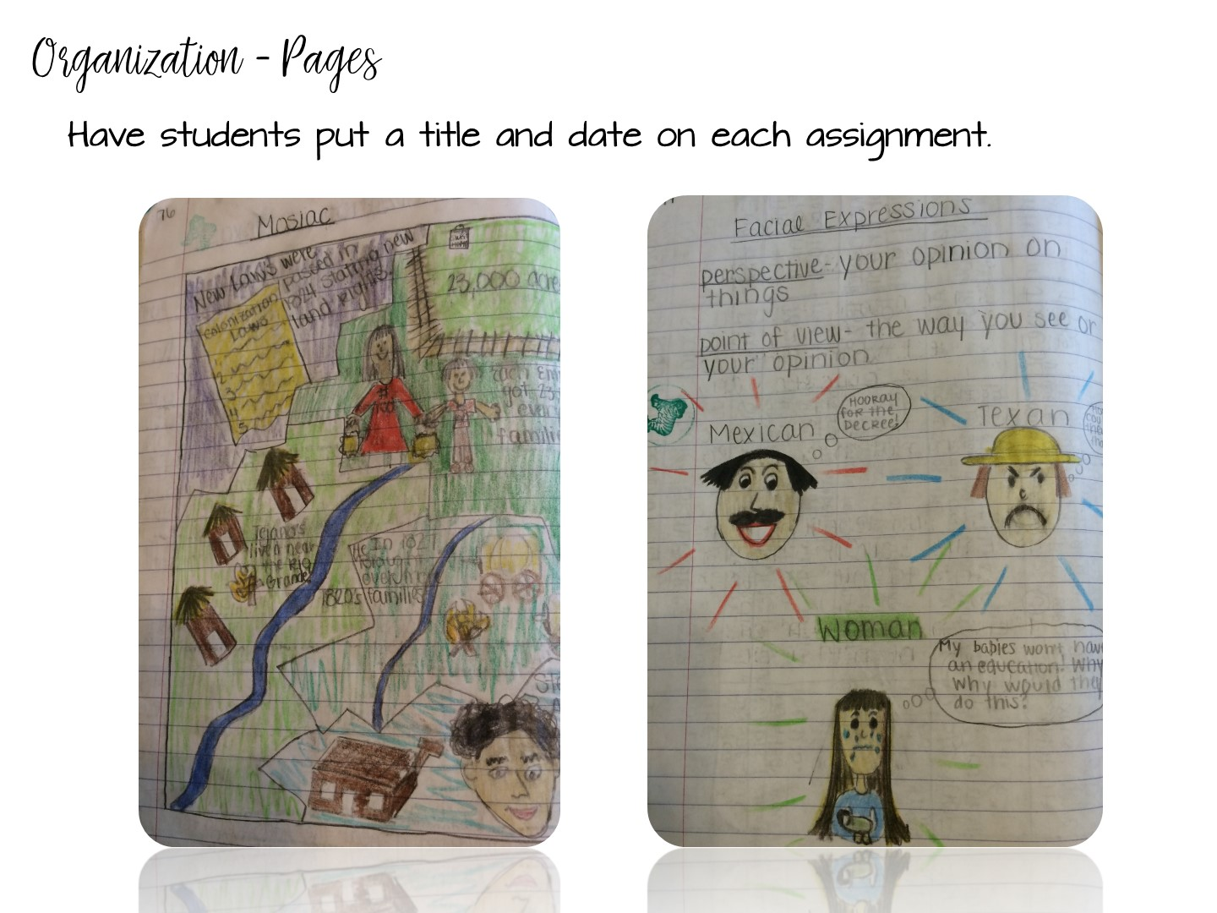
Notes:
This will help kids know what the assignment is about and when it was done. This will help absent kids too.

Slide 93

Notes:
Discuss with participants how you can number pages. There are a variety of ways you can do this. Share the above with them and what you have done or tried in the past. You might need to explain that we are teaching without left-side/right-side if you have some folks who were taught the ISN by an old-schooler!
Number as you go - Explain to participants it is best to number as you go so if a kid messes up their whole notebook is not messed up.
Number by activity – each activity has a number
A,B,C method – Can use this with either. Preview is 2A, Notes 2B, Processing 2C or if you number as you go, if a kid needs more room than the page you gave them, they can make that A and move to page B.
Explain that all kids should be on the same number system and do not let them number on their own or their will be a lot of confusion when you want to grade or have the kids find something.

Slide 94

Notes:
I showed two examples, if you do something different, explain that to them.
I also share how I go to the teacher center and use a poster maker to make a big poster of the Table of Contents and laminate it. That way I can use dry erase markers on it and keep it up where the kids can see.

Slide 95

Notes:
You can include other things besides preview, notes, and processing in your notebooks as well. Vocabulary, maps are a few examples.

Slide 96

Notes:
You can give the example of 5-5-5 5 terms, 5 phrases, 5 colors required for a unit page. This picture does not have it, but that is something they can require their students to do.

Slide 97

Notes:
Low look at the organization in the ISN.

Slide 98

Notes:
Debrief with these stems.

Slide 99


Slide 100

Notes:
Turn and Talk
This decides how you grade the notebook – either looking for perfection or grading the learning process.

Slide 101

Notes:
Monitor often at the beginning of the year.
Stamp, initial, or place stickers to indicate you have seen the item.
Write comments, especially positive comments or suggestions, on sticky notes.

Slide 102

Notes:
Allow students to use notebooks on a quiz
Helps students understand the importance of taking notes.
Encourages students to bring their notebooks daily.
Builds good work habits for the future.
z or test.

Slide 103

Notes:
Have students look at other student examples.
Examples from previous years
Gallery walk
Peer Review

Slide 104


Slide 105


Slide 106

Notes:
Share any tips you have for grading. Remind teachers that they have sample rubrics on the website in the folder on Interactive Student Notebook resources.

Slide 107


Slide 108

Notes:
Discuss by bullet points
Notes with highlighting key terms are easier to use to study for tests
Model when give notes use different color pens on overhead or in powerpoint.
Put color as part of the grade – stress color for organizing not for “prettiness”

Slide 109

Notes:
Discuss point
Can help them study; is a portfolio of evidence of learning
Help with test at state level; give story of student who kept and used their notebook

Slide 110


Slide 111

Notes:
Point out my blog on social studies success if they want to learn more.

