Slide 1

Notes:
Post Word Wall terms in the front of the room

Slide 2


Slide 3

Notes:
Spend a few minutes introducing your personal and professional life.

Slide 4

Notes:
The following slides list the research that goes into my workshops. I quickly share all of the research, and on the last slide I ask, “Which of these do you agree with?” and share the answer with a partner.

Slide 5


Slide 6
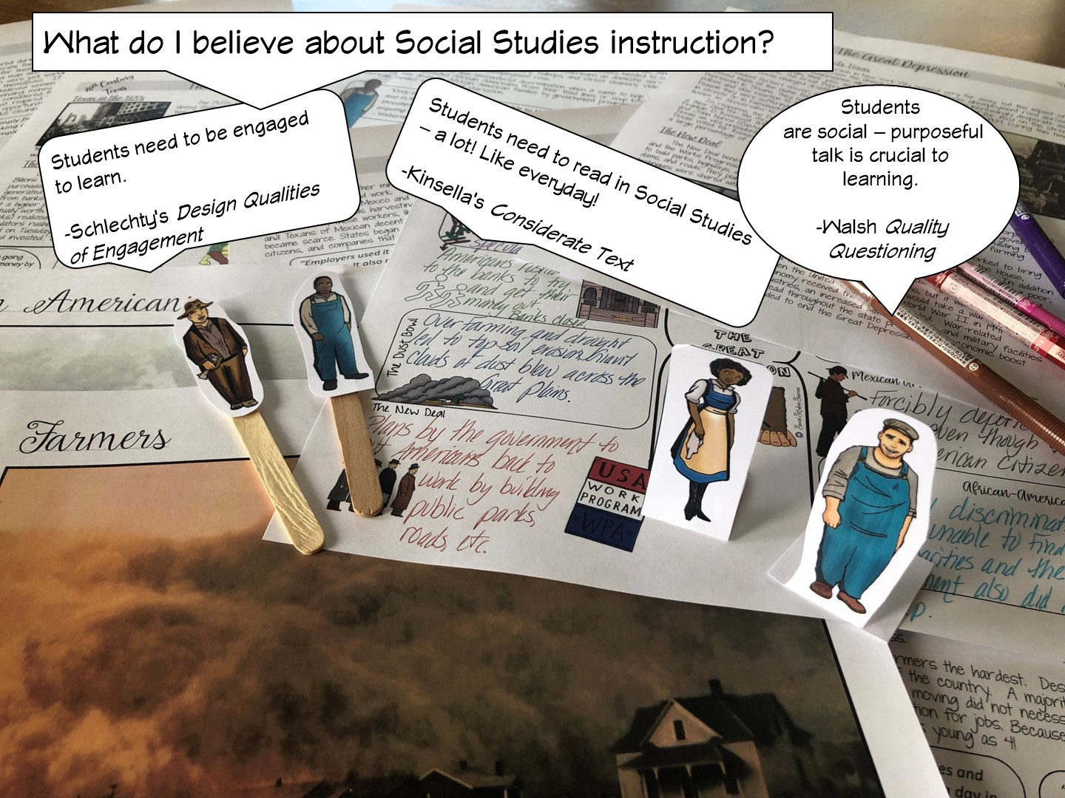

Slide 7
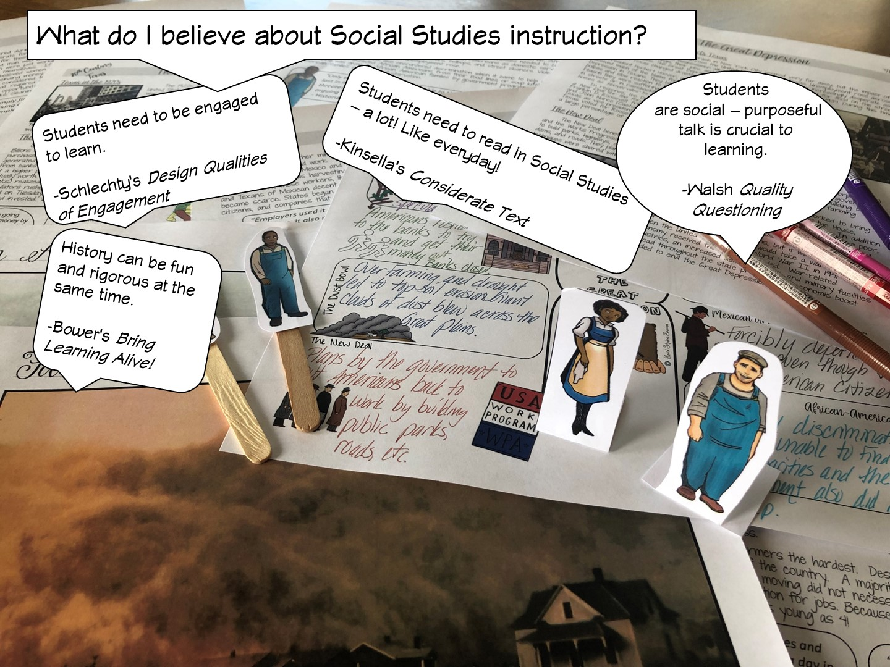

Slide 8


Slide 9
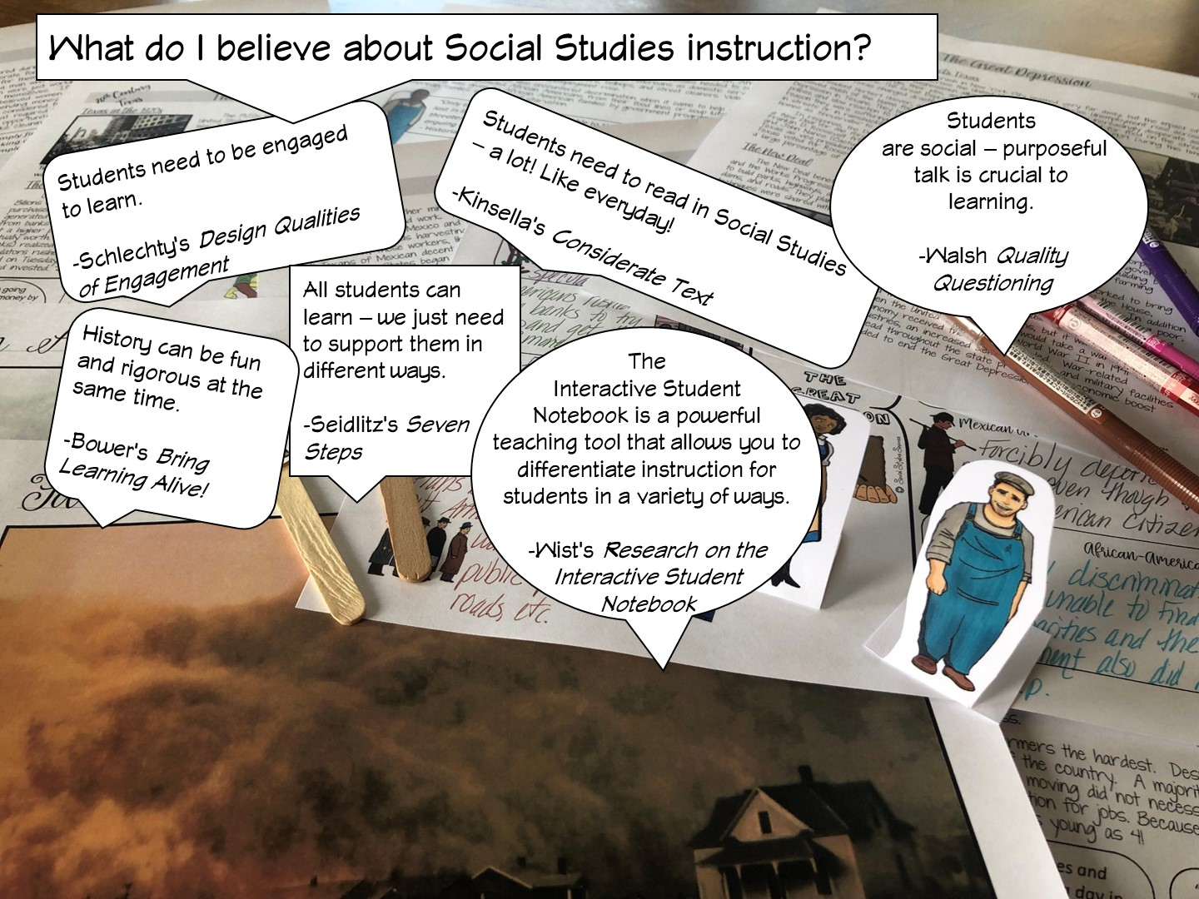

Slide 10
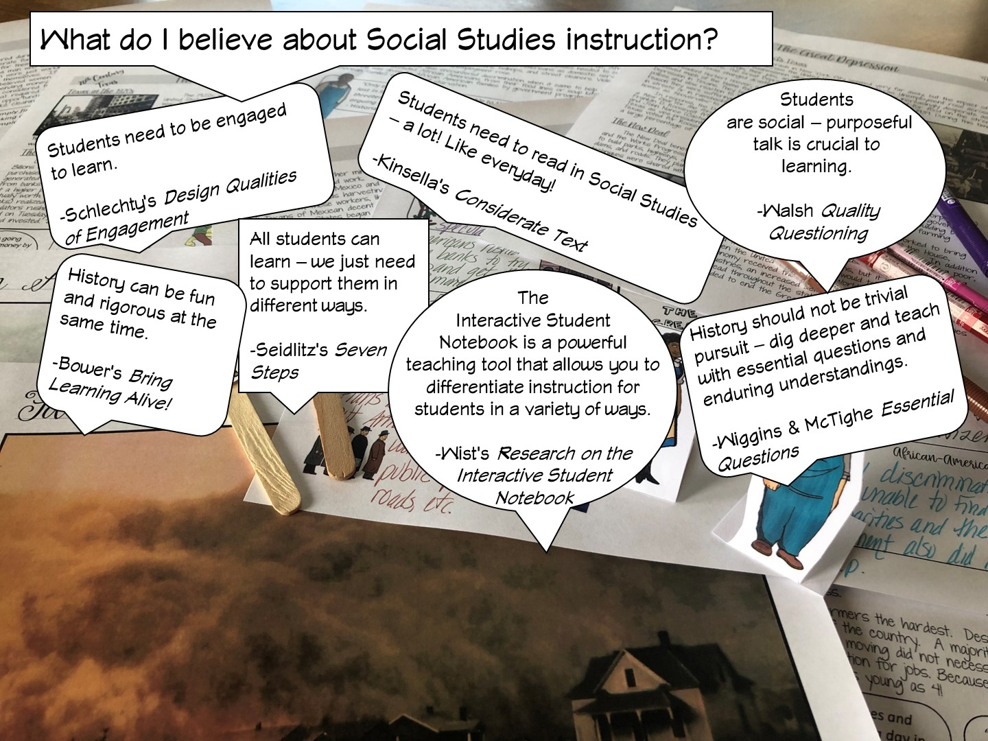

Slide 11
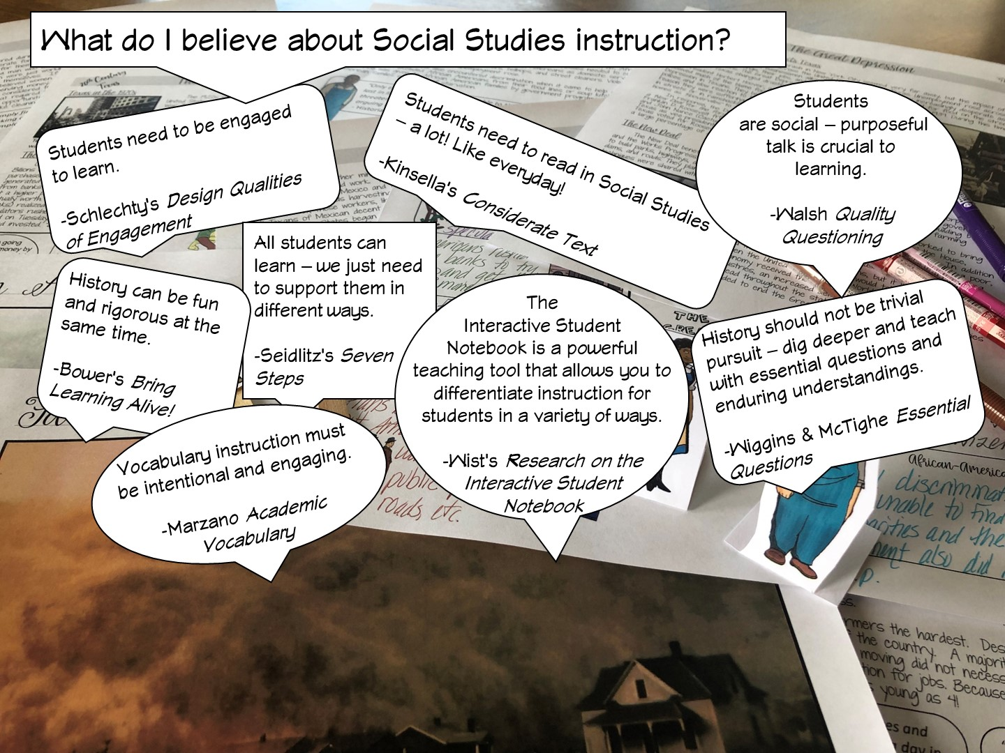

Slide 12
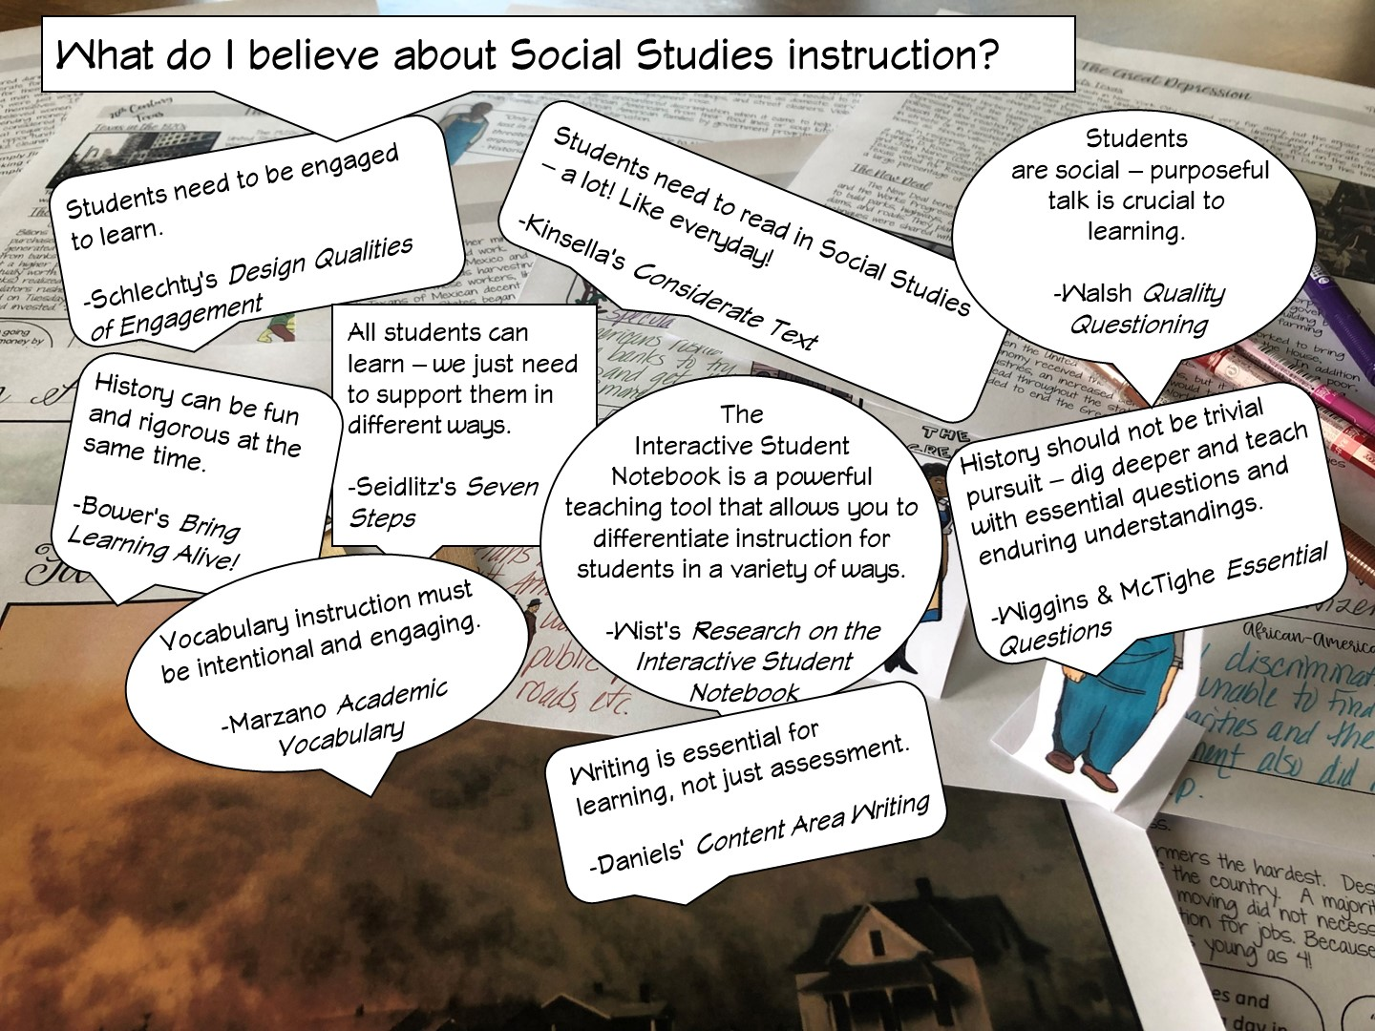

Slide 13
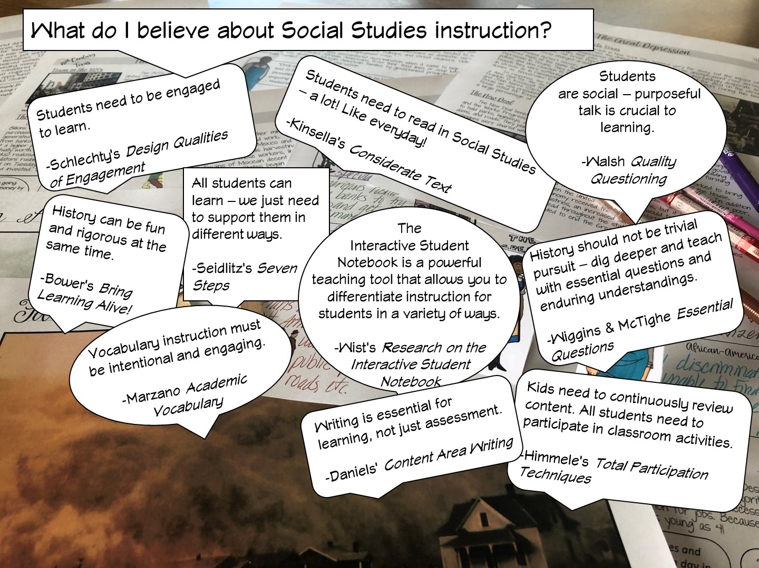

Slide 14
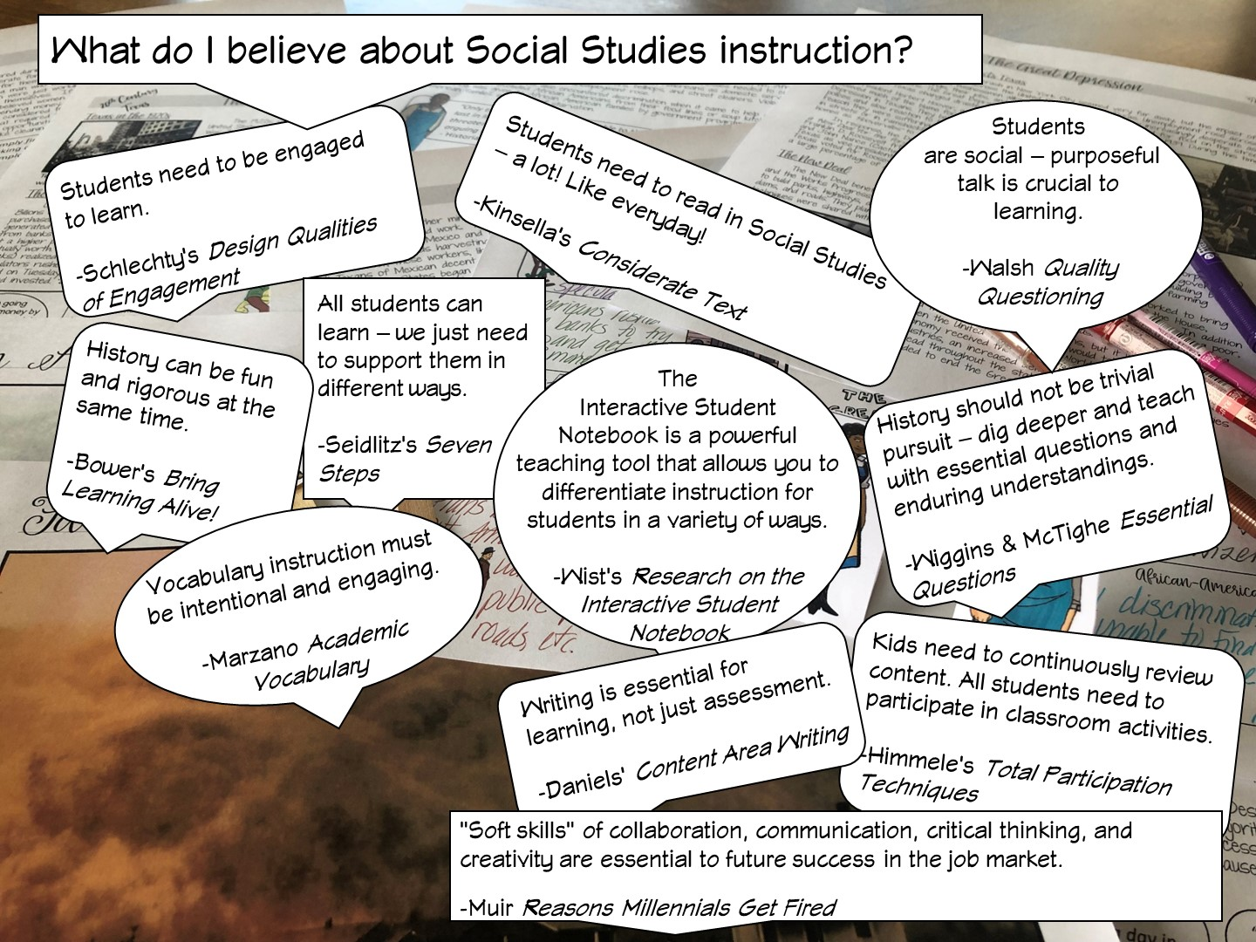

Slide 15
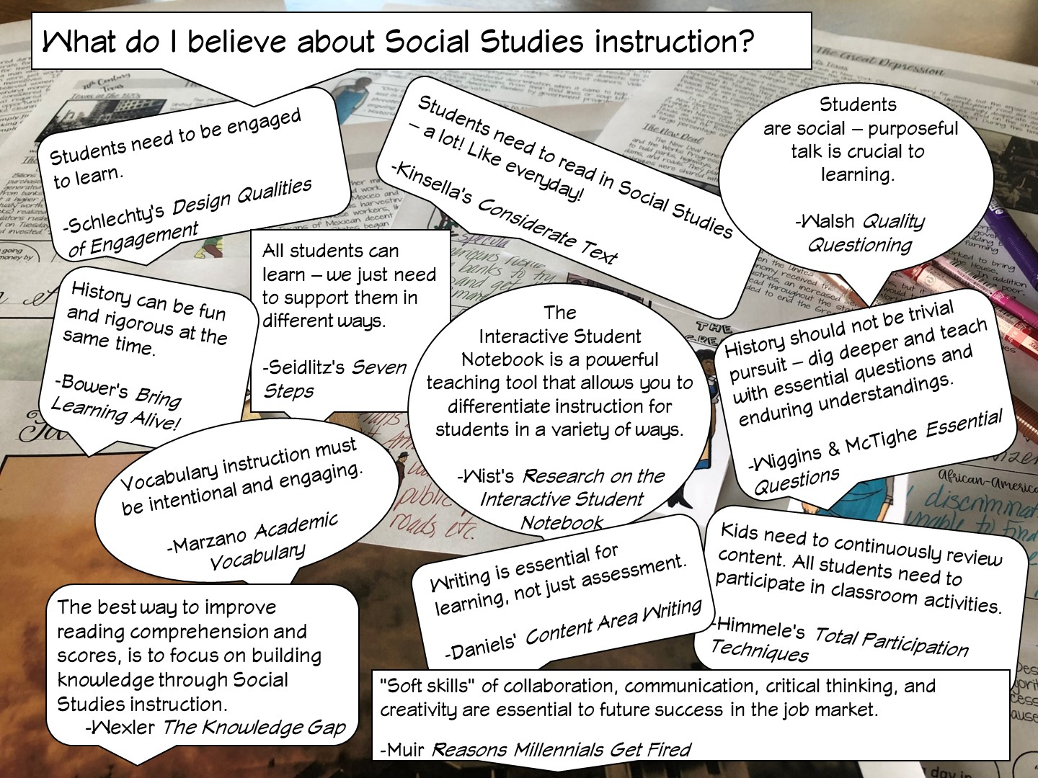
Notes:
After I have reviewed the different research – I ask the teachers, which one they agree with and why – have them talk to their table or partner.

Slide 16

Notes:
History teachers are the guardians of democracy

Slide 17


Slide 18

Notes:
Place the teachers with a partner.

Slide 19

Notes:
You are going to be modeling lessons they would use in the first six weeks of school.

Slide 20
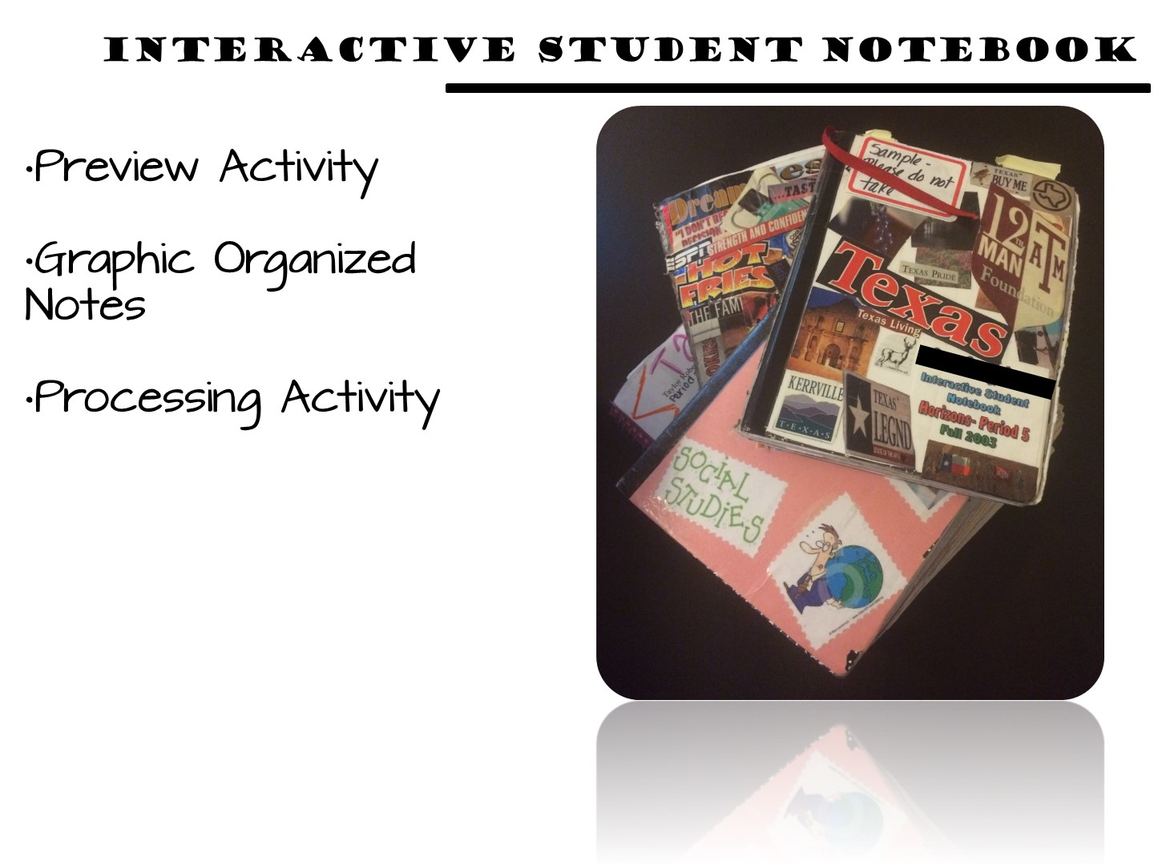
Notes:
All of my resources for Texas History support the Interactive Student Notebook, which is a district initiative for Ysleta ISD. The packet I am going to give you for this activity will simulate an ISN but would actually be put in your students notebook.

Slide 21
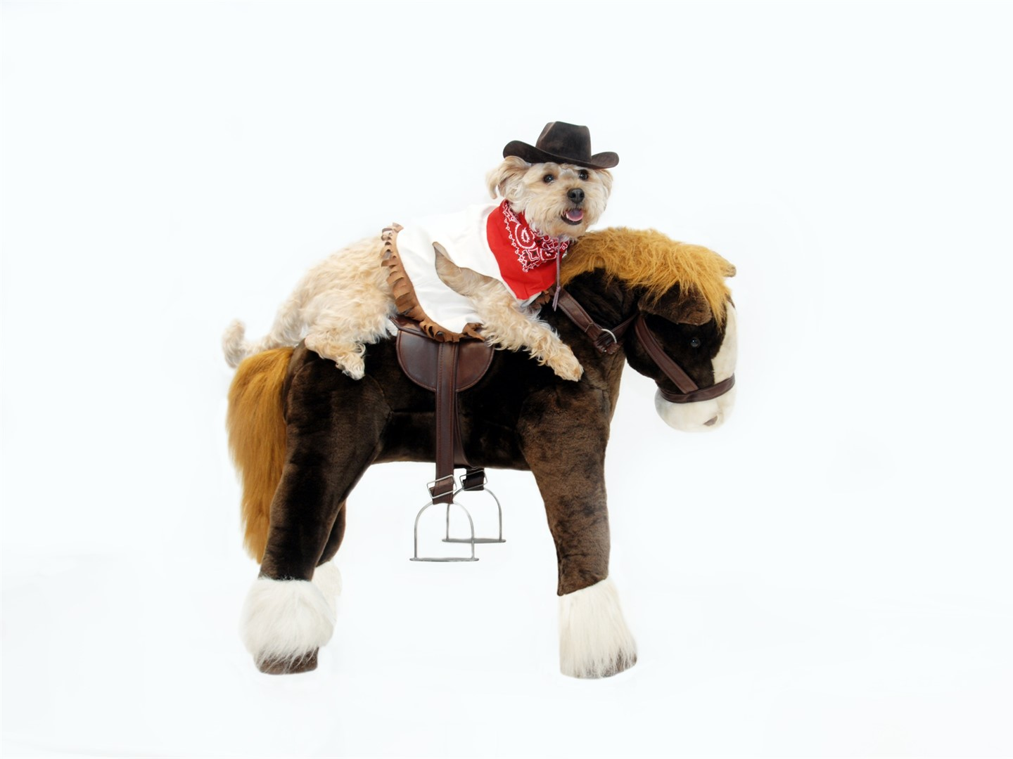
Notes:
This lesson is a dog and pony show as you will be modeling as many different strategies as you can. The lesson in their own classroom will be much simpler.

Slide 22


Slide 23

Notes:
Students use critical-thinking skills and a variety of primary and secondary source material to explain and apply different methods that historians use to understand and interpret the past, including multiple points of view and historical context.

Slide 24

Notes:
Point and pronounce each term.

Slide 25
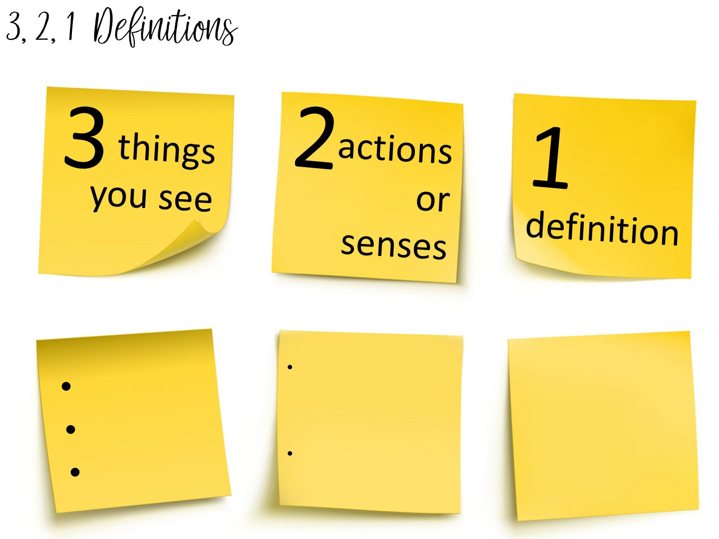
Notes:
You are going to teach vocabulary with images is the 3, 2, 1 Definitions – Allow students time to analyze an image to build their understanding of an image.
Allow them to pick a term with a partner and complete the 3, 2, 1 definition. I always bring the teachers close to word wall to get them out of their seats.

Slide 26

Notes:
Preview the lesson with this question. Do a four-corner activity.

Slide 27

Notes:
Ask teachers to look at each part of the image as you reveal it.

Slide 28
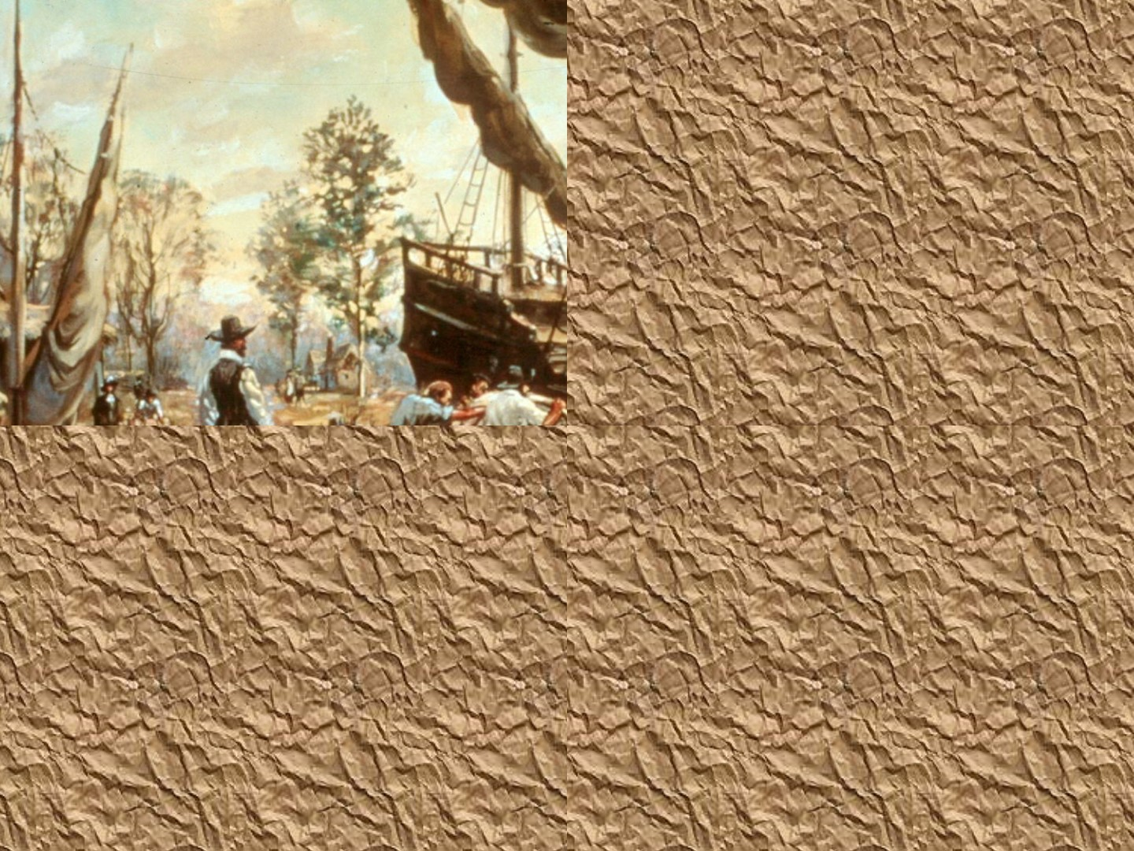

Slide 29
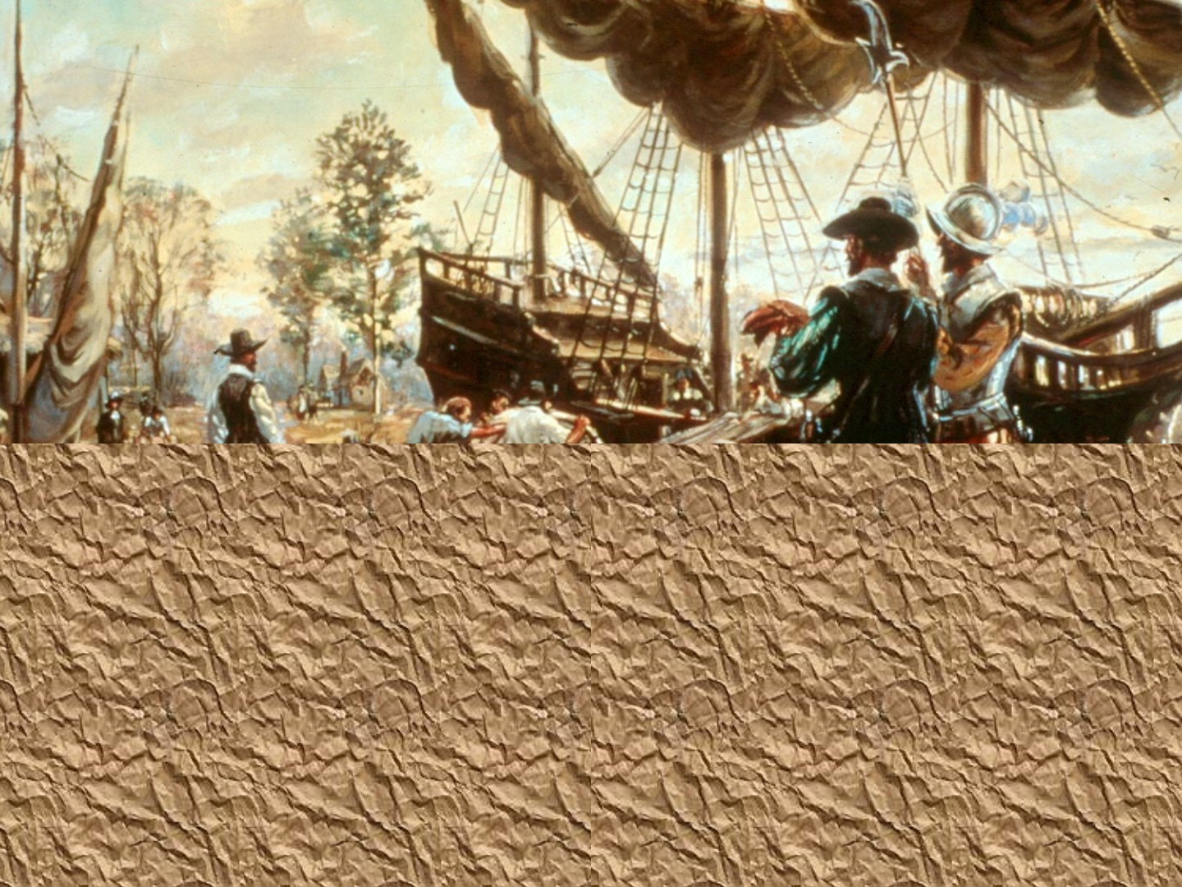

Slide 30
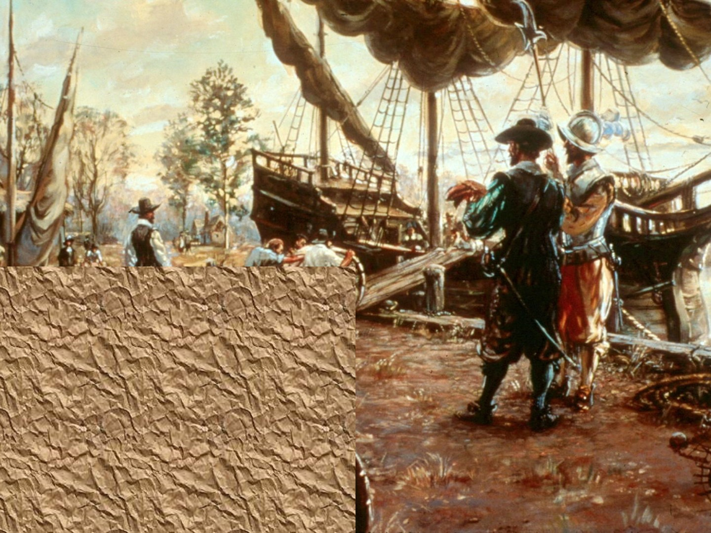

Slide 31
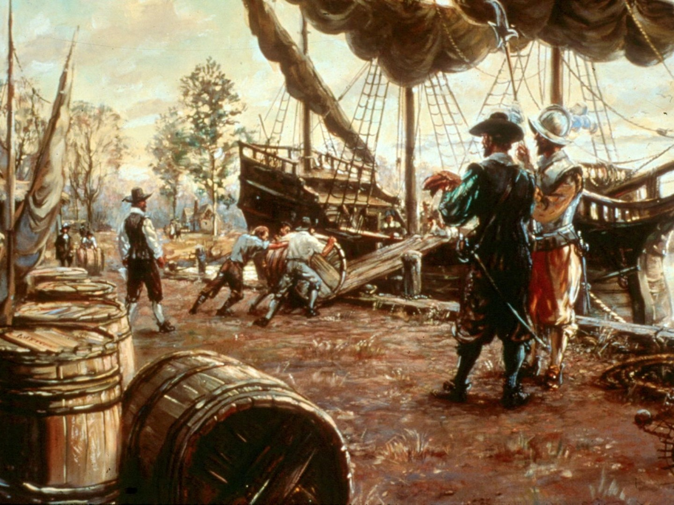

Slide 32
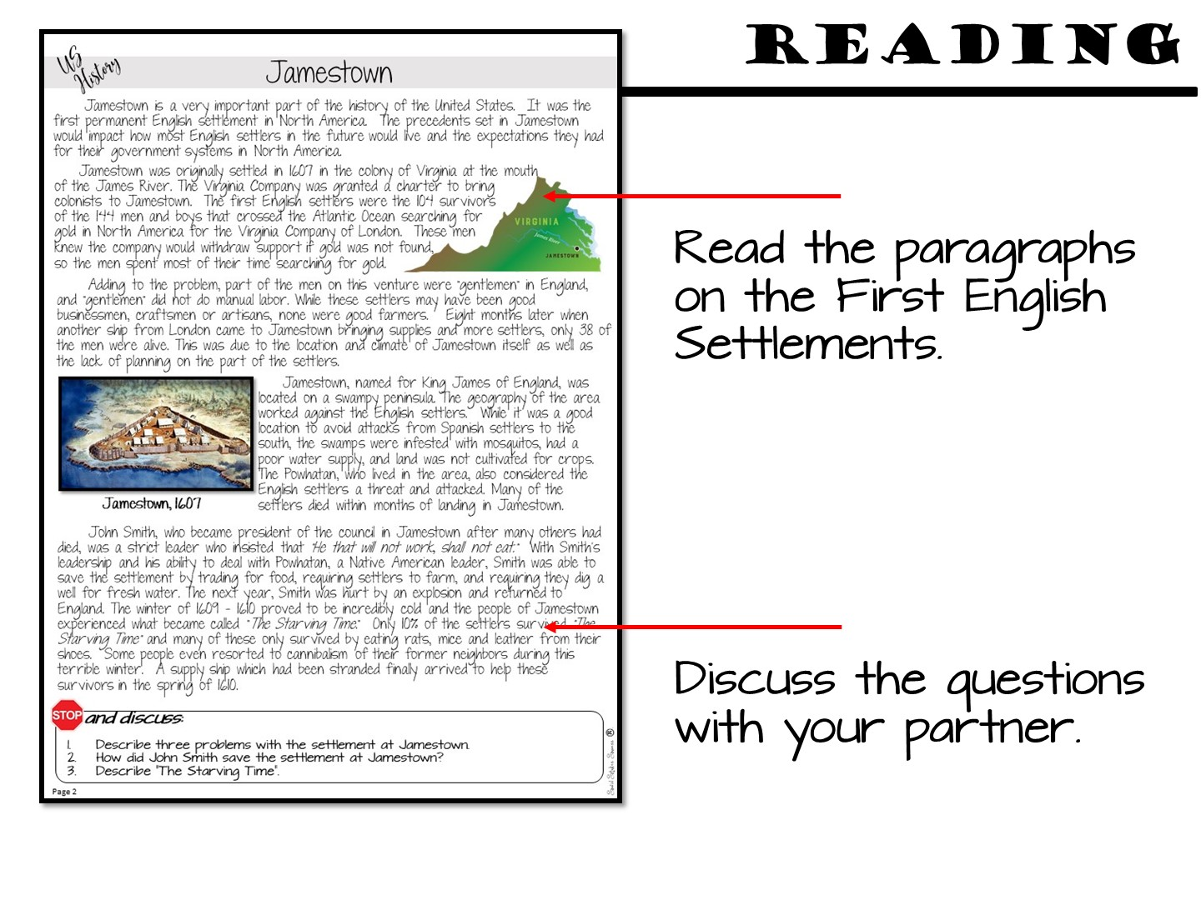

Slide 33
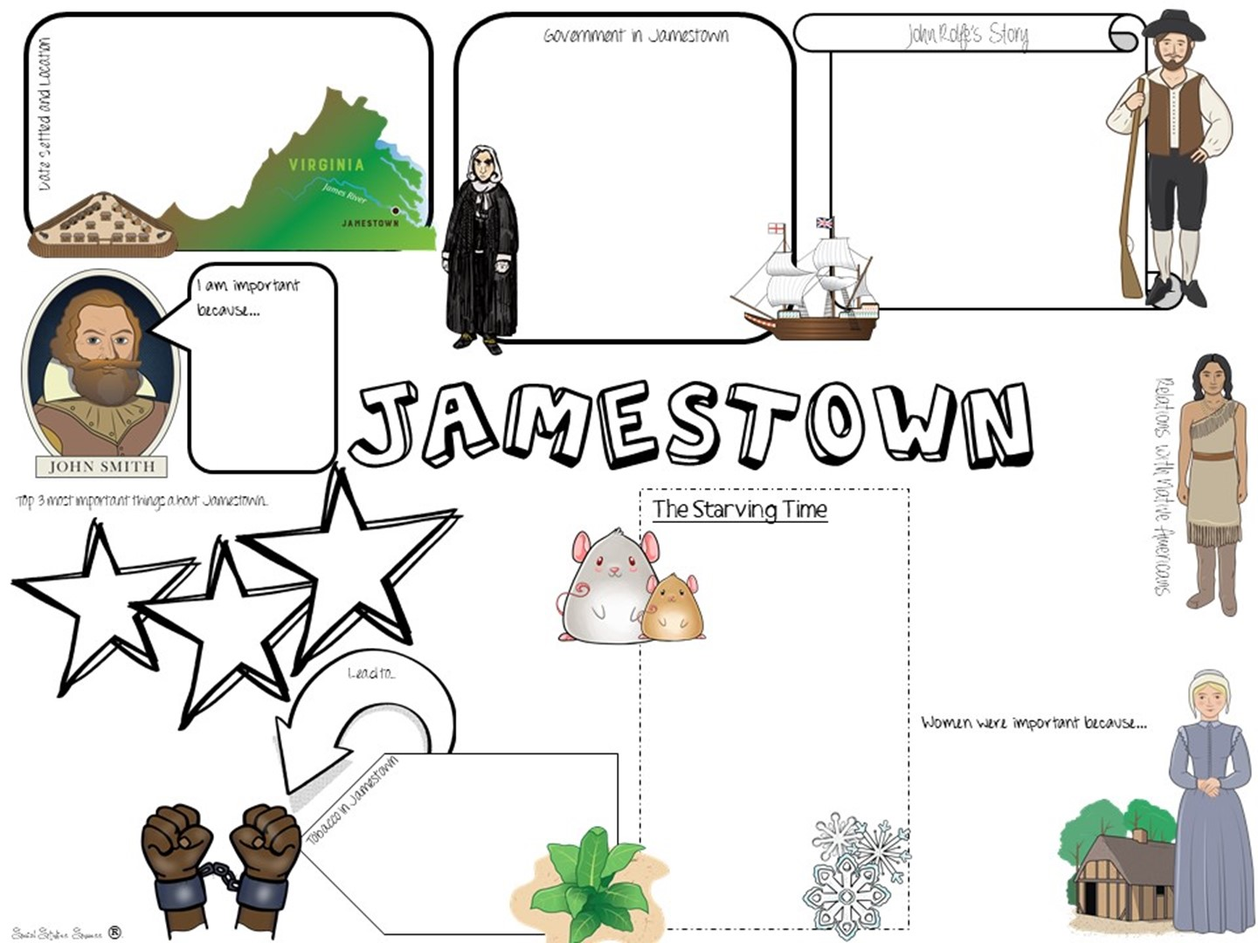
Notes:
Complete their Doodle Notes

Slide 35
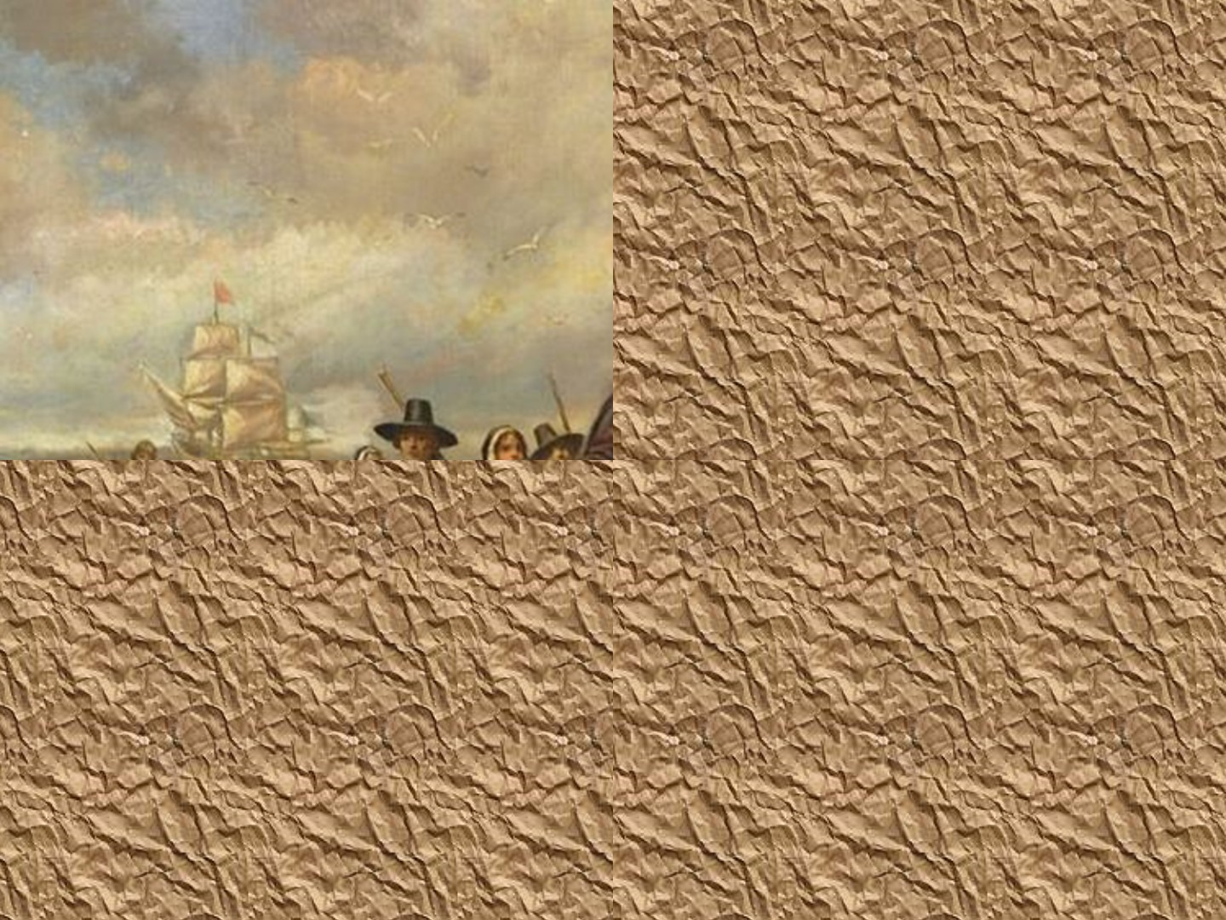

Slide 36
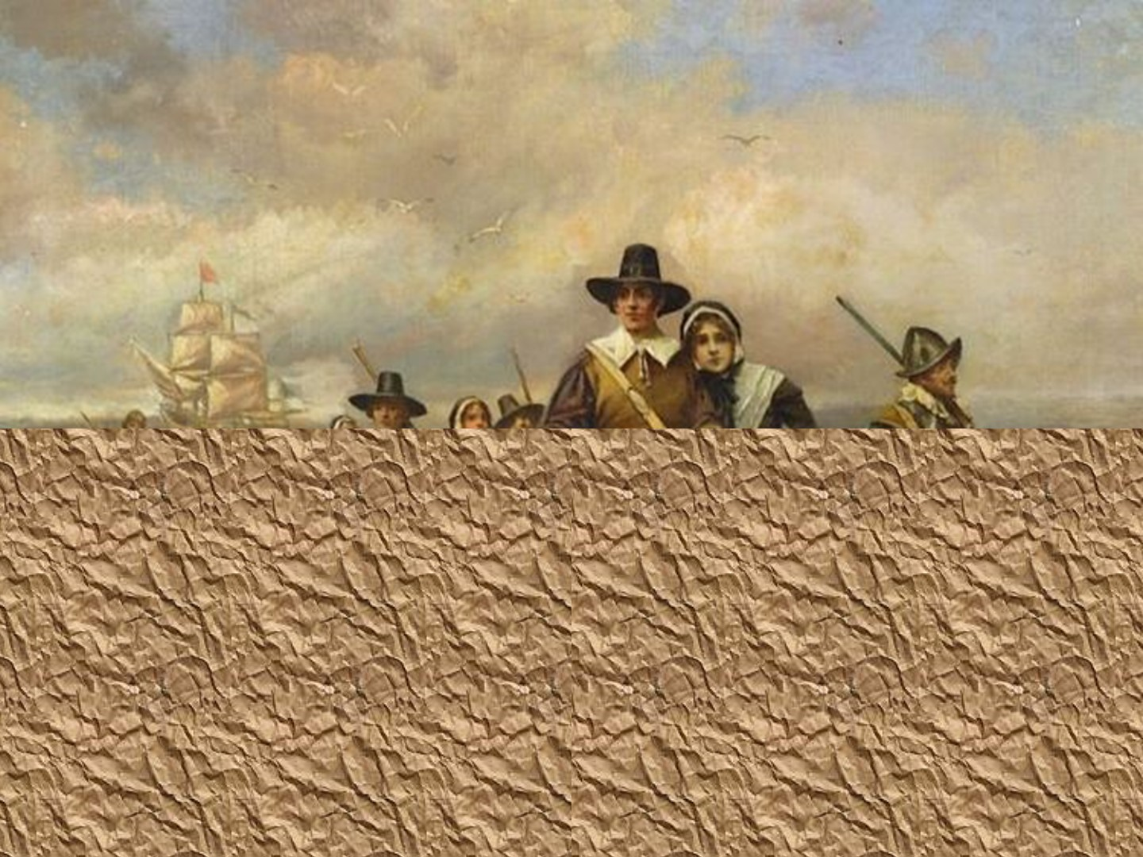

Slide 37
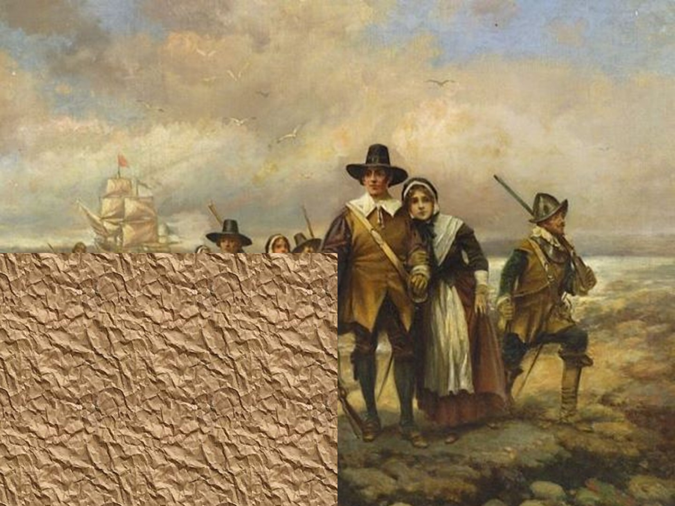

Slide 38
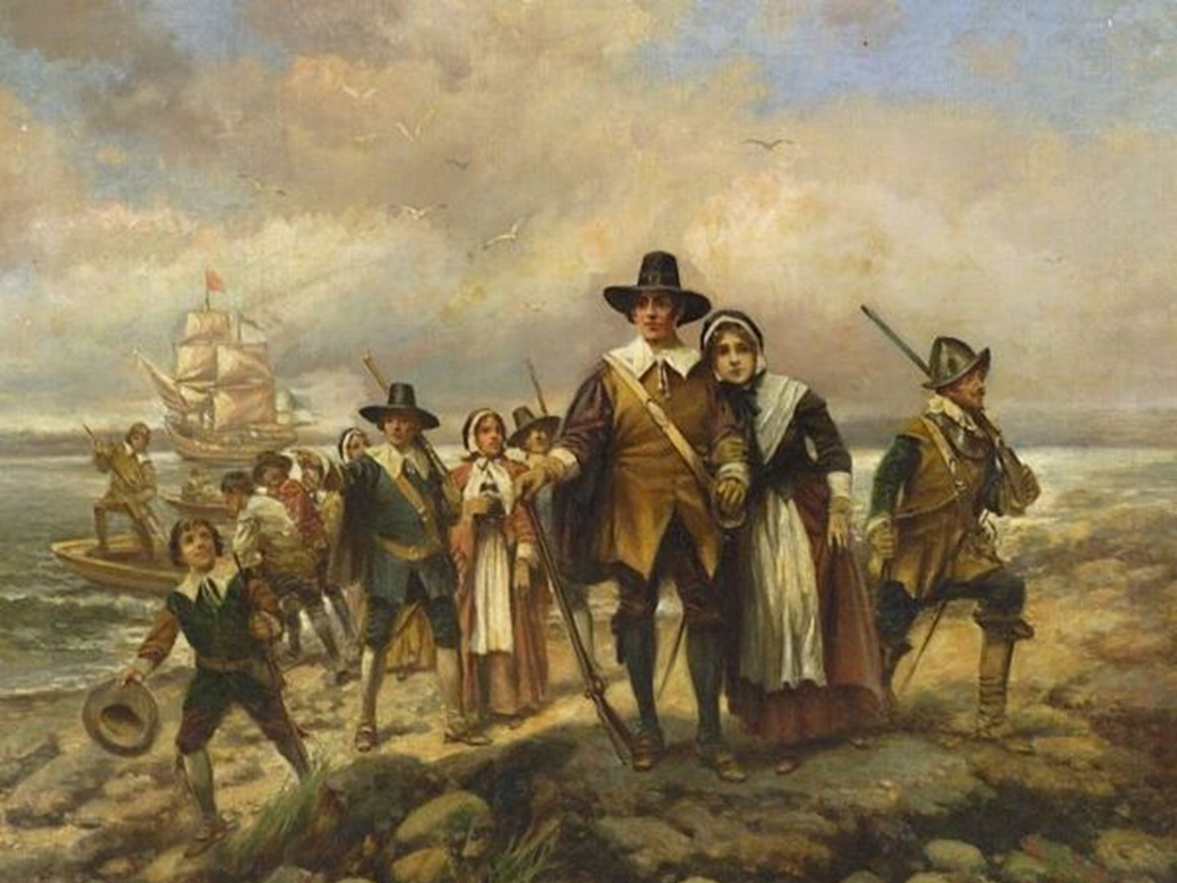

Slide 39
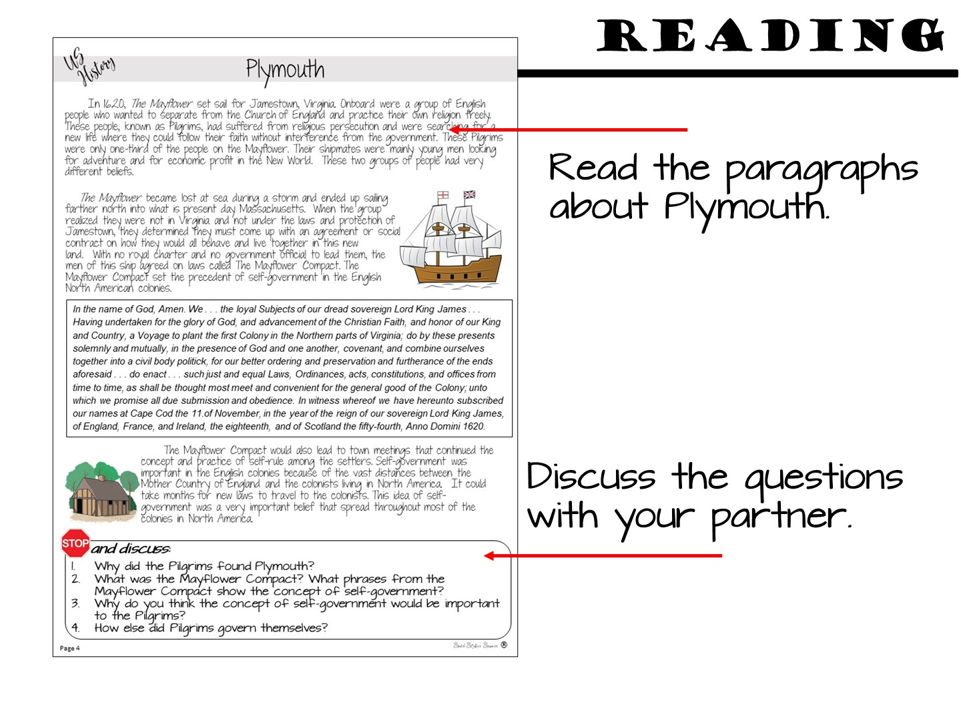

Slide 40
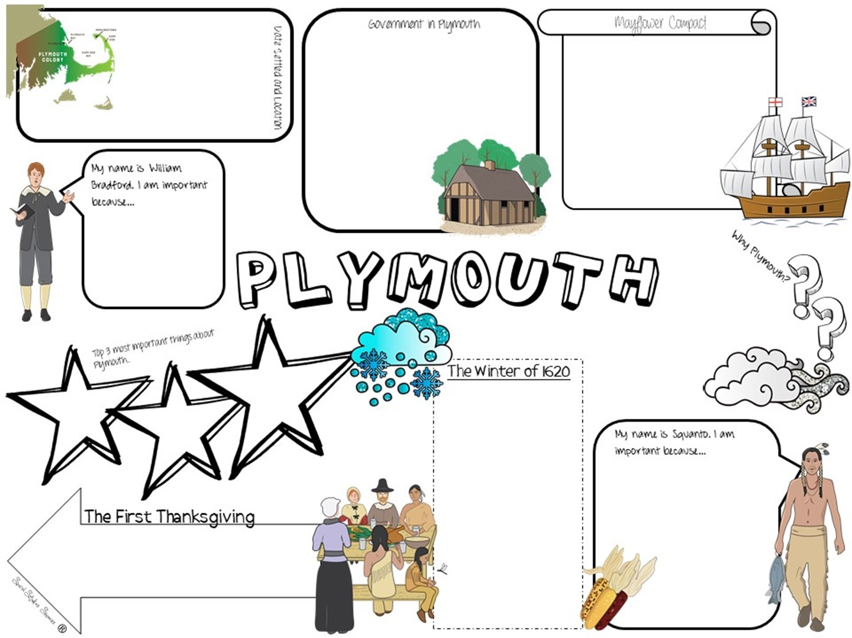

Slide 41
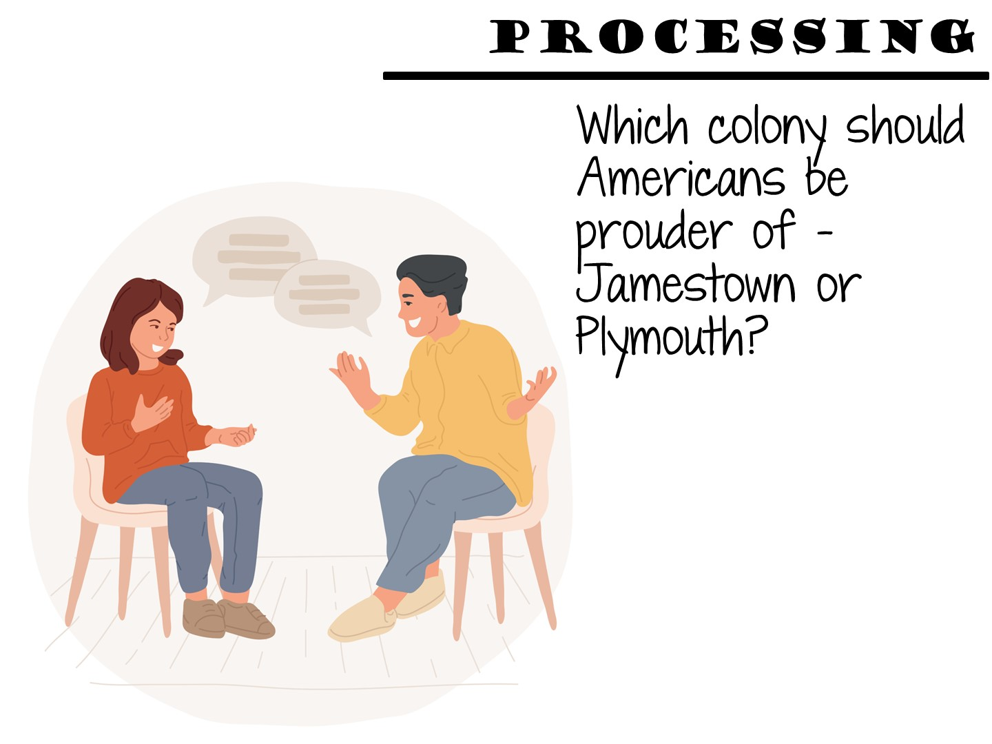
Notes:
Have them discuss with their partner, then “write” in their Interactive Notebook.

Slide 42
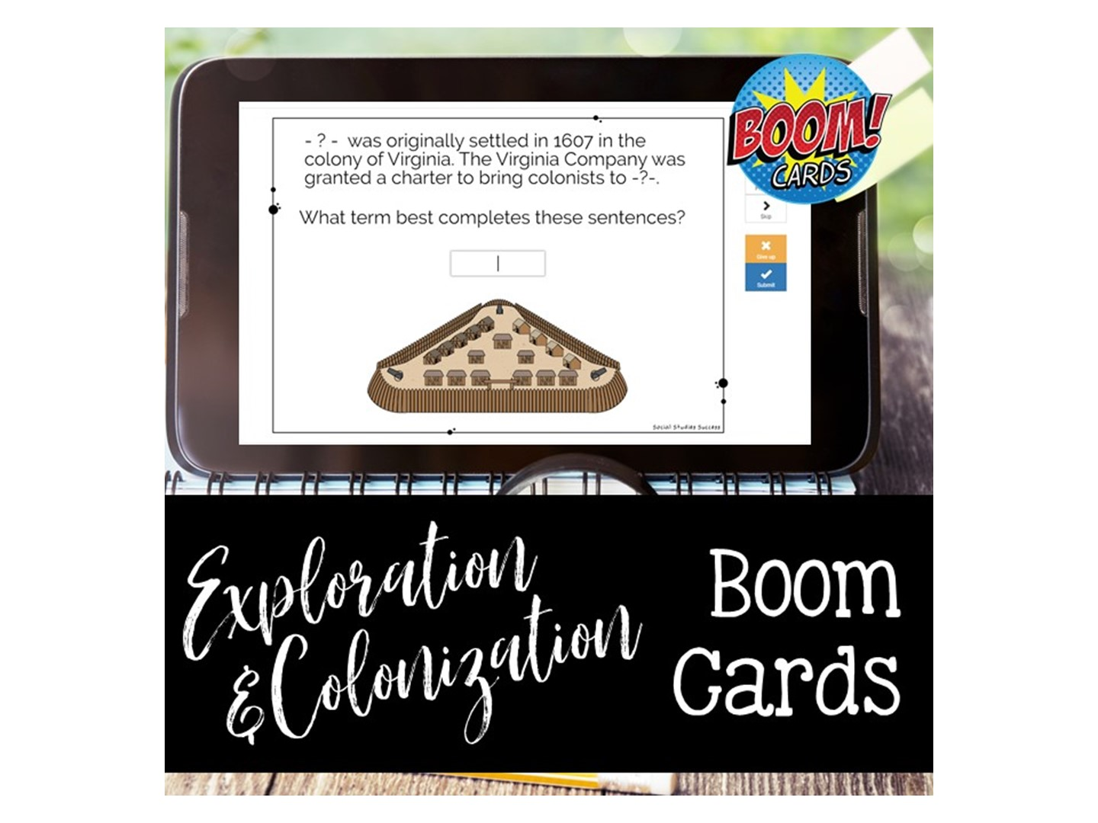
Notes:
You will need to set up a fast pin for this – call me and I will walk you through it.

Slide 43


Slide 44


Slide 45

Welcome to Social Studies Success! Please follow these directions for accessing your new resources. Go to www.SocialStudiesSuccess.com
Notes:
Give them the handout with the directions, tell them to try on their own and contact their coordinator if they can’t get in.

Slide 46
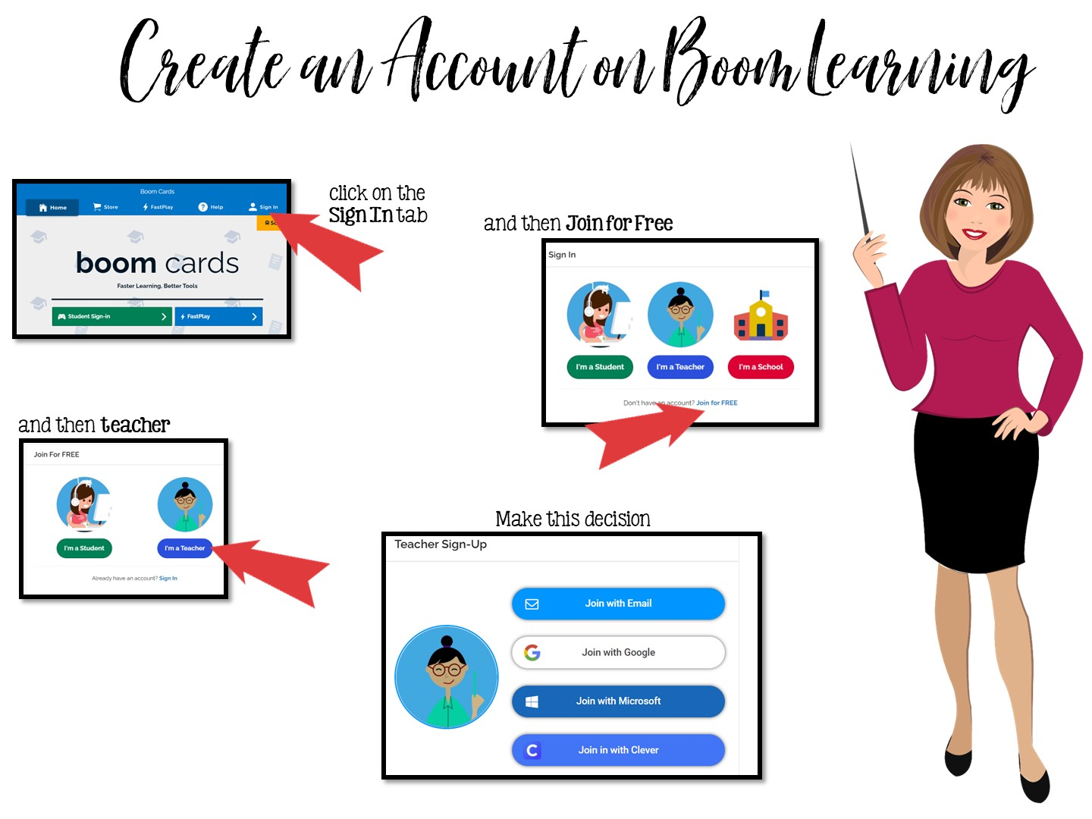
Go to www.boomlearning.com
Notes:
Pass out handout on creating Boom Cards. They need to follow these directions exactly to access their boom cards. Do Not purchase Boom Cards from the Boom Learning site – your district has already purchased them all for you. You must access the games through my website.

Slide 47
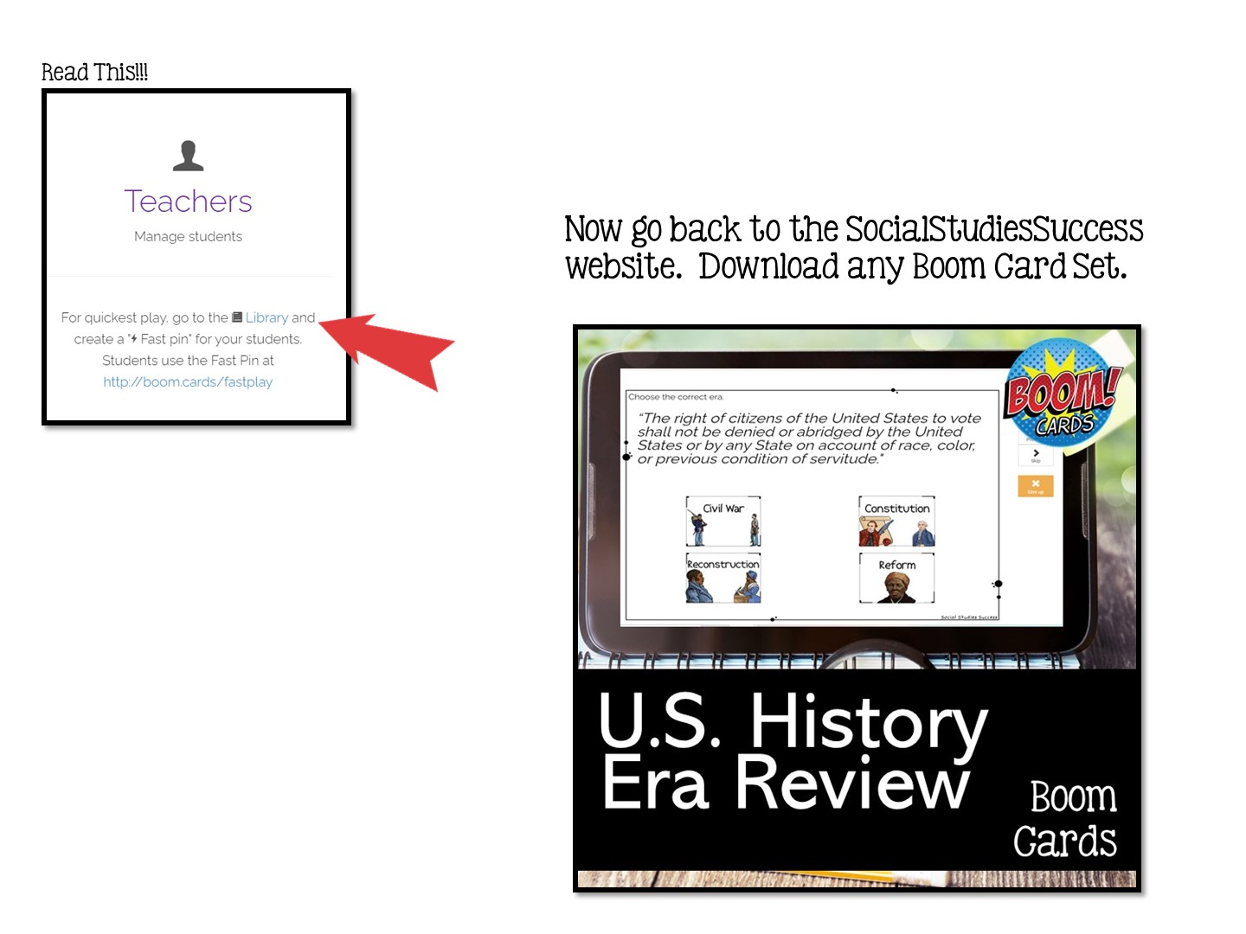

Slide 48


Slide 49
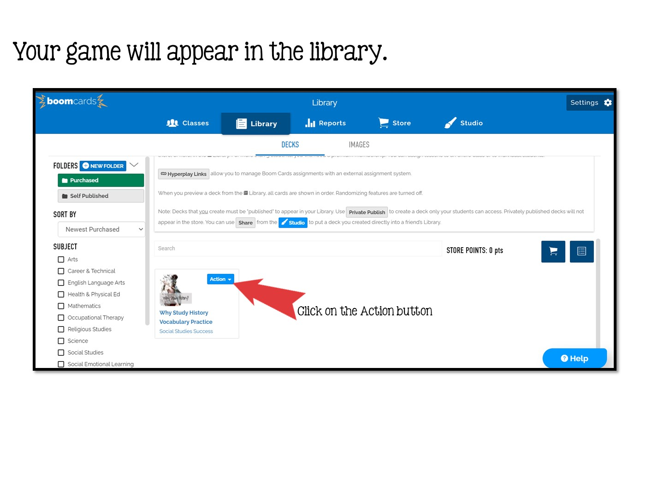

Slide 50
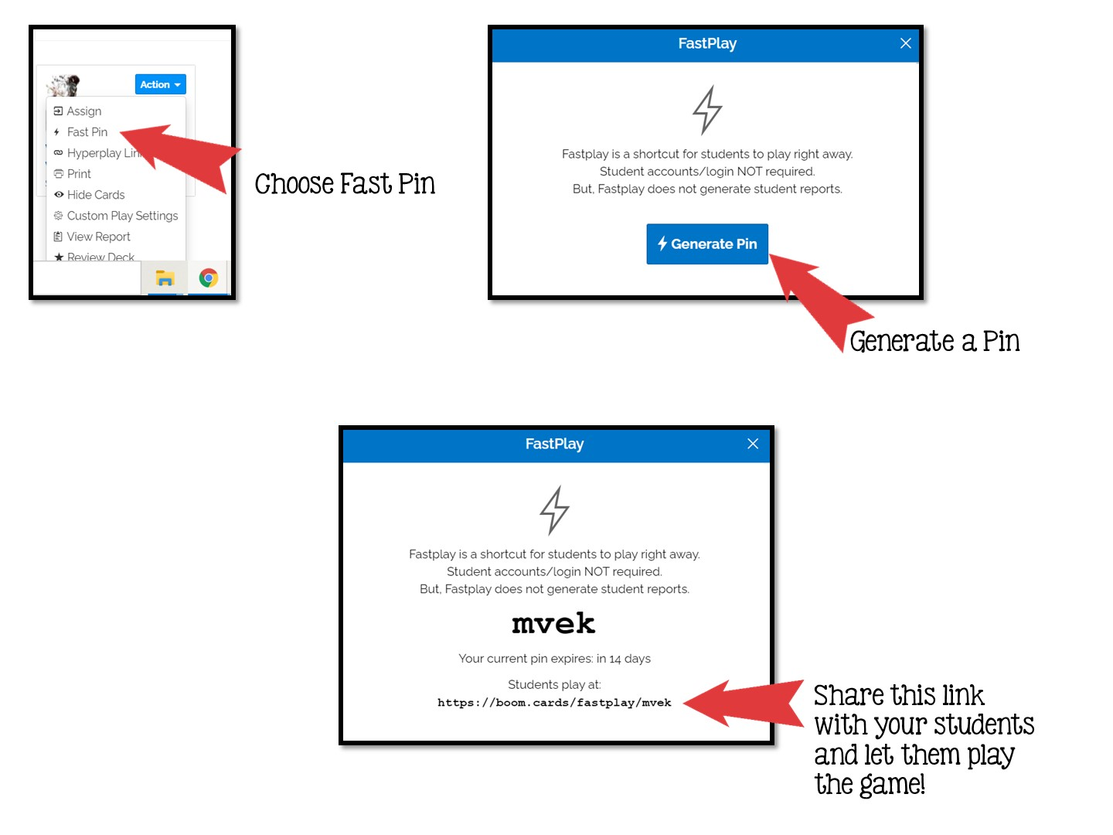

Slide 51


