Slide 1

Understanding the
Interactive
Student Notebook
Kathleen Geraghty,
Social Studies Success

Slide 2



Slide 3

Who am i?
Trainer
Teacher
Mom
Team Lead
Dept
Chair
Wife
Kathleen
Social Studies Success
Notes:
Introduce yourself

Slide 4
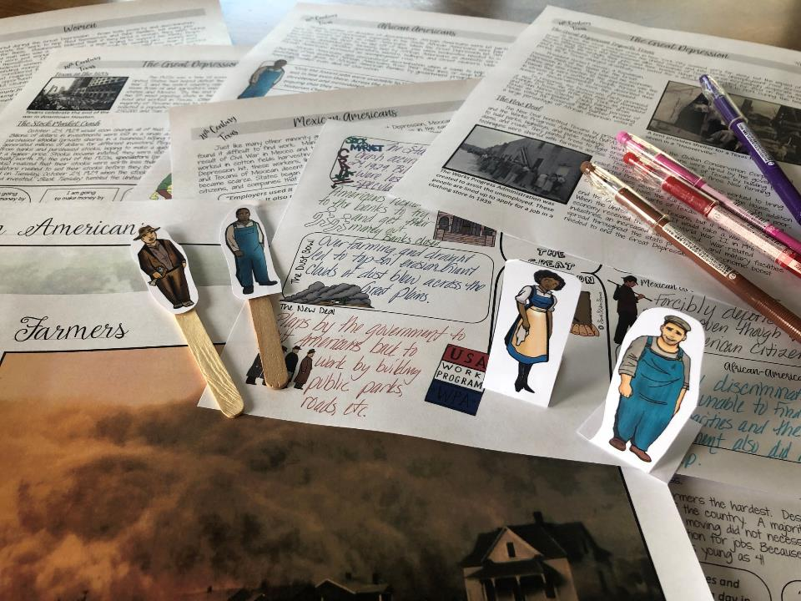
What do I believe about Social Studies instruction?
Students need to be engaged to learn.
-Schlechty’s Design Qualities of Engagement

Slide 5
What do I believe about Social Studies instruction?
Students need to be engaged to learn.
-Schlechty’s Design Qualities of Engagement
Students need to read in Social Studies – a lot! Like everyday!
-Kinsella’s Considerate Text

Slide 6
What do I believe about Social Studies instruction?
Students
are social – purposeful talk is crucial to learning.
-Walsh Quality Questioning
Students need to be engaged to learn.
-Schlechty’s Design Qualities of Engagement
Students need to read in Social Studies – a lot! Like everyday!
-Kinsella’s Considerate Text

Slide 7
What do I believe about Social Studies instruction?
Students
are social – purposeful talk is crucial to learning.
-Walsh Quality Questioning
Students need to be engaged to learn.
-Schlechty’s Design Qualities of Engagement
Students need to read in Social Studies – a lot! Like everyday!
-Kinsella’s Considerate Text
History can be fun and rigorous at the same time.
-Bower’s Bring Learning Alive!
Notes:
.

Slide 8
What do I believe about Social Studies instruction?
Students
are social – purposeful talk is crucial to learning.
-Walsh Quality Questioning
Students need to be engaged to learn.
-Schlechty’s Design Qualities of Engagement
Students need to read in Social Studies – a lot! Like everyday!
-Kinsella’s Considerate Text
All students can learn – we just need to support them in different ways.
-Seidlitz’s Seven Steps
History can be fun and rigorous at the same time.
-Bower’s Bring Learning Alive!

Slide 9
What do I believe about Social Studies instruction?
Students
are social – purposeful talk is crucial to learning.
-Walsh Quality Questioning
Students need to be engaged to learn.
-Schlechty’s Design Qualities of Engagement
Students need to read in Social Studies – a lot! Like everyday!
-Kinsella’s Considerate Text
All students can learn – we just need to support them in different ways.
-Seidlitz’s Seven Steps
The students were able to understand the lessons and the text and pictures for the ELL modified lessons worked great! Thanks for making this! Made my life easier. – Mary
History can be fun and rigorous at the same time.
-Bower’s Bring Learning Alive!
The
Interactive Student
Notebook is a powerful
teaching tool that allows you to differentiate instruction for students in a variety of ways.
-Wist’s Research on the Interactive Student
Notebook
Content-Area Conversations
by Douglas Fisher, Nancy Frey and Carol Rothenberg
Awesome and engaging resource! My students loved it!
Notes:
Differentiated instruction is ensuring that learning happens in an accessible way for the student. ISNs allow the students to format their thoughts however they find suitable, thus, differentiating by learning styles — someone who loves writing can love in the notebooks, another student who would rather draw is free to express his/her ideas through diagrams, charts and pictures.

Slide 10
What do I believe about Social Studies instruction?
Students
are social – purposeful talk is crucial to learning.
-Walsh Quality Questioning
Students need to be engaged to learn.
-Schlechty’s Design Qualities of Engagement
Students need to read in Social Studies – a lot! Like everyday!
-Kinsella’s Considerate Text
All students can learn – we just need to support them in different ways.
-Seidlitz’s Seven Steps
History can be fun and rigorous at the same time.
-Bower’s Bring Learning Alive!
The
Interactive Student
Notebook is a powerful
teaching tool that allows you to differentiate instruction for students in a variety of ways.
-Wist’s Research on the Interactive Student
Notebook
History should not be trivial pursuit – dig deeper and teach with essential questions and enduring understandings.
-Wiggins & McTighe Essential Questions

Slide 11
What do I believe about Social Studies instruction?
Students
are social – purposeful talk is crucial to learning.
-Walsh Quality Questioning
Students need to be engaged to learn.
-Schlechty’s Design Qualities of Engagement
Students need to read in Social Studies – a lot! Like everyday!
-Kinsella’s Considerate Text
All students can learn – we just need to support them in different ways.
-Seidlitz’s Seven Steps
History can be fun and rigorous at the same time.
-Bower’s Bring Learning Alive!
The
Interactive Student
Notebook is a powerful
teaching tool that allows you to differentiate instruction for students in a variety of ways.
-Wist’s Research on the Interactive Student
Notebook
History should not be trivial pursuit – dig deeper and teach with essential questions and enduring understandings.
-Wiggins & McTighe Essential Questions
Vocabulary instruction must be intentional and engaging.
-Marzano Academic Vocabulary

Slide 12
What do I believe about Social Studies instruction?
Students
are social – purposeful talk is crucial to learning.
-Walsh Quality Questioning
Students need to be engaged to learn.
-Schlechty’s Design Qualities of Engagement
Students need to read in Social Studies – a lot! Like everyday!
-Kinsella’s Considerate Text
All students can learn – we just need to support them in different ways.
-Seidlitz’s Seven Steps
History can be fun and rigorous at the same time.
-Bower’s Bring Learning Alive!
The
Interactive Student
Notebook is a powerful
teaching tool that allows you to differentiate instruction for students in a variety of ways.
-Wist’s Research on the Interactive Student
Notebook
History should not be trivial pursuit – dig deeper and teach with essential questions and enduring understandings.
-Wiggins & McTighe Essential Questions
Vocabulary instruction must be intentional and engaging.
-Marzano Academic Vocabulary
Writing is essential for learning, not just assessment.
-Daniels’ Content Area Writing

Slide 13
What do I believe about Social Studies instruction?
Students
are social – purposeful talk is crucial to learning.
-Walsh Quality Questioning
Students need to be engaged to learn.
-Schlechty’s Design Qualities of Engagement
Students need to read in Social Studies – a lot! Like everyday!
-Kinsella’s Considerate Text
All students can learn – we just need to support them in different ways.
-Seidlitz’s Seven Steps
History can be fun and rigorous at the same time.
-Bower’s Bring Learning Alive!
The
Interactive Student
Notebook is a powerful
teaching tool that allows you to differentiate instruction for students in a variety of ways.
-Wist’s Research on the Interactive Student
Notebook
History should not be trivial pursuit – dig deeper and teach with essential questions and enduring understandings.
-Wiggins & McTighe Essential Questions
Vocabulary instruction must be intentional and engaging.
-Marzano Academic Vocabulary
Writing is essential for learning, not just assessment.
-Daniels’ Content Area Writing
Kids need to continuously review content. All students need to participate in classroom activities.
-Himmele’s Total Participation Techniques

Slide 14
What do I believe about Social Studies instruction?
Students
are social – purposeful talk is crucial to learning.
-Walsh Quality Questioning
Students need to be engaged to learn.
-Schlechty’s Design Qualities of Engagement
Students need to read in Social Studies – a lot! Like everyday!
-Kinsella’s Considerate Text
All students can learn – we just need to support them in different ways.
-Seidlitz’s Seven Steps
History can be fun and rigorous at the same time.
-Bower’s Bring Learning Alive!
The
Interactive Student
Notebook is a powerful
teaching tool that allows you to differentiate instruction for students in a variety of ways.
-Wist’s Research on the Interactive Student
Notebook
History should not be trivial pursuit – dig deeper and teach with essential questions and enduring understandings.
-Wiggins & McTighe Essential Questions
Vocabulary instruction must be intentional and engaging.
-Marzano Academic Vocabulary
Writing is essential for learning, not just assessment.
-Daniels’ Content Area Writing
Kids need to continuously review content. All students need to participate in classroom activities.
-Himmele’s Total Participation Techniques
“Soft skills” of collaboration, communication, critical thinking, and creativity are essential to future success in the job market.
-Muir Reasons Millennials Get Fired

Slide 15
What do I believe about Social Studies instruction?
Students
are social – purposeful talk is crucial to learning.
-Walsh Quality Questioning
Students need to be engaged to learn.
-Schlechty’s Design Qualities of Engagement
Students need to read in Social Studies – a lot! Like everyday!
-Kinsella’s Considerate Text
All students can learn – we just need to support them in different ways.
-Seidlitz’s Seven Steps
History can be fun and rigorous at the same time.
-Bower’s Bring Learning Alive!
The
Interactive Student
Notebook is a powerful
teaching tool that allows you to differentiate instruction for students in a variety of ways.
-Wist’s Research on the Interactive Student
Notebook
History should not be trivial pursuit – dig deeper and teach with essential questions and enduring understandings.
-Wiggins & McTighe Essential Questions
Vocabulary instruction must be intentional and engaging.
-Marzano Academic Vocabulary
Writing is essential for learning, not just assessment.
-Daniels’ Content Area Writing
Kids need to continuously review content. All students need to participate in classroom activities.
-Himmele’s Total Participation Techniques
The best way to improve reading comprehension and scores, is to focus on building knowledge through Social Studies instruction.
-Wexler The Knowledge Gap
“Soft skills” of collaboration, communication, critical thinking, and creativity are essential to future success in the job market.
-Muir Reasons Millennials Get Fired

Slide 16

History Teachers
are the
Guardians
Democracy!
of

Slide 17

Goals
What
are your
for this session?
goals
Notes:
Have teachers discuss

Slide 18

Examine different types of notebooks.
Learn what makes an Interactive Student Notebook.
Problem solve issues with the notebook.

Slide 19

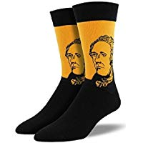
Notes:
I share my rule of the socks:
They have never been on my feet
They are not a souvenir of the workshop
Put your cellphones away in the sock (model with your own)

Slide 20
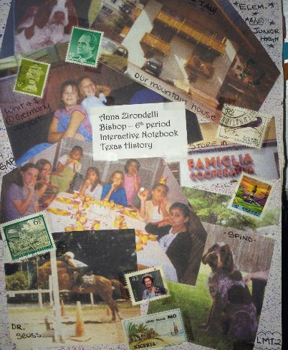
Set up your ISN
Cover Page
Title of session
Grade you teach
Goal for today
Notes:
If you provide teachers notebooks, use the next two slides. If not, delete.

Slide 21
Table of Contents
Page # Activity
1 Why Study History
Notes:
21
If you want to use a TOC

Slide 22

Why Study History?
Notes:
This is a great lesson for the beginning of the year! Use within the first week if possible.
Let them know they all have a subscription to Social Studies Success and to reach out to me via the website if they do not yet have access.

Slide 23

Notes:
This lesson is a dog and pony show as you will be modeling as many different strategies as you can. The lesson in their own classroom will be much simpler.

Slide 24

Objectives
Content Objective: Students will use critical-thinking skills and a variety of primary and secondary sources to explain and apply different methods that historians use to understand and
interpret the past, including multiple
points of view and historical content.
Language Objective: Students will be
able to use new vocabulary focusing
on historical skills.
Notes:
Just read

Slide 25




clue
Making generalizations and predictions
Using information to create a conclusion that is true most of the time. Using details found in the text to support what will happen next.
Similarity
clue
clue
clue
Difference
Difference
Detail
Detail
Detail
Detail
Detail
Generalization or
Prediction
_____ and _____ lead me to believe _____.
Because_____ I can predict that _____.
Social
Studies
Success
Notes:
Just read – this is the skill the students will be using in the lesson.

Slide 26

Why do we study history in school?
Social Studies Success
Notes:
This is the essential question

Slide 27
Preview
Which of these sentences do you agree with the most? Why?
Studying history teaches that people change and still always stay the same.
History helps us understand the way we live now.
History teaches us that actions have consequences.
History teaches you to ask questions and challenge ideas.
Social Studies Success
Notes:
This is the preview question – have them put into their ISN.

Slide 28

Vocabulary Terms
evidence
artifact
bias
primary source
secondary source
point of view
chronology
era
Notes:
These are the vocabulary terms we are going to learn

Slide 29

Why Study History?
Predict This
Use the vocabulary word wall as your word bank. Choose the word that you think matches that definition. Once you learn the vocabulary, come back and see if your prediction was correct or not.
Which word means… | Word Guessed | Clues You Used
A human made object.
A way of looking at something, may be shaped by many things, such as the person’s age, religion, job, or political views.
The sequence of events in time.
Information that can be used to prove a statement or support a conclusion.
A document or other record of past events created by people who were present at that time.
Anything that might change a person’s observations. It can make a source less than trustworthy.
Information written after the time period by an expert or historian.
A long and distinct period of history with a particular feature of characteristic.
Social Studies Success ®.
Notes:
Pass out Predict This
Give each teacher one of these and place them with a partner. Have them all come up to the word wall and discuss with their partner to see what they think the correct answer is.

Slide 30

Notes:
Use the following slides to debrief the answers

Slide 31


Slide 32


Slide 33


Slide 34


Slide 35


Slide 36
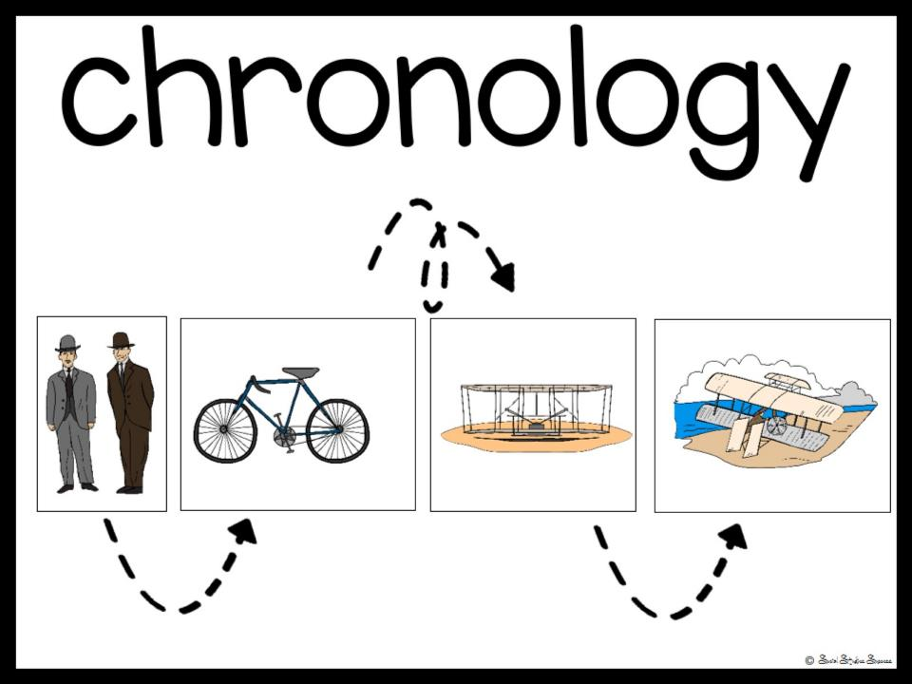

Slide 37
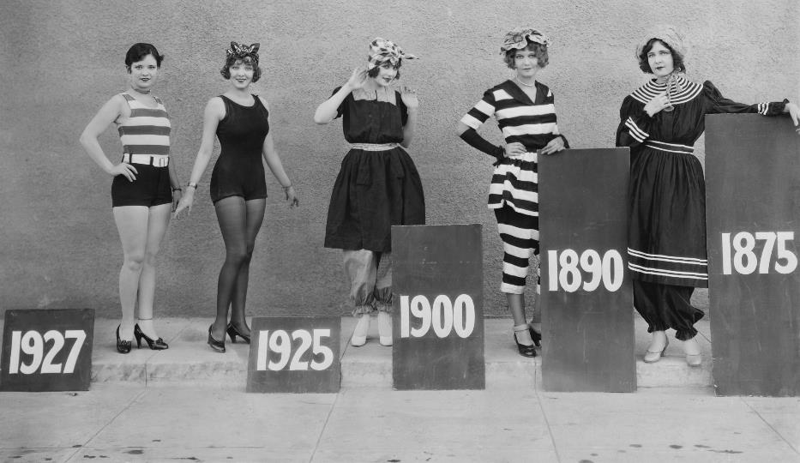

era
Social Studies Success

Slide 38
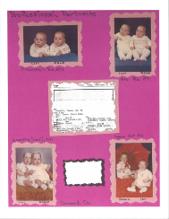

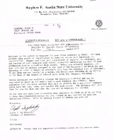

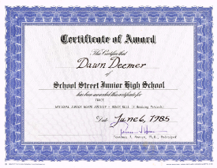
Artifact Study
What facts can you tell about this person?
What inferences can you make from the facts?
What is important to this person? How do you know?
Do you see any patterns in their life?
How are you similar to this person? Different?
Notes:
Now pass out your own artifacts in an envelope. In their groups, have them examine the artifacts to see if they can answer any of thee questions.

Slide 39
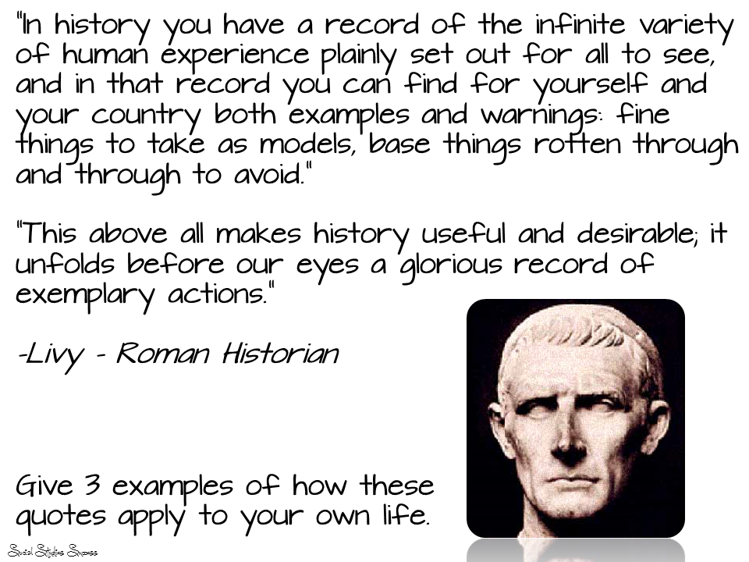
What part of this quote do you think is the most important?
Notes:
You can discuss or have them add to their ISN under the other preview.

Slide 40
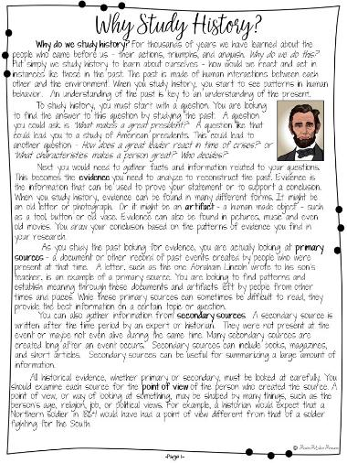
Why study history?
Read
the handout, then highlight the one most important sentence on the page. Be prepared to share.
Notes:
Pass out the first page of the reading. Follow the directions on the slide.

Slide 41
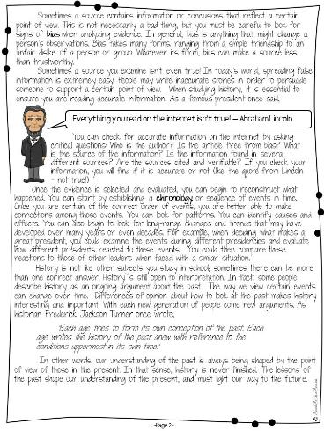
Why study history?
Read
the handout, then highlight the one most important sentence on the page. Be prepared to share.
Social Studies Success

Slide 42
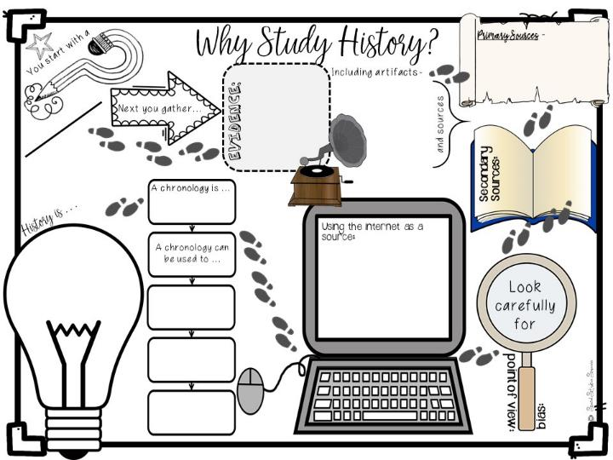
Why study history?
Complete the Doodle Notes.
Social Studies Success
Notes:
Pass out Doodle Notes and just do for about 5 minutes. Glue into ISN

Slide 43
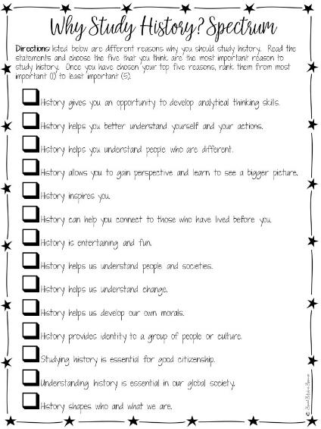
Why study history?
Rank and Write
the top 3 reasons and write them in your ISN. Write an explanation why you choose those answers.
Notes:
Pass out spectrum and have them read and discuss. Write their top 3 responses into their interactive student notebook with an explanation.

Slide 44

How did I incorporate the ISN into the lesson?

Slide 45

What
Questions
have I created?

Slide 46

Reflection
Notes:
Give them 5 minutes to write down reflections on their Doodle Notes.

Slide 47

Break Time!

Slide 48

Create Groups of Three

Slide 49

Understanding
the
Interactive Student
Notebook

Slide 50

How well do you know / use the Interactive Student Notebook?
Notes:
Have them respond 1-Don’t know anything, 5 – close to an expert

Slide 51


Structure
Style
Notes:
We are going to look at what makes an ISN – Structure
and how we can personalize it in our classroom - Style

Slide 52

Structure

Slide 53
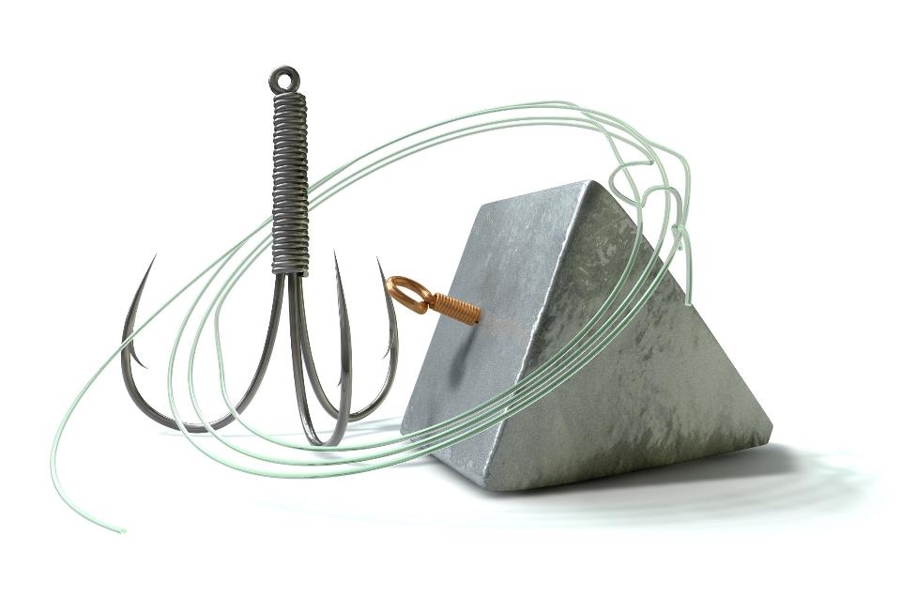
Hook, Line and Sinker
Notes:
This is the analogy we use for the ISN.

Slide 54

Use preview activities to prepare students for learning.
Activities
Preview
Tap into existing schema
Establish a purpose for the lesson
Prepares the brain to acquire new knowledge
Assess prior knowledge
Hook

Slide 55

Anticipation Guide
Identify the major concepts or big ideas you want students to learn.
Create four to six statements that support or challenge students' beliefs.
Ask students to agree or disagree with the statements and to be prepared to defend their opinions.
Conduct a class discussion.
Have students read to find evidence to support or disprove their responses.
After reading, students confirm or revise their responses.

Slide 56
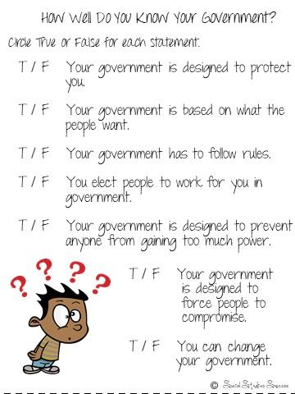
Anticipation Guide
Notes:
Sample for the 7 Principles of Government

Slide 57
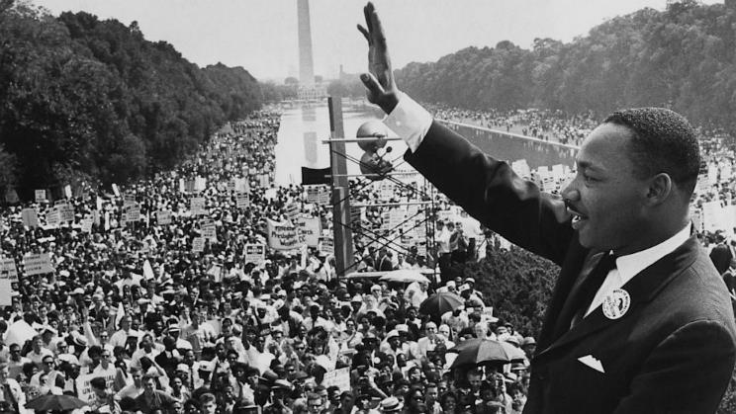
Visual Discovery
Select key images that tell a story.
Ask student spiral questions that pull them into the image.
Challenge your students to read more about the topic.

Slide 58
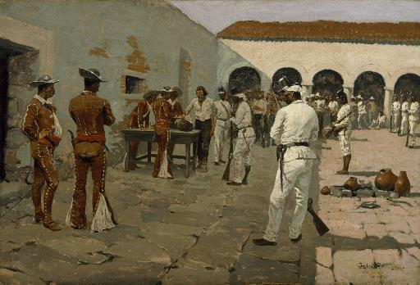
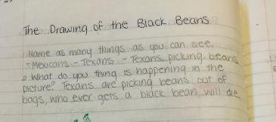
Visual Discovery
Notes:
Example for Texas History

Slide 59
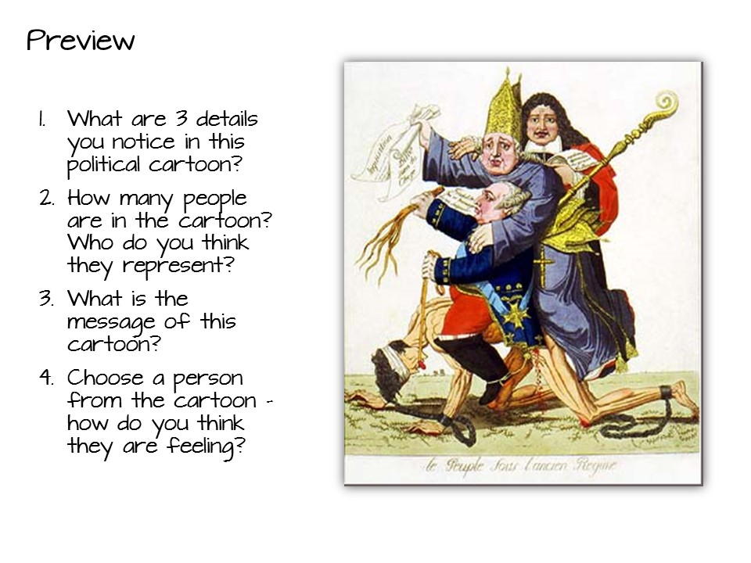
Visual Discovery
Notes:
Example for World History

Slide 60
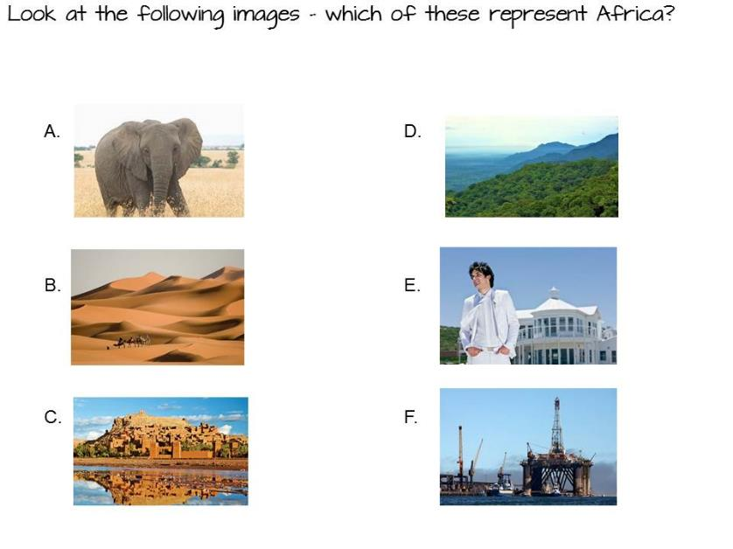
Comparison
Notes:
Example for Geography

Slide 61
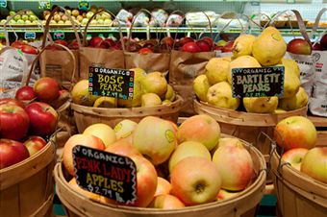


Relevant Example
You have the following items on your grocery list: apples, carrots, bread, milk, fish, steak, trash bags, chips, butter, cheese and paper towels.
You need to get in and out of the store as soon as possible.
How do you group these items to speed up your task?
Why did you group them the way they did?
Notes:
Geography

Slide 62


Preview Activities
Examine the preview strategies in the Social Studies Strategies for Success manual.
Choose one to read in depth – make sure everyone has a different strategy.
Discuss with your group which strategy you would use and why.
7 minutes
Notes:
Place teachers into a small group. Pass out the literacy strategy manual and conduct this activity. They can be found by looking at the table of contents.

Slide 63

What preview strategy are you most likely to use and why?
Notes:
Debrief after chalk talk

Slide 64
vs.
Taking Notes
Make Thinking Visible
Making Notes
Use graphic organizers to help students construct meaning as they read.
Create a visual summary of the content
Embed processing standards
Line

Slide 65
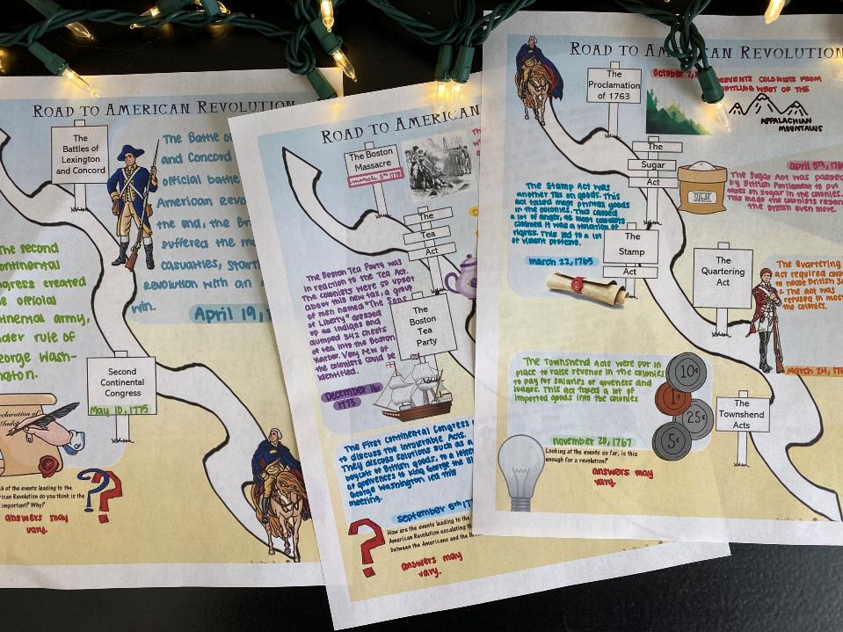
Graphic Organizers
Notes:
Graphic Organizers come in a variety of forms.

Slide 66
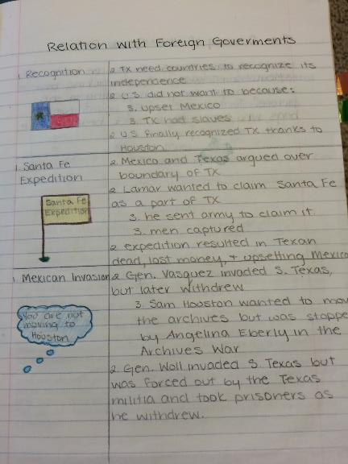
2 column Notes
Notes:
Other types of Graphic Notes include 2 –Column notes, with the topic and a summary.

Slide 67
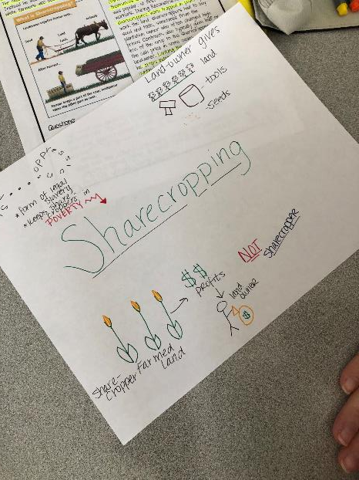
sketch Notes
Notes:
Sketch notes are created by students while they are reading.

Slide 68
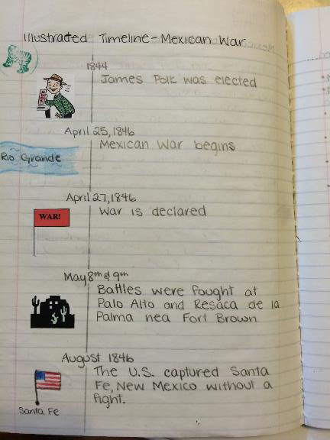
Illustrated timeline

Slide 69
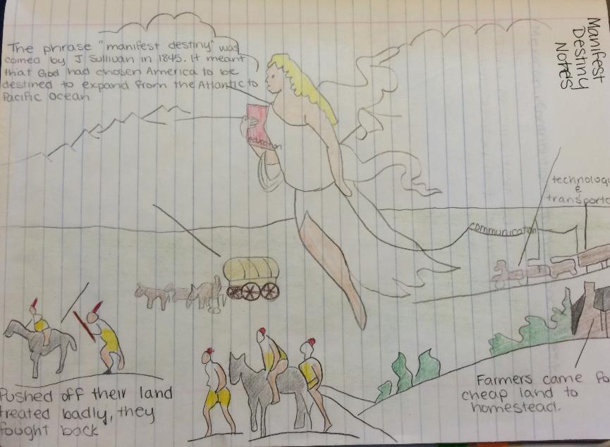
Annotated image

Slide 70
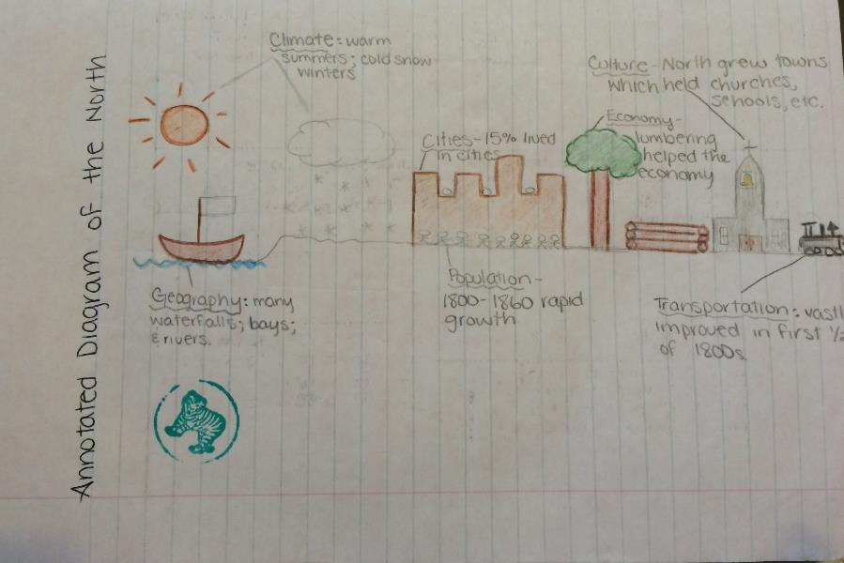
Annotated diagram

Slide 71
Doodle notes

Slide 72
Graphic organizers
Examine the graphic organizers in the Social Studies Strategies for Success manual.
Choose one to read in depth – make sure everyone has a different strategy.
Discuss with your group which strategy you would use and why.
7 minutes
Notes:
You will need to indicate which pages these are on – just flip through to find them.

Slide 73
What additional ideas do you have for graphic organizers?

Slide 74
Use processing strategies that allow students to reflect, make connections, and apply learning.
Activities
Processing
make connections
extend the reading experience
lead students to a deeper analysis of the text
be able to apply new content
allows for Differentiated Learning
Sinker
Notes:
Handouts: Before Reading Activities packet
More background knowledge
2.1 Tap into existing schema with activities
2.2 Establish a purpose for reading
2.3 Prepares the brain to acquire new knowledge
Construct the reading activity around a purpose that has significance for the students
Make sure students understand what the purpose for reading is: to get the main idea, obtain specific information, understand most or all of the message, enjoy a story, or decide whether or not to read more. Recognizing the purpose for reading will help students select appropriate reading strategies.
Use pre-reading activities to prepare students for reading
The activities you use during pre-reading may serve as preparation in several ways. During pre-reading you may:
Assess students' background knowledge of the topic and linguistic content of the text
Give students the background knowledge necessary for comprehension of the text, or activate the existing knowledge that the students possess
Clarify any cultural information which may be necessary to comprehend the passage
Make students aware of the type of text they will be reading and the purpose(s) for reading
Provide opportunities for group or collaborative work and for class discussion activities
Sample pre-reading activities:
Using the title, subtitles, and divisions within the text to predict content and organization or sequence of information
Looking at pictures, maps, diagrams, or graphs and their captions
Talking about the author's background, writing style, and usual topics
Skimming to find the theme or main idea and eliciting related prior knowledge
Reviewing vocabulary or grammatical structures
Reading over the comprehension questions to focus attention on finding that information while reading
Constructing semantic webs (a graphic arrangement of concepts or words showing how they are related)
Doing guided practice with guessing meaning from context or checking comprehension while reading
Pre-reading activities are most important at lower levels of language proficiency and at earlier stages of reading instruction. As students become more proficient at using reading strategies, you will be able to reduce the amount of guided pre-reading and allow students to do these activities themselves.

Slide 75
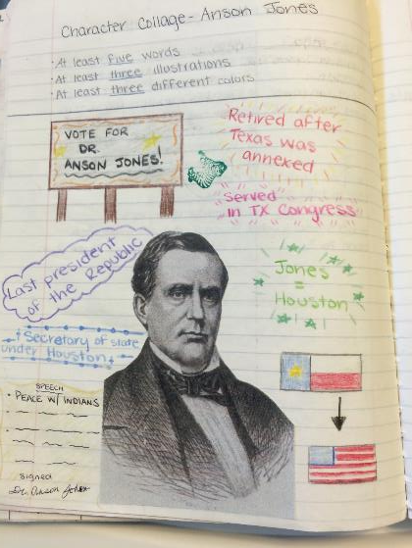
Character Collage
Notes:
Character collages allow students to process information about historical figures by adding images and quotes.

Slide 76
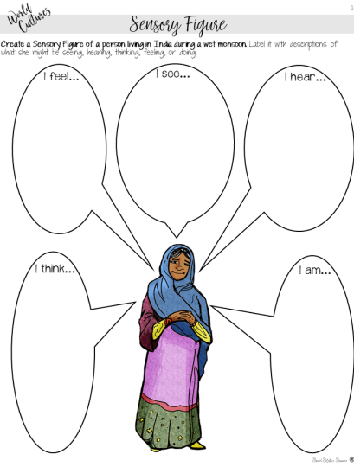
Sensory figure
Notes:
Sensory figures process by inferencing senses.

Slide 77
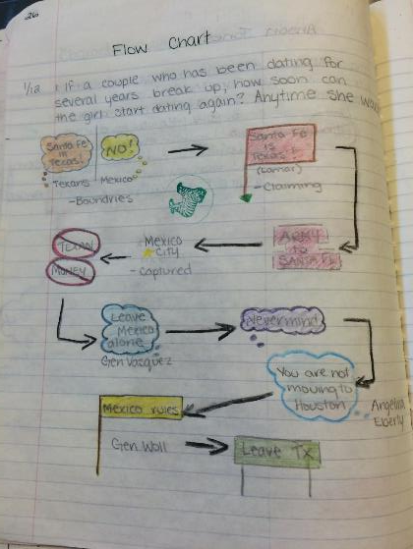
Flow Chart
Notes:
Flow charts show the movement of an idea.

Slide 78
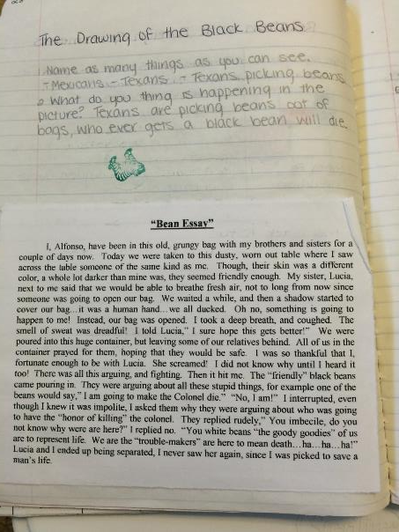
Point of view story
Notes:
Point of view stories are great for inferencing as well.

Slide 79
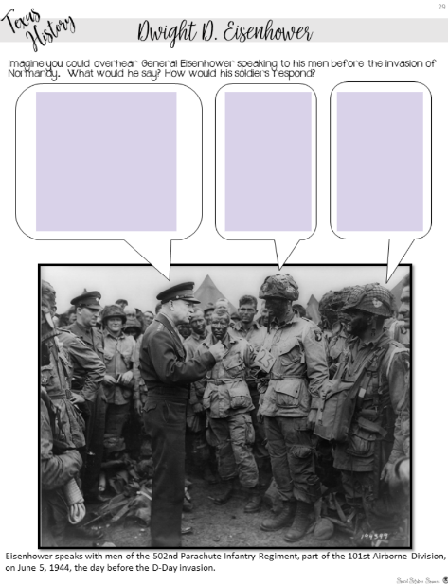
Annotated Image
Notes:
Students bring to life images by adding text.

Slide 80
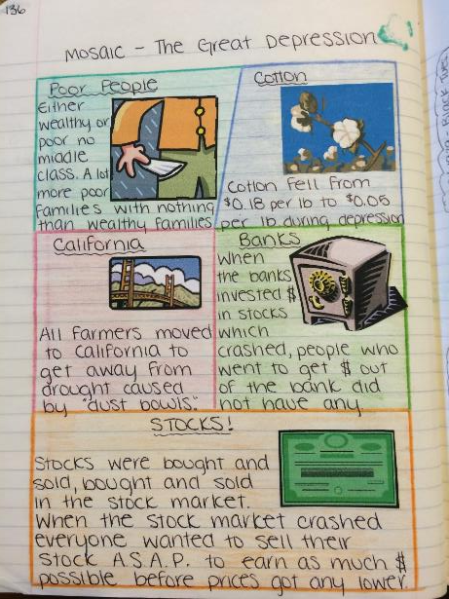
Mosaic
Notes:
A mosaic is great for showing the parts of a topic.

Slide 81
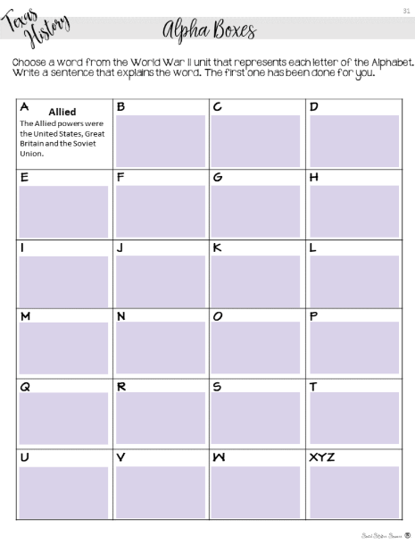
Alpha boxes
Notes:
Challenge students to create summaries for the topic with Alpha Boxes.

Slide 82
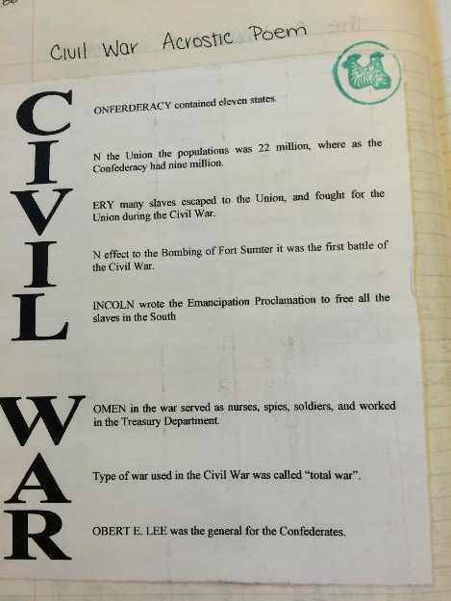
Acrostic poem
Notes:
Explain an acrostic poem.

Slide 83
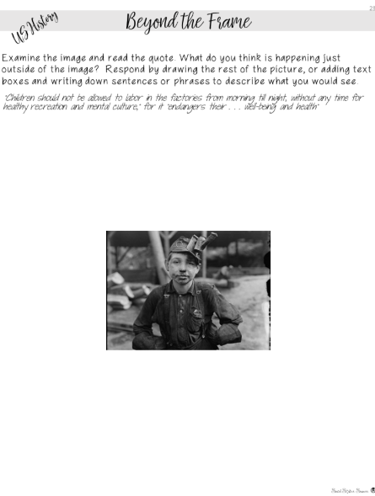
Beyond the frame
Notes:
Students write or draw what they would see beyond the picture frame.

Slide 84
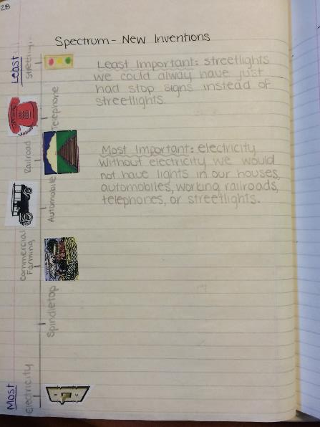
Spectrum
Notes:
Students rank the importance of certain events.

Slide 85
Processing activities
Examine the processing activities in the Social Studies Strategies for Success manual.
Choose one to read in depth – make sure everyone has a different strategy.
Discuss with your group which strategy you would use and why.
7 minutes
Notes:
These can be found in the table of contents.

Slide 86

Gimmie
Five!
Notes:
Have participants hold up their hands in a “gimmie five”. Then for each finger up they have to say one thing they learned. For their thumb, they need to say one question they still have.

Slide 87

Examine
the sample notebooks
Hook
Line
Sinker
Notes:
Now examine at the sample notebooks you brought to look for these parts in the notebook.

Slide 88

What did you learn looking at the sample notebooks?

Slide 89

Style
Notes:
This is your personal choice in the classroom (share all your tips in this section).

Slide 90
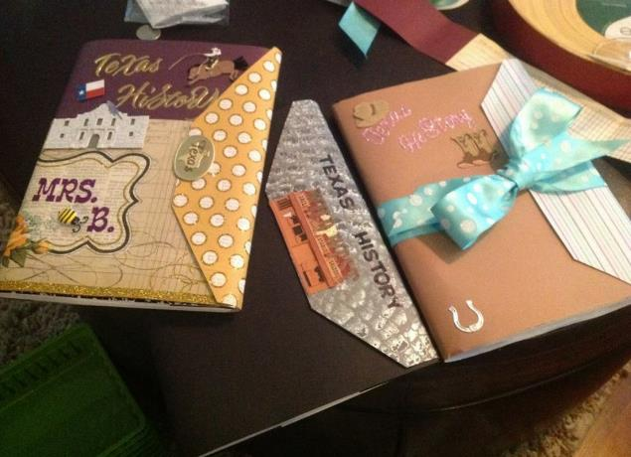
Personalization - Cover
Use magazines.
Cover with packing tape or contact paper.
Add special touches such as bookmarks and dividers.
Notes:
There are also things that you can do to individualize them. As you go over these, give your tips and experiences using notebooks.
For reduce the number of lost notebooks explain that the students have invested their time and personality into them, so they now have value to the kids.

Slide 91
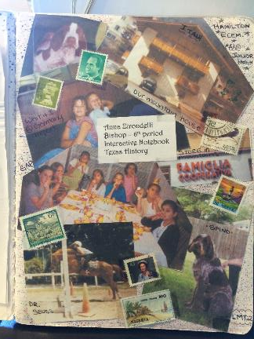
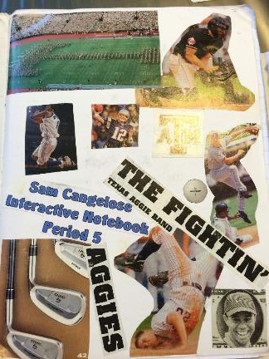
Personalization – Author Page
reflect content or individuals.
encourage students to take pride in their notebooks.
reduce the number of lost notebooks.
Notes:
There are also things that you can do to individualize them. As you go over these, give your tips and experiences using notebooks.
For reduce the number of lost notebooks explain that the students have invested their time and personality into them, so they now have value to the kids.

Slide 92
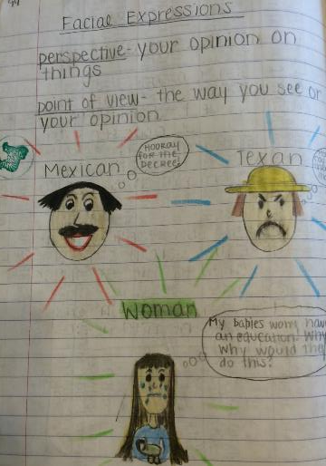
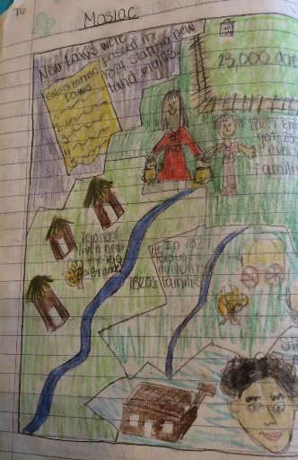
Organization - Pages
Interactive Student Notebook: Five Steps to Implementation
Have students put a title and date on each assignment.
Notes:
This will help kids know what the assignment is about and when it was done. This will help absent kids too.

Slide 93

Organization - Numbering
Interactive Student Notebook: Five Steps to Implementation
Show students how you want their pages numbered.
Number as you go
Number by activity
Use an A, B, C method with your numbers
Notes:
Discuss with participants how you can number pages. There are a variety of ways you can do this. Share the above with them and what you have done or tried in the past. You might need to explain that we are teaching without left-side/right-side if you have some folks who were taught the ISN by an old-schooler!
Number as you go - Explain to participants it is best to number as you go so if a kid messes up their whole notebook is not messed up.
Number by activity – each activity has a number
A,B,C method – Can use this with either. Preview is 2A, Notes 2B, Processing 2C or if you number as you go, if a kid needs more room than the page you gave them, they can make that A and move to page B.
Explain that all kids should be on the same number system and do not let them number on their own or their will be a lot of confusion when you want to grade or have the kids find something.

Slide 94
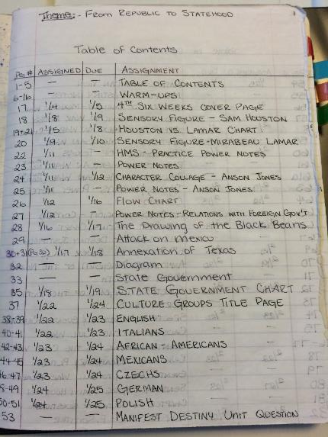
Organization – Table of Contents
Interactive Student Notebook: Five Steps to Implementation
Add a table of contents to help guide students.
Include page numbers and title.
May have the date you did the assignment.
Can include assignment grades.
Consider keeping a master table of contents in your room.
Notes:
I showed two examples, if you do something different, explain that to them.
I also share how I go to the teacher center and use a poster maker to make a big poster of the Table of Contents and laminate it. That way I can use dry erase markers on it and keep it up where the kids can see.

Slide 95
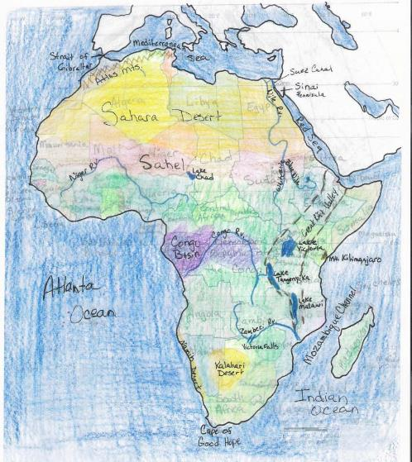
Organization – Resource Pages
Interactive Student Notebook: Five Steps to Implementation
Include lesson material with each unit such as:
vocabulary
maps
Notes:
You can include other things besides preview, notes, and processing in your notebooks as well. Vocabulary, maps are a few examples.

Slide 96
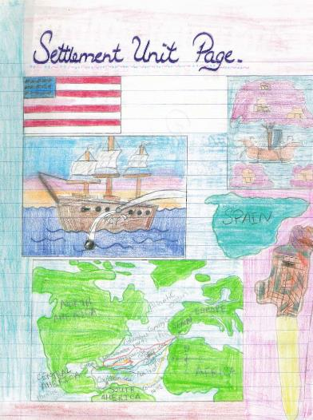
Organization – Unit Pages
Interactive Student Notebook: Five Steps to Implementation
Add unit title pages that echo the unit theme and contain:
the title of the unit.
pictures that represent the unit content.
a phrase that describes the unit.
Notes:
You can give the example of 5-5-5 5 terms, 5 phrases, 5 colors required for a unit page. This picture does not have it, but that is something they can require their students to do.

Slide 97
Examine
the sample notebooks
Organization
Notes:
Low look at the organization in the ISN.

Slide 98

What are some ideas that you will use in your classroom?
I will use…
Notes:
Debrief with these stems.

Slide 99

Grading
the ISN

Slide 100

Is the Interactive Student Notebook
a Product or a Process?
Notes:
Turn and Talk
This decides how you grade the notebook – either looking for perfection or grading the learning process.

Slide 101

Inspect
What you Expect
Notes:
Monitor often at the beginning of the year.
Stamp, initial, or place stickers to indicate you have seen the item.
Write comments, especially positive comments or suggestions, on sticky notes.

Slide 102

Notes:
Allow students to use notebooks on a quiz
Helps students understand the importance of taking notes.
Encourages students to bring their notebooks daily.
Builds good work habits for the future.
z or test.

Slide 103

Peer
Review
Notes:
Have students look at other student examples.
Examples from previous years
Gallery walk
Peer Review

Slide 104

Evaluate
Notebook
Assignments
What grade would each of these assignments earn?

Slide 105

Grading

Slide 106
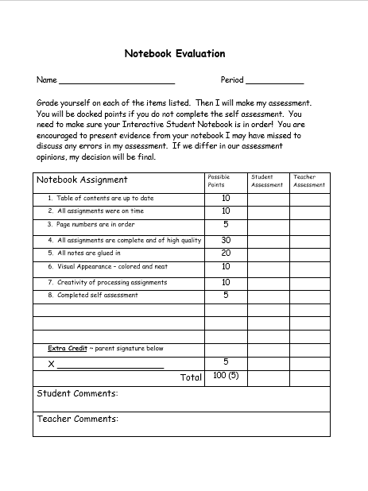
Explain to students the criteria used to grade notebooks.
Share rubric in advance
Stagger collection and grading
Notes:
Share any tips you have for grading. Remind teachers that they have sample rubrics on the website in the folder on Interactive Student Notebook resources.

Slide 107

Improving
Quality

Slide 108
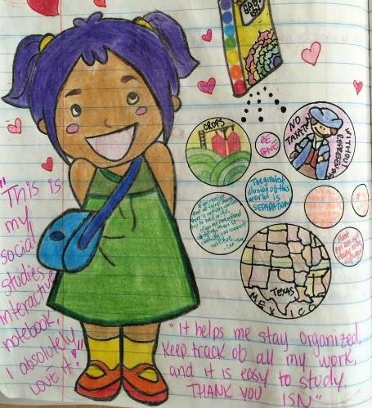
Require students to add color.
Show students how color improves notes and processing assignments.
Model what you expect to see in their notebooks.
Incorporate color for organizing into rubrics.
Notes:
Discuss by bullet points
Notes with highlighting key terms are easier to use to study for tests
Model when give notes use different color pens on overhead or in powerpoint.
Put color as part of the grade – stress color for organizing not for “prettiness”

Slide 109
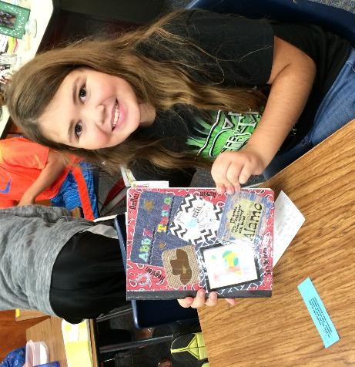
Encourage a sense of pride in notebooks.
Show students that their notebook has value and importance to them.
Provide evidence of students who have used their notebooks in future years.
Notes:
Discuss point
Can help them study; is a portfolio of evidence of learning
Help with test at state level; give story of student who kept and used their notebook

Slide 110


Questions?
Ideas?

Slide 111






Connect with me!
www.SocialStudiesSuccess.com
Notes:
Point out my blog on social studies success if they want to learn more.

