Slide 1


Slide 2


Slide 3

Notes:
Introduce yourself

Slide 4


Slide 5


Slide 6
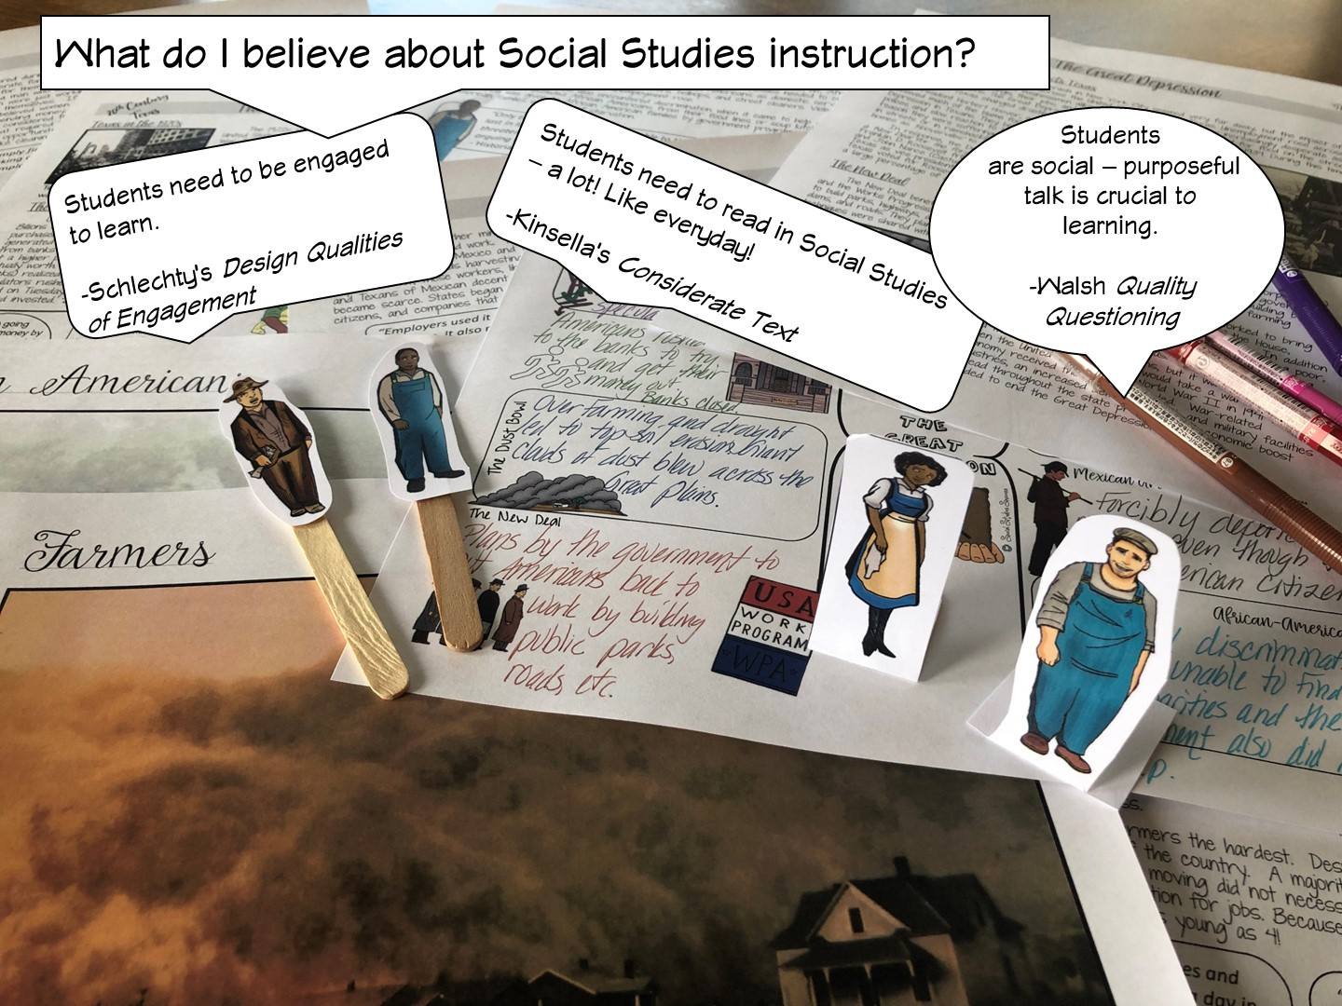

Slide 7
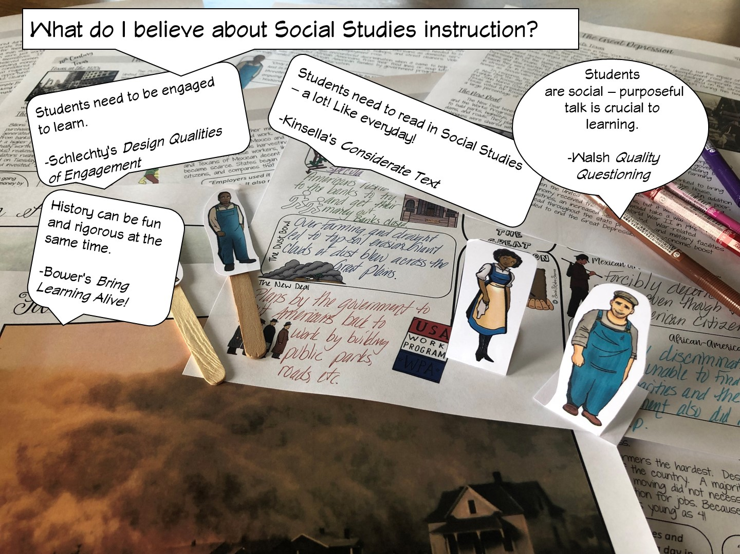

Slide 8


Slide 9
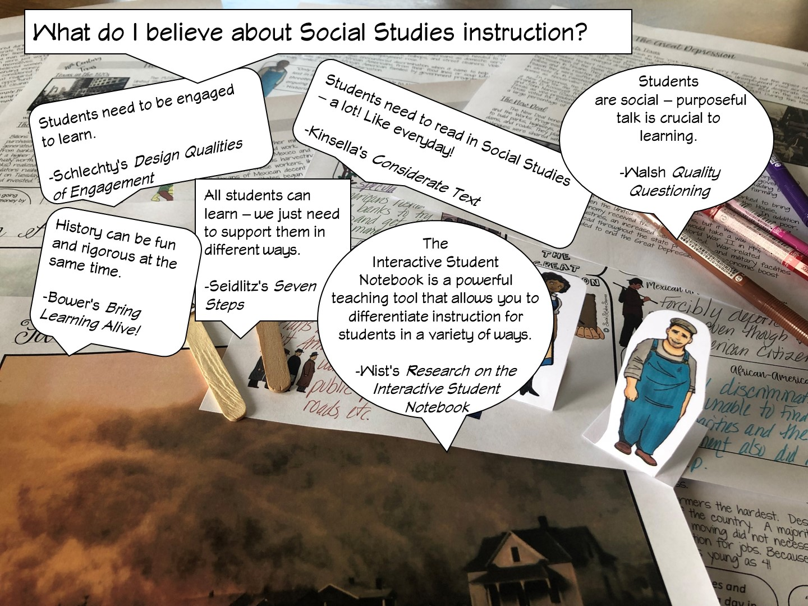

Slide 10
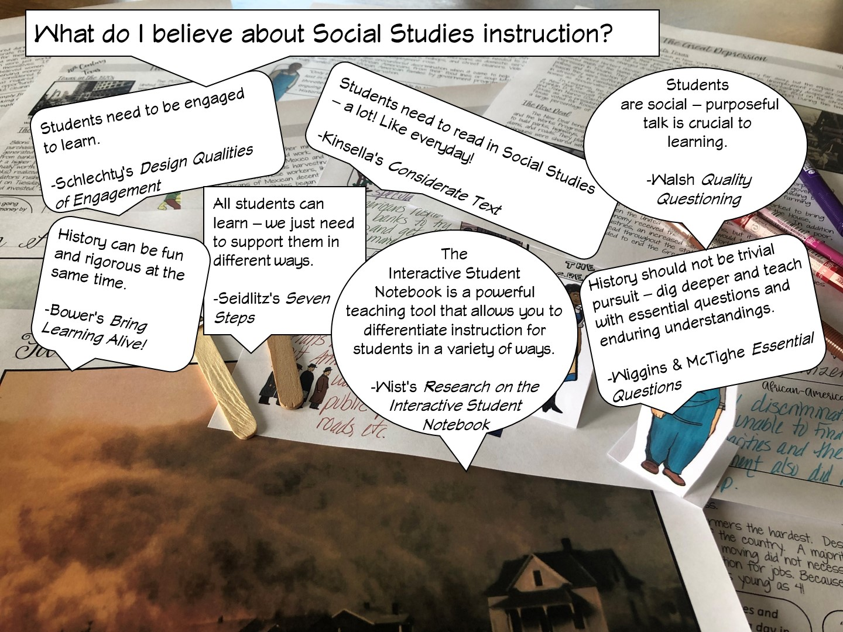

Slide 11
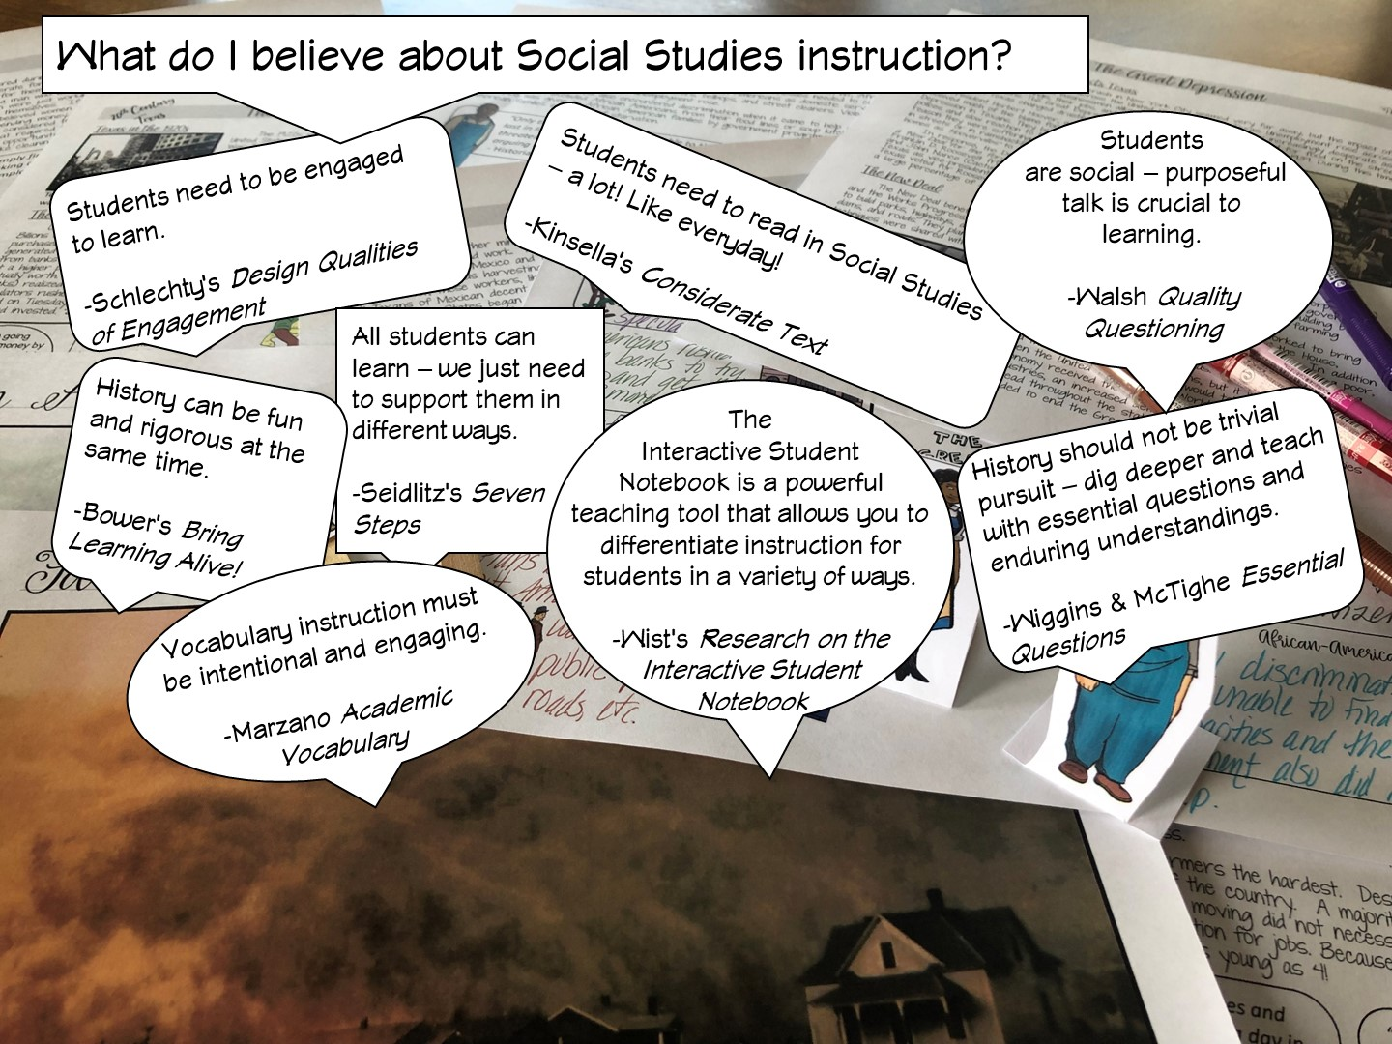
Notes:
Differentiated instruction is ensuring that learning happens in an accessible way for the student. ISNs allow the students to format their thoughts however they find suitable, thus, differentiating by learning styles — someone who loves writing can love in the notebooks, another student who would rather draw is free to express his/her ideas through diagrams, charts and pictures.

Slide 12
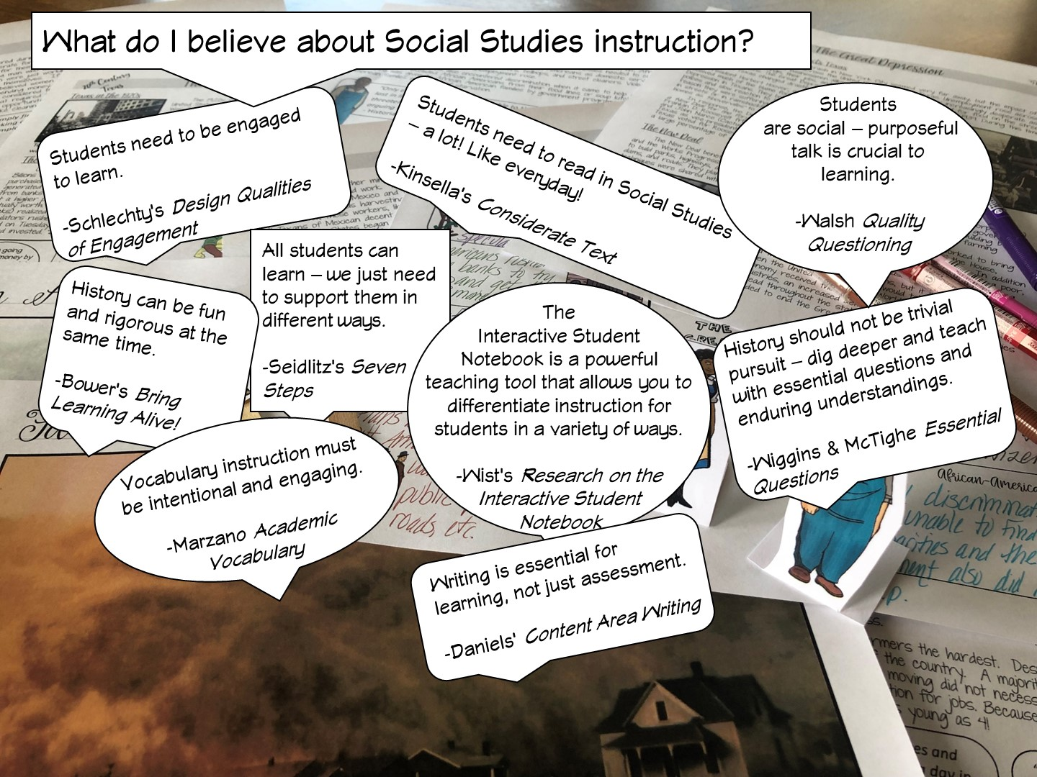

Slide 13
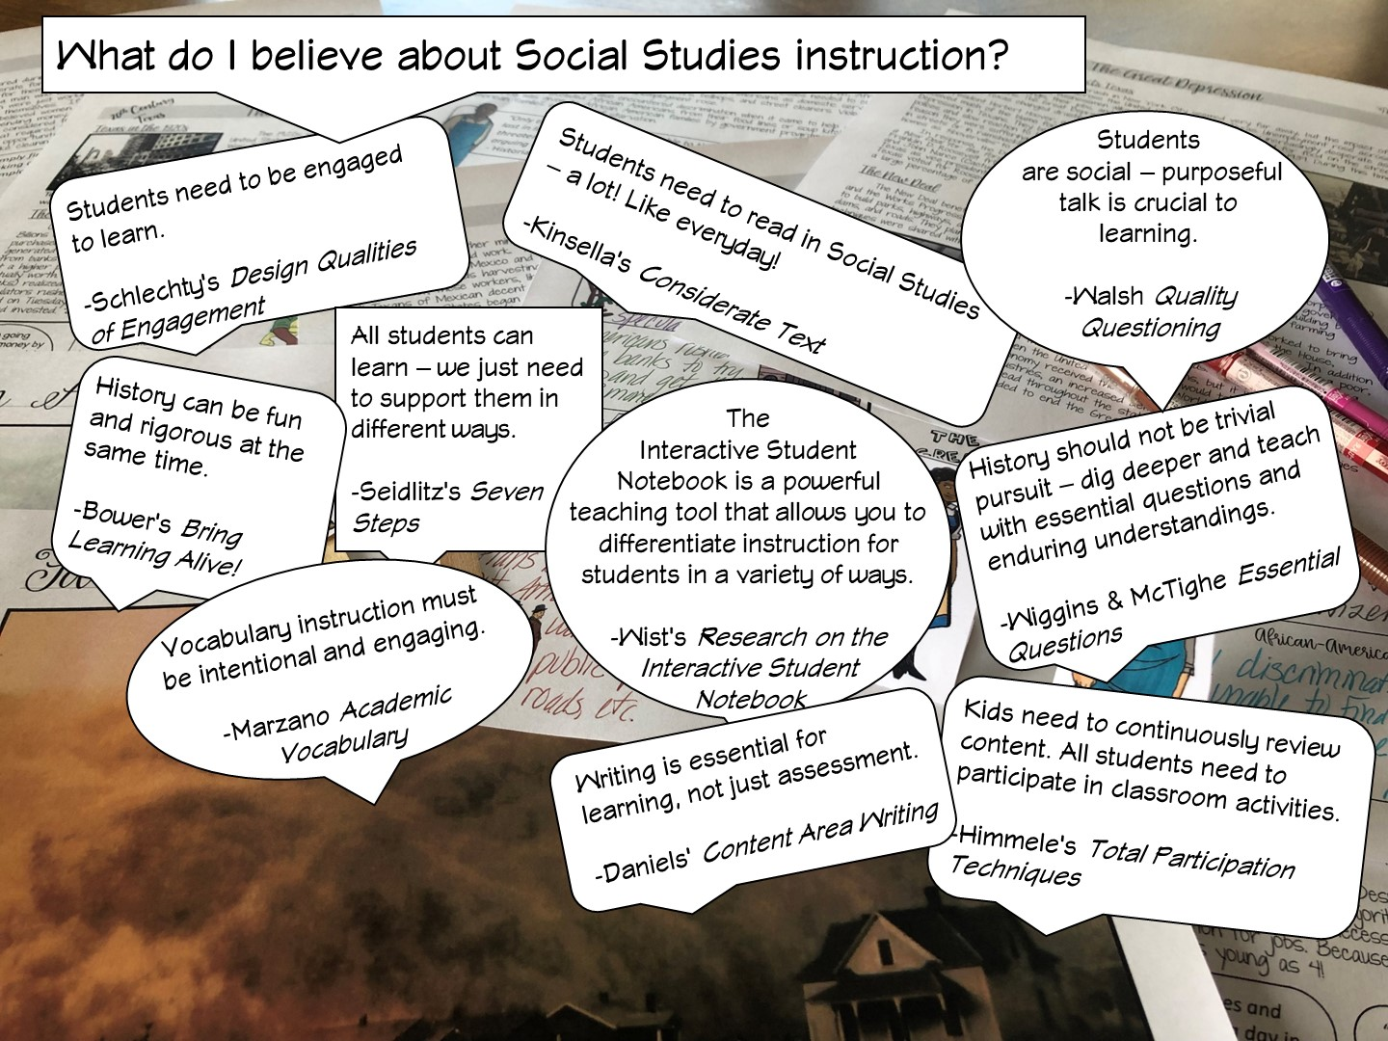

Slide 14
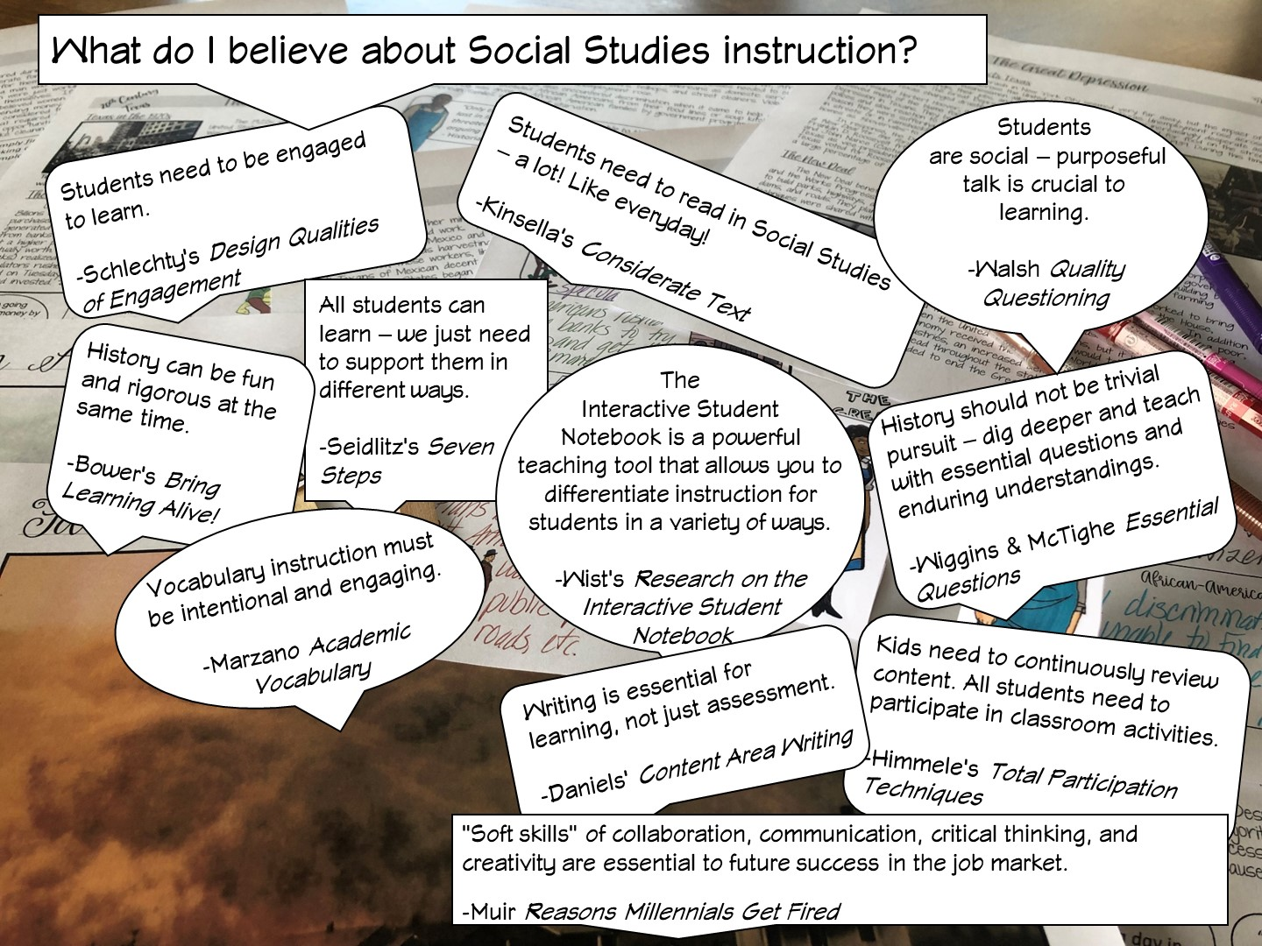

Slide 15
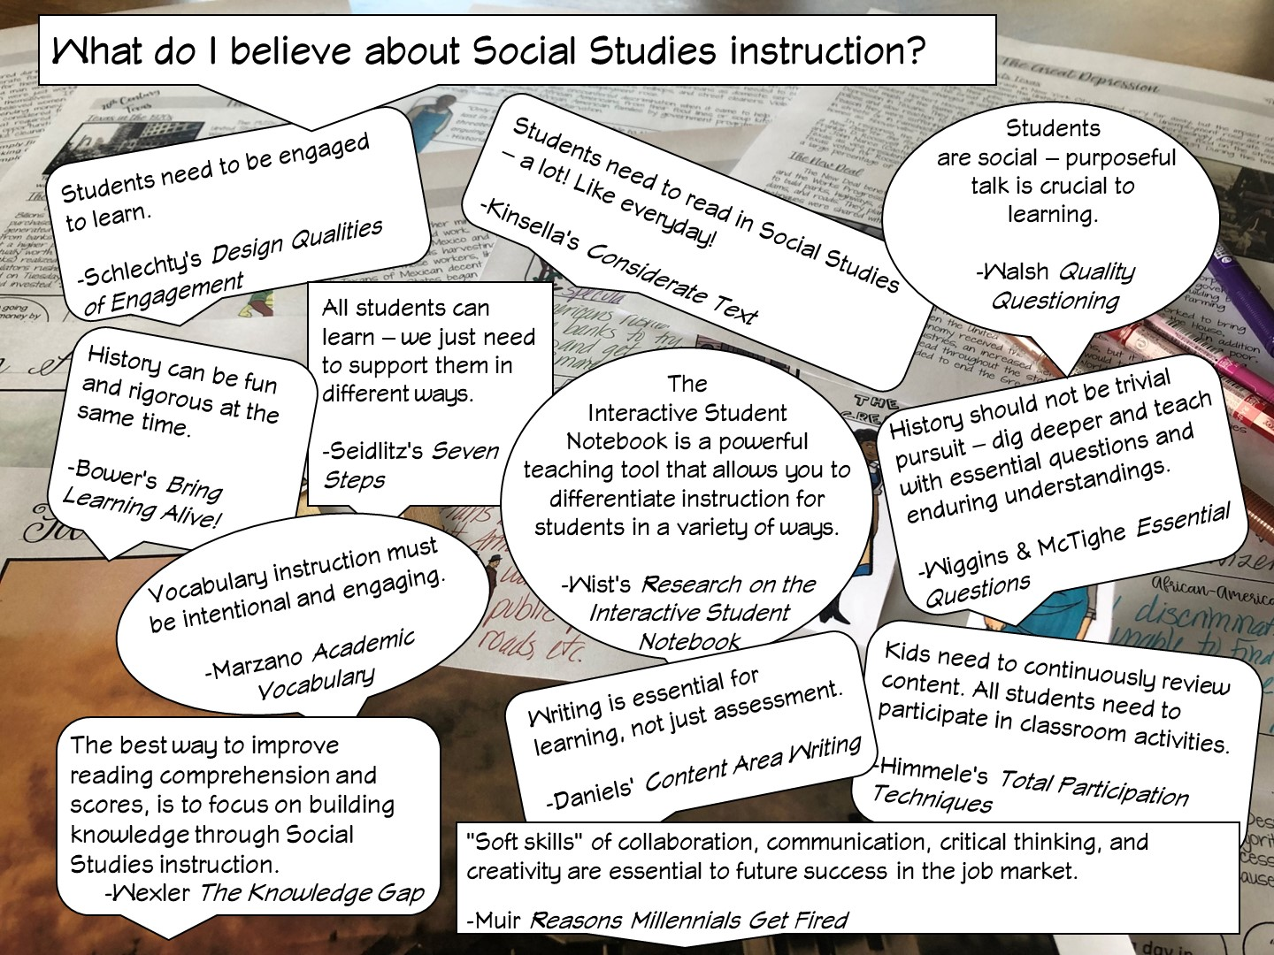
Notes:
.

Slide 16

Notes:
History teachers are the guardians of democracy

Slide 17
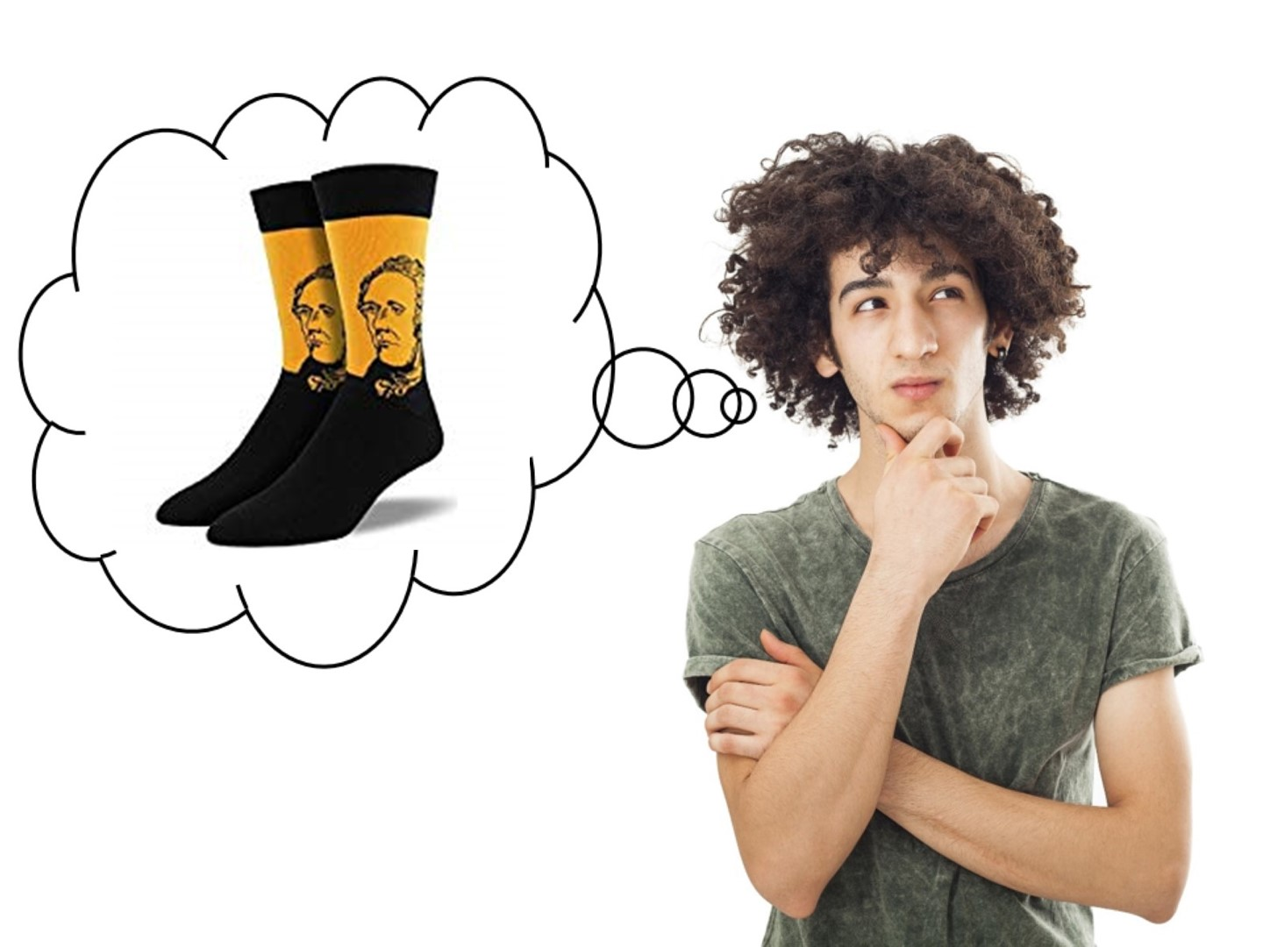

Slide 18

Notes:
Have teachers write their goals on a post it note and share with their table mates.
Review our goals in the next slide

Slide 19

Notes:
You are just going to quickly review these design qualities of engagement from last year. All of the Social Studies Success resources are designed to engage students.

Slide 20

Notes:
Put them with a different partner.

Slide 21
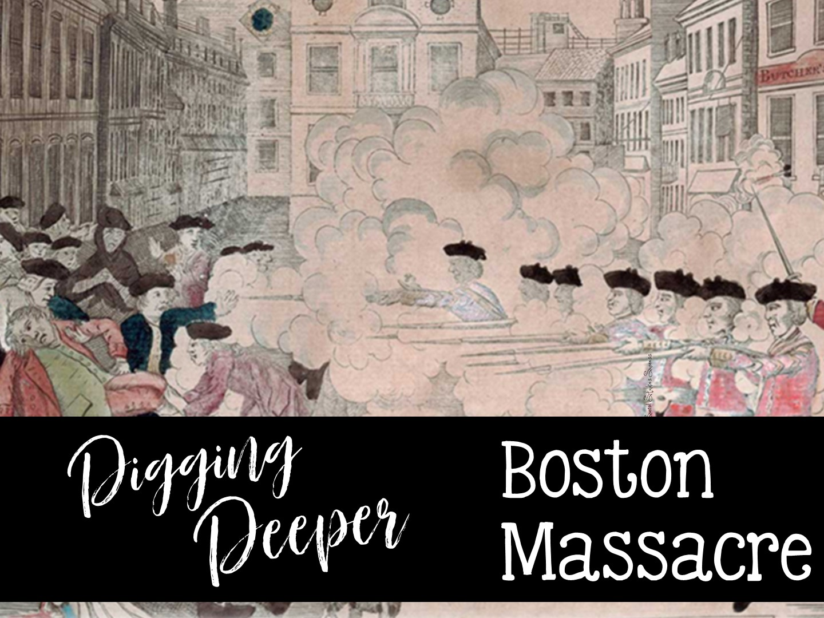

Slide 22
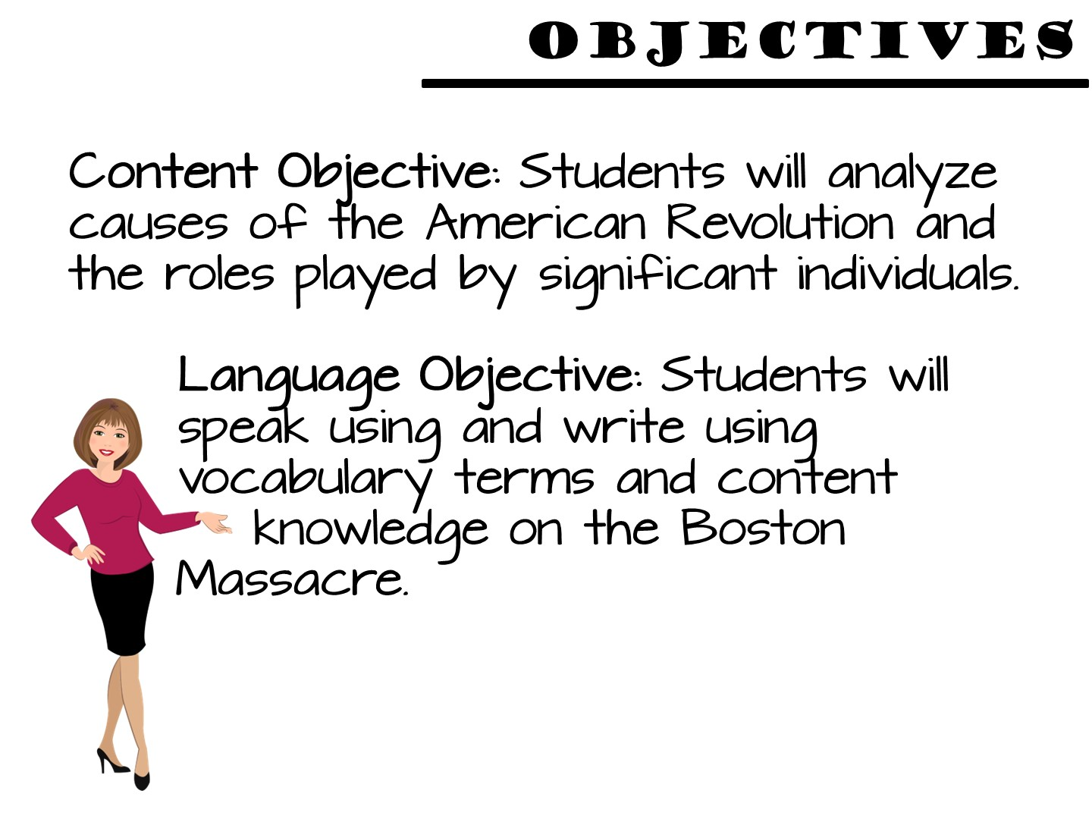

Slide 23


Slide 24
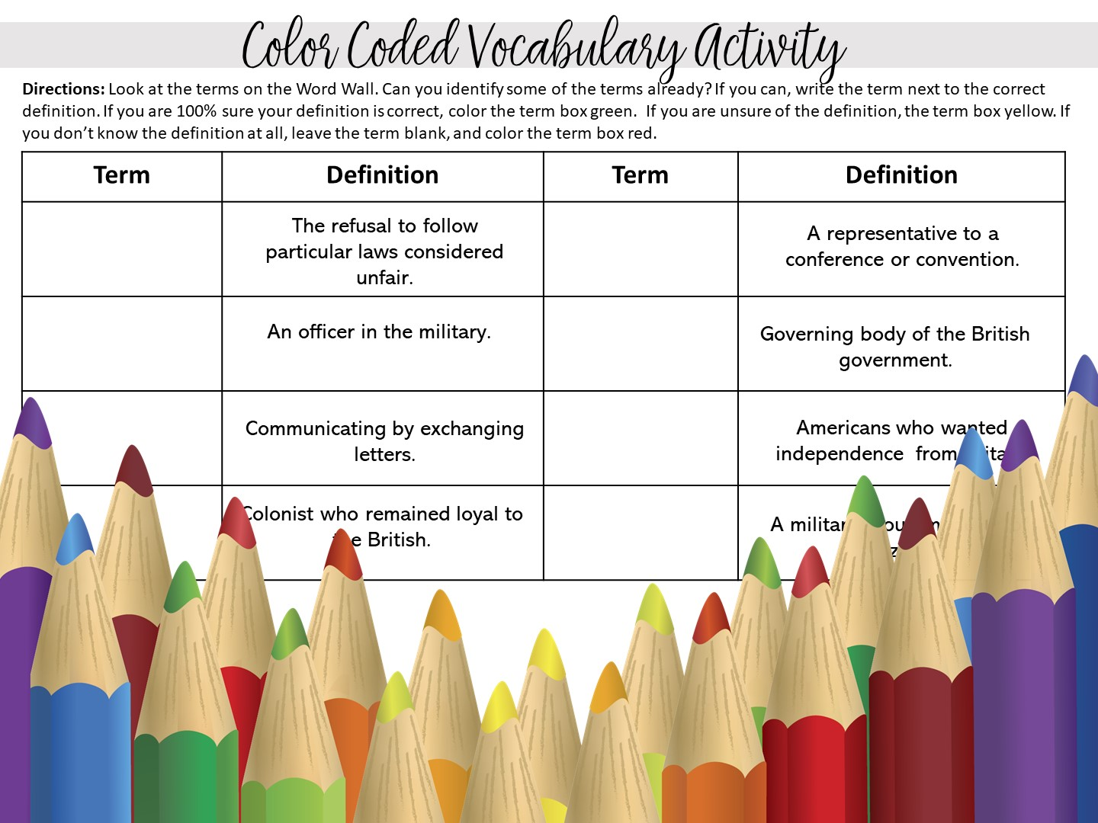
Notes:
Pass out the Color-Coded Vocabulary for the Boston Massacre

Slide 25
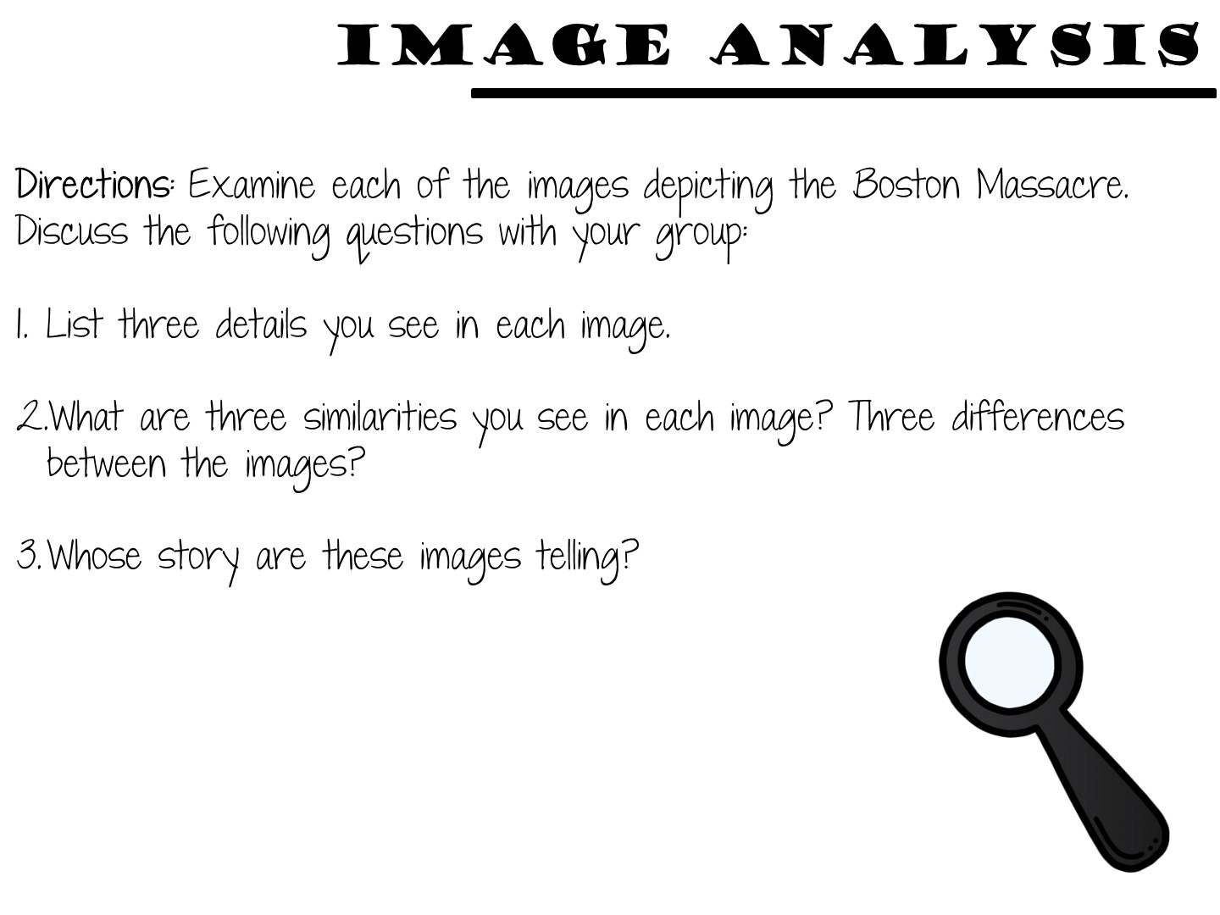

Slide 26
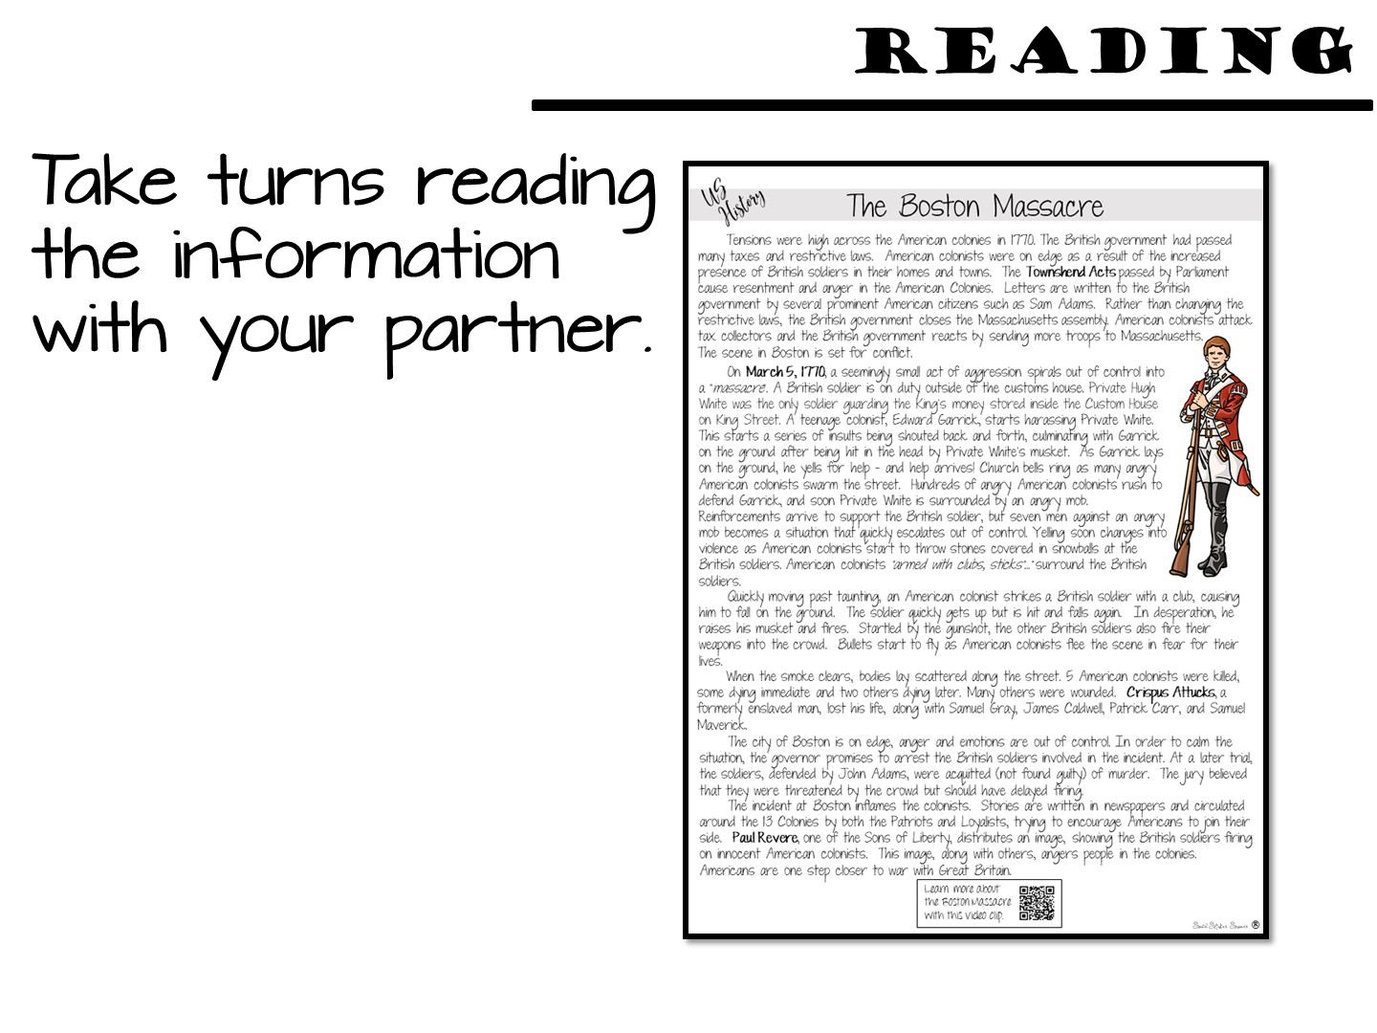

Slide 27


Slide 28
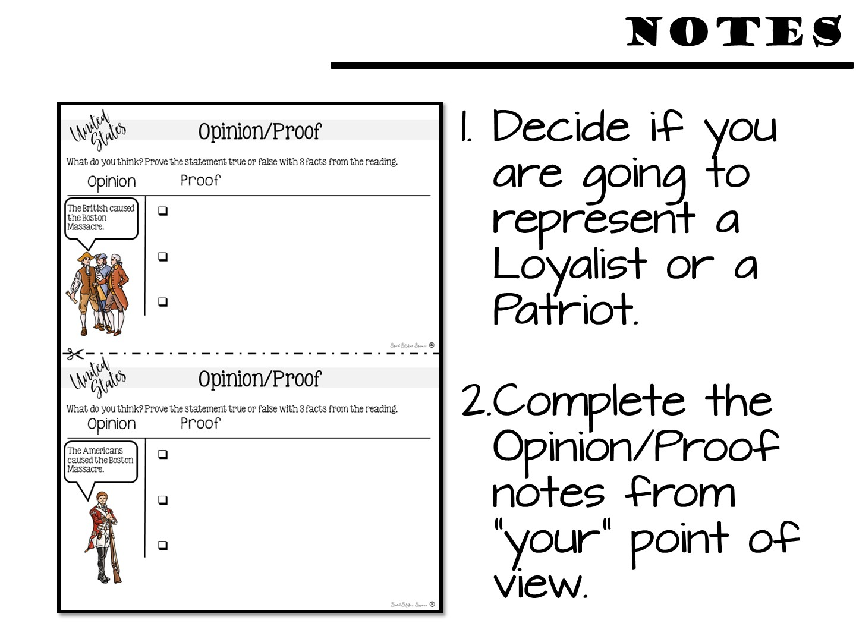

Slide 29
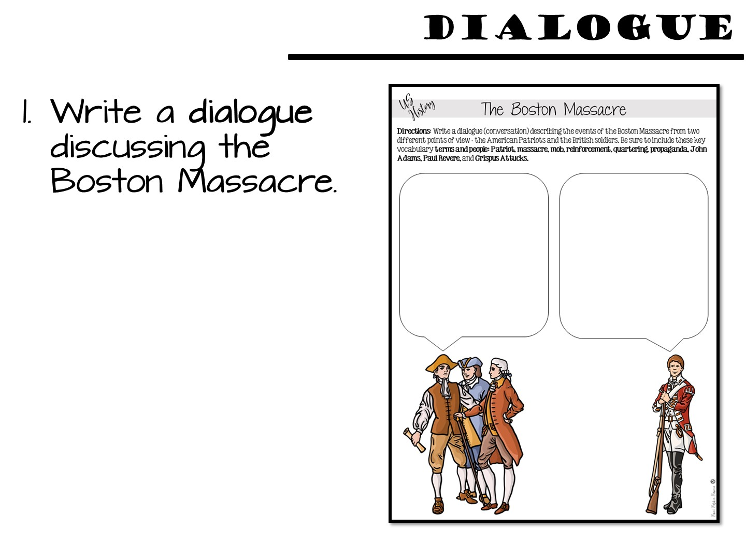
Notes:
I have removed the puppet portion of this model.

Slide 30


Slide 31


Slide 32

Notes:
Put them with a different partner.

Slide 33
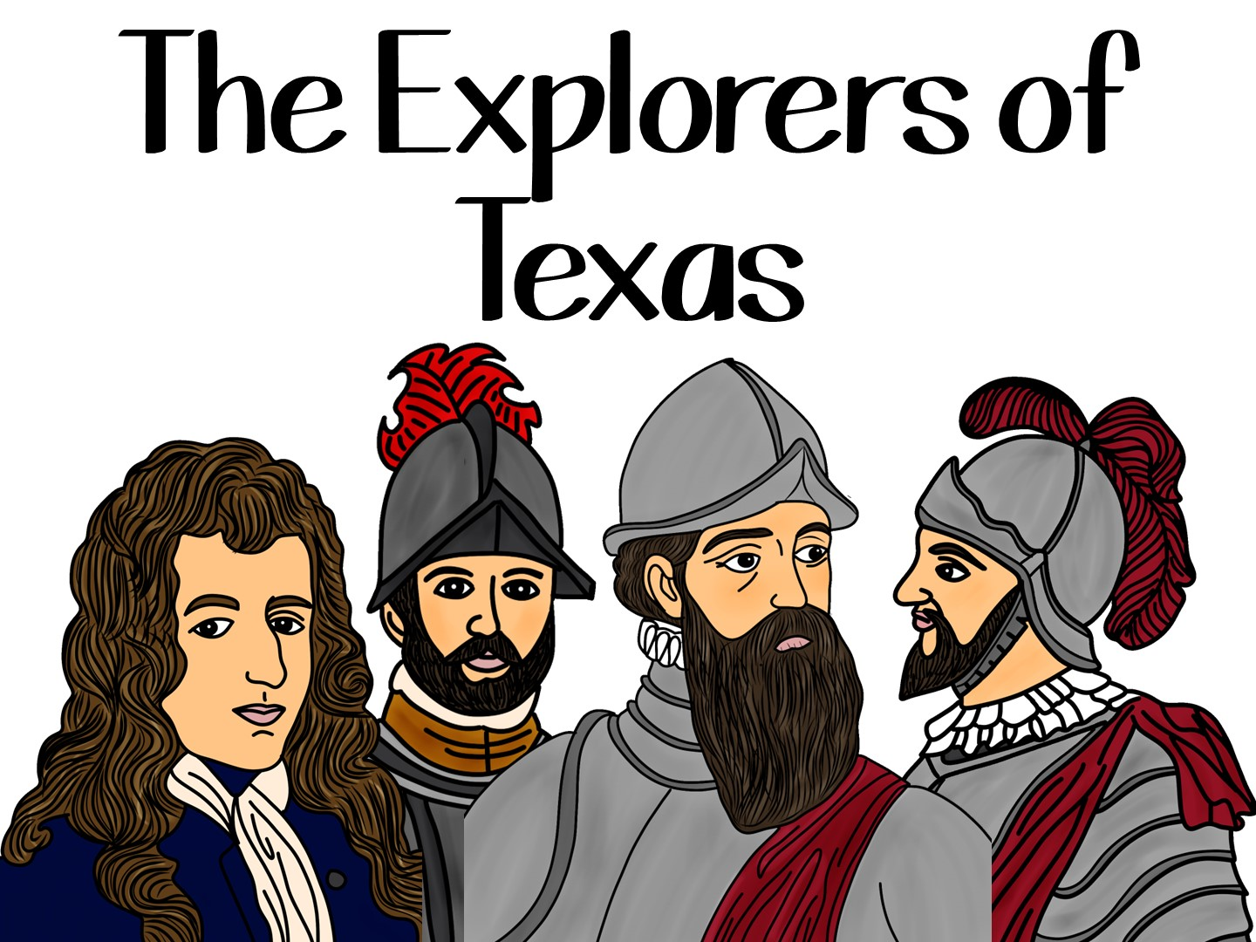
Notes:
The sample we are going to do next is a scavenger hunt that relies heavily on inferencing.

Slide 34
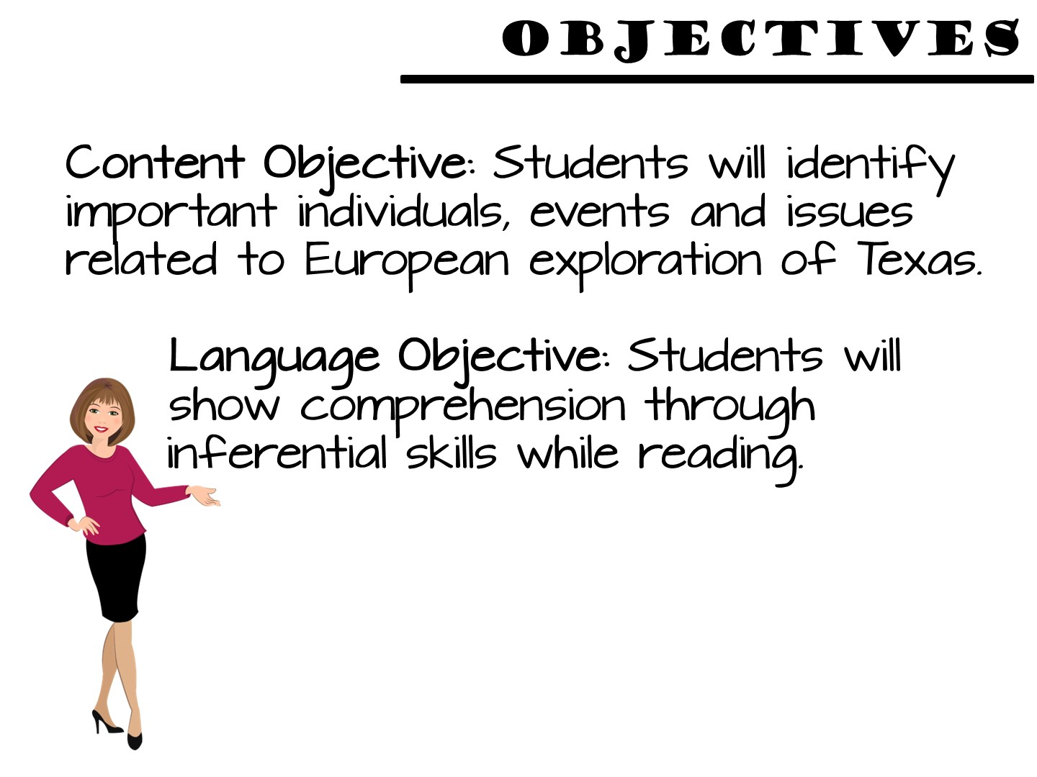

Slide 35
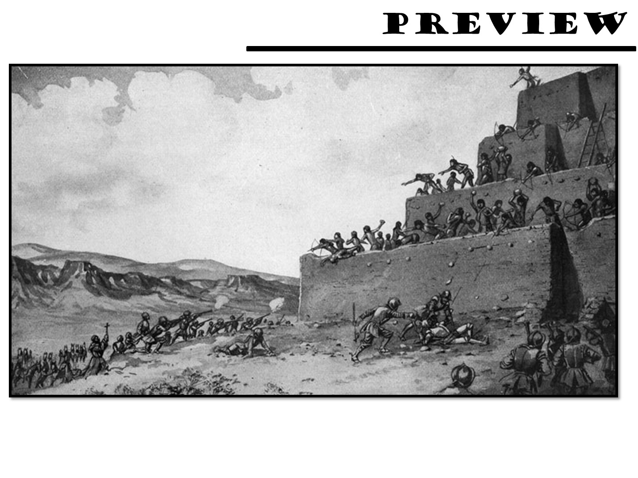
Notes:
Project this image and ask the students to discuss what they see.

Slide 36
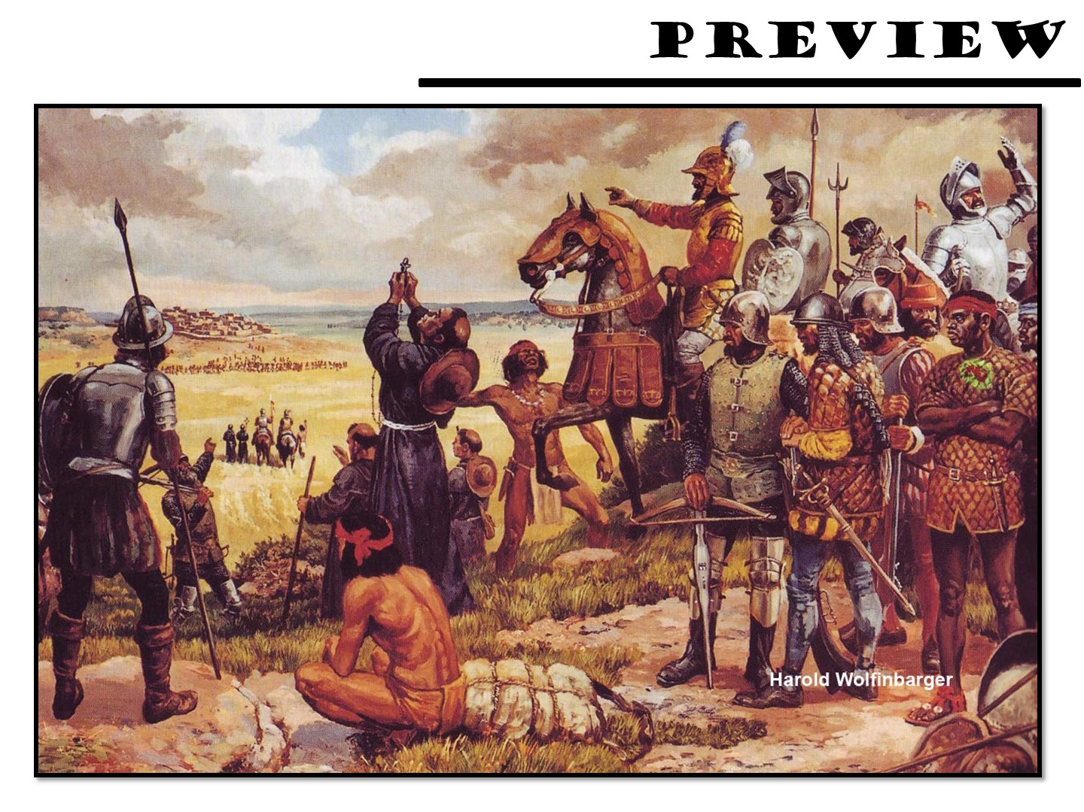
Notes:
Project this image and ask the students to discuss what they see.

Slide 37
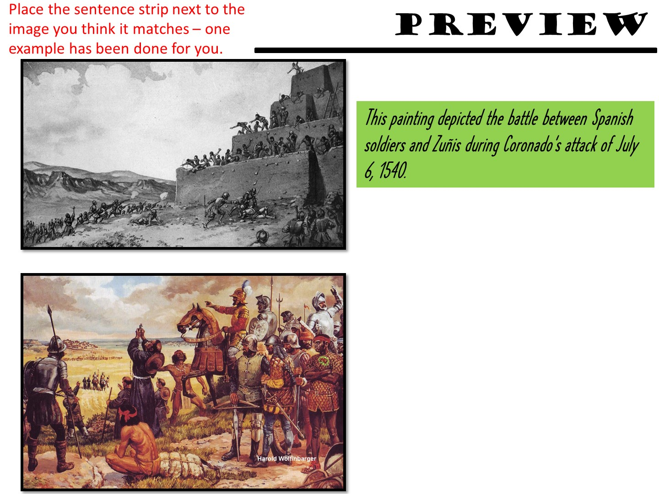
Notes:
Give students time to match sentences to pictures. Debrief.

Slide 38
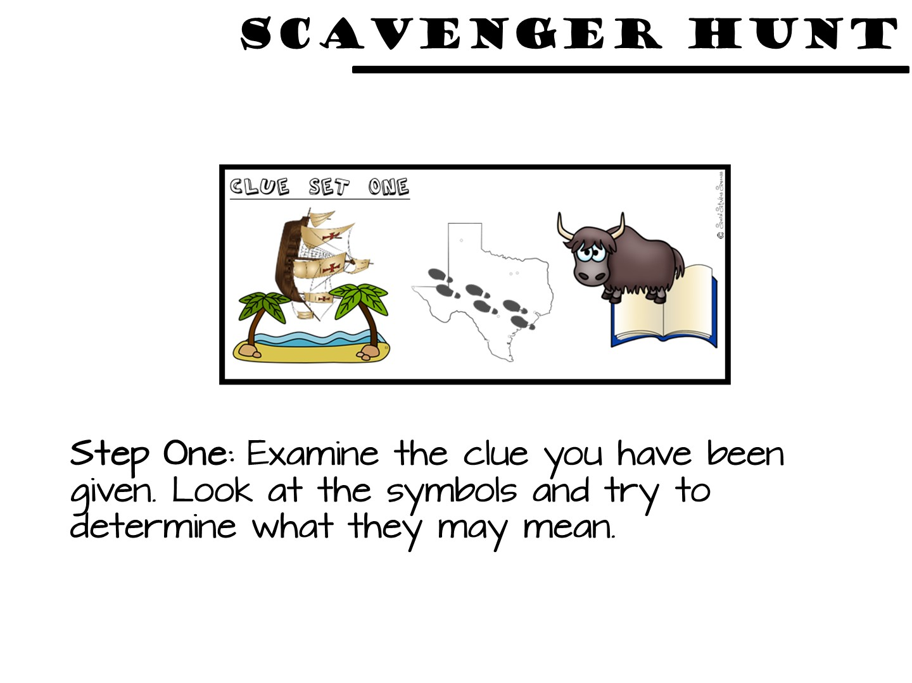

Slide 39
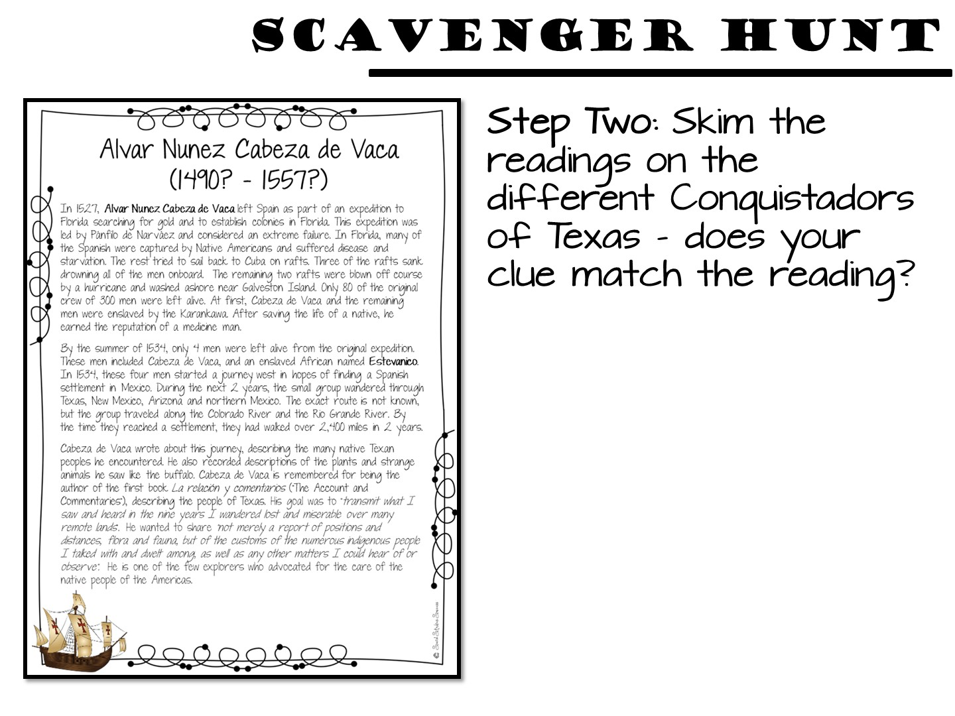

Slide 40
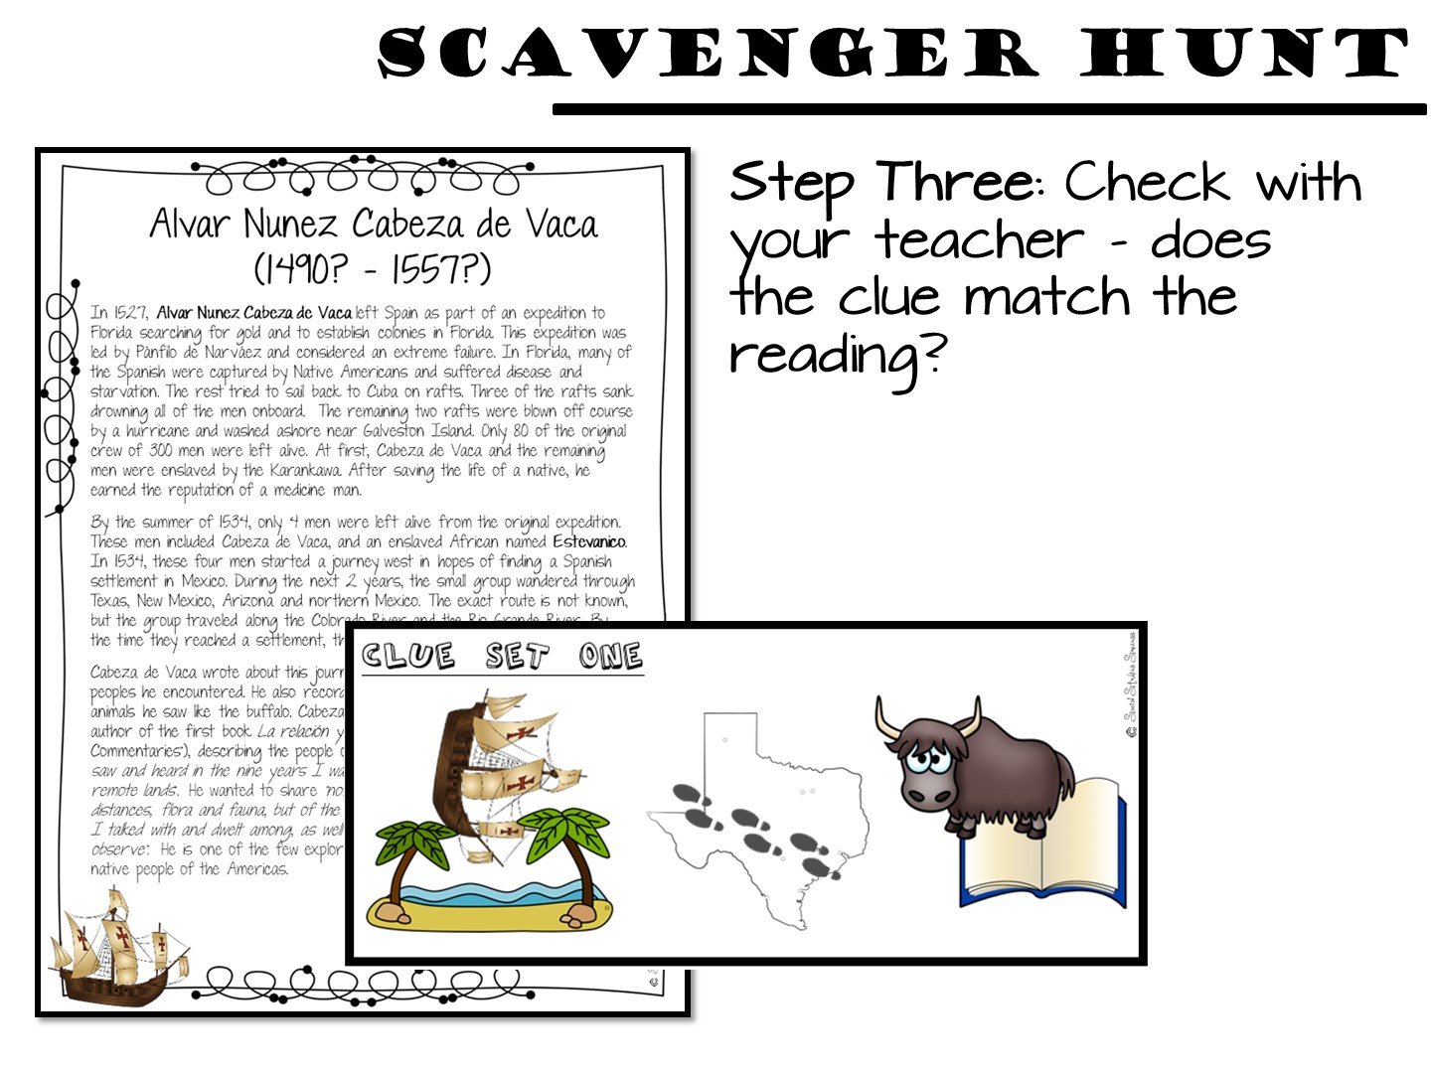

Slide 41
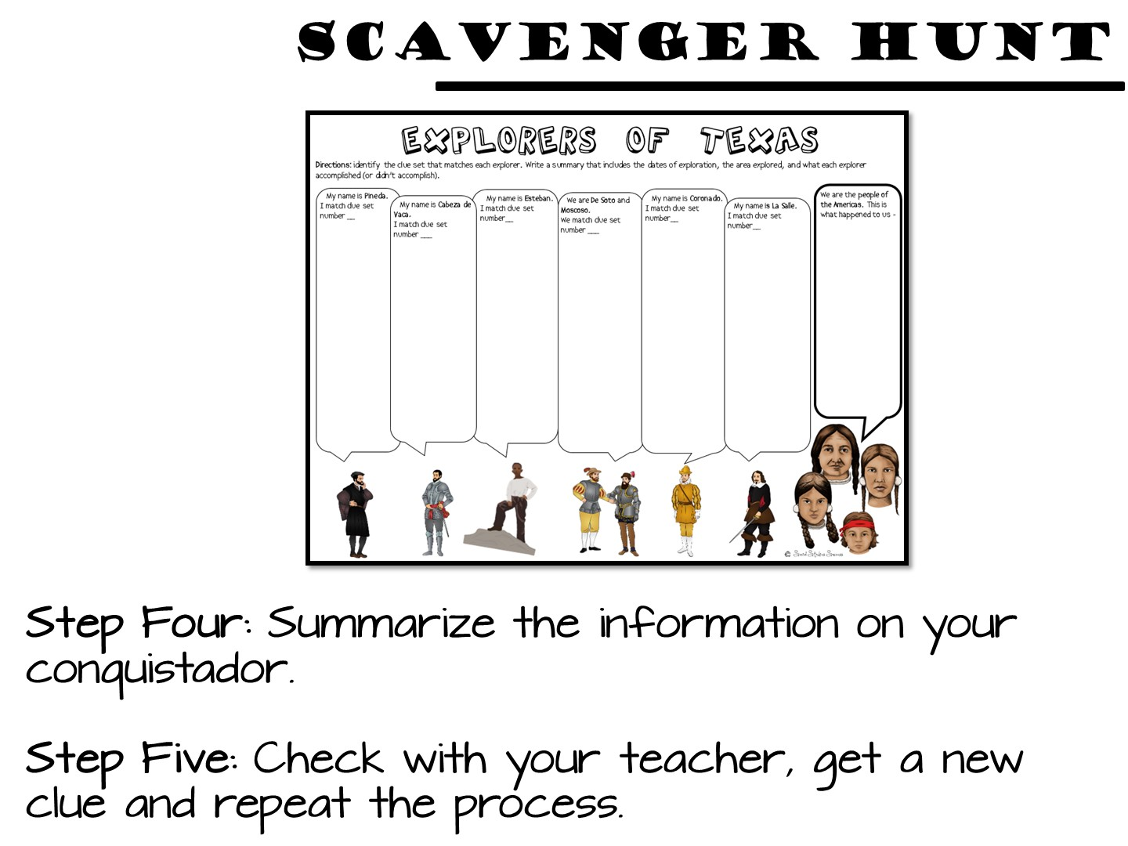

Slide 42
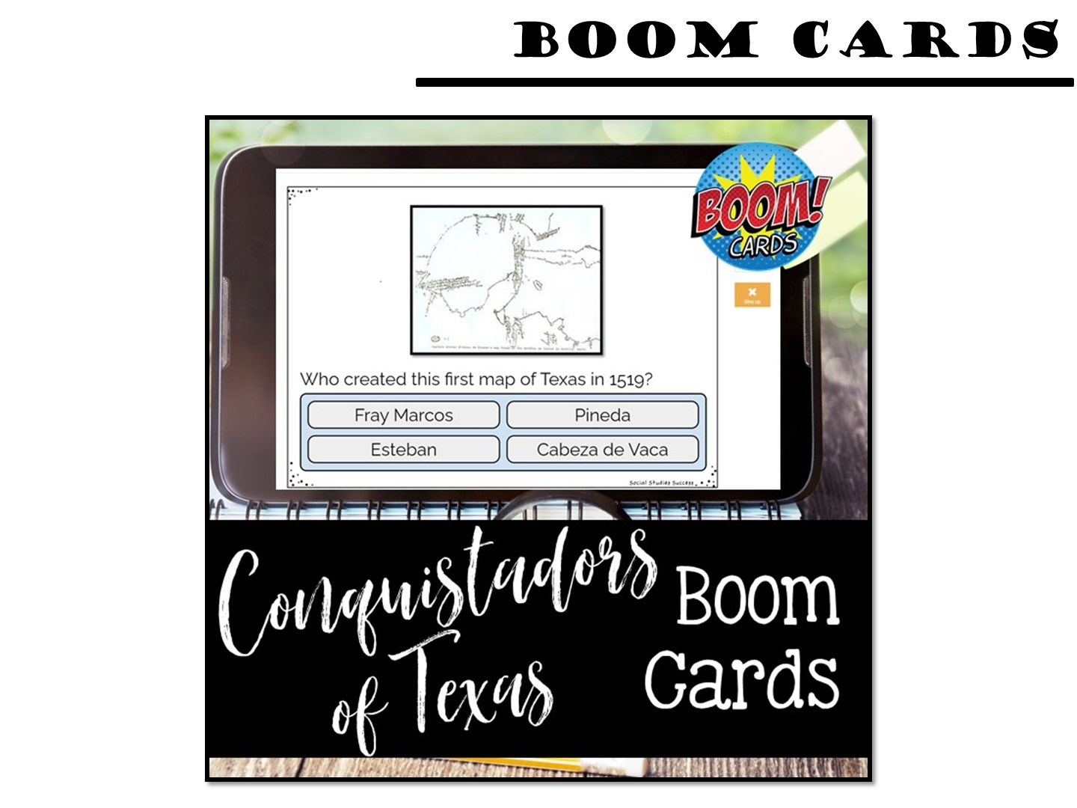
Notes:
You can set up a code for the boom cards up to 14 days in advance of the training.

Slide 43


Slide 44


Slide 45


Slide 46


Slide 47
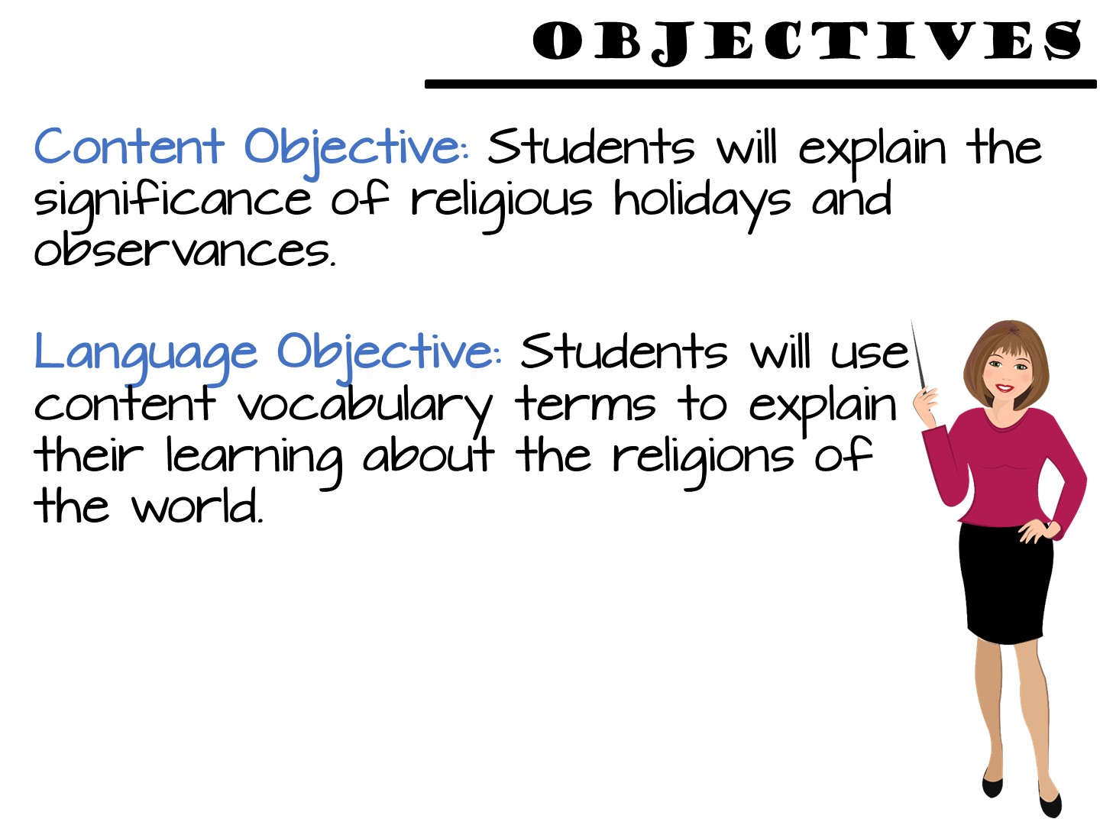
Notes:
Just read

Slide 48
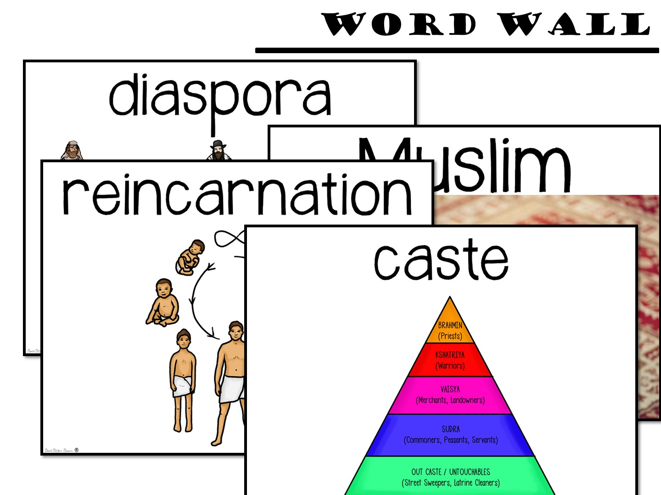

Slide 49
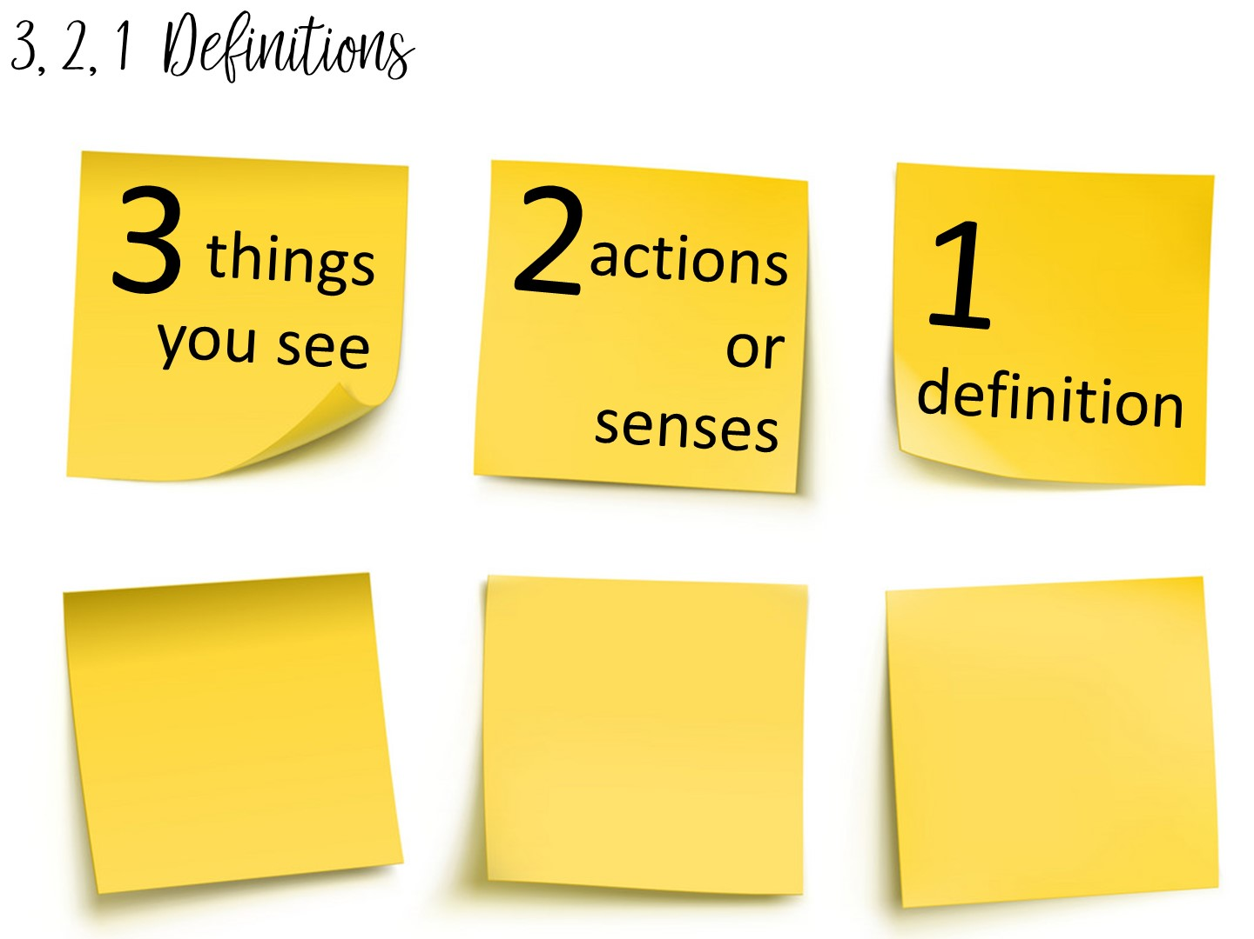
Notes:
Another method to teach vocabulary with images is the 3, 2, 1 Definitions – Allow students time to analyze an image to build their understanding of an image.
Model this with the word Columbian Exchange
Allow them to pick a term with a partner and complete the 3, 2, 1 definition. I always bring the teachers close to word wall to get them out of their seats.

Slide 50
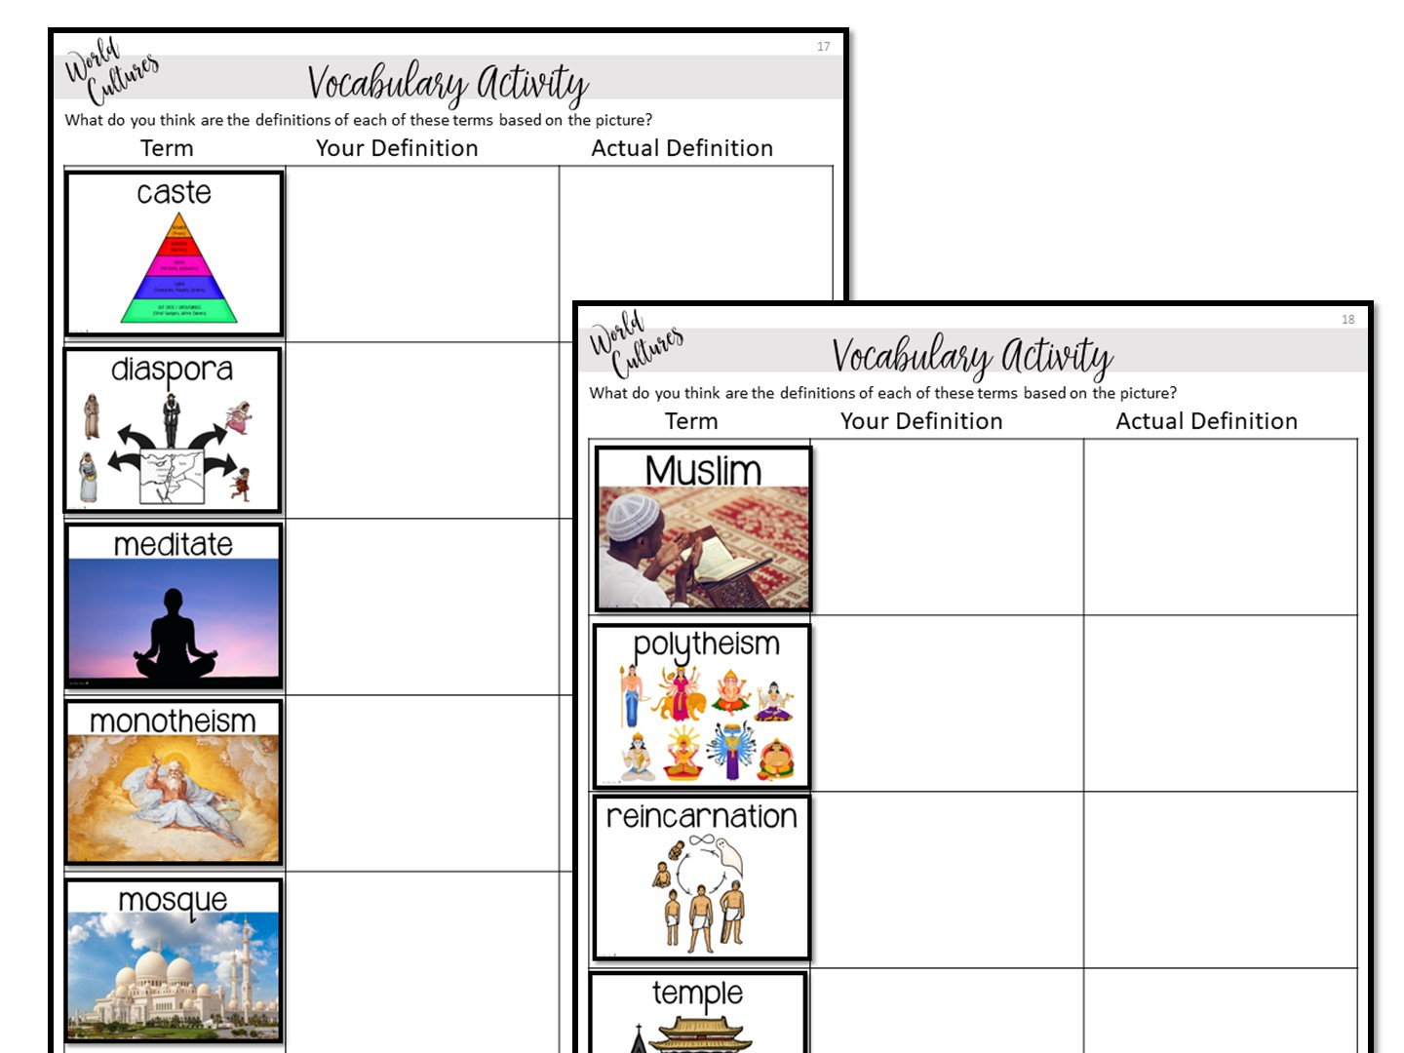
Notes:
Students can write definitions on vocabulary activity. We are not doing to save time.

Slide 51
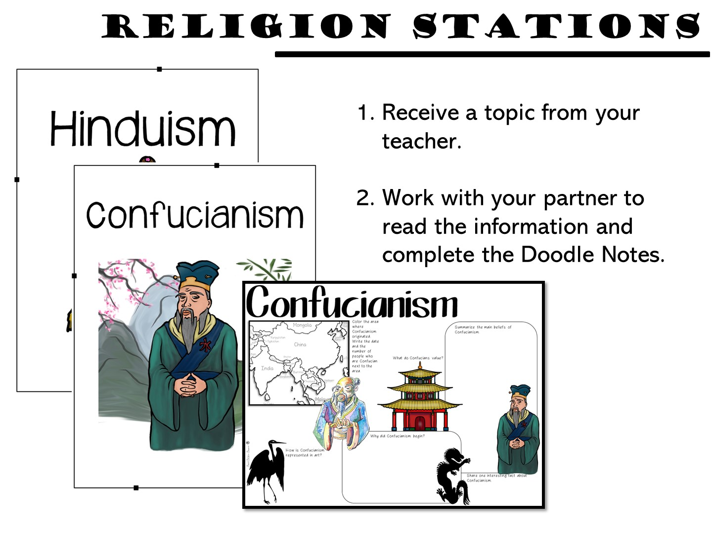

Slide 52
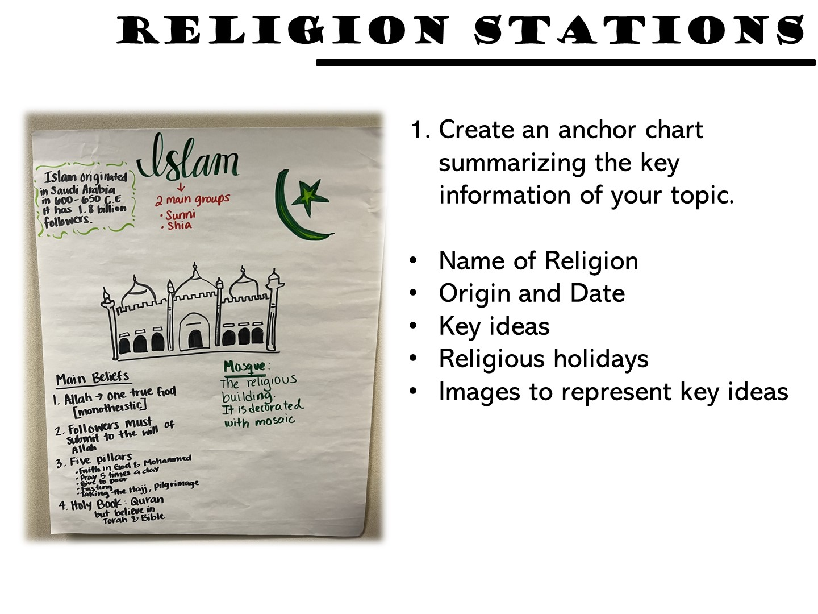
Notes:
Pass out chart paper to each group. They need to include the following information to make their anchor chart. Make sure to tell the Islam group not to draw Mohammed as it is offensive.

Slide 53
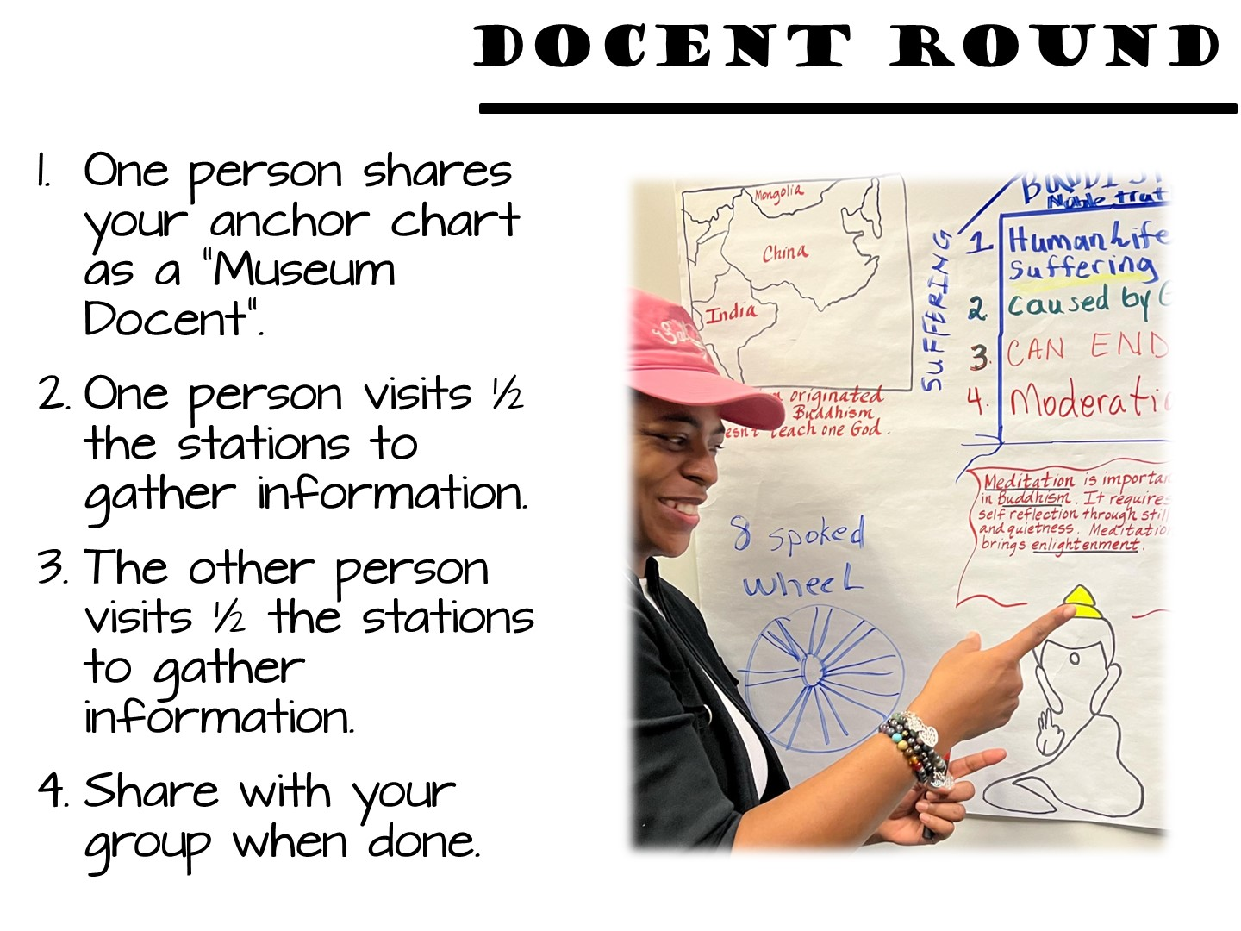
Notes:
One person stays to explain their anchor chart – the other two people go to visit other anchor charts to learn about their topic. They could take notes on Doodle Notes in the classroom, but for this workshop, just have them visit to learn. When they have had a chance to visit all of the stations, they come back and share what they have learned with the other members of the group.

Slide 54

Notes:
Create your FastPlay Pin for this set.

Slide 55

Notes:
Stand on one foot and summarize what you have learned so far to your partner.

Slide 56

Welcome to Social Studies Success! Please follow these directions for accessing your new resources. Go to www.SocialStudiesSuccess.com

Slide 57
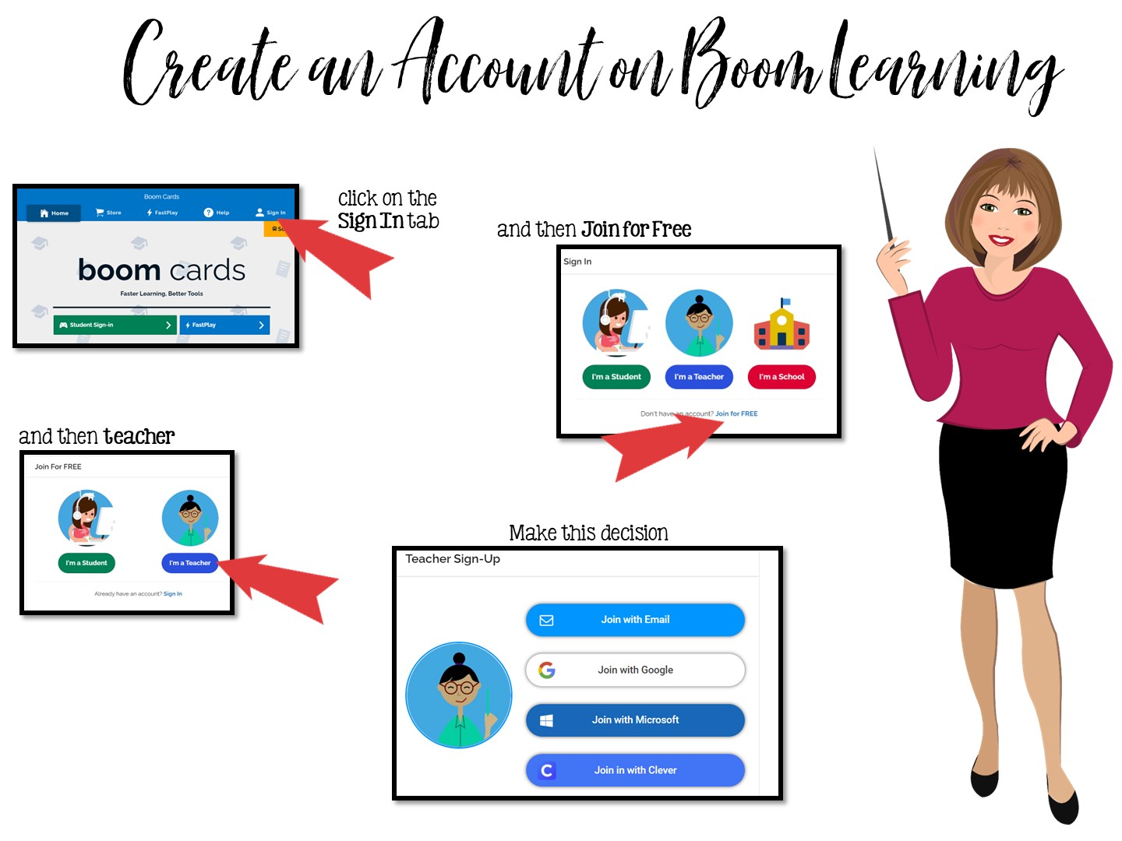
Go to www.boomlearning.com

Slide 58
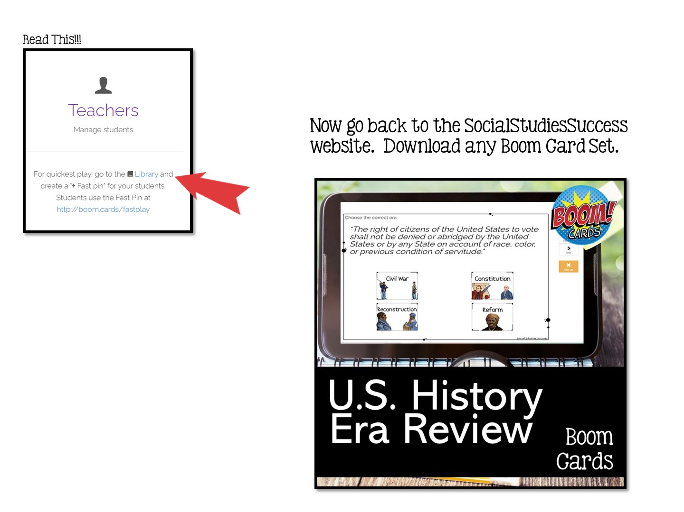

Slide 59


Slide 60
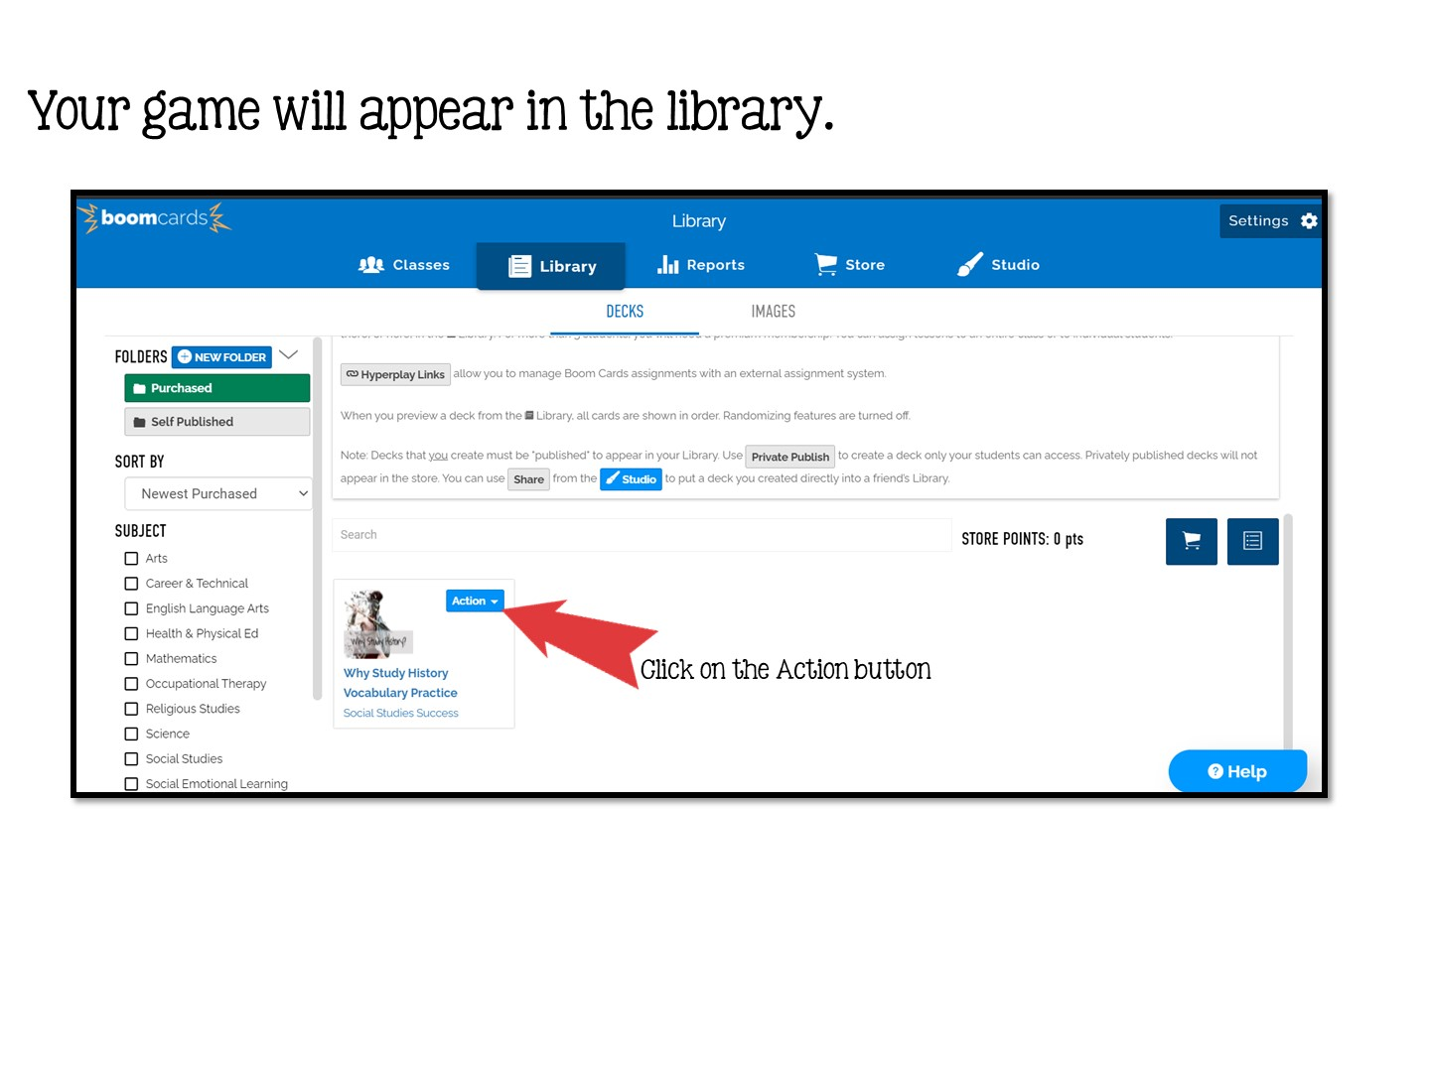

Slide 61
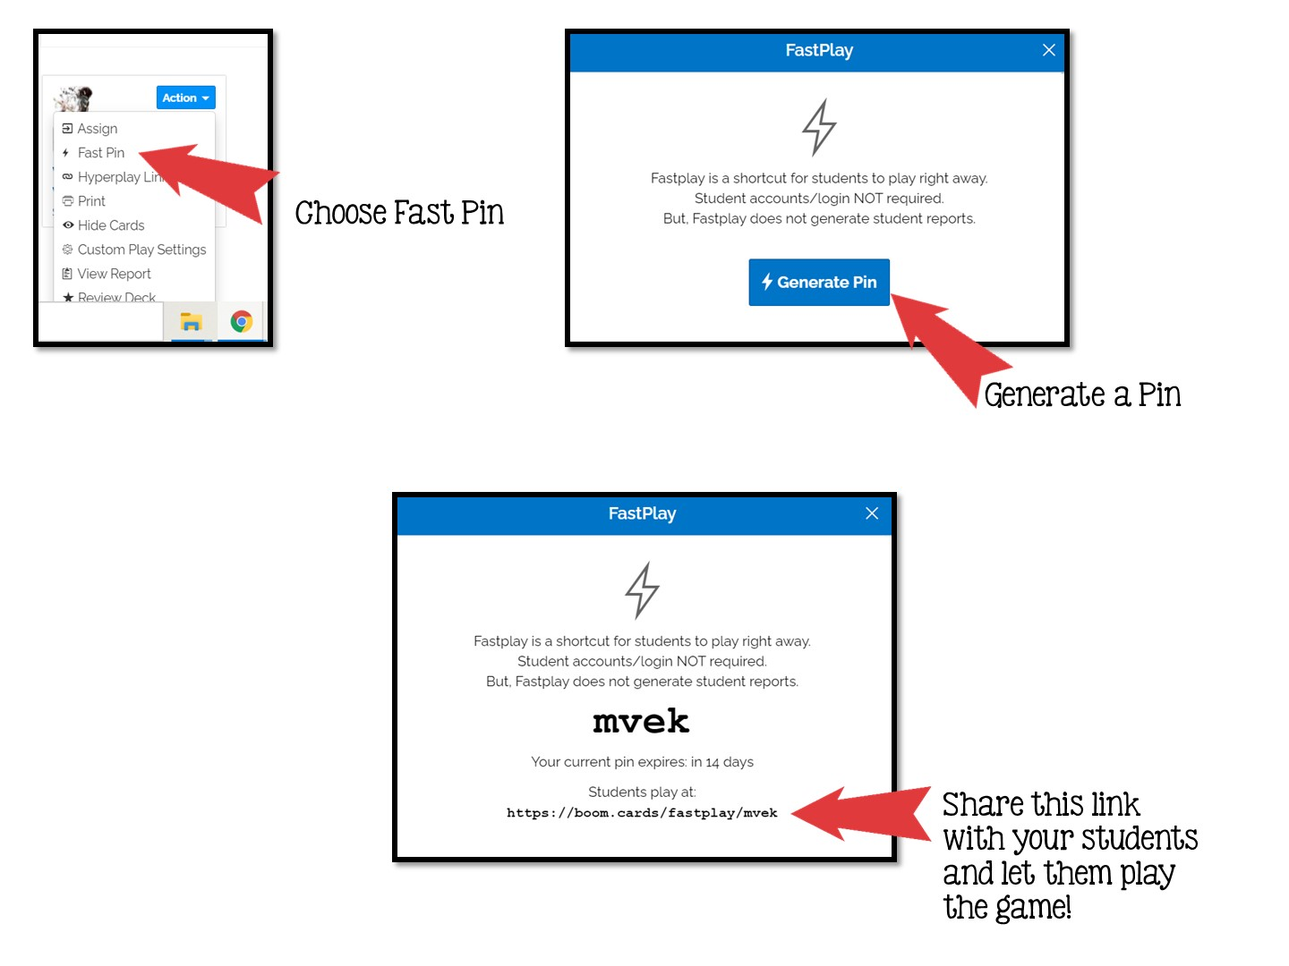

Slide 63


