Slide 1


Slide 2


Slide 3

Notes:
Introduce yourself

Slide 4

Notes:
Differentiated instruction is ensuring that learning happens in an accessible way for the student. ISNs allow the students to format their thoughts however they find suitable, thus, differentiating by learning styles — someone who loves writing can love in the notebooks, another student who would rather draw is free to express his/her ideas through diagrams, charts and pictures.

Slide 5

Notes:
Differentiated instruction is ensuring that learning happens in an accessible way for the student. ISNs allow the students to format their thoughts however they find suitable, thus, differentiating by learning styles — someone who loves writing can love in the notebooks, another student who would rather draw is free to express his/her ideas through diagrams, charts and pictures.

Slide 6
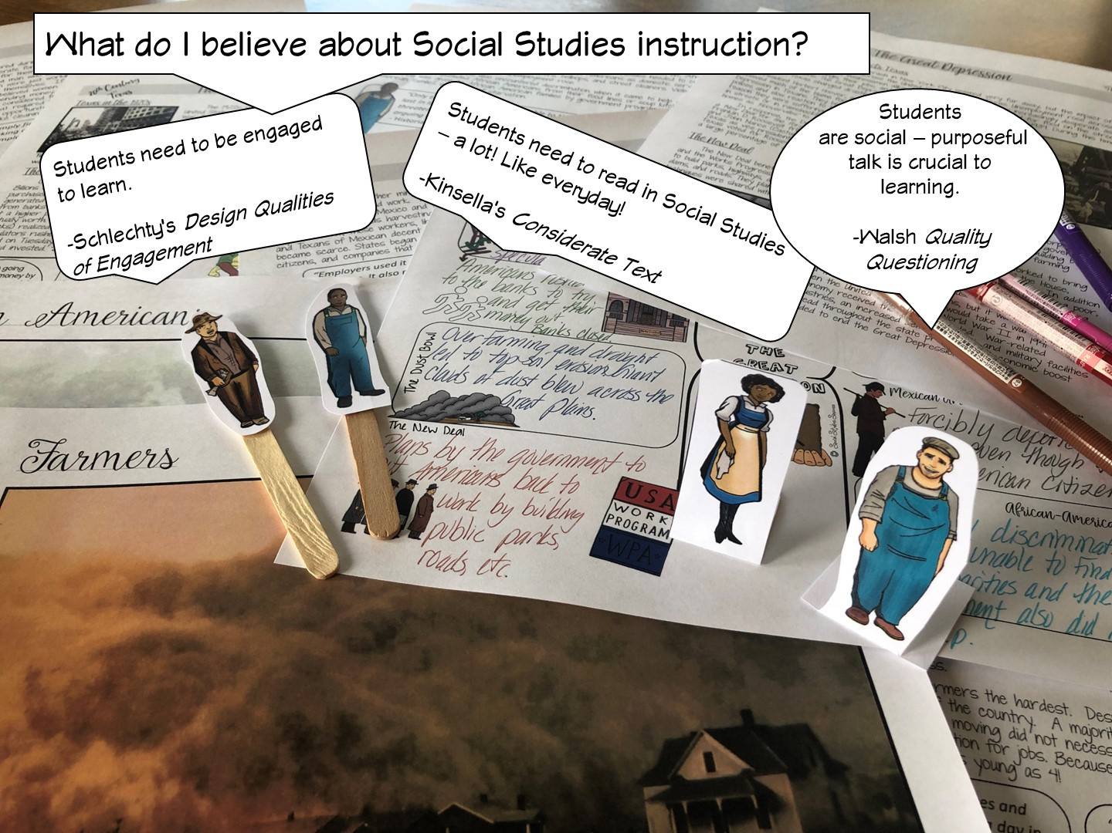
Notes:
Differentiated instruction is ensuring that learning happens in an accessible way for the student. ISNs allow the students to format their thoughts however they find suitable, thus, differentiating by learning styles — someone who loves writing can love in the notebooks, another student who would rather draw is free to express his/her ideas through diagrams, charts and pictures.

Slide 7
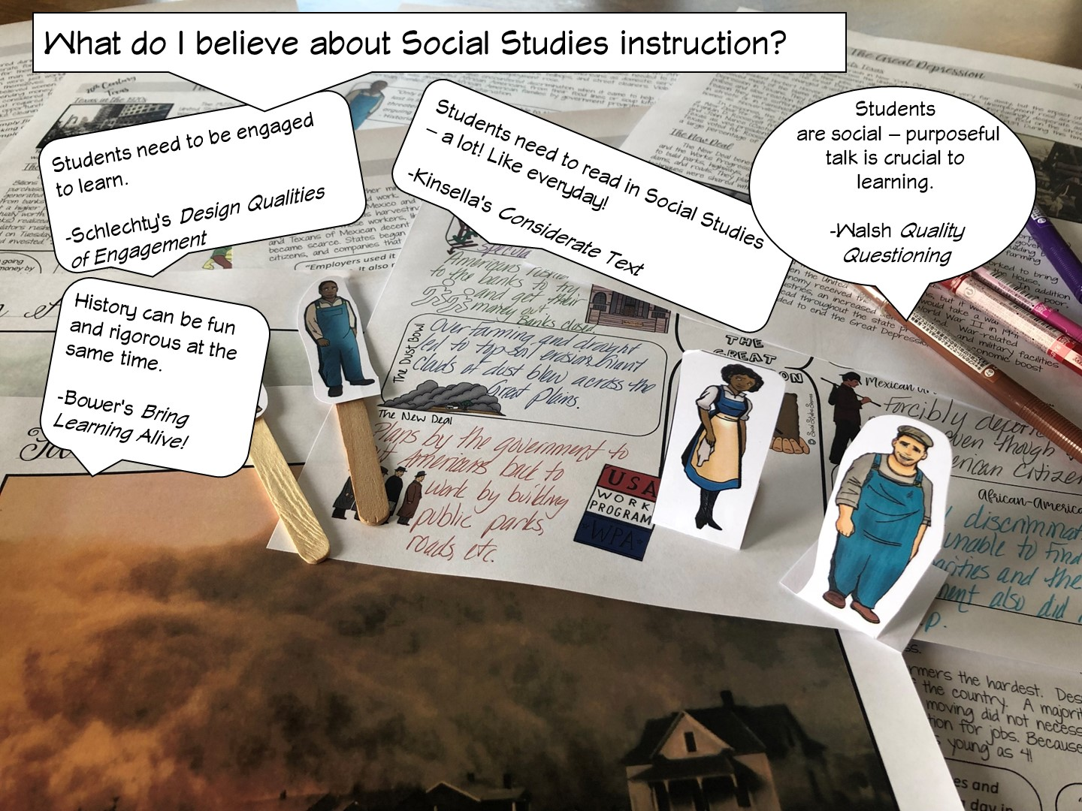
Notes:
Differentiated instruction is ensuring that learning happens in an accessible way for the student. ISNs allow the students to format their thoughts however they find suitable, thus, differentiating by learning styles — someone who loves writing can love in the notebooks, another student who would rather draw is free to express his/her ideas through diagrams, charts and pictures.

Slide 8

Notes:
Differentiated instruction is ensuring that learning happens in an accessible way for the student. ISNs allow the students to format their thoughts however they find suitable, thus, differentiating by learning styles — someone who loves writing can love in the notebooks, another student who would rather draw is free to express his/her ideas through diagrams, charts and pictures.

Slide 9
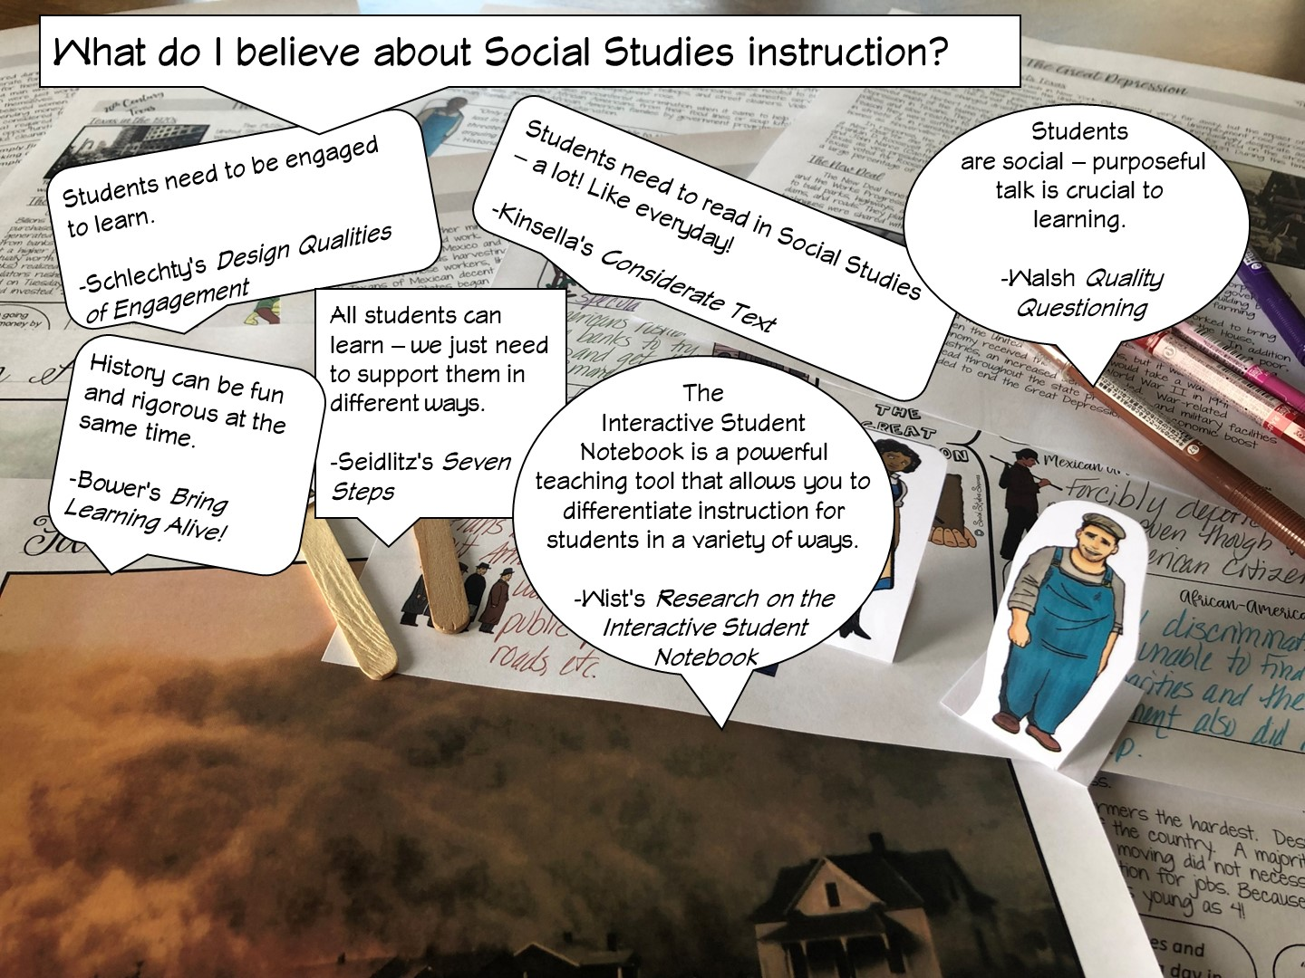
Notes:
Differentiated instruction is ensuring that learning happens in an accessible way for the student. ISNs allow the students to format their thoughts however they find suitable, thus, differentiating by learning styles — someone who loves writing can love in the notebooks, another student who would rather draw is free to express his/her ideas through diagrams, charts and pictures.

Slide 10
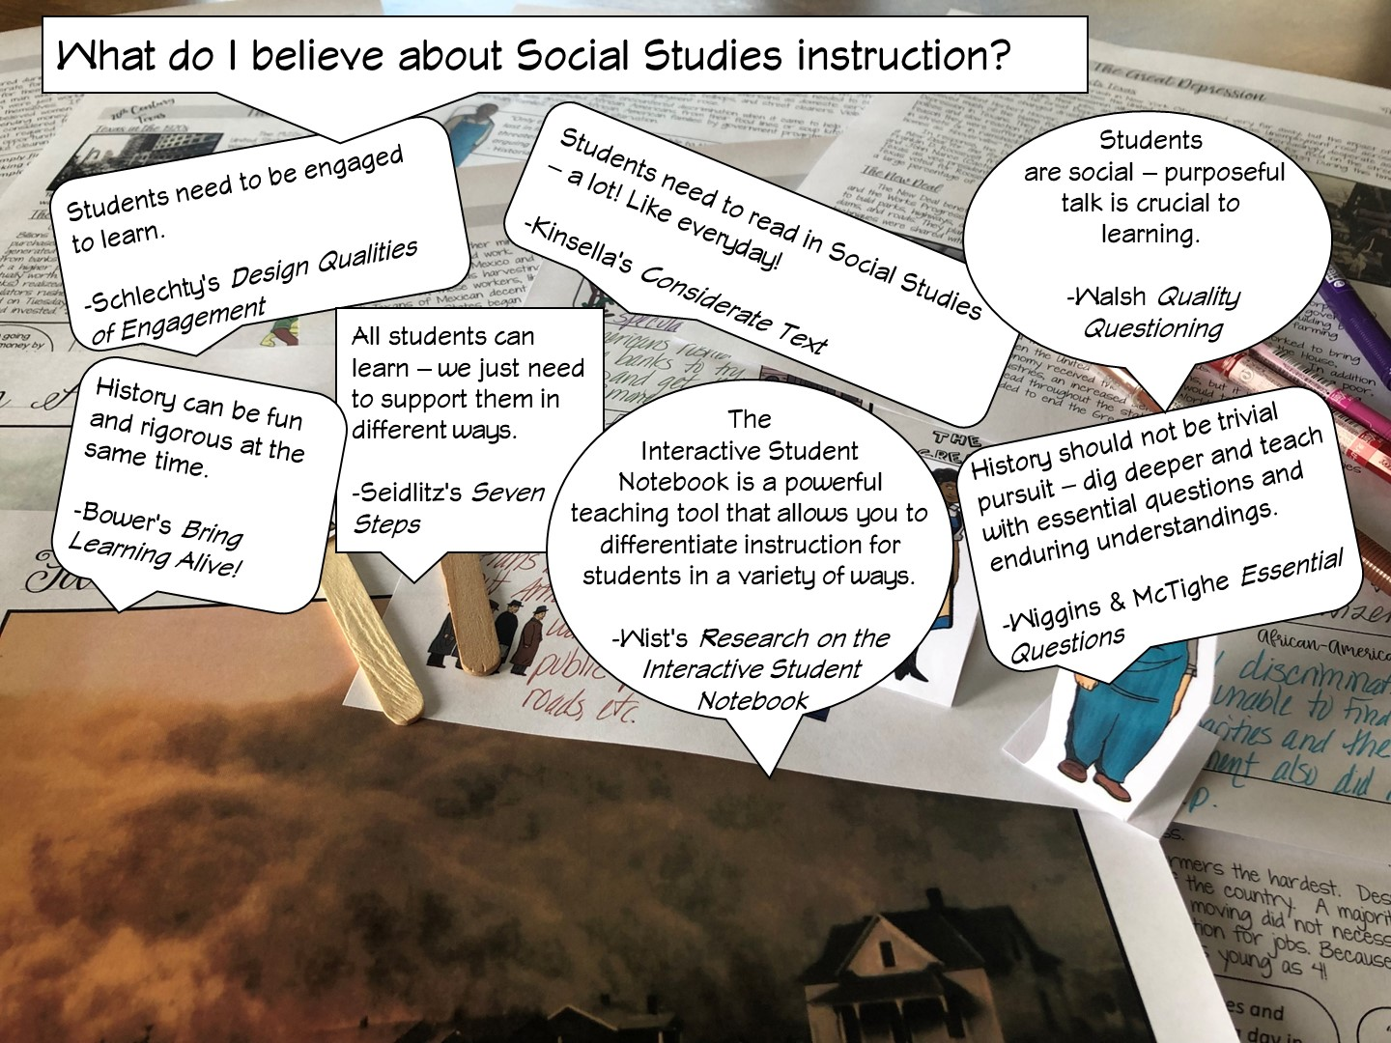
Notes:
Differentiated instruction is ensuring that learning happens in an accessible way for the student. ISNs allow the students to format their thoughts however they find suitable, thus, differentiating by learning styles — someone who loves writing can love in the notebooks, another student who would rather draw is free to express his/her ideas through diagrams, charts and pictures.

Slide 11
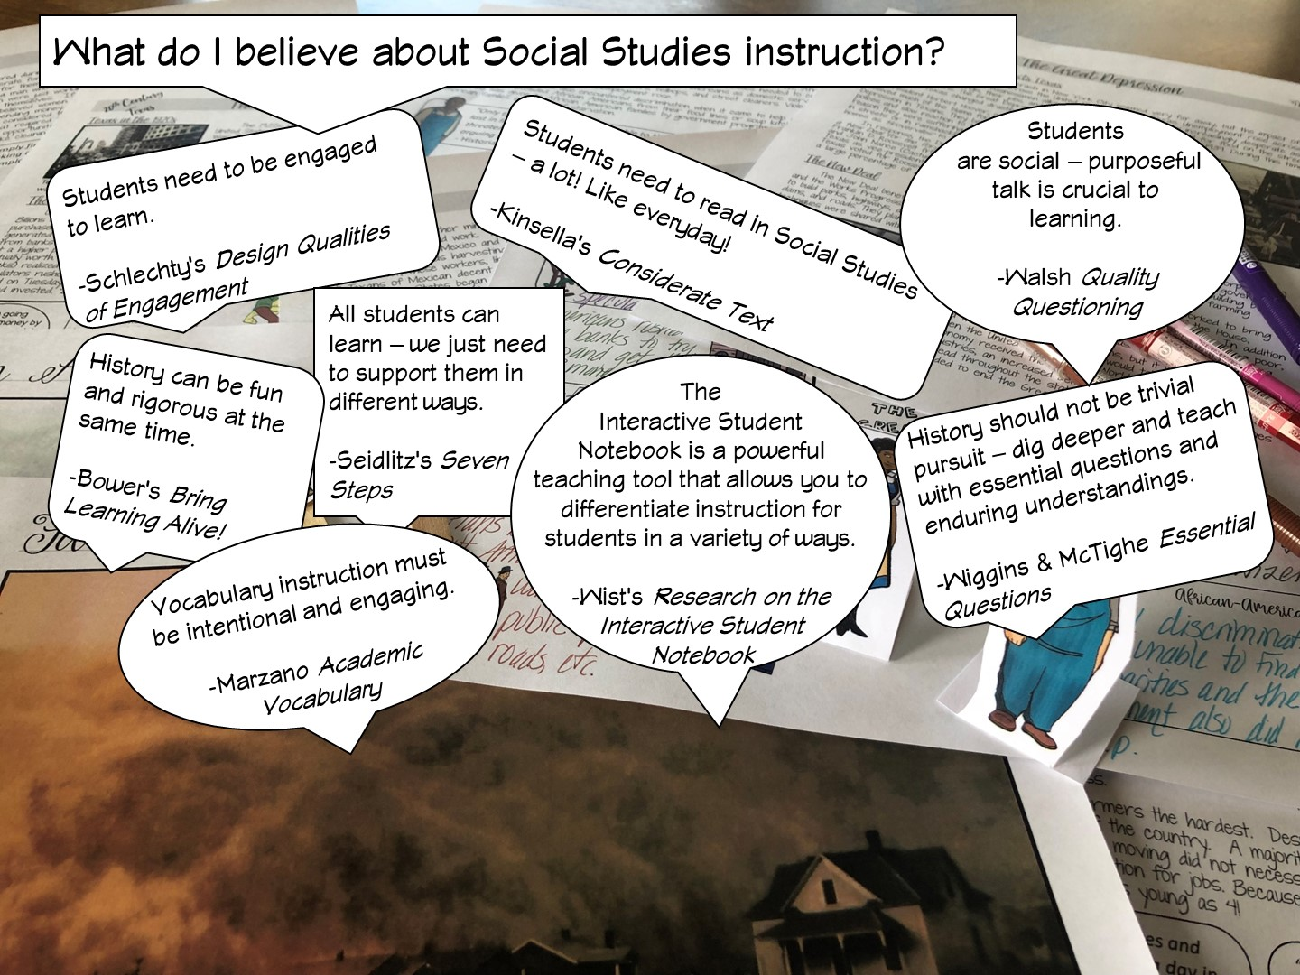
Notes:
Differentiated instruction is ensuring that learning happens in an accessible way for the student. ISNs allow the students to format their thoughts however they find suitable, thus, differentiating by learning styles — someone who loves writing can love in the notebooks, another student who would rather draw is free to express his/her ideas through diagrams, charts and pictures.

Slide 12
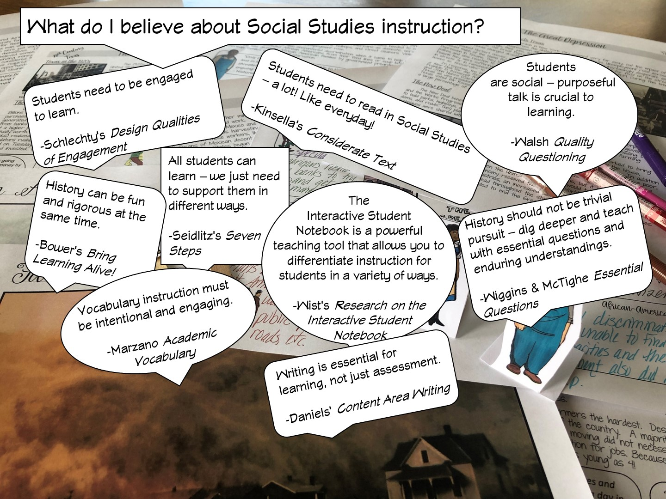
Notes:
Differentiated instruction is ensuring that learning happens in an accessible way for the student. ISNs allow the students to format their thoughts however they find suitable, thus, differentiating by learning styles — someone who loves writing can love in the notebooks, another student who would rather draw is free to express his/her ideas through diagrams, charts and pictures.

Slide 13
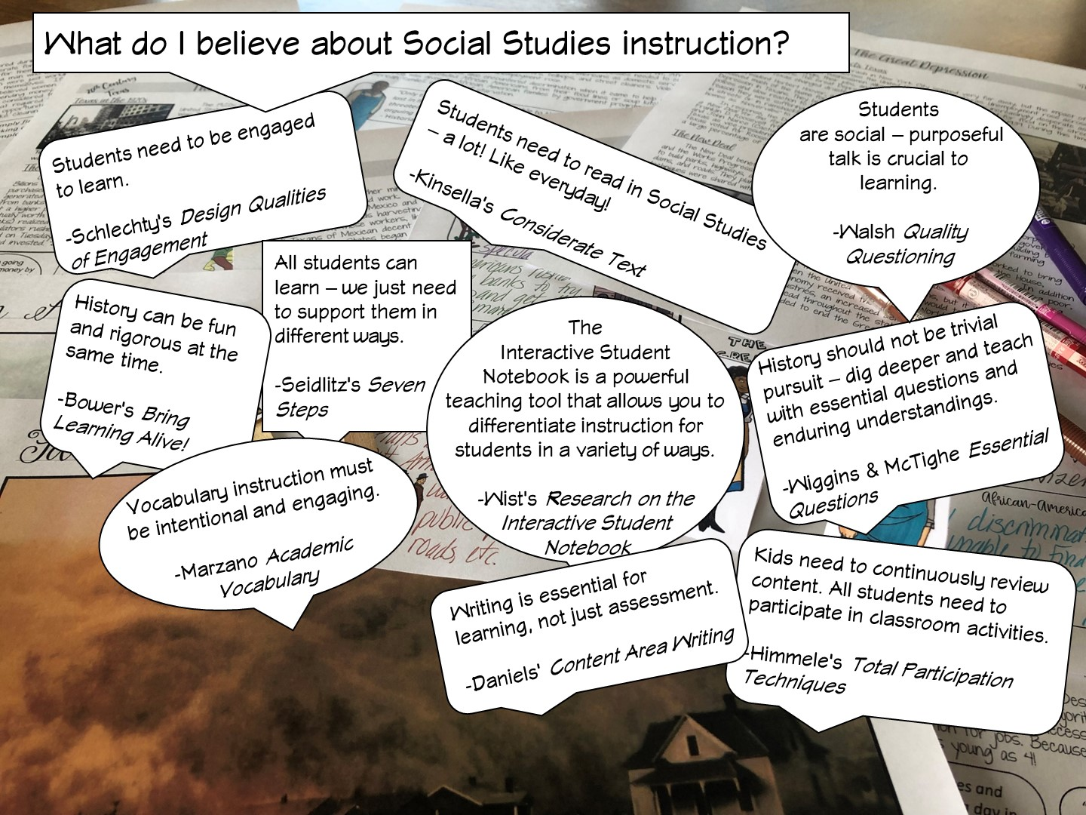
Notes:
Differentiated instruction is ensuring that learning happens in an accessible way for the student. ISNs allow the students to format their thoughts however they find suitable, thus, differentiating by learning styles — someone who loves writing can love in the notebooks, another student who would rather draw is free to express his/her ideas through diagrams, charts and pictures.

Slide 14
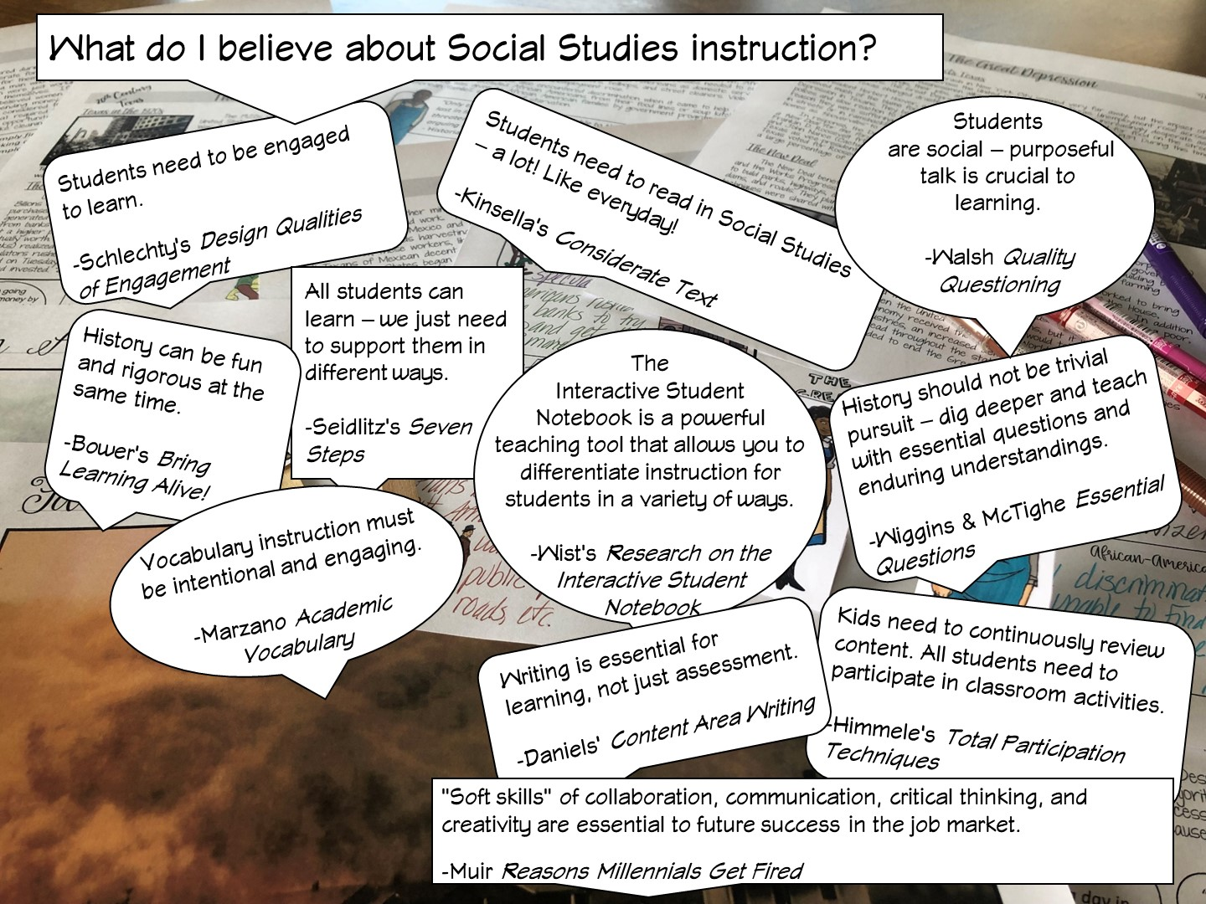
Notes:
Differentiated instruction is ensuring that learning happens in an accessible way for the student. ISNs allow the students to format their thoughts however they find suitable, thus, differentiating by learning styles — someone who loves writing can love in the notebooks, another student who would rather draw is free to express his/her ideas through diagrams, charts and pictures.

Slide 15
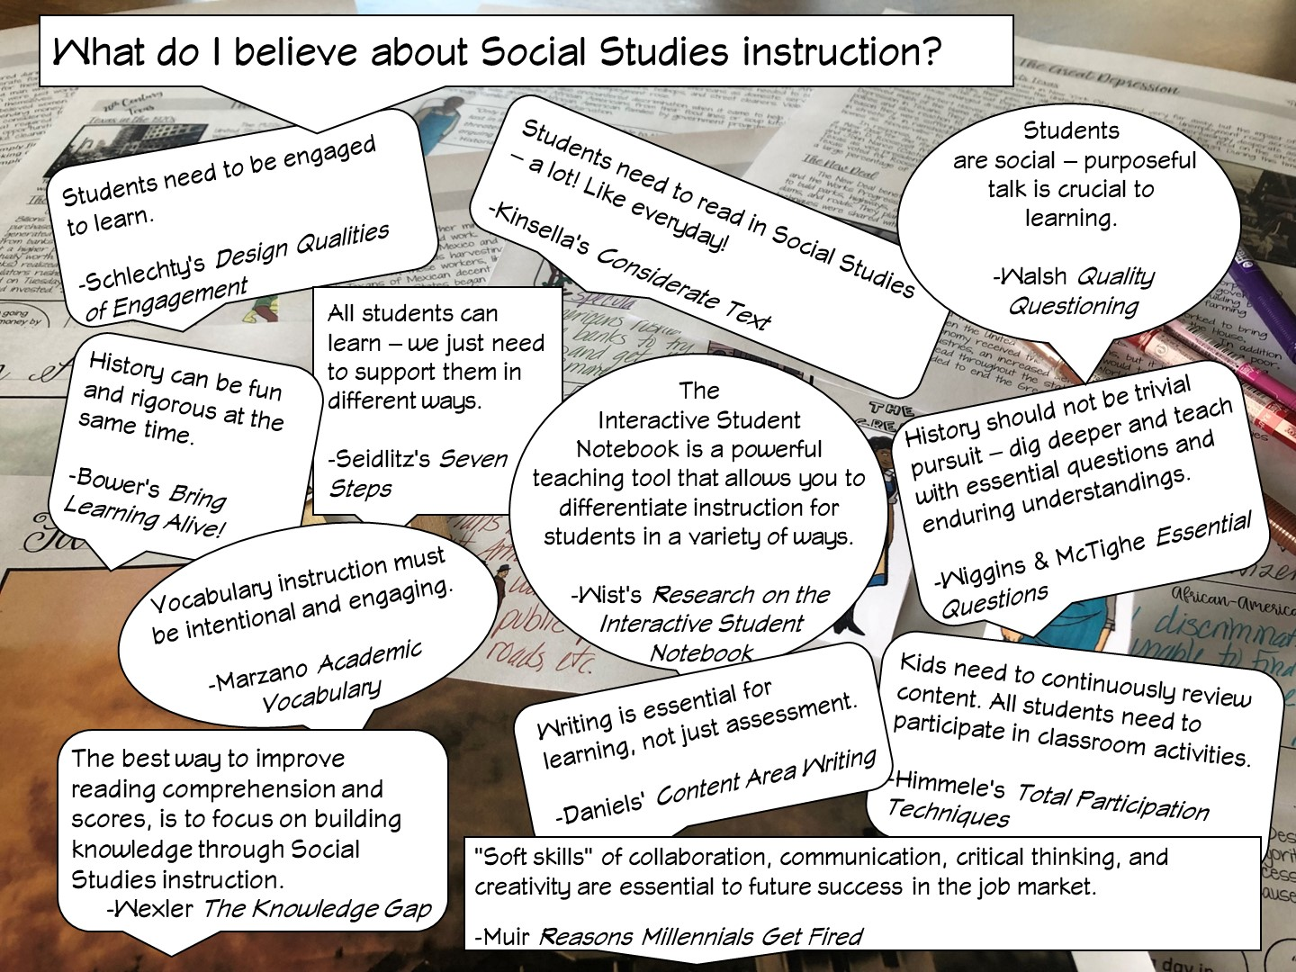
Notes:
Differentiated instruction is ensuring that learning happens in an accessible way for the student. ISNs allow the students to format their thoughts however they find suitable, thus, differentiating by learning styles — someone who loves writing can love in the notebooks, another student who would rather draw is free to express his/her ideas through diagrams, charts and pictures.

Slide 16

Notes:
History teachers are the guardians of democracy

Slide 17


Slide 18


Slide 19

Notes:
Pass out handout on supporting GT Students. Once they have had a chance to write some ideas, hand out the envelopes with the GT sentences and add to the list.

Slide 20
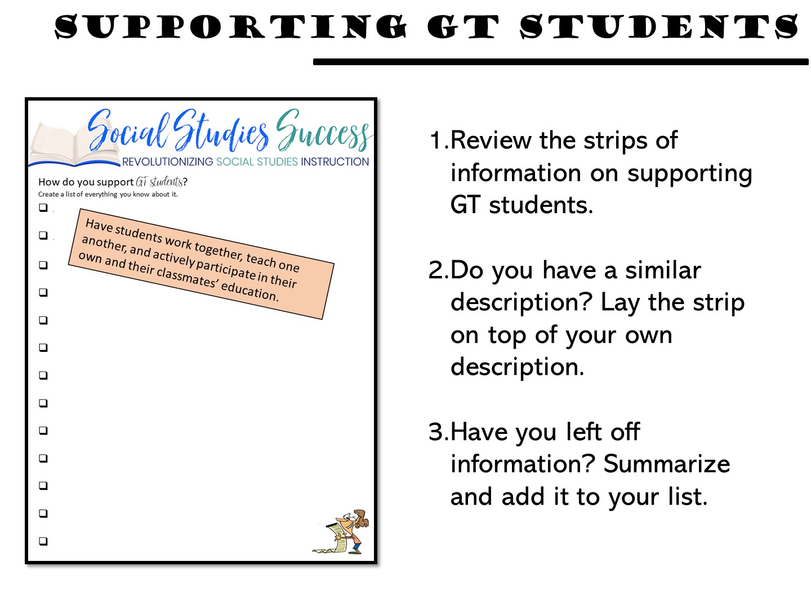
Notes:
Get with a partner Take the envelope of information about supporting GT Students
Lay each strip on top of your bulleted list if it is similar
Discuss – what was left off?
Create your own definition of formative assessment

Slide 21


Slide 22
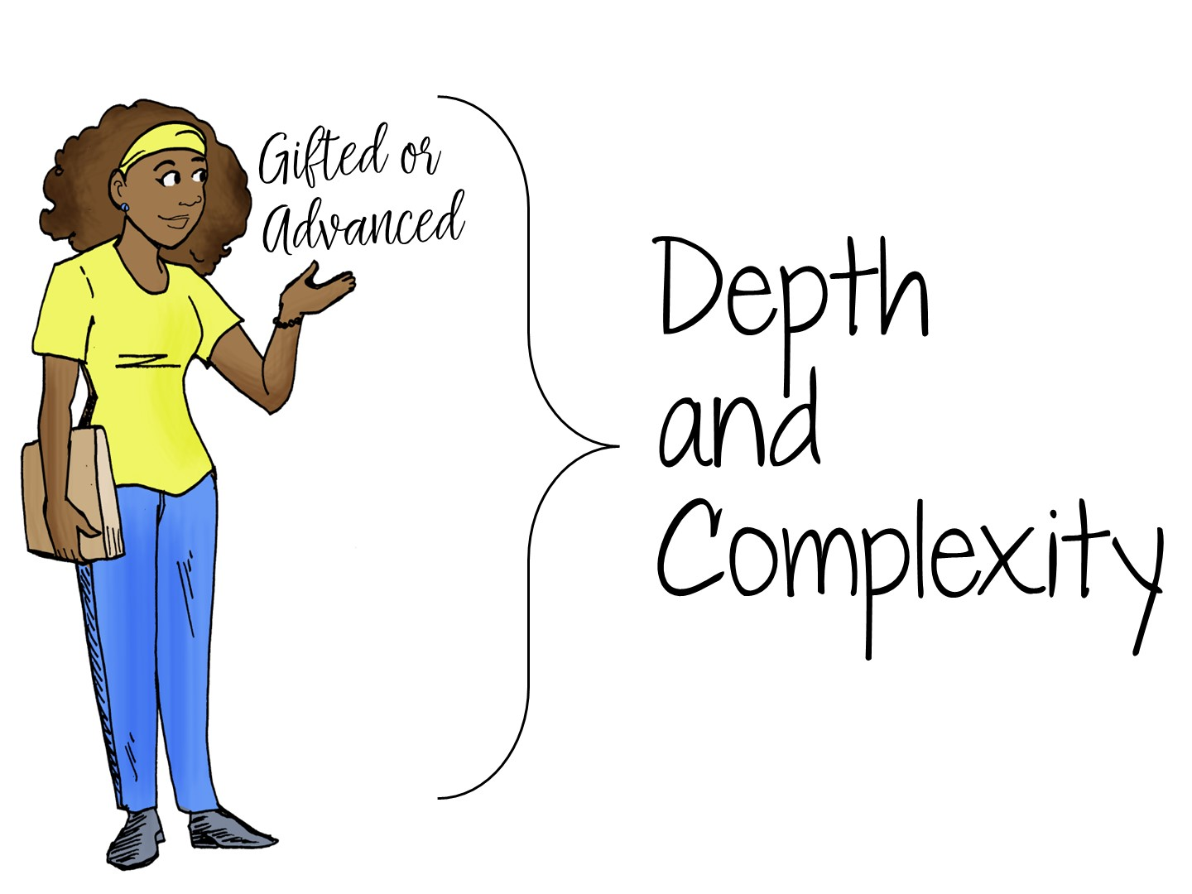
Notes:
We are now going to explore the concept of adding depth and complexity to our assignments.

Slide 23
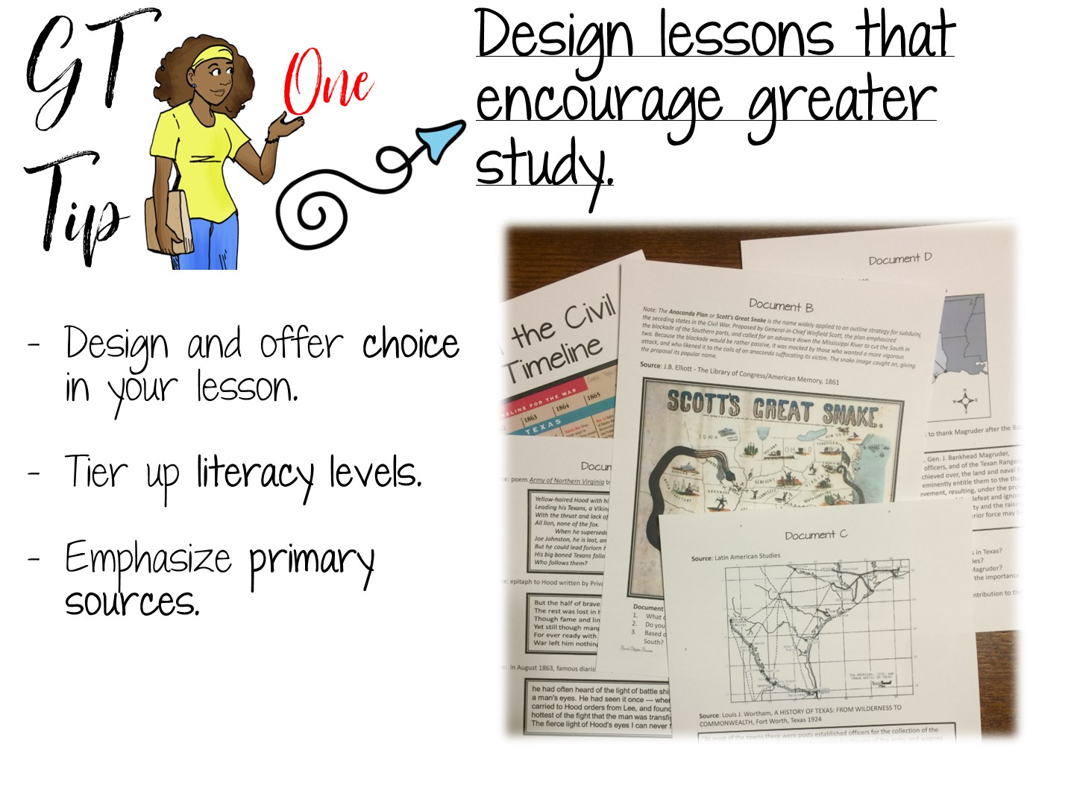

Slide 24


Slide 25


Slide 26
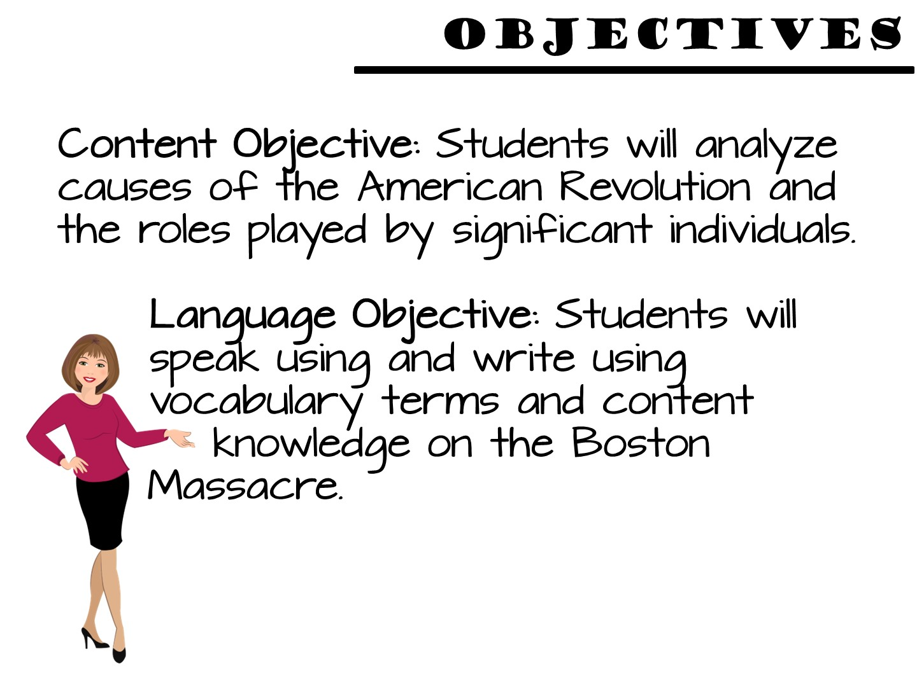
Notes:
analyze the political, economic, and social impact of World War I, the Great Depression, World War II, and significant issues in the latter half of the 20th and early 2
(B) explain ways in which geographic factors such as the Galveston Hurricane of 1900, the Dust Bowl, limited water resources, and alternative energy sources have affected the political, economic, and social development of Texas.
1st centuries such as political and economic controversies, immigration, and migration on the history of Texas.

Slide 27


Slide 28
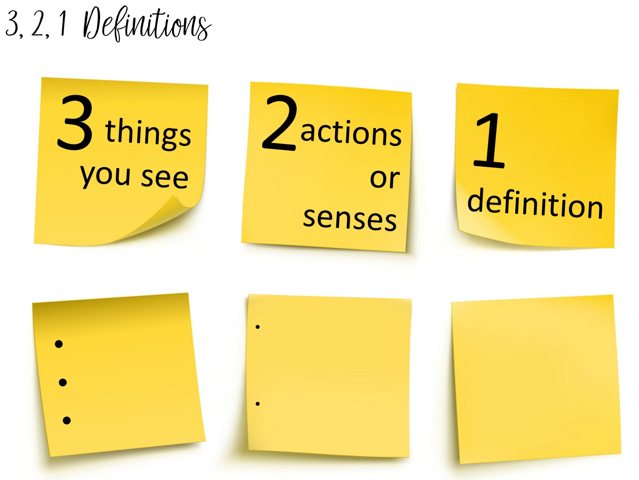
Notes:
Allow them to pick a term with a partner and complete the 3, 2, 1 definition. I always bring the teachers close to word wall to get them out of their seats.

Slide 29
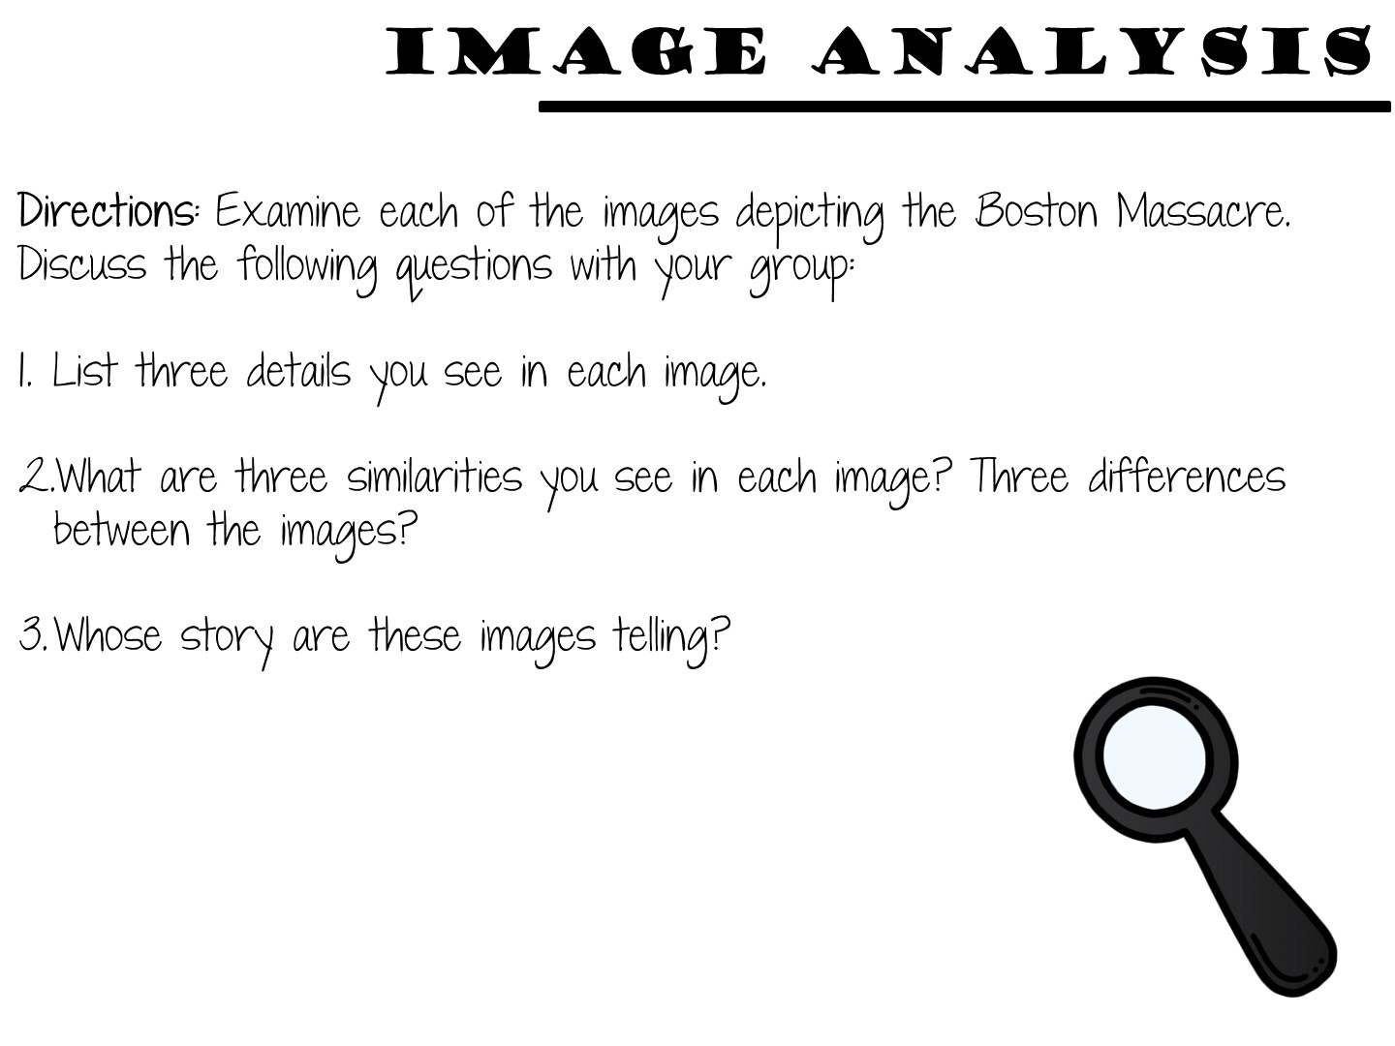

Slide 30
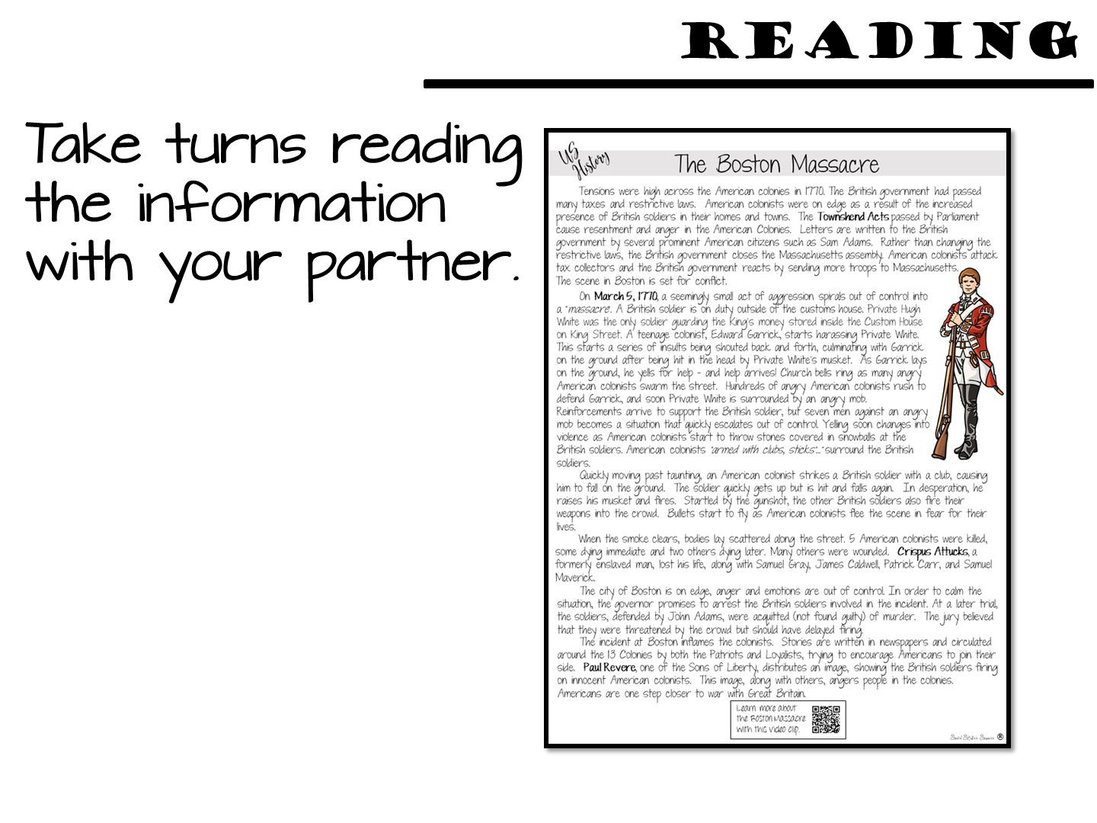

Slide 31


Slide 32
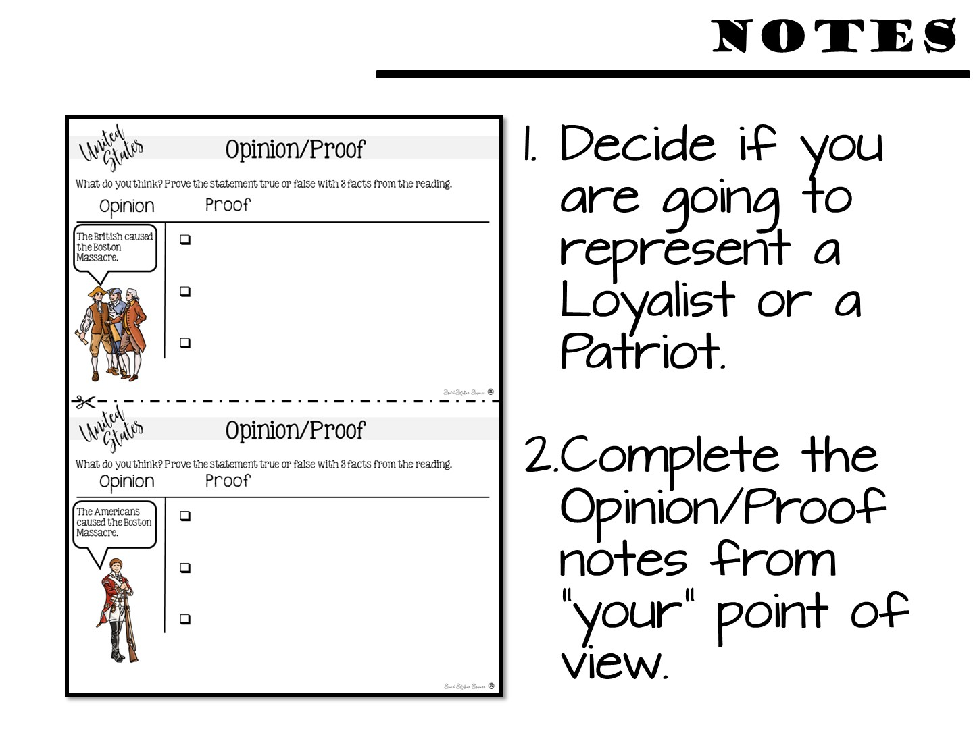

Slide 33
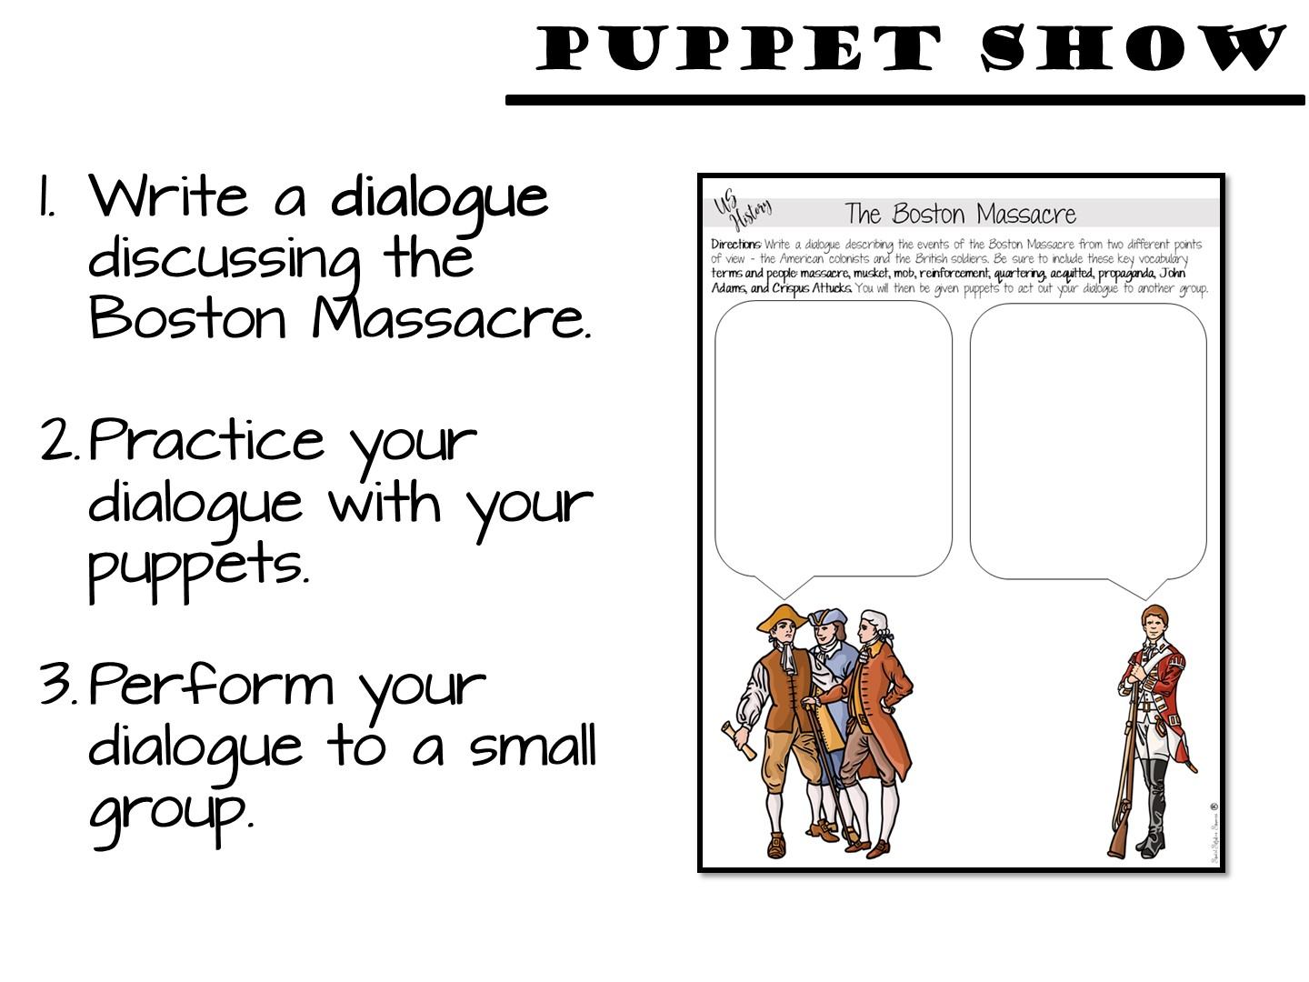

Slide 34
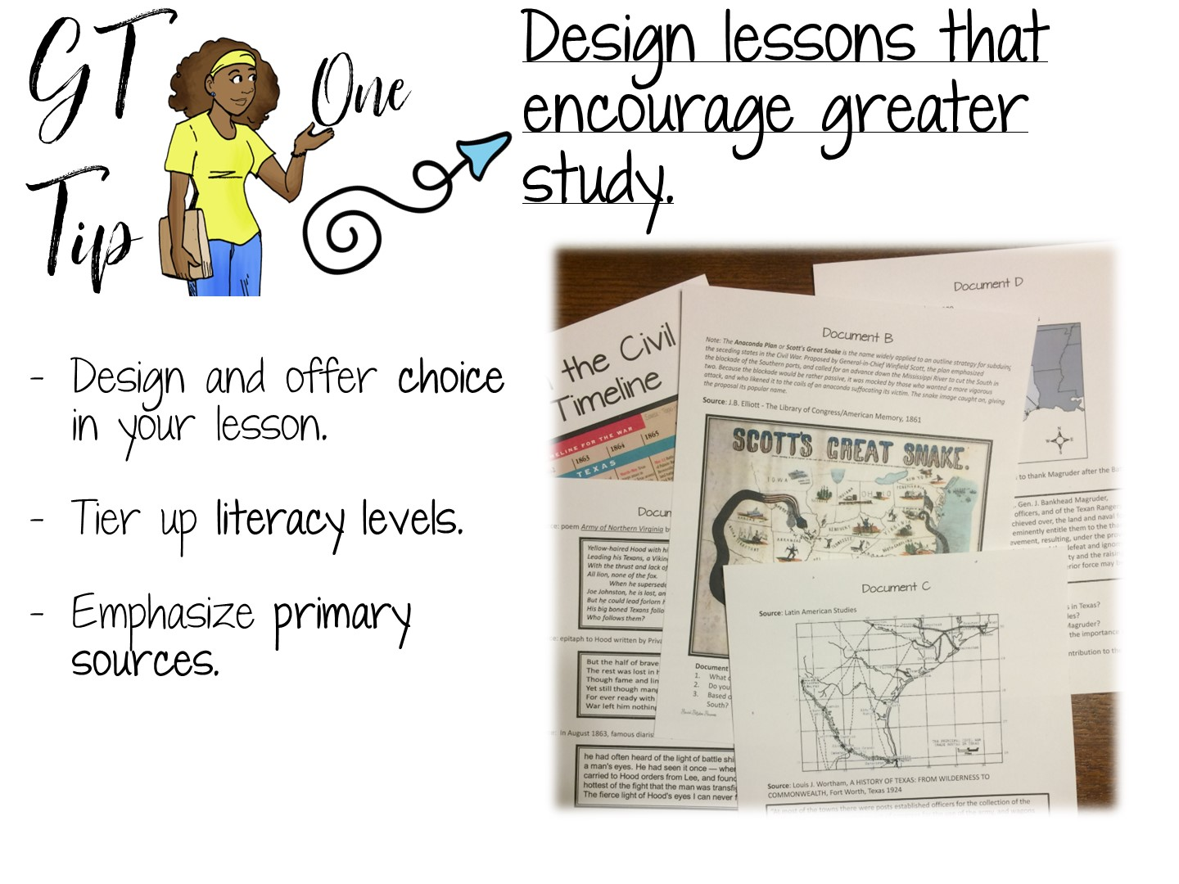
Notes:
Reflect on how the model lesson showcased each of these elements.
Now we are going to look at some additional ways to support these elements.

Slide 35
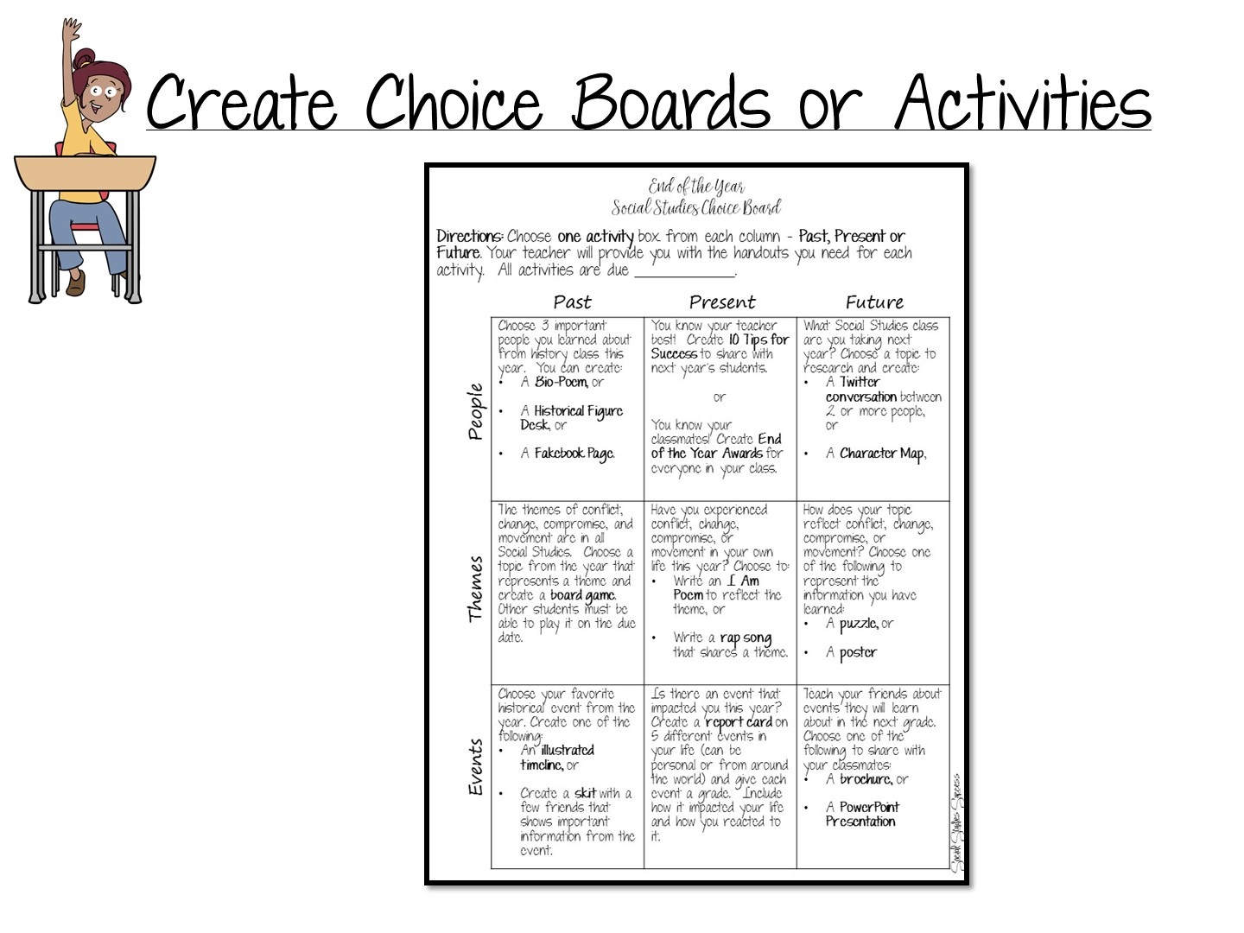
Notes:
Additional ideas for greater study -

Slide 36
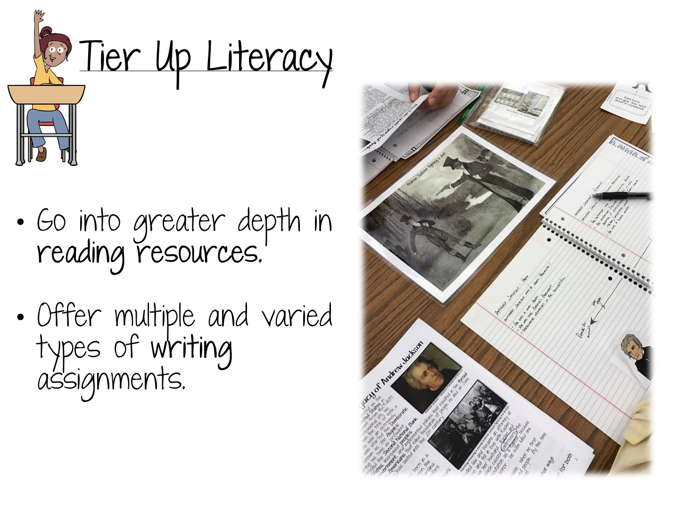

Slide 37
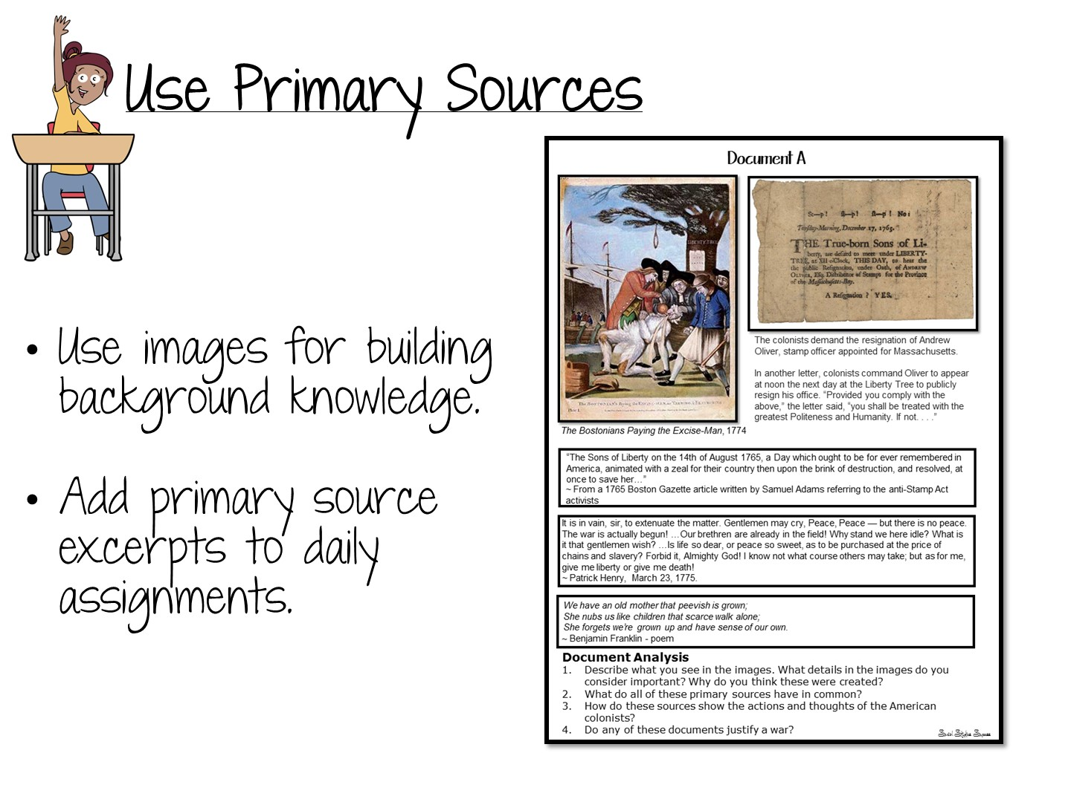

Slide 38


Slide 39

Notes:
39
Pair participants.
One person stands on one leg and shares everything they have learned about before reading strategies.
When that person loses her balance (or runs out of things to say), the other person stands on one leg & shares what she knows.
Gets blood flowing & usually keeps summaries short – people can’t maintain their balance & think. Plus it is funny to watch!

Slide 40
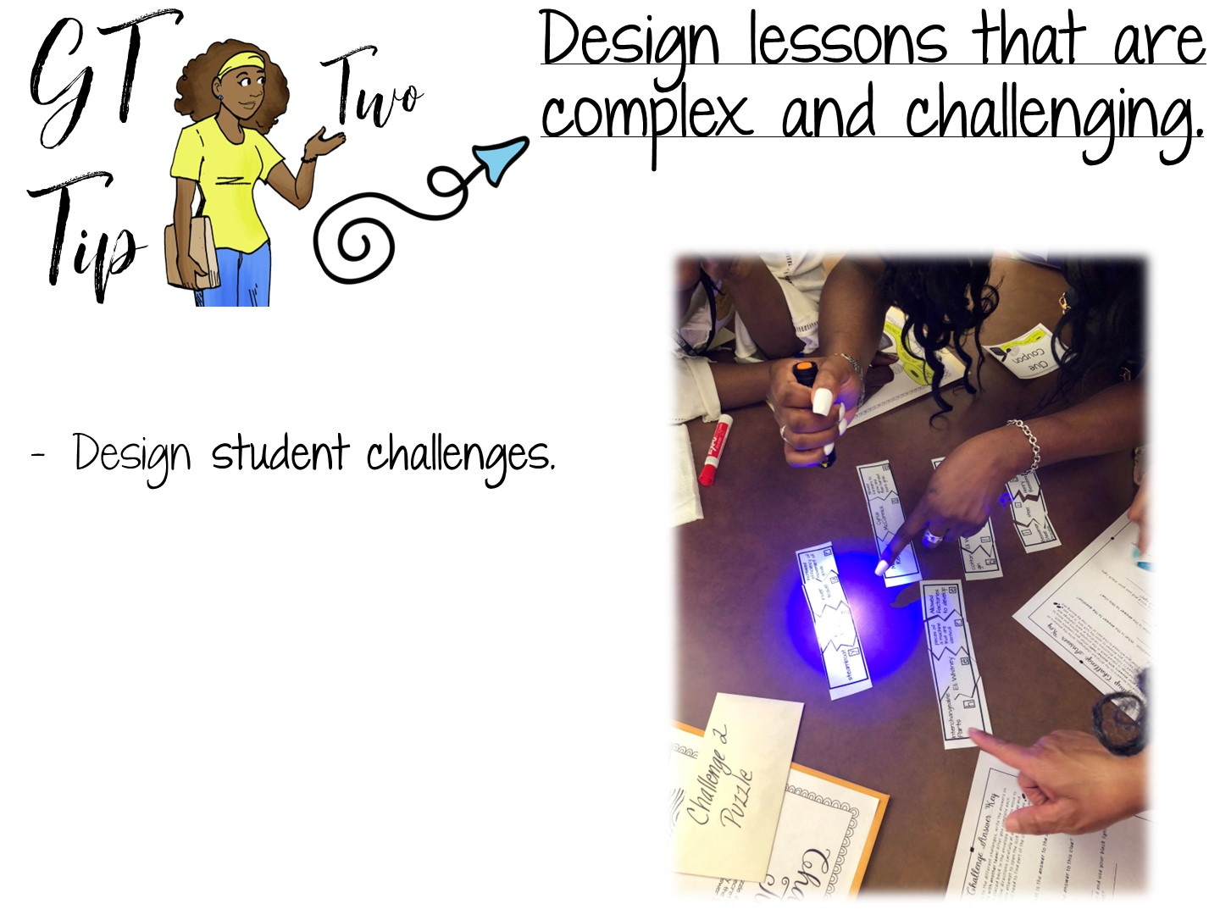

Slide 41
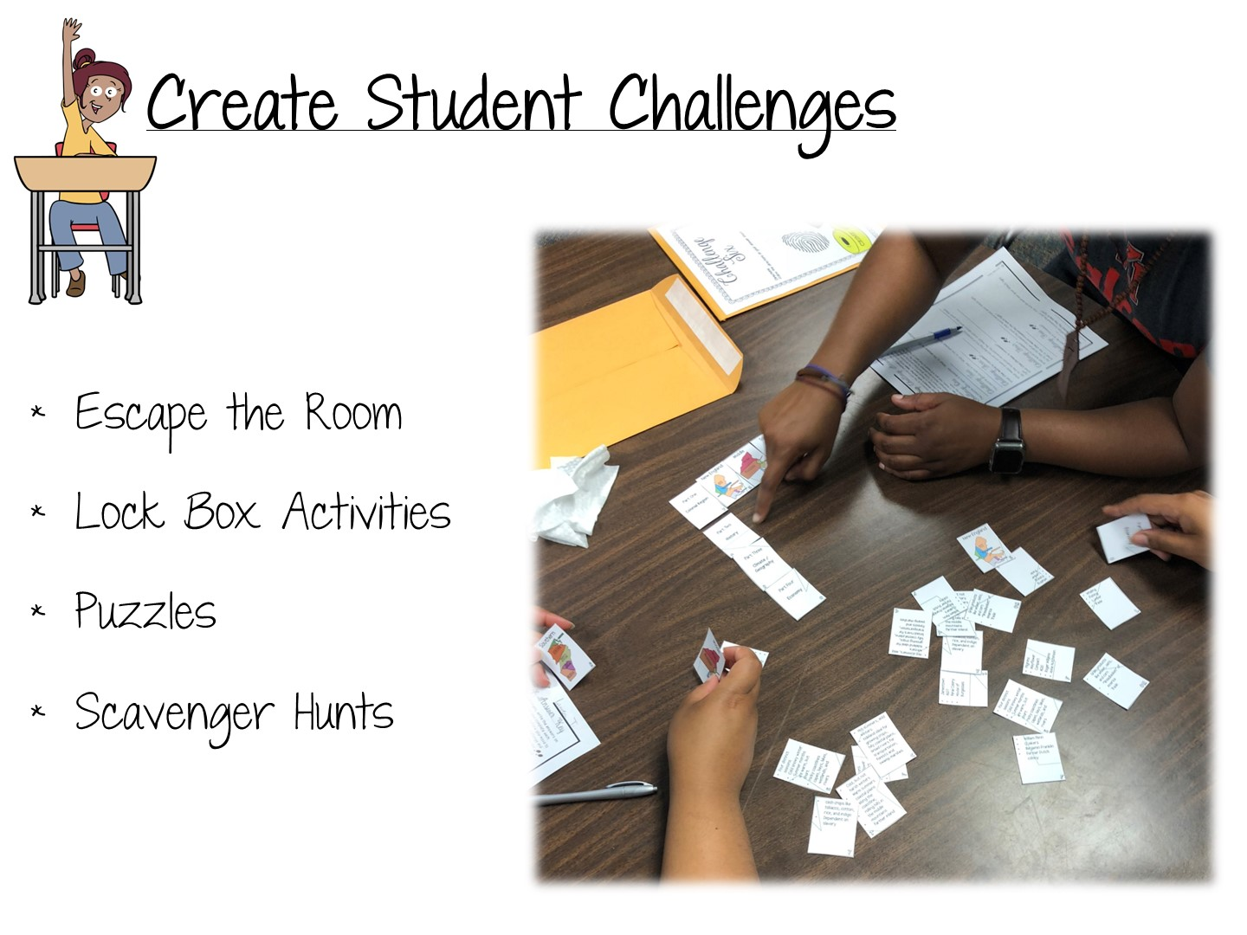

Slide 42

Notes:
The sample we are going to do next is a scavenger hunt that relies heavily on inferencing.

Slide 43
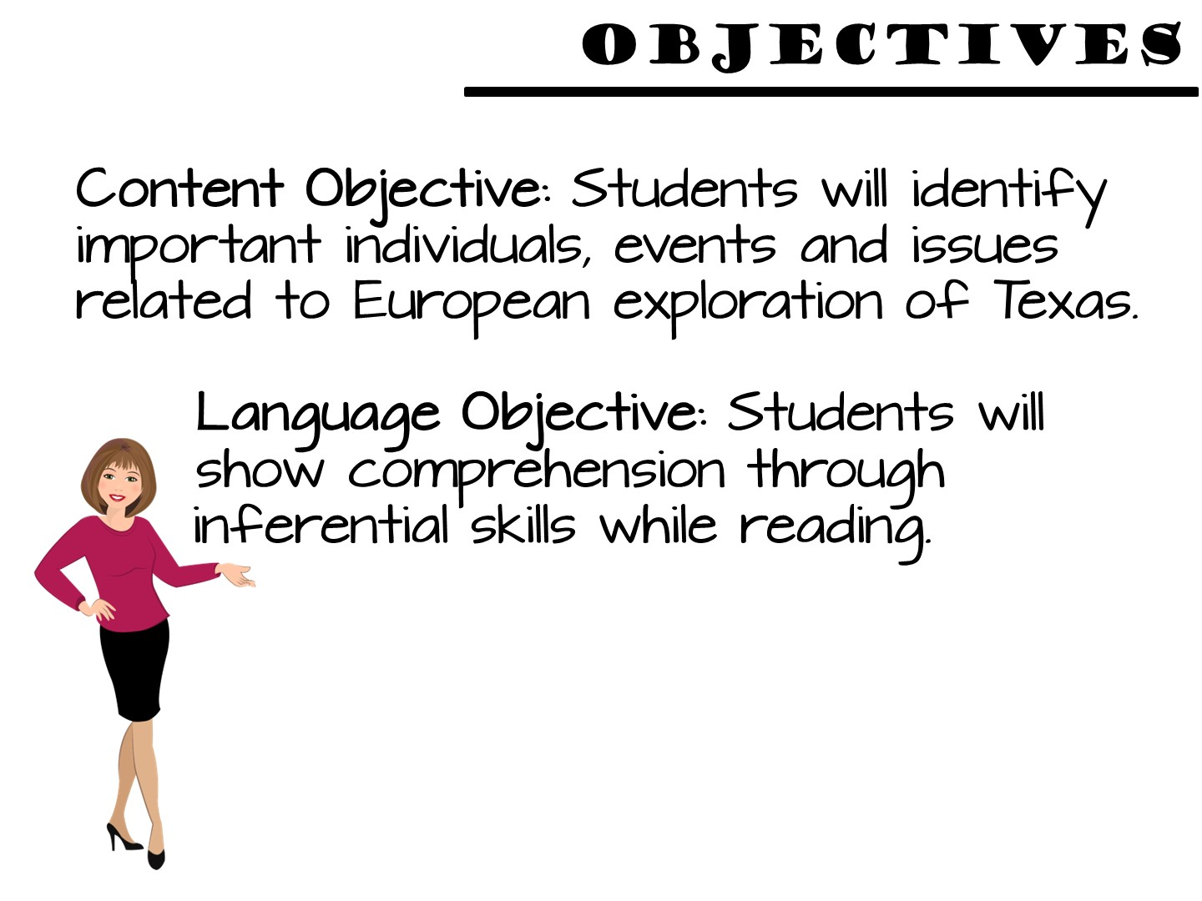

Slide 44
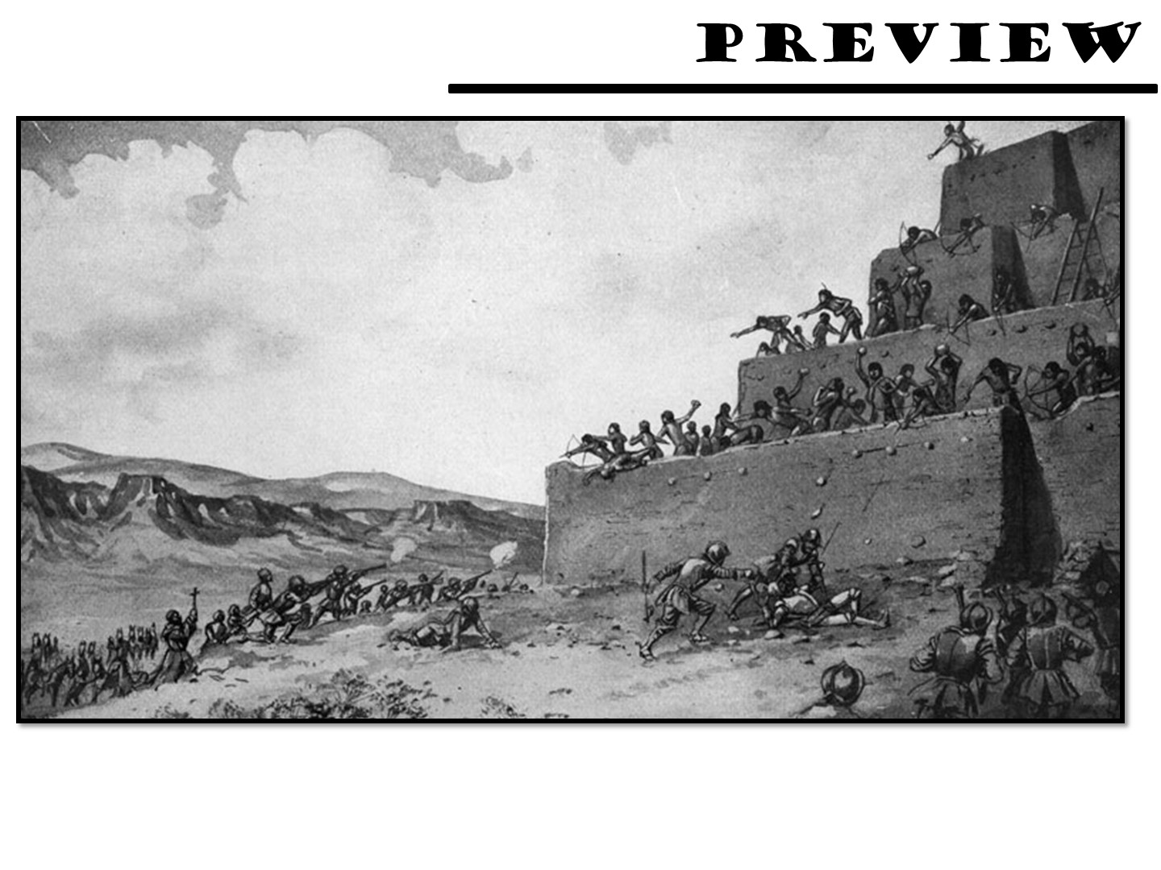
Notes:
Project this image and ask the students to discuss what they see.

Slide 45
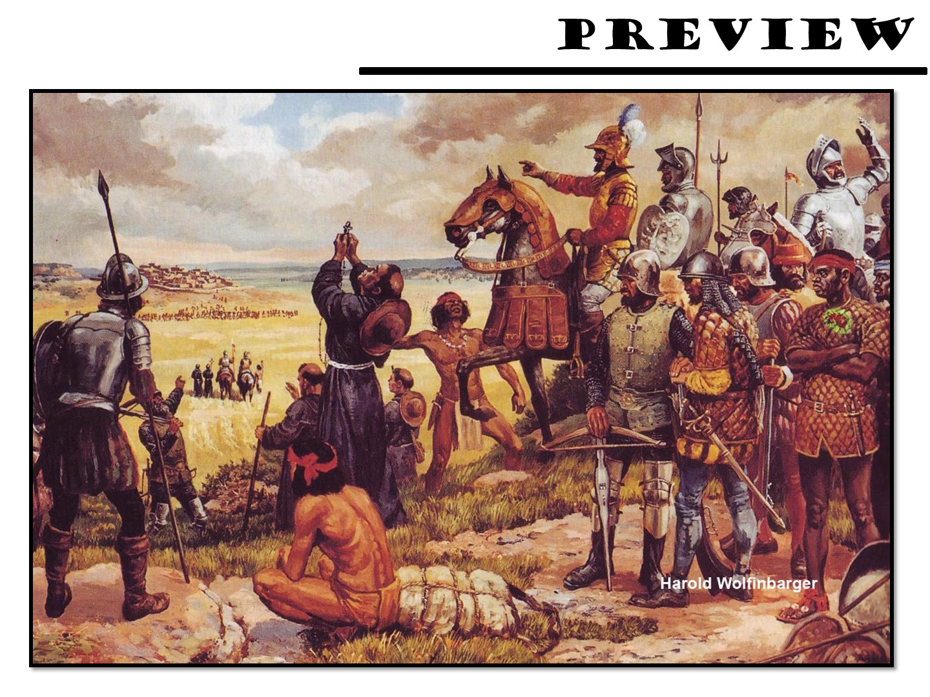
Notes:
Project this image and ask the students to discuss what they see.

Slide 46
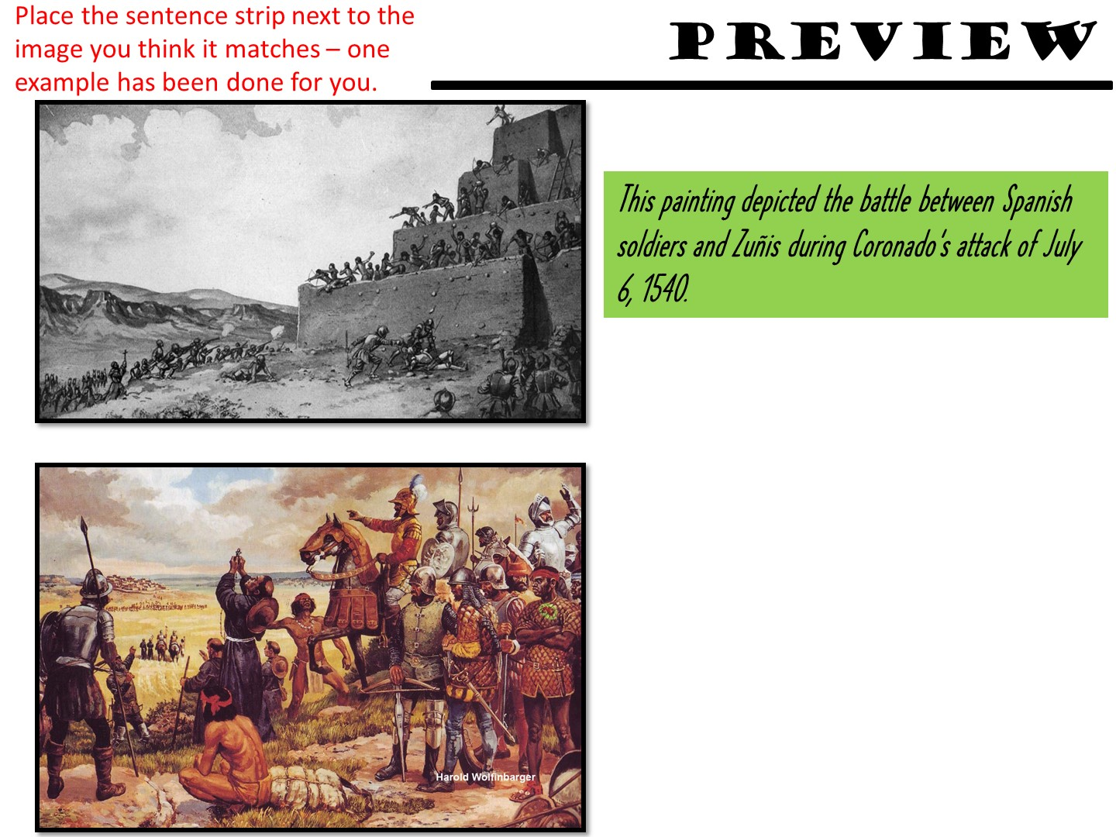
Notes:
Give students time to match sentences to pictures. Debrief.

Slide 47
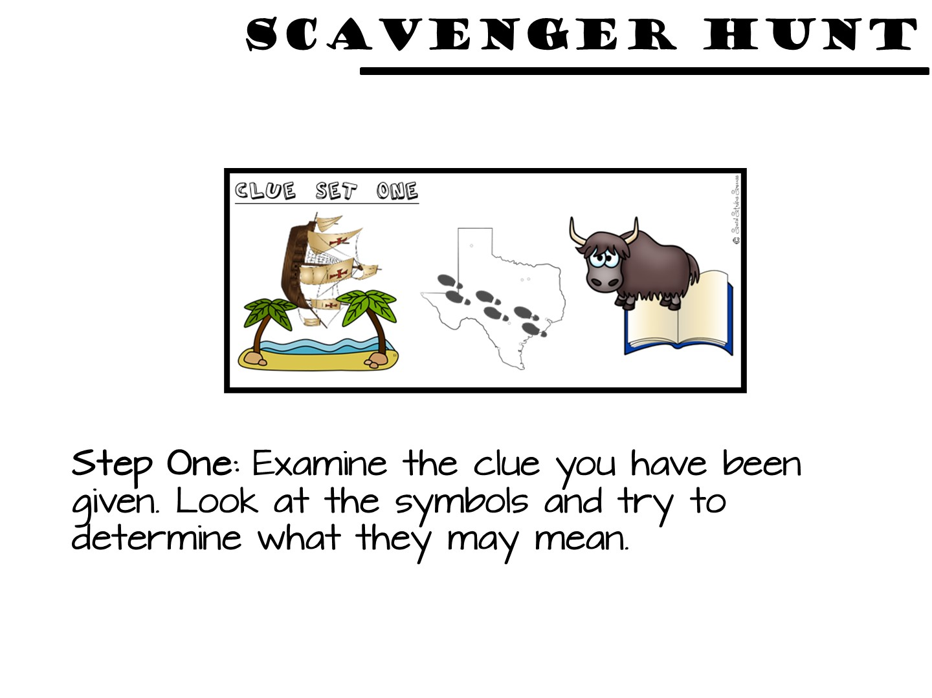

Slide 48
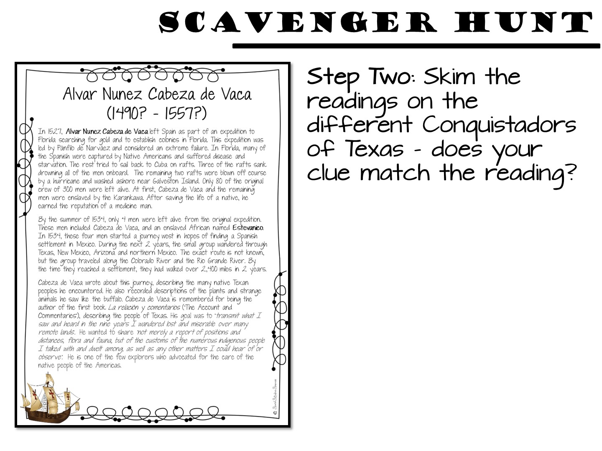

Slide 49
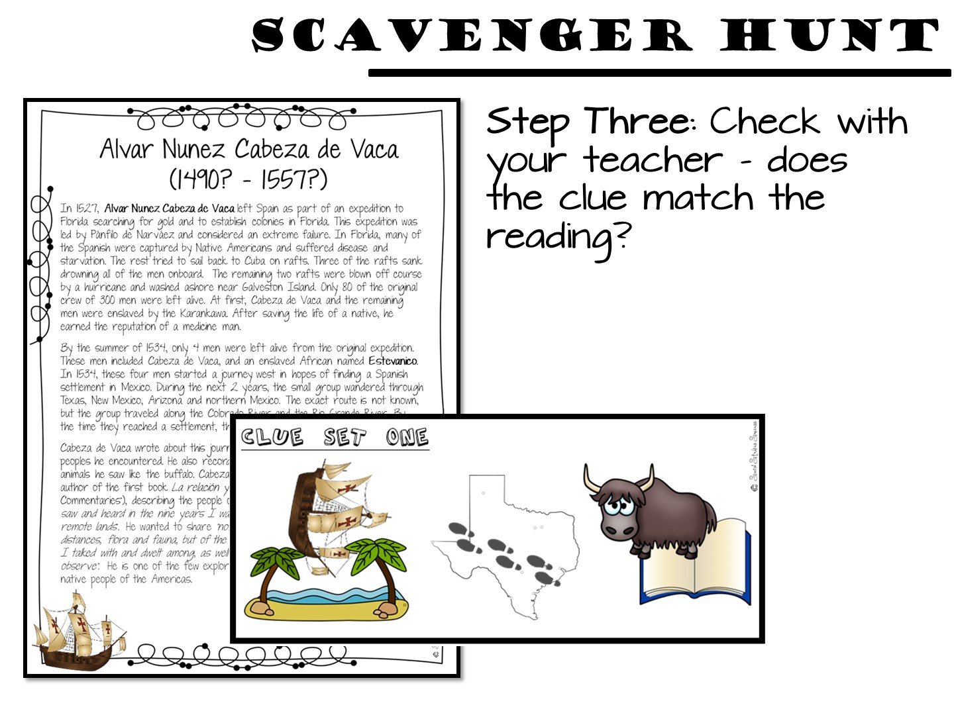

Slide 50
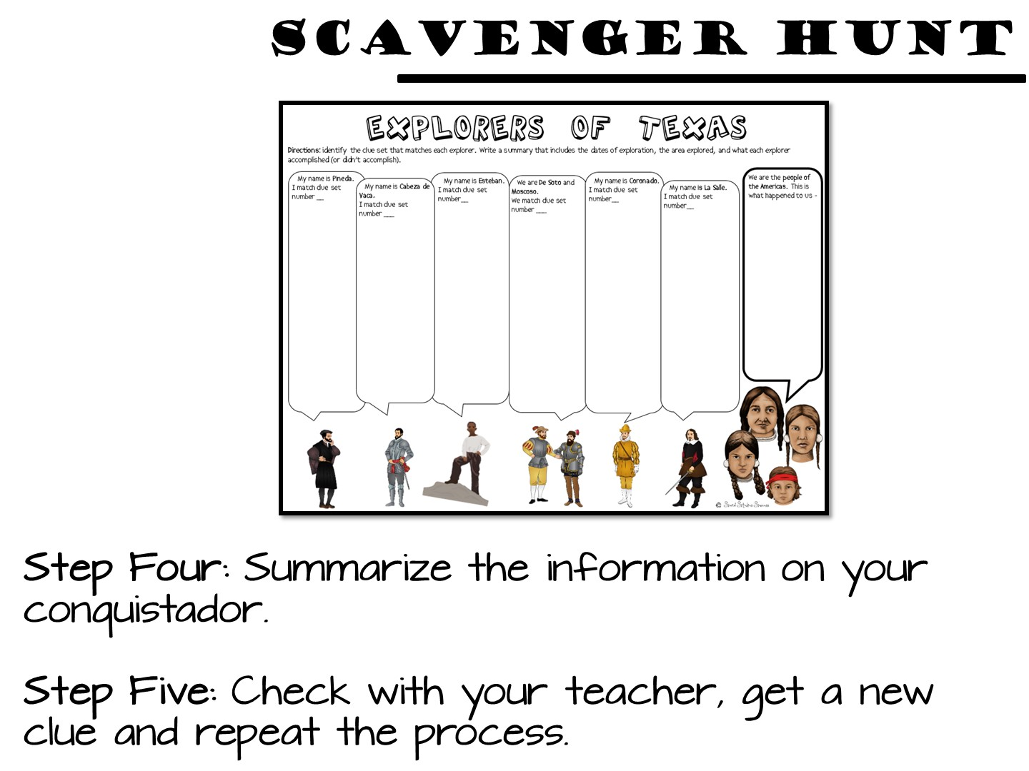

Slide 51
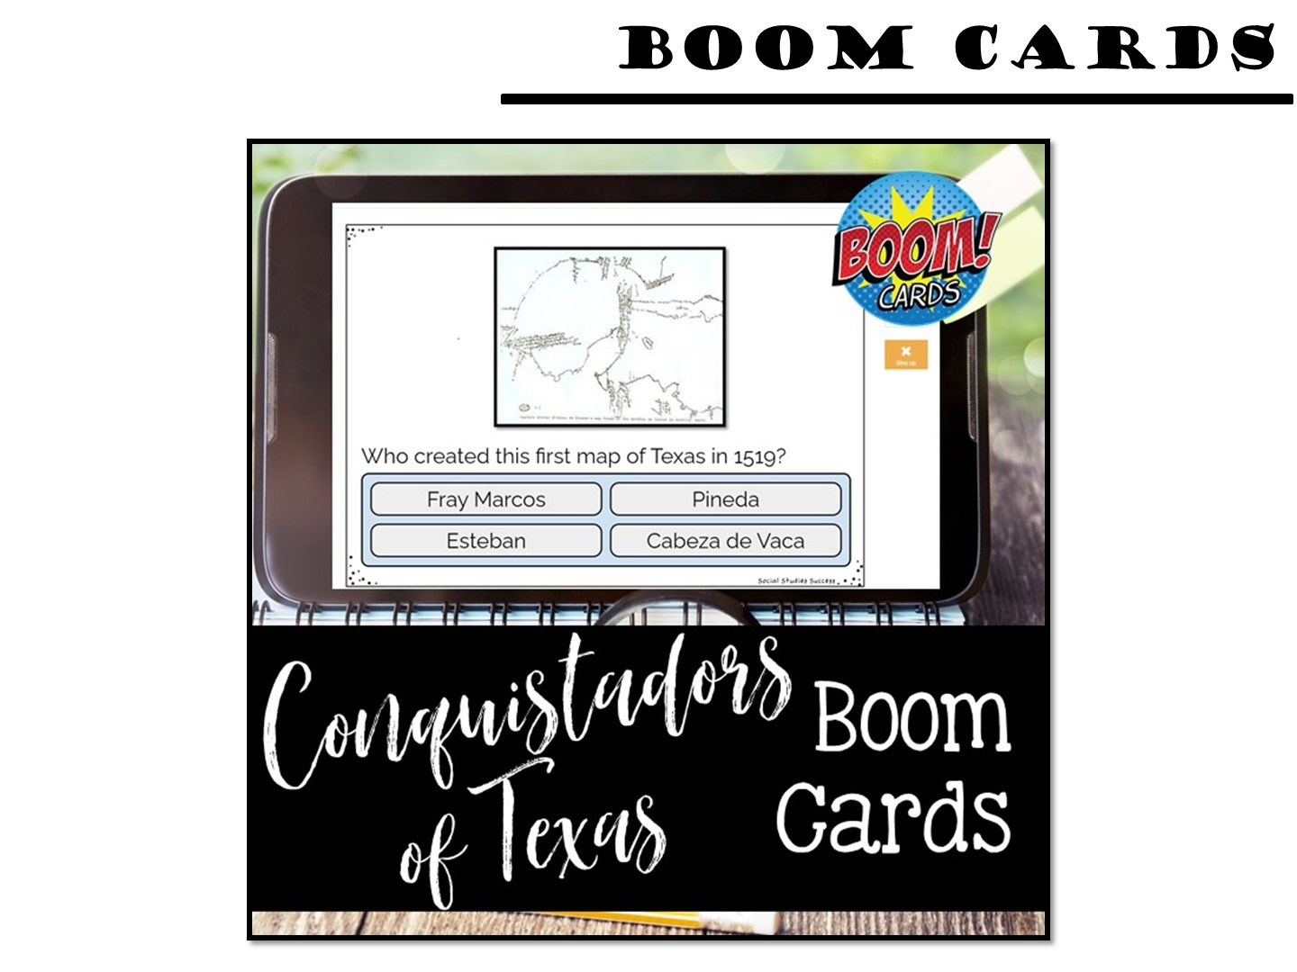
Notes:
You can set up a code for the boom cards up to 14 days in advance of the training.

Slide 52


Slide 53


Slide 54


