Slide 1

Notes:
Post Word Wall terms in the front of the room

Slide 2


Slide 3

Notes:
Spend a few minutes introducing your personal and professional life.

Slide 4

Notes:
The following slides list the research that goes into my workshops. I quickly share all of the research, and on the last slide I ask, “Which of these do you agree with?” and share the answer with a partner.

Slide 5


Slide 6
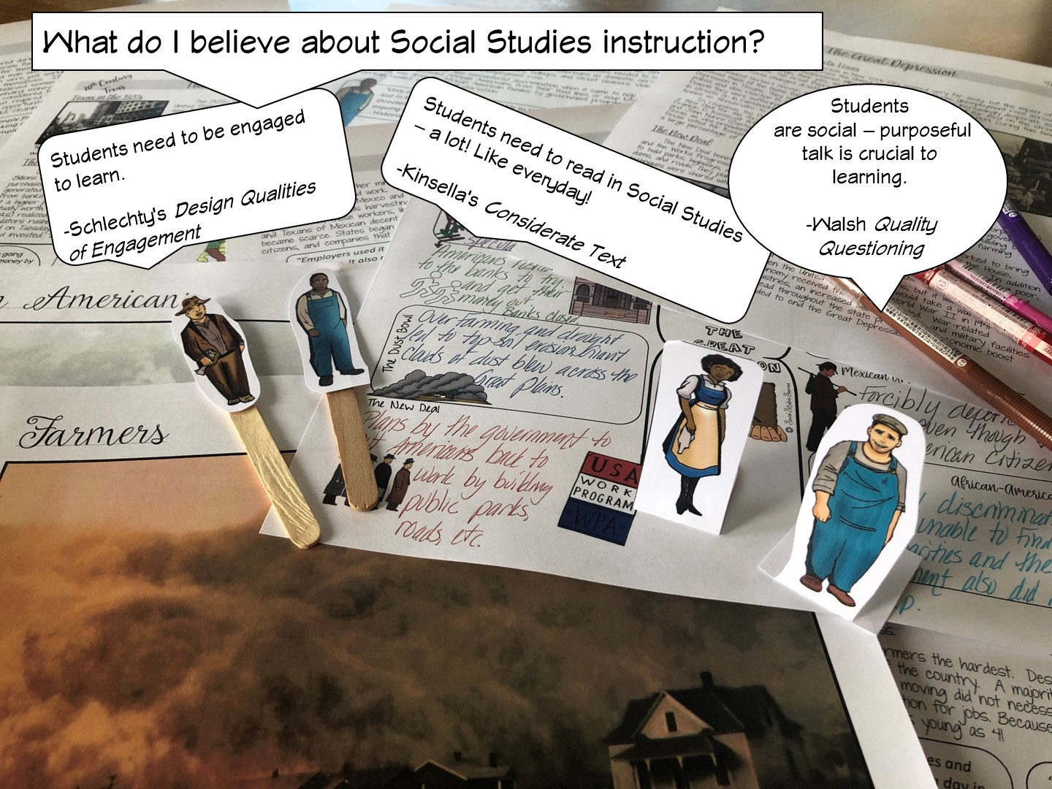

Slide 7
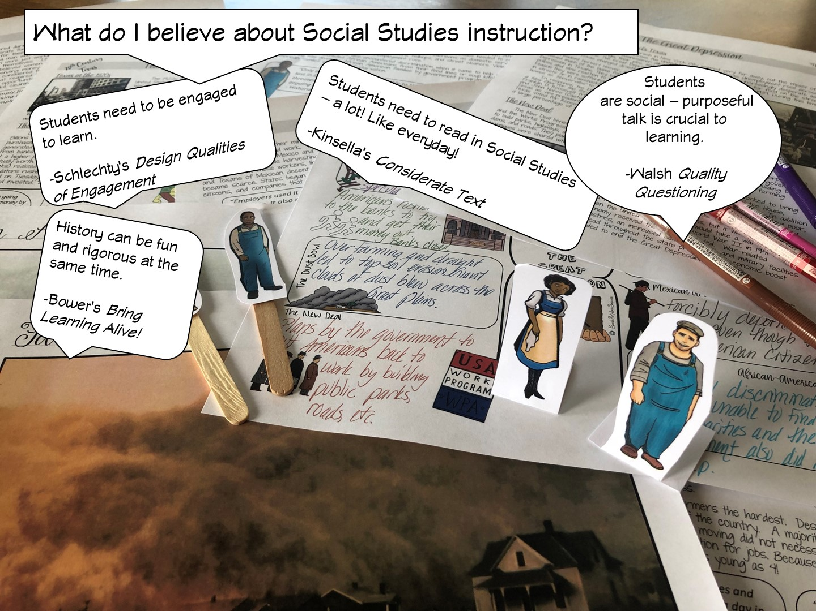

Slide 8


Slide 9
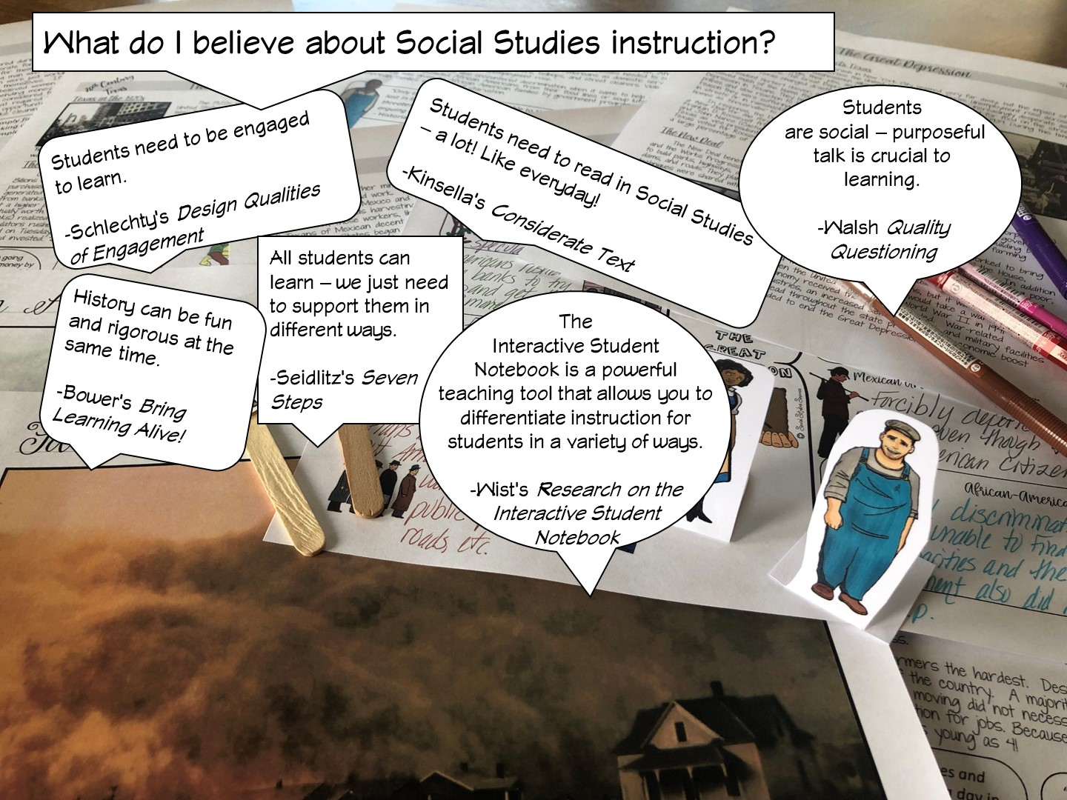

Slide 10
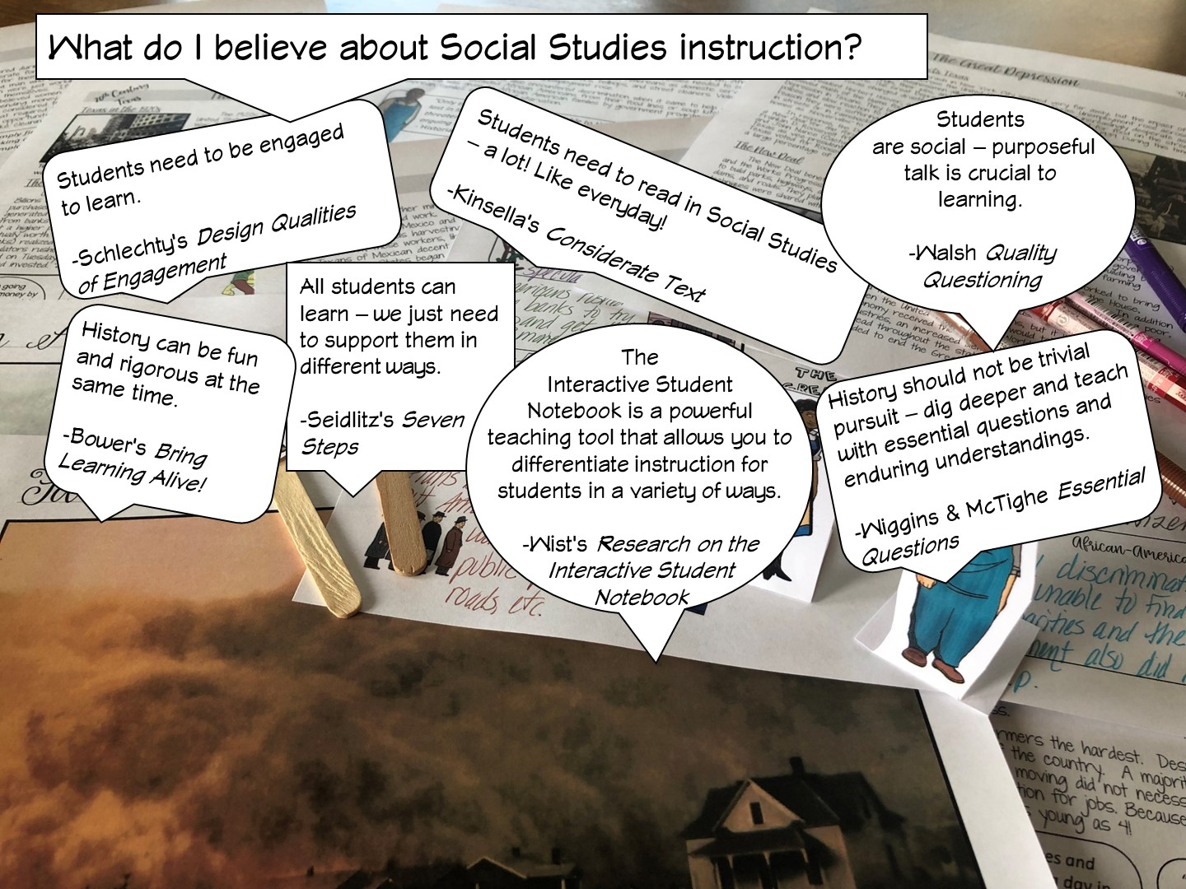

Slide 11
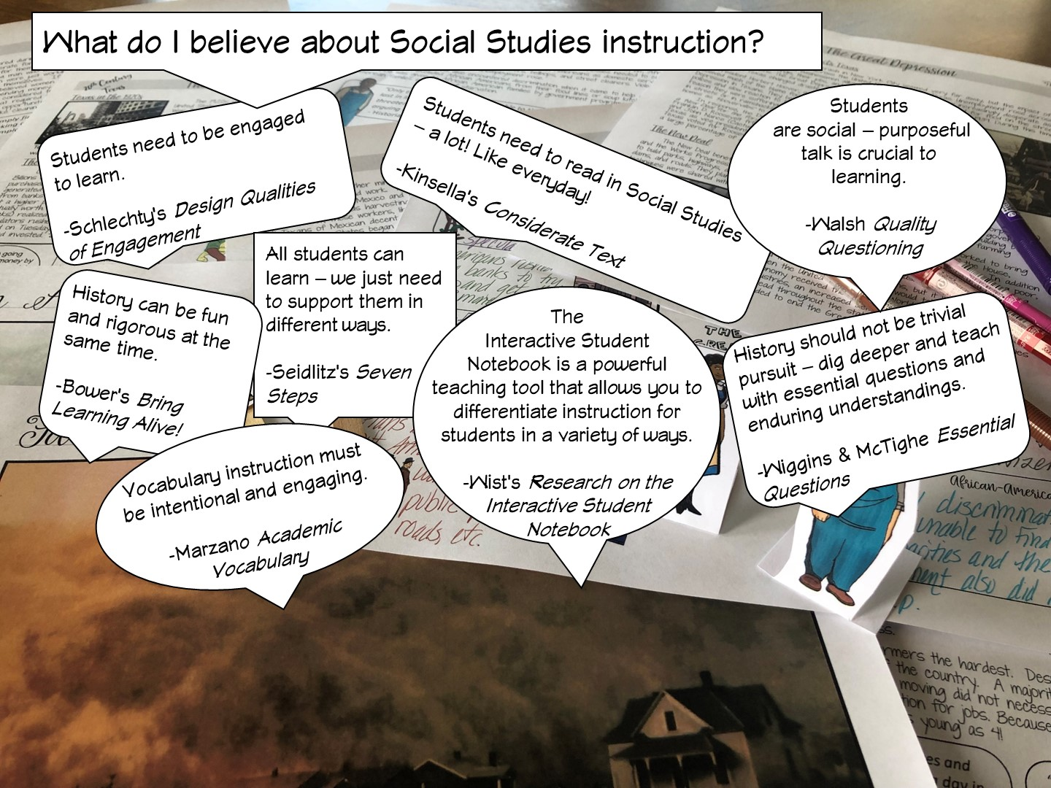

Slide 12
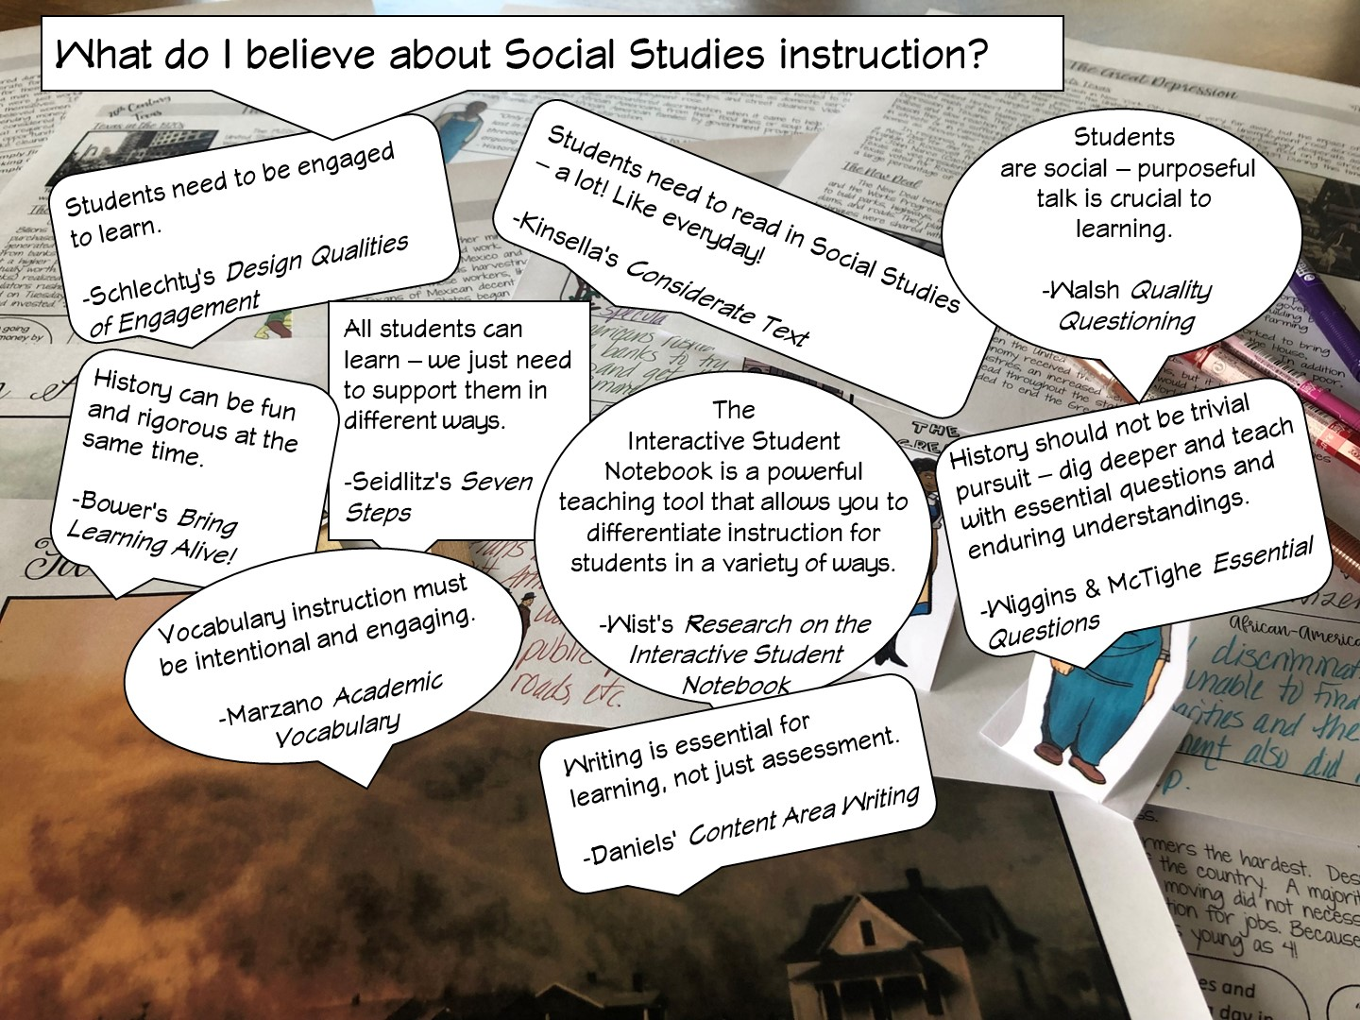

Slide 13
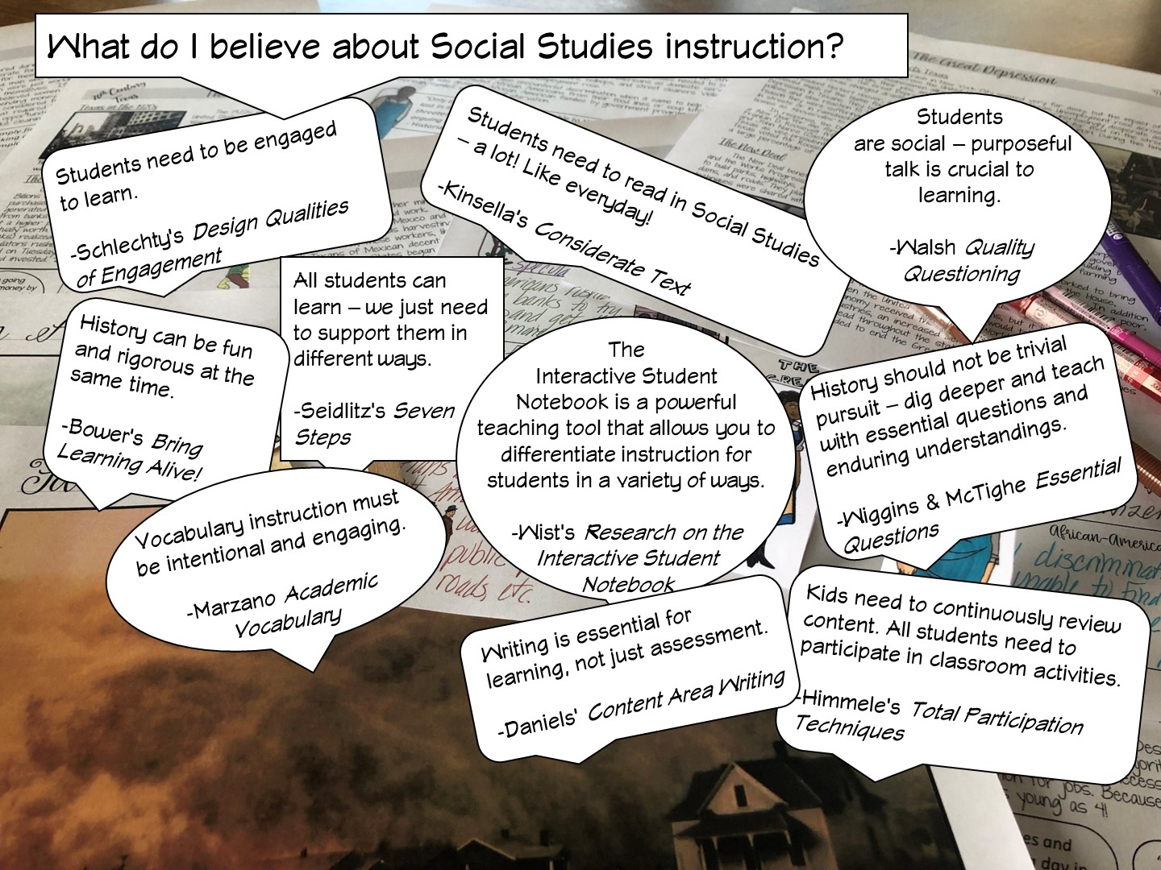

Slide 14
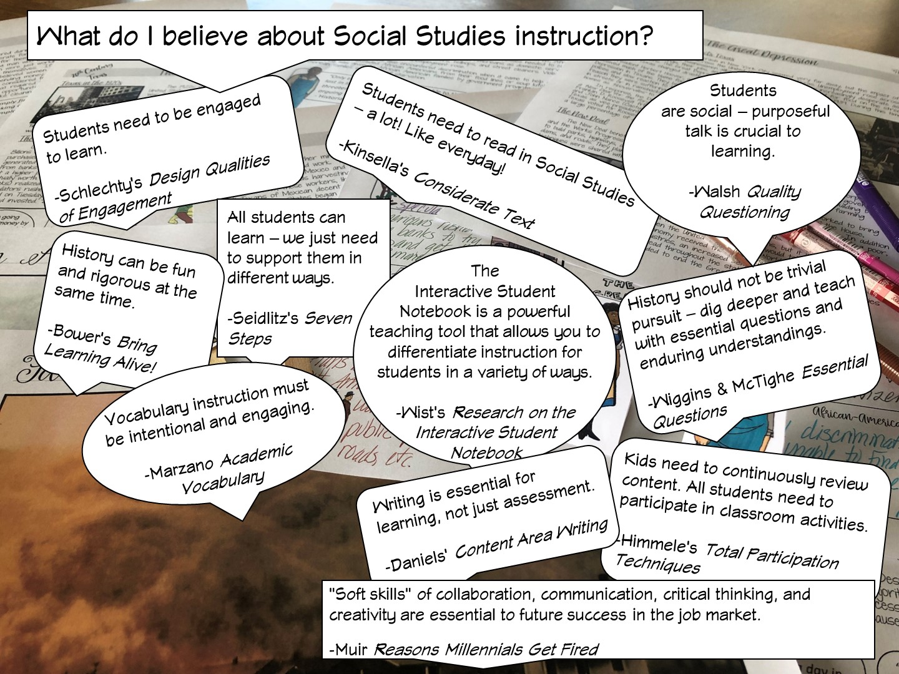

Slide 15
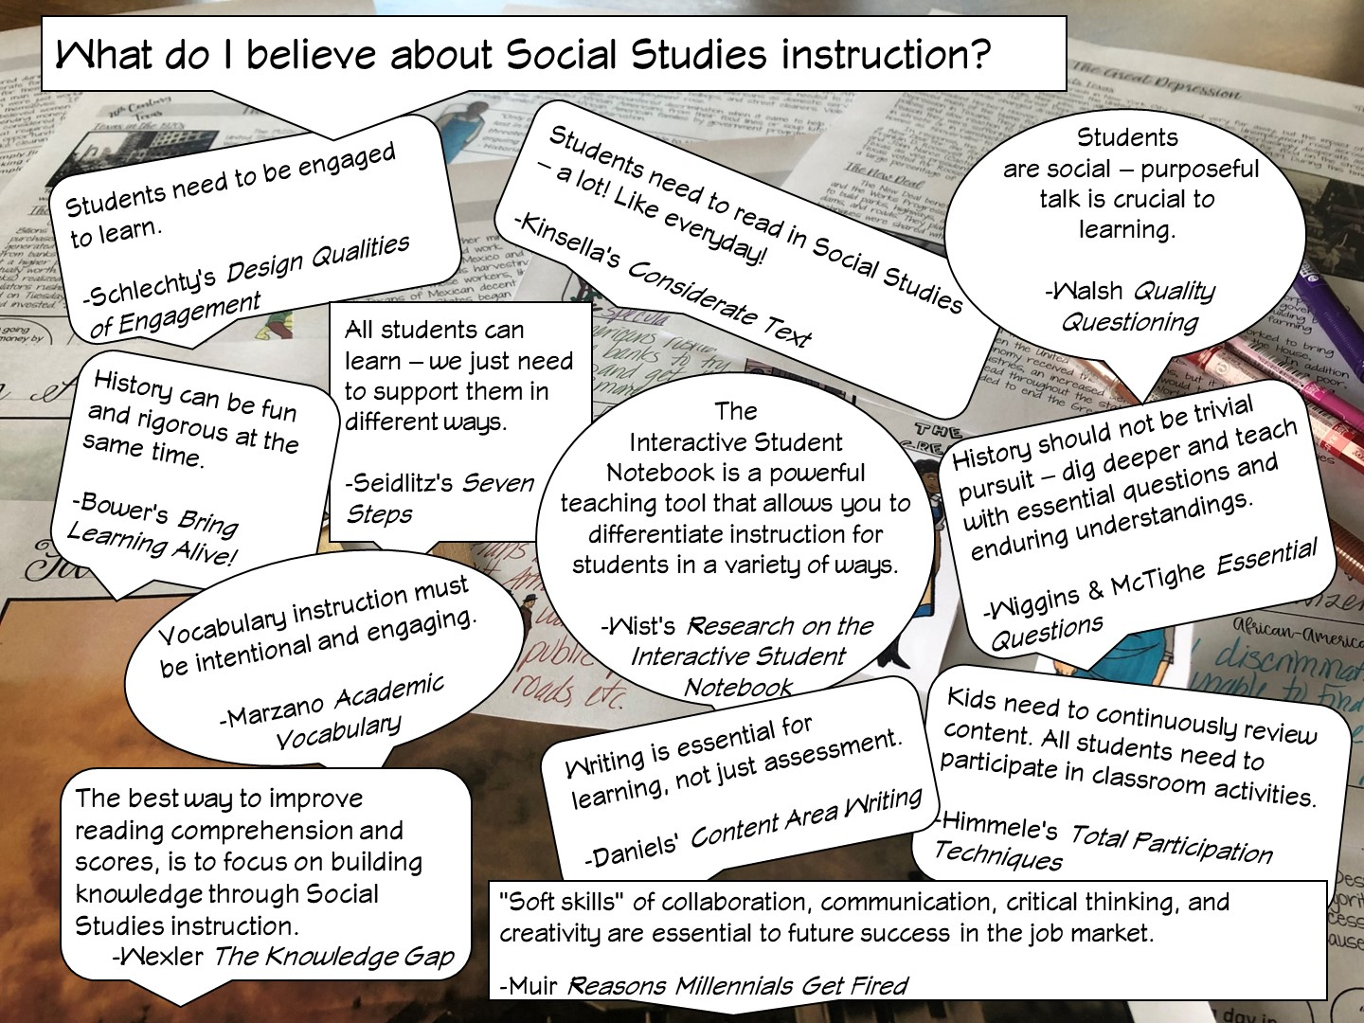
Notes:
After I have reviewed the different research – I ask the teachers, which one they agree with and why – have them talk to their table or partner.

Slide 16

Notes:
History teachers are the guardians of democracy

Slide 17


Slide 18

Notes:
Place the teachers with a partner.

Slide 19

Notes:
I never received a scope and sequence, so I don’t know when they would use this.

Slide 20
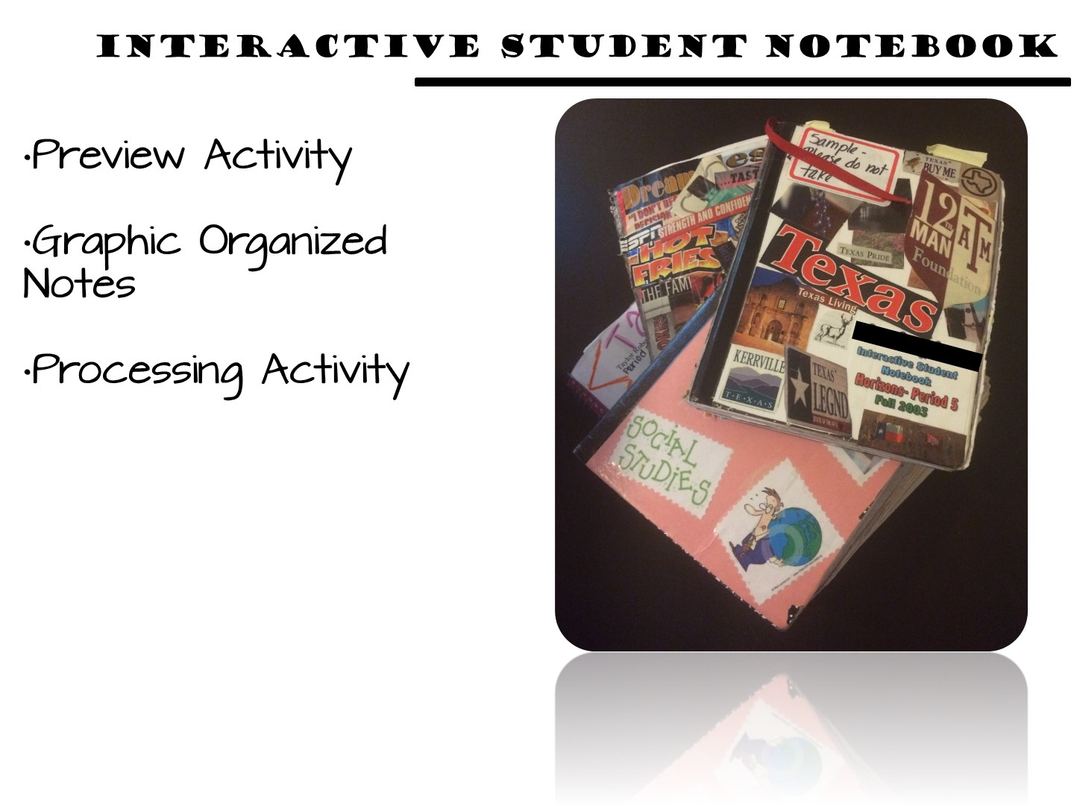
Notes:
All of my resources for World Cultures support the Interactive Student Notebook, which is a district initiative for Ysleta ISD. The packet I am going to give you for this activity will simulate an ISN but would actually be put in your students notebook.

Slide 21
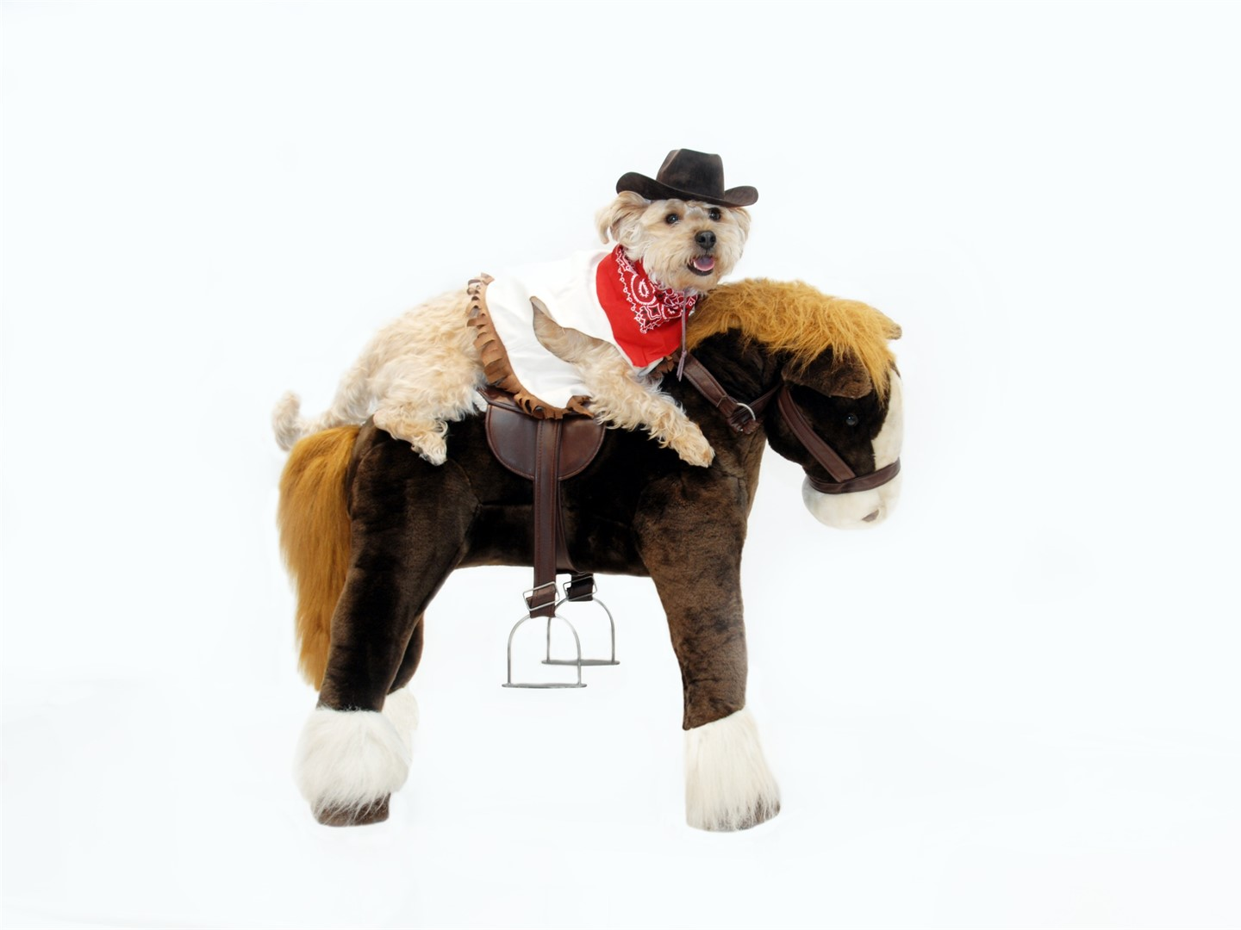
Notes:
This lesson is a dog and pony show as you will be modeling as quickly as you can. The lesson in their own classroom will be much slower.

Slide 22

Notes:
The next lesson you are going to model is for 6th grade World Cultures

Slide 23
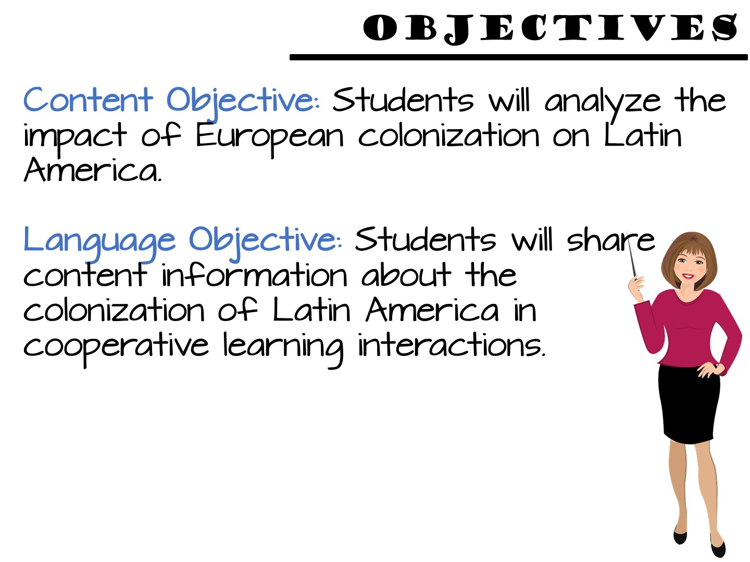
Notes:
Just read

Slide 24
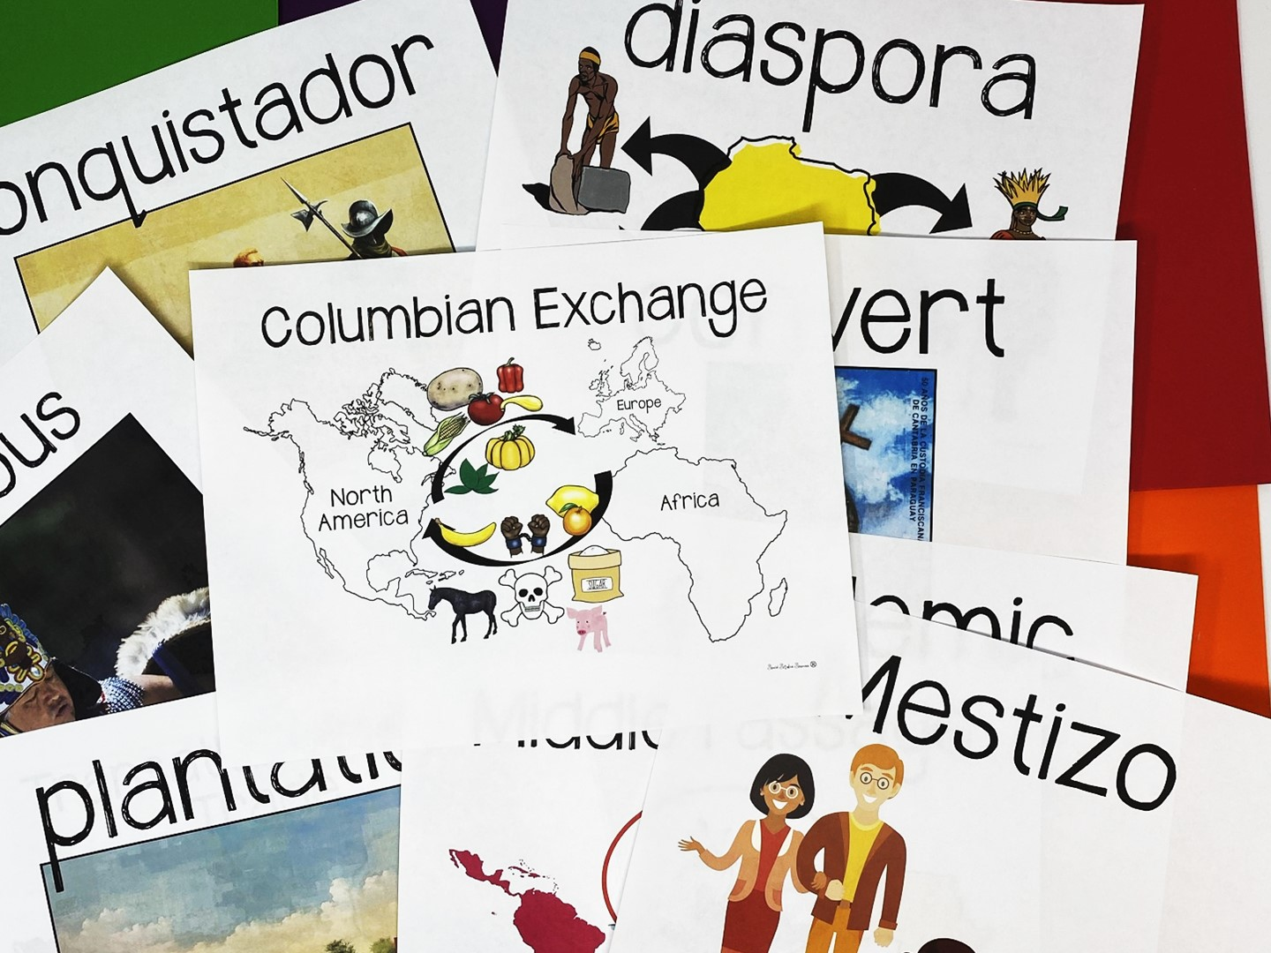
Notes:
Share that you are going to model one method of teaching vocabulary.
Point to the word wall and read each of the terms – tell the teachers we are going to do a 3, 2, 1 definition to learn the terms. They will need post-it notes for the activity.

Slide 25
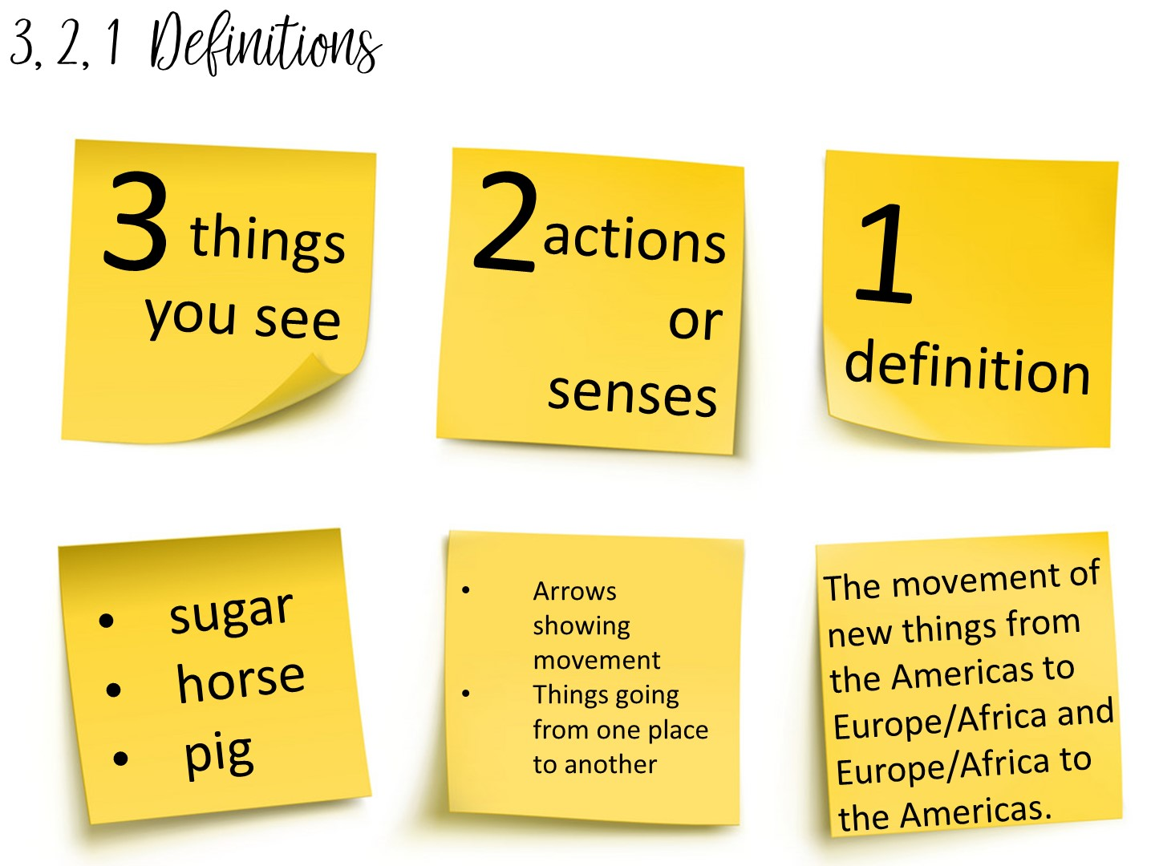
Notes:
Another method to teach vocabulary with images is the 3, 2, 1 Definitions – Allow students time to analyze an image to build their understanding of an image.
Model this with the word Columbian Exchange
Allow them to pick a term with a partner and complete the 3, 2, 1 definition. I always bring the teachers close to word wall to get them out of their seats.

Slide 26
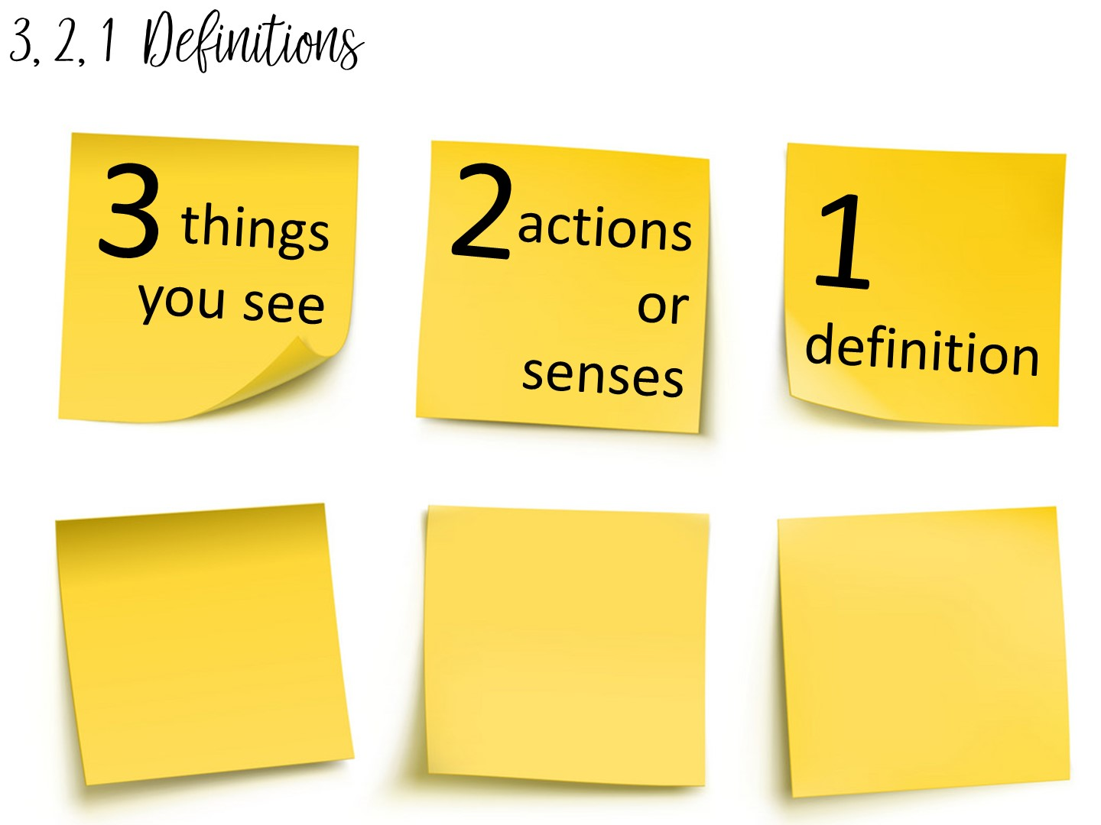
Notes:
Now do with another term.

Slide 27
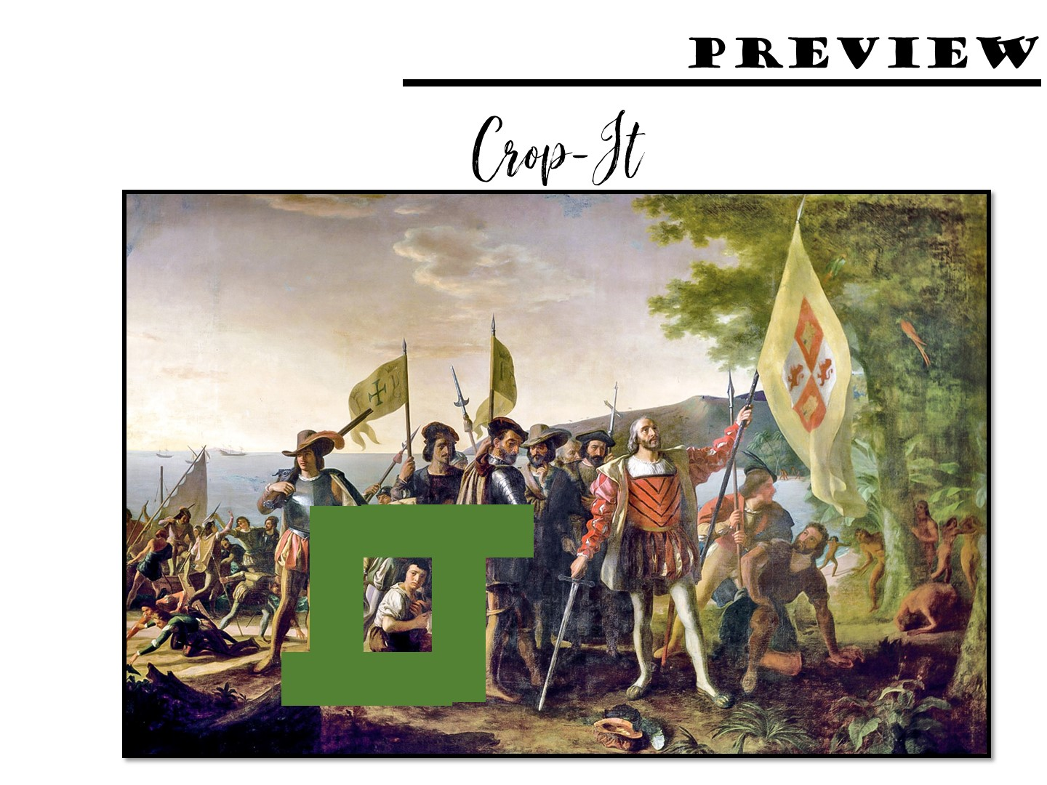
Notes:
Pass out the crop-it tools and the Columbus images. Use the handout with questions to ask questions for the teachers to answer using the tool.

Slide 28
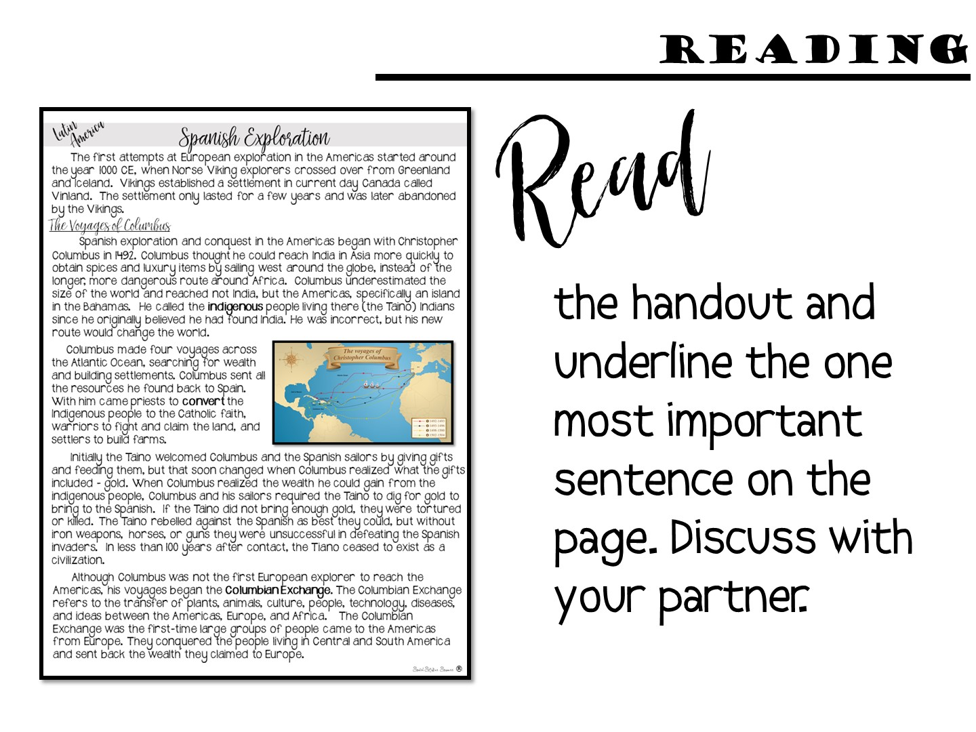

Slide 29
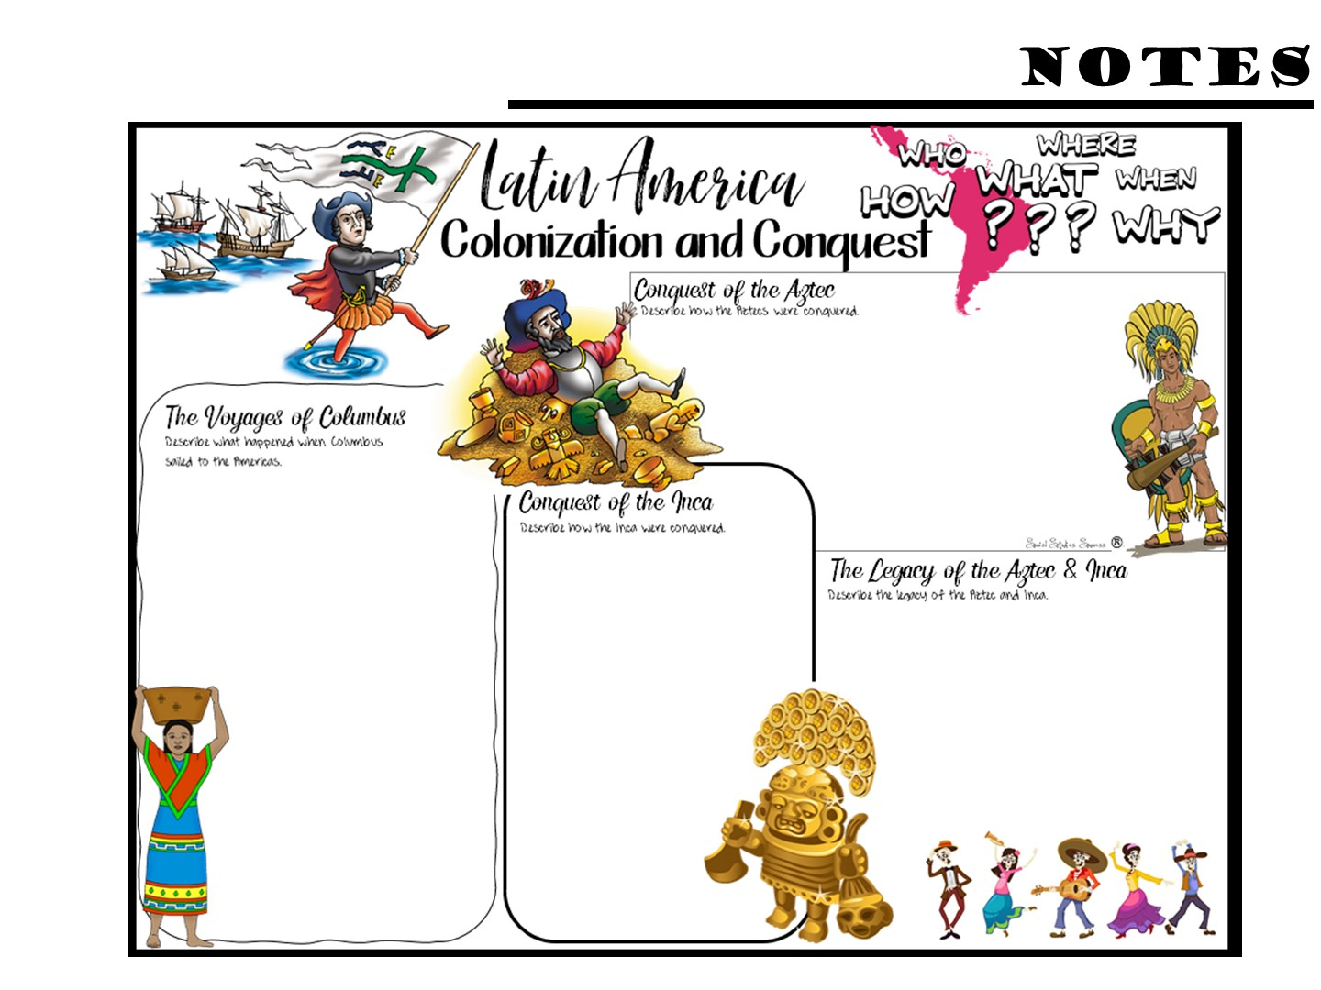
Notes:
Pass out the Doodle Notes and have them complete what they can with the first page of reading – not all of the info comes from the first page. This would be glued into their ISN when complete.

Slide 30
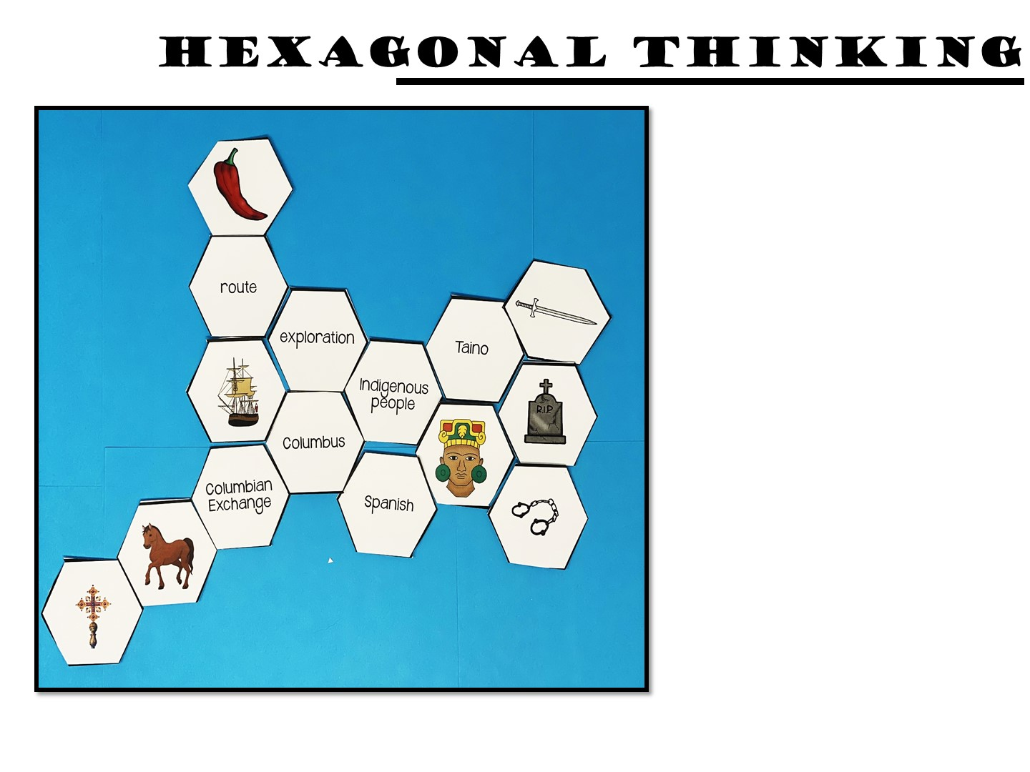
Make connections between the hexagon shapes.
Notes:
Pass out the first round of the hexagon cards. Make connections between the hexagon shapes. For every connection they make, they earn 1 point. For example, the indigenous people shape is connected on 5 sides, exploration, Columbus, Spanish, person figure and Taino. A student should be able to explain how all of these are connected. If they can, they earn 5 points. You can ask them to annotate their connections with post it notes
Once you have finished the directions, go to the next slide before you start – you don’t want them to just copy your example.

Slide 31

Play

Slide 32

Notes:
You probably don’t have time for the next round, just walk the teachers through it. You can just tell them what they would do next, how they add hexagons everytime so that it grows.

Slide 33
Notes:
Pass out the Doodle Notes and have them complete what they can with the second page of reading

Slide 34
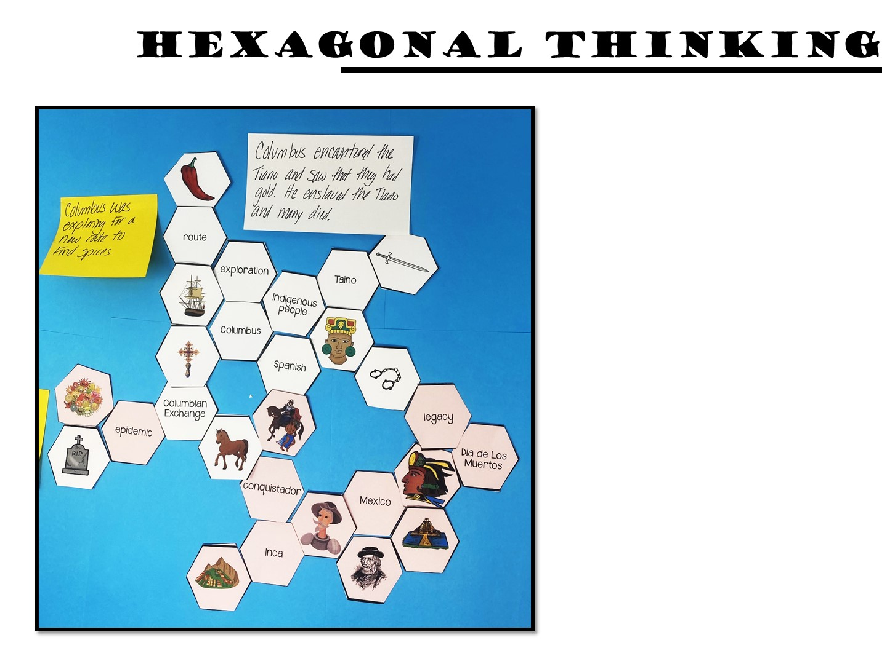
Make connections between the hexagon shapes.
Notes:
Once you have finished the directions, go to the next slide before you start – you don’t want them to just copy your example.

Slide 35
Play

Slide 36
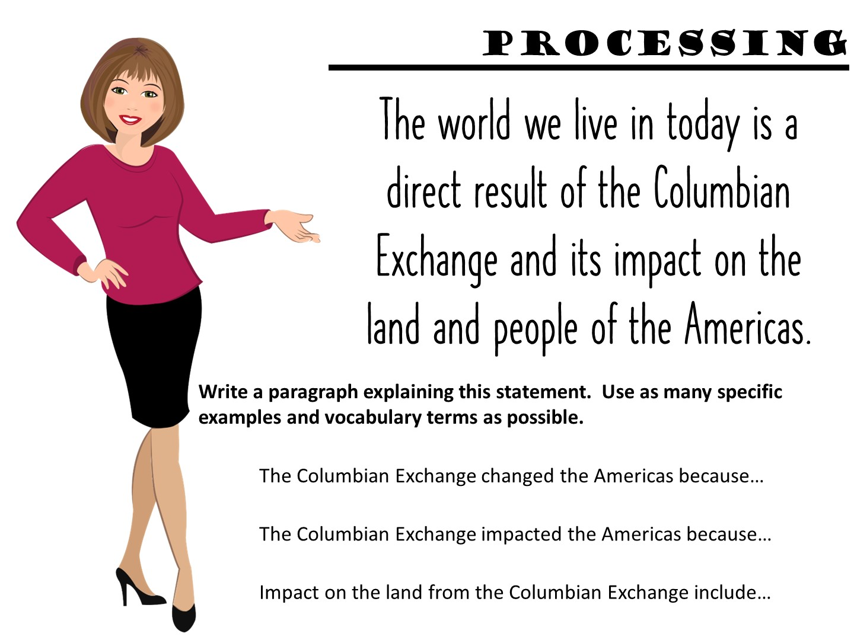
Notes:
This is an example of a processing assignment they can use in their notebook. I have also included sentence stems.

Slide 37
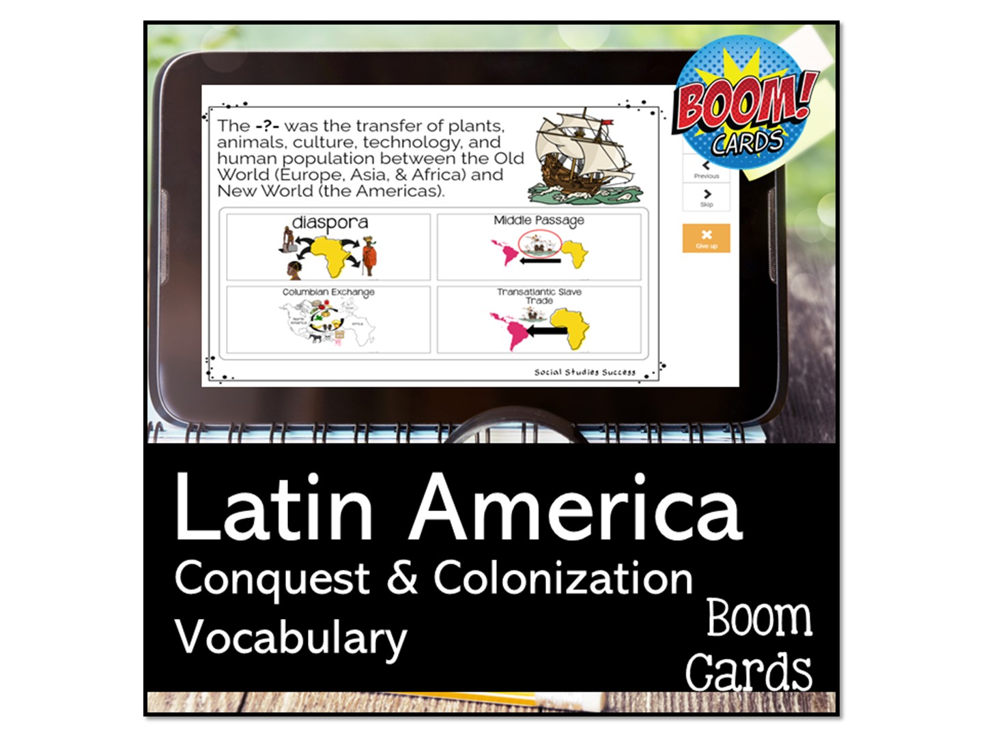
Notes:
You will need to set up a fast pin for this – call me and I will walk you through it.

Slide 38


Slide 39


Slide 40

Welcome to Social Studies Success! Please follow these directions for accessing your new resources. Go to www.SocialStudiesSuccess.com
Notes:
Give them the handout with the directions, tell them to try on their own and contact their coordinator if they can’t get in.

Slide 41
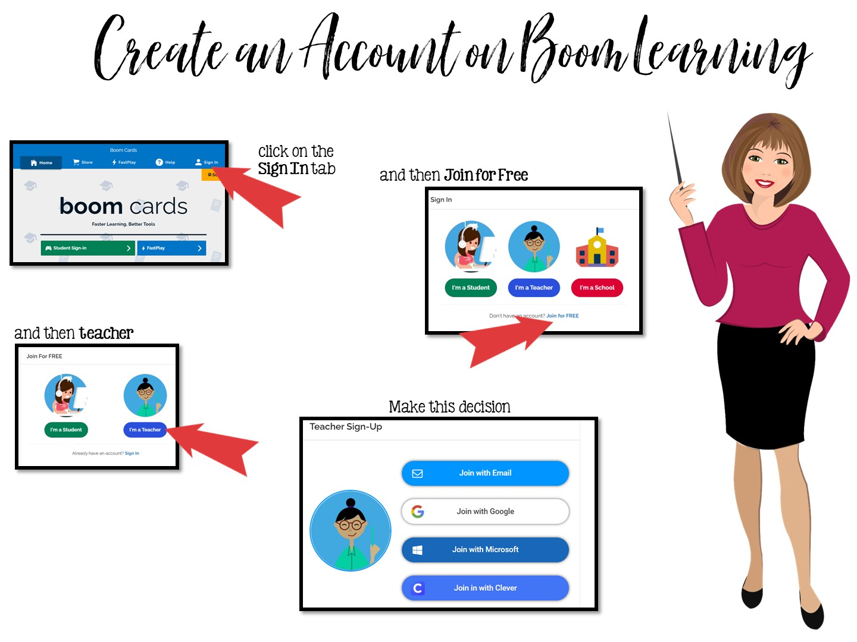
Go to www.boomlearning.com
Notes:
Pass out handout on creating Boom Cards. They need to follow these directions exactly to access their boom cards. Do Not purchase Boom Cards from the Boom Learning site – your district has already purchased them all for you. You must access the games through my website.

Slide 42
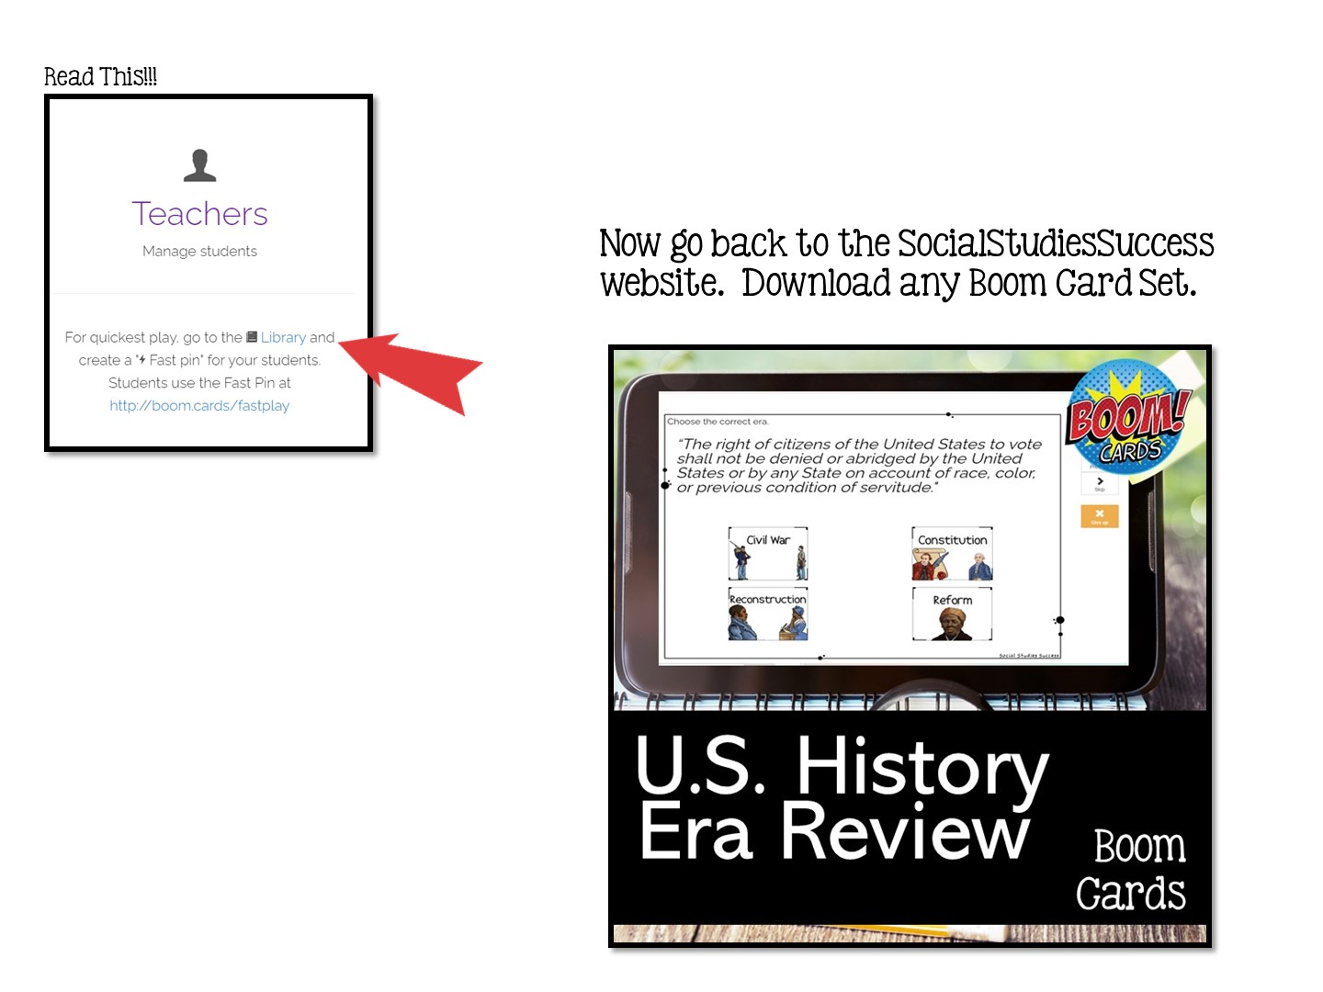

Slide 43


Slide 44
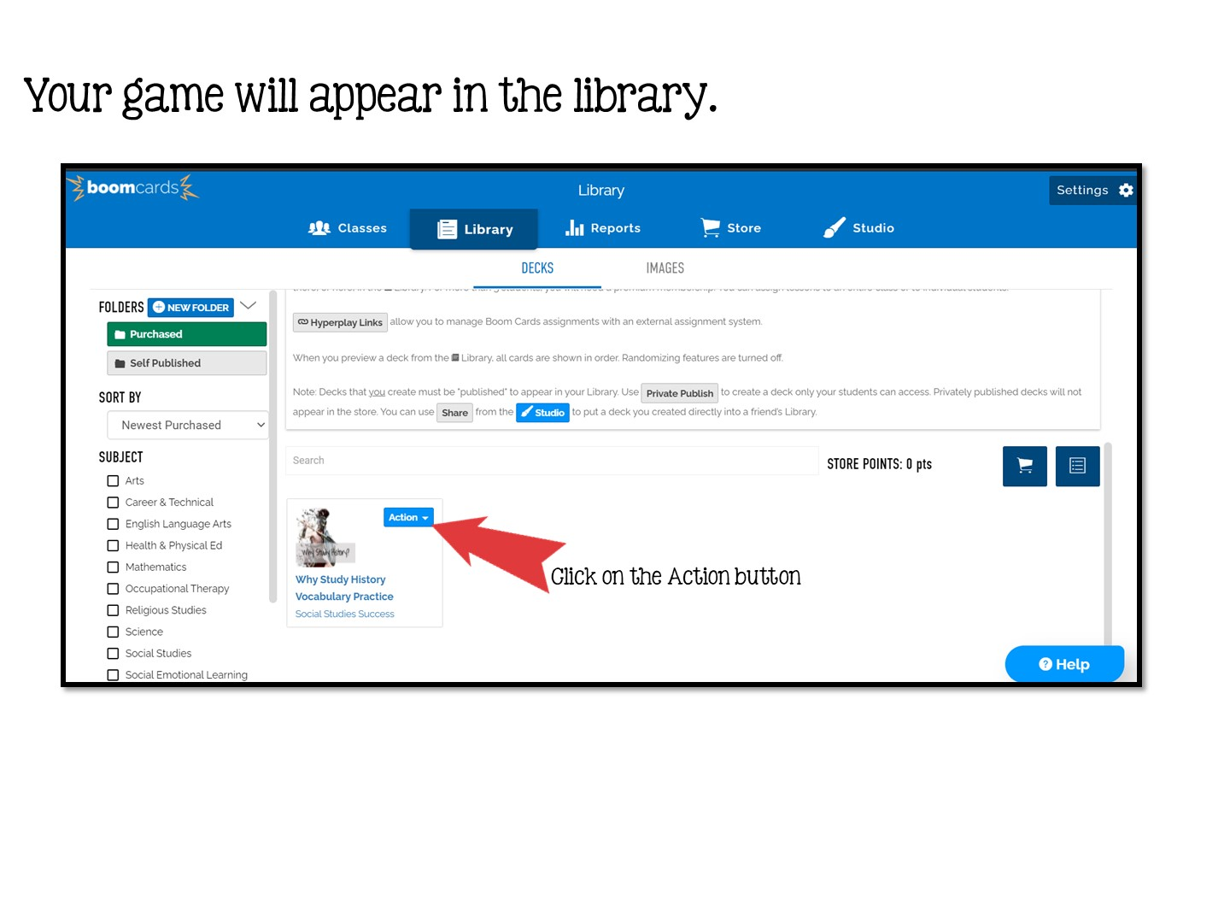

Slide 45
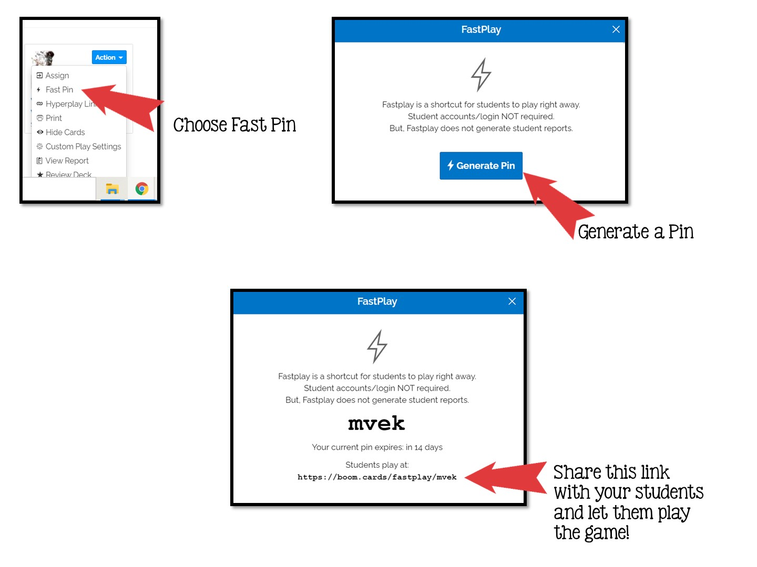

Slide 46


