Slide 1

Notes:
Put out popsicle stick people and socks for participants to pick up as they enter.
Post why study history word wall and engagement anchor chart
Put post-it notes on the table (make sure they are all one color) have another set of colored post-it notes to hand out later
Also put up #1-4 in each corner of the room

Slide 2


Slide 3

Notes:
Introduce yourself

Slide 4

Notes:
The following slides list the research that goes into my workshops. I quickly share all of the research, and on the last slide I ask, “Which of these do you agree with?” and share the answer with a partner.

Slide 5


Slide 6
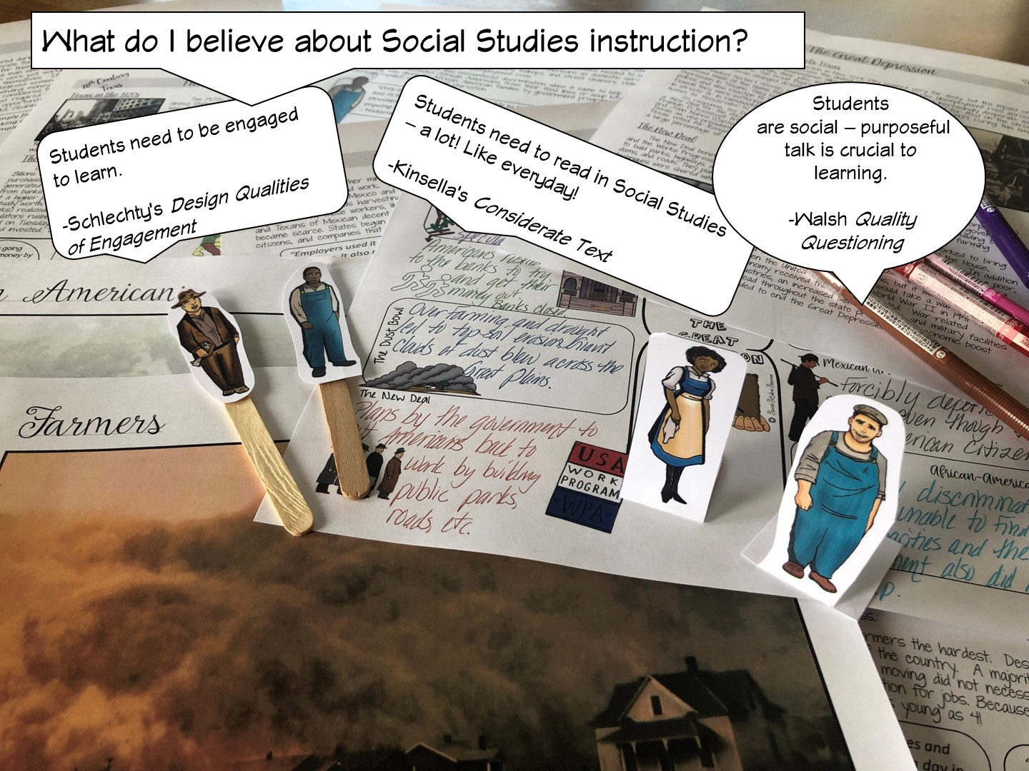

Slide 7
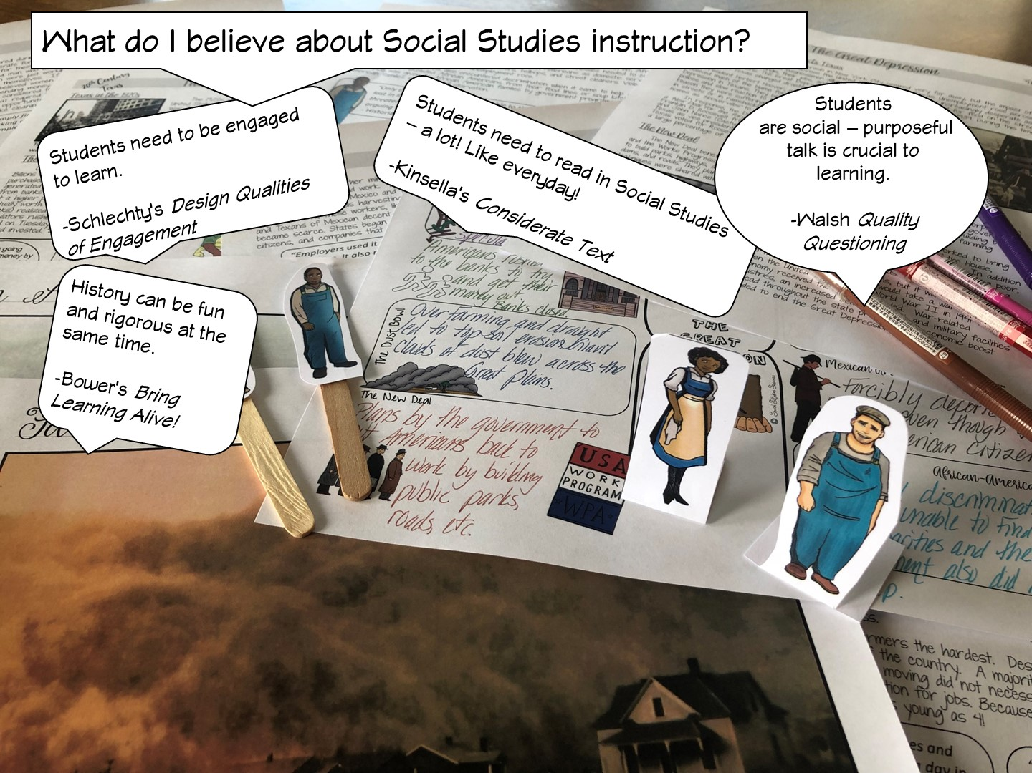

Slide 8


Slide 9
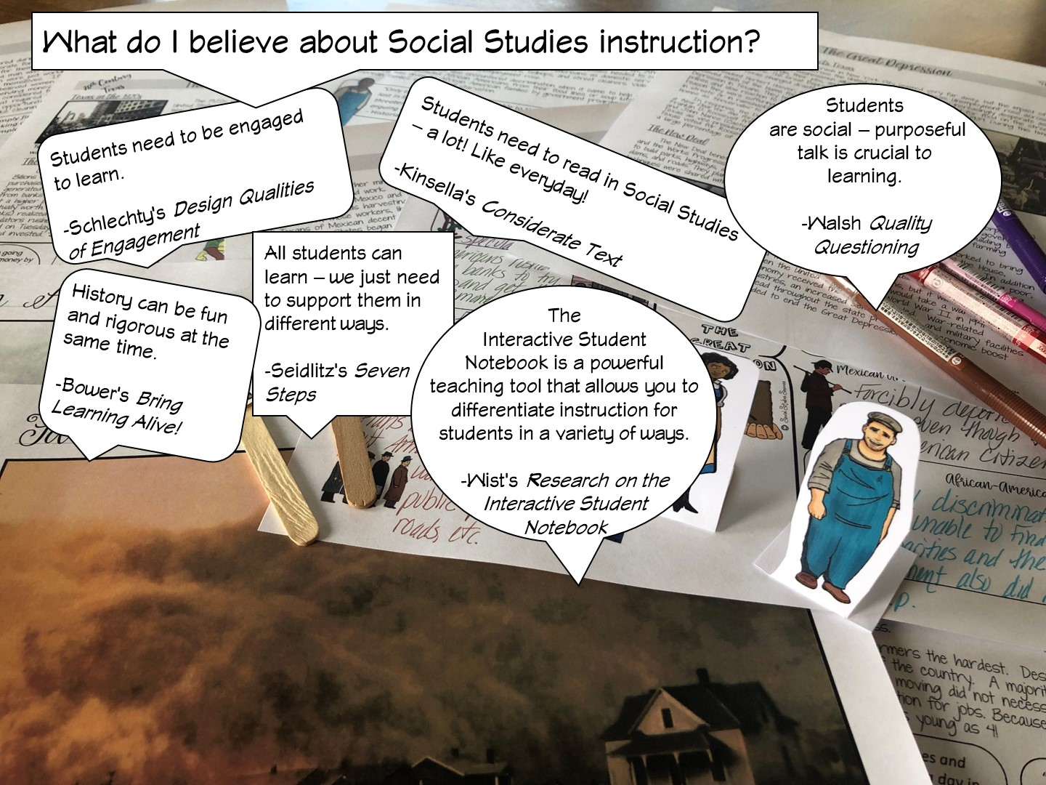

Slide 10
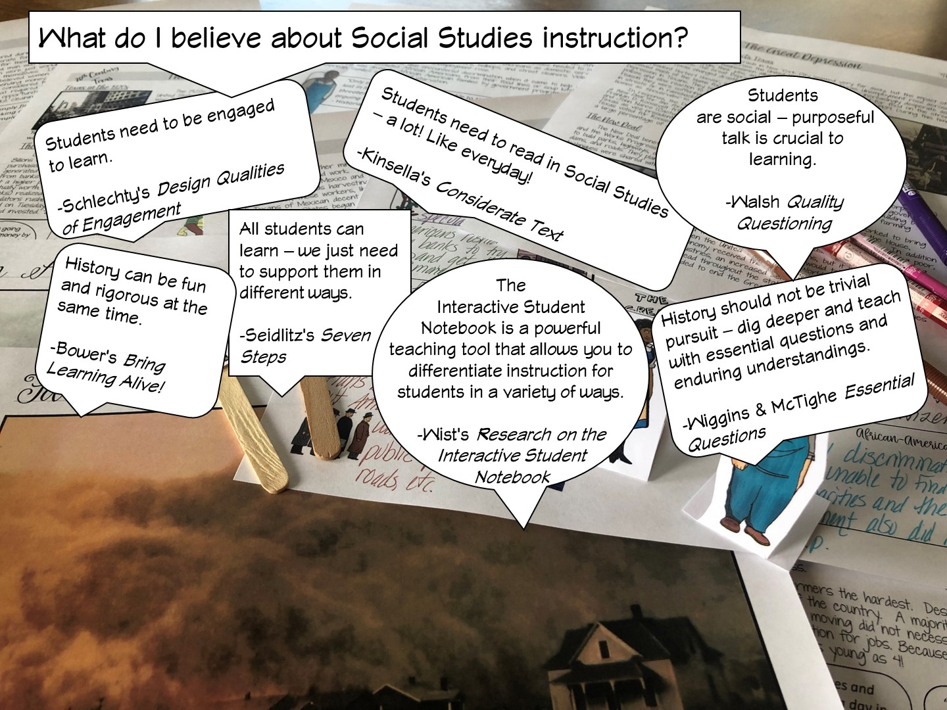

Slide 11
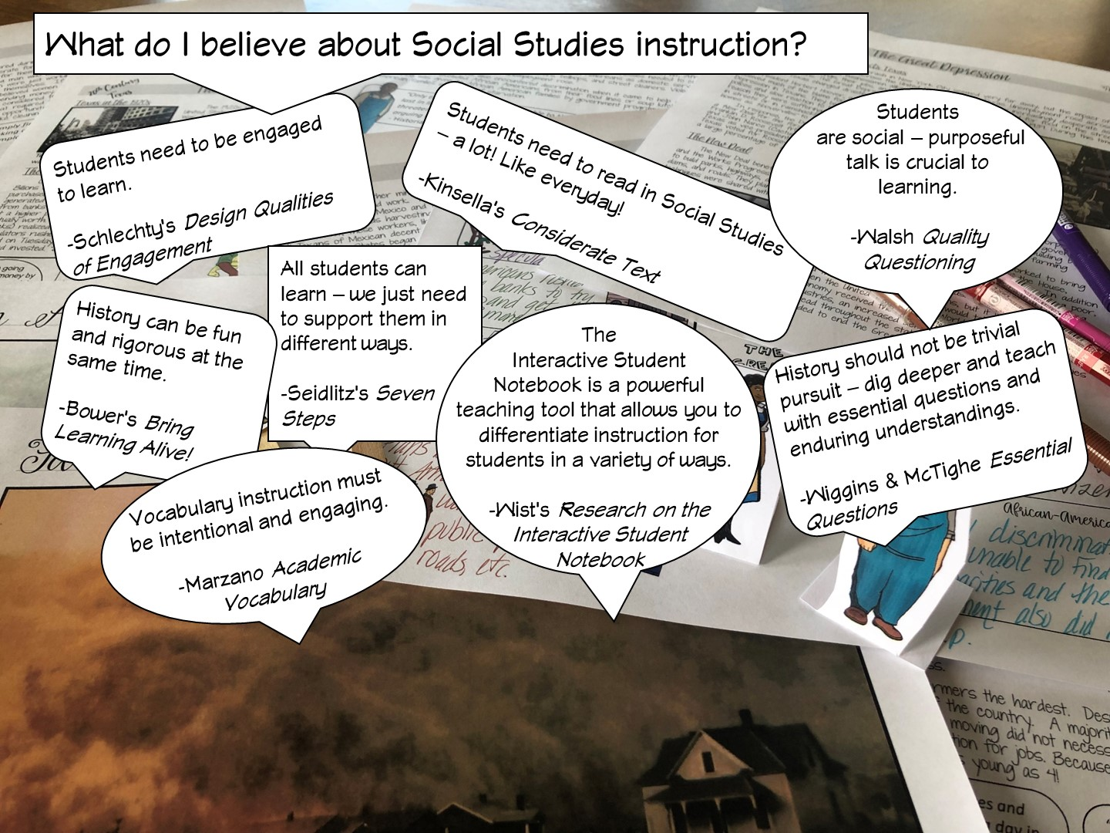

Slide 12
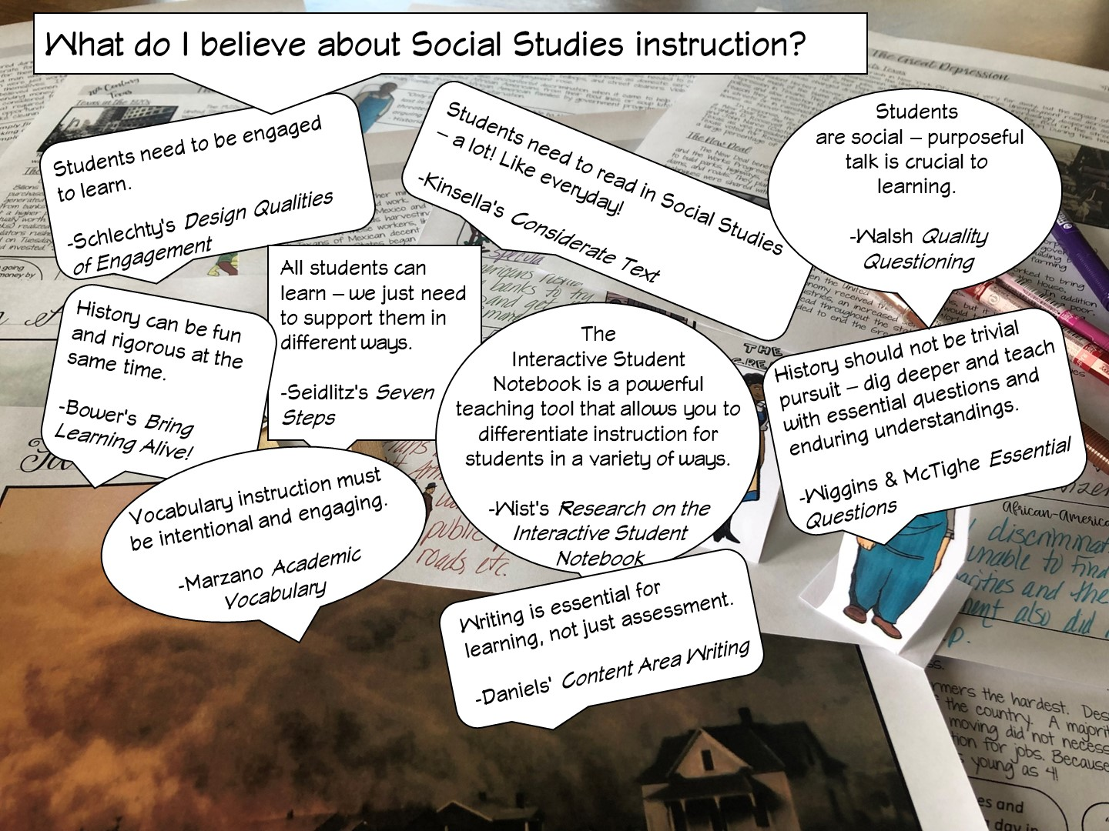

Slide 13


Slide 14


Slide 15

Notes:
After I have reviewed the different research – I ask the teachers, which one they agree with and why – have them talk to their table or partner.

Slide 16

Notes:
Have teachers write their goals on a post it note and share
Review our goals in the next slide

Slide 17


Slide 18
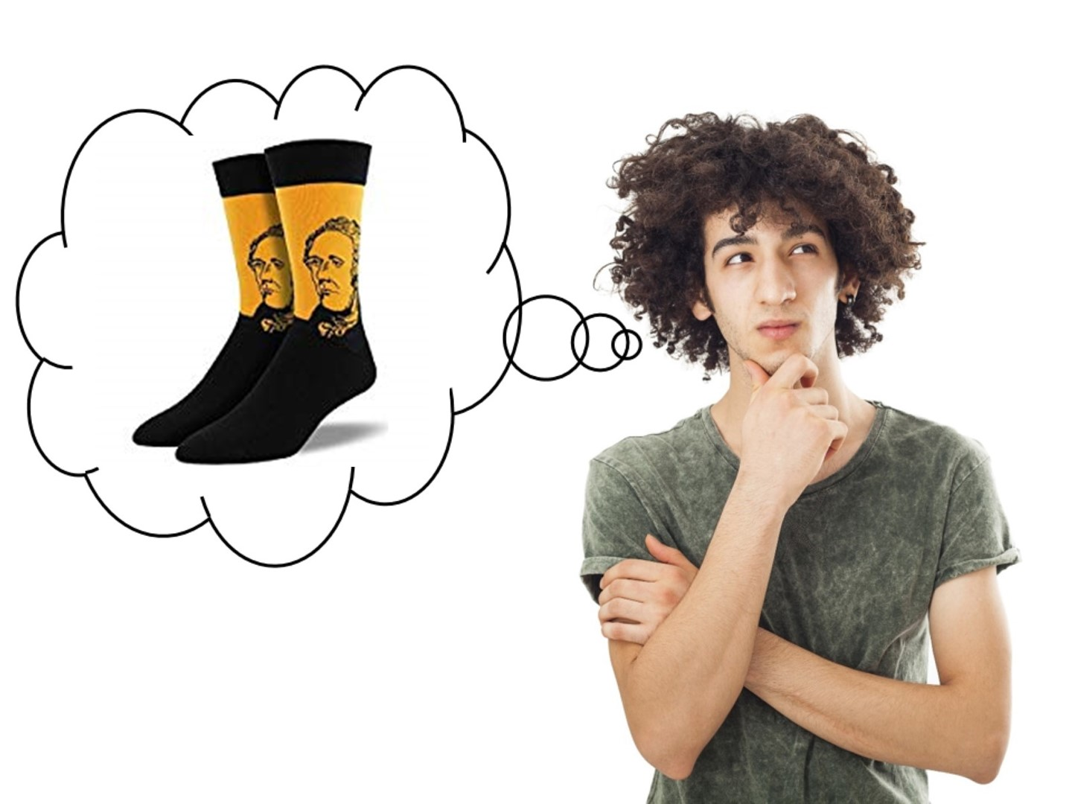
Notes:
I share my rule of the socks:
They have never been on my feet
They are not a souvenir of the workshop
Put your cellphones away in the sock (model with your own)

Slide 19

Notes:
Pass out Engagement Doodle Notes
Ask this question and have them respond on the Engagement Doodle Notes handout – list 3 reasons
Have them discuss with a partner.

Slide 20
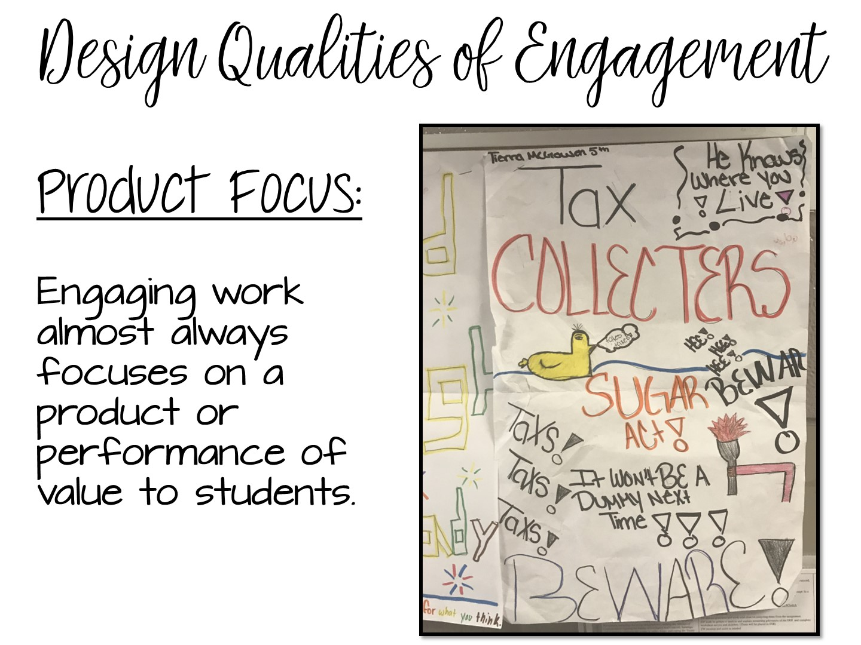
Notes:
Now share the official research from Philip Schlechty and his book – Working on the Work. Just read the next few slides to the teachers. Allow them to take notes if they wish.
Schlechty’s Design Qualities of Engagement

Slide 21
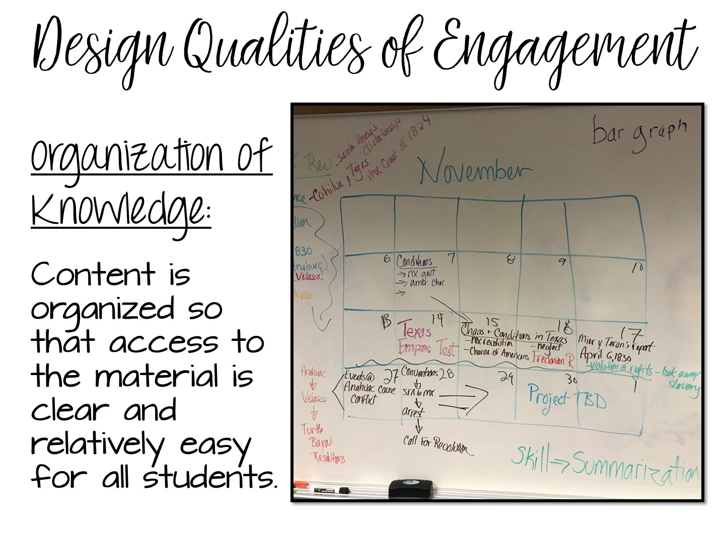

Slide 22
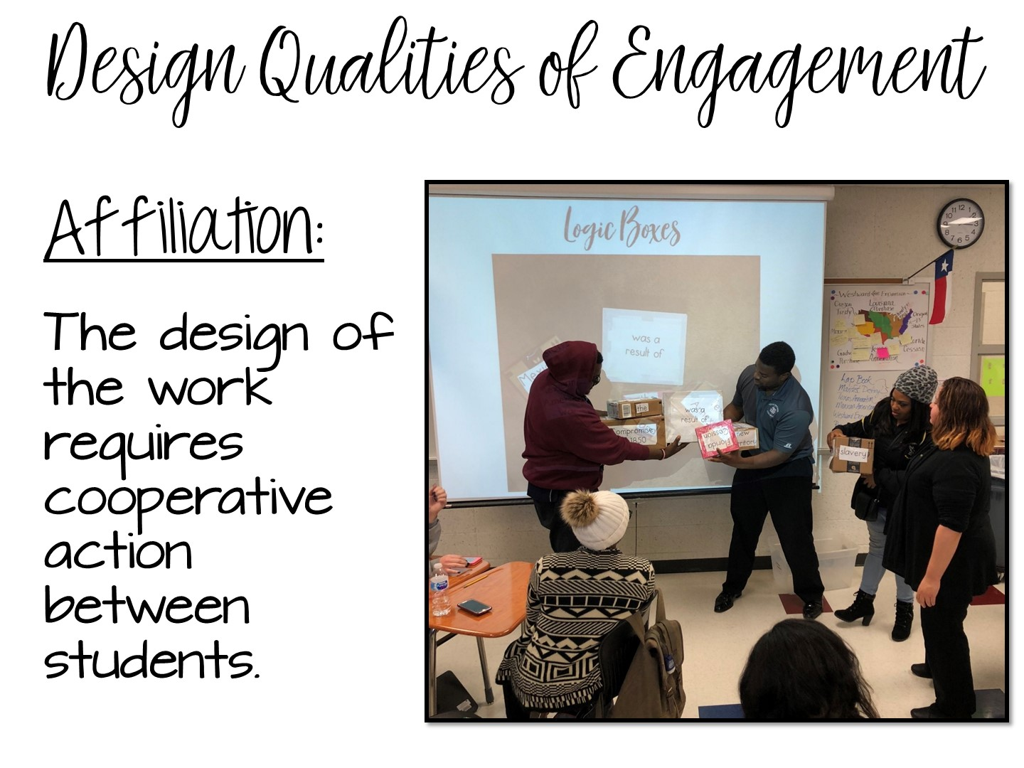

Slide 23
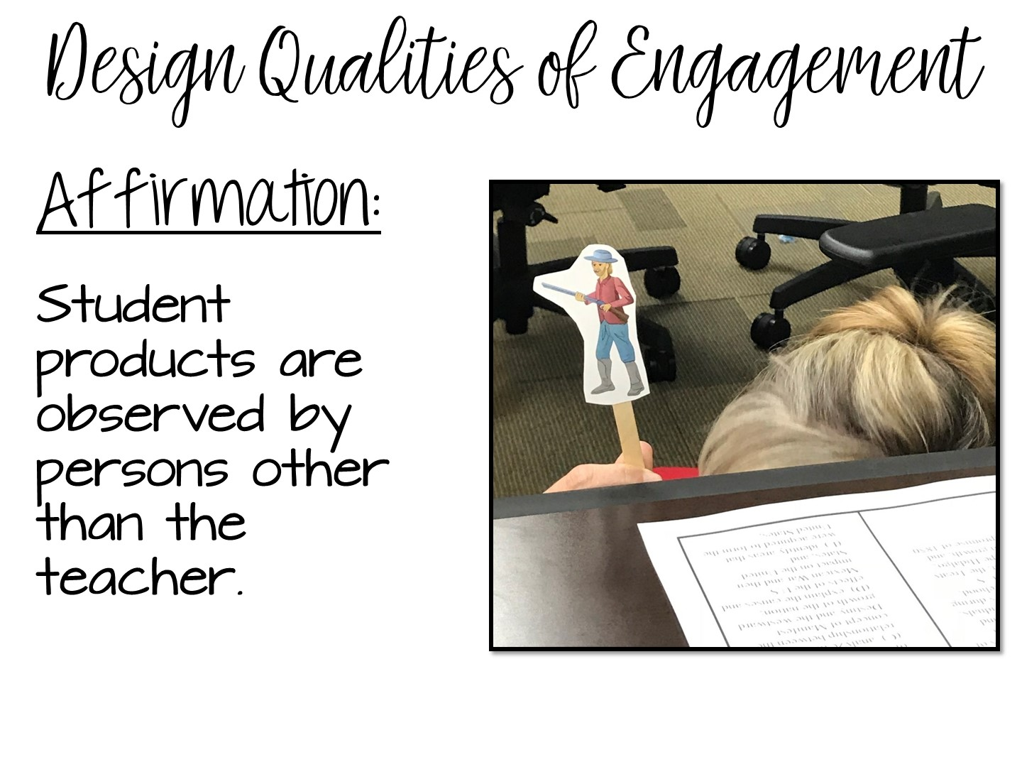

Slide 24
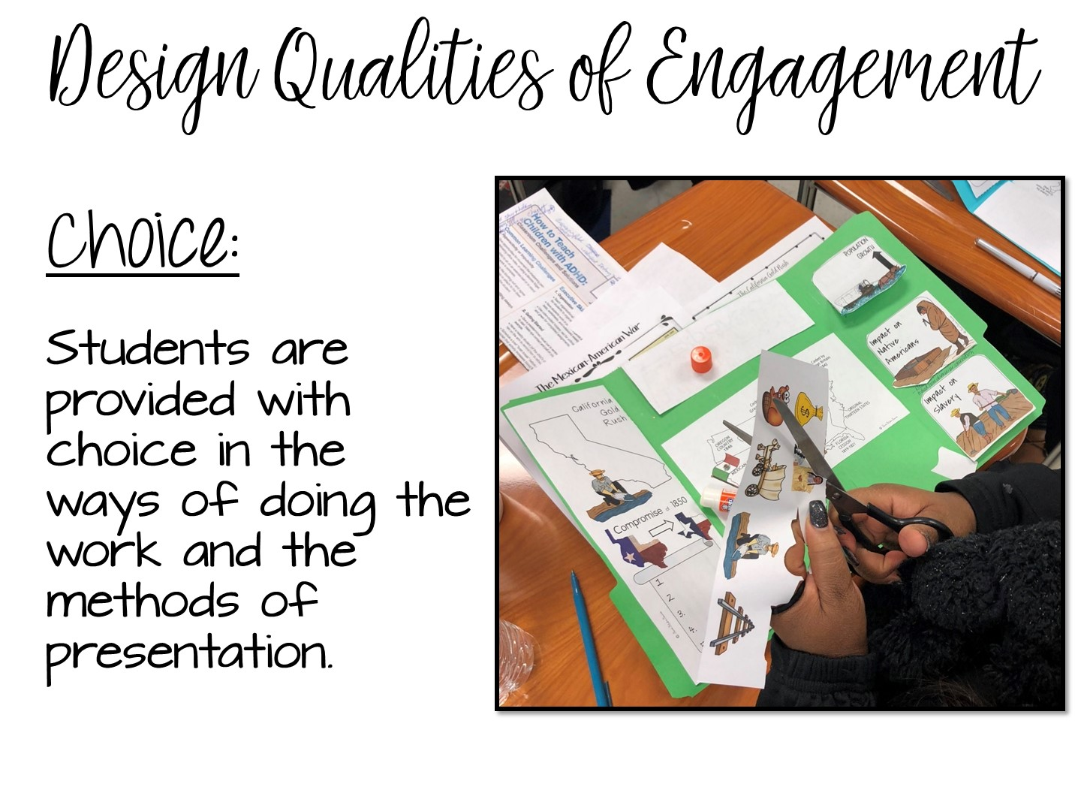

Slide 25
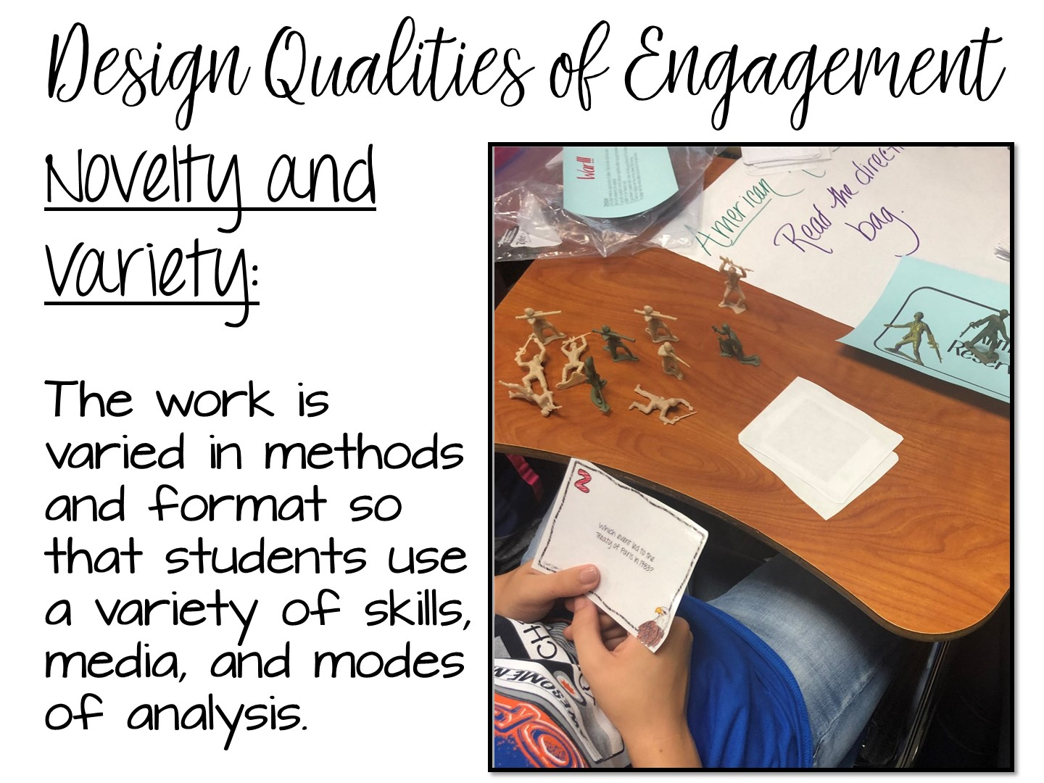

Slide 26
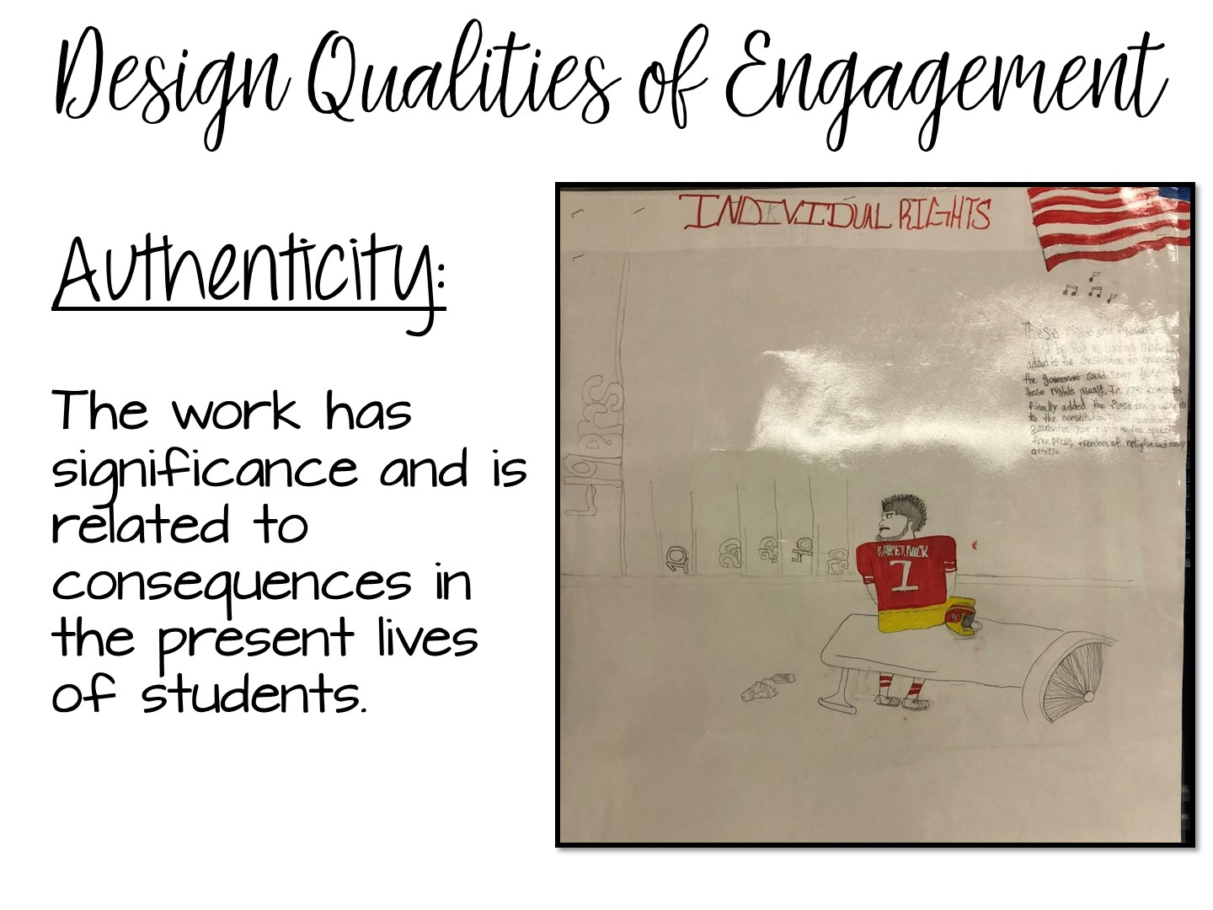

Slide 27

Notes:
What did they just see you model? What design qualities – example: affiliation (working in a group)
Use popsicle people to randomly call on teachers

Slide 28

Notes:
Use popsicle people to randomly call on teachers
28

Slide 29
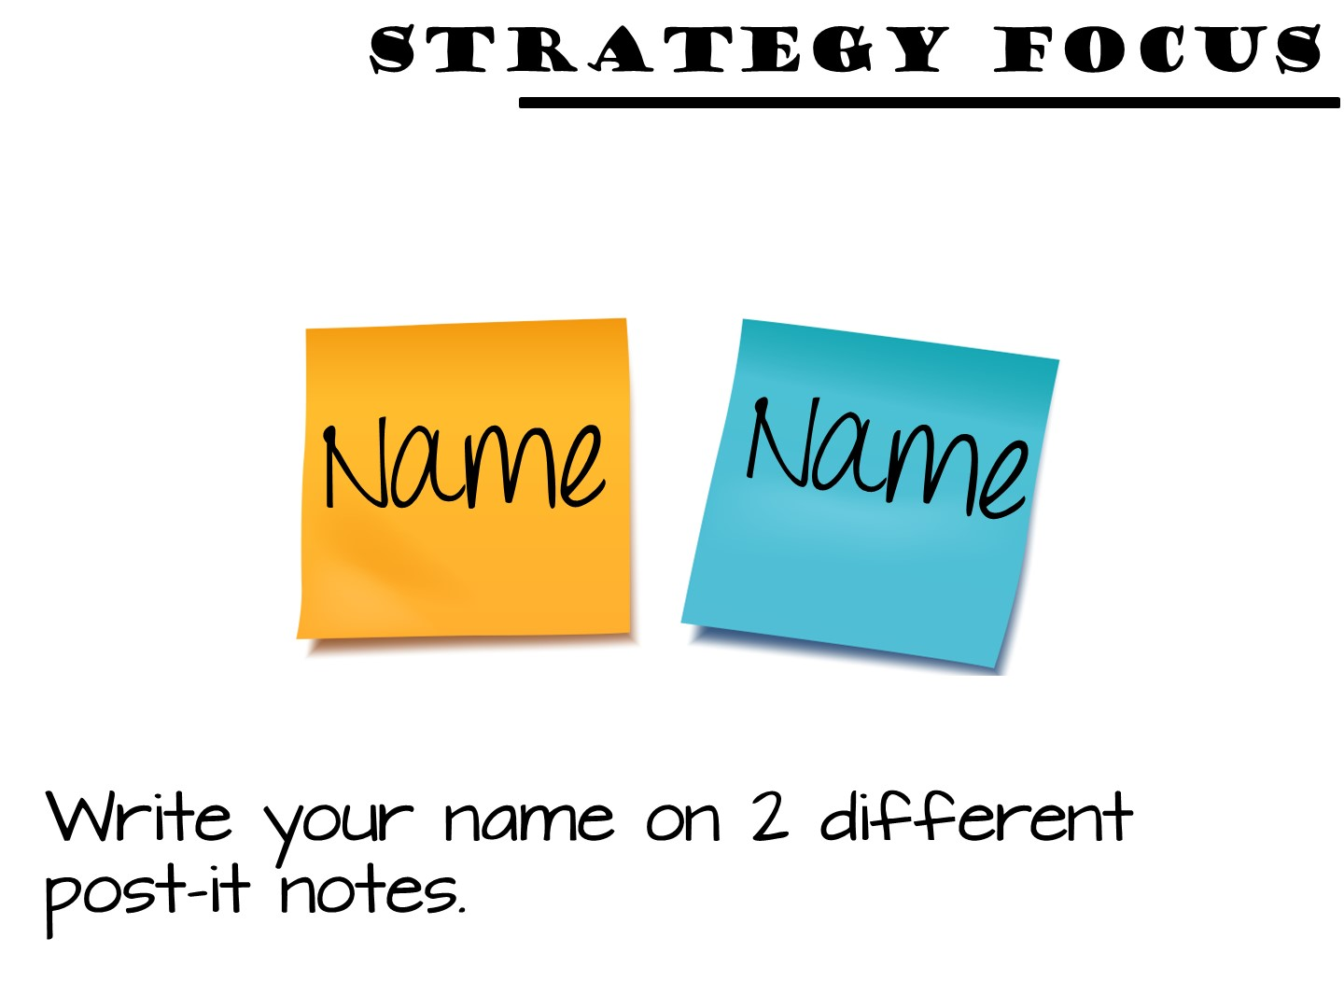
Notes:
Have the teacher participants write their name on two different post-it notes.

Slide 30
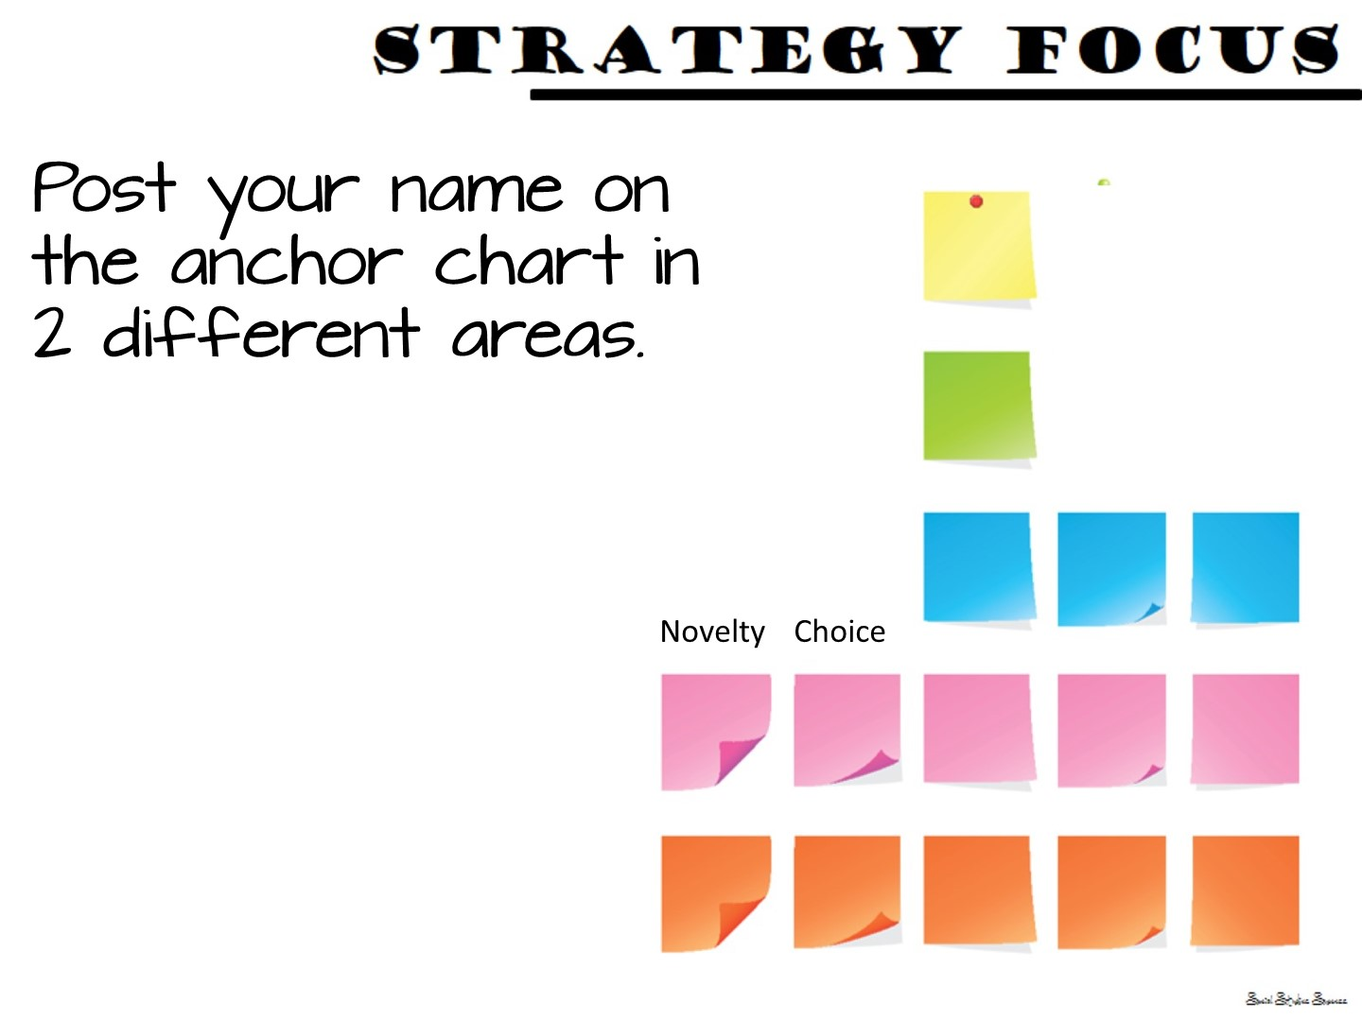
Notes:
Ask them which design quality of engagement they themselves need to work on. They will put their name post-it note on the anchor chart next to 2 different design qualities of engagement. This will be their focus for the day. You can then ask them throughout the day – “Johnny, where did you see x” by pulling his name off the chart.

Slide 31


Slide 32

Notes:
We are now going to model a lesson focusing on a different design quality of engagement – authenticity. But be on the lookout for more!

Slide 33

Notes:
This is a great lesson for the beginning of the year! Use within the first week if possible.

Slide 34
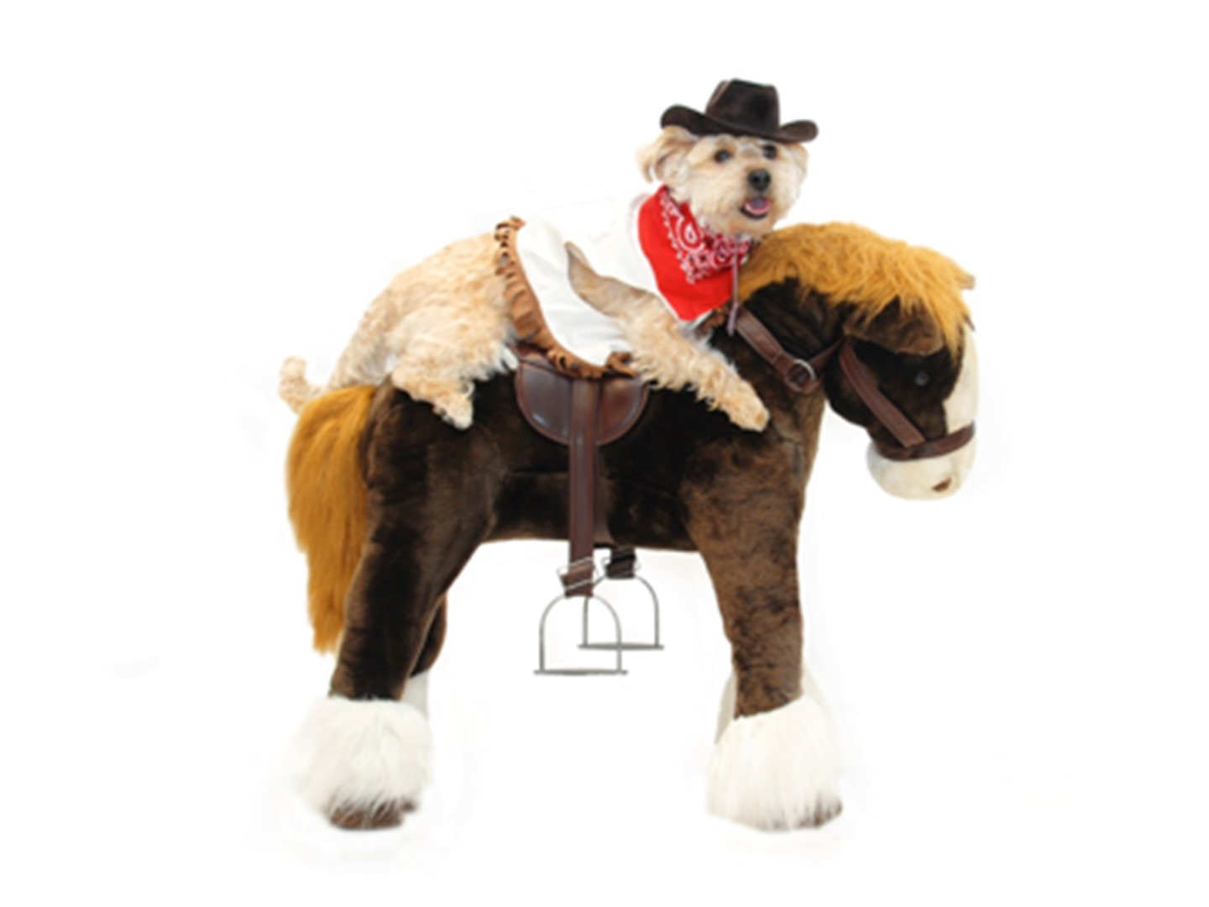
Notes:
This lesson is a dog and pony show as you will be modeling as many different strategies as you can. The lesson in their own classroom will be much simpler.

Slide 35

Notes:
Just read

Slide 36
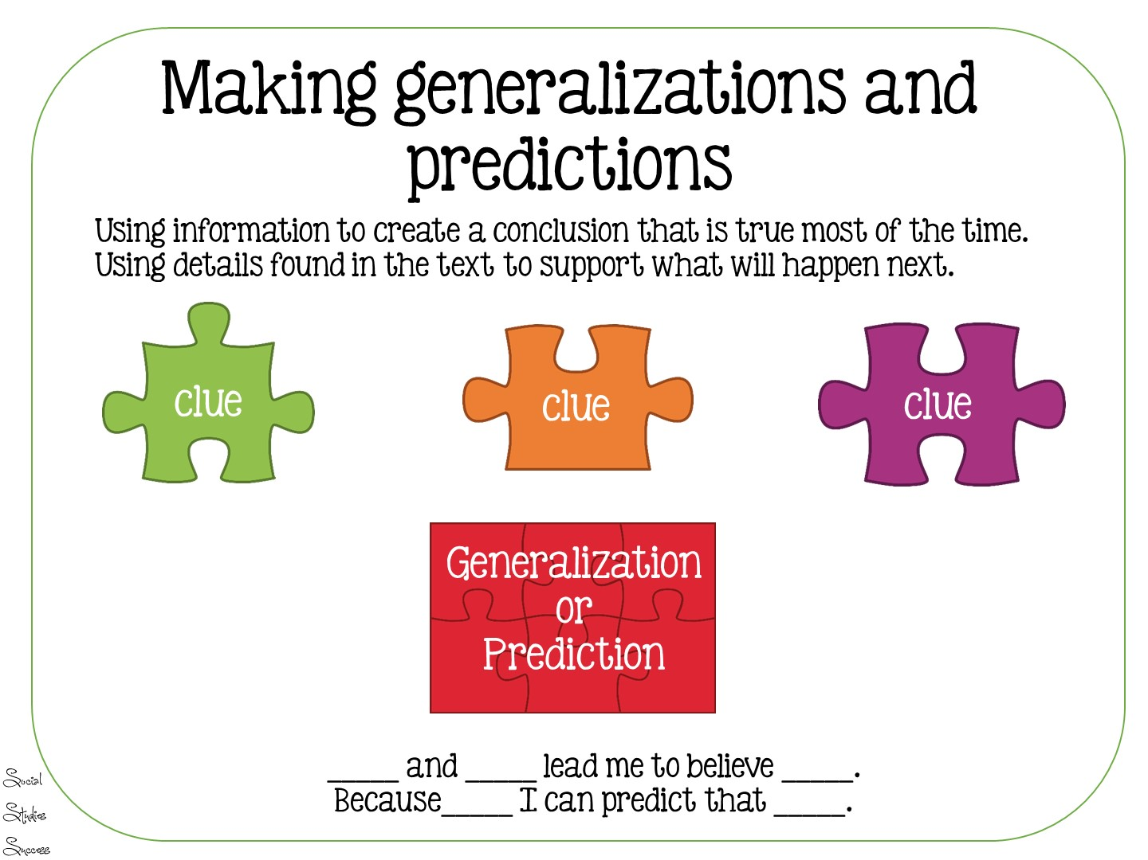
Notes:
Just read – this is the skill the students will be using in the lesson.

Slide 37

Notes:
This is the essential question

Slide 38

Notes:
Ask the teachers to think about the answer and then stand in each one of the 4 corners that represent their response. Once they are their, talk with each other to see why they all have similar response, then share out.

Slide 39

Notes:
These are the vocabulary terms we are going to learn

Slide 40

Notes:
Pass out Predict This
Give each teacher one of these and place them with a partner. Have them all come up to the word wall and discuss with their partner to see what they think the correct answer is.

Slide 41

Notes:
Use the following slides to debrief the answers

Slide 42


Slide 43


Slide 44


Slide 45


Slide 46


Slide 47
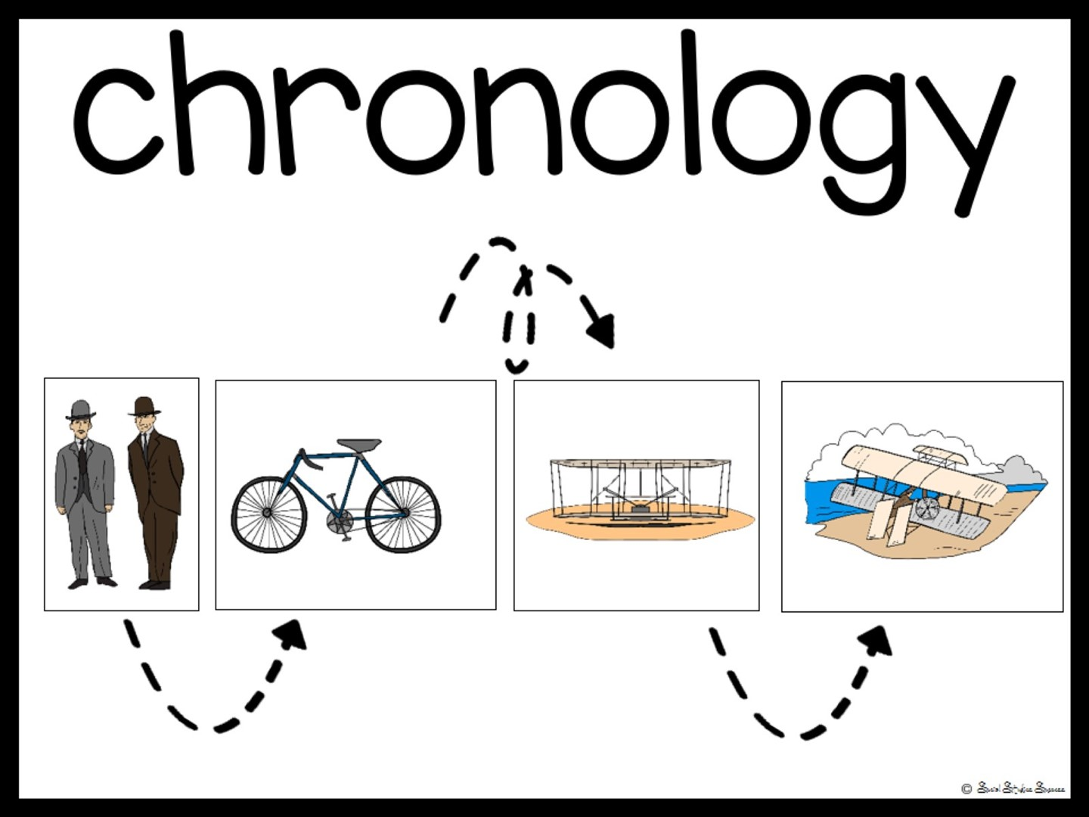

Slide 48


Slide 49
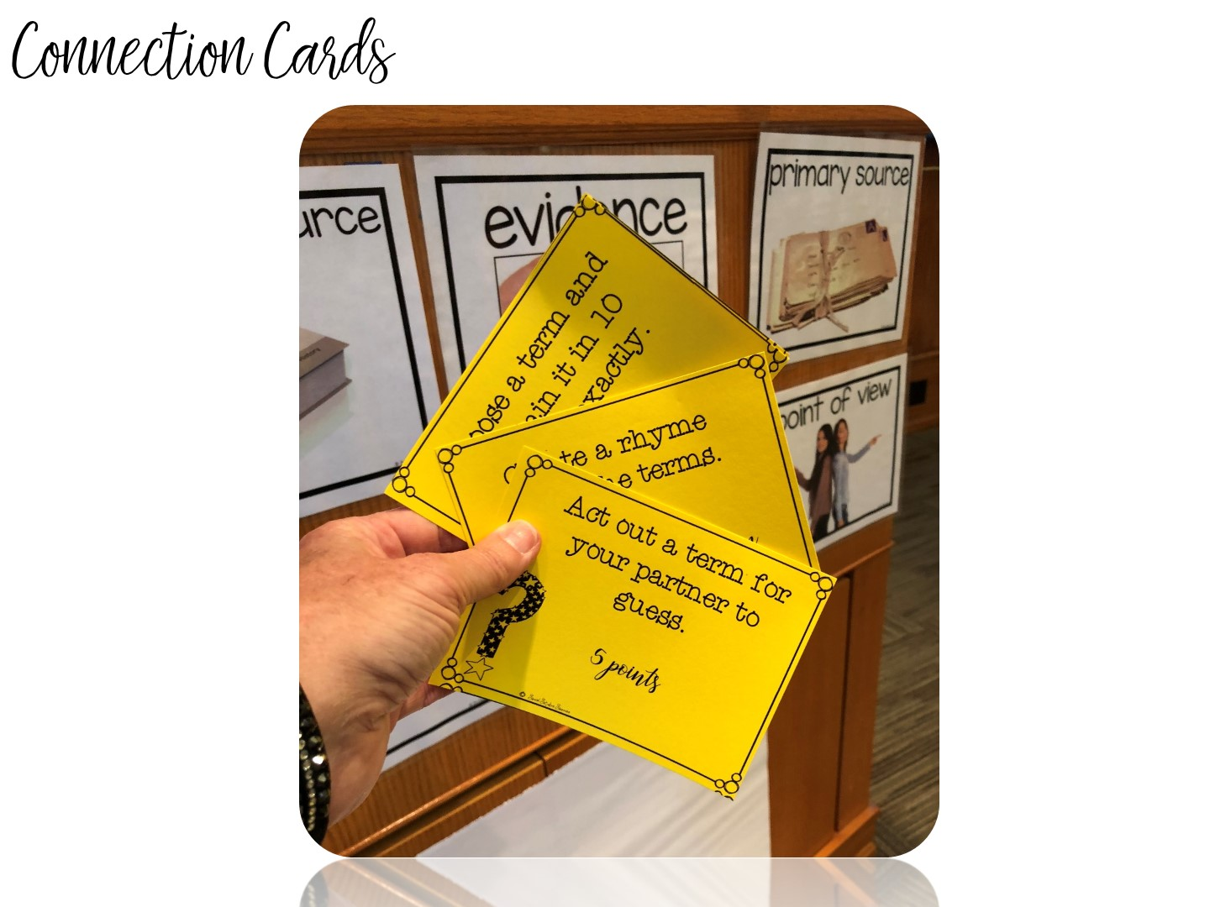
Notes:
Play connection cards – give a pack of cards to a group of 3-4. Have them turn the cards face down and just draw a card. Then do what is on the card. 4-5 minutes only.

Slide 50

Notes:
Now pass out your own artifacts in an envelope. In their groups, have them examine the artifacts to see if they can answer any of thee questions.

Slide 51
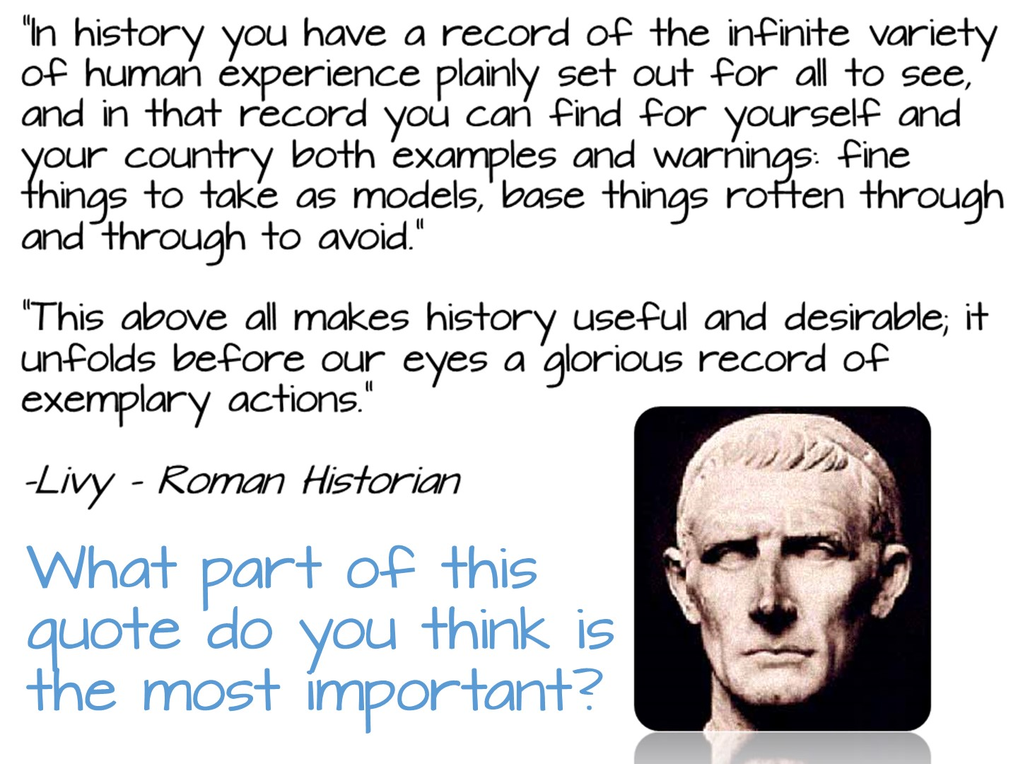
Notes:
Read to group

Slide 52

Notes:
Pass out the first page of the reading. Put them with a partner and use question dice for the reading. Model how to use question dice.

Slide 53
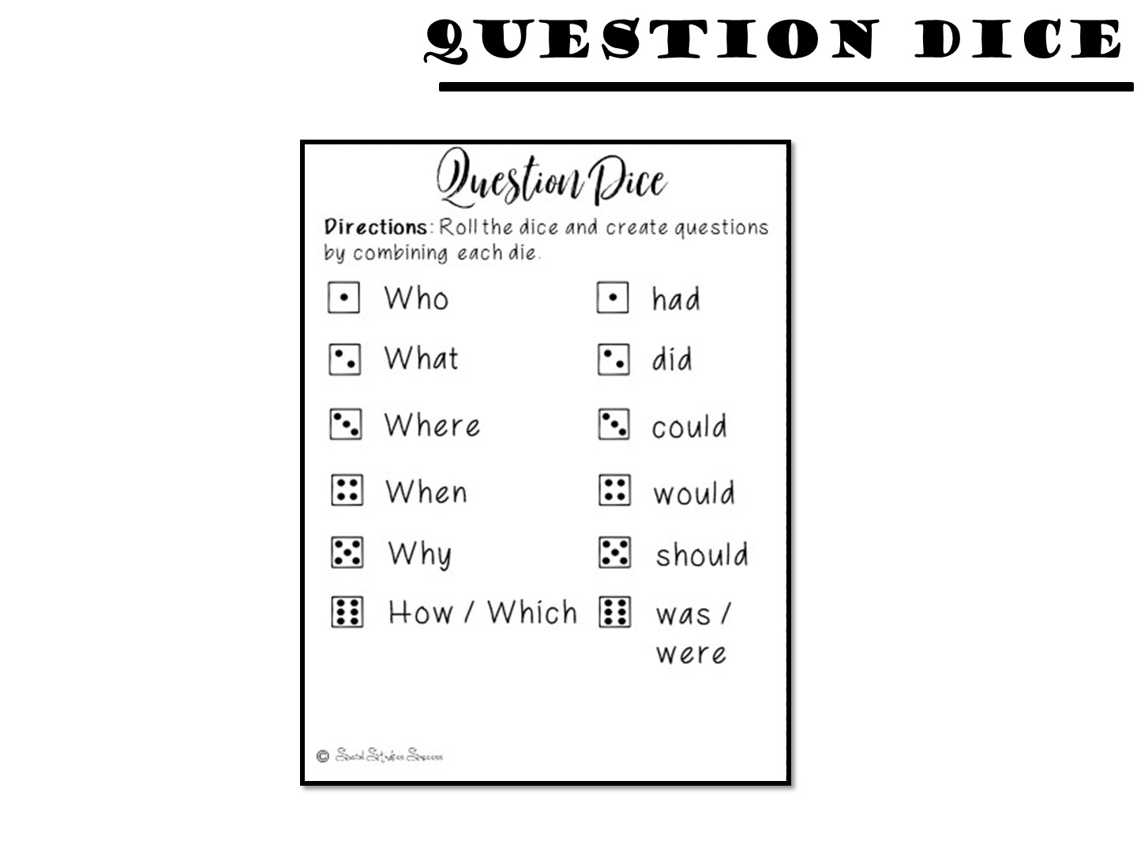
Notes:
Project so they can see if they can’t read the tiny cards in the boxes.

Slide 54

Notes:
Pass out the second reading and model how to read with pick a card. After they have read, give them one of the pick a cards to use as a sentence starter with the whole group.

Slide 55

Notes:
Pass out Doodle Notes and just do for about 5 minutes

Slide 56

Notes:
Pass out spectrum and have them read and discuss

Slide 57


Slide 58


Slide 59

Notes:
Give them 5 minutes to write down reflections on their notes (on the back)

Slide 60

Notes:
Prep for the next lesson model during the break:
Hang up the word wall vocabulary terms for colonization

Slide 61

Notes:
Check for any questions before you begin

Slide 62
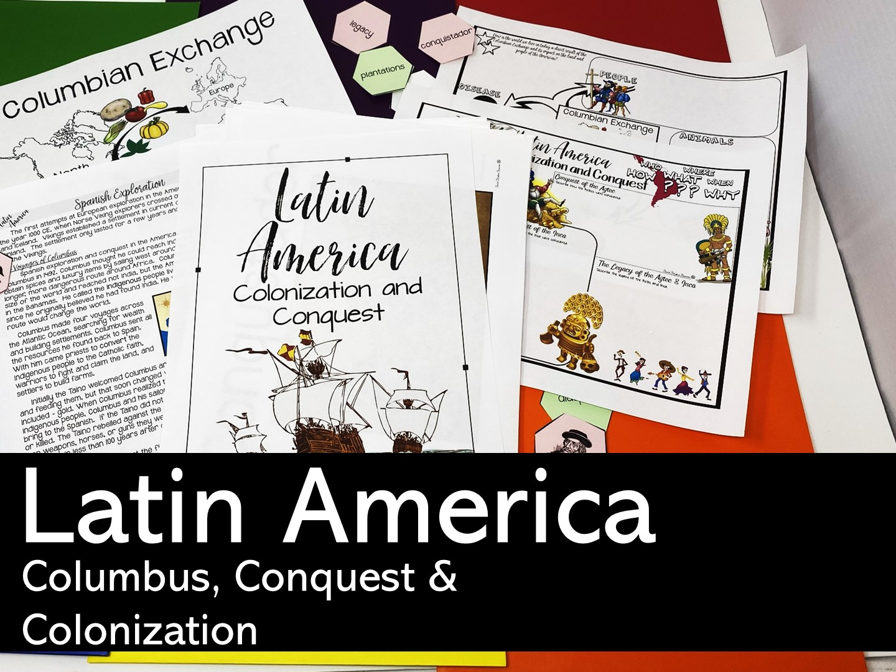
Notes:
The next lesson you are going to model is for 6th grade World Cultures

Slide 63
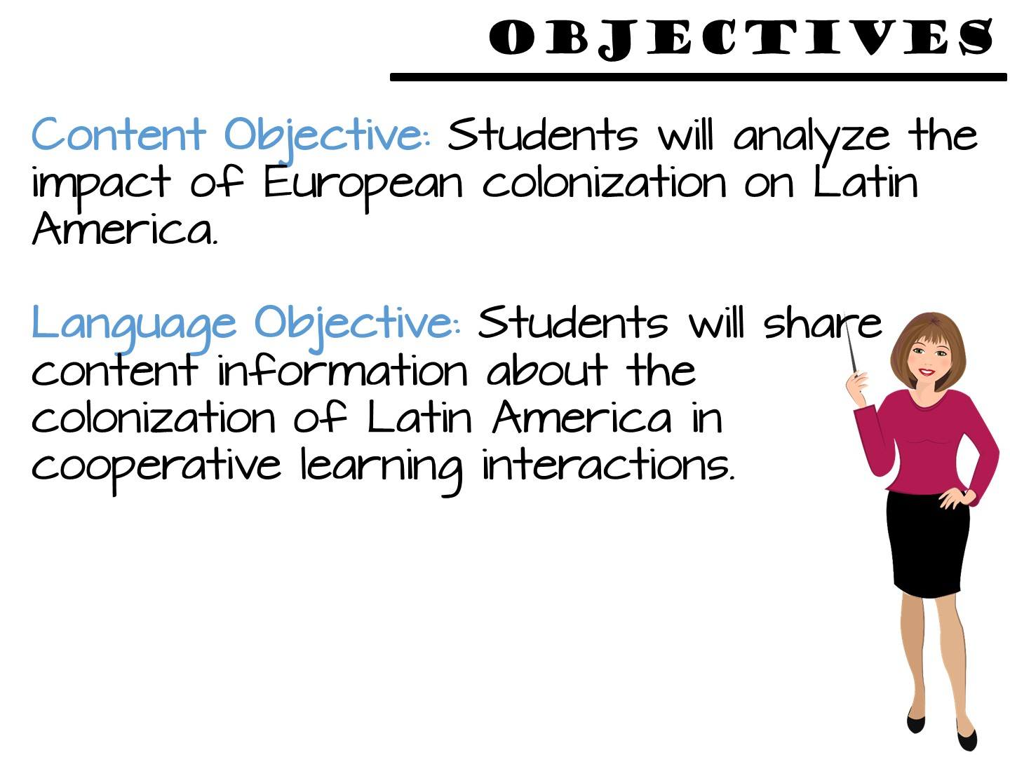
Notes:
Just read

Slide 64


Slide 65
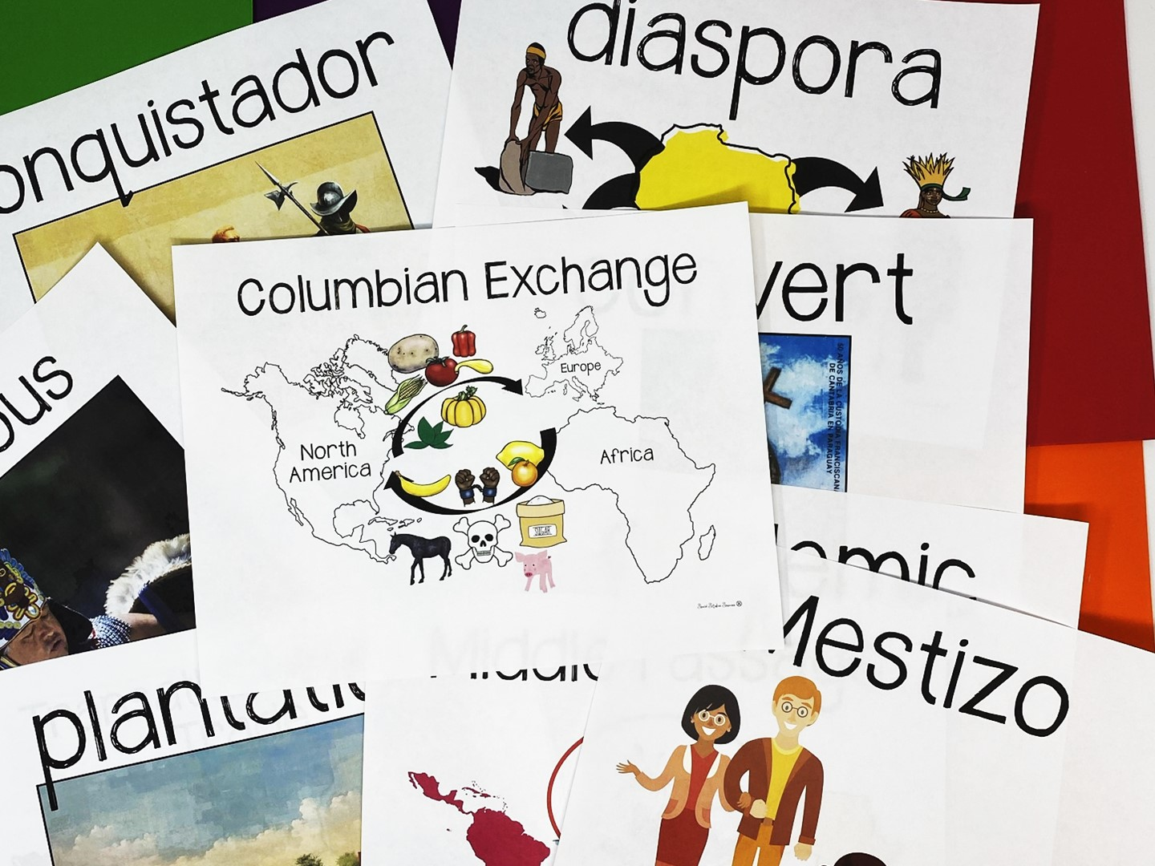
Notes:
Share that you are going to model several different methods of teaching vocabulary.
Point to the word wall and read each of the terms – tell the teachers we are going to do a 3, 2, 1 definition to learn the terms. They will need post-it notes for the activity.

Slide 66
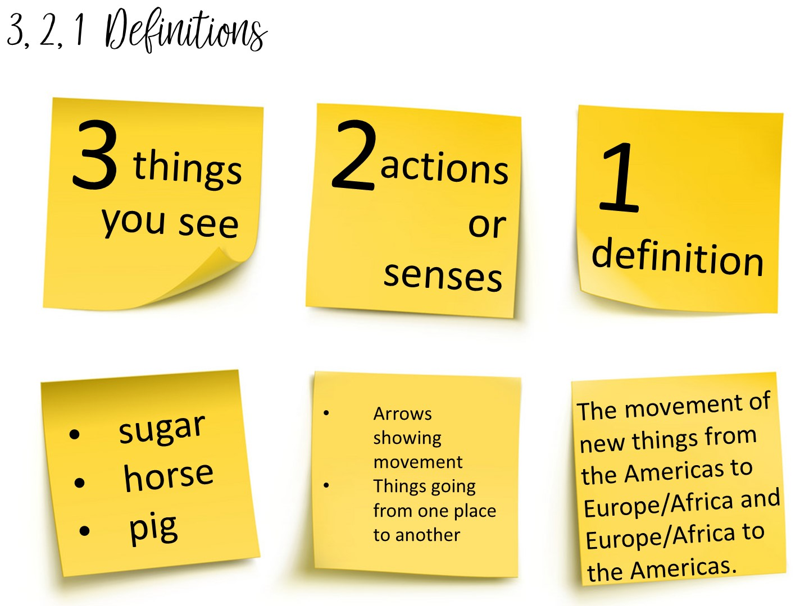
Notes:
Another method to teach vocabulary with images is the 3, 2, 1 Definitions – Allow students time to analyze an image to build their understanding of an image.
Model this with the word Columbian Exchange
Allow them to pick a term with a partner and complete the 3, 2, 1 definition. I always bring the teachers close to word wall to get them out of their seats.

Slide 67
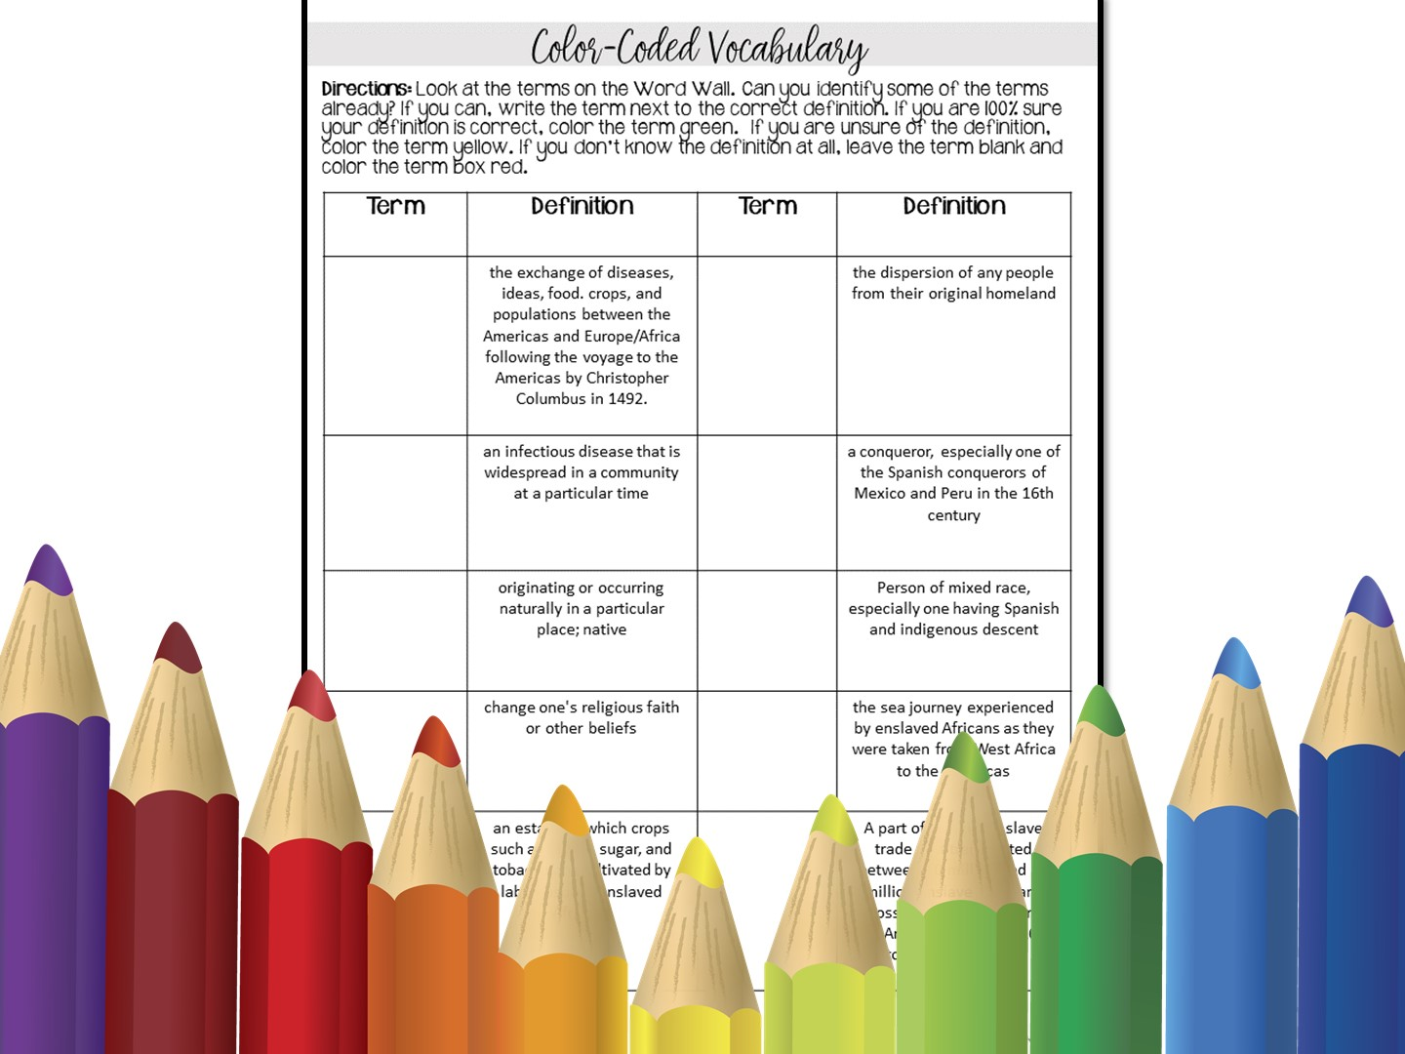
Notes:
Or you can use this vocabulary actvity - Make sure teachers have red-, green- and yellow-colored pencils. They will look at the terms on the word wall to complete this activity.

Slide 68
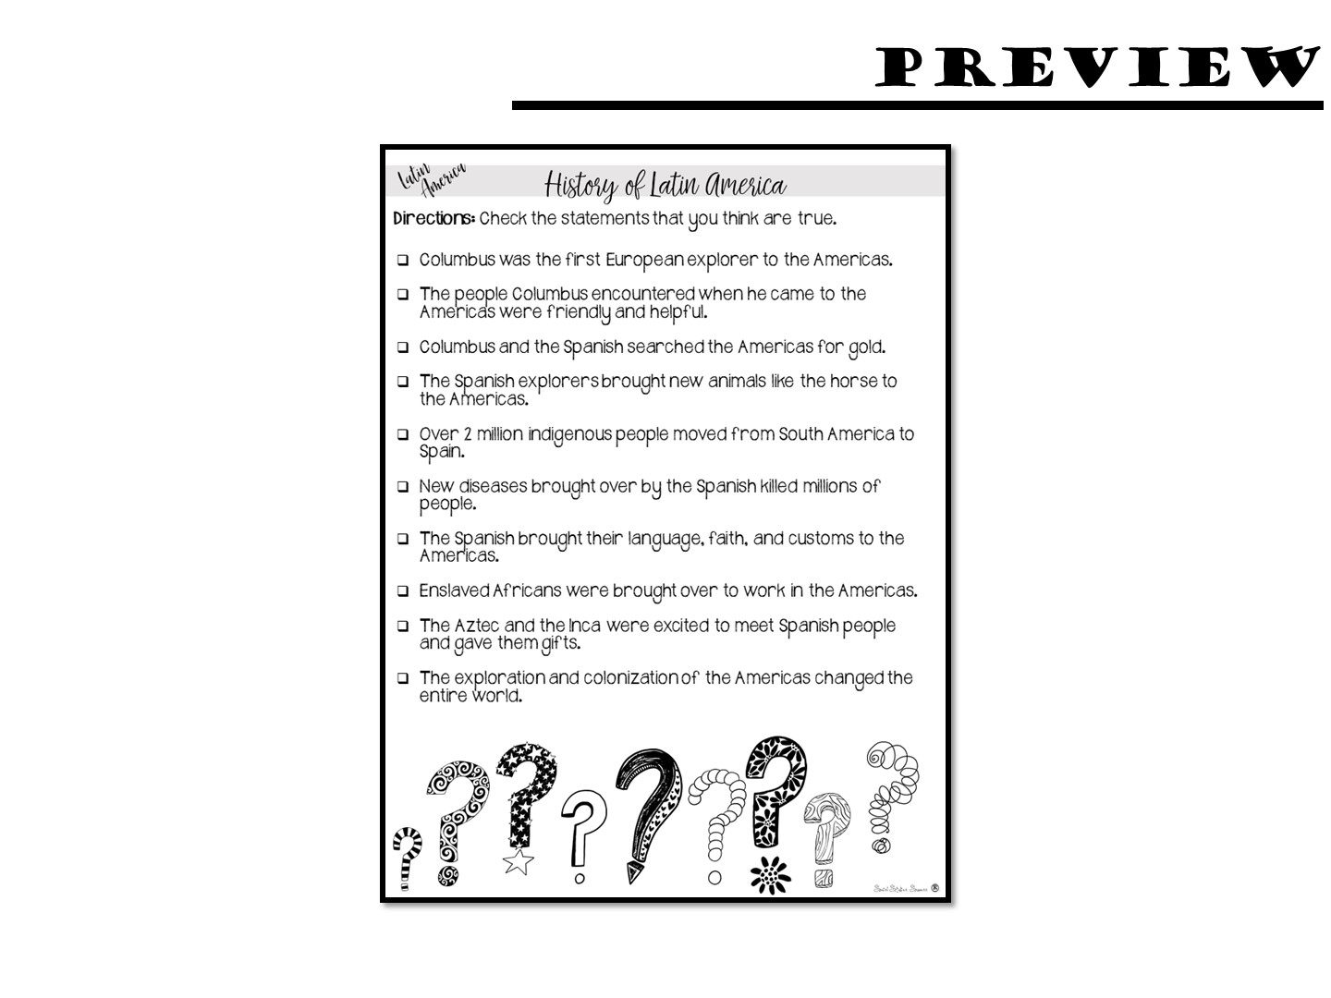
Notes:
Pass out anticipation guide - do for just a few minutes

Slide 69
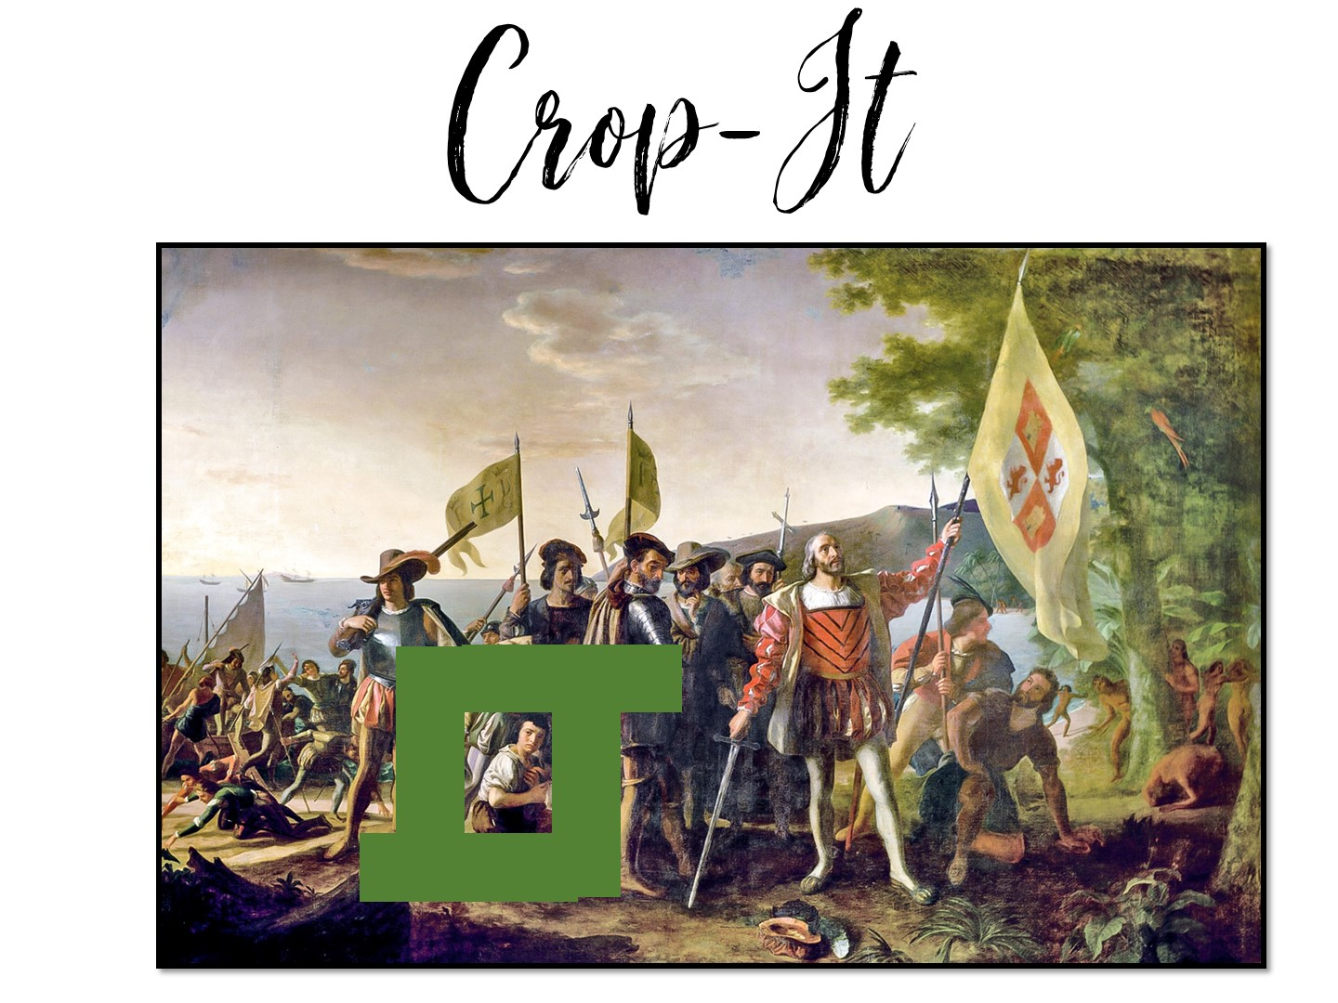
Notes:
Pass out the crop-it tools and the Columbus images. Use the handout with questions to ask questions for the teachers to answer using the tool.

Slide 70
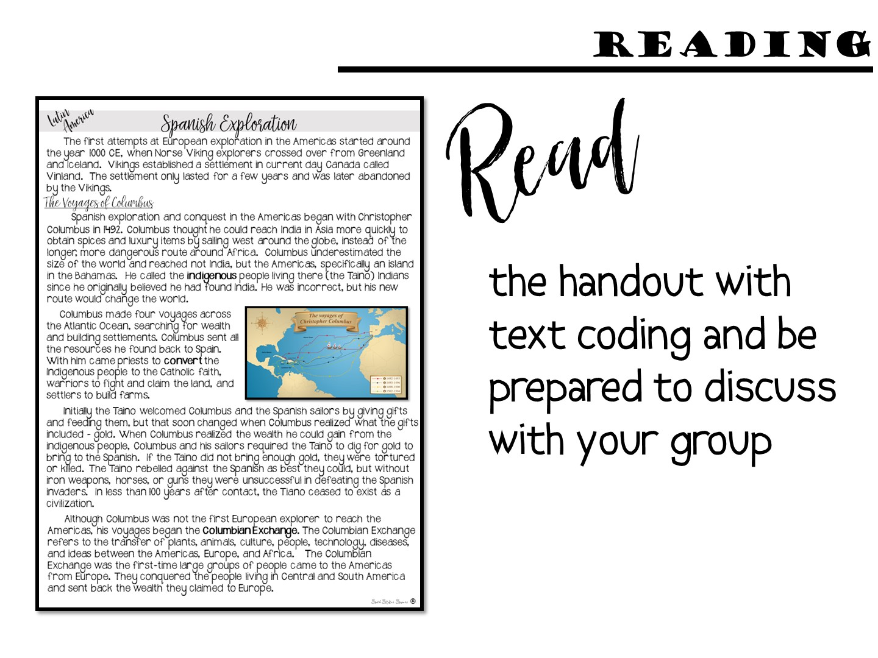
Notes:
Give each group a sheet of manila paper, copy of the first page of the reading (Spanish Exploration), the first page of Doodle Notes™ (Latin America Colonization) and Conquest and the first page of hexagons (Round One).
Model Text Coding – hand out the text coding cards and choose one thing to model – usually one new thing they learned.

Slide 71
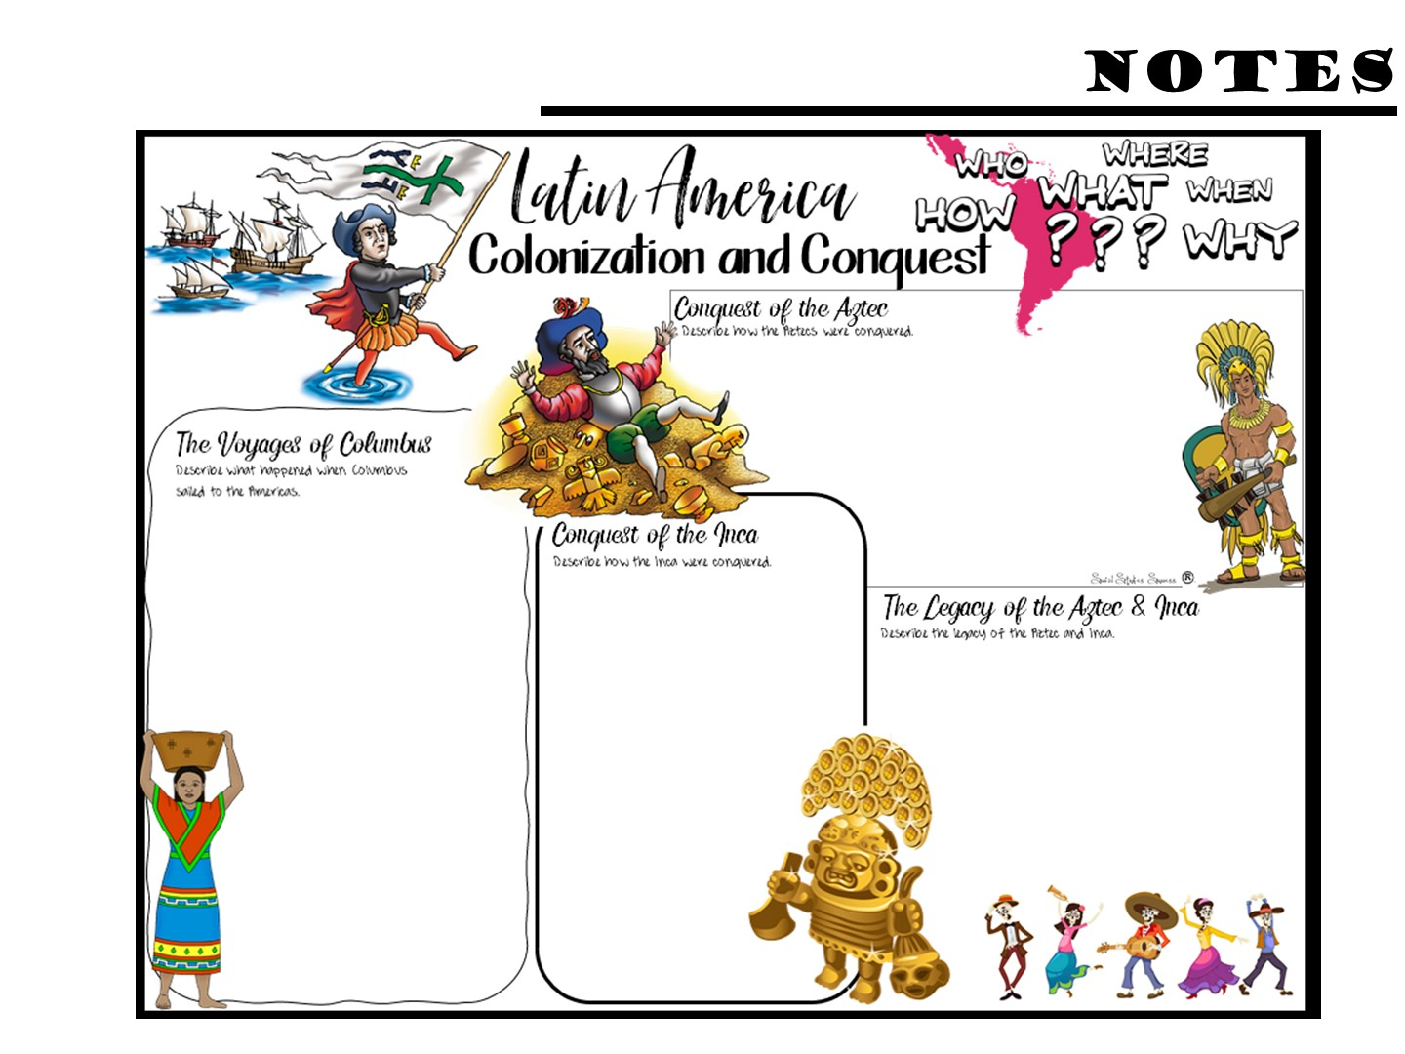
Notes:
Pass out the Doodle Notes and have them complete what they can with the first page of reading – not all of the info comes from the first page.

Slide 72
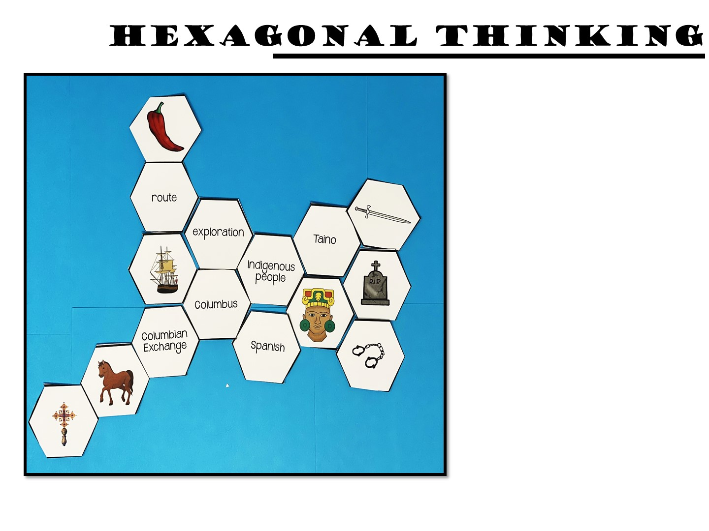
Make connections between the hexagon shapes.
Notes:
Pass out the first round of the hexagon cards. Make connections between the hexagon shapes. For every connection they make, they earn 1 point. For example, the indigenous people shape is connected on 5 sides, exploration, Columbus, Spanish, person figure and Taino. A student should be able to explain how all of these are connected. If they can, they earn 5 points. You can ask them to annotate their connections with post it notes
Once you have finished the directions, go to the next slide before you start – you don’t want them to just copy your example.

Slide 73

Play

Slide 74

Notes:
You may not want to do round two or three, depends on your time. You can just tell them what they would do next, how they add hexagons everytime so that it grows.

Slide 75
Notes:
Pass out the Doodle Notes and have them complete what they can with the second page of reading

Slide 76
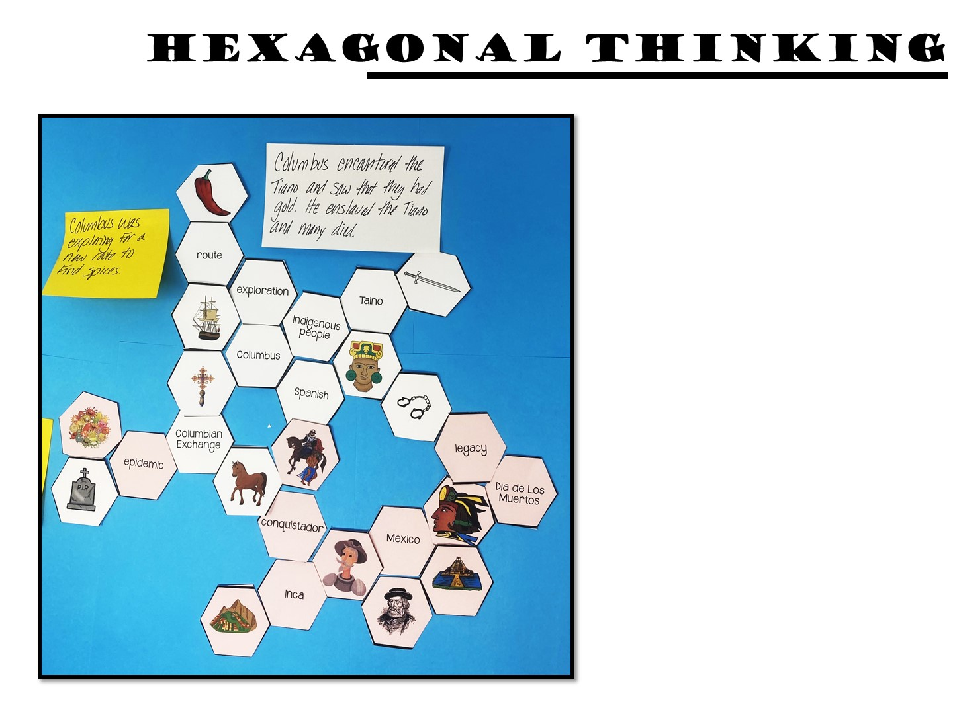
Make connections between the hexagon shapes.
Notes:
Once you have finished the directions, go to the next slide before you start – you don’t want them to just copy your example.

Slide 77
Play

Slide 78
Notes:
After you have your small groups discuss, ask a few the answer. Then person 0 stays put, person 1 moves one space, and person 2 moves 2 spaces in the circle. Then present the next slide to discuss.

Slide 79


Slide 81
Notes:
Give them 5 minutes to write down reflections on their notes (on the back)

Slide 82
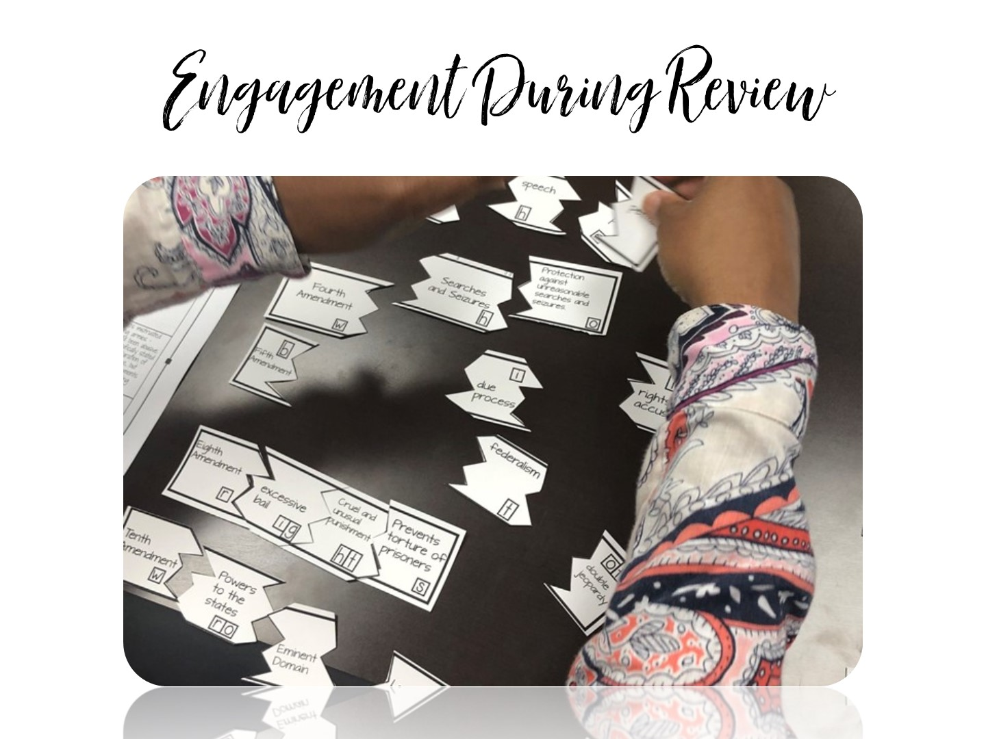

Slide 83
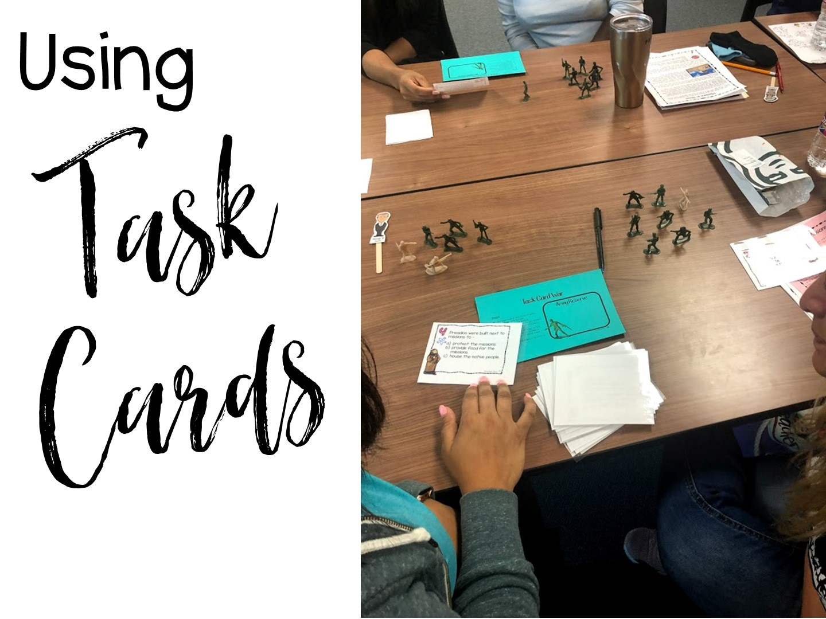
Notes:
Group teachers by grade level. Pass out the Task Cards for Colonization.

Slide 84
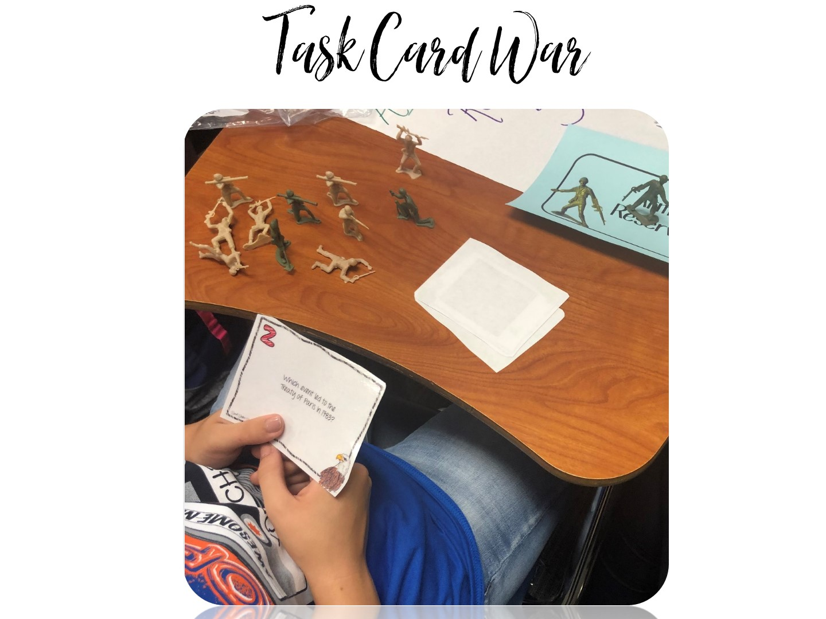
Notes:
Pass out army soldiers – each person gets about 10 soldiers. Directions are on the next slide.

Slide 85
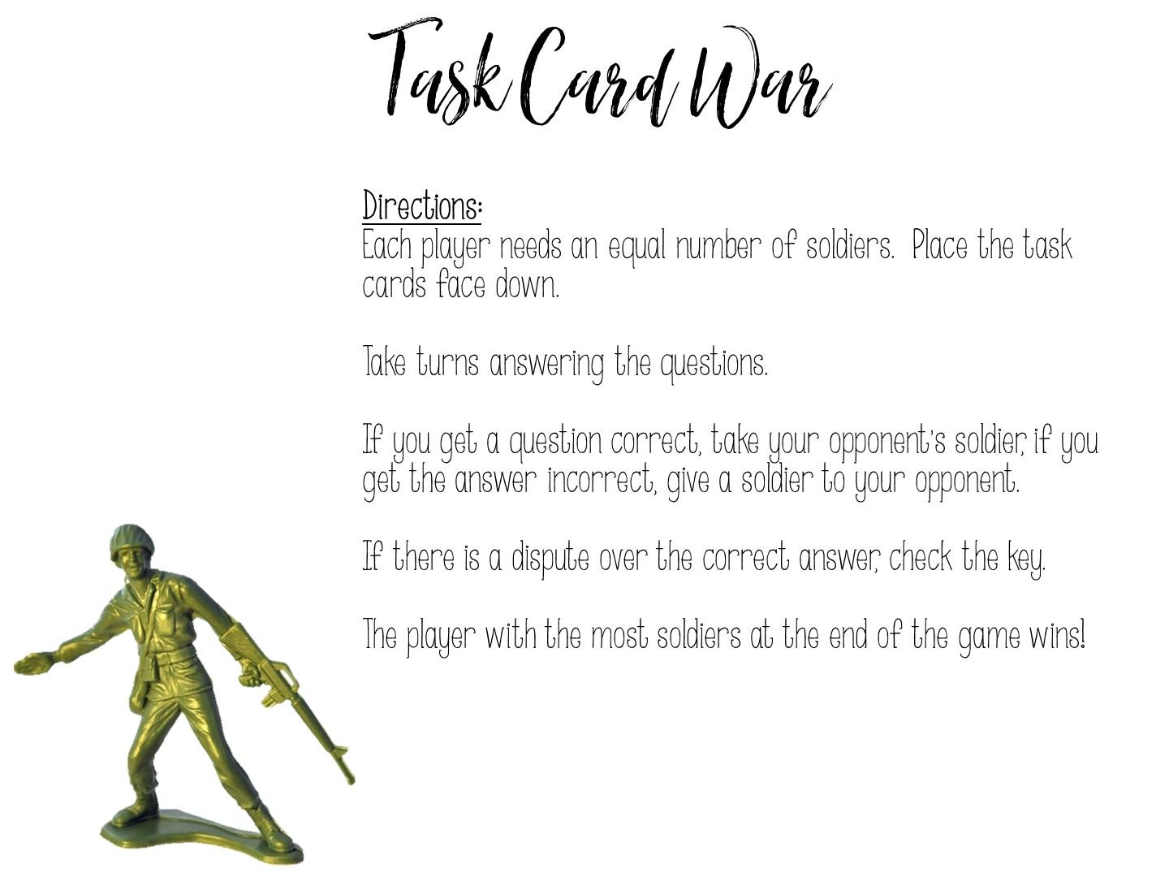
Notes:
Play ☺

Slide 86
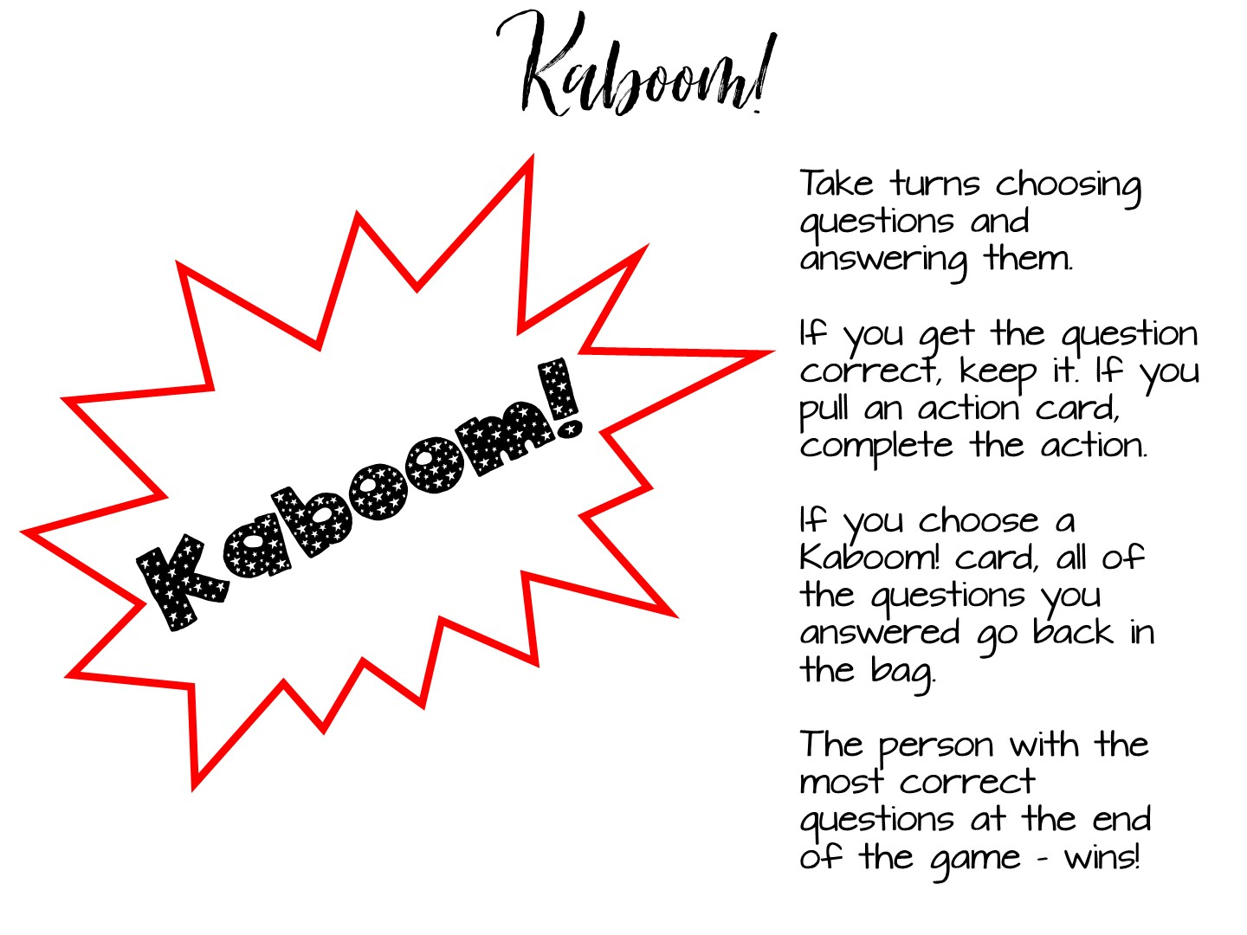
Notes:
Add a few of the kaboom cards to each set. Put the cards into a paper bag or turn them face down. Play like UNO.

Slide 88
Notes:
Give them 5 minutes to write down reflections on their notes (on the back)

Slide 89

Notes:
During lunch, set up the engagement stations. Play soft music while they work.

Slide 90


Slide 91
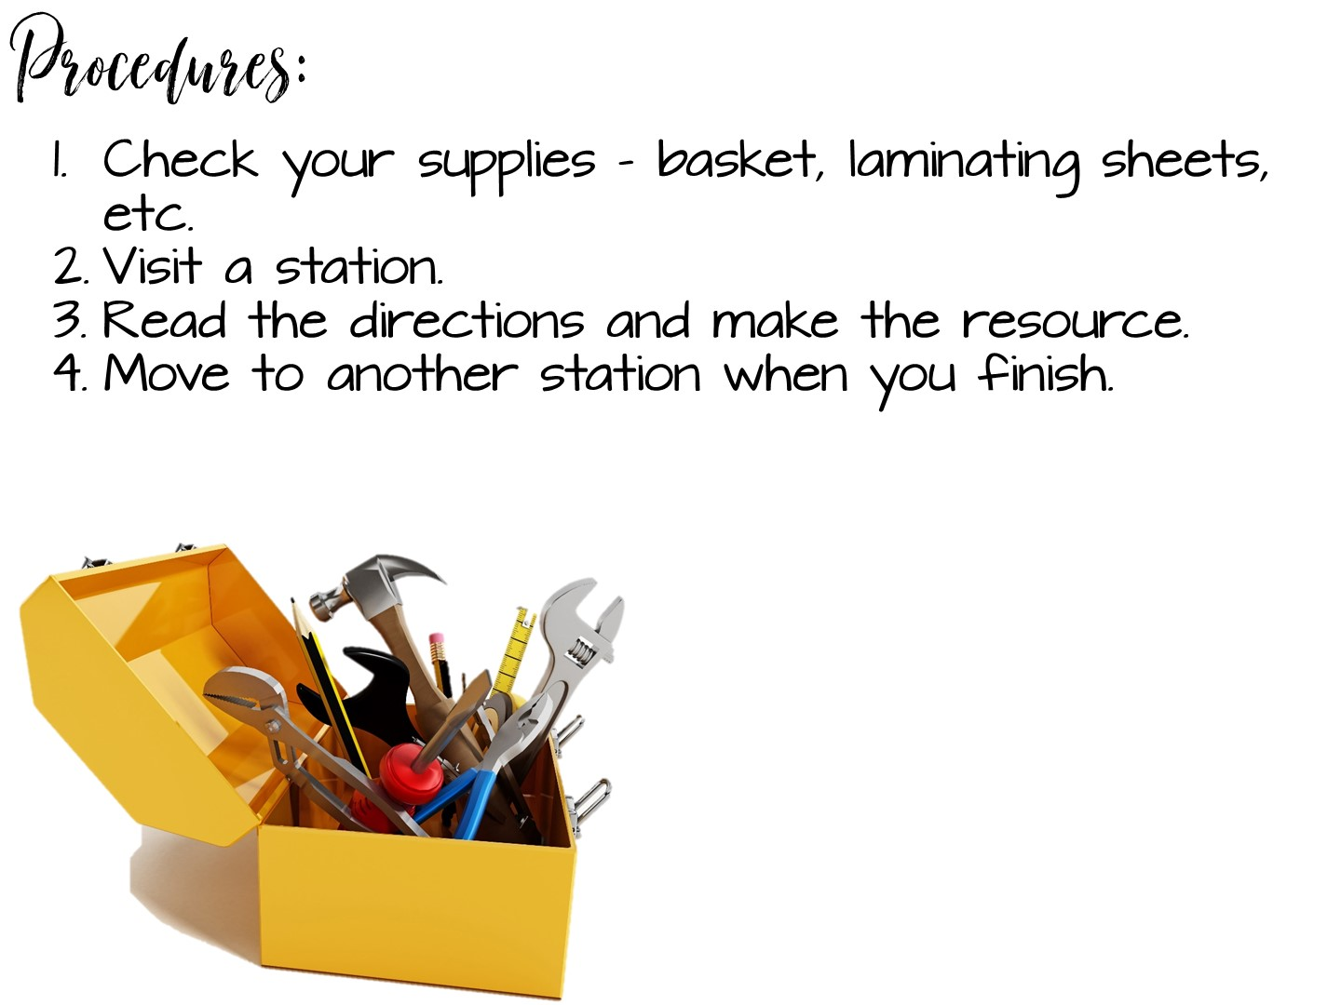
Notes:
They love this part! Just wander around and help as needed.

Slide 92
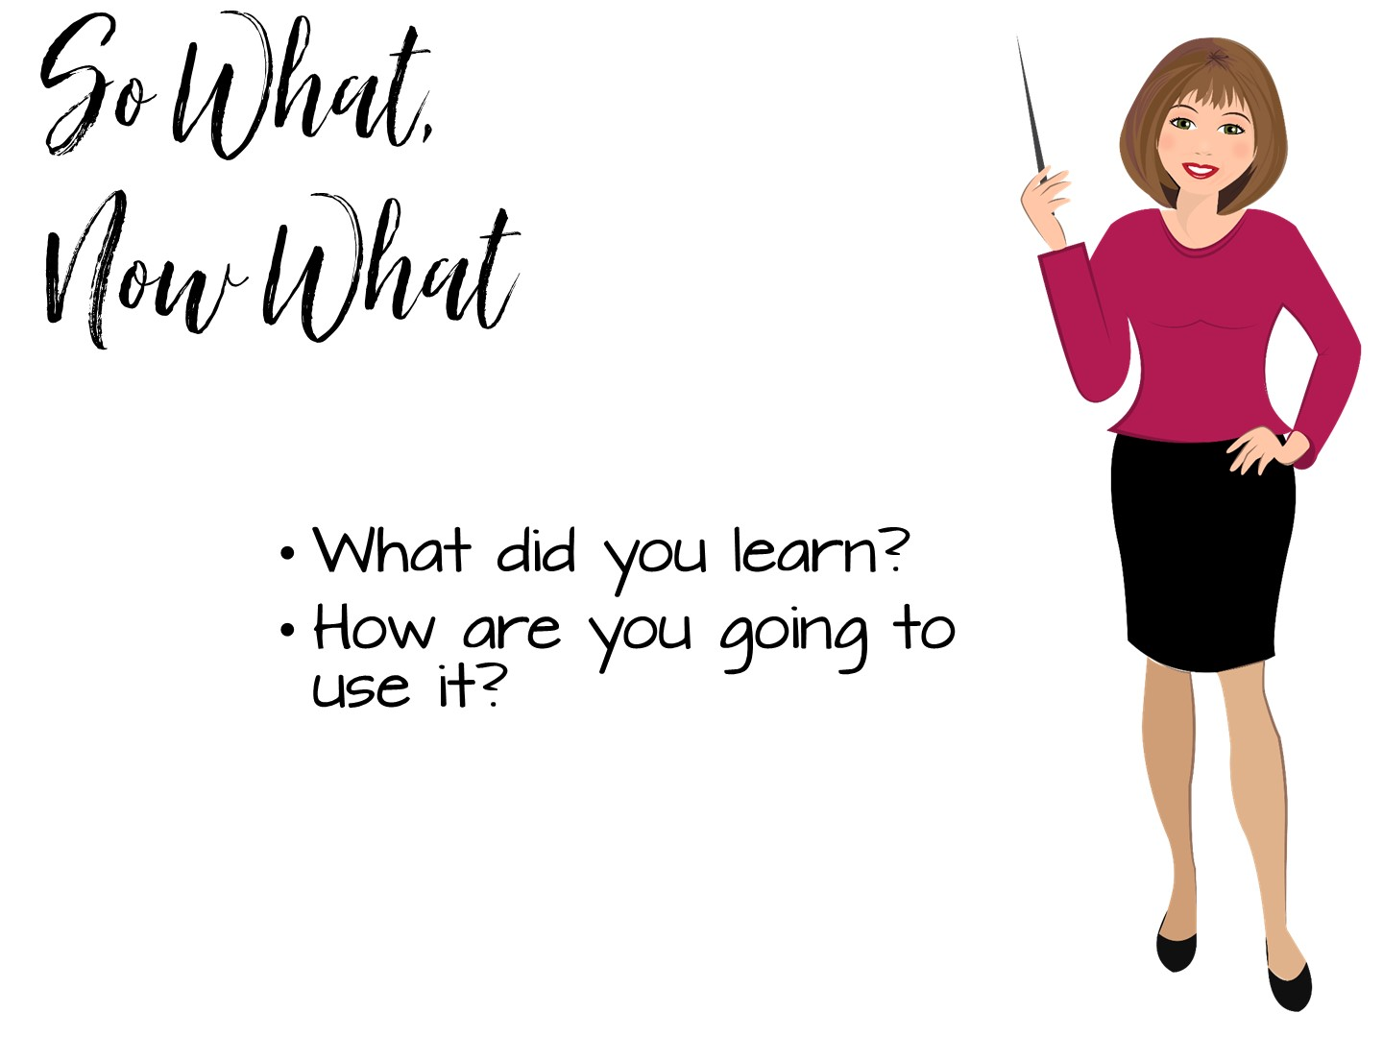

Slide 93

Notes:
Point out my blog on social studies success if they want to learn more.

