Slide 1

Notes:
Set up teachers into Break Out Rooms – you need at leas 3-4 teachers in each group. Tell each group their number – they will need it later on the Jamboard.
Open up all of the documents and the Jamboard.
If you have any notebooks you can show, make sure to have them next to you.

Slide 2

Notes:
Share one fun fact about yourself in the comments section – an example, I am a twin.
This is a time killer until everyone joins.

Slide 3


Slide 4

Notes:
Have teachers download the manuals to save time later in the session

Slide 5

Notes:
Introduce yourself

Slide 6


Slide 7


Slide 8
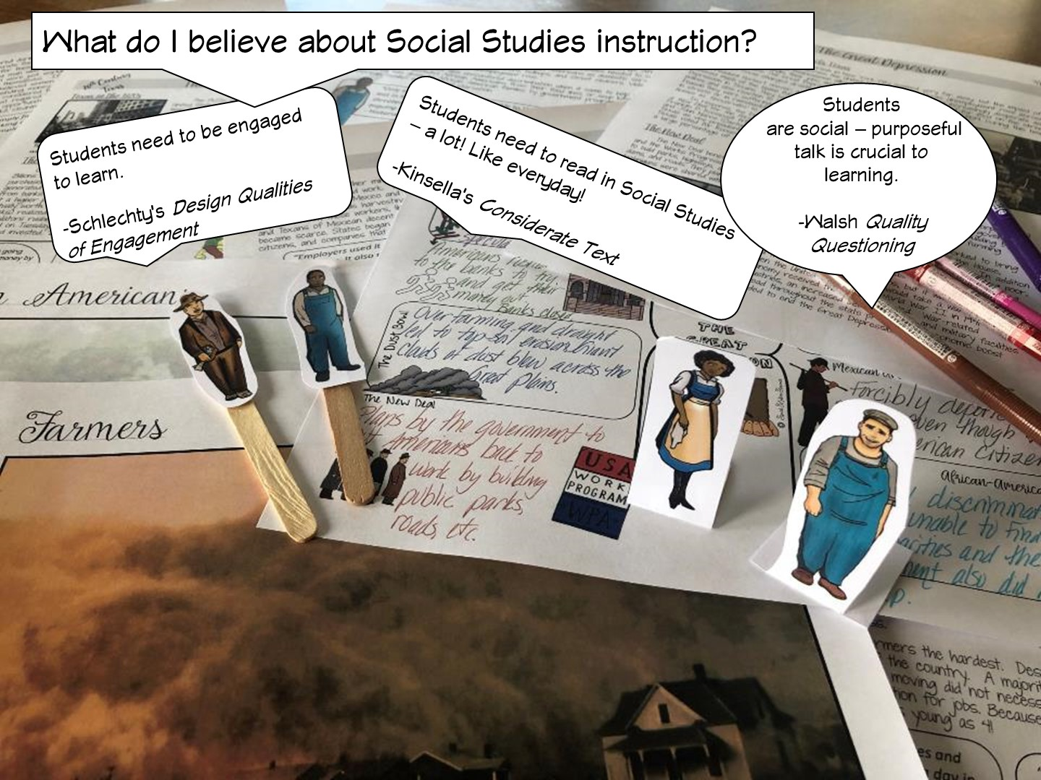

Slide 9
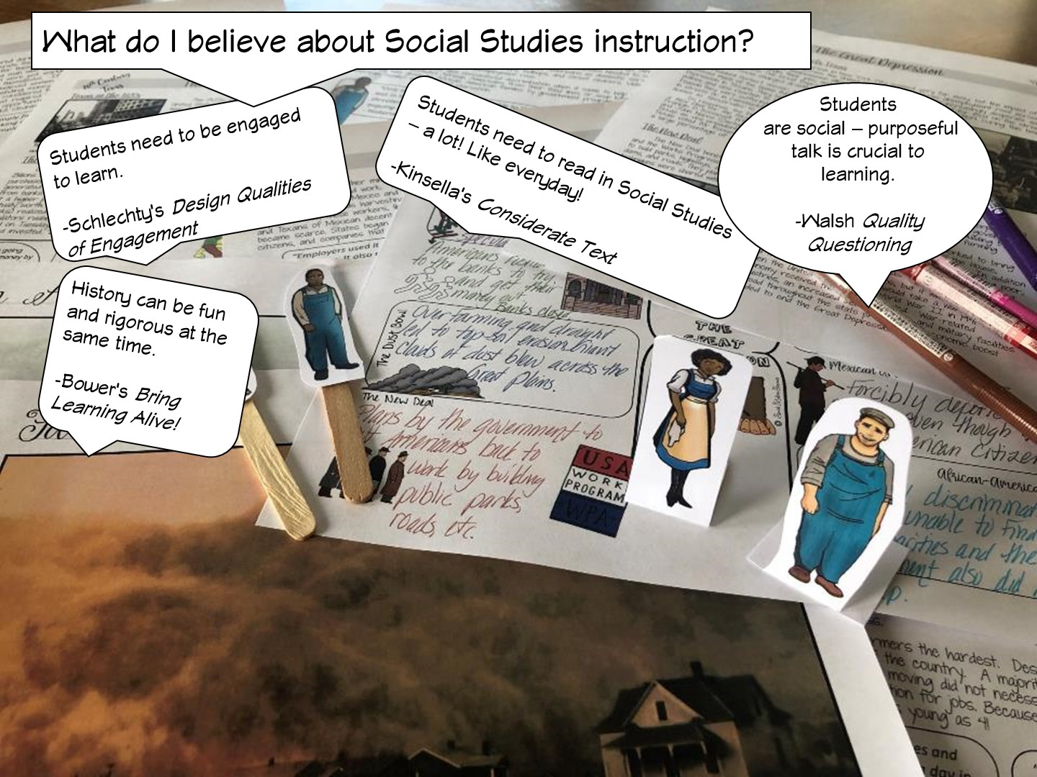
Notes:
.

Slide 10


Slide 11
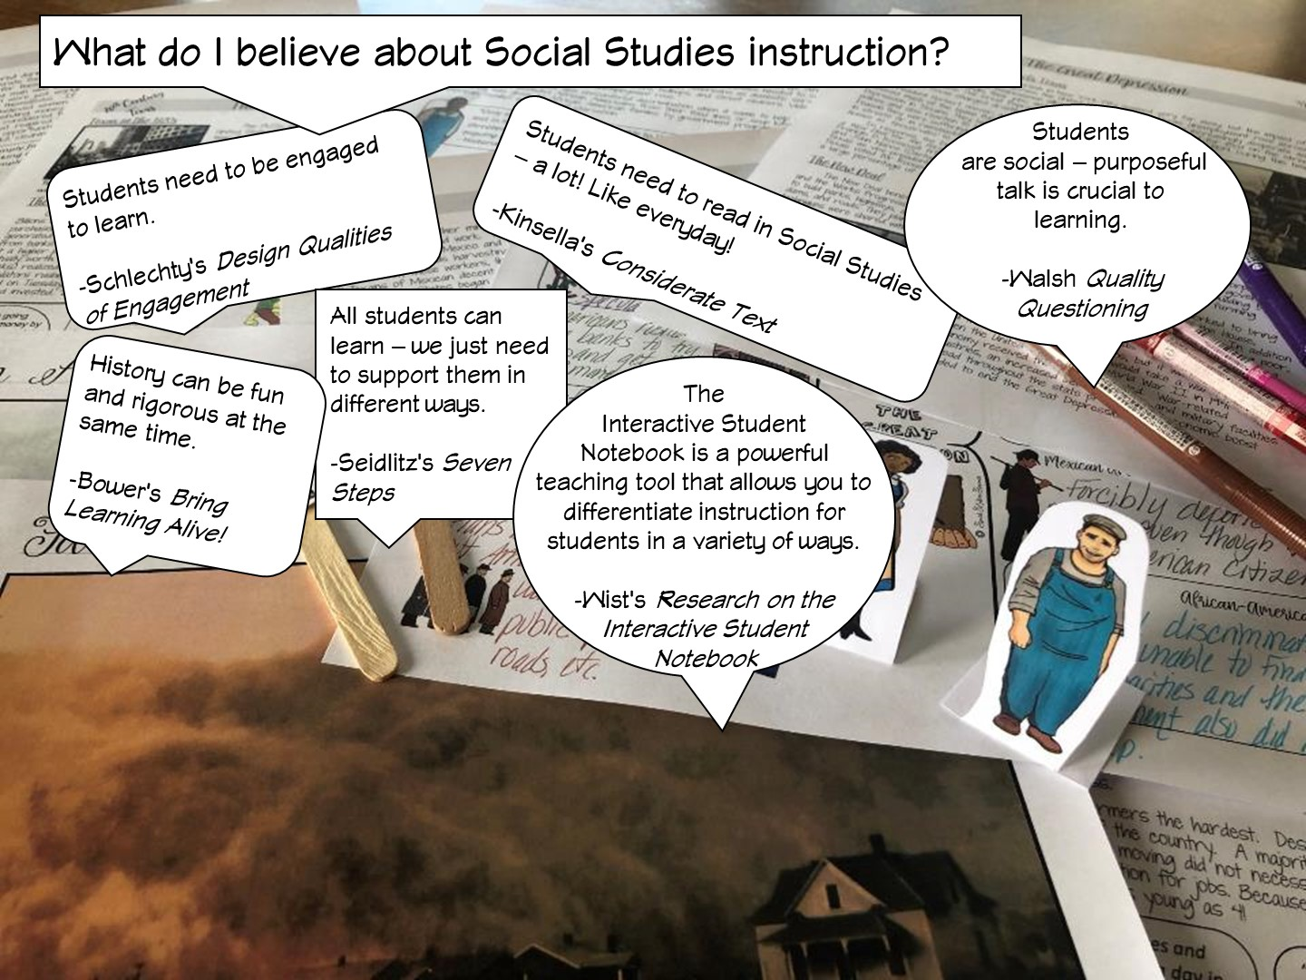
Notes:
Differentiated instruction is ensuring that learning happens in an accessible way for the student. ISNs allow the students to format their thoughts however they find suitable, thus, differentiating by learning styles — someone who loves writing can love in the notebooks, another student who would rather draw is free to express his/her ideas through diagrams, charts and pictures.

Slide 12
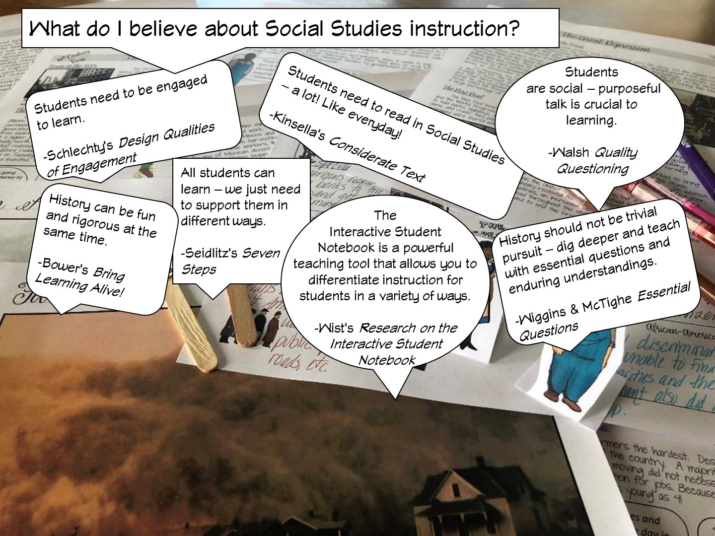

Slide 13
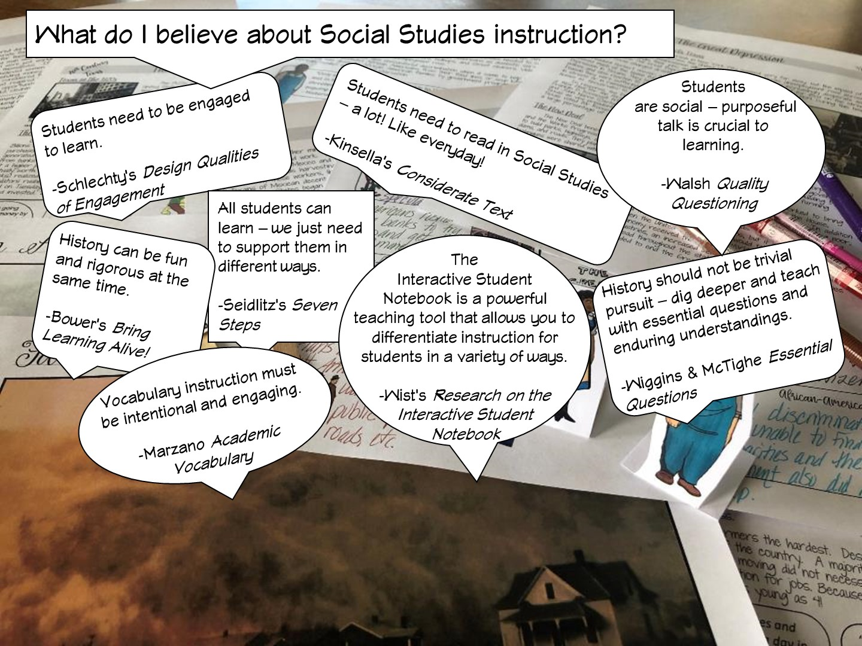

Slide 14
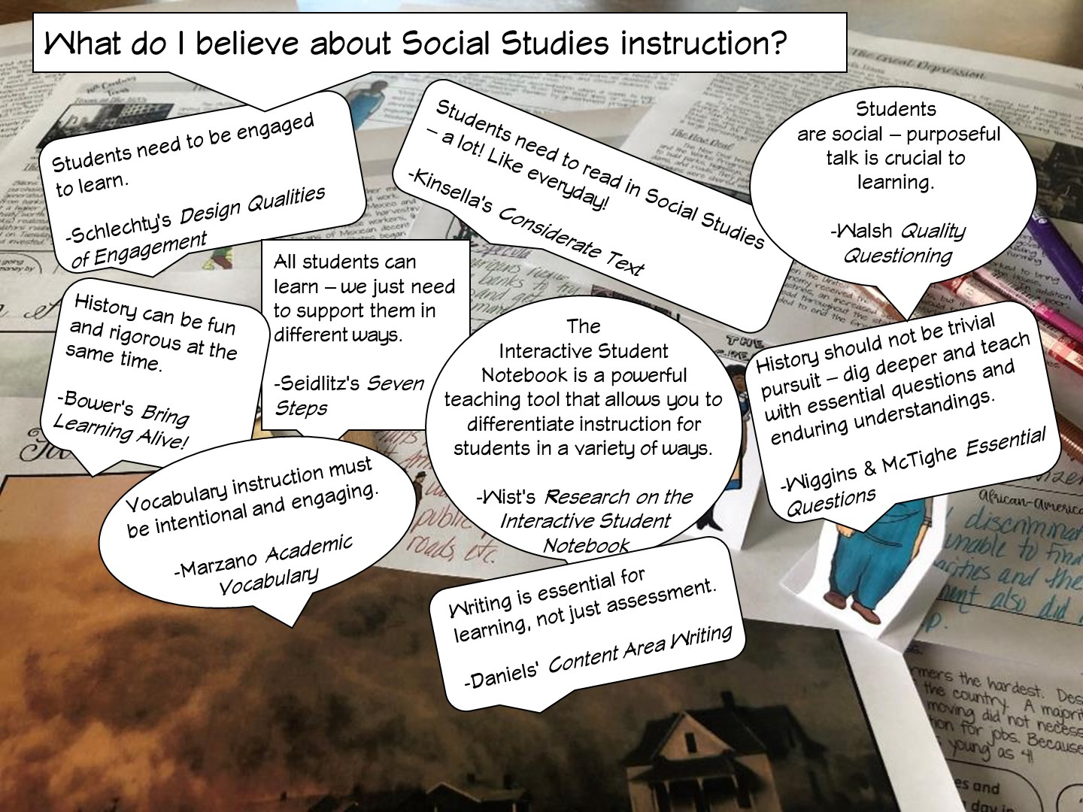

Slide 15
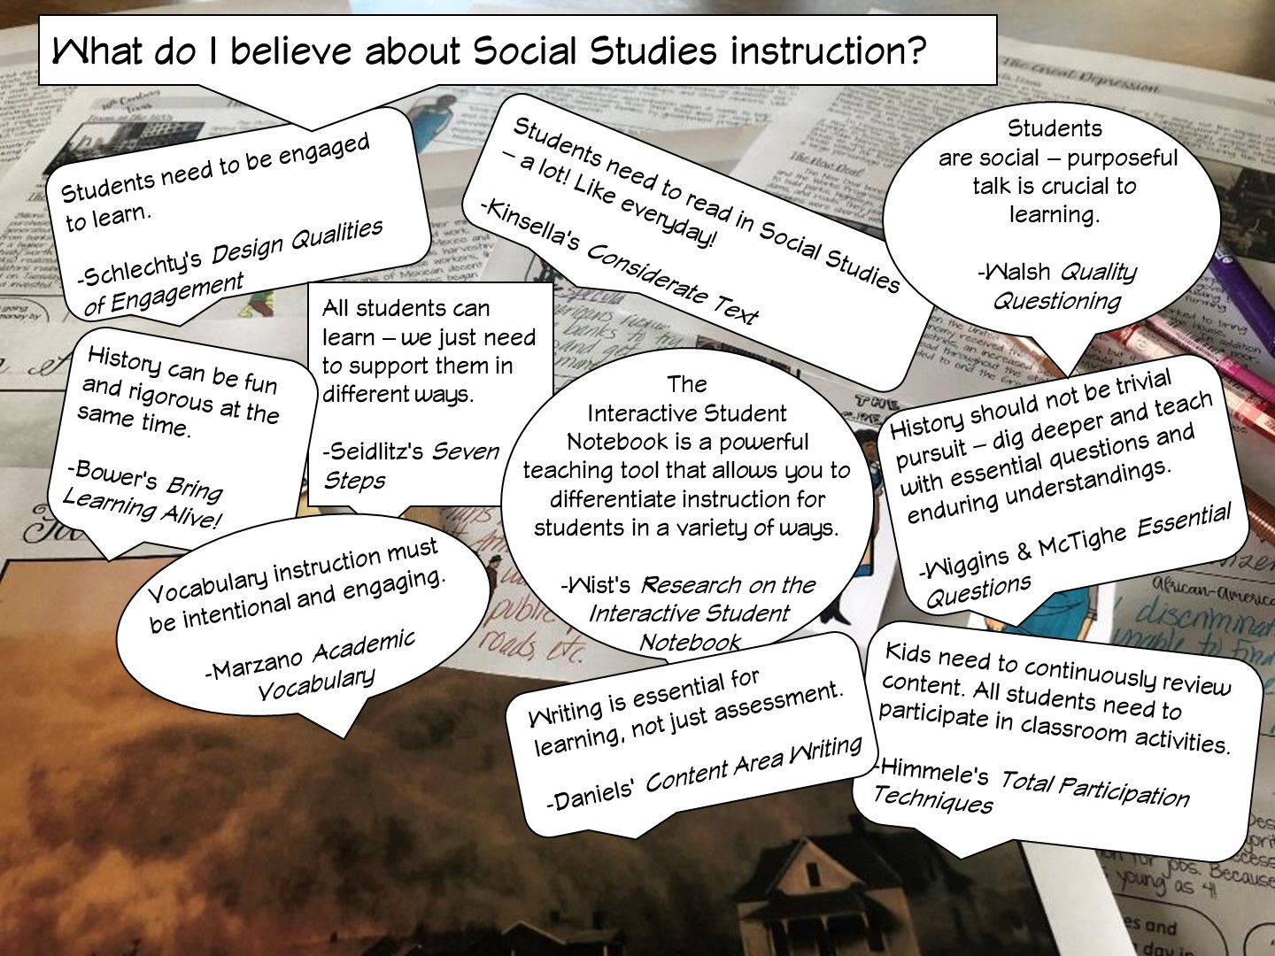

Slide 16
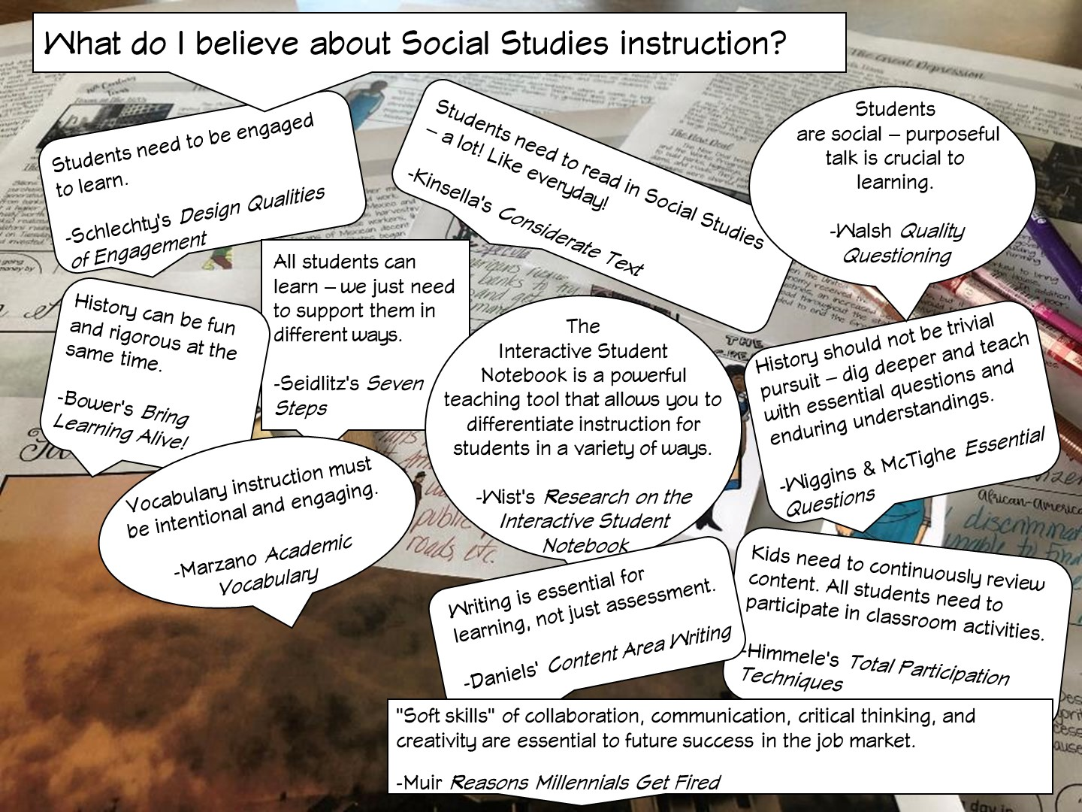

Slide 17
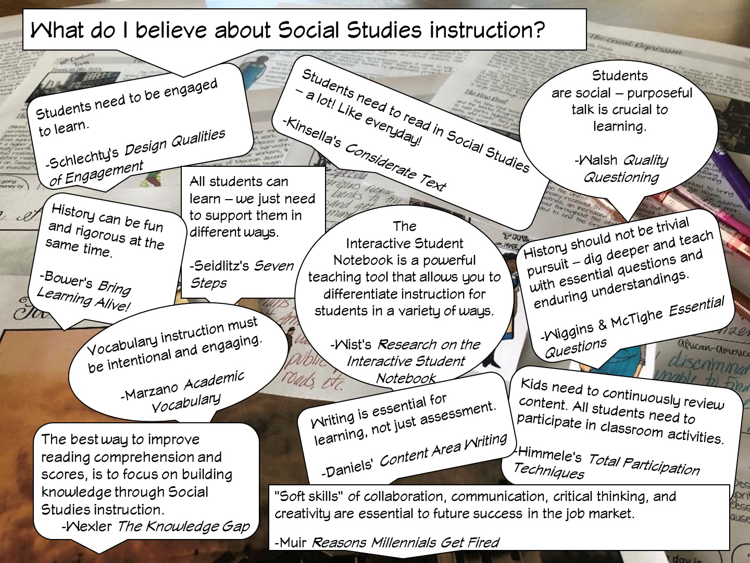

Slide 18


Slide 19


Slide 20

Notes:
Type response in chat box.

Slide 21


Slide 22


Slide 23

Notes:
I am going to model a lesson for you that uses the interactive student notebook.

Slide 24

Notes:
Tell them to look for these different parts during the lesson.

Slide 25
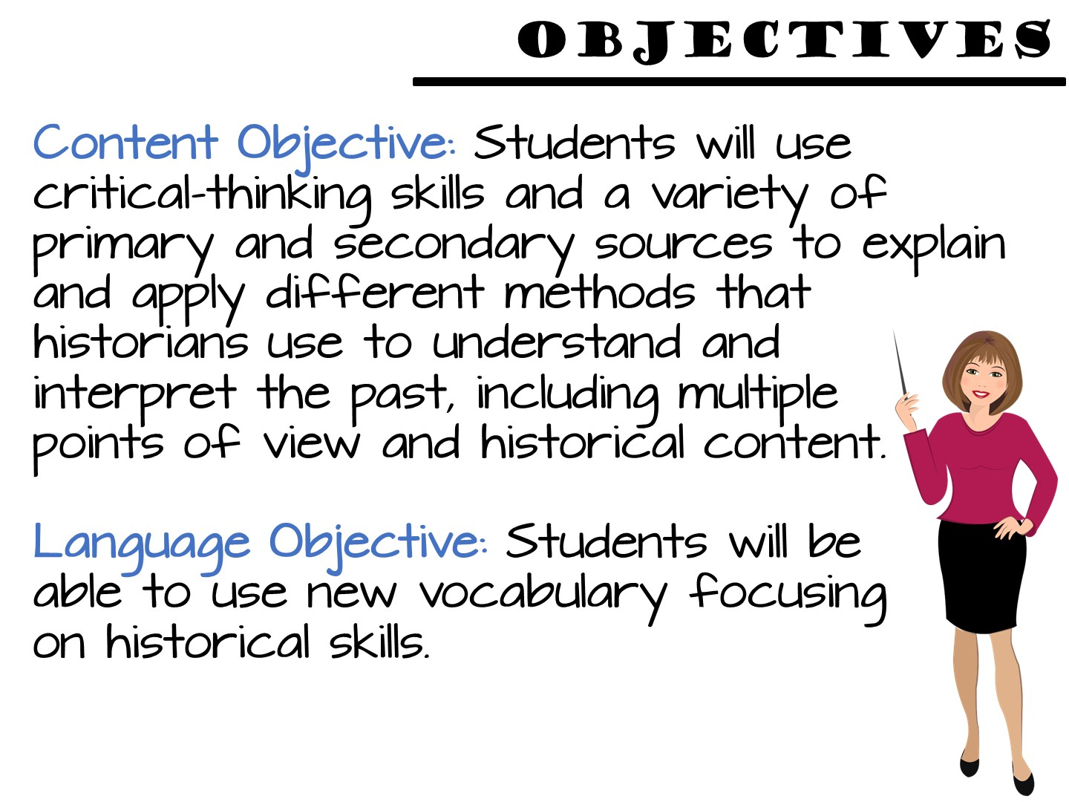
Notes:
Students use critical-thinking skills and a variety of primary and secondary source material to explain and apply different methods that historians use to understand and interpret the past, including multiple points of view and historical context.

Slide 26
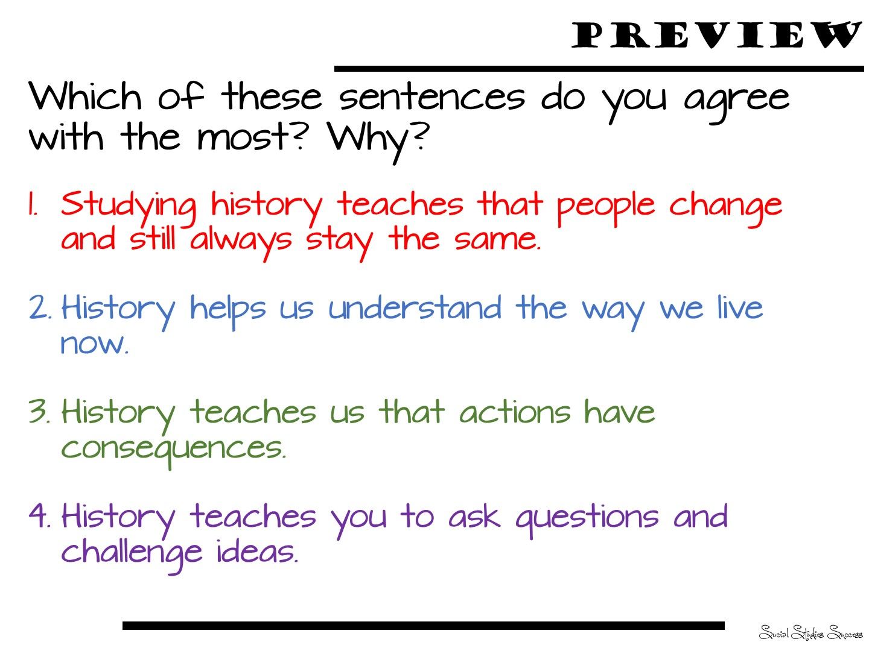
Notes:
You will need to create a poll in Zoom with these questions.
Response on poll in question

Slide 27

Notes:
Go to breakout session to read and discuss

Slide 28
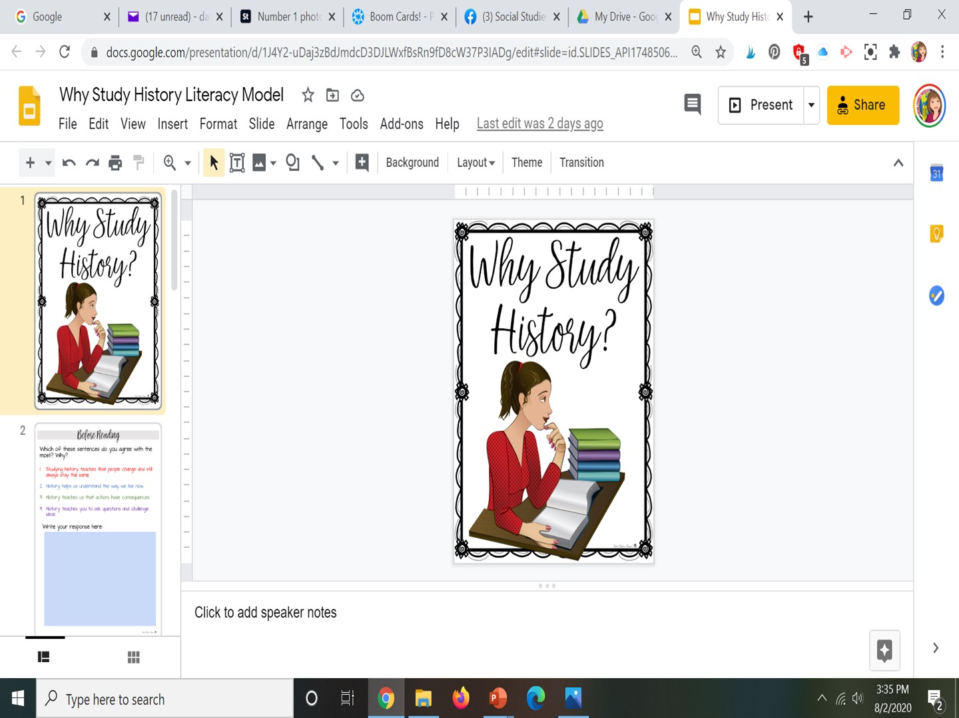
Notes:
In just a moment you will need to click on the link opening up this activity.
If you need to send the link during the presentation – here it is https://docs.google.com/presentation/d/1Cn8kHb69W6bOLuwA8LviLYGUXen2nw7R2JeFNJDaFIY/copy
Complete the preview activity on Why Study History.
Then…

Slide 29

Notes:
Read the page on Why Study History and choose the one most important sentence.

Slide 30
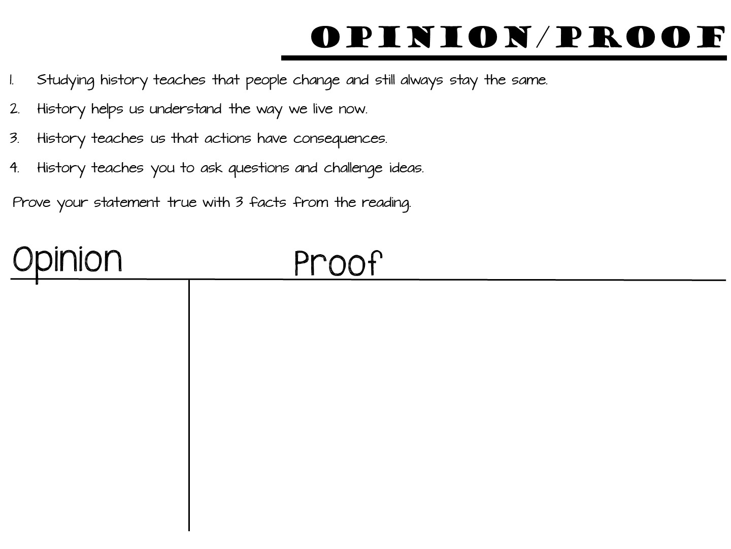
Notes:
Then read the second page and complete the Opinion / Proof

Slide 31
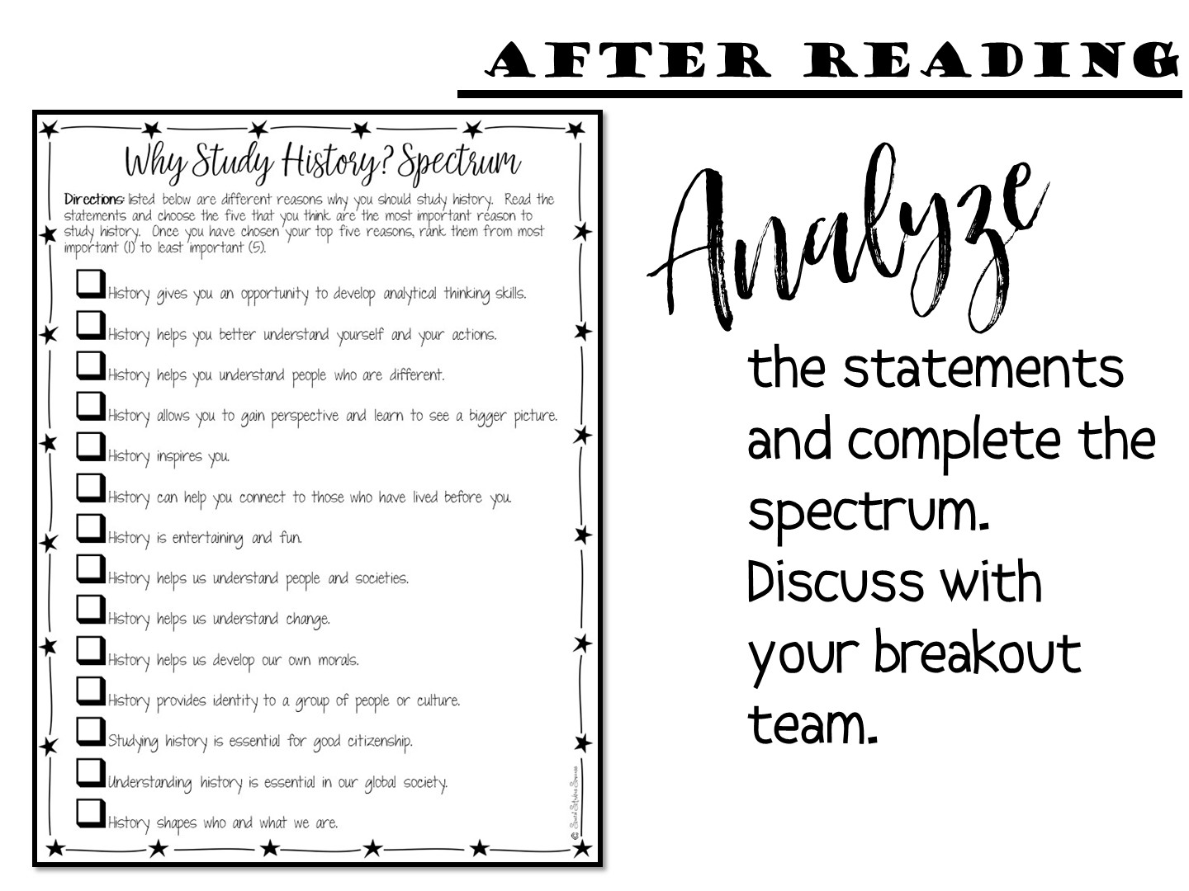
Notes:
Then complete your spectrum.

Slide 32


Slide 33
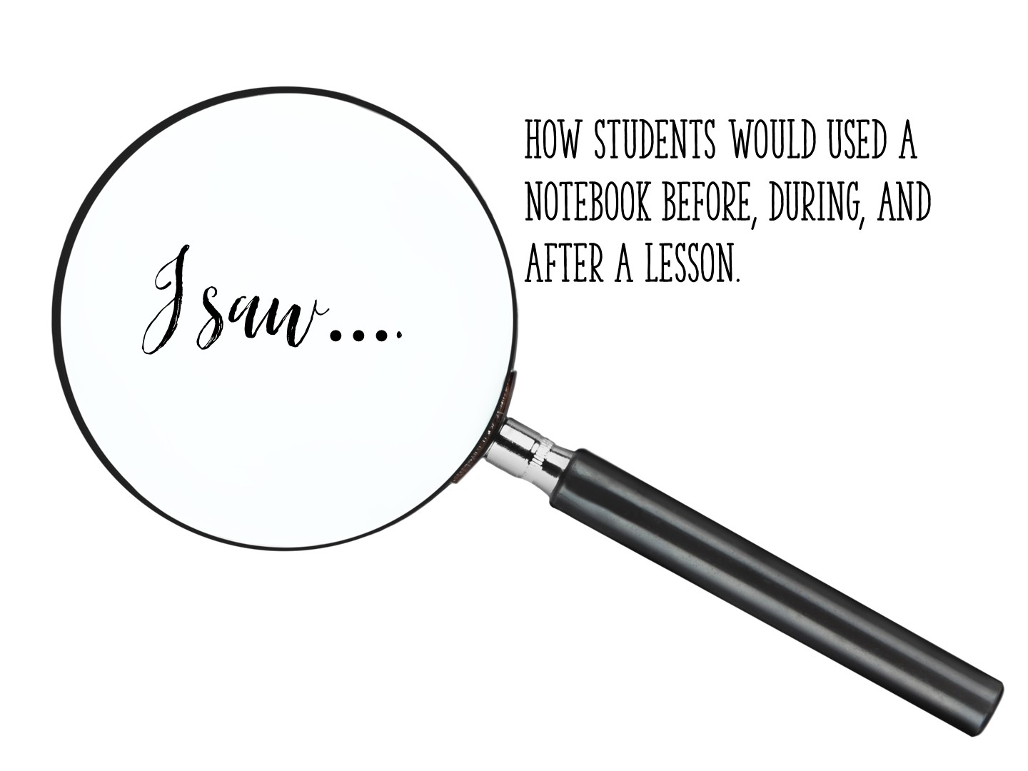
Notes:
What did they see in the model lesson?

Slide 34

Notes:
Break slide – move where you need it

Slide 35

Notes:
We are now going to look at the interactive student notebook, using the Why Study History lesson as our reference model.

Slide 36

Notes:
We are going to look at what makes an ISN – Structure
and how we can personalize it in our classroom - Style

Slide 37


Slide 38
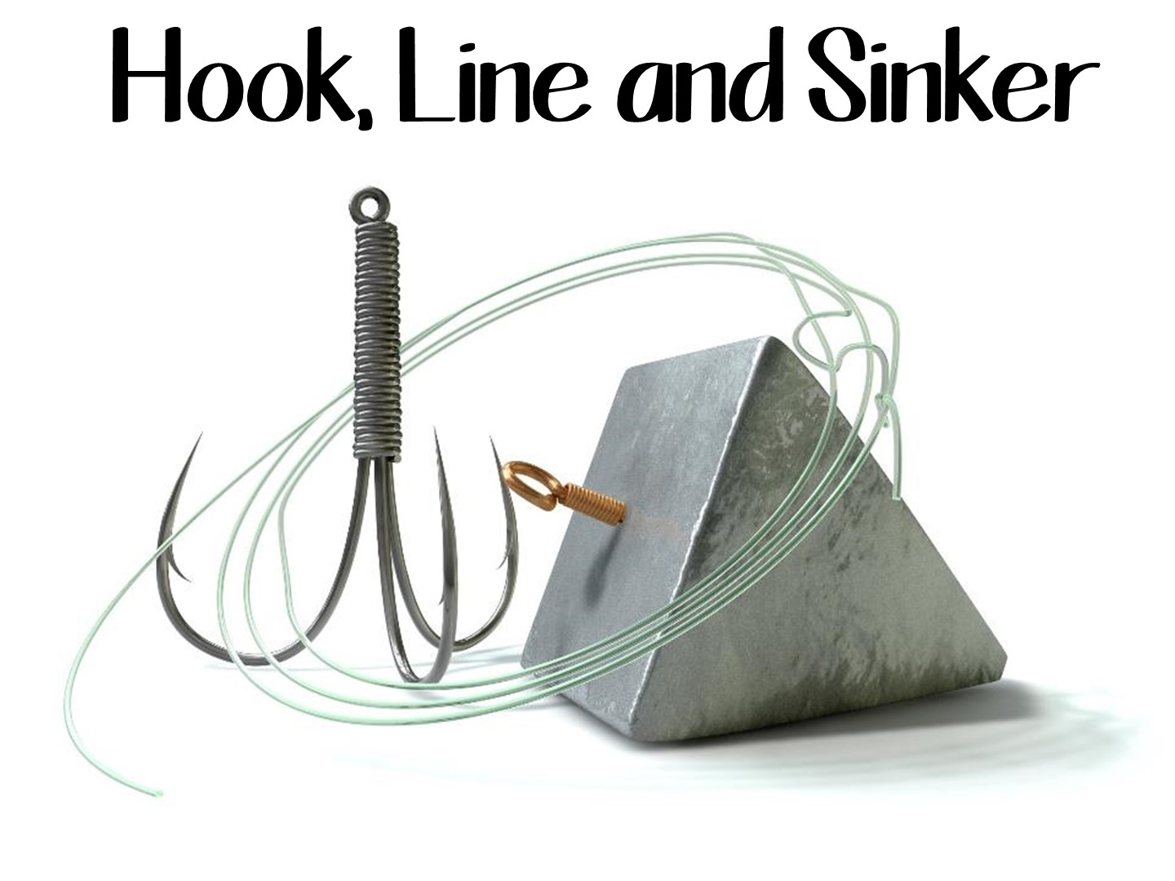
Notes:
This is the analogy we use for the ISN.

Slide 39
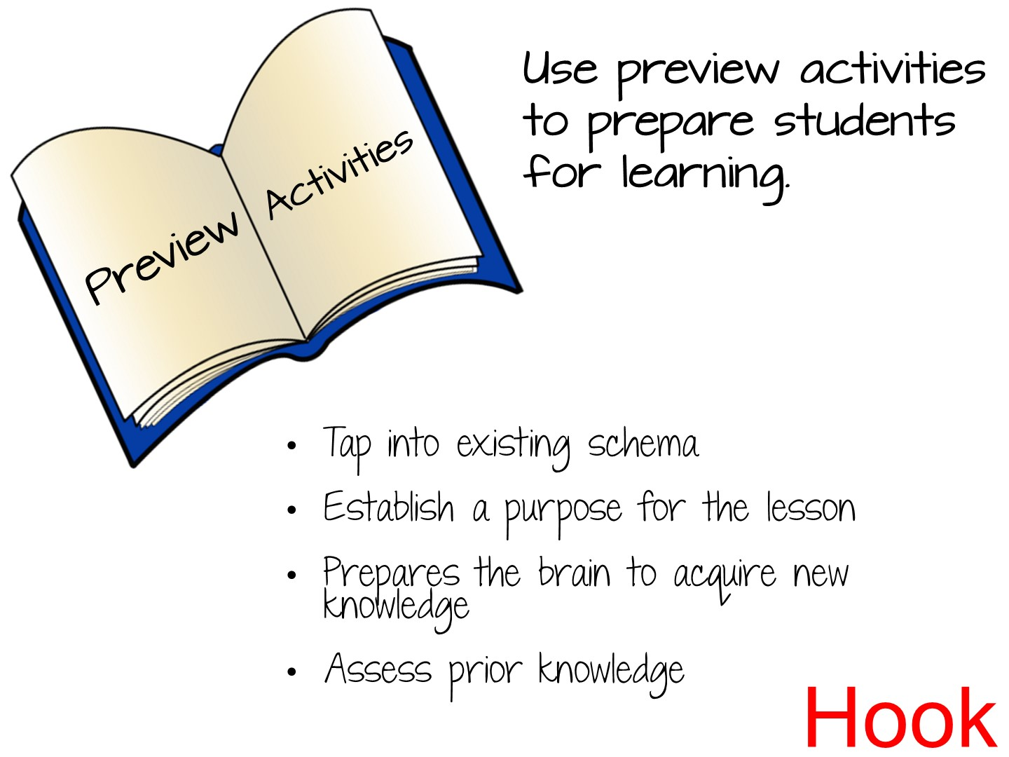

Slide 40
Notes:
In our model lesson, this was our preview.

Slide 41
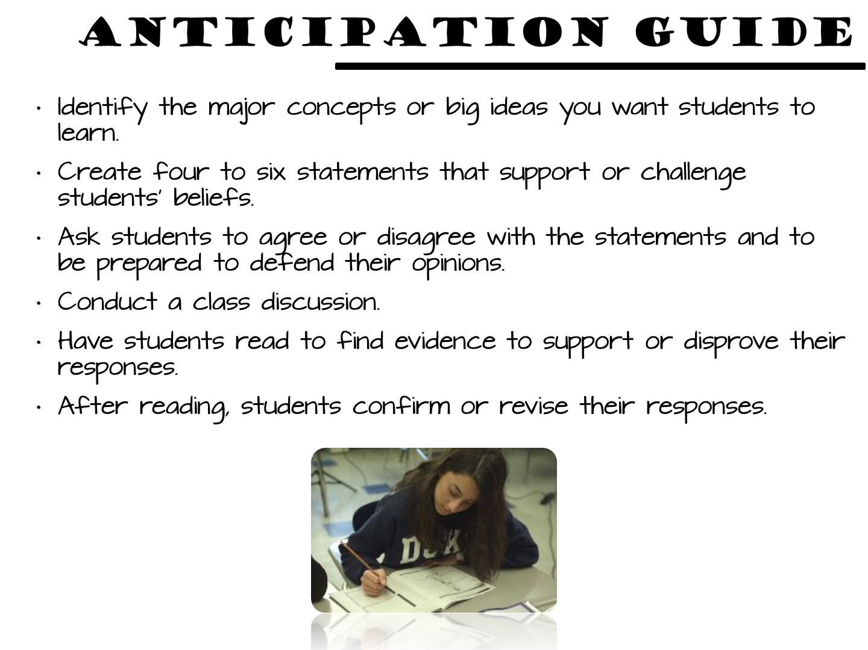

Slide 42
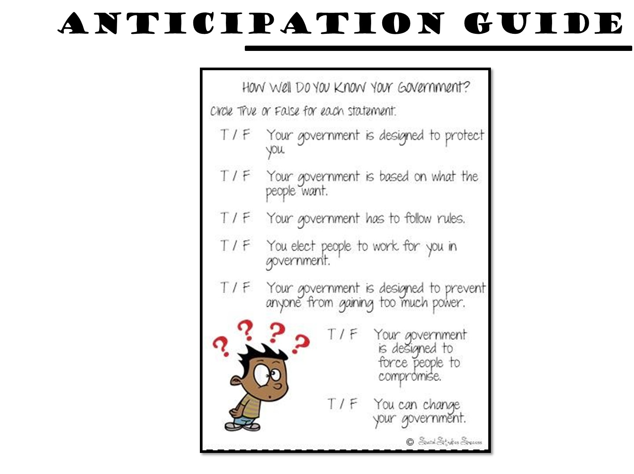
Notes:
Sample for the 7 Principles of Government

Slide 43


Slide 44
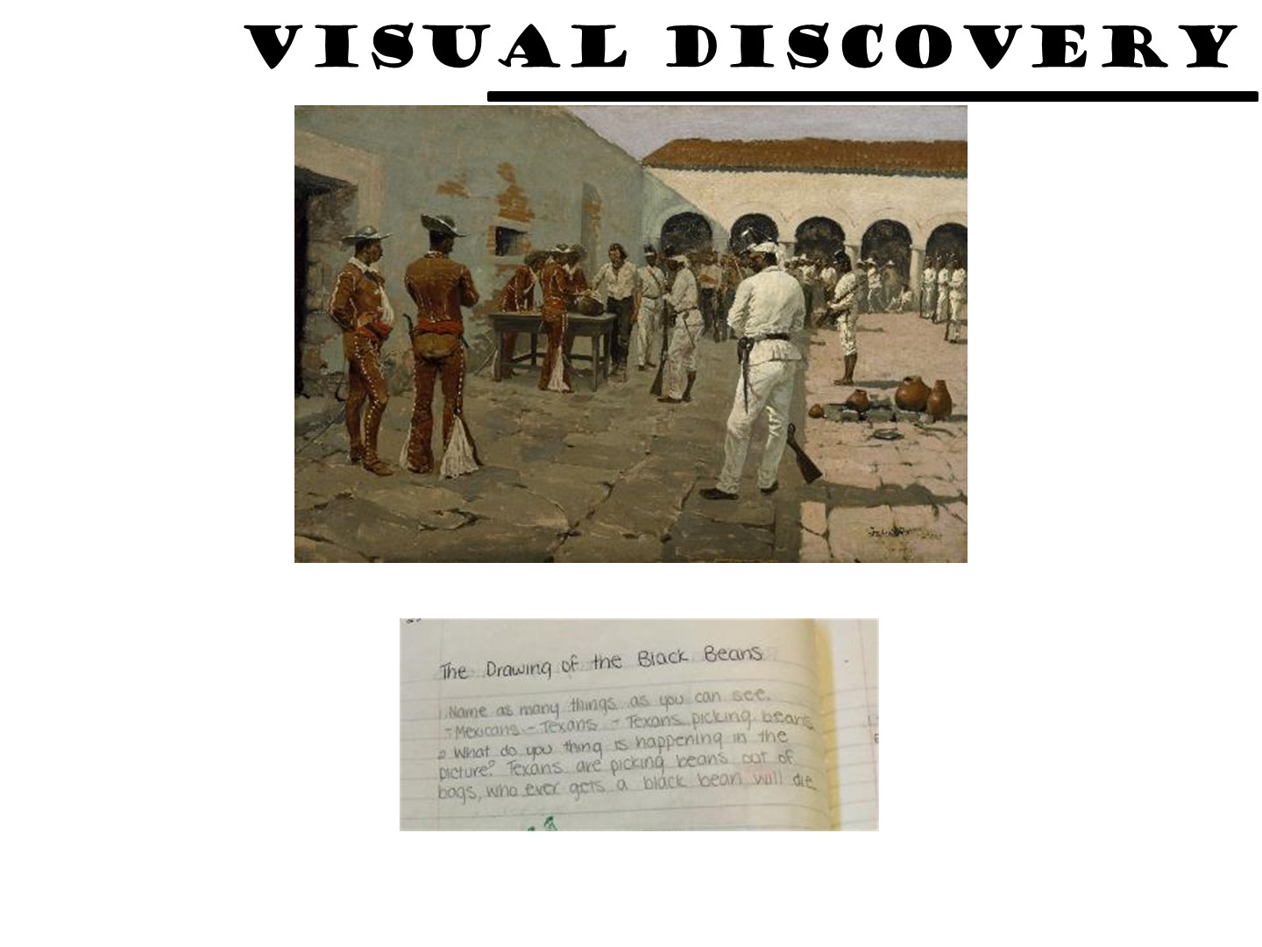
Notes:
Example for Texas History

Slide 45
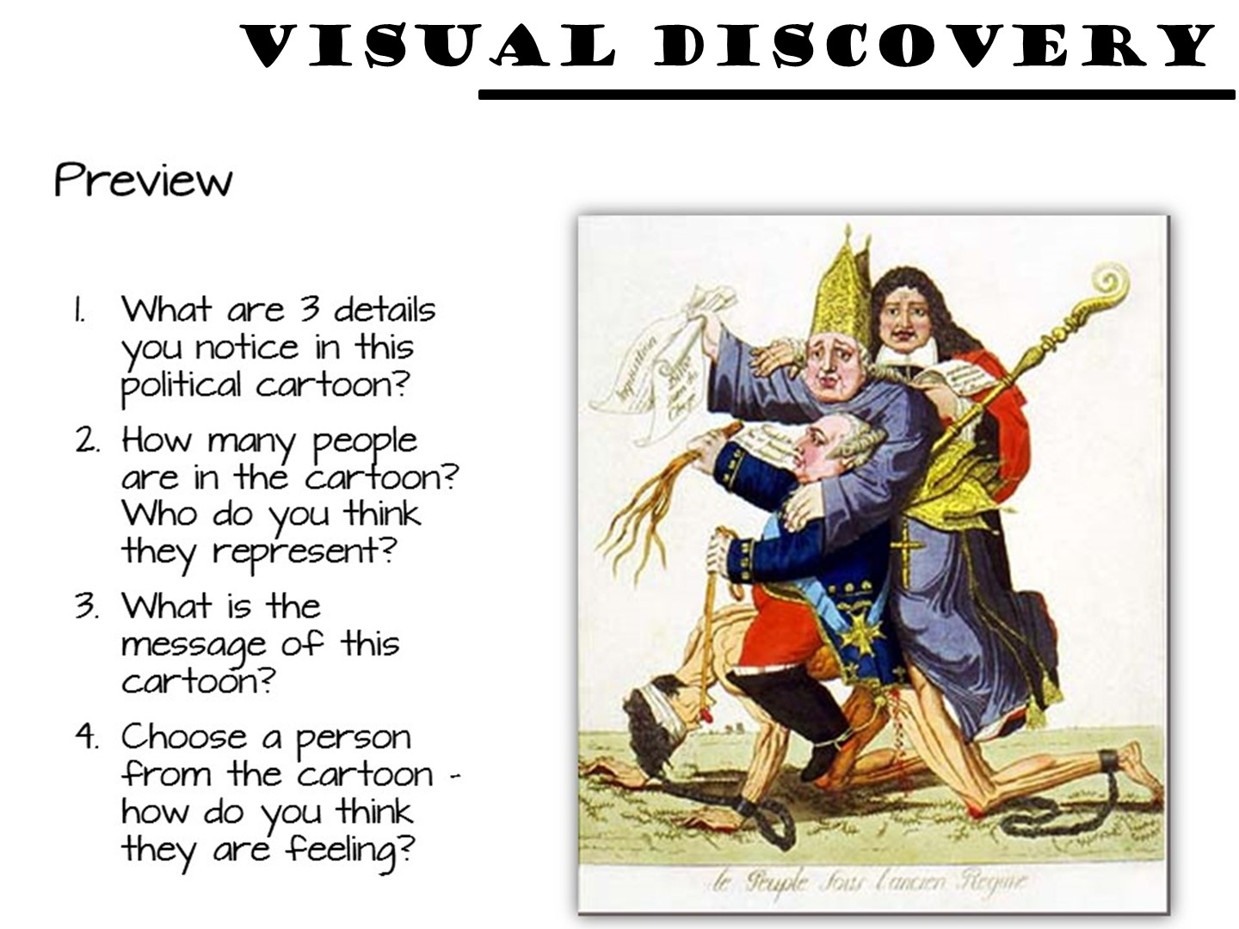
Notes:
Example for World History

Slide 46
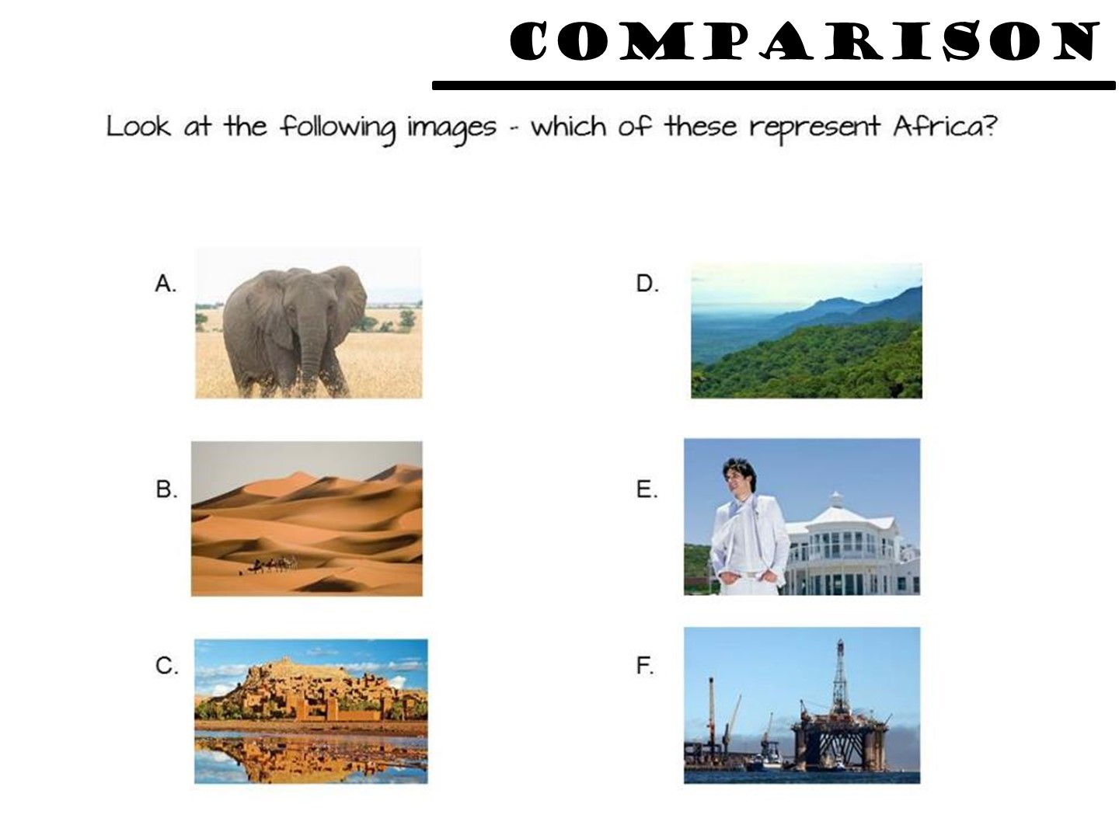
Notes:
Example for Geography

Slide 47
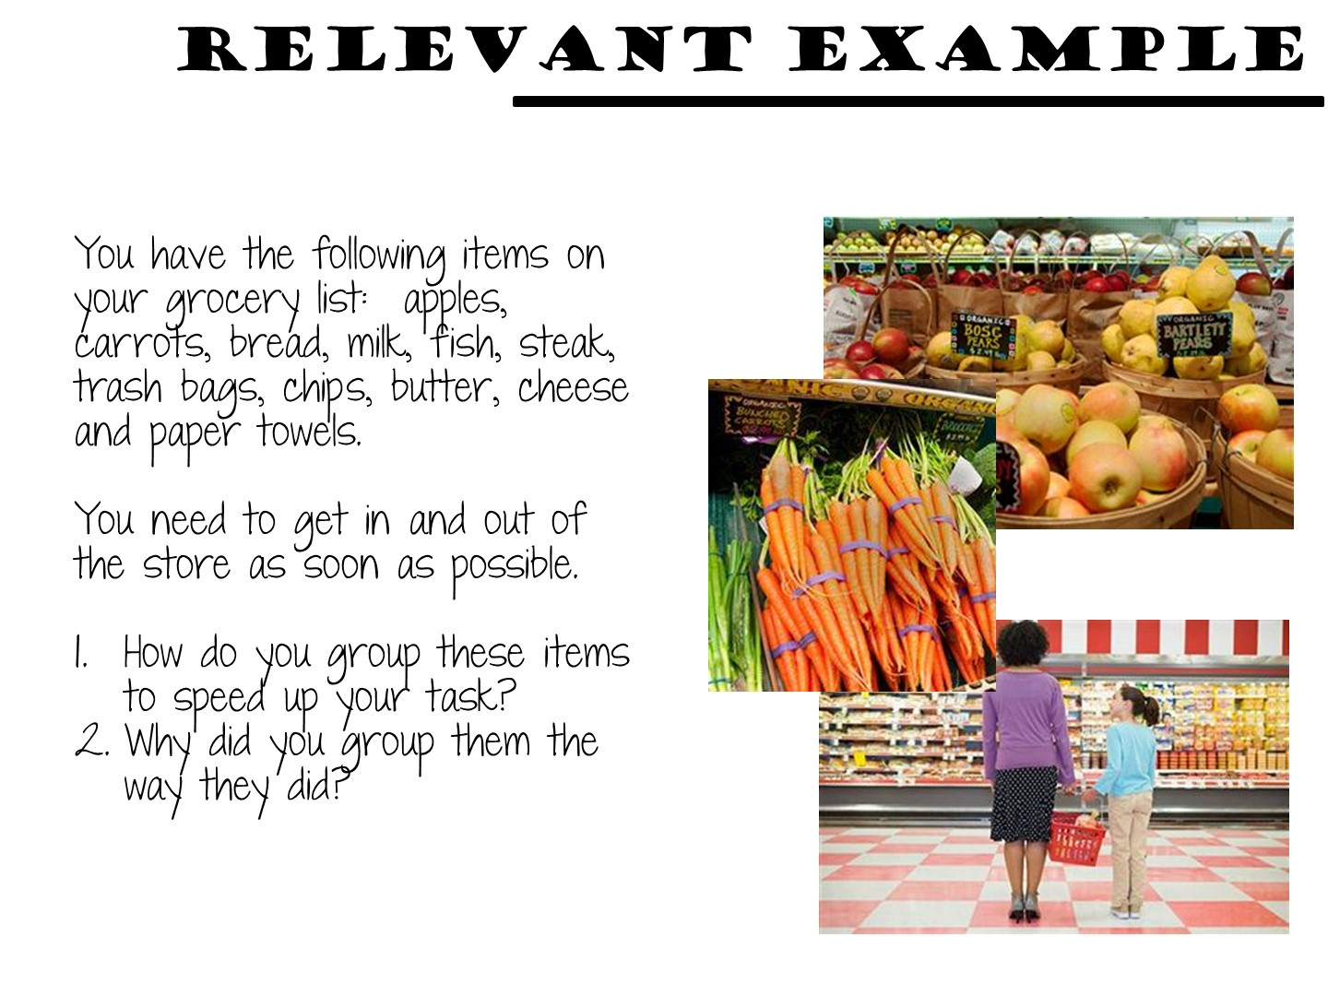
Notes:
Geography

Slide 48
Notes:
Go to breakout session to read and discuss

Slide 49

Notes:
Place teachers into a small group. Refer to the Social Studies Strategy manual and conduct this activity. They can be found by looking at the table of contents.

Slide 50

Notes:
Debrief in chat box.

Slide 51
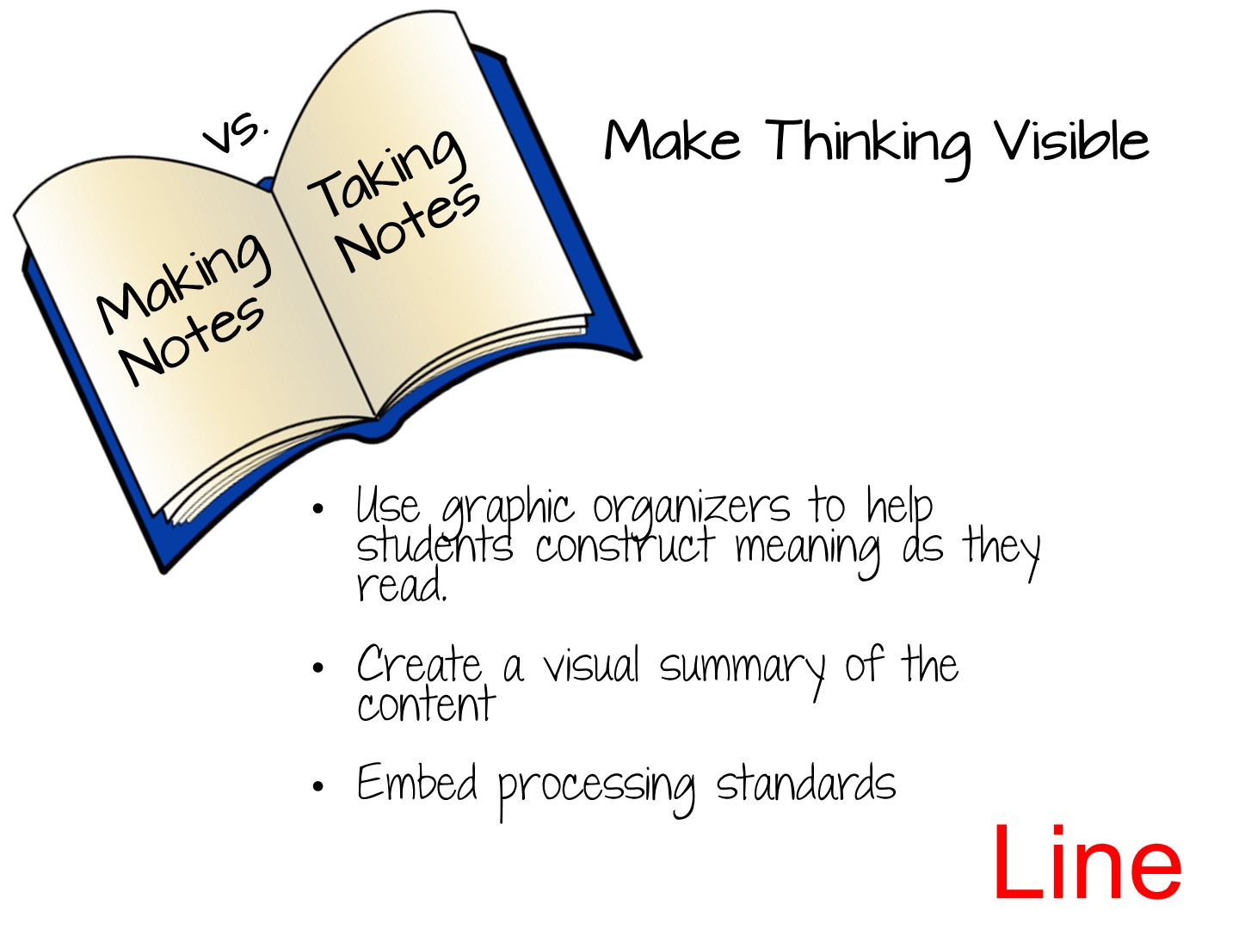

Slide 52
Notes:
As a reference, this is what we used in our model in our Interactive Student Notebook.

Slide 53
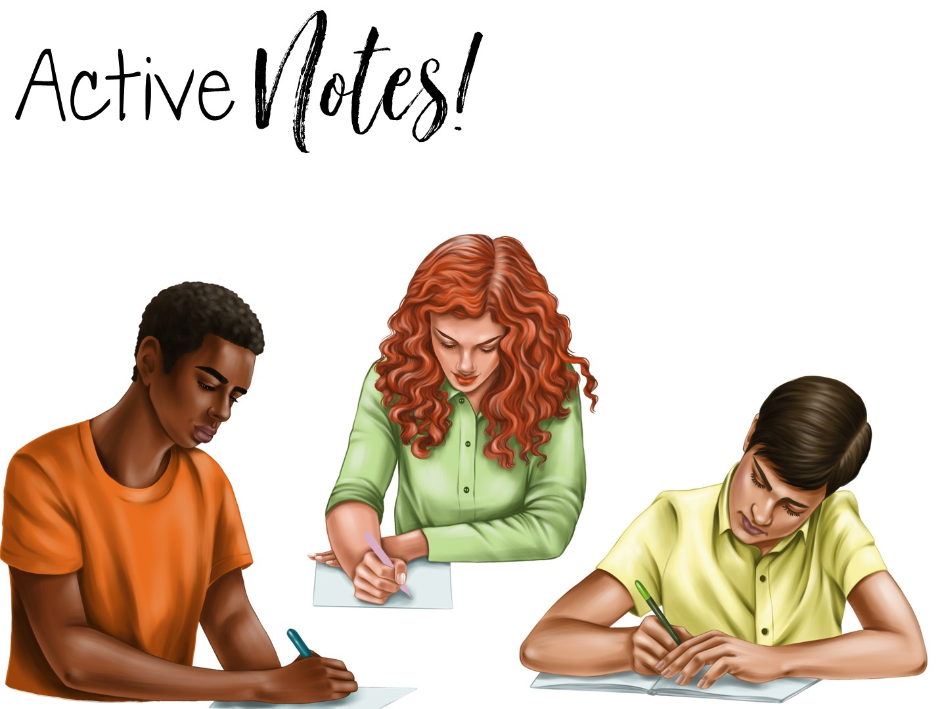
Notes:
Now as we look at the note making portion of the Interactive Student Notebook, we are going to look at Active Notes - Notes that are designed to reinforce Social Studies Skills.

Slide 54

Notes:
Let’s take a look at Processing Standards.

Slide 55
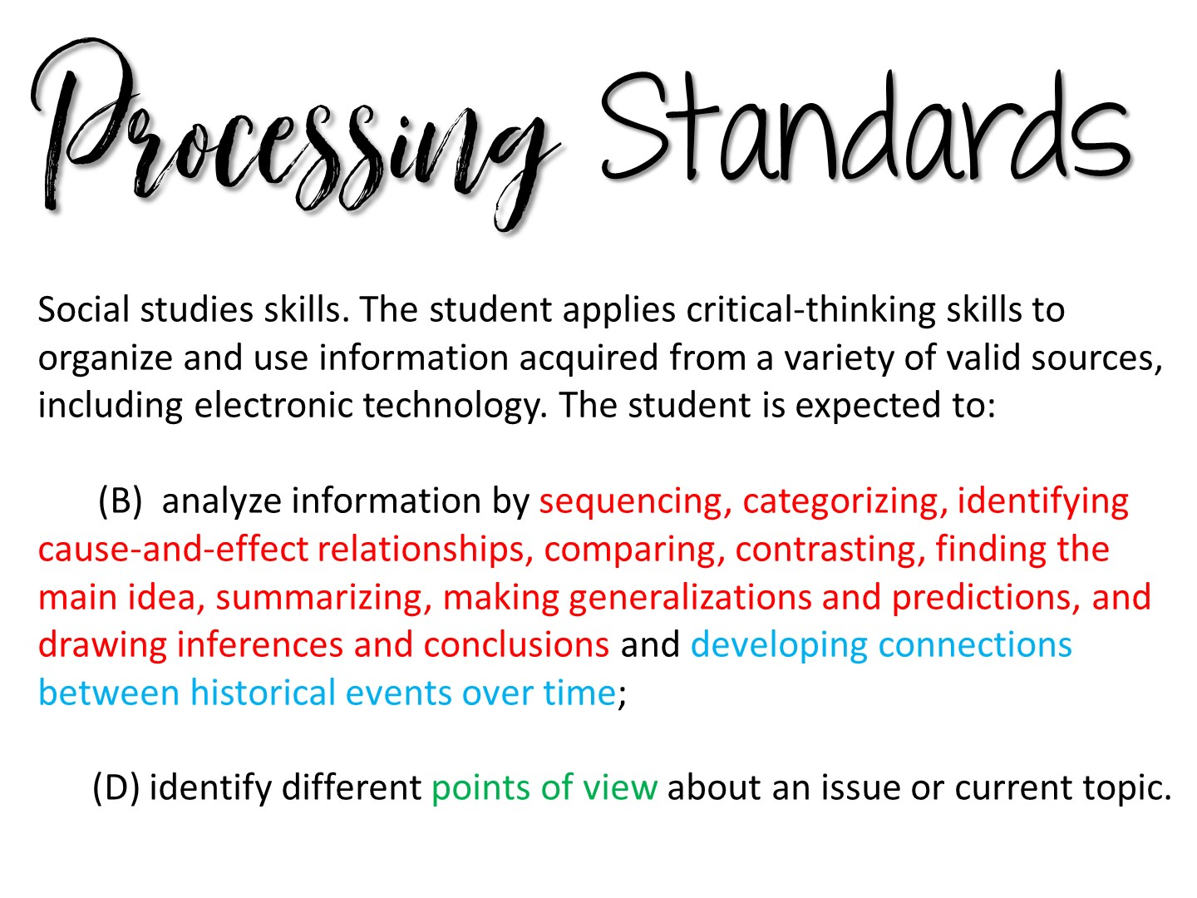
Notes:
Read to teachers and remind them that this is more than 60% of what is tested on STAAR

Slide 56

Notes:
Next we are going to look at the Social Studies Skills and see how they provide the framework for our notes in the Interactive Student Notebook. Take them to the Jamboard and let them work in their breakout room to sort the “cards” into skills, when they are done, share how the skills are connected with the next slides.
The first slide is for you to model how to move the images and add a sticky note onto the Jamboard.

Slide 57
Notes:
Go to breakout session to complete Jamboard activity – the link is on the website and also here:
https://jamboard.google.com/d/1rWg2UUJ_9v3mE2Y9vKD5vdHCRnhcZnJUi79dfFl2bTw/viewer
Give them 5-7 minutes to complete this activity.

Slide 58
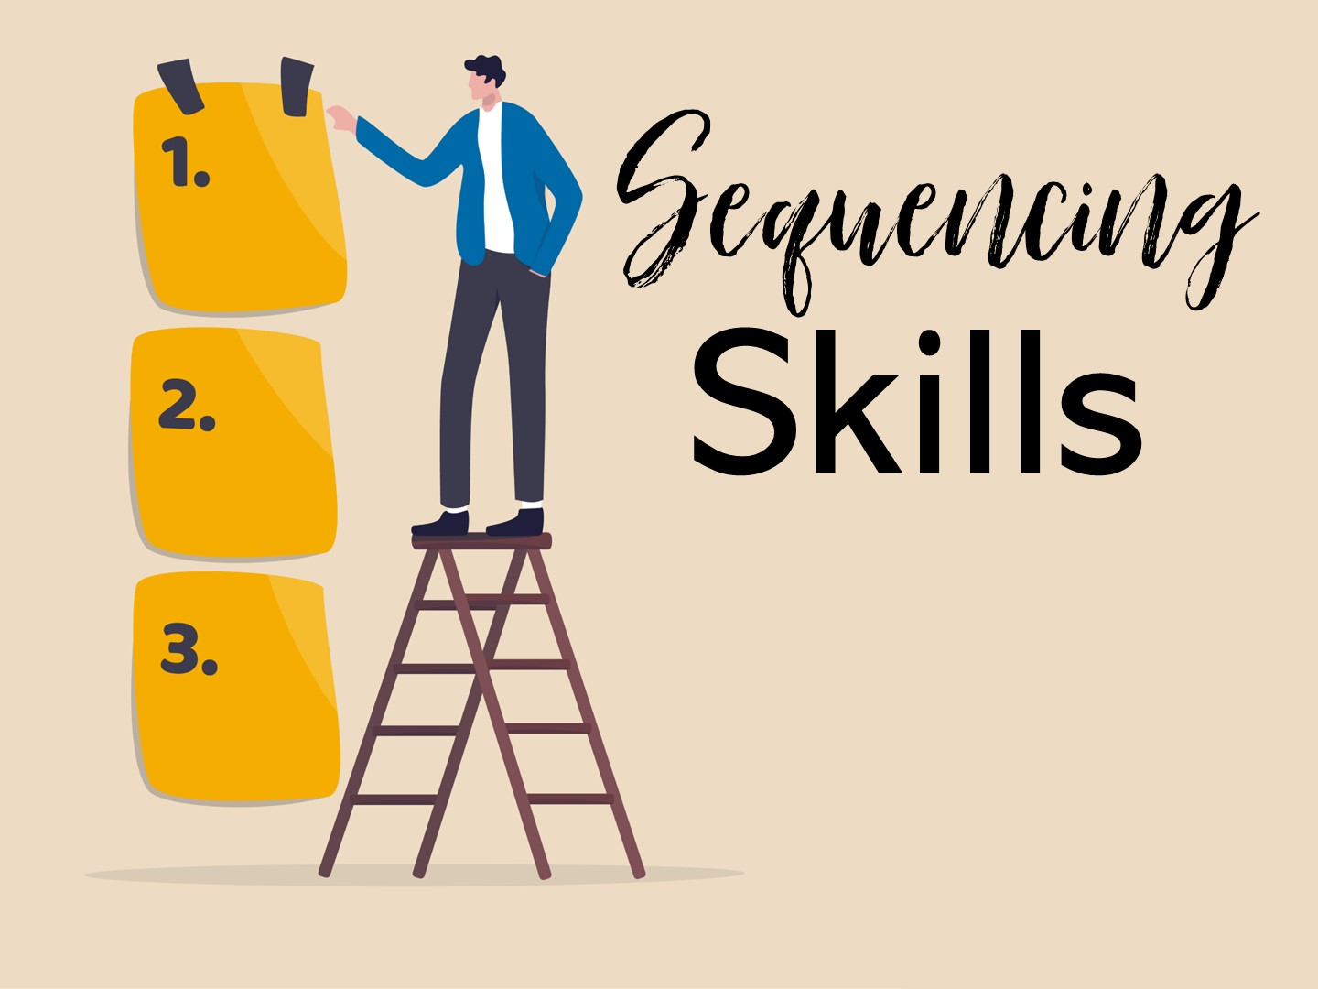
Notes:
Review the Social Studies Skills.
The first set of skills naturally fit with Social Studies – sequencing skills

Slide 59
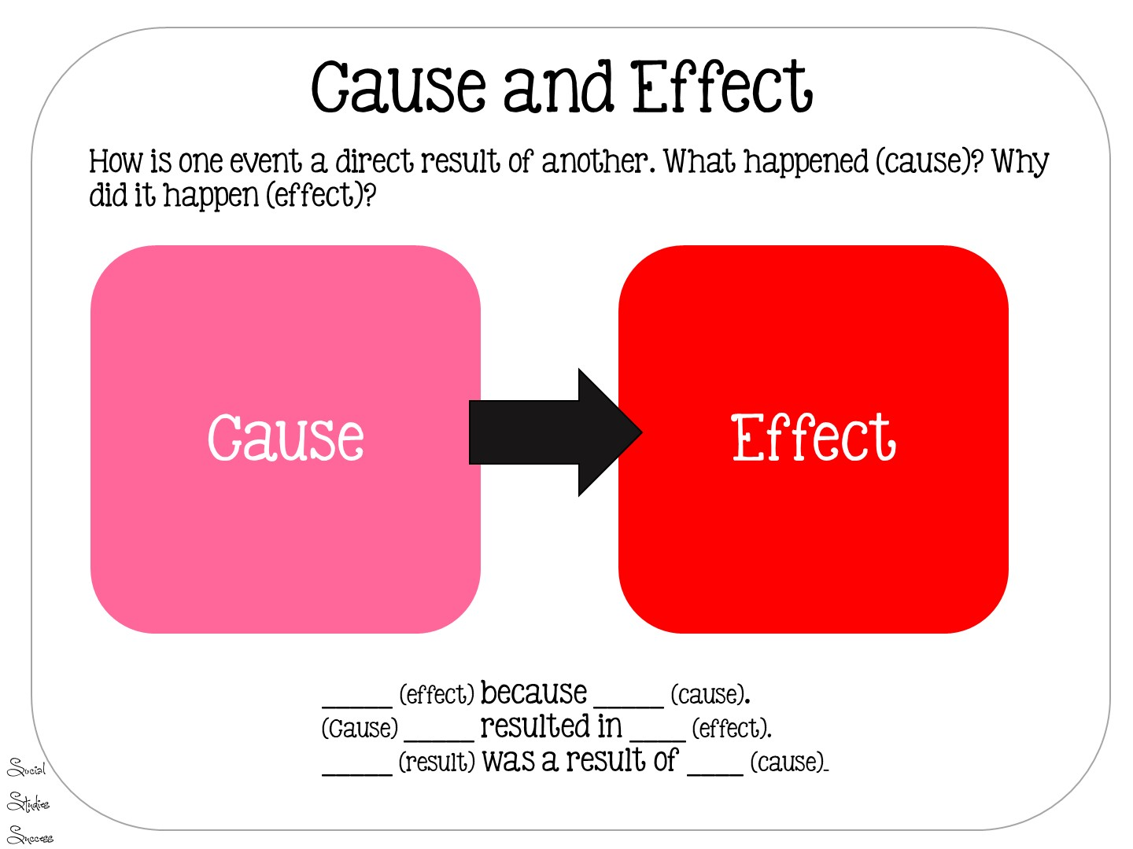
Notes:
Read Slide

Slide 60
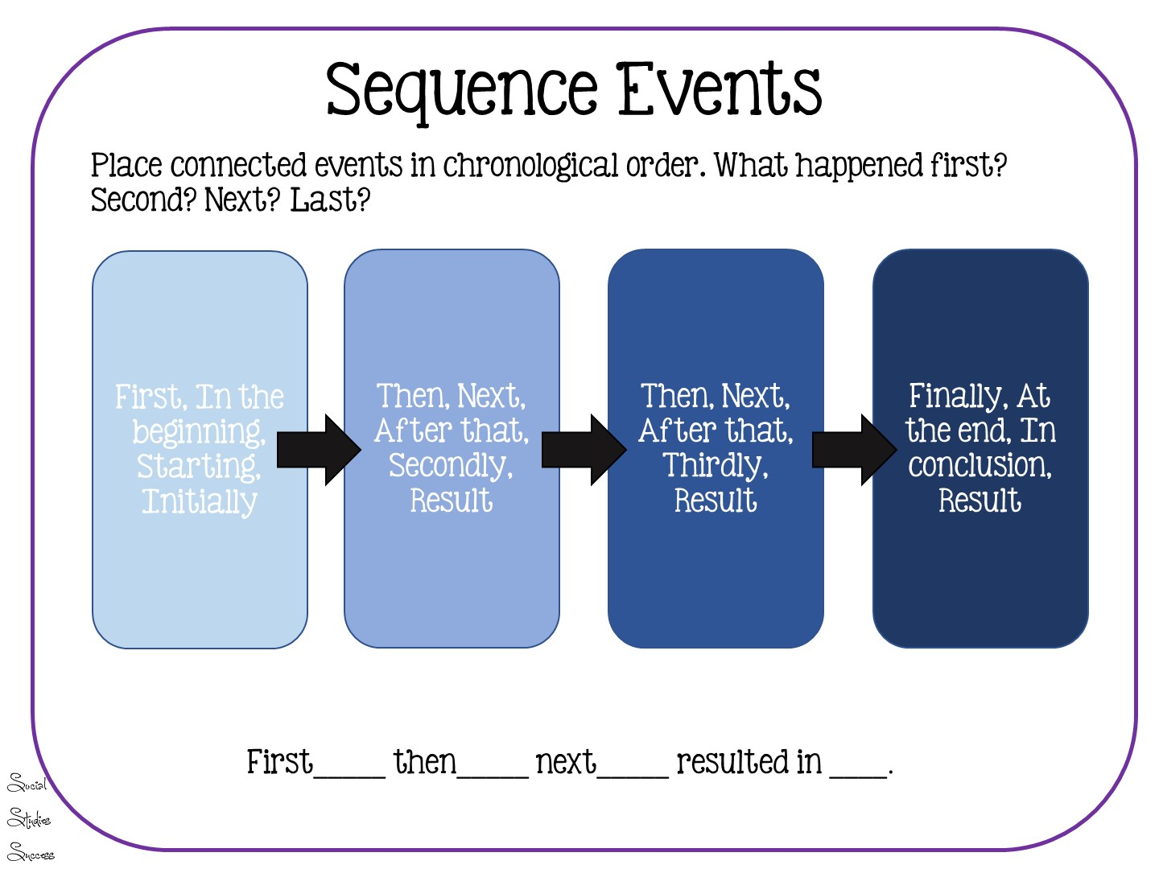
Notes:
Read slide

Slide 61
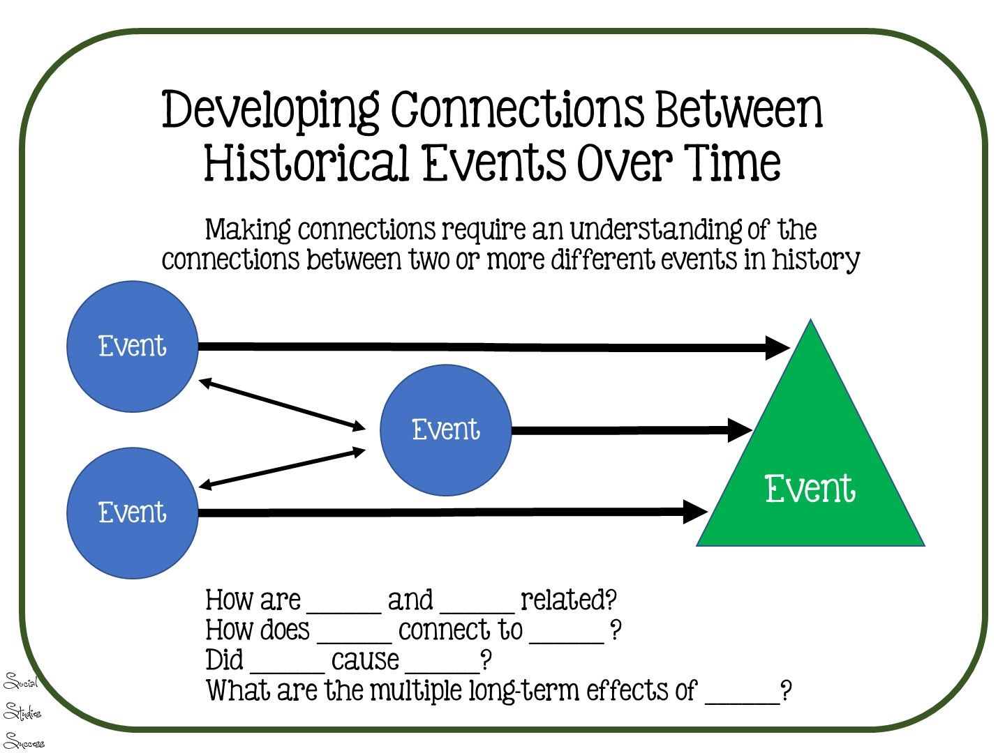
Notes:
This is a standard inferred by the STAAR test – it includes historical influences on the Constitution.

Slide 62

Notes:
The next set of skills has to do with categorization.

Slide 63
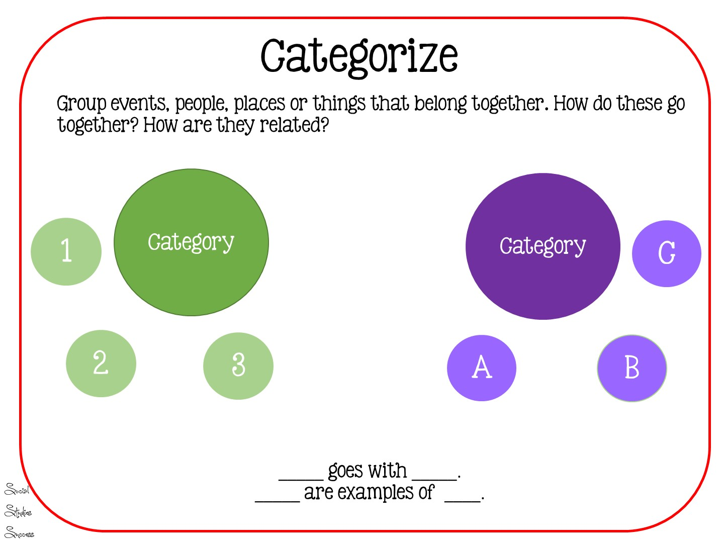
Notes:
Categorization helps our students organize information

Slide 64
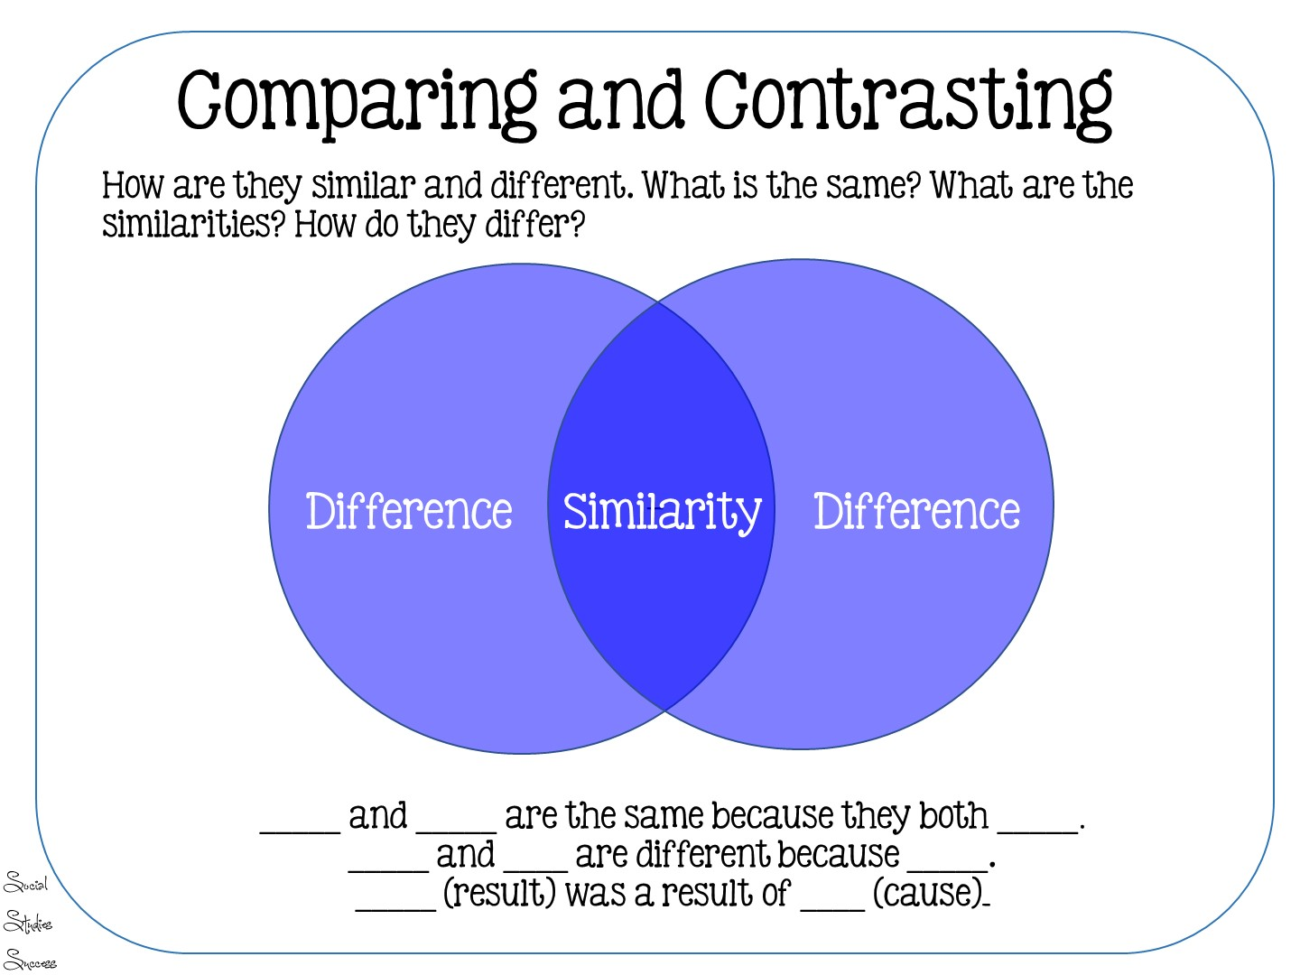
Notes:
Comparing and contrasting of categories

Slide 65

Notes:
Quick Debrief – have them type in chat box

Slide 66

Notes:
The next set of skills are usually associated with reading historical text.

Slide 67
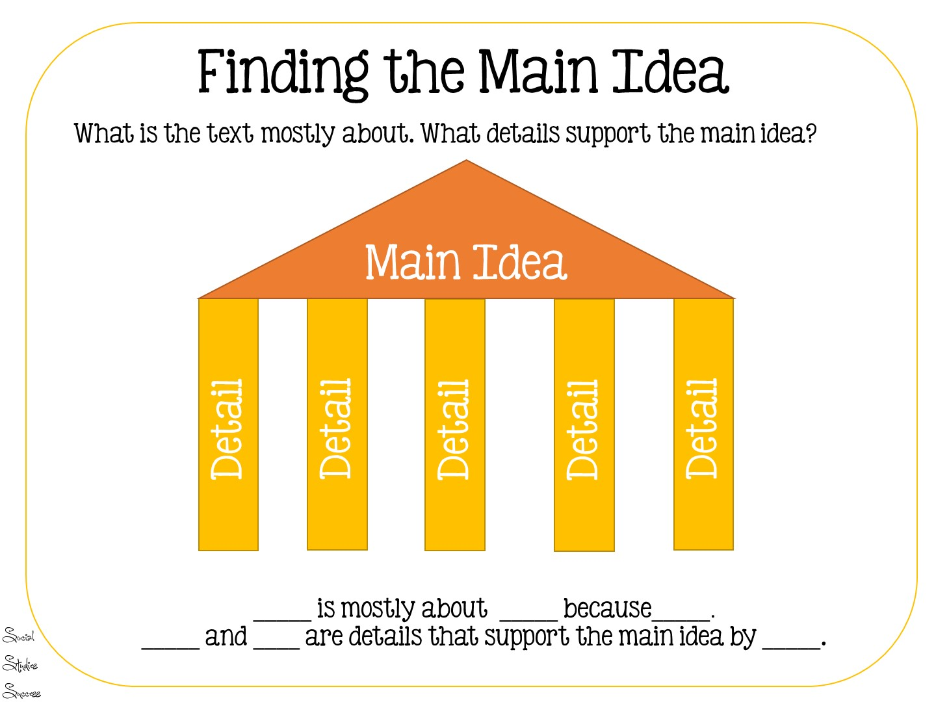

Slide 68
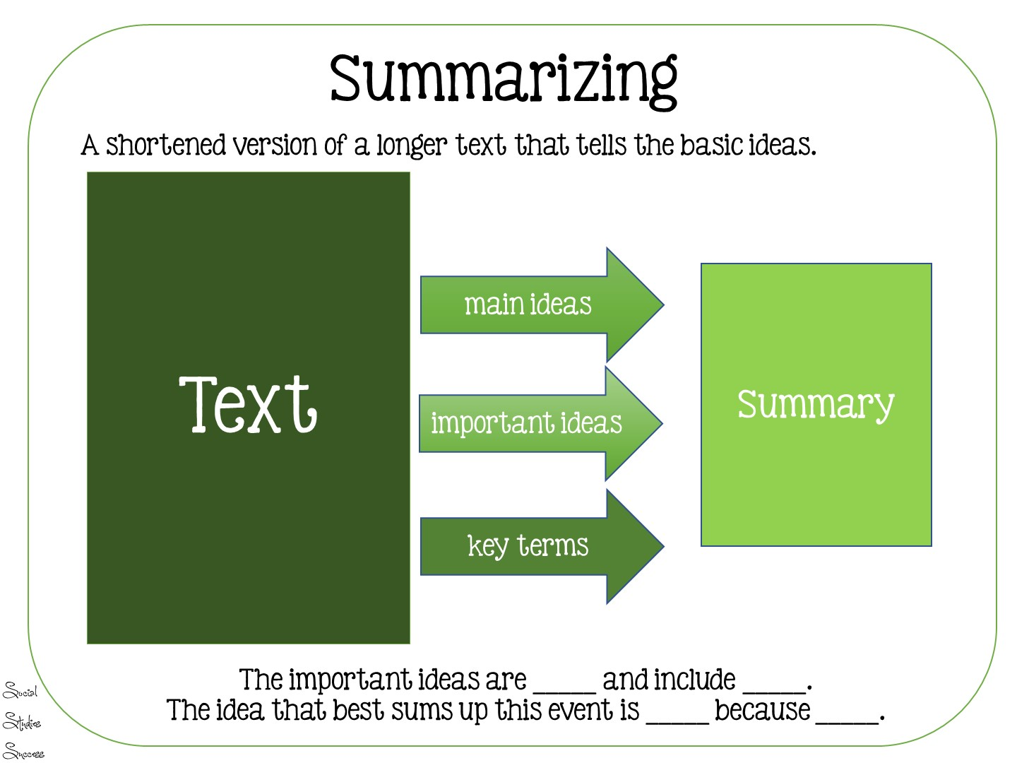

Slide 69

Notes:
Use of evidence skills are the most difficult for students. They require students to draw inferences from history by: • identifying relationships among the parts • detecting inconsistencies • weighing conflicting facts and statements
generalize from data by: • applying previously learned concepts and generalizations to the data or situation • checking reasoning against basic principles of logic and looking for inconsistencies, limitations of data, and irrelevancies • creating a broad statement which encompasses findings

Slide 70
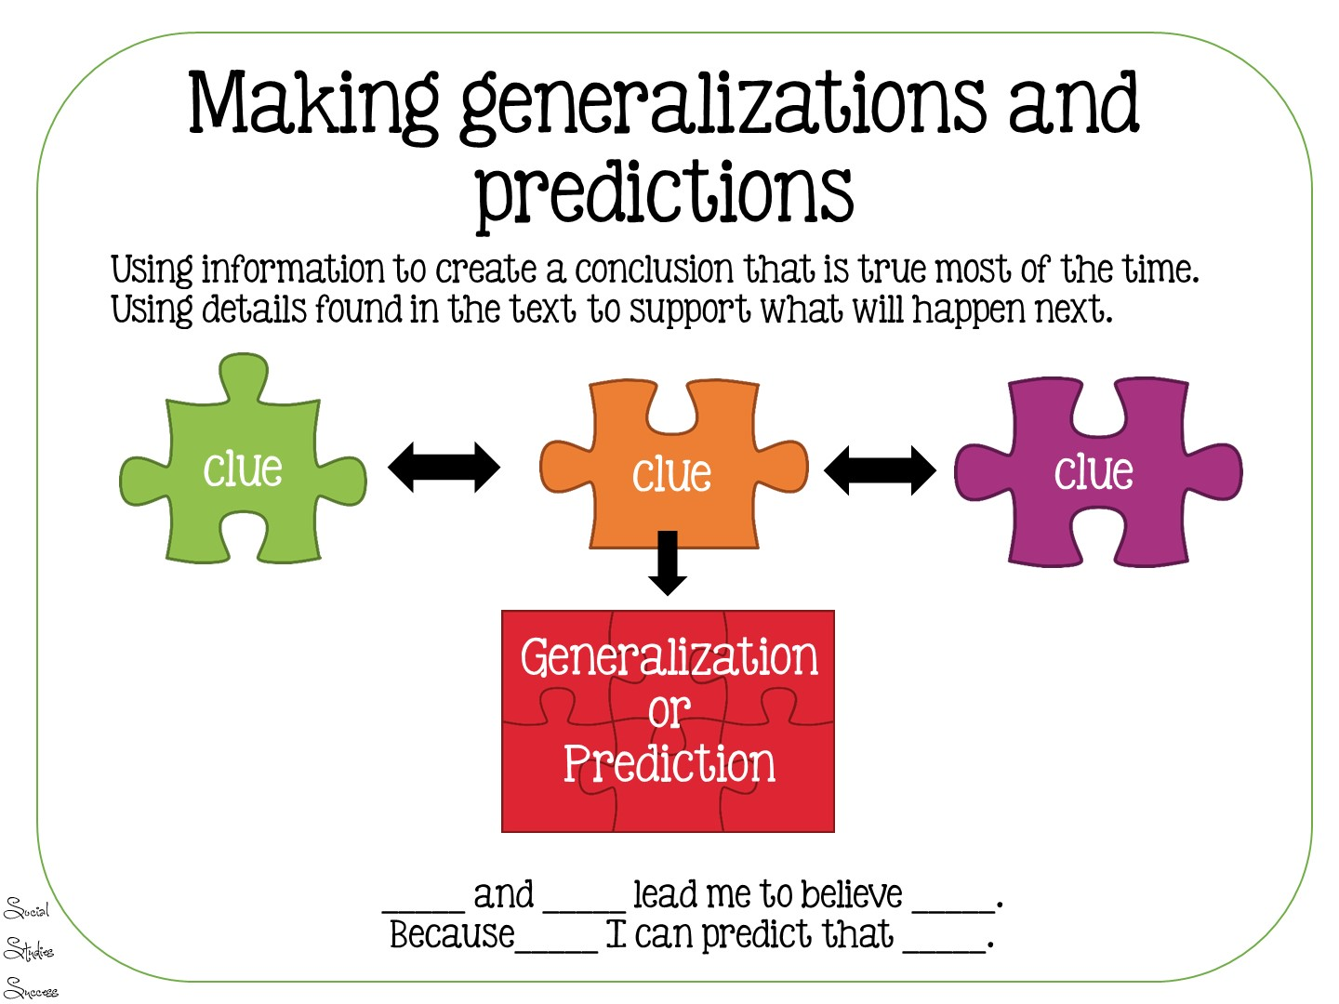

Slide 71
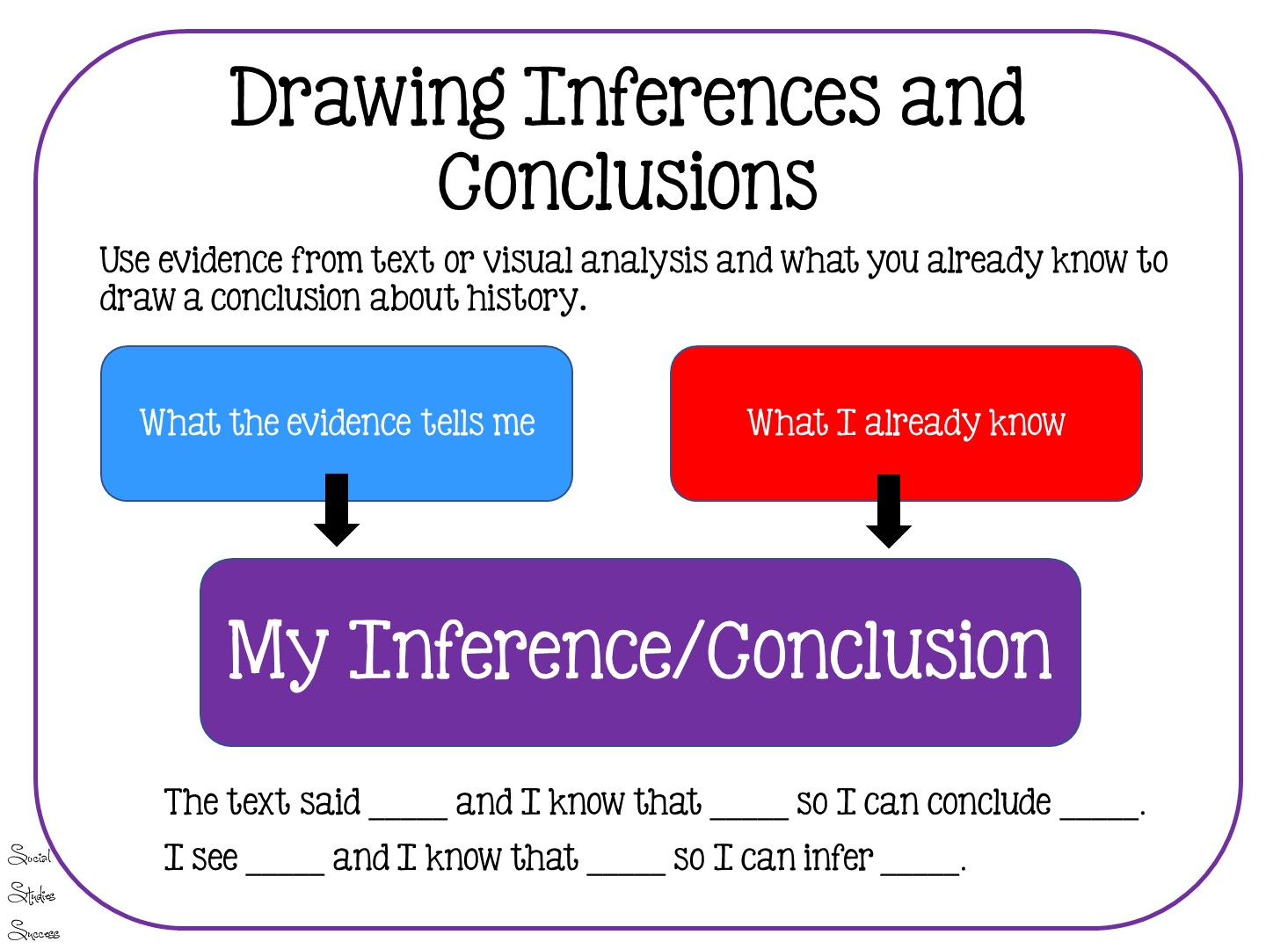

Slide 72
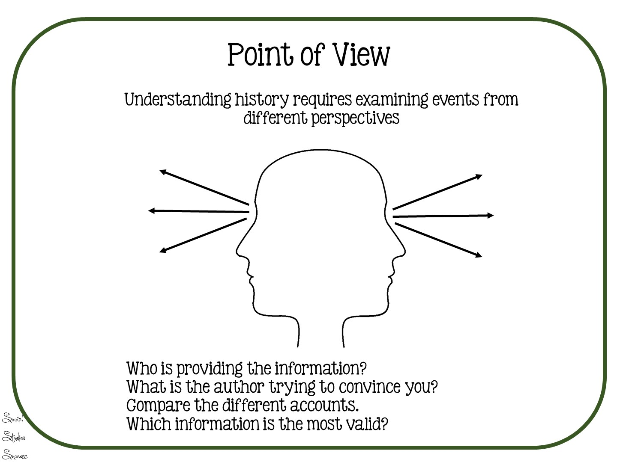

Slide 73

Notes:
Type in chat box.
73

Slide 75
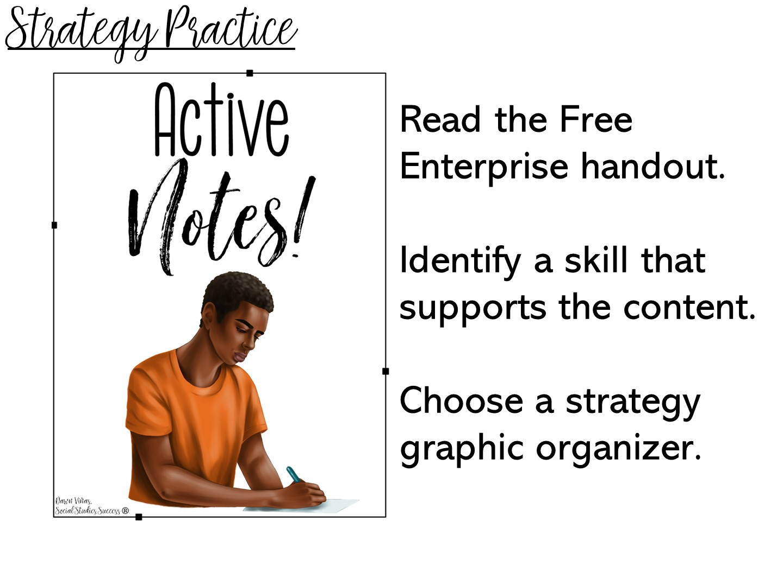
Notes:
Put them in a breakout group to do this.
Free Enterprise Handout is on the website.

Slide 76

Notes:
Type in chat box.

Slide 77
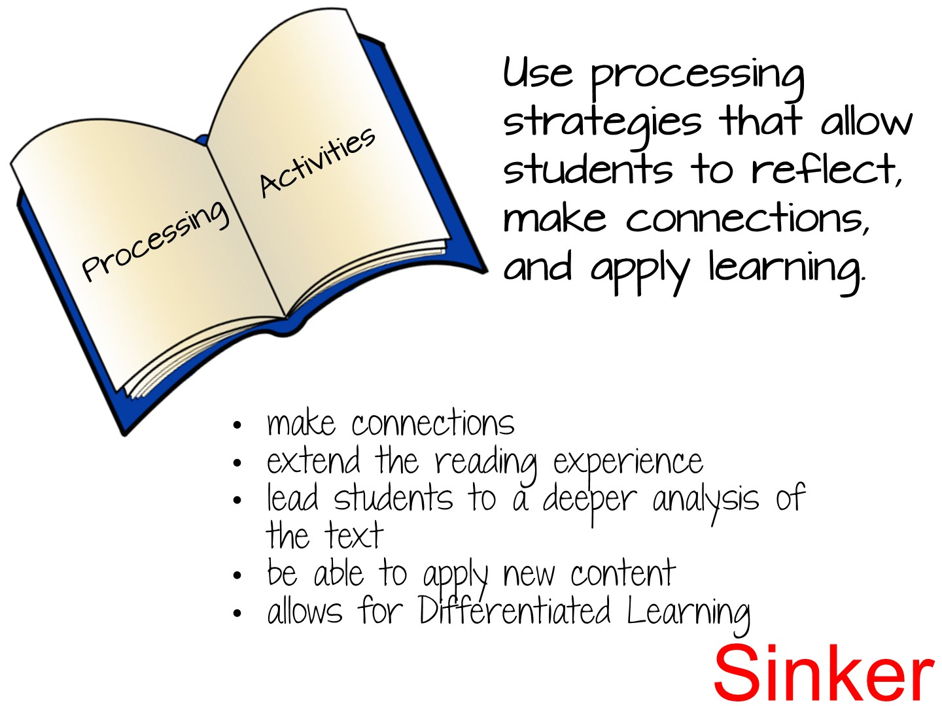

Slide 78
Notes:
This was our sinker in the model lesson.

Slide 79
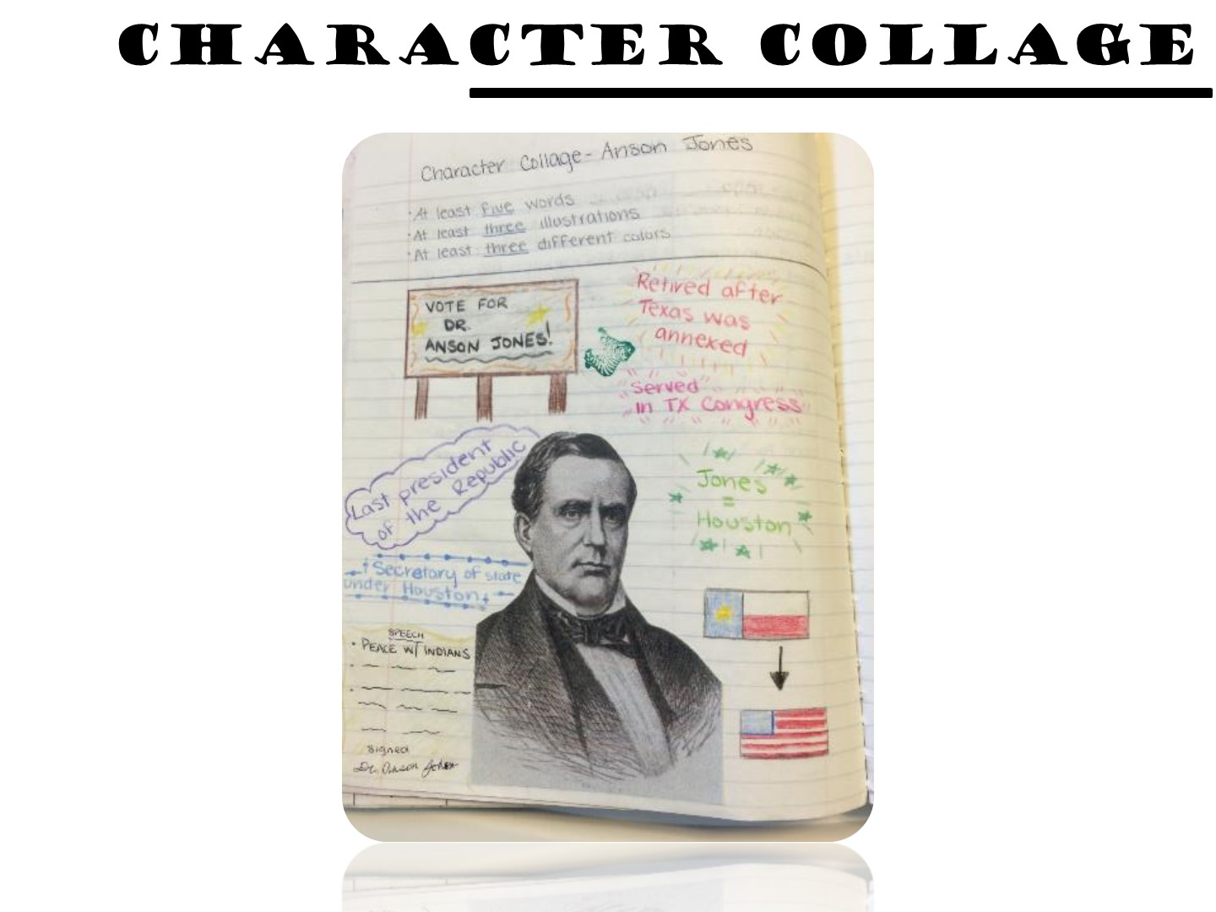
Notes:
Character collages allow students to process information about historical figures by adding images and quotes.

Slide 80
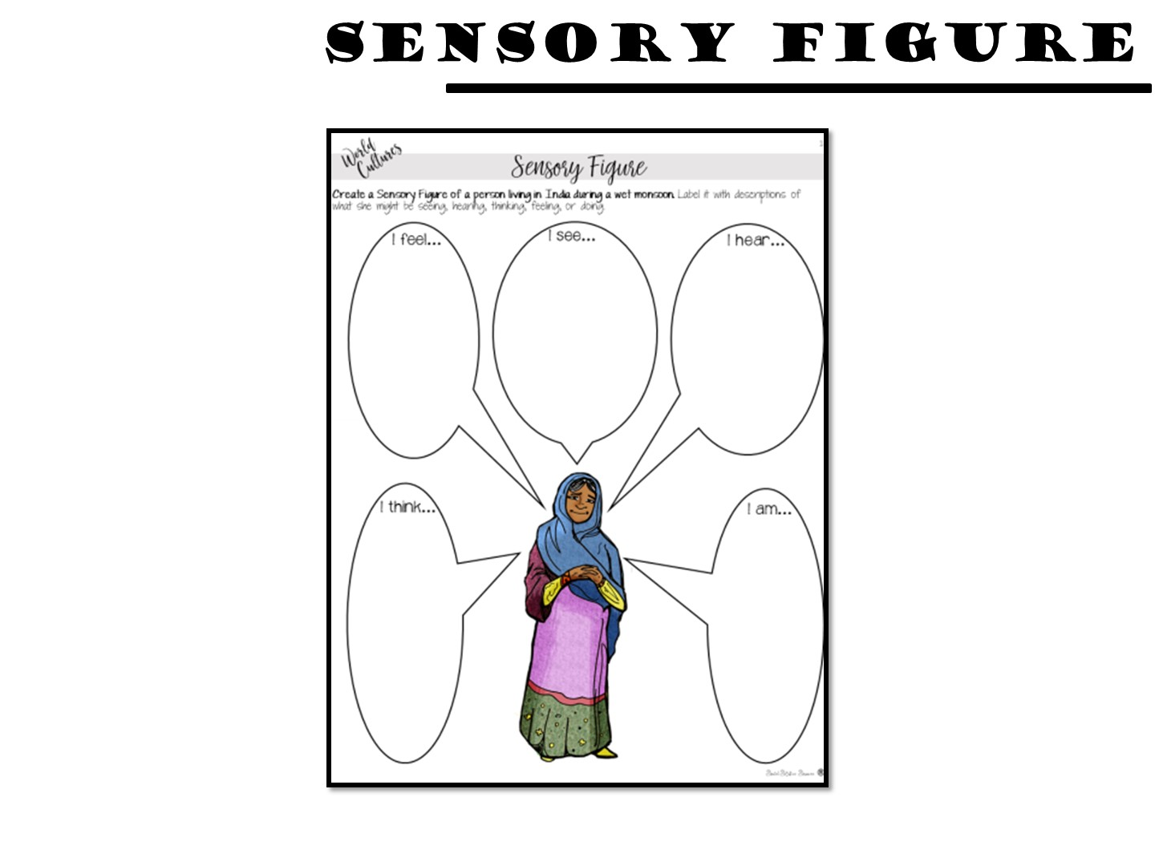
Notes:
Sensory figures process by inferencing senses.

Slide 81
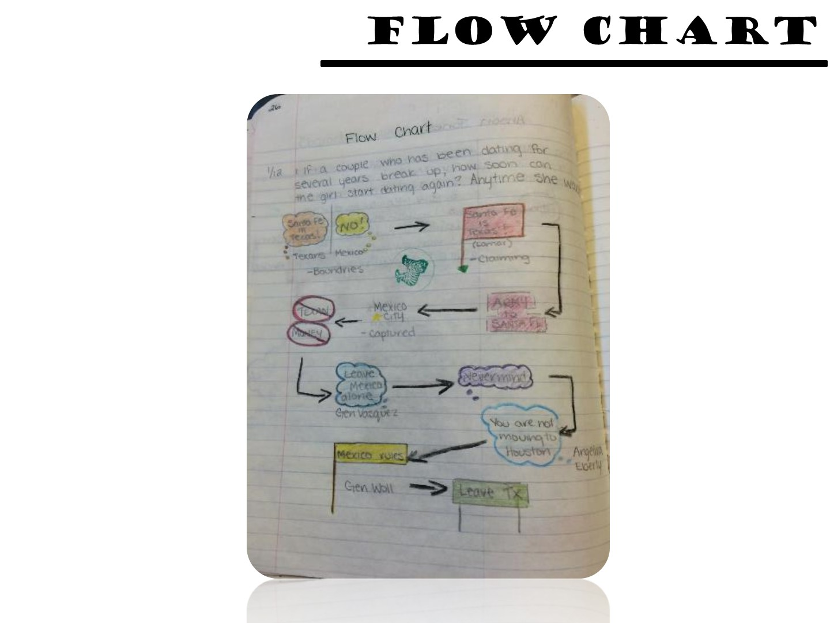
Notes:
Flow charts show the movement of an idea.

Slide 82
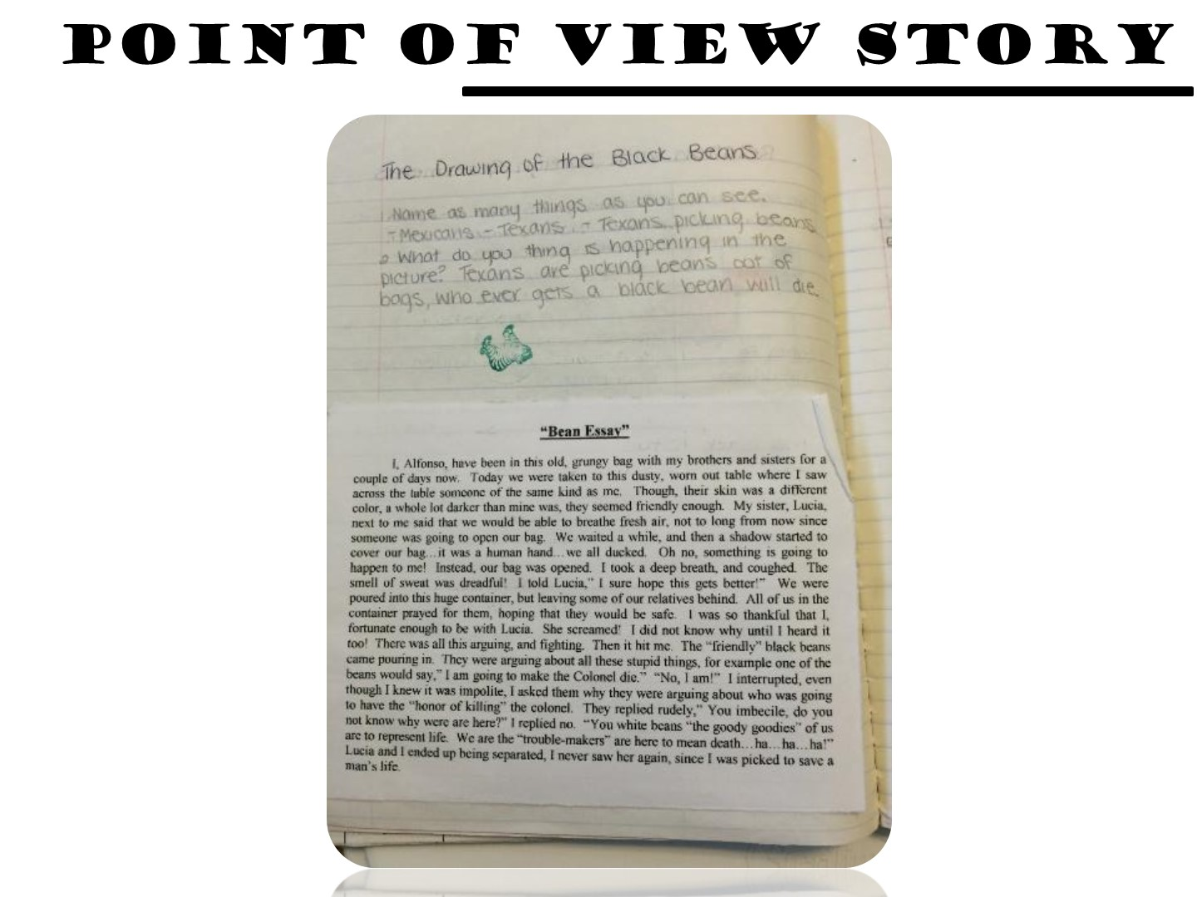
Notes:
Point of view stories are great for inferencing as well.

Slide 83
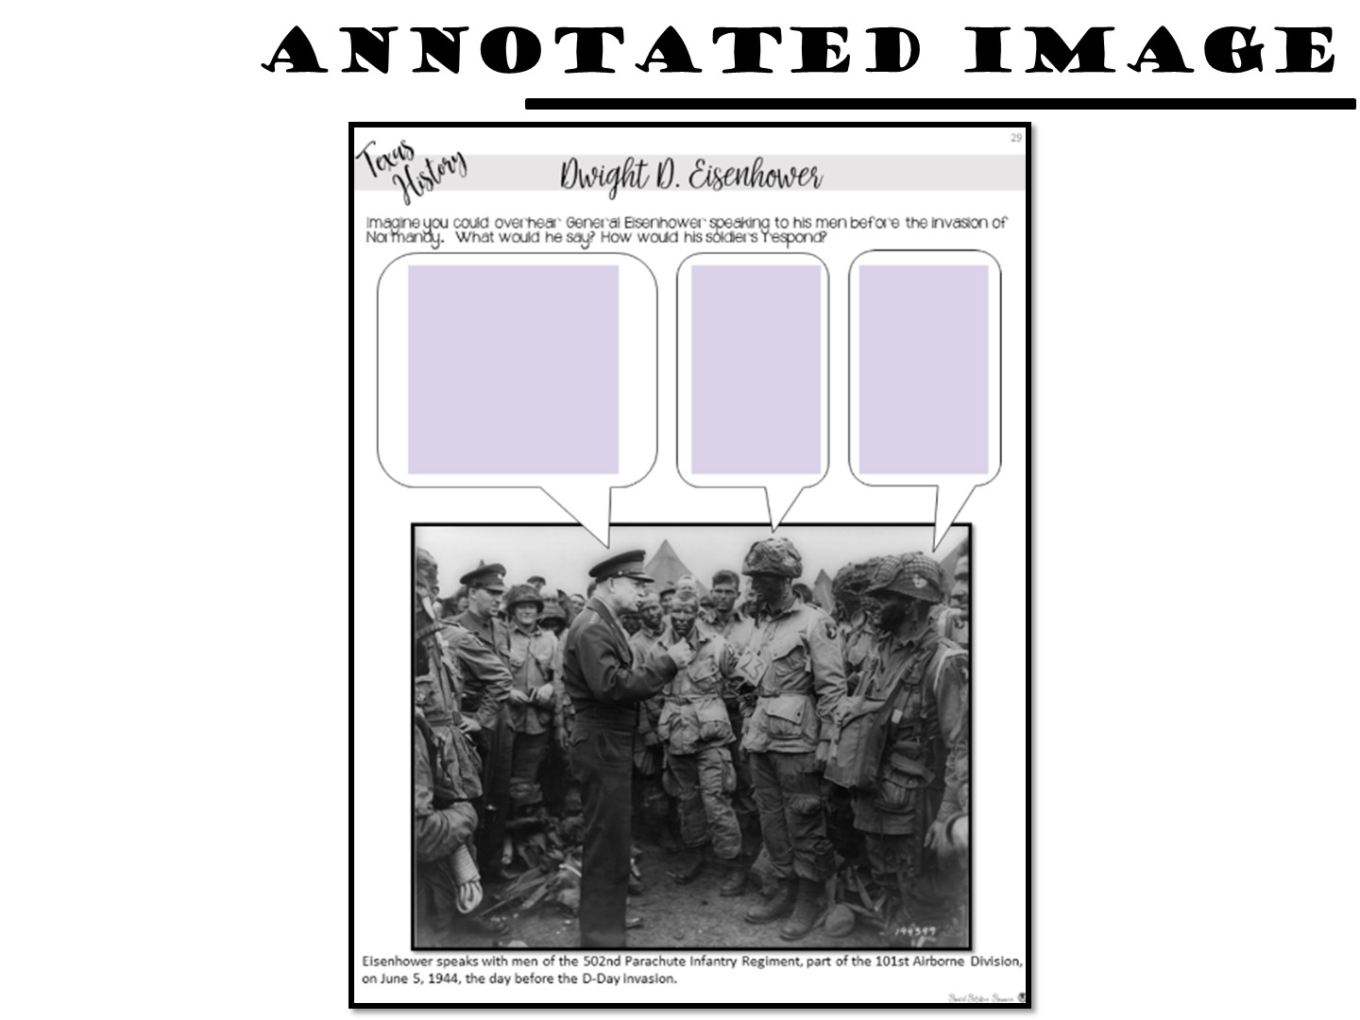
Notes:
Students bring to life images by adding text.

Slide 84
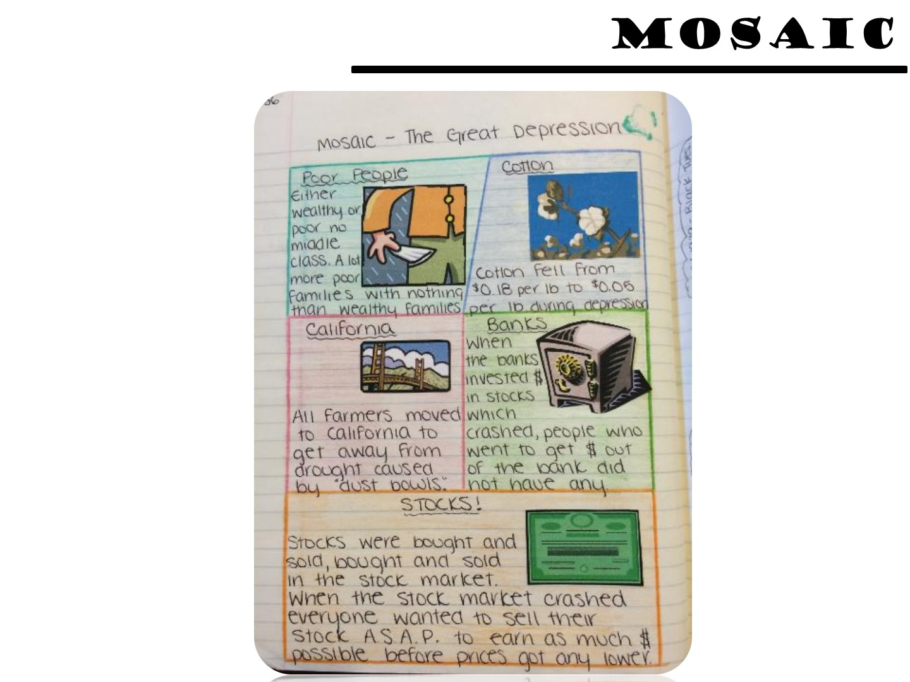
Notes:
A mosaic is great for showing the parts of a topic.

Slide 85
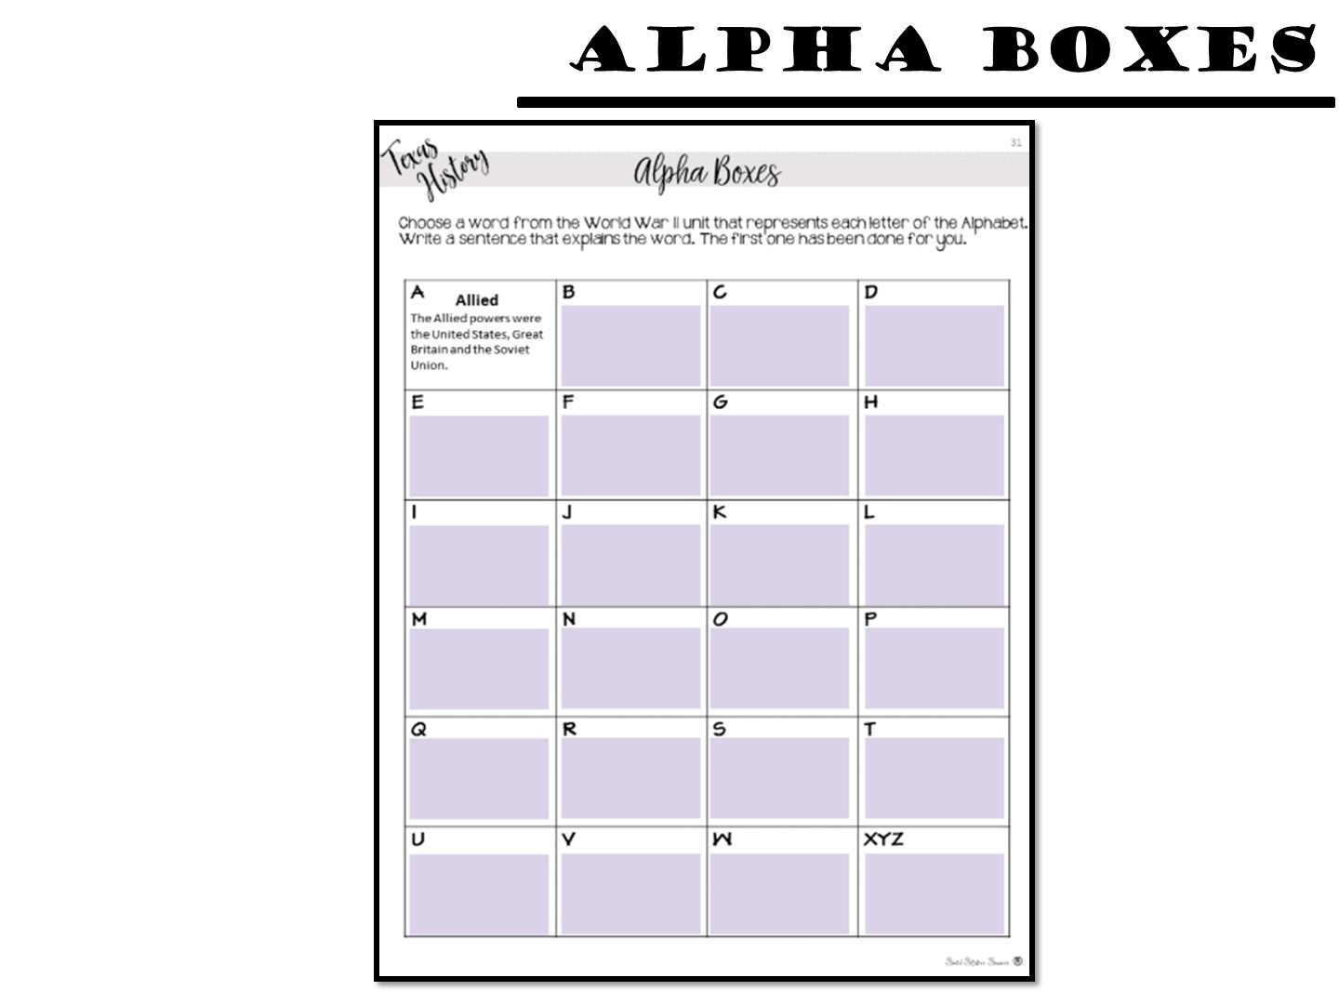
Notes:
Challenge students to create summaries for the topic with Alpha Boxes.

Slide 86
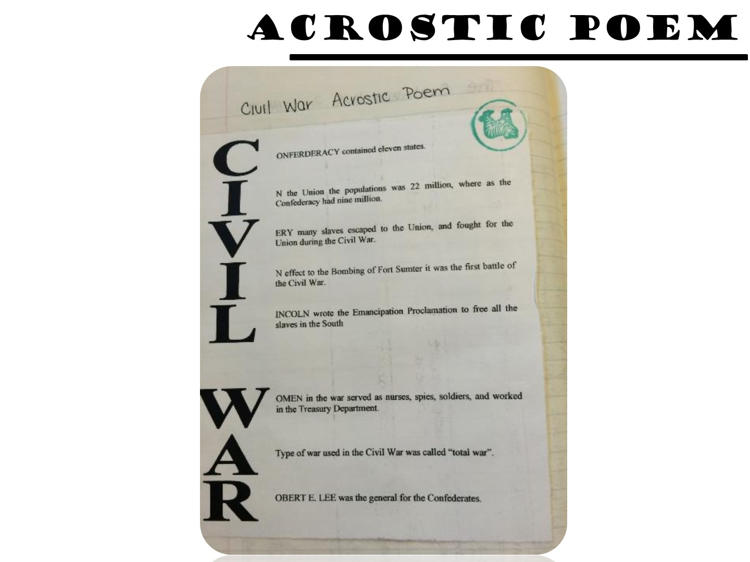
Notes:
Explain an acrostic poem.

Slide 87
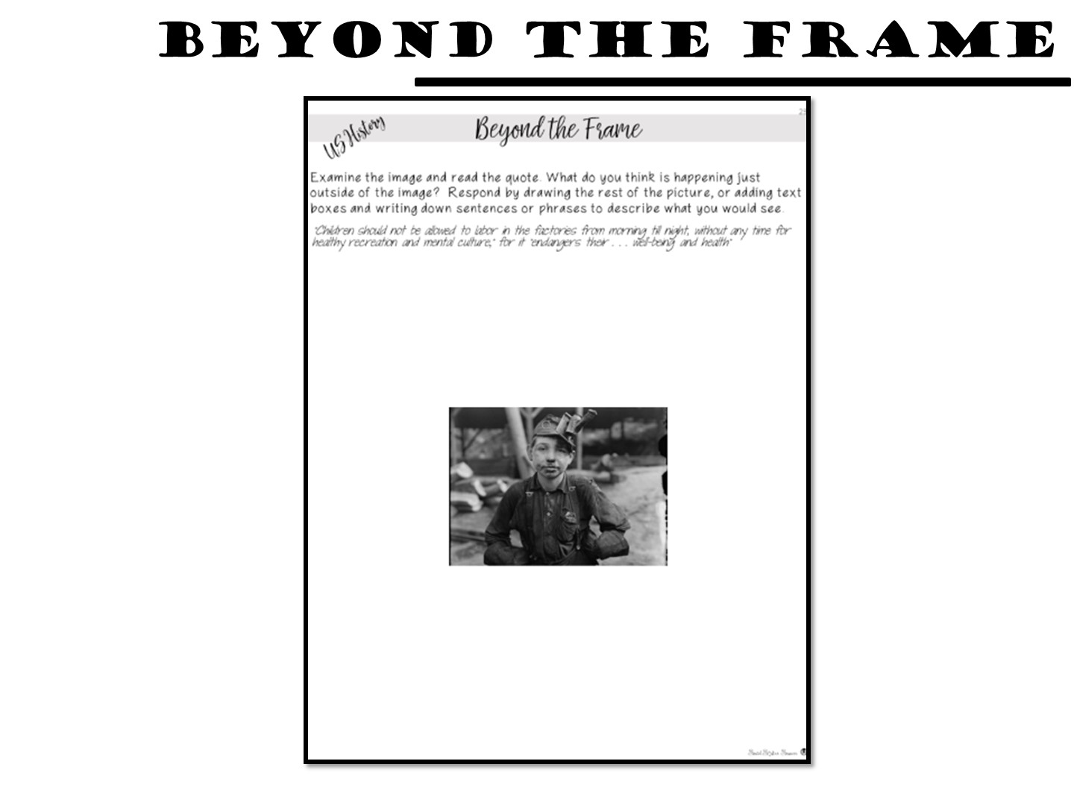
Notes:
Students write or draw what they would see beyond the picture frame.

Slide 88
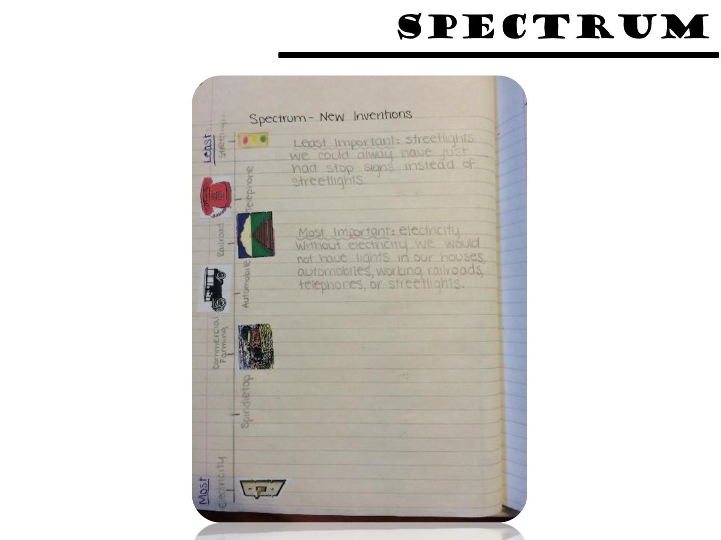
Notes:
Students rank the importance of certain events.

Slide 89
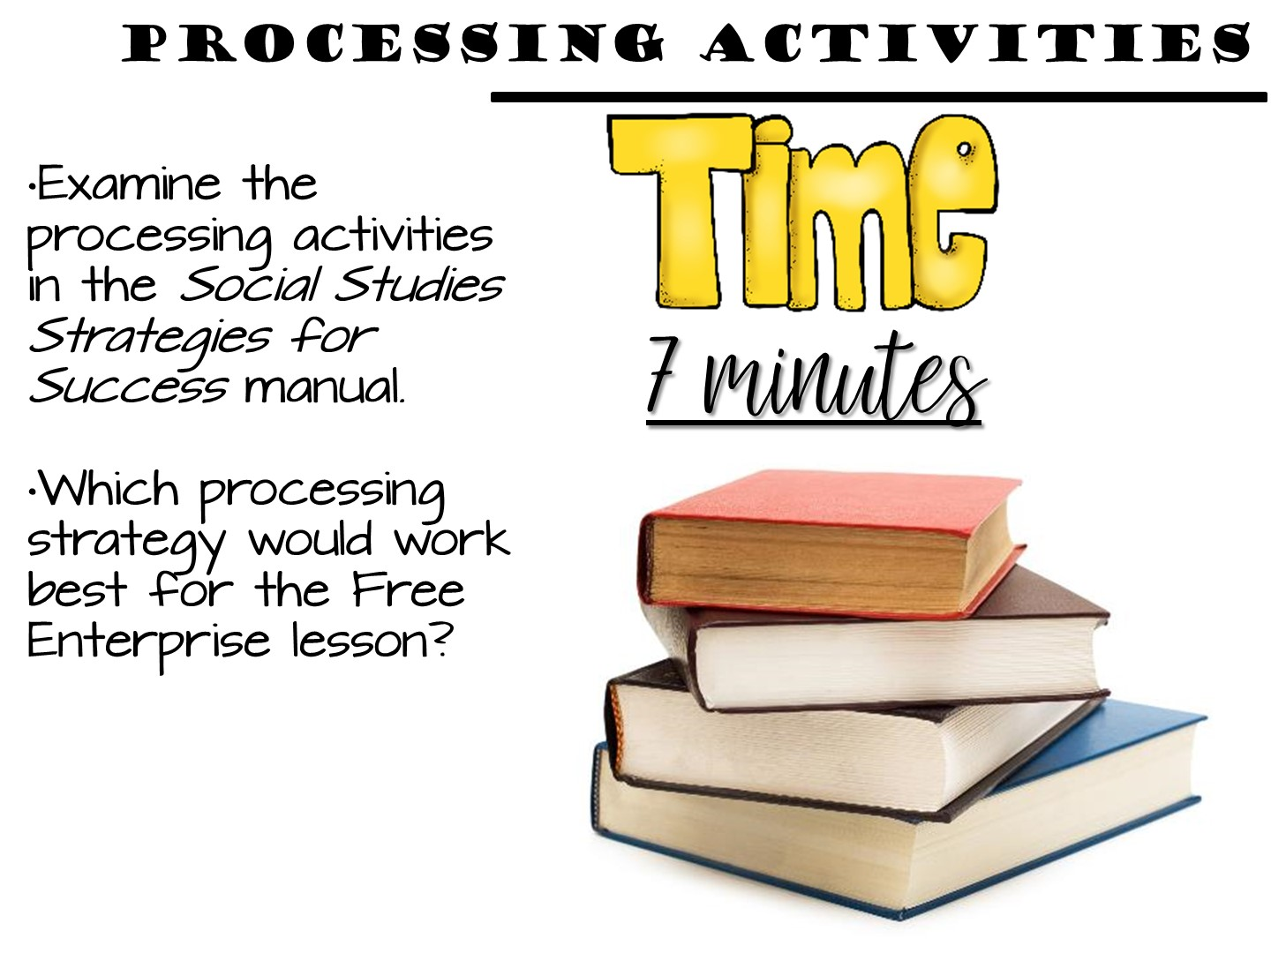
Notes:
These can be found in the table of contents.

Slide 90


Slide 91

Notes:
This is your personal choice in the classroom (share all your tips in this section).

Slide 92

Notes:
There are also things that you can do to individualize them. As you go over these, give your tips and experiences using notebooks.
For reduce the number of lost notebooks explain that the students have invested their time and personality into them, so they now have value to the kids.

Slide 93

Notes:
There are also things that you can do to individualize them. As you go over these, give your tips and experiences using notebooks.
For reduce the number of lost notebooks explain that the students have invested their time and personality into them, so they now have value to the kids.

Slide 94

Notes:
This will help kids know what the assignment is about and when it was done. This will help absent kids too.

Slide 95

Notes:
Discuss with participants how you can number pages. There are a variety of ways you can do this. Share the above with them and what you have done or tried in the past. You might need to explain that we are teaching without left-side/right-side if you have some folks who were taught the ISN by an old-schooler!
Number as you go - Explain to participants it is best to number as you go so if a kid messes up their whole notebook is not messed up.
Number by activity – each activity has a number
A,B,C method – Can use this with either. Preview is 2A, Notes 2B, Processing 2C or if you number as you go, if a kid needs more room than the page you gave them, they can make that A and move to page B.
Explain that all kids should be on the same number system and do not let them number on their own or their will be a lot of confusion when you want to grade or have the kids find something.

Slide 96

Notes:
I showed two examples, if you do something different, explain that to them.
I also share how I go to the teacher center and use a poster maker to make a big poster of the Table of Contents and laminate it. That way I can use dry erase markers on it and keep it up where the kids can see.

Slide 97

Notes:
You can include other things besides preview, notes, and processing in your notebooks as well. Vocabulary, maps are a few examples.

Slide 98

Notes:
You can give the example of 5-5-5 5 terms, 5 phrases, 5 colors required for a unit page. This picture does not have it, but that is something they can require their students to do.

Slide 99

Notes:
Debrief with these stems.

Slide 100

Notes:
There are rubrics for teachers to download on the website.

Slide 101

Notes:
Turn and Talk
This decides how you grade the notebook – either looking for perfection or grading the learning process.

Slide 102

Notes:
Monitor often at the beginning of the year.
Stamp, initial, or place stickers to indicate you have seen the item.
Write comments, especially positive comments or suggestions, on sticky notes.

Slide 103

Notes:
Allow students to use notebooks on a quiz
Helps students understand the importance of taking notes.
Encourages students to bring their notebooks daily.
Builds good work habits for the future.
z or test.

Slide 104

Notes:
Have students look at other student examples.
Examples from previous years
Gallery walk
Peer Review

Slide 105


Slide 106

Notes:
Share any tips you have for grading.

Slide 107


Slide 108

Notes:
Discuss by bullet points
Notes with highlighting key terms are easier to use to study for tests
Model when give notes use different color pens on overhead or in powerpoint.
Put color as part of the grade – stress color for organizing not for “prettiness”

Slide 109

Notes:
Discuss point
Can help them study; is a portfolio of evidence of learning
Help with test at state level; give story of student who kept and used their notebook

Slide 110


Slide 111

Notes:
Point out my blog on social studies success if they want to learn more.

