Slide 1
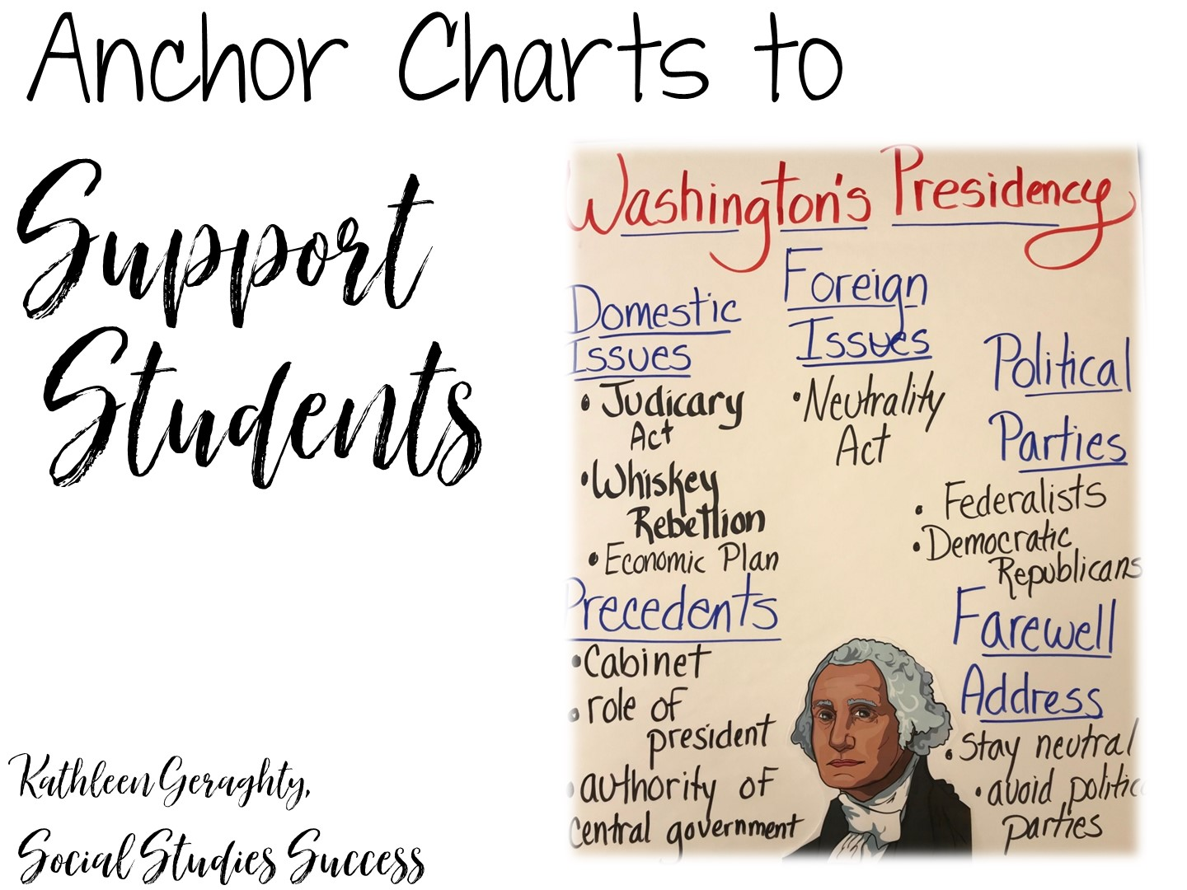
Notes:
Hello, This is Dawn with Social Studies Success, and I would like to welcome you to this session on using anchor charts in secondary Social Studies.

Slide 2


Slide 3

Notes:
Introduce yourself

Slide 4

Notes:
Differentiated instruction is ensuring that learning happens in an accessible way for the student. ISNs allow the students to format their thoughts however they find suitable, thus, differentiating by learning styles — someone who loves writing can love in the notebooks, another student who would rather draw is free to express his/her ideas through diagrams, charts and pictures.

Slide 5

Notes:
Differentiated instruction is ensuring that learning happens in an accessible way for the student. ISNs allow the students to format their thoughts however they find suitable, thus, differentiating by learning styles — someone who loves writing can love in the notebooks, another student who would rather draw is free to express his/her ideas through diagrams, charts and pictures.

Slide 6
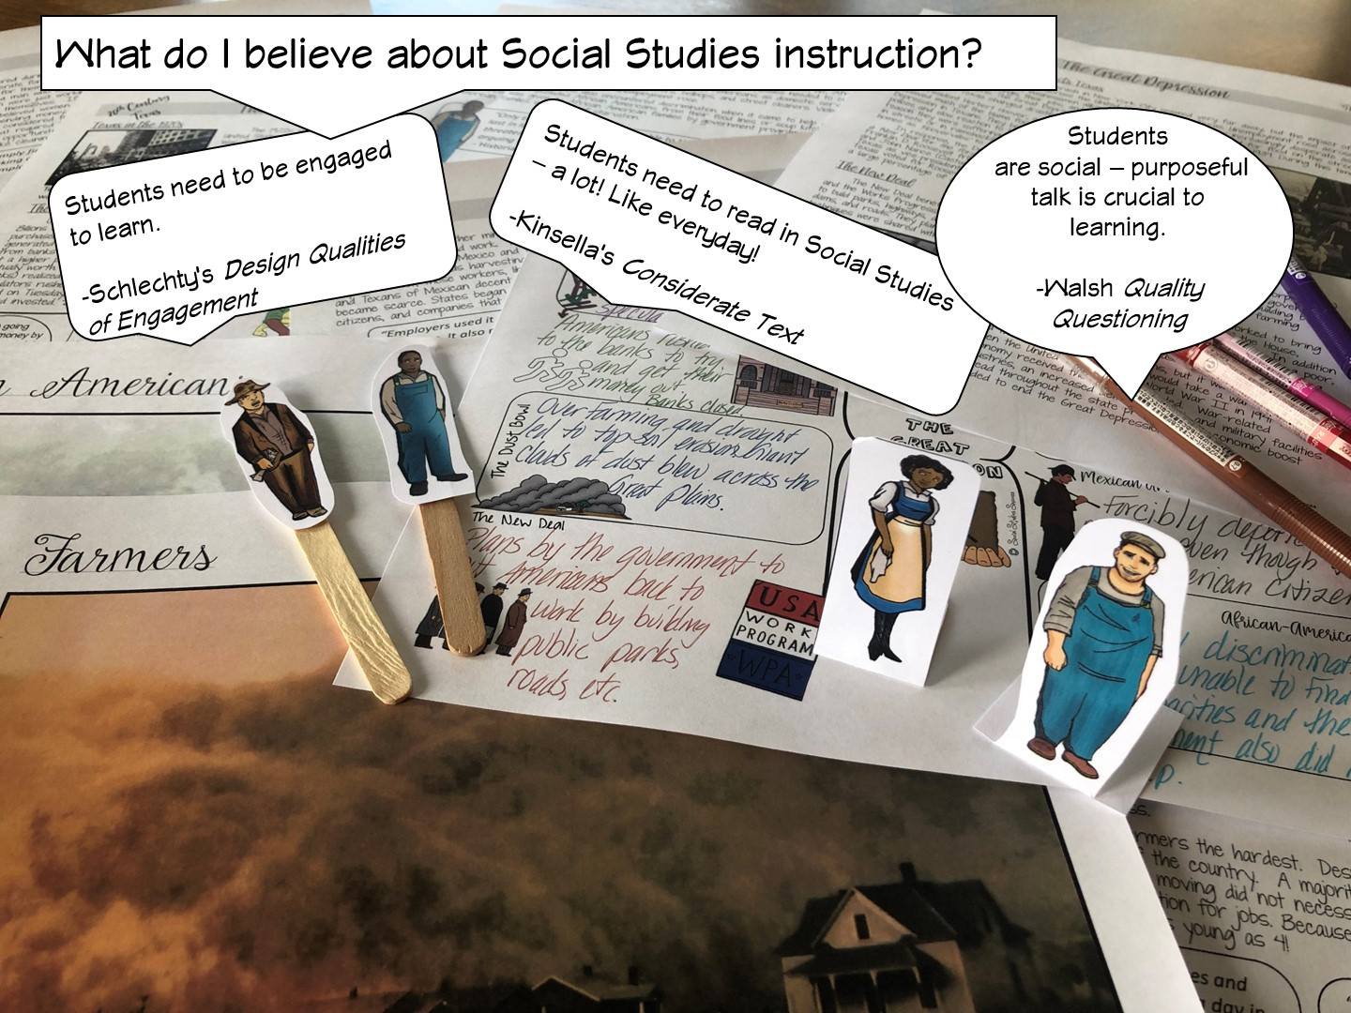
Notes:
Differentiated instruction is ensuring that learning happens in an accessible way for the student. ISNs allow the students to format their thoughts however they find suitable, thus, differentiating by learning styles — someone who loves writing can love in the notebooks, another student who would rather draw is free to express his/her ideas through diagrams, charts and pictures.

Slide 7
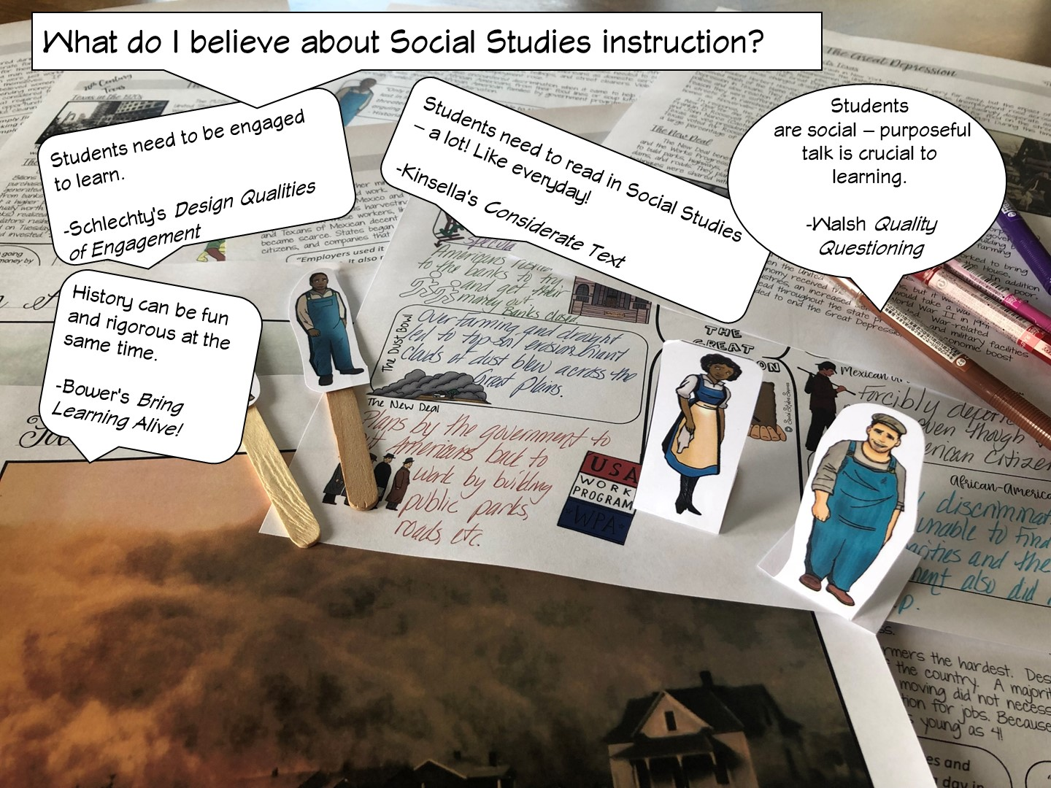
Notes:
Differentiated instruction is ensuring that learning happens in an accessible way for the student. ISNs allow the students to format their thoughts however they find suitable, thus, differentiating by learning styles — someone who loves writing can love in the notebooks, another student who would rather draw is free to express his/her ideas through diagrams, charts and pictures.

Slide 8

Notes:
Differentiated instruction is ensuring that learning happens in an accessible way for the student. ISNs allow the students to format their thoughts however they find suitable, thus, differentiating by learning styles — someone who loves writing can love in the notebooks, another student who would rather draw is free to express his/her ideas through diagrams, charts and pictures.

Slide 9
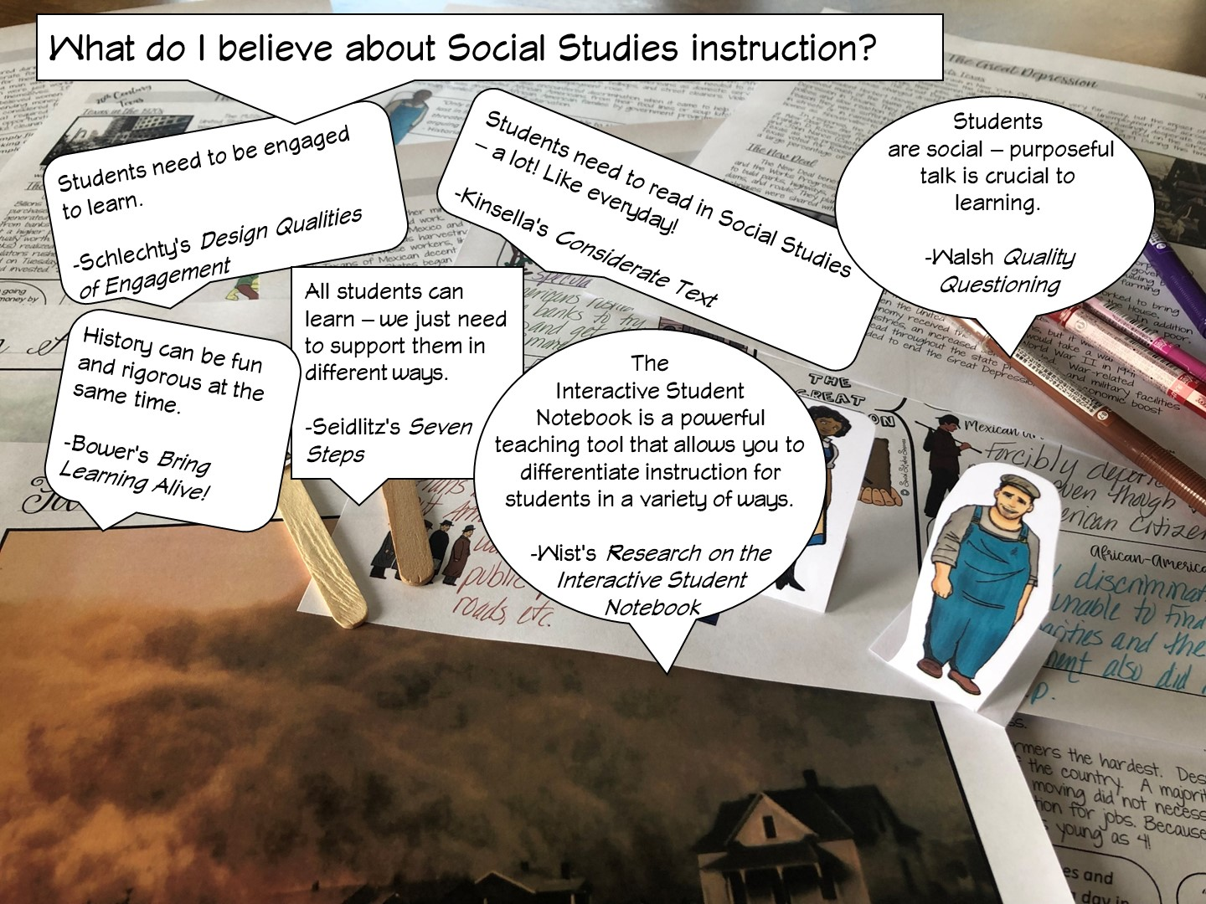
Notes:
Differentiated instruction is ensuring that learning happens in an accessible way for the student. ISNs allow the students to format their thoughts however they find suitable, thus, differentiating by learning styles — someone who loves writing can love in the notebooks, another student who would rather draw is free to express his/her ideas through diagrams, charts and pictures.

Slide 10

Notes:
Differentiated instruction is ensuring that learning happens in an accessible way for the student. ISNs allow the students to format their thoughts however they find suitable, thus, differentiating by learning styles — someone who loves writing can love in the notebooks, another student who would rather draw is free to express his/her ideas through diagrams, charts and pictures.

Slide 11

Notes:
Differentiated instruction is ensuring that learning happens in an accessible way for the student. ISNs allow the students to format their thoughts however they find suitable, thus, differentiating by learning styles — someone who loves writing can love in the notebooks, another student who would rather draw is free to express his/her ideas through diagrams, charts and pictures.

Slide 12

Notes:
Differentiated instruction is ensuring that learning happens in an accessible way for the student. ISNs allow the students to format their thoughts however they find suitable, thus, differentiating by learning styles — someone who loves writing can love in the notebooks, another student who would rather draw is free to express his/her ideas through diagrams, charts and pictures.

Slide 13

Notes:
Differentiated instruction is ensuring that learning happens in an accessible way for the student. ISNs allow the students to format their thoughts however they find suitable, thus, differentiating by learning styles — someone who loves writing can love in the notebooks, another student who would rather draw is free to express his/her ideas through diagrams, charts and pictures.

Slide 14
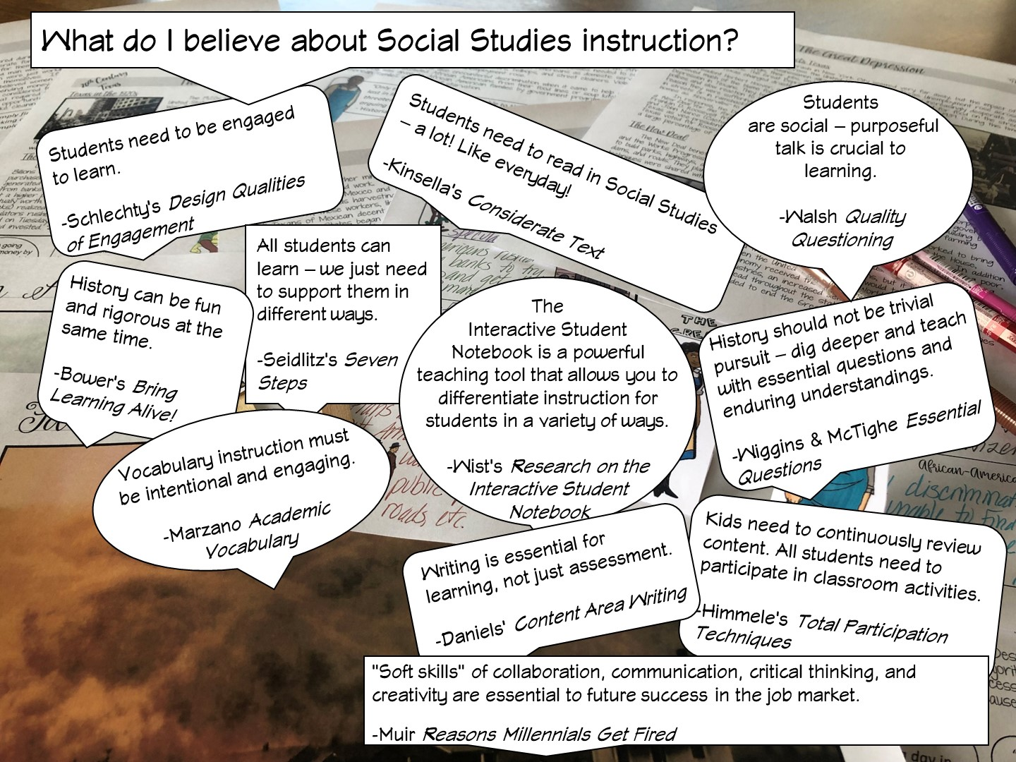
Notes:
Differentiated instruction is ensuring that learning happens in an accessible way for the student. ISNs allow the students to format their thoughts however they find suitable, thus, differentiating by learning styles — someone who loves writing can love in the notebooks, another student who would rather draw is free to express his/her ideas through diagrams, charts and pictures.

Slide 15
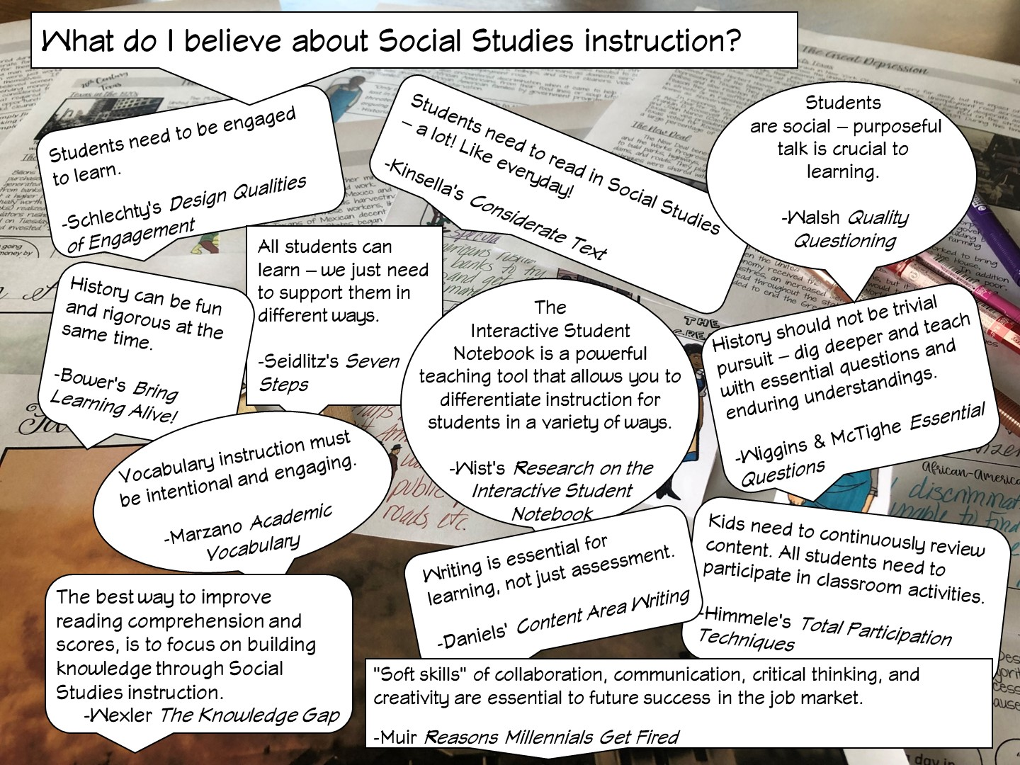
Notes:
Differentiated instruction is ensuring that learning happens in an accessible way for the student. ISNs allow the students to format their thoughts however they find suitable, thus, differentiating by learning styles — someone who loves writing can love in the notebooks, another student who would rather draw is free to express his/her ideas through diagrams, charts and pictures.

Slide 16


Slide 17
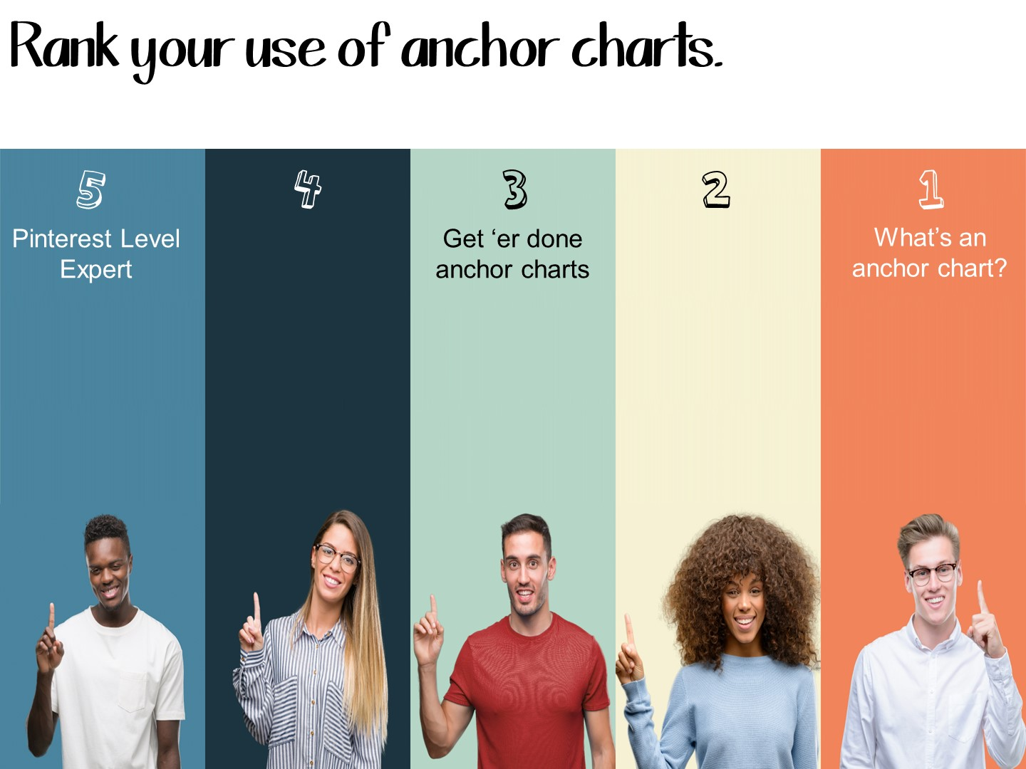
Notes:
Hold up their hand and rank from 1-5

Slide 18

Notes:
Obviously we are going to start with what makes the most sense – what is an anchor chart.
You can tell your own story or just fake mine ;)
Let me tell you my own personal story about using anchor charts in Social Studies. I first heard of them in a meeting where we were discussing differentiated instruction. I can vividly remember thinking, well that may work for you (it was an elementary math teacher talking at the time), but I have no idea how it would work in Secondary Social Studies. The premise was that you would create an anchor chart every day with your class – and it would really work best if you made it with your students every time. I really couldn’t see how that would work in secondary Social Studies. I had 6 classes – over 130 students, if I attempted that, I would spend all day, every day, creating anchor charts and nothing else would happen in class. Nope – not doing that! I dismissed the idea as great for elementary, but wouldn’t work for me.

Slide 19
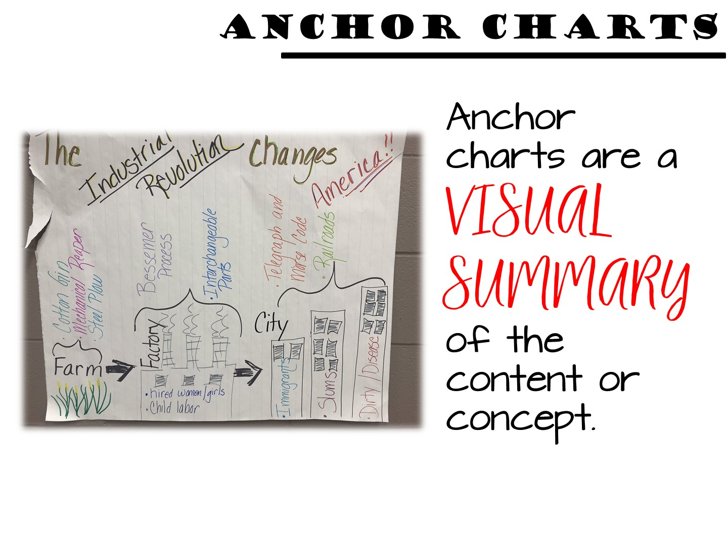
Notes:
It wasn’t until I actually saw anchor charts being used by a secondary social studies teacher, that I had my epiphany. Anchor charts in secondary social studies are VISUAL SUMMARIES of important content or concepts. You create anchor charts for the big ideas or difficult concepts you want students to remember. It is not an everyday, with every student in every class thing. Anchor charts can be manageable for secondary teachers, and more importantly are essential in supporting our ELL and SPED students.

Slide 20

Notes:
So how do anchor charts benefit our students? Why would teachers spend time making them? I knew I needed to do more research to see if anchor charts really are worth our time. But when I researched anchor charts in secondary social studies, I came up against a blank wall – I could find plenty of research for the effectiveness in elementary school, but nothing for secondary. I then started to do my own research based on classroom observations. For the past 5 years I have worked with teachers across Texas. I observed their teaching, and more importantly their students reactions to anchor charts. This workshop is based on the research I have compiled in the past 5 years watching secondary social studies teachers use anchor charts in their classroom. The examples you see are shared with permission from these teachers. Some I have created on my own as I work with different teams of teachers. All are great examples for you to see and use.

Slide 21
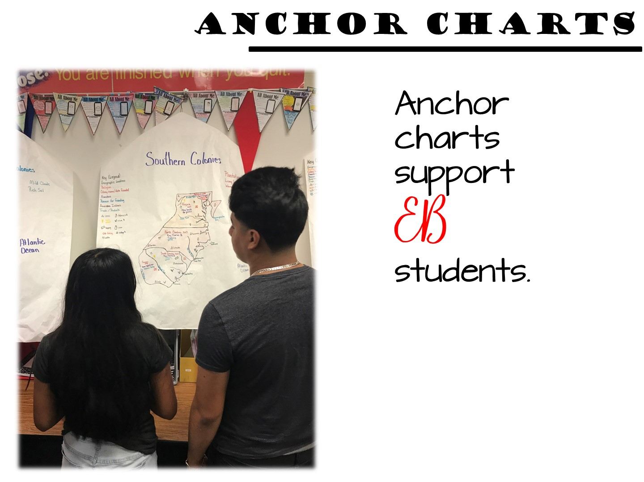
Notes:
How do anchor charts support our ELL and SPED students? Because of what they are – visual summaries of important content. Too often our ELL and SPED students struggle with difficult text or teacher lectures. But anchor charts help students focus on the key points of a lesson. An anchor chart lets students know what is really important about a topic – what do they need to walk away knowing about the topic.

Slide 22
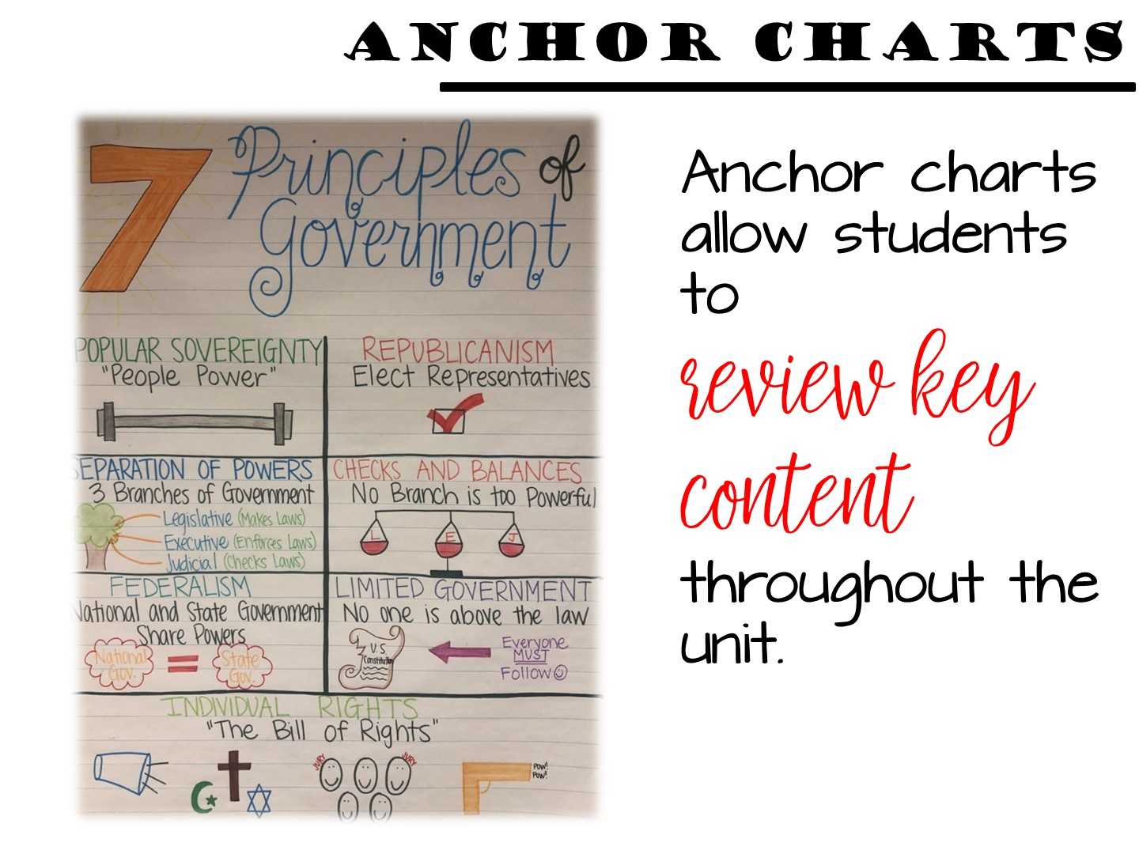
Notes:
When you hang your anchor chart in your classroom and USE IT – point to it, require questions to be answered from it, base exit ticket or entrance ticket questions on it - students develop episodic memory around the anchor chart. They can visualize it in their mind and use it as a reference point. Students will even look at a blank wall where an anchor chart hung as they recall information.
One of my favorite memories of an anchor chart was when I saw students using it during a class debate – one student got up, went to the anchor chart and pointed out certain features to reinforce his argument. I was thrilled to see how he had incorporated it into his learning. It was evident that the teacher had been using the anchor chart throughout her instructional unit.

Slide 23
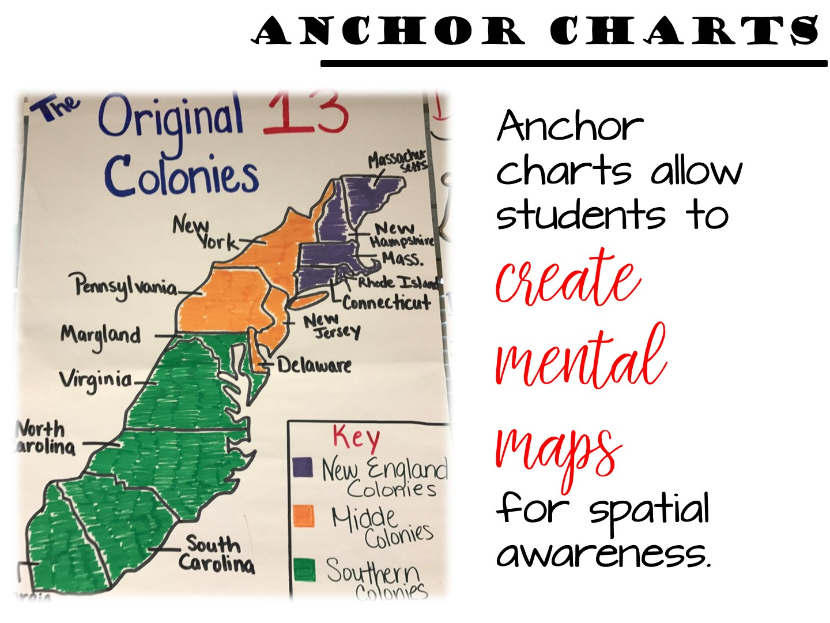
Notes:
Students are notoriously weak in their geographic skills – especially mental mapping. Creating a anchor chart that incorporates a map can be beneficial in so many ways. While this anchor chart can be posted during your colonial unit, revisiting it during your unit on sectionalism can help cement the idea that geographic differences and the economy and history of the colonies helped lead to the Civil War.

Slide 24
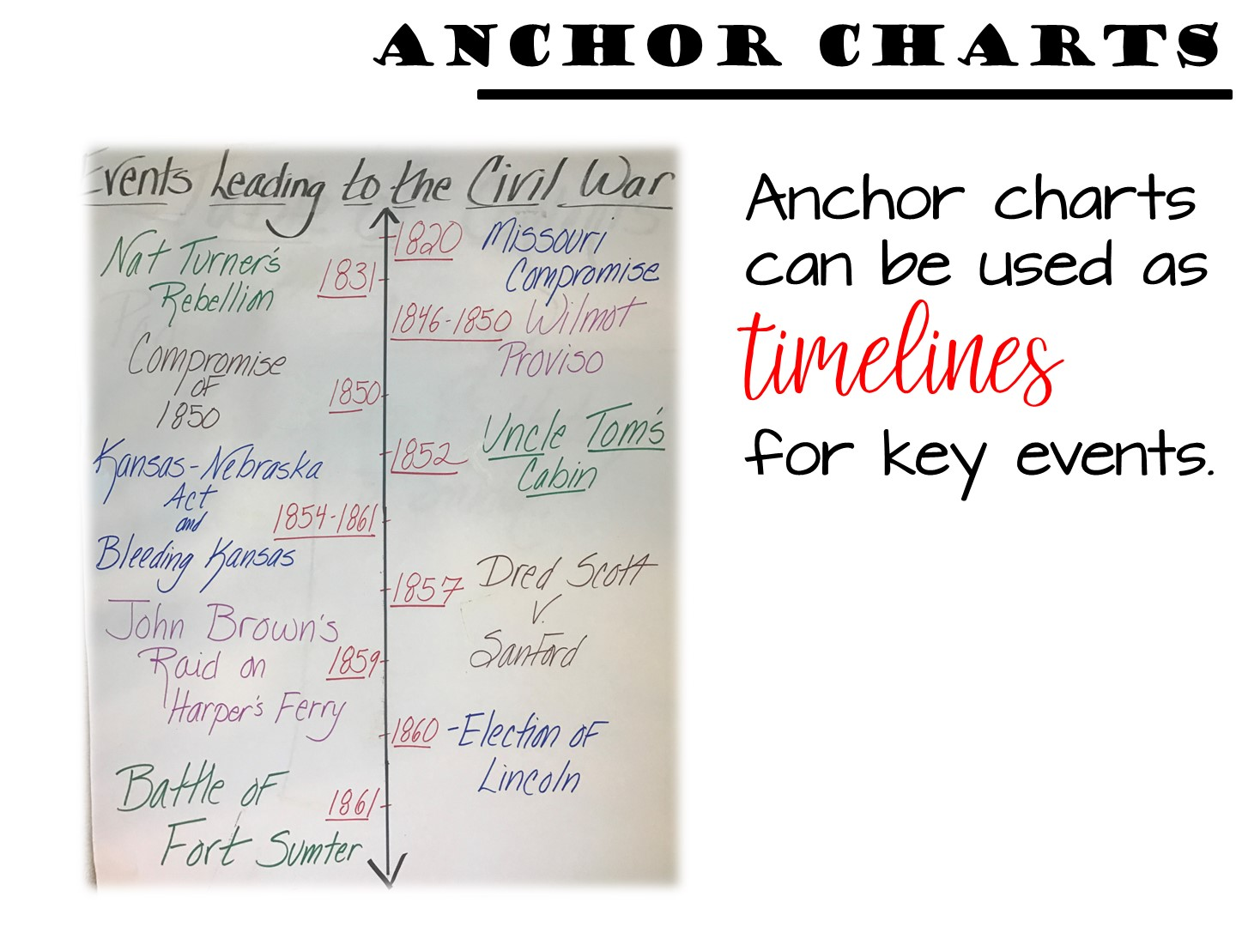
Notes:
In addition to mental mapping, anchor charts can help reinforce chronological events or the concept of an era. Anchor charts can be created as timelines or can even be used to …

Slide 25
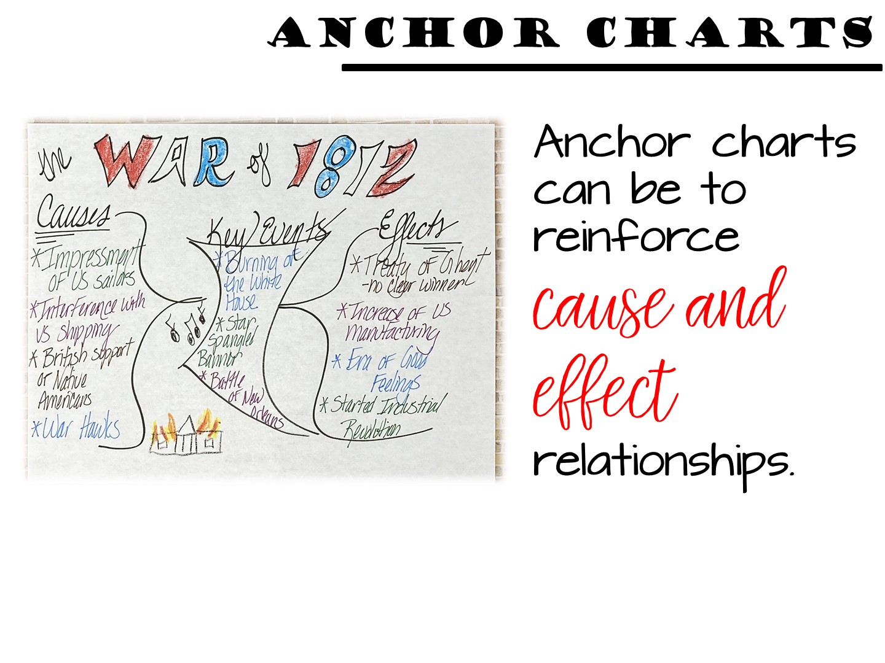
Notes:
reinforce cause and effect relationships. An idea that can be used for an anchor chart like this is to leave the information in it blank. Then give your students cards with the different cause and effect events on them. As you learn about the content, your students can add the cards to the anchor charts. When you are done with the unit, you can glue the cards down to complete the anchor chart.

Slide 26
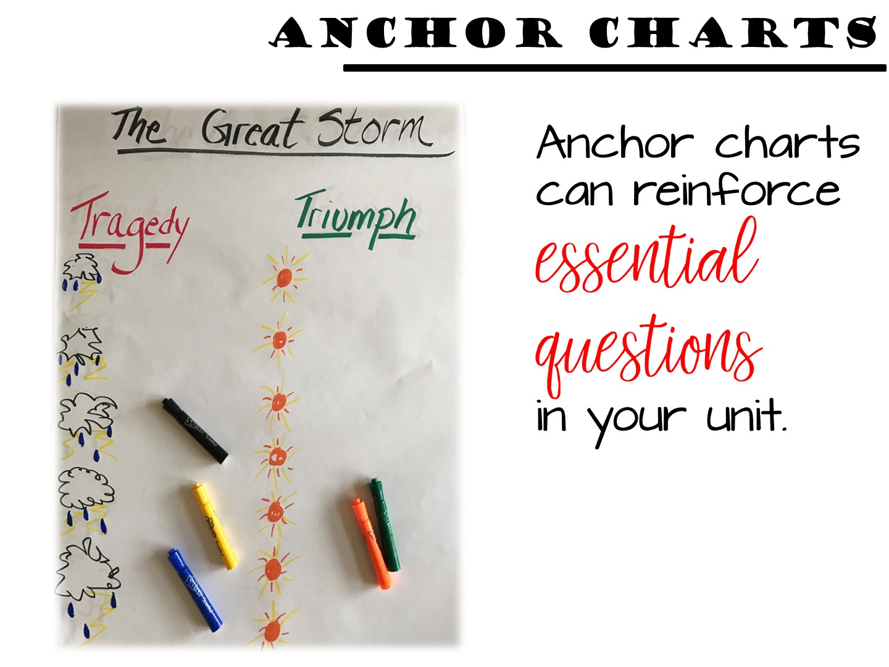
Notes:
Anchor charts are also great for reinforcing an essential questions. With any good essential question, you introduce it at the beginning of a unit. Then teach to the essential question throughout the unit. As student learn about the content – Was the Great Storm Galveston’s Greatest Tragedy or Triumph – they can share their answers to build this chart. Instead of making one for every class period – make one and add answers on post-it notes.

Slide 27
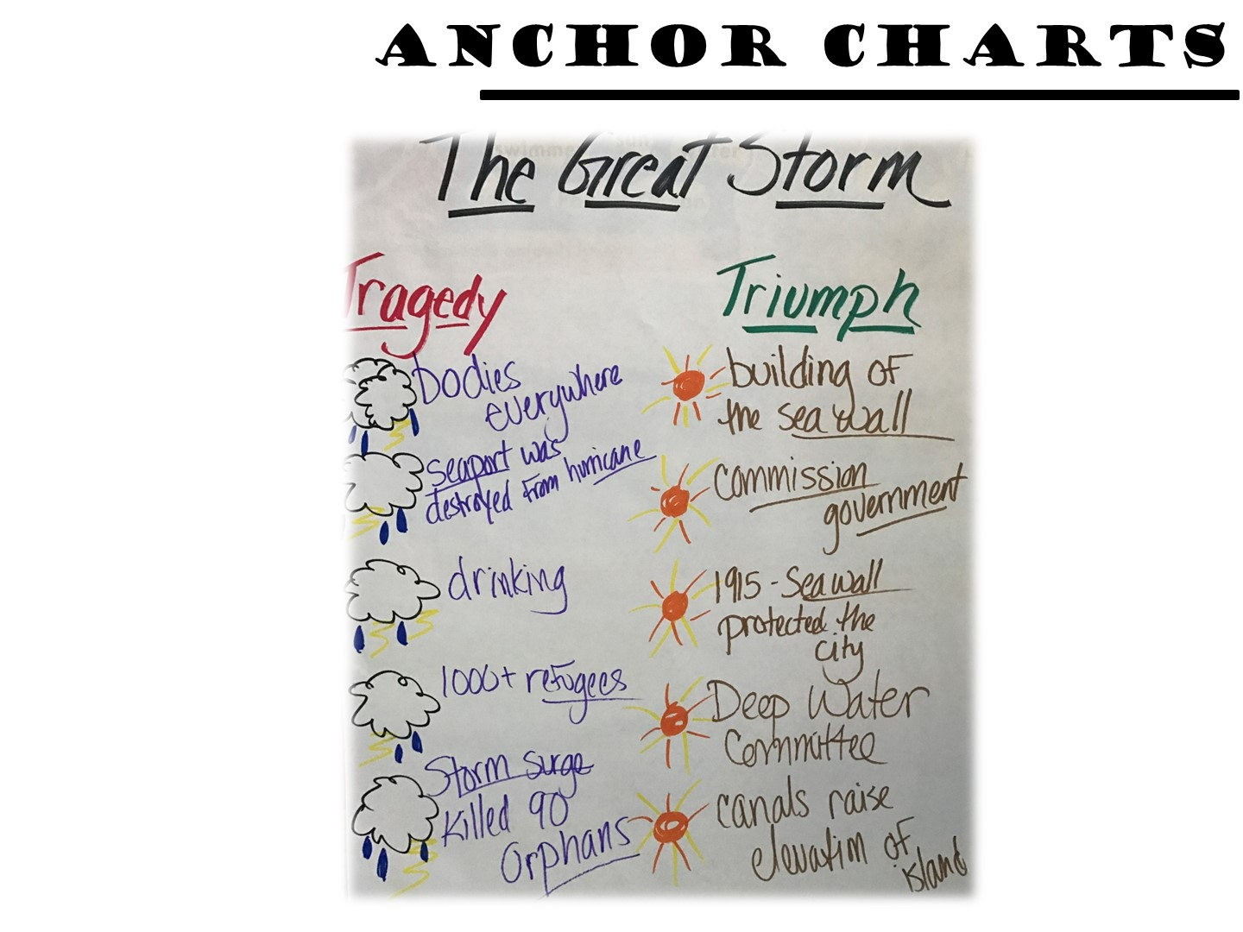
Notes:
At the end of the unit, you can have students summarize their learning on a class anchor chart

Slide 28
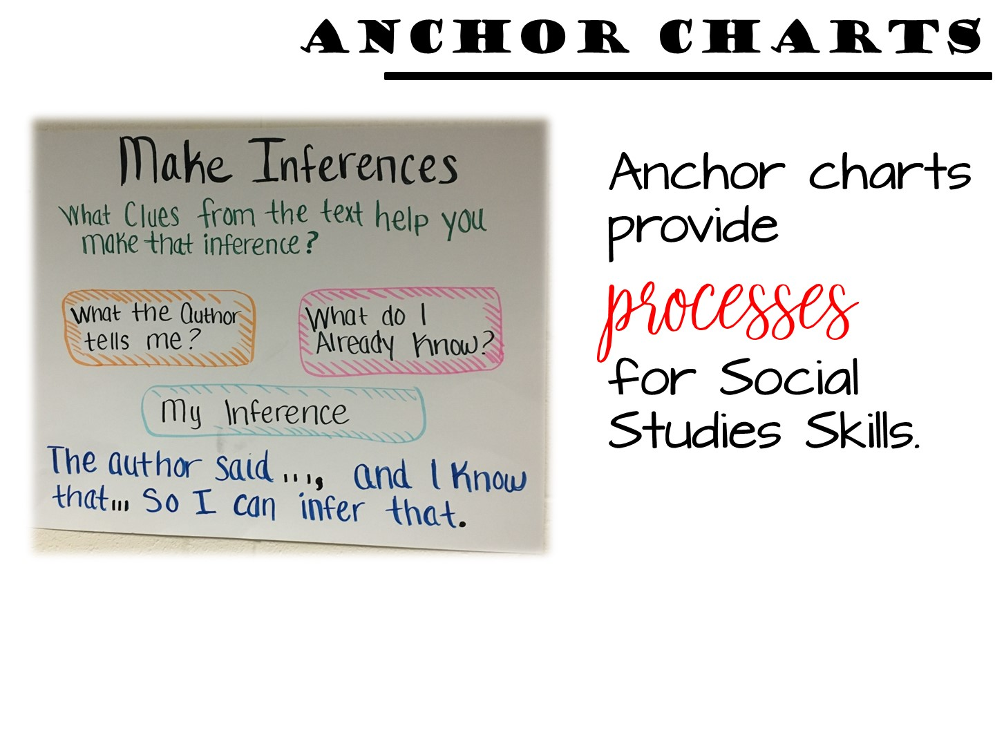
Notes:
Anchor charts are also great for Social Studies Skills and Processes. These can easily be made ahead of instruction and kept up for the entire year. When you embed or focus on a skill, quickly reteach it with an anchor chart. These can also help your SPED students focus on the thinking that is required in their lesson for the day.

Slide 29
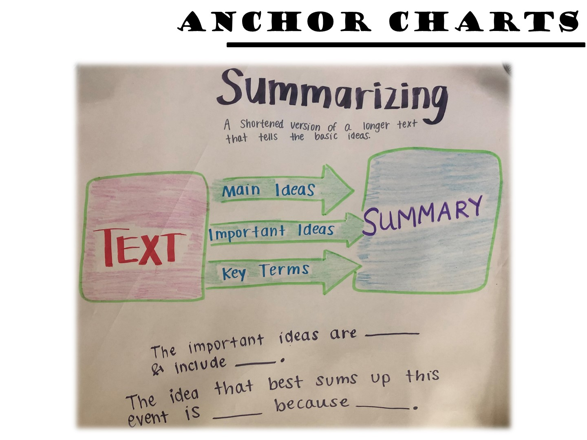
Notes:
Anchor charts can also provide sentence starters for your ELL students. In addition to a visual summary of the skill, sentence starters are beneficial to ELL students moving along the language spectrum from listening to speaking to reading to writing.

Slide 30
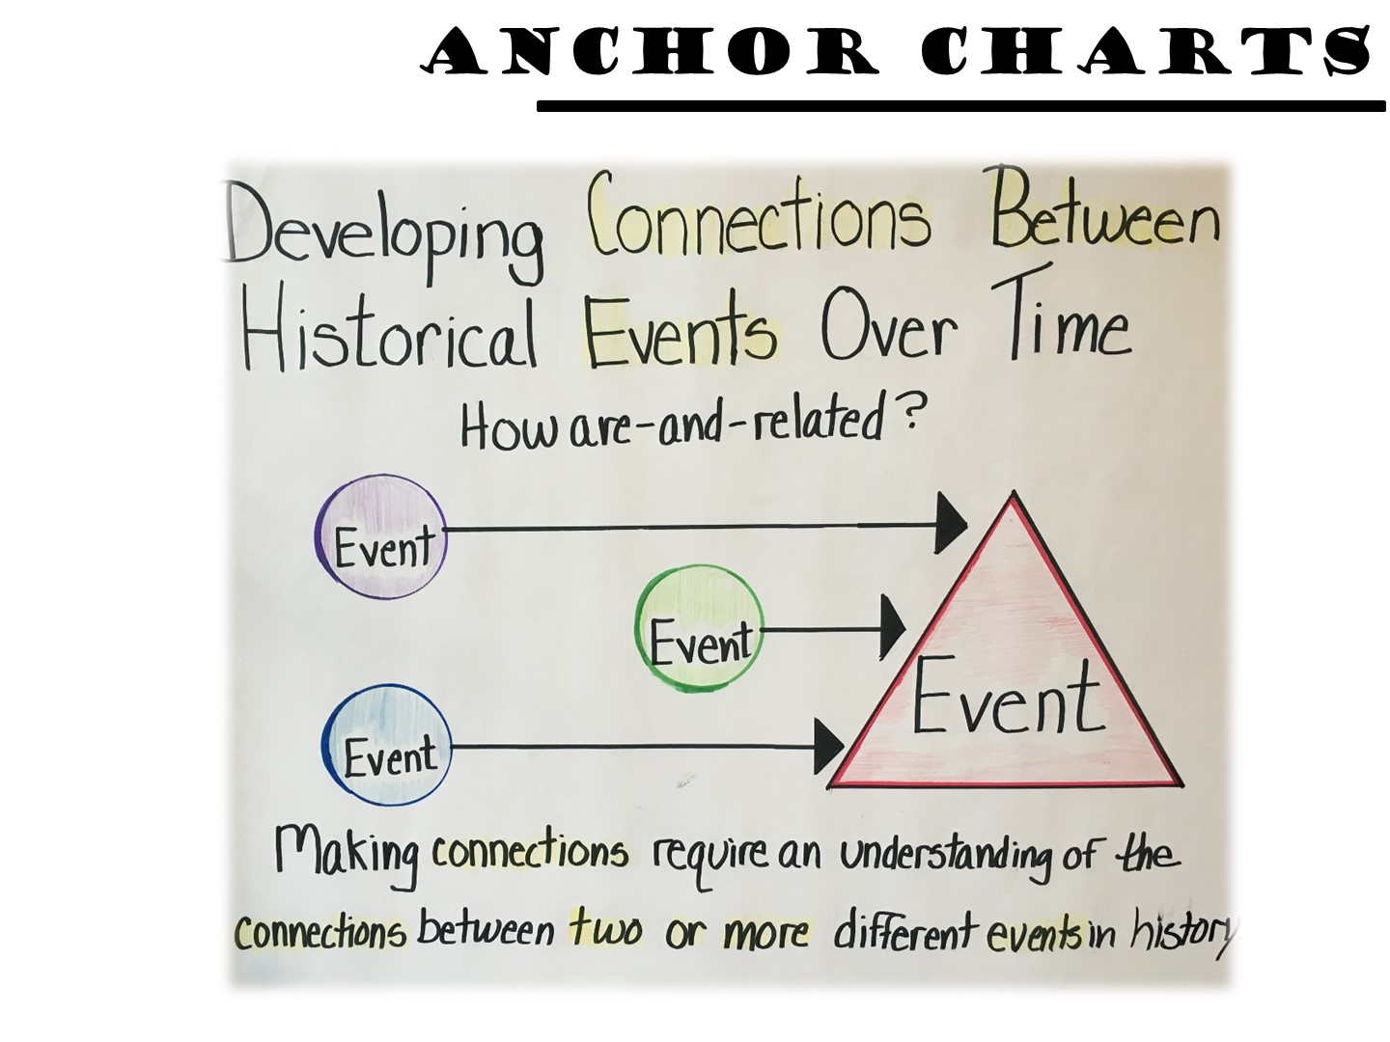
Notes:
Anchor charts make thinking visible. Making connections across time is difficult for students to see sometimes – they lack the content knowledge that allows them to see connections between events. An anchor chart that models this process can help your students.

Slide 31
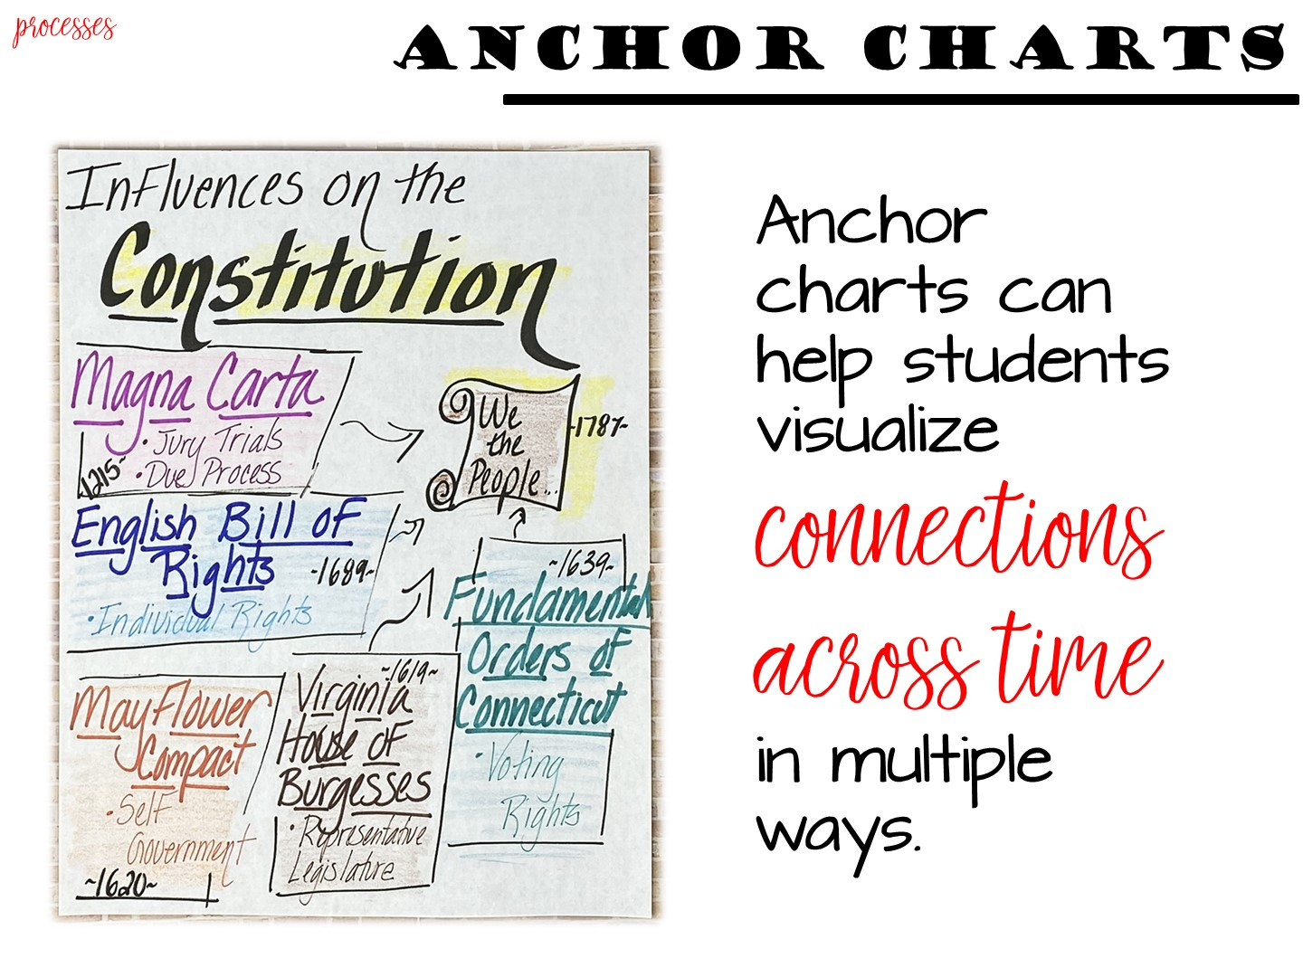
Notes:
One example of developing connections between historical events over time has to do with the documents that influenced the US Constitution. While this is not a cause and effect relationship, each of these documents influenced the thinking behind the American Constitution. An anchor chart can make this series of relationships visible to students.

Slide 32

Notes:
Turn and Talk

Slide 33

Notes:
Next we are going to look at the different ways to make anchor charts.

Slide 34
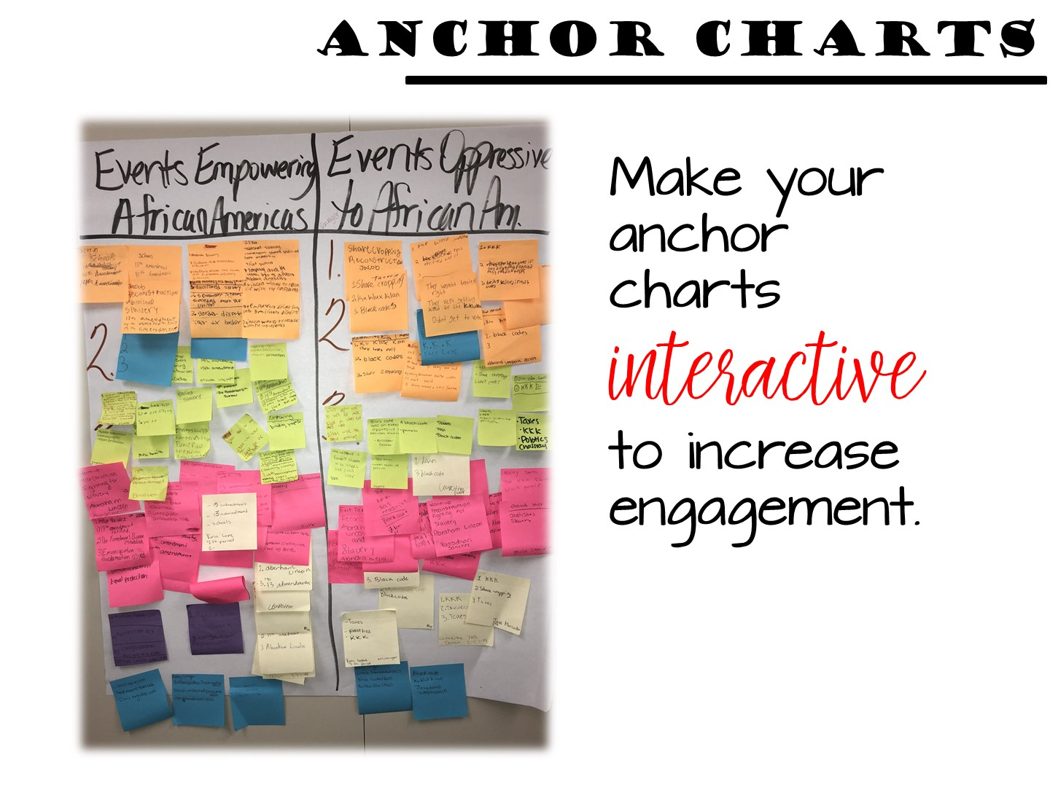
Notes:
Anchor charts do not have to just be posters in your classroom. In fact, I highly recommend against that. In order for anchor charts to become a part of episodic memory, students must interact with anchor charts. There are a variety of ways to do that.

Slide 35
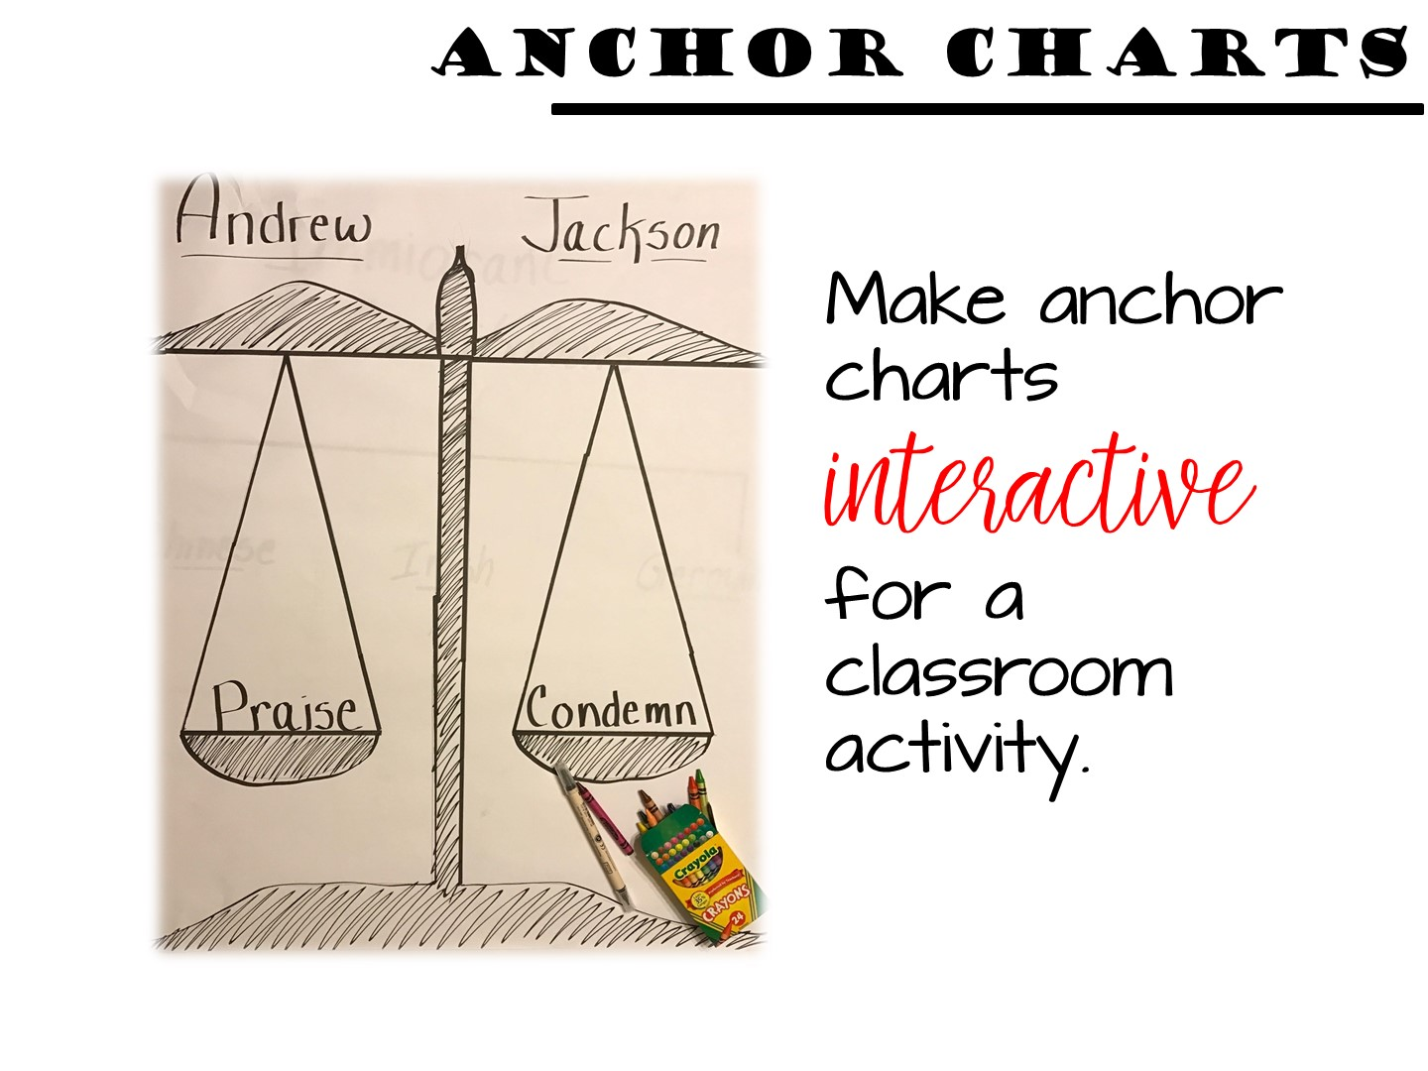
Notes:
Anchor charts can be used as part of a classroom activity. Let’s take a look at the unit on Andrew Jackson. Many teachers use this unit for a point of view lesson. Was Andrew Jackson a hero or a villain? Anchor charts can be used to explore that essential question.

Slide 36
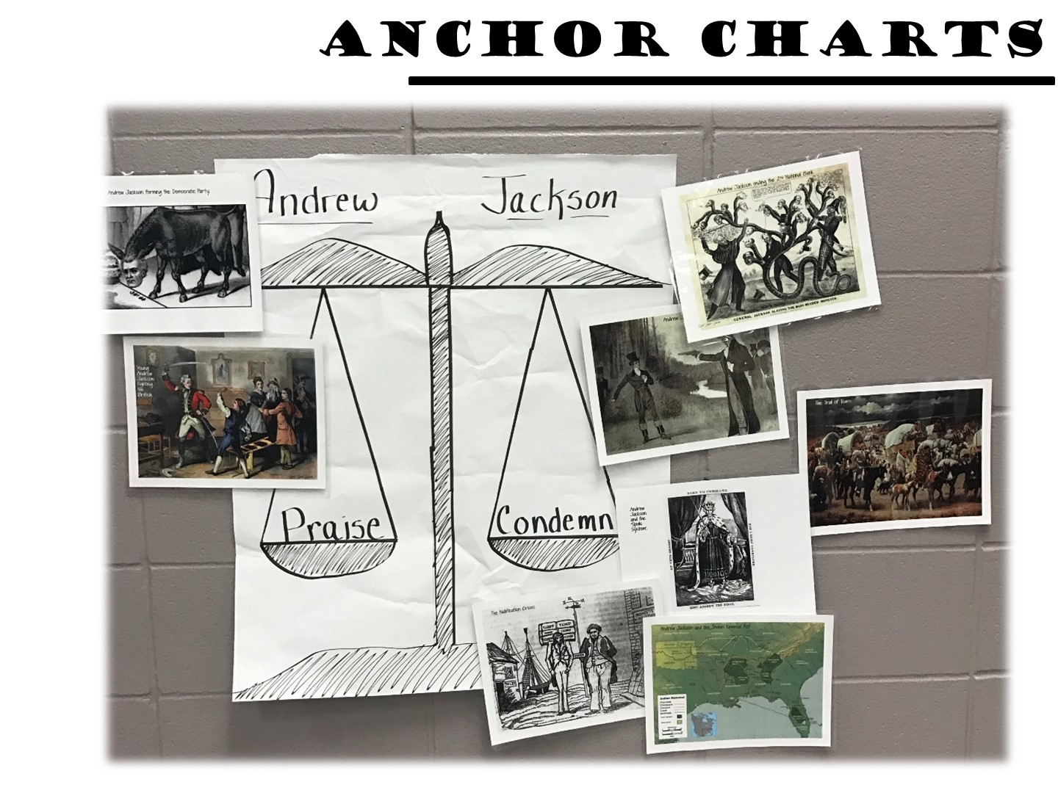
Notes:
Use an anchor chart to evaluate the events that occurred during his presidency. Should Andrew Jackson be praised or condemned for his actions during each of these events? As students post images on the anchor chart, it can help them develop and defend their ideas. The visual element of using pictures as the content can also help cement the learning.
Students refer to the charts and use them as tools as they answer questions, expand ideas, or contribute to discussions and problem-solving in class.

Slide 37
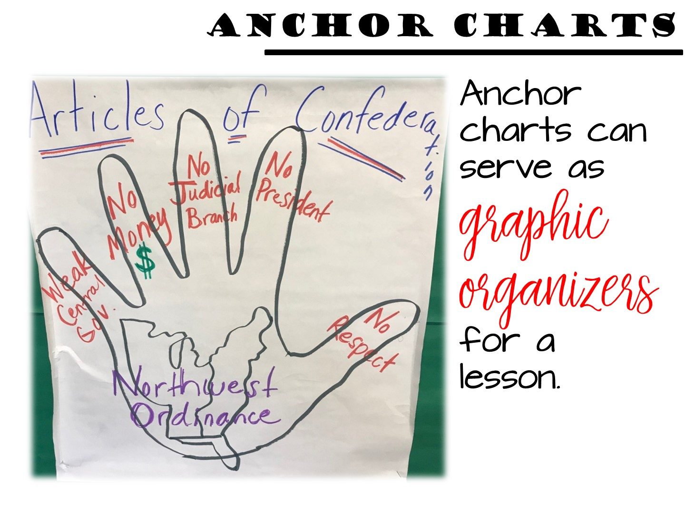
Notes:
Do you have a visual that you always use for a lesson? You can turn that into an anchor chart.

Slide 38
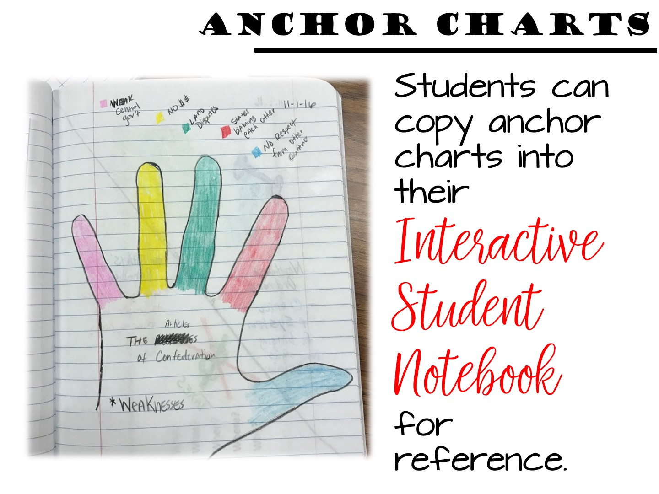
Notes:
Require your students to copy important anchor charts into their interactive student notebook for reference.

Slide 39
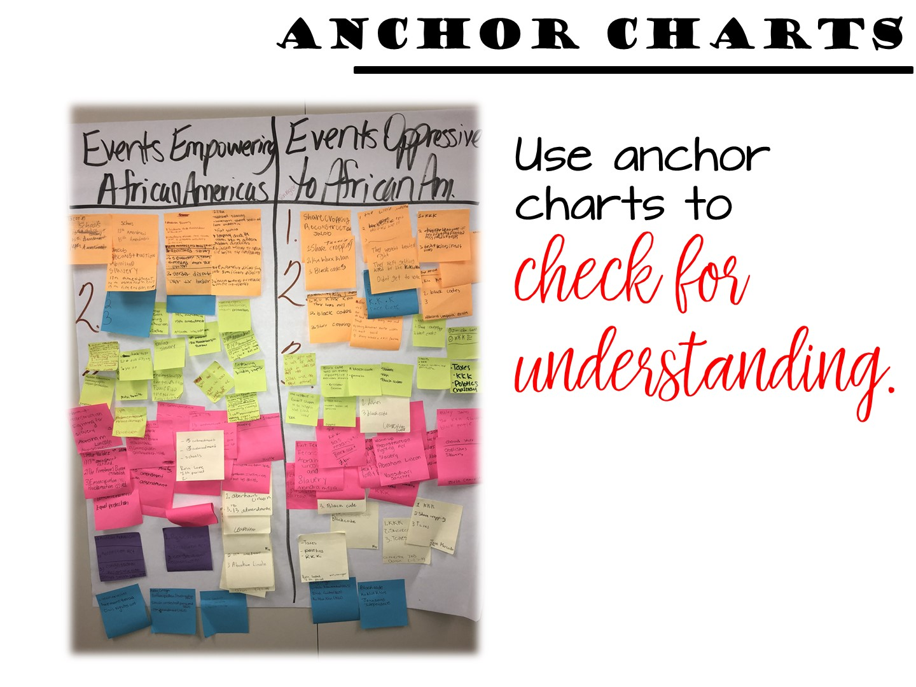
Notes:
Create a simple anchor chart to use as part of your instruction cycle. Anchor charts can be used at the end of a lesson or unit to check for understanding. Did your kids understand the key content or concepts? Anchor charts like these increase engagement and help students check their own understanding as well.

Slide 40
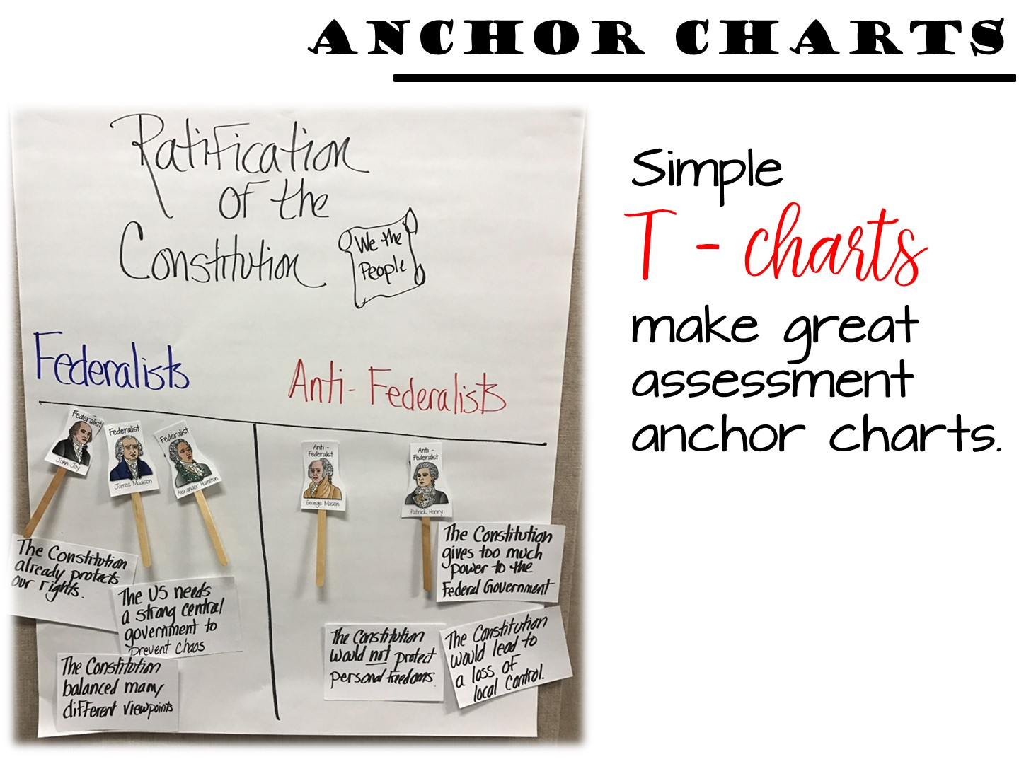
Notes:
You can turn almost anything into an interactive anchor chart.

Slide 41
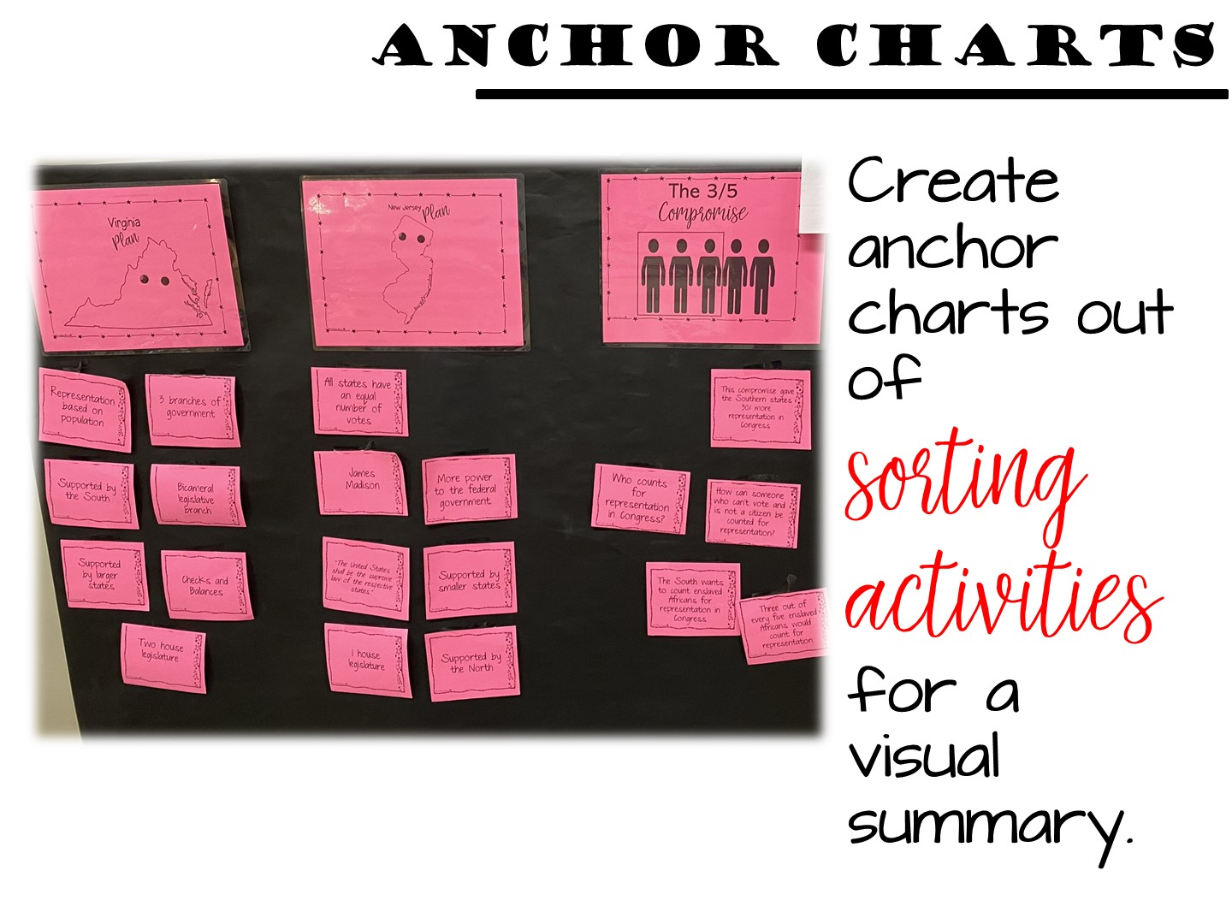
Notes:
Anchor charts can also be made after a formative assessment using the game you just played!

Slide 42
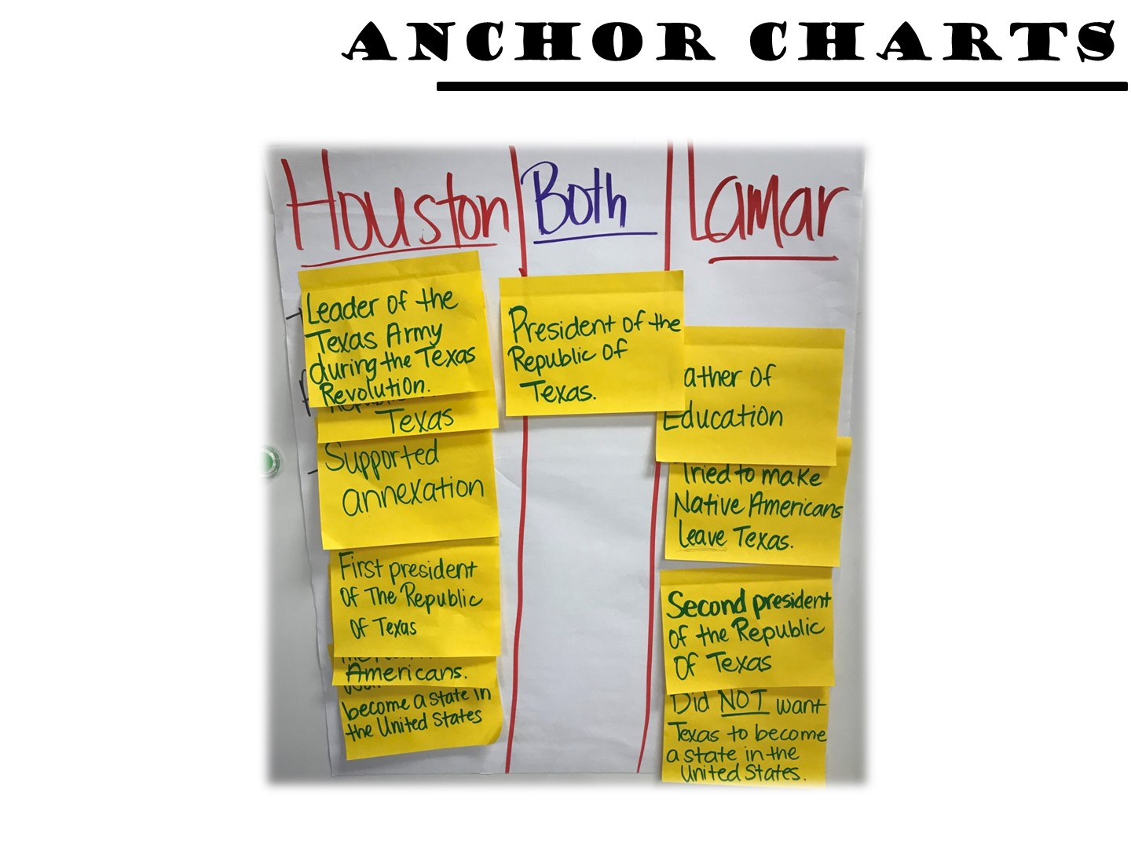
Notes:
Students can use anchor charts to compare ideas or people. Give students a simple post it note with key content and allow them to create categories of the information.

Slide 43
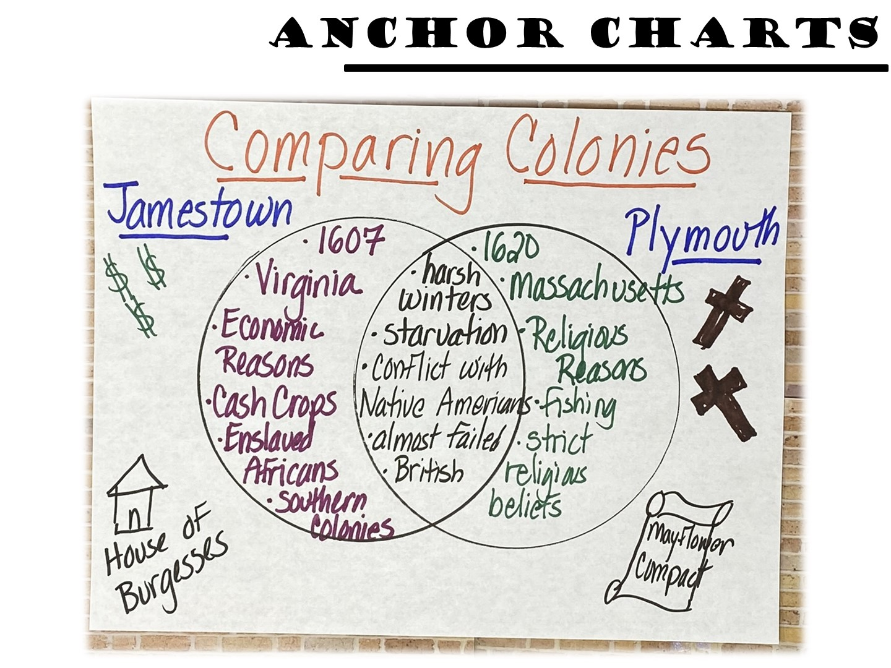
Notes:
Once categories of content have been created, you can make a simple anchor charts summarizing the student’s information.

Slide 44
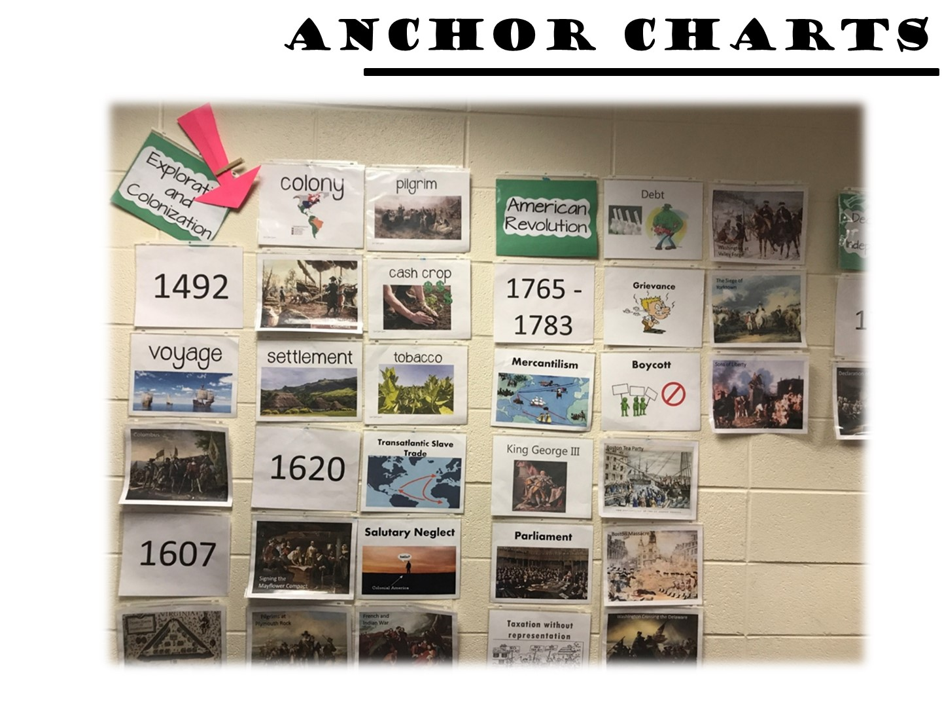
Notes:
You can also create informal anchor charts to help teach the eras of your course. I love the way the arrow helps students visualize where they are in history.

Slide 45

Notes:
Turn and Talk

Slide 46
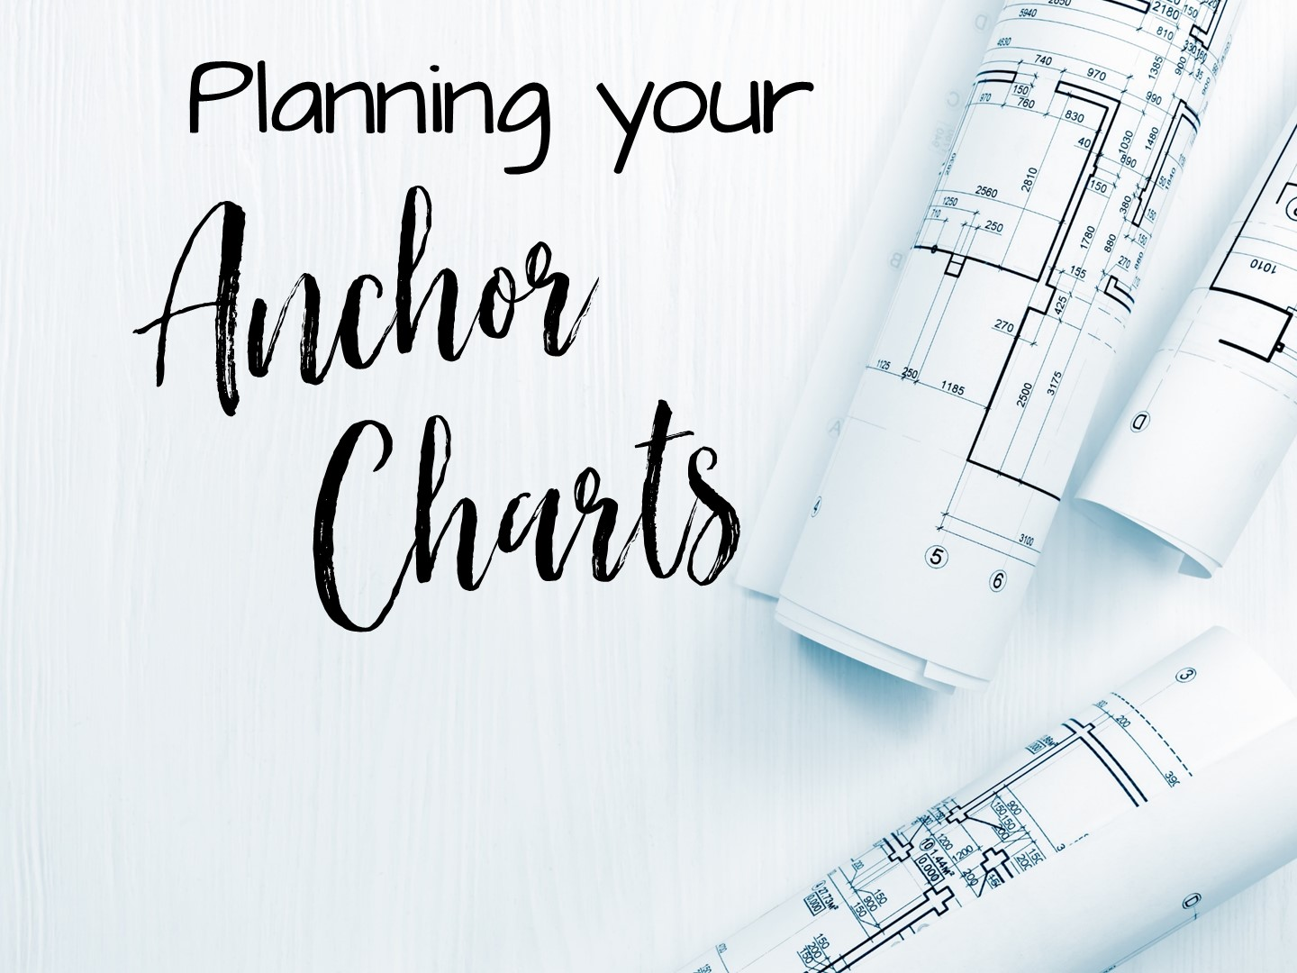
Notes:
Let’s talk about planning your anchor charts.

Slide 47
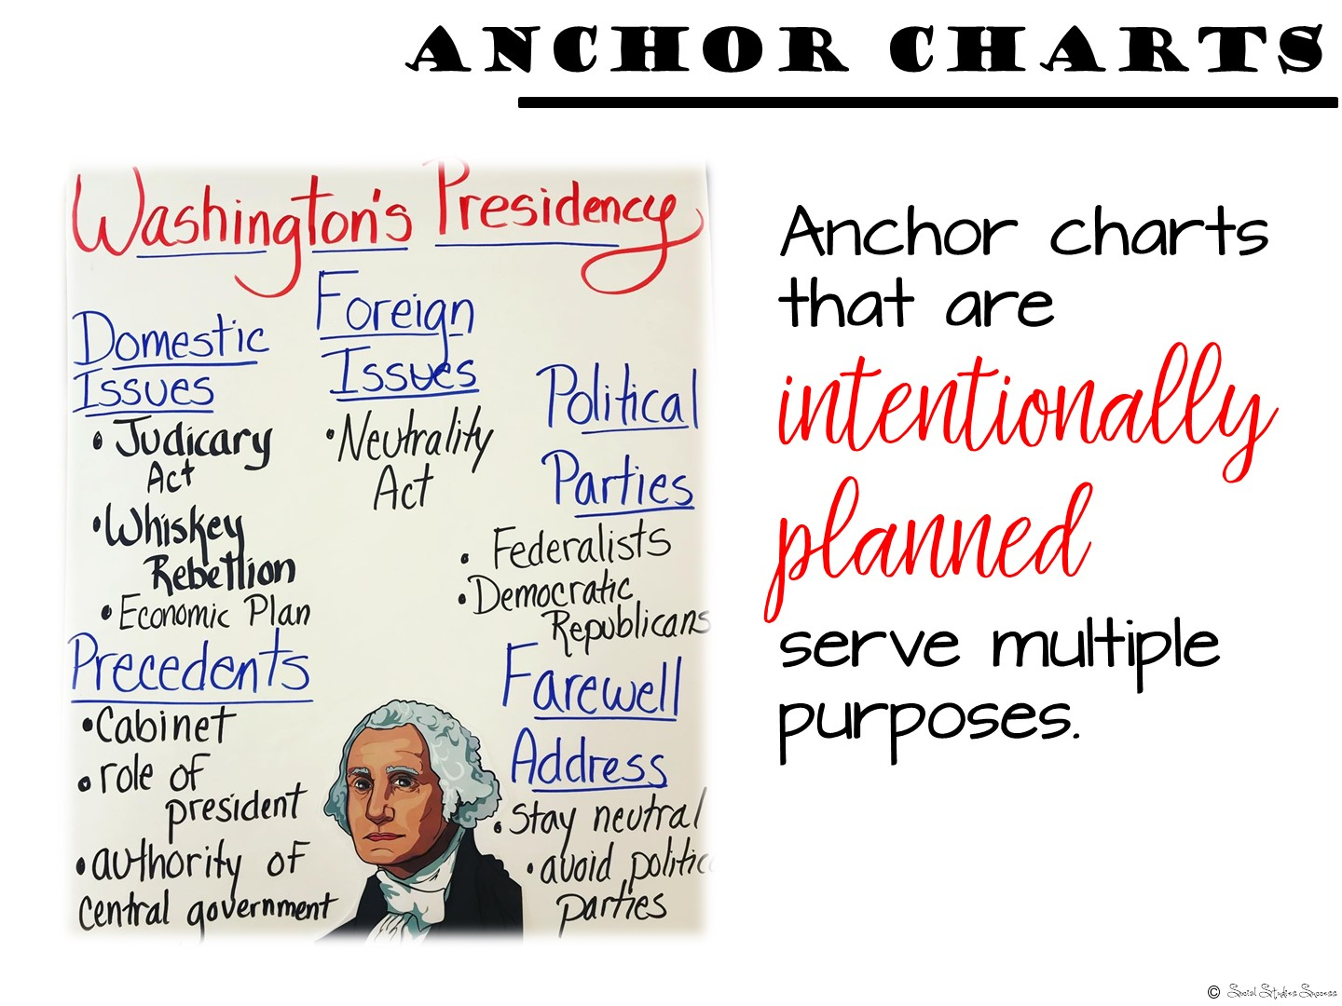
Notes:
Anchor charts work best when they are planned in advance to provide a visual summary for students. In fact, anchor charts can even help in your planning process. When you plan a unit, think of the key content you want your students to walk away with. What is so essential, so important, that you want your students to know it next week, at the end of the year, and into adulthood? Create an anchor chart on that!

Slide 48
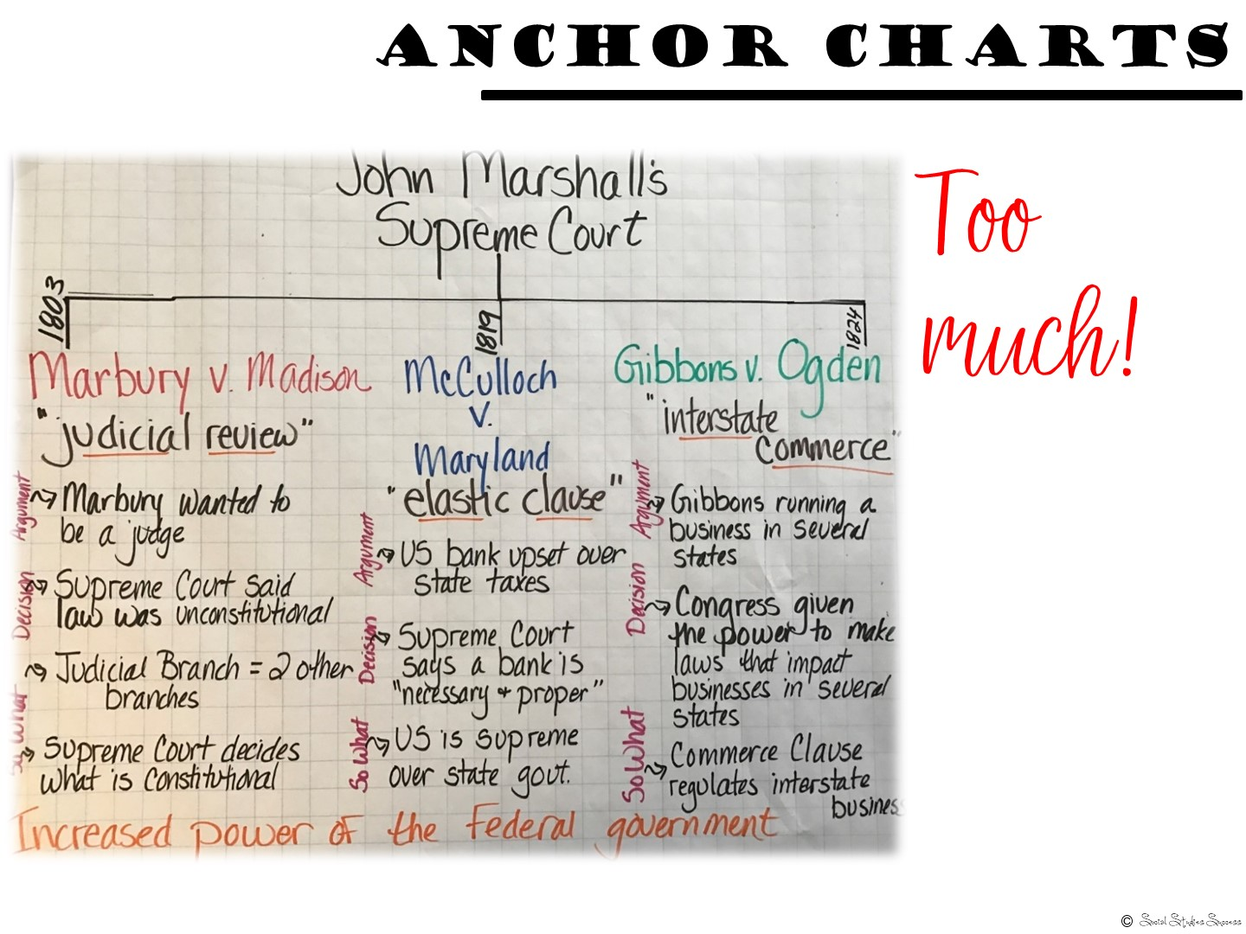
Notes:
Talk with your team about the important content you want to include in your unit. Discuss ways you can visually represent the content. Sketch a few ideas, some will work and some won’t. For example, when I first started making anchor charts, I tried to include ABSOLUTELY EVERYTHING into an anchor chart. This is not a visual summary, it is almost a textbook! Students will have a hard time visualizing this in their heads!

Slide 49
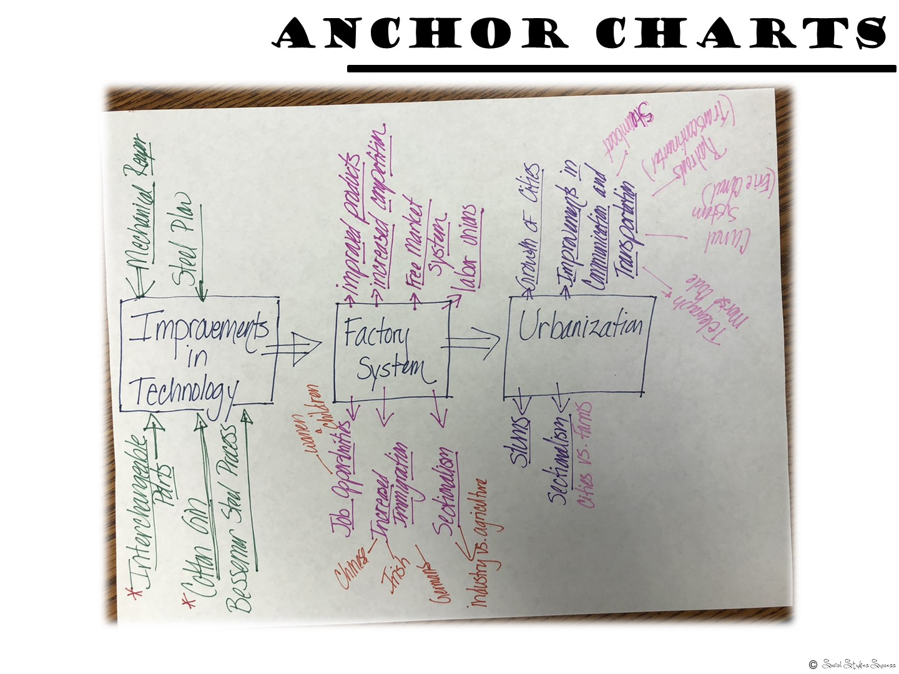
Notes:
Here are a few more examples to explain what I mean when I talked about planning out an anchor chart. In this image, you can see all of the ideas I wanted to incorporate into my anchor chart on the Industrial Revolution.

Slide 50
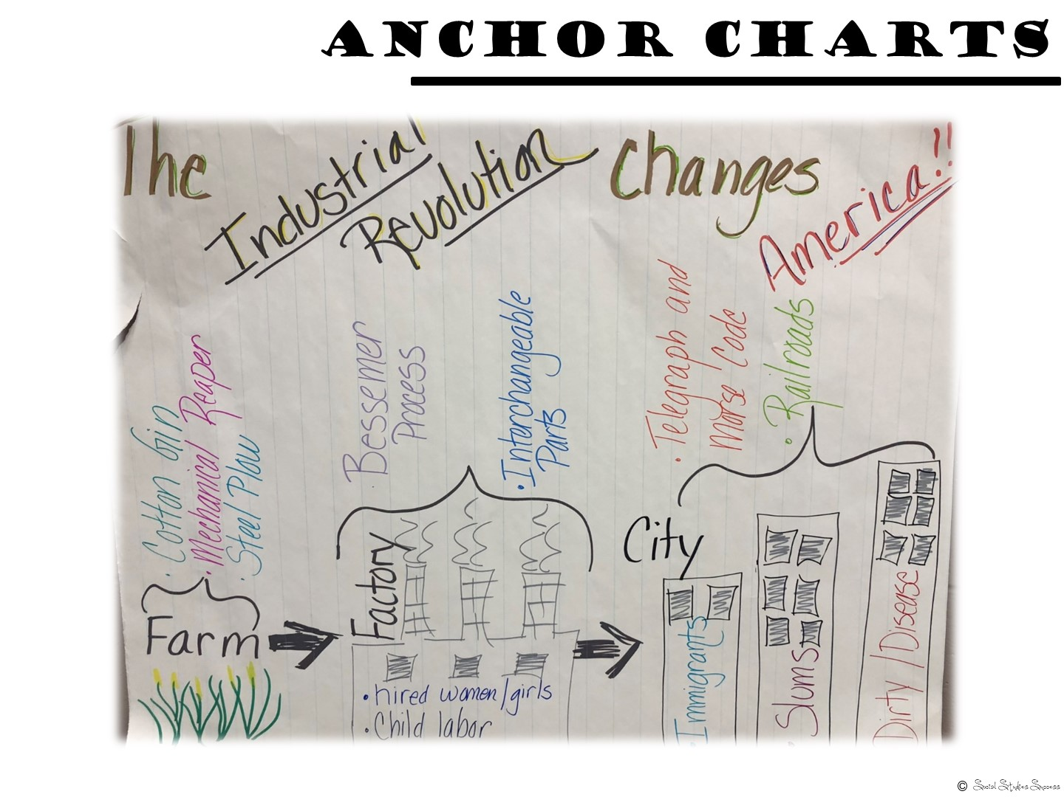
Notes:
And here is the completed process – it has more of a visual element to the organization of information.

Slide 51
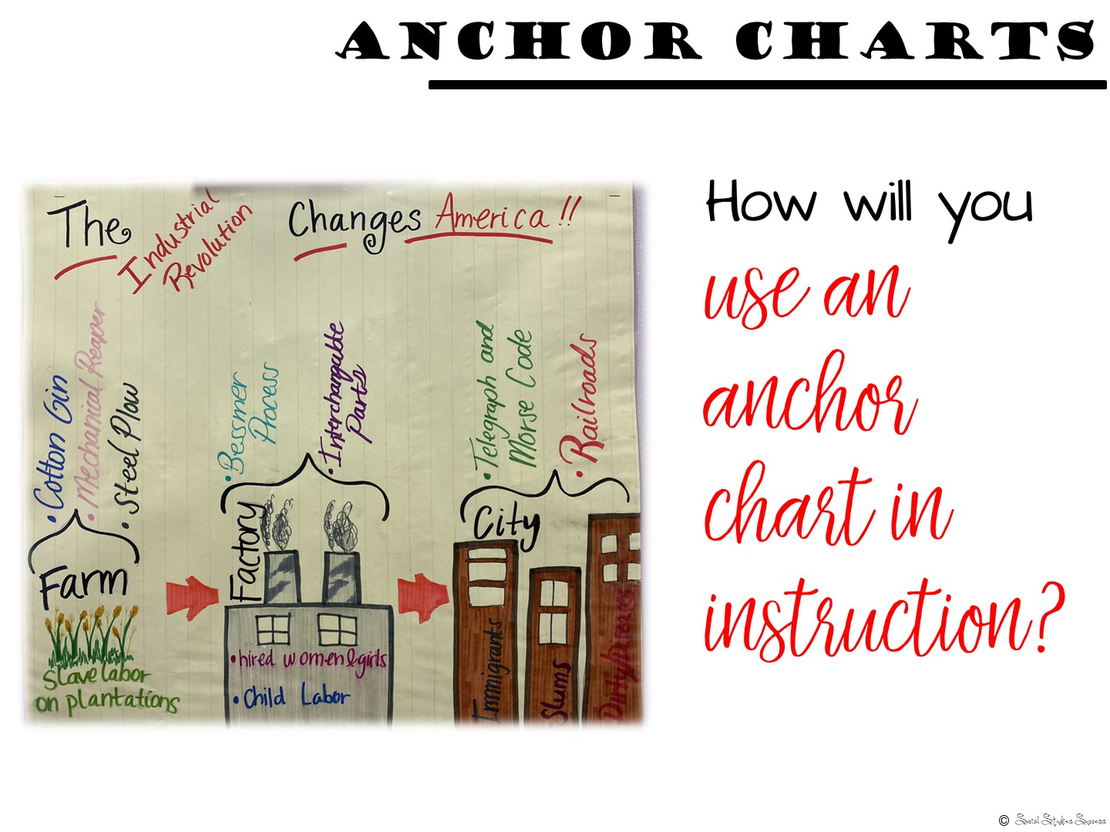
Notes:
Once you develop those ideas into your anchor chart, discuss how you would plan instruction around it. An anchor chart is not just another poster to decorate your room, so how will you use it in your instruction? Will it serve as a word bank? Concept chart? Formative assessment? Will students copy it into their notebook? Play games with it?
Plan for the different ways you can reinforce your key content throughout the unit with your anchor chart.

Slide 52
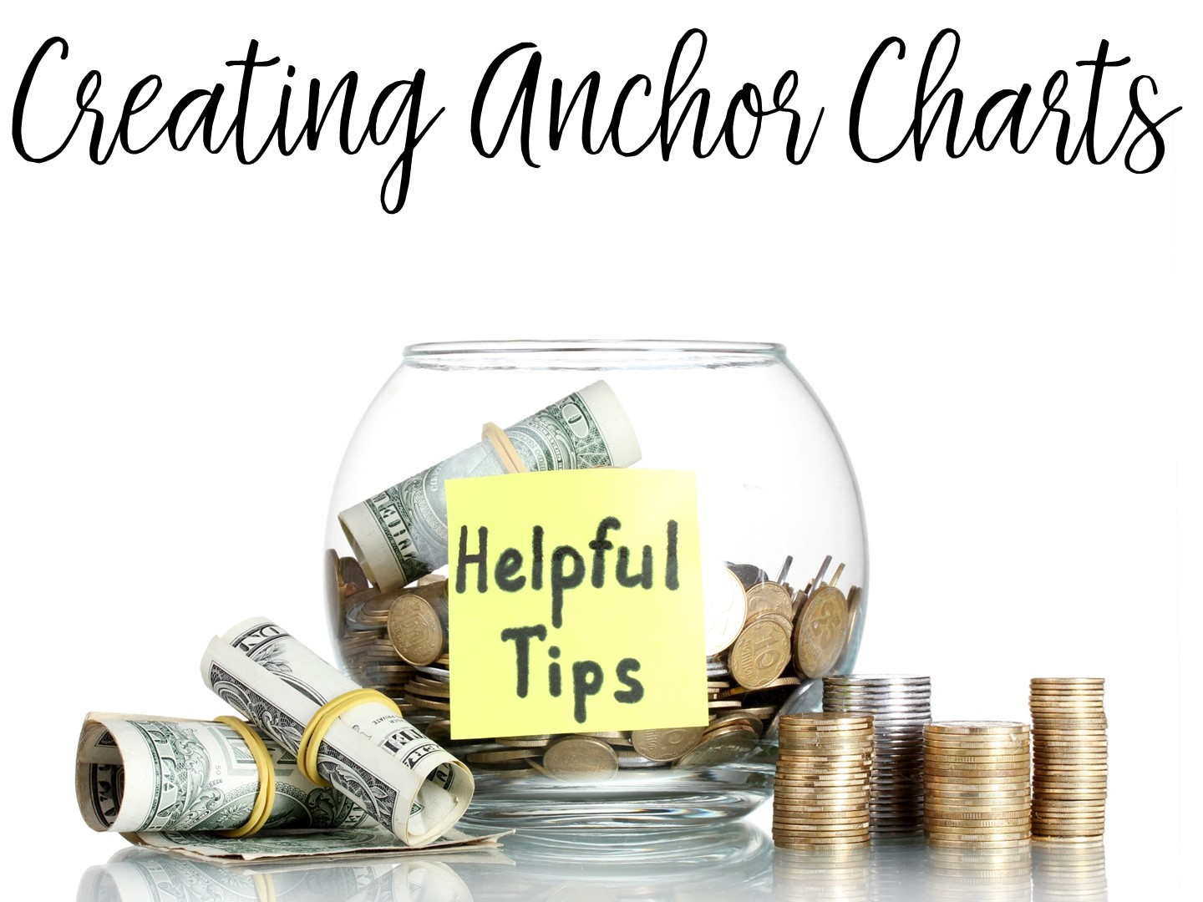
Notes:
Let’s take a look at some helpful tips for creating anchor charts.

Slide 53
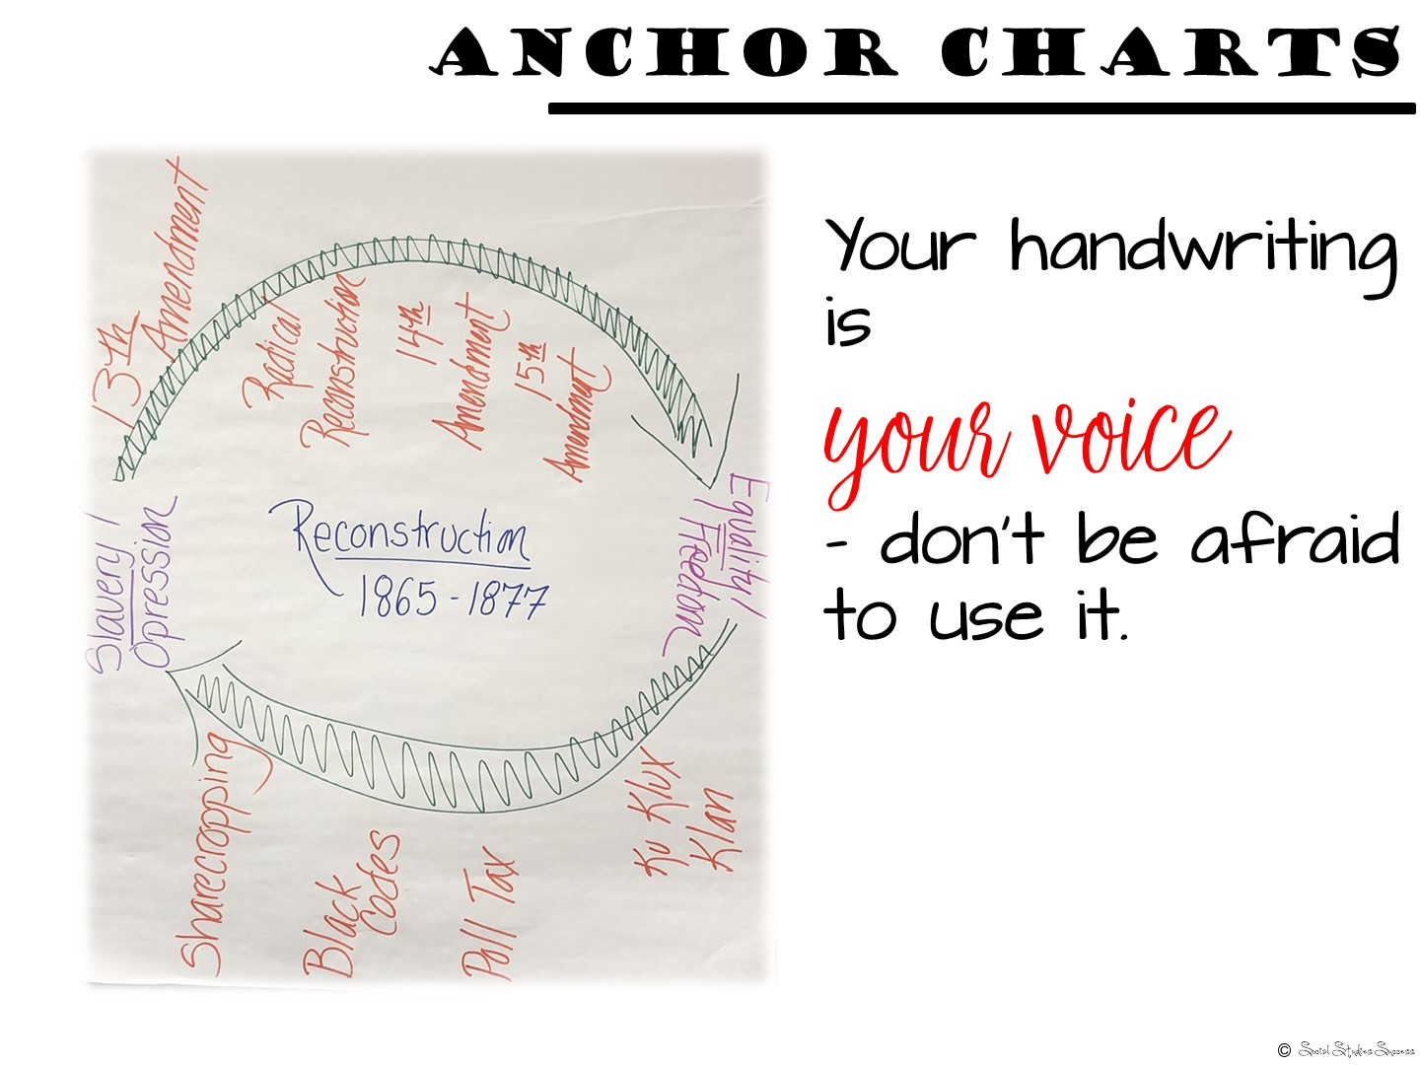
Notes:
Your handwriting is your voice and is important – you train kids all year long to pay attention to your handwriting – what is written on the board, what is written on their papers - be sure to use your own handwriting when creating anchor charts. It is tempting to have students or other teachers make your anchor chart for you – but if you do, you are missing out on a connection with your students. They know what you say is important, it might not have the same effect in another person’s handwriting.

Slide 54
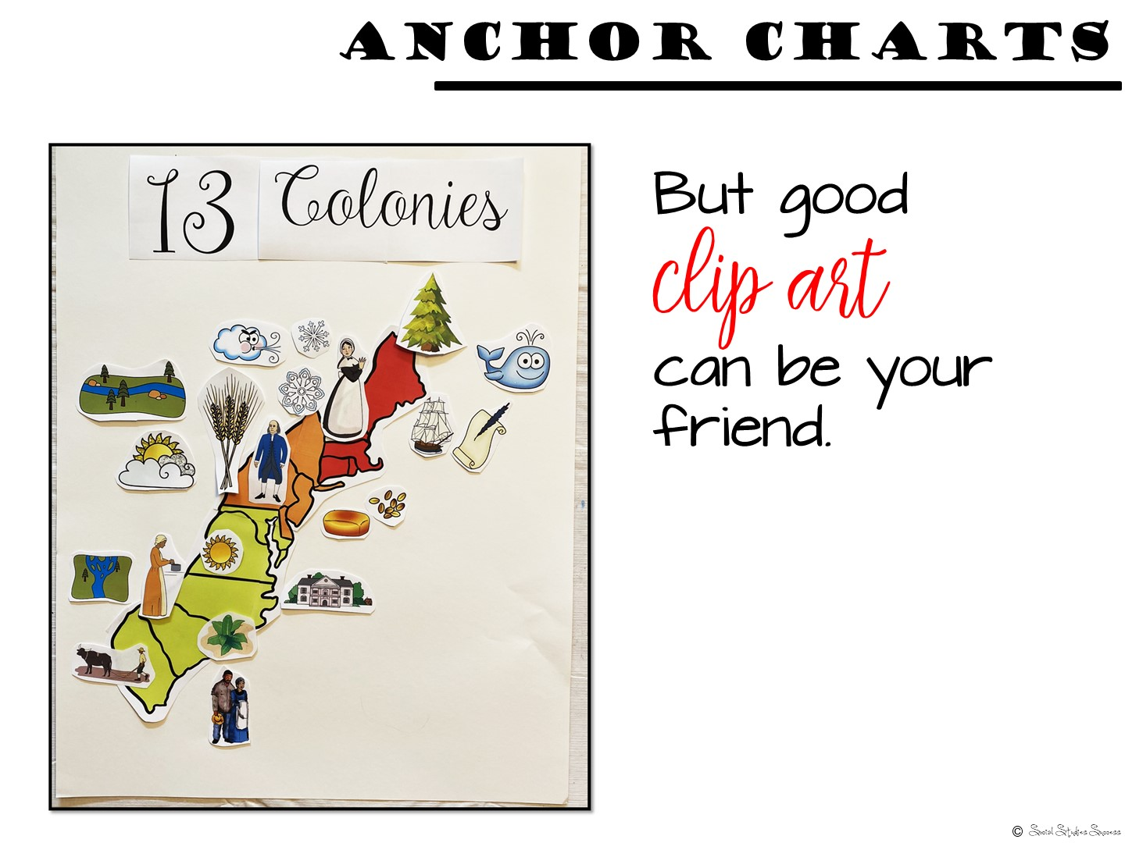
Notes:
With that being said, there is nothing wrong with some good clip art or images to help the visual aspect of your anchor chart.

Slide 55

Notes:
The supplies that you use for your anchor charts is obvious – markers, crayons, highlighters, but here are another few options that can make a difference when you are creating anchor charts.
A good calligraphy pen – I love the way it makes my handwriting look elegant (or at least better!)

Slide 56
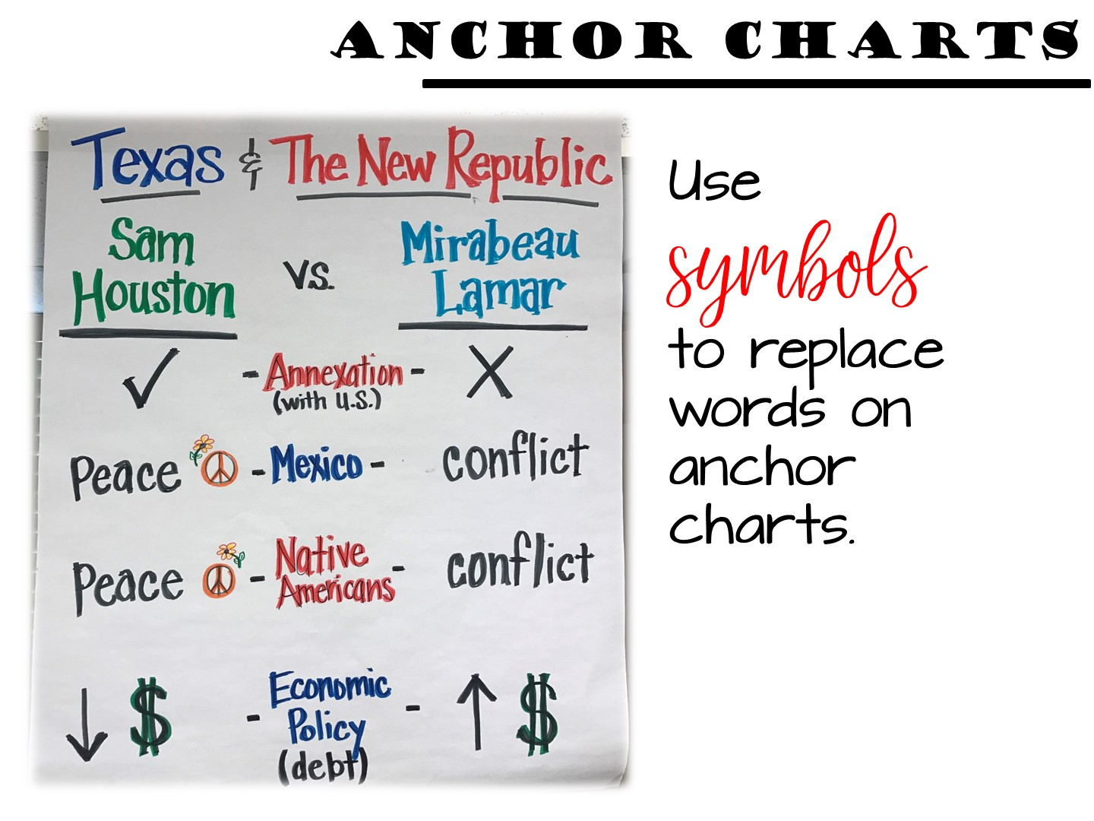
Notes:
Symbols are essential for a visual summary. They can be “read” quickly and help convey meaning. How are you going to incorporate different symbols into your anchor chart?

Slide 57
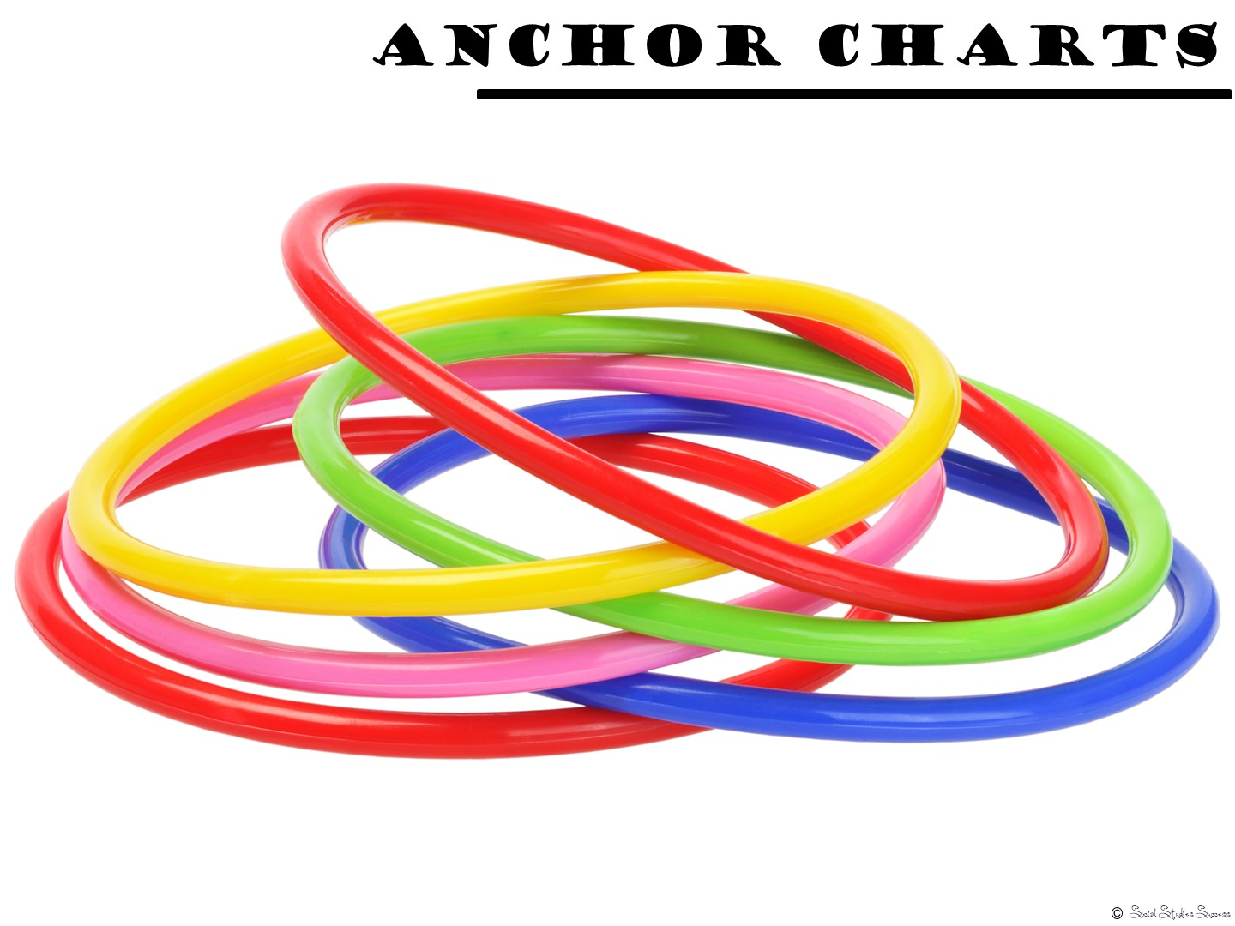
Notes:
Grab a pair of cheap hula hoops at the Dollar Store – these are great for making Venn Diagrams on chart paper.

Slide 58
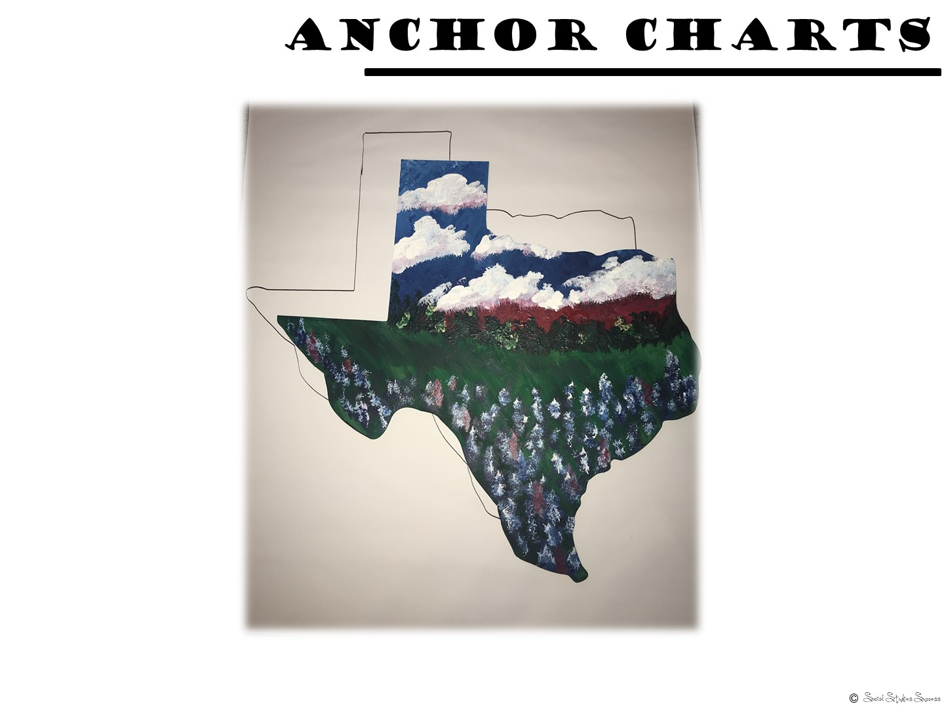
Notes:
Are you going to use one shape over and over and over again? See if you can make or purchase a hard template to trace. I decorated this Texas at a painting event, but I love it even more when I discovered I can use it for anchor charts. Consider doing the same for the shape of the United States. Project a map onto the wall, trace it onto tag board and then cut it out. You now have a template to use for the rest of the year.

Slide 59
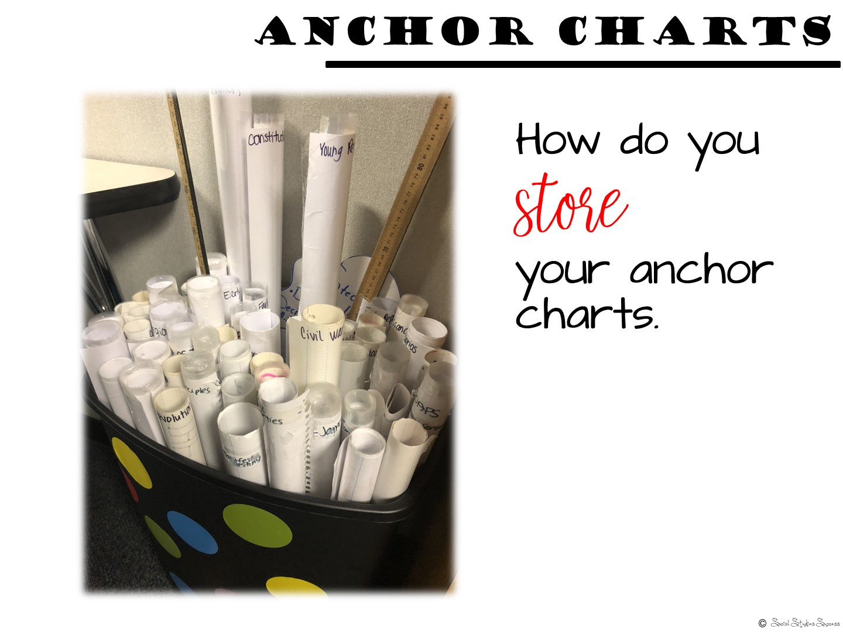
Notes:
How do you store your anchor charts is always a question I get. You could laminate them, roll them up tight, write on the end what the title is and store them in a large trash size container. Or you can hang your anchor charts on pant hangers.

Slide 60
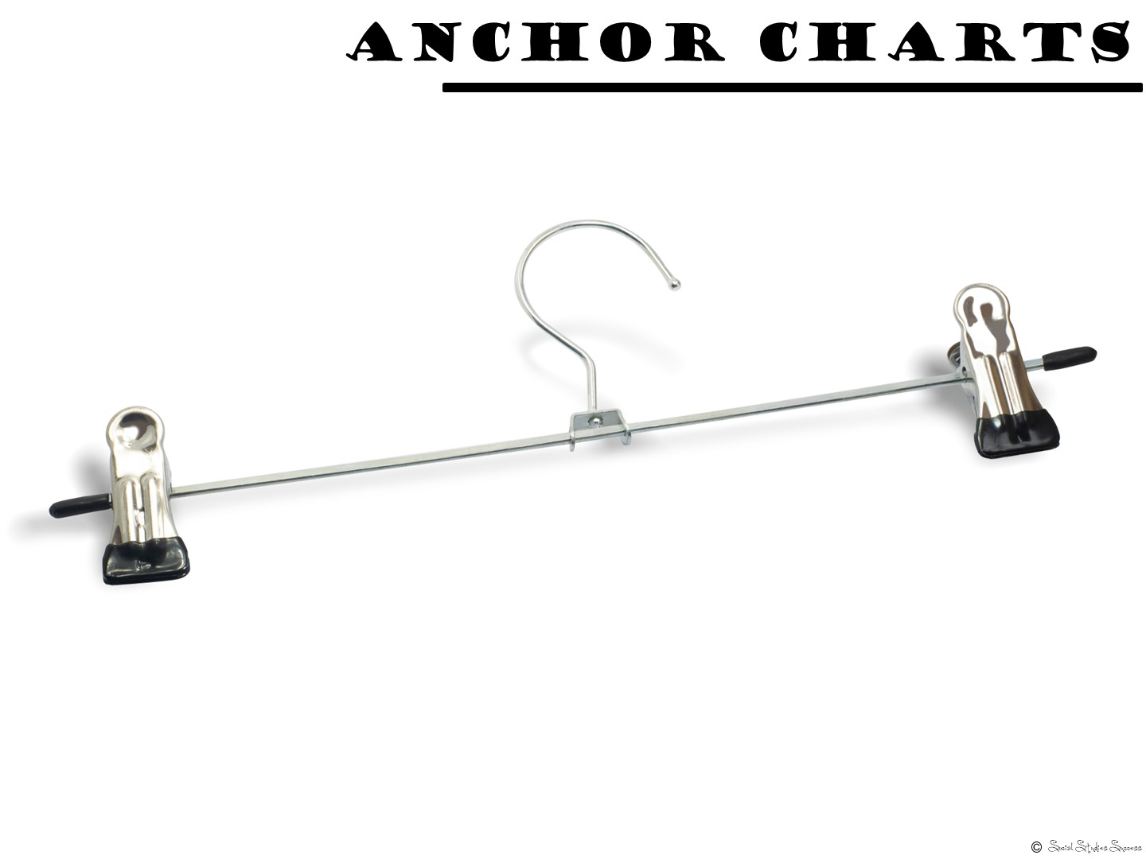
Notes:
Or you can hang your anchor charts on pant hangers.

Slide 61
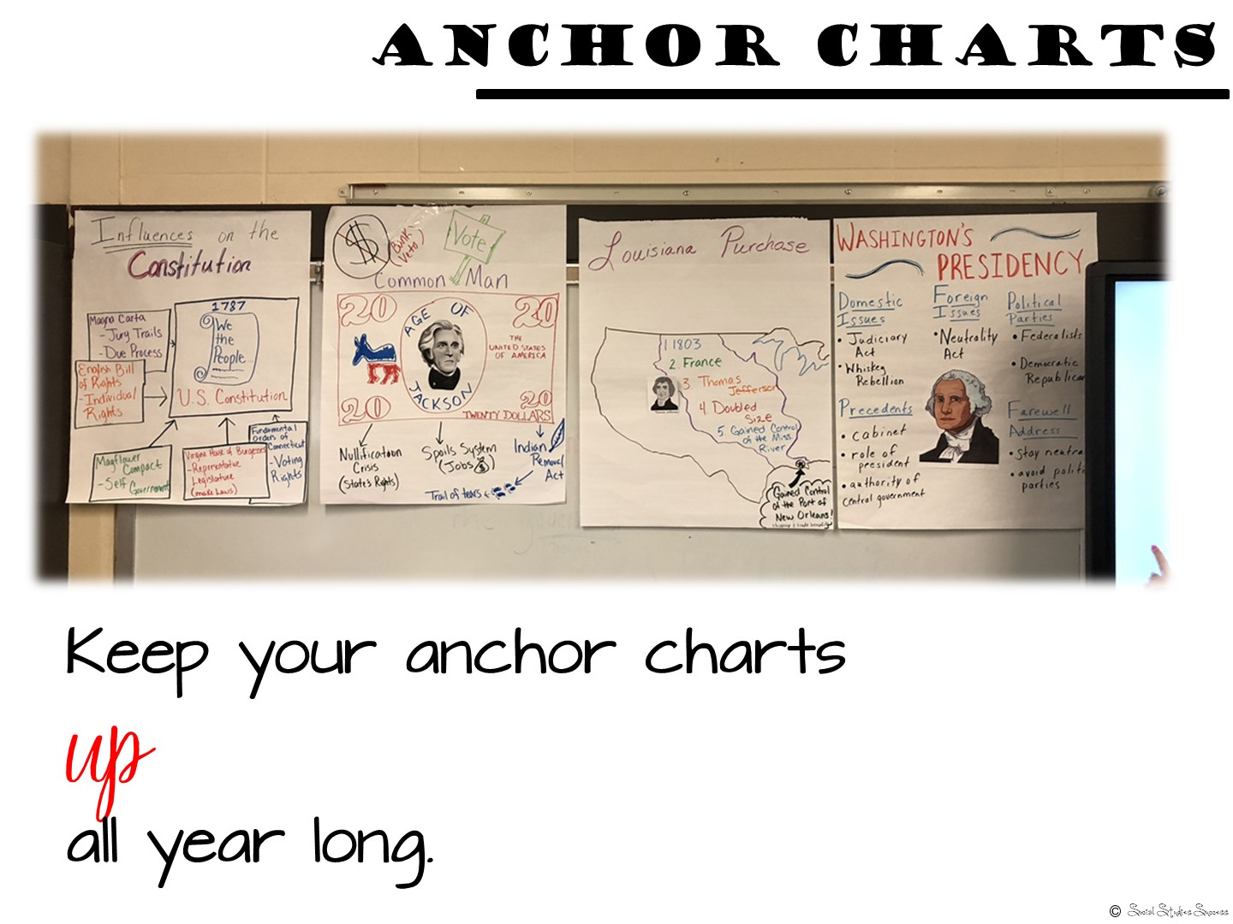
Notes:
And keep up as many as you can as long as they are relevant.

Slide 62
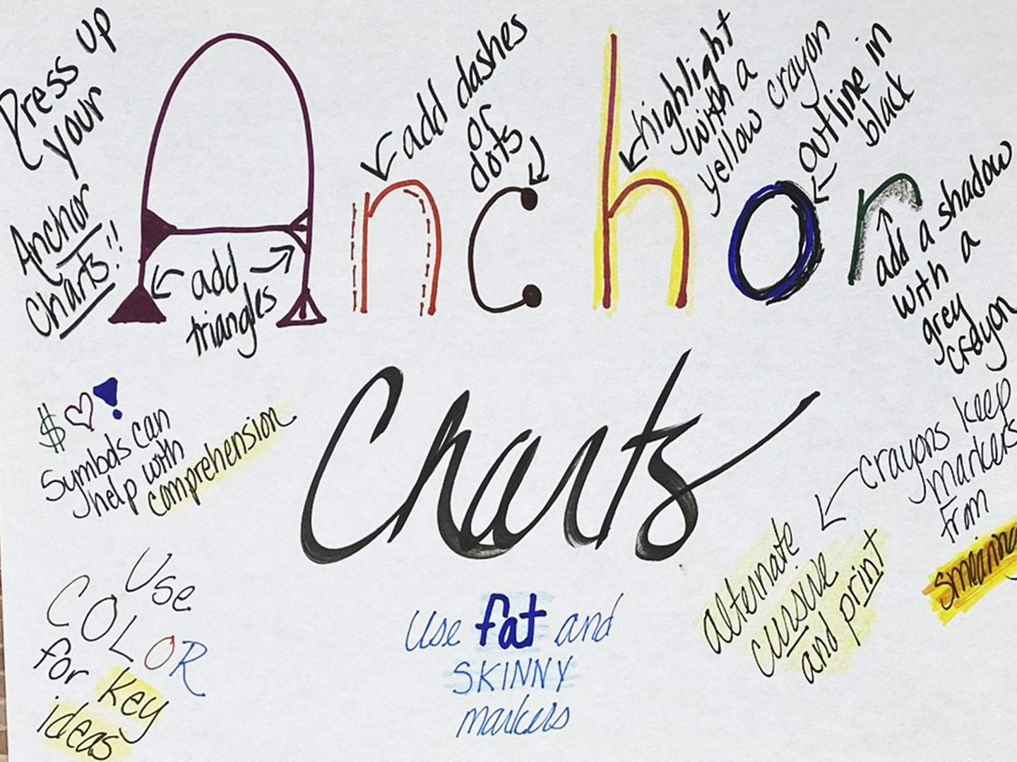
Notes:
There are several different ways you can make your anchor charts “fancy”. Take a look at this image to see some of your different options.

Slide 63
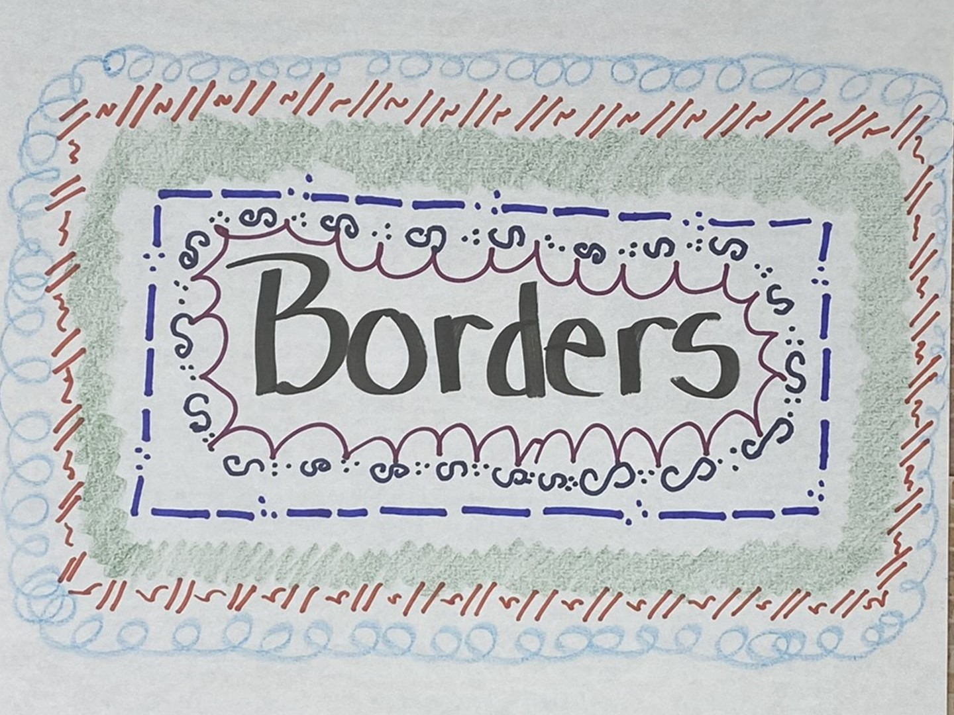
Notes:
You can also add different types of borders for emphasis. Dots and dashes, S’s and Dots, slashes, curly cues and even just crayons can make nice borders.

Slide 64
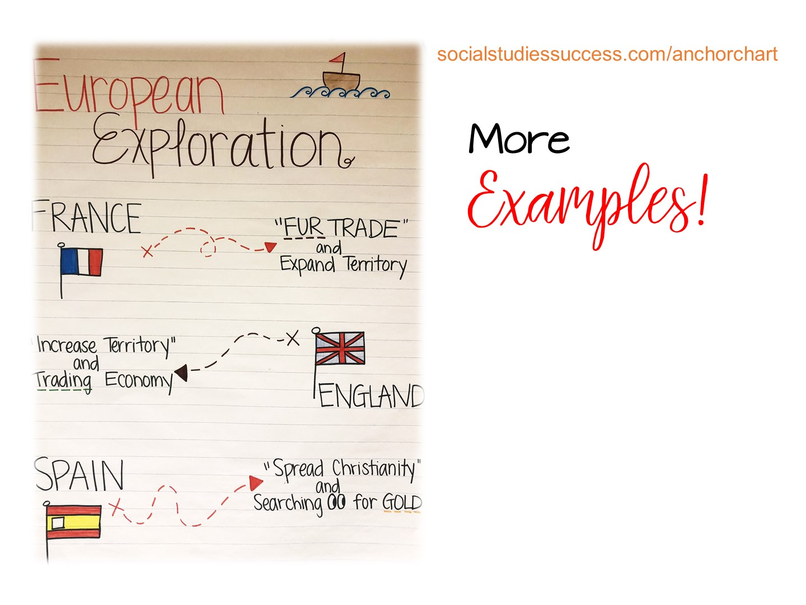
Notes:
They can either type in this link on their phone or use the manuals I have provided.

Slide 65

Notes:
Provide markers and chart paper to the teachers and give them the rest of the session to make an anchor chart.

Slide 66


Slide 67
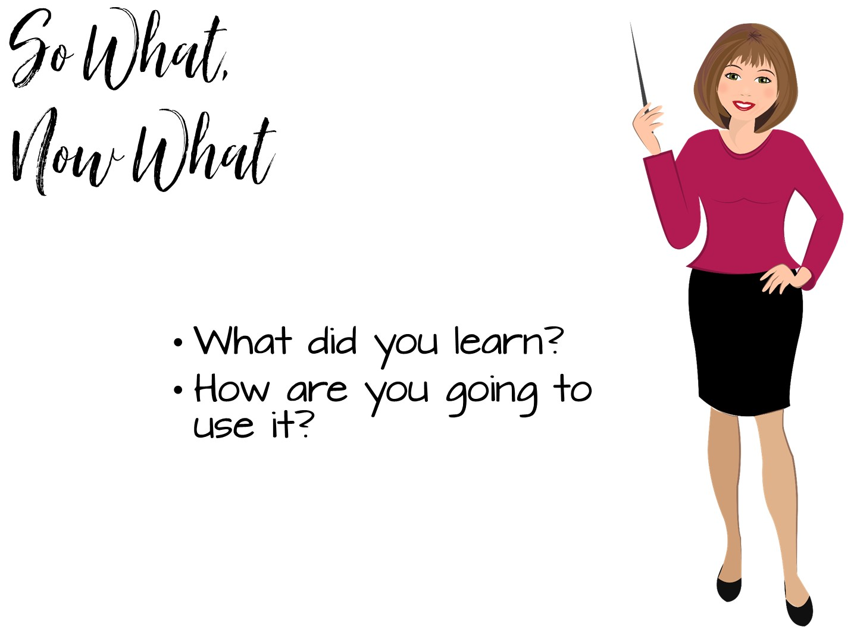

Slide 68


