Slide 1

Notes:
Post any of the Word Wall sets I sent you
Handouts: Tips for Vocabulary
Choice Board
Vocabulary Pyramid
Hands
Bumper Word Template
Charades Plus Cards and sets

Slide 2


Slide 3


Slide 4

Notes:
First we must start with the research. There are multiple books and articles written on how to teach vocabulary – but here are the key parts…

Slide 5
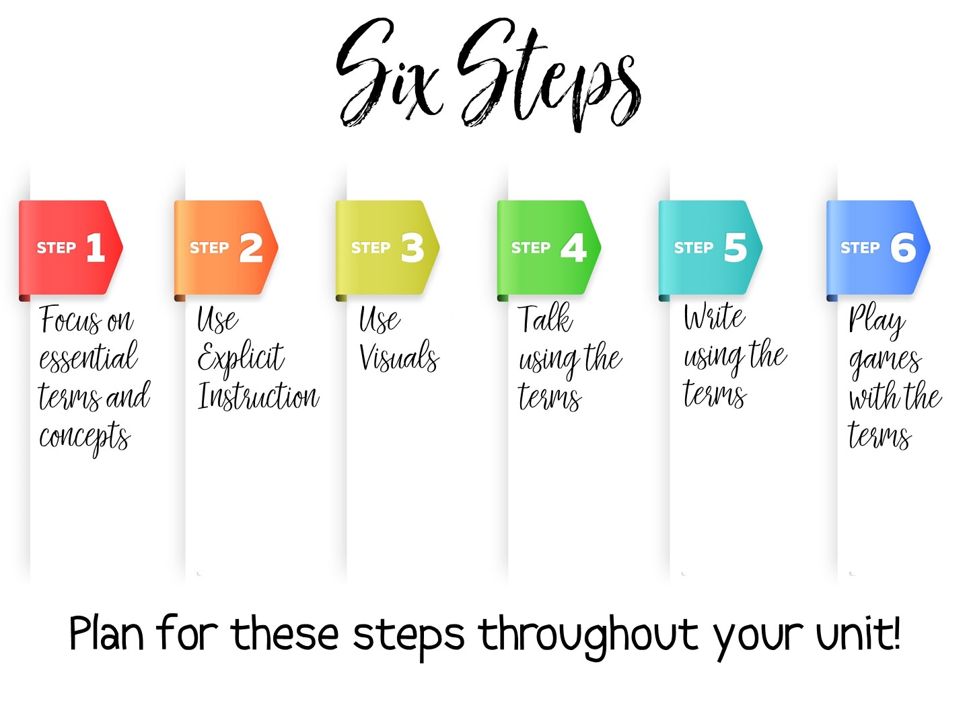
Notes:
I have taken the research and created my own 6 steps for practical vocabulary instruction. We will examine each of these steps in this workshop. Steps one and two need to be done in order, but the rest of the steps can be done at any point in the unit.
Some key points to remember:
Vocabulary instruction must be intentional, not just the initial instruction on the definition of the term, but included deliberately in subsequent lesson plans throughout the unit.
Vocabulary must be taught directly – students need to see the term, hear the term, and say the term in order to build their understanding of key content vocabulary.
Students need to encounter the vocabulary term in a meaningful way at least six times throughout the unit before it can be understood and applied.
One of the best ways for students to learn vocabulary is to associate an image with the term.
Students must participate in engaging activities for long term retention.

Slide 6
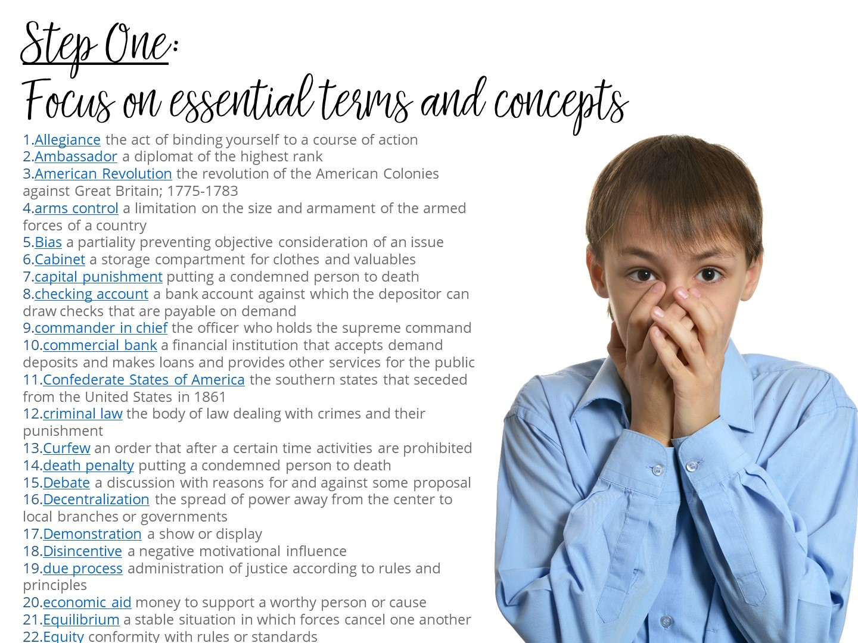
Notes:
Step One actually seems obvious – you need to know the terms that you will be teaching. In the discipline of Social Studies there are more than 26,000 terms – more than math, Language Arts, and Science combined. Social Studies vocabulary is actually the vocabulary needed most in college.
But there is actually more to just teaching a list of terms out of the textbook. What are the specific vocabulary terms students will need to master your daily lesson? The unit? You cannot teach too many vocabulary terms in one setting and expect immediate mastery. You need to carefully examine the terms you are given or you find for each unit and decide – is this a term that is essential for this lesson? For this unit? Can this term be introduced and master at a later point? Or does it need mastery now? Is this a term that has already been taught and just needs a refresher? Thougtful planning needs to happen before instruction.

Slide 7

Notes:
Stop the video now and read the handout on Tips for Selecting Vocabulary Terms. When you have finished reading the Tips – jot down 1-2 new learnings or thoughts on your Doodle Notes before you start the video again.

Slide 8
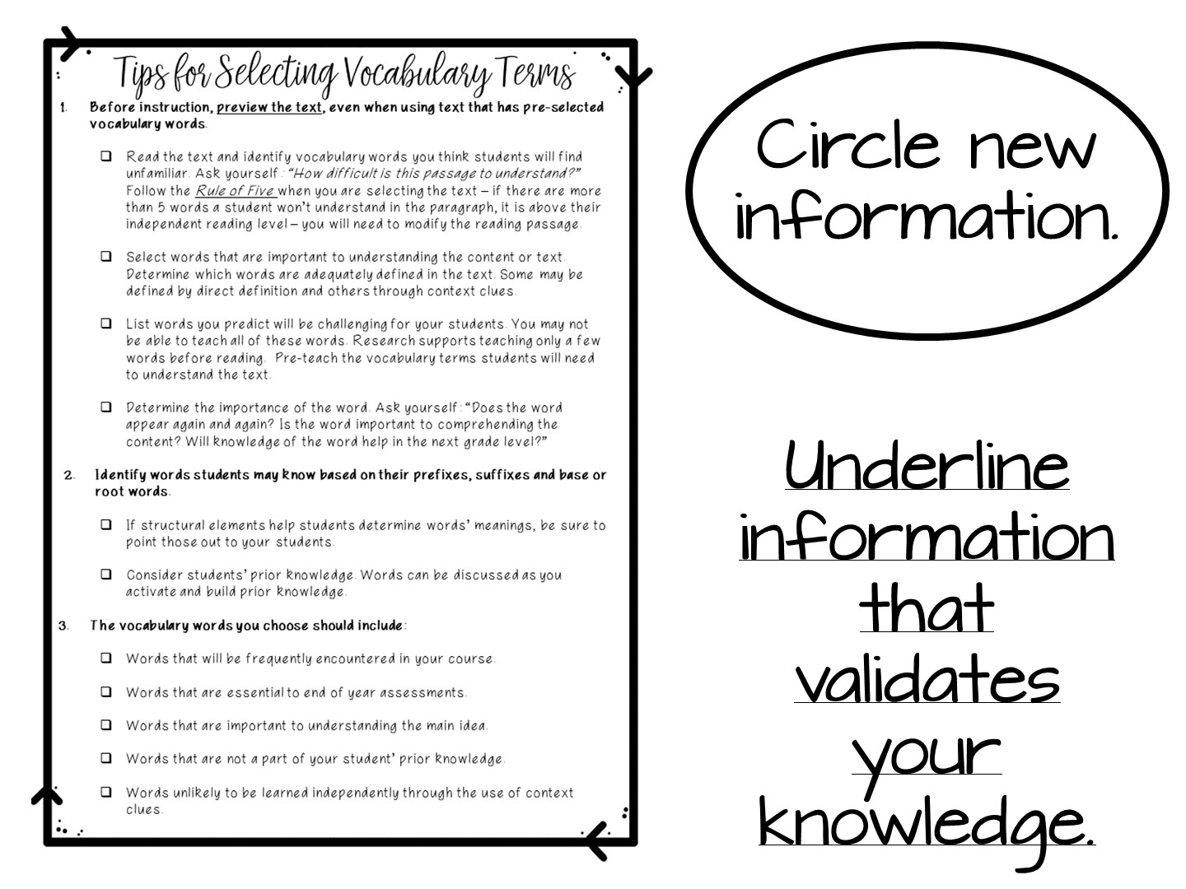

Slide 9
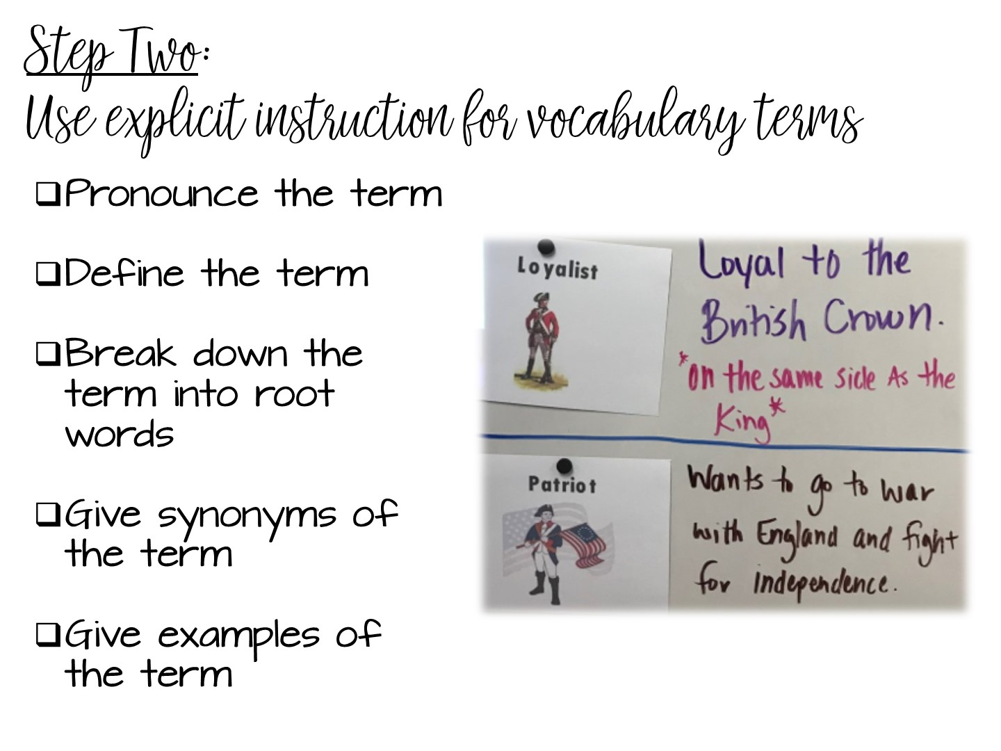
Notes:
Vocabulary instruction is active, it is not a passive activity to fill time. Assigning vocabulary out of the back of the book and having students copy the definition does not work. Just like you would plan for a lesson on teaching content, you need to plan how you will teach vocabulary.
The 2nd step involves explicit instruction. Pronounce the vocabulary terms to your students. Students must hear the word out loud to help build their understanding of the term. Many time students will understand a term more if they hear it first. Think of the term militia – the way it is pronounced and the way it is spelled can be confusing to your students. But if you pronounce the term first, they may already know the word, just not have experienced it in text.
The rest of the vocabulary instruction can differ depending on the term, but these activities are recommended when you are teaching vocabulary.
Define it, or help your students define the term. There is nothing more dangerous than asking kids to just “google” the definition. They will usually just choose the first definition rather than correct one.
Help students make connections to any root terms. This is important for transfer of knowledge – if they understand the root, they can understand the term.
Help students make connections with synonyms – many times, vocabulary on an assessment is actually a synonym of a term they were taught.
And finally, give concrete SOCIAL STUDIES examples of the term.

Slide 10
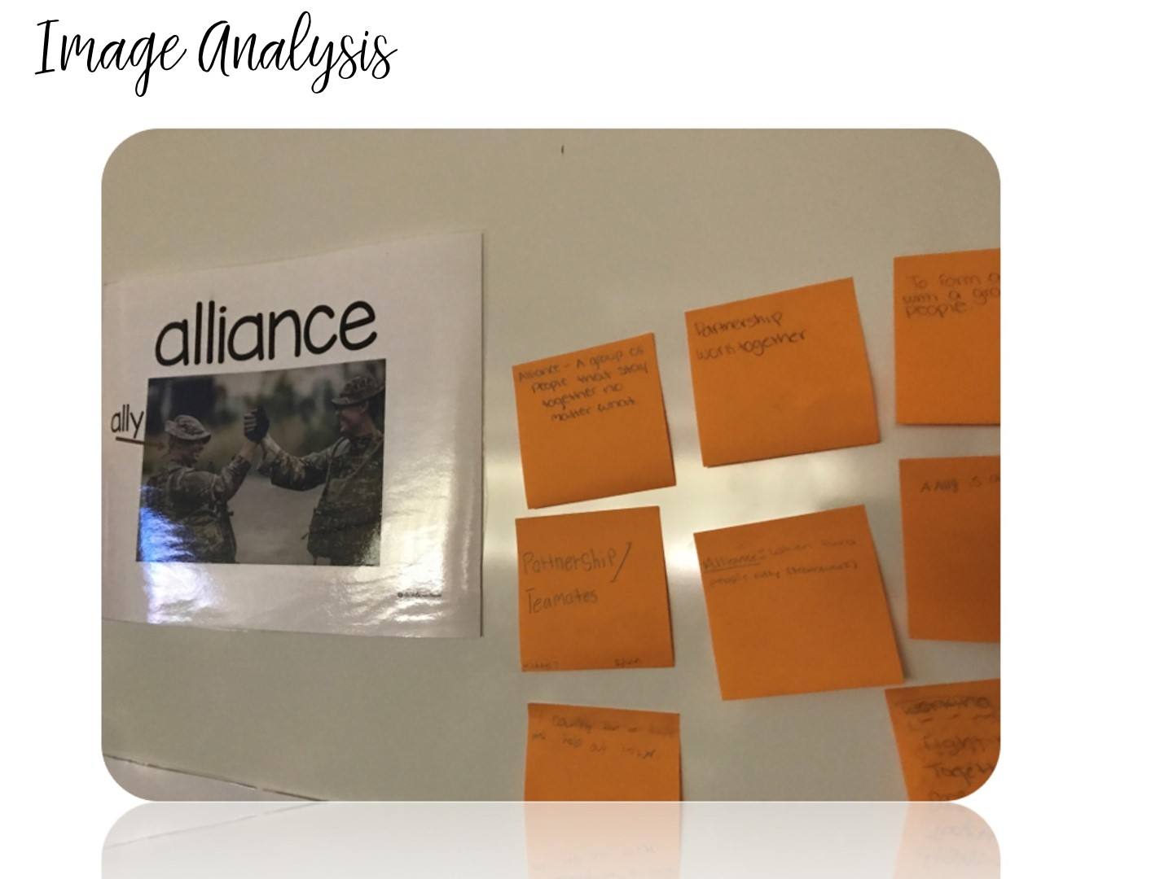
Notes:
Use the Latin America Word Wall. Give each teacher post-it notes. Have them work with a partner to look at the picture and write what they think the definitions are. Share what they have written and generate class definitions. You can also do the following:
Work with a partner to analyze an image
Generate definitions
Make connections with another word or to your personal life
Make sentences

Slide 11
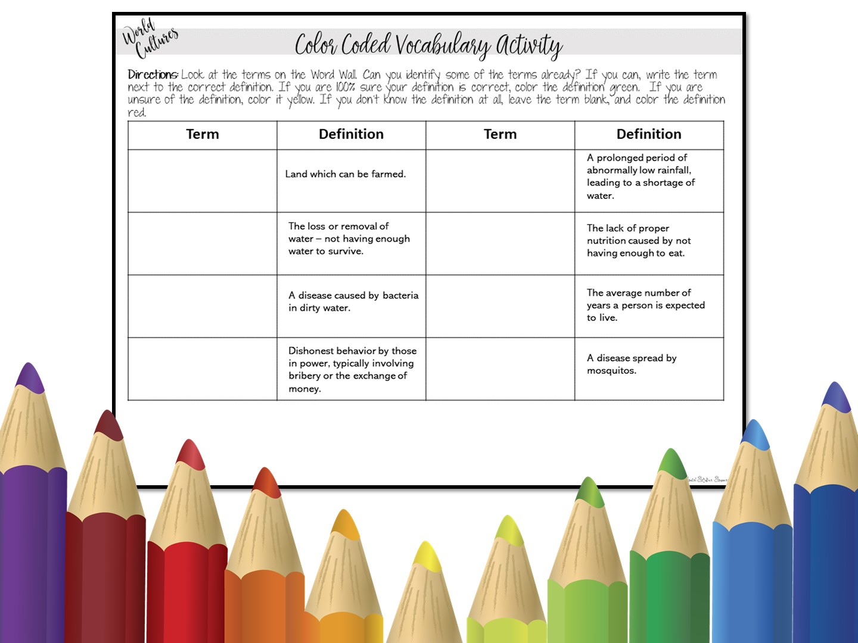
Notes:
Use the Africa word wall terms

Slide 12
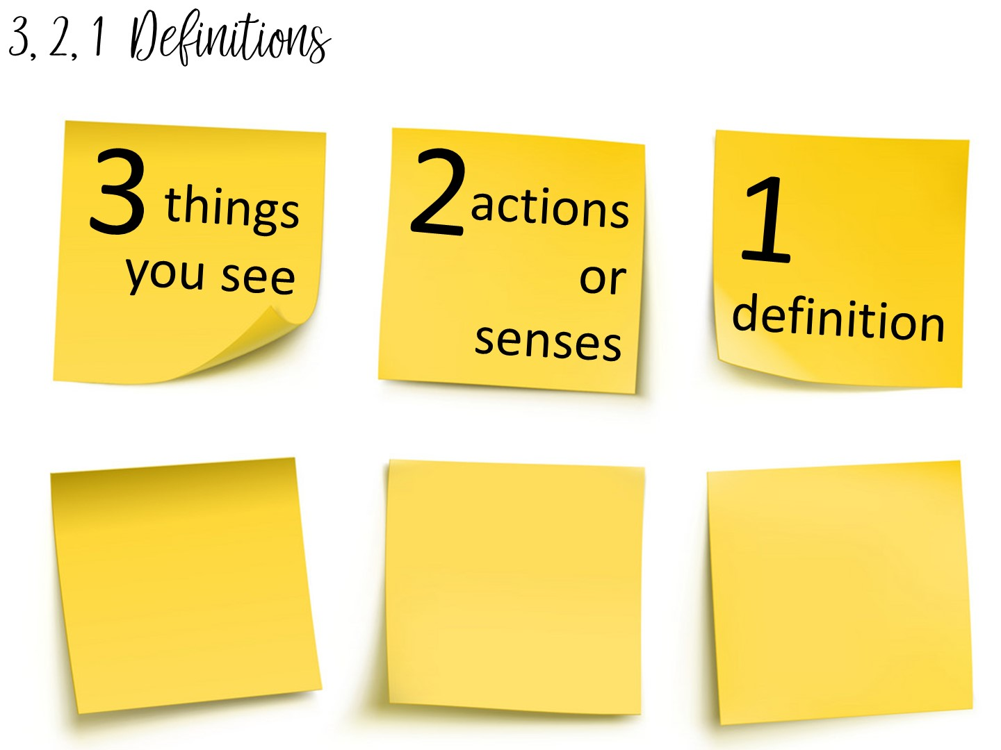
Notes:
Another method to teach vocabulary with images is the 3, 2, 1 Definitions – Allow students time to analyze an image to build their understanding of an image.

Slide 13

Notes:
Take a quick look at this image -

Slide 14
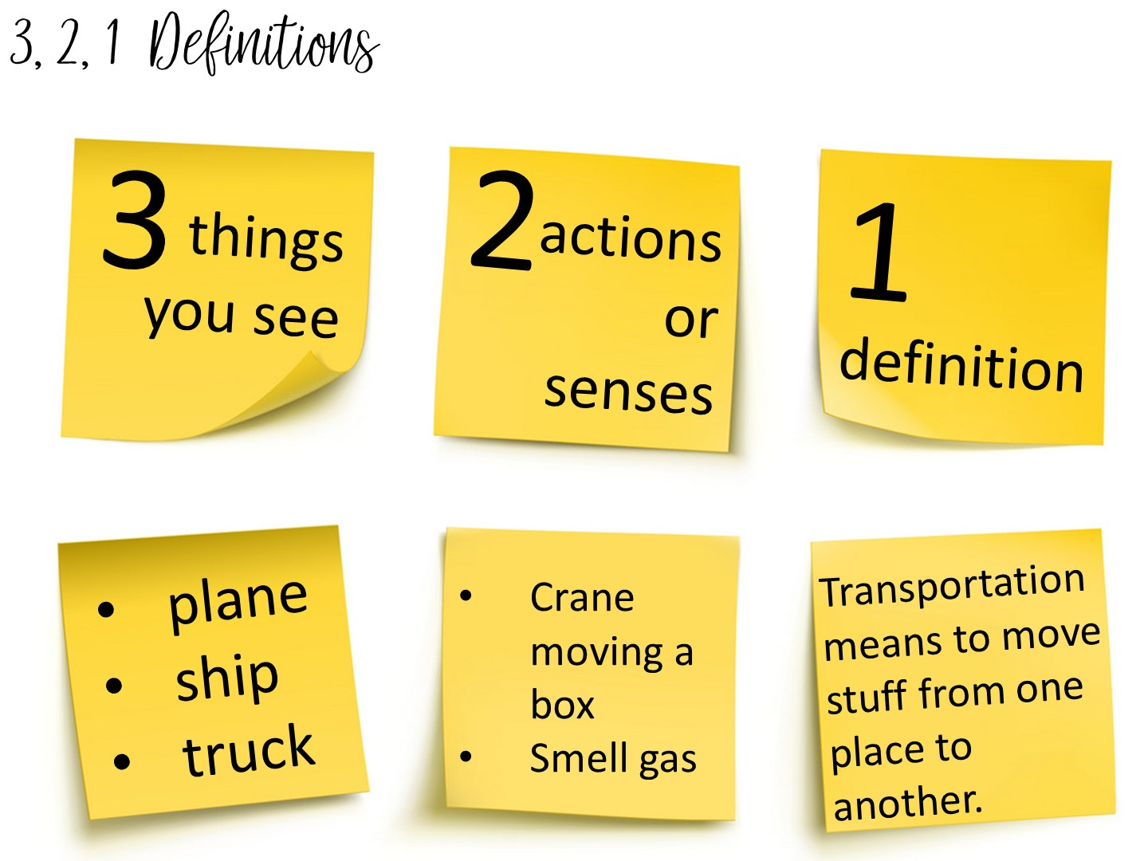
Notes:
Example questions

Slide 15
Notes:
Another method to teach vocabulary with images is the 3, 2, 1 Definitions – Allow students time to analyze an image to build their understanding of an image.

Slide 16
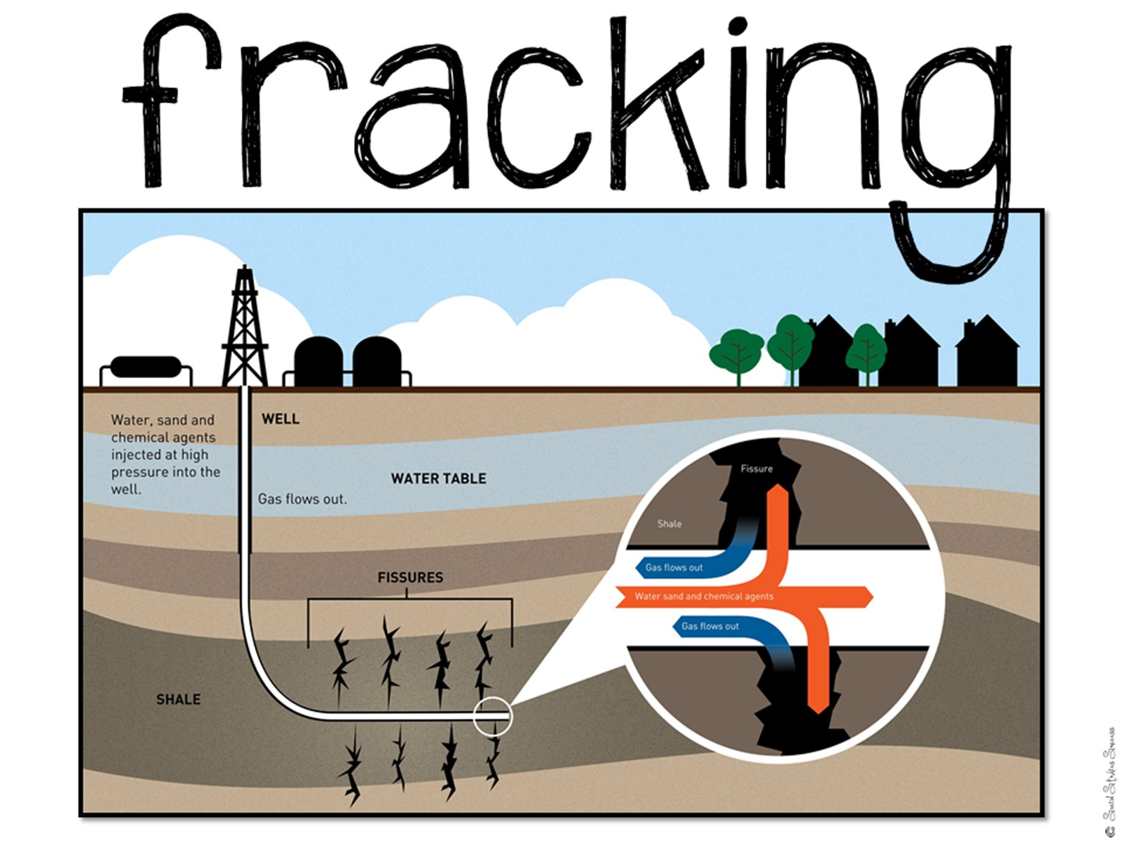
Notes:
Have them create a 3, 2, 1 definition on this image

Slide 17
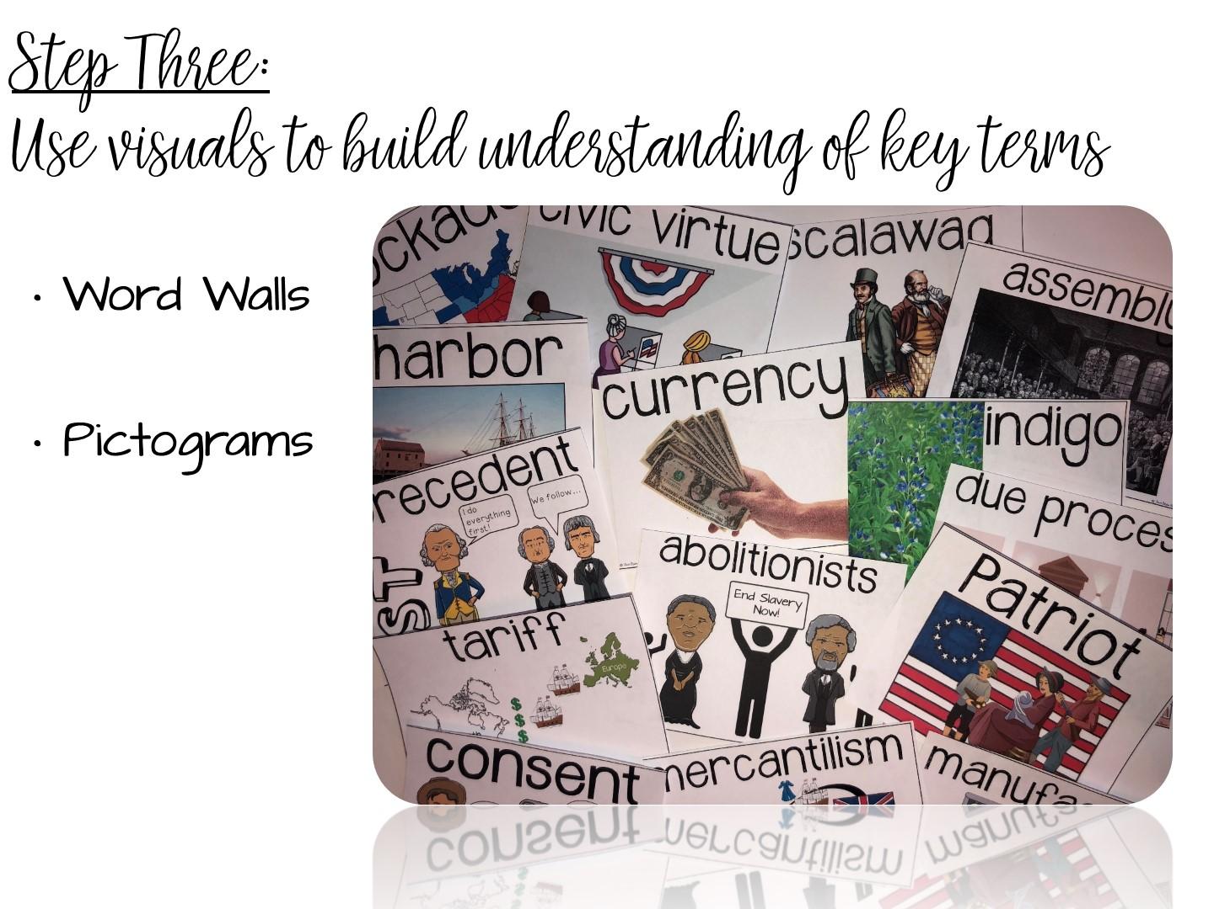

Slide 18

Notes:
Have you had instruction on how to use Word Walls, or was it just a district initiative you were told to follow? Let’s take a look on why word walls work.

Slide 19

Notes:
Word Walls work because of several different reasons – the first of which is episodic memory. Students begin to associate a certain space in your room with vocabulary terms, and if you have taken the time to teach the terms, they will associate the space with learning.
It is important that you put your current word wall in the focal point of your room – near where you teach.

Slide 20

Notes:
Word walls reinforce sight-word acquisition. When students recognize the terms on sight, their fluency increases. When their fluency increases, their comprehension increases. The goal is to build content literacy across grades and disciplines.

Slide 21
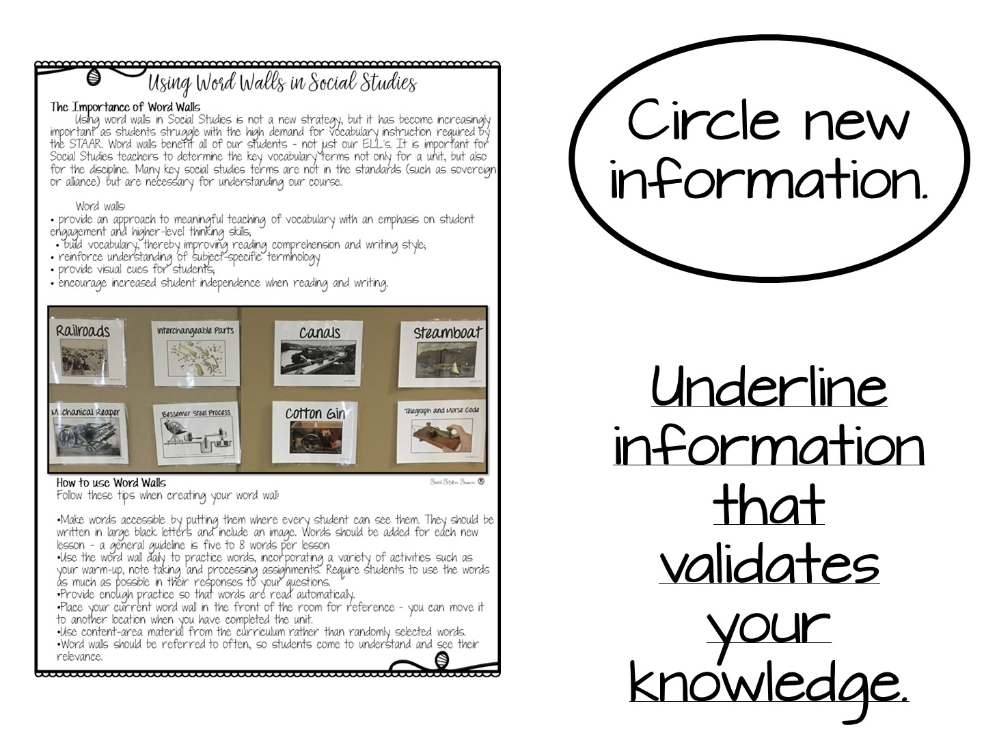
Notes:
Pass out this handout and have them read it. Discuss what they circled or underlined with their partner.

Slide 22

Notes:
Now you are going to share tips for making word walls work in the classroom.

Slide 23
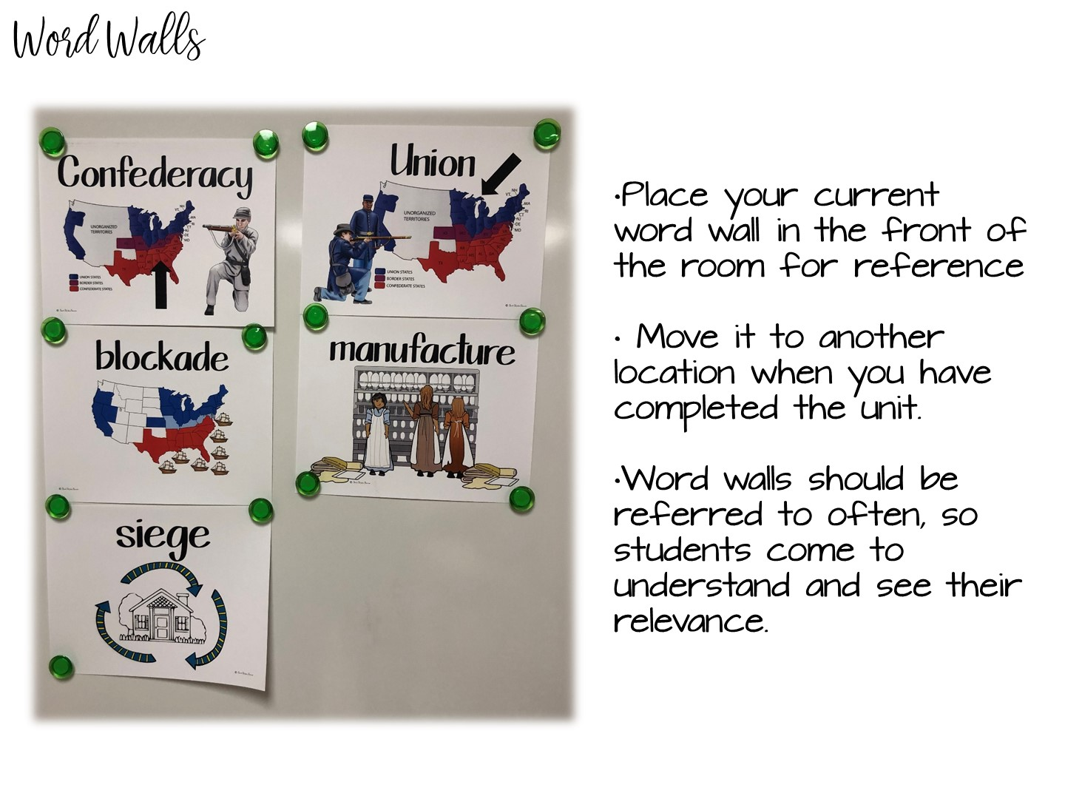
Notes:
See above

Slide 24
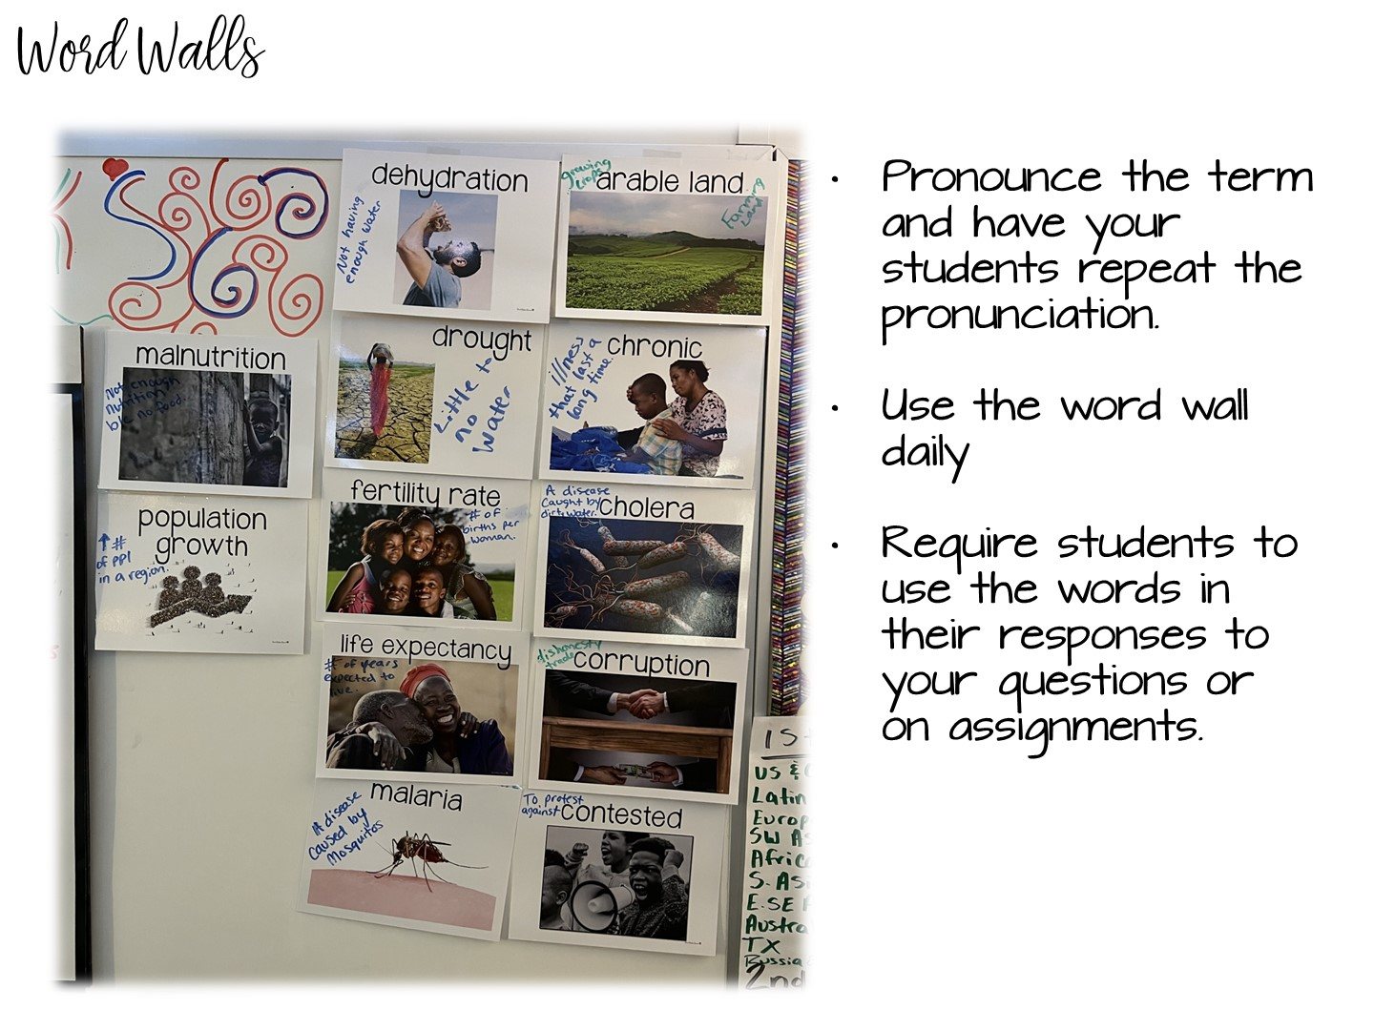
Notes:
See above

Slide 25
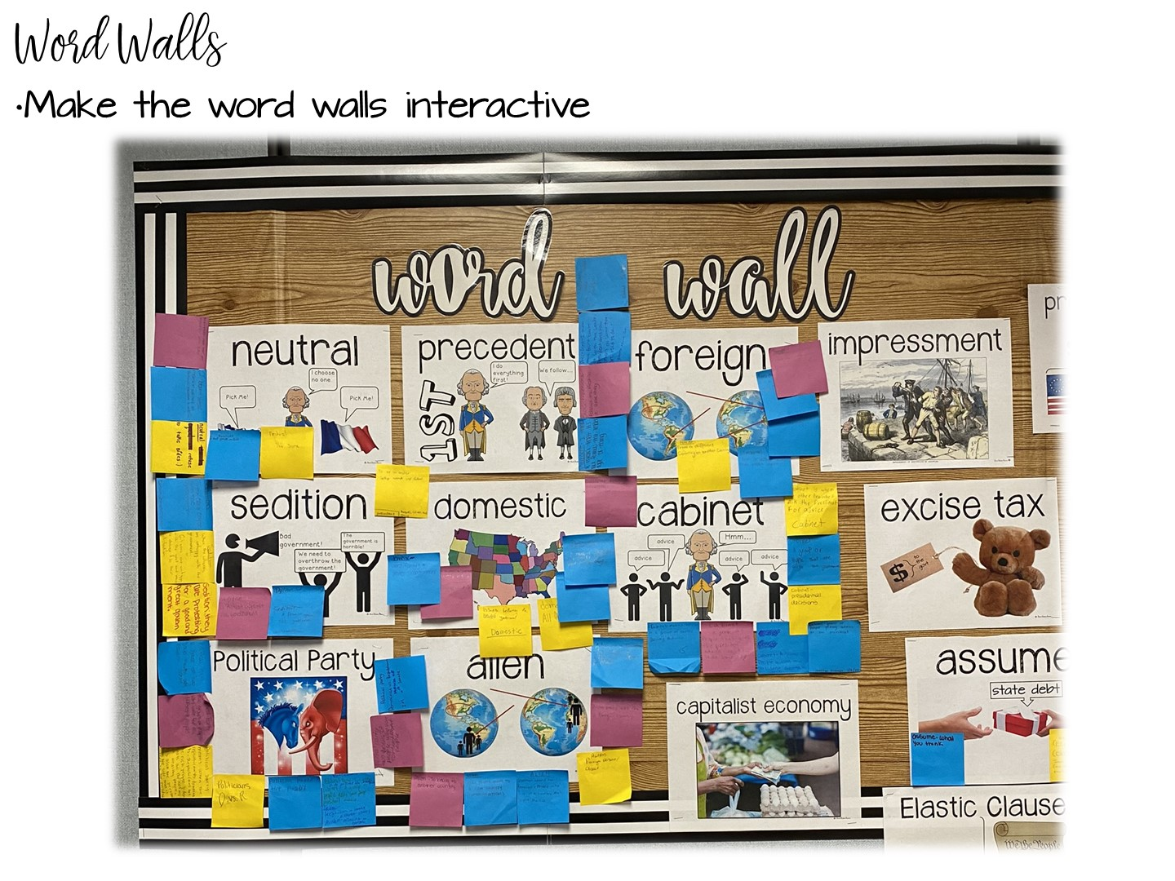
Notes:
You can use post-it notes to interact with the word walls.

Slide 26
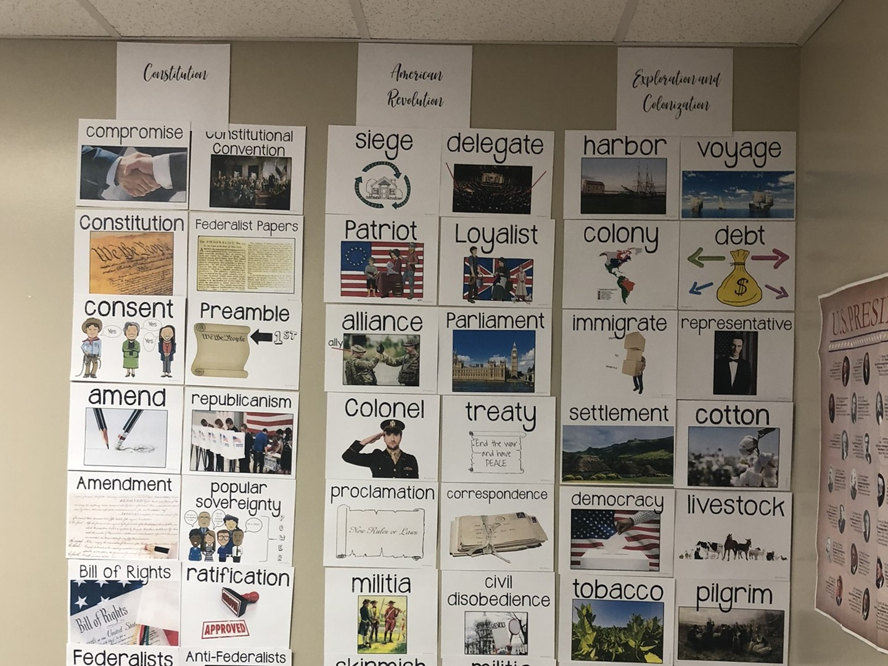
Notes:
When you finish with a unit, you can always take your word wall terms and put them in the back of the room. I recommend this for tested content areas.

Slide 27

Notes:
How to make your own word walls.

Slide 28
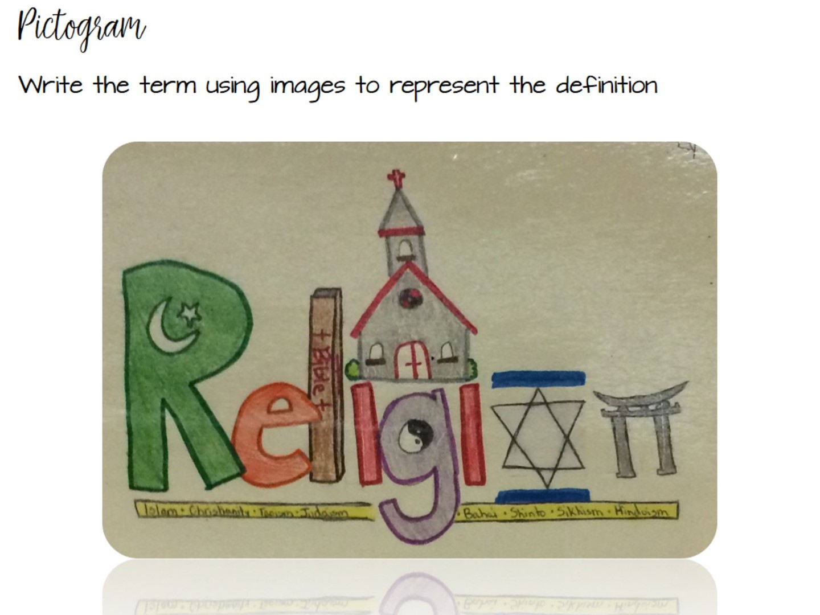

Slide 29

Notes:
Have them sum up what they have learned so far in just one word – then explain it.

Slide 30
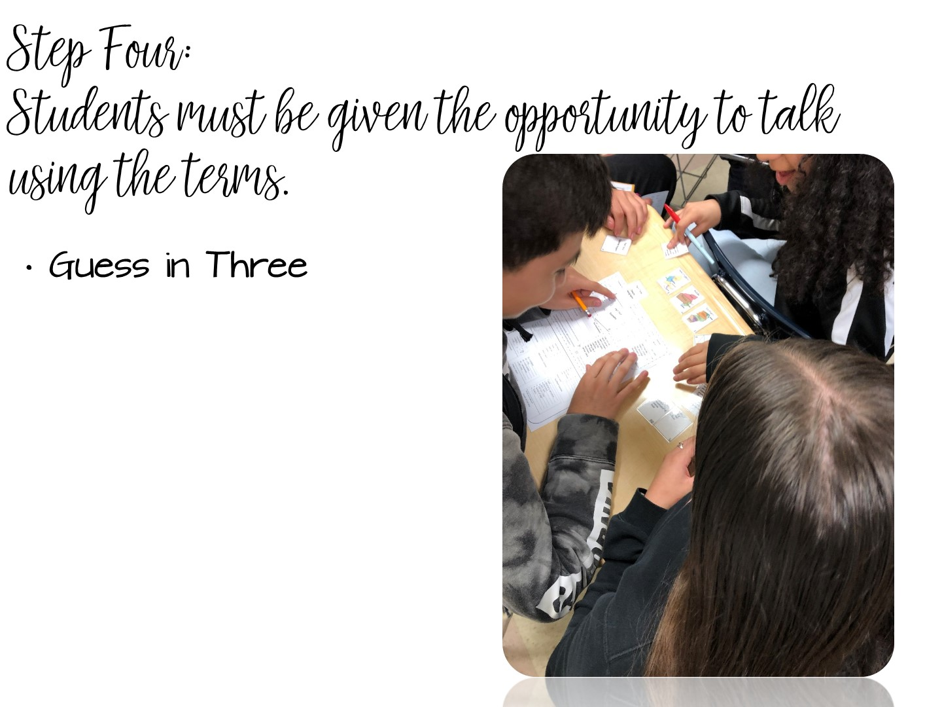
Notes:
See above

Slide 31
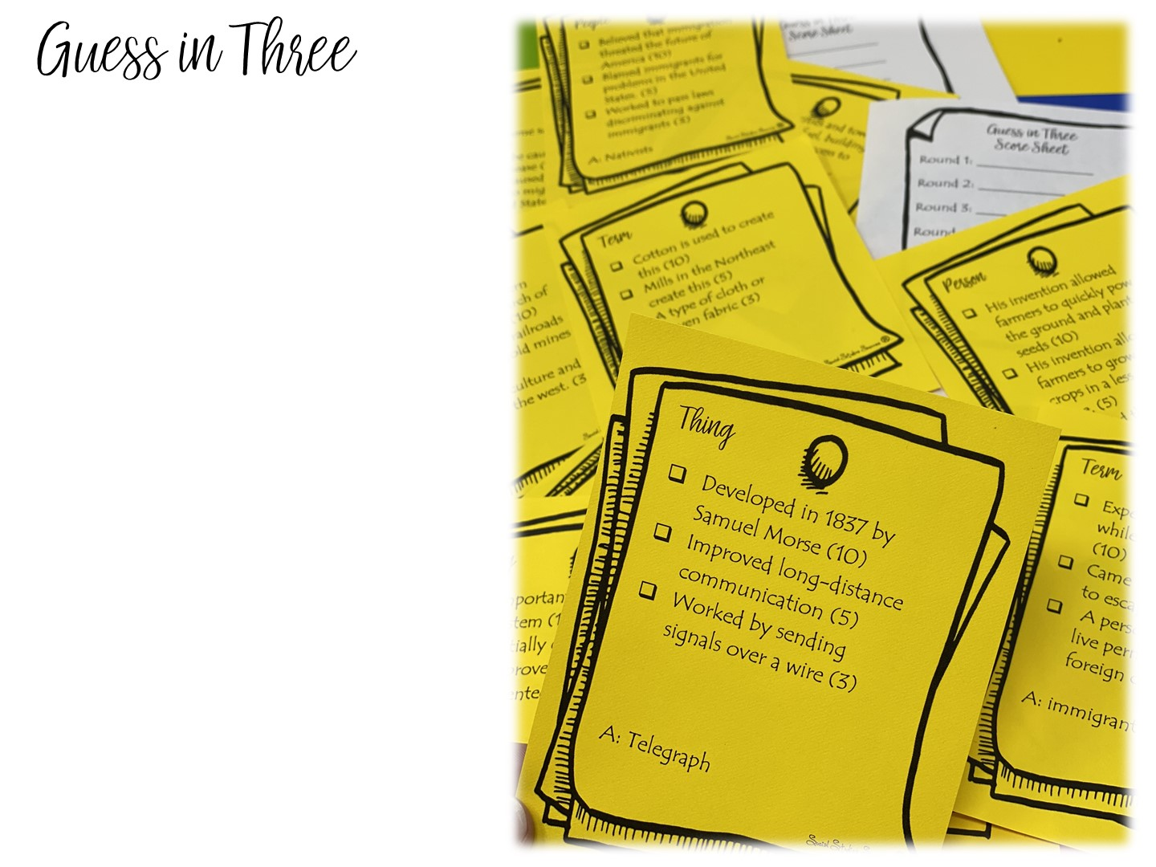
One person in the group will choose a card. They will read the statements on the card to the person on their left. If the person can guess the Person, Place, Term or Thing with one statement, they get 10 points.
If they don’t know the answer or give an incorrect answer, read the second clue. If they get it right, they earn 5 points.
If they don’t know or give an incorrect answer, read the third clue. If they get it right, they earn 3 points.
Rotate the role of reader within the group for each round.
Notes:
Guess in 3 is another opportunity for you to allow your students to talk using the terms.

Slide 32


Slide 33
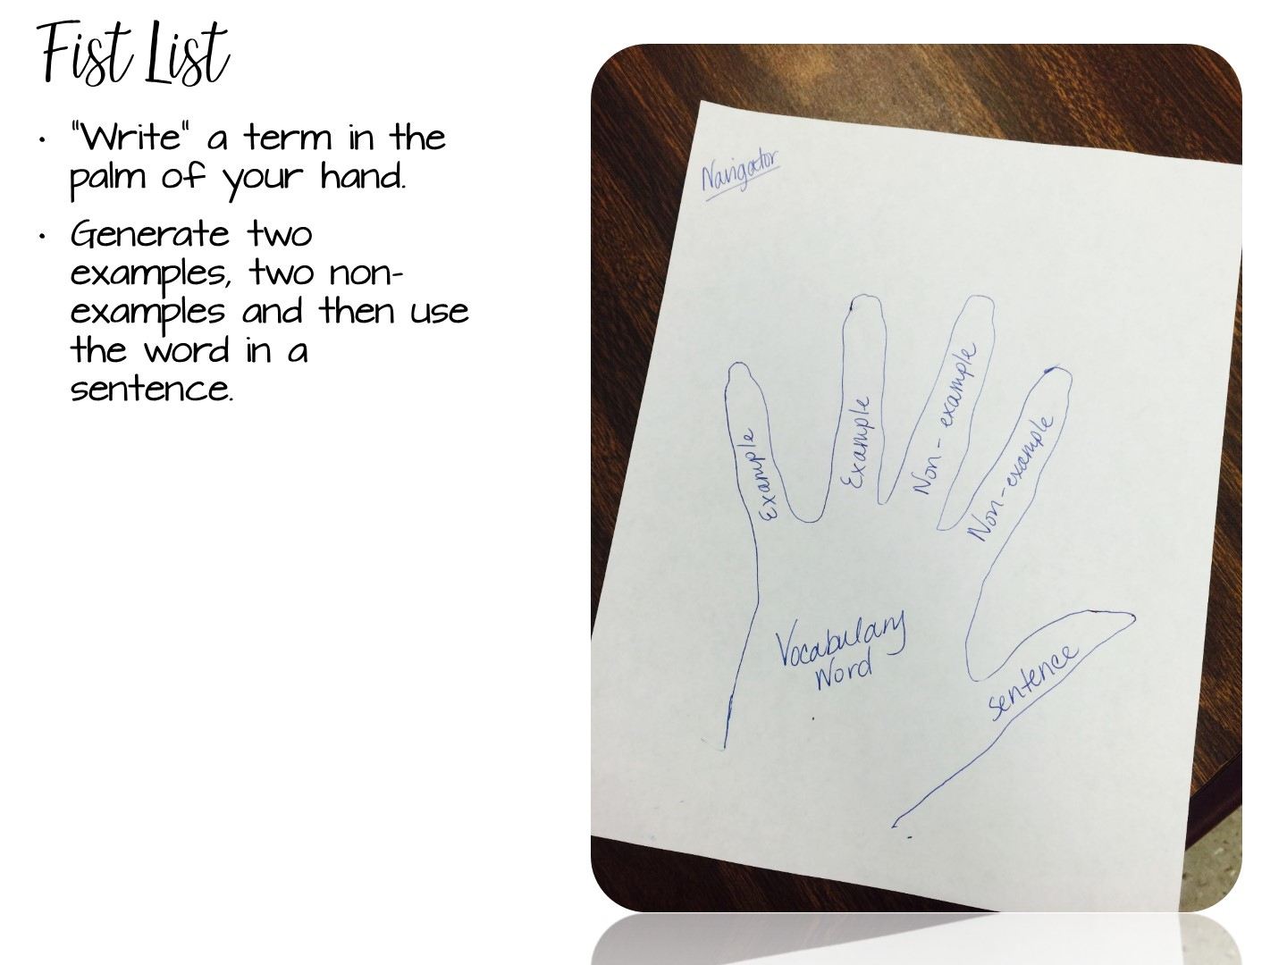
Notes:
5 minutes
Tell the participants to use the back of their pen to “write” the term in the palm of their hand or write the term on a slip of paper and put it into their closed fist.
Two of their fingers will be used for examples of the word, and two for non-examples. Their thumb would represent the word in a sentence.
5 minutes
An alternate way of doing this activity is for students to trace their hand on a sheet of paper. They then fill out the information on paper. Students can then cut the hands out & you can hang them up around the room.
EX:
Pretty
Examples – a flower, a model
Non examples – trash, pollution
Sentence – the girl wore a pretty dress to prom.
Have them do an example on the template of one of the terms

Slide 34
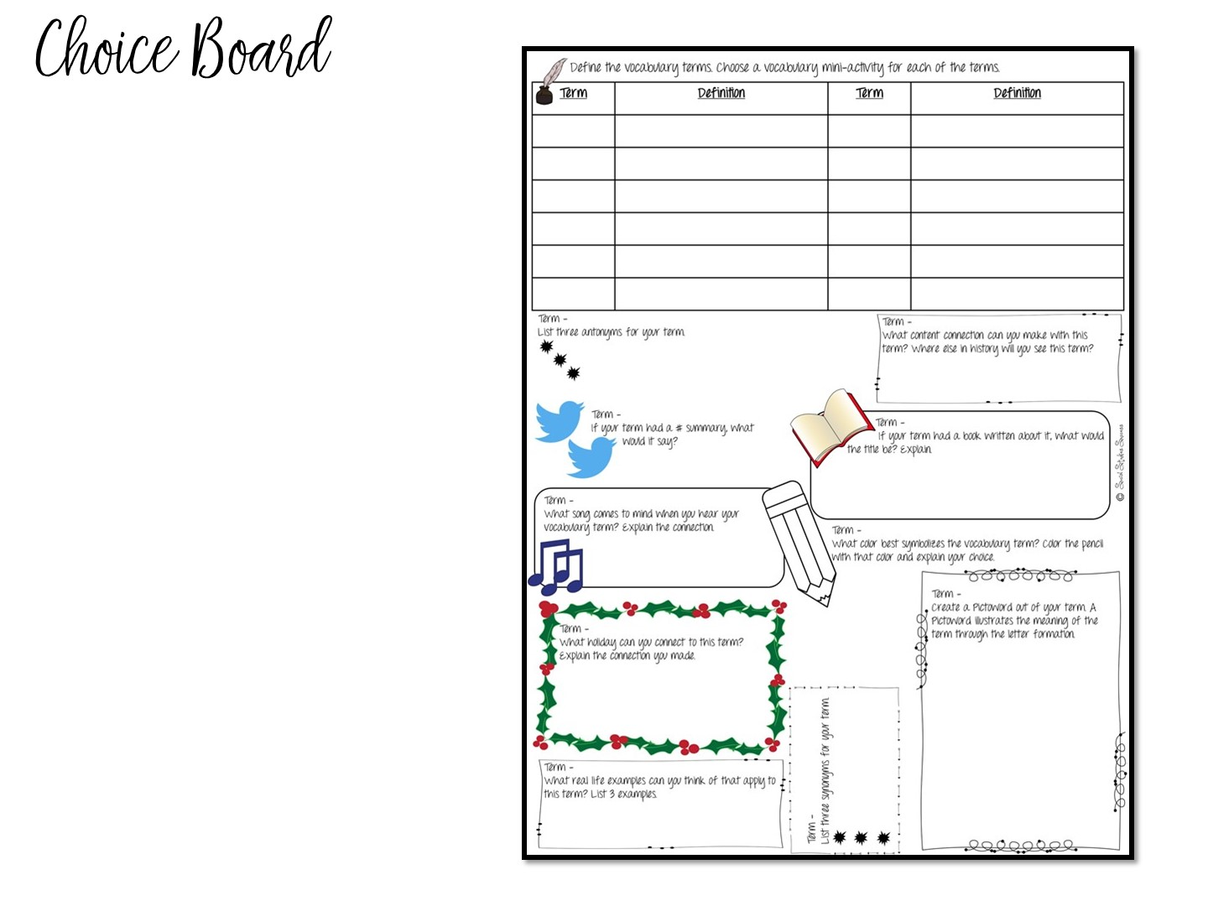
Notes:
This choice board allows students multiple opportunities to both write with the term and think of the term in different ways.

Slide 35
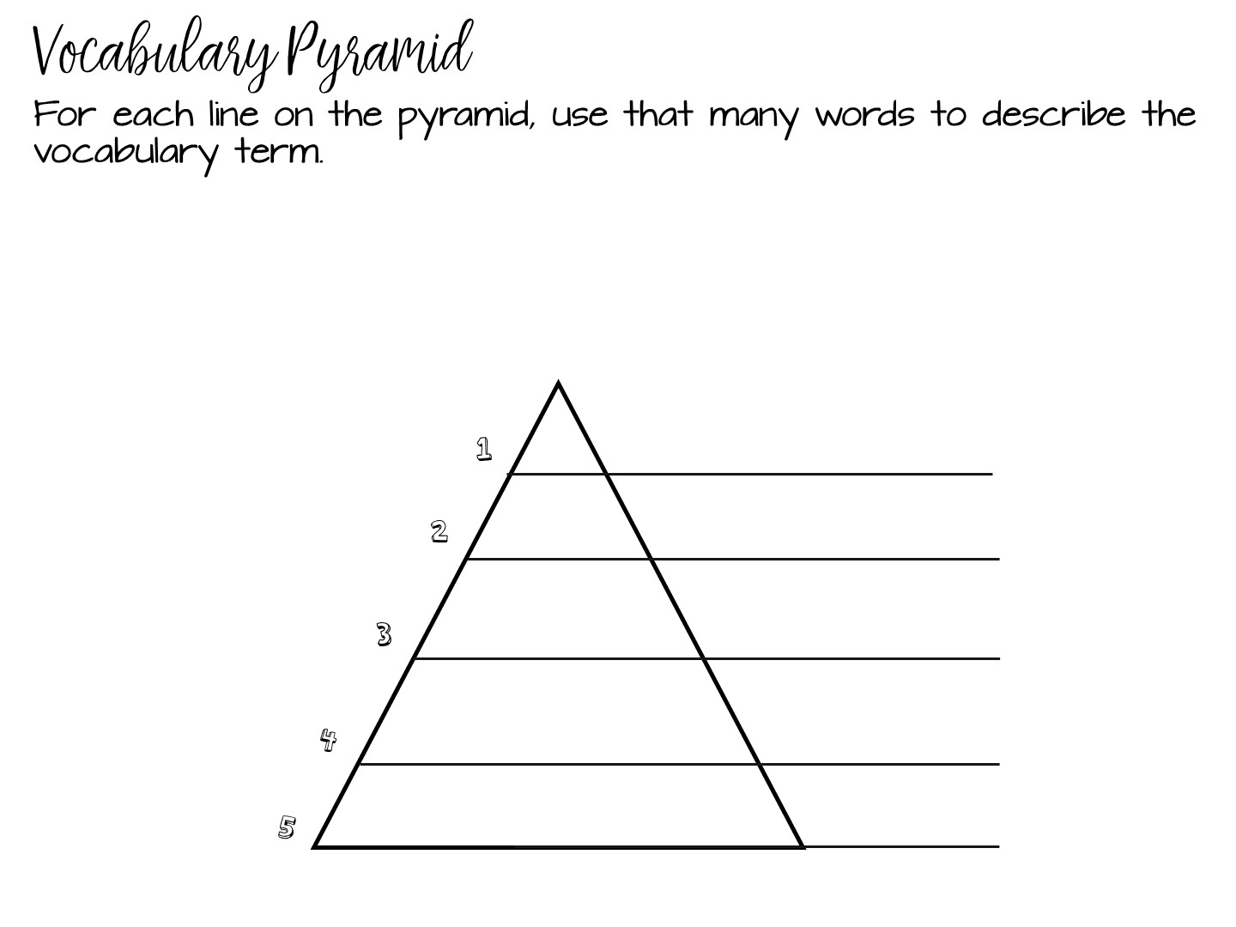

Slide 36
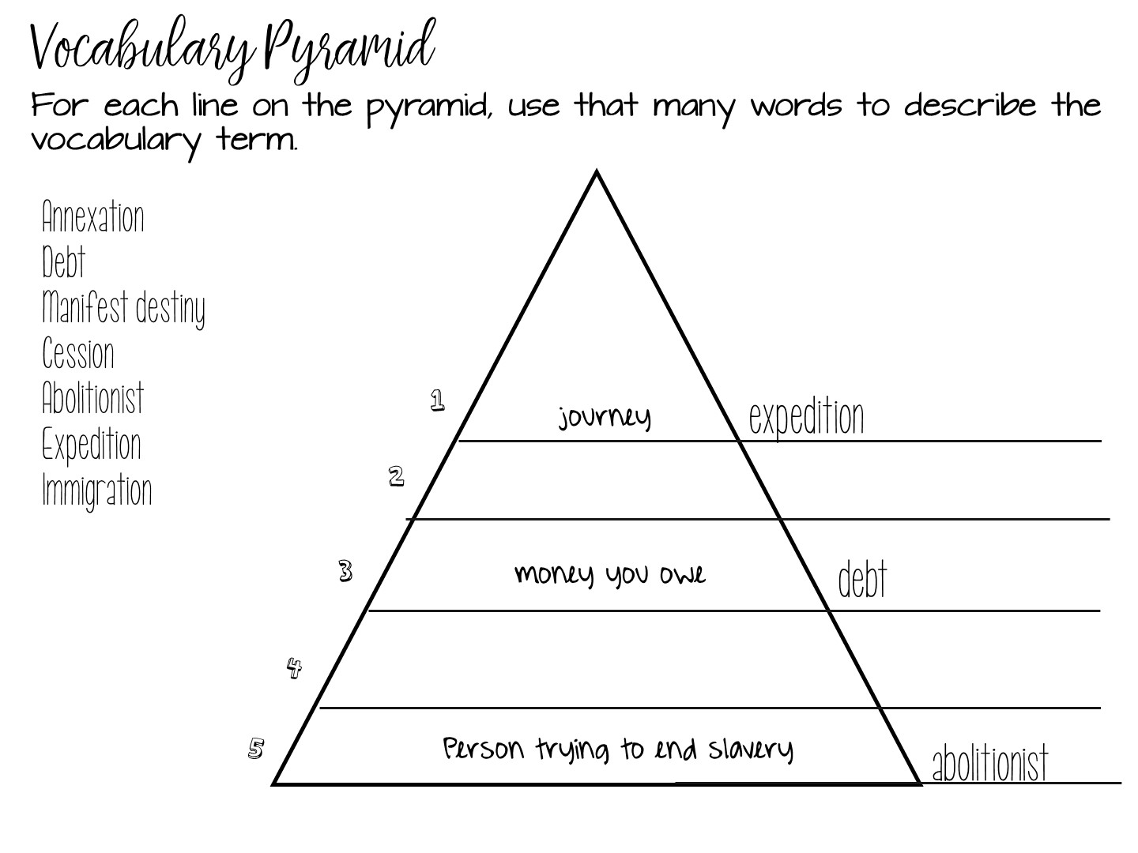
Notes:
Explain example

Slide 37
Notes:
Have them do one with example from Word Wall

Slide 38
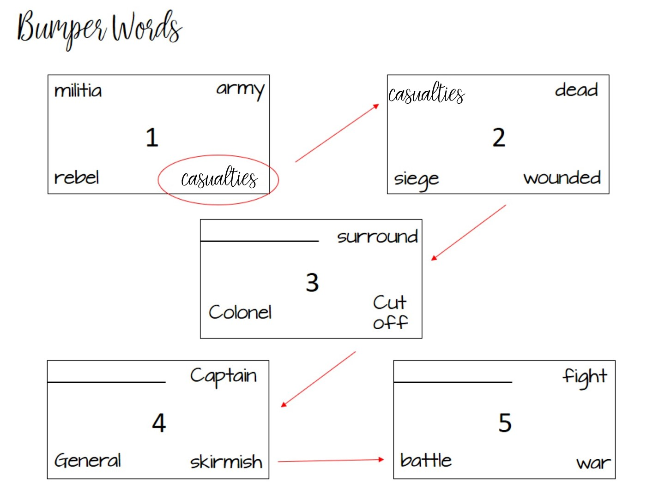
Notes:
Bumper words is a vocabulary strategy that is based on synonyms. In each box, you have a vocabulary term with synonyms. The student has to talk to a partner to determine which term does not fit. It gets bumped to the next box causing one of those terms to not fit. At the end, all of the terms in the box will go together.
Go over pattern

Slide 39
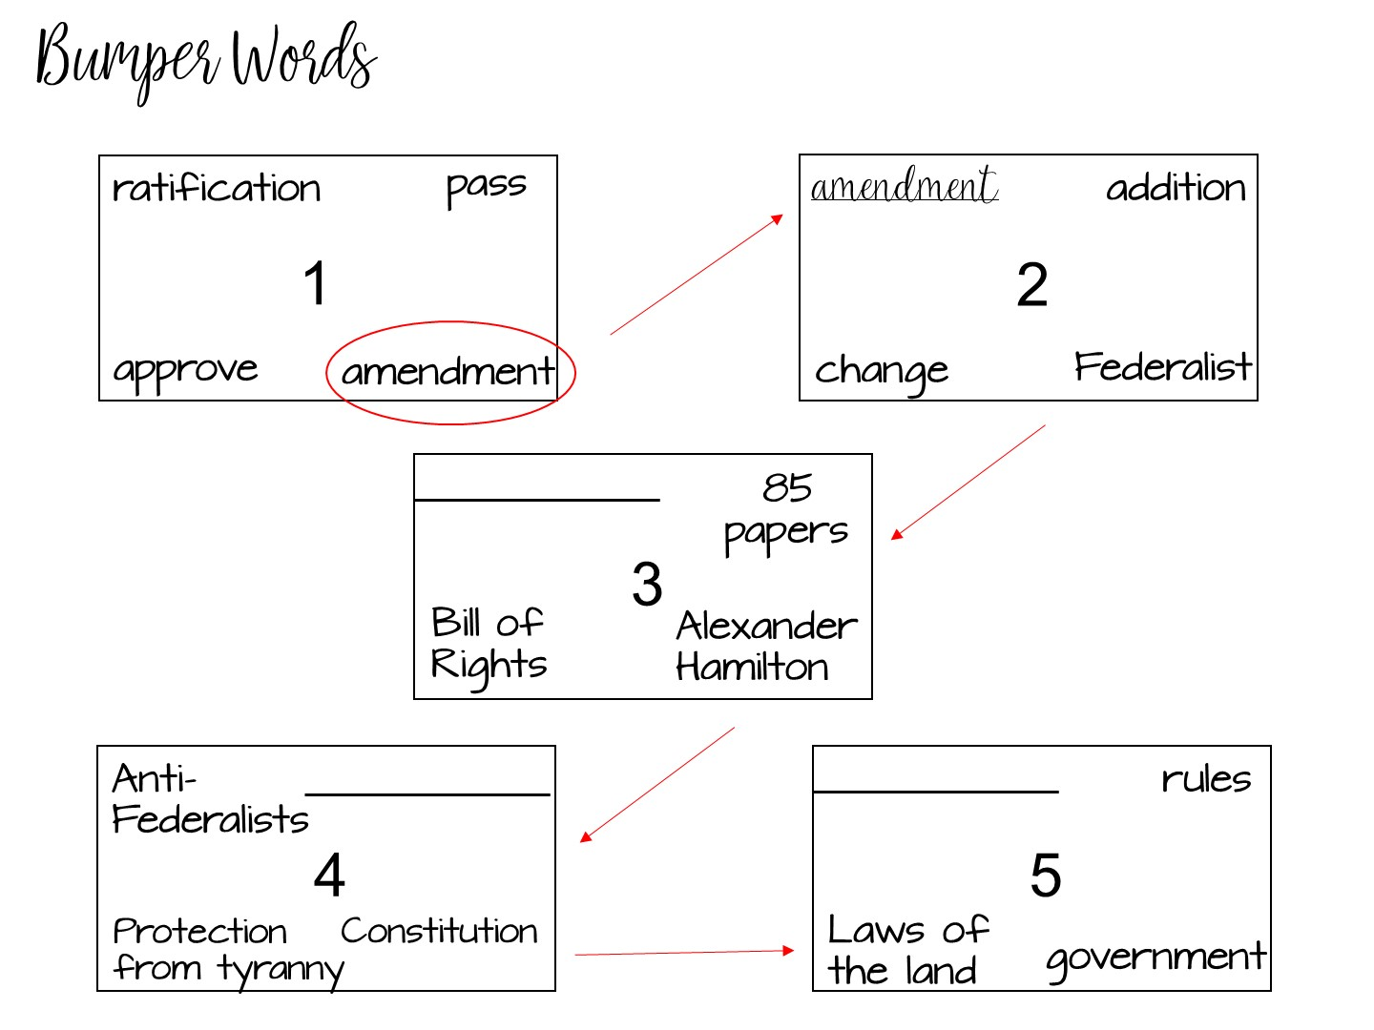
Notes:
Here is another example using both content and vocabulary terms.

Slide 40

Notes:
Have them do an example on the template

Slide 41
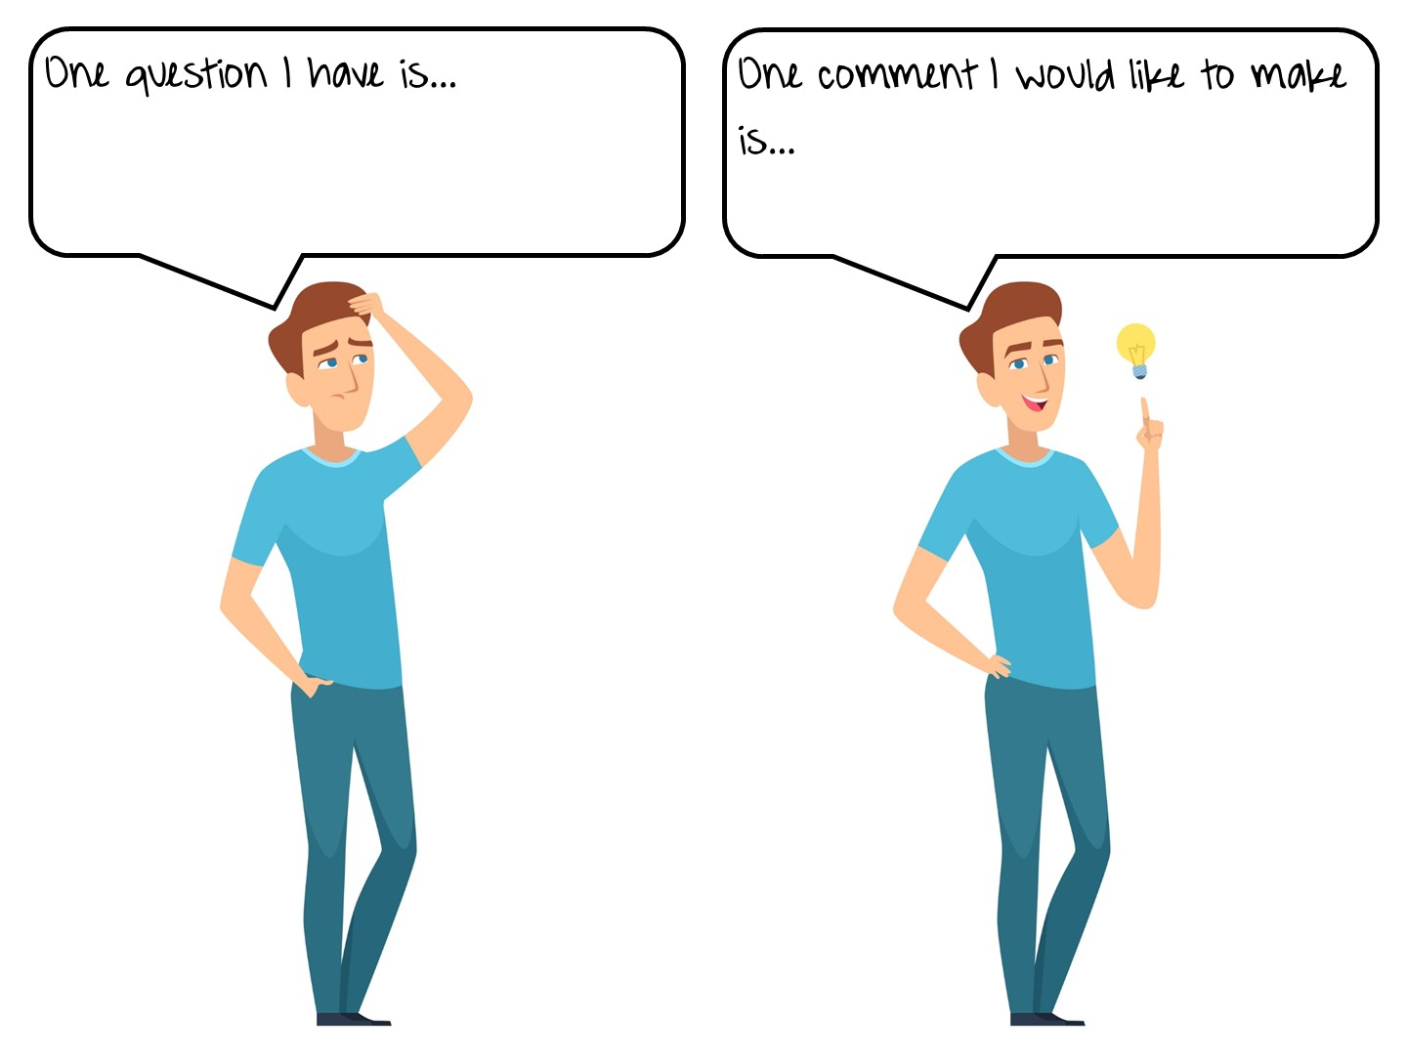
Notes:
Stop the video and write down one question this information brings to mind and one comment you would want to share with a colleague.
Illustration 167469207 © Onyxprj | Dreamstime.com

Slide 42
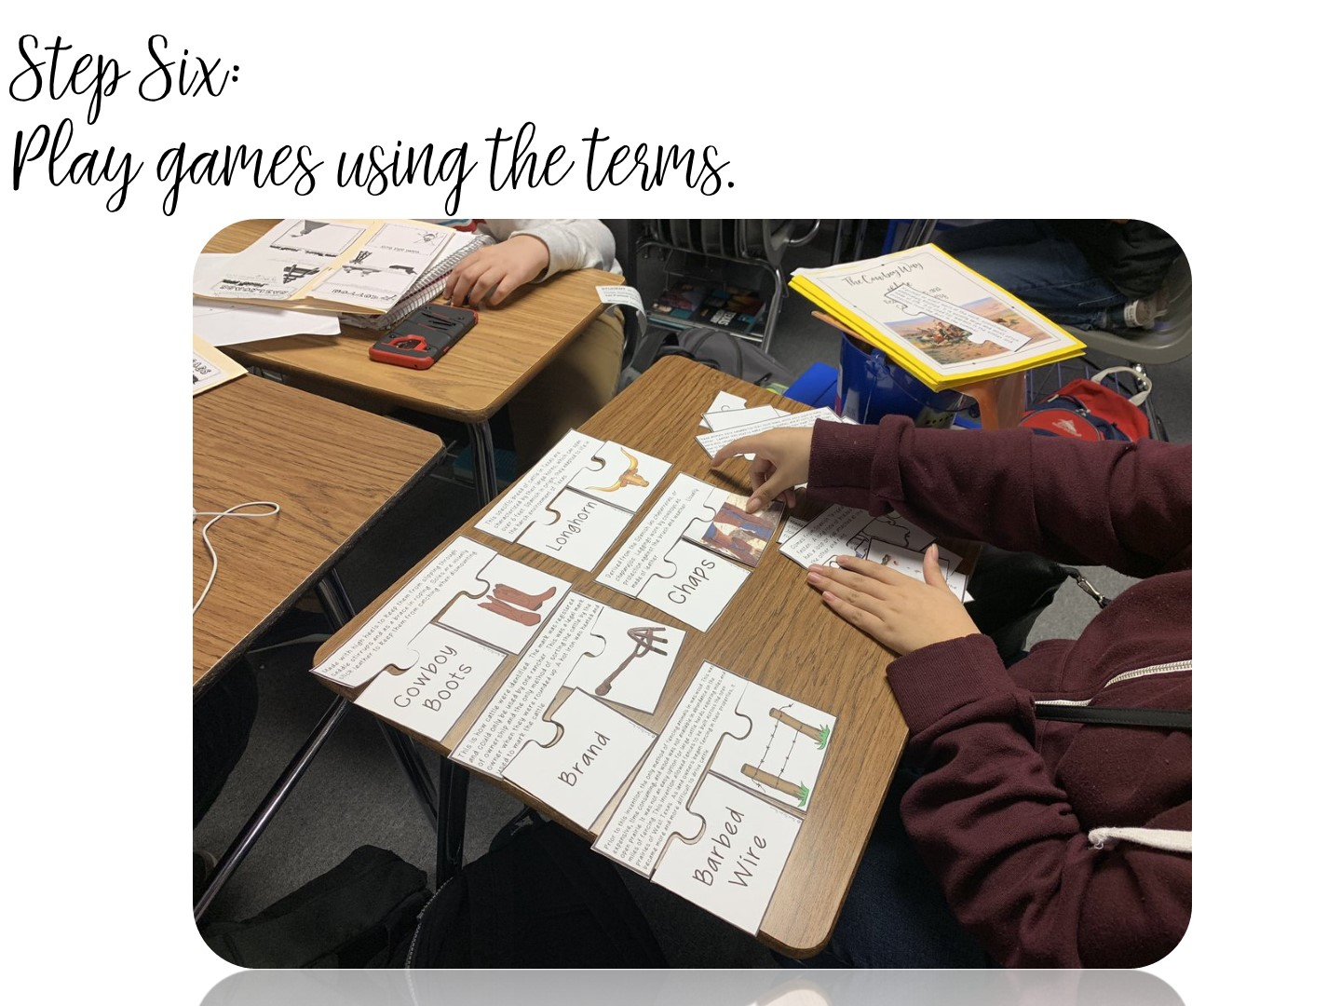
Notes:
Students LOVE games – I would like to share several different strategies for games with you.

Slide 43
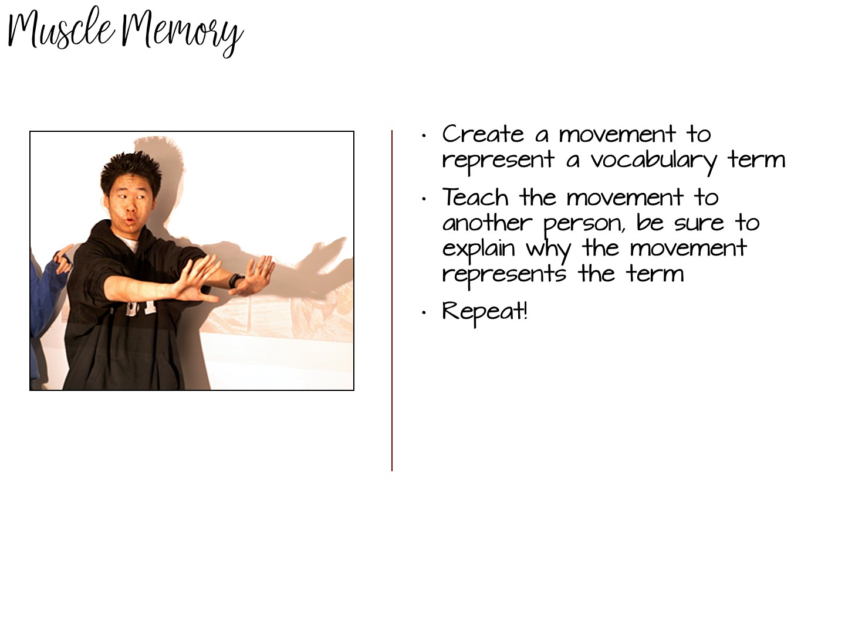
Notes:
explain
Have each group member act out or create a movement of the definition of the word – other group members guess the terms.

Slide 44
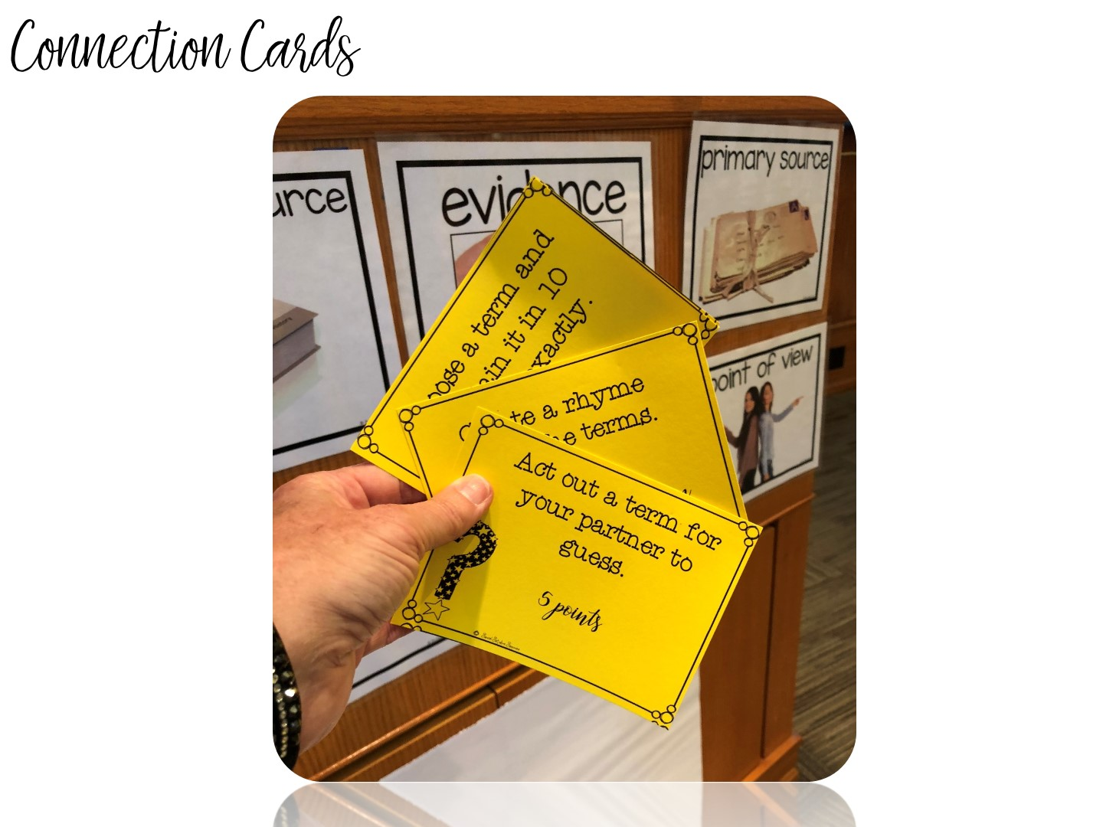
Notes:
explain

Slide 45

Notes:
With all those specific strategies you learned, there is only one addition – your students must read!

Slide 46


