Slide 1
Supporting GT Students in
Social
Studies
Kathleen Geraghty,
Social Studies Success

Slide 3
Who am i?
Trainer
Teacher
Mom
Team Lead
Dept
Chair
Wife
Kathleen
Social Studies Success
Notes:
Introduce yourself

Slide 4
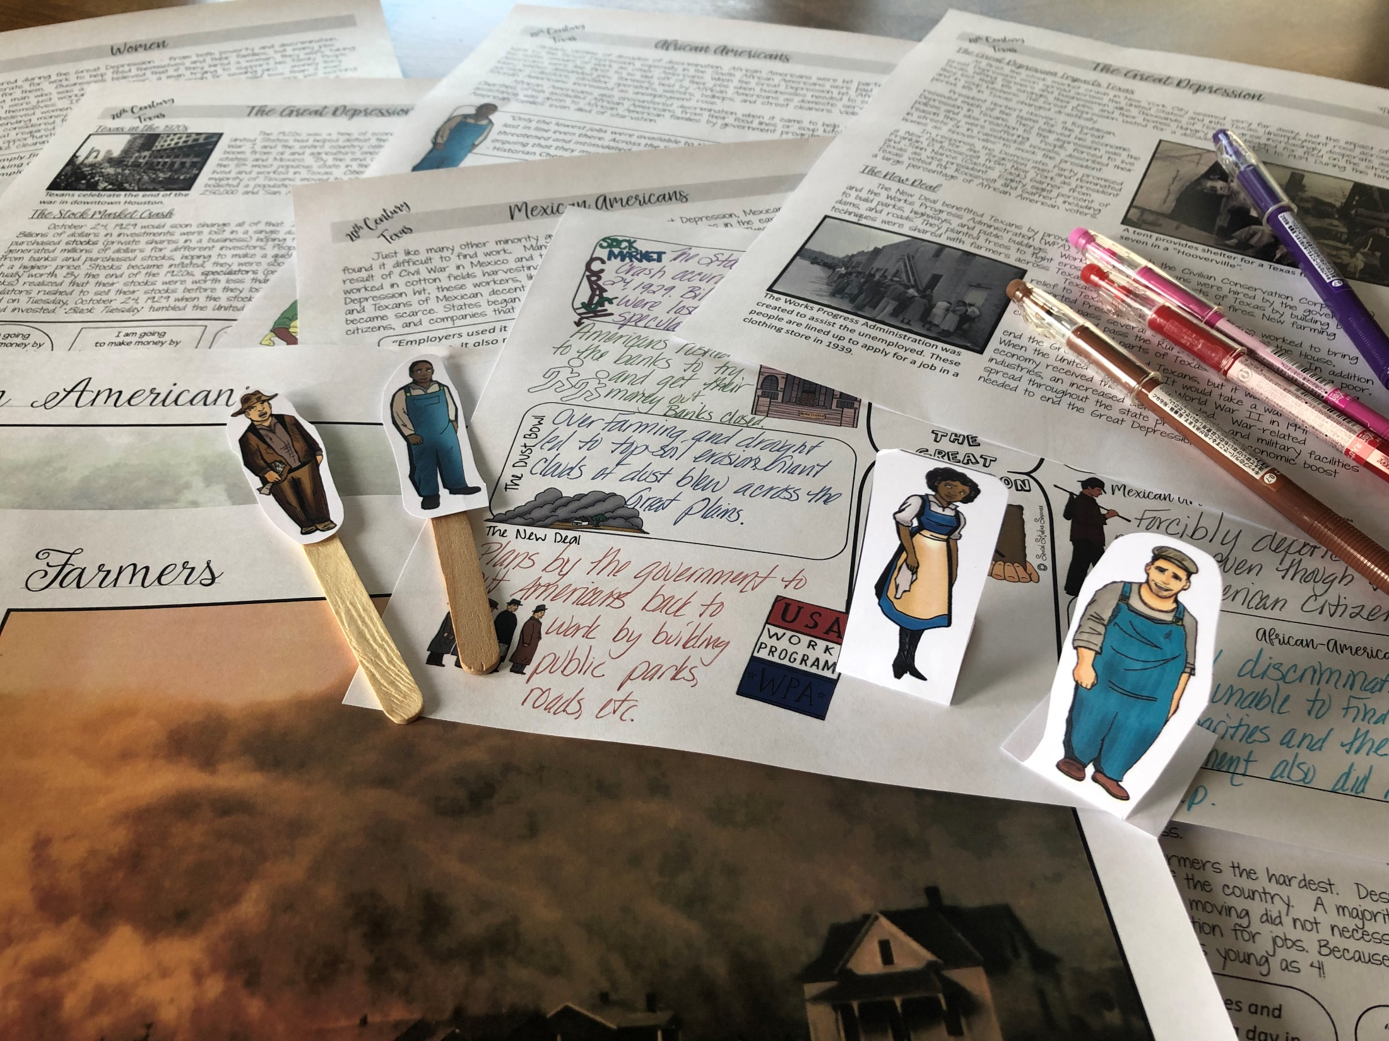
What do I believe about Social Studies instruction?
Students need to be engaged to learn.
-Schlechty’s Design Qualities of Engagement
The students were able to understand the lessons and the text and pictures for the ELL modified lessons worked great! Thanks for making this! Made my life easier. – Mary
Content-Area Conversations
by Douglas Fisher, Nancy Frey and Carol Rothenberg
Awesome and engaging resource! My students loved it!
Notes:
Differentiated instruction is ensuring that learning happens in an accessible way for the student. ISNs allow the students to format their thoughts however they find suitable, thus, differentiating by learning styles — someone who loves writing can love in the notebooks, another student who would rather draw is free to express his/her ideas through diagrams, charts and pictures.

Slide 5
What do I believe about Social Studies instruction?
Students need to be engaged to learn.
-Schlechty’s Design Qualities of Engagement
Students need to read in Social Studies – a lot! Like everyday!
-Kinsella’s Considerate Text
The students were able to understand the lessons and the text and pictures for the ELL modified lessons worked great! Thanks for making this! Made my life easier. – Mary
Content-Area Conversations
by Douglas Fisher, Nancy Frey and Carol Rothenberg
Awesome and engaging resource! My students loved it!
Notes:
Differentiated instruction is ensuring that learning happens in an accessible way for the student. ISNs allow the students to format their thoughts however they find suitable, thus, differentiating by learning styles — someone who loves writing can love in the notebooks, another student who would rather draw is free to express his/her ideas through diagrams, charts and pictures.

Slide 6
What do I believe about Social Studies instruction?
Students
are social – purposeful talk is crucial to learning.
-Walsh Quality Questioning
Students need to be engaged to learn.
-Schlechty’s Design Qualities of Engagement
Students need to read in Social Studies – a lot! Like everyday!
-Kinsella’s Considerate Text
The students were able to understand the lessons and the text and pictures for the ELL modified lessons worked great! Thanks for making this! Made my life easier. – Mary
Content-Area Conversations
by Douglas Fisher, Nancy Frey and Carol Rothenberg
Awesome and engaging resource! My students loved it!
Notes:
Differentiated instruction is ensuring that learning happens in an accessible way for the student. ISNs allow the students to format their thoughts however they find suitable, thus, differentiating by learning styles — someone who loves writing can love in the notebooks, another student who would rather draw is free to express his/her ideas through diagrams, charts and pictures.

Slide 7
What do I believe about Social Studies instruction?
Students
are social – purposeful talk is crucial to learning.
-Walsh Quality Questioning
Students need to be engaged to learn.
-Schlechty’s Design Qualities of Engagement
Students need to read in Social Studies – a lot! Like everyday!
-Kinsella’s Considerate Text
The students were able to understand the lessons and the text and pictures for the ELL modified lessons worked great! Thanks for making this! Made my life easier. – Mary
History can be fun and rigorous at the same time.
-Bower’s Bring Learning Alive!
Content-Area Conversations
by Douglas Fisher, Nancy Frey and Carol Rothenberg
Awesome and engaging resource! My students loved it!
Notes:
Differentiated instruction is ensuring that learning happens in an accessible way for the student. ISNs allow the students to format their thoughts however they find suitable, thus, differentiating by learning styles — someone who loves writing can love in the notebooks, another student who would rather draw is free to express his/her ideas through diagrams, charts and pictures.

Slide 8
What do I believe about Social Studies instruction?
Students
are social – purposeful talk is crucial to learning.
-Walsh Quality Questioning
Students need to be engaged to learn.
-Schlechty’s Design Qualities of Engagement
Students need to read in Social Studies – a lot! Like everyday!
-Kinsella’s Considerate Text
All students can learn – we just need to support them in different ways.
-Seidlitz’s Seven Steps
The students were able to understand the lessons and the text and pictures for the ELL modified lessons worked great! Thanks for making this! Made my life easier. – Mary
History can be fun and rigorous at the same time.
-Bower’s Bring Learning Alive!
Content-Area Conversations
by Douglas Fisher, Nancy Frey and Carol Rothenberg
Awesome and engaging resource! My students loved it!
Notes:
Differentiated instruction is ensuring that learning happens in an accessible way for the student. ISNs allow the students to format their thoughts however they find suitable, thus, differentiating by learning styles — someone who loves writing can love in the notebooks, another student who would rather draw is free to express his/her ideas through diagrams, charts and pictures.

Slide 9
What do I believe about Social Studies instruction?
Students
are social – purposeful talk is crucial to learning.
-Walsh Quality Questioning
Students need to be engaged to learn.
-Schlechty’s Design Qualities of Engagement
Students need to read in Social Studies – a lot! Like everyday!
-Kinsella’s Considerate Text
All students can learn – we just need to support them in different ways.
-Seidlitz’s Seven Steps
The students were able to understand the lessons and the text and pictures for the ELL modified lessons worked great! Thanks for making this! Made my life easier. – Mary
History can be fun and rigorous at the same time.
-Bower’s Bring Learning Alive!
The
Interactive Student
Notebook is a powerful
teaching tool that allows you to differentiate instruction for students in a variety of ways.
-Wist’s Research on the Interactive Student
Notebook
Content-Area Conversations
by Douglas Fisher, Nancy Frey and Carol Rothenberg
Awesome and engaging resource! My students loved it!
Notes:
Differentiated instruction is ensuring that learning happens in an accessible way for the student. ISNs allow the students to format their thoughts however they find suitable, thus, differentiating by learning styles — someone who loves writing can love in the notebooks, another student who would rather draw is free to express his/her ideas through diagrams, charts and pictures.

Slide 10
What do I believe about Social Studies instruction?
Students
are social – purposeful talk is crucial to learning.
-Walsh Quality Questioning
Students need to be engaged to learn.
-Schlechty’s Design Qualities of Engagement
Students need to read in Social Studies – a lot! Like everyday!
-Kinsella’s Considerate Text
All students can learn – we just need to support them in different ways.
-Seidlitz’s Seven Steps
The students were able to understand the lessons and the text and pictures for the ELL modified lessons worked great! Thanks for making this! Made my life easier. – Mary
History can be fun and rigorous at the same time.
-Bower’s Bring Learning Alive!
The
Interactive Student
Notebook is a powerful
teaching tool that allows you to differentiate instruction for students in a variety of ways.
-Wist’s Research on the Interactive Student
Notebook
History should not be trivial pursuit – dig deeper and teach with essential questions and enduring understandings.
-Wiggins & McTighe Essential Questions
Content-Area Conversations
by Douglas Fisher, Nancy Frey and Carol Rothenberg
Awesome and engaging resource! My students loved it!
Notes:
Differentiated instruction is ensuring that learning happens in an accessible way for the student. ISNs allow the students to format their thoughts however they find suitable, thus, differentiating by learning styles — someone who loves writing can love in the notebooks, another student who would rather draw is free to express his/her ideas through diagrams, charts and pictures.

Slide 11
What do I believe about Social Studies instruction?
Students
are social – purposeful talk is crucial to learning.
-Walsh Quality Questioning
Students need to be engaged to learn.
-Schlechty’s Design Qualities of Engagement
Students need to read in Social Studies – a lot! Like everyday!
-Kinsella’s Considerate Text
All students can learn – we just need to support them in different ways.
-Seidlitz’s Seven Steps
The students were able to understand the lessons and the text and pictures for the ELL modified lessons worked great! Thanks for making this! Made my life easier. – Mary
History can be fun and rigorous at the same time.
-Bower’s Bring Learning Alive!
The
Interactive Student
Notebook is a powerful
teaching tool that allows you to differentiate instruction for students in a variety of ways.
-Wist’s Research on the Interactive Student
Notebook
History should not be trivial pursuit – dig deeper and teach with essential questions and enduring understandings.
-Wiggins & McTighe Essential Questions
Vocabulary instruction must be intentional and engaging.
-Marzano Academic Vocabulary
Content-Area Conversations
by Douglas Fisher, Nancy Frey and Carol Rothenberg
Awesome and engaging resource! My students loved it!
Notes:
Differentiated instruction is ensuring that learning happens in an accessible way for the student. ISNs allow the students to format their thoughts however they find suitable, thus, differentiating by learning styles — someone who loves writing can love in the notebooks, another student who would rather draw is free to express his/her ideas through diagrams, charts and pictures.

Slide 12
What do I believe about Social Studies instruction?
Students
are social – purposeful talk is crucial to learning.
-Walsh Quality Questioning
Students need to be engaged to learn.
-Schlechty’s Design Qualities of Engagement
Students need to read in Social Studies – a lot! Like everyday!
-Kinsella’s Considerate Text
All students can learn – we just need to support them in different ways.
-Seidlitz’s Seven Steps
The students were able to understand the lessons and the text and pictures for the ELL modified lessons worked great! Thanks for making this! Made my life easier. – Mary
History can be fun and rigorous at the same time.
-Bower’s Bring Learning Alive!
The
Interactive Student
Notebook is a powerful
teaching tool that allows you to differentiate instruction for students in a variety of ways.
-Wist’s Research on the Interactive Student
Notebook
History should not be trivial pursuit – dig deeper and teach with essential questions and enduring understandings.
-Wiggins & McTighe Essential Questions
Vocabulary instruction must be intentional and engaging.
-Marzano Academic Vocabulary
Content-Area Conversations
by Douglas Fisher, Nancy Frey and Carol Rothenberg
Awesome and engaging resource! My students loved it!
Writing is essential for learning, not just assessment.
-Daniels’ Content Area Writing
Notes:
Differentiated instruction is ensuring that learning happens in an accessible way for the student. ISNs allow the students to format their thoughts however they find suitable, thus, differentiating by learning styles — someone who loves writing can love in the notebooks, another student who would rather draw is free to express his/her ideas through diagrams, charts and pictures.

Slide 13
What do I believe about Social Studies instruction?
Students
are social – purposeful talk is crucial to learning.
-Walsh Quality Questioning
Students need to be engaged to learn.
-Schlechty’s Design Qualities of Engagement
Students need to read in Social Studies – a lot! Like everyday!
-Kinsella’s Considerate Text
All students can learn – we just need to support them in different ways.
-Seidlitz’s Seven Steps
The students were able to understand the lessons and the text and pictures for the ELL modified lessons worked great! Thanks for making this! Made my life easier. – Mary
History can be fun and rigorous at the same time.
-Bower’s Bring Learning Alive!
The
Interactive Student
Notebook is a powerful
teaching tool that allows you to differentiate instruction for students in a variety of ways.
-Wist’s Research on the Interactive Student
Notebook
History should not be trivial pursuit – dig deeper and teach with essential questions and enduring understandings.
-Wiggins & McTighe Essential Questions
Vocabulary instruction must be intentional and engaging.
-Marzano Academic Vocabulary
Content-Area Conversations
by Douglas Fisher, Nancy Frey and Carol Rothenberg
Writing is essential for learning, not just assessment.
-Daniels’ Content Area Writing
Kids need to continuously review content. All students need to participate in classroom activities.
-Himmele’s Total Participation Techniques
Awesome and engaging resource! My students loved it!
Notes:
Differentiated instruction is ensuring that learning happens in an accessible way for the student. ISNs allow the students to format their thoughts however they find suitable, thus, differentiating by learning styles — someone who loves writing can love in the notebooks, another student who would rather draw is free to express his/her ideas through diagrams, charts and pictures.

Slide 14
What do I believe about Social Studies instruction?
Students
are social – purposeful talk is crucial to learning.
-Walsh Quality Questioning
Students need to be engaged to learn.
-Schlechty’s Design Qualities of Engagement
Students need to read in Social Studies – a lot! Like everyday!
-Kinsella’s Considerate Text
All students can learn – we just need to support them in different ways.
-Seidlitz’s Seven Steps
The students were able to understand the lessons and the text and pictures for the ELL modified lessons worked great! Thanks for making this! Made my life easier. – Mary
History can be fun and rigorous at the same time.
-Bower’s Bring Learning Alive!
The
Interactive Student
Notebook is a powerful
teaching tool that allows you to differentiate instruction for students in a variety of ways.
-Wist’s Research on the Interactive Student
Notebook
History should not be trivial pursuit – dig deeper and teach with essential questions and enduring understandings.
-Wiggins & McTighe Essential Questions
Vocabulary instruction must be intentional and engaging.
-Marzano Academic Vocabulary
Content-Area Conversations
by Douglas Fisher, Nancy Frey and Carol Rothenberg
Writing is essential for learning, not just assessment.
-Daniels’ Content Area Writing
Kids need to continuously review content. All students need to participate in classroom activities.
-Himmele’s Total Participation Techniques
Awesome and engaging resource! My students loved it!
“Soft skills” of collaboration, communication, critical thinking, and creativity are essential to future success in the job market.
-Muir Reasons Millennials Get Fired
Notes:
Differentiated instruction is ensuring that learning happens in an accessible way for the student. ISNs allow the students to format their thoughts however they find suitable, thus, differentiating by learning styles — someone who loves writing can love in the notebooks, another student who would rather draw is free to express his/her ideas through diagrams, charts and pictures.

Slide 15
What do I believe about Social Studies instruction?
Students
are social – purposeful talk is crucial to learning.
-Walsh Quality Questioning
Students need to be engaged to learn.
-Schlechty’s Design Qualities of Engagement
Students need to read in Social Studies – a lot! Like everyday!
-Kinsella’s Considerate Text
All students can learn – we just need to support them in different ways.
-Seidlitz’s Seven Steps
History can be fun and rigorous at the same time.
-Bower’s Bring Learning Alive!
The
Interactive Student
Notebook is a powerful
teaching tool that allows you to differentiate instruction for students in a variety of ways.
-Wist’s Research on the Interactive Student
Notebook
History should not be trivial pursuit – dig deeper and teach with essential questions and enduring understandings.
-Wiggins & McTighe Essential Questions
Vocabulary instruction must be intentional and engaging.
-Marzano Academic Vocabulary
Writing is essential for learning, not just assessment.
-Daniels’ Content Area Writing
Kids need to continuously review content. All students need to participate in classroom activities.
-Himmele’s Total Participation Techniques
The best way to improve reading comprehension and scores, is to focus on building knowledge through Social Studies instruction.
-Wexler The Knowledge Gap
“Soft skills” of collaboration, communication, critical thinking, and creativity are essential to future success in the job market.
-Muir Reasons Millennials Get Fired
Notes:
Differentiated instruction is ensuring that learning happens in an accessible way for the student. ISNs allow the students to format their thoughts however they find suitable, thus, differentiating by learning styles — someone who loves writing can love in the notebooks, another student who would rather draw is free to express his/her ideas through diagrams, charts and pictures.

Slide 16
History Teachers
are the
Guardians
Democracy!
of
Notes:
History teachers are the guardians of democracy

Slide 17
Explore strategies for supporting GT students
Experience model lessons

Slide 18
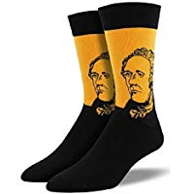

Slide 19
How do you support GT students?
Create a bullet list of everything you know about it.
Notes:
Pass out handout on supporting GT Students. Once they have had a chance to write some ideas, hand out the envelopes with the GT sentences and add to the list.

Slide 20
Supporting GT Students
Review the strips of information on supporting GT students.
Do you have a similar description? Lay the strip on top of your own description.
Have you left off information? Summarize and add it to your list.
Have students work together, teach one another, and actively participate in their own and their classmates’ education.
Notes:
Get with a partner Take the envelope of information about supporting GT Students
Lay each strip on top of your bulleted list if it is similar
Discuss – what was left off?
Create your own definition of formative assessment

Slide 21
How does this list validate what you already know?

Slide 22
Gifted or Advanced
Depth
and Complexity
Notes:
We are now going to explore the concept of adding depth and complexity to our assignments.

Slide 23
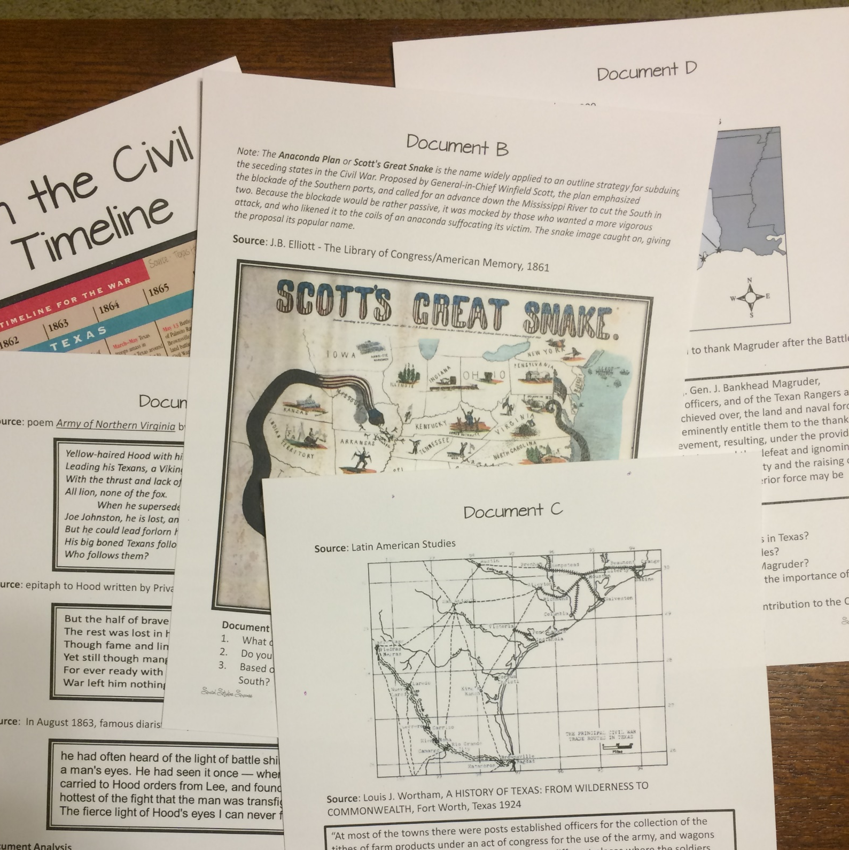
GT
Tip
Design lessons that encourage greater study.
One
Design and offer choice in your lesson.
Tier up literacy levels.
Emphasize primary sources.

Slide 24
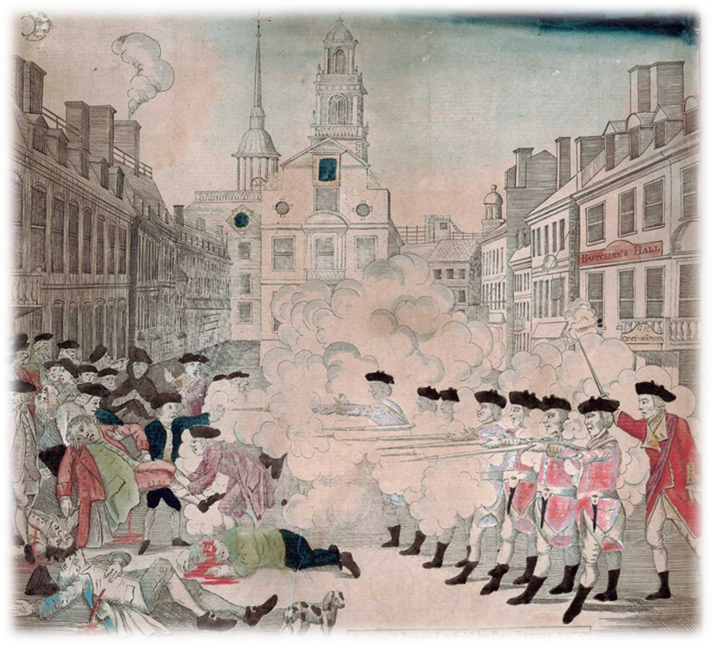
Social Studies Success
Digging
Boston
Massacre
Deeper

Slide 25
Find a Partner

Slide 26
Objectives
Content Objective: Students will analyze causes of the American Revolution and the roles played by significant individuals.
Language Objective: Students will speak using and write using
vocabulary terms and content
knowledge on the Boston
Massacre.
analyze causes of the American Revolution, including the Proclamation of 1763, the
Intolerable Acts, the Stamp Act, mercantilism, lack of representation in Parliament, and
British economic policies following the French and Indian War;
(B) explain the roles played by significant individuals during the American Revolution,
including Abigail Adams, John Adams, Wentworth Cheswell, Samuel Adams, Mercy
Otis Warren, James Armistead, Benjamin Franklin, Crispus Attucks, King George III,
Patrick Henry, Thomas Jefferson, the Marquis de Lafayette, Thomas Paine, and George
Washington;
Notes:
analyze the political, economic, and social impact of World War I, the Great Depression, World War II, and significant issues in the latter half of the 20th and early 2
(B) explain ways in which geographic factors such as the Galveston Hurricane of 1900, the Dust Bowl, limited water resources, and alternative energy sources have affected the political, economic, and social development of Texas.
1st centuries such as political and economic controversies, immigration, and migration on the history of Texas.

Slide 27
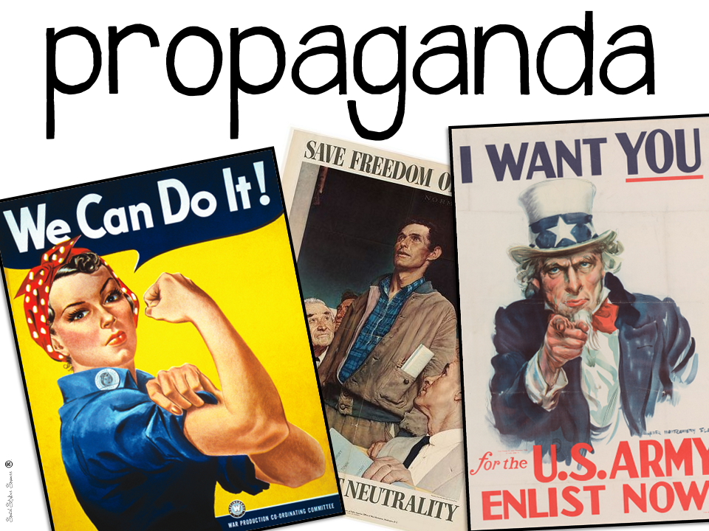
Word Wall

Slide 28
3, 2, 1 Definitions
3
2
1
things you see
actions or
senses
definition
Notes:
Allow them to pick a term with a partner and complete the 3, 2, 1 definition. I always bring the teachers close to word wall to get them out of their seats.

Slide 29
Image analysis
Directions: Examine each of the images depicting the Boston Massacre. Discuss the following questions with your group:
List three details you see in each image.
What are three similarities you see in each image? Three differences between the images?
Whose story are these images telling?

Slide 30
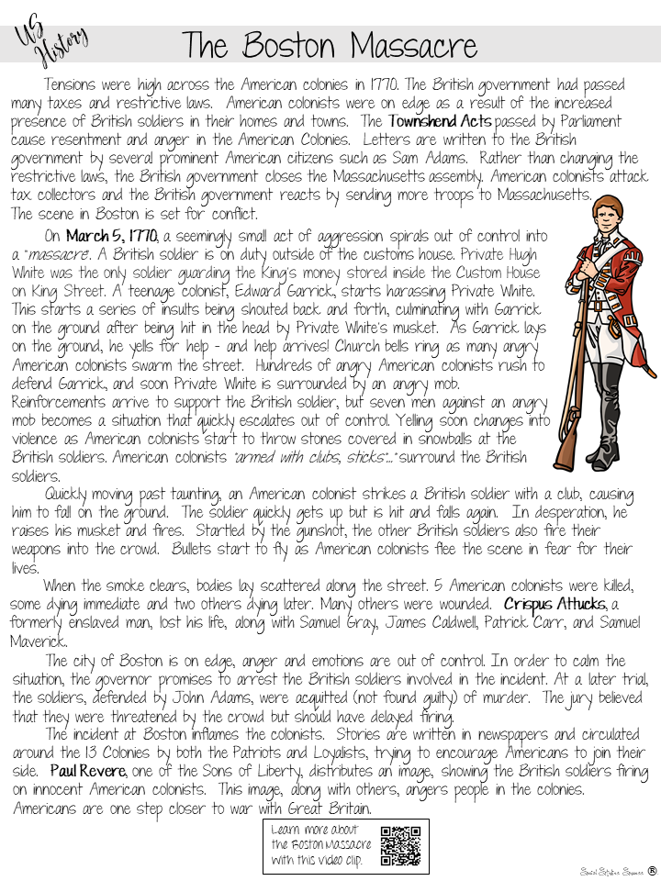
Reading
Take turns reading the information with your partner.

Slide 31
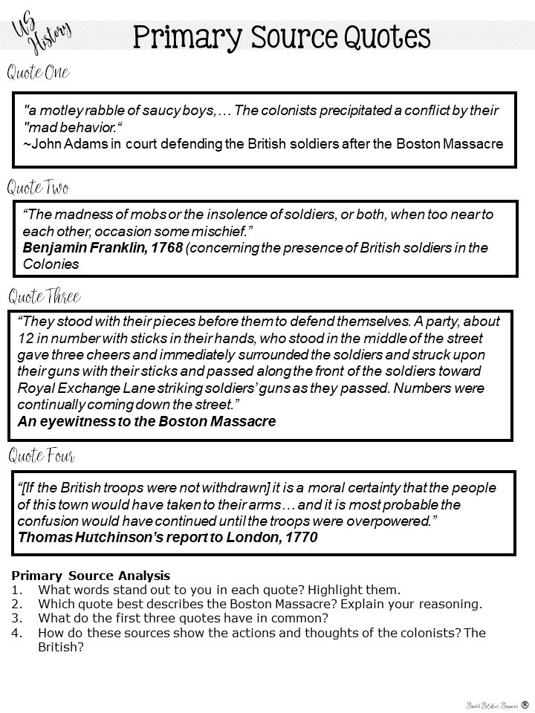
Primary Sources
Read the primary source quotes and discuss the questions with your partner.

Slide 32
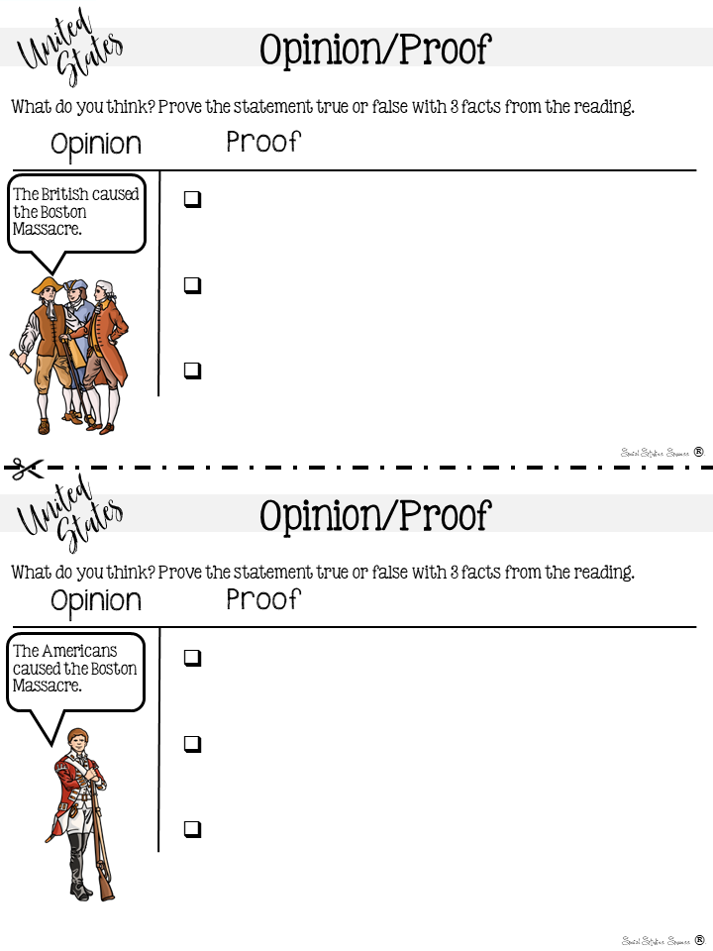
notes
Decide if you are going to represent a Loyalist or a Patriot.
Complete the Opinion/Proof notes from “your” point of view.

Slide 33
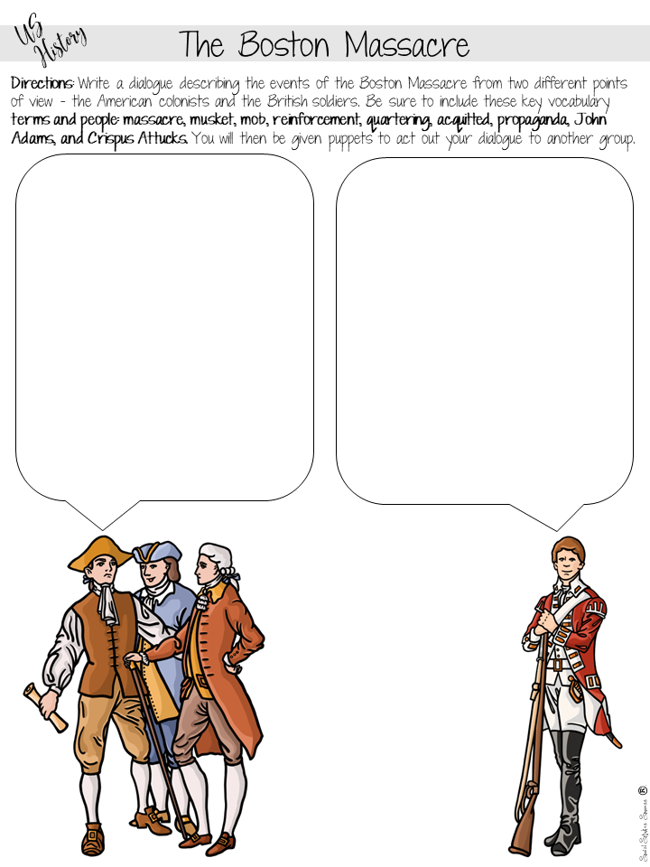
Puppet show
Write a dialogue discussing the Boston Massacre.
Practice your dialogue with your puppets.
Perform your dialogue to a small group.

Slide 34
GT
Tip
Design lessons that encourage greater study.
One
Design and offer choice in your lesson.
Tier up literacy levels.
Emphasize primary sources.
Notes:
Reflect on how the model lesson showcased each of these elements.
Now we are going to look at some additional ways to support these elements.

Slide 35
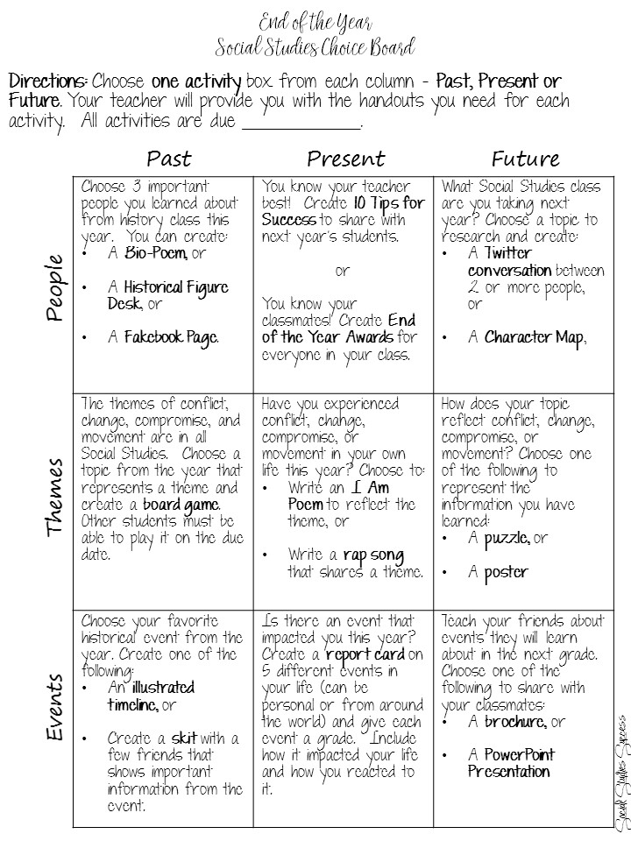
Create Choice Boards or Activities
Notes:
Additional ideas for greater study -

Slide 36
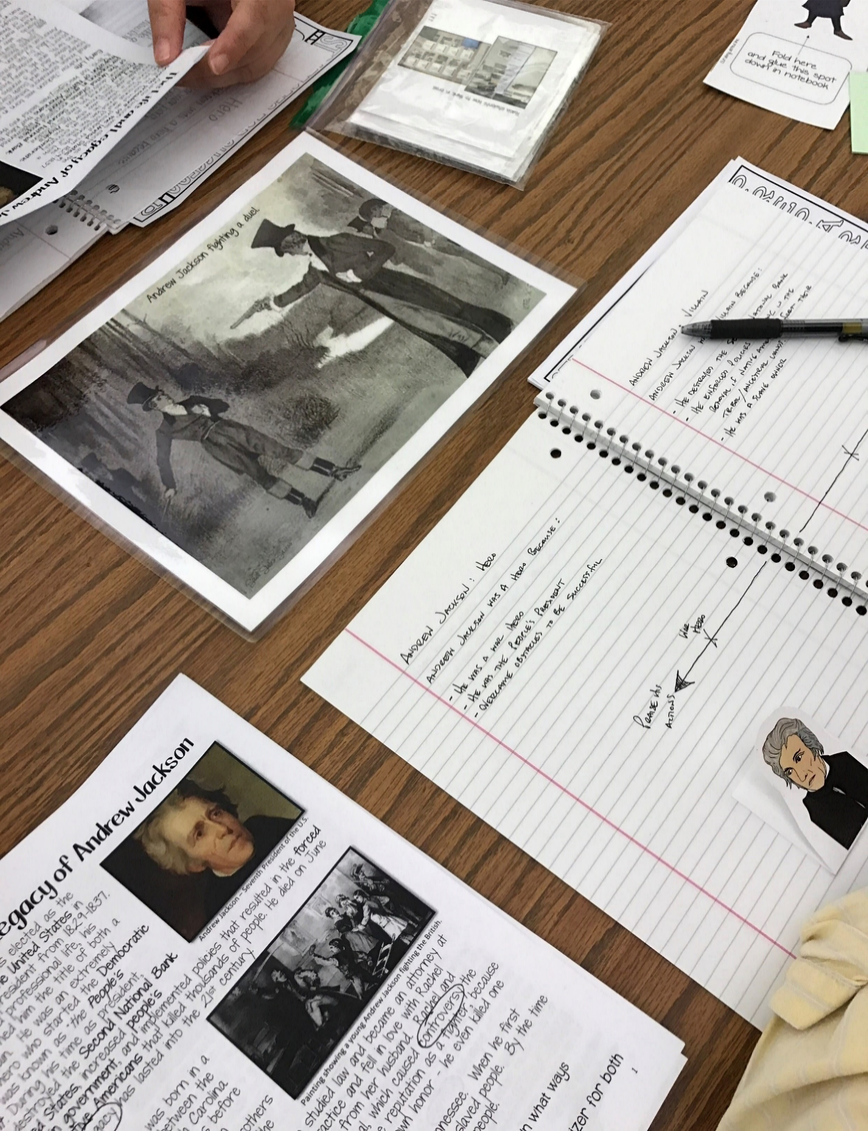
Tier Up Literacy
Go into greater depth in reading resources.
Offer multiple and varied types of writing assignments.

Slide 37
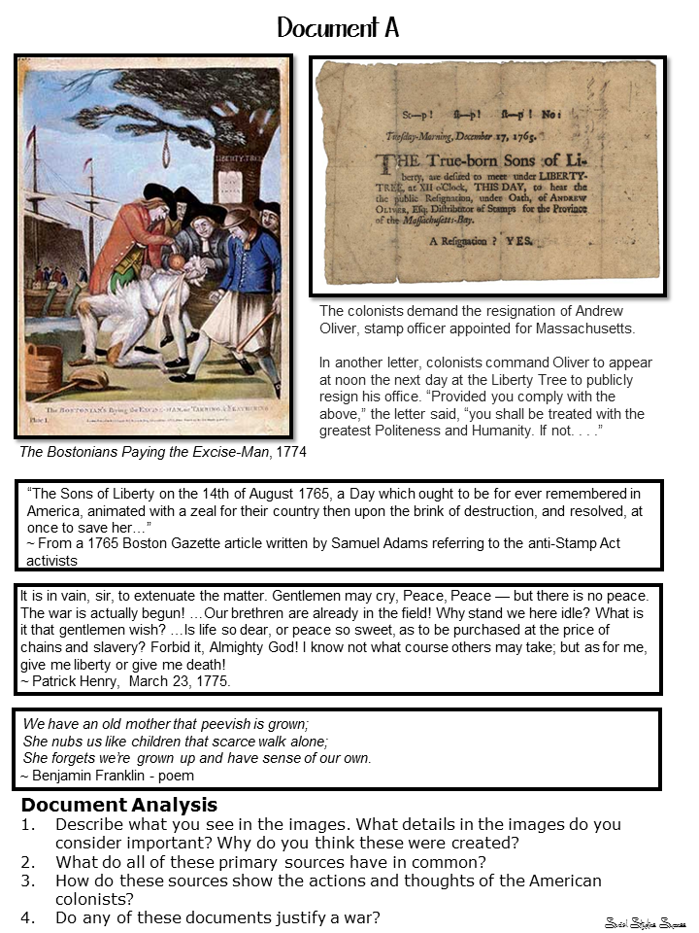
Use Primary Sources
Use images for building background knowledge.
Add primary source excerpts to daily assignments.

Slide 38
Take a 15 minute
Break!

Slide 39
Do a “one-legged interview.”
Share what you have learned so far.
Notes:
39
Pair participants.
One person stands on one leg and shares everything they have learned about before reading strategies.
When that person loses her balance (or runs out of things to say), the other person stands on one leg & shares what she knows.
Gets blood flowing & usually keeps summaries short – people can’t maintain their balance & think. Plus it is funny to watch!

Slide 40
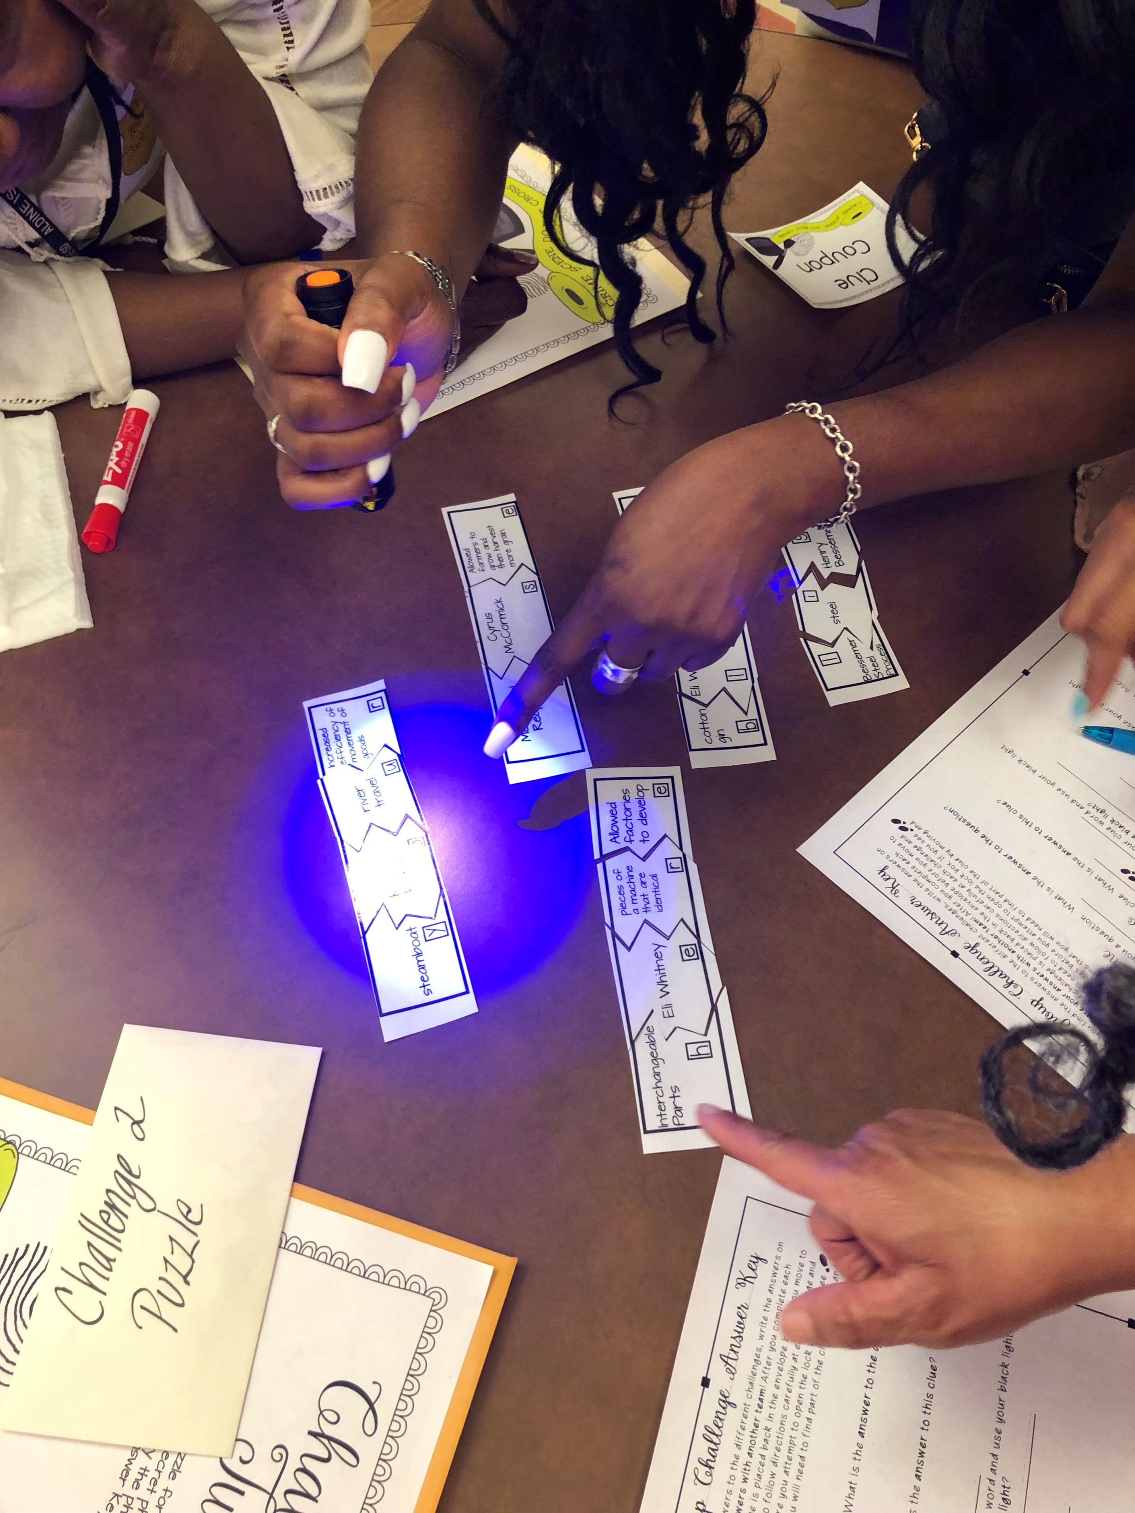
GT
Tip
Design lessons that are complex and challenging.
Two
Design student challenges.

Slide 41
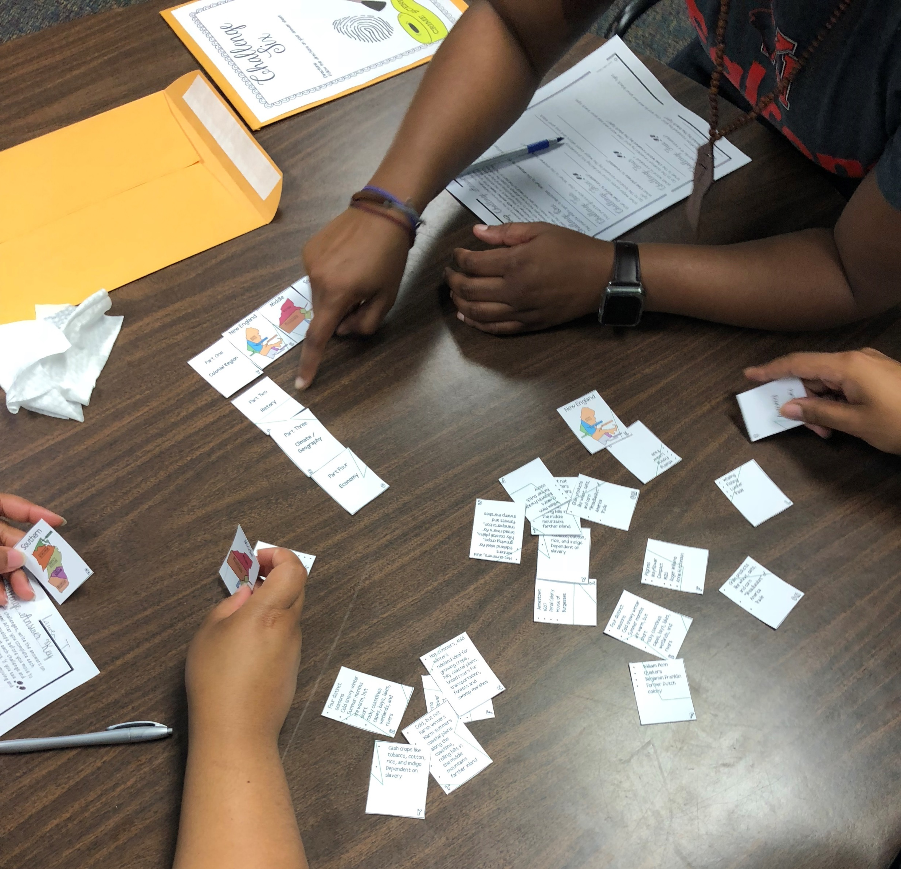
Create Student Challenges
Escape the Room
Lock Box Activities
Puzzles
Scavenger Hunts

Slide 42
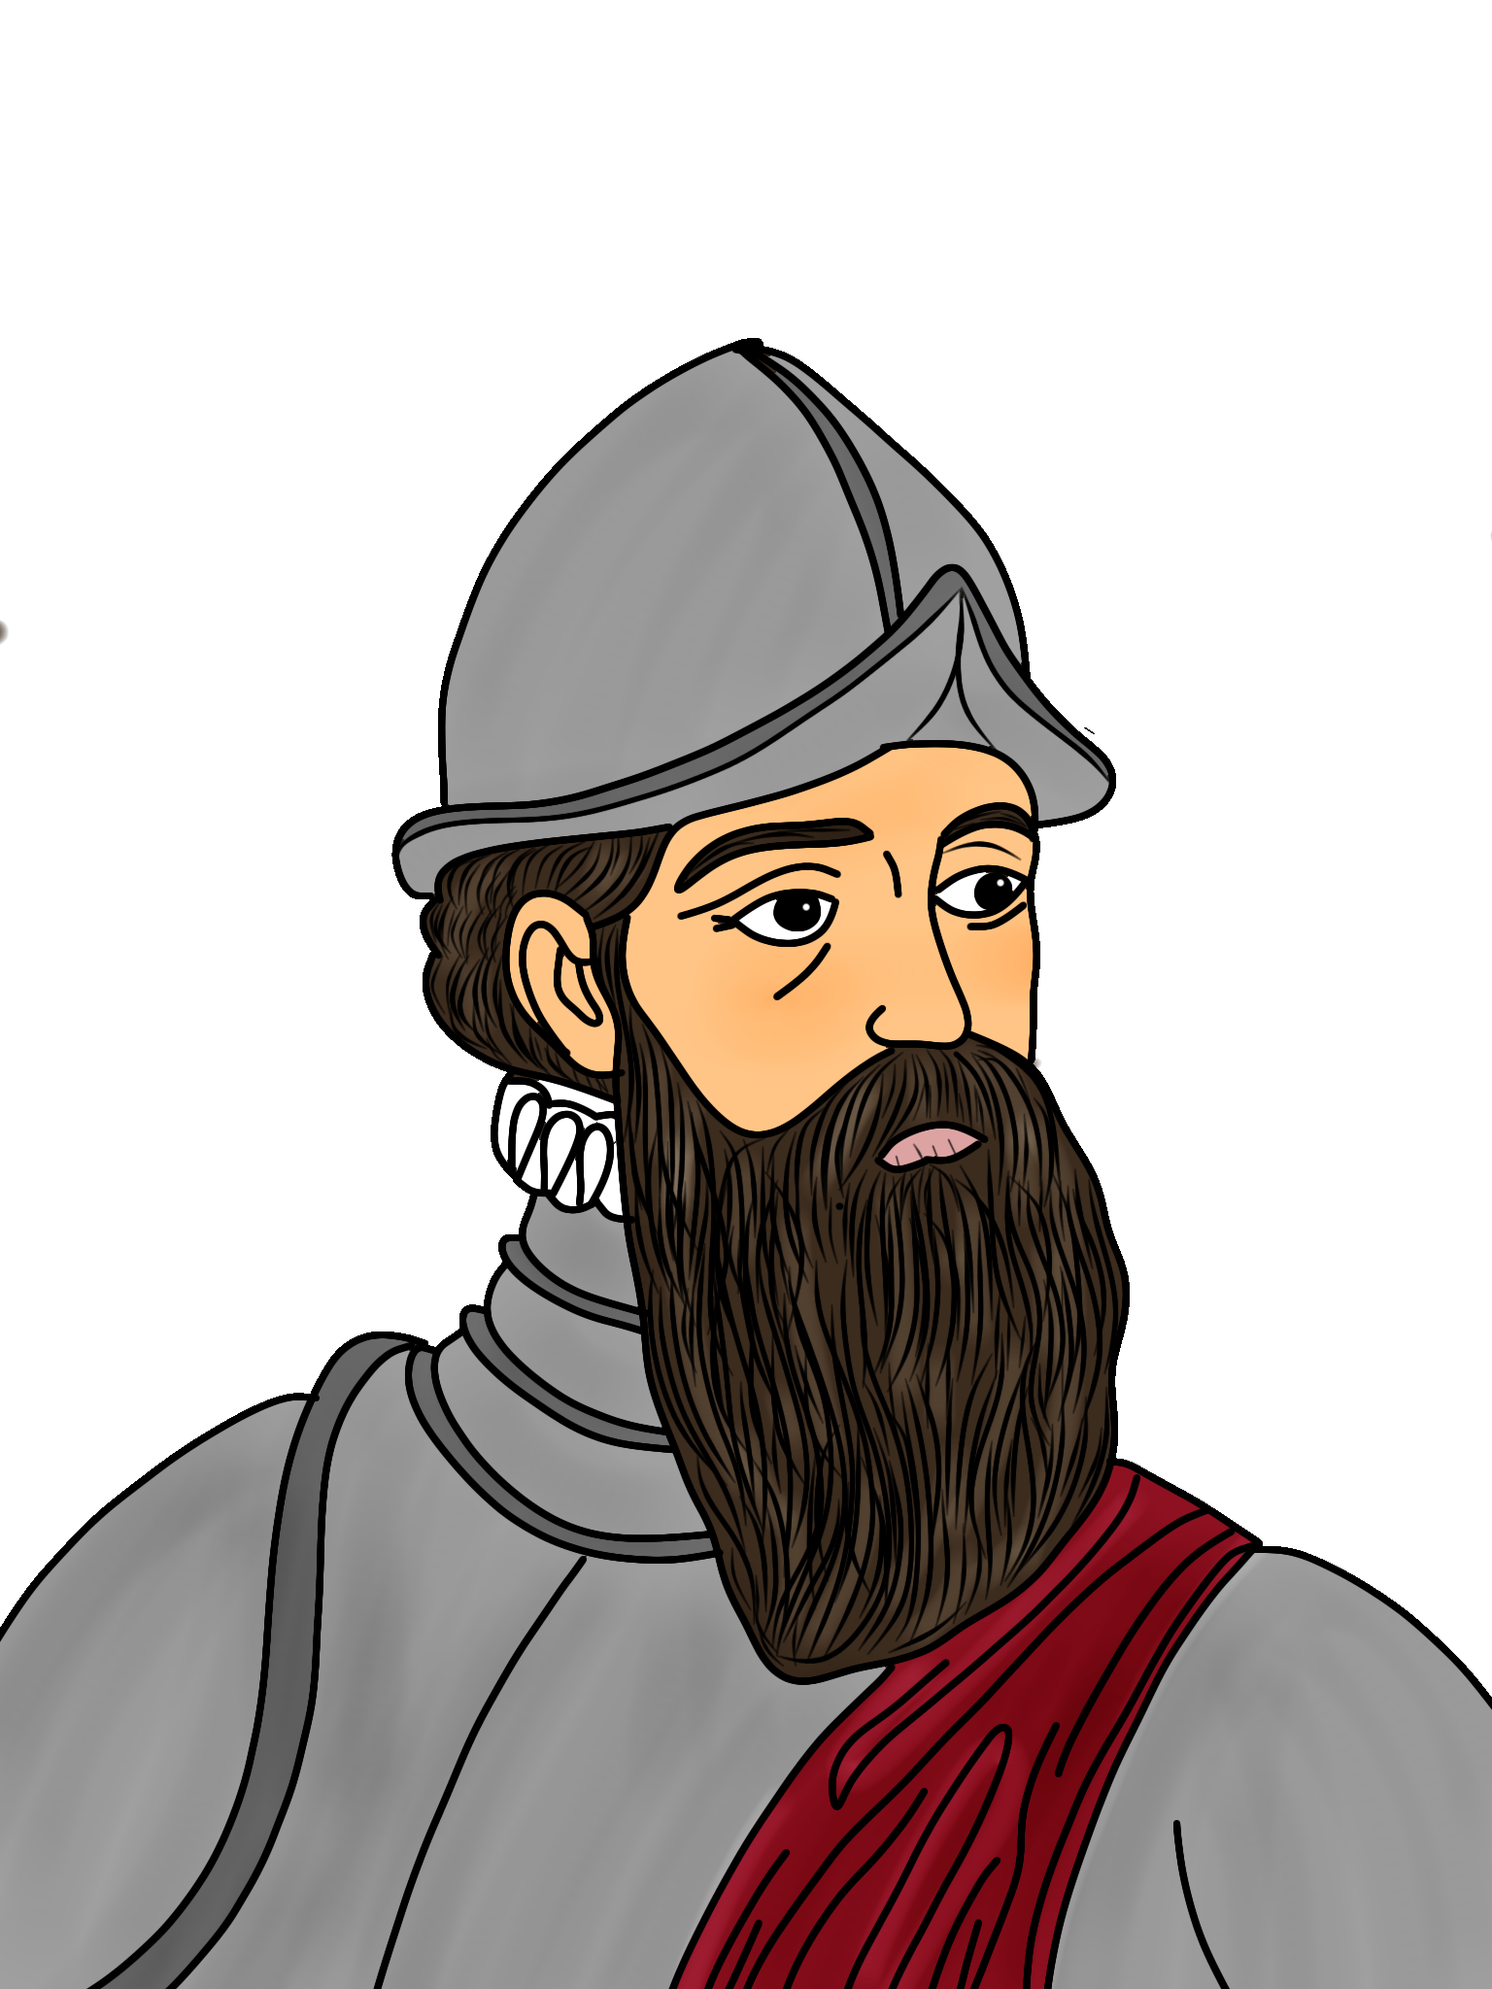
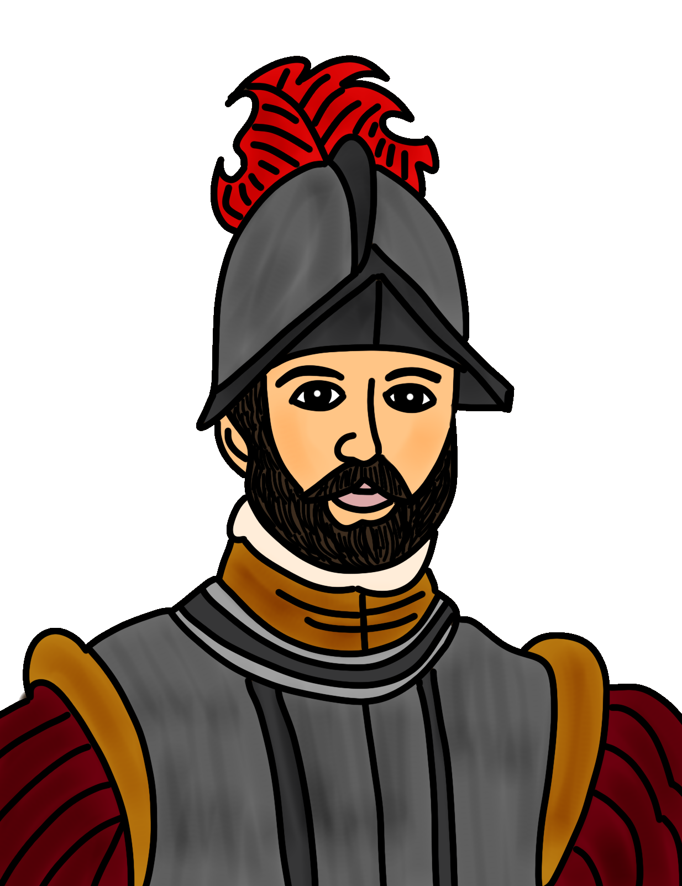
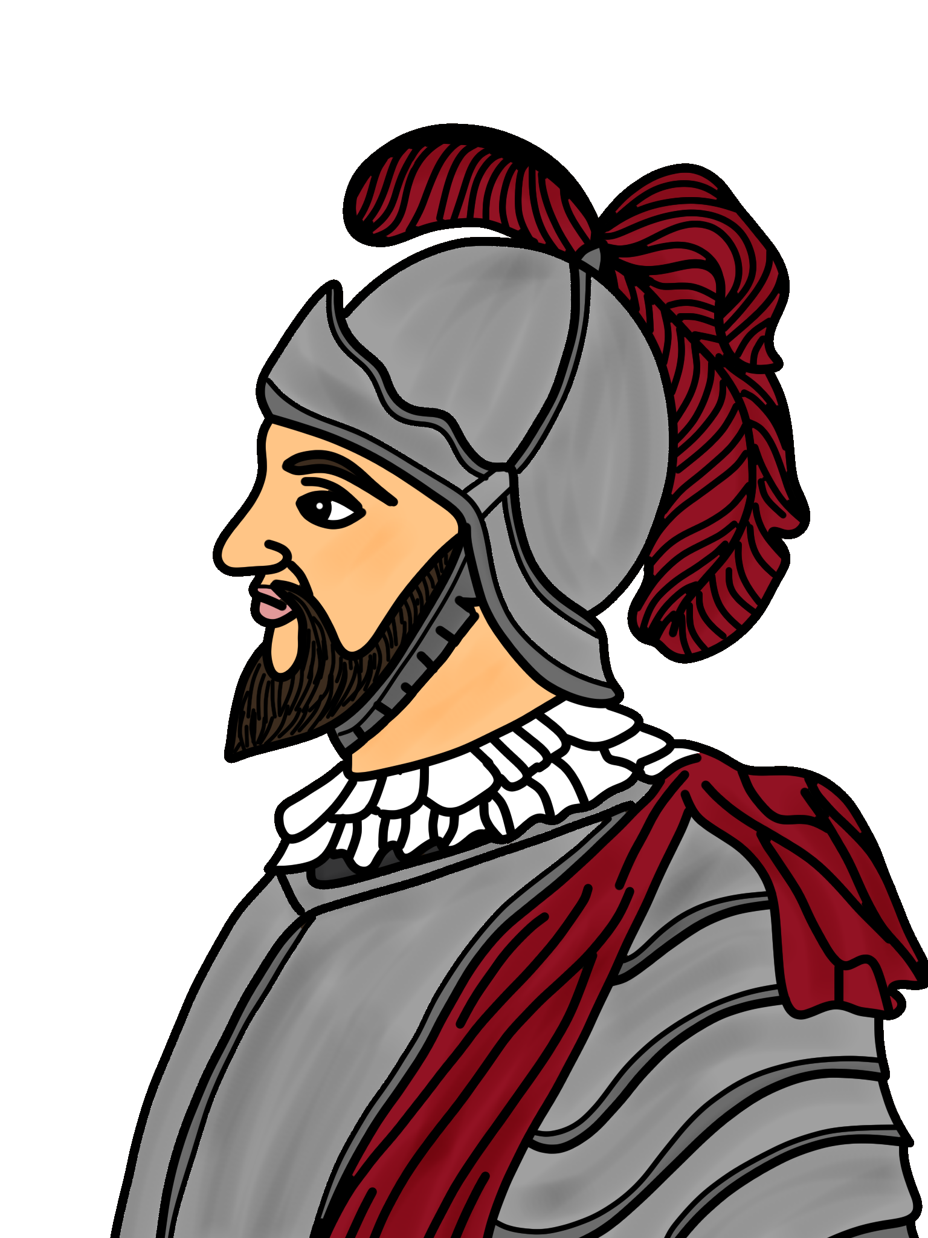
The Explorers of Texas
Notes:
The sample we are going to do next is a scavenger hunt that relies heavily on inferencing.

Slide 43
Objectives
(B) identify important individuals, events, and issues related to European exploration of Texas such as Alonso Álvarez de Pineda, Álvar Núñez Cabeza de Vaca, the search for gold, and the conflicting territorial claims between France and Spain;
Content Objective: Students will identify important individuals, events and issues related to European exploration of Texas.
Language Objective: Students will show comprehension through
inferential skills while reading.

Slide 44
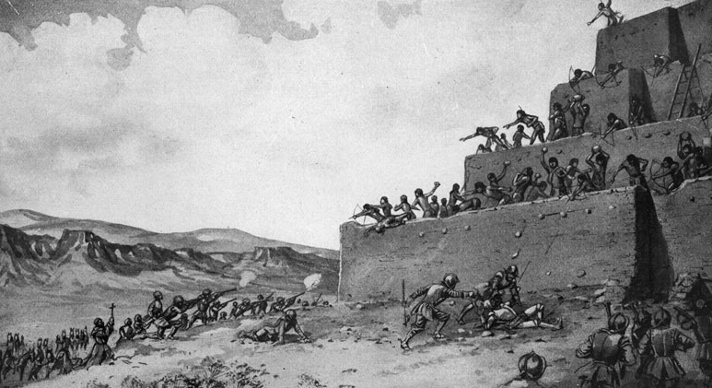
Preview
Notes:
Project this image and ask the students to discuss what they see.

Slide 45
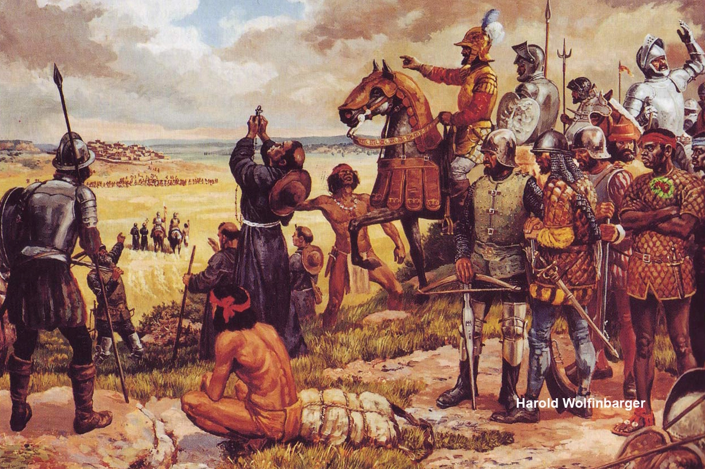
Preview
Notes:
Project this image and ask the students to discuss what they see.

Slide 46
Place the sentence strip next to the image you think it matches – one example has been done for you.
Preview
This painting depicted the battle between Spanish soldiers and Zuñis during Coronado’s attack of July 6, 1540.
Notes:
Give students time to match sentences to pictures. Debrief.

Slide 47
Scavenger Hunt
Step One: Examine the clue you have been given. Look at the symbols and try to determine what they may mean.

Slide 48
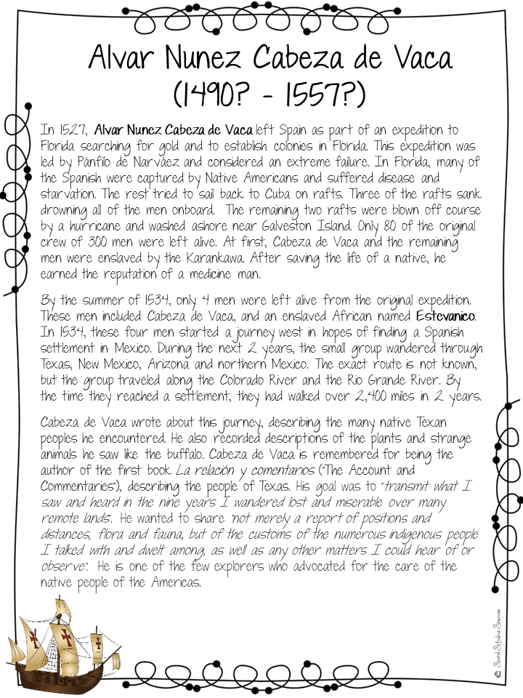
Scavenger Hunt
Step Two: Skim the readings on the different Conquistadors of Texas – does your clue match the reading?

Slide 49
Scavenger Hunt
Step Three: Check with your teacher – does the clue match the reading?

Slide 50
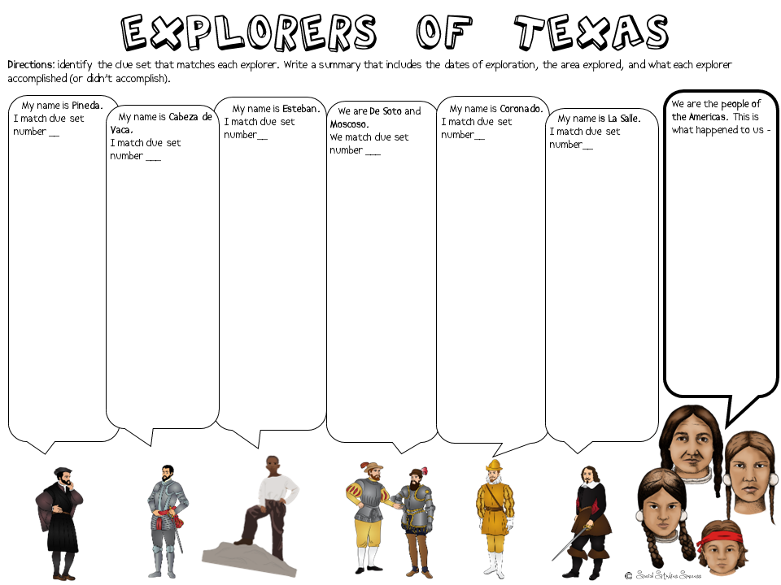
Scavenger Hunt
Step Four: Summarize the information on your conquistador.
Step Five: Check with your teacher, get a new clue and repeat the process.

Slide 51
Boom cards
Notes:
You can set up a code for the boom cards up to 14 days in advance of the training.

Slide 52
Questions?

Slide 53
Card Chat
Write down one GT strategy you will commit
to using.

Slide 54
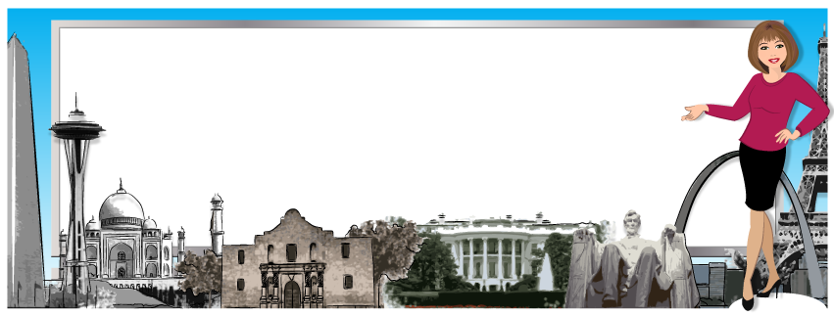
Connect with me!
www.SocialStudiesSuccess.com

