Slide 1

Notes:
Post Word Wall terms in the front of the room

Slide 2


Slide 3

Notes:
Spend a few minutes introducing your personal and professional life.

Slide 4

Notes:
The following slides list the research that goes into my workshops. I quickly share all of the research, and on the last slide I ask, “Which of these do you agree with?” and share the answer with a partner.

Slide 5


Slide 6
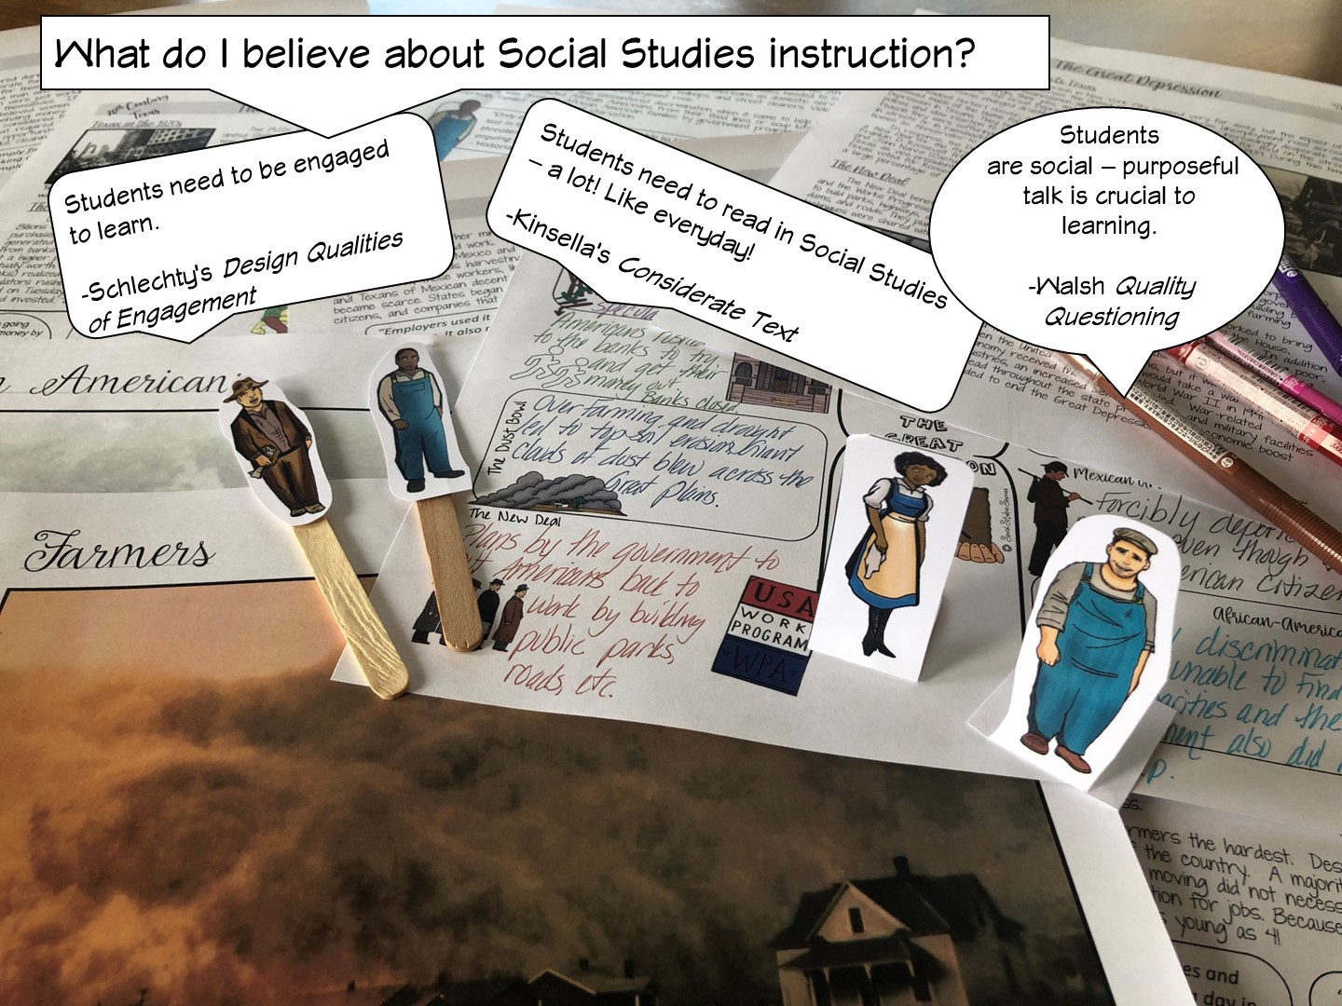

Slide 7
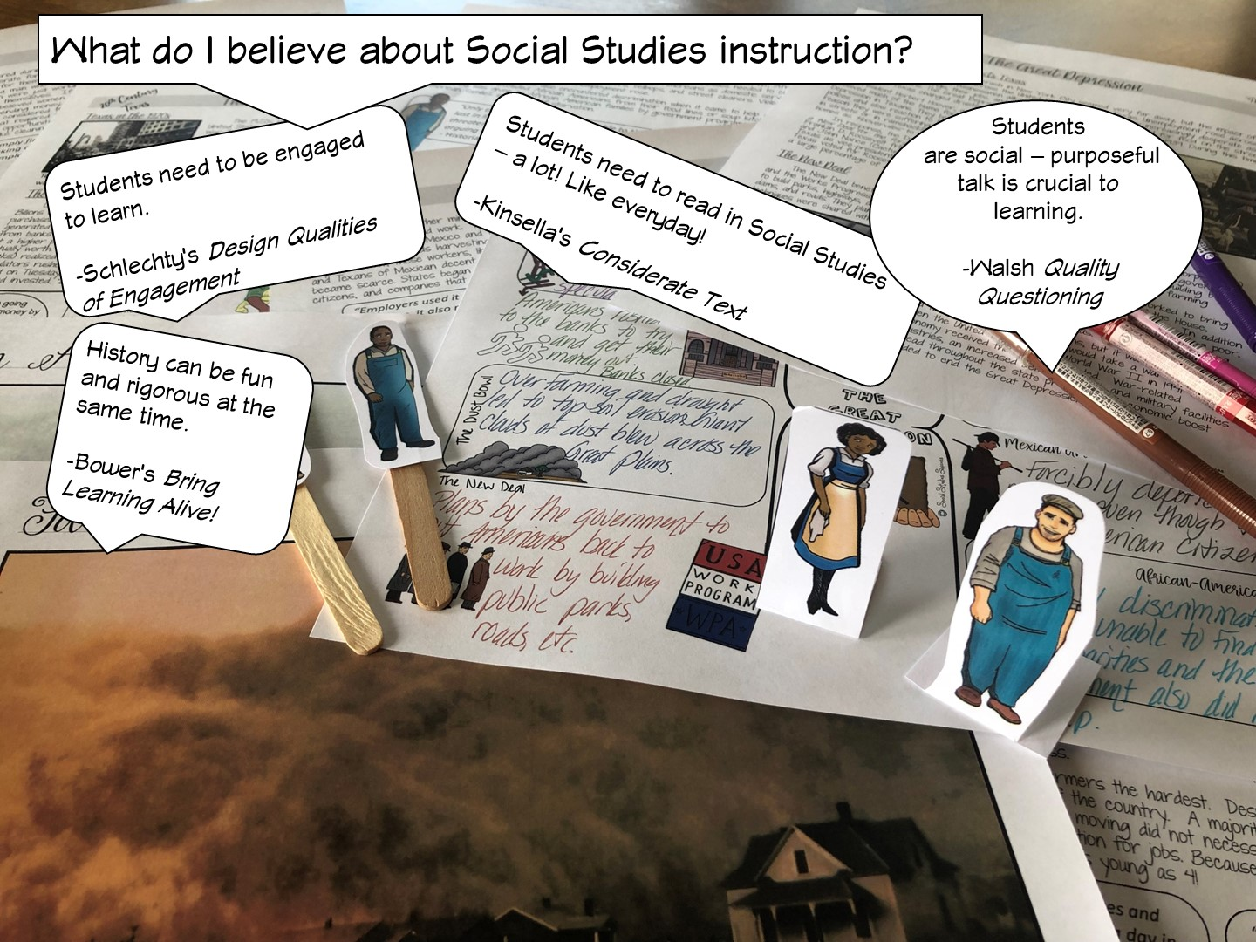

Slide 8


Slide 9
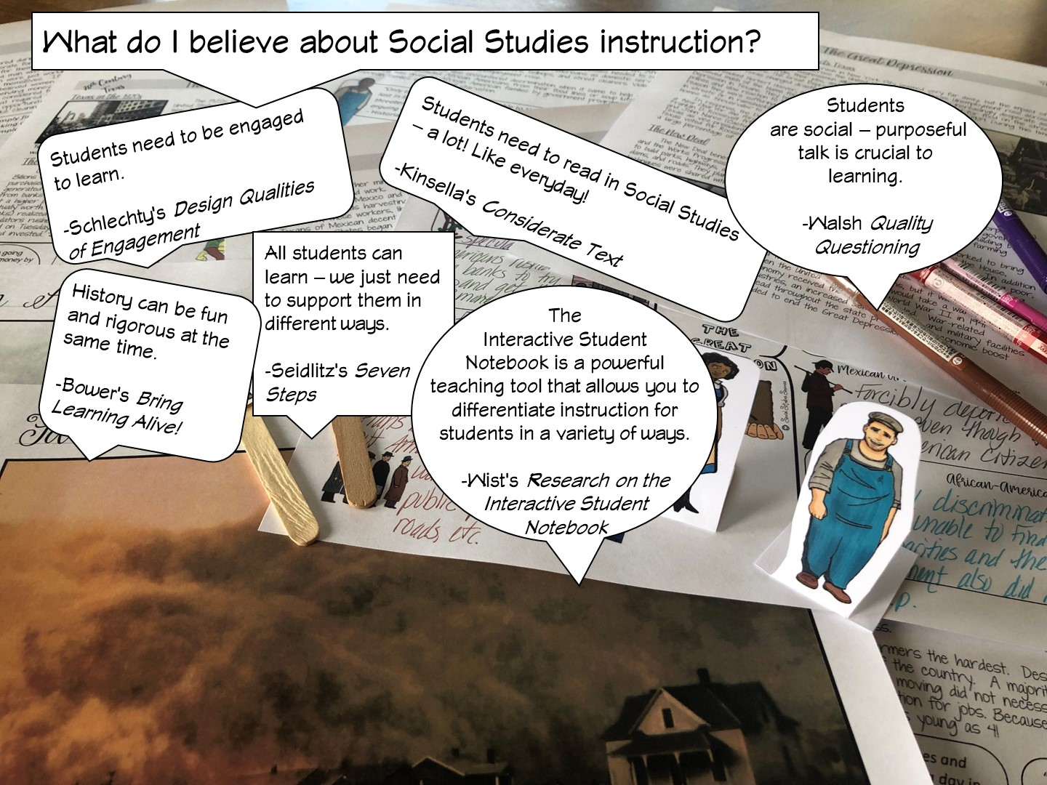

Slide 10
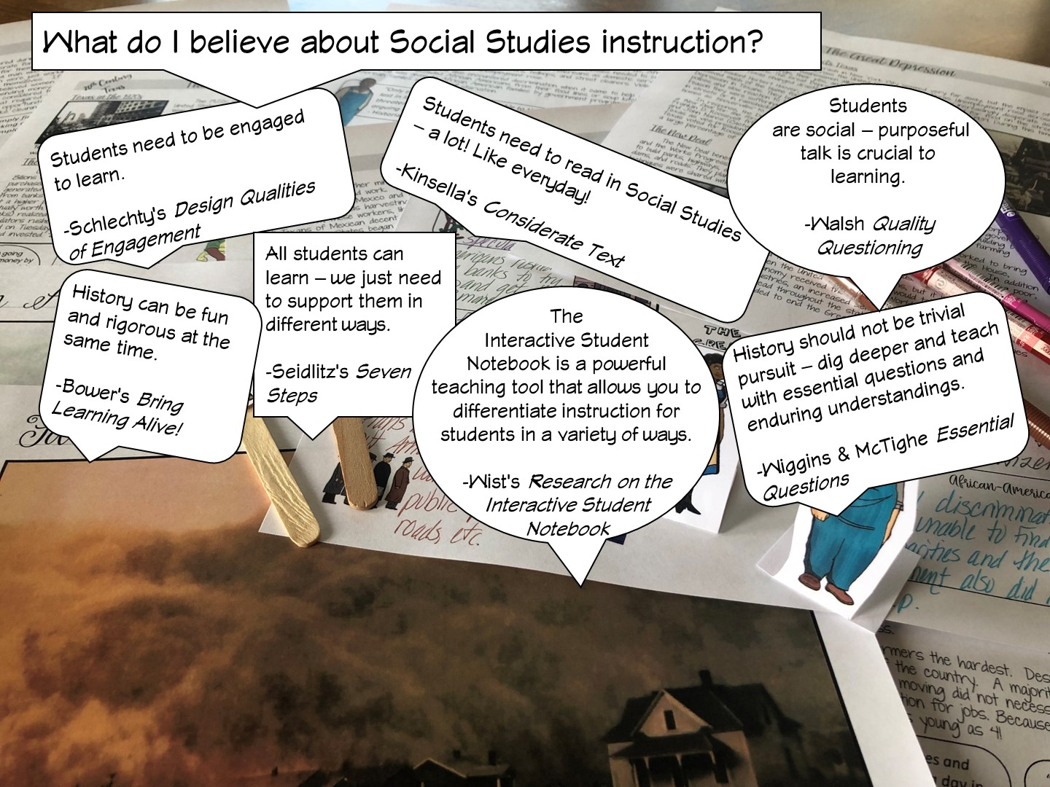

Slide 11
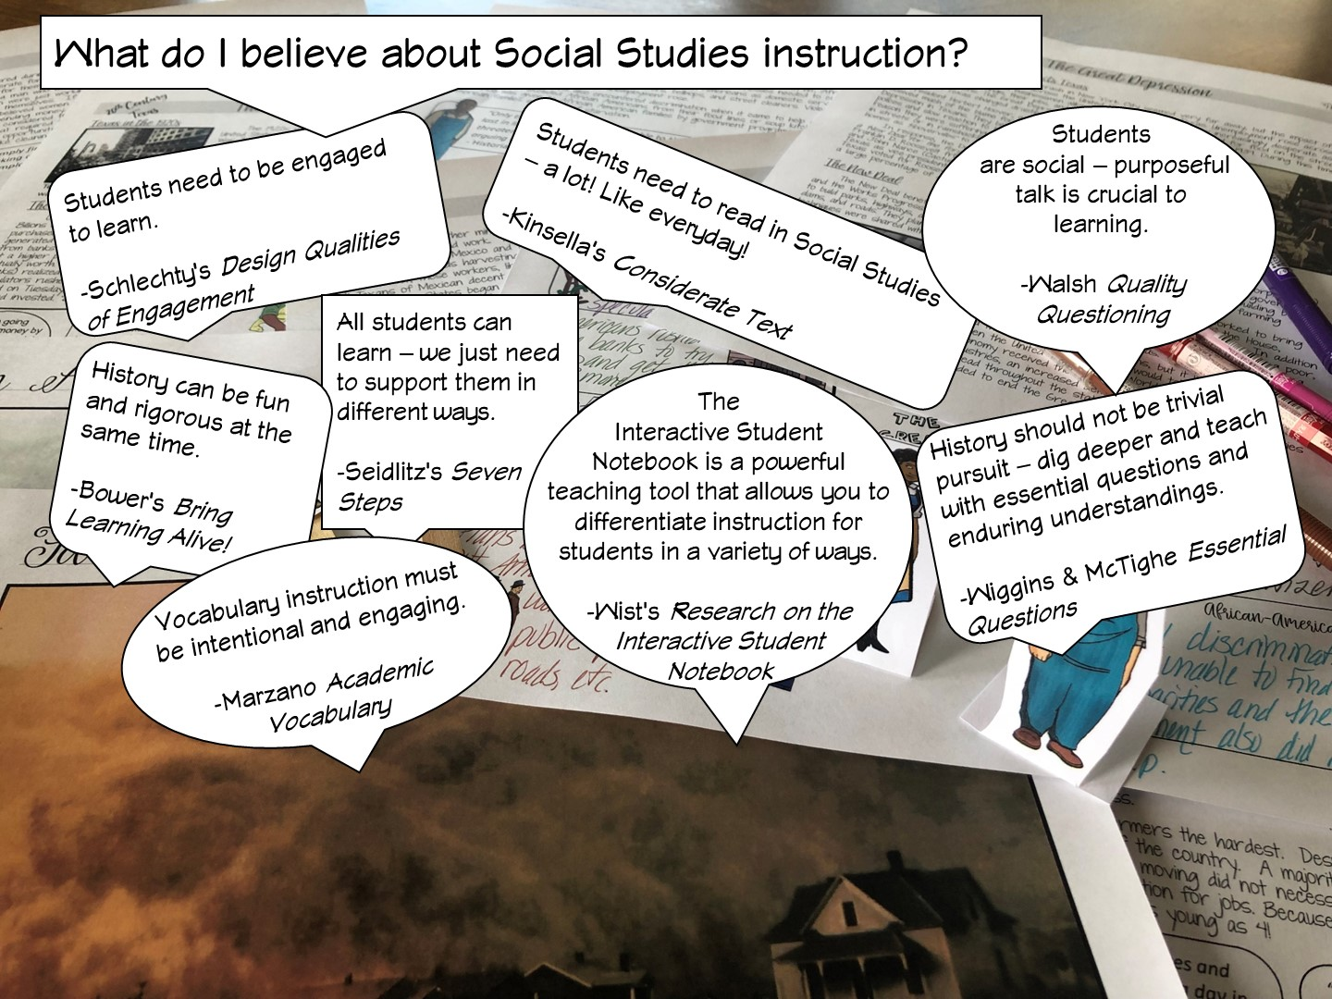

Slide 12
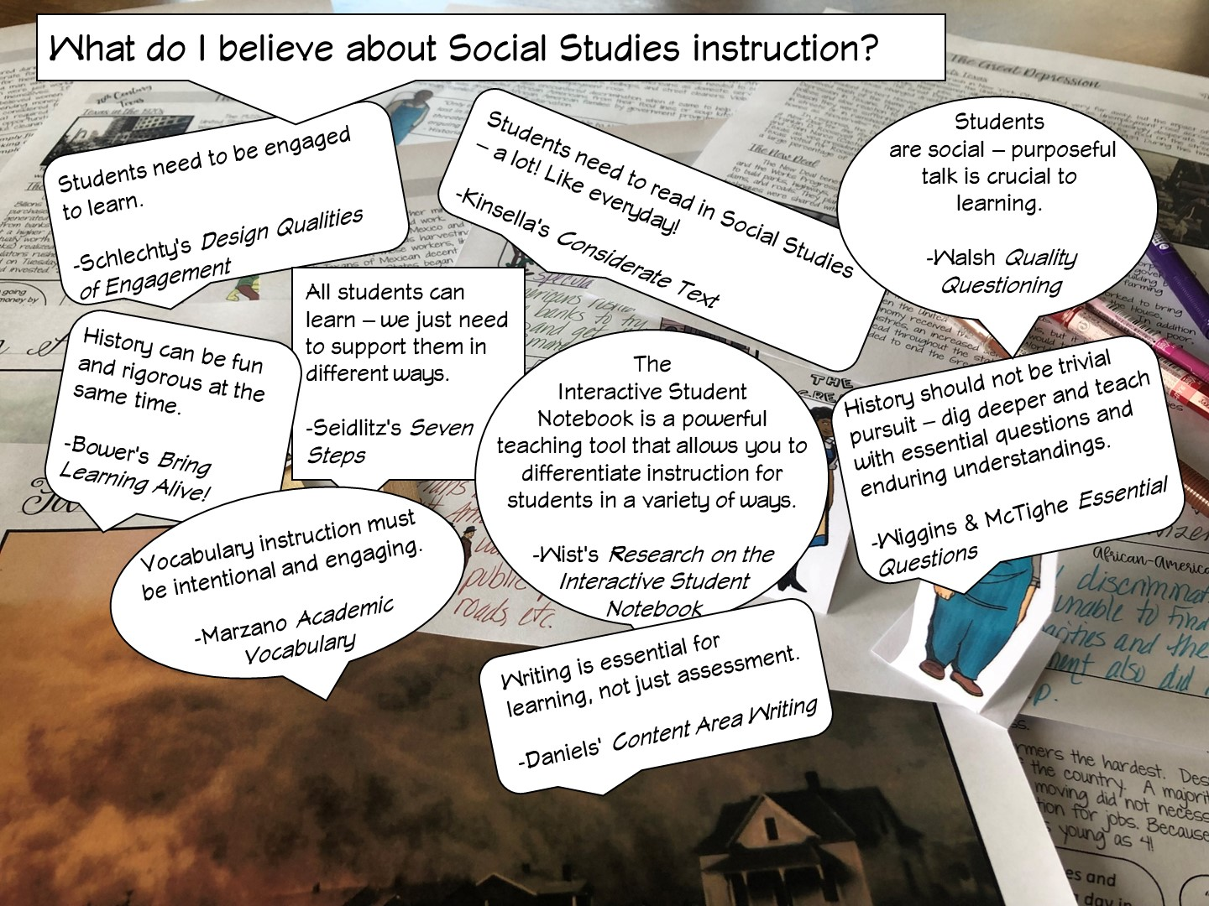

Slide 13
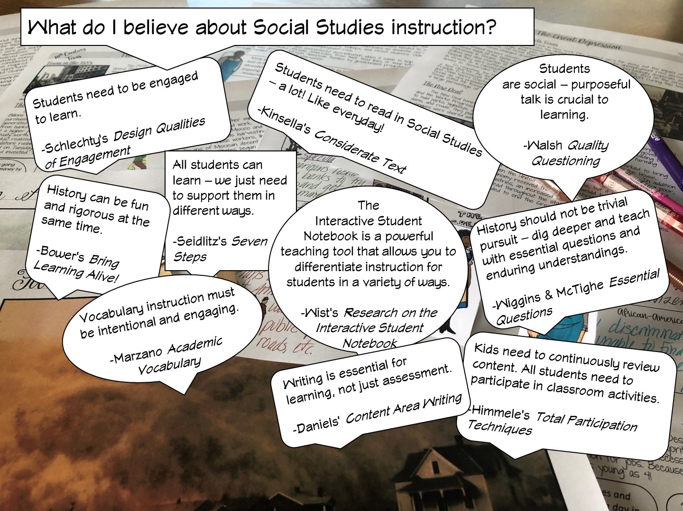

Slide 14
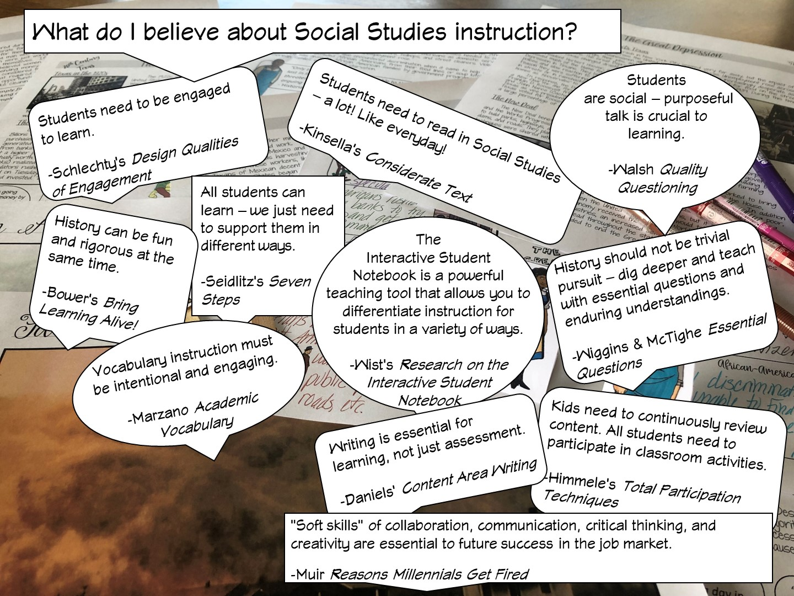

Slide 15
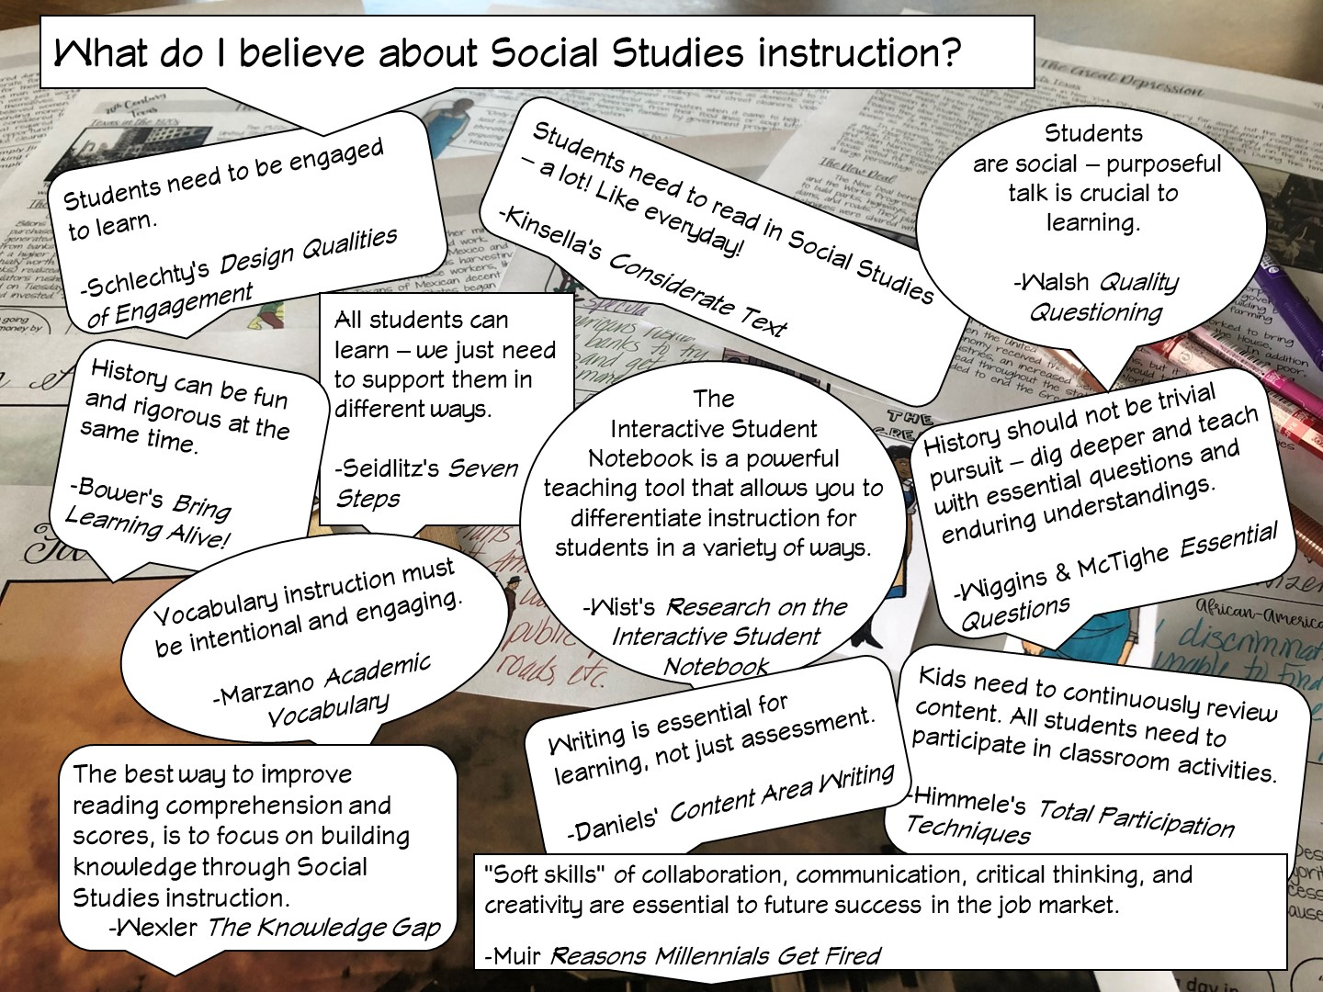
Notes:
After I have reviewed the different research – I ask the teachers, which one they agree with and why – have them talk to their table or partner.

Slide 16

Notes:
History teachers are the guardians of democracy

Slide 17


Slide 18

Notes:
Place the teachers with a partner.

Slide 19

Notes:
You are going to be modeling lessons they would use in the first six weeks of school.

Slide 20
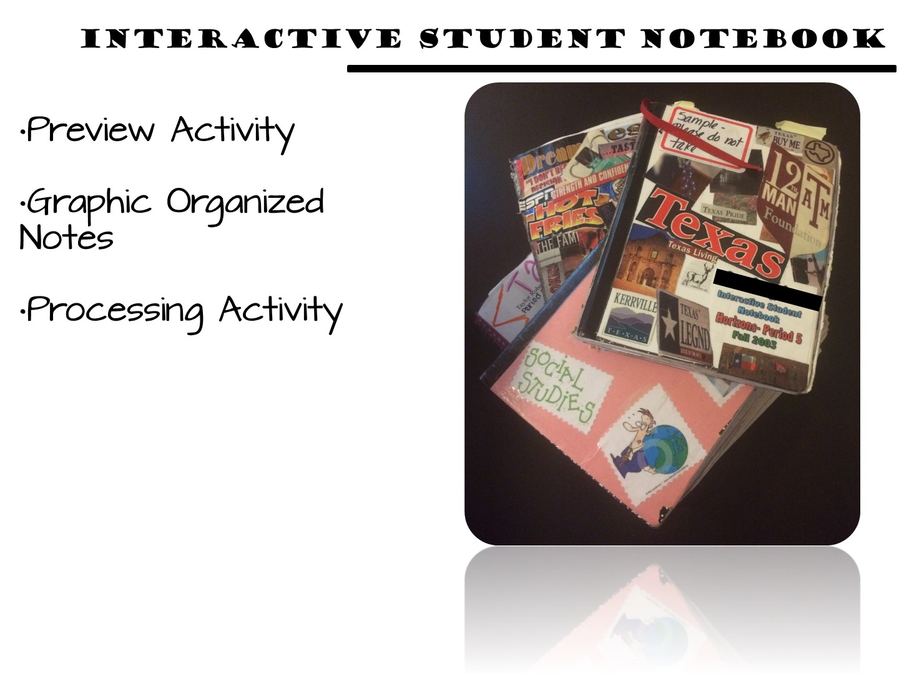
Notes:
All of my resources for Texas History support the Interactive Student Notebook, which is a district initiative for Ysleta ISD. The packet I am going to give you for this activity will simulate an ISN but would actually be put in your students notebook.

Slide 21
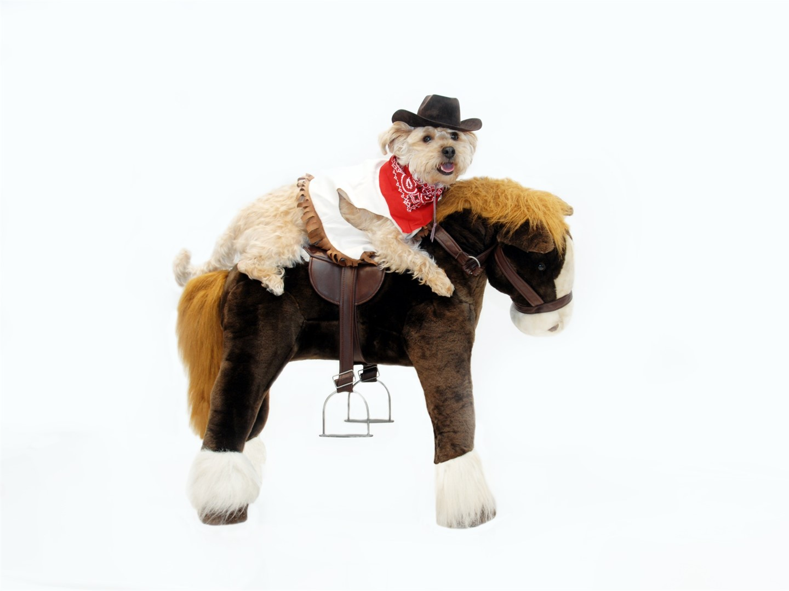
Notes:
This lesson is a dog and pony show as you will be modeling as many different strategies as you can. The lesson in their own classroom will be much simpler.

Slide 22


Slide 23

Notes:
TEKS: compare the cultures of American Indians in Texas prior to European colonization such as Gulf, Plains, Puebloan, and Southeastern;

Slide 24
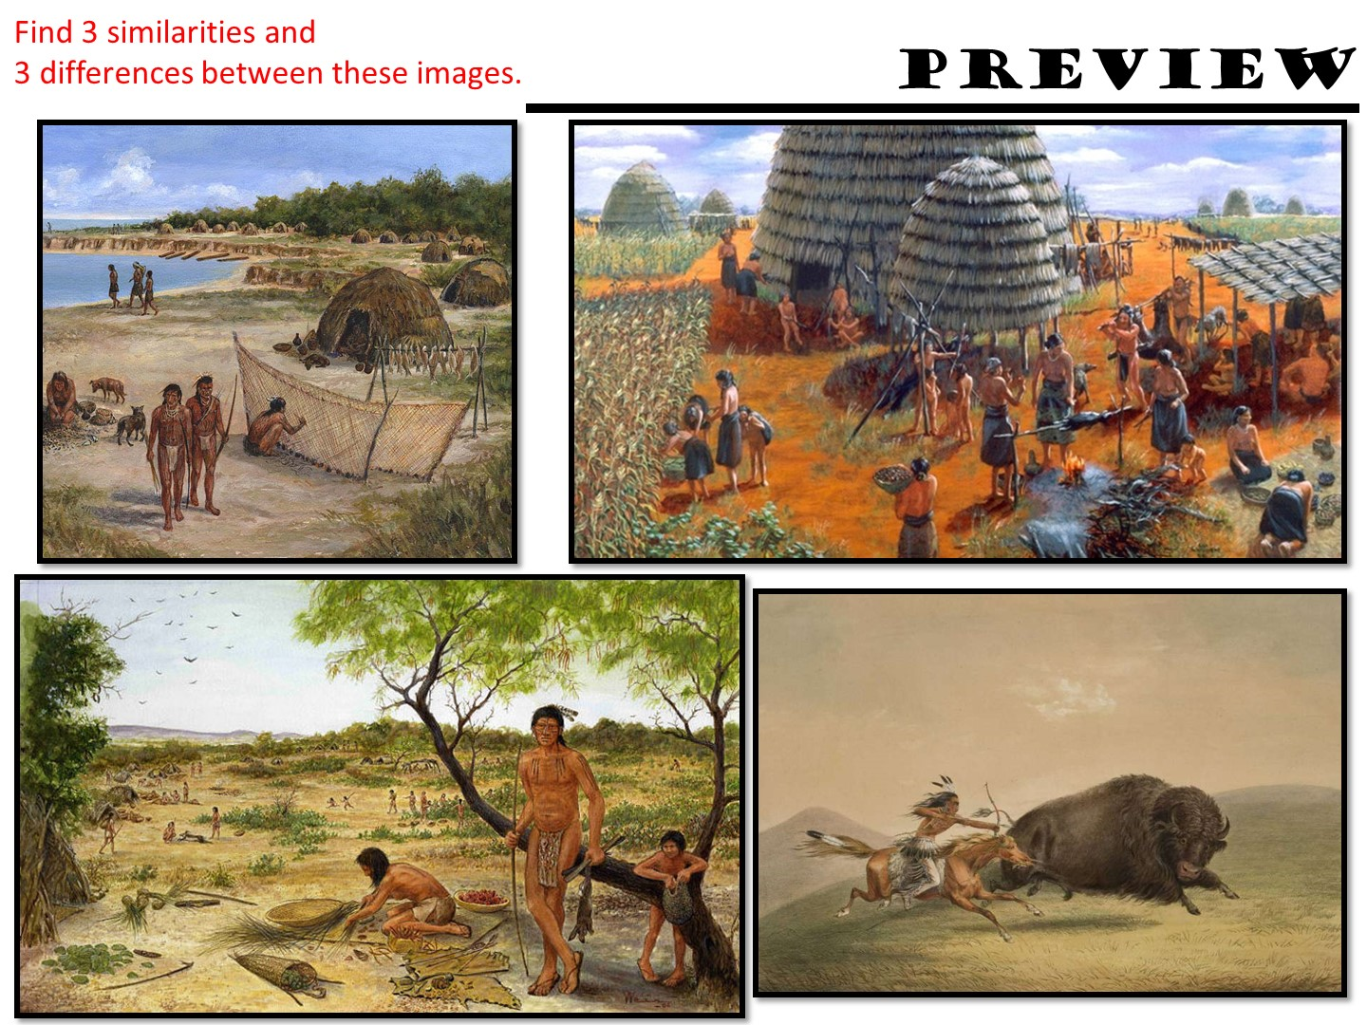
Notes:
Have them find 3 similarities and 3 differences between these images – they can discuss as a partner.

Slide 25
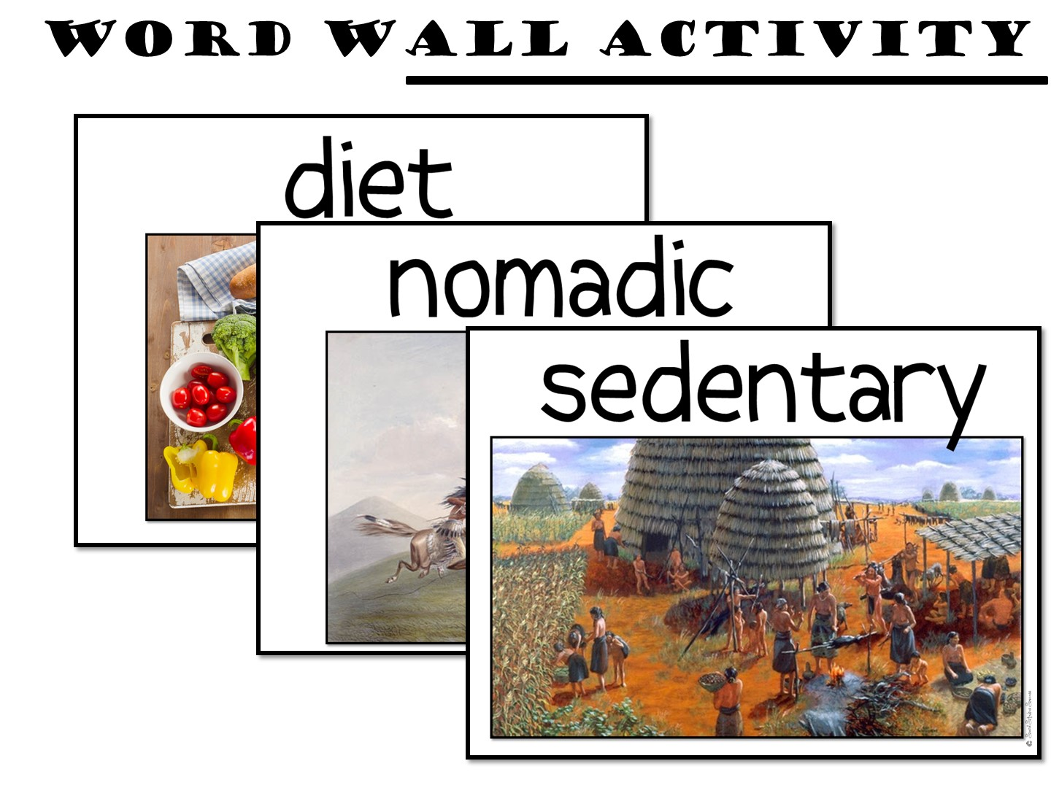
Notes:
You are going to model how to use the word wall. Point to each term and pronounce it to the teachers. Require them to pronounce the terms back.

Slide 26
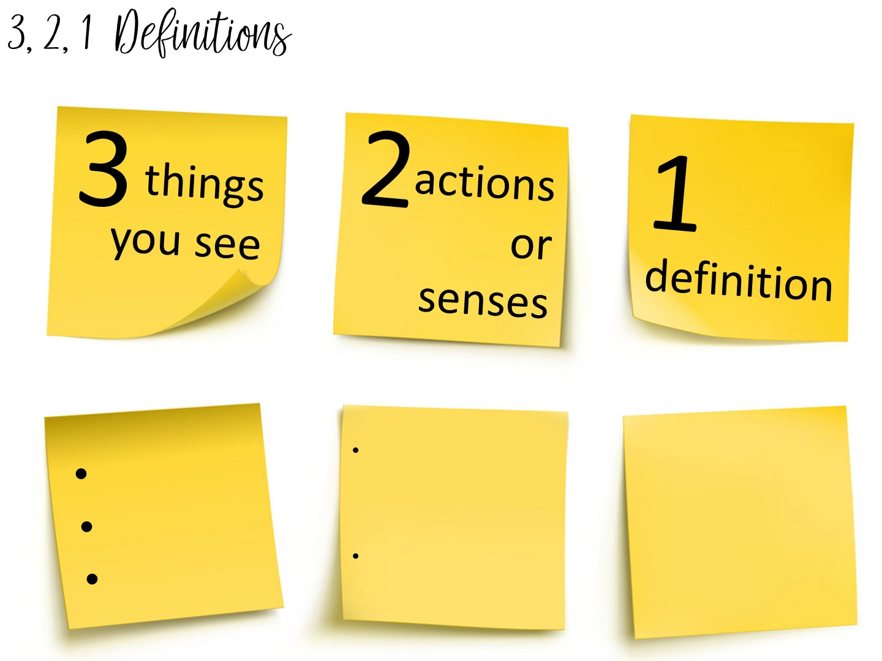
Notes:
You are going to teach vocabulary with images is the 3, 2, 1 Definitions – Allow students time to analyze an image to build their understanding of an image.
Allow them to pick a term with a partner and complete the 3, 2, 1 definition. I always bring the teachers close to word wall to get them out of their seats.

Slide 27
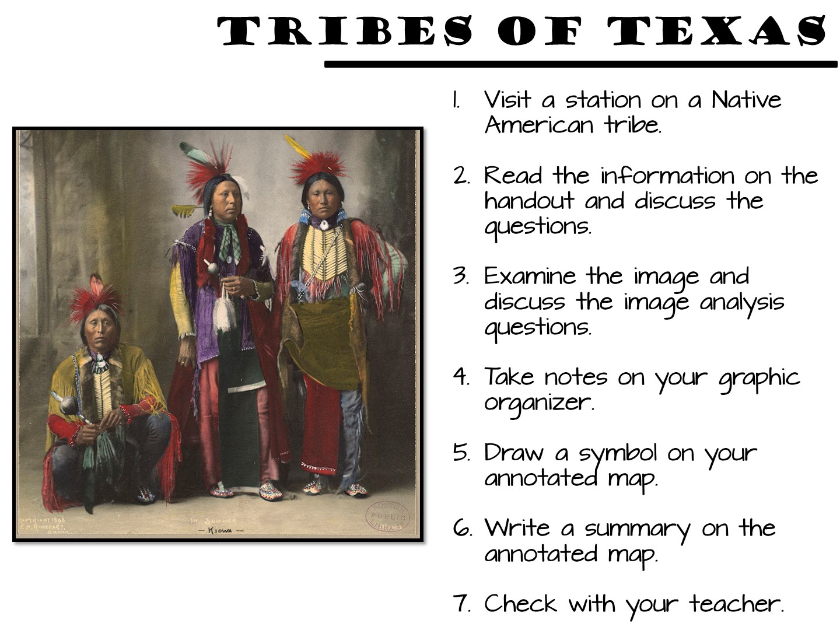
Notes:
Give them time to complete 1-2 centers.
These are the overall directions – the next slide will allow you to model step by step.

Slide 28
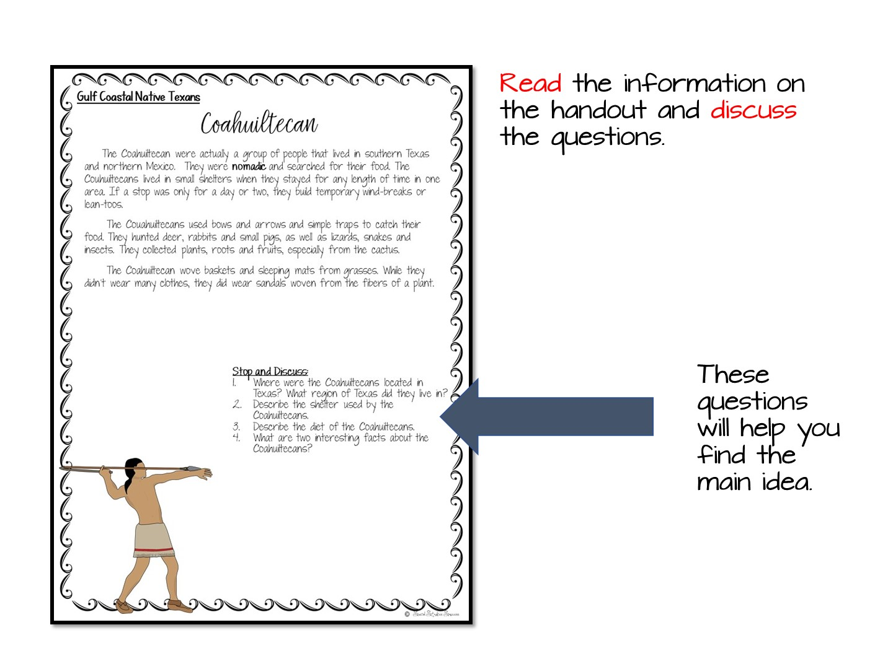

Slide 29
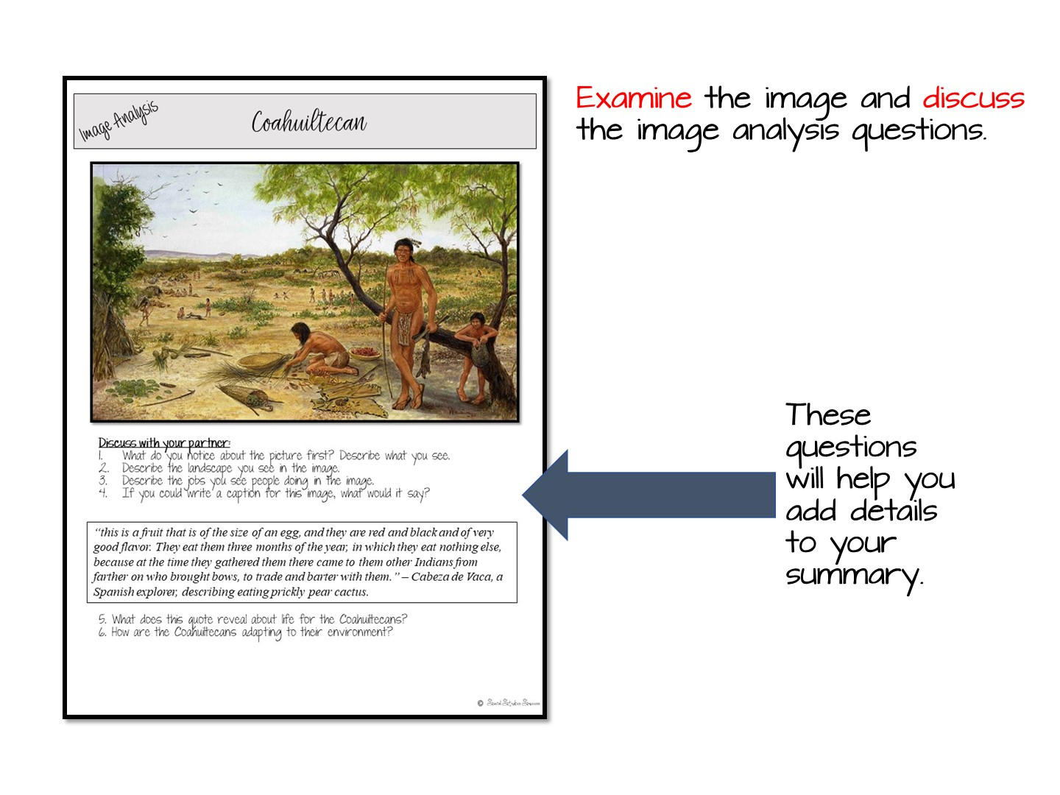

Slide 30
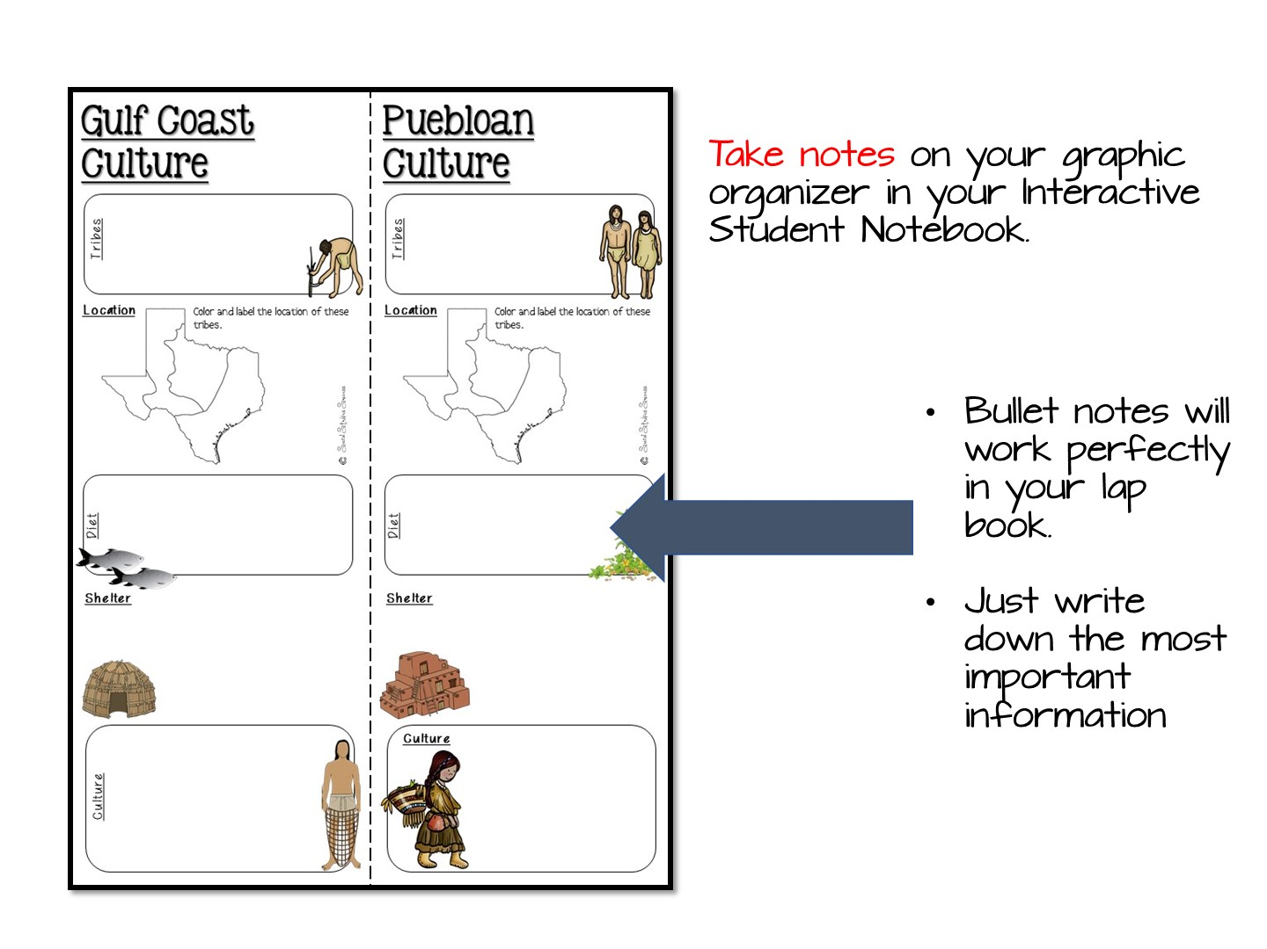

Slide 31
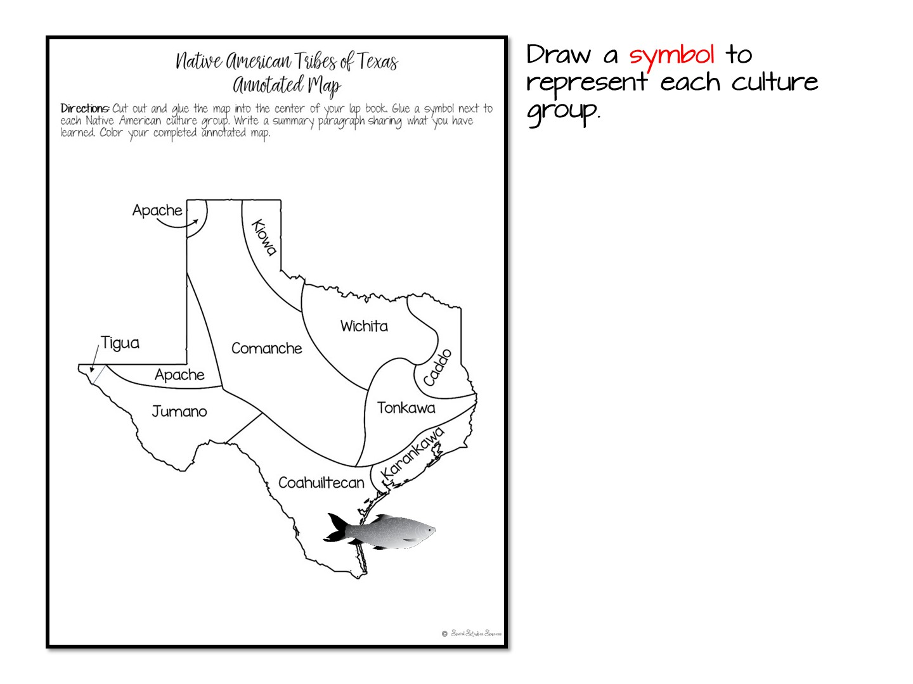

Slide 32
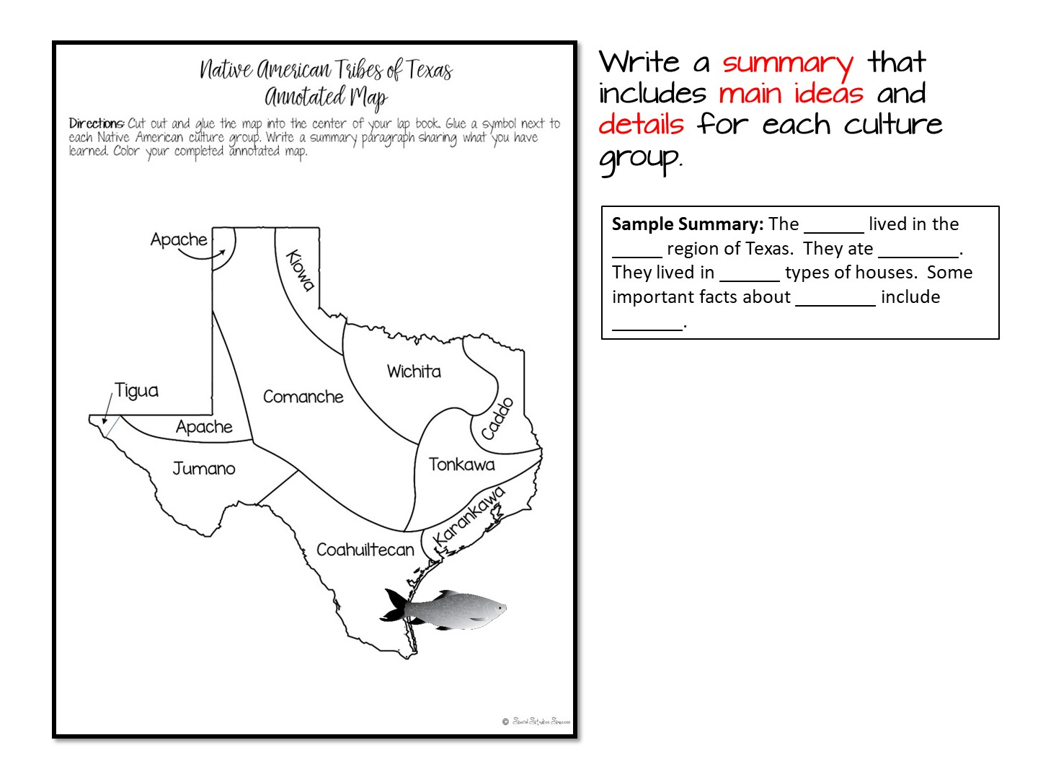

Slide 33


Slide 34
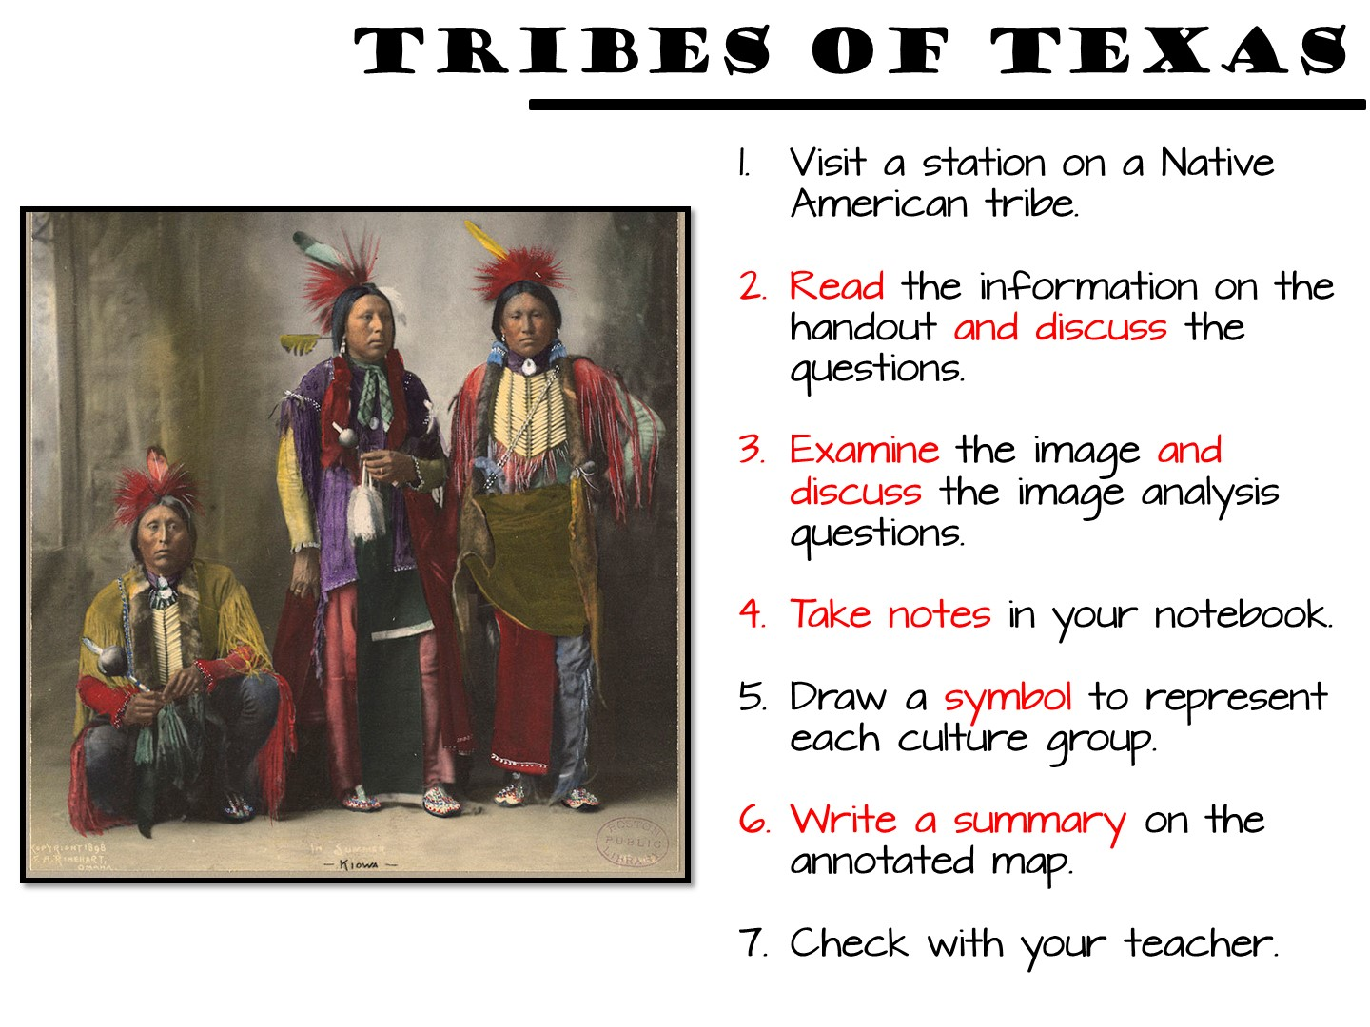
Notes:
These directions can be up while they work in their small groups.

Slide 35
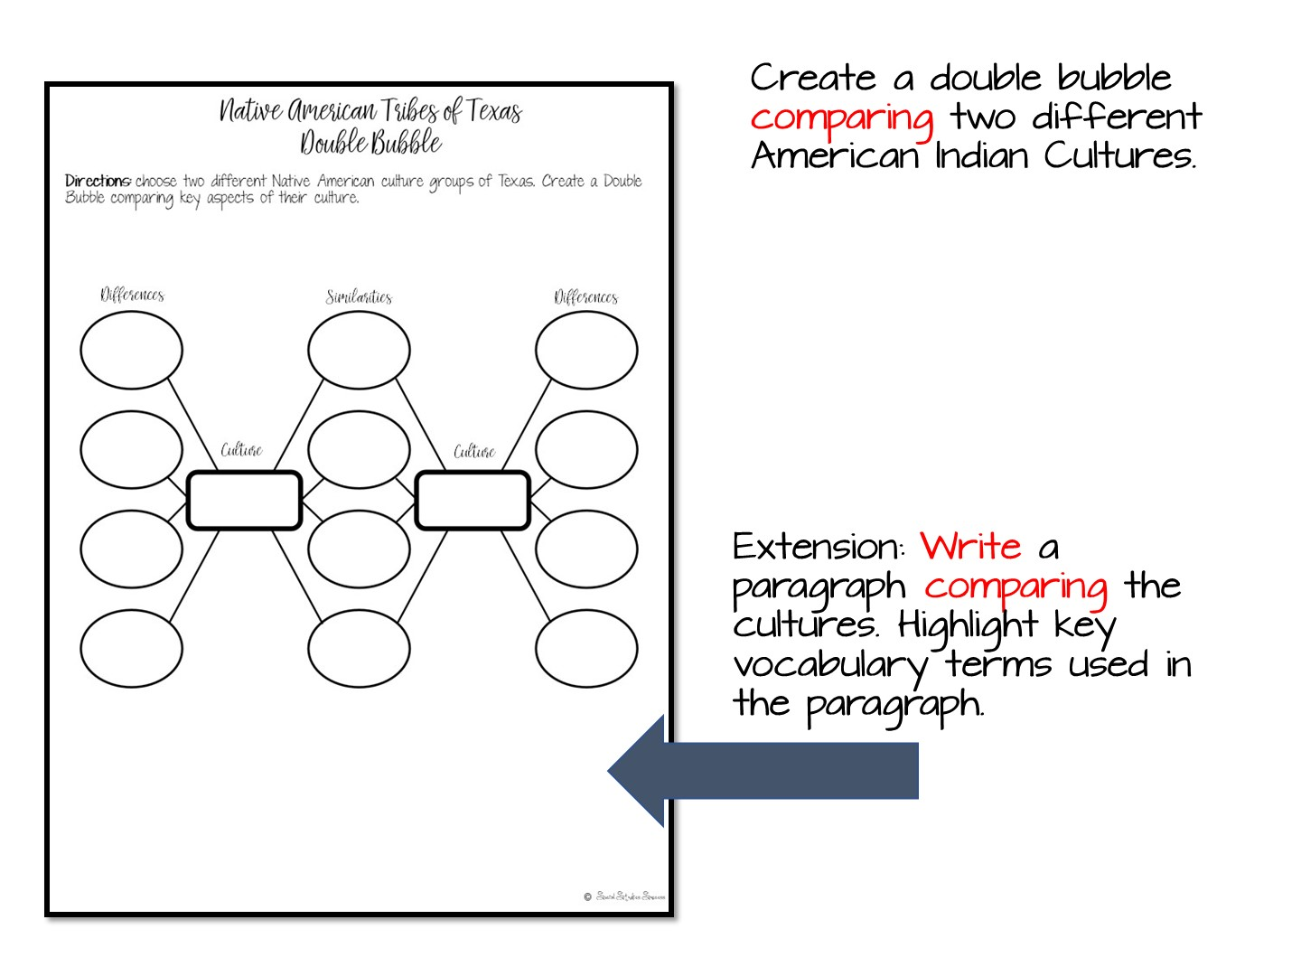
Notes:
They do not have time for this, just show.

Slide 36
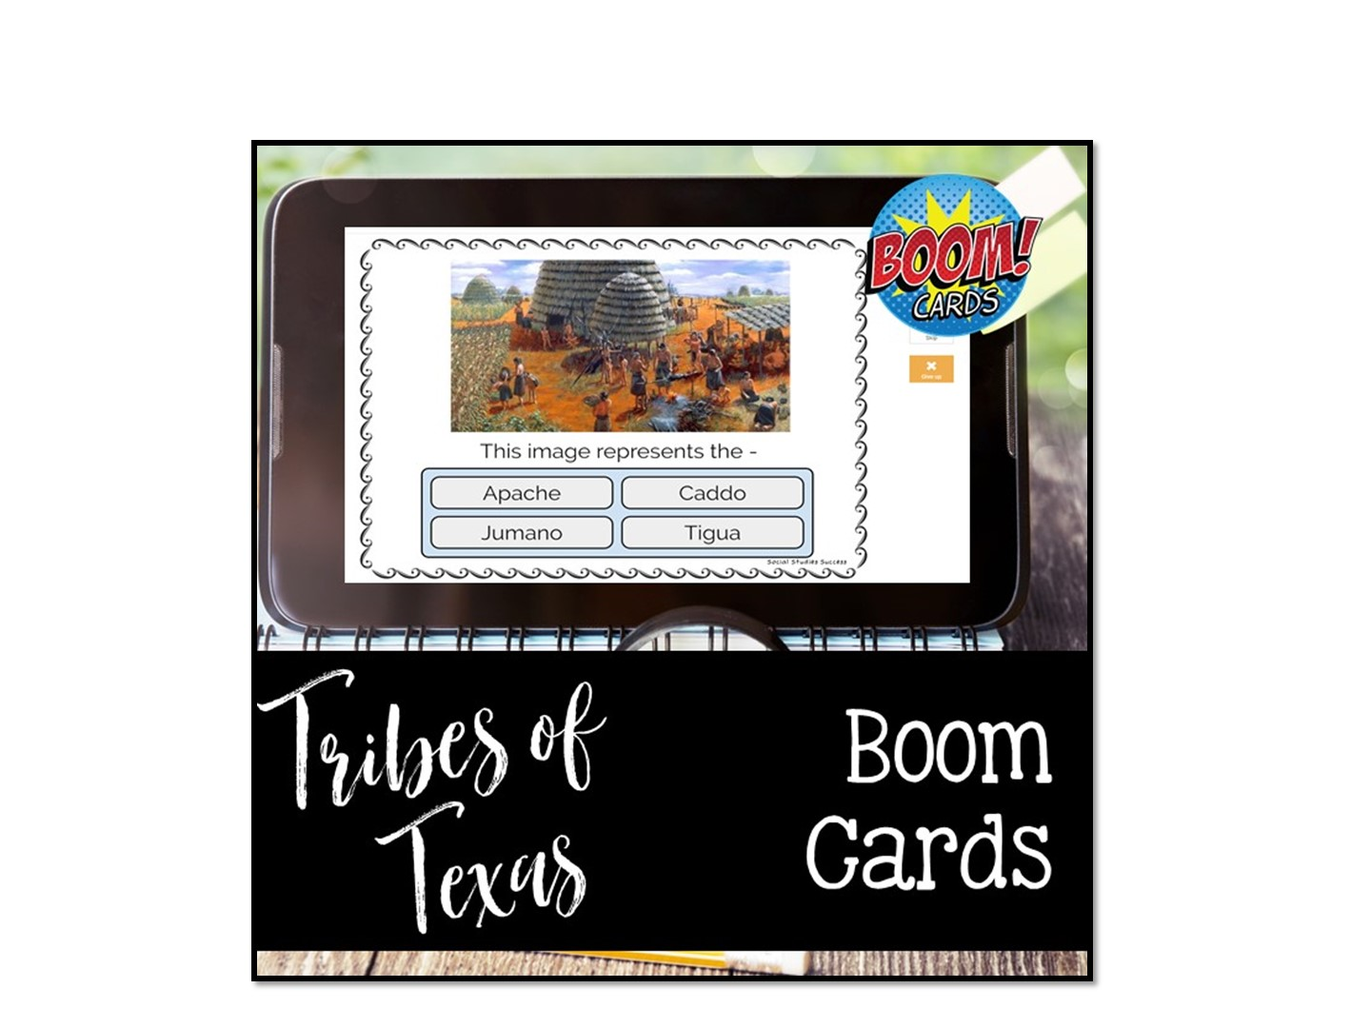
Notes:
You will need to set up a fast pin for this – call me and I will walk you through it.

Slide 37


Slide 38


Slide 39

Welcome to Social Studies Success! Please follow these directions for accessing your new resources. Go to www.SocialStudiesSuccess.com
Notes:
Give them the handout with the directions, tell them to try on their own and contact their coordinator if they can’t get in.

Slide 40
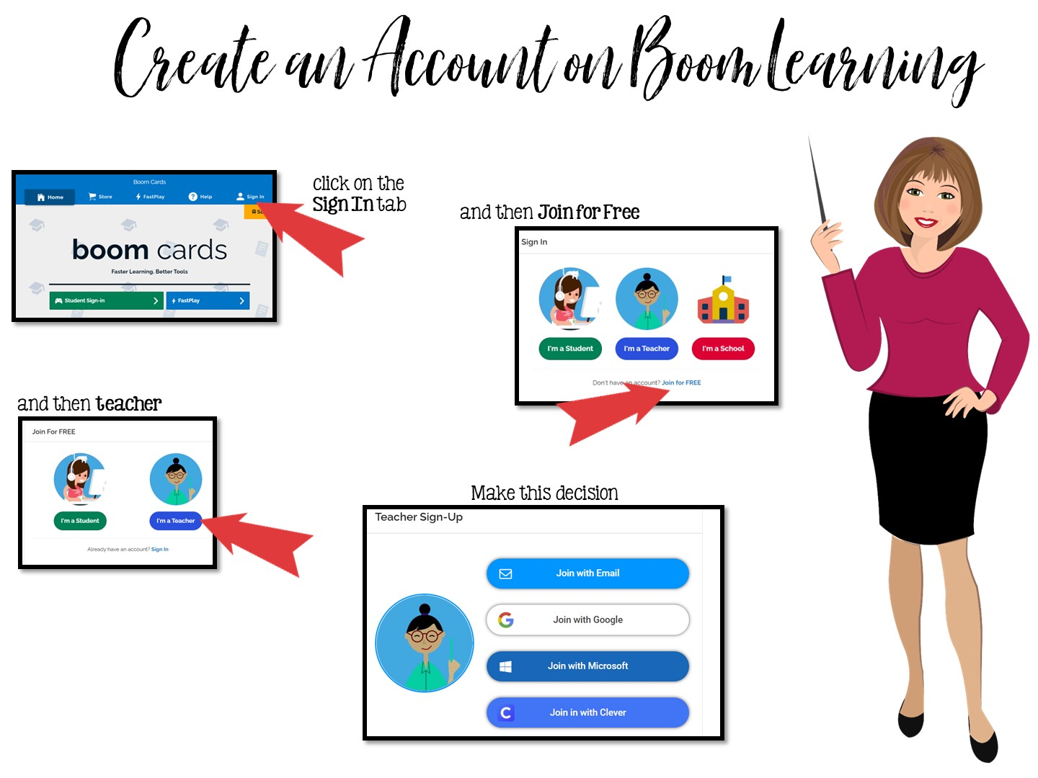
Go to www.boomlearning.com
Notes:
Pass out handout on creating Boom Cards. They need to follow these directions exactly to access their boom cards. Do Not purchase Boom Cards from the Boom Learning site – your district has already purchased them all for you. You must access the games through my website.

Slide 41
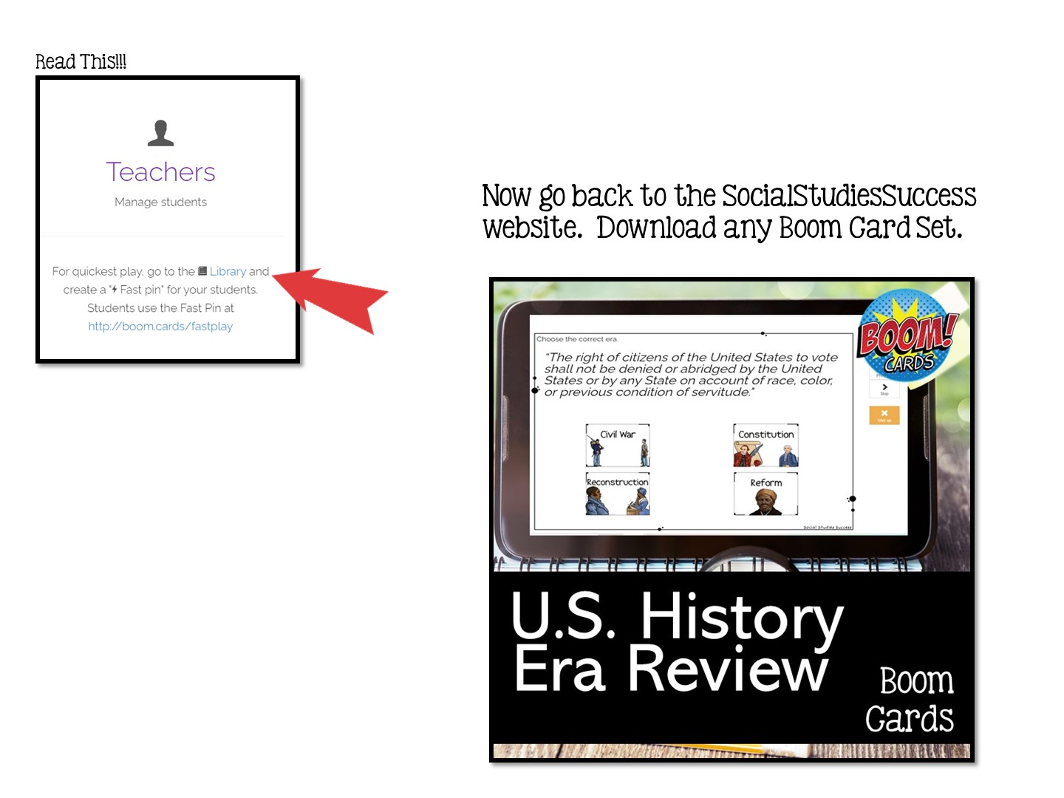

Slide 42


Slide 43
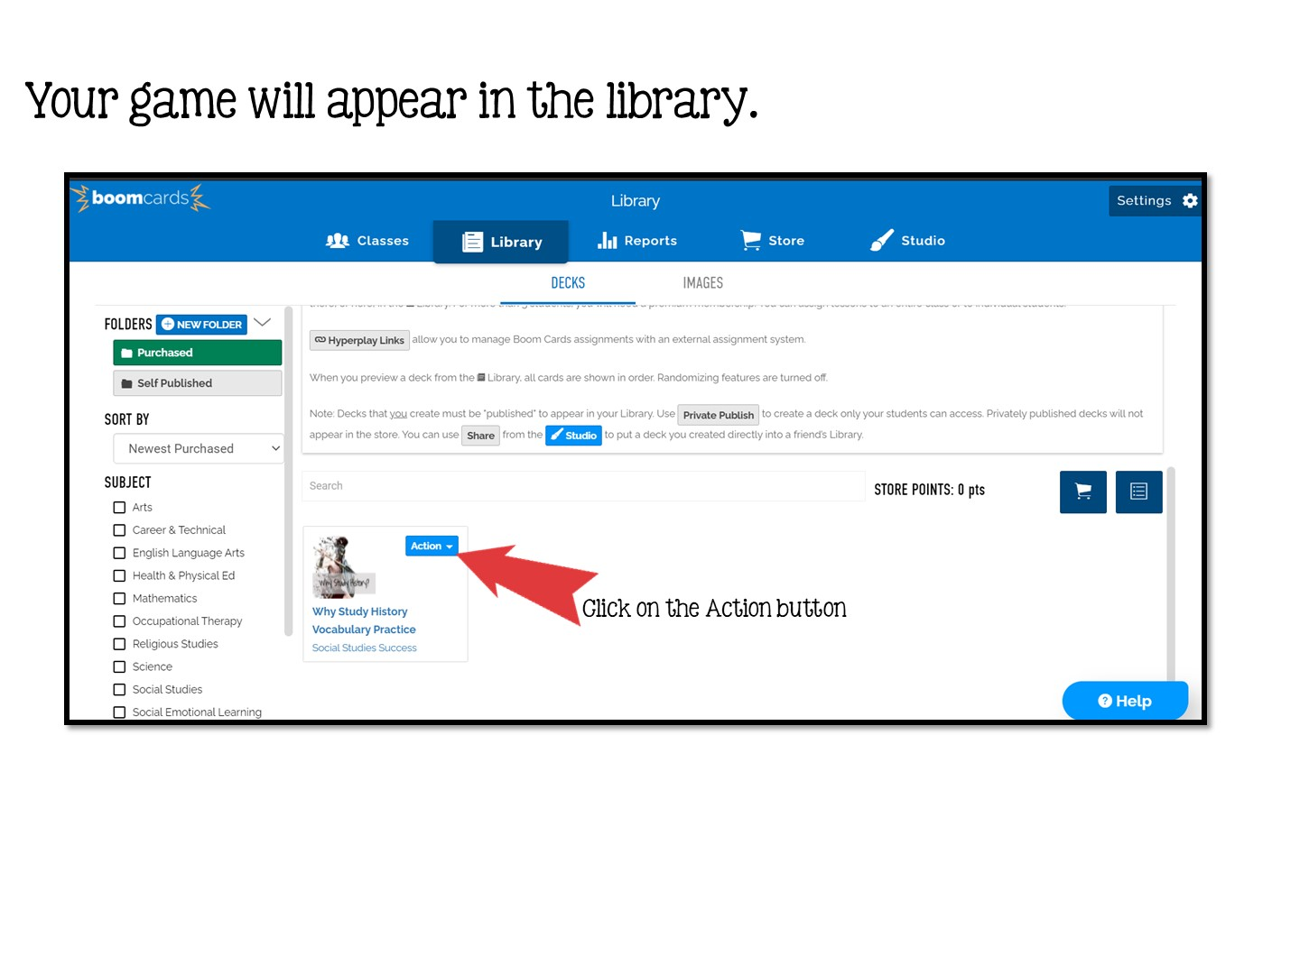

Slide 44
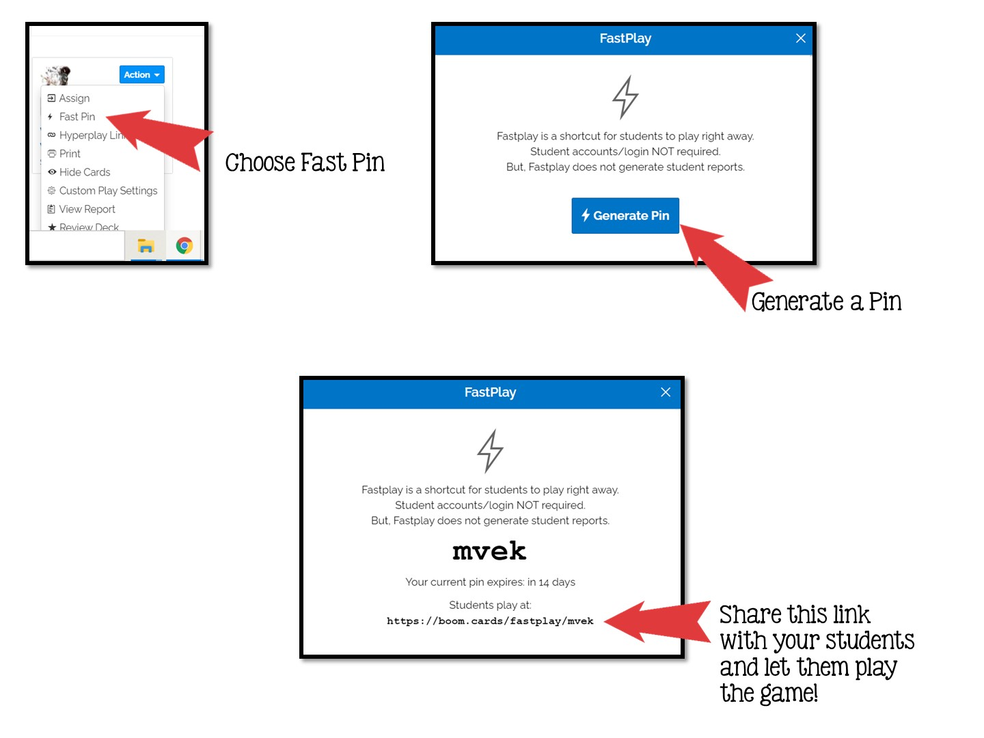

Slide 45


