Slide 1
Understanding the
Interactive
Student Notebook
Kathleen Geraghty,
Social Studies Success
Notes:
Set up teachers into Break Out Rooms – you need at leas 3-4 teachers in each group. Tell each group their number – they will need it later on the Jamboard.
Open up all of the documents and the Jamboard.
If you have any notebooks you can show, make sure to have them next to you.

Slide 2
Share one
Fun
Fact
Notes:
Share one fun fact about yourself in the comments section – an example, I am a twin.
This is a time killer until everyone joins.

Slide 4
Prepare your
Handouts
https://www.socialstudiessuccess.com/sstisn
Notes:
Have teachers download the manuals to save time later in the session

Slide 5
Who am i?
Trainer
Teacher
Mom
Team Lead
Dept
Chair
Wife
Kathleen
Social Studies Success
Notes:
Introduce yourself

Slide 6
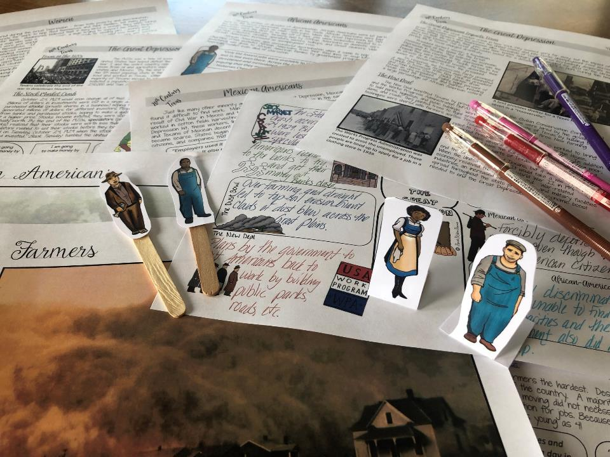
What do I believe about Social Studies instruction?
Students need to be engaged to learn.
-Schlechty’s Design Qualities of Engagement

Slide 7
What do I believe about Social Studies instruction?
Students need to be engaged to learn.
-Schlechty’s Design Qualities of Engagement
Students need to read in Social Studies – a lot! Like everyday!
-Kinsella’s Considerate Text

Slide 8
What do I believe about Social Studies instruction?
Students
are social – purposeful talk is crucial to learning.
-Walsh Quality Questioning
Students need to be engaged to learn.
-Schlechty’s Design Qualities of Engagement
Students need to read in Social Studies – a lot! Like everyday!
-Kinsella’s Considerate Text

Slide 9
What do I believe about Social Studies instruction?
Students
are social – purposeful talk is crucial to learning.
-Walsh Quality Questioning
Students need to be engaged to learn.
-Schlechty’s Design Qualities of Engagement
Students need to read in Social Studies – a lot! Like everyday!
-Kinsella’s Considerate Text
History can be fun and rigorous at the same time.
-Bower’s Bring Learning Alive!
Notes:
.

Slide 10
What do I believe about Social Studies instruction?
Students
are social – purposeful talk is crucial to learning.
-Walsh Quality Questioning
Students need to be engaged to learn.
-Schlechty’s Design Qualities of Engagement
Students need to read in Social Studies – a lot! Like everyday!
-Kinsella’s Considerate Text
All students can learn – we just need to support them in different ways.
-Seidlitz’s Seven Steps
History can be fun and rigorous at the same time.
-Bower’s Bring Learning Alive!

Slide 11
What do I believe about Social Studies instruction?
Students
are social – purposeful talk is crucial to learning.
-Walsh Quality Questioning
Students need to be engaged to learn.
-Schlechty’s Design Qualities of Engagement
Students need to read in Social Studies – a lot! Like everyday!
-Kinsella’s Considerate Text
All students can learn – we just need to support them in different ways.
-Seidlitz’s Seven Steps
The students were able to understand the lessons and the text and pictures for the ELL modified lessons worked great! Thanks for making this! Made my life easier. – Mary
History can be fun and rigorous at the same time.
-Bower’s Bring Learning Alive!
The
Interactive Student
Notebook is a powerful
teaching tool that allows you to differentiate instruction for students in a variety of ways.
-Wist’s Research on the Interactive Student
Notebook
Content-Area Conversations
by Douglas Fisher, Nancy Frey and Carol Rothenberg
Awesome and engaging resource! My students loved it!
Notes:
Differentiated instruction is ensuring that learning happens in an accessible way for the student. ISNs allow the students to format their thoughts however they find suitable, thus, differentiating by learning styles — someone who loves writing can love in the notebooks, another student who would rather draw is free to express his/her ideas through diagrams, charts and pictures.

Slide 12
What do I believe about Social Studies instruction?
Students
are social – purposeful talk is crucial to learning.
-Walsh Quality Questioning
Students need to be engaged to learn.
-Schlechty’s Design Qualities of Engagement
Students need to read in Social Studies – a lot! Like everyday!
-Kinsella’s Considerate Text
All students can learn – we just need to support them in different ways.
-Seidlitz’s Seven Steps
History can be fun and rigorous at the same time.
-Bower’s Bring Learning Alive!
The
Interactive Student
Notebook is a powerful
teaching tool that allows you to differentiate instruction for students in a variety of ways.
-Wist’s Research on the Interactive Student
Notebook
History should not be trivial pursuit – dig deeper and teach with essential questions and enduring understandings.
-Wiggins & McTighe Essential Questions

Slide 13
What do I believe about Social Studies instruction?
Students
are social – purposeful talk is crucial to learning.
-Walsh Quality Questioning
Students need to be engaged to learn.
-Schlechty’s Design Qualities of Engagement
Students need to read in Social Studies – a lot! Like everyday!
-Kinsella’s Considerate Text
All students can learn – we just need to support them in different ways.
-Seidlitz’s Seven Steps
History can be fun and rigorous at the same time.
-Bower’s Bring Learning Alive!
The
Interactive Student
Notebook is a powerful
teaching tool that allows you to differentiate instruction for students in a variety of ways.
-Wist’s Research on the Interactive Student
Notebook
History should not be trivial pursuit – dig deeper and teach with essential questions and enduring understandings.
-Wiggins & McTighe Essential Questions
Vocabulary instruction must be intentional and engaging.
-Marzano Academic Vocabulary

Slide 14
What do I believe about Social Studies instruction?
Students
are social – purposeful talk is crucial to learning.
-Walsh Quality Questioning
Students need to be engaged to learn.
-Schlechty’s Design Qualities of Engagement
Students need to read in Social Studies – a lot! Like everyday!
-Kinsella’s Considerate Text
All students can learn – we just need to support them in different ways.
-Seidlitz’s Seven Steps
History can be fun and rigorous at the same time.
-Bower’s Bring Learning Alive!
The
Interactive Student
Notebook is a powerful
teaching tool that allows you to differentiate instruction for students in a variety of ways.
-Wist’s Research on the Interactive Student
Notebook
History should not be trivial pursuit – dig deeper and teach with essential questions and enduring understandings.
-Wiggins & McTighe Essential Questions
Vocabulary instruction must be intentional and engaging.
-Marzano Academic Vocabulary
Writing is essential for learning, not just assessment.
-Daniels’ Content Area Writing

Slide 15
What do I believe about Social Studies instruction?
Students
are social – purposeful talk is crucial to learning.
-Walsh Quality Questioning
Students need to be engaged to learn.
-Schlechty’s Design Qualities of Engagement
Students need to read in Social Studies – a lot! Like everyday!
-Kinsella’s Considerate Text
All students can learn – we just need to support them in different ways.
-Seidlitz’s Seven Steps
History can be fun and rigorous at the same time.
-Bower’s Bring Learning Alive!
The
Interactive Student
Notebook is a powerful
teaching tool that allows you to differentiate instruction for students in a variety of ways.
-Wist’s Research on the Interactive Student
Notebook
History should not be trivial pursuit – dig deeper and teach with essential questions and enduring understandings.
-Wiggins & McTighe Essential Questions
Vocabulary instruction must be intentional and engaging.
-Marzano Academic Vocabulary
Writing is essential for learning, not just assessment.
-Daniels’ Content Area Writing
Kids need to continuously review content. All students need to participate in classroom activities.
-Himmele’s Total Participation Techniques

Slide 16
What do I believe about Social Studies instruction?
Students
are social – purposeful talk is crucial to learning.
-Walsh Quality Questioning
Students need to be engaged to learn.
-Schlechty’s Design Qualities of Engagement
Students need to read in Social Studies – a lot! Like everyday!
-Kinsella’s Considerate Text
All students can learn – we just need to support them in different ways.
-Seidlitz’s Seven Steps
History can be fun and rigorous at the same time.
-Bower’s Bring Learning Alive!
The
Interactive Student
Notebook is a powerful
teaching tool that allows you to differentiate instruction for students in a variety of ways.
-Wist’s Research on the Interactive Student
Notebook
History should not be trivial pursuit – dig deeper and teach with essential questions and enduring understandings.
-Wiggins & McTighe Essential Questions
Vocabulary instruction must be intentional and engaging.
-Marzano Academic Vocabulary
Writing is essential for learning, not just assessment.
-Daniels’ Content Area Writing
Kids need to continuously review content. All students need to participate in classroom activities.
-Himmele’s Total Participation Techniques
“Soft skills” of collaboration, communication, critical thinking, and creativity are essential to future success in the job market.
-Muir Reasons Millennials Get Fired

Slide 17
What do I believe about Social Studies instruction?
Students
are social – purposeful talk is crucial to learning.
-Walsh Quality Questioning
Students need to be engaged to learn.
-Schlechty’s Design Qualities of Engagement
Students need to read in Social Studies – a lot! Like everyday!
-Kinsella’s Considerate Text
All students can learn – we just need to support them in different ways.
-Seidlitz’s Seven Steps
History can be fun and rigorous at the same time.
-Bower’s Bring Learning Alive!
The
Interactive Student
Notebook is a powerful
teaching tool that allows you to differentiate instruction for students in a variety of ways.
-Wist’s Research on the Interactive Student
Notebook
History should not be trivial pursuit – dig deeper and teach with essential questions and enduring understandings.
-Wiggins & McTighe Essential Questions
Vocabulary instruction must be intentional and engaging.
-Marzano Academic Vocabulary
Writing is essential for learning, not just assessment.
-Daniels’ Content Area Writing
Kids need to continuously review content. All students need to participate in classroom activities.
-Himmele’s Total Participation Techniques
The best way to improve reading comprehension and scores, is to focus on building knowledge through Social Studies instruction.
-Wexler The Knowledge Gap
“Soft skills” of collaboration, communication, critical thinking, and creativity are essential to future success in the job market.
-Muir Reasons Millennials Get Fired

Slide 18
History Teachers
are the
Guardians
Democracy!
of

Slide 19
Do you agree with any of the ideas? Share in your chat box.

Slide 20
Goals
What
are your
for this session?
goals
Notes:
Type response in chat box.

Slide 21
Learn what makes an Interactive Student Notebook.
See how to support Social Studies Skills with Active Notes!

Slide 22
What do you already know about the Interactive Student Notebook?
Answer in chat box.

Slide 23
Why Study History?
Notes:
I am going to model a lesson for you that uses the interactive student notebook.

Slide 24
How students would be using a notebook before, during, and after a lesson.
Look For….
Notes:
Tell them to look for these different parts during the lesson.

Slide 25
Objectives
Content Objective: Students will use critical-thinking skills and a variety of primary and secondary sources to explain and apply different methods that historians use to understand and
interpret the past, including multiple
points of view and historical content.
Language Objective: Students will be
able to use new vocabulary focusing
on historical skills.
Notes:
Students use critical-thinking skills and a variety of primary and secondary source material to explain and apply different methods that historians use to understand and interpret the past, including multiple points of view and historical context.

Slide 26
Preview
Which of these sentences do you agree with the most? Why?
Studying history teaches that people change and still always stay the same.
History helps us understand the way we live now.
History teaches us that actions have consequences.
History teaches you to ask questions and challenge ideas.
Social Studies Success
Notes:
You will need to create a poll in Zoom with these questions.
Response on poll in question

Slide 27
Directions for Breakout Session
Notes:
Go to breakout session to read and discuss

Slide 28
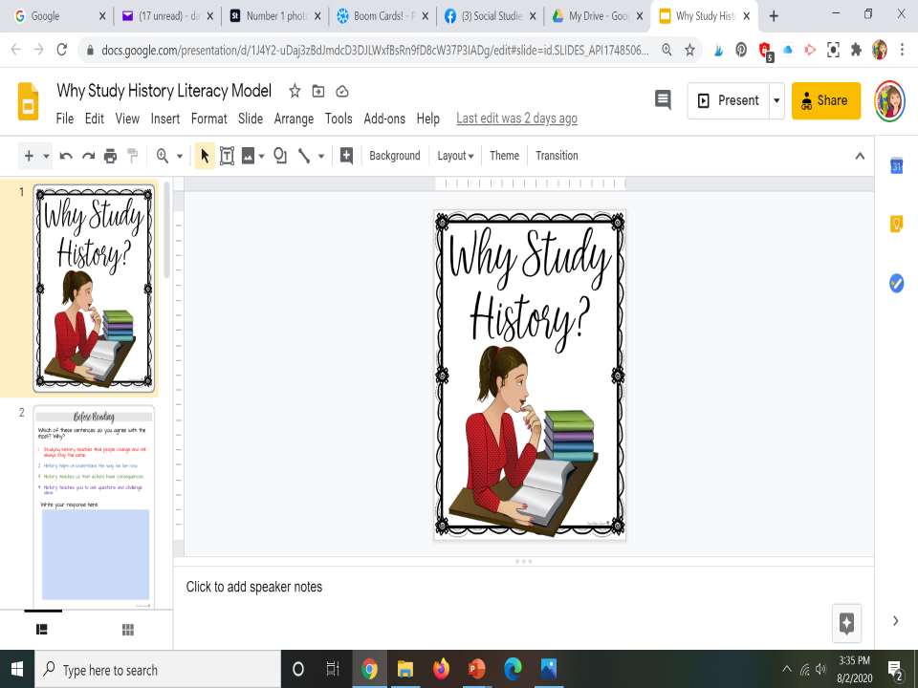
https://docs.google.com/presentation/d/1Cn8kHb69W6bOLuwA8LviLYGUXen2nw7R2JeFNJDaFIY/copy
Notes:
In just a moment you will need to click on the link opening up this activity.
If you need to send the link during the presentation – here it is https://docs.google.com/presentation/d/1Cn8kHb69W6bOLuwA8LviLYGUXen2nw7R2JeFNJDaFIY/copy
Complete the preview activity on Why Study History.
Then…

Slide 29
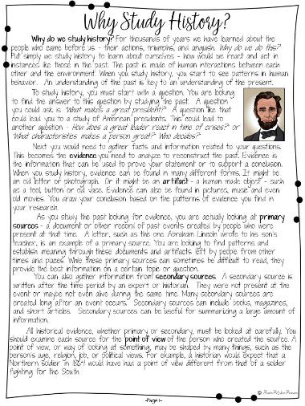
Why study history?
Read
the Why Study History? and discuss with
Just
One
Notes:
Read the page on Why Study History and choose the one most important sentence.

Slide 30
Opinion/proof
Studying history teaches that people change and still always stay the same.
History helps us understand the way we live now.
History teaches us that actions have consequences.
History teaches you to ask questions and challenge ideas.
Prove your statement true with 3 facts from the reading.
Opinion
Proof
Notes:
Then read the second page and complete the Opinion / Proof

Slide 31
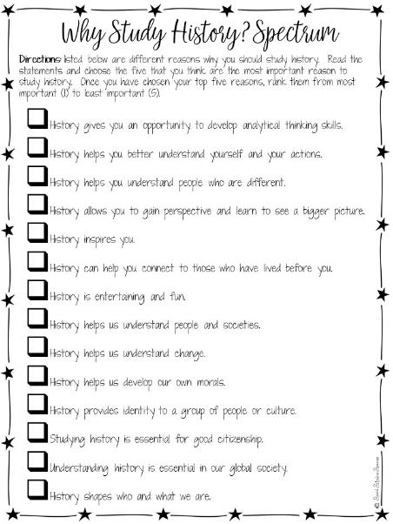
After Reading
Analyze
the statements and complete the spectrum. Discuss with your breakout team.
Notes:
Then complete your spectrum.

Slide 32
See you
in 12 minutes

Slide 33
How students would Used a notebook before, during, and after a lesson.
I saw….
Notes:
What did they see in the model lesson?

Slide 34
Notes:
Break slide – move where you need it

Slide 35
Understanding
the
Interactive Student
Notebook
Notes:
We are now going to look at the interactive student notebook, using the Why Study History lesson as our reference model.

Slide 36
Structure
Style
Notes:
We are going to look at what makes an ISN – Structure
and how we can personalize it in our classroom - Style

Slide 37
Structure

Slide 38
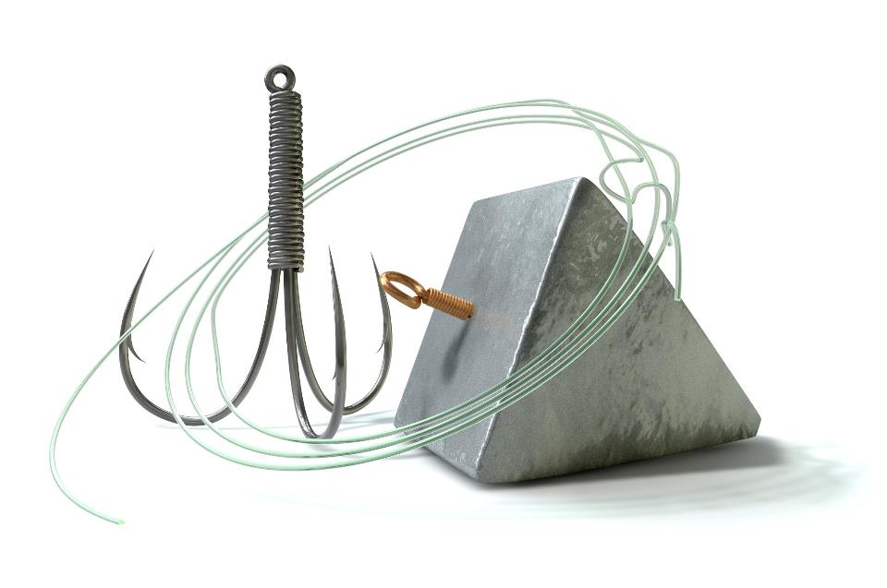
Hook, Line and Sinker
Notes:
This is the analogy we use for the ISN.

Slide 39
Use preview activities to prepare students for learning.
Activities
Preview
Tap into existing schema
Establish a purpose for the lesson
Prepares the brain to acquire new knowledge
Assess prior knowledge
Hook

Slide 40
Preview
Which of these sentences do you agree with the most? Why?
Studying history teaches that people change and still always stay the same.
History helps us understand the way we live now.
History teaches us that actions have consequences.
History teaches you to ask questions and challenge ideas.
Social Studies Success
Notes:
In our model lesson, this was our preview.

Slide 41
Anticipation Guide
Identify the major concepts or big ideas you want students to learn.
Create four to six statements that support or challenge students' beliefs.
Ask students to agree or disagree with the statements and to be prepared to defend their opinions.
Conduct a class discussion.
Have students read to find evidence to support or disprove their responses.
After reading, students confirm or revise their responses.

Slide 42
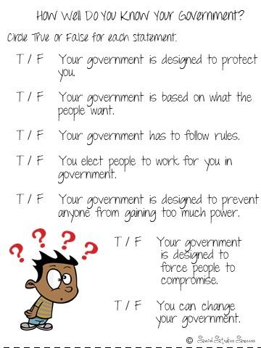
Anticipation Guide
Notes:
Sample for the 7 Principles of Government

Slide 43
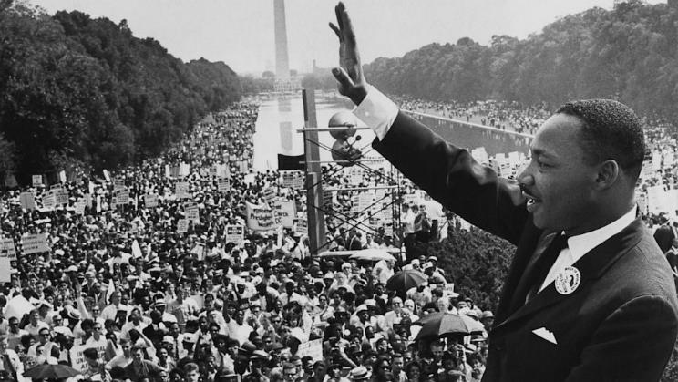
Visual Discovery
Select key images that tell a story.
Ask student spiral questions that pull them into the image.
Challenge your students to read more about the topic.

Slide 44
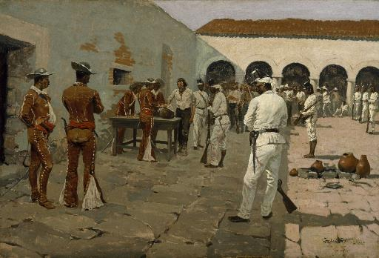
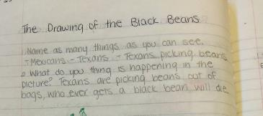
Visual Discovery
Notes:
Example for Texas History

Slide 45
Visual Discovery
Notes:
Example for World History

Slide 46
Comparison
Notes:
Example for Geography

Slide 47
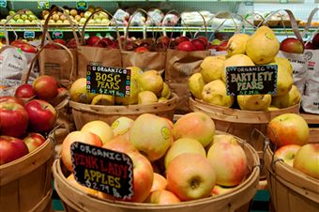
Relevant Example
You have the following items on your grocery list: apples, carrots, bread, milk, fish, steak, trash bags, chips, butter, cheese and paper towels.
You need to get in and out of the store as soon as possible.
How do you group these items to speed up your task?
Why did you group them the way they did?
Notes:
Geography

Slide 48
Directions for Breakout Session
Notes:
Go to breakout session to read and discuss

Slide 49
Preview Activities
Examine the preview strategies in the Social Studies Strategies for Success manual.
Choose one to read in depth – make sure everyone has a different strategy.
Discuss with your group which strategy you would use and why.
7 minutes
Notes:
Place teachers into a small group. Refer to the Social Studies Strategy manual and conduct this activity. They can be found by looking at the table of contents.

Slide 50
What preview strategy are you most likely to use and why?
Notes:
Debrief in chat box.

Slide 51
vs.
Taking Notes
Make Thinking Visible
Making Notes
Use graphic organizers to help students construct meaning as they read.
Create a visual summary of the content
Embed processing standards
Line

Slide 52
Opinion/proof
Studying history teaches that people change and still always stay the same.
History helps us understand the way we live now.
History teaches us that actions have consequences.
History teaches you to ask questions and challenge ideas.
Prove your statement true with 3 facts from the reading.
Opinion
Proof
Notes:
As a reference, this is what we used in our model in our Interactive Student Notebook.

Slide 53
Notes!
Active
Notes:
Now as we look at the note making portion of the Interactive Student Notebook, we are going to look at Active Notes - Notes that are designed to reinforce Social Studies Skills.

Slide 54
Review
Processing
Standards
Notes:
Let’s take a look at Processing Standards.

Slide 55
Processing
Standards
Social studies skills. The student applies critical-thinking skills to organize and use information acquired from a variety of valid sources, including electronic technology. The student is expected to:
(B) analyze information by sequencing, categorizing, identifying cause-and-effect relationships, comparing, contrasting, finding the main idea, summarizing, making generalizations and predictions, and drawing inferences and conclusions and developing connections between historical events over time;
(D) identify different points of view about an issue or current topic.
Notes:
Read to teachers and remind them that this is more than 60% of what is tested on STAAR

Slide 56
Card
Sort
Notes:
Next we are going to look at the Social Studies Skills and see how they provide the framework for our notes in the Interactive Student Notebook. Take them to the Jamboard and let them work in their breakout room to sort the “cards” into skills, when they are done, share how the skills are connected with the next slides.
The first slide is for you to model how to move the images and add a sticky note onto the Jamboard.

Slide 57
Directions for Breakout Session
Notes:
Go to breakout session to complete Jamboard activity – the link is on the website and also here:
https://jamboard.google.com/d/1rWg2UUJ_9v3mE2Y9vKD5vdHCRnhcZnJUi79dfFl2bTw/viewer
Give them 5-7 minutes to complete this activity.

Slide 58
Sequencing
Skills
Notes:
Review the Social Studies Skills.
The first set of skills naturally fit with Social Studies – sequencing skills

Slide 59
Cause and Effect
How is one event a direct result of another. What happened (cause)? Why did it happen (effect)?
Cause
Effect
_____ (effect) because _____ (cause).
(Cause) _____ resulted in ____ (effect).
_____ (result) was a result of ____ (cause)_
Social
Studies
Success
Notes:
Read Slide

Slide 60
Sequence Events
Place connected events in chronological order. What happened first? Second? Next? Last?
First, In the beginning, Starting,
Initially
Then, Next, After that, Secondly, Result
Then, Next, After that, Thirdly, Result
Finally, At the end, In conclusion, Result
First_____ then_____ next_____ resulted in ____.
Social
Studies
Success
Notes:
Read slide

Slide 61
Developing Connections Between Historical Events Over Time
Making connections require an understanding of the connections between two or more different events in history
Event
Event
Event
Event
How are ______ and ______ related?
How does ______ connect to ______ ?
Did ______ cause ______?
What are the multiple long-term effects of ______?
Social
Studies
Success
Notes:
This is a standard inferred by the STAAR test – it includes historical influences on the Constitution.

Slide 62
Categorizing
Skills
Notes:
The next set of skills has to do with categorization.

Slide 63
Categorize
Group events, people, places or things that belong together. How do these go together? How are they related?
Category
Category
1
C
2
3
A
B
_____ goes with _____.
_____ are examples of ____.
Social
Studies
Success
Notes:
Categorization helps our students organize information

Slide 64
_
Comparing and Contrasting
How are they similar and different. What is the same? What are the similarities? How do they differ?
Difference
Similarity
Difference
_____ and _____ are the same because they both _____.
_____ and ____ are different because _____.
_____ (result) was a result of ____ (cause)_
Social
Studies
Success
Notes:
Comparing and contrasting of categories

Slide 65
Share one new piece of information you learned.
Notes:
Quick Debrief – have them type in chat box

Slide 66
Text
Dependent
Skills
Notes:
The next set of skills are usually associated with reading historical text.

Slide 67
Finding the Main Idea
What is the text mostly about. What details support the main idea?
Main Idea
Similarity
Difference
Difference
Detail
Detail
Detail
Detail
Detail
_____ is mostly about _____ because_____.
_____ and ____ are details that support the main idea by _____.
Social
Studies
Success

Slide 68
Summarizing
A shortened version of a longer text that tells the basic ideas.
Text
main ideas
Similarity
Summary
Difference
important ideas
Difference
Detail
Detail
Detail
Detail
Detail
key terms
The important ideas are _____ and include _____.
The idea that best sums up this event is _____ because _____.
Social
Studies
Success

Slide 69
Evidence
Skills
Notes:
Use of evidence skills are the most difficult for students. They require students to draw inferences from history by: • identifying relationships among the parts • detecting inconsistencies • weighing conflicting facts and statements
generalize from data by: • applying previously learned concepts and generalizations to the data or situation • checking reasoning against basic principles of logic and looking for inconsistencies, limitations of data, and irrelevancies • creating a broad statement which encompasses findings

Slide 70
clue
Making generalizations and predictions
Using information to create a conclusion that is true most of the time. Using details found in the text to support what will happen next.
Similarity
clue
clue
clue
Difference
Difference
Detail
Detail
Detail
Detail
Detail
Generalization or
Prediction
_____ and _____ lead me to believe _____.
Because_____ I can predict that _____.
Social
Studies
Success

Slide 71
Drawing Inferences and Conclusions
Use evidence from text or visual analysis and what you already know to draw a conclusion about history.
What the evidence tells me
What I already know
My Inference/Conclusion
The text said _____ and I know that _____ so I can conclude _____.
Social
Studies
Success
I see _____ and I know that _____ so I can infer _____.

Slide 72
Point of View
Understanding history requires examining events from different perspectives
Who is providing the information?
What is the author trying to convince you?
Compare the different accounts.
Which information is the most valid?
Social
Studies
Success

Slide 73
Brain Break
How does this information either confirm or challenge what you already know?
Notes:
Type in chat box.
73

Slide 74
Directions for Breakout Session

Slide 75
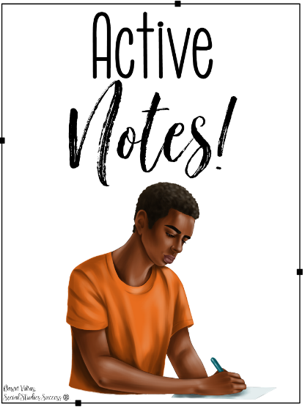
Strategy Practice
Read the Free Enterprise handout.
Identify a skill that supports the content.
Choose a strategy graphic organizer.
(14) Economics. The student understands the origins and development of the free enterprise system in
the United States. The student is expected to:
(A) explain why a free enterprise system of economics developed in the new nation,
including minimal government regulation, taxation, and property rights; and
(B) describe the characteristics and the benefits of the U.S. free enterprise system through
1877.
Notes:
Put them in a breakout group to do this.
Free Enterprise Handout is on the website.

Slide 76
What additional ideas do you have for graphic organizers?
Notes:
Type in chat box.

Slide 77
Use processing strategies that allow students to reflect, make connections, and apply learning.
Activities
Processing
make connections
extend the reading experience
lead students to a deeper analysis of the text
be able to apply new content
allows for Differentiated Learning
Sinker

Slide 78
After Reading
Analyze
the statements and complete the spectrum. Discuss with your breakout team.
Notes:
This was our sinker in the model lesson.

Slide 79
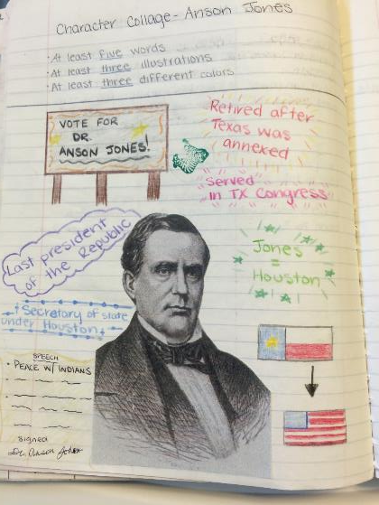
Character Collage
Notes:
Character collages allow students to process information about historical figures by adding images and quotes.

Slide 80
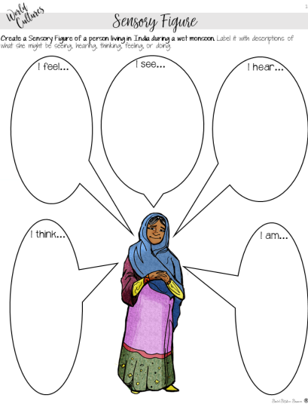
Sensory figure
Notes:
Sensory figures process by inferencing senses.

Slide 81
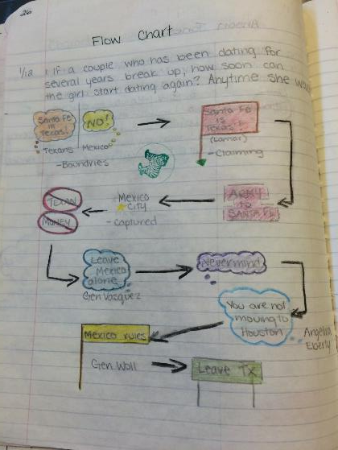
Flow Chart
Notes:
Flow charts show the movement of an idea.

Slide 82
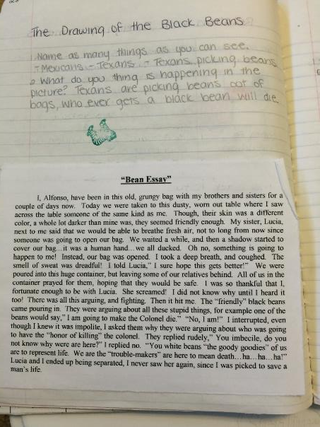
Point of view story
Notes:
Point of view stories are great for inferencing as well.

Slide 83
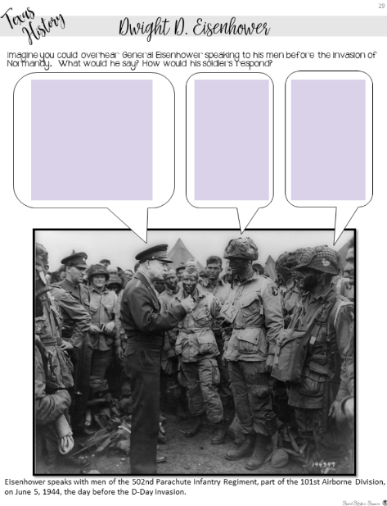
Annotated Image
Notes:
Students bring to life images by adding text.

Slide 84
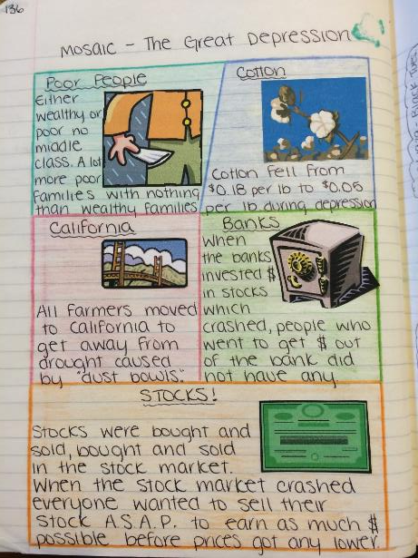
Mosaic
Notes:
A mosaic is great for showing the parts of a topic.

Slide 85
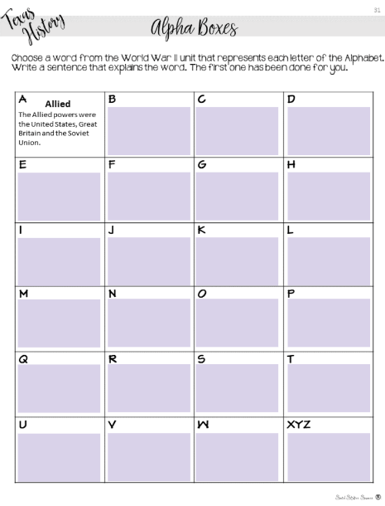
Alpha boxes
Notes:
Challenge students to create summaries for the topic with Alpha Boxes.

Slide 86
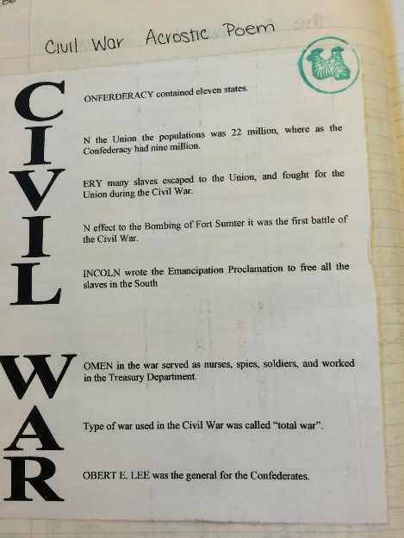
Acrostic poem
Notes:
Explain an acrostic poem.

Slide 87
Beyond the frame
Notes:
Students write or draw what they would see beyond the picture frame.

Slide 88
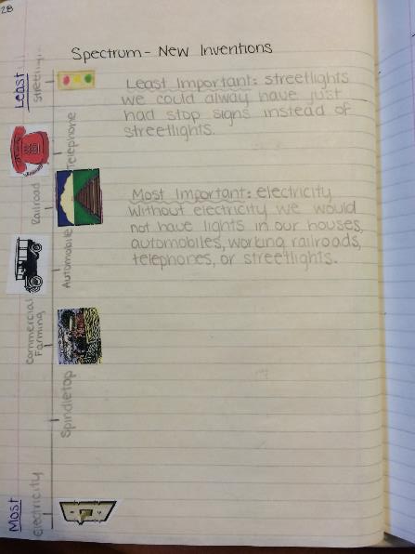
Spectrum
Notes:
Students rank the importance of certain events.

Slide 89
Processing activities
Examine the processing activities in the Social Studies Strategies for Success manual.
Which processing strategy would work best for the Free Enterprise lesson?
7 minutes
Notes:
These can be found in the table of contents.

Slide 90
Answer in chat box…
What part of this workshop was new information?

Slide 91
Style
Notes:
This is your personal choice in the classroom (share all your tips in this section).

Slide 92
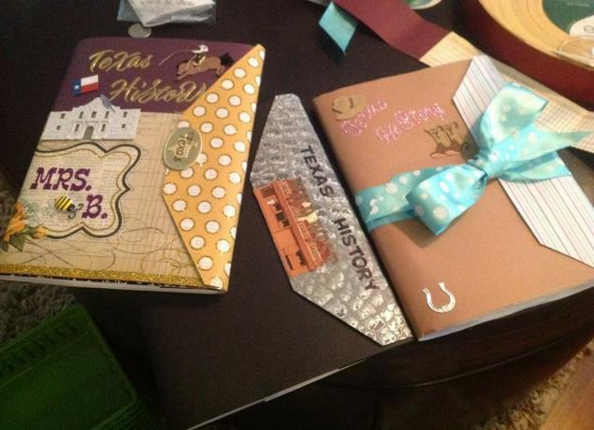
Personalization - Cover
Use magazines.
Cover with packing tape or contact paper.
Add special touches such as bookmarks and dividers.
Notes:
There are also things that you can do to individualize them. As you go over these, give your tips and experiences using notebooks.
For reduce the number of lost notebooks explain that the students have invested their time and personality into them, so they now have value to the kids.

Slide 93
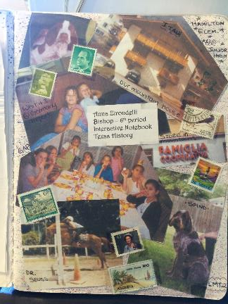
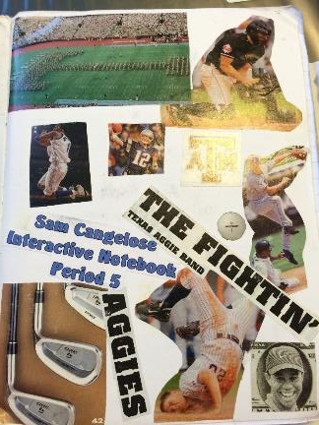
Personalization – Author Page
reflect content or individuals.
encourage students to take pride in their notebooks.
reduce the number of lost notebooks.
Notes:
There are also things that you can do to individualize them. As you go over these, give your tips and experiences using notebooks.
For reduce the number of lost notebooks explain that the students have invested their time and personality into them, so they now have value to the kids.

Slide 94
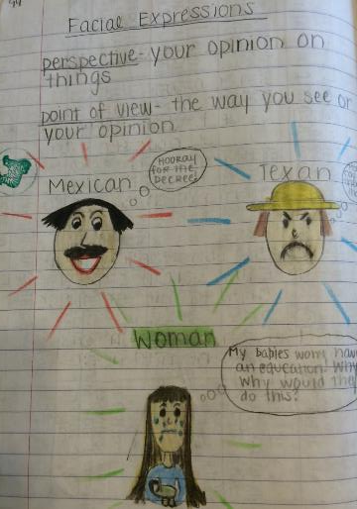
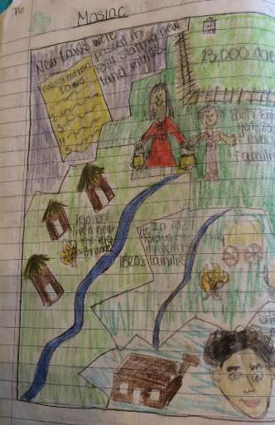
Organization - Pages
Interactive Student Notebook: Five Steps to Implementation
Have students put a title and date on each assignment.
Notes:
This will help kids know what the assignment is about and when it was done. This will help absent kids too.

Slide 95
Organization - Numbering
Interactive Student Notebook: Five Steps to Implementation
Show students how you want their pages numbered.
Number as you go
Number by activity
Use an A, B, C method with your numbers
Notes:
Discuss with participants how you can number pages. There are a variety of ways you can do this. Share the above with them and what you have done or tried in the past. You might need to explain that we are teaching without left-side/right-side if you have some folks who were taught the ISN by an old-schooler!
Number as you go - Explain to participants it is best to number as you go so if a kid messes up their whole notebook is not messed up.
Number by activity – each activity has a number
A,B,C method – Can use this with either. Preview is 2A, Notes 2B, Processing 2C or if you number as you go, if a kid needs more room than the page you gave them, they can make that A and move to page B.
Explain that all kids should be on the same number system and do not let them number on their own or their will be a lot of confusion when you want to grade or have the kids find something.

Slide 96
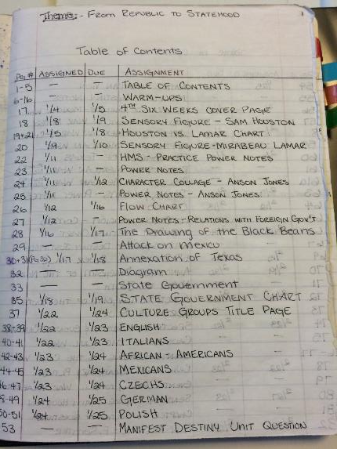
Organization – Table of Contents
Interactive Student Notebook: Five Steps to Implementation
Add a table of contents to help guide students.
Include page numbers and title.
May have the date you did the assignment.
Can include assignment grades.
Consider keeping a master table of contents in your room.
Notes:
I showed two examples, if you do something different, explain that to them.
I also share how I go to the teacher center and use a poster maker to make a big poster of the Table of Contents and laminate it. That way I can use dry erase markers on it and keep it up where the kids can see.

Slide 97
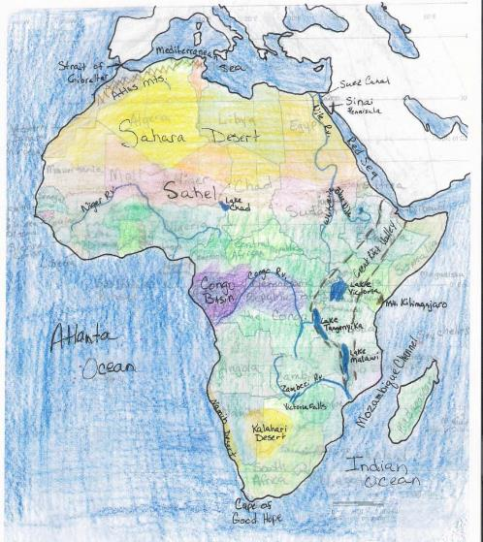
Organization – Resource Pages
Interactive Student Notebook: Five Steps to Implementation
Include lesson material with each unit such as:
vocabulary
maps
Notes:
You can include other things besides preview, notes, and processing in your notebooks as well. Vocabulary, maps are a few examples.

Slide 98
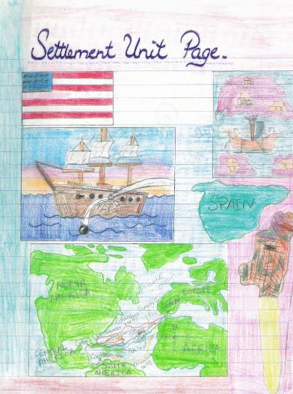
Organization – Unit Pages
Interactive Student Notebook: Five Steps to Implementation
Add unit title pages that echo the unit theme and contain:
the title of the unit.
pictures that represent the unit content.
a phrase that describes the unit.
Notes:
You can give the example of 5-5-5 5 terms, 5 phrases, 5 colors required for a unit page. This picture does not have it, but that is something they can require their students to do.

Slide 99
What are some ideas that you will use in your classroom?
I will use…
Notes:
Debrief with these stems.

Slide 100
Grading
the ISN
Notes:
There are rubrics for teachers to download on the website.

Slide 101
Is the Interactive Student Notebook
a Product or a Process?
Notes:
Turn and Talk
This decides how you grade the notebook – either looking for perfection or grading the learning process.

Slide 102
Inspect
What you Expect
Notes:
Monitor often at the beginning of the year.
Stamp, initial, or place stickers to indicate you have seen the item.
Write comments, especially positive comments or suggestions, on sticky notes.

Slide 103
Notes:
Allow students to use notebooks on a quiz
Helps students understand the importance of taking notes.
Encourages students to bring their notebooks daily.
Builds good work habits for the future.
z or test.

Slide 104
Peer
Review
Notes:
Have students look at other student examples.
Examples from previous years
Gallery walk
Peer Review

Slide 105
Grading

Slide 106
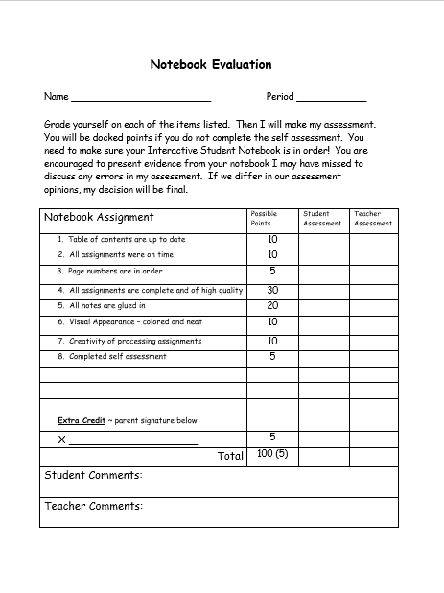
Explain to students the criteria used to grade notebooks.
Share rubric in advance
Stagger collection and grading
Notes:
Share any tips you have for grading.

Slide 107
Improving
Quality

Slide 108
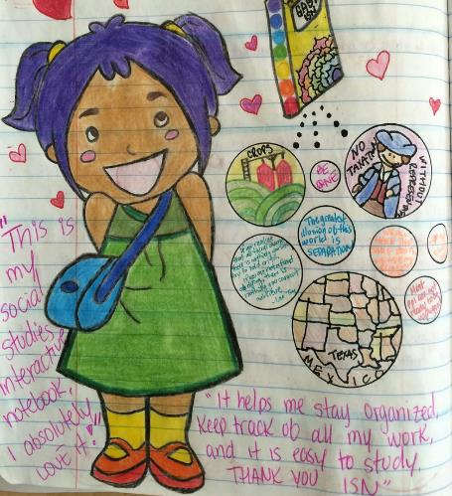
Require students to add color.
Show students how color improves notes and processing assignments.
Model what you expect to see in their notebooks.
Incorporate color for organizing into rubrics.
Notes:
Discuss by bullet points
Notes with highlighting key terms are easier to use to study for tests
Model when give notes use different color pens on overhead or in powerpoint.
Put color as part of the grade – stress color for organizing not for “prettiness”

Slide 109
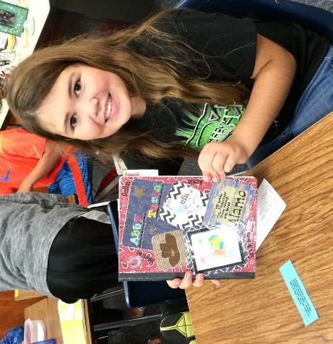
Encourage a sense of pride in notebooks.
Show students that their notebook has value and importance to them.
Provide evidence of students who have used their notebooks in future years.
Notes:
Discuss point
Can help them study; is a portfolio of evidence of learning
Help with test at state level; give story of student who kept and used their notebook

Slide 110
Questions?
Ideas?

Slide 111
Connect with me!
www.SocialStudiesSuccess.com
Notes:
Point out my blog on social studies success if they want to learn more.

