Slide 1
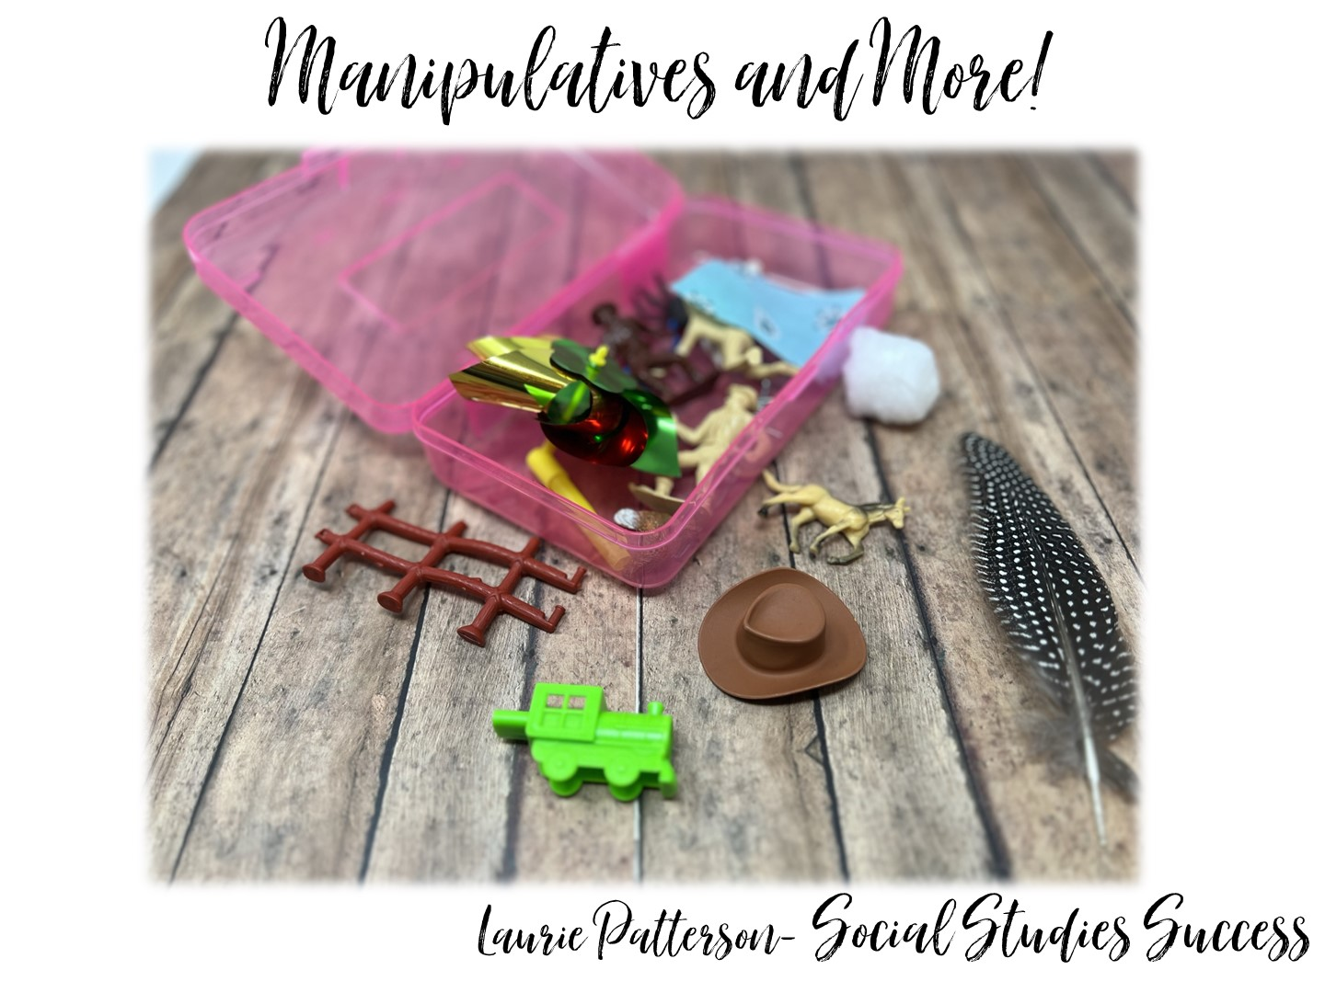

Slide 2


Slide 3

Notes:
Spend a few minutes introducing your personal and professional life.

Slide 4

Notes:
The following slides list the research that goes into my workshops. I quickly share all of the research, and on the last slide I ask, “Which of these do you agree with?” and share the answer with a partner.

Slide 5


Slide 6
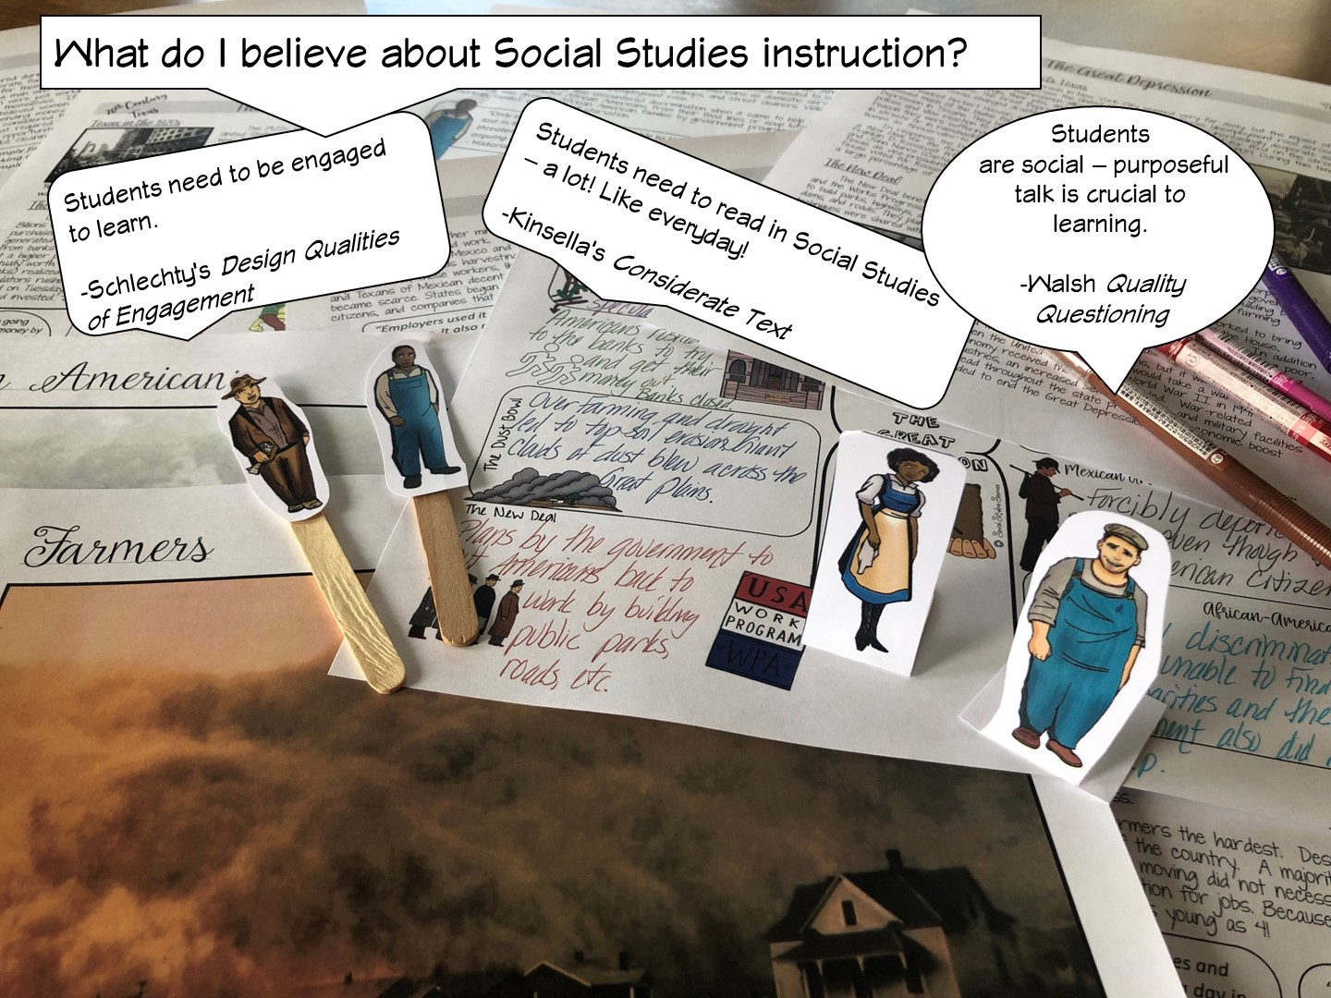

Slide 7
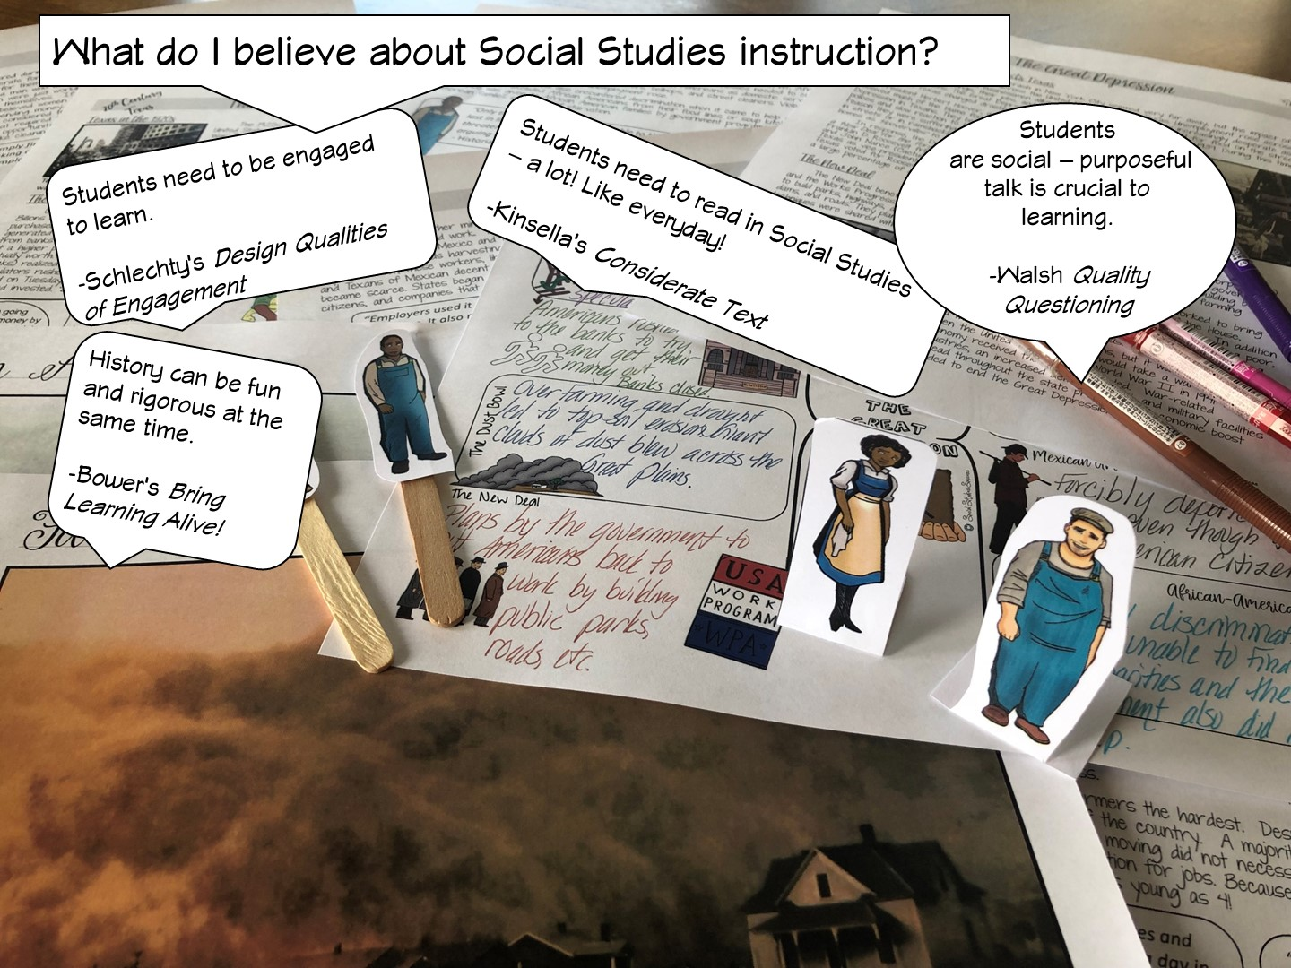

Slide 8


Slide 9
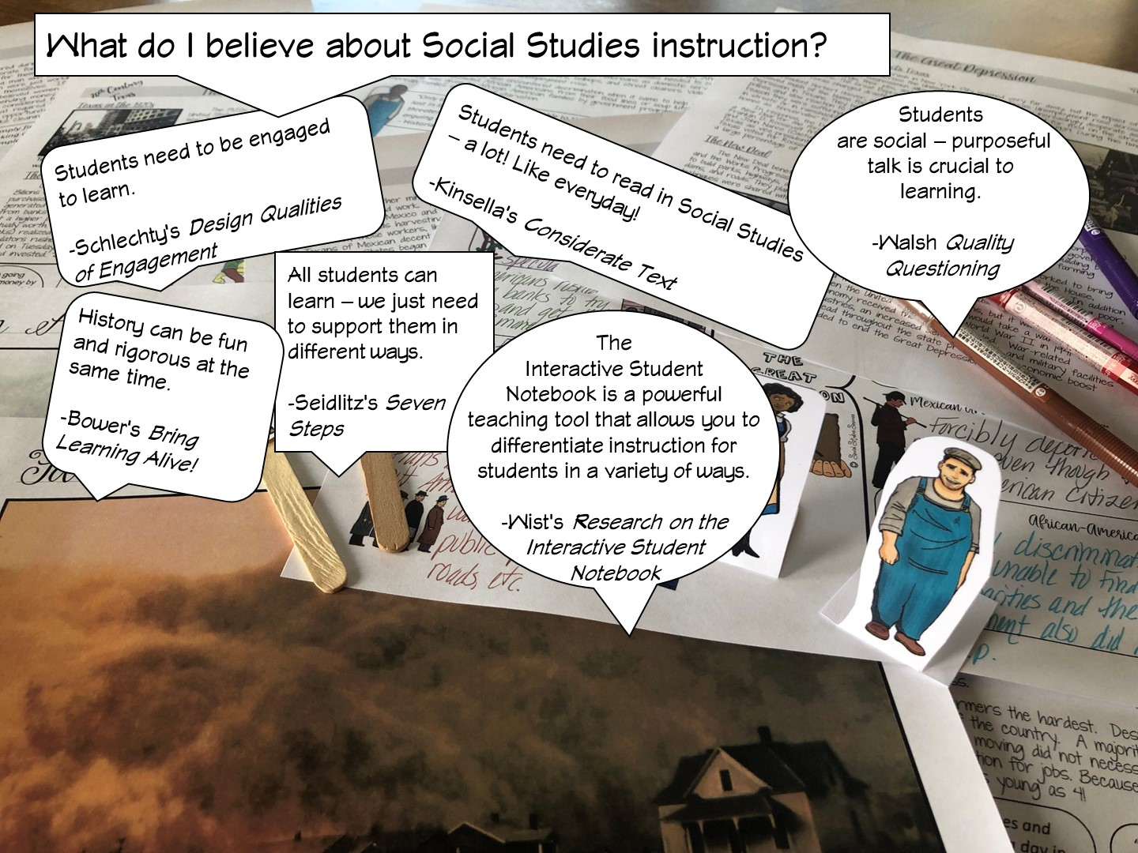

Slide 10
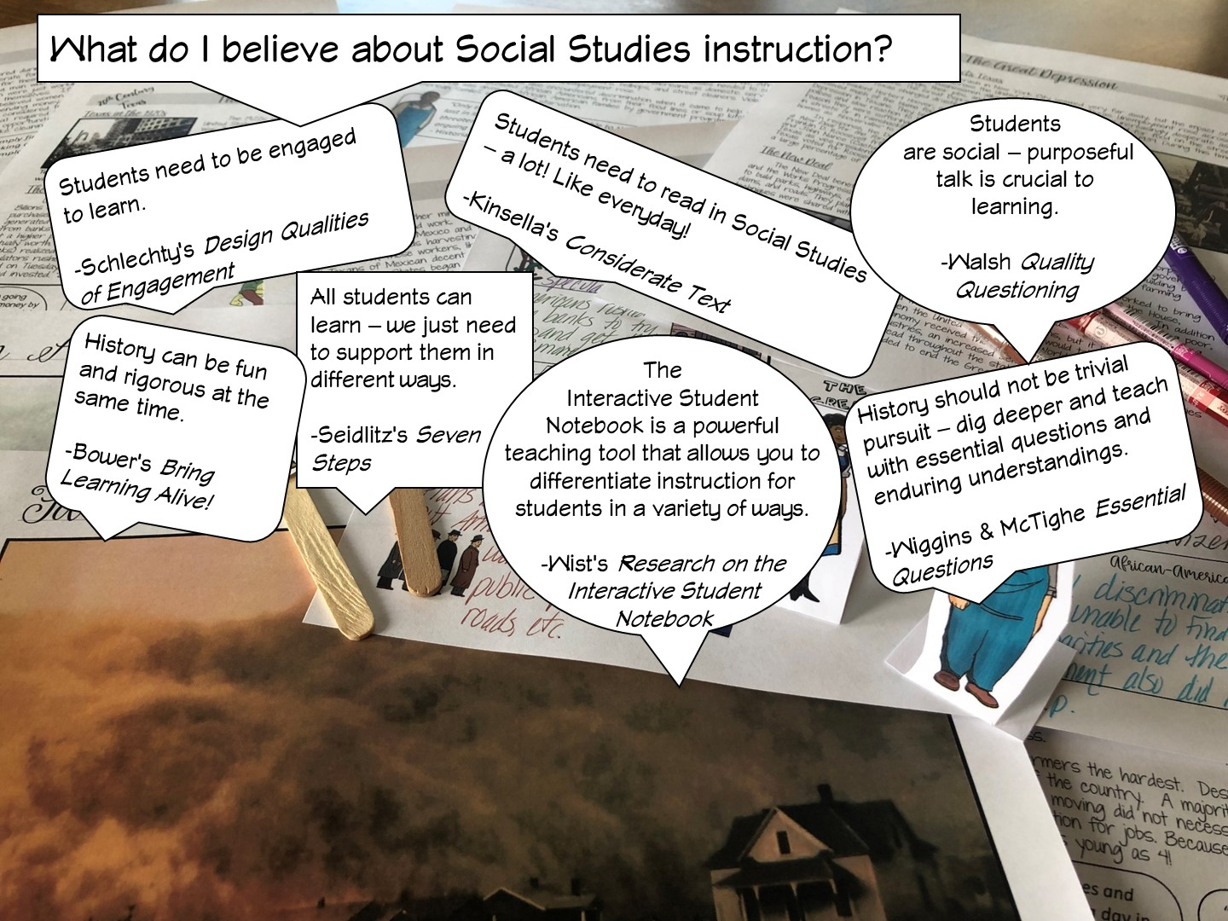

Slide 11
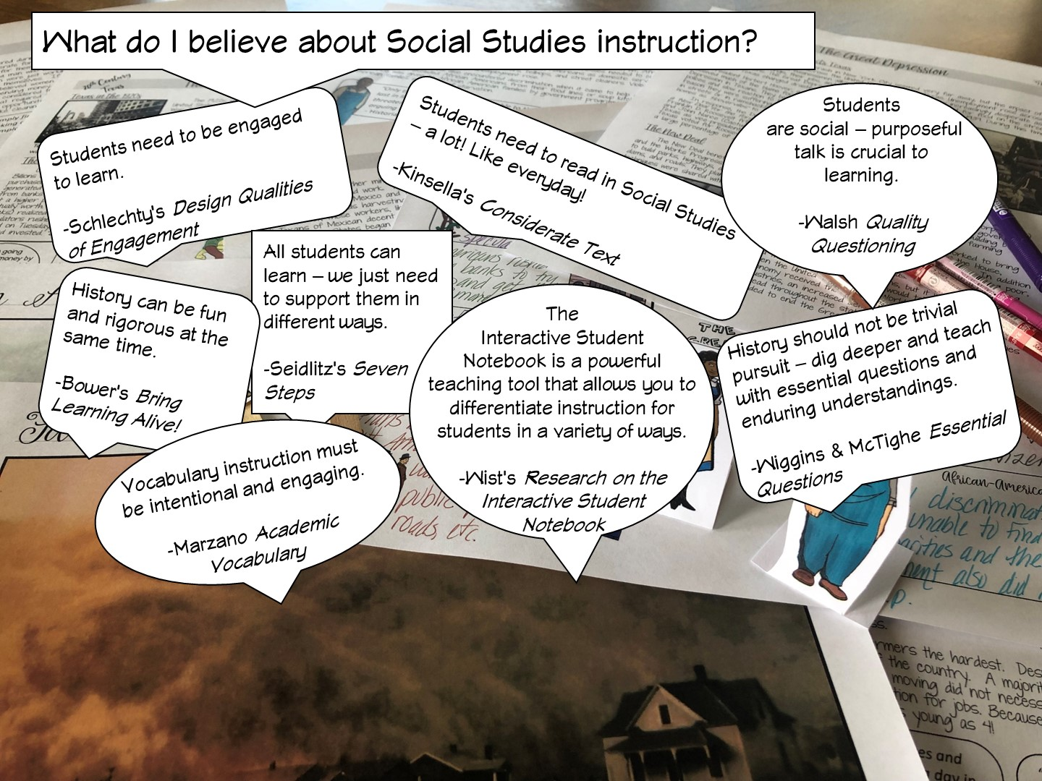

Slide 12
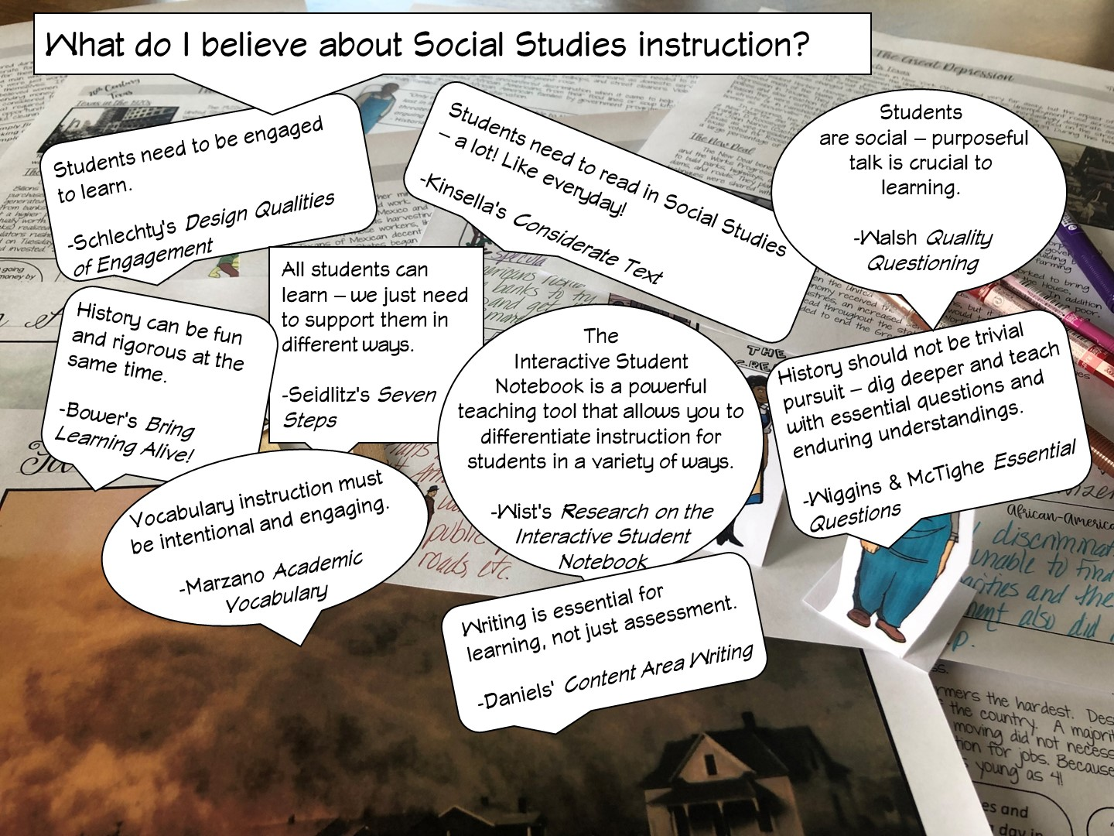

Slide 13
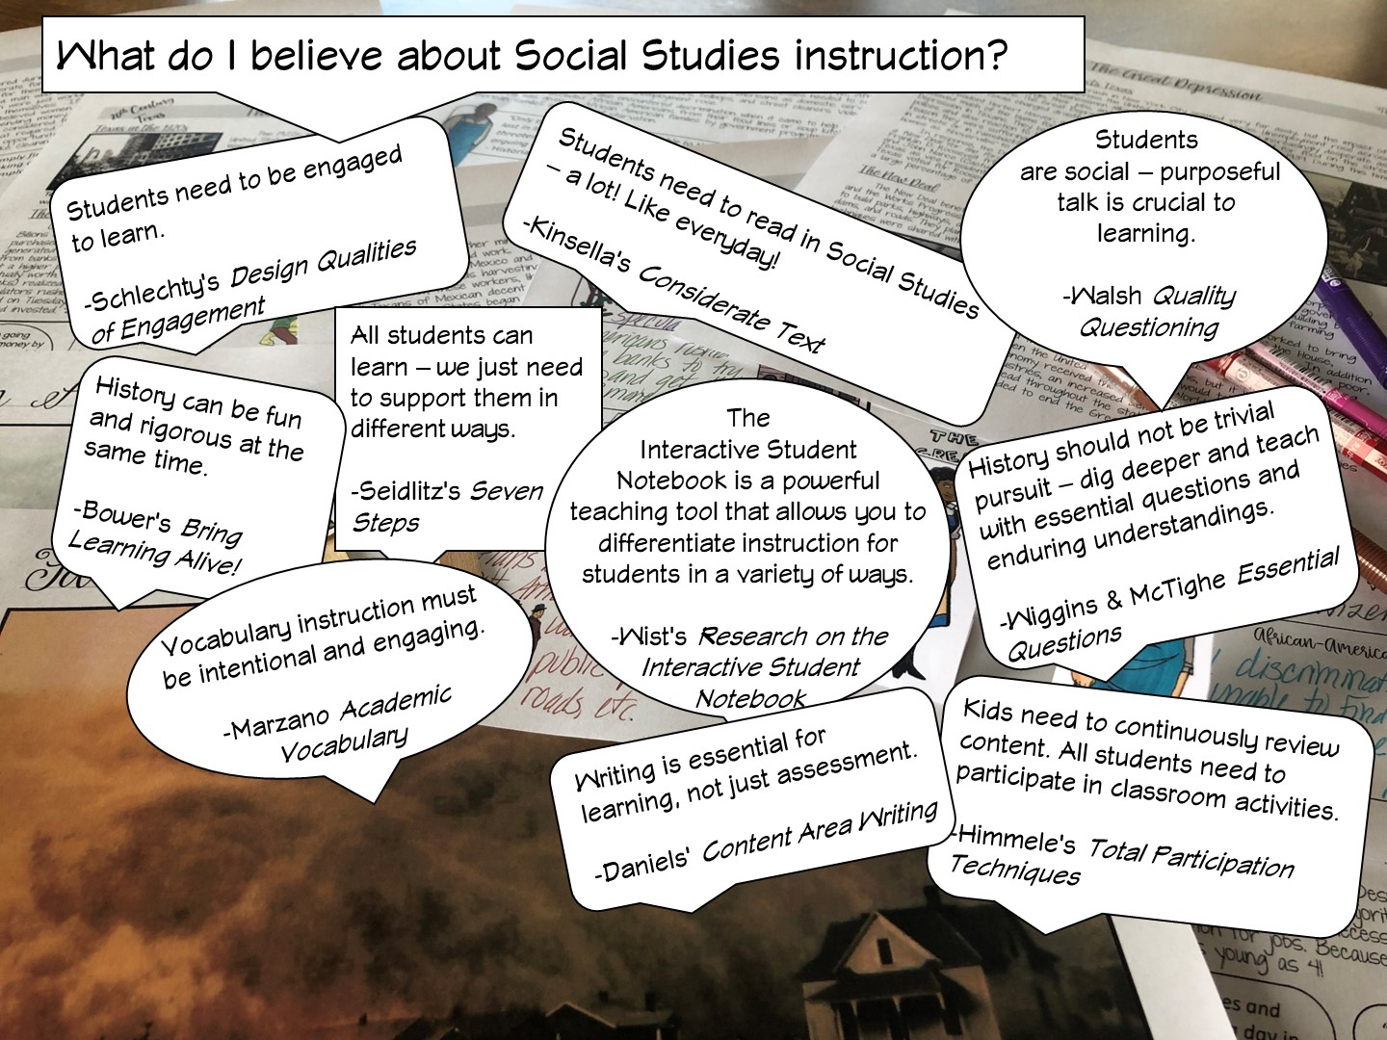

Slide 14
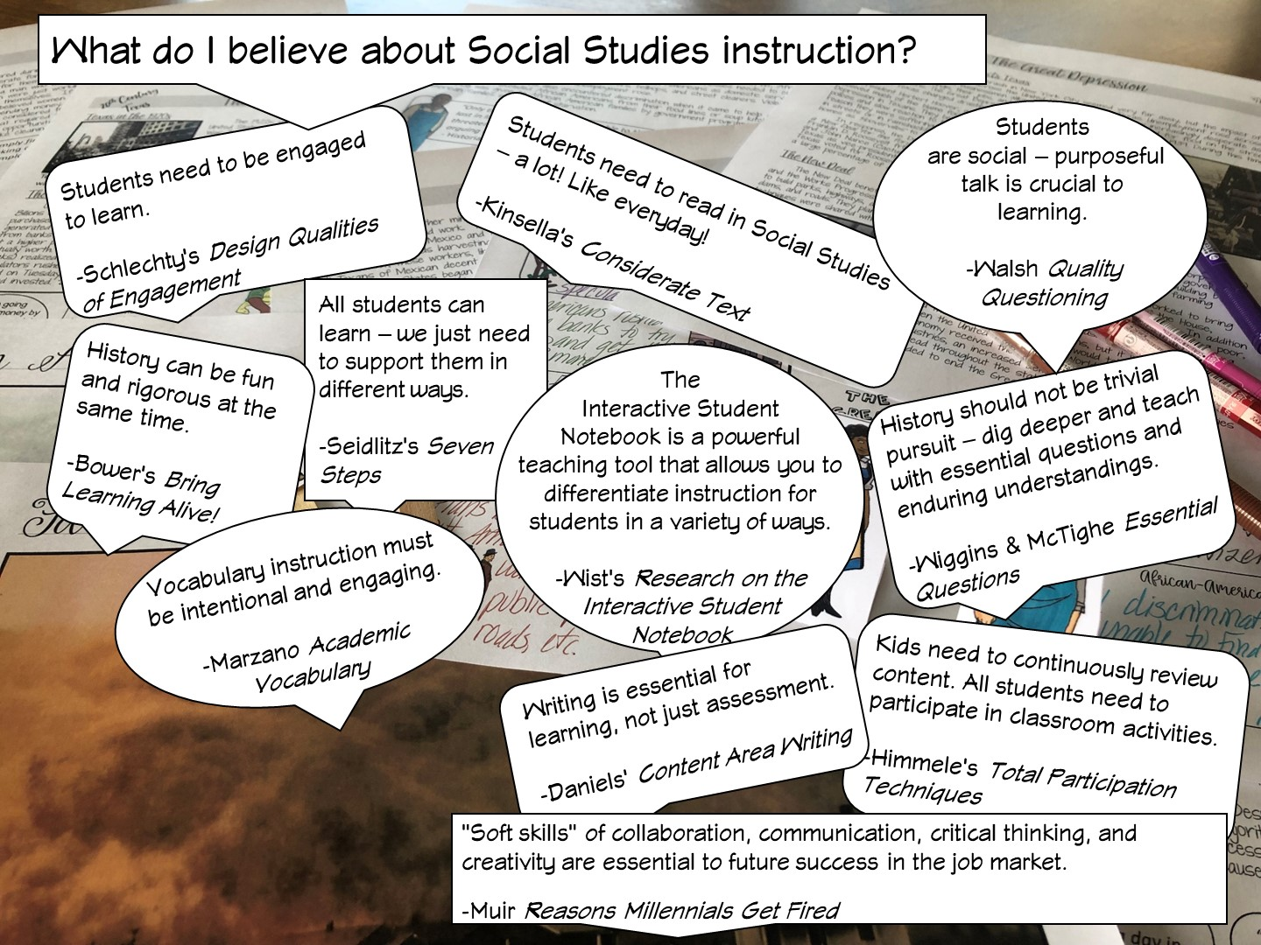

Slide 15
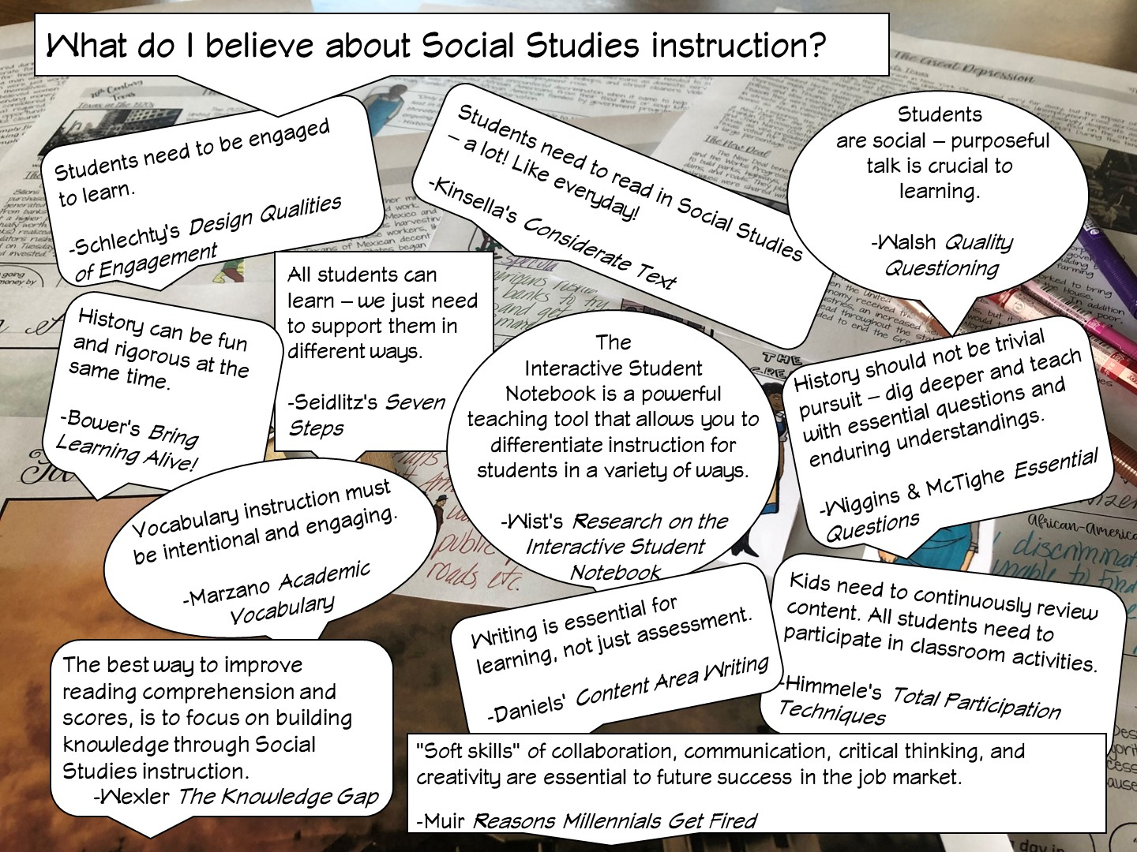
Notes:
After I have reviewed the different research – I ask the teachers, which one they agree with and why – have them talk to their table or partner.

Slide 16
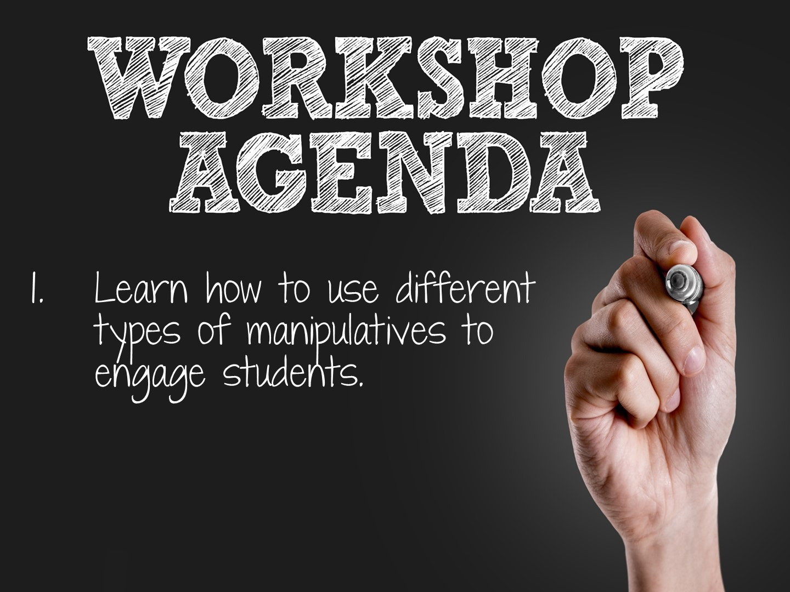

Slide 17

Notes:
Pass out pink and yellow cards to each person. When you ask the following questions, they need to hold up the correct colored card to answer the question. We will be looking at statements on why we use manipulatives and how we use manipulatives.

Slide 18
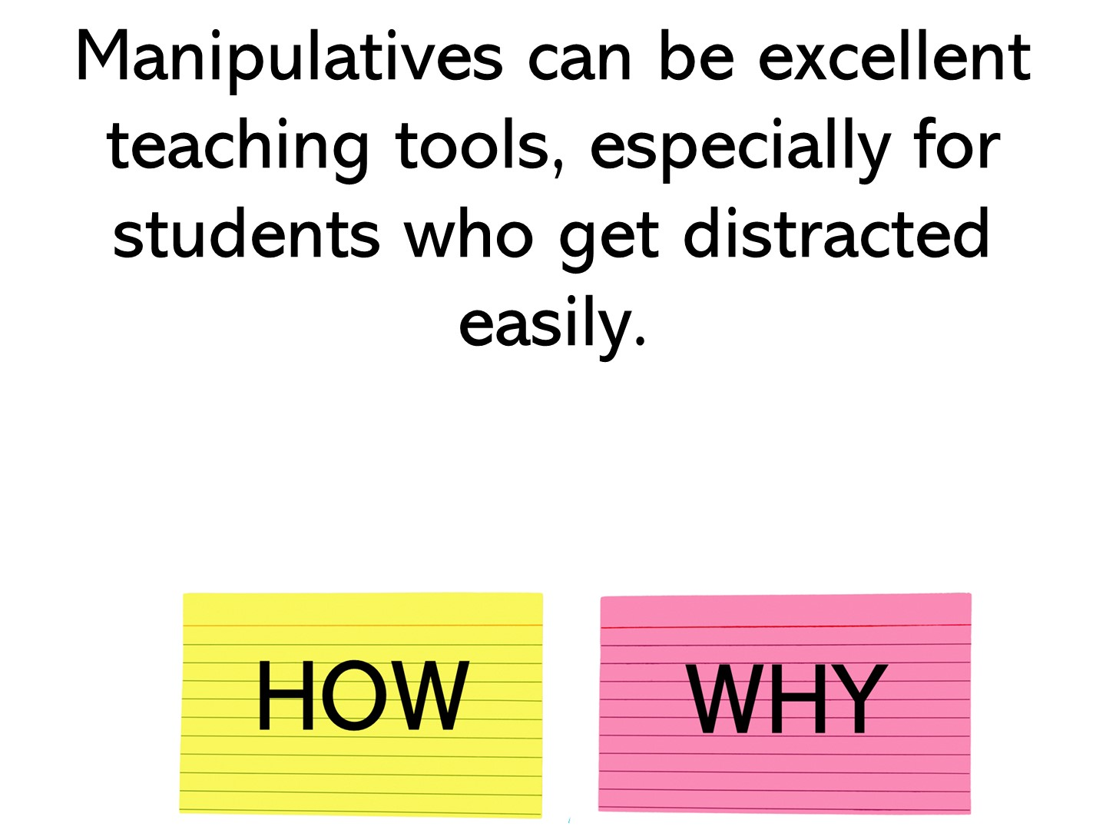
Notes:
why

Slide 19
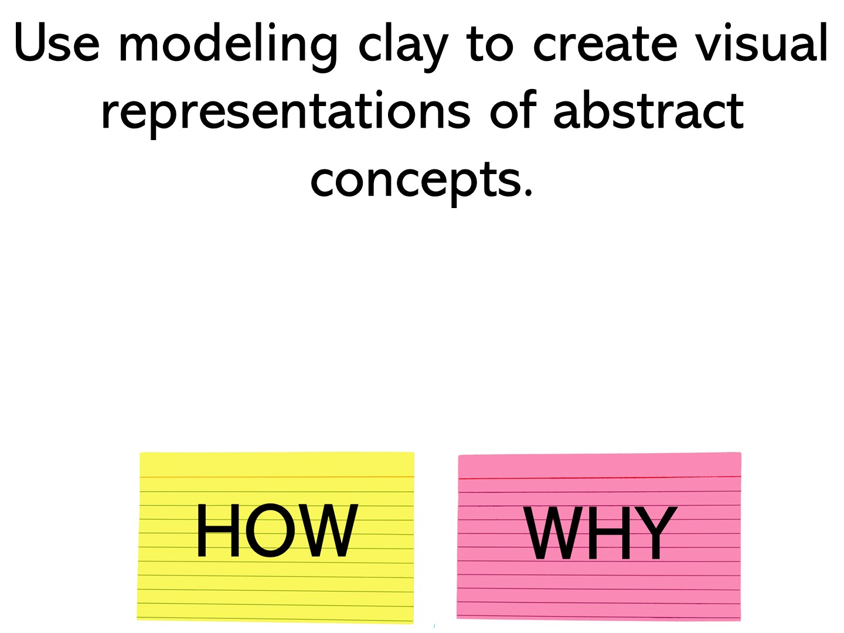
Notes:
how

Slide 20
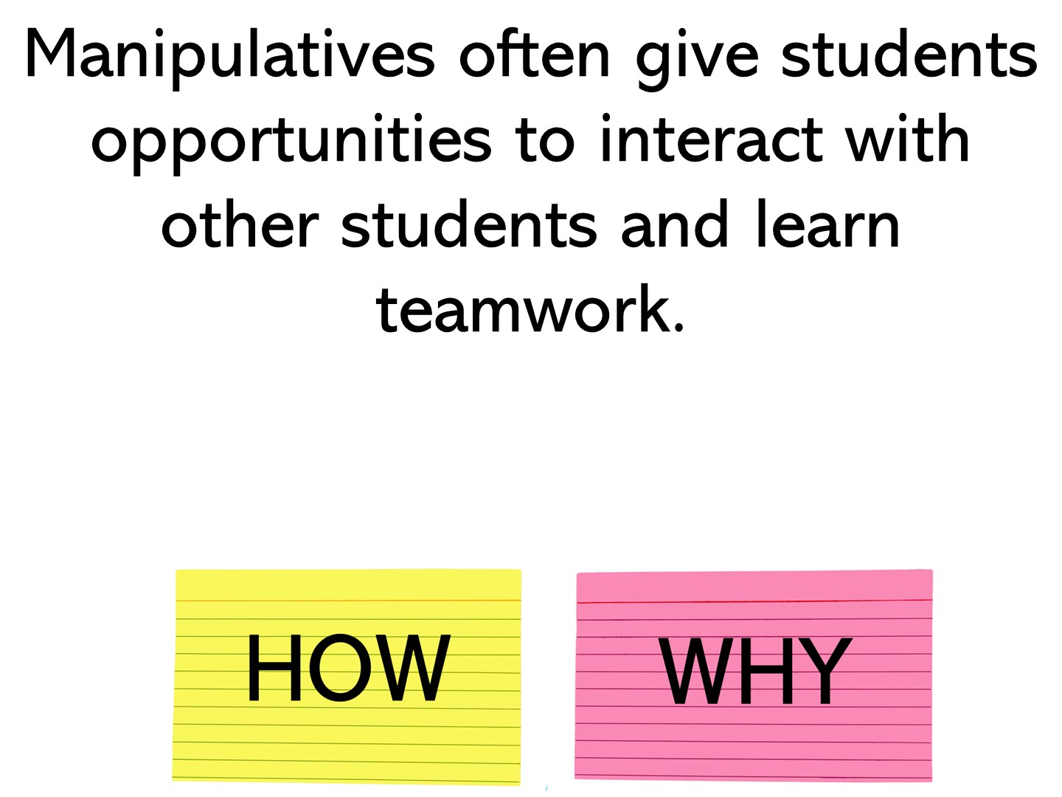
Notes:
why

Slide 21
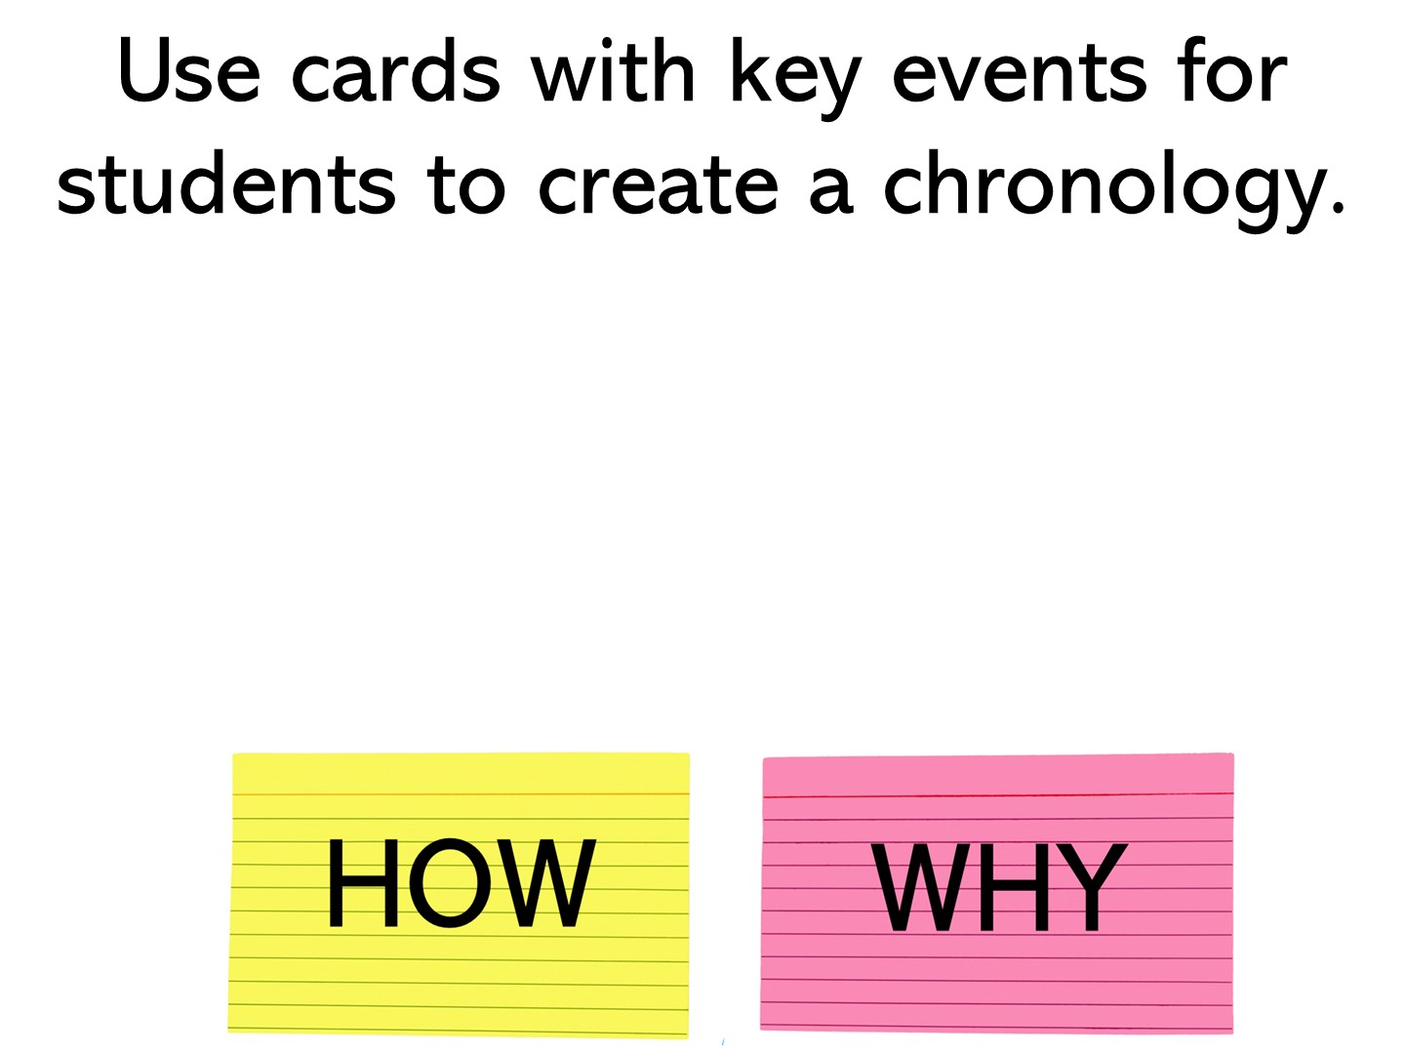
Notes:
how

Slide 22
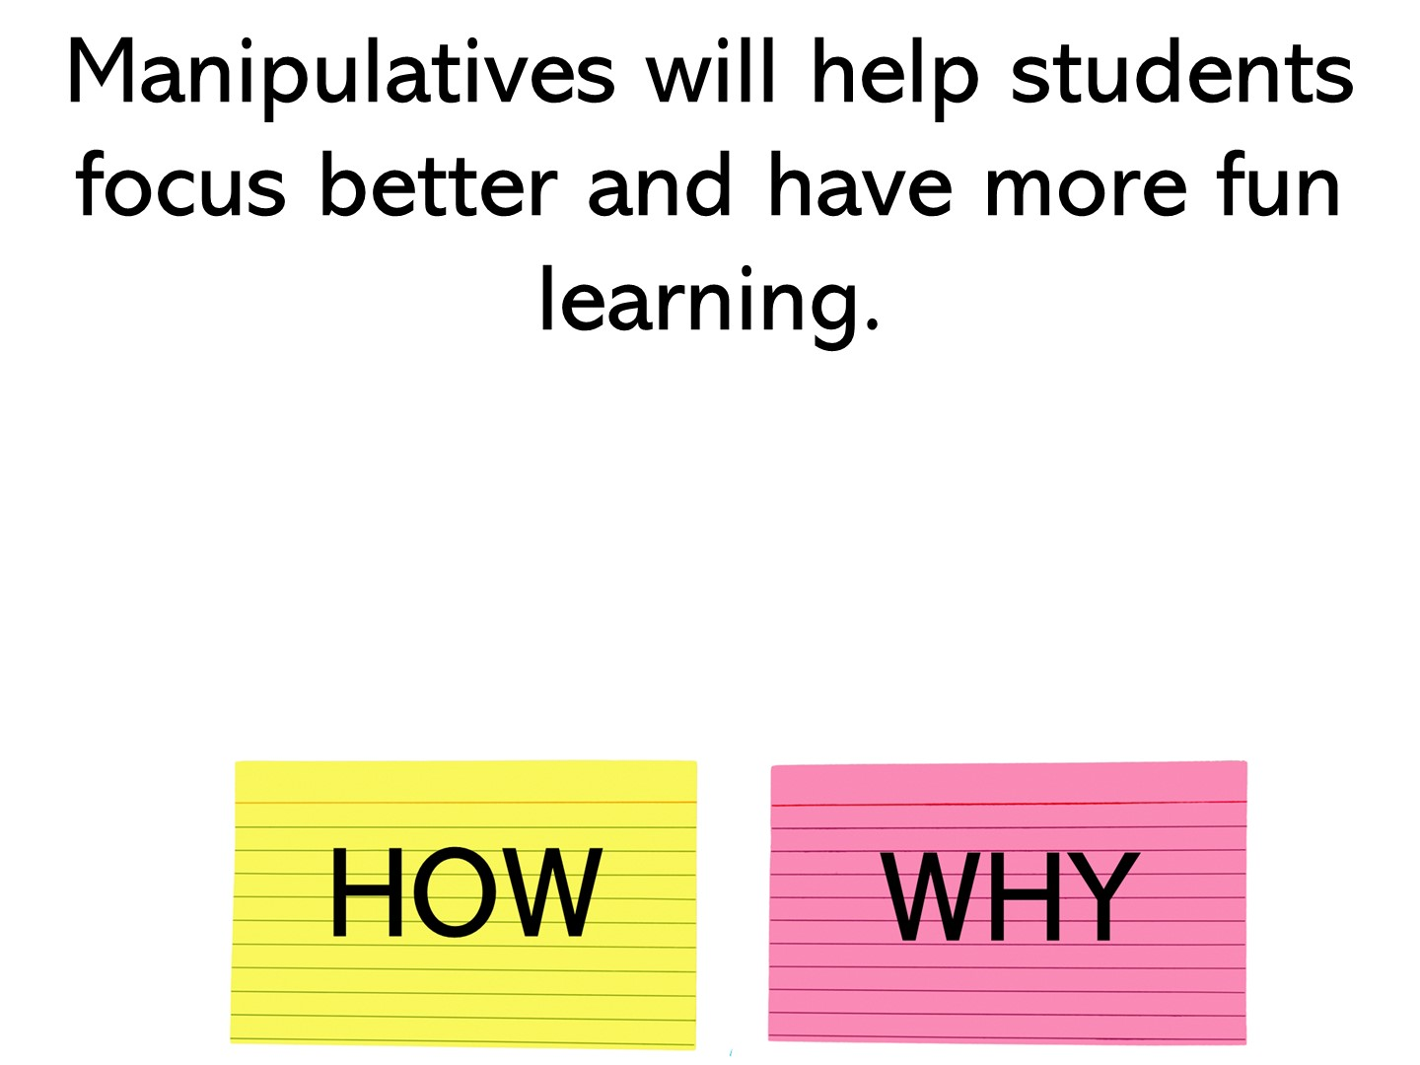
Notes:
why

Slide 23
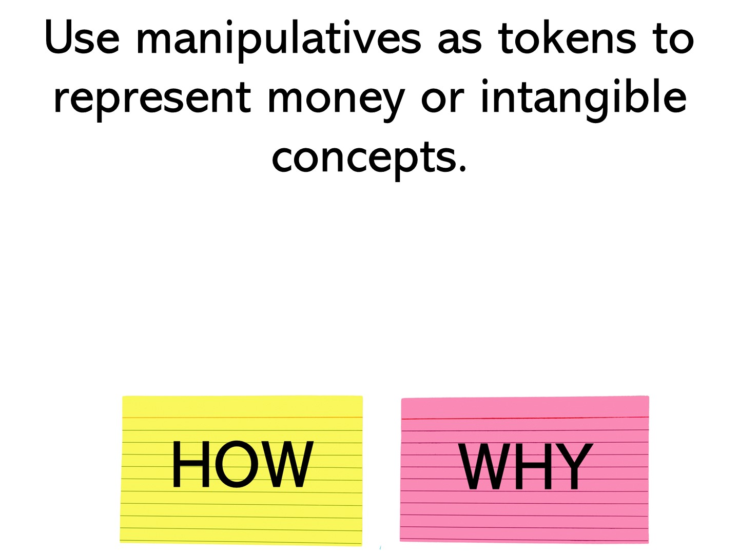
Notes:
how

Slide 24
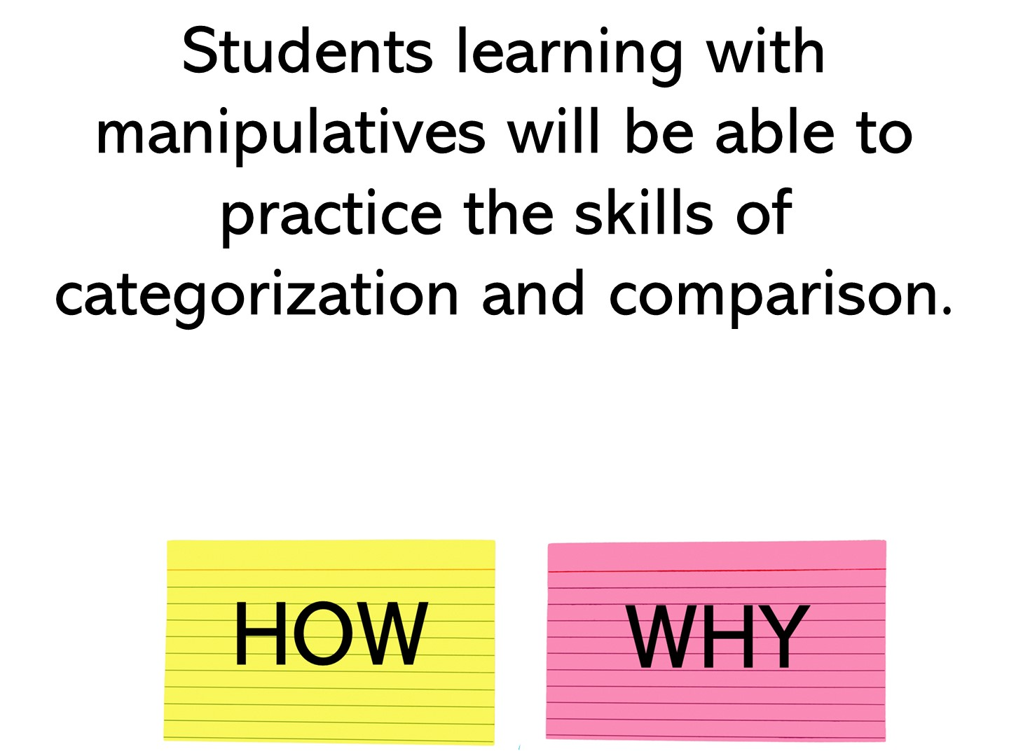
Notes:
why

Slide 25
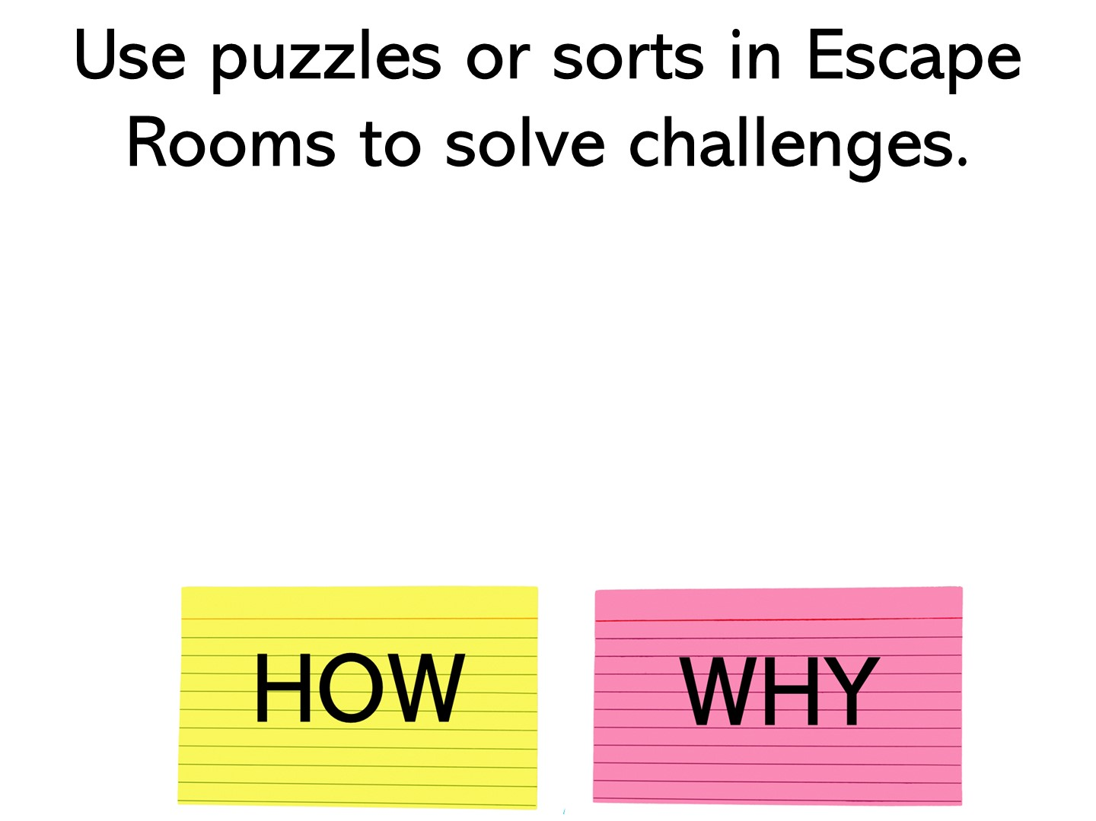
Notes:
how

Slide 26
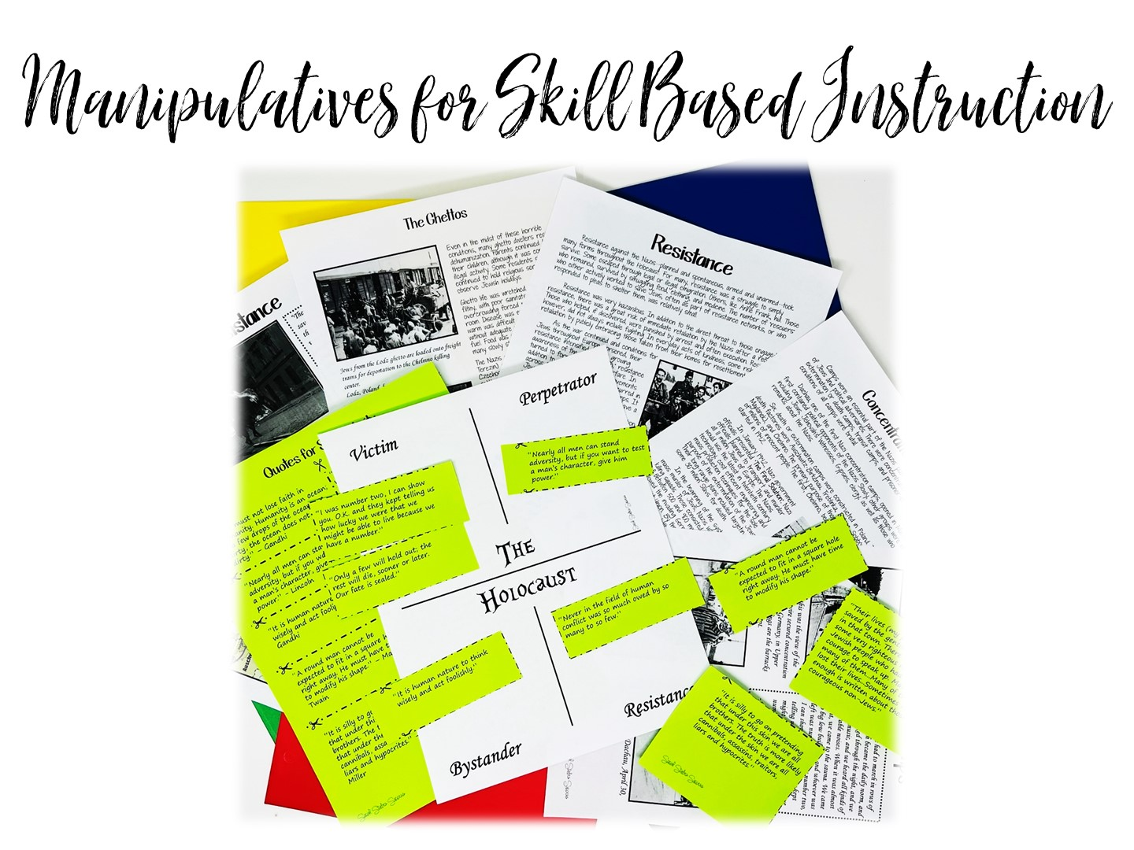
Notes:
I have divided this workshop into two different parts – using manipulatives for Skill Based Instruction and Skill Based Review

Slide 27
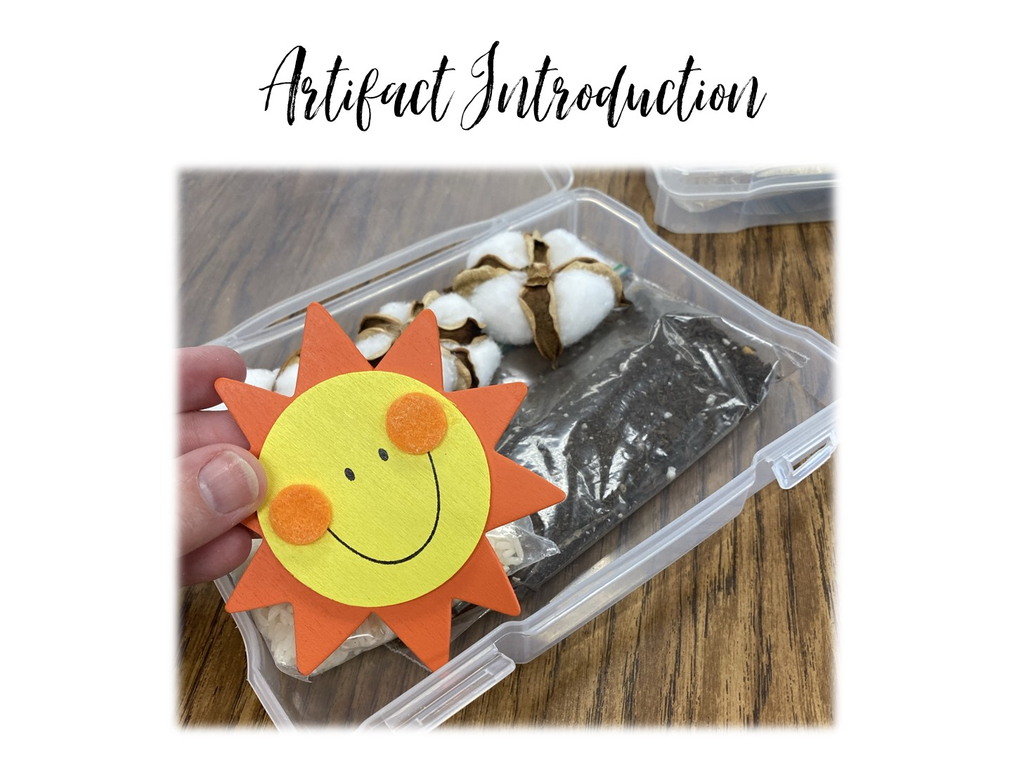
Notes:
Lets take a look at how you can preview a unit with artifacts (or faked artifacts). The boxes I have given you are for the Cotton, Cattle, and Railroads era of Texas History (Don’t tell them that yet).

Slide 28
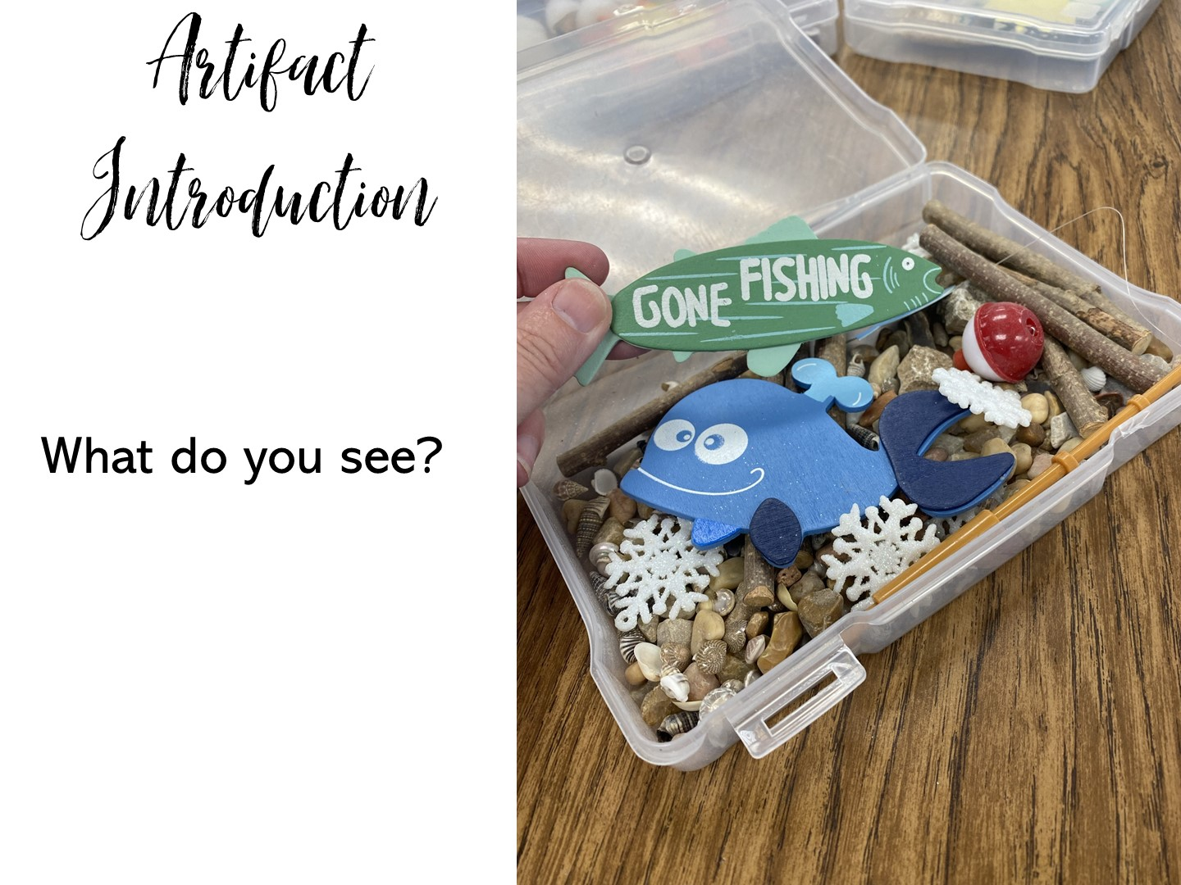
Notes:
Pass out the boxes and have them talk through these questions with a partner. At the end you can pass out the artifact questions. All of the items in the boxes came from Amazon.

Slide 29
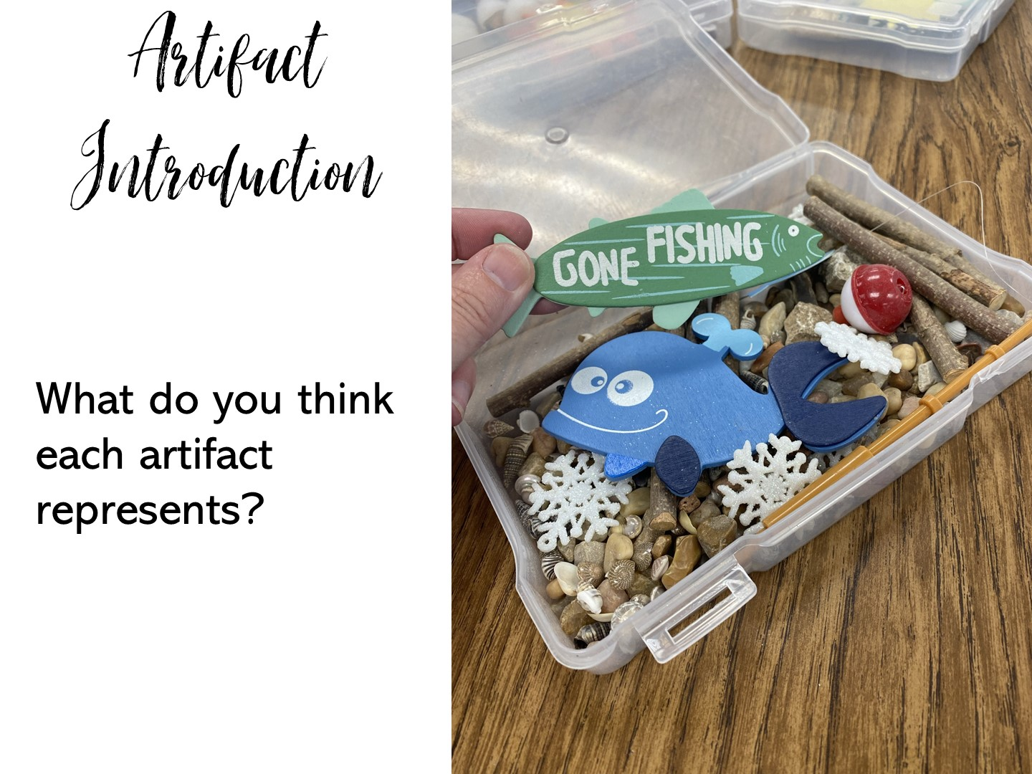

Slide 30
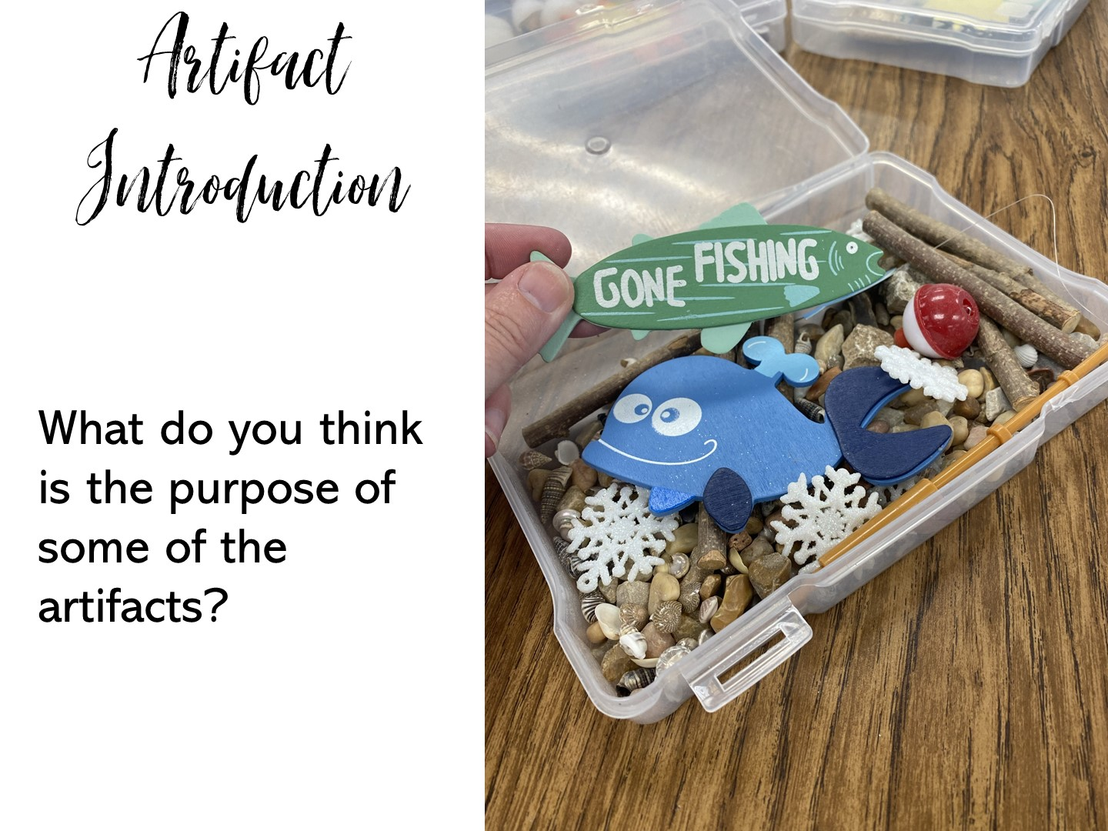

Slide 31
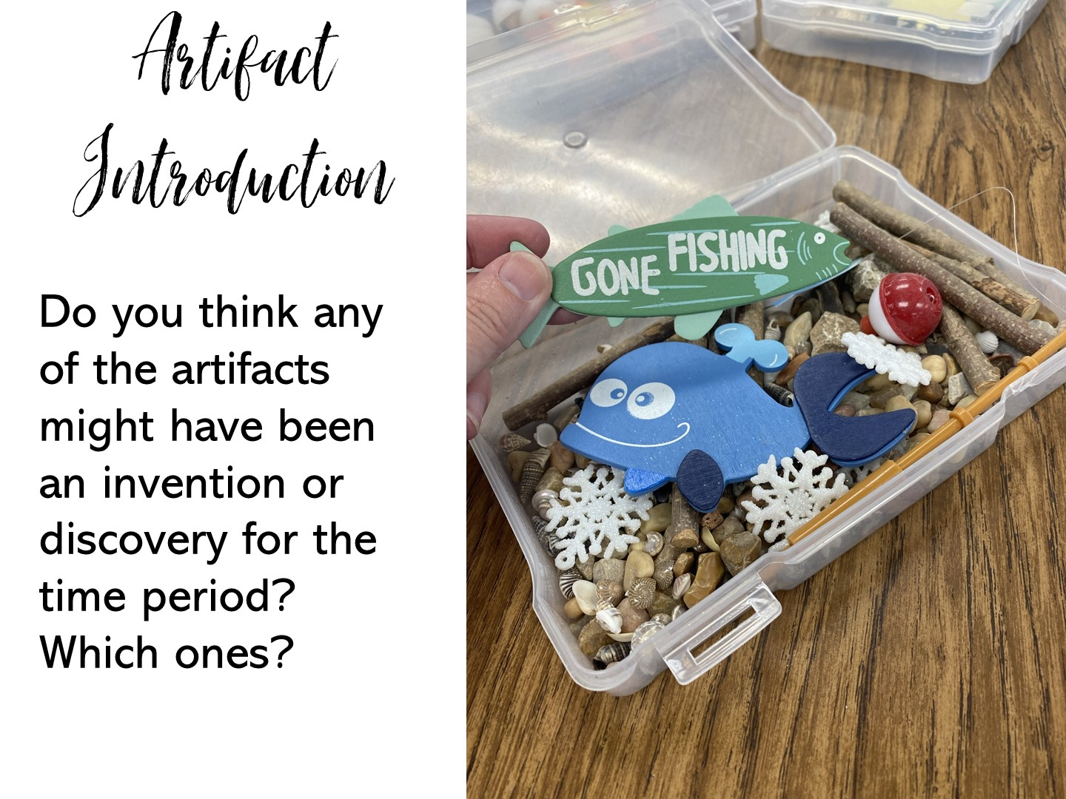

Slide 32
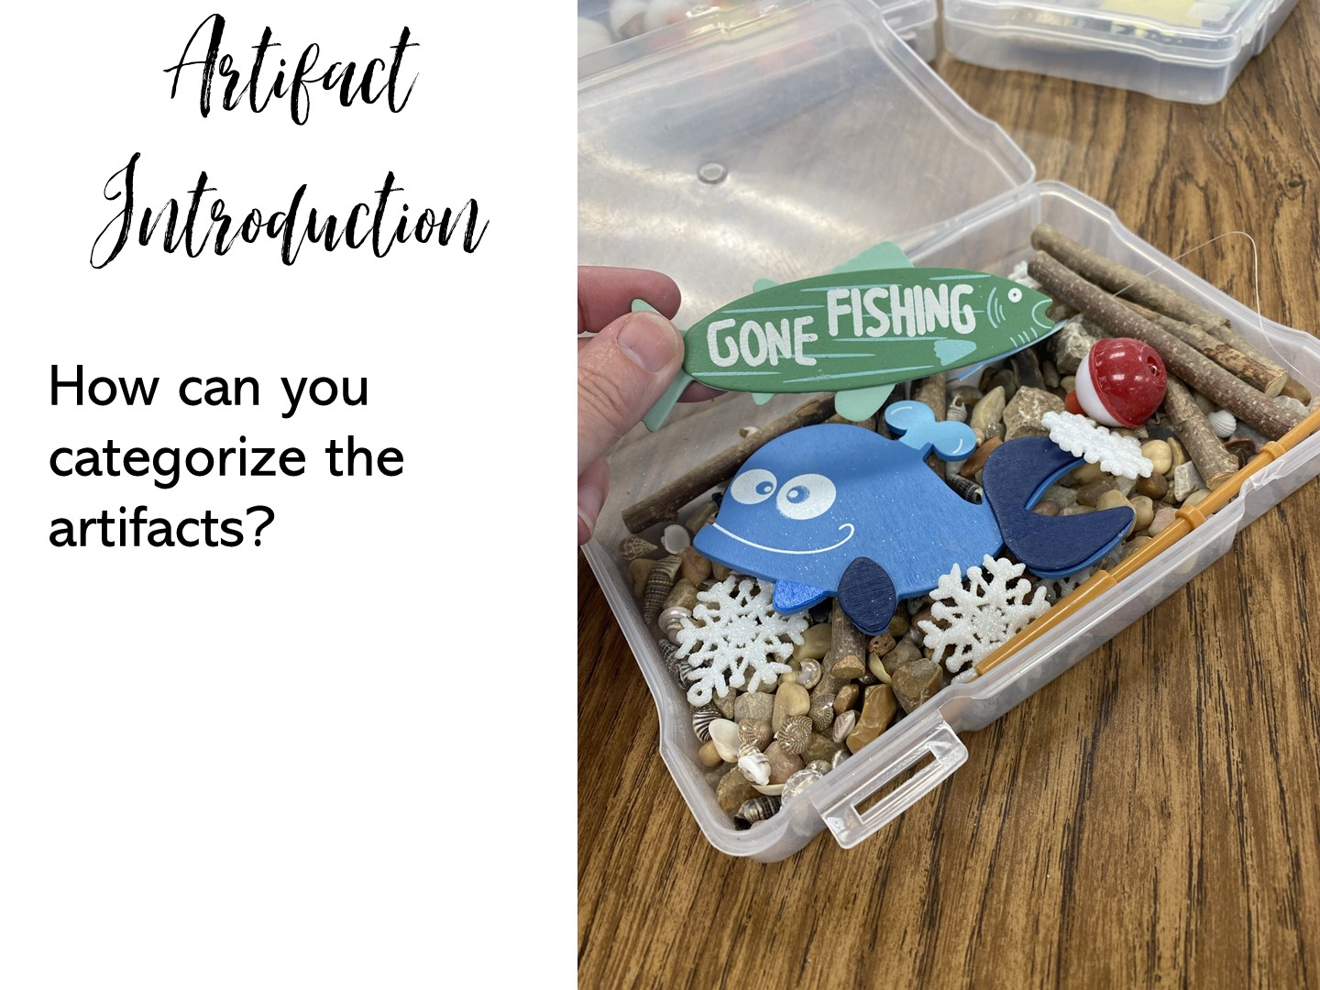

Slide 33
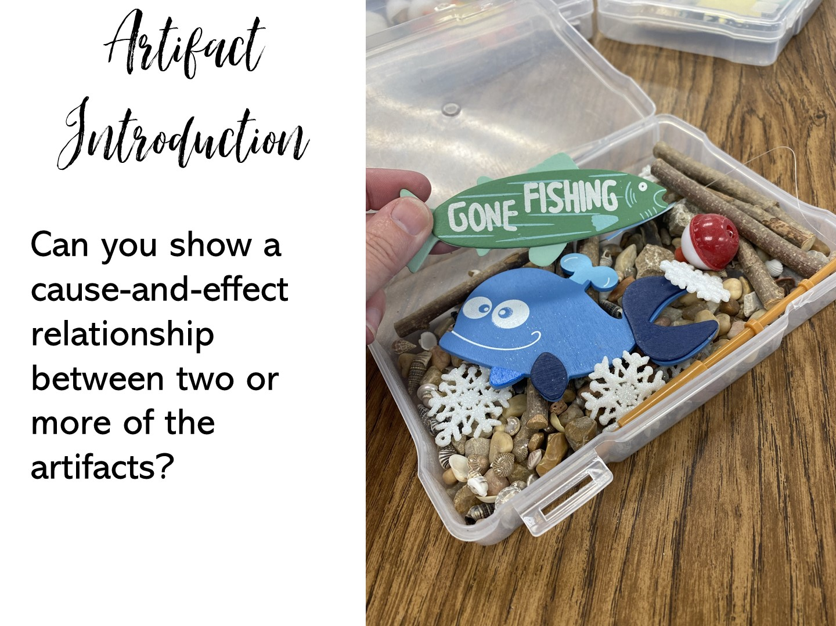

Slide 34
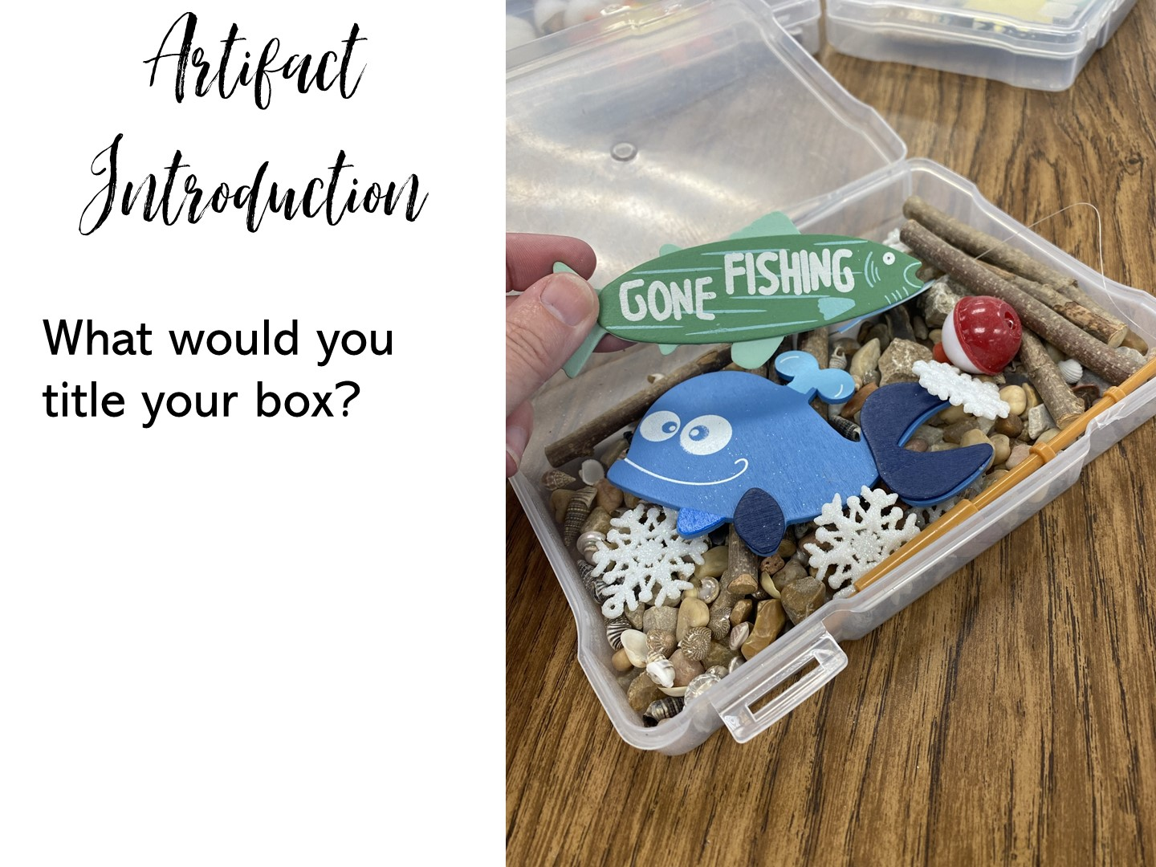

Slide 35
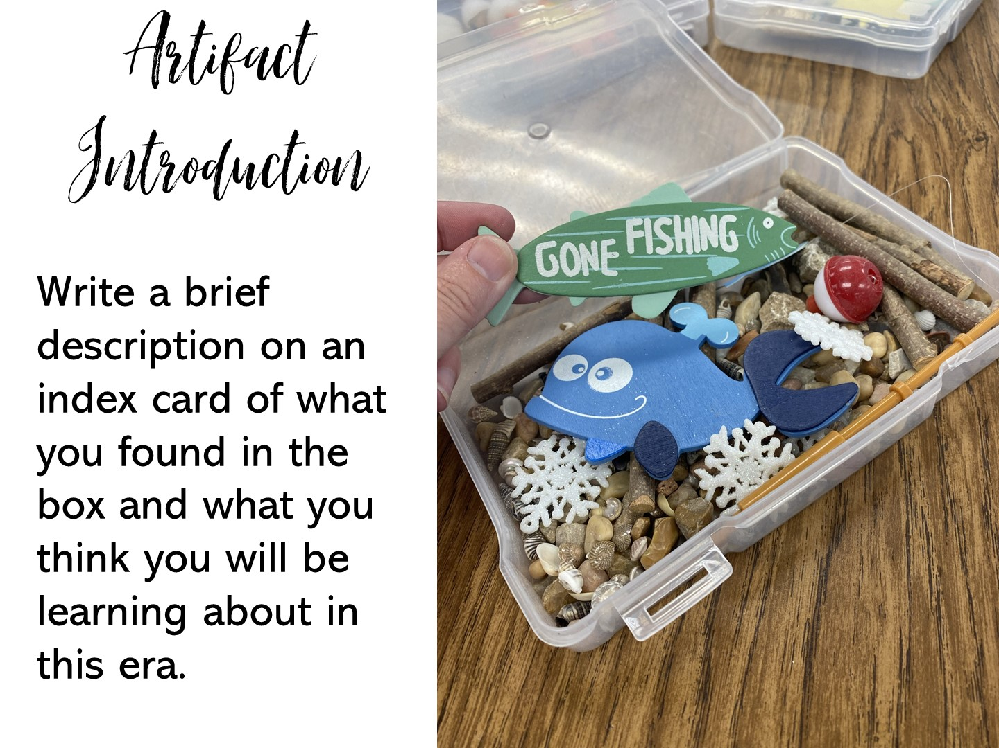

Slide 36


Slide 37

Notes:
Do not create artifact boxes on sensitive topics.

Slide 38
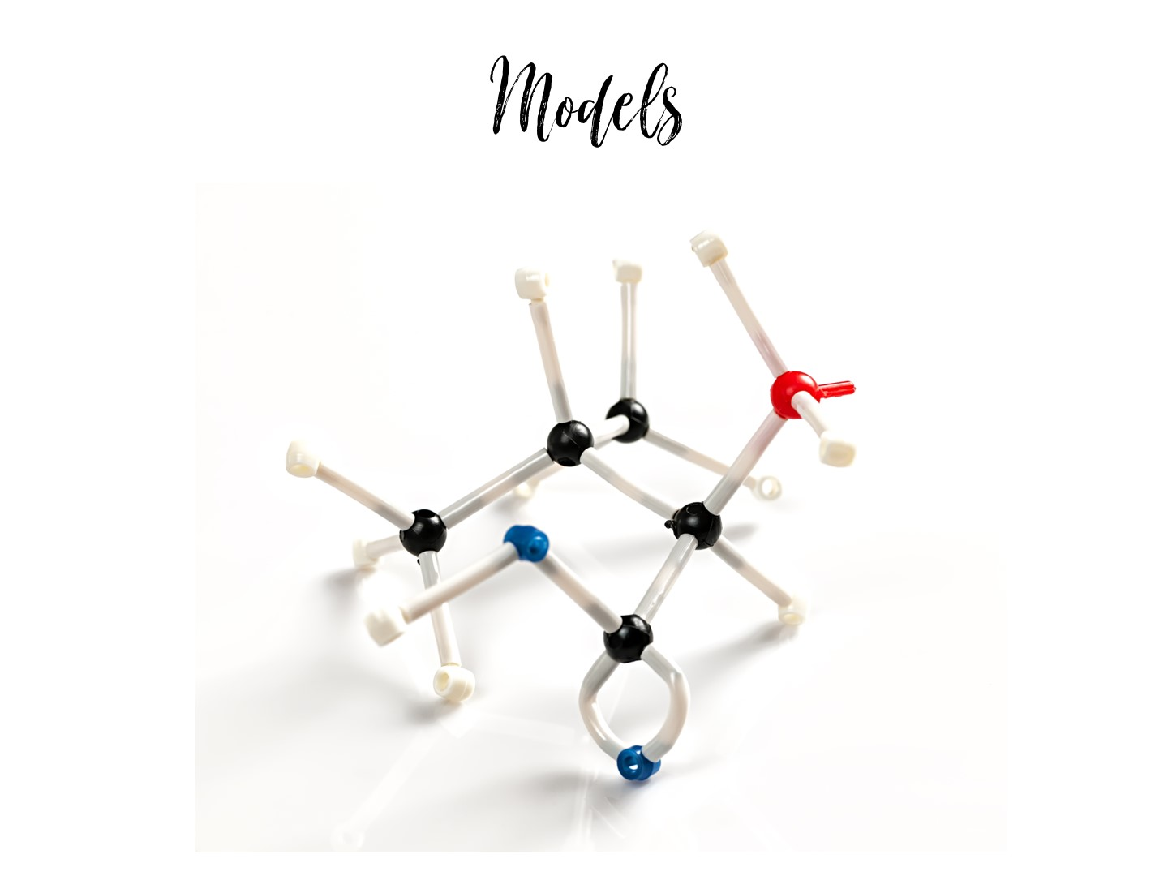
Notes:
Next let's look at how to use manipulatives to make models.

Slide 39
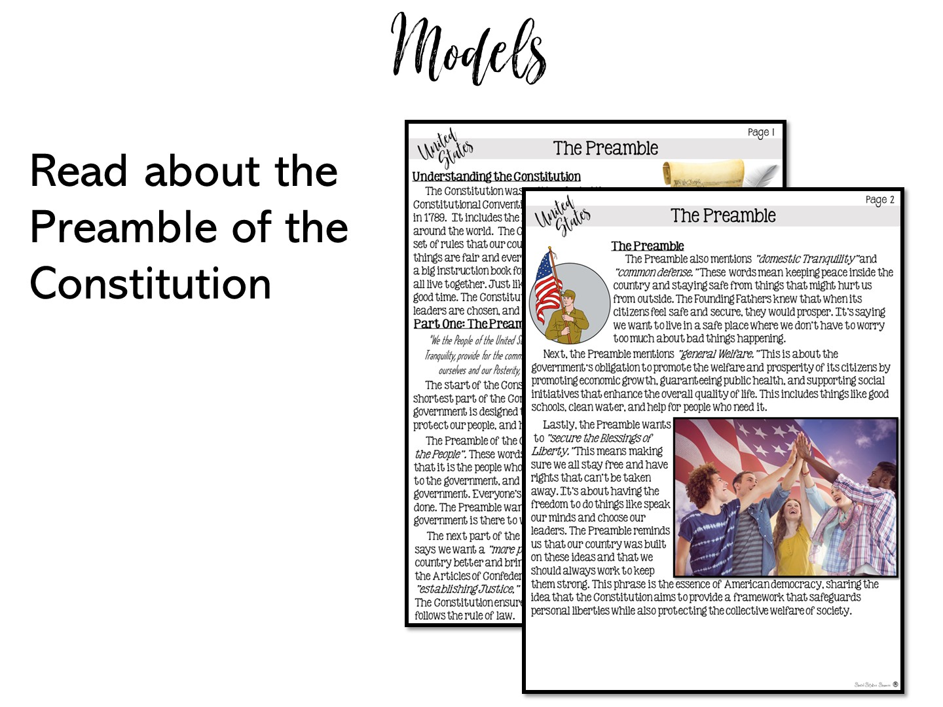
Notes:
Pass out the reading on the Preamble from 5th grade. Give them time to quickly read. Explain that this is only part of the lesson, you are not modeling reading strategies or note taking that is also a part of the lesson.

Slide 40
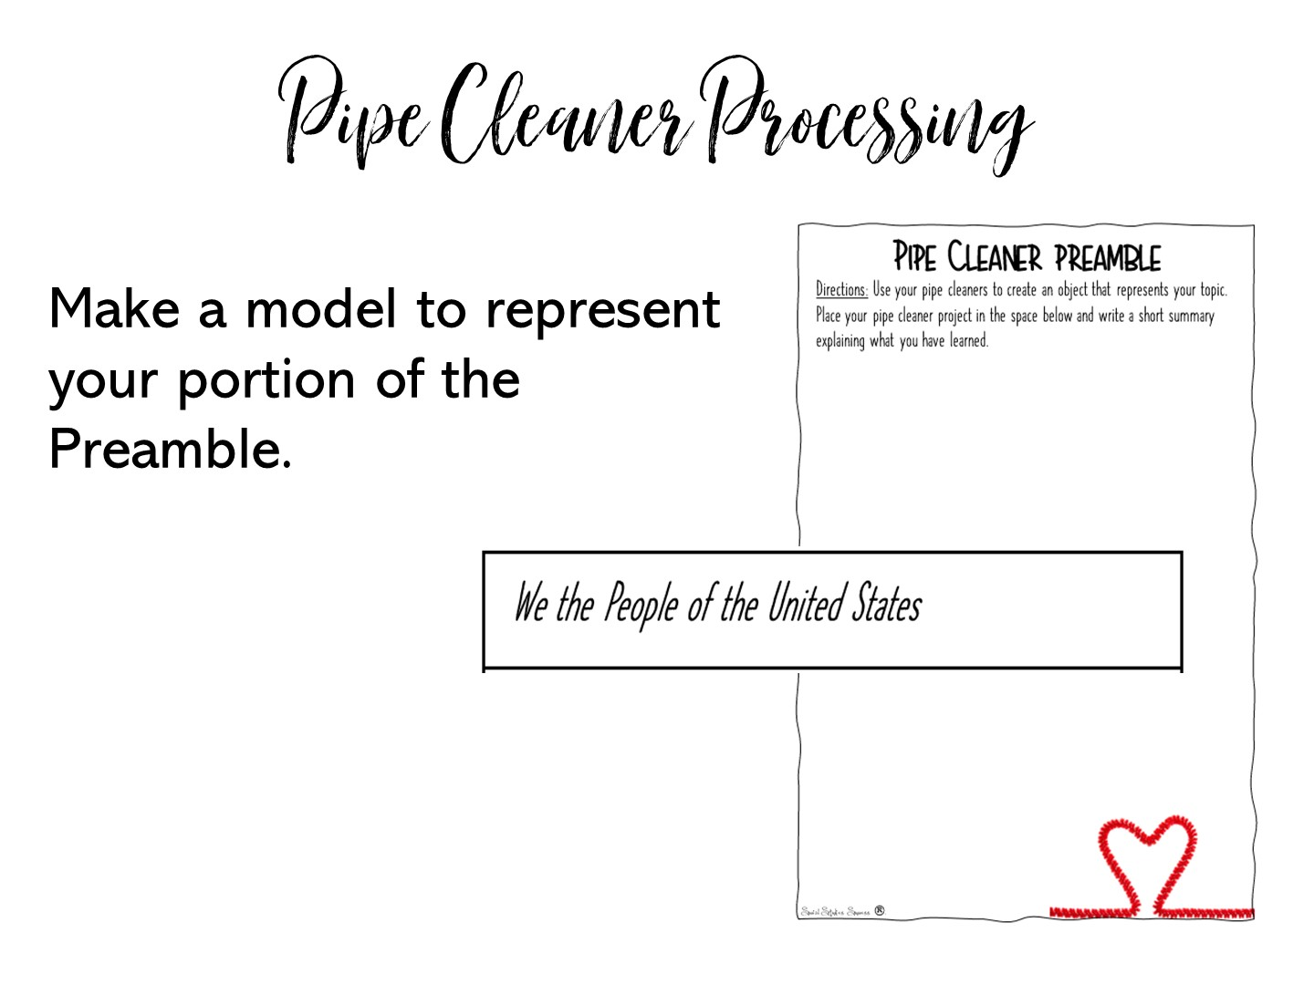
Notes:
Pass out one of the strips for the pipe cleaner Preamble and a ½ sheet to each teacher.
Review directions and show the example on the next slide.

Slide 41
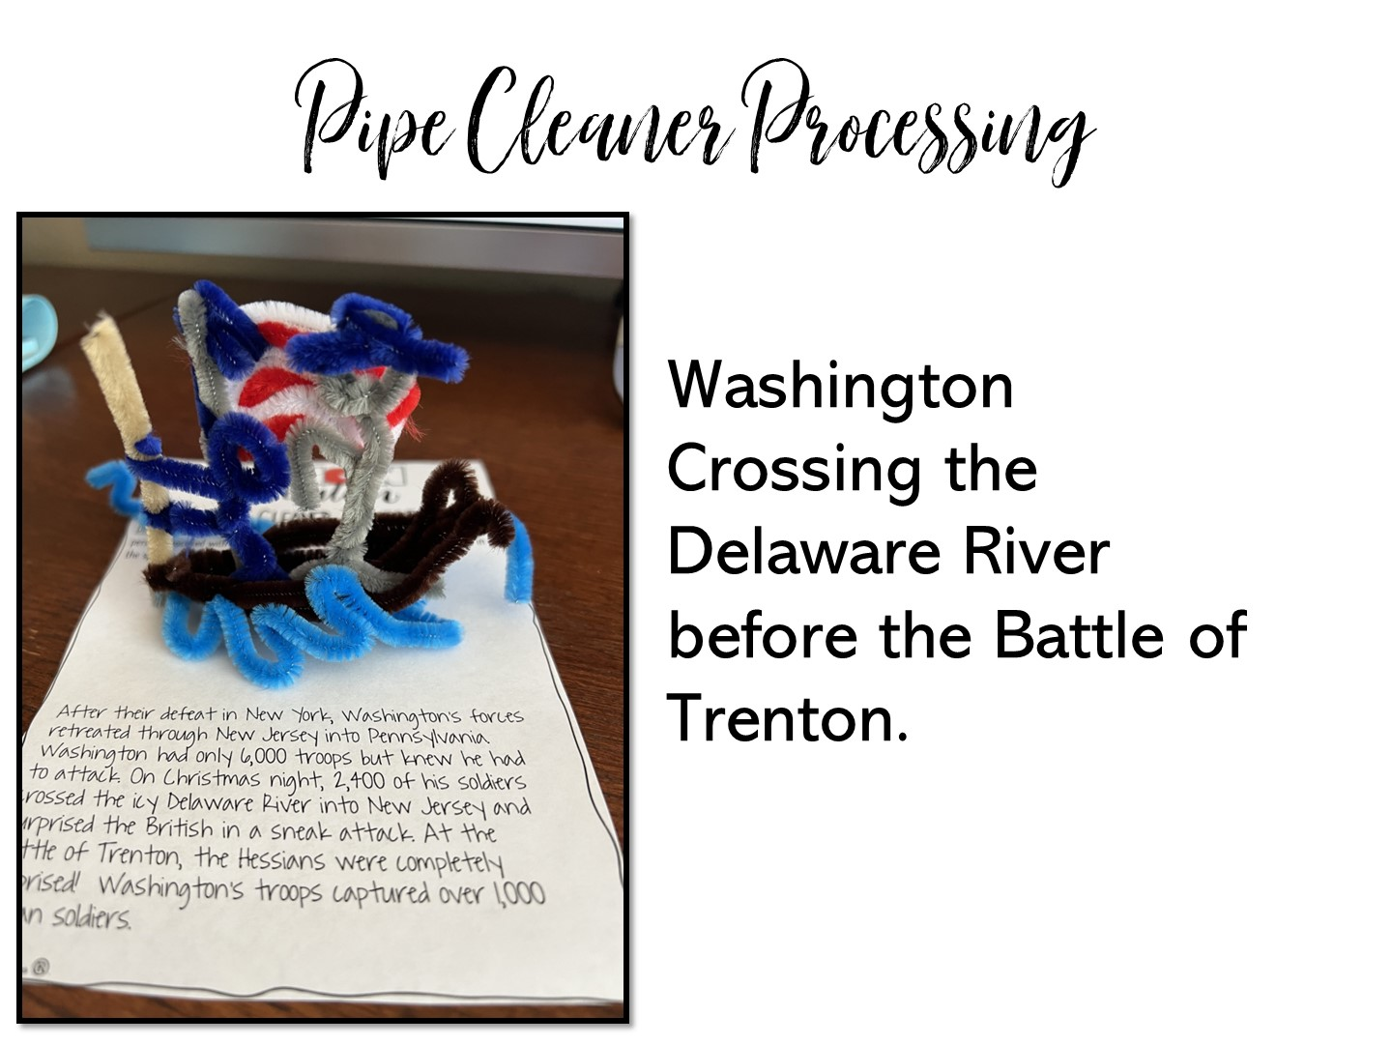
Notes:
Here is an example of a pipe cleaner model for the American Revolution.

Slide 42
Notes:
After everyone is done, do a quick gallery walk so they can see each other’s models.

Slide 43

Notes:
Have them talk about one thing they learned and one question they have while you pass out the crop-it tools and images.

Slide 44
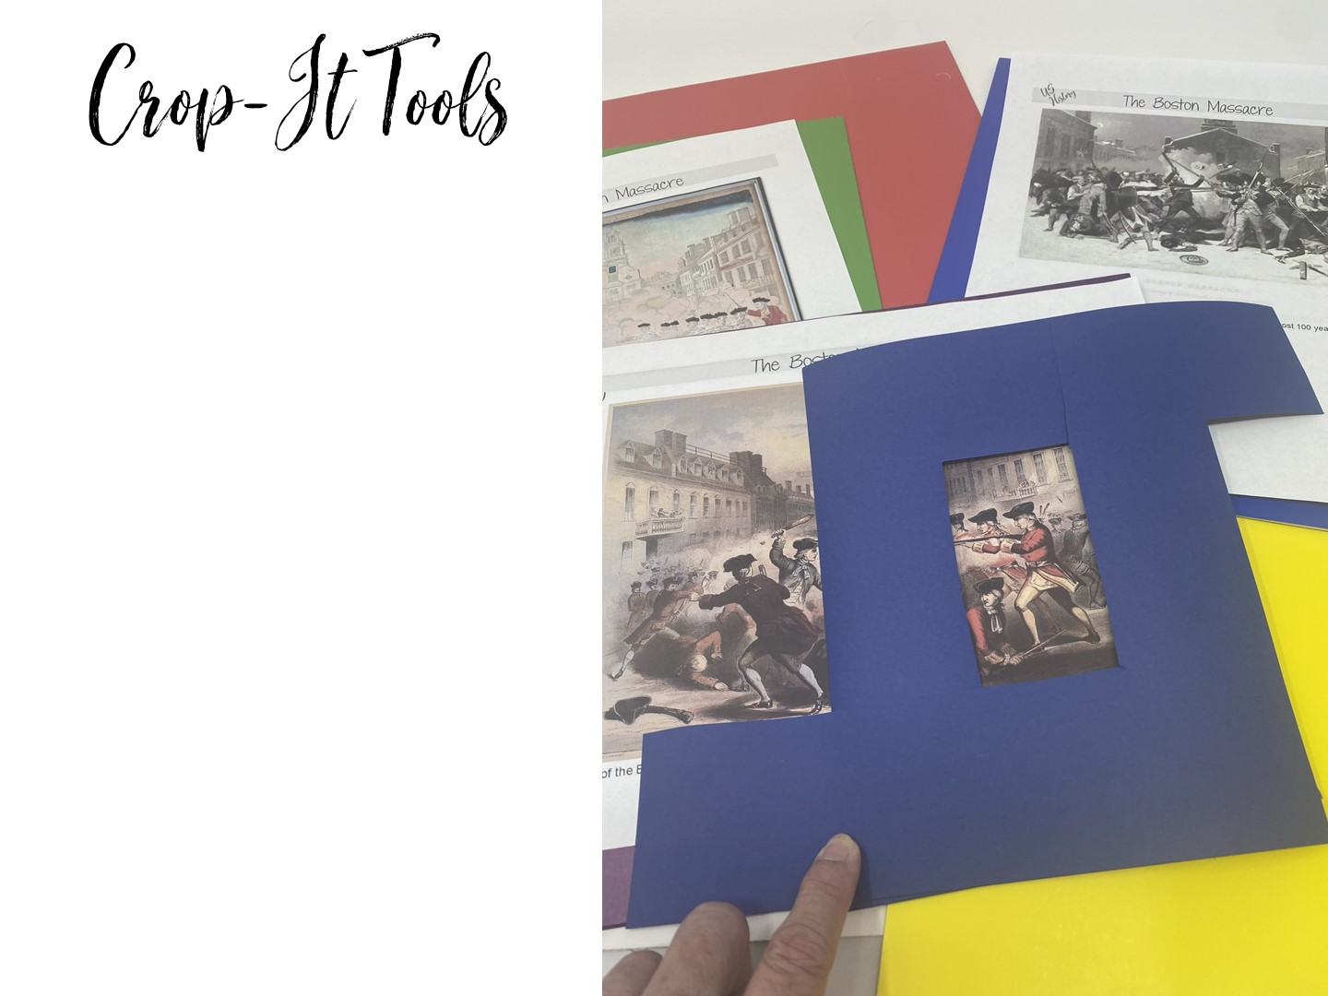
Notes:
Explain how you can use crop-it tools to analyze images. Pass out the crop-it tools and the Boston Massacre images. Use the handout with questions to ask questions for the teachers to answer using the tool.

Slide 45
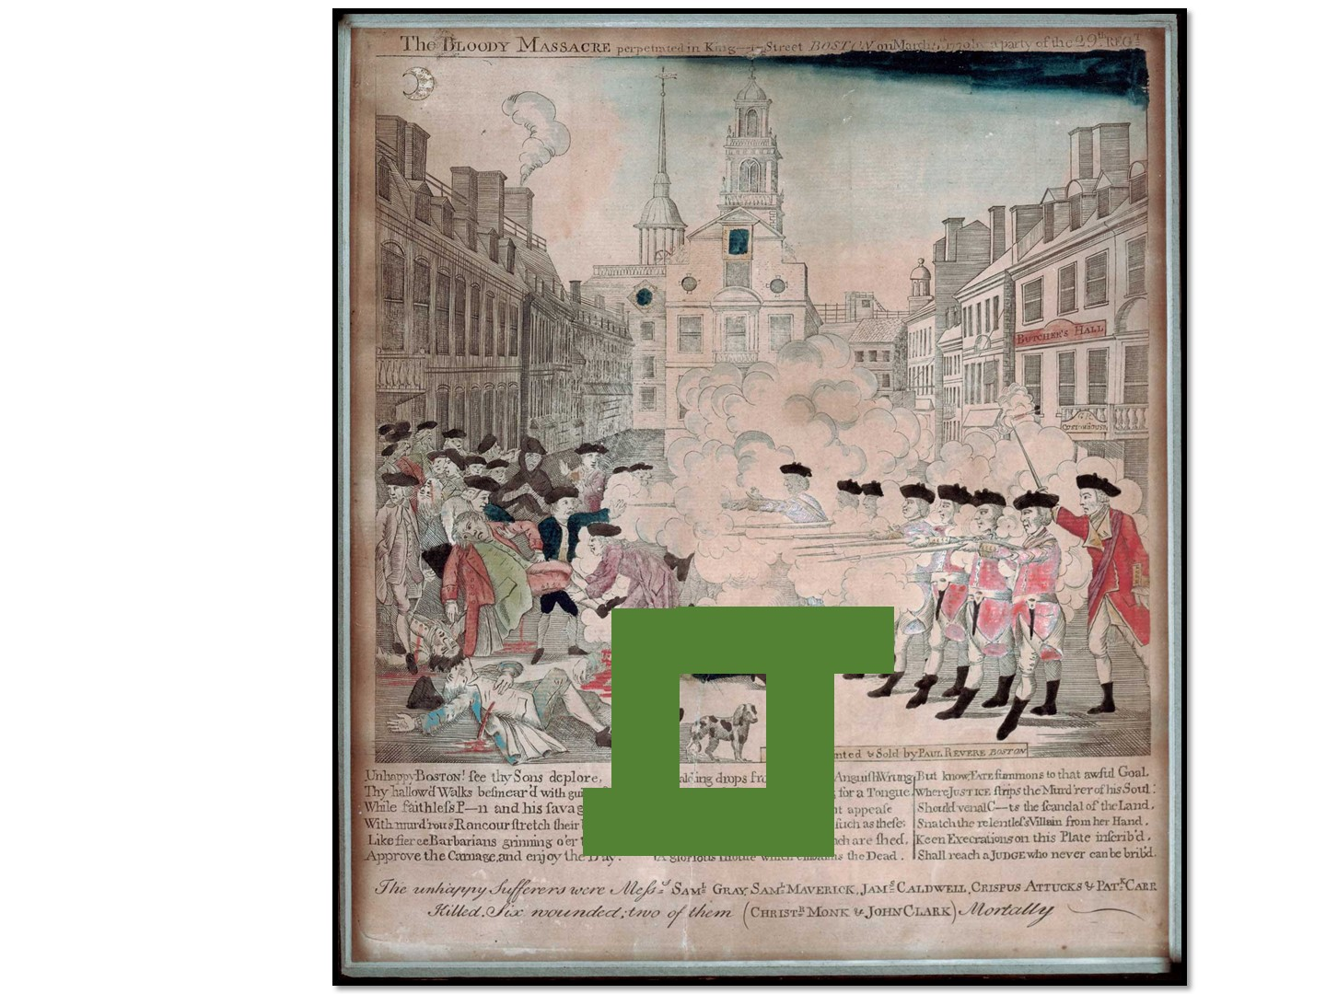
Notes:
Pass out the crop-it tools and the Boston Massacre images. Use the handout with questions to ask questions for the teachers to answer using the tool.

Slide 46
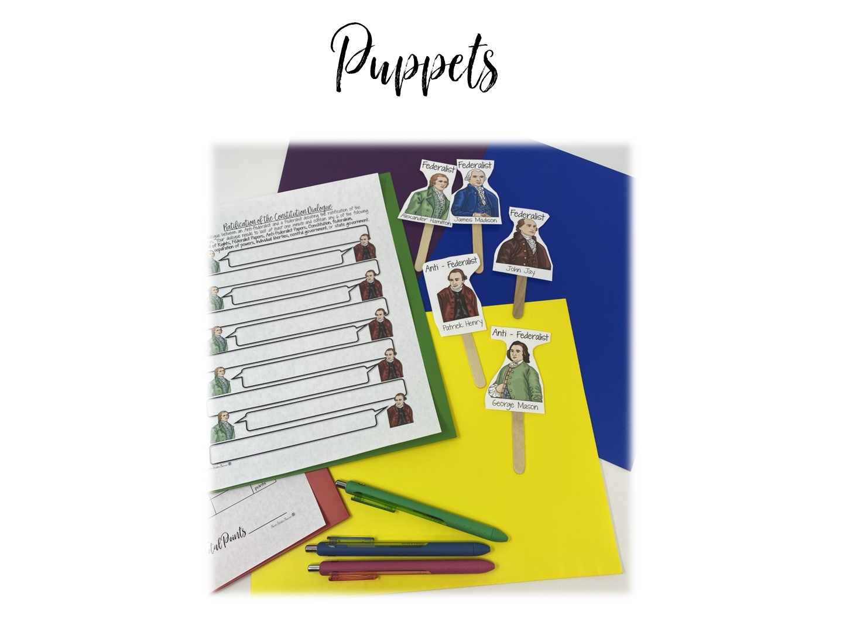
Notes:
You can just hold up a puppet and explain what you can do with puppets – reading, debating, random calling, etc.

Slide 47
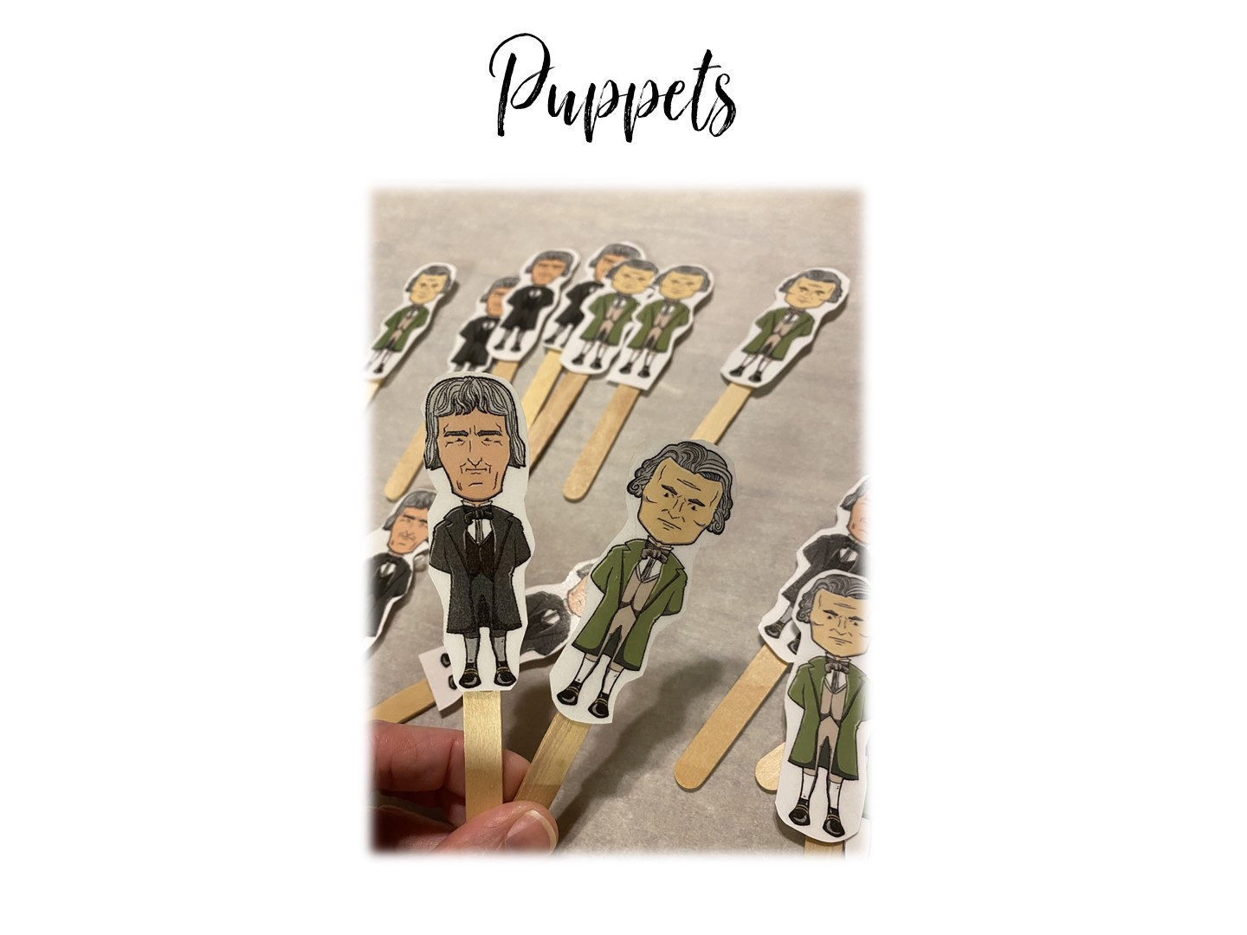
Notes:
This is for a debate between Hamilton and Jefferson.

Slide 48
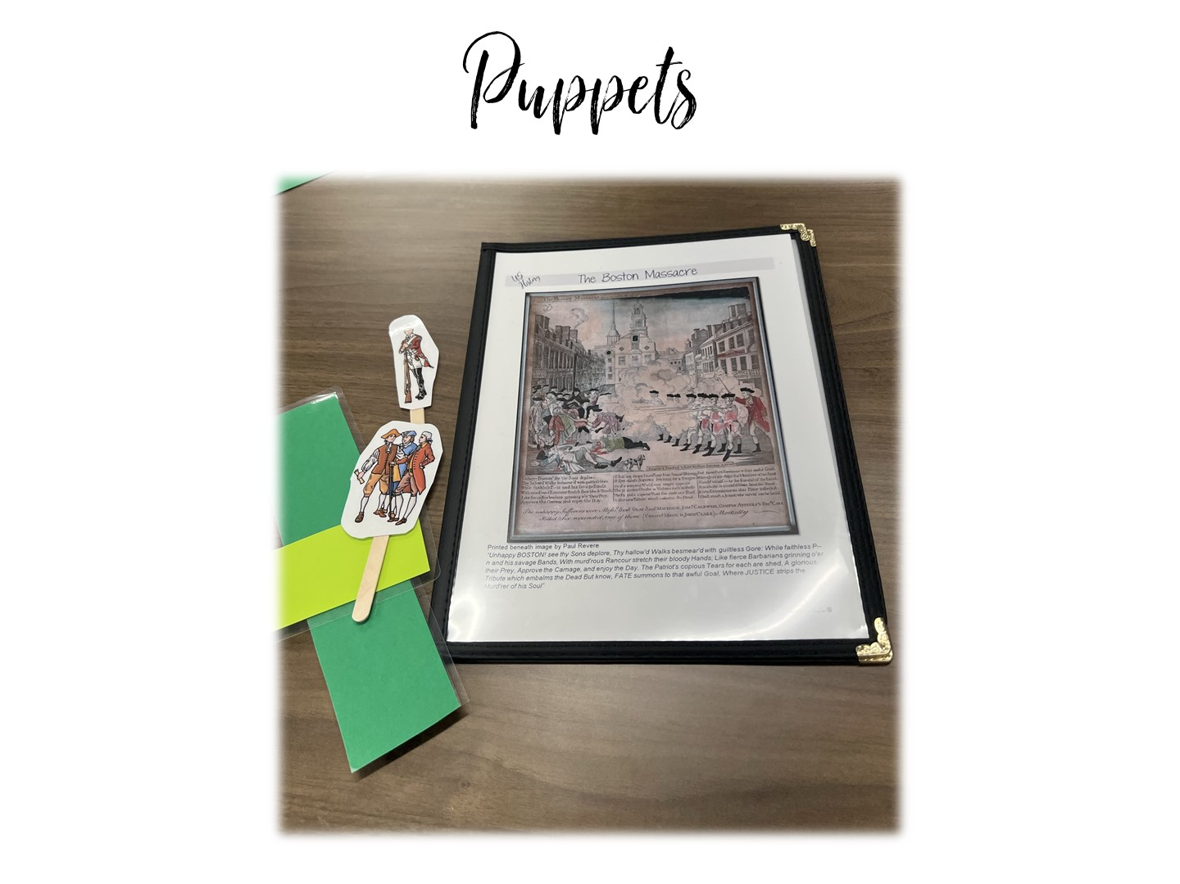
Notes:
This is for a debate between Patriots and Loyalists over the Boston Massacre.

Slide 49
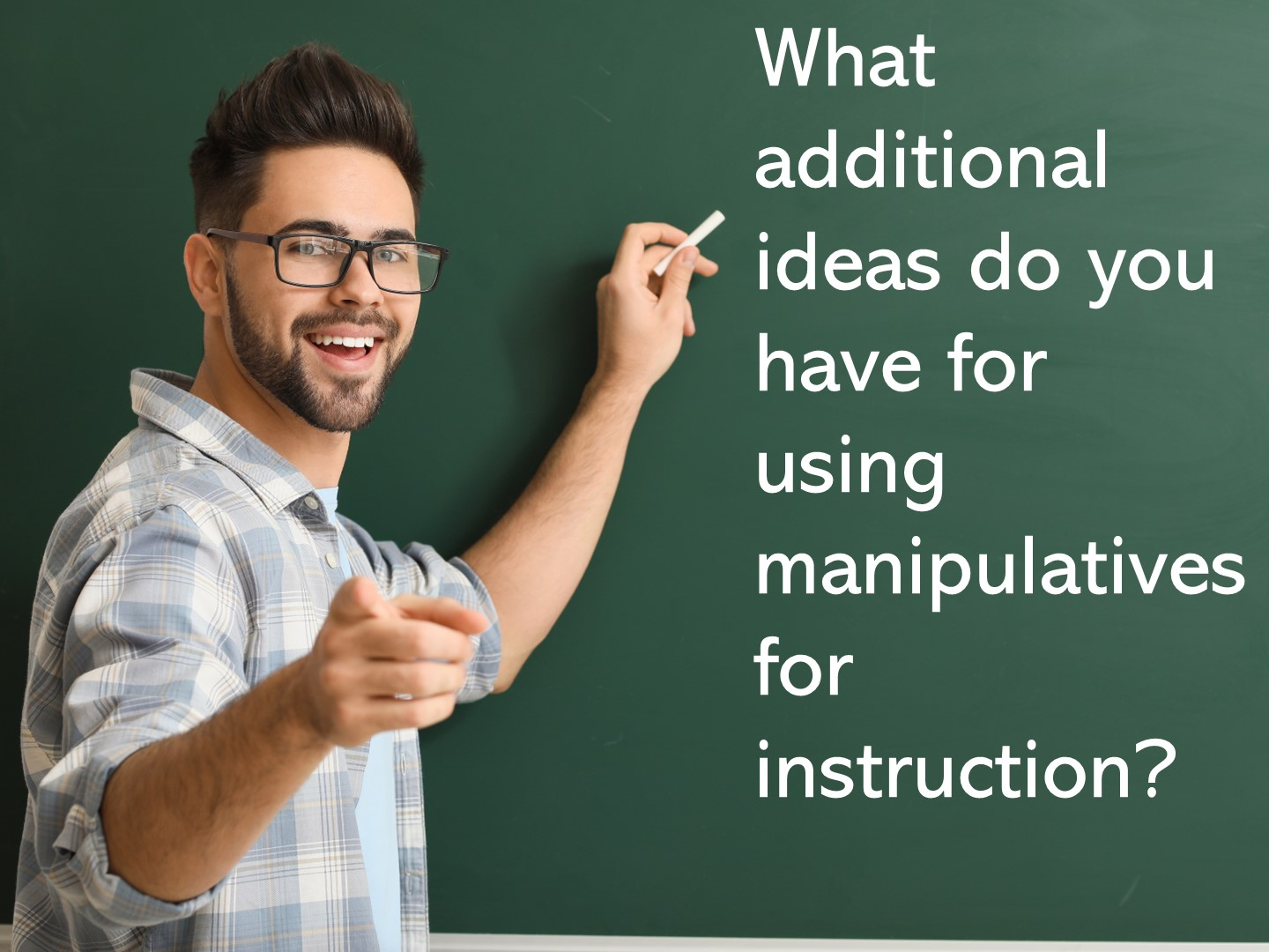

Slide 50
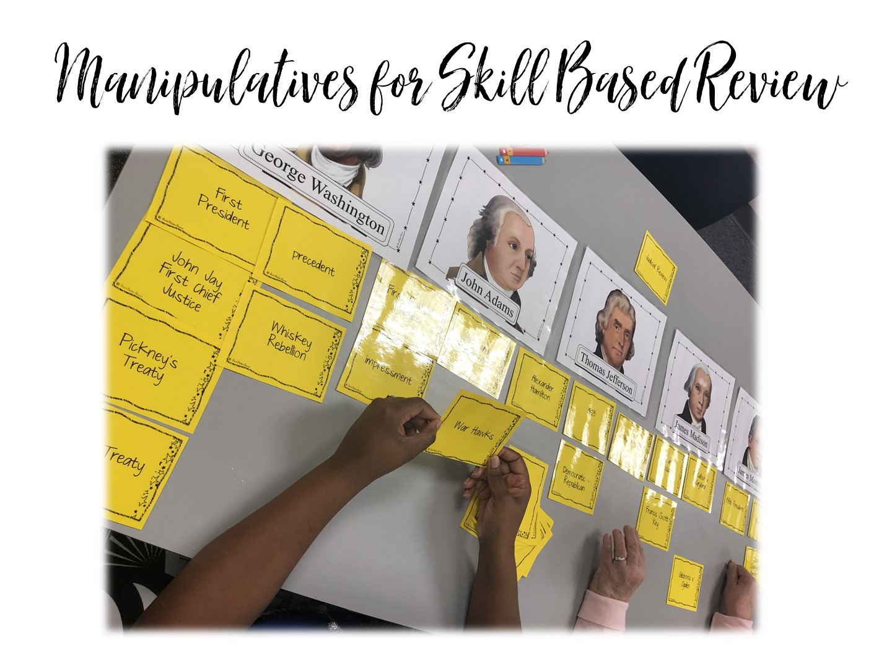
Notes:
Now we are going to look at manipulatives for review.

Slide 51
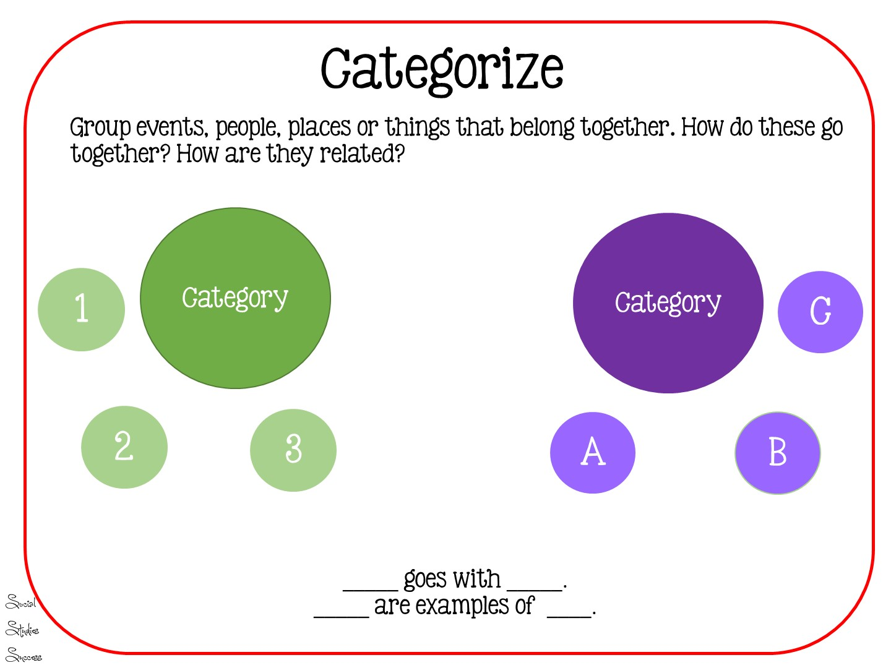
Notes:
Categorization helps our students organize information

Slide 52
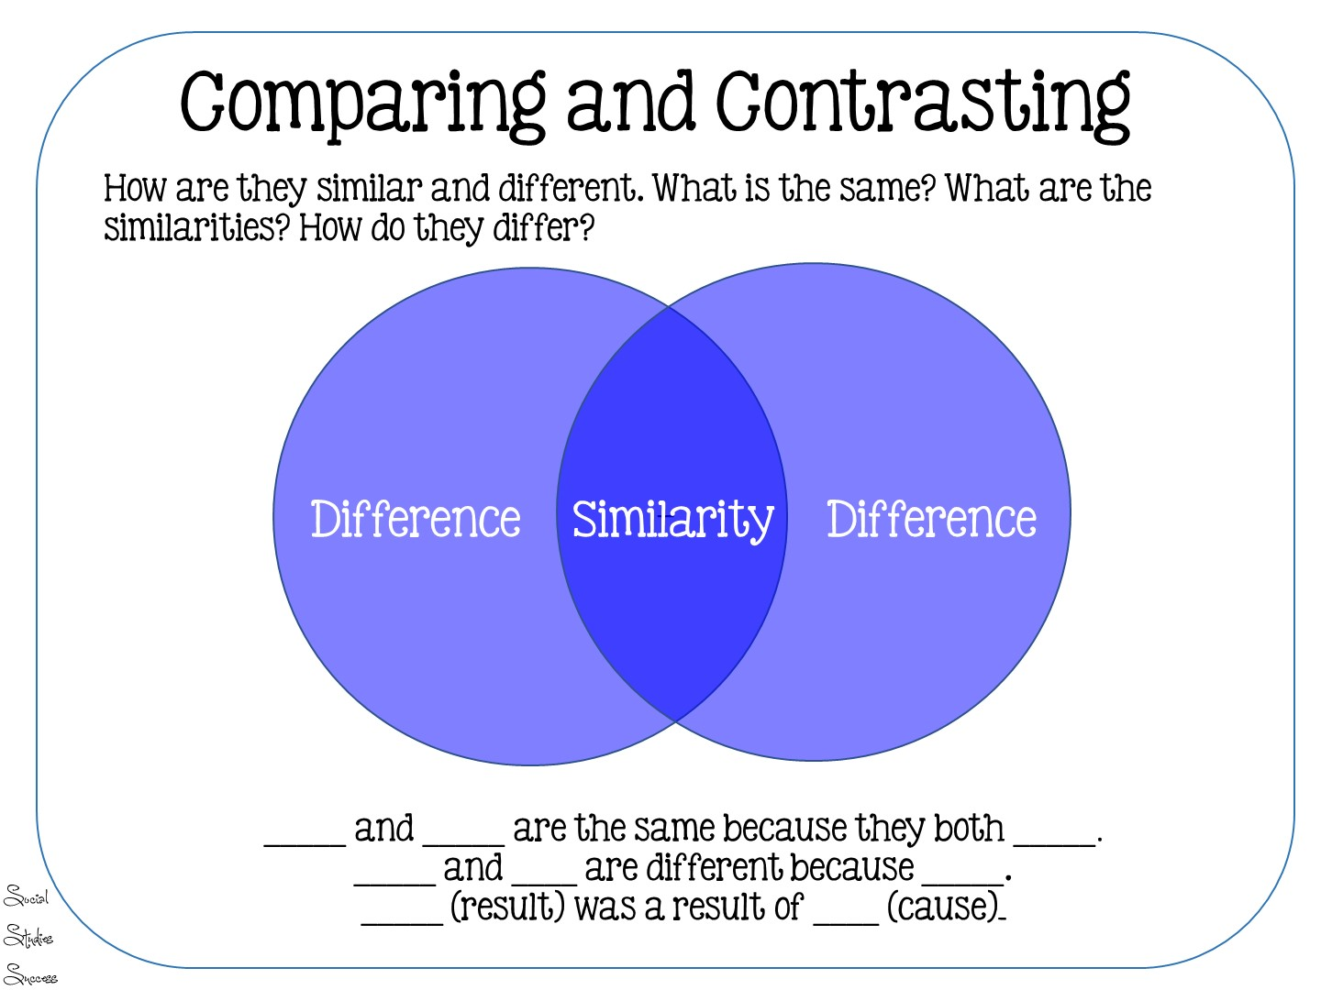
Notes:
Comparing and contrasting of categories

Slide 53
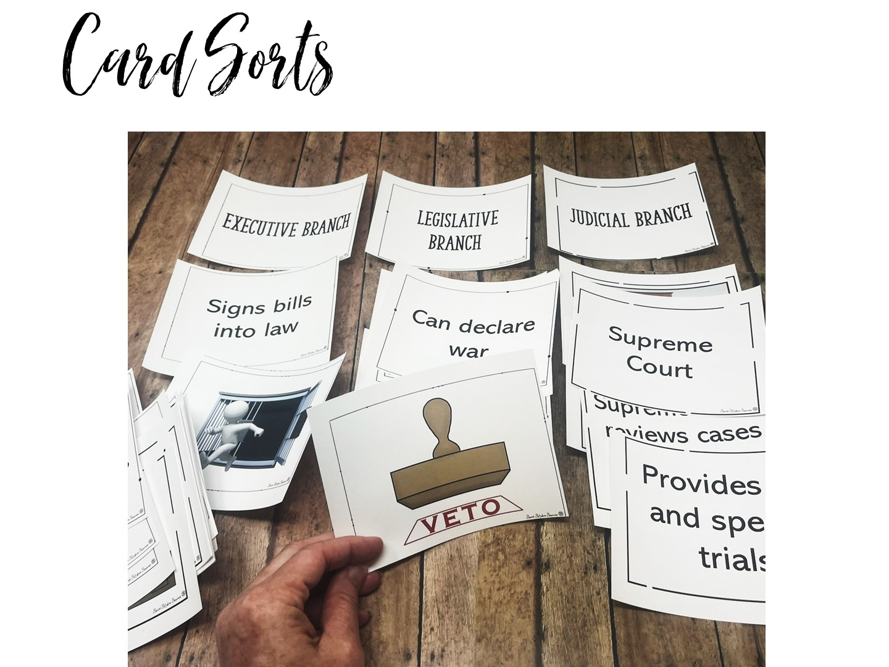
Notes:
Pass out the card sort for the 3 branches of government and play the game. This is for 5th grade.

Slide 54
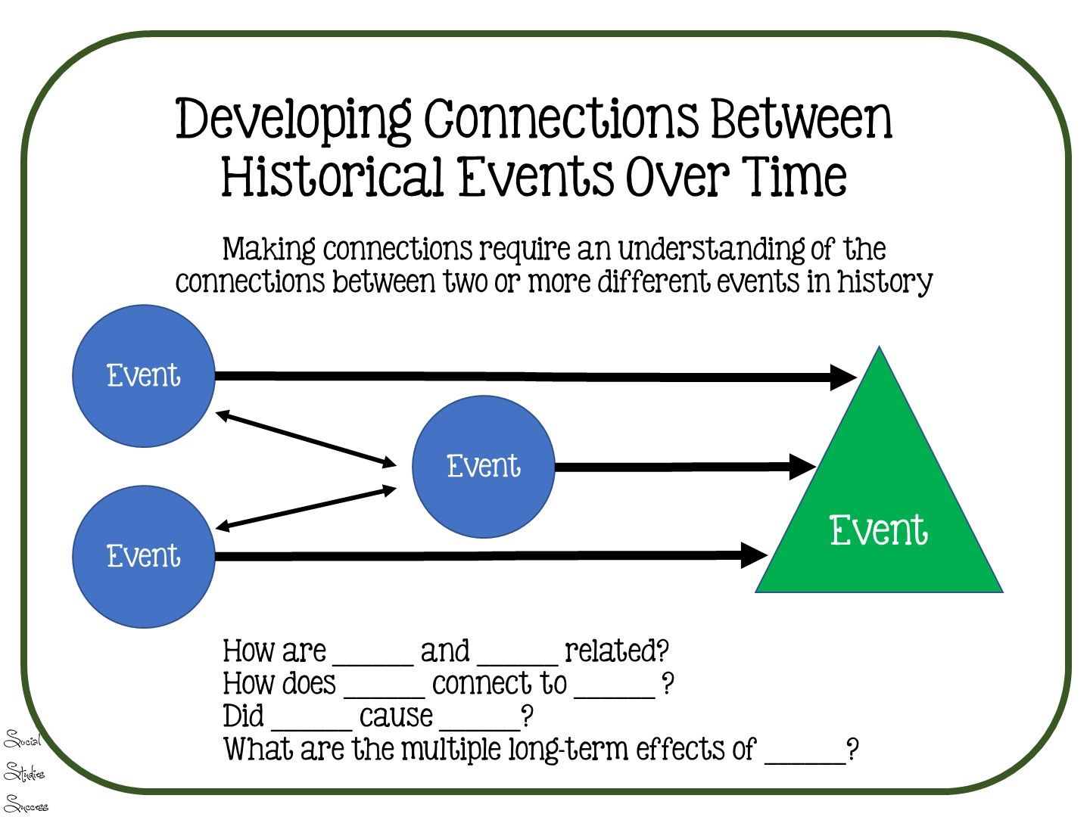
Notes:
This is a standard inferred by the STAAR test – it includes historical influences on the Constitution.

Slide 55
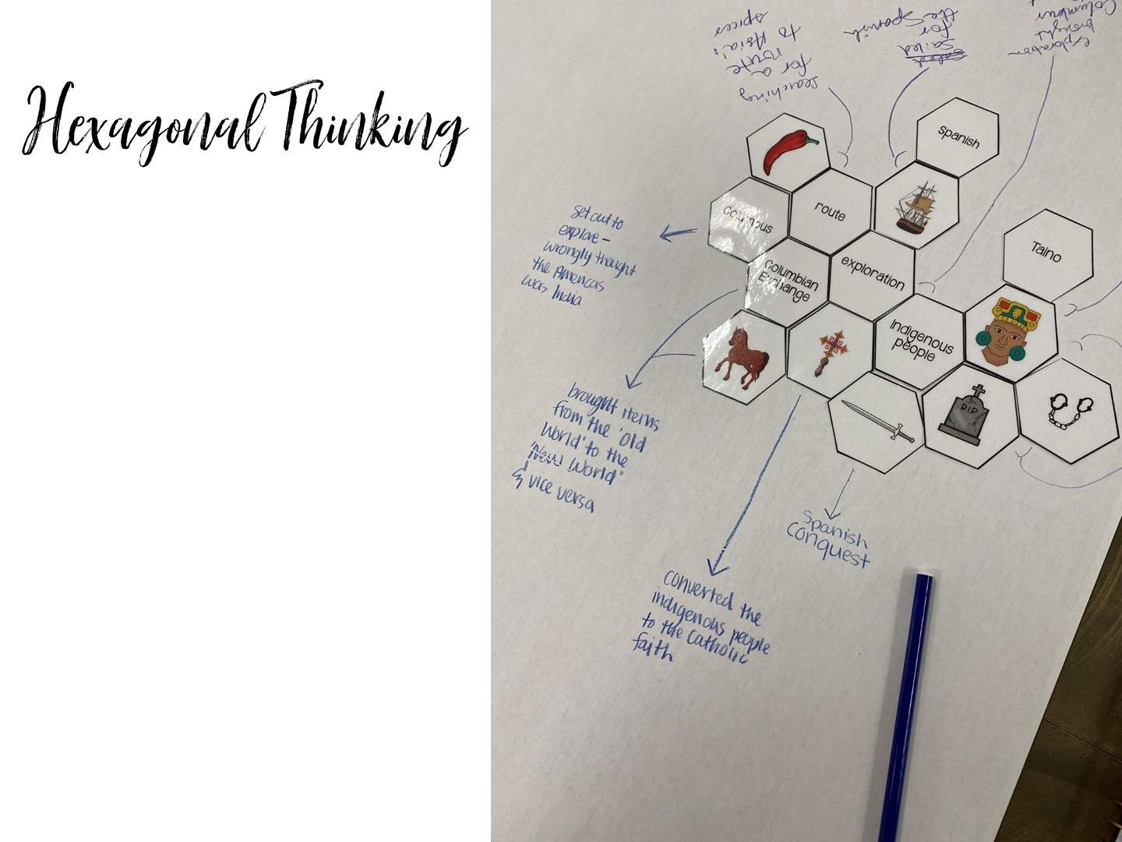
Notes:
Pass out Hexagonal Thinking for American Revolution

Slide 56
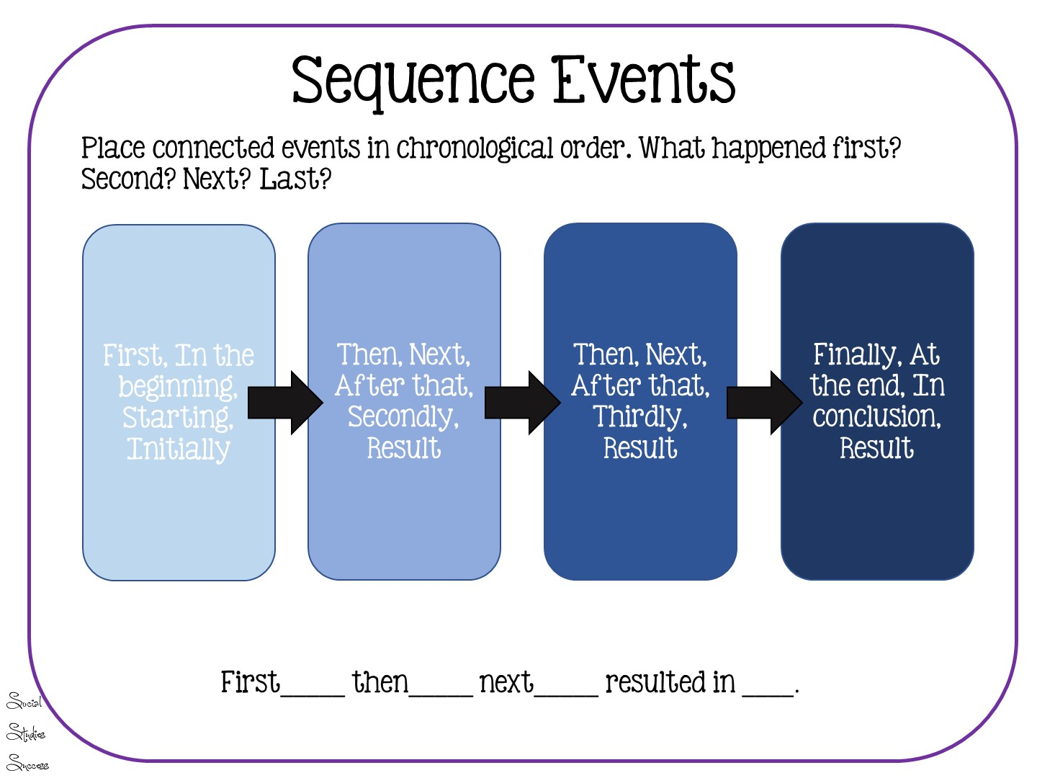
Notes:
Read slide

Slide 57
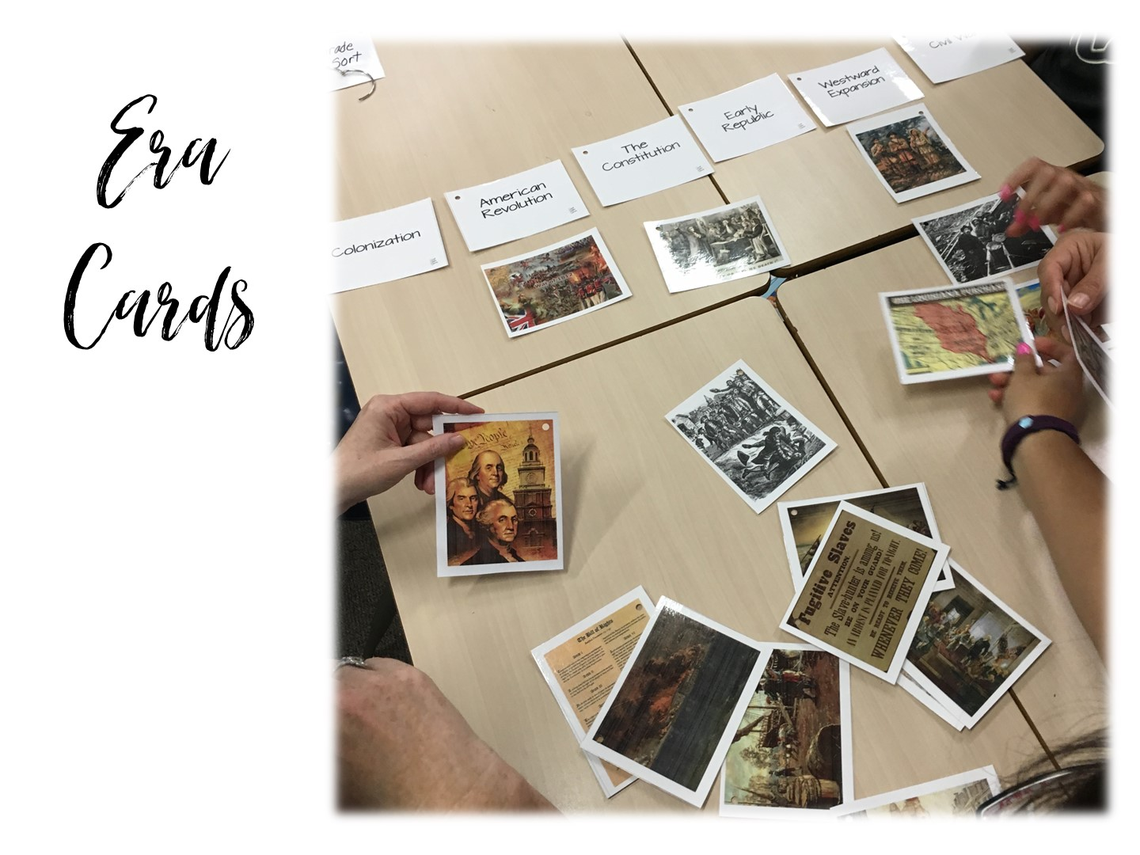
Notes:
You won’t have time for this, just explain it. Students put pictures of events under correct eras.

Slide 58
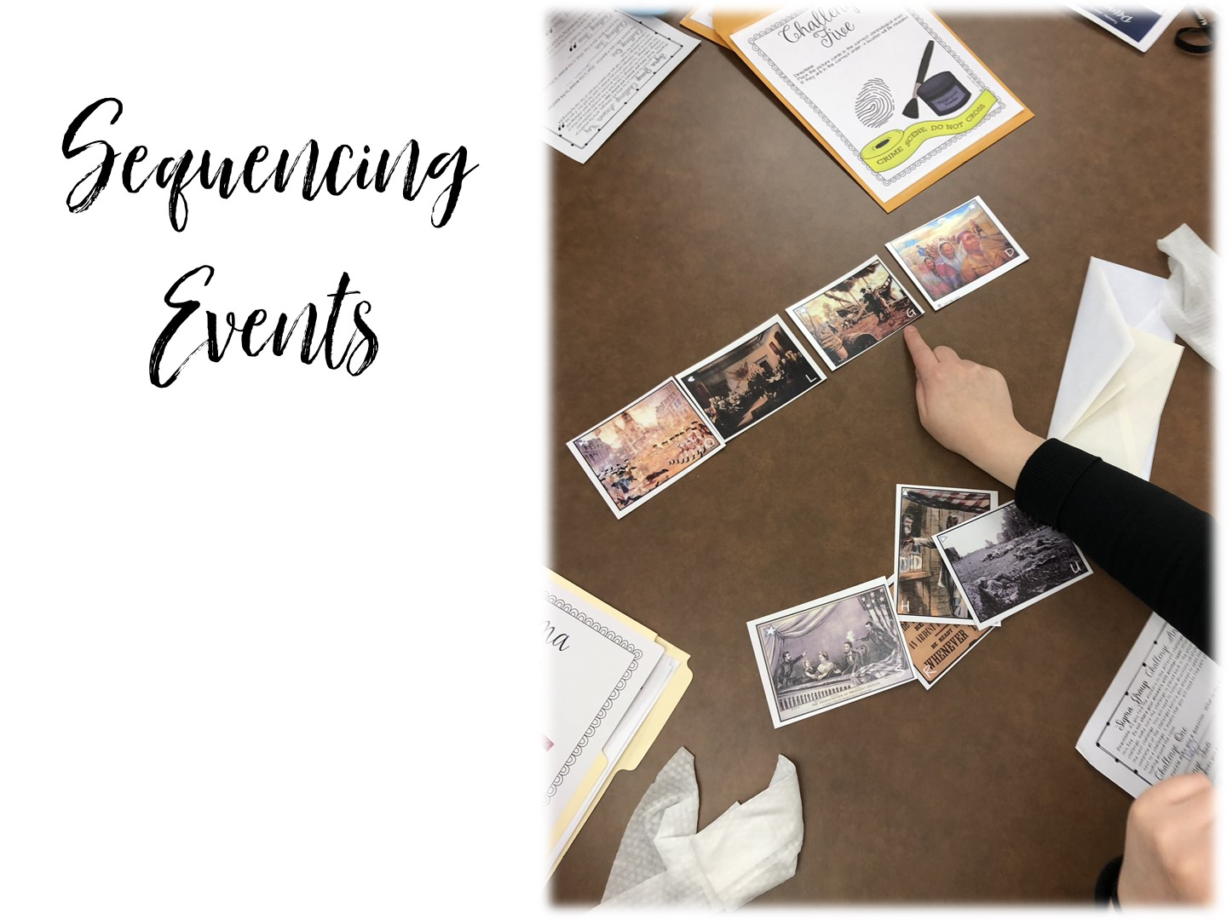
Notes:
Students put pictures of events in chronological order.

Slide 59
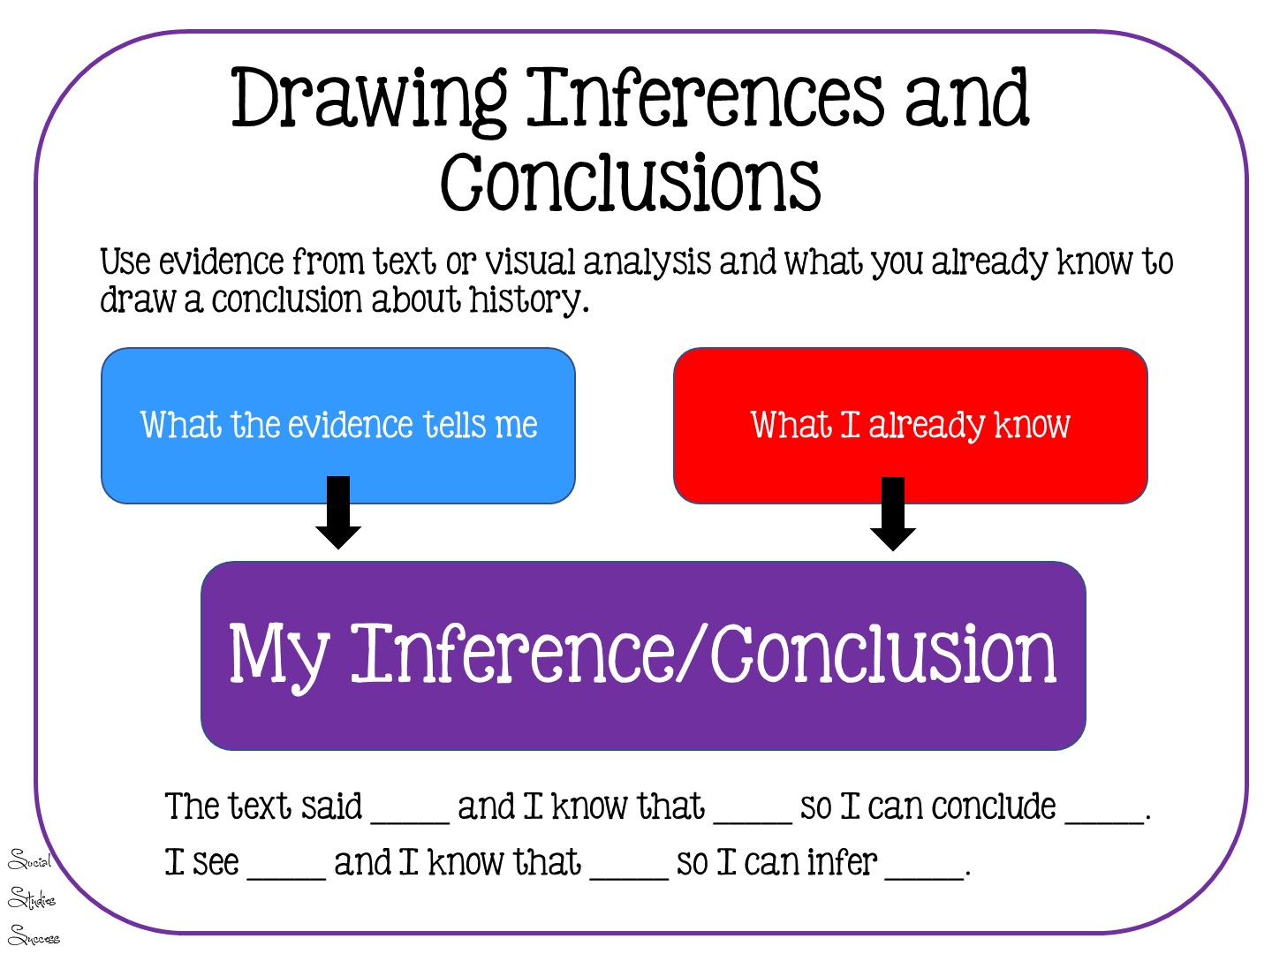

Slide 60


Slide 61


