Slide 1

Notes:
Post the 4 corner signs and the Word Wall terms
Post the Design Qualities of Engagement Placards

Slide 2


Slide 3

Notes:
Introduce yourself

Slide 4

Notes:
Go through all of the beliefs, then ask teachers to discuss which ones they agree with.

Slide 5


Slide 6
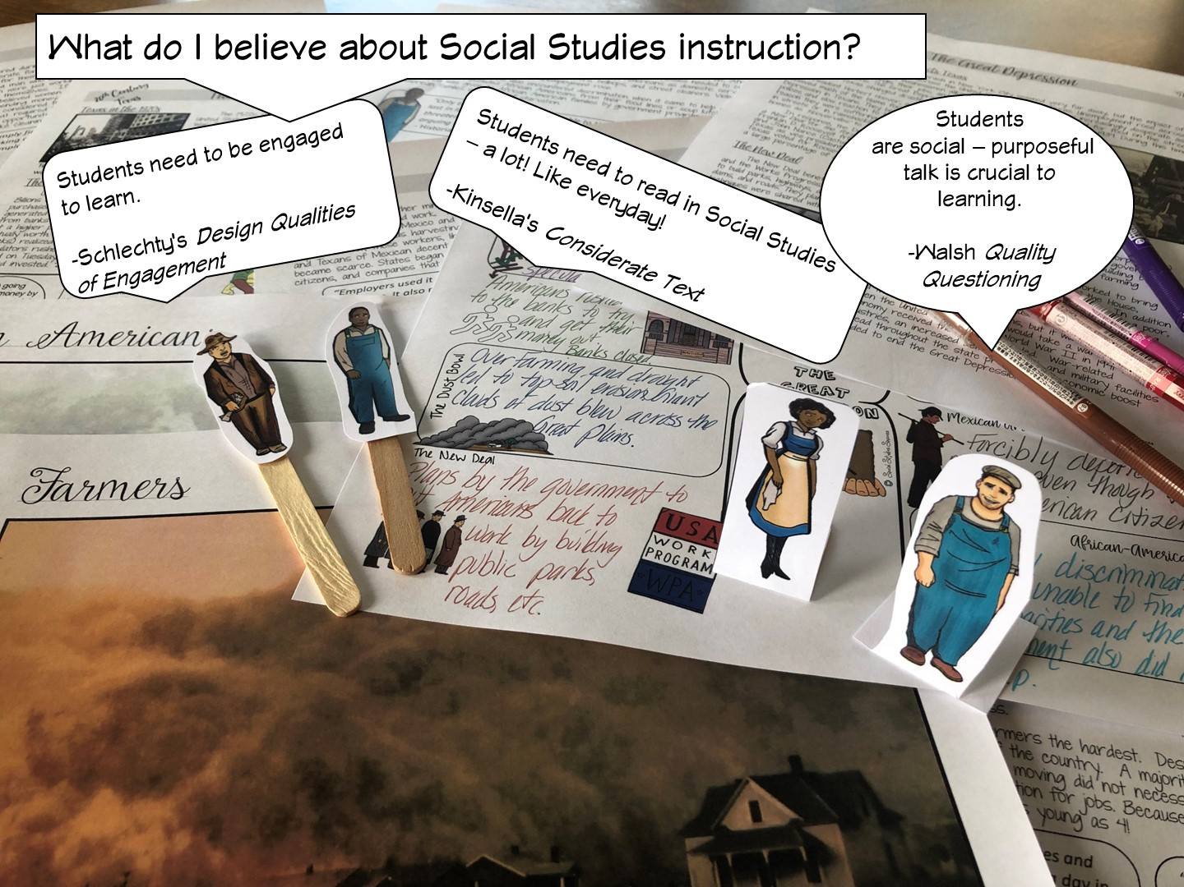

Slide 7
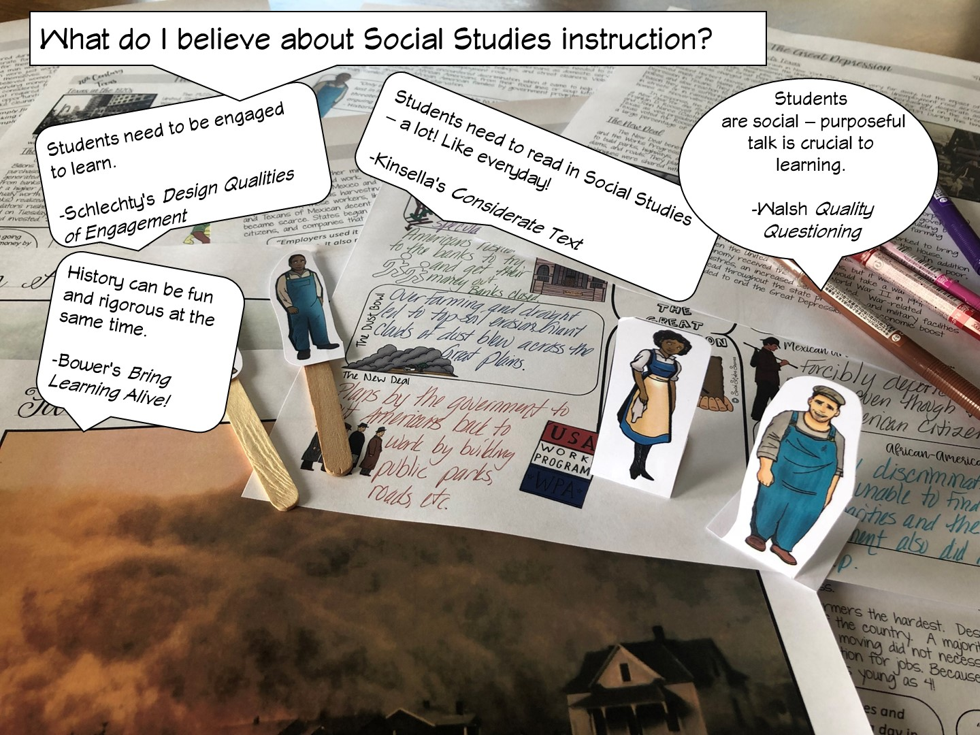

Slide 8


Slide 9
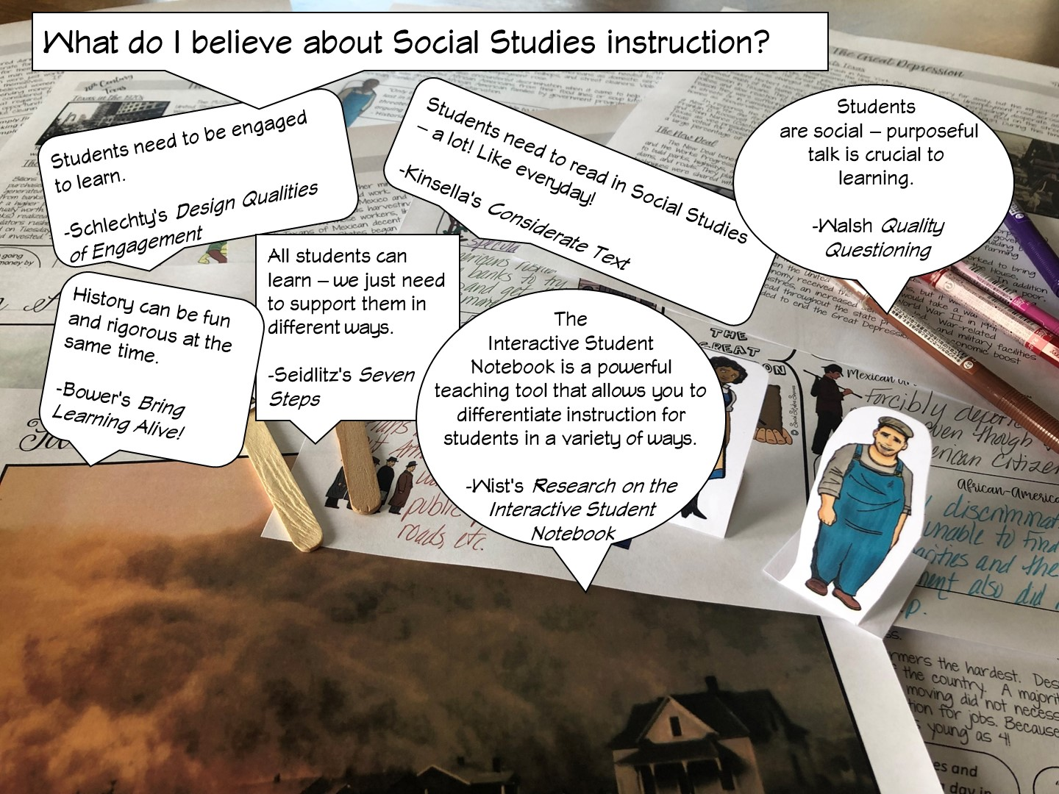

Slide 10
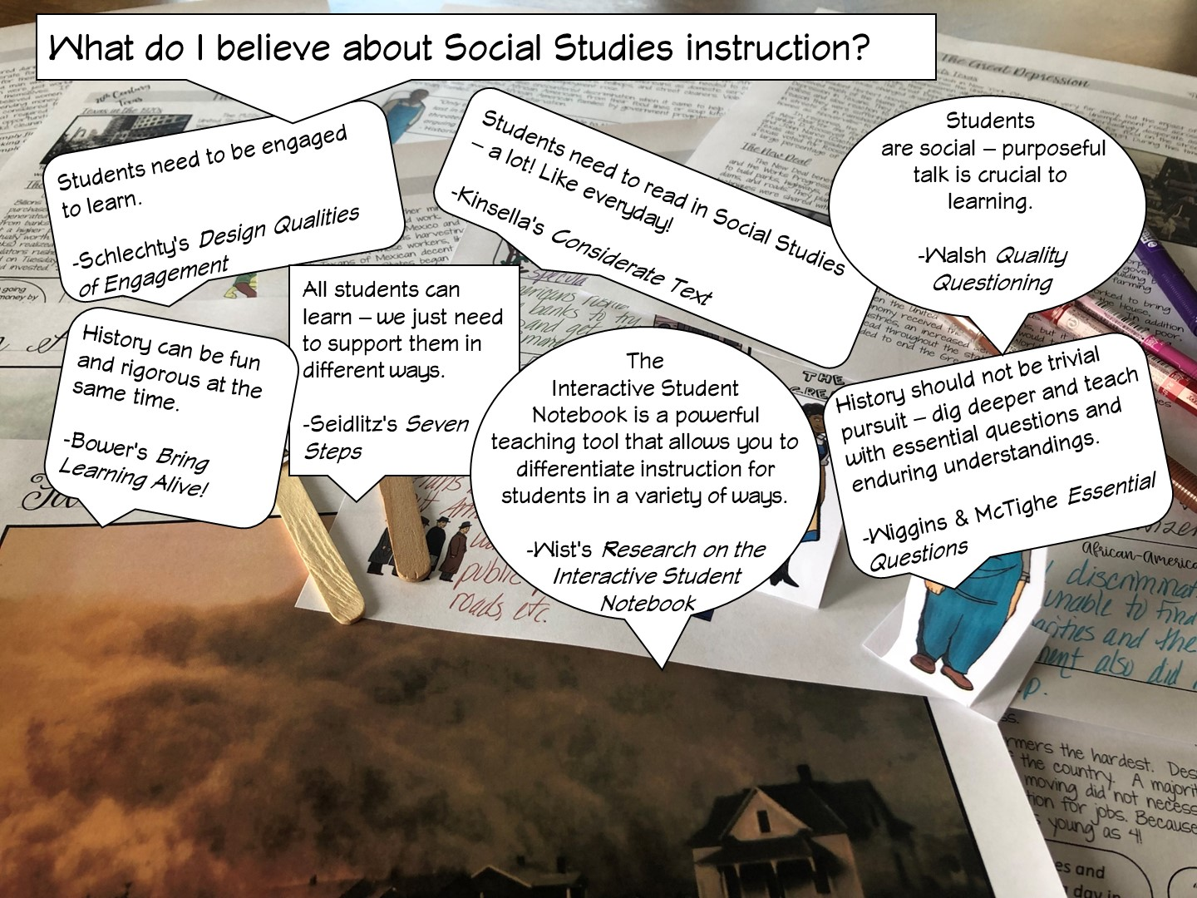

Slide 11


Slide 12


Slide 13


Slide 14


Slide 15

Notes:
.

Slide 16

Notes:
Have teachers write their goals on a post it note and share with their table mates.
Review our goals in the next slide

Slide 17


Slide 18
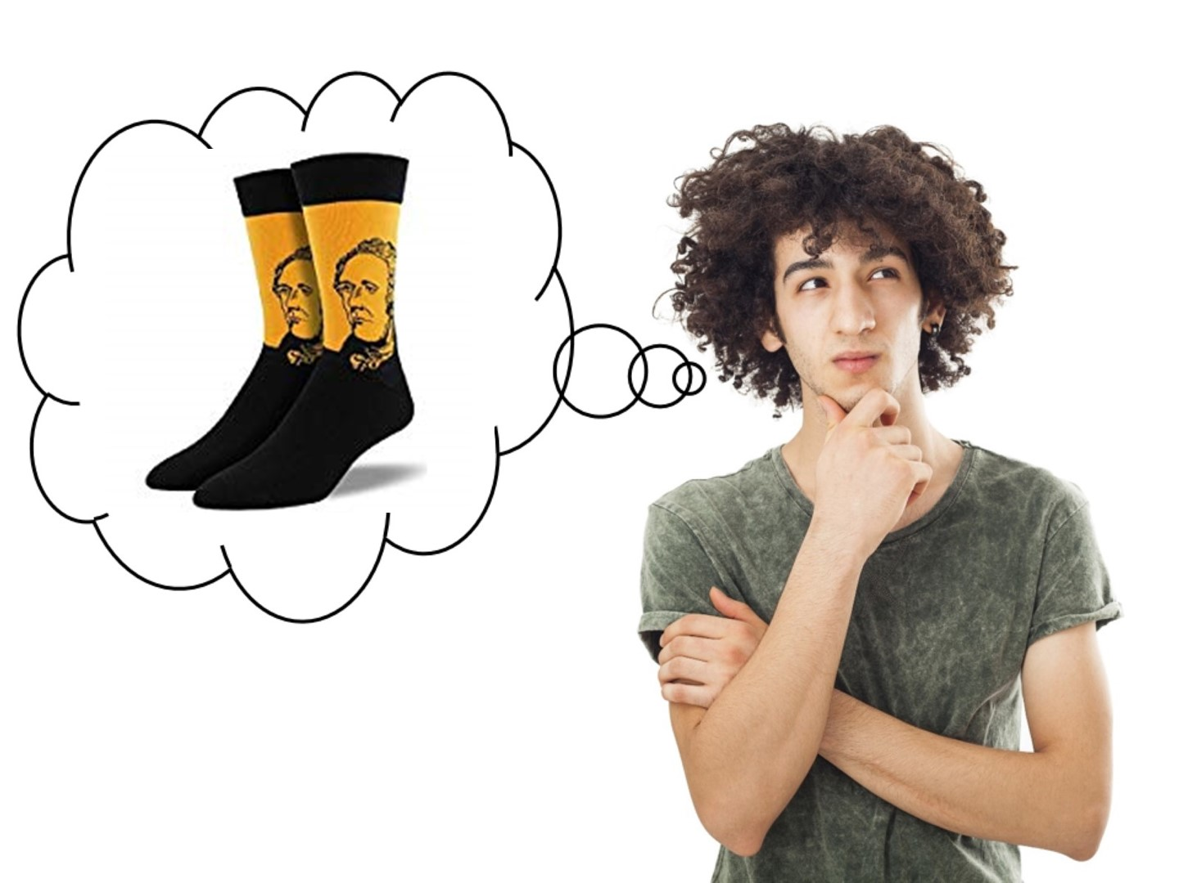
Notes:
I share my rule of the socks:
They have never been on my feet
They are not a souvenir of the workshop
Put your cellphones away in the sock (model with your own)

Slide 19

Notes:
This is a spectrum to break up the teacher cliques – they line up from most experienced to brand new, then fold the spectrum to put them with a partner. This allows me to identify who my novice teachers are, and I can provide them more assistance as needed.

Slide 20

Notes:
Pass out Engagement Doodle Notes
Ask this question and have them respond on the Engagement Doodle Notes handout – list 3 reasons. When they have finished, have them share their responses with their tablemates.

Slide 21
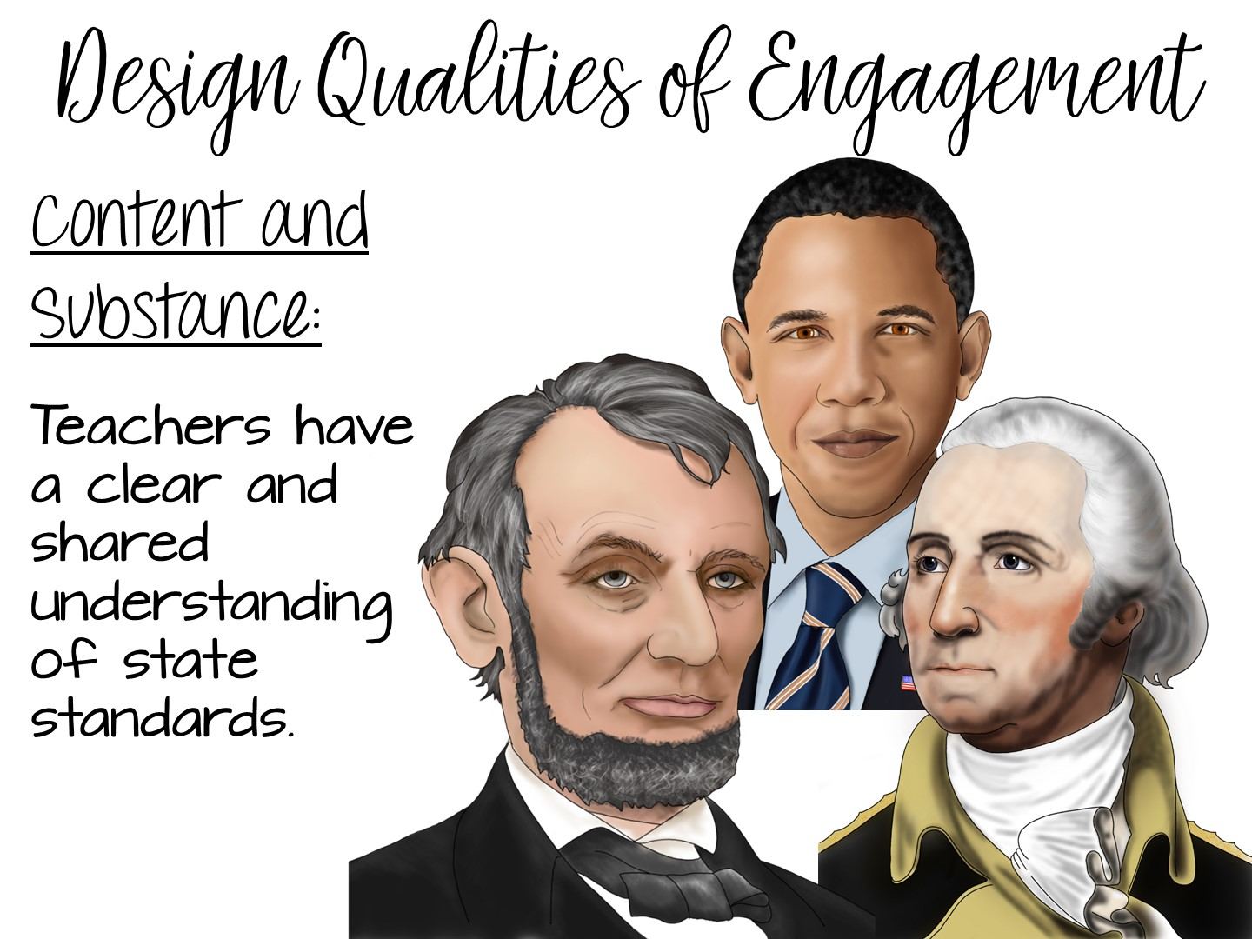
Notes:
Now share the official research from Philip Schlechty and his book – Working on the Work. Just read the next few slides to the teachers. Add any personal examples of things you have done for each slide. Allow them to take notes if they wish on their Engagement Doodle Notes.
Teachers know their content and have spent time breaking down the TEKS.

Slide 22
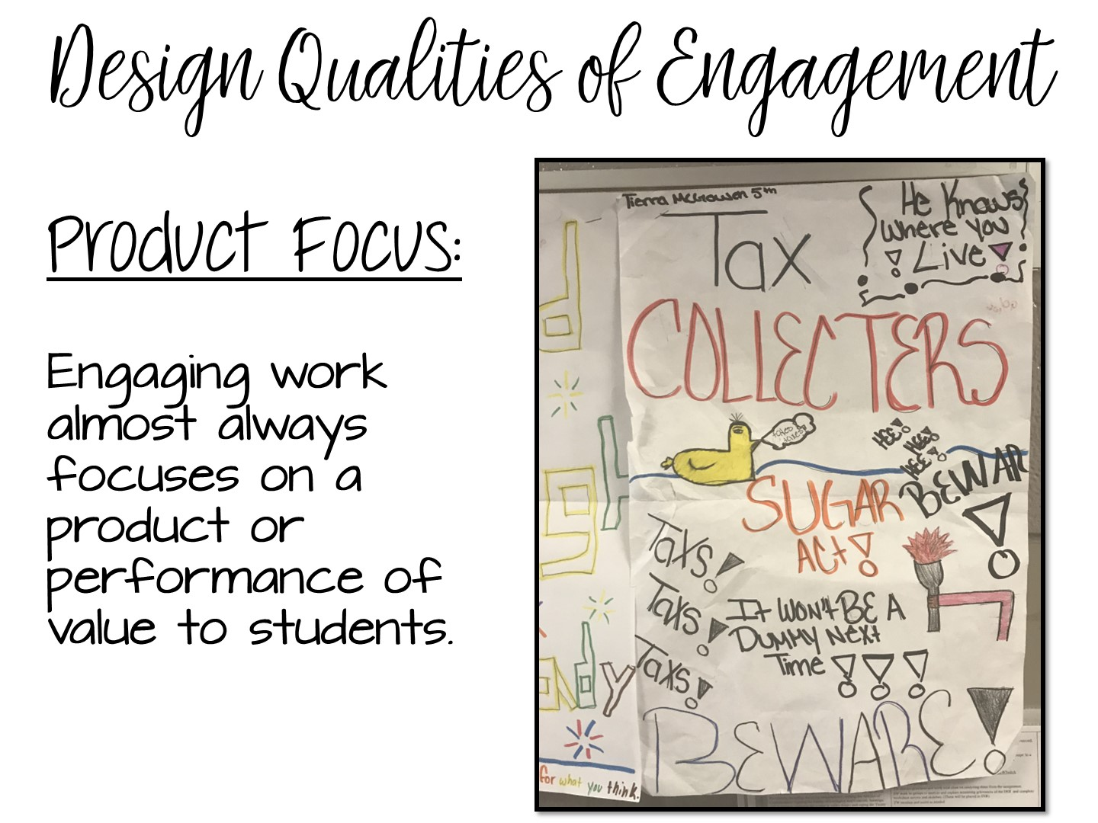
Notes:
Product focus – students are making a product or a project.

Slide 23
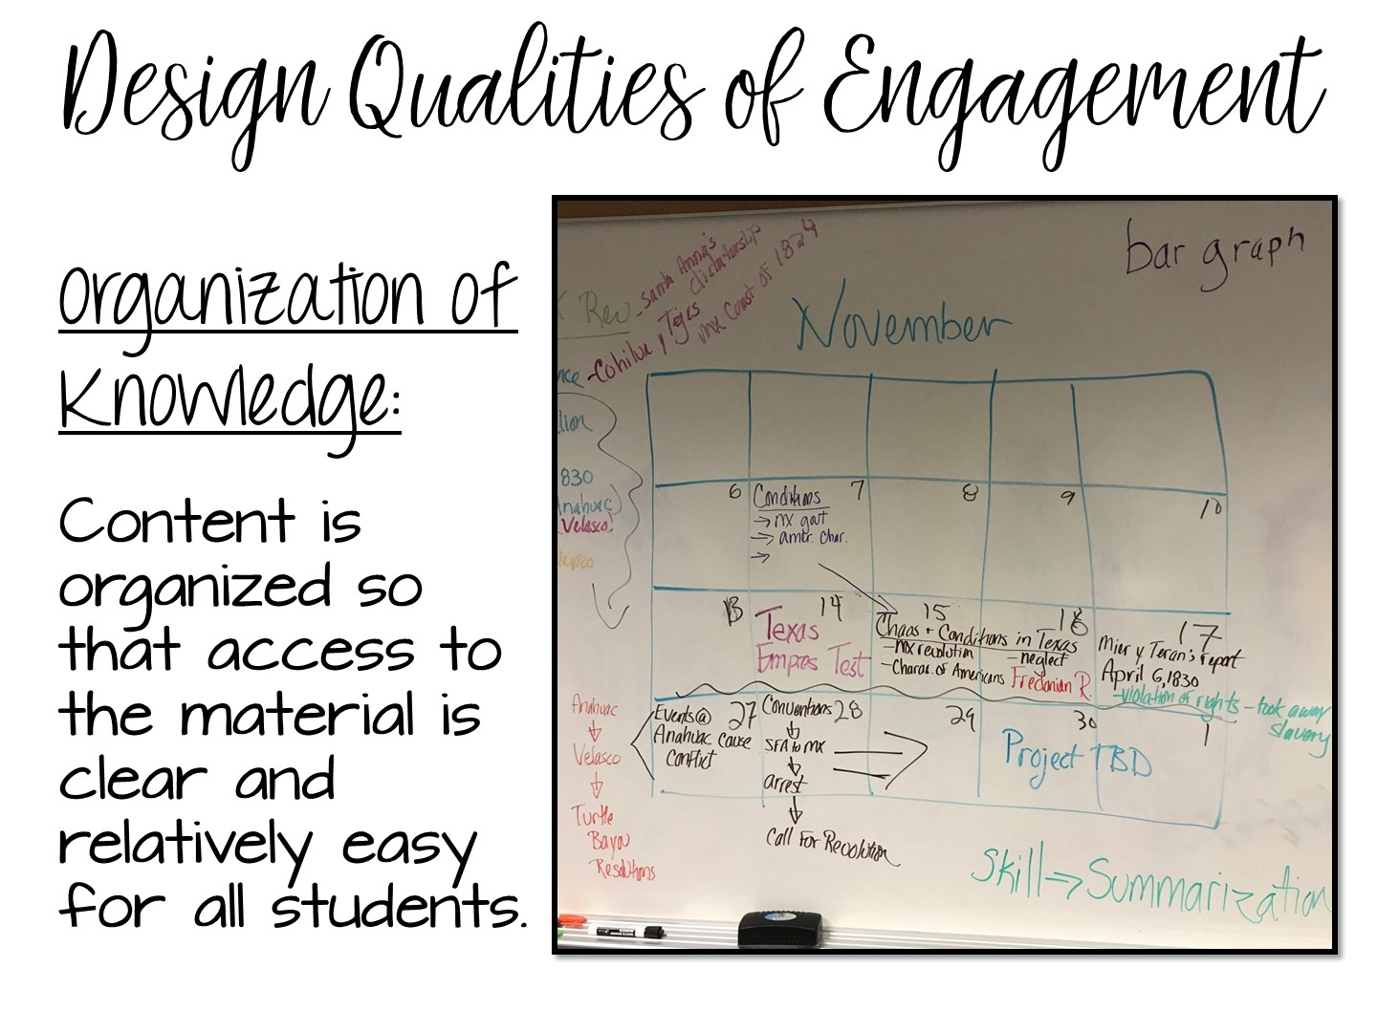

Slide 24
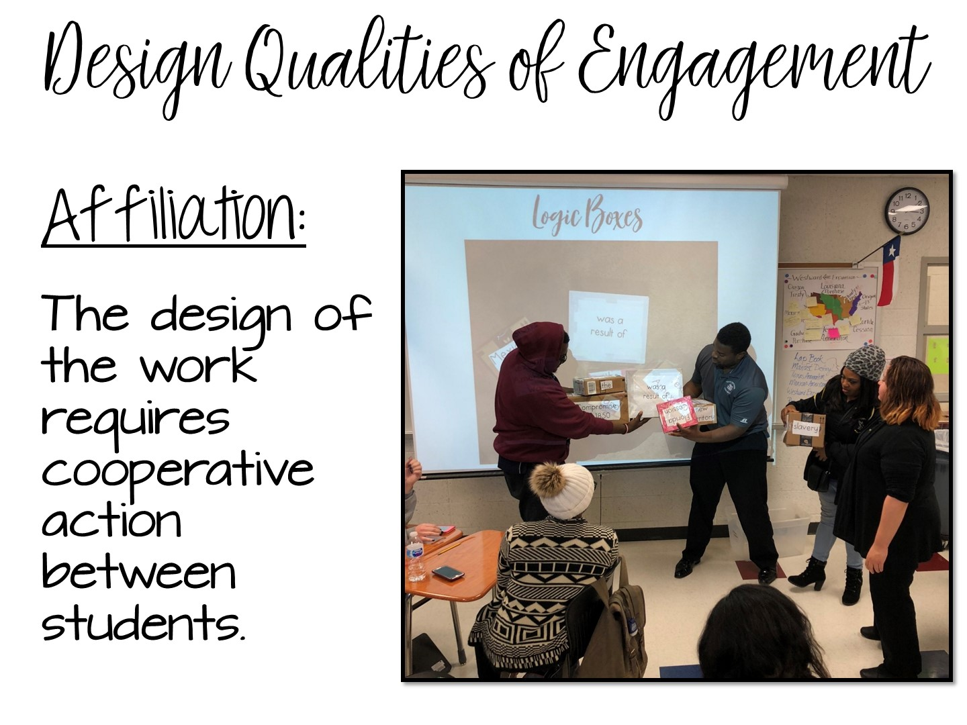
Notes:
Affiliation – students are working together to complete a task, not just splitting an assignment in ½ and each doing a portion, but cooperatively engaged with each other.

Slide 25

Notes:
Give teachers time to discuss.

Slide 26
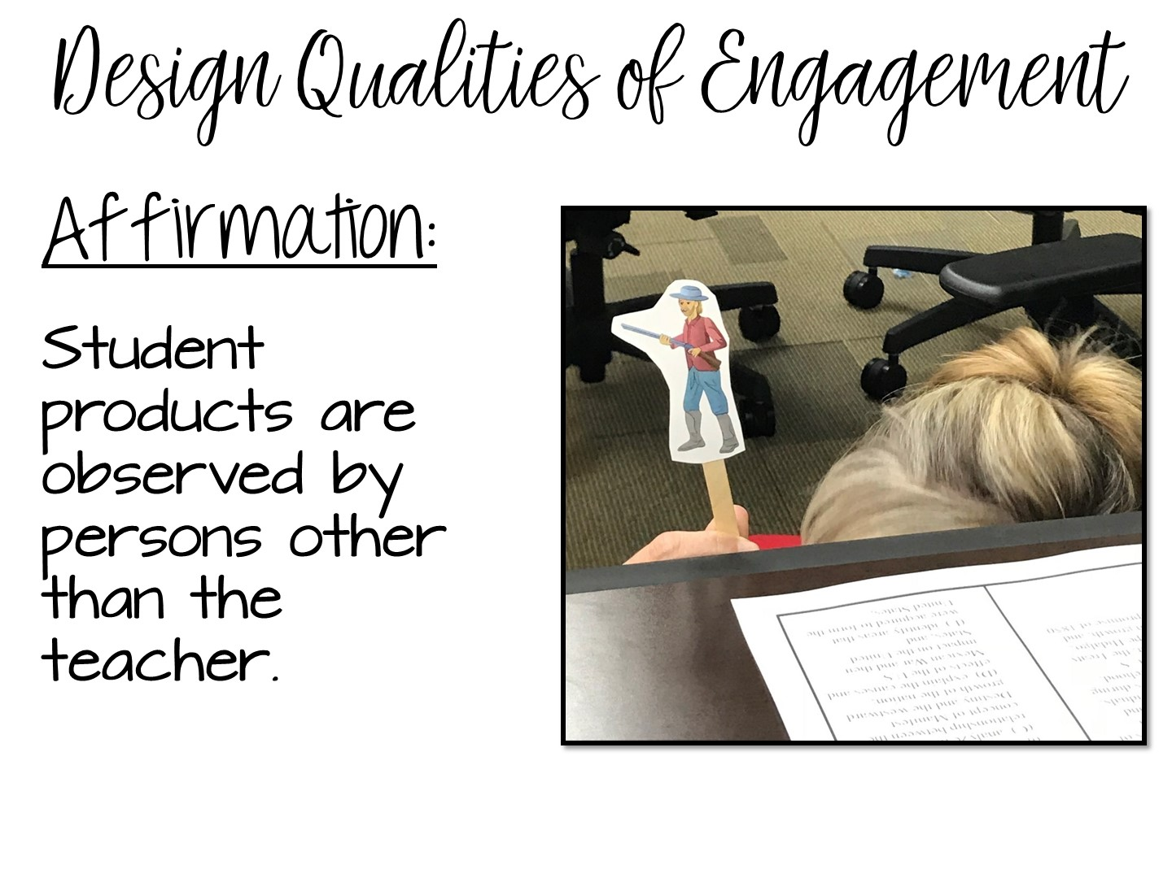
Notes:
Examples include hanging products in the hallway, display in the library, other classes come observe, share with other classes.

Slide 27
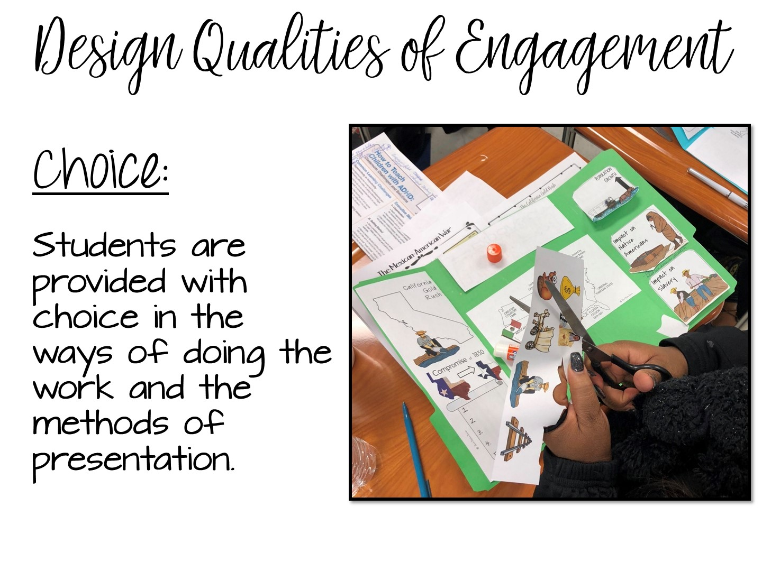
Notes:
PERCEPTION OF CHOICE is the key – it doesn’t just mean a choice board. Any choice students have increases engagement.

Slide 28
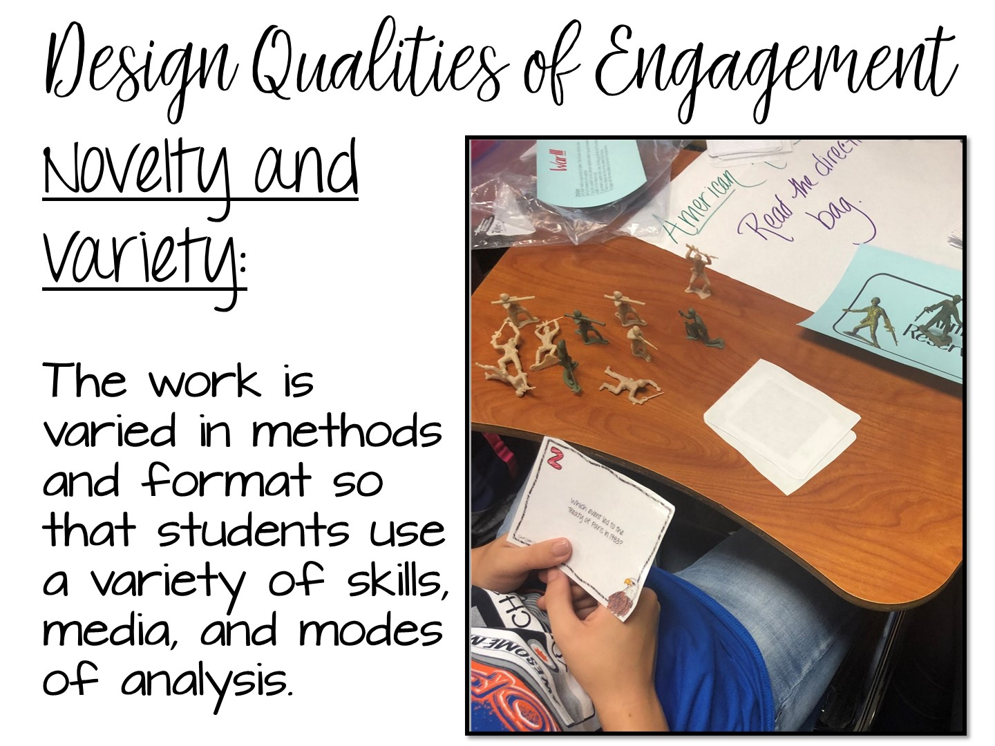
Notes:
New and different. What is new at the beginning of the year, is not new at the end. What is different (like Kahoot) is no longer different if everyone in every class is doing it.

Slide 29
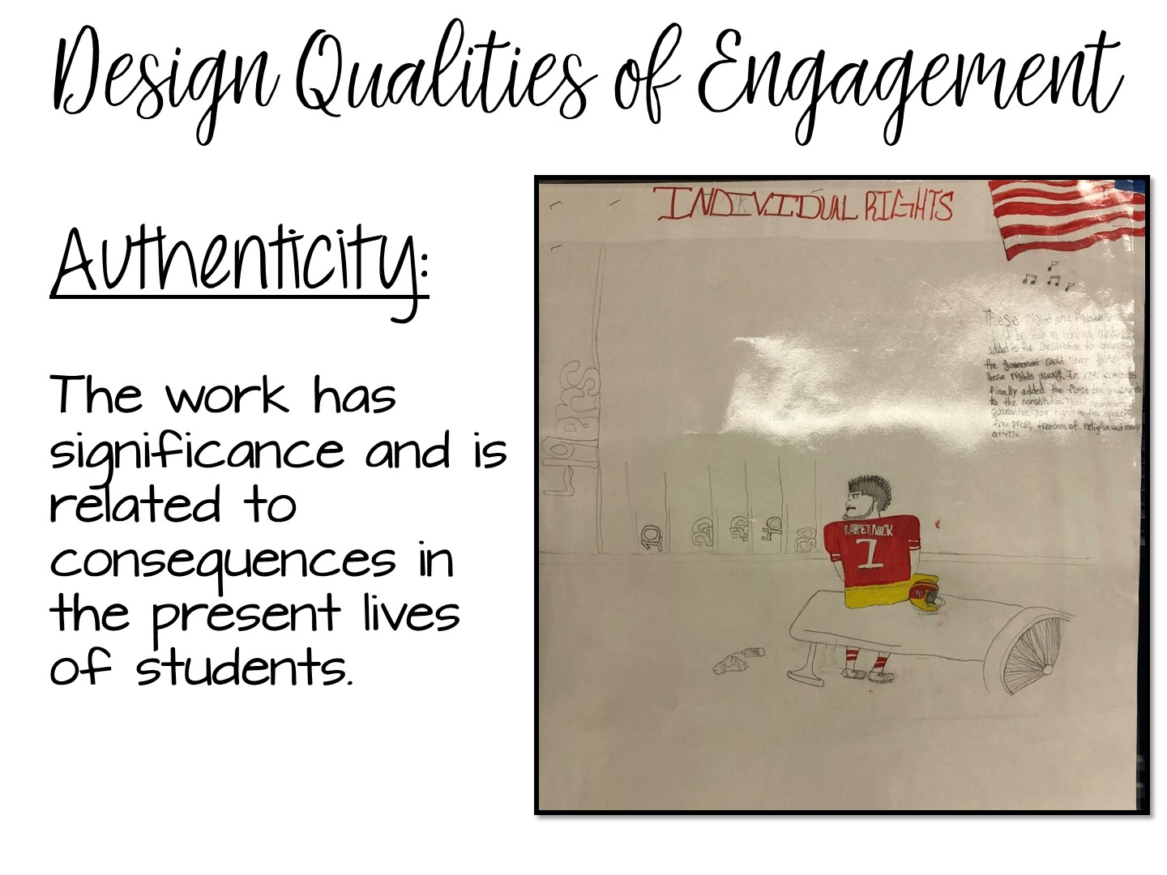
Notes:
Needs to have real world connections or a project that has a real-world application.

Slide 30

Notes:
Use popsicle people to randomly call on teachers
30

Slide 31
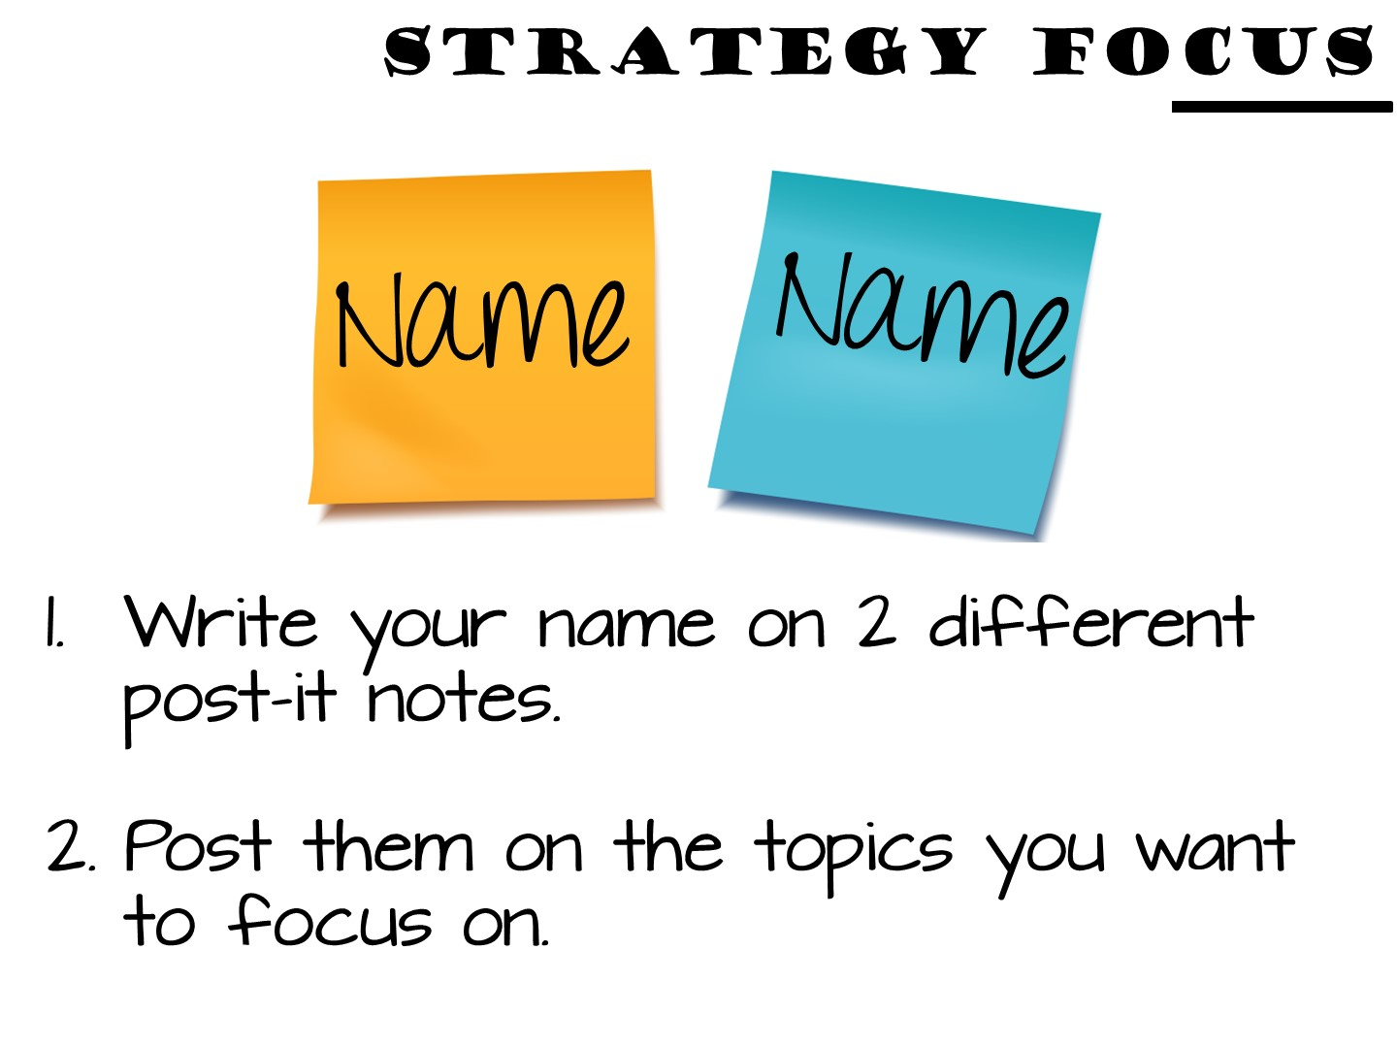
Notes:
Have the teacher participants write their name on two different post-it notes and then post their names on two different design qualities placards.

Slide 32


Slide 33
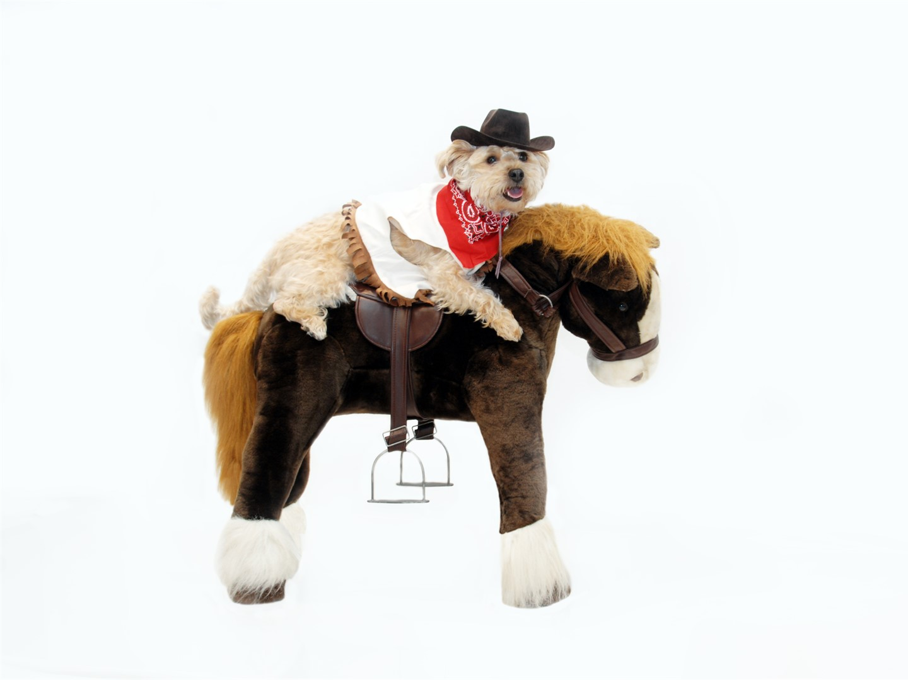
Notes:
State that these next series of lessons are “dog and pony” shows. You won’t have time to implement as seen, but it is designed to show you a variety of ways you can teach a topic with more hands-on resources.

Slide 34


Slide 35


Slide 36
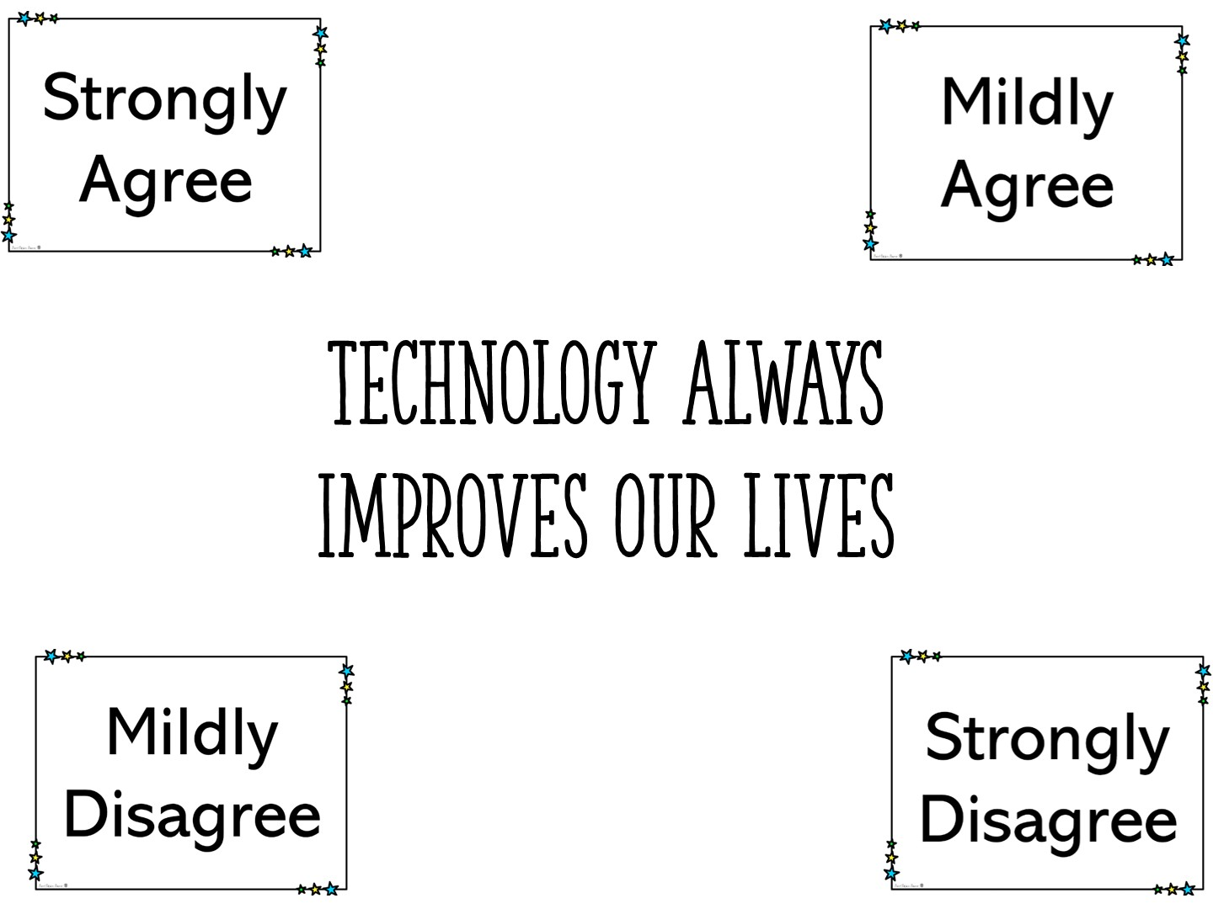
Notes:
Post this question and the 4 corner signs. Pass out each teacher an index card. Have them write their response. Once you have given them time to write their response, ask them to move to the corner and discuss what they have written on their card. When they have finished discussing, call on one volunteer to represent the corner. Once each of the 4 corners has spoken, make new partners out of the teachers. Usually who they are standing next to.

Slide 37

Notes:
Pronounce each of the terms on the world wall – require the teachers to repeat the term after you. You will not be defining the terms because they will learn what the definitions are during the activity.

Slide 38
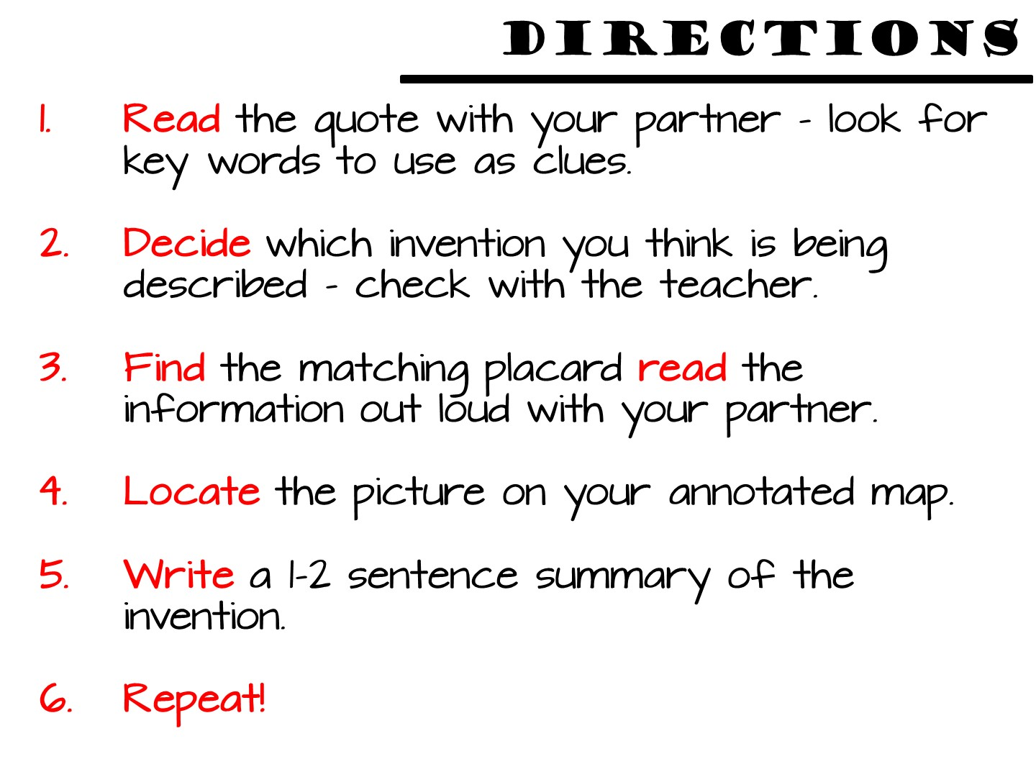

Slide 39
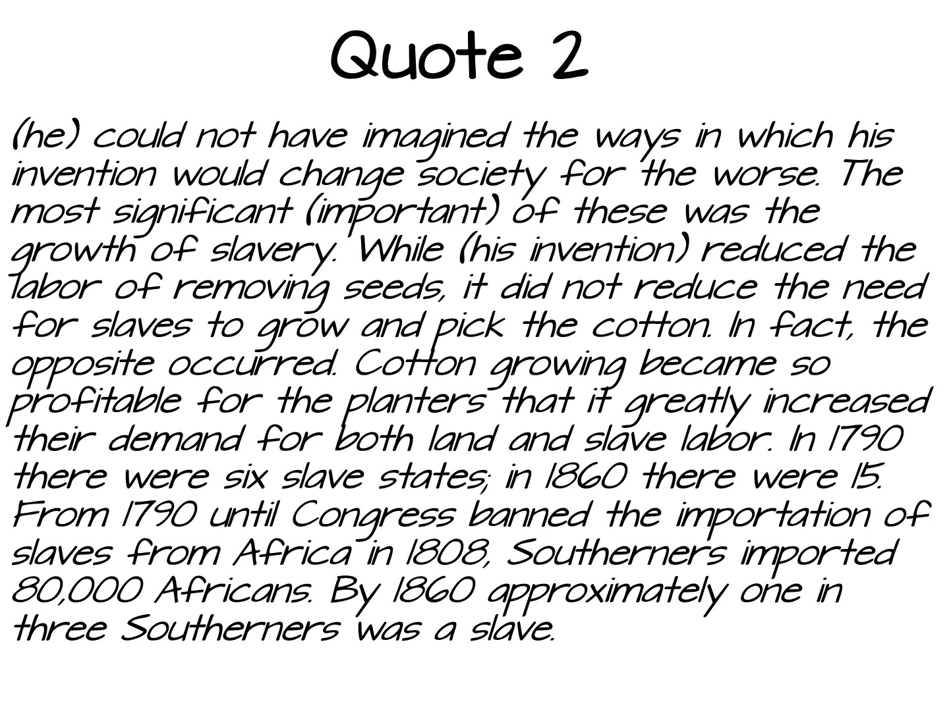
Notes:
Use this quote to model the process.

Slide 40
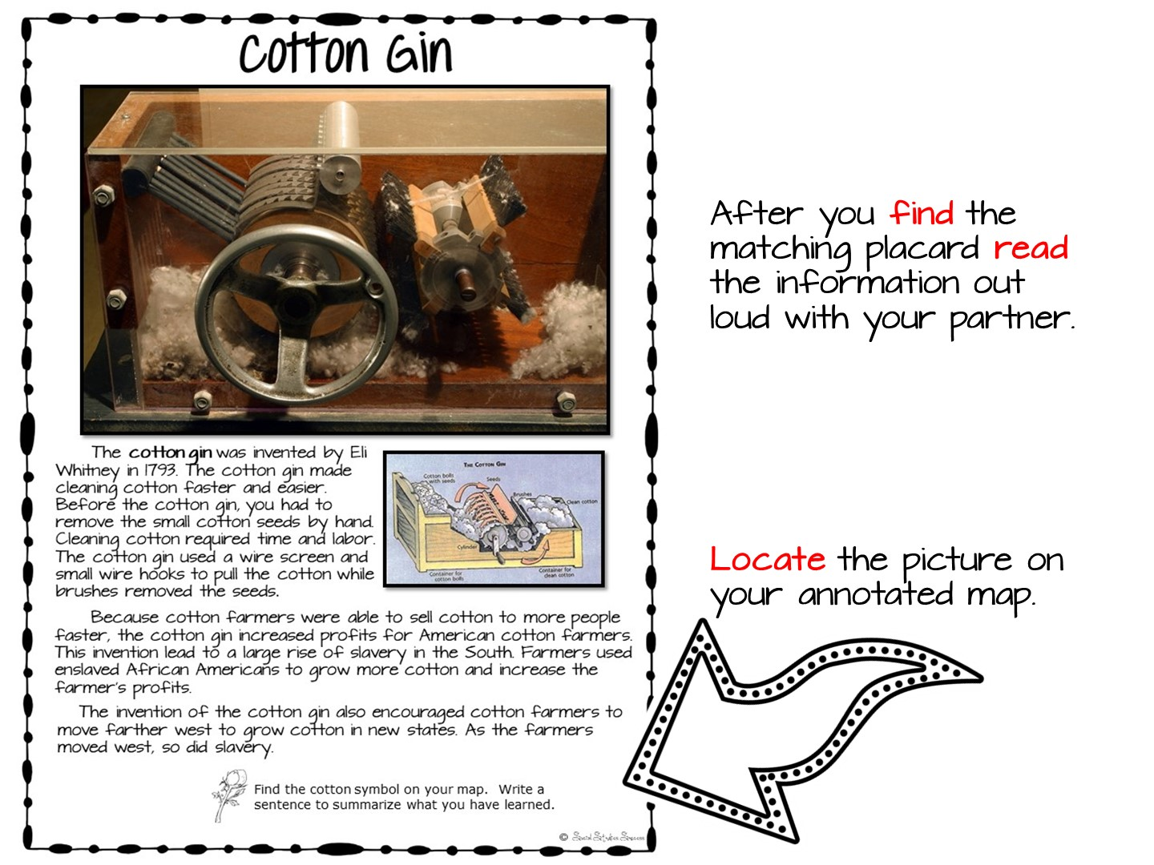
Notes:
Model the process.

Slide 41
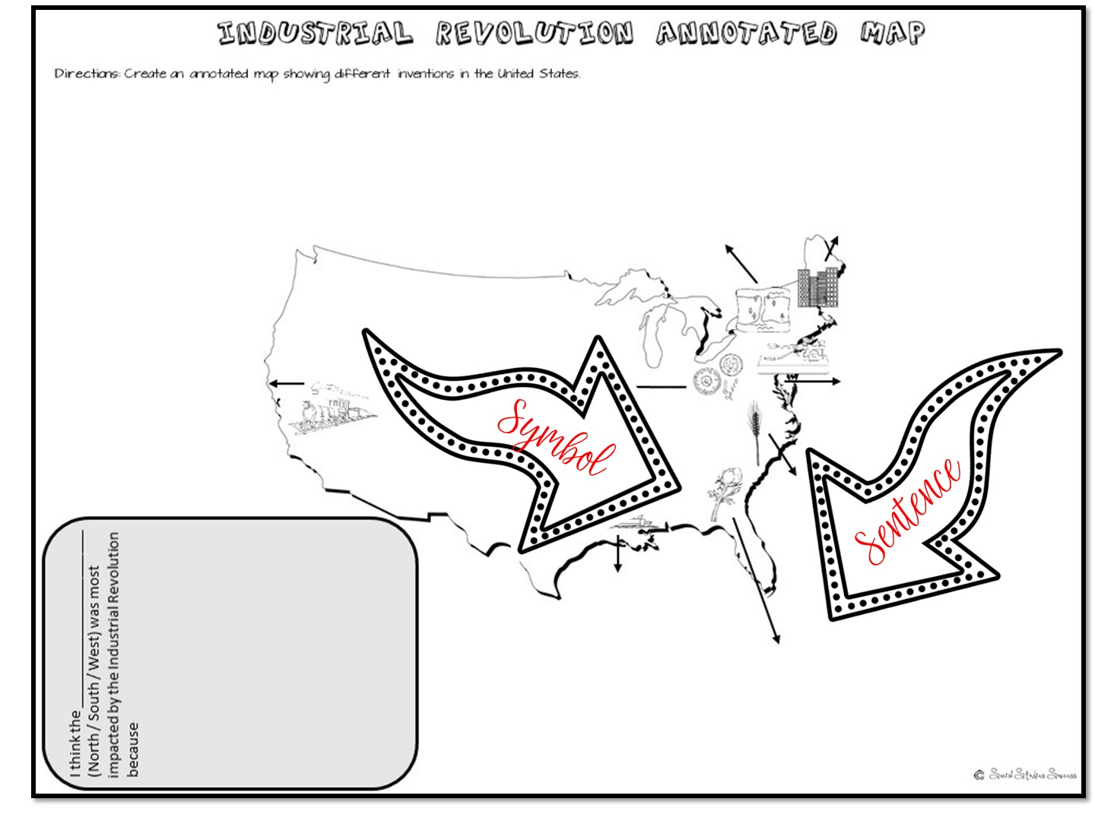

Slide 43
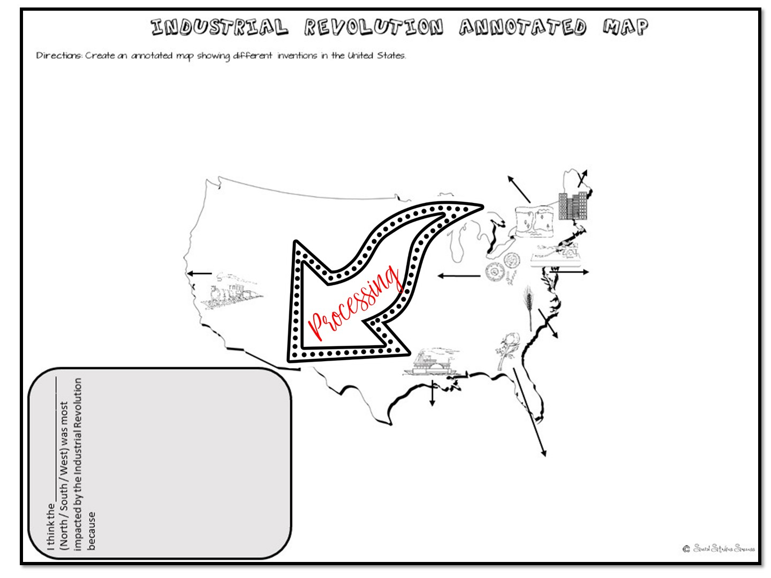

Slide 44


Slide 45
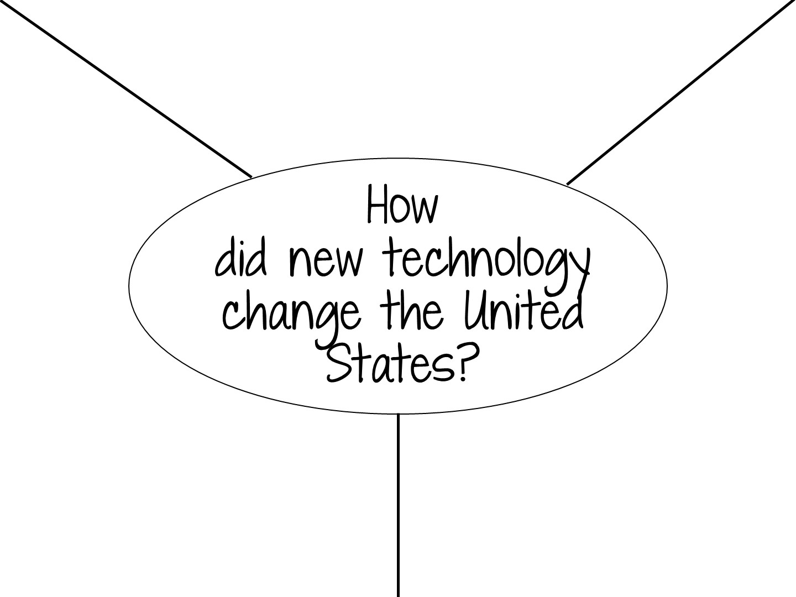
Notes:
Place teachers into groups of 3 and give each group a large sheet of chart paper and markers. Have them copy this question into the middle of the page. When you say go, the teachers will answer their question silently on their portion of the paper, and then discuss their answers. Have them come to a sonsensus for the best answer for the group to share out loud.

Slide 46
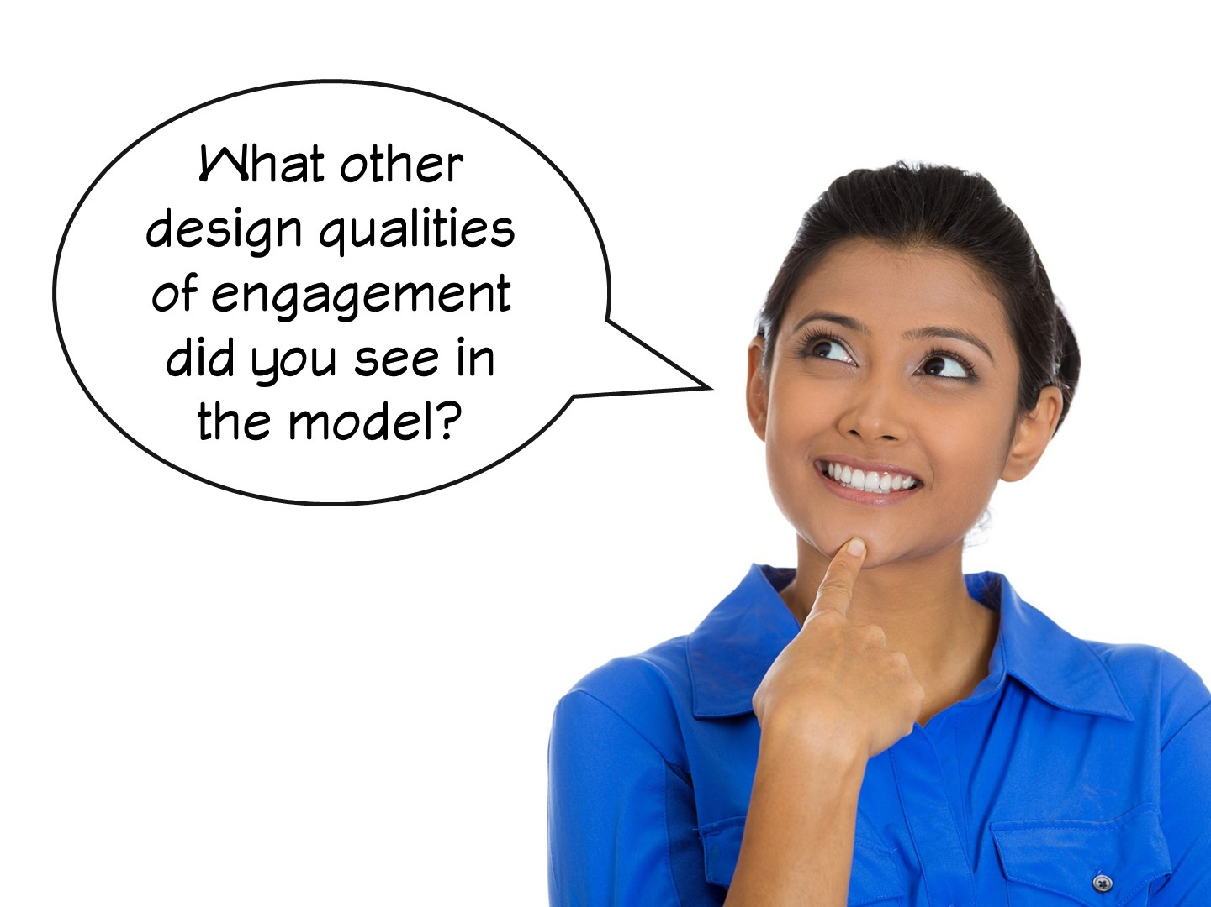

Slide 47


Slide 48


Slide 49


Slide 50

Notes:
All of the following speakers will need to use the following phrases in their response –
I heard you say (and summarize their response)…
My Group agrees or disagrees with your group because…
Once they have finished speaking, they call on the next speaker allowing every group to share. After each of the groups have finished sharing, have them choose a new speaker and pass over the number card. You will then ask the next question, call on the first speaker, and repeat the process.
If you find students interrupting each other or being disrespectful, stop the discussion and remind them of the rules.

Slide 51

Notes:
The next lesson you are going to model is for World History.

Slide 52
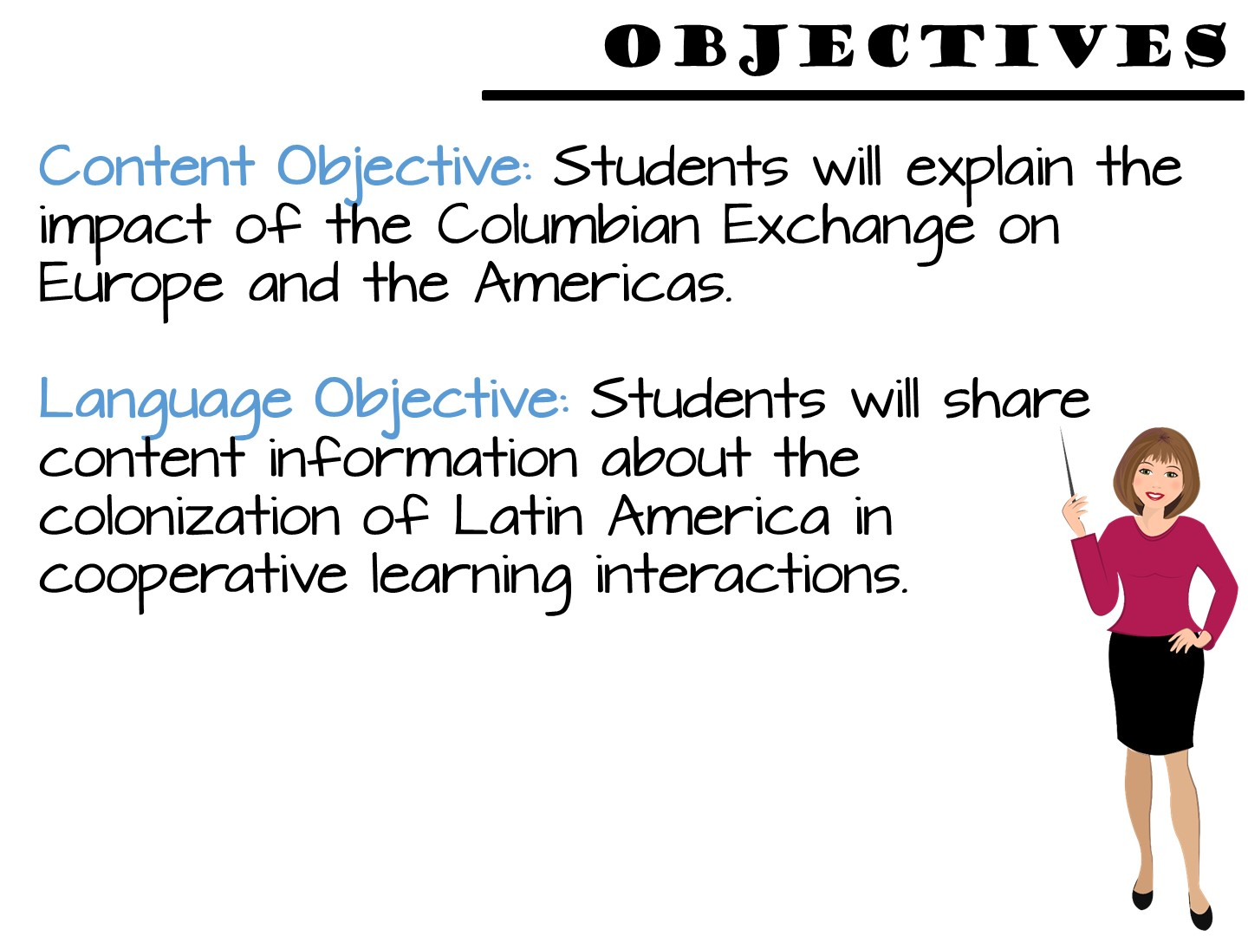
Notes:
Just read.

Slide 53
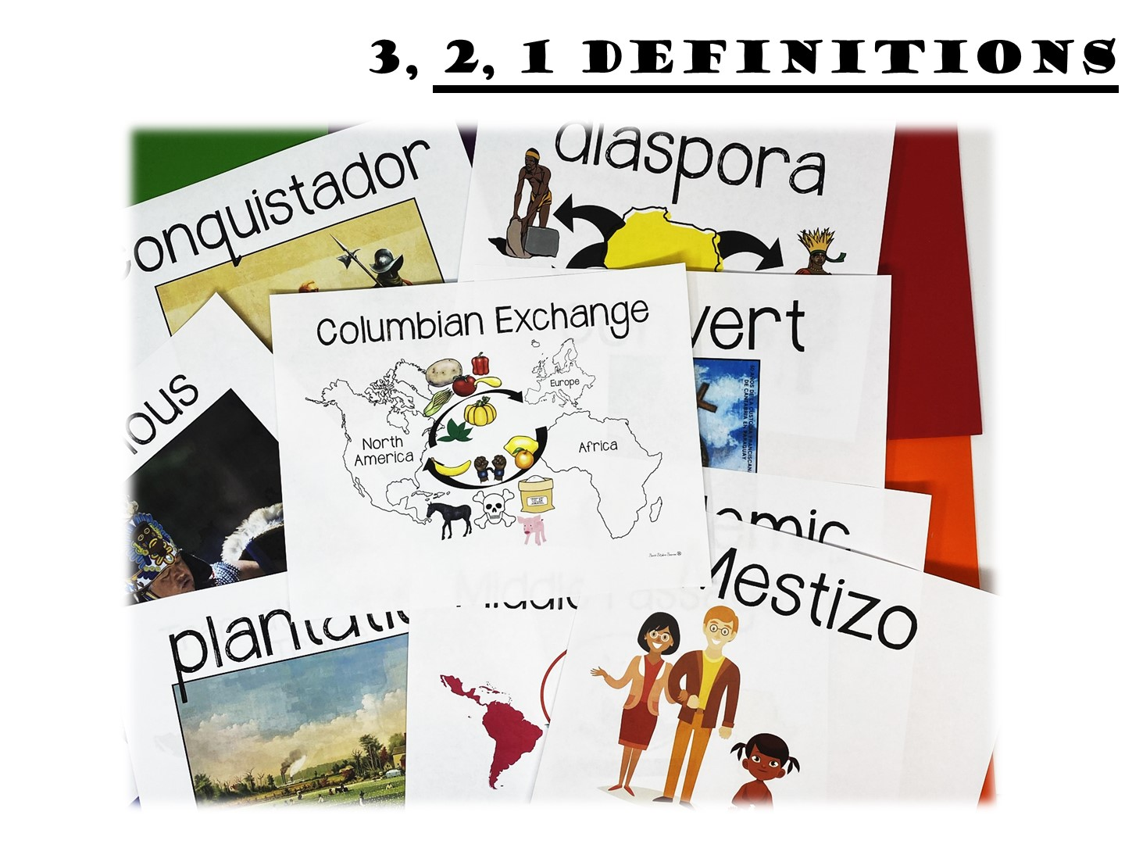
Notes:
Read the terms and have teachers repeat.

Slide 54
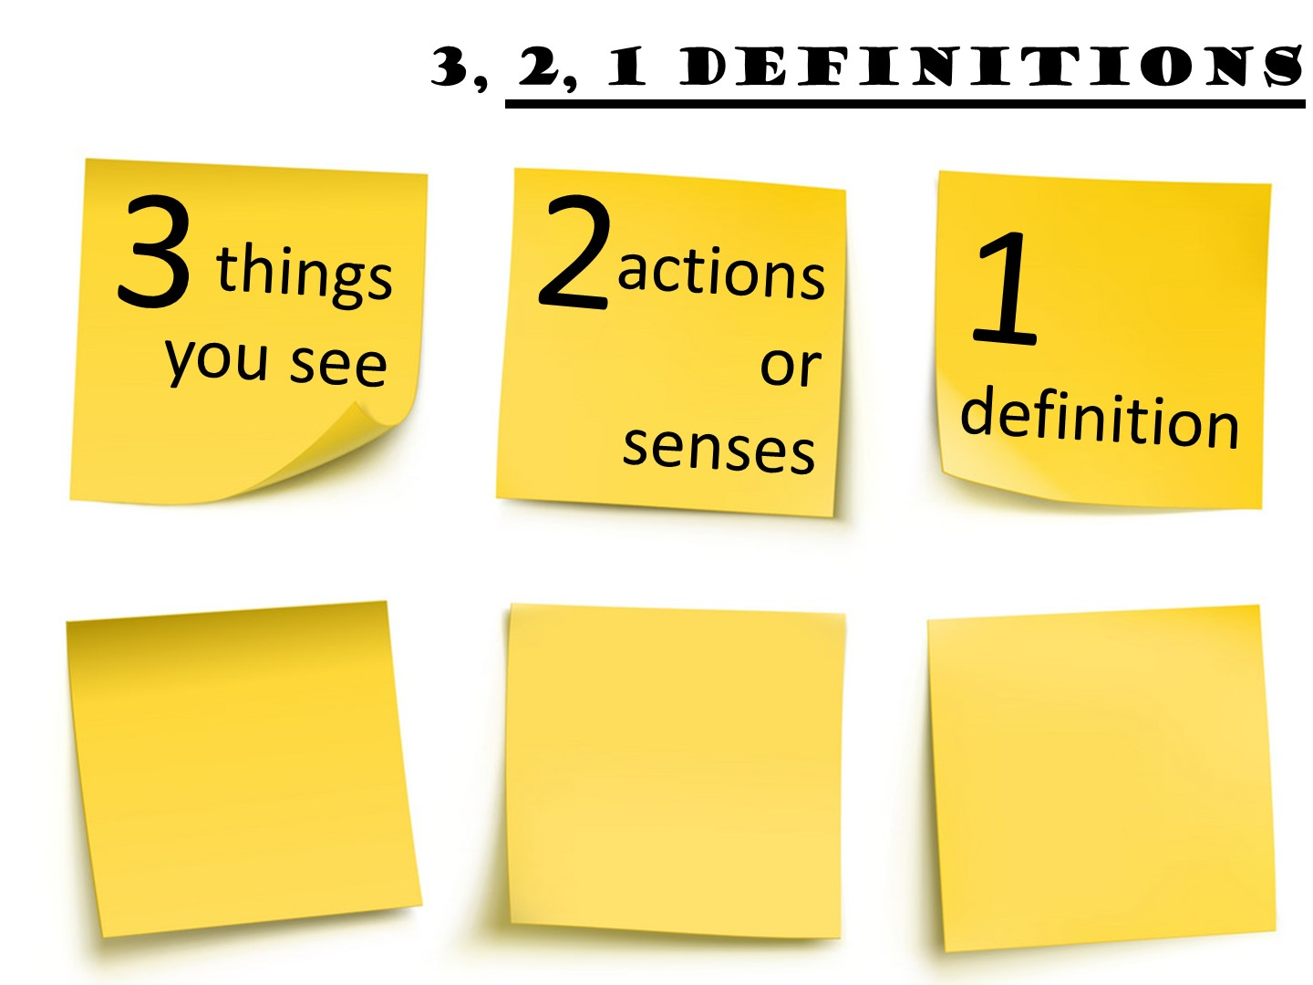
Notes:
Review the directions for the 3, 2, 1 activity and then give teachers time to define a term.

Slide 55
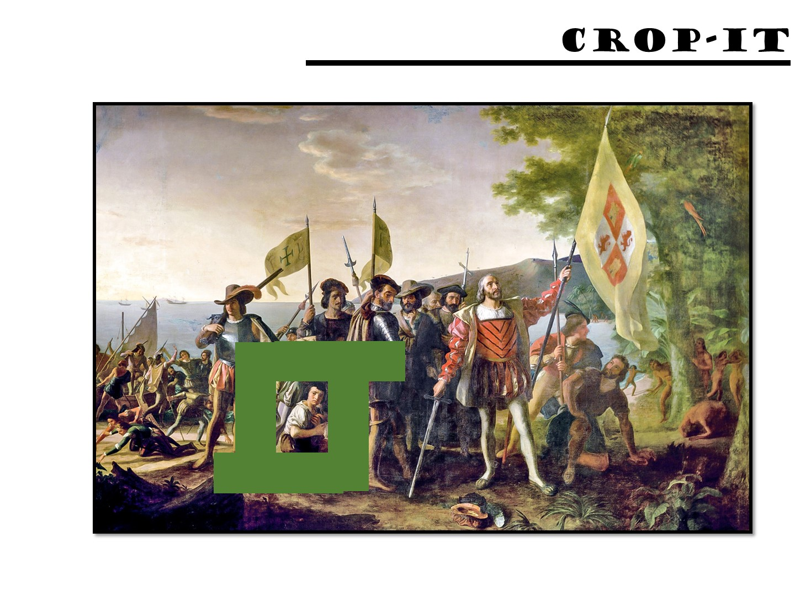
Notes:
Pass out the crop-it tools and the Columbus images. Use the handout with questions to ask questions for the teachers to answer using the tool.

Slide 56
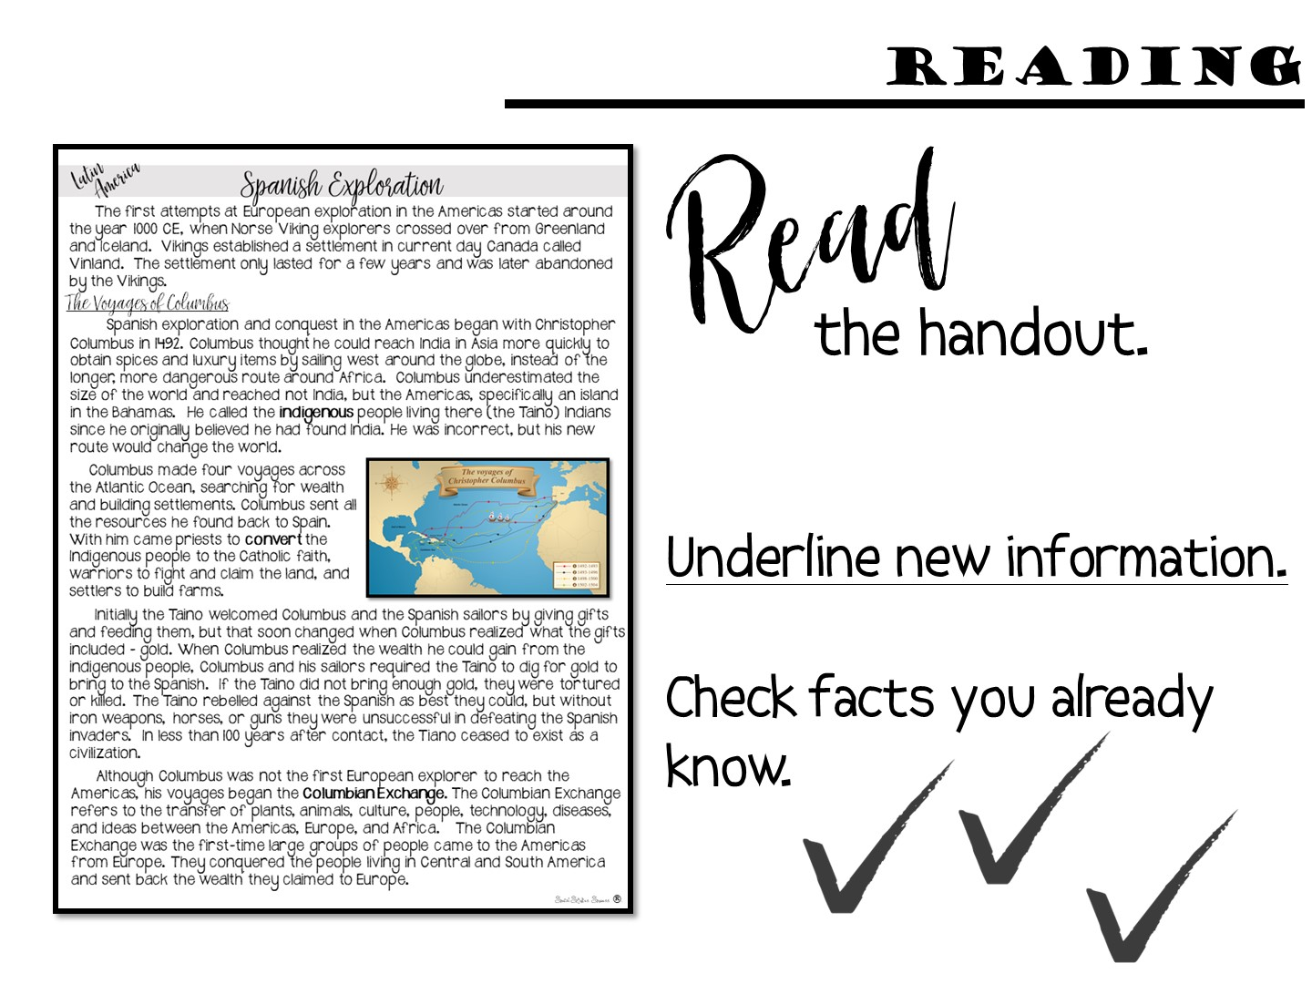
Notes:
Give each group a copy of the first page of the reading (Spanish Exploration) and conduct the reading.

Slide 57
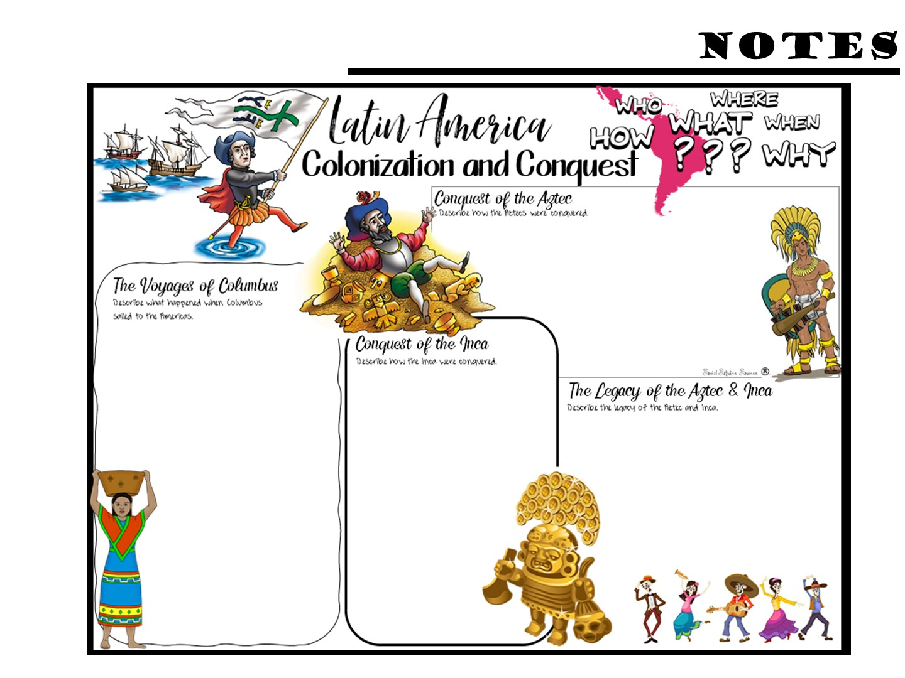
Notes:
Pass out the Doodle Notes and have them complete what they can with the first page of reading – not all of the info comes from the first page.

Slide 58
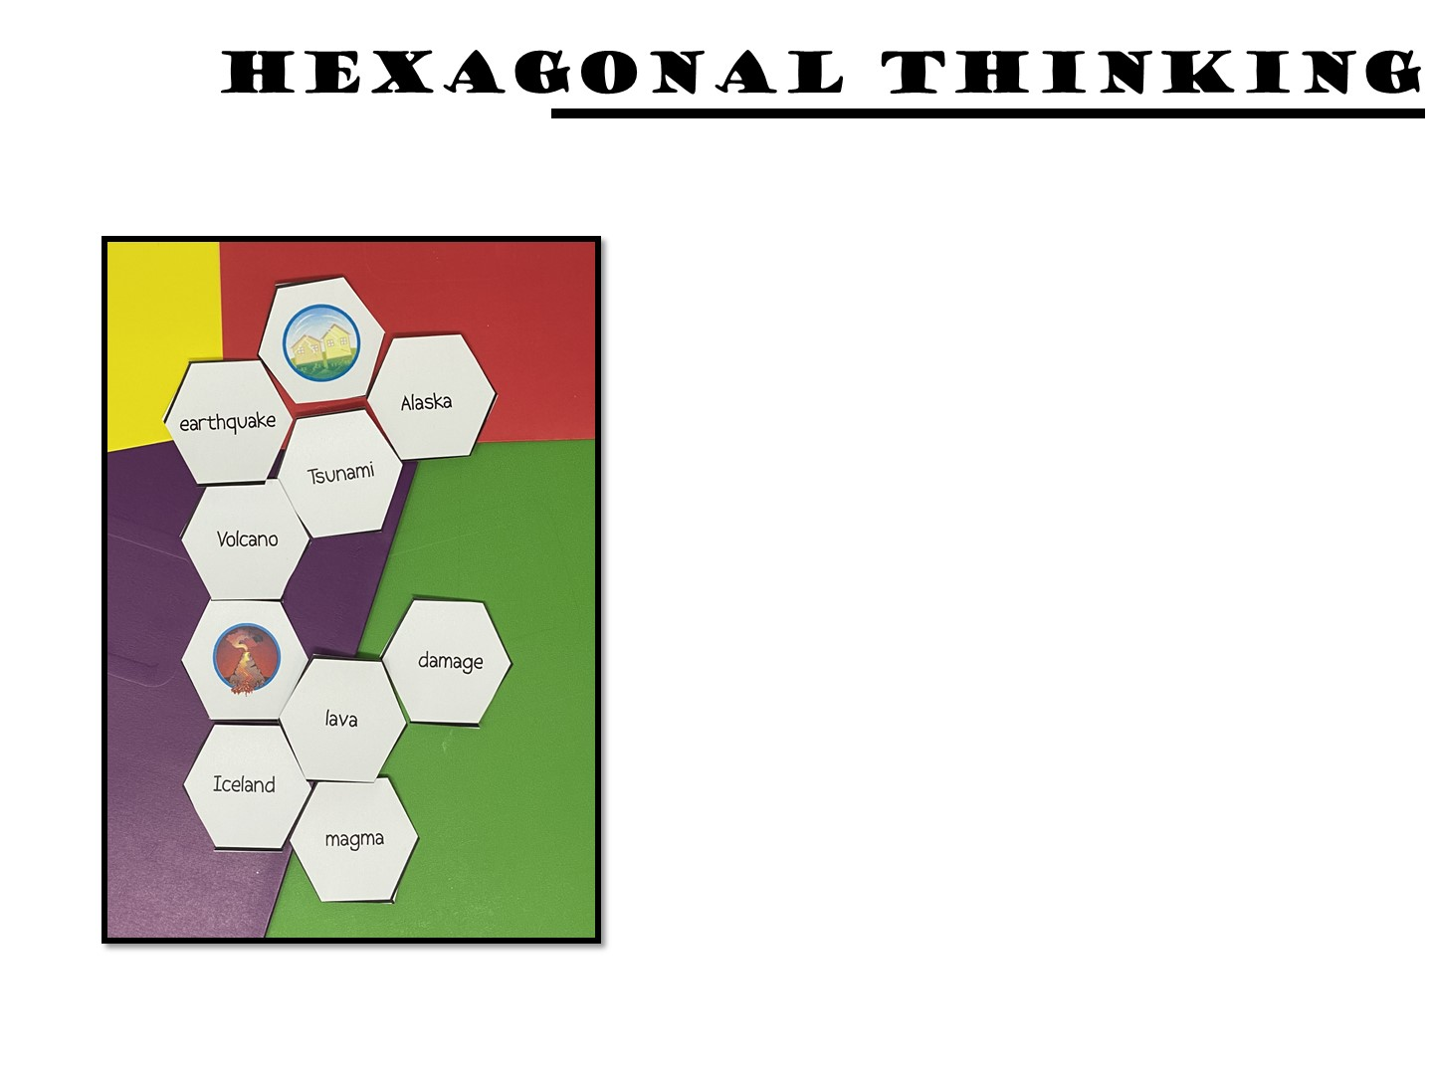
Make connections between the hexagon shapes.
Notes:
Pass out the first round of the hexagons. Make connections between the hexagon shapes. For every connection they make, they earn 1 point. For example, the indigenous people shape is connected on 5 sides, exploration, Columbus, Spanish, person figure and Taino. A student should be able to explain how all of these are connected. If they can, they earn 5 points. You can ask them to annotate their connections with post it notes
Once you have finished the directions, go to the next slide before you start – you don’t want them to just copy your example.

Slide 59

Play
Notes:
Give them time to make connections with the hexagons. Do not clean up the hexagons, they need to stay out for the next round.

Slide 60
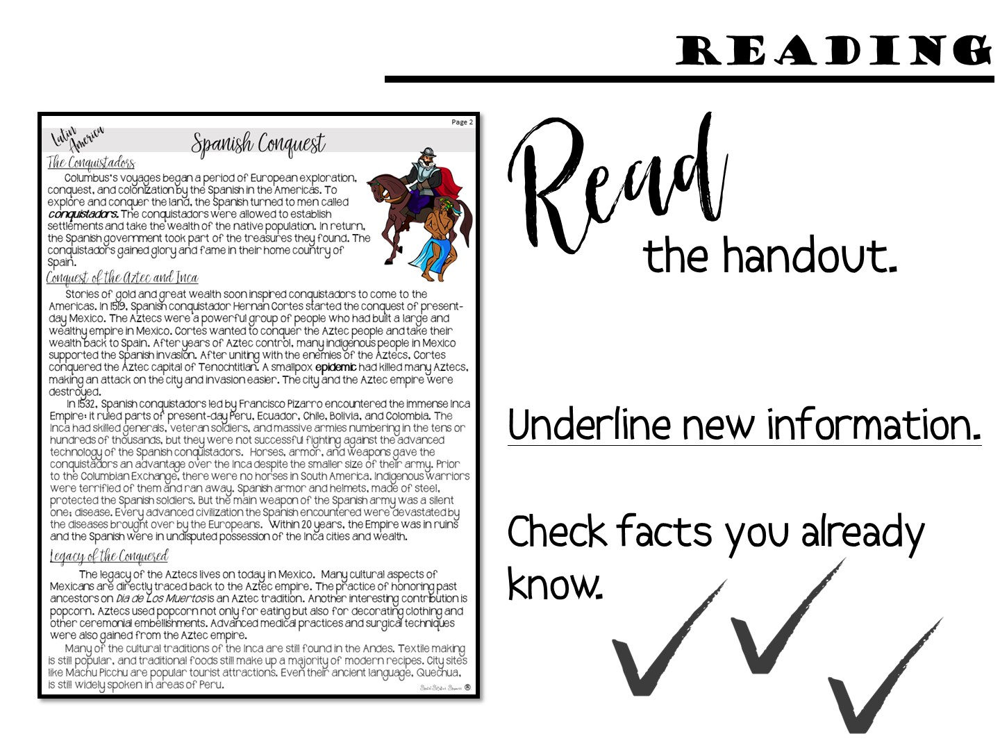
Notes:
You may not want to do round two or three, depends on your time. You can just tell them what they would do next, how they add hexagons everytime so that it grows.

Slide 61
Notes:
Pass out the Doodle Notes and have them complete what they can with the second page of reading

Slide 62
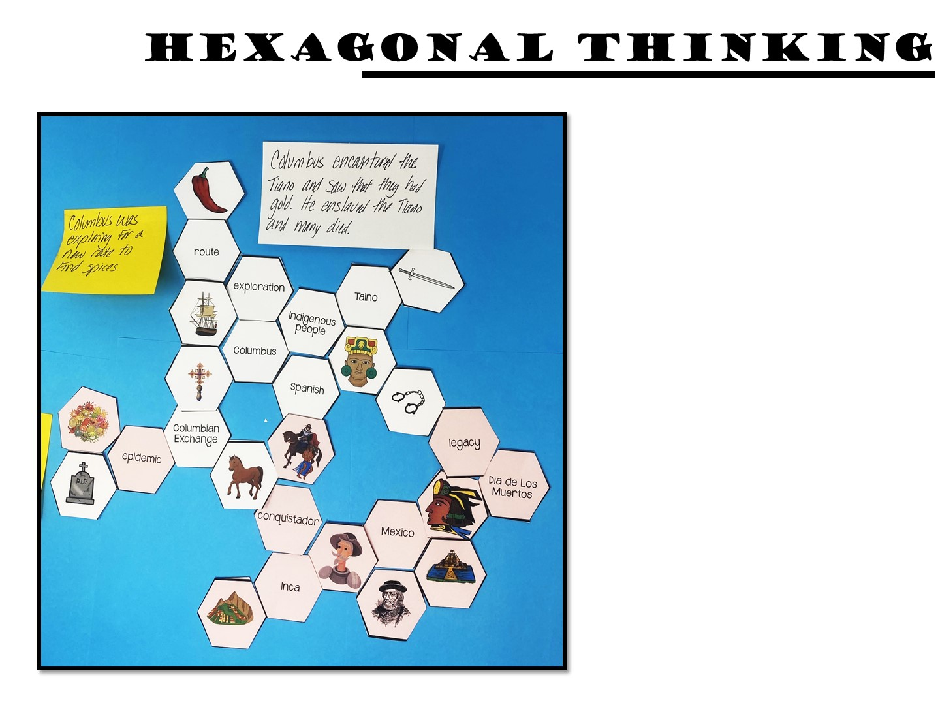
Make connections between the hexagon shapes.
Notes:
Pass out the next set of hexagons, they will then add to their first set.

Slide 63
Play

Slide 64

Notes:
Debrief the lesson by asking them to use specific design qualities of engagement terminology to identify different parts of the lesson that increase engagement.

Slide 65

Notes:
Share with a partner.

Slide 67

Notes:
Give them 5 minutes to write down reflections on their notes (on the back)

Slide 68
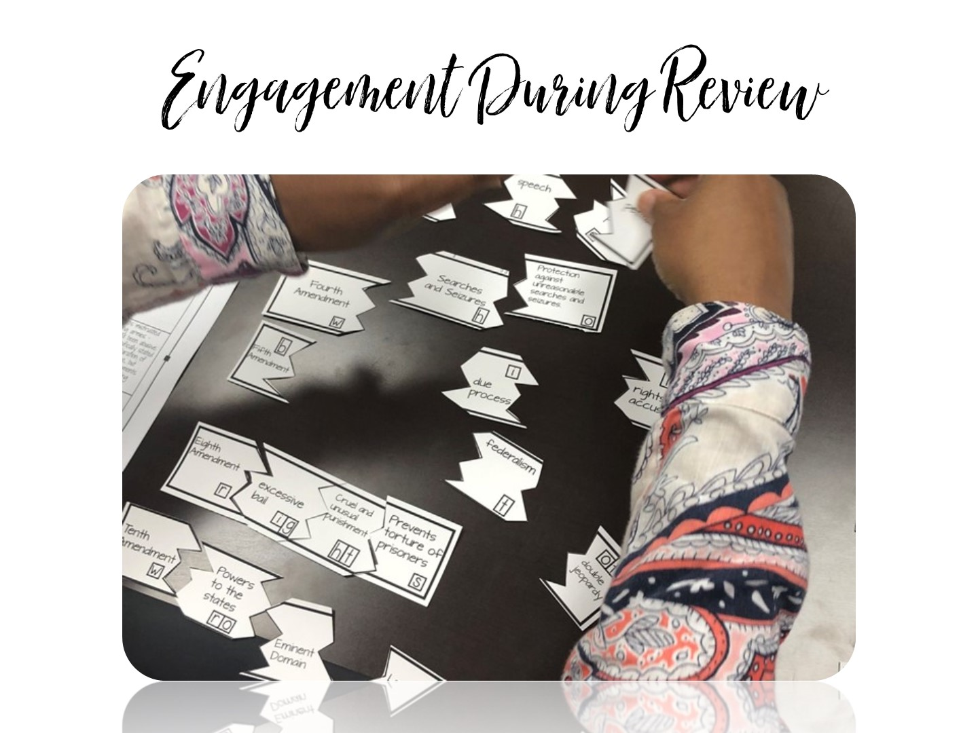
Notes:
We are now going to look at how to build engagement during review sessions.

Slide 69
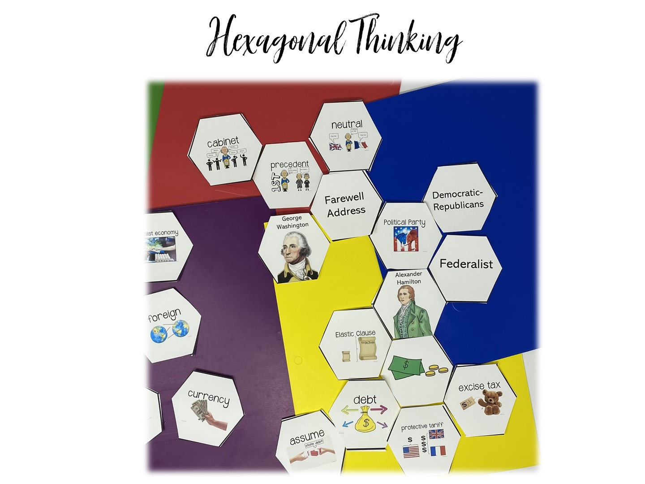

Slide 71

Notes:
Stand on one foot and summarize what you have learned so far to your partner.

Slide 72


Slide 73

Notes:
Rotating Trios
Using the number on your popsicle stick (0,1 or 2), make a “trio”. Each trio should contain a 0, 1, and 2. Give the trio 1-2 minutes to discuss the question. Then choose one or two groups to share their responses.
DI Notes: MI – Kinesthetic, Verbal/Linguistic and Intra-Personal
73

Slide 74


