Slide 1
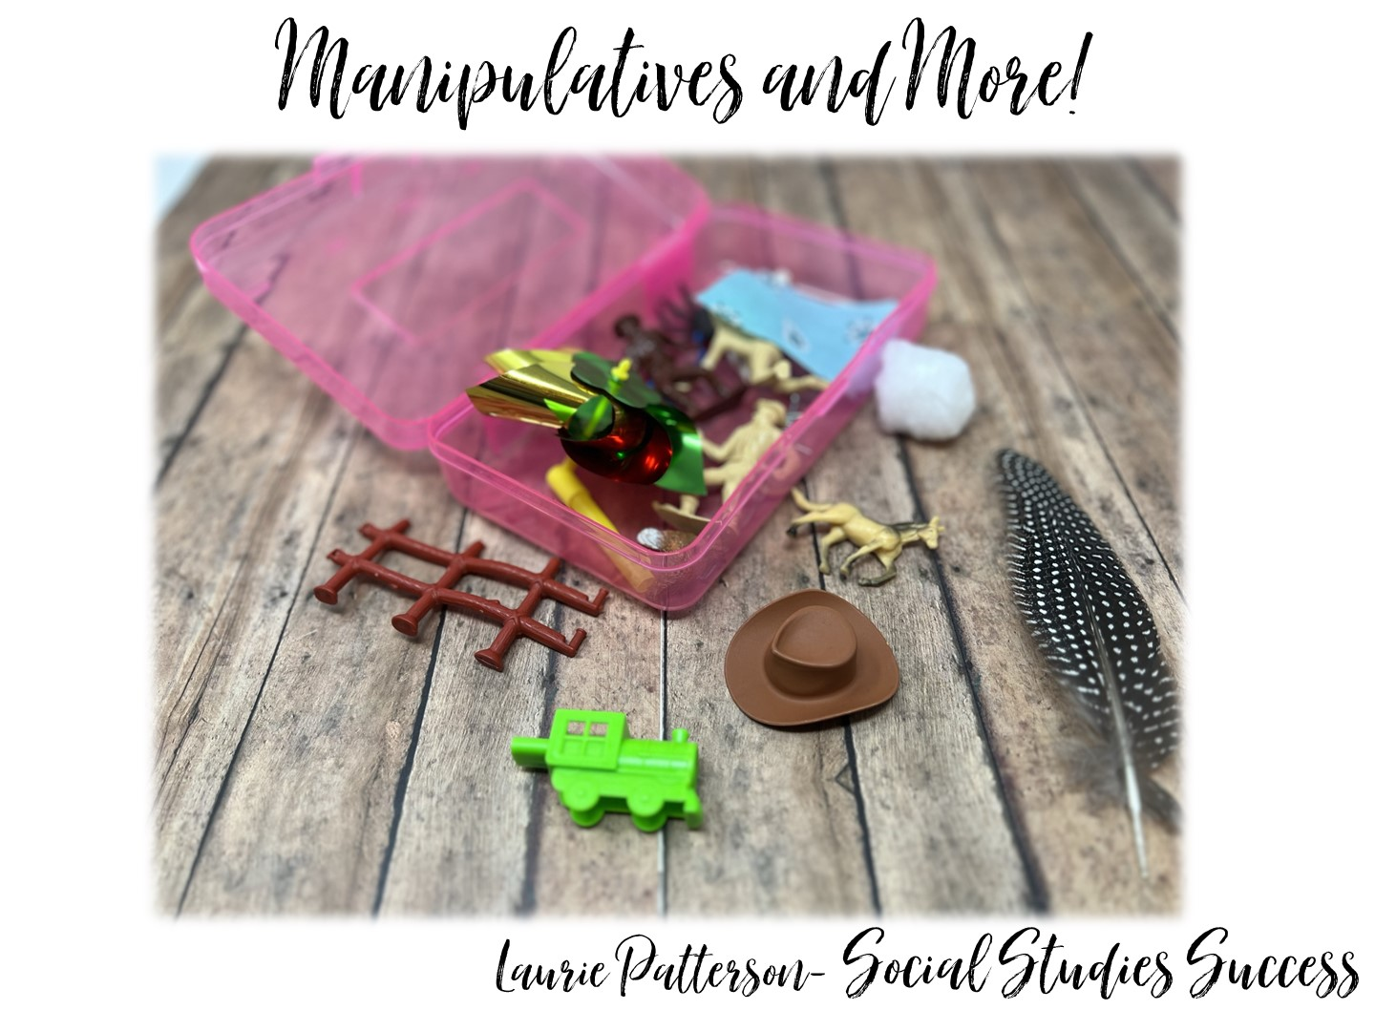

Slide 2


Slide 3

Notes:
Spend a few minutes introducing your personal and professional life.

Slide 4

Notes:
The following slides list the research that goes into my workshops. I quickly share all of the research, and on the last slide I ask, “Which of these do you agree with?” and share the answer with a partner.

Slide 5


Slide 6
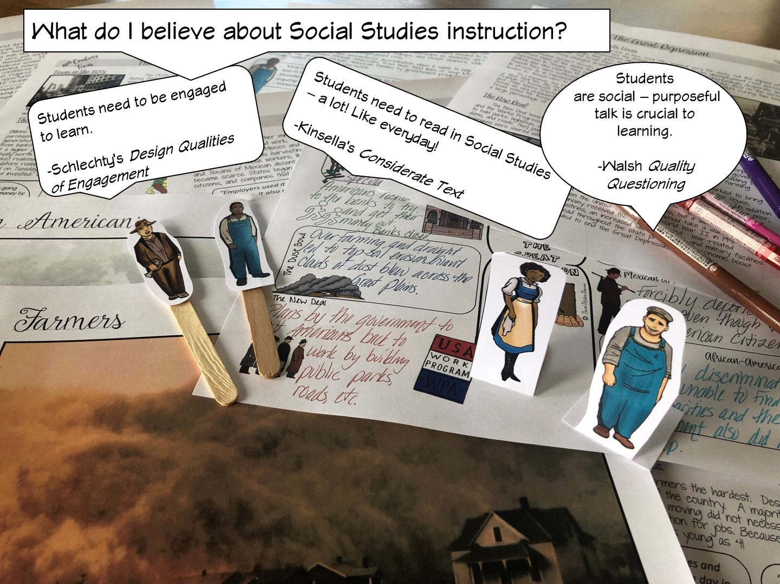

Slide 7
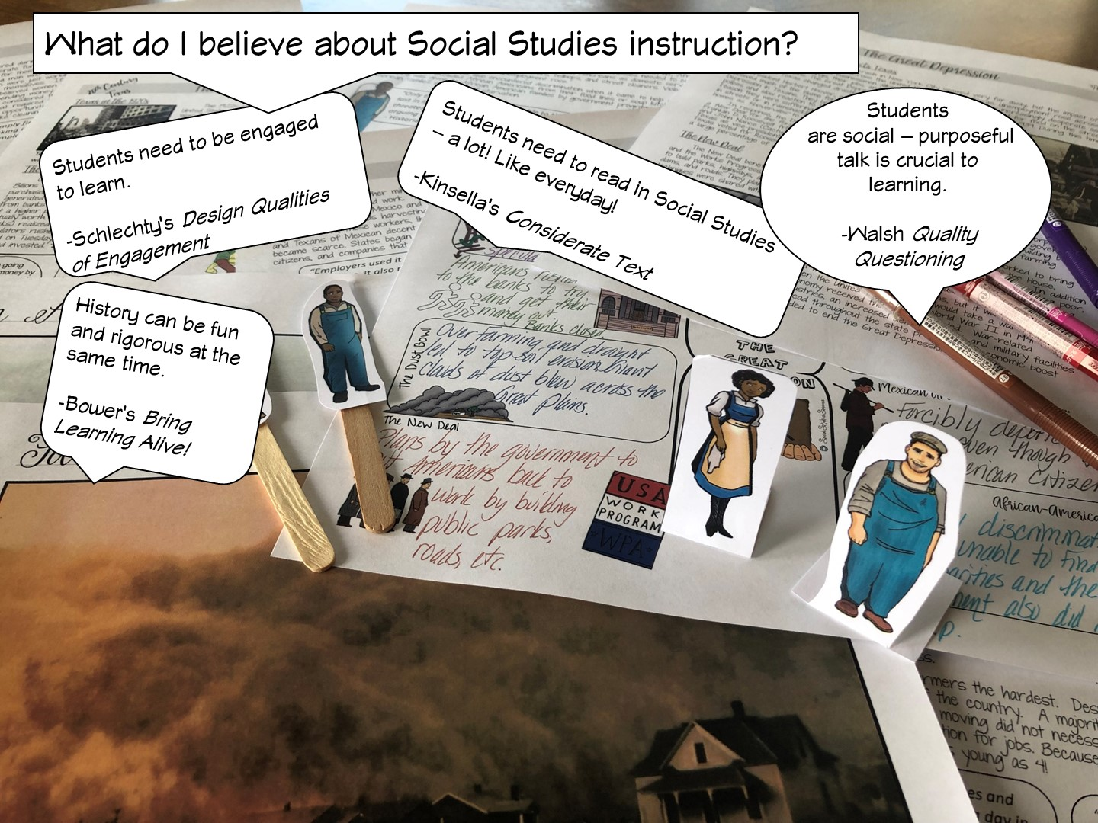

Slide 8


Slide 9
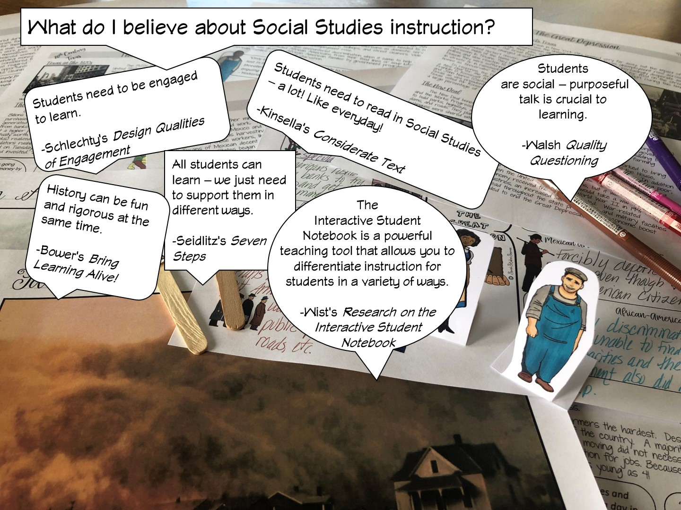

Slide 10
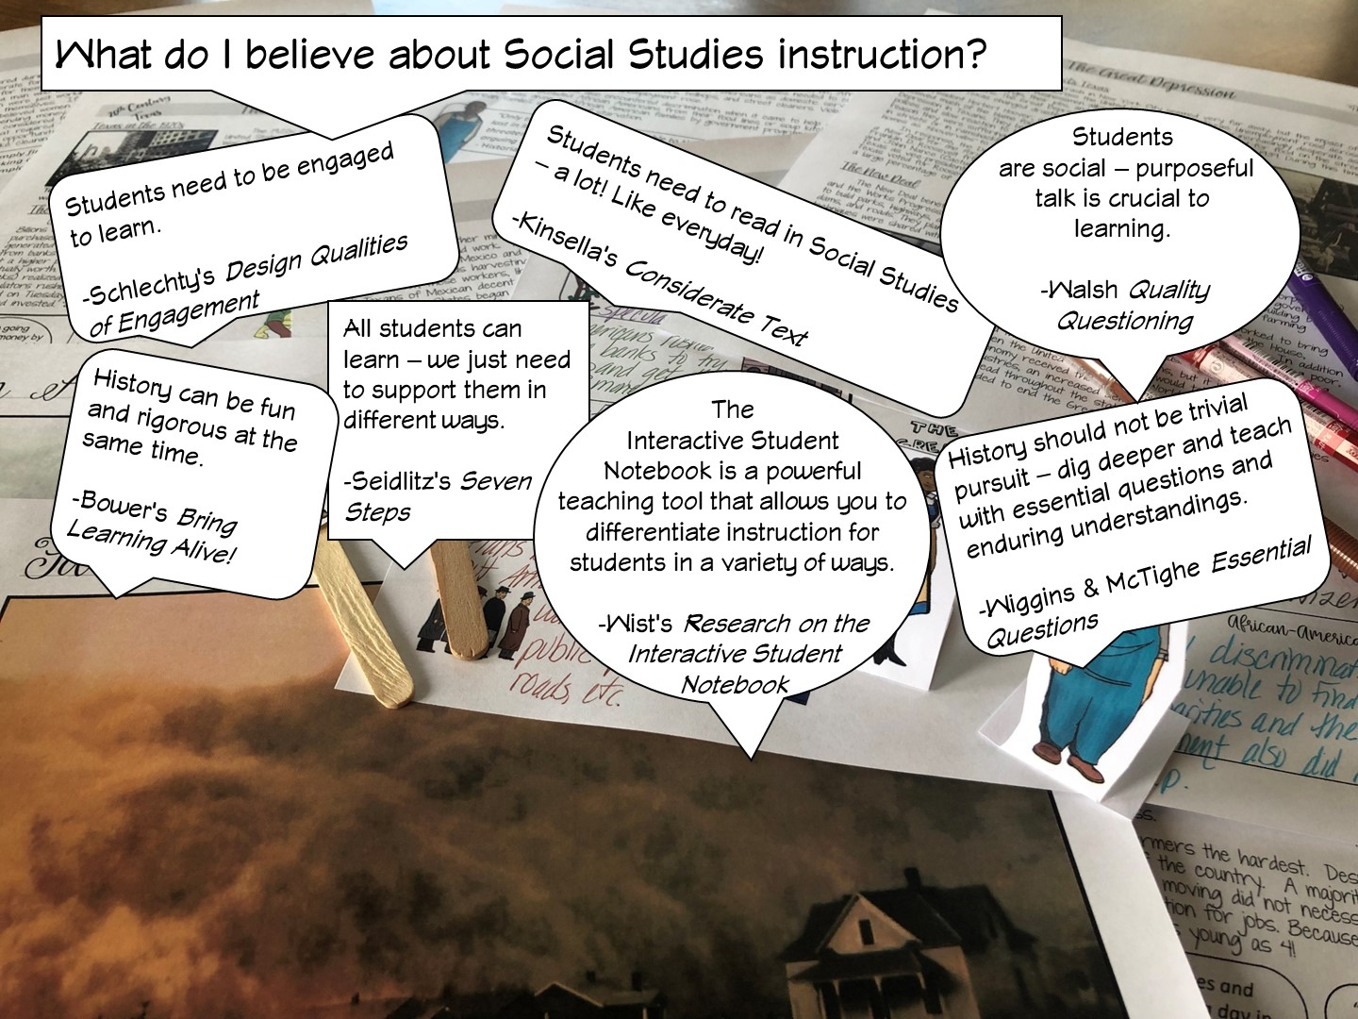

Slide 11
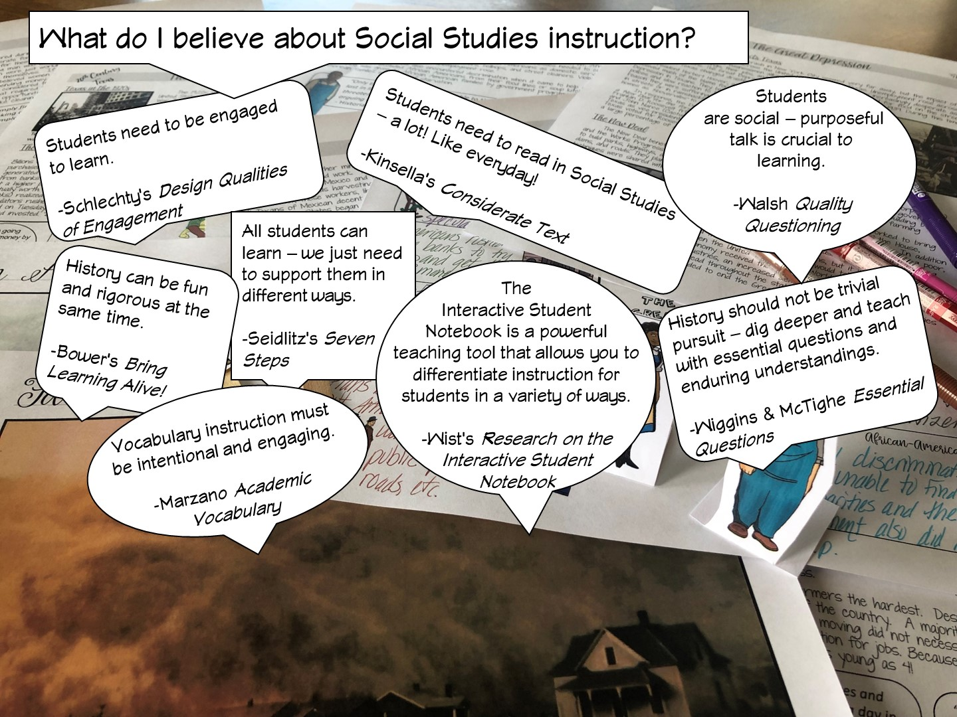

Slide 12
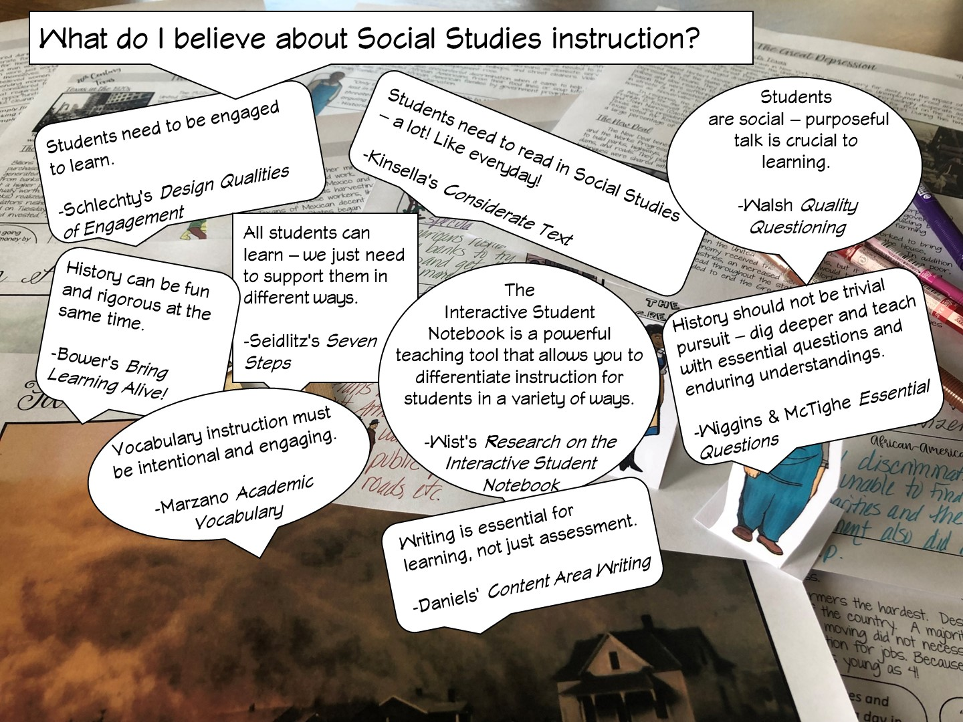

Slide 13
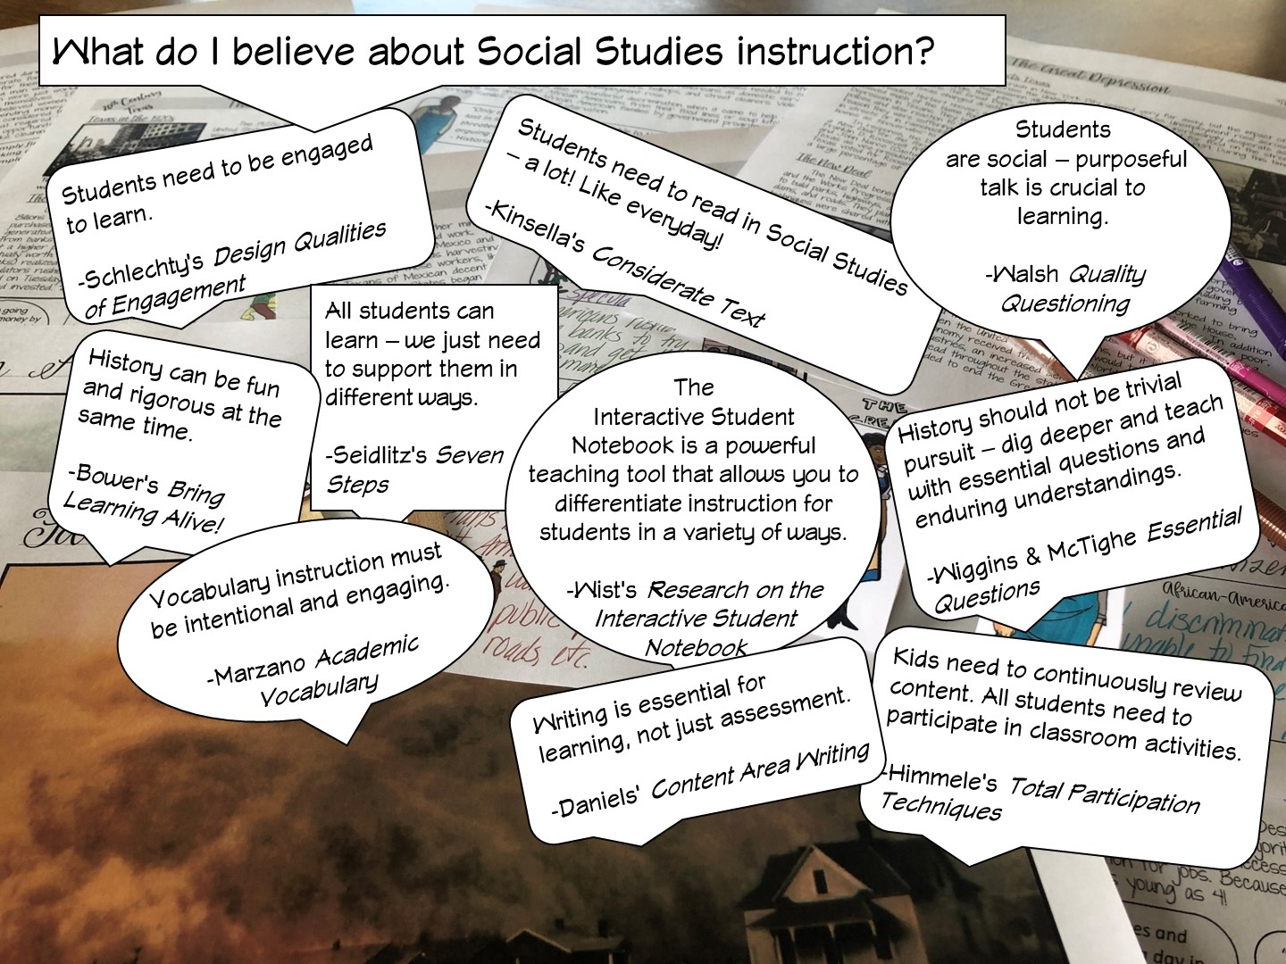

Slide 14
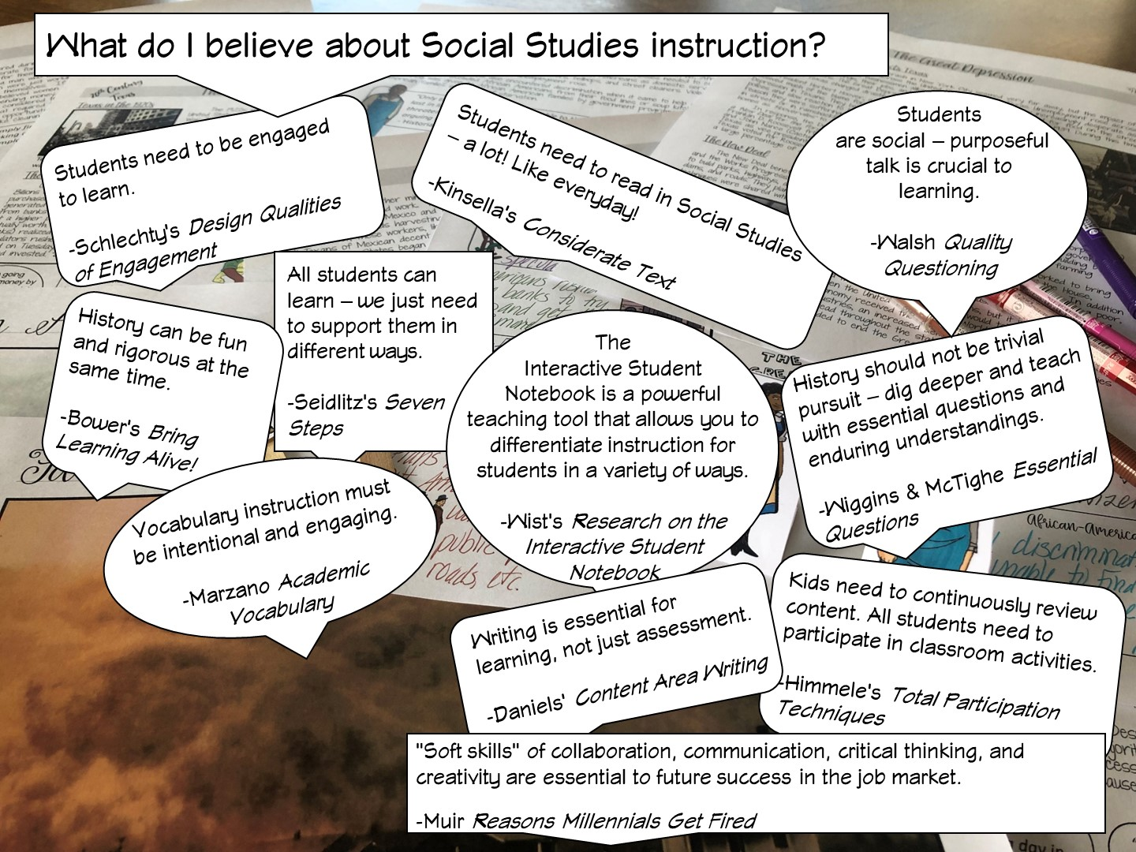

Slide 15
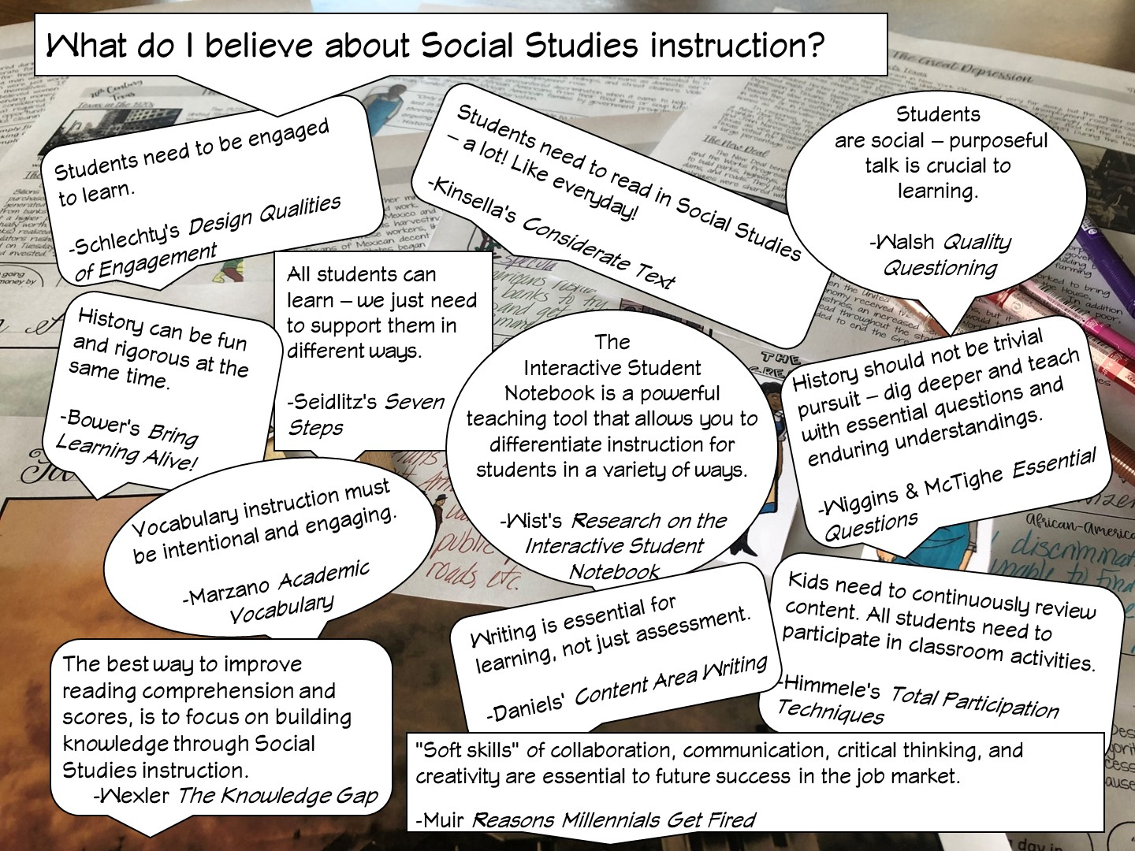
Notes:
After I have reviewed the different research – I ask the teachers, which one they agree with and why – have them talk to their table or partner.

Slide 16
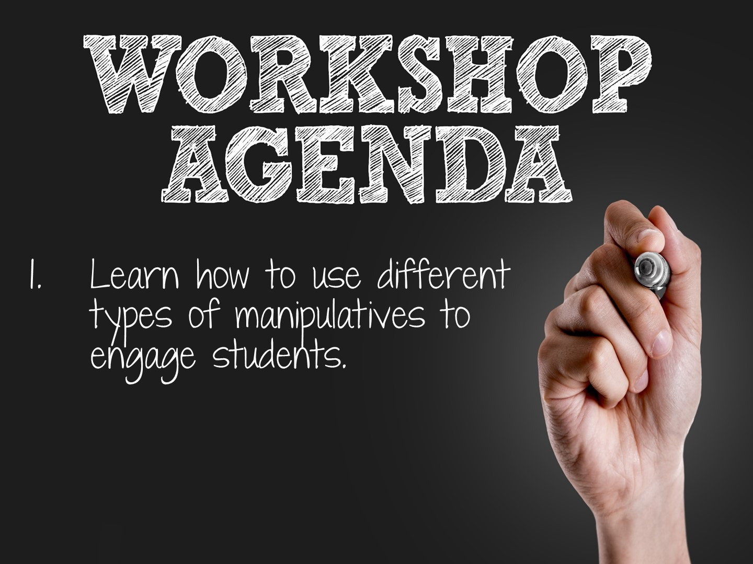

Slide 17
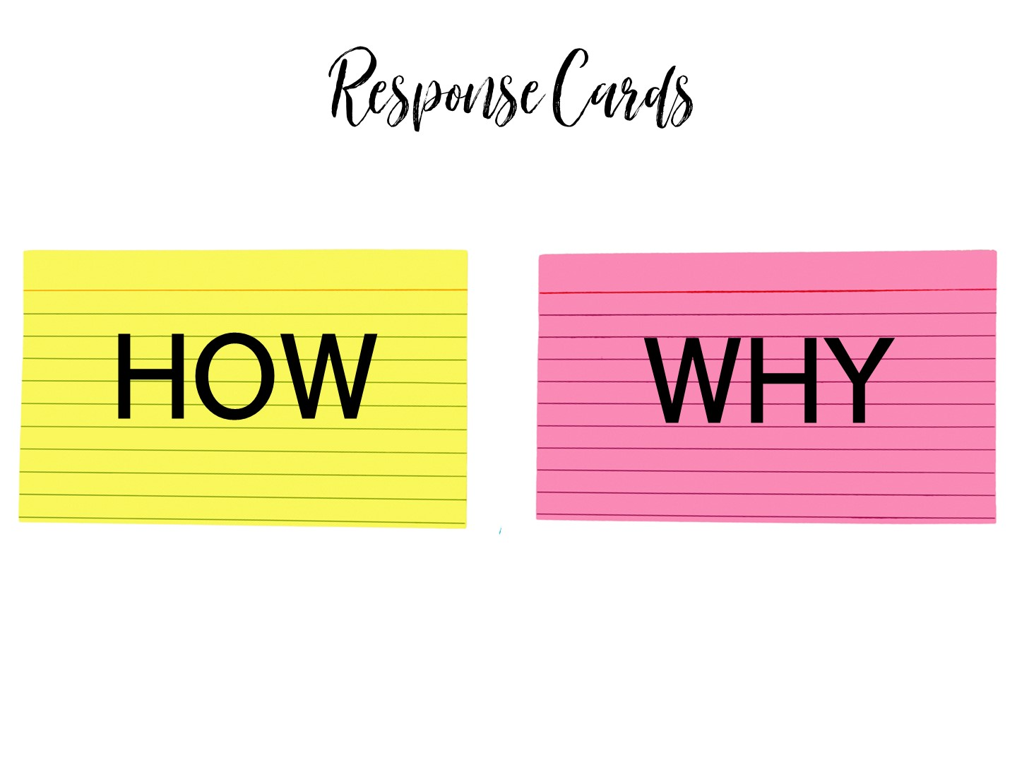
Notes:
Pass out pink and yellow cards to each person. When you ask the following questions, they need to hold up the correct colored card to answer the question. We will be looking at statements on why we use manipulatives and how we use manipulatives.

Slide 18
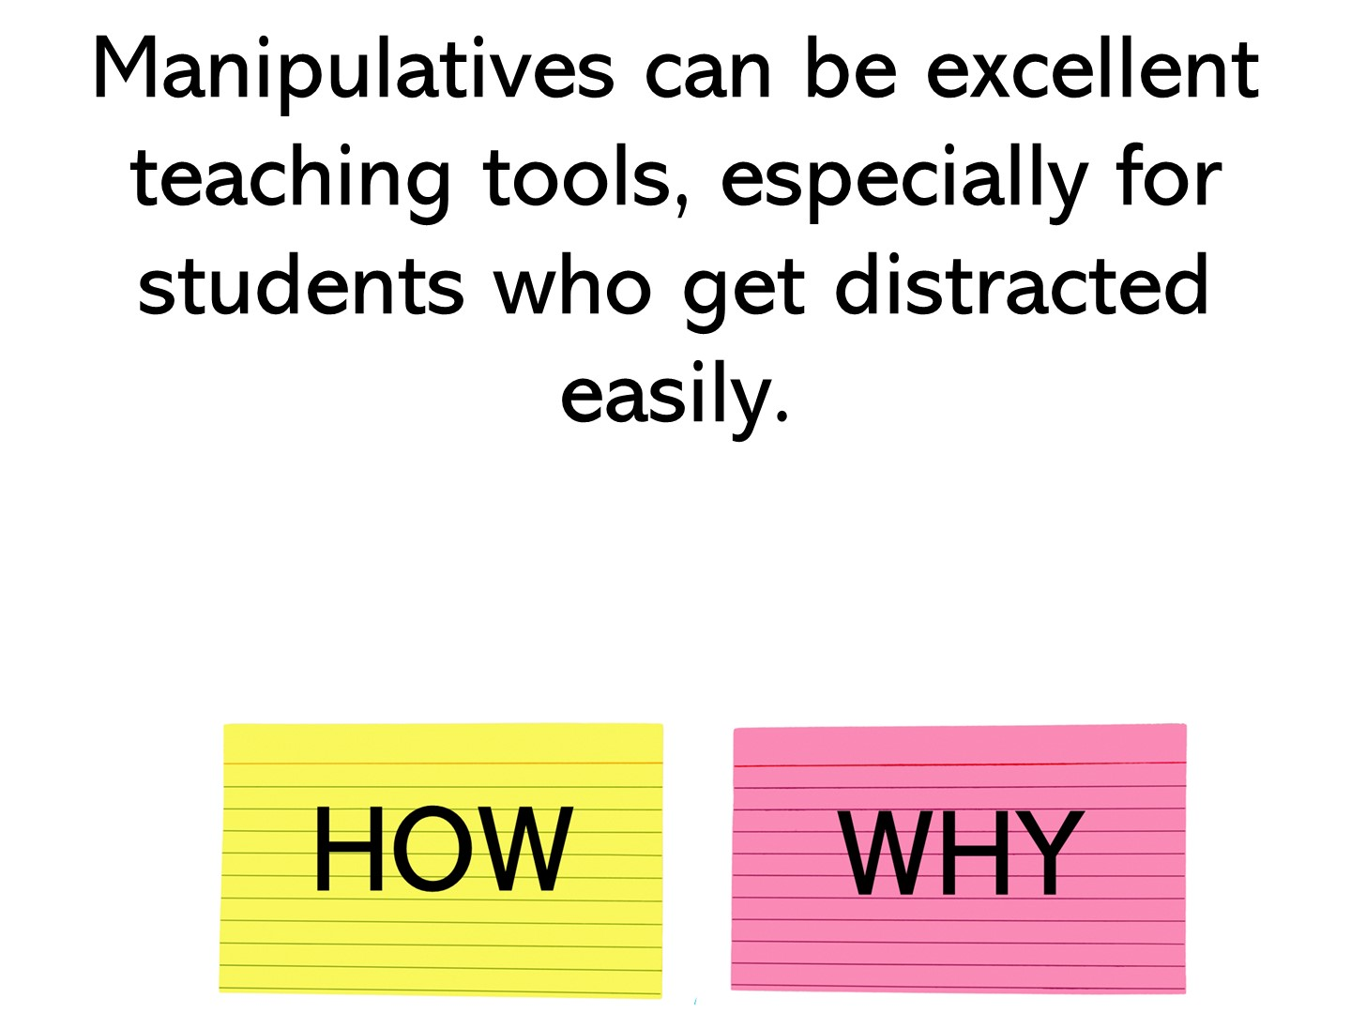
Notes:
why

Slide 19
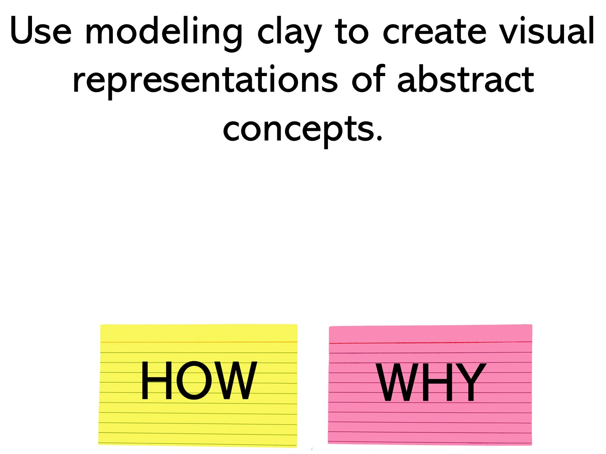
Notes:
how

Slide 20
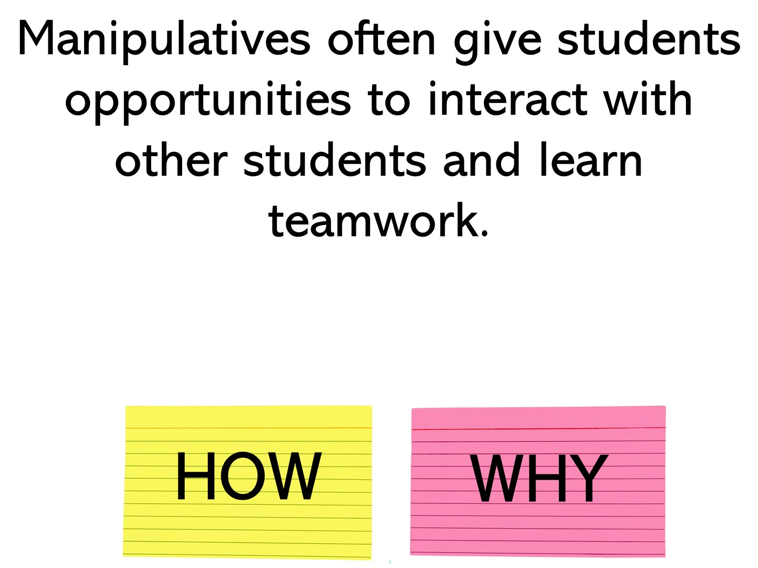
Notes:
why

Slide 21
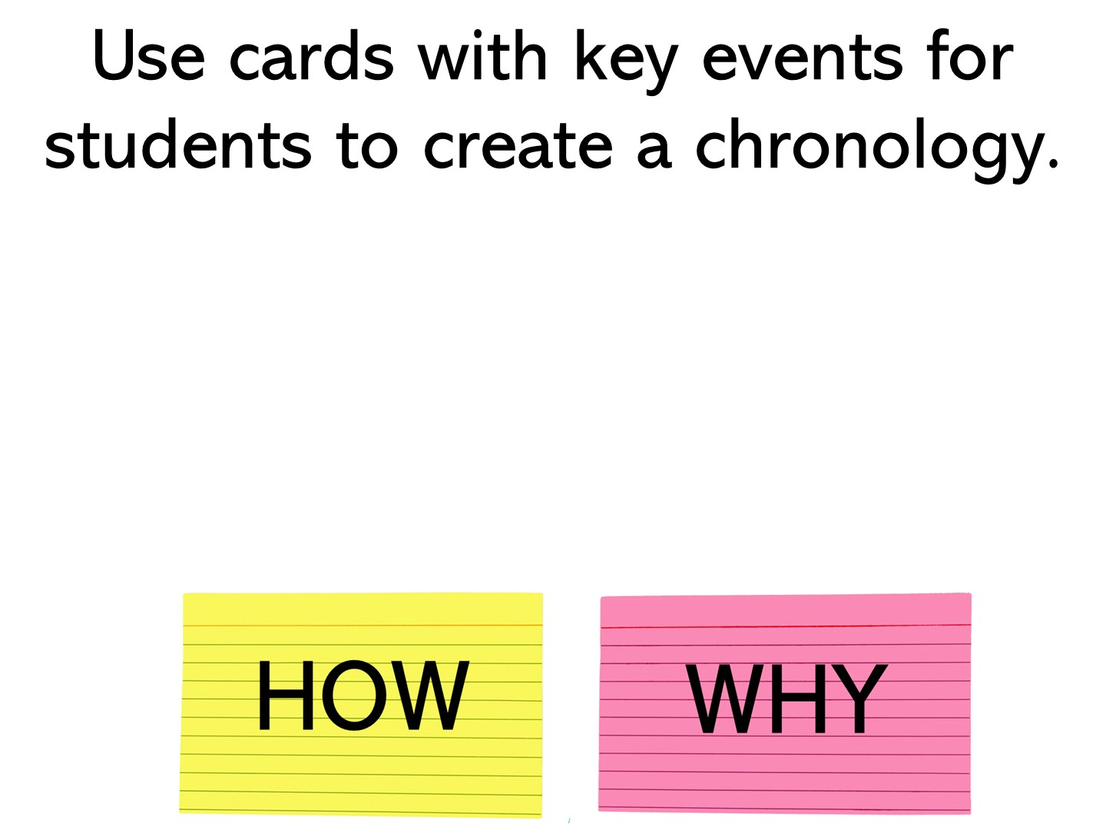
Notes:
how

Slide 22
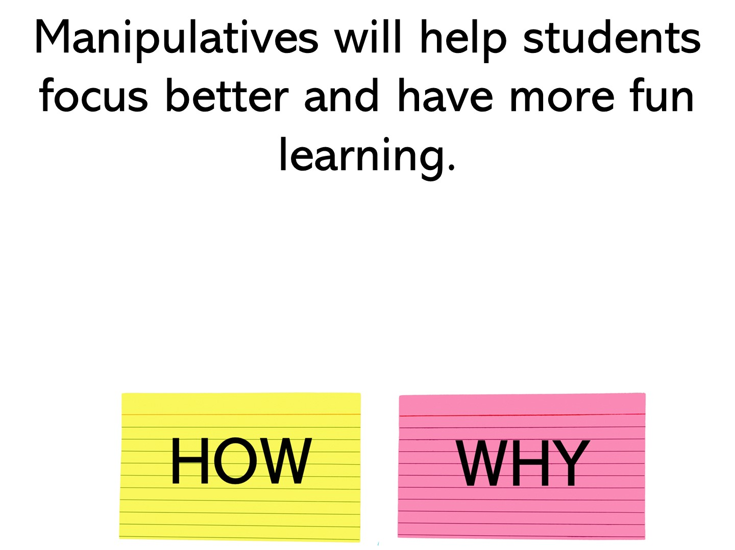
Notes:
why

Slide 23
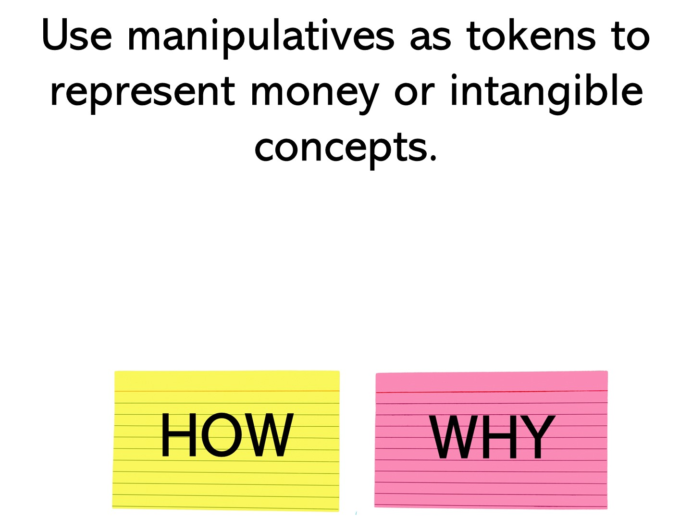
Notes:
how

Slide 24
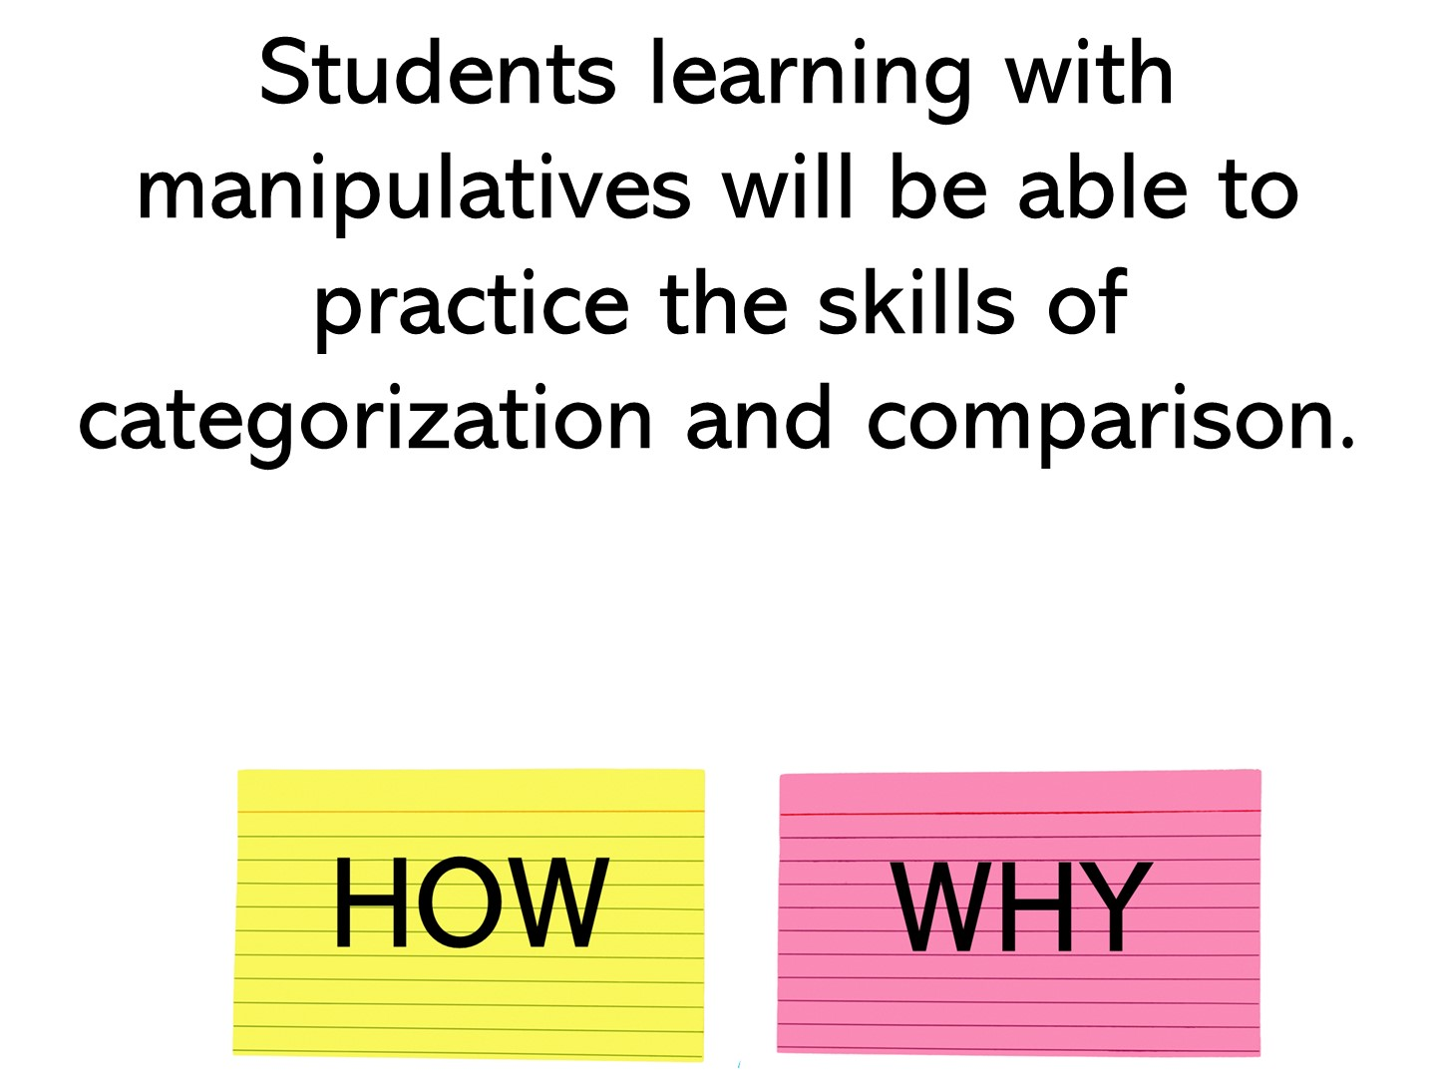
Notes:
why

Slide 25
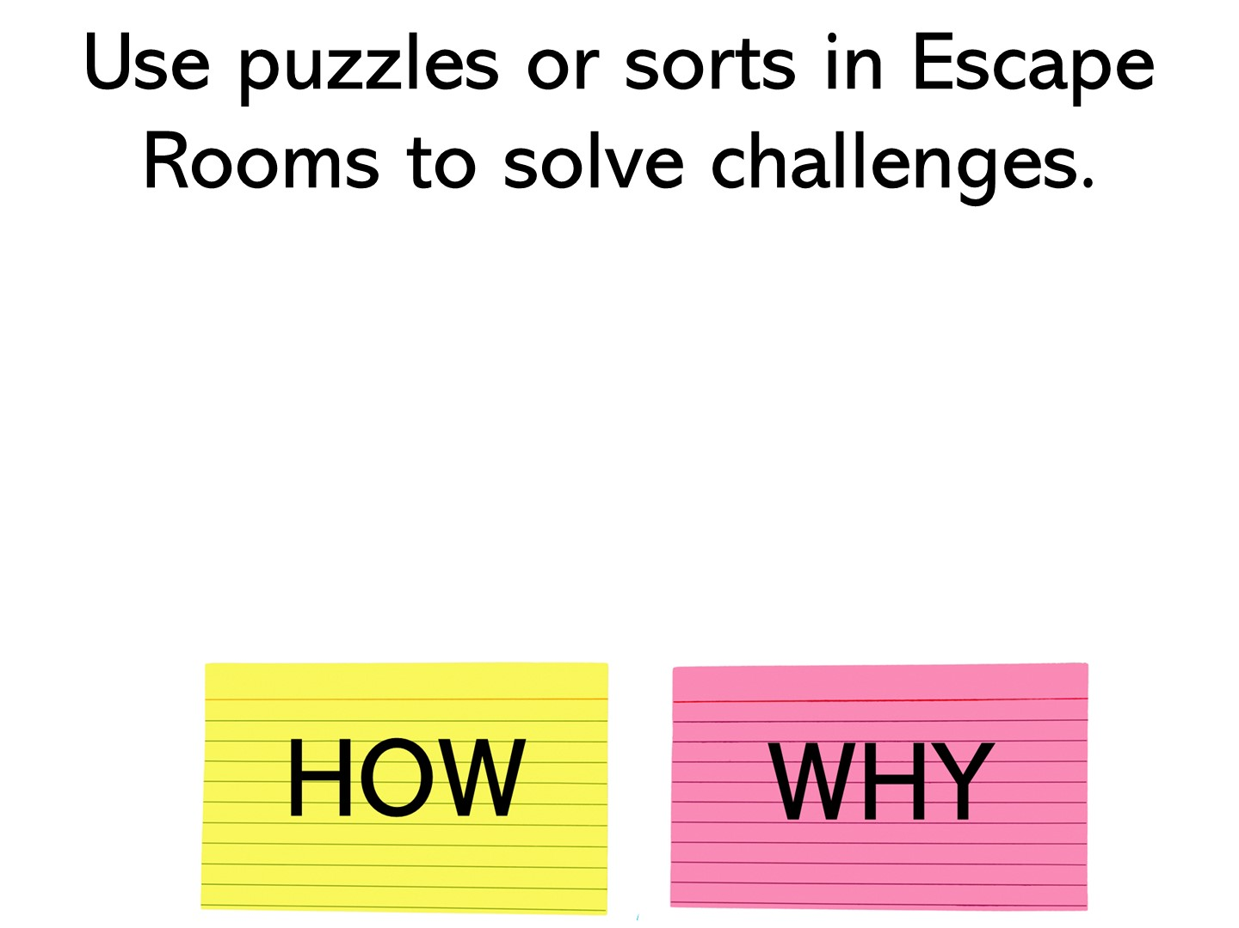
Notes:
how

Slide 26
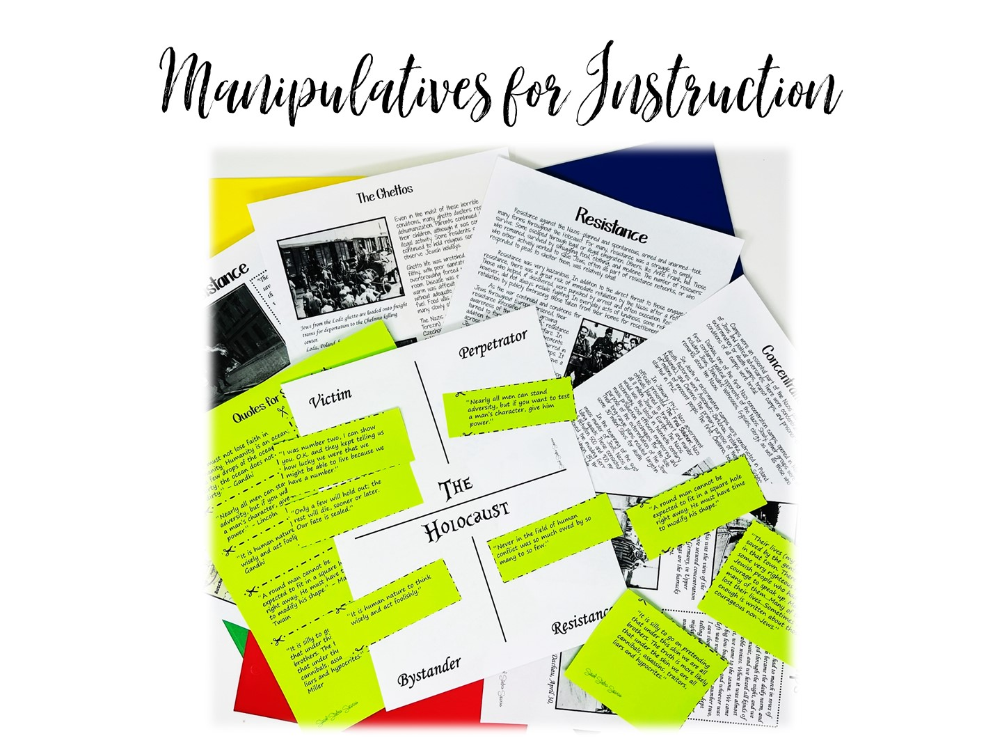
Notes:
I have divided this workshop into two different parts – using manipulatives for Skill Based Instruction and Skill Based Review

Slide 27
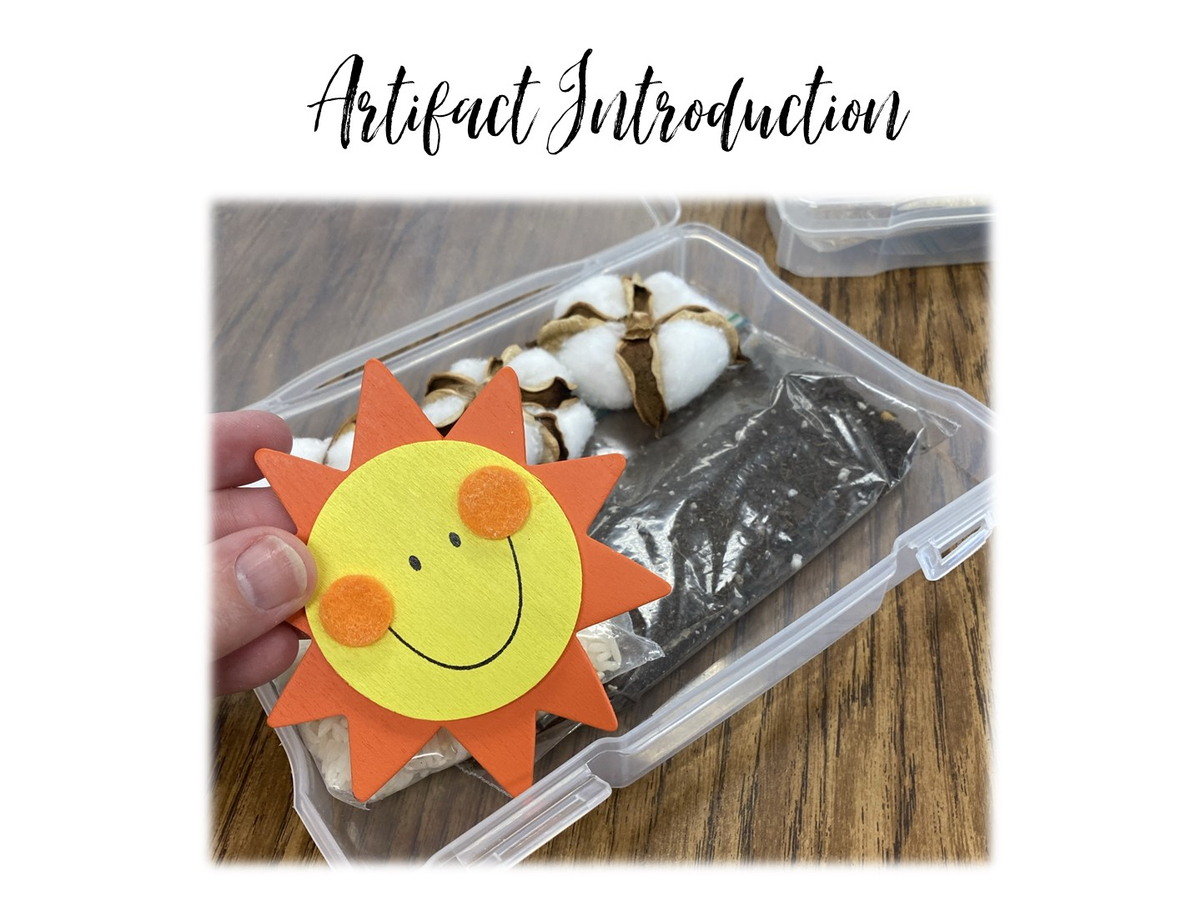
Notes:
Lets take a look at how you can preview a unit with artifacts (or faked artifacts). The boxes I have given you are for the Cotton, Cattle, and Railroads era of Texas History (Don’t tell them that yet).

Slide 28
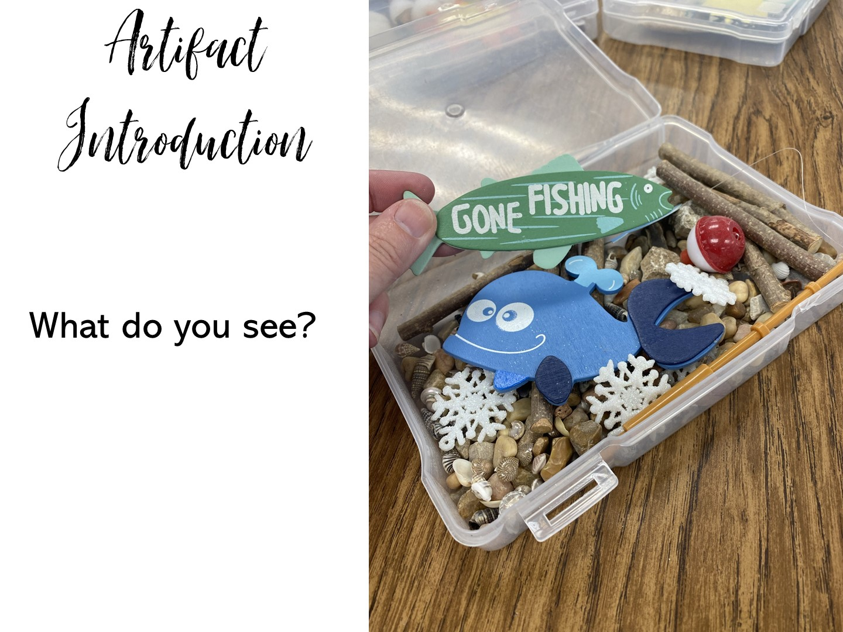
Notes:
Pass out the boxes and have them talk through these questions with a partner. At the end you can pass out the artifact questions. All of the items in the boxes came from Amazon.

Slide 29
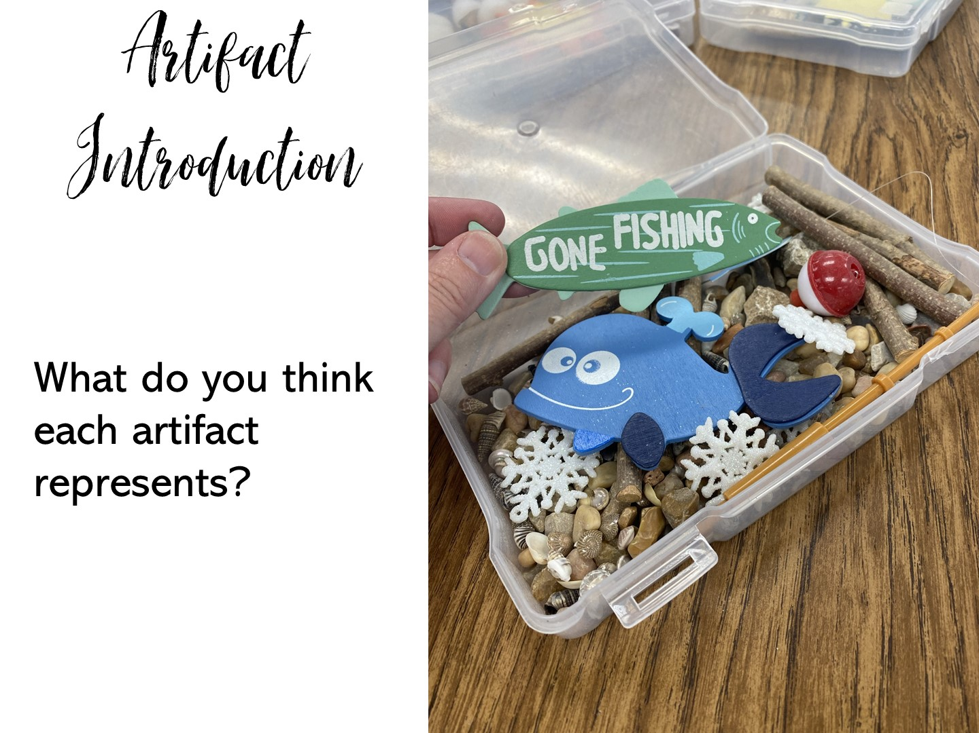

Slide 30
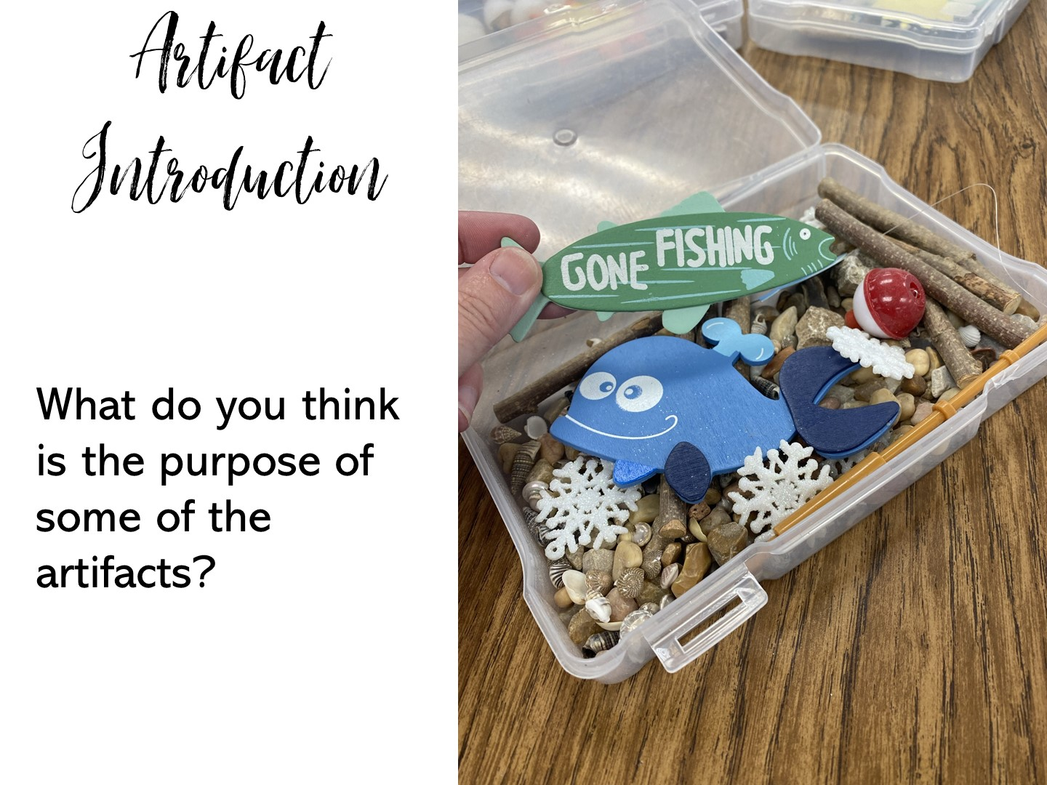

Slide 31
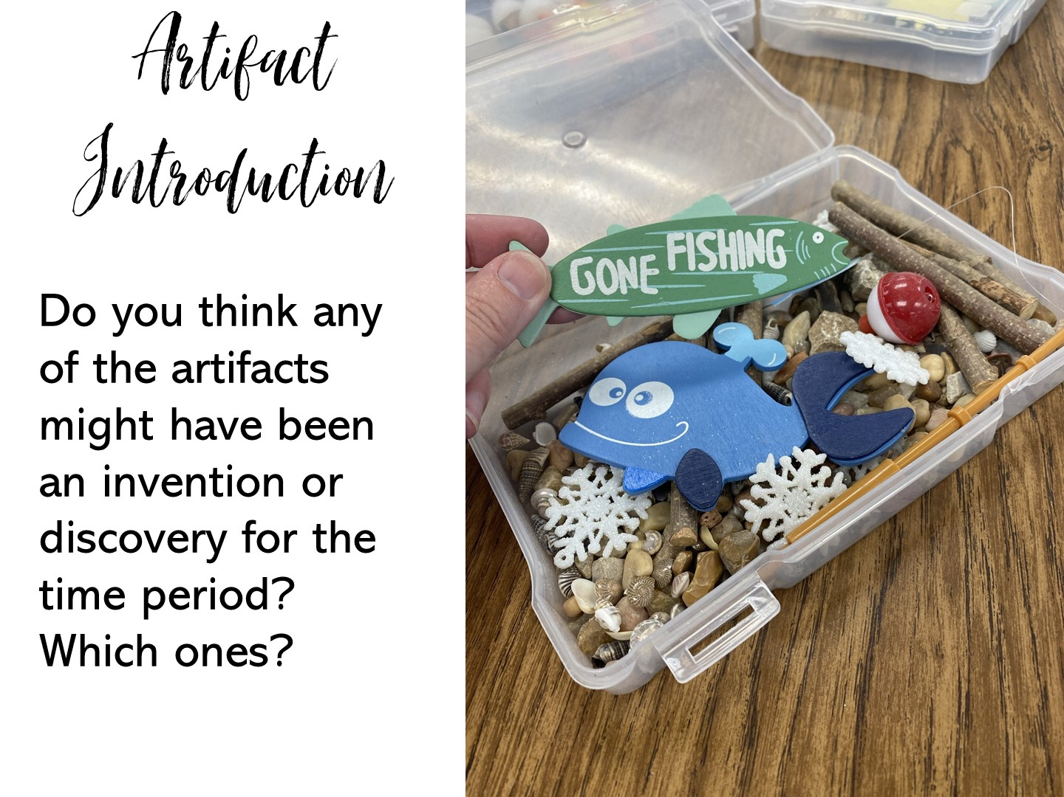

Slide 32
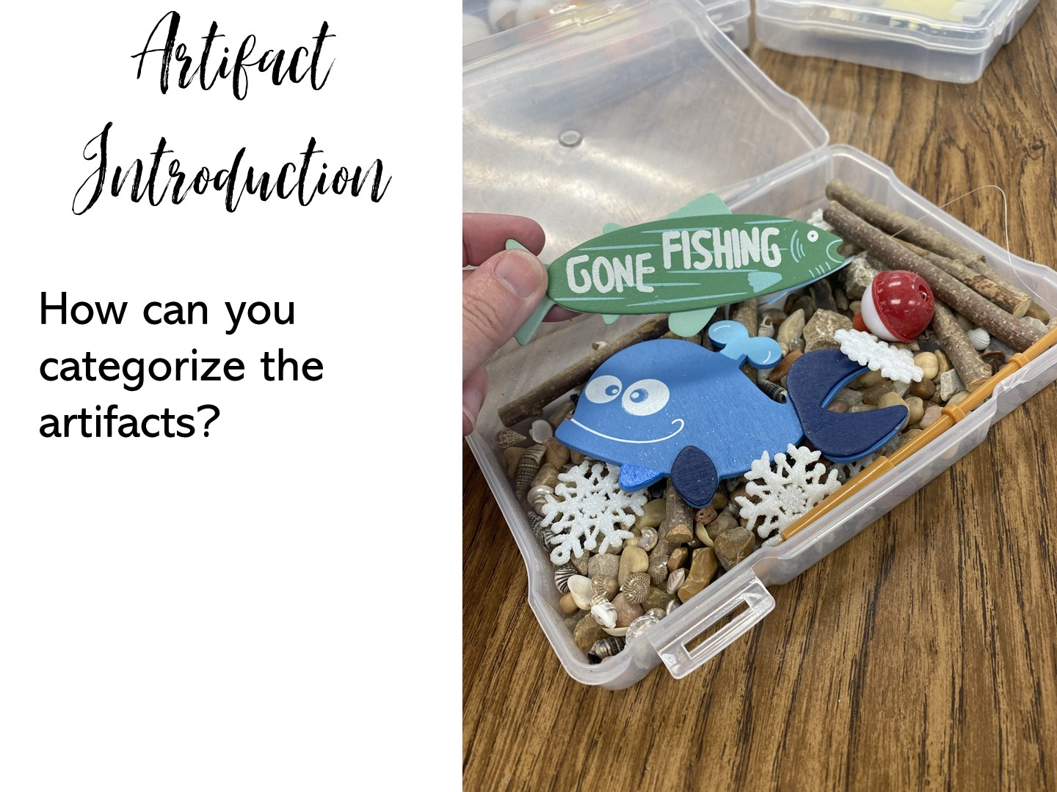

Slide 33
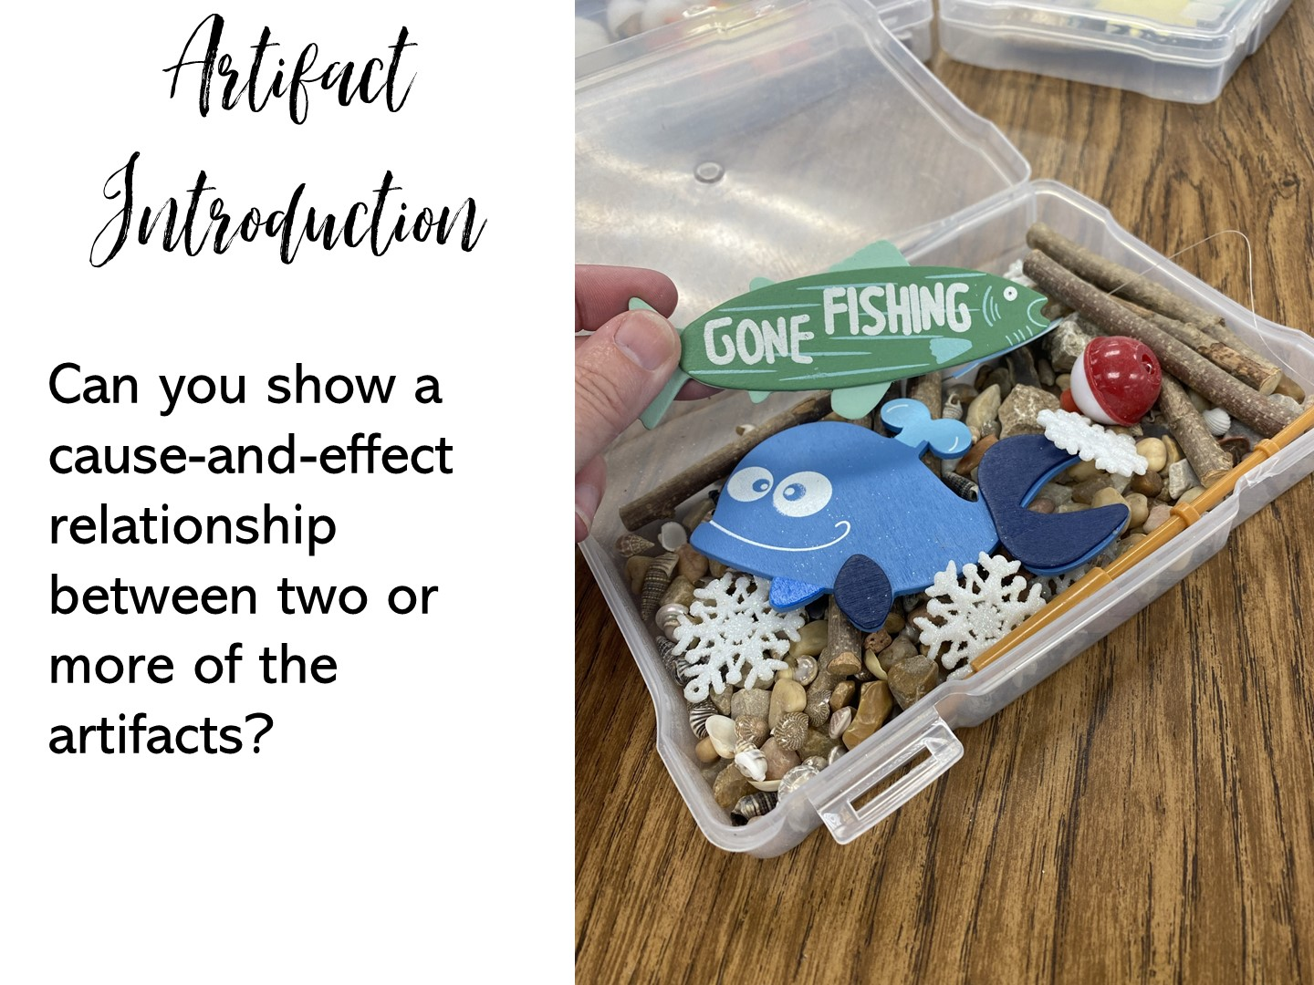

Slide 34
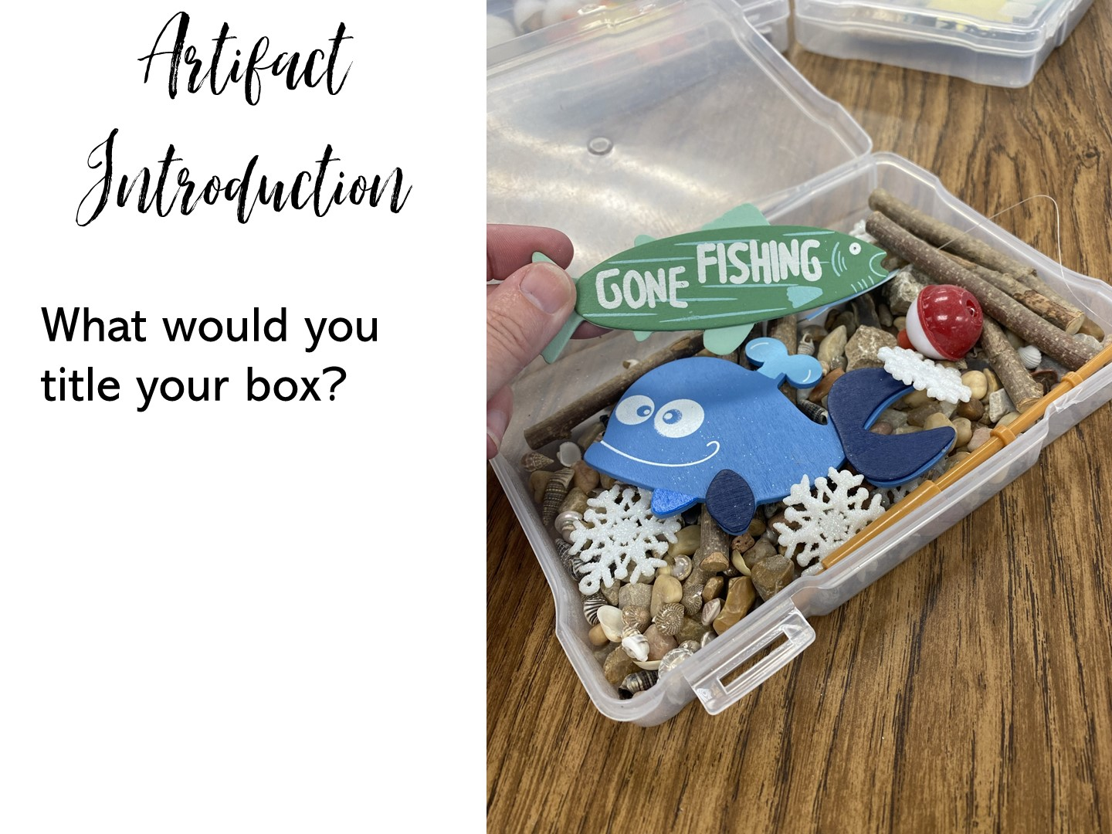

Slide 35
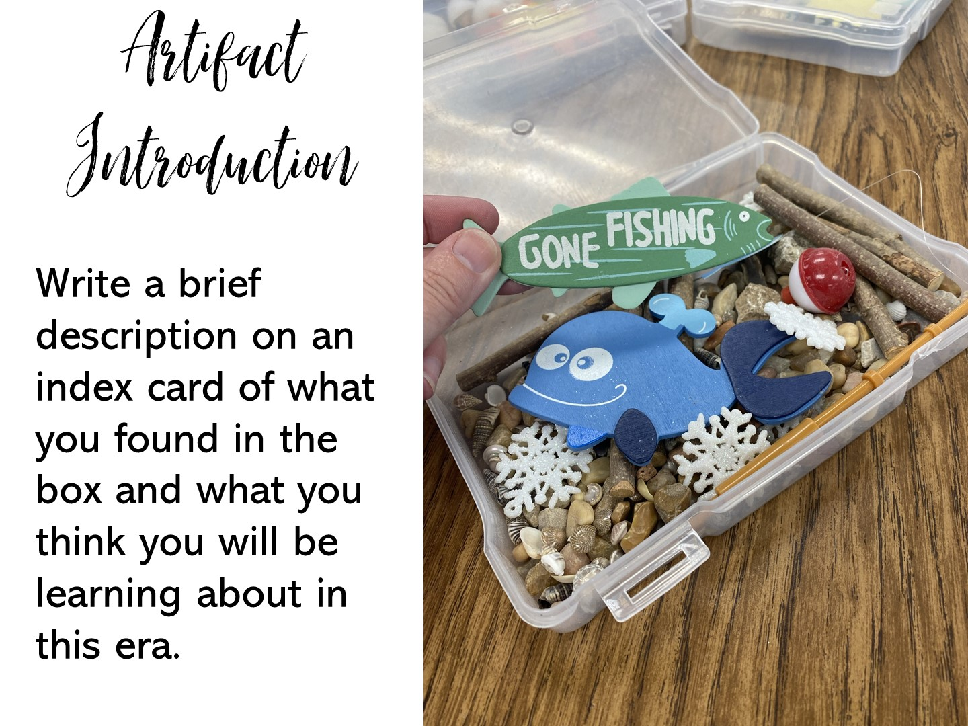

Slide 36


Slide 37

Notes:
Do not create artifact boxes on sensitive topics.

Slide 38
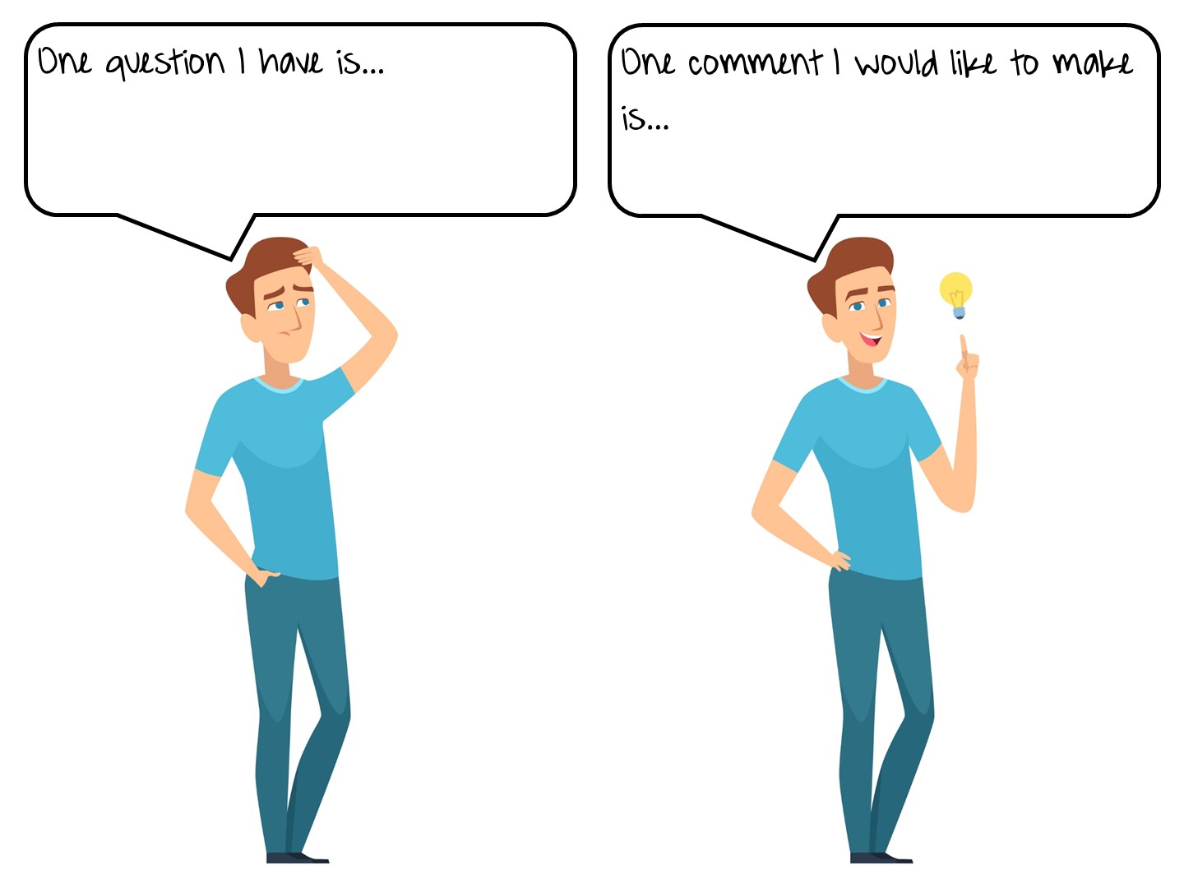
Notes:
Use these as sentence stems to debrief the workshop so far.

Slide 39
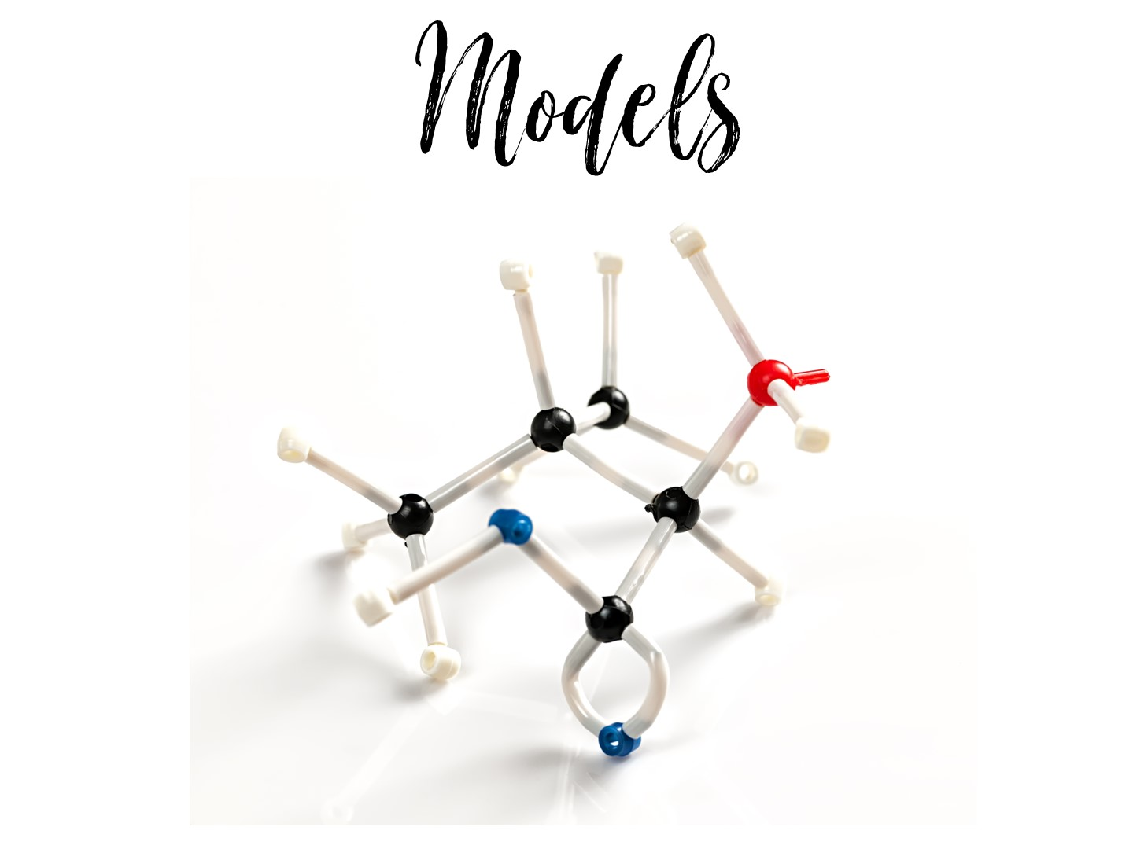
Notes:
Next let's look at how to use manipulatives to make models.

Slide 40
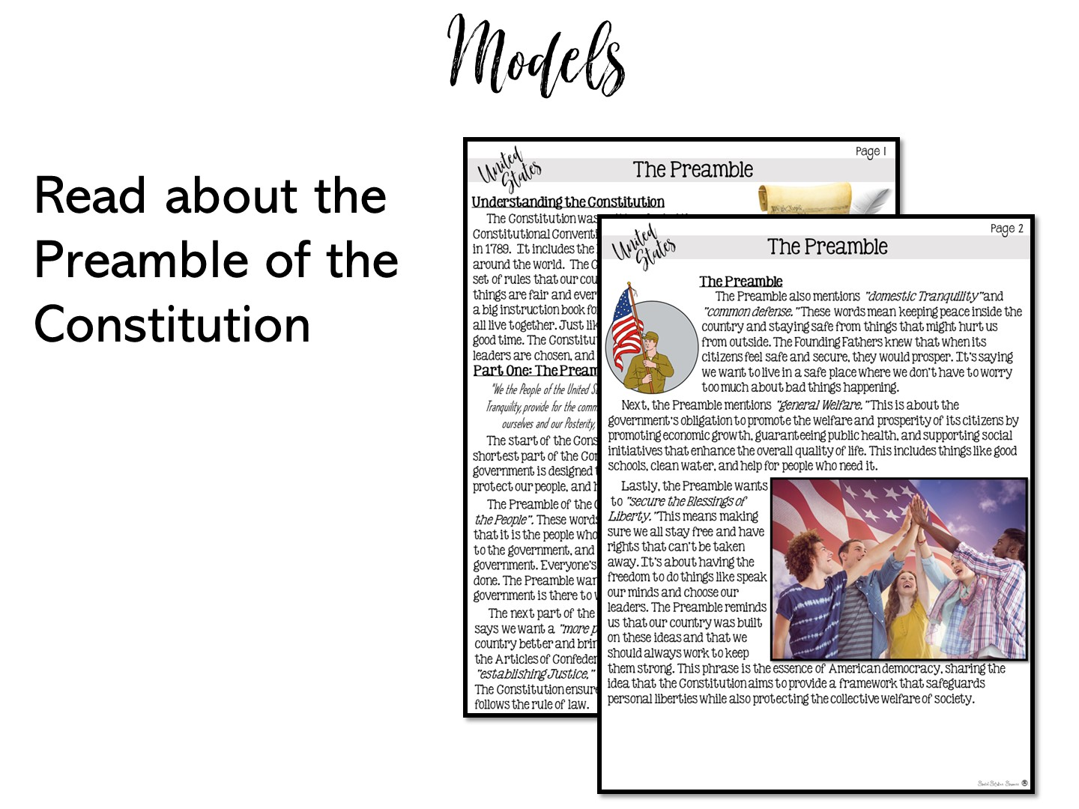
Notes:
Pass out the reading on the Preamble from 5th grade. Give them time to quickly read. Explain that this is only part of the lesson, you are not modeling reading strategies or note taking that is also a part of the lesson.

Slide 41
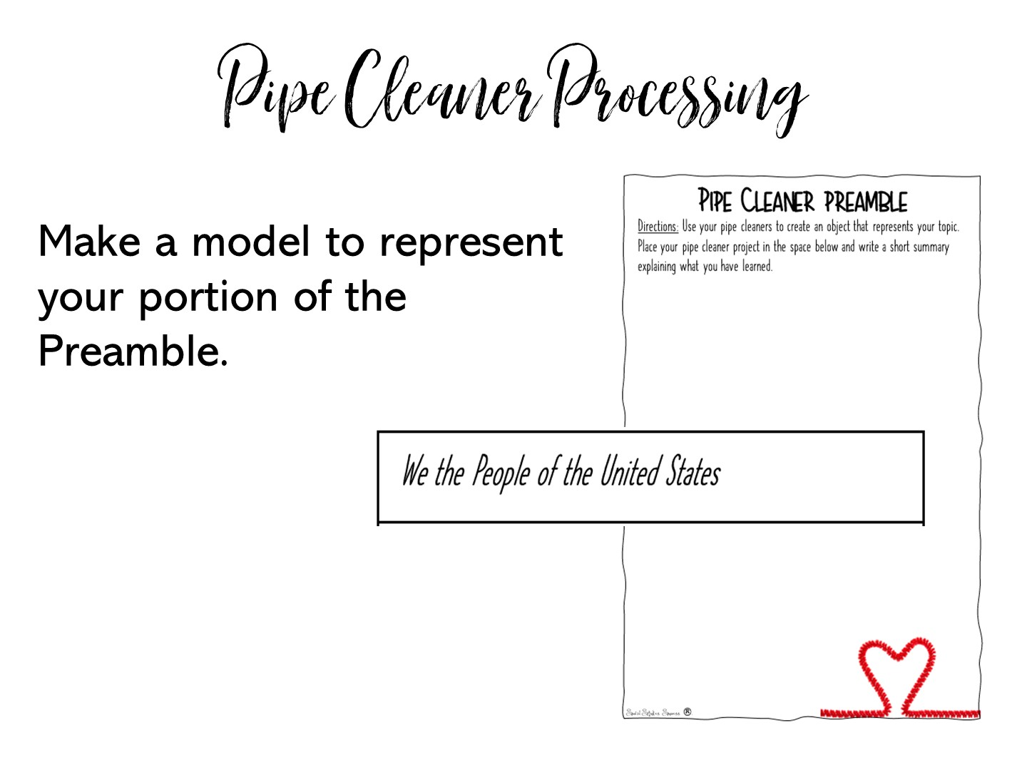
Notes:
Pass out one of the strips for the pipe cleaner Preamble and a ½ sheet to each teacher.
Review directions and show the example on the next slide.

Slide 42
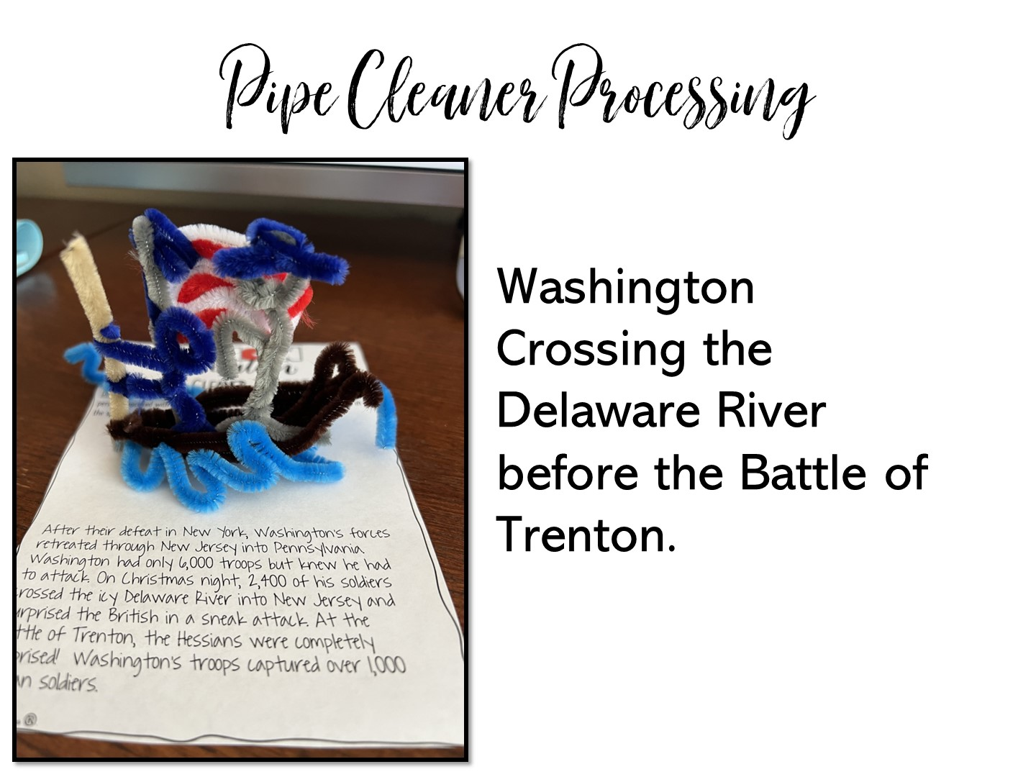
Notes:
Here is an example of a pipe cleaner model for the American Revolution.

Slide 43
Notes:
After everyone is done, do a quick gallery walk so they can see each other’s models.

Slide 44

Notes:
Have them talk about one thing they learned and one question they have while you prepare for the Earthquake model and pass out the resources.

Slide 45

Notes:
Now you are going to model a brief lesson on Earthquakes for 3rd grade to show how you can combine manipulatives into a lesson.

Slide 46
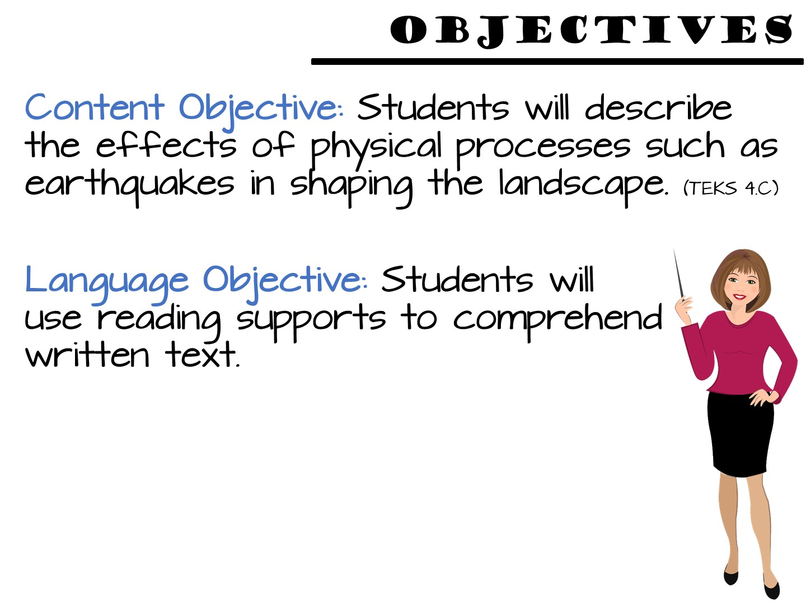
Notes:
Just read

Slide 47
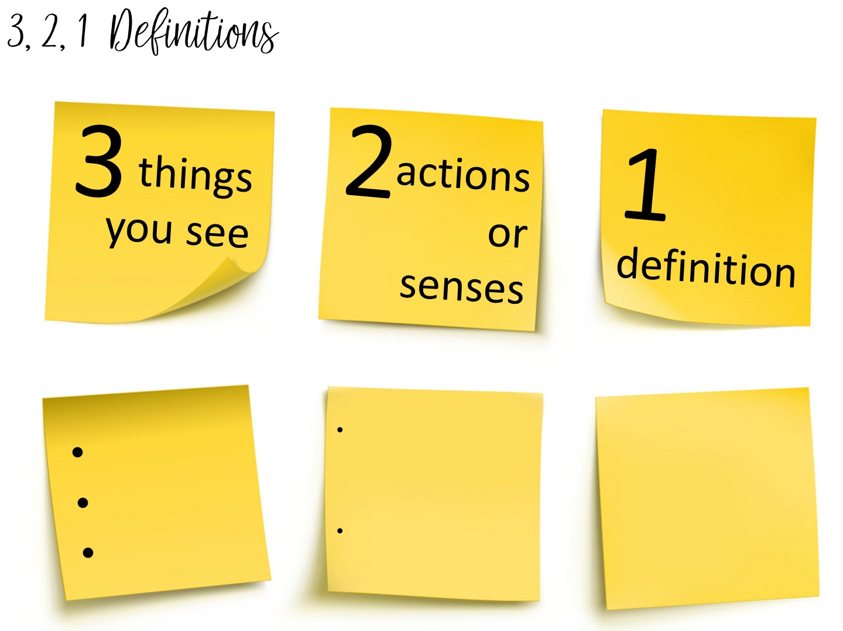
Notes:
Another method to teach vocabulary with images is the 3, 2, 1 Definitions – Allow students time to analyze an image to build their understanding of an image.
Allow them to pick a term with a partner and complete the 3, 2, 1 definition. I always bring the teachers close to word wall to get them out of their seats.

Slide 48
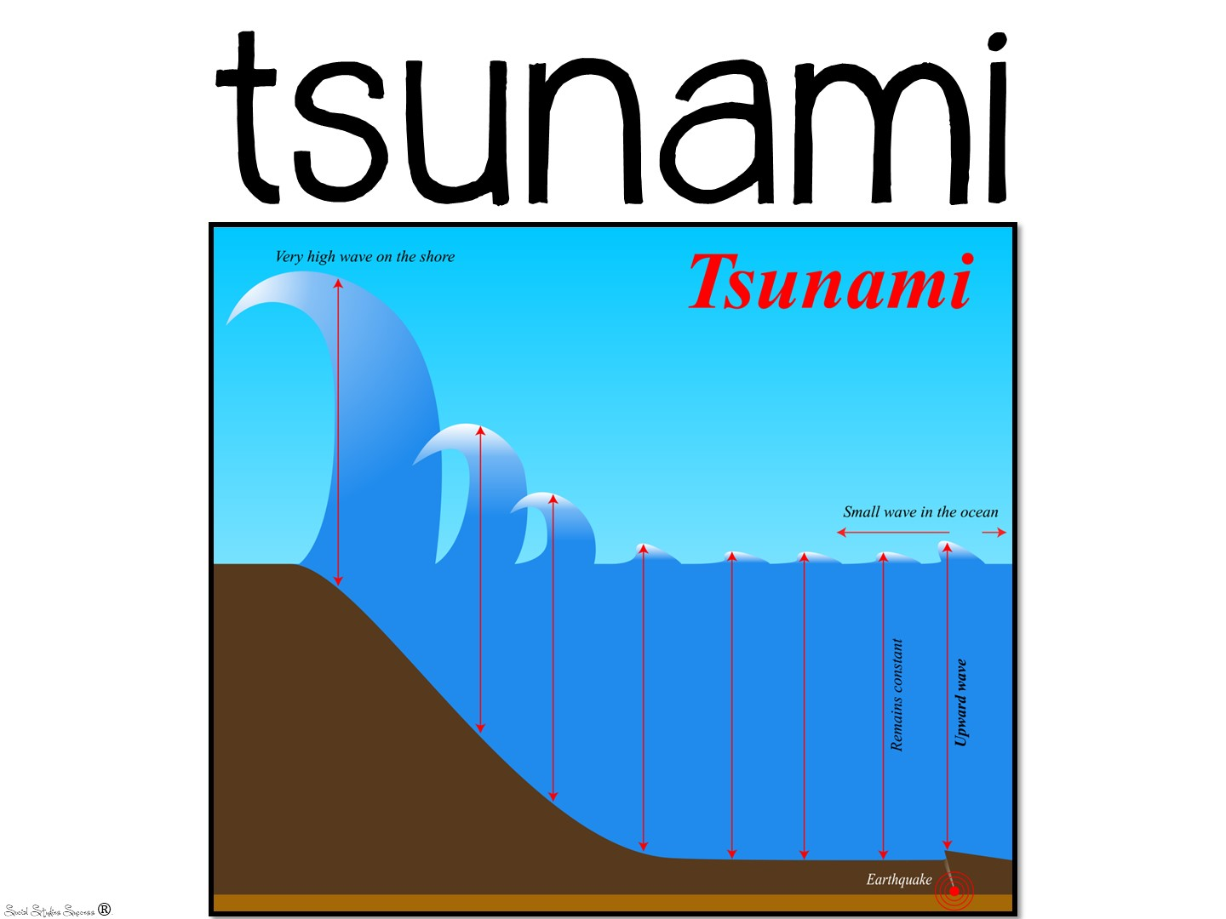

Slide 49


Slide 50
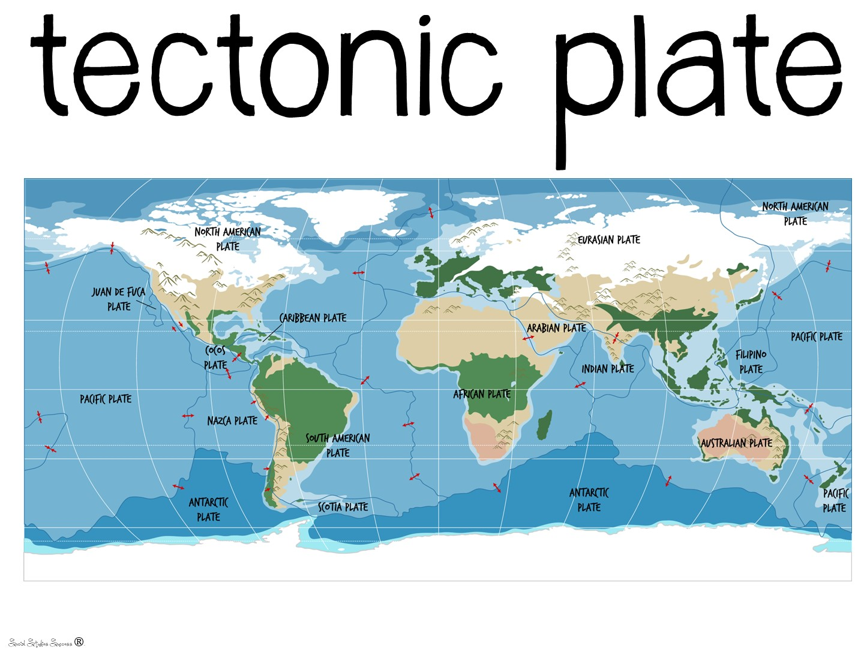

Slide 51
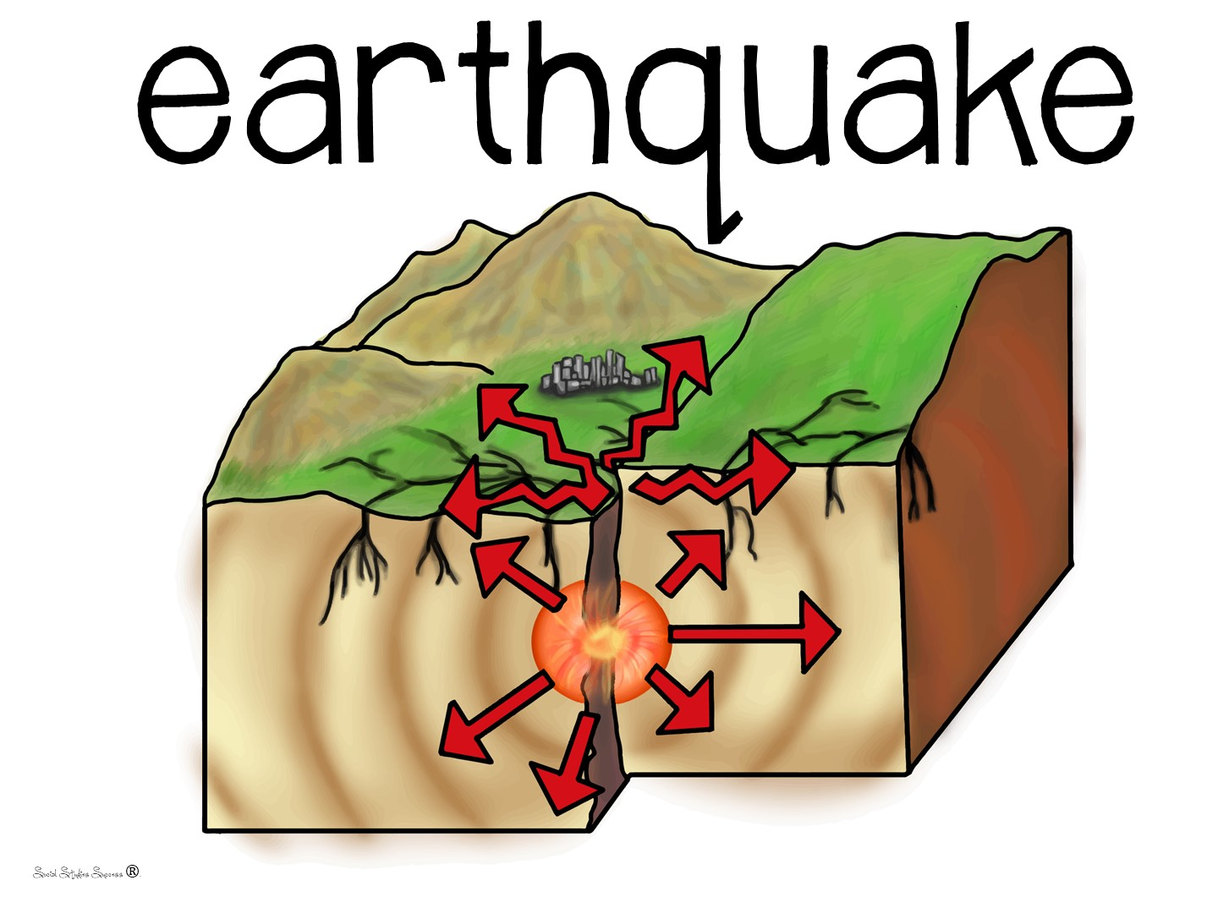

Slide 52
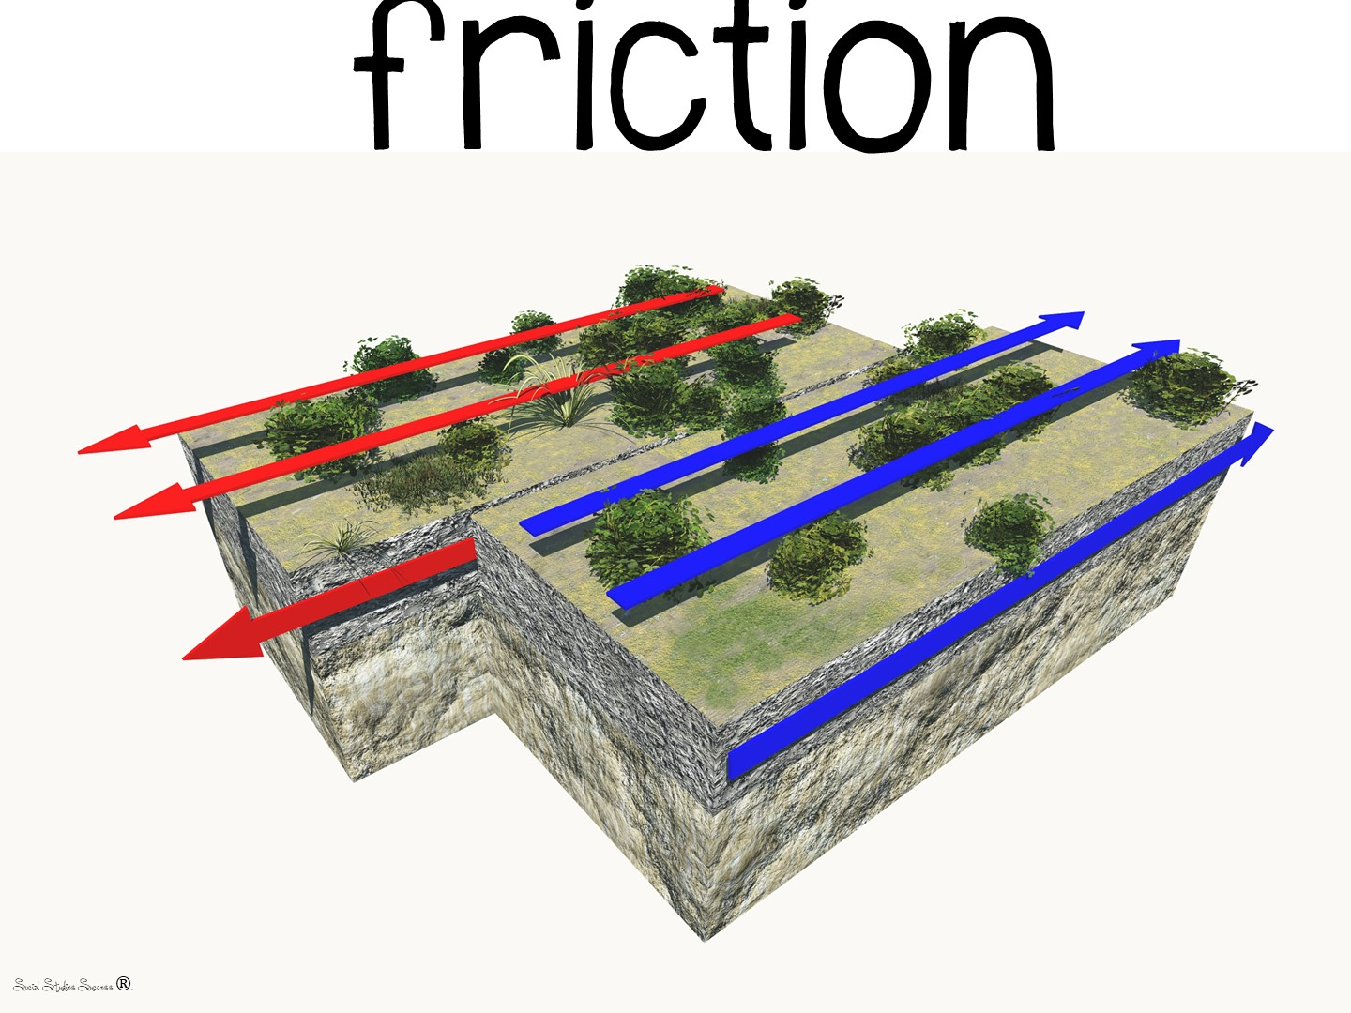
Notes:
When you go over this definition – rub your hands together to model friction. Have the teachers do it as well.

Slide 53
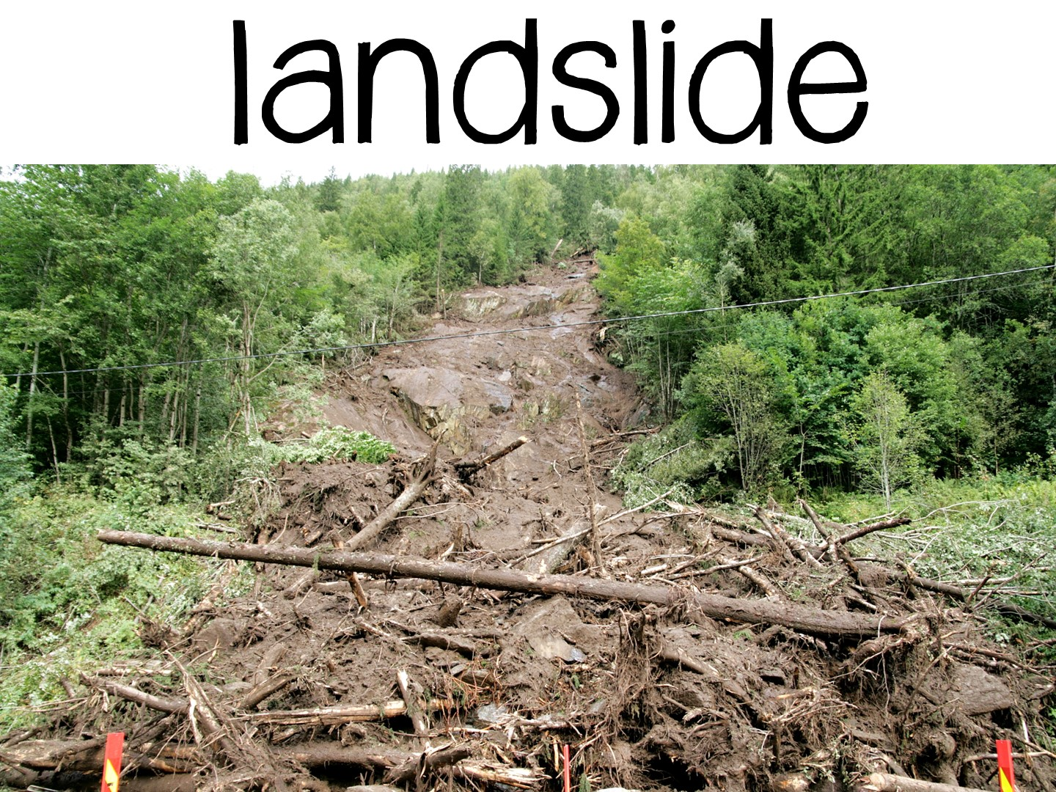

Slide 54
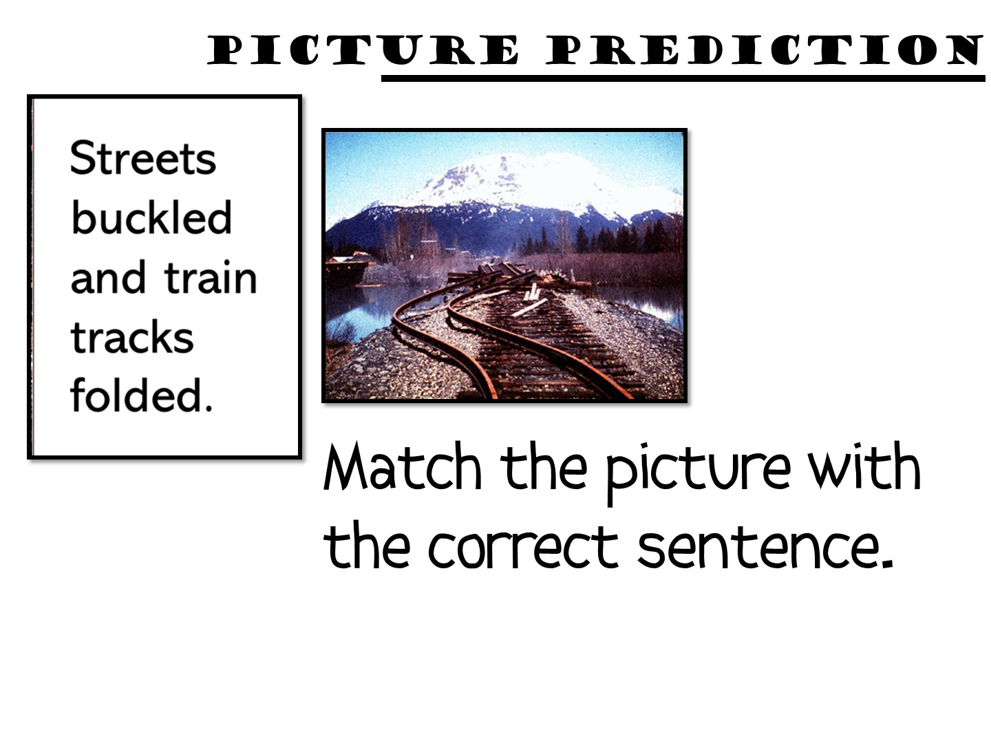
Notes:
This is a prereading strategy using manipulatives to help students visualize what they are going to read.

Slide 55


Slide 56
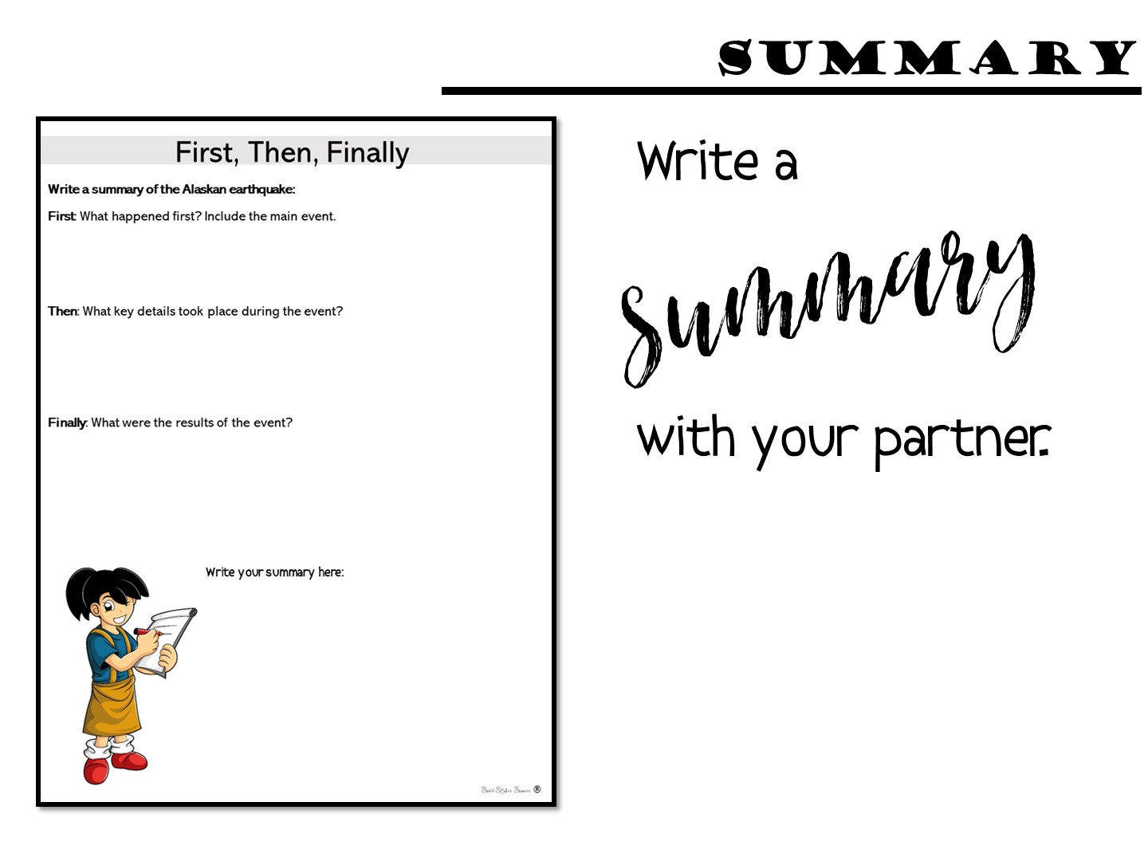
Notes:
Just give them a few minutes to do.

Slide 57

Notes:
How can you summarize what you have learned so far about teaching with manipulatives in just one word?

Slide 58
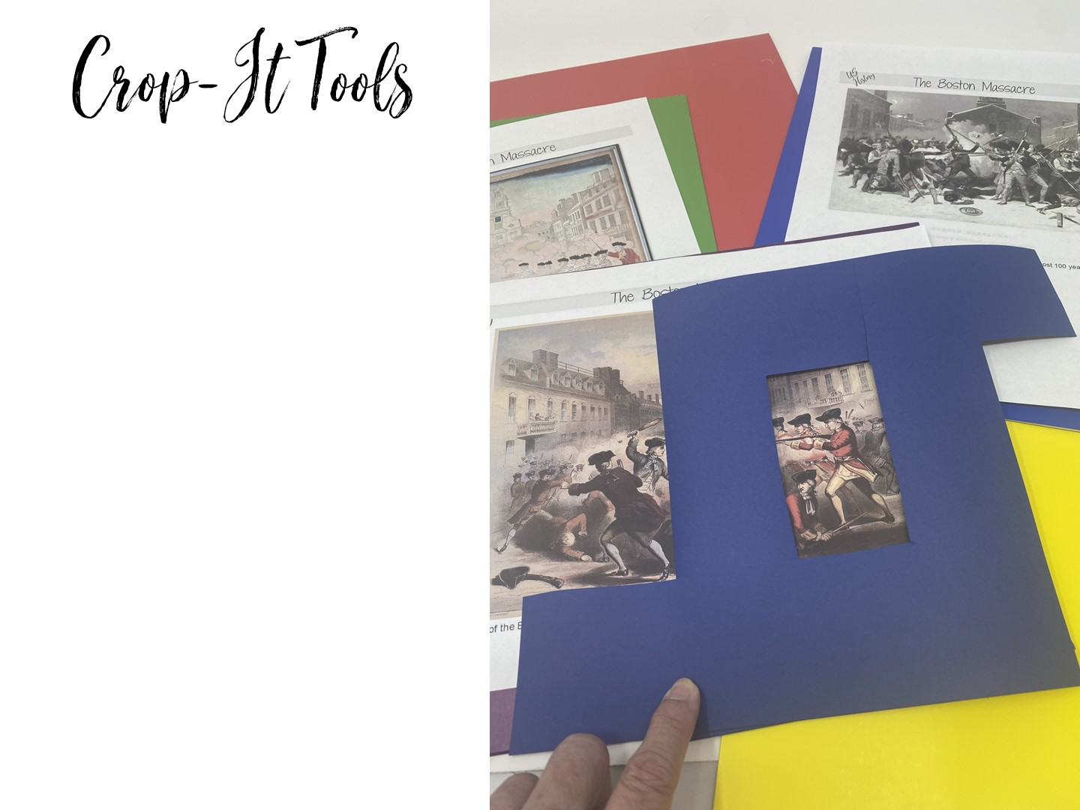
Notes:
Explain how you can use crop-it tools to analyze images. Pass out the crop-it tools and the Boston Massacre images. Use the handout with questions to ask questions for the teachers to answer using the tool.

Slide 59
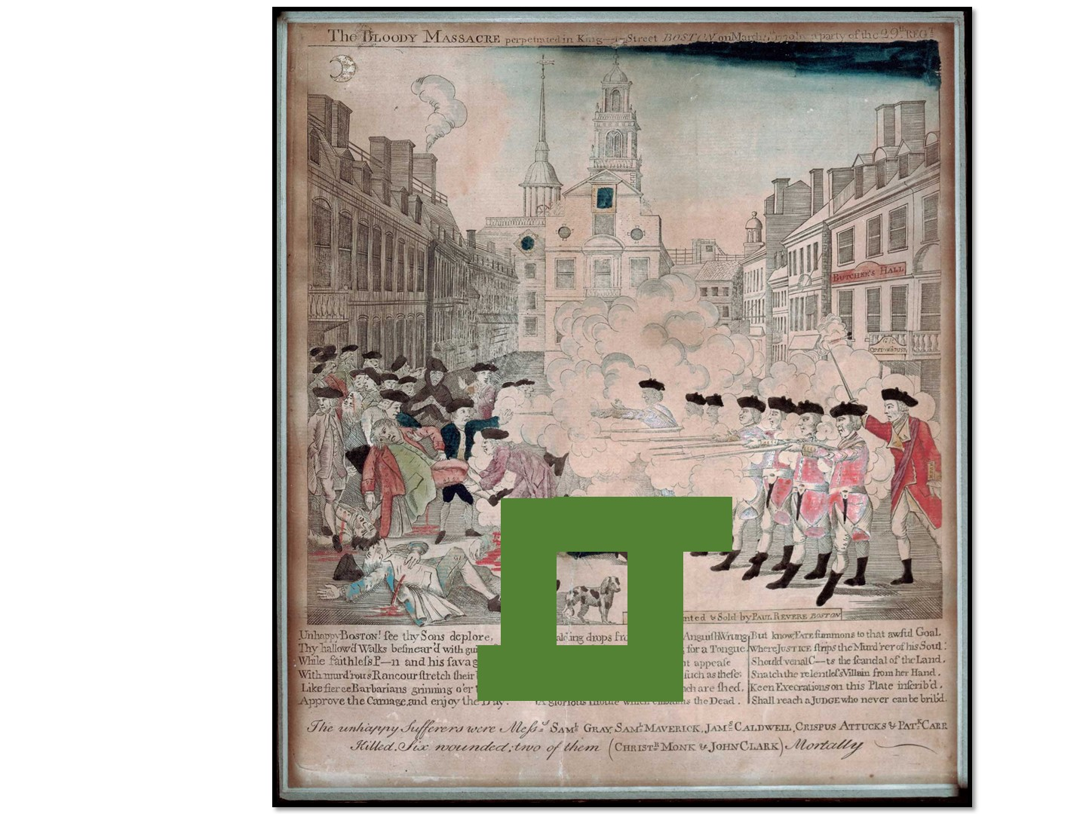
Notes:
Pass out the crop-it tools and the Boston Massacre images. Use the handout with questions to ask questions for the teachers to answer using the tool.

Slide 60
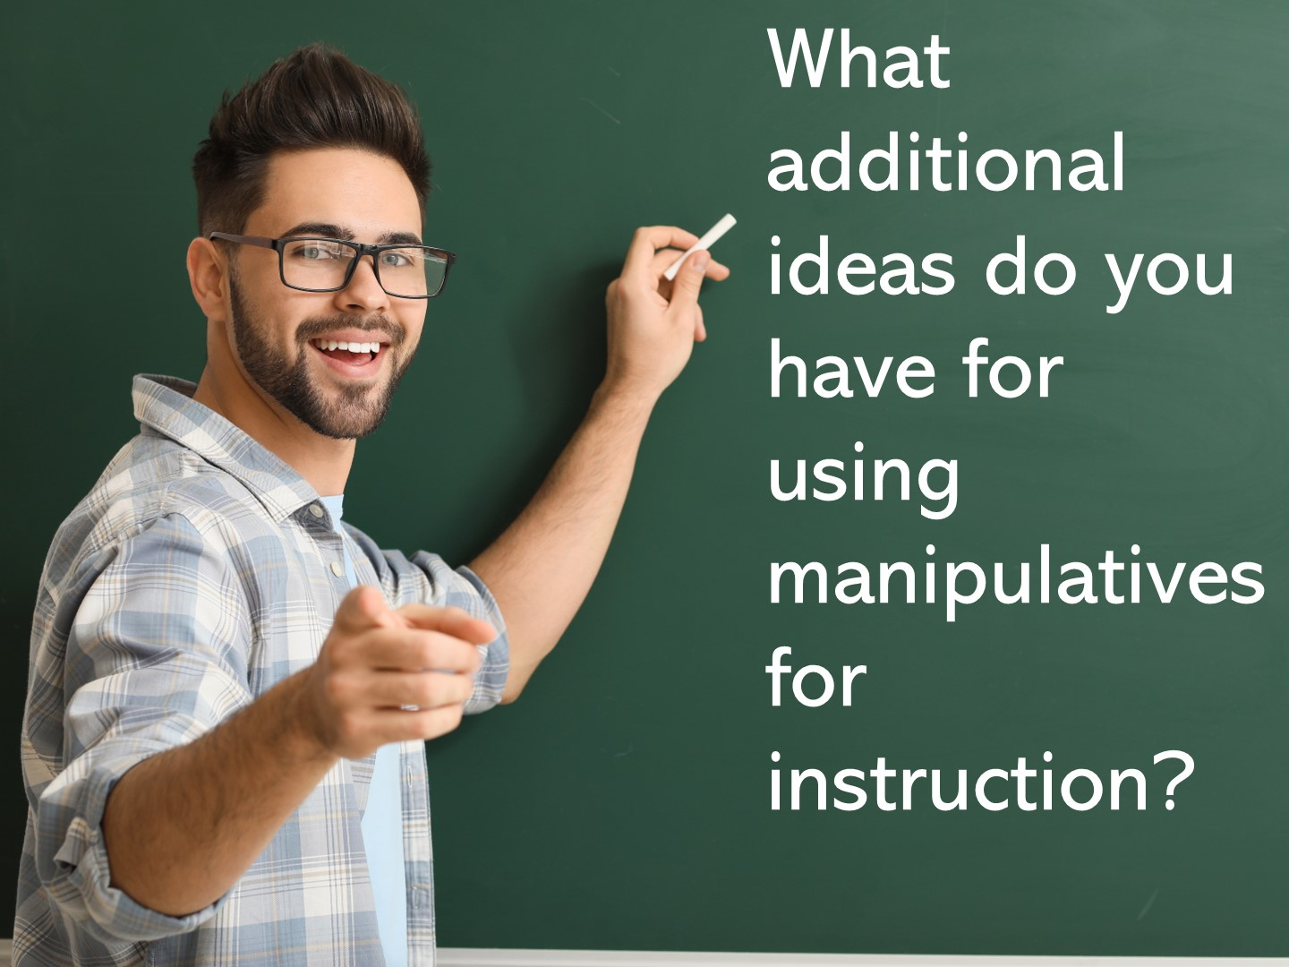

Slide 61
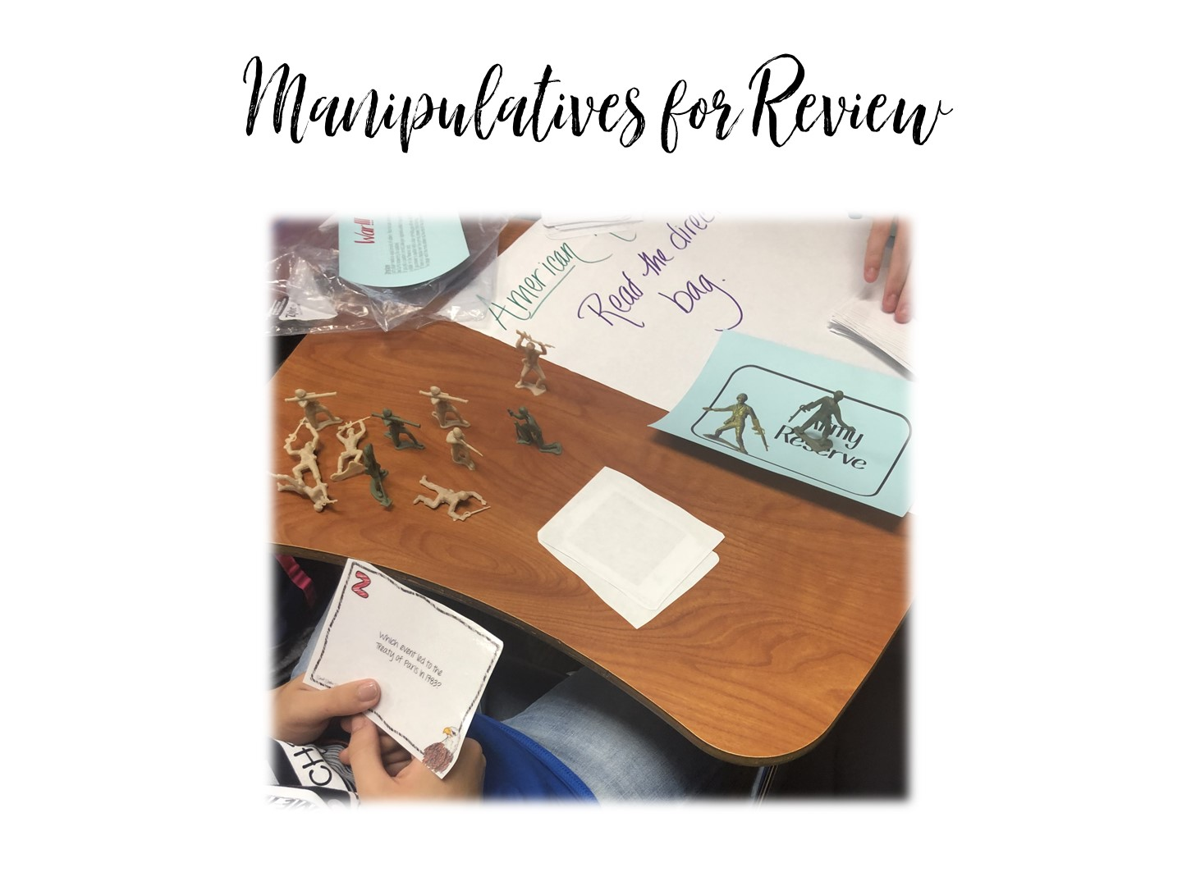
Notes:
Now we are going to look at manipulatives for review.

Slide 62
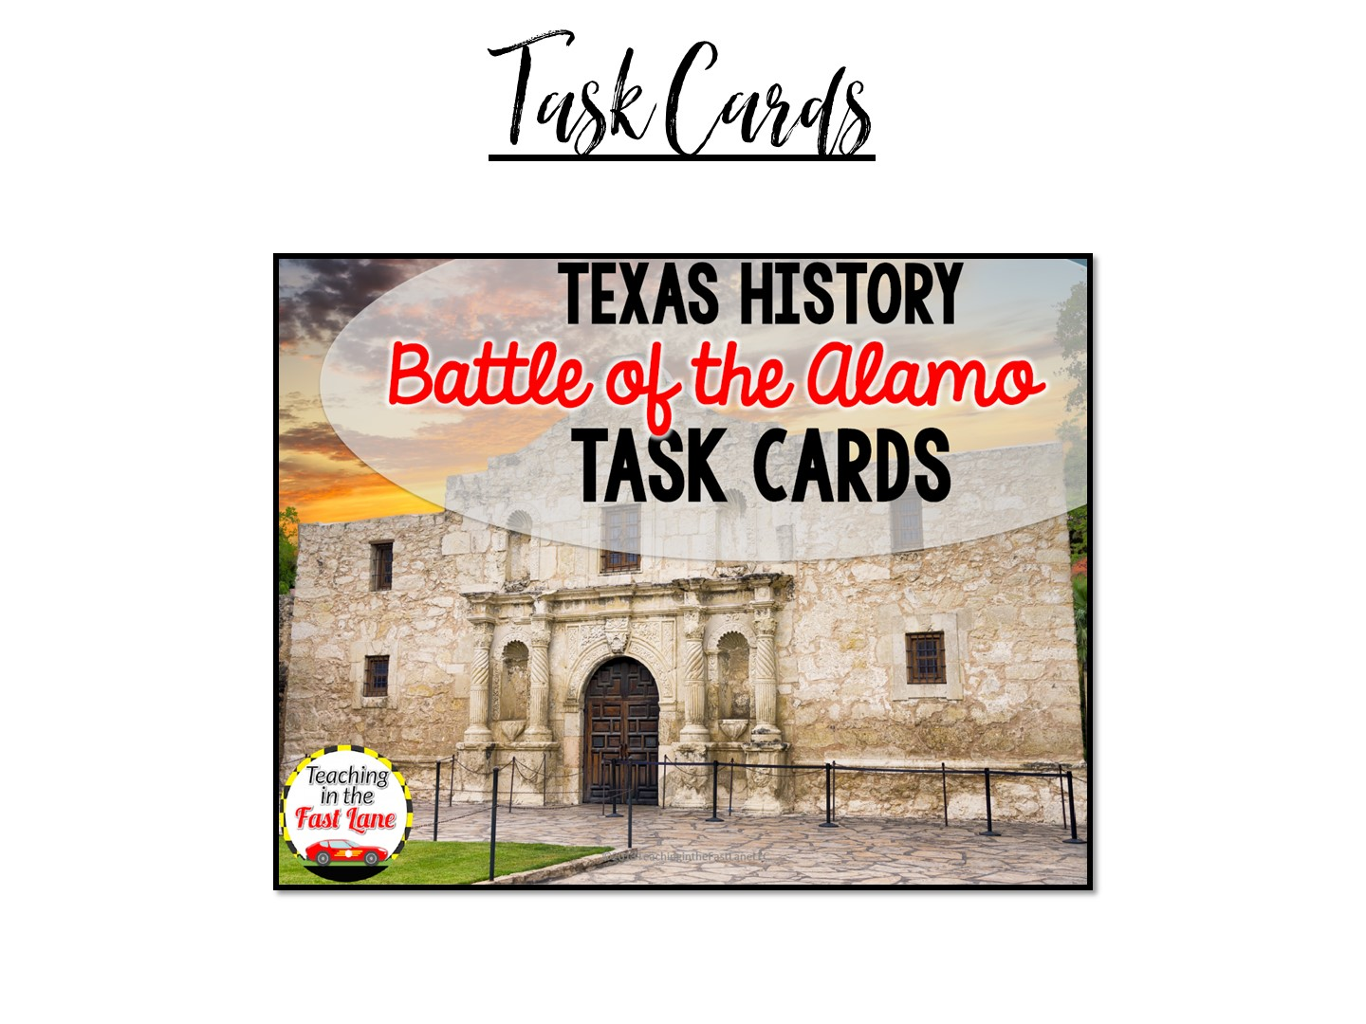
Notes:
If you have extra time you can use these task cards to play war. They are from Teaching in the Fast Lane and she has given me permission to use these with you.

Slide 63
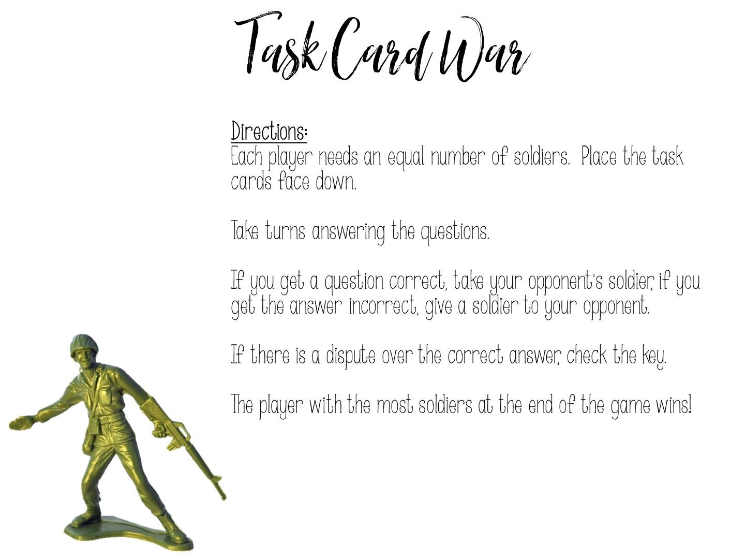
Notes:
Play ☺

Slide 64


Slide 65


