Slide 1

Notes:
Post the 4 corner signs and the Word Wall terms
Post the Design Qualities of Engagement Placards

Slide 2


Slide 3

Notes:
Take a moment to open this page in another tab so you have any handouts ready to go.

Slide 4

Notes:
Introduce yourself

Slide 5

Notes:
Go through all of the beliefs, then ask teachers to discuss which ones they agree with.

Slide 6


Slide 7
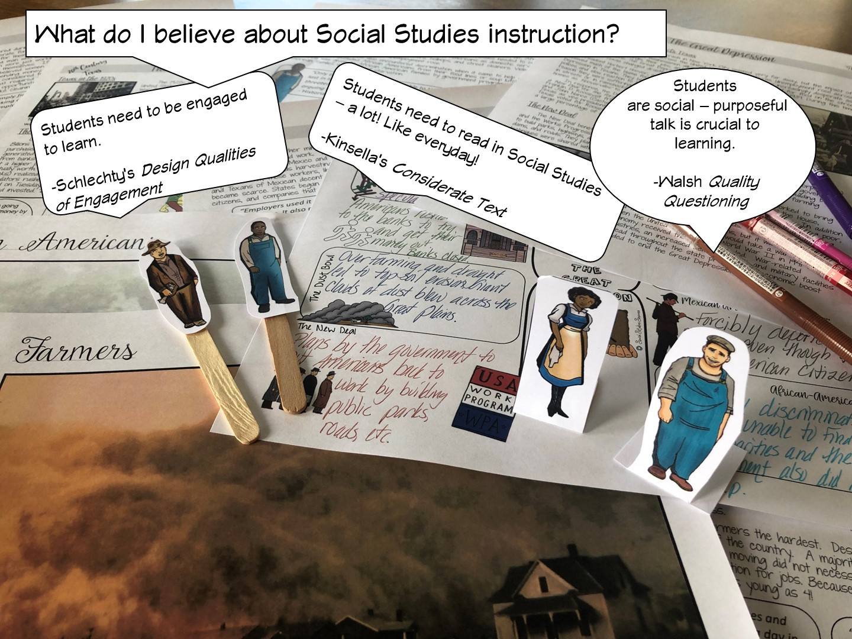

Slide 8
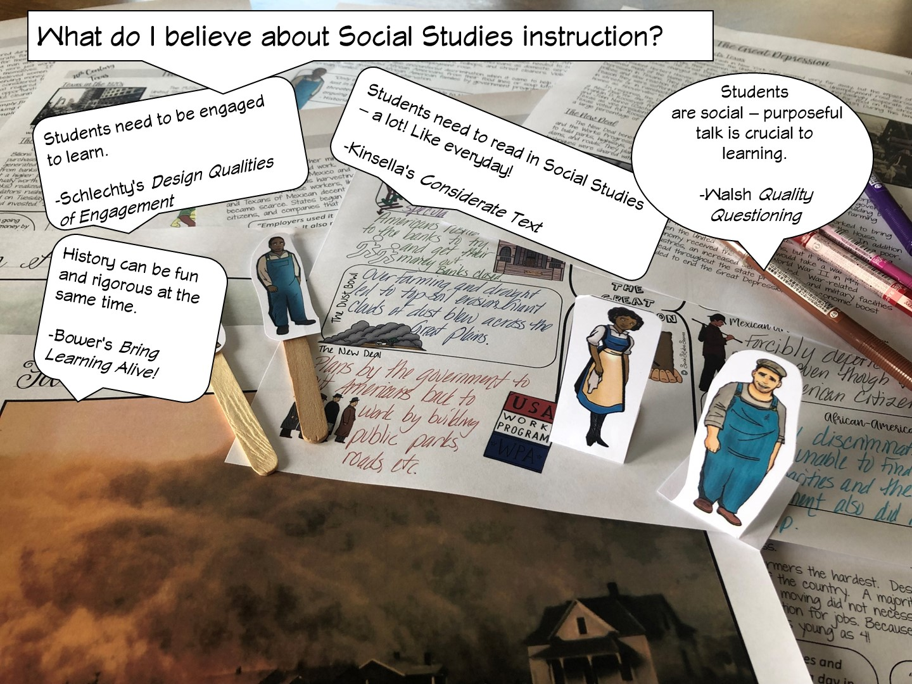

Slide 9


Slide 10
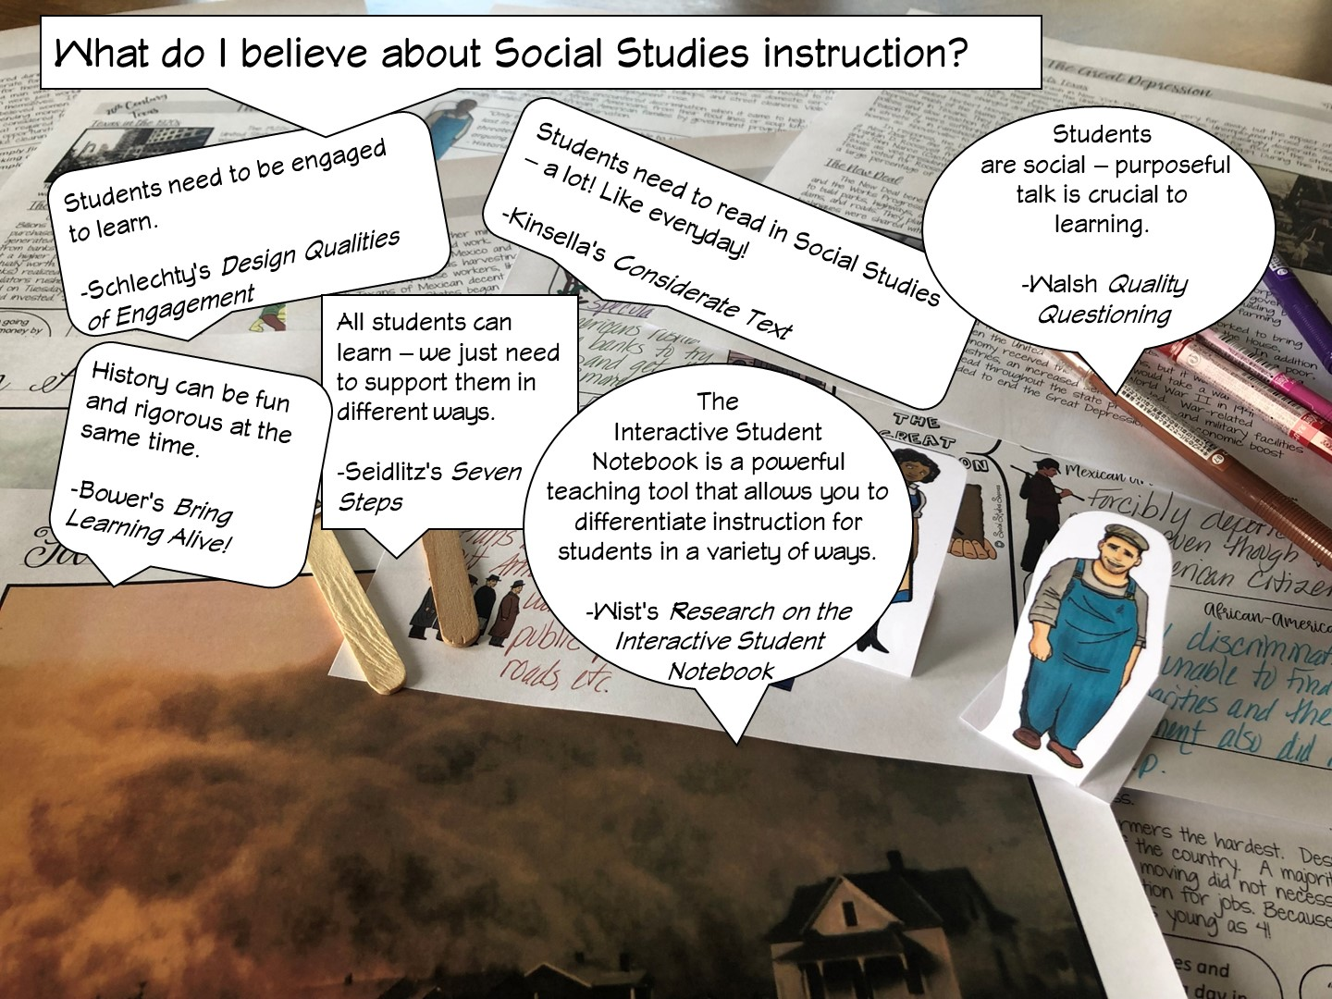

Slide 11
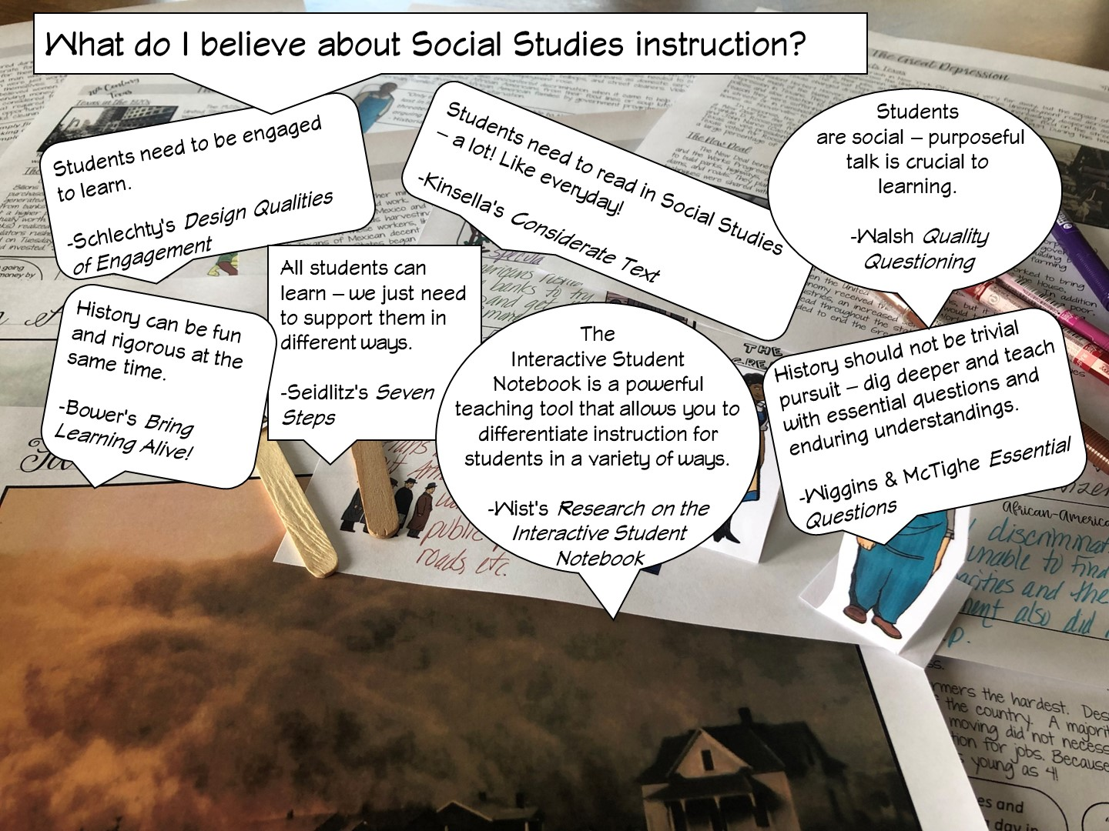

Slide 12
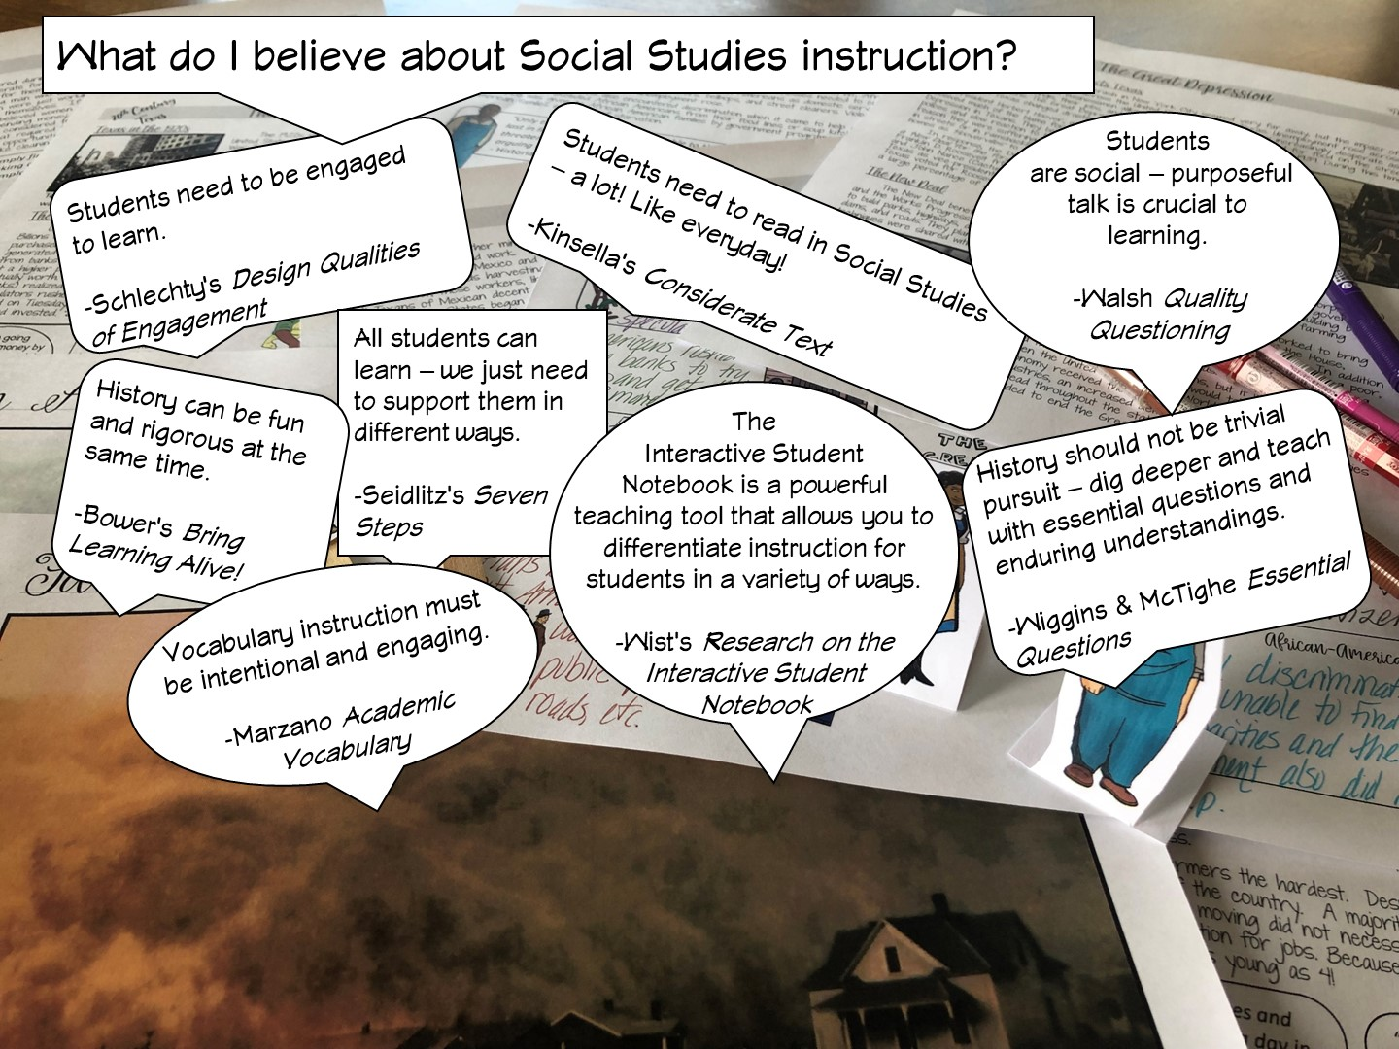

Slide 13
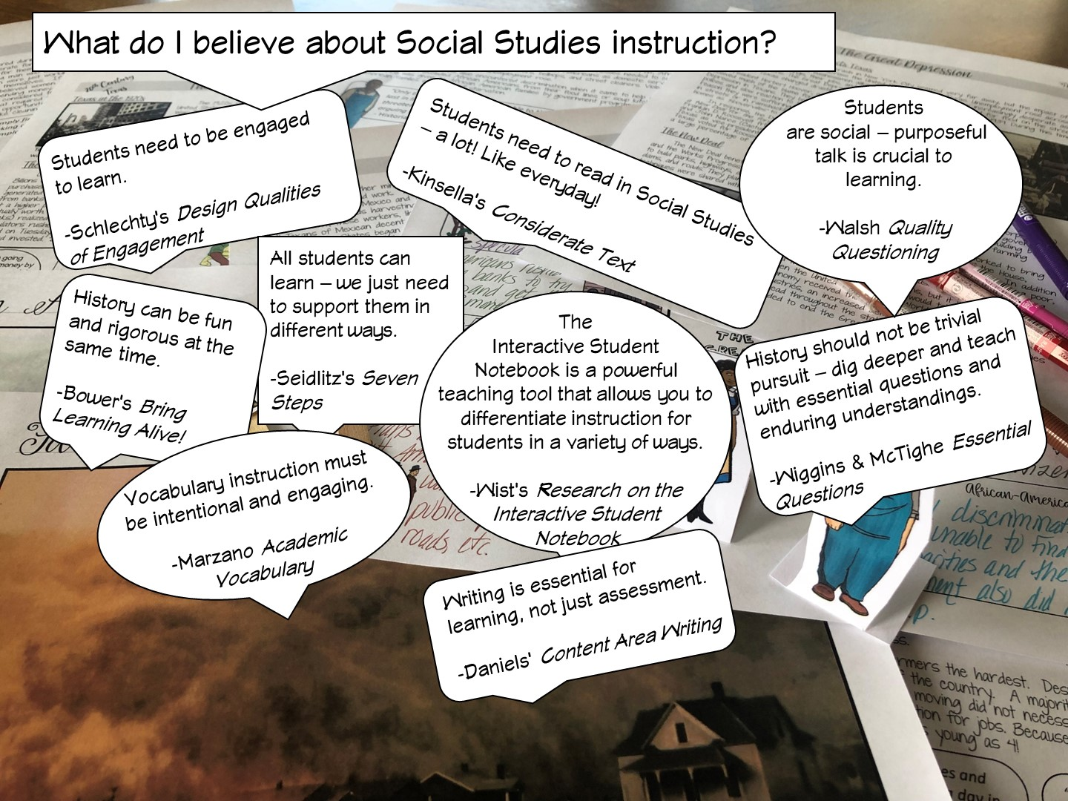

Slide 14
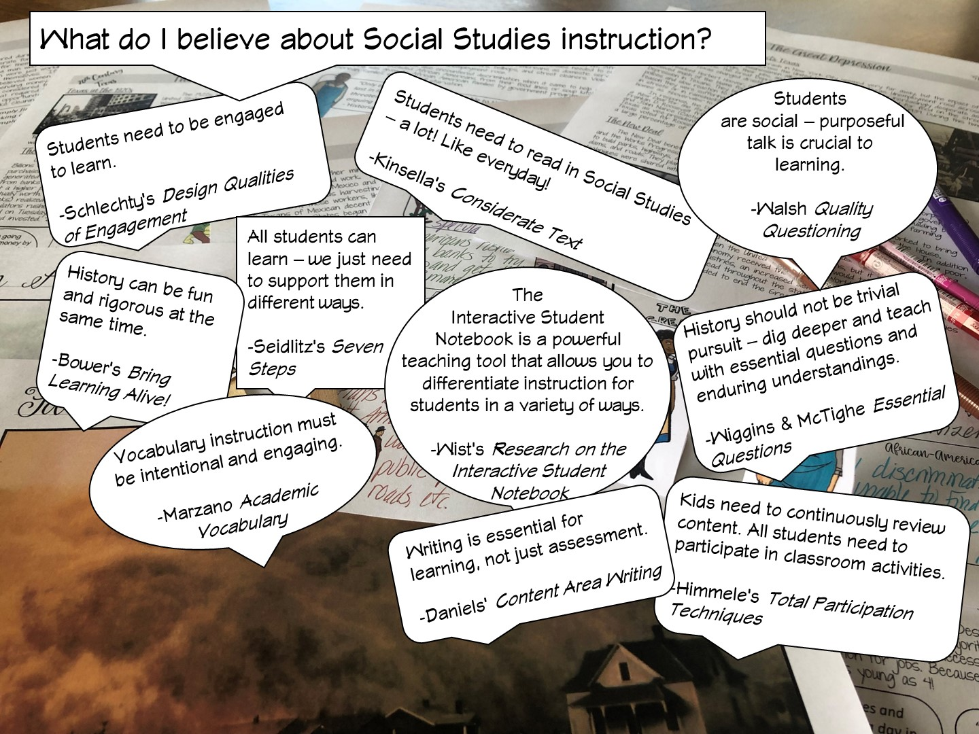

Slide 15
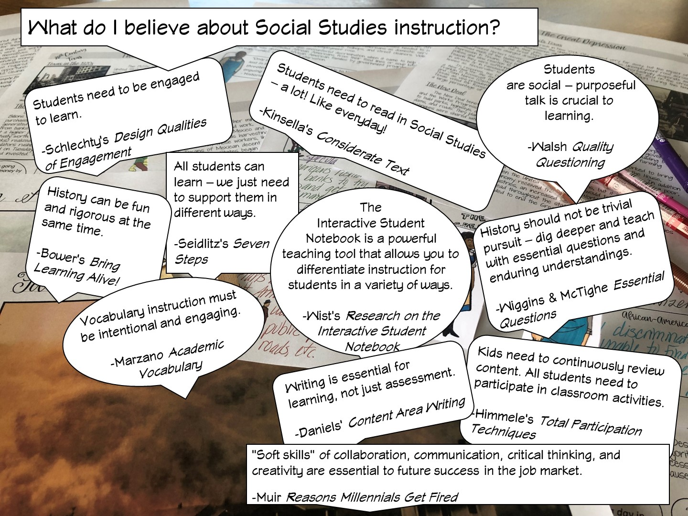

Slide 16
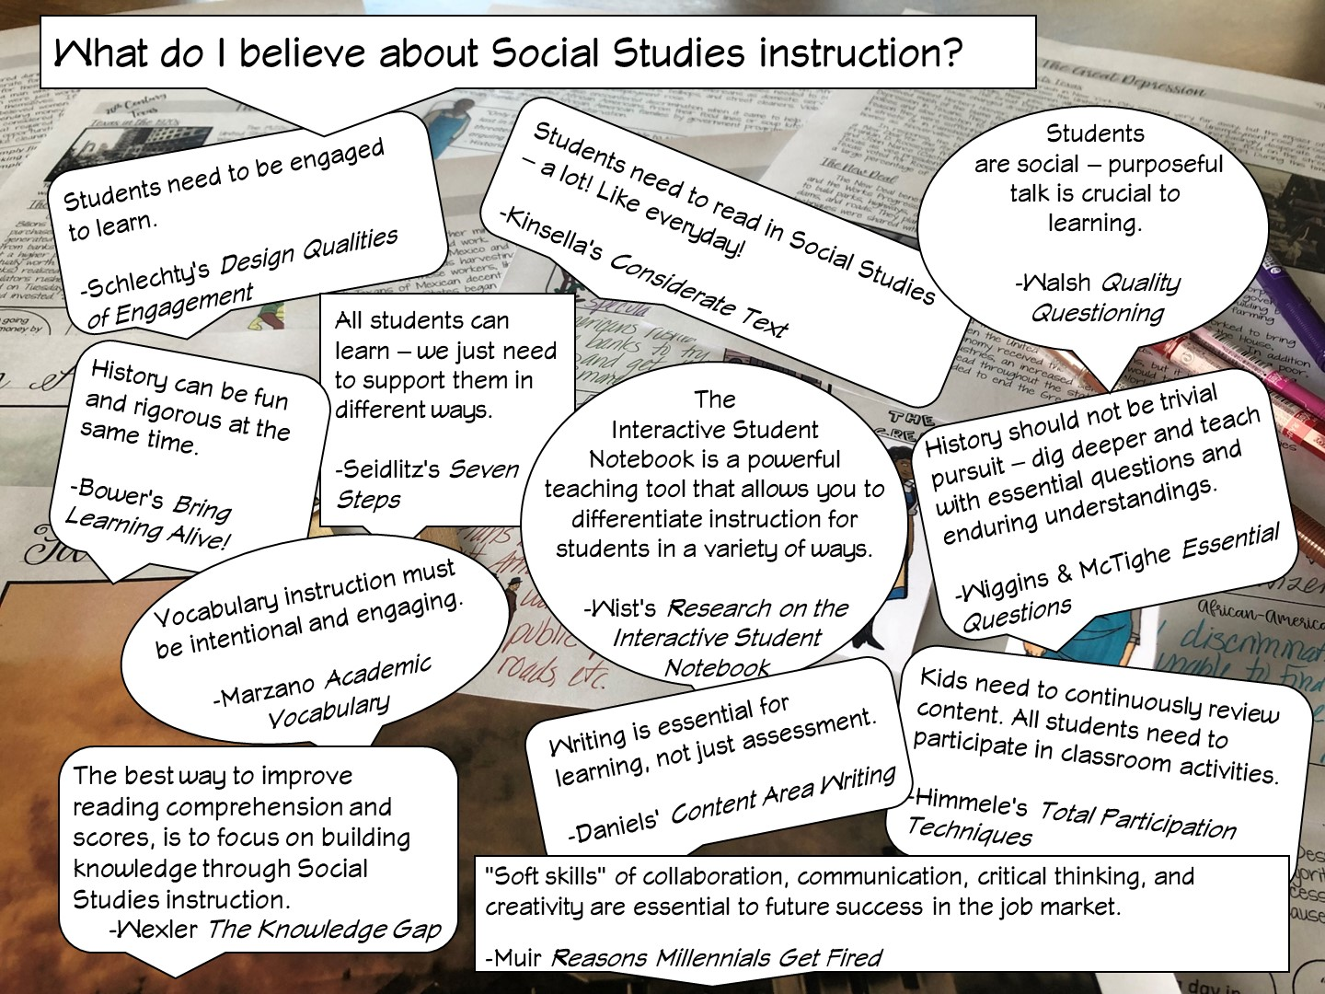
Notes:
.

Slide 17
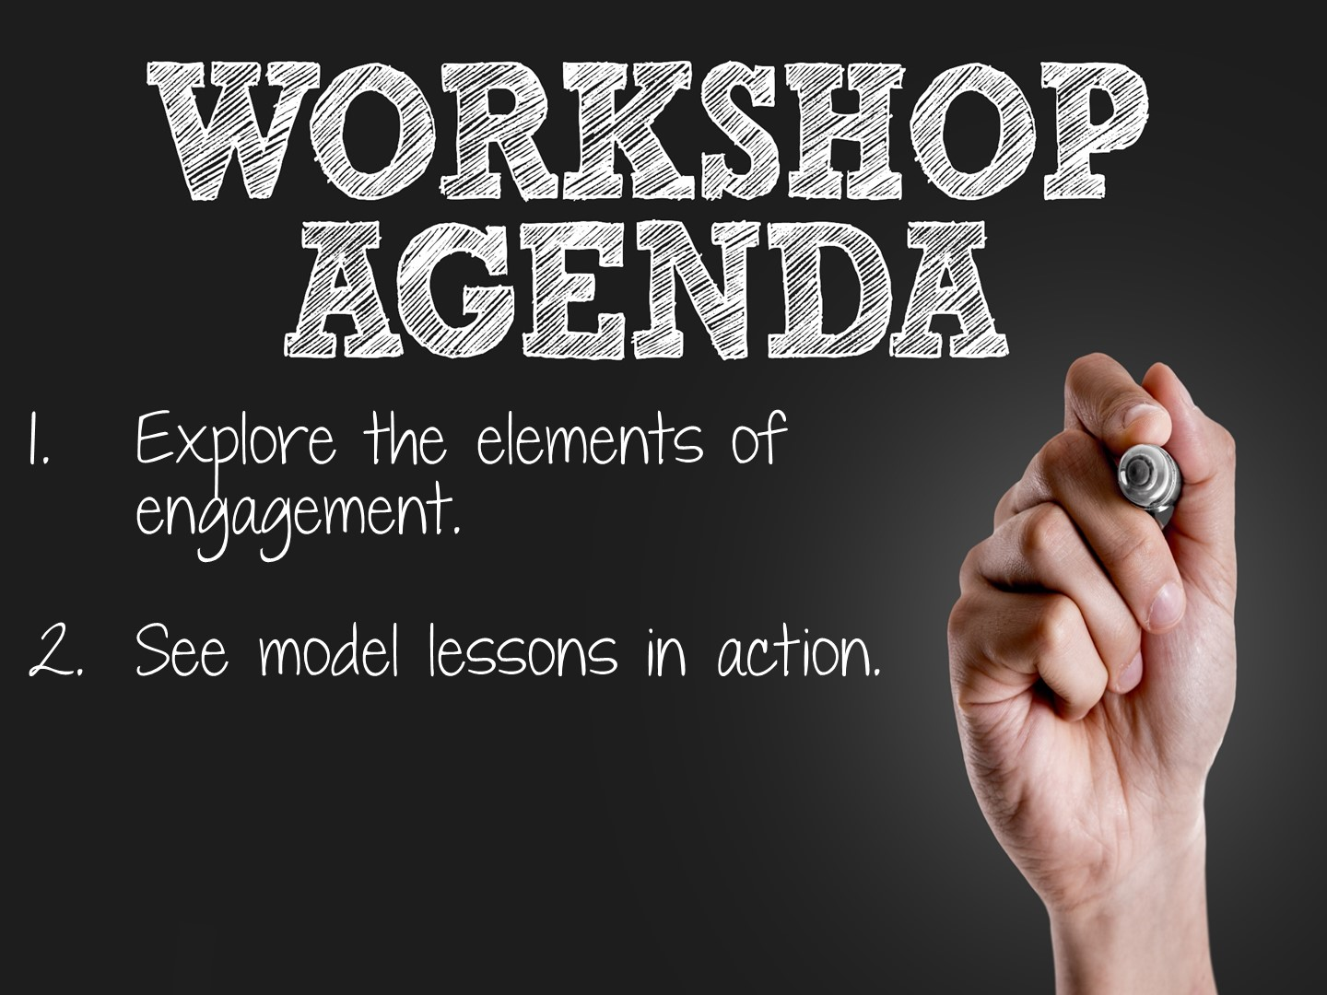

Slide 18
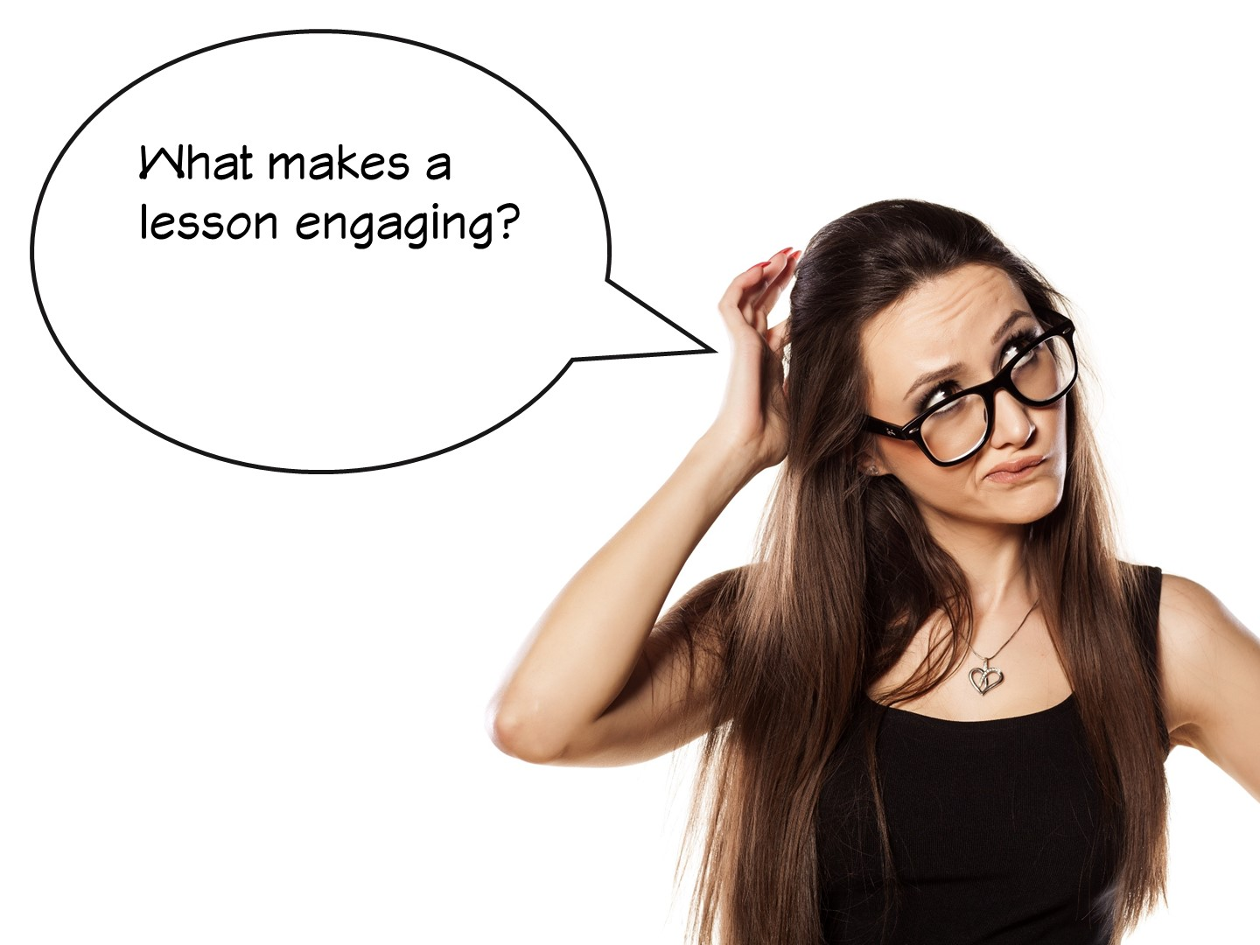
Notes:
https://jamboard.google.com/d/11GFbrWuHEN5FVPRJ8sJryJsUeGDJHuBoMG5Rtnd5oxA/edit?usp=sharing

Slide 19
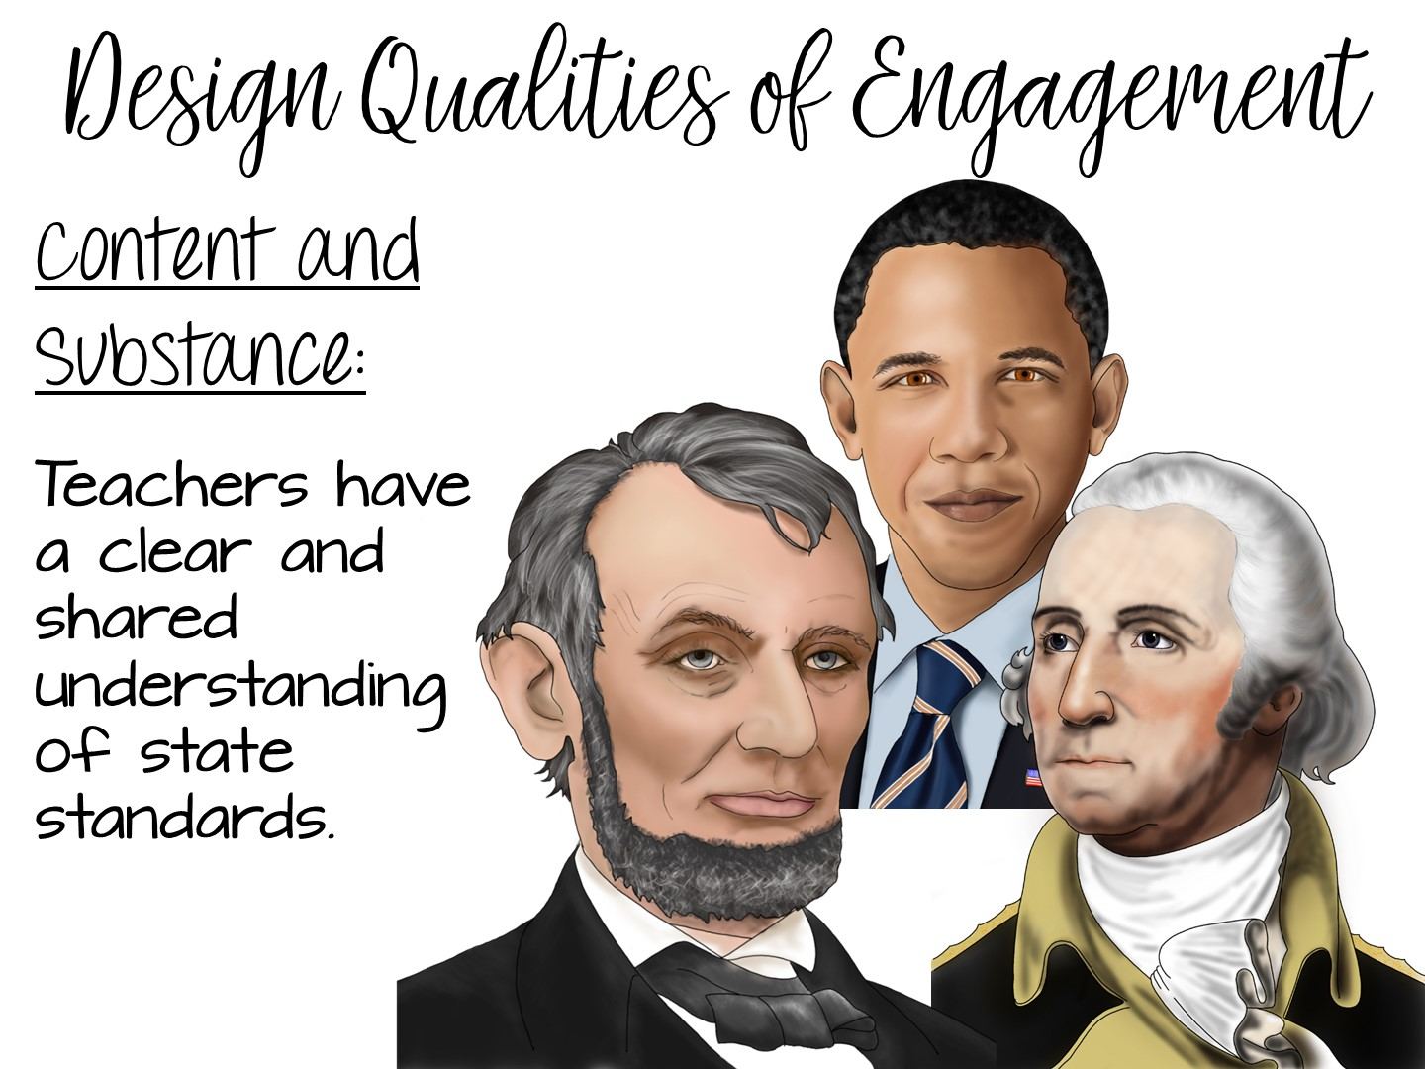
Notes:
Now share the official research from Philip Schlechty and his book – Working on the Work. Just read the next few slides to the teachers. Add any personal examples of things you have done for each slide. You will be providing them a copy of these slides in the downloads, so they don’t need to write anything down.
Teachers know their content and have spent time breaking down the TEKS.

Slide 20
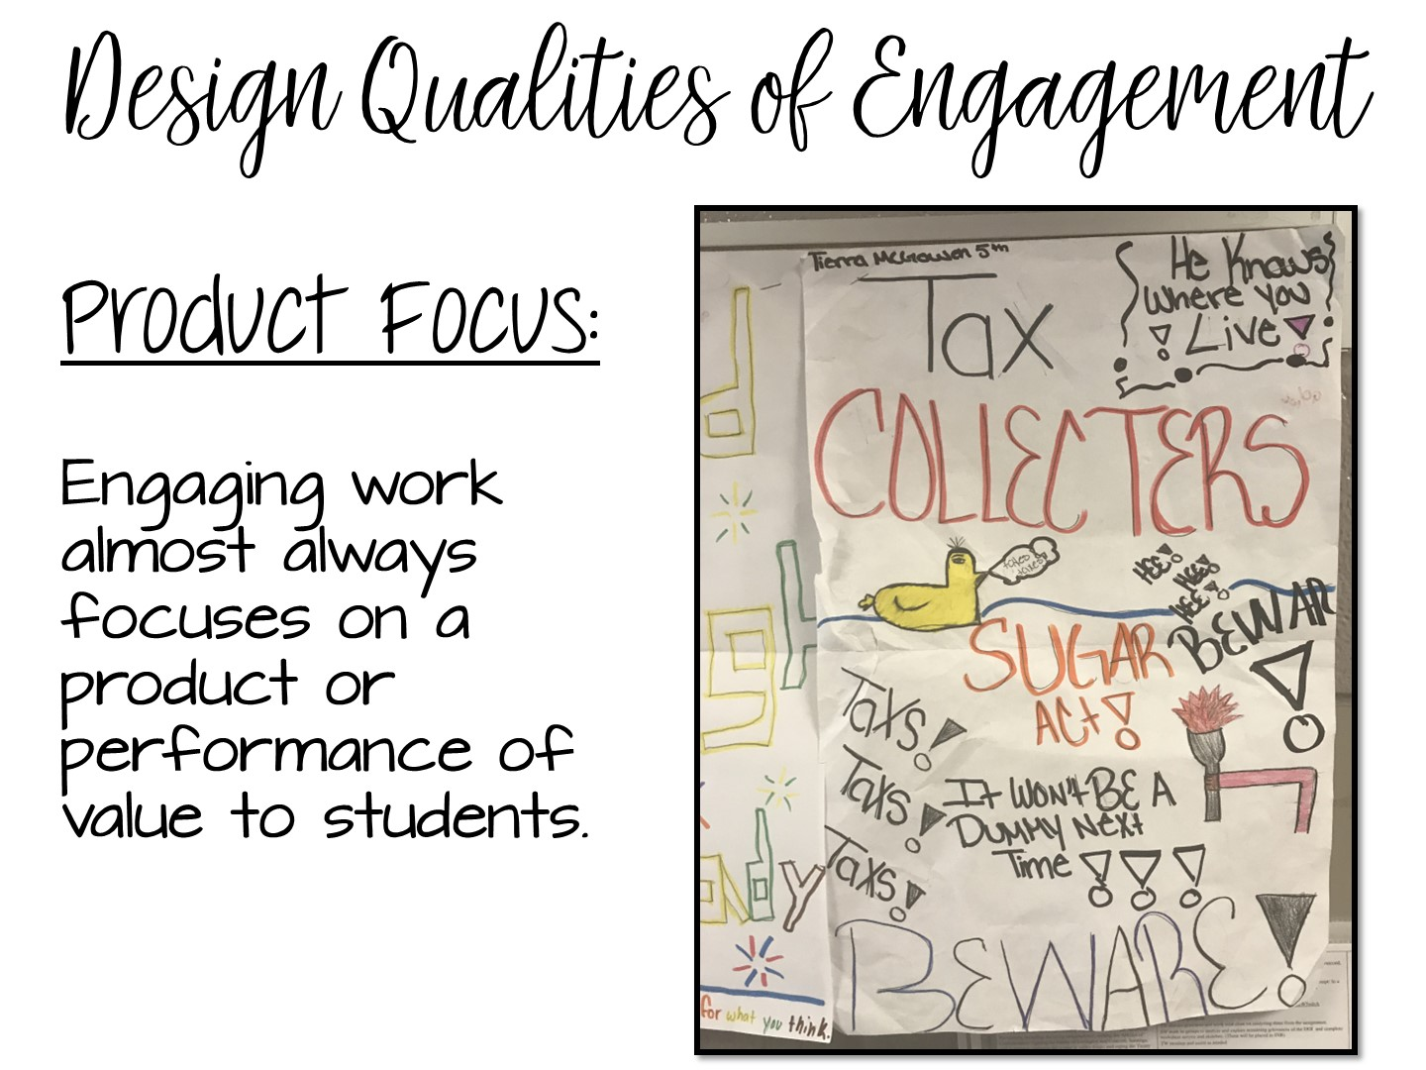
Notes:
Product focus – students are making a product or a project.

Slide 21
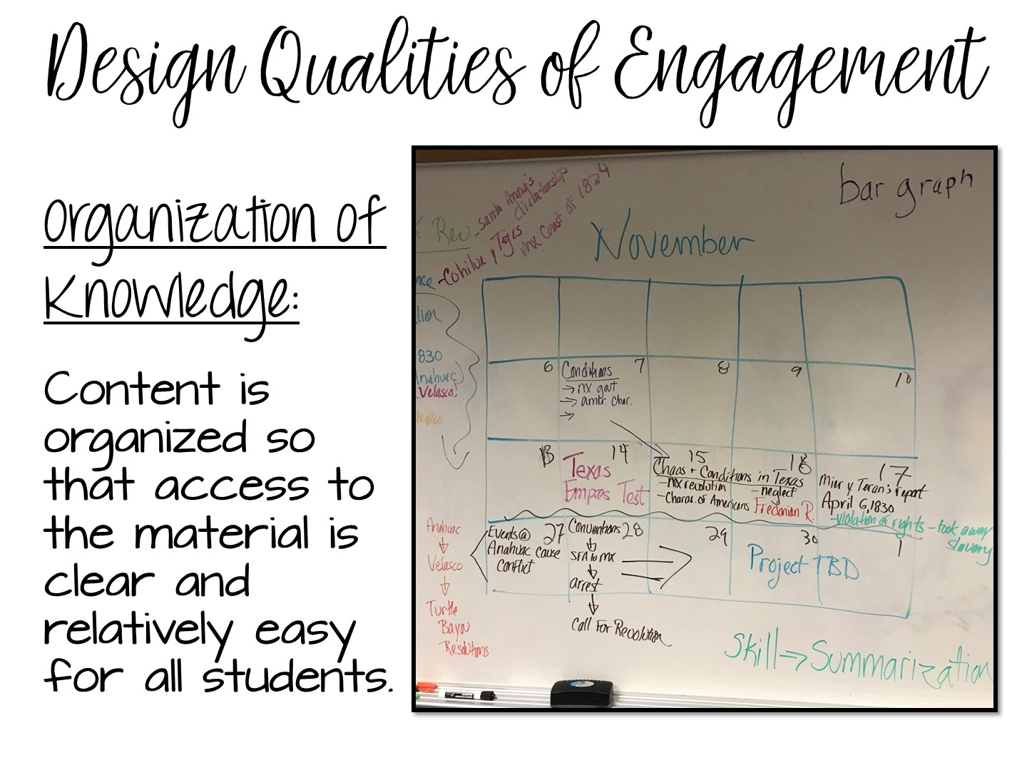

Slide 22
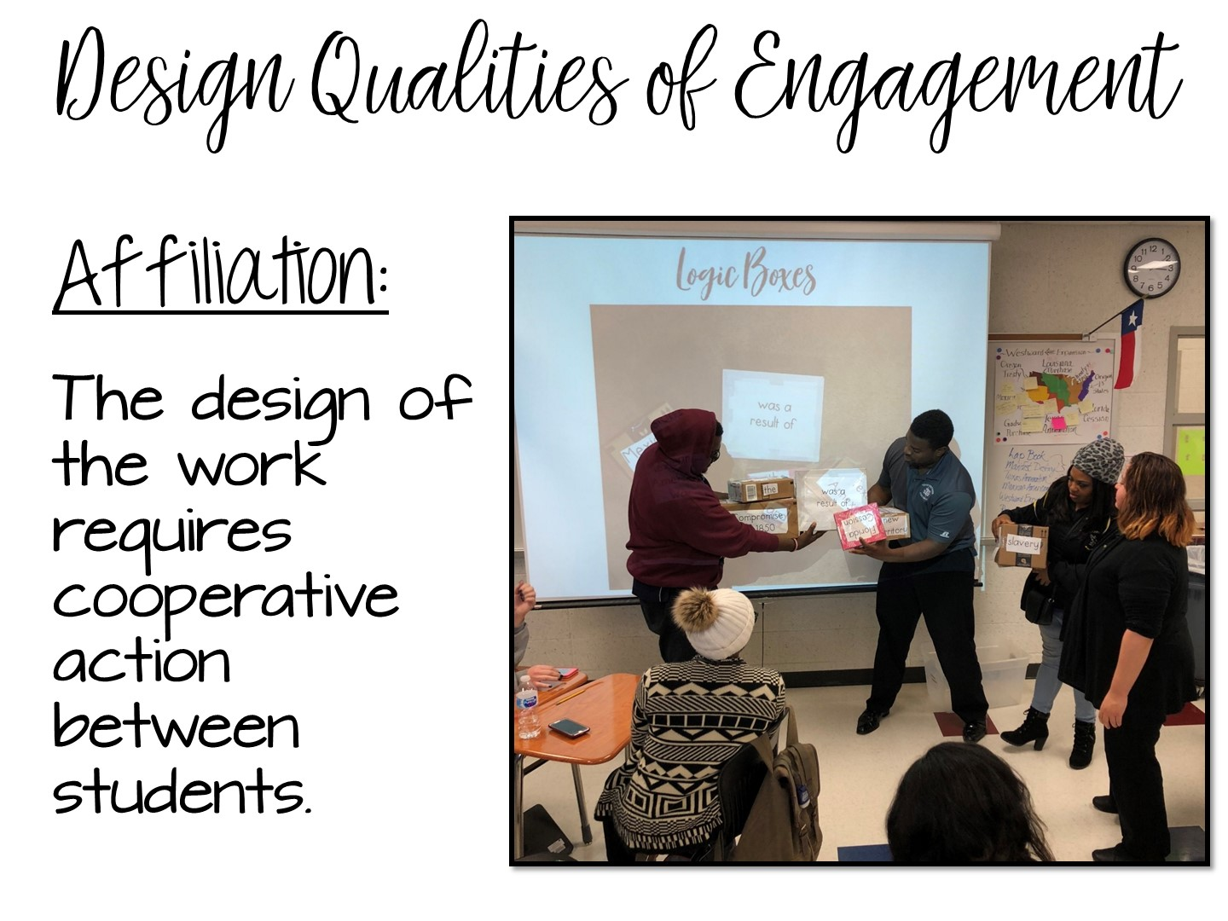
Notes:
Affiliation – students are working together to complete a task, not just splitting an assignment in ½ and each doing a portion, but cooperatively engaged with each other.

Slide 23
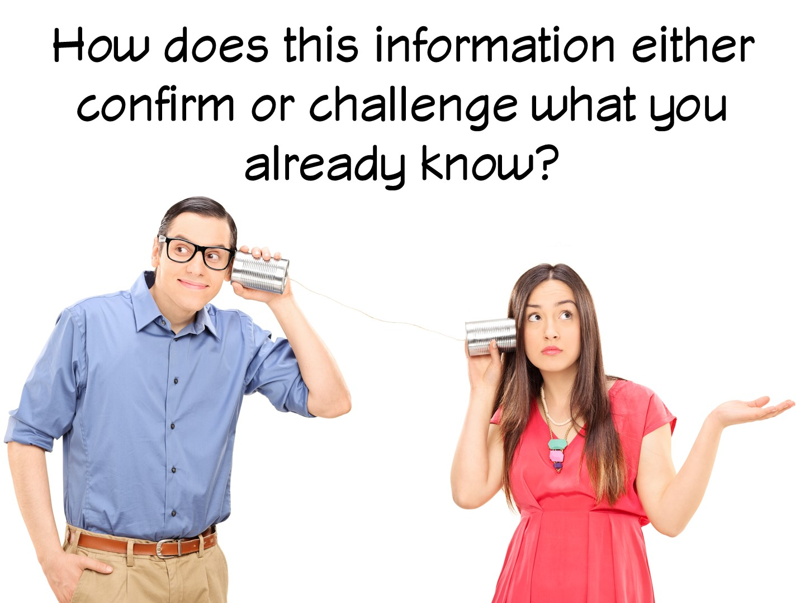
Notes:
Answer in chat box.

Slide 24
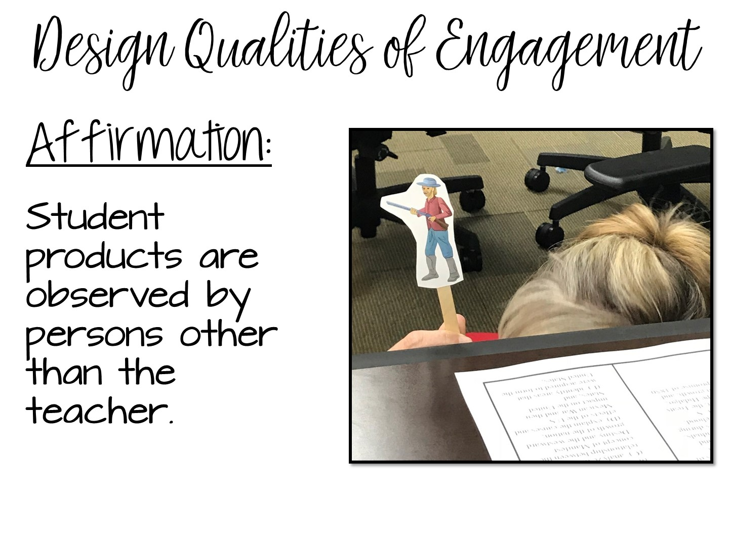
Notes:
Examples include hanging products in the hallway, display in the library, other classes come observe, share with other classes.

Slide 25
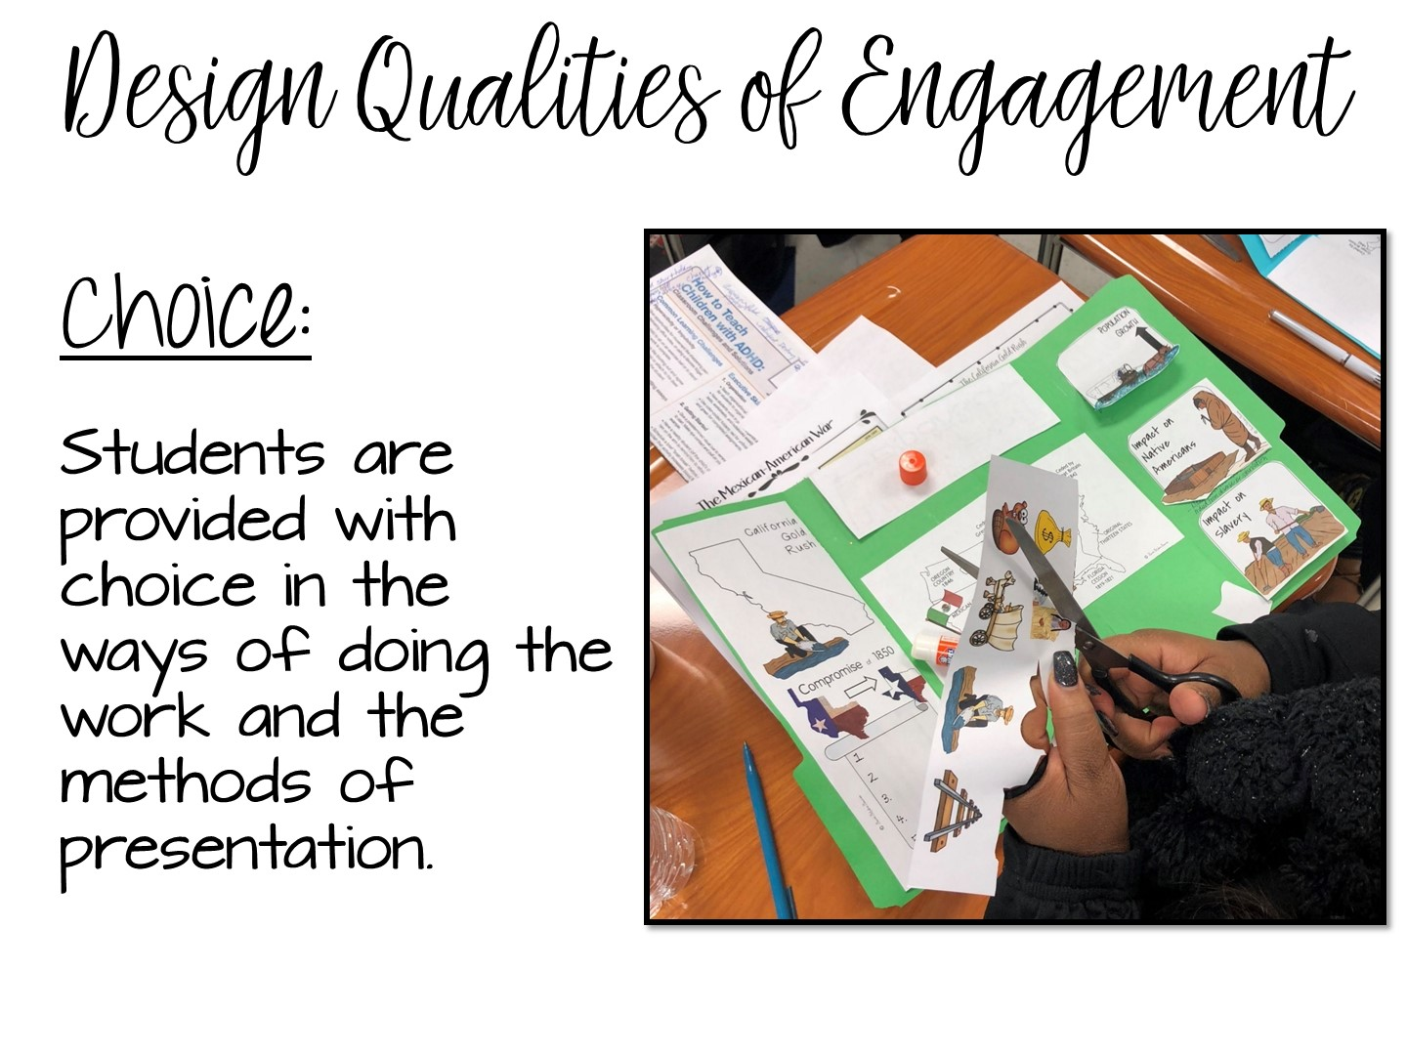
Notes:
PERCEPTION OF CHOICE is the key – it doesn’t just mean a choice board. Any choice students have increases engagement.

Slide 26
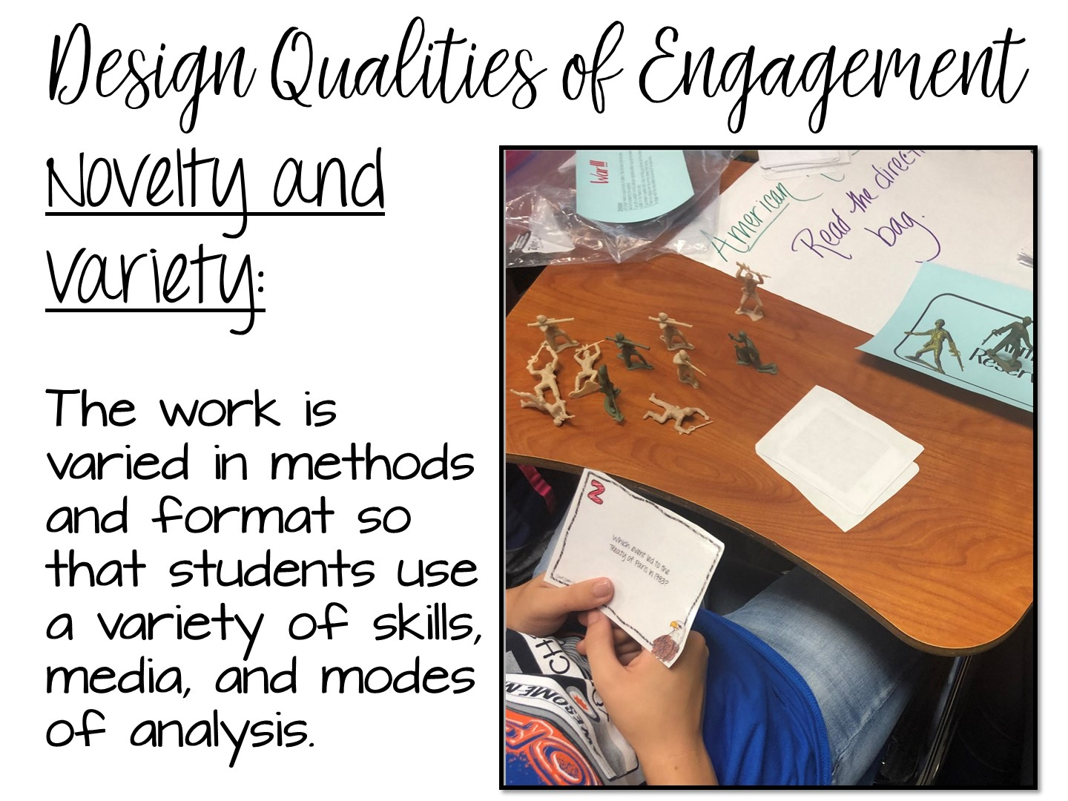
Notes:
New and different. What is new at the beginning of the year, is not new at the end. What is different (like Kahoot) is no longer different if everyone in every class is doing it.

Slide 27
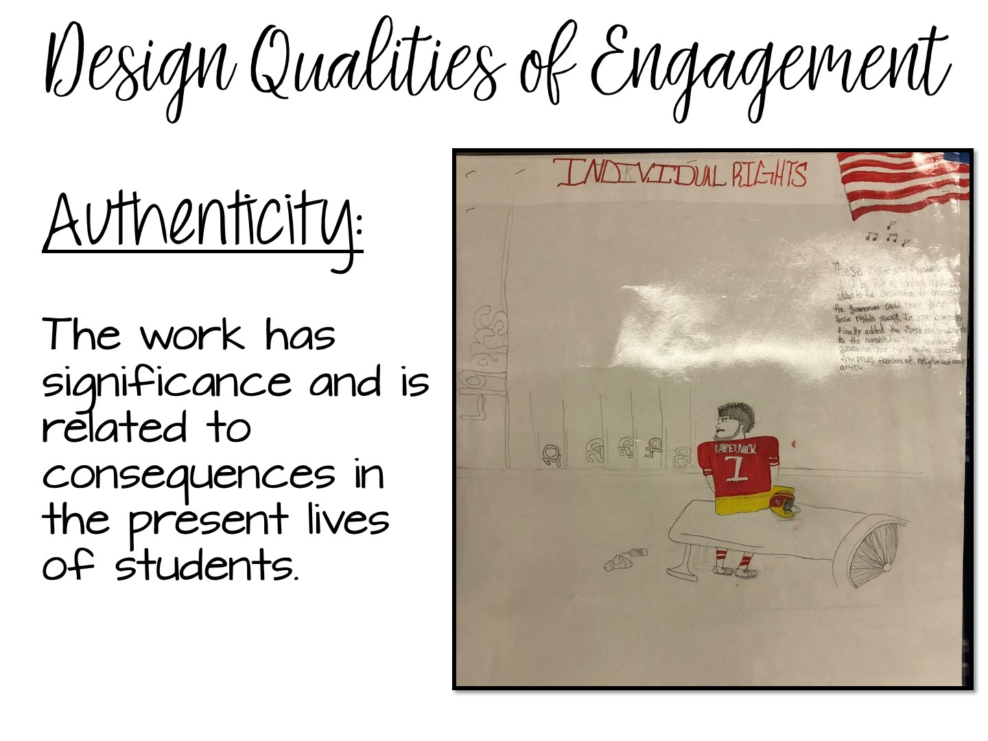
Notes:
Needs to have real world connections or a project that has a real-world application.

Slide 28

Notes:
Answer in chat box.
28

Slide 29


Slide 30

Notes:
Introduce lesson

Slide 31
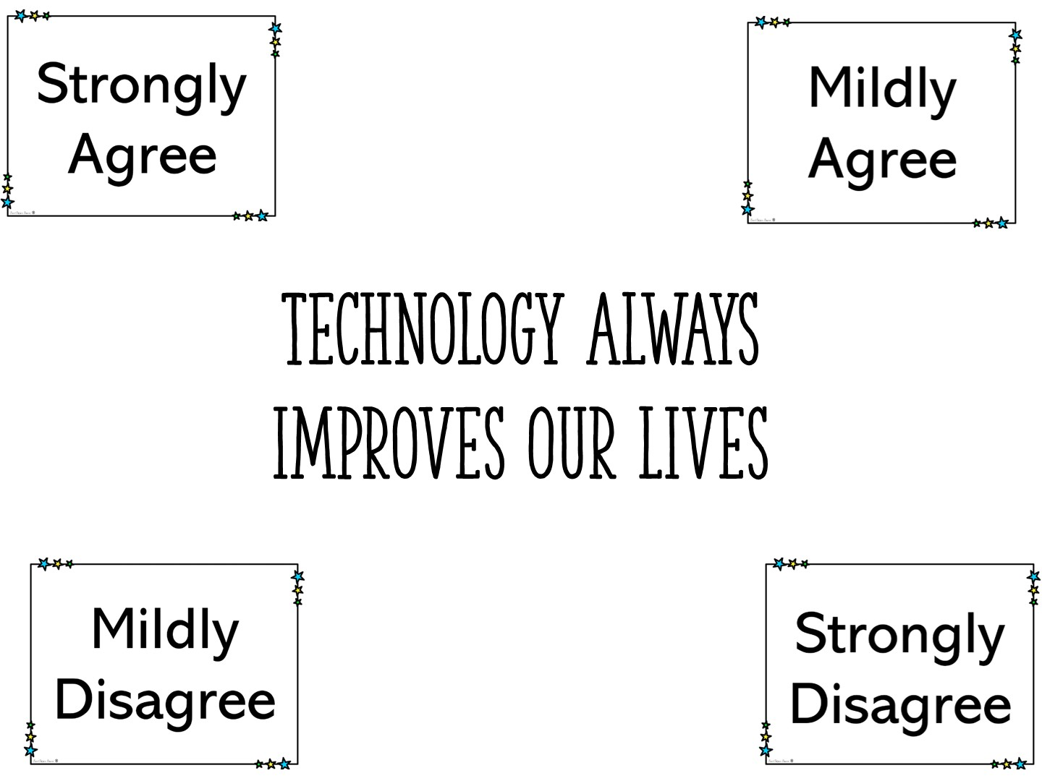
Notes:
You will need to create a zoom poll with this question, or have them type in the chat box.

Slide 32
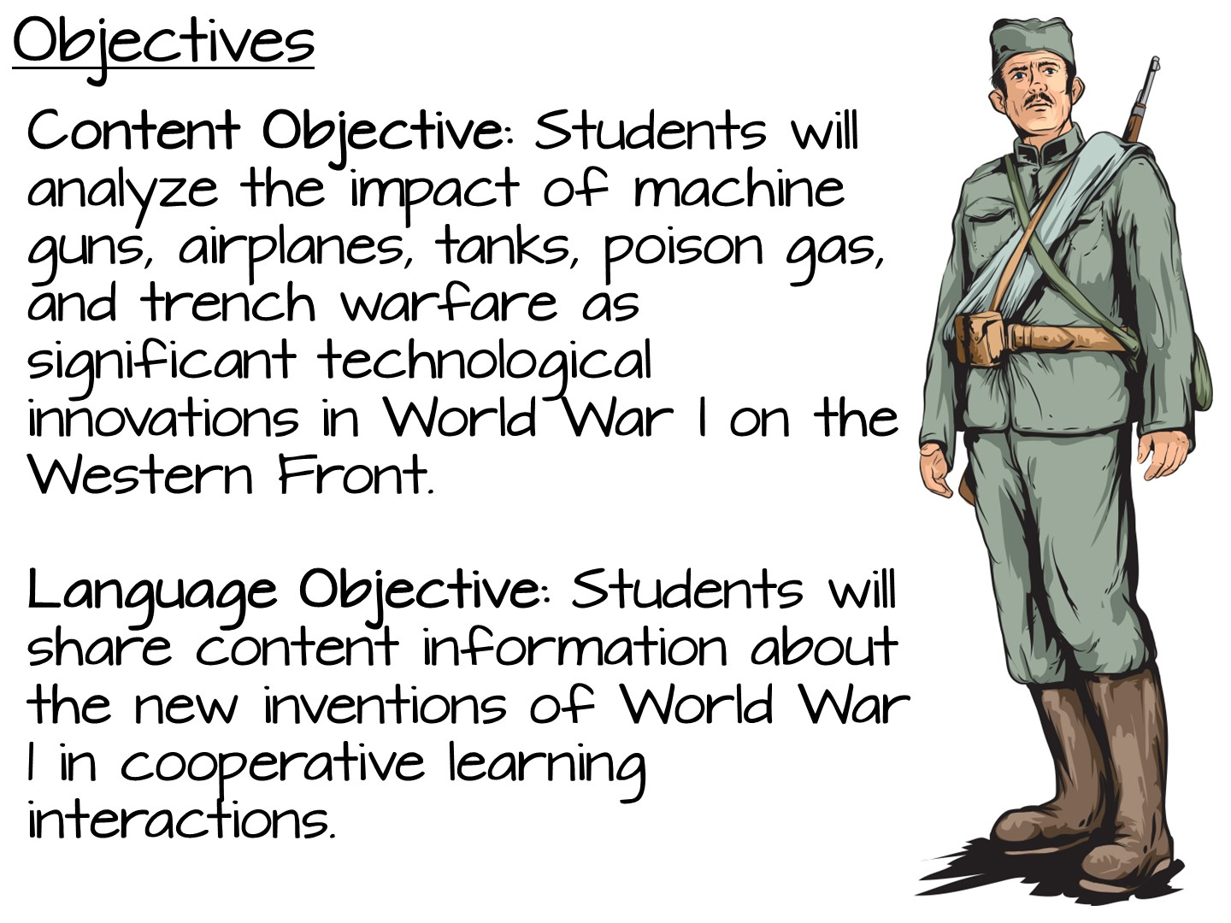
Notes:
(4) History. The student understands the emergence of the United States as a world power between 1898 and 1920. The student is expected to:
(E) analyze the impact of machine guns, airplanes, tanks, poison gas, and trench warfare as significant technological innovations in World War I on the Western Front;

Slide 33
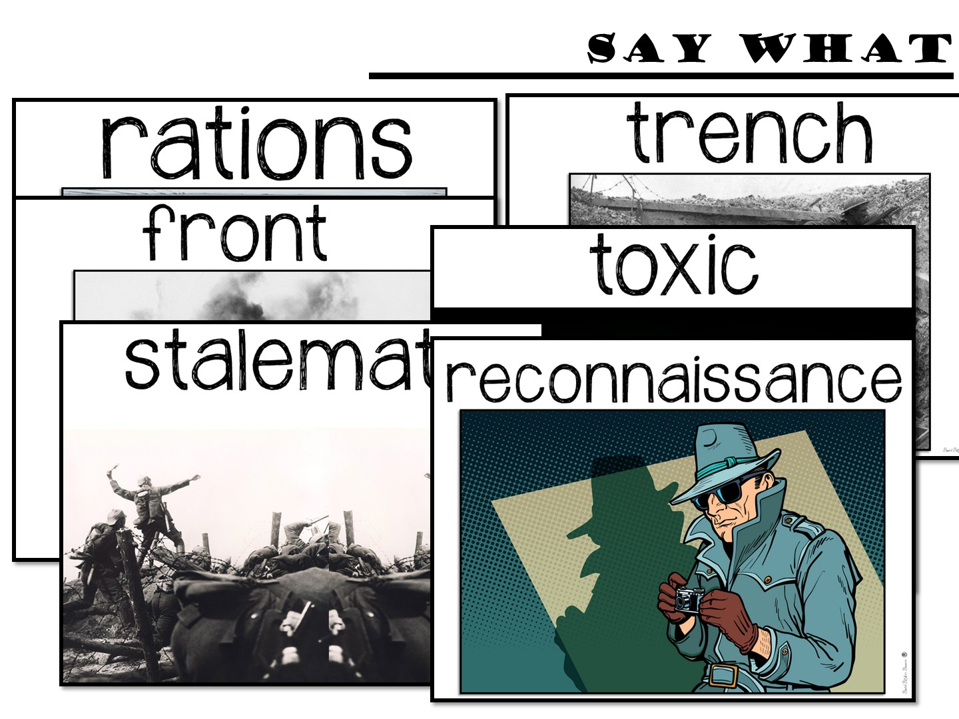
Notes:
Go to the Jamboard for the “Say What” Activity – Review directions for the activity. Assign teachers a partner and send them to a break-out room for a few minutes to work on the vocabulary activity.
https://jamboard.google.com/d/141U4HaWJcjU3xY4QhQ6P_Cw2NgEhnhbqdD4PvdWy_vg/edit?usp=sharing

Slide 34

Notes:
Send them to their break-out room

Slide 35
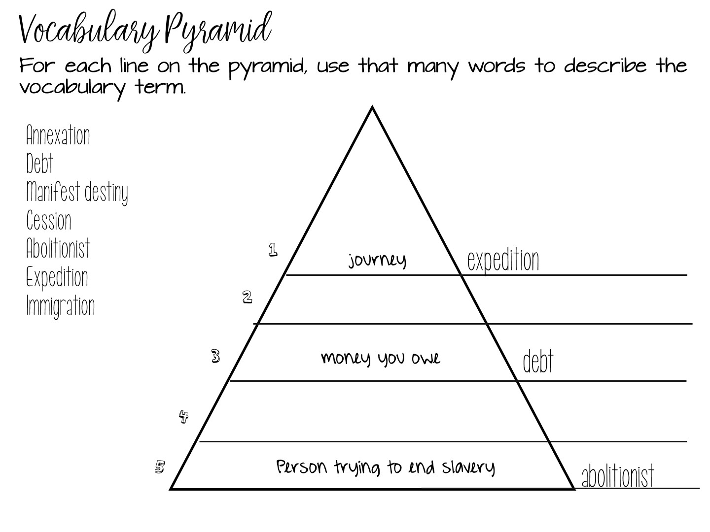
Notes:
Explain example

Slide 36
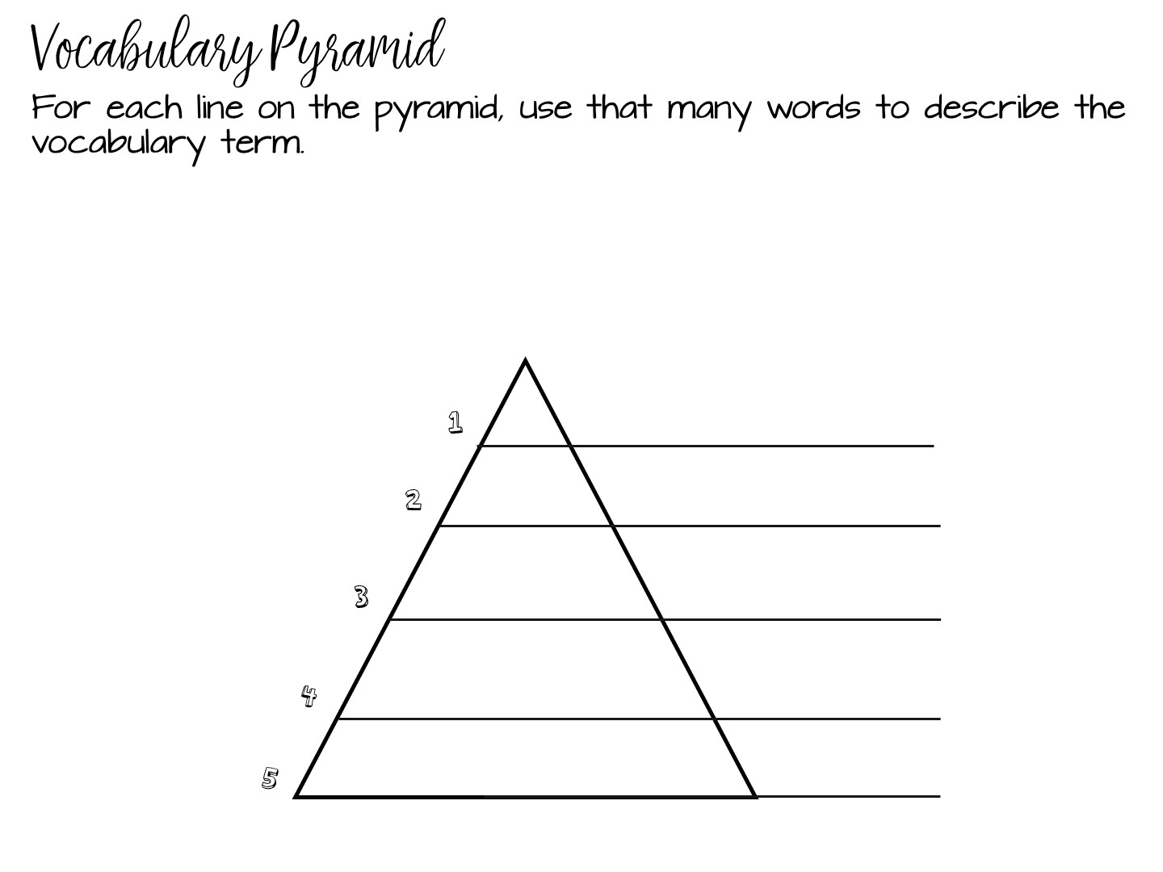
Notes:
Give them time to work on the Vocabulary Pyramid – instead of sending them to a breakout room, just have them type in the chat box : 1 – reconnaissance – spy, etc.

Slide 37
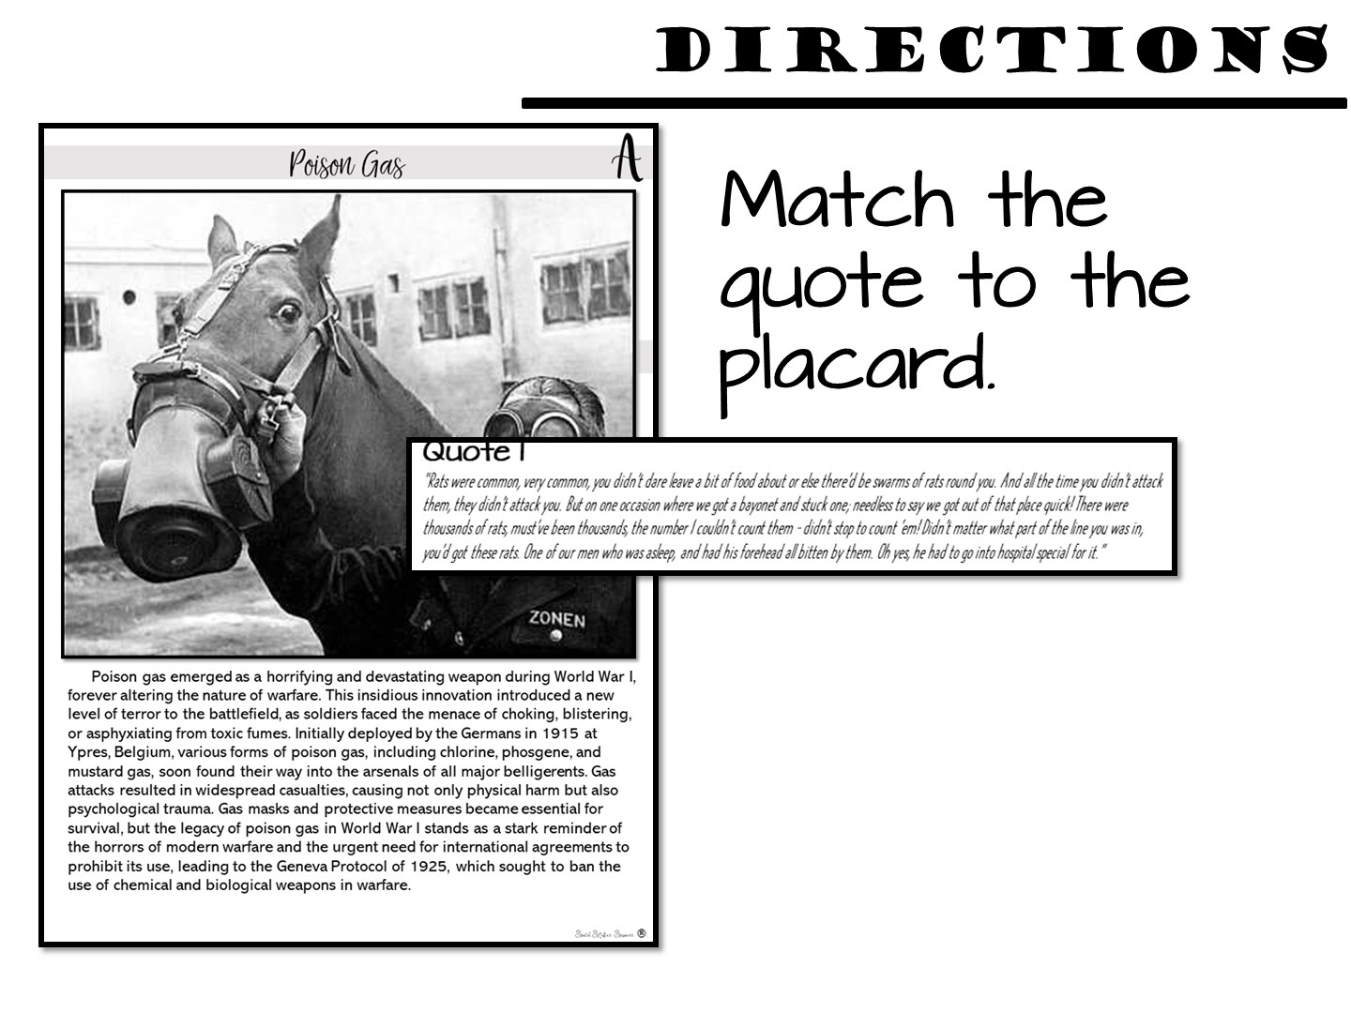
Notes:
In just a moment they are going back to work with their partner as they examine the inventions of World War I.
Open Jamboard – You will need to make several copies of this jamboard to share with each partner group. I really don’t know if this is the best way, but this is all I could think of:
https://jamboard.google.com/d/1TQaCExHXC3wXpoiSA6zZ9VV2lr_D-s9tkSOxej_WgTA/edit?usp=sharing
Go through all of the directions before you assign them back to their breakout groups with their partners. They will do the matching activity, take notes on the Doodle Notes, then create a spectrum of the inventions on the last slide.

Slide 38
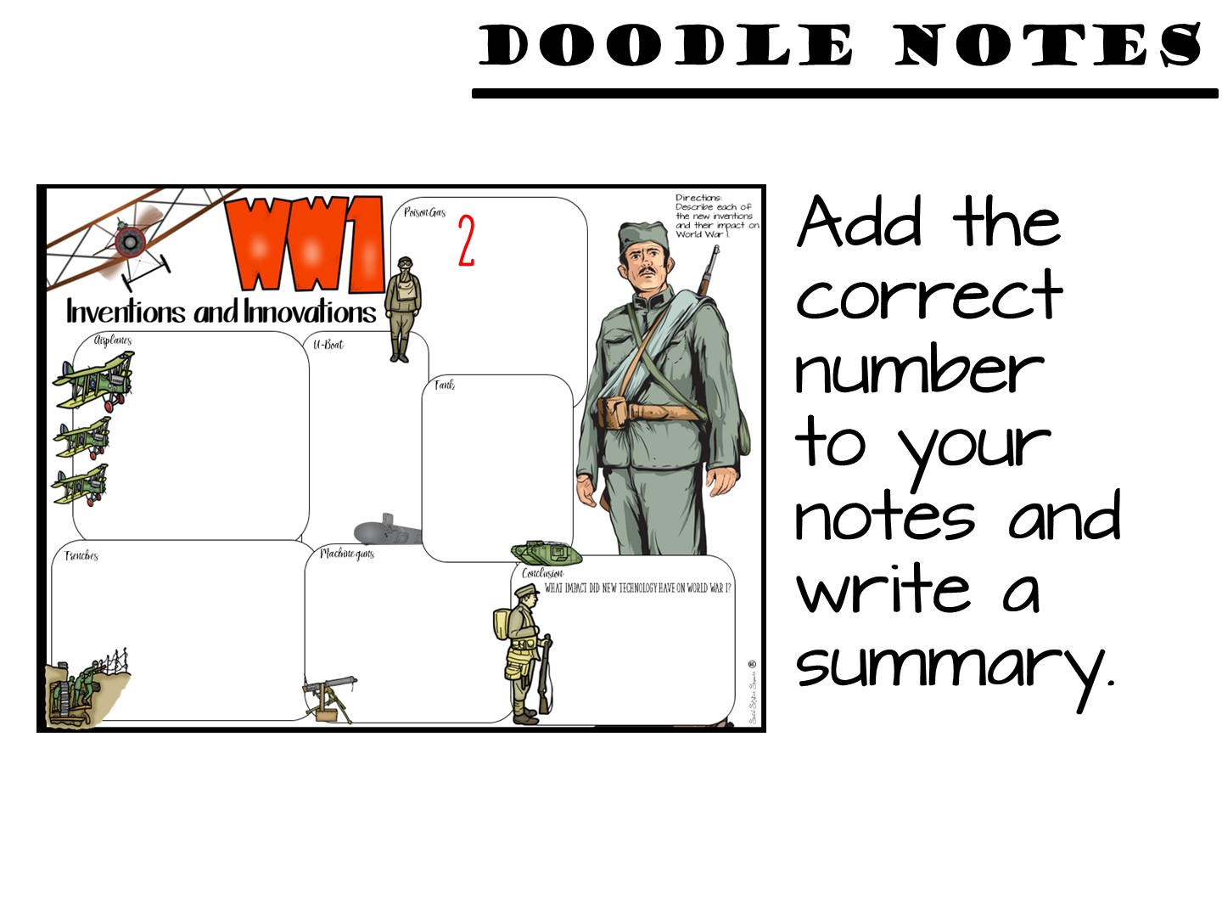

Slide 39
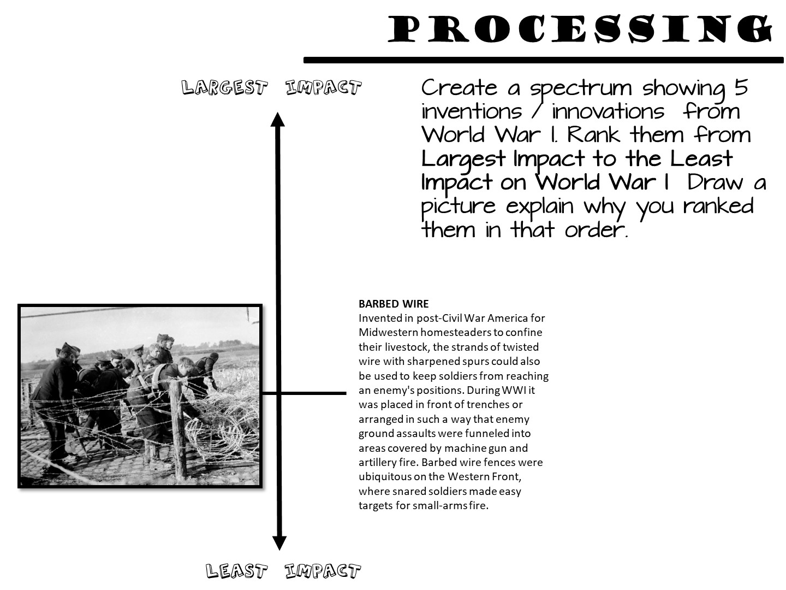
Notes:
Pass out the inventions cards and yarn. Give them time to create a spectrum, then switch partners and explain.

Slide 40


Slide 41
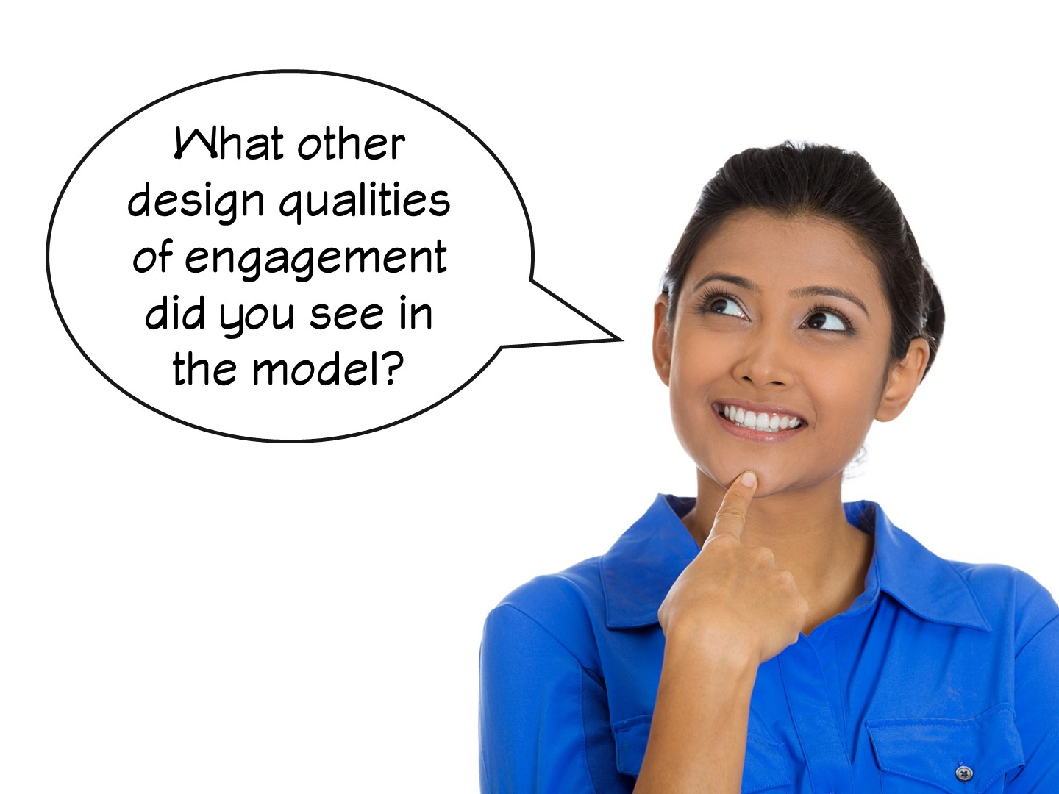

Slide 42


Slide 43


Slide 44

Notes:
Tell Me Two
Now that we are back from our break, share two things you have learned so far in the chat box.

Slide 45


Slide 46

Notes:
Next we are going to look at different ways to increase engagement during a lecture – interactive brain breaks.

Slide 47
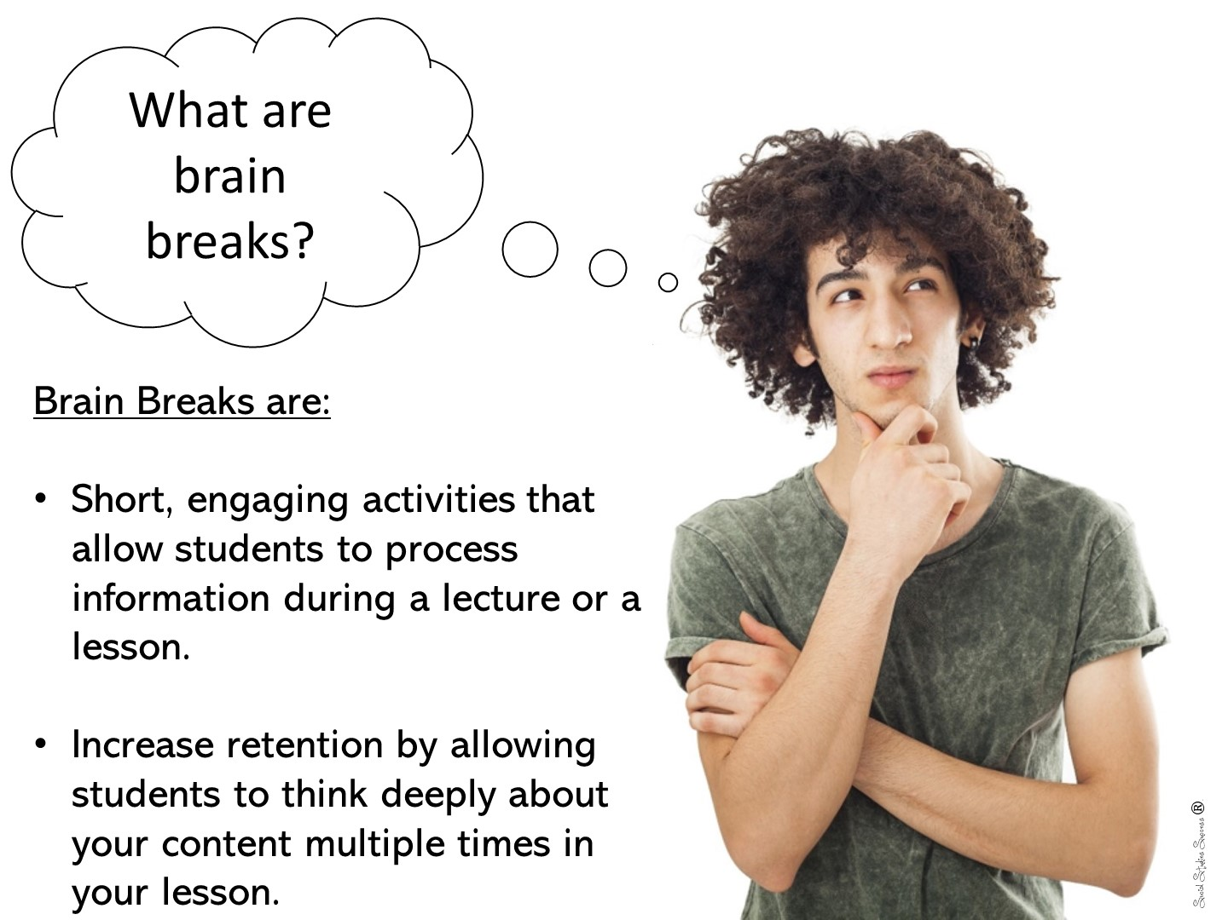
Notes:
Just read

Slide 48
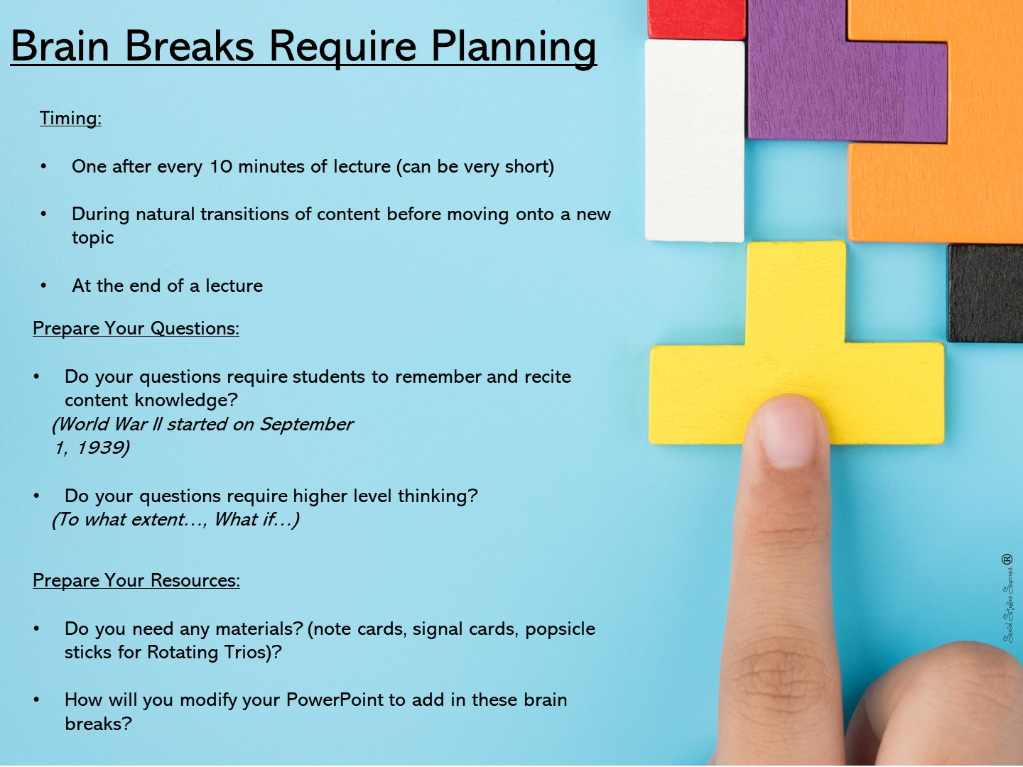

Slide 49

Notes:
Let everyone know that they will be receiving the next set of slides to add to any activity.

Slide 50

Notes:
Say-It-In-A-Word
Ask a question about your topic. After think time ask students to decide on one word that best expresses their response. Allow every student to share his or her word. Based on their responses, ask follow-up questions. Encourage students to ask questions of one another.

Slide 51


Slide 52


Slide 53
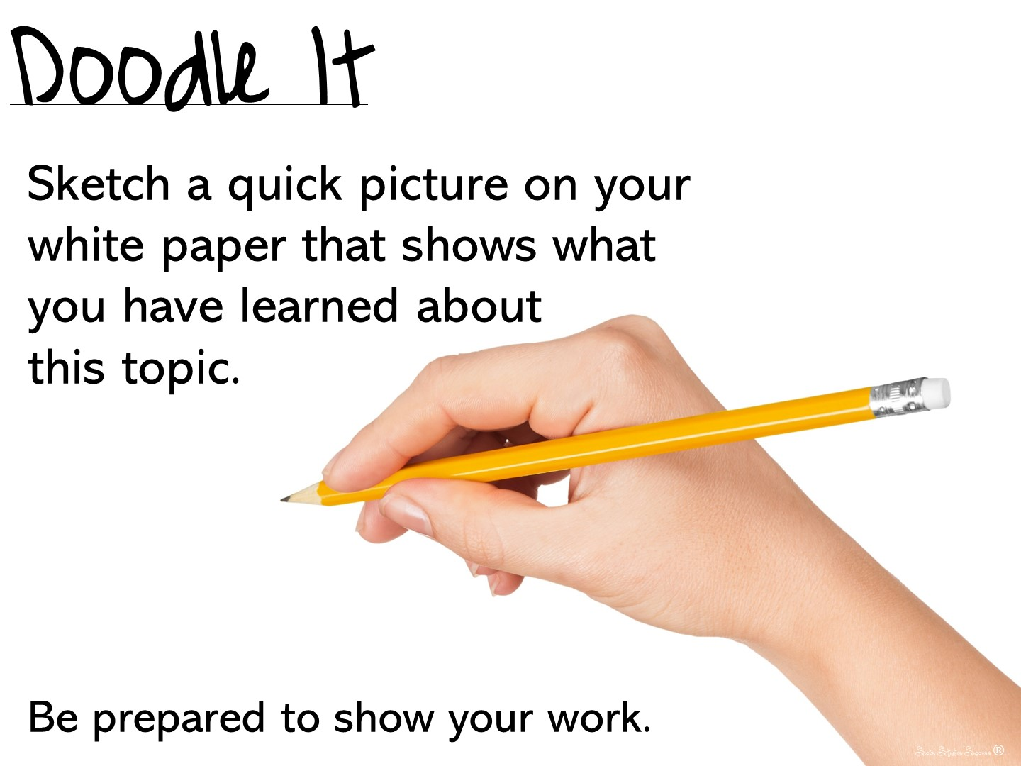

Slide 54
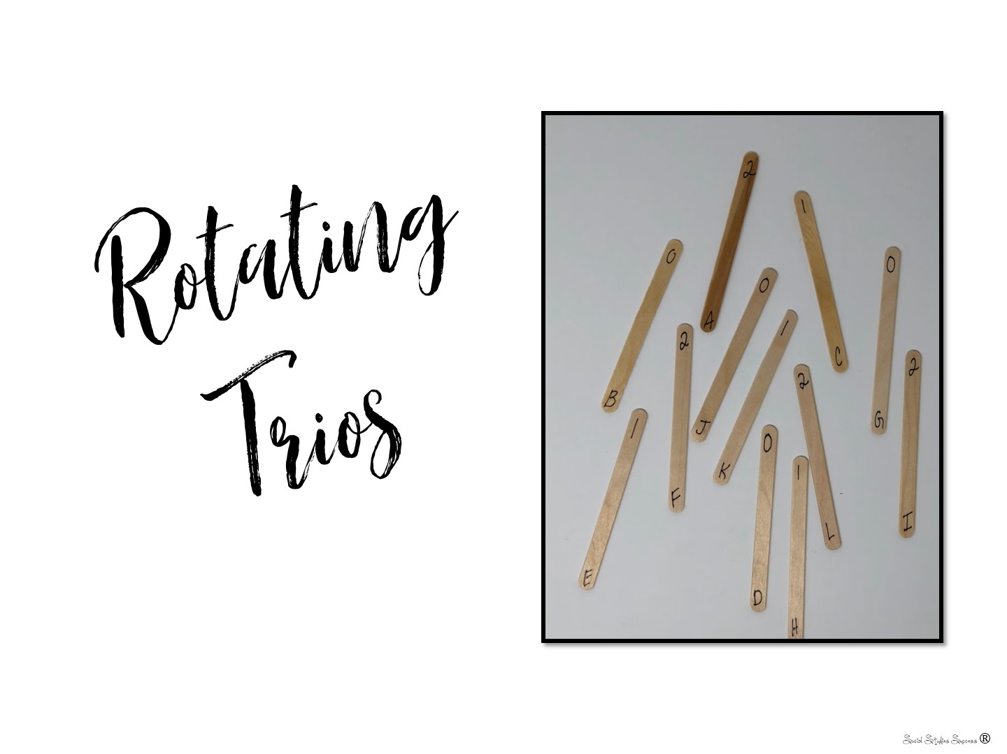
Notes:
Rotating Trios
Create index cards or popsicle sticks with the numbers 0, 1 and 2. Place your students into groups of 3 (0, 1, and 2) and then each of the large groups into a smaller group around you. Ask your students an open ended question. Give them a moment to discuss and answer. Rotate the groups, 0 stays in place, 1 rotates one spot, 2 rotates two spots. Ask a new question and continue the process.

Slide 55

Notes:
Stand on one foot and summarize what you have learned so far to your partner.

Slide 56
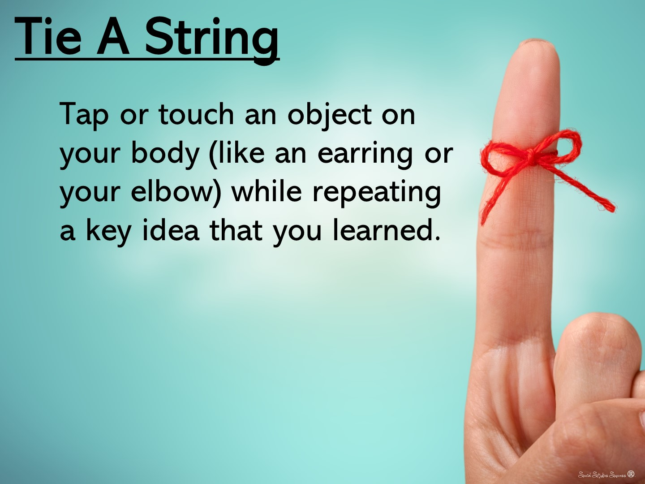
Notes:
Did you ever tie a string around your finger to remember something? This is the same idea – have students tap or touch an object on their body (like an earring or their elbow) while repeating key ideas from the lesson. Later on in the period, ask your students to point to the same location and repeat what they were supposed to remember.

Slide 57
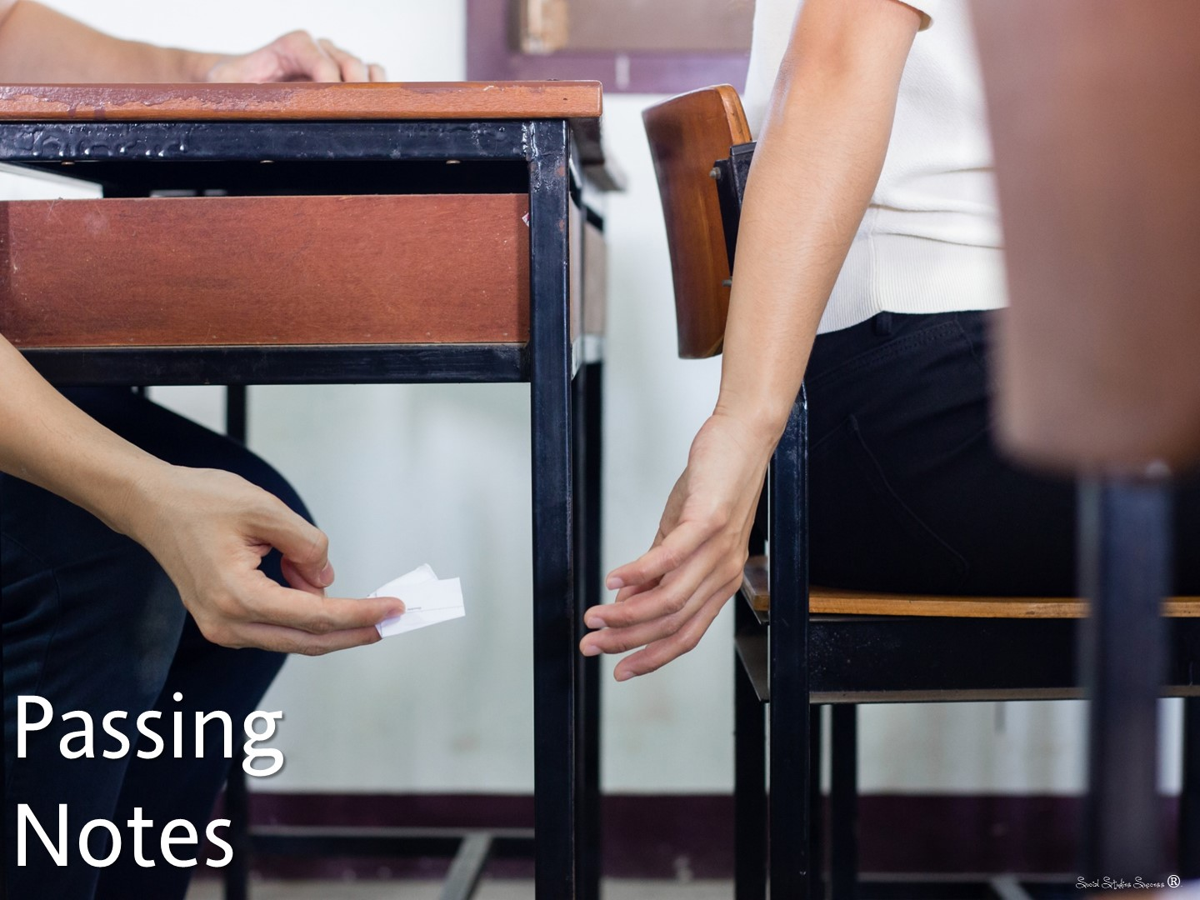
Notes:
Passing Notes
Have students write what they have learned or the answer to a question you ask on a note card. Students will then pass their note to the person next to them who will respond by correcting or adding information to the answer.
Passing Notes with a Twist
Instead of you asking the questions for the students to respond to, ask your students to write a question about the topic, then pass the note card to another student to answer.

Slide 58

Notes:
We are going to take a brain break now – Reflect on what you have learned about brain breaks… Write a question you could ask a colleague in the chat box. When everyone is finished with their questions, choose one question from the chat box and write a response to it.

Slide 59
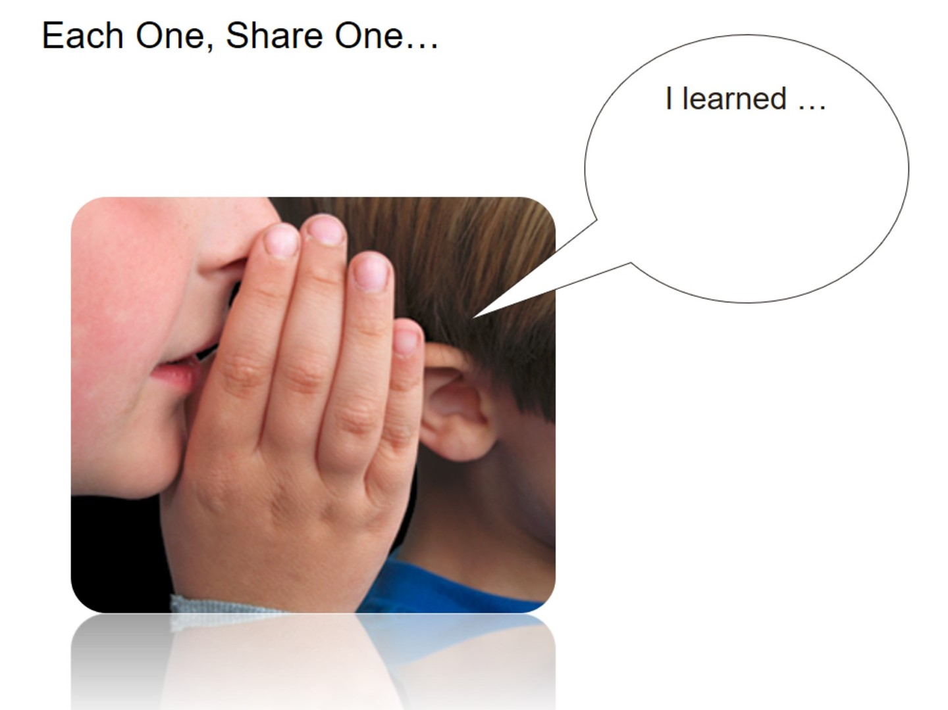
Notes:
Tap your neighbor on the shoulder and share a new fact you have learned.

Slide 60

Notes:
Gimmie Five
Have students list off 4 things they learned and one question they still have on their fingers and thumb.

Slide 61

Notes:
Fast Five
Give your students a highlighter. Ask them to go back into their notes and highlight 5 key ideas. Allow your students to share and compare these ideas with a neighbor.

Slide 62
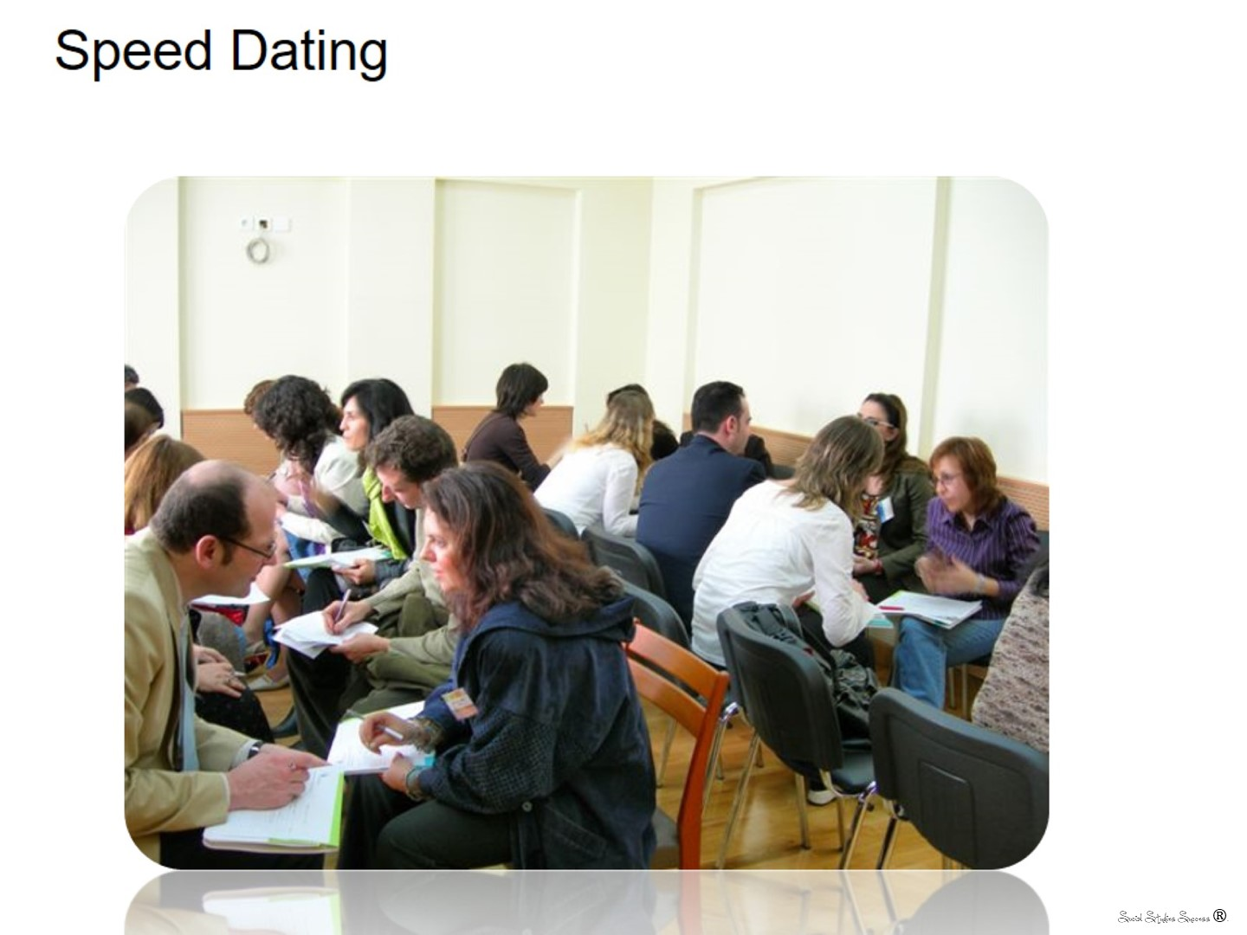
Notes:
Line students up and have them face a partner – ask a question, they repeat the question to their partner and then the partner has to answer it.

Slide 63

Notes:
It’s a FACT!
Student writes a Fact from the lesson on the card. You pass the card through all the students who then write on the back, True or False. If false.. they must write why. All students review all facts.

Slide 64

Notes:
What additional ideas do they have for brain breaks? Have them type the ideas in their chat box.
Point out that they have a handout with additional ideas on the website.

Slide 65


Slide 66
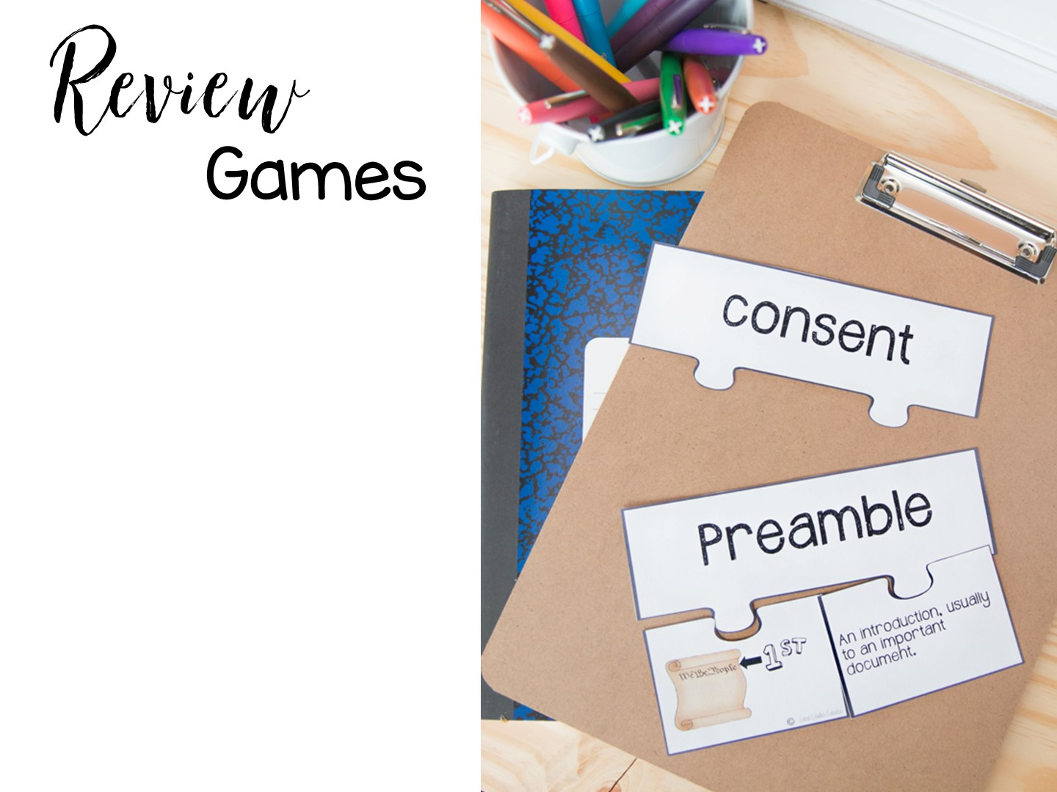
Notes:
We are now going to look at building affiliation (working with a group) with review games.
You will need to make groups of 3 when you assign them to break out rooms

Slide 67
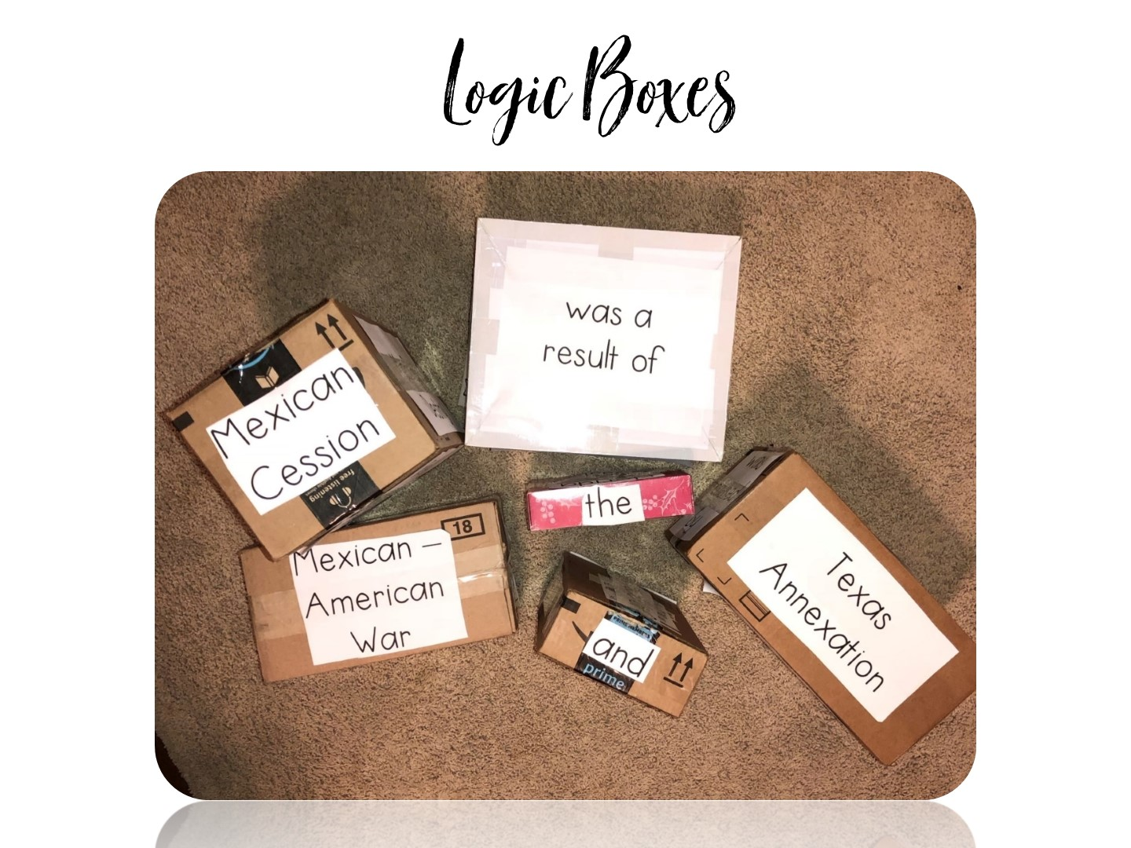

Slide 68
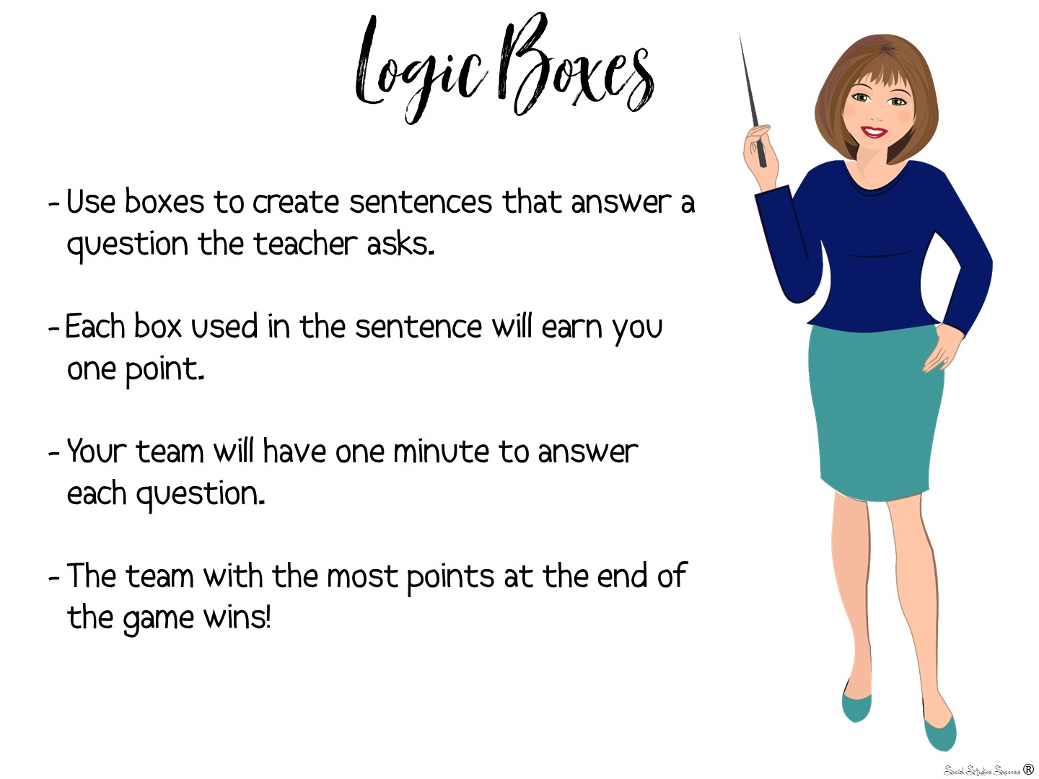
Notes:
We are going to do this on a jamboard to see the experience.
Take them to jamboard and assign groups of teachers a slide. Ask your questions (below) and have them answer by moving the terms around the jamboard.
https://jamboard.google.com/d/1eO3hY5hYYBqs7OcY_wECn5gEQZW8PwInR29htu2Eu58/edit?usp=sharing
Create a sentence that:
shows what you have learned about Westward Expansion.
shows a cause and effect relationship
places the events in chronological order
focuses on Mexico
focuses on slavery
focuses on economics
focuses on transportation
shows a positive effect of Westward Expansion
shows a negative effect of Westward Expansion

Slide 69
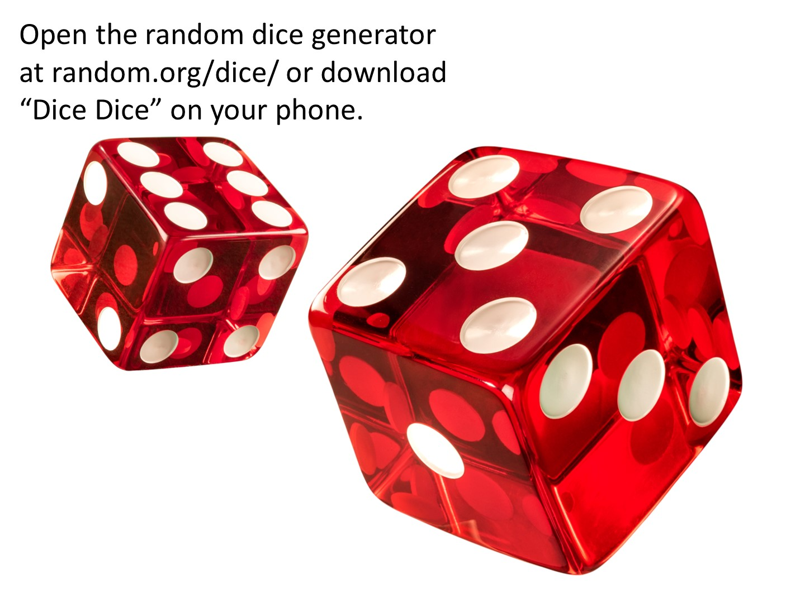

Slide 70
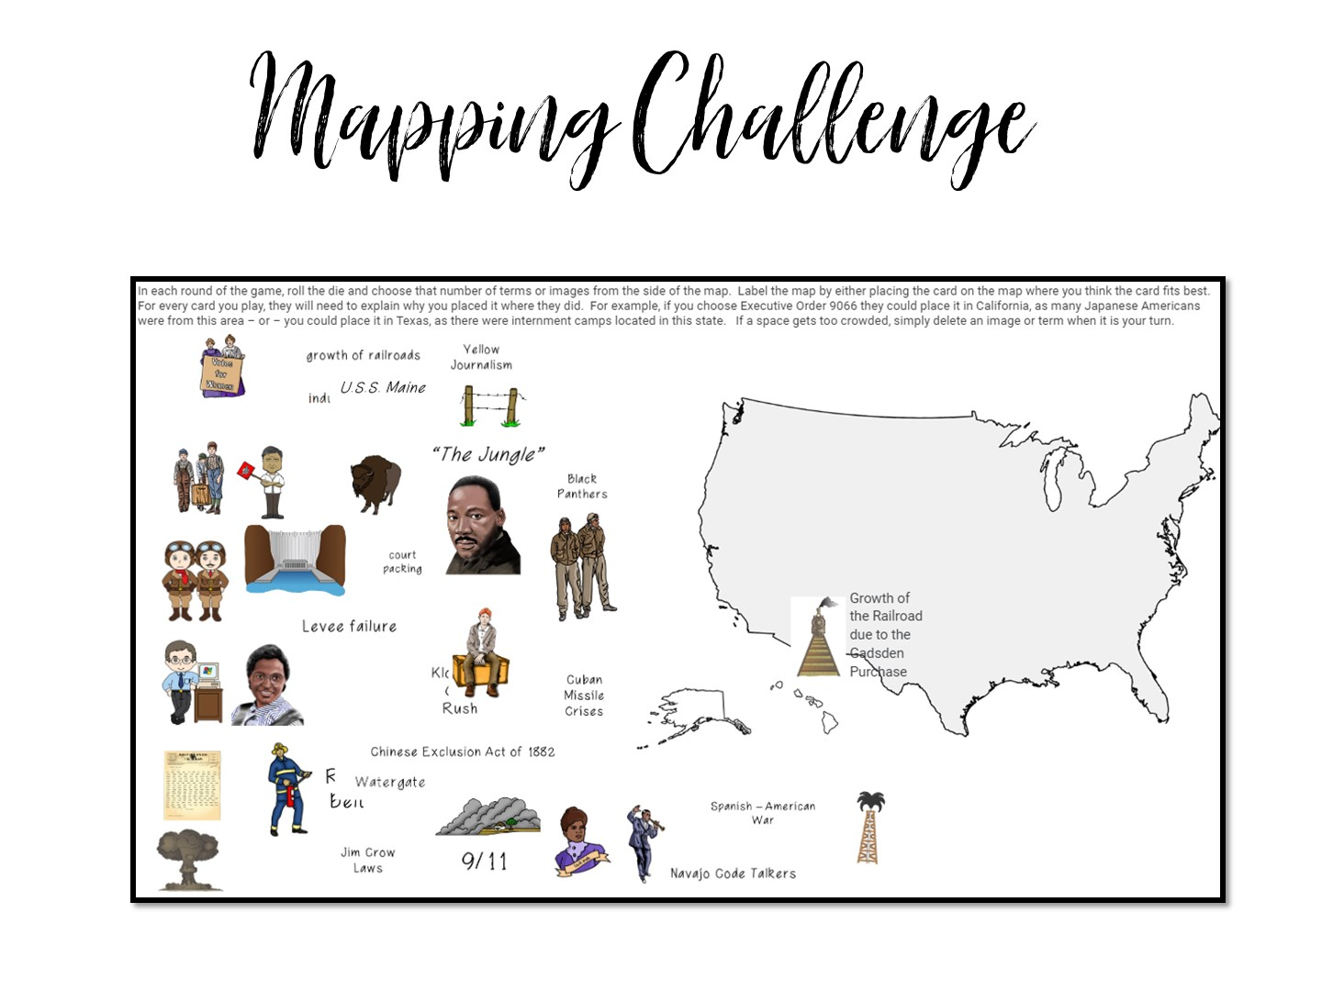
Notes:
Next we are going to try a mapping challenge – explain the directions and then take them back to jamboard to play the game.
https://jamboard.google.com/d/1yz68FlmnUmUPpY-dcSI-IYPFxlkfdy04ujqaZt4ab8g/edit?usp=sharing

Slide 71
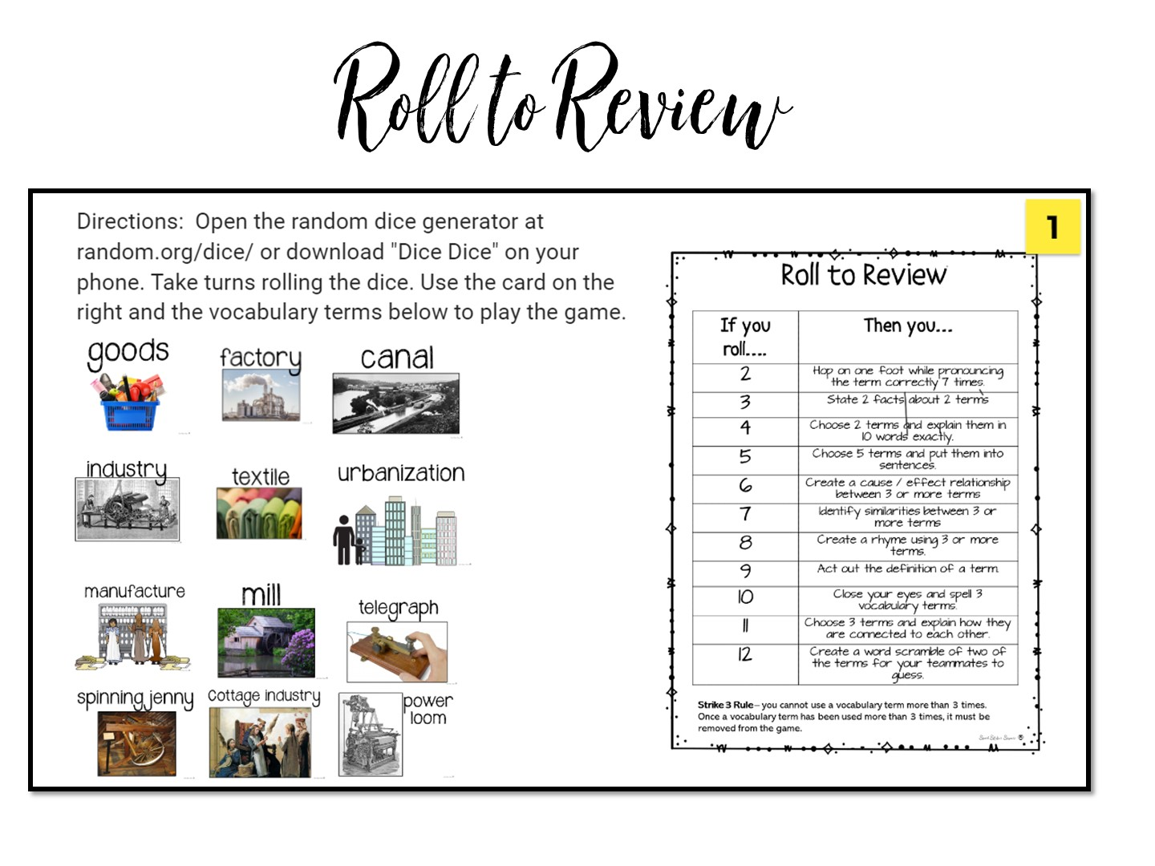
Notes:
Explain the directions and take them to the jamboard
https://jamboard.google.com/d/1aGt-YRSPh8BGKYqBg_Z1I54ZtHRwzuhMCWDqlB2pbZ4/edit?usp=sharing

Slide 72
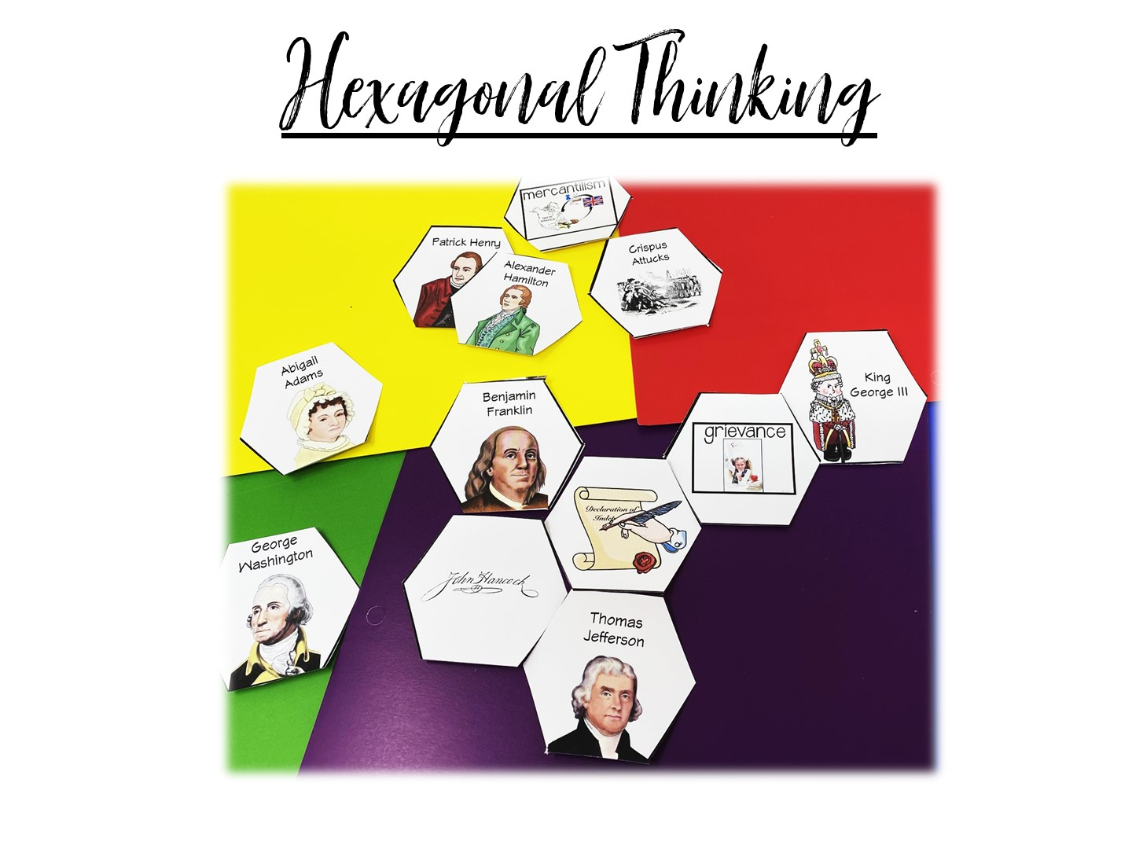
Notes:
Explain the directions and take them to the jamboard
https://jamboard.google.com/d/1IPhSI1Xa51AcH5z3RJDROK5lF4EyR2FYi_q07V_6cMY/edit?usp=sharing

Slide 73


Slide 74


Slide 75

Notes:
Rotating Trios
Using the number on your popsicle stick (0,1 or 2), make a “trio”. Each trio should contain a 0, 1, and 2. Give the trio 1-2 minutes to discuss the question. Then choose one or two groups to share their responses.
DI Notes: MI – Kinesthetic, Verbal/Linguistic and Intra-Personal
75

Slide 76


