Slide 1


Slide 2


Slide 3


Slide 4


Slide 5


Slide 6
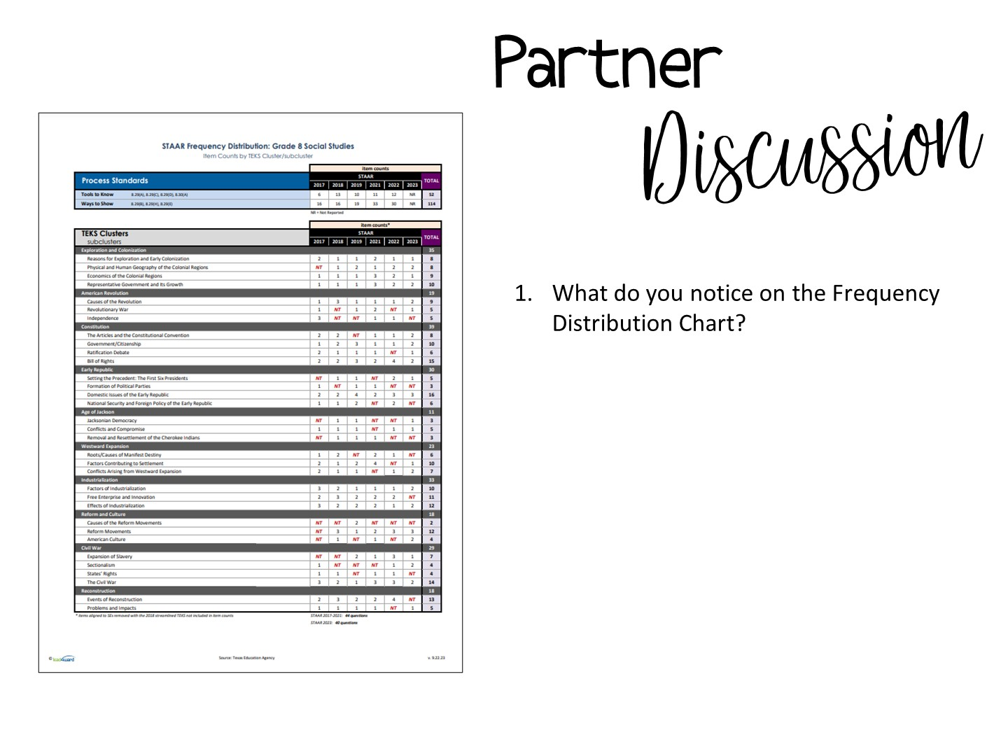
Notes:
Pass out the Frequency Distribution Chart and have them discuss their observations with a partner.

Slide 7


Slide 8
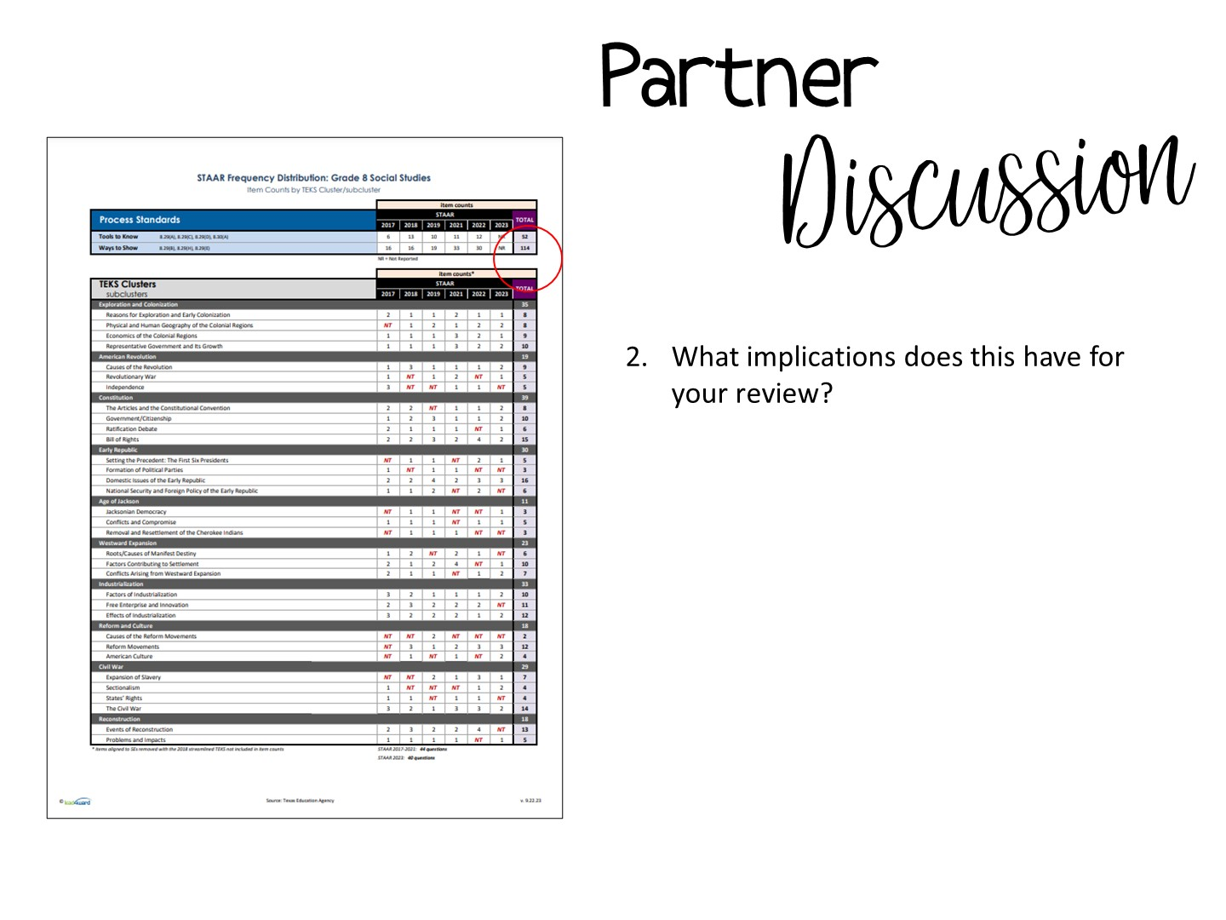
Notes:
Point out that the number one standard tested is the skills standard.

Slide 9

Notes:
We are going to review the skills

Slide 10
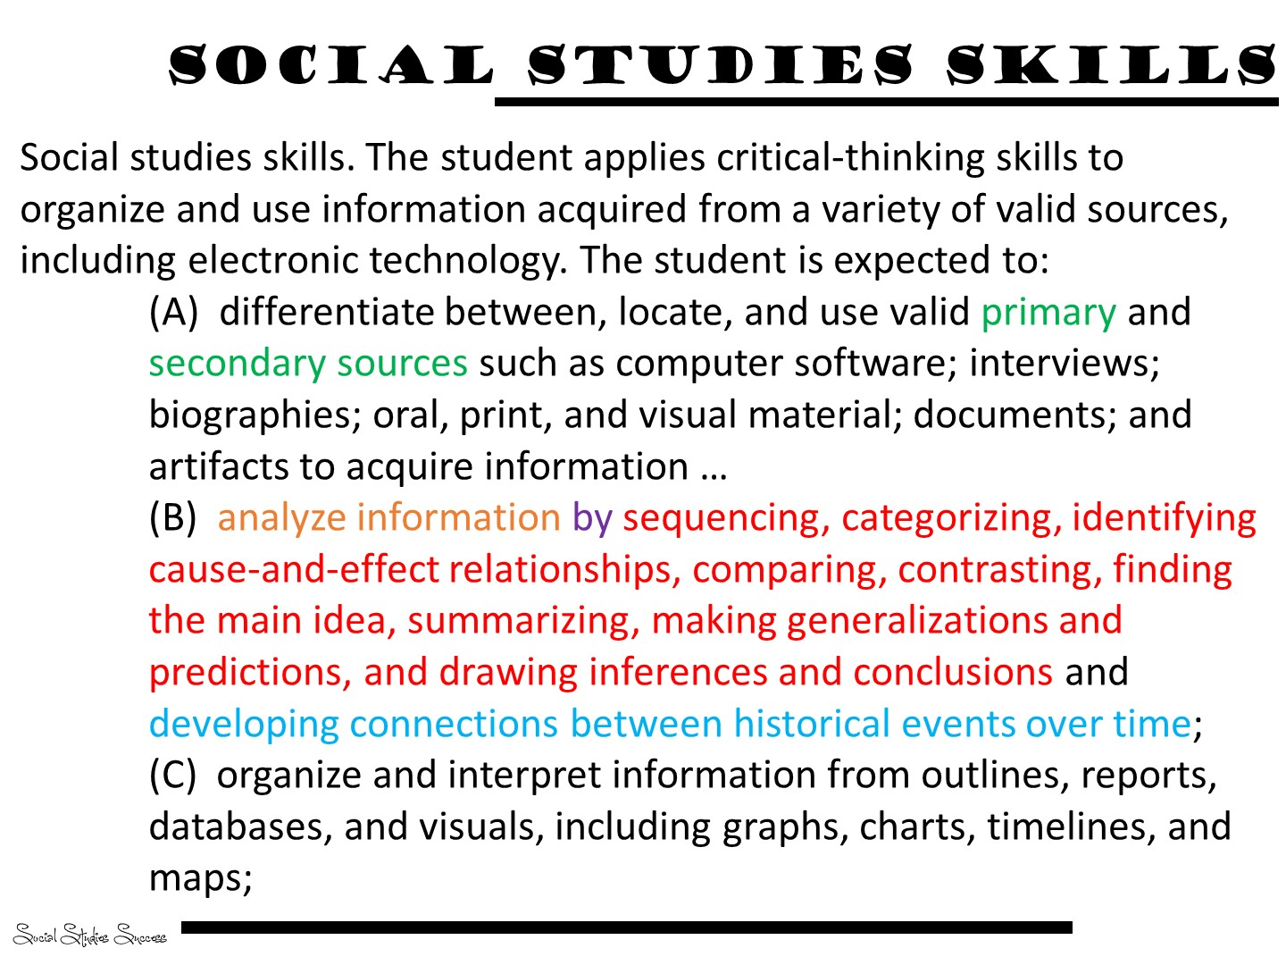

Slide 11

Notes:
Pass out the skills cards

Slide 12
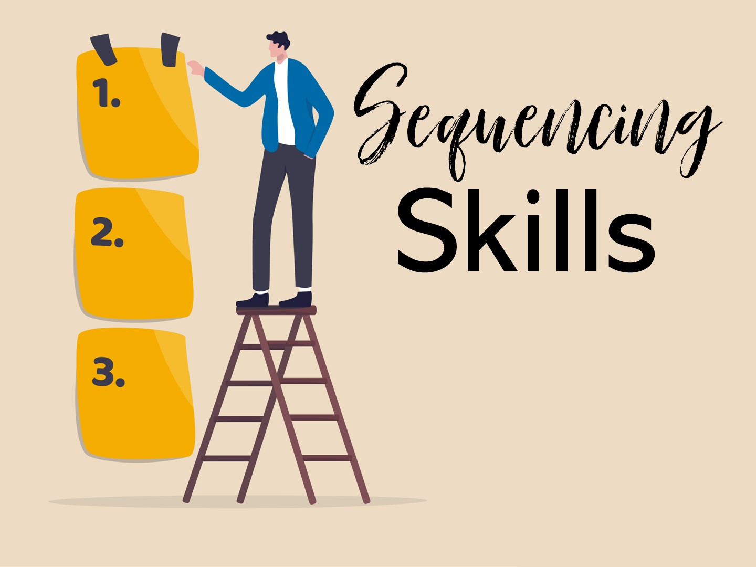
Notes:
The first set of skills naturally fit with Social Studies – sequencing skills

Slide 13
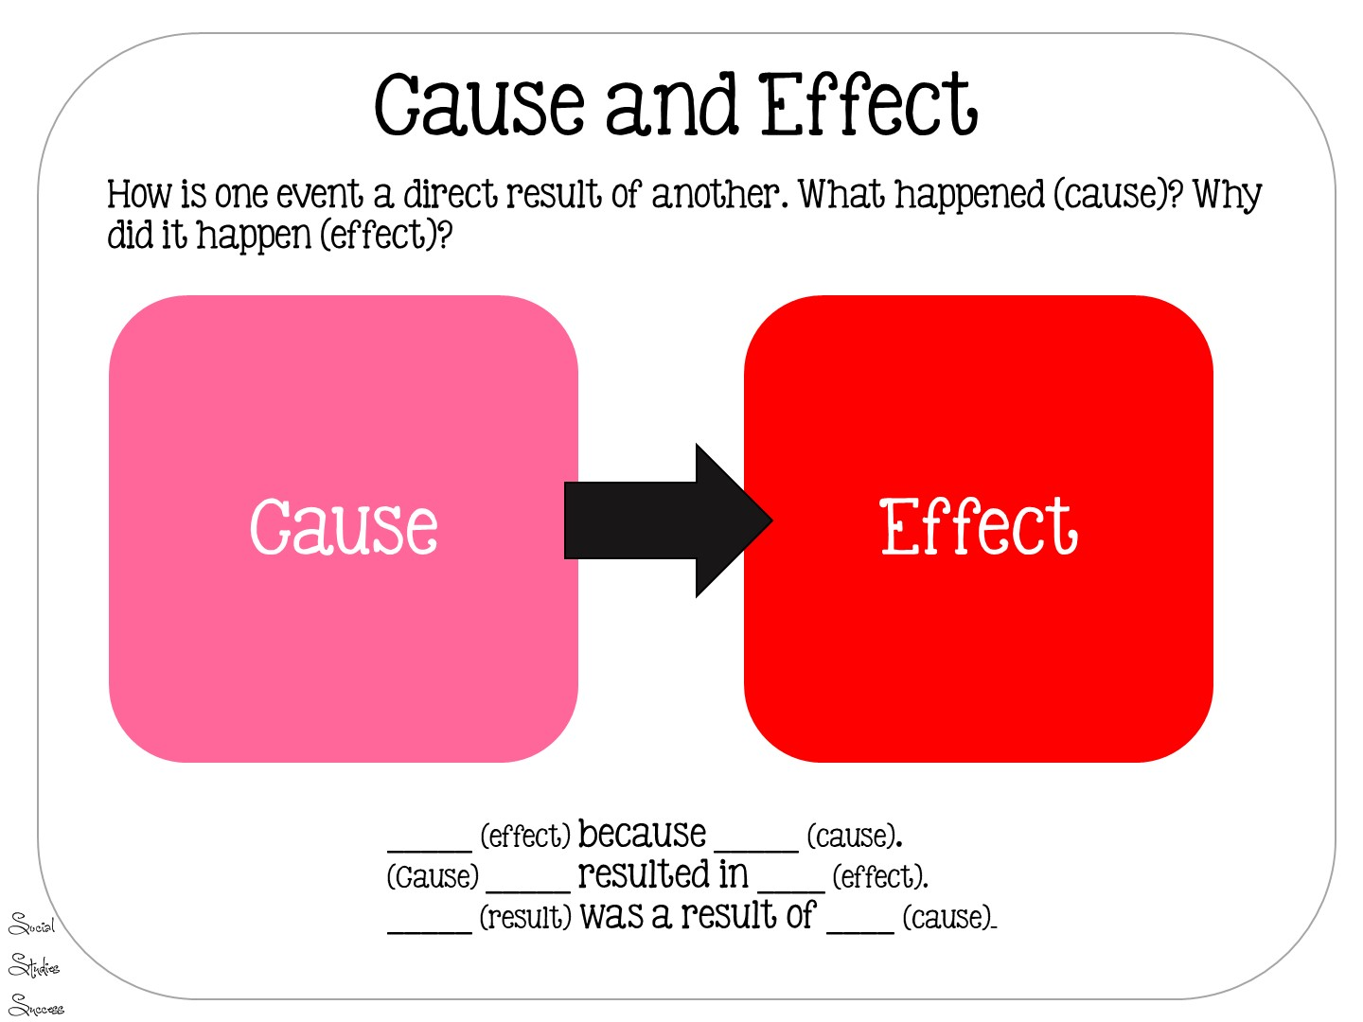
Notes:
Read Slide

Slide 14
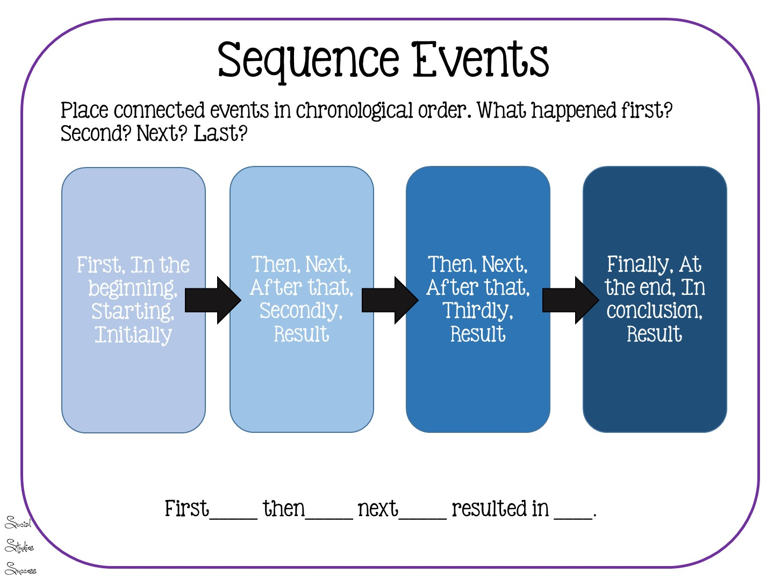
Notes:
Read slide

Slide 15
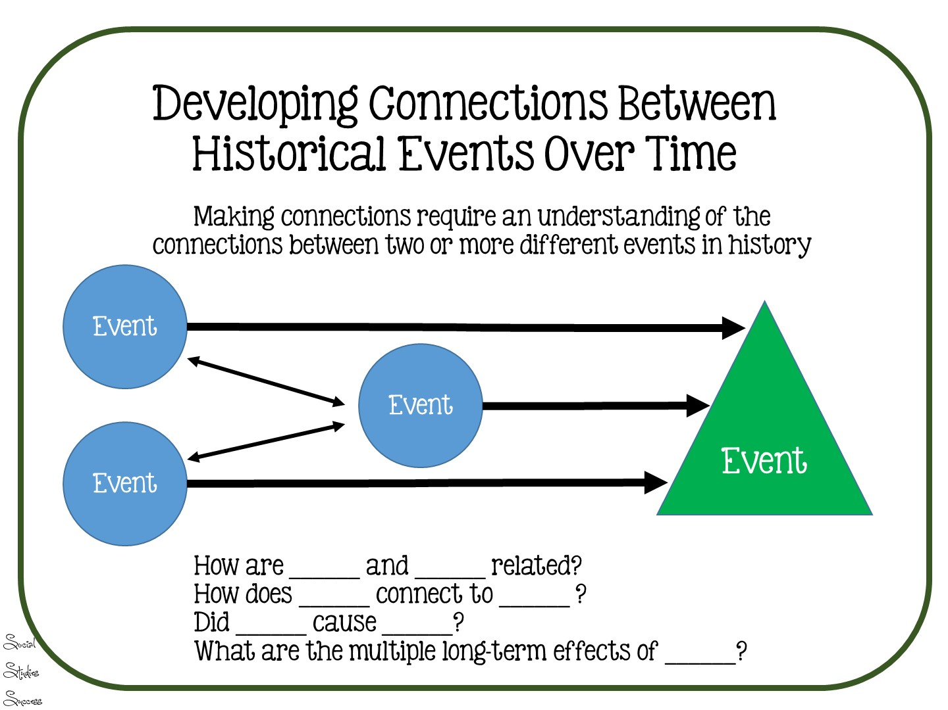
Notes:
This is a standard inferred by the STAAR test – it includes historical influences on the Constitution.

Slide 16

Notes:
The next set of skills has to do with categorization.

Slide 17
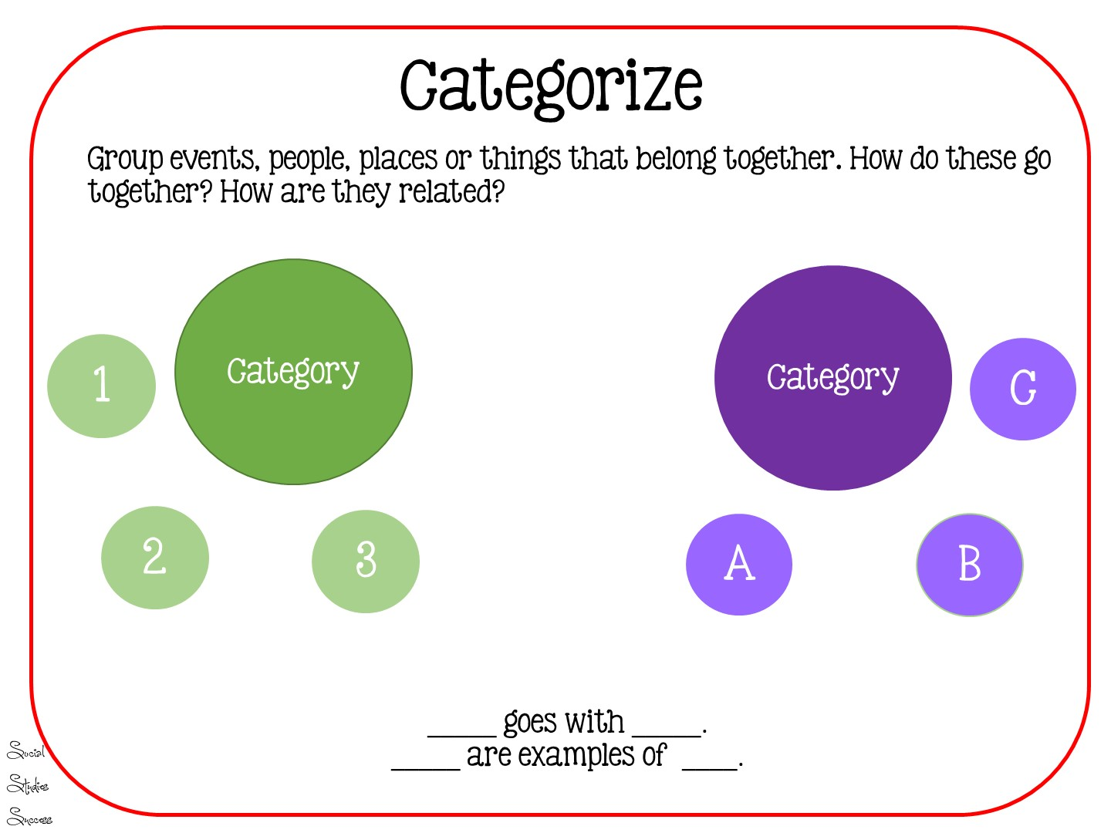
Notes:
Categorization helps our students organize information

Slide 18
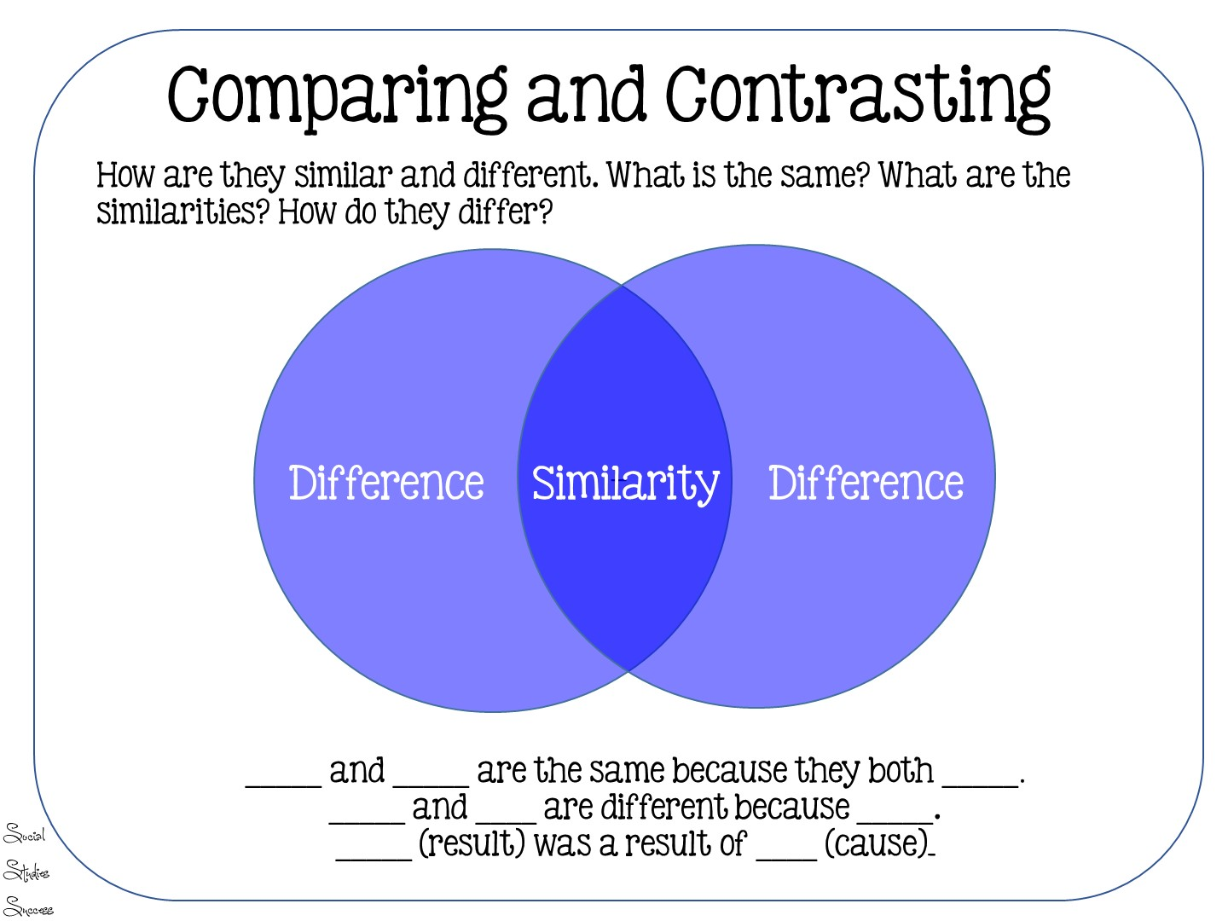
Notes:
Comparing and contrasting of categories

Slide 19


Slide 20

Notes:
The next set of skills are usually associated with reading historical text.

Slide 21
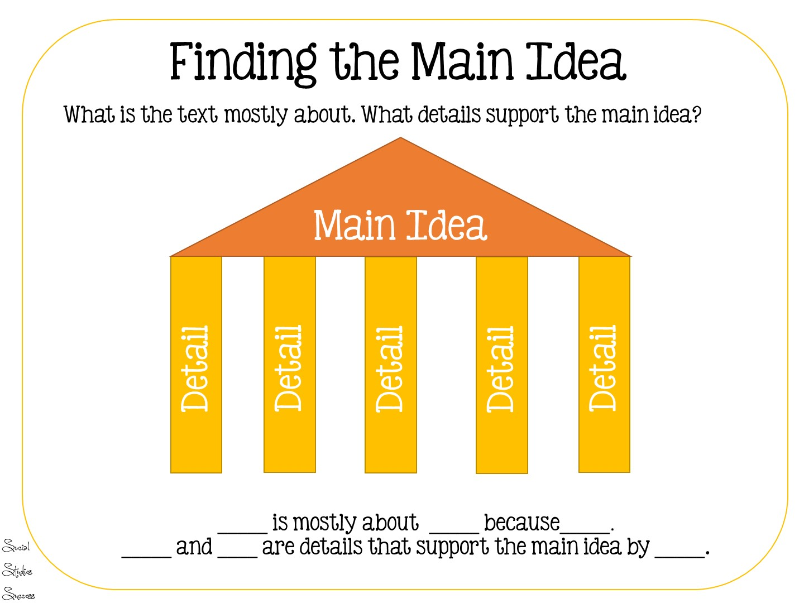

Slide 22
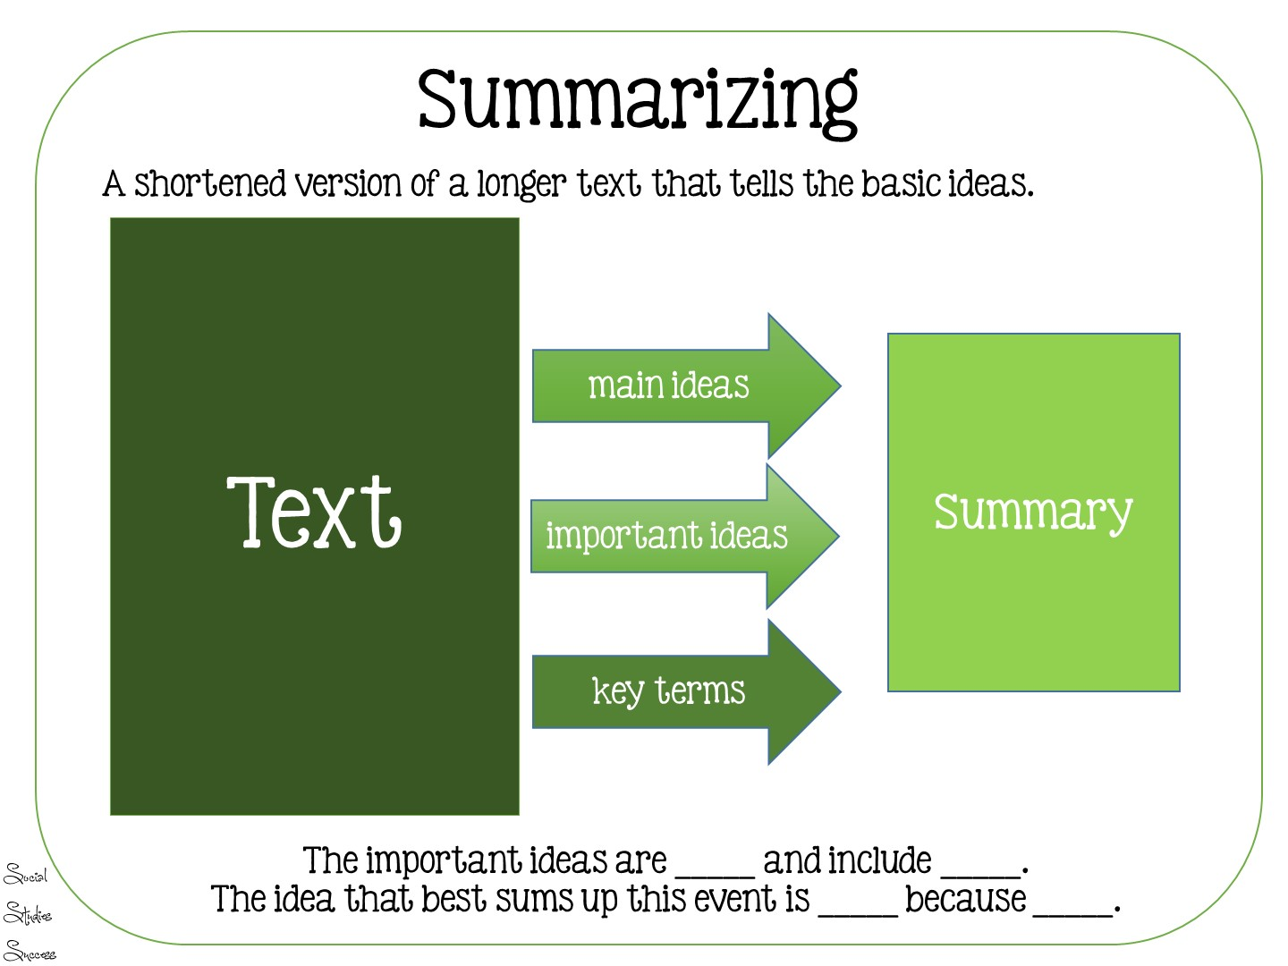

Slide 23

Notes:
Use of evidence skills are the most difficult for students. They require students to draw inferences from history by: • identifying relationships among the parts • detecting inconsistencies • weighing conflicting facts and statements
generalize from data by: • applying previously learned concepts and generalizations to the data or situation • checking reasoning against basic principles of logic and looking for inconsistencies, limitations of data, and irrelevancies • creating a broad statement which encompasses findings

Slide 24
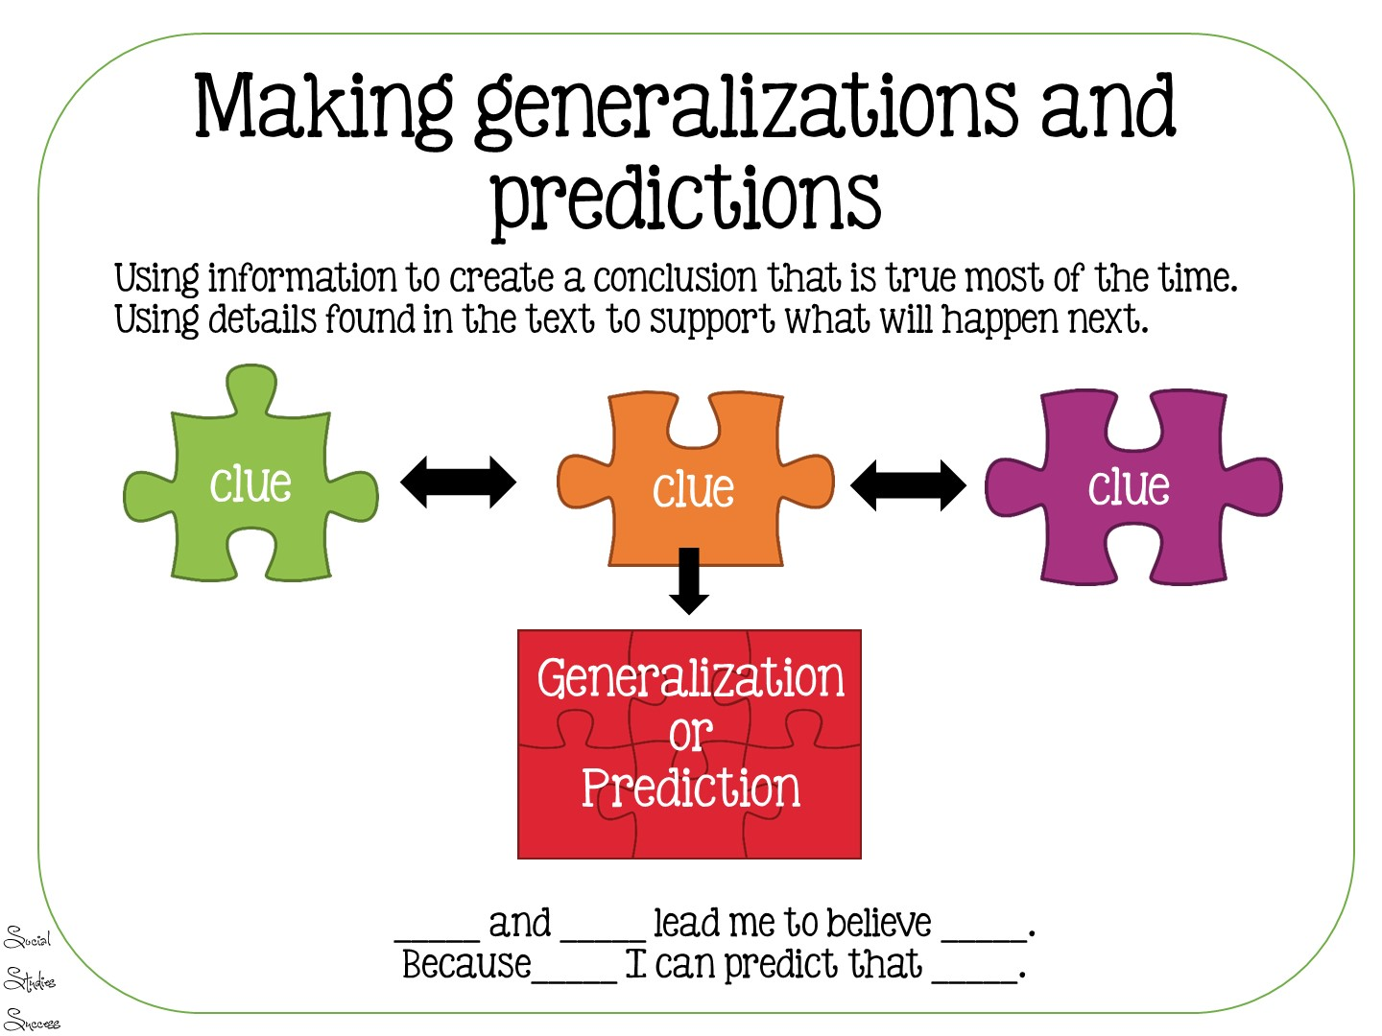

Slide 25
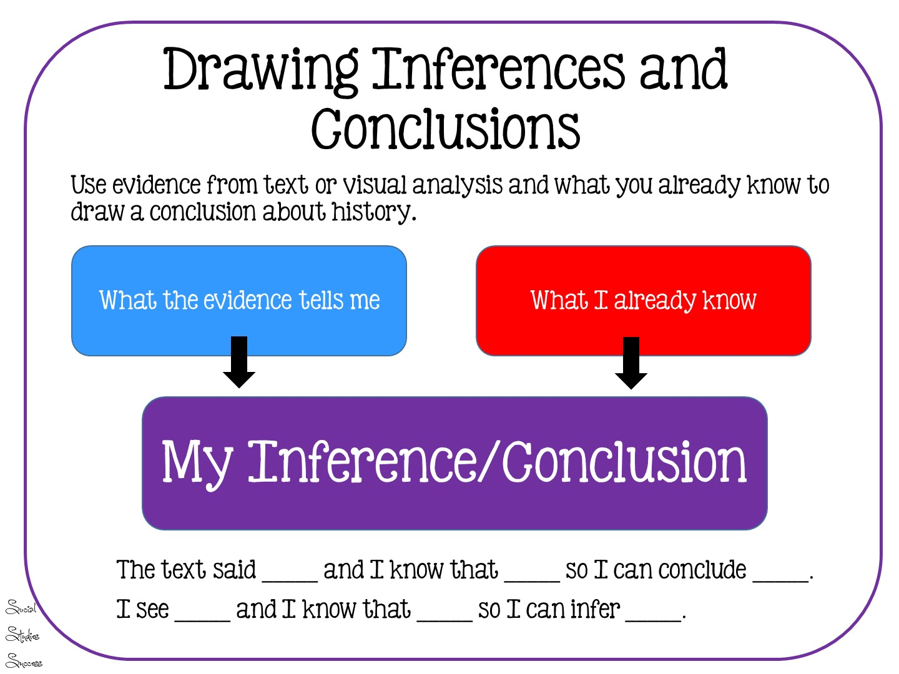

Slide 26
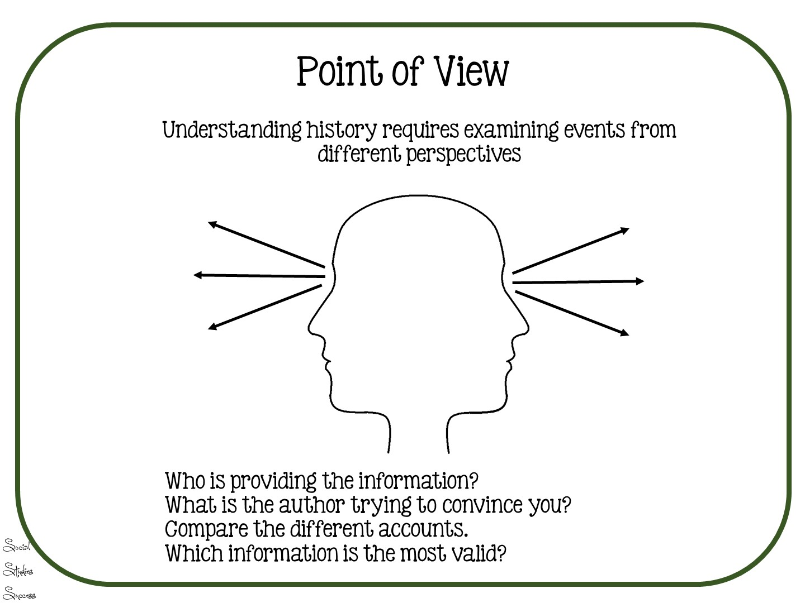

Slide 27

Notes:
27

Slide 28


Slide 29
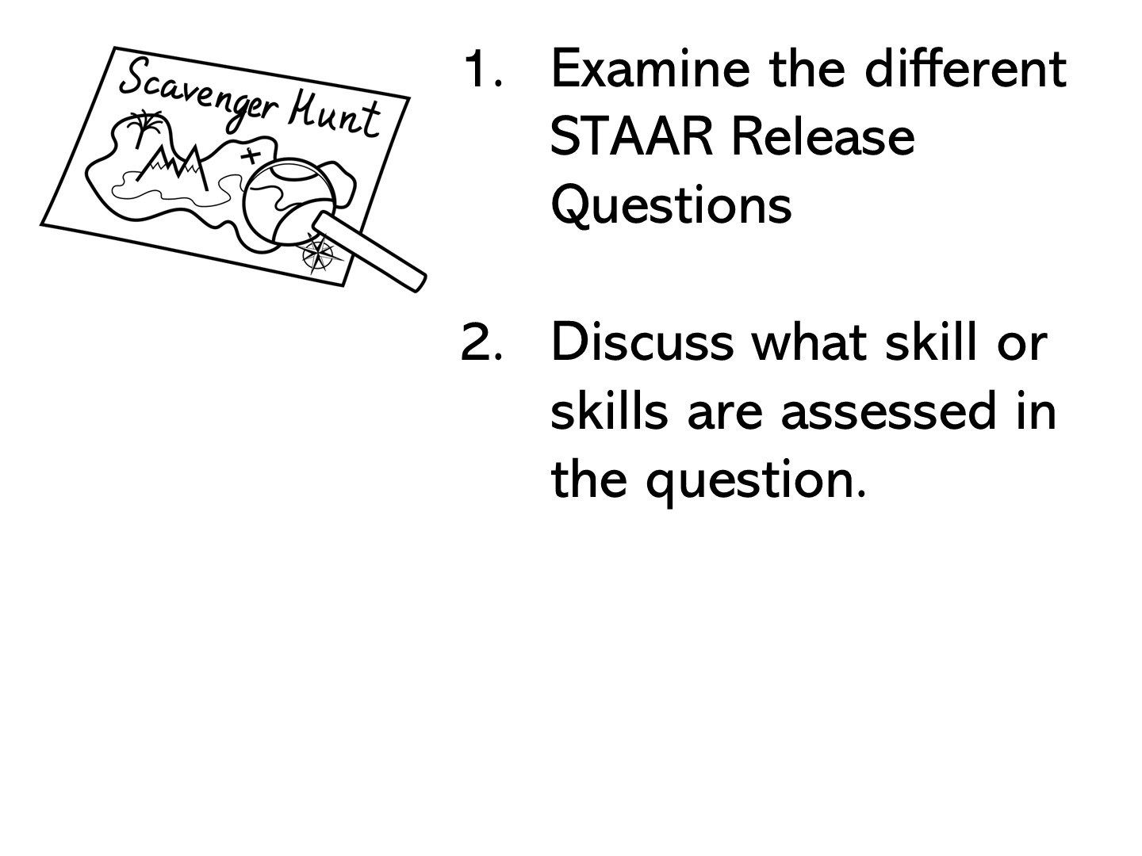
Notes:
Pass out a variety of STAAR release questions and have them discuss.

Slide 30


Slide 31

Notes:
All of the games you are going to model are based on content and skills.

Slide 32
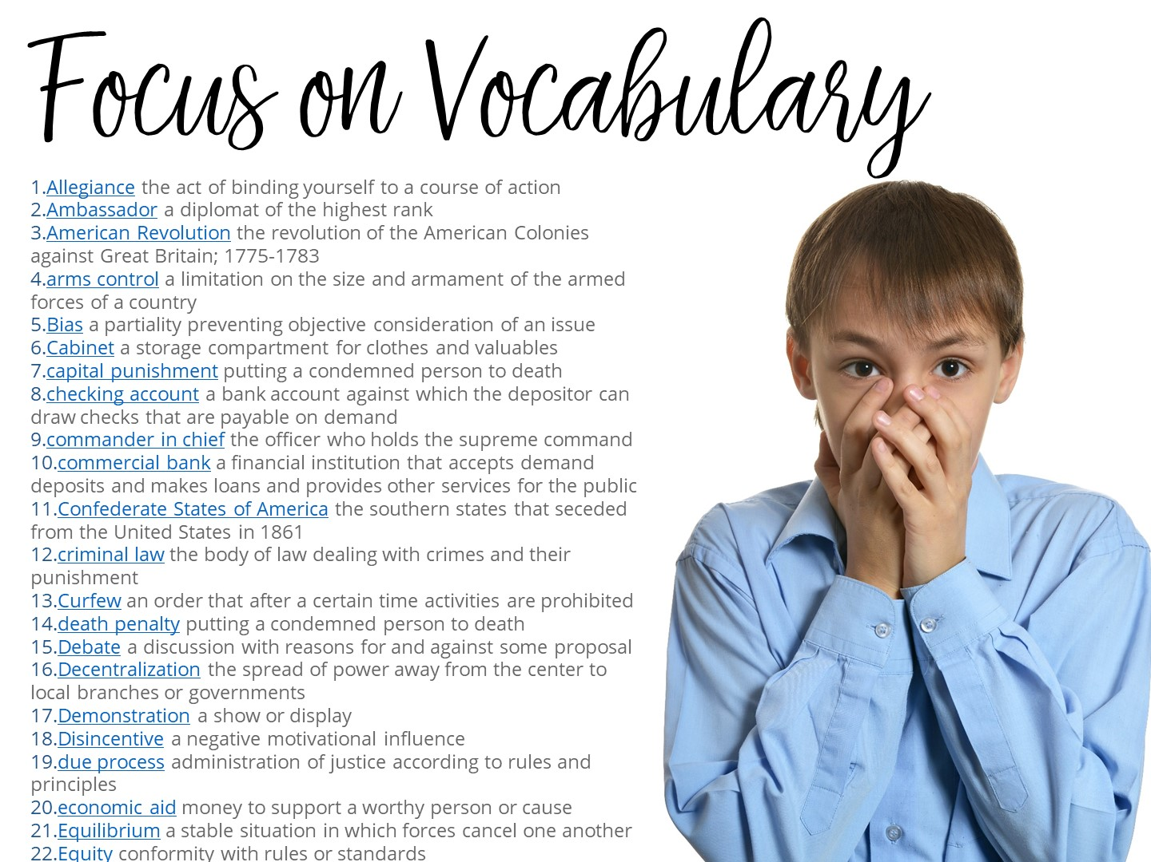
Notes:
Vocabulary is intensive on the test! We must review vocabulary throughout your entire review.
Pass out Colonization Vocabulary Cards.

Slide 33
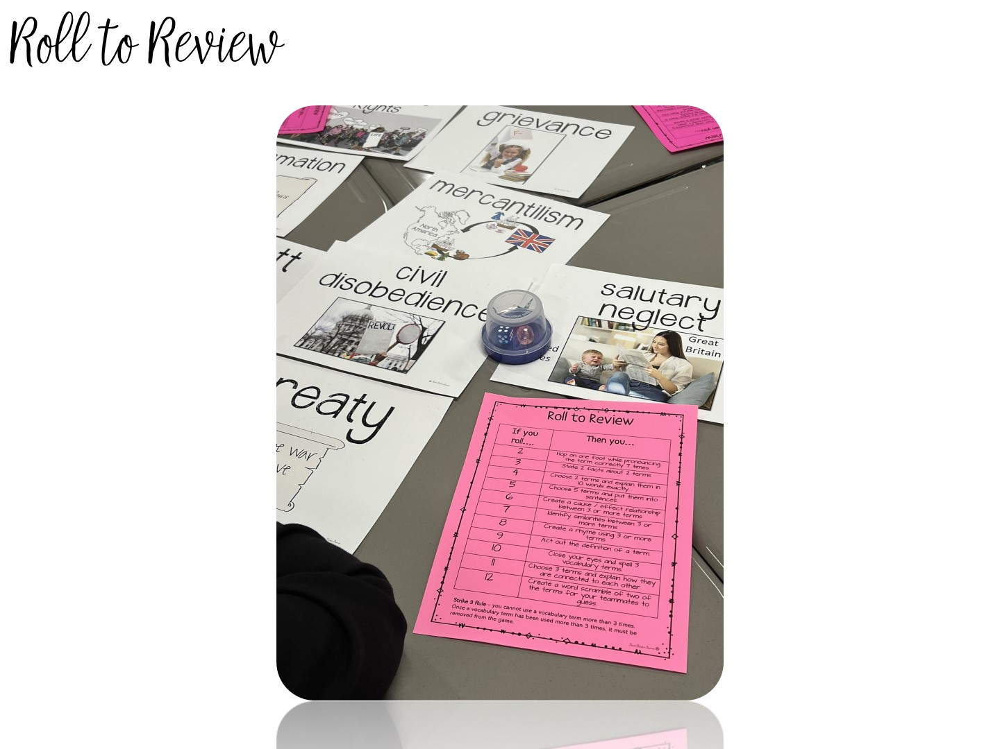
Notes:
Pass out Roll to Review Handout and dice boxes.

Slide 34
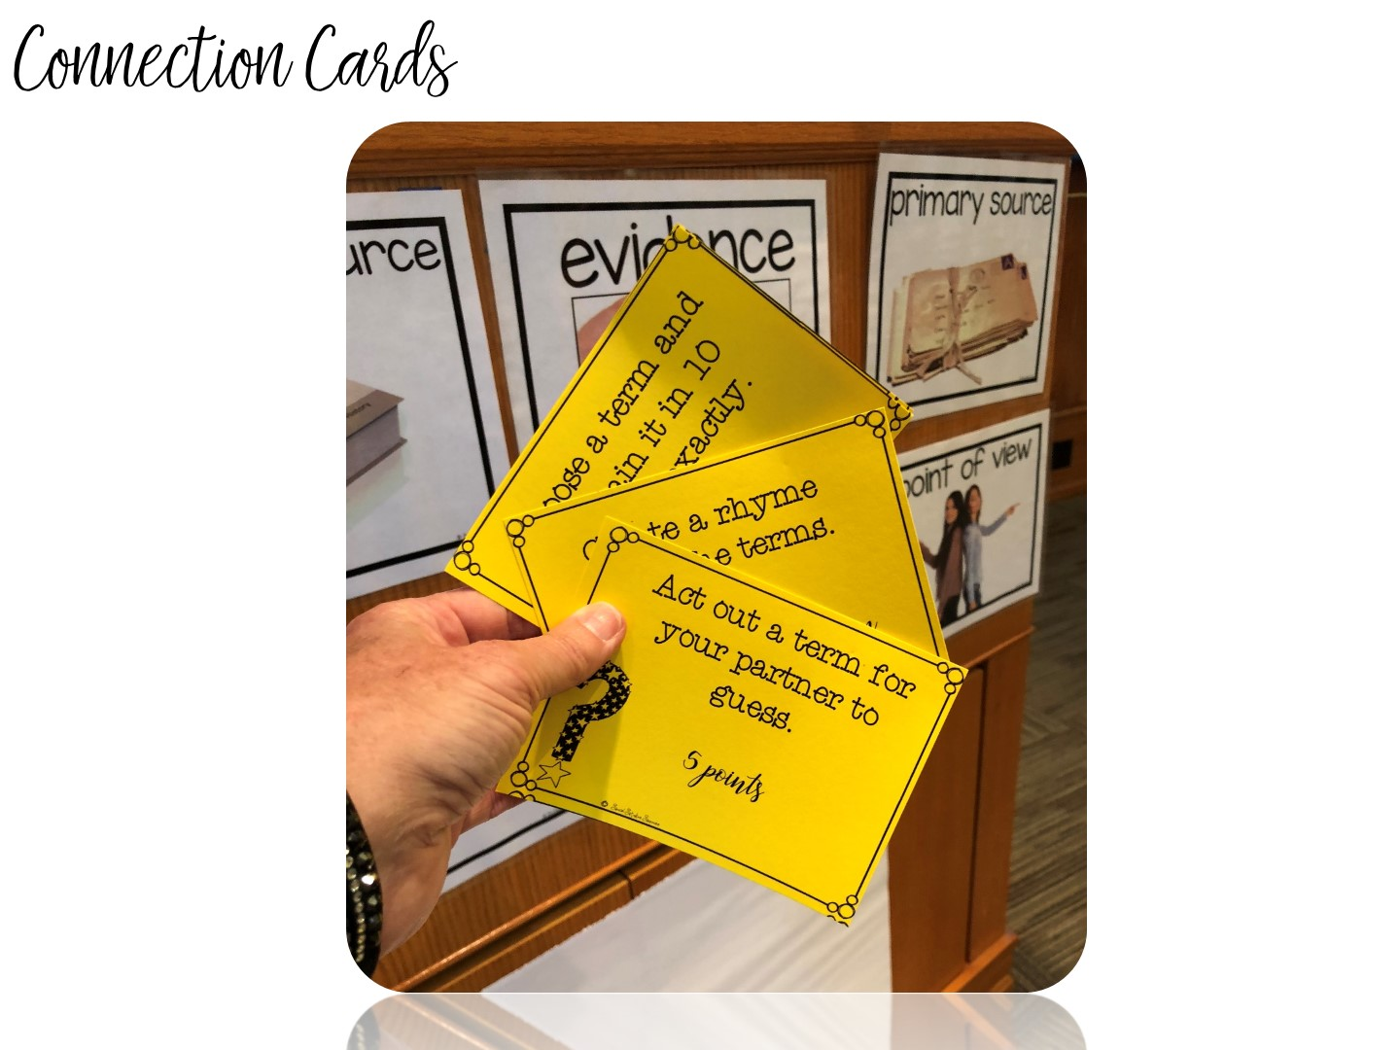
Notes:
Explain and play if given time.

Slide 35

Notes:
You are now going to highlight different activities and games for the different eras, but keep in mind, all of the eras have similar games to choose from.

Slide 36
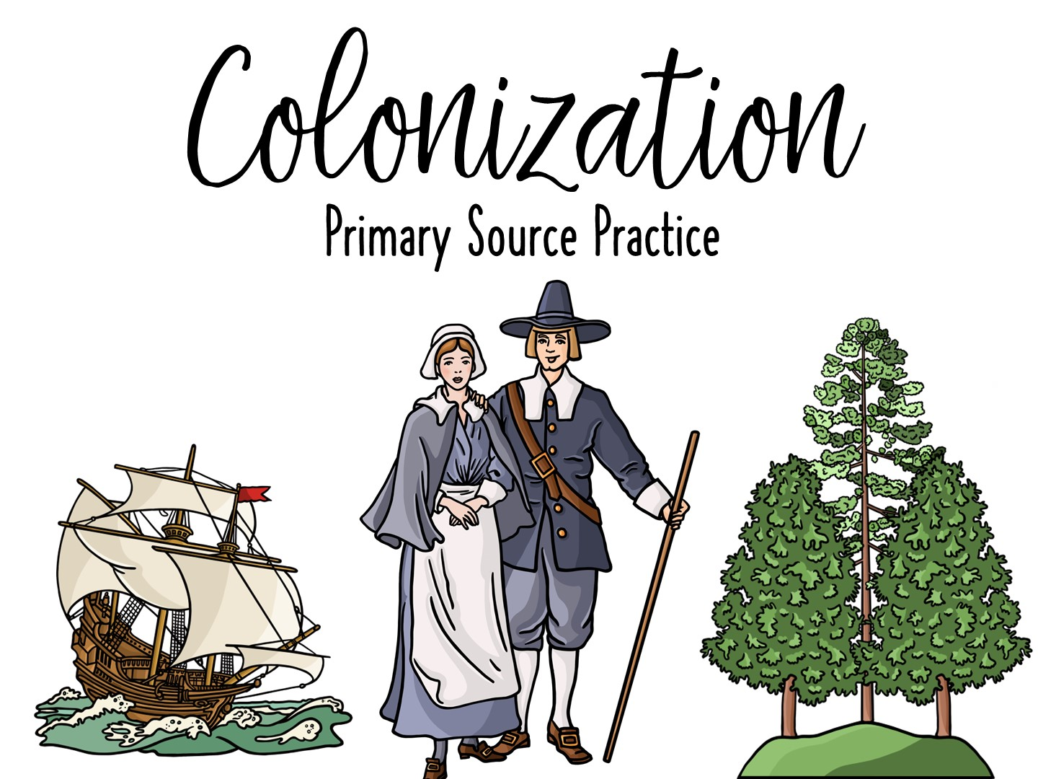
Notes:
Let’s take a look at how to tackle practicing for Primary Source Questions.

Slide 37
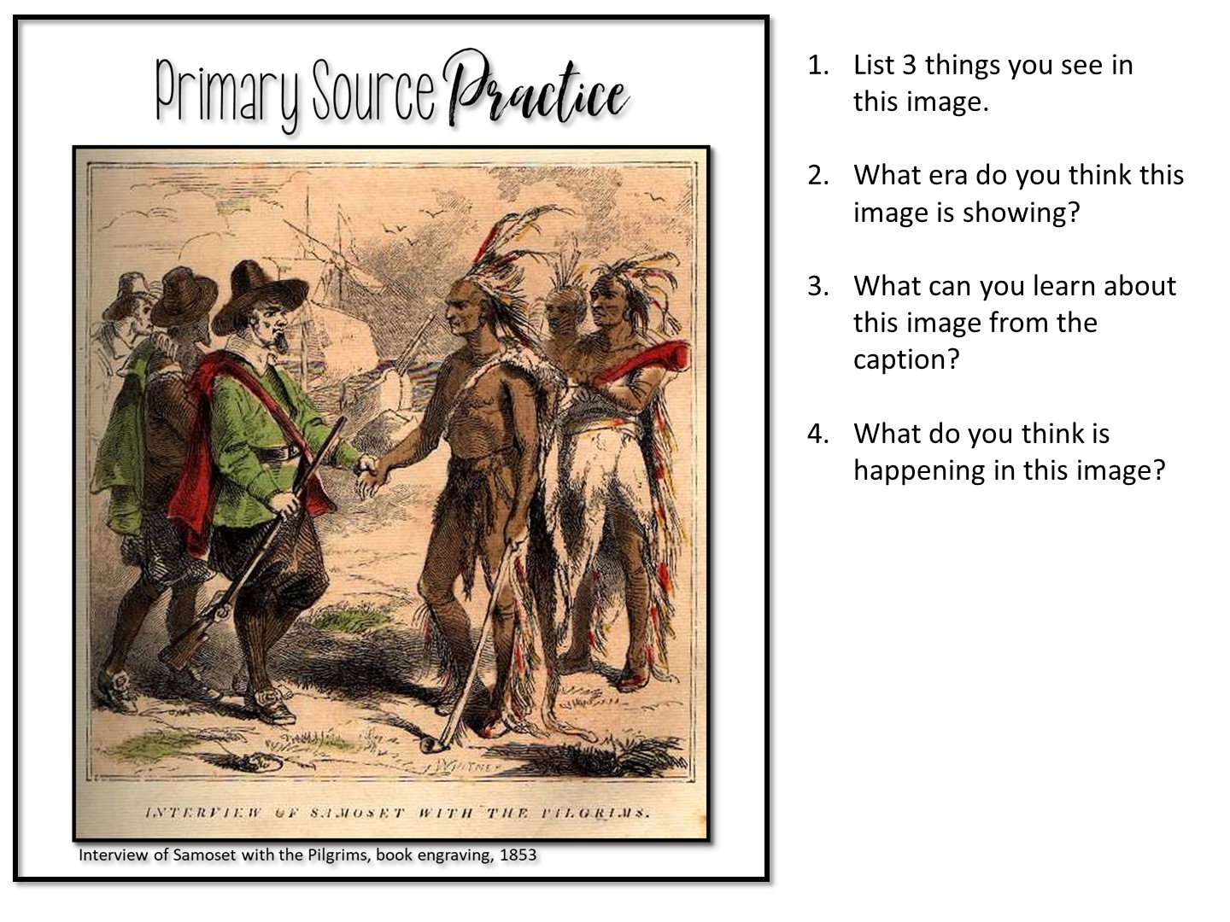
Notes:
Discuss with partner

Slide 38
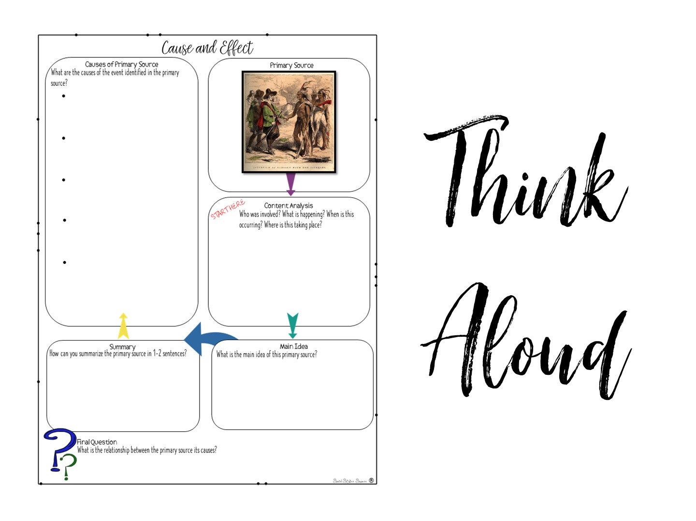
Notes:
Model how to complete this cause and effect handout with a think aloud

Slide 39
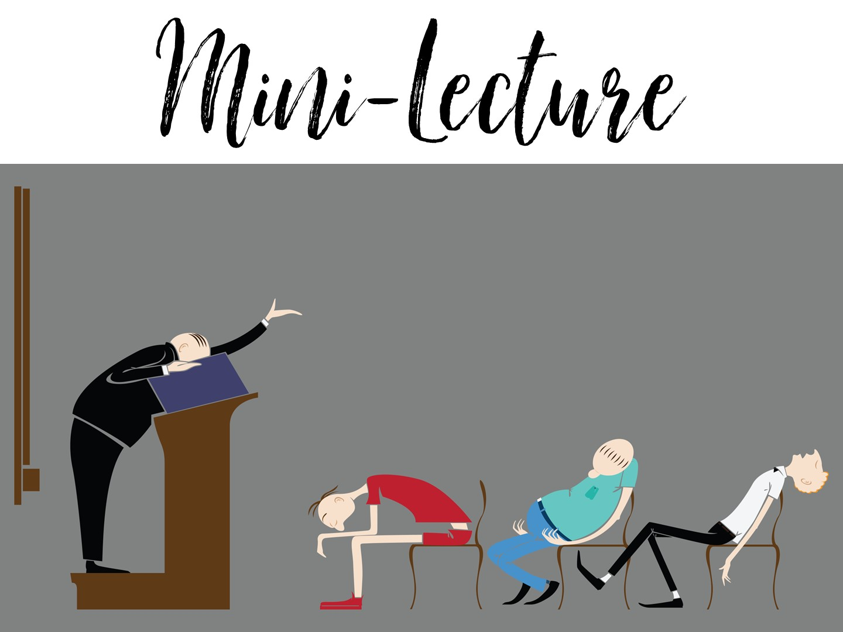
Notes:
You can use short lectures to review content

Slide 40
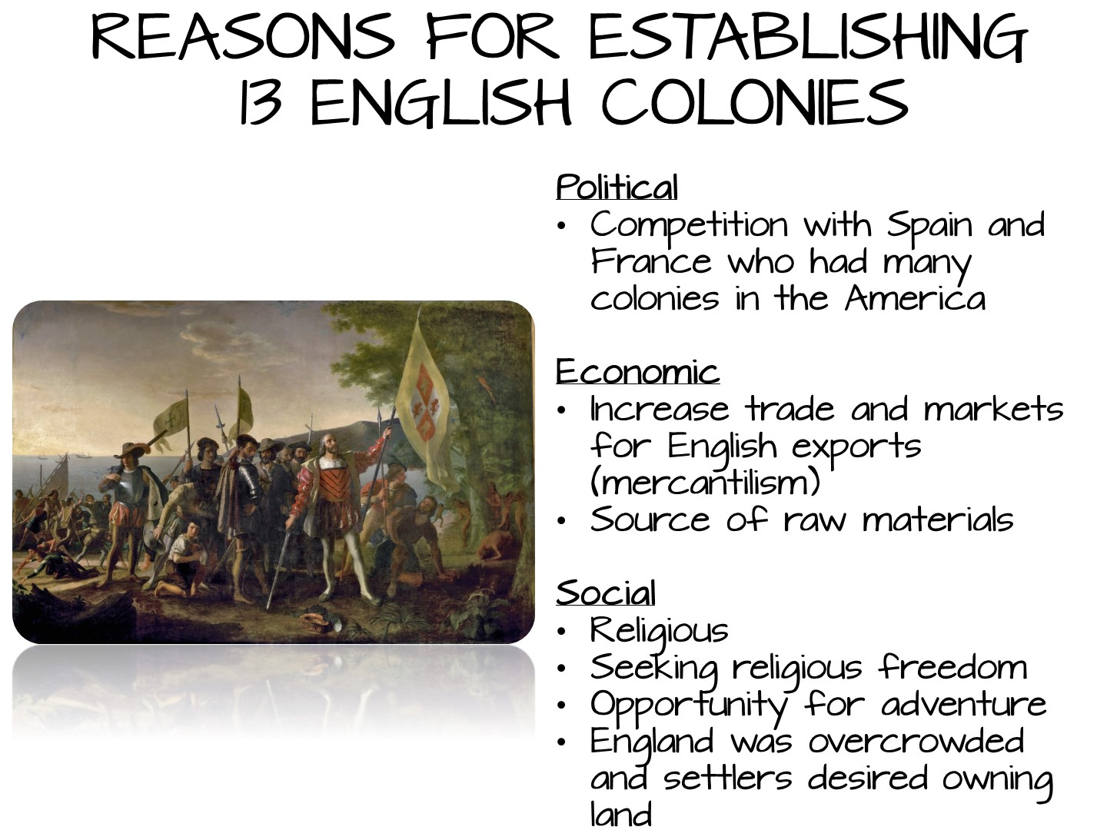

Slide 41
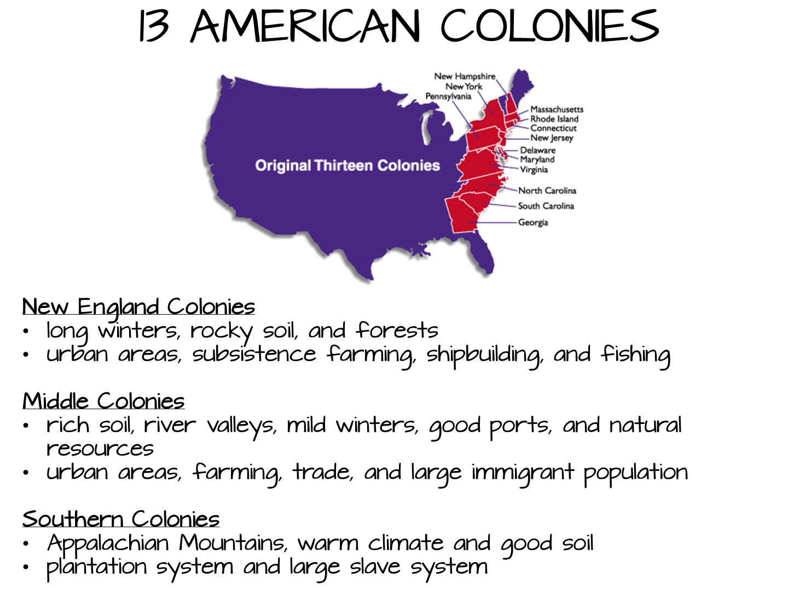

Slide 42


Slide 43


Slide 44


Slide 45
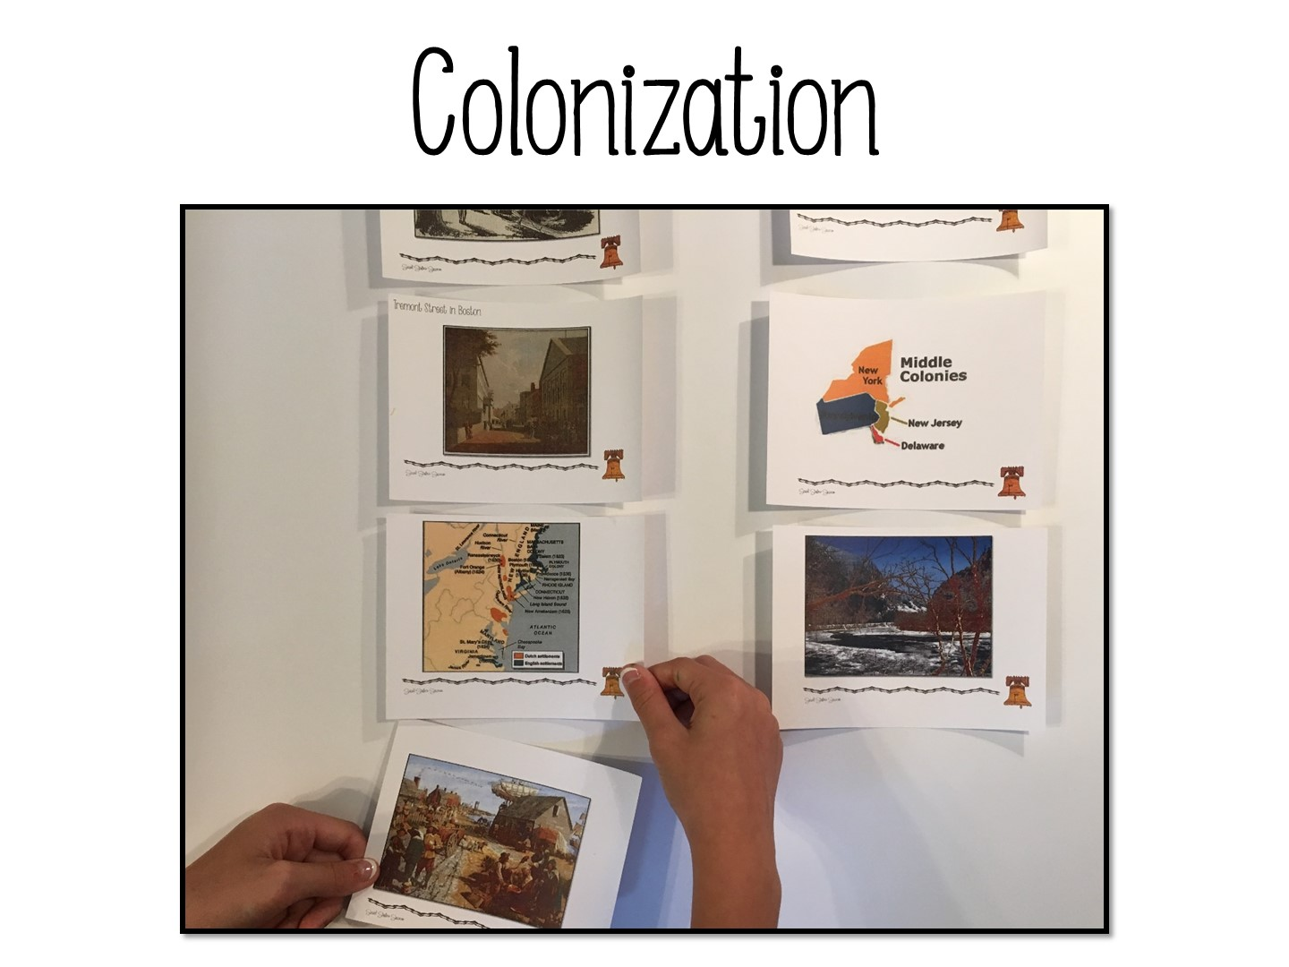
Notes:
Colonization Card Sort

Slide 46
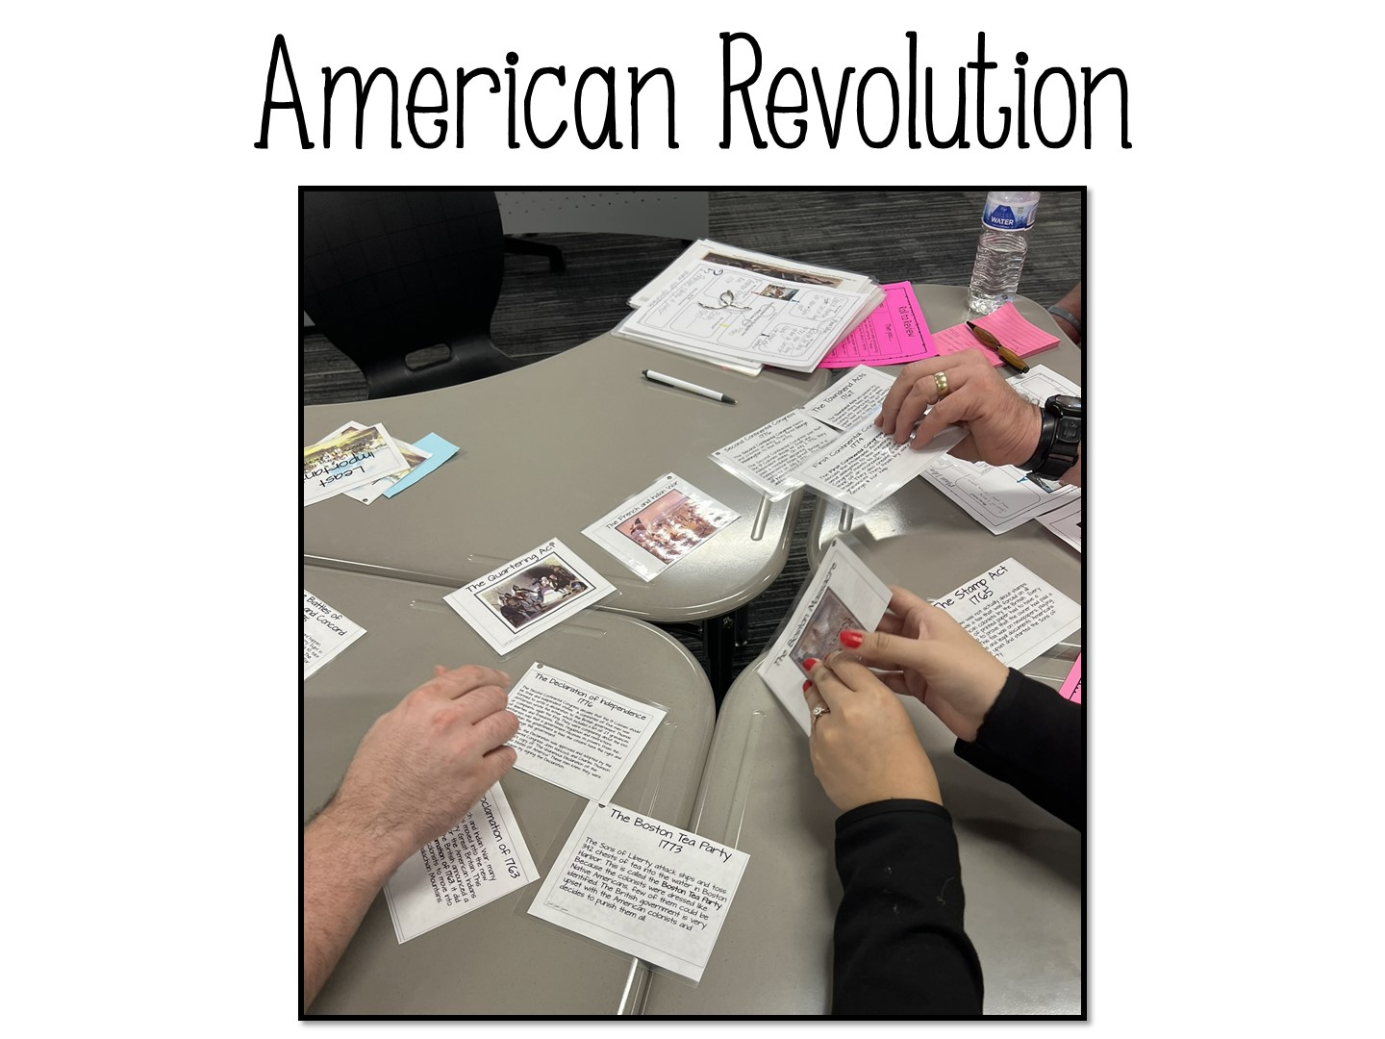
Notes:
American Revolution Sequencing Activity

Slide 47
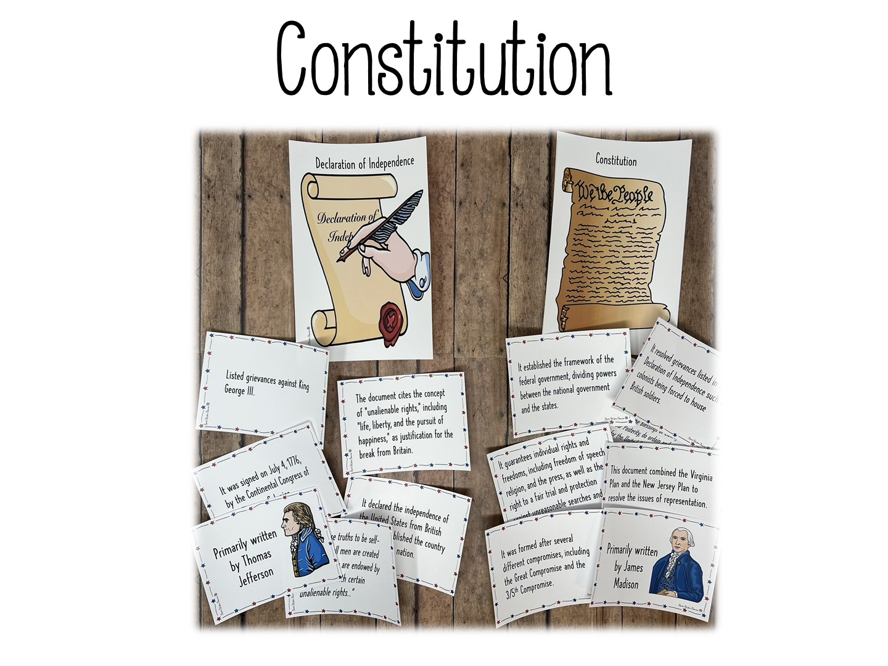
Notes:
Declaration of Independence vs Constitution Card Sort – note, this has been tested several times.

Slide 48
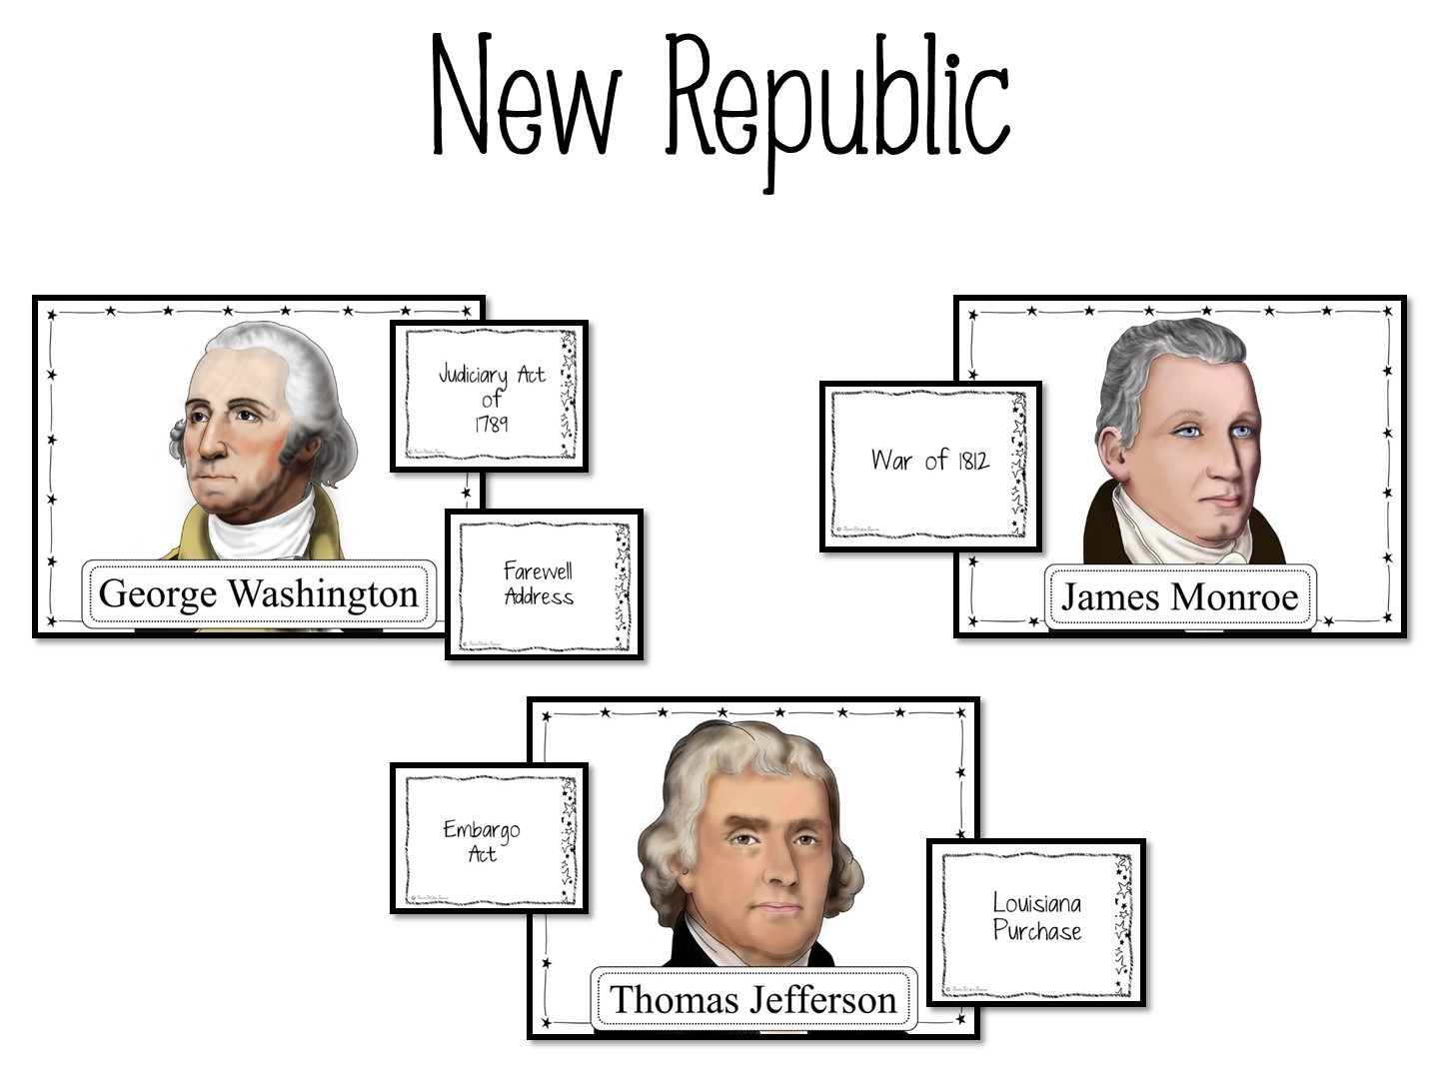
Notes:
Presidents of the New Republic Card Sort

Slide 49

Notes:
Industrial Revolution Guess in 3

Slide 50

One person in the group will choose a card. They will read the statements on the card to the person on their left. If the person can guess the Person, Place, Term or Thing with one statement, they get 10 points.
If they don’t know the answer or give an incorrect answer, read the second clue. If they get it right, they earn 5 points.
If they don’t know or give an incorrect answer, read the third clue. If they get it right, they earn 3 points.
Rotate the role of reader within the group for each round.
Notes:
Guess in 3 is another opportunity for you to allow your students to talk using the terms.

Slide 51
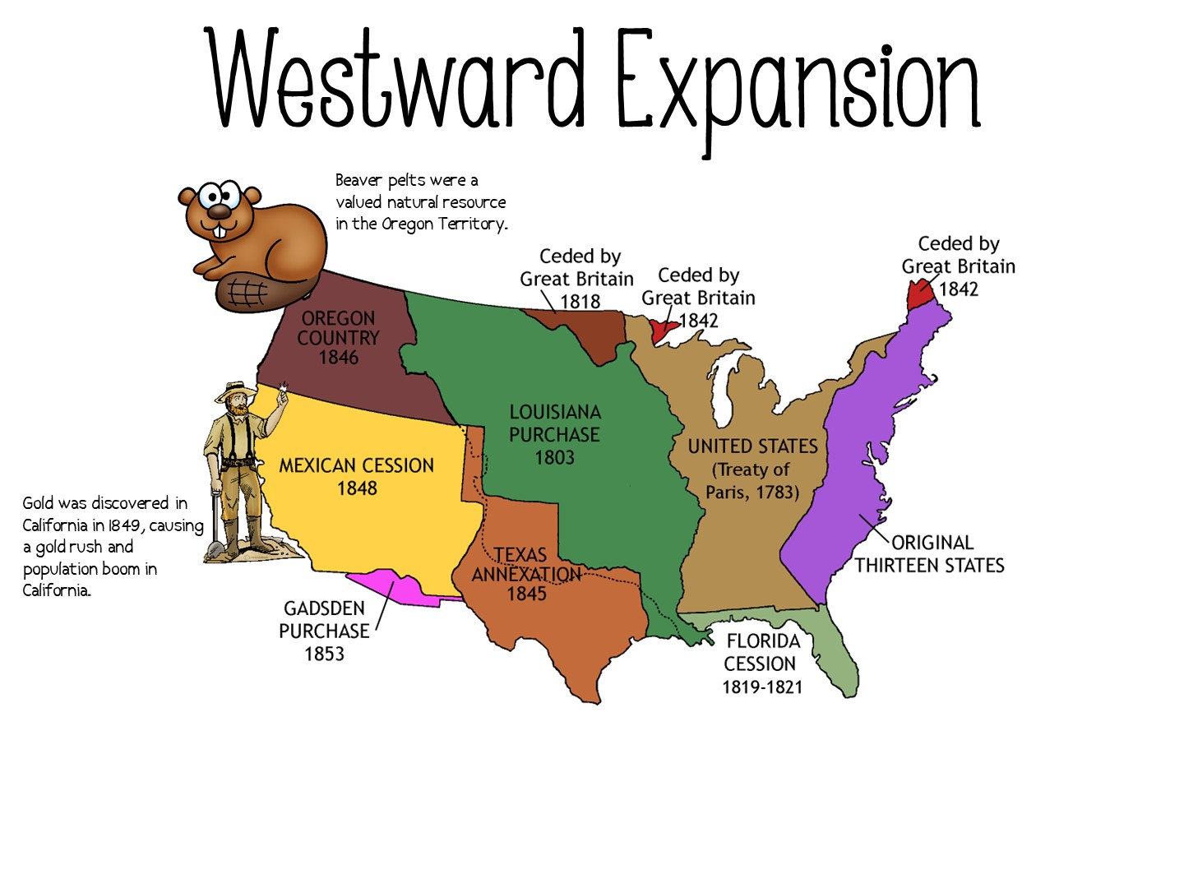
Notes:
Just show and explain Annotated Map for Westward Expansion

Slide 52
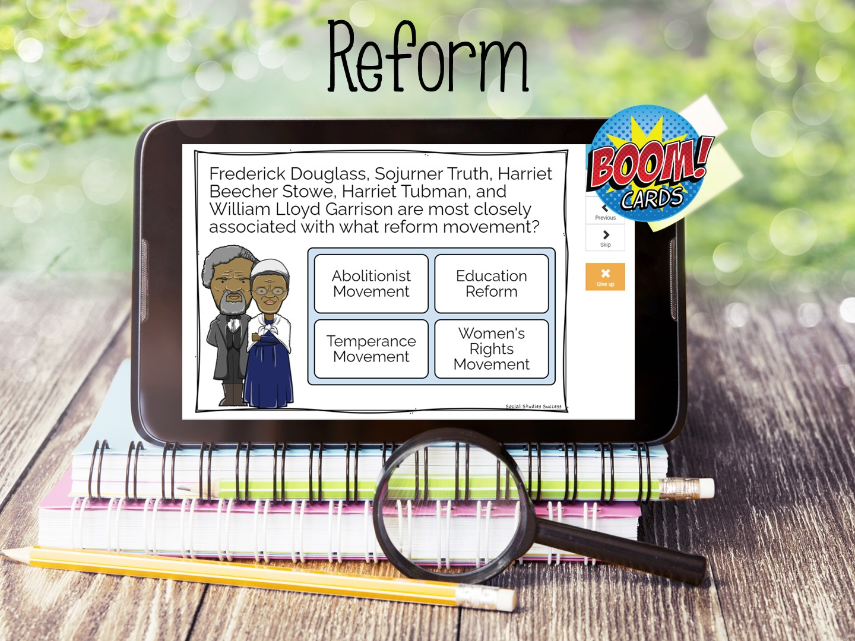
Notes:
You will need to create a link for the Boom Cards

Slide 53
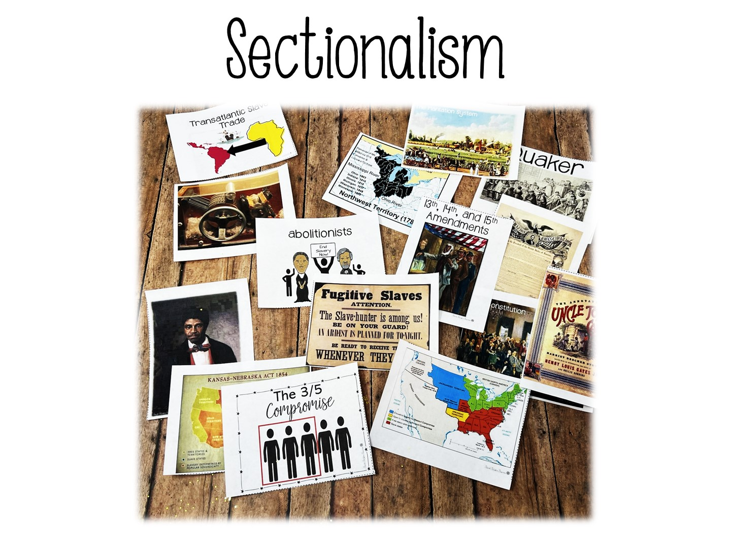
Notes:
History of Slavery Activity – Note that this works really well for connections across time

Slide 54
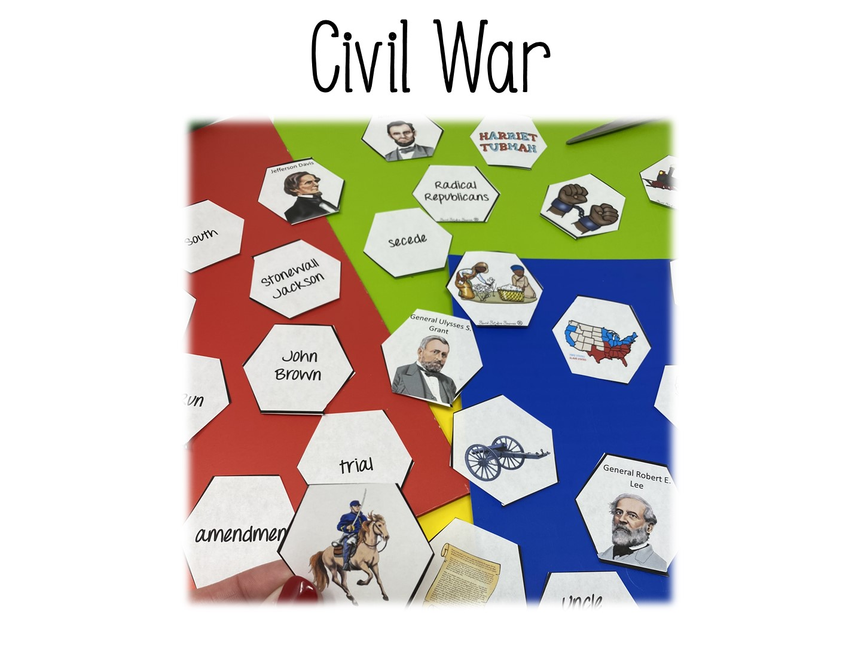
Notes:
Civil War Hexagonal Thinking

Slide 55
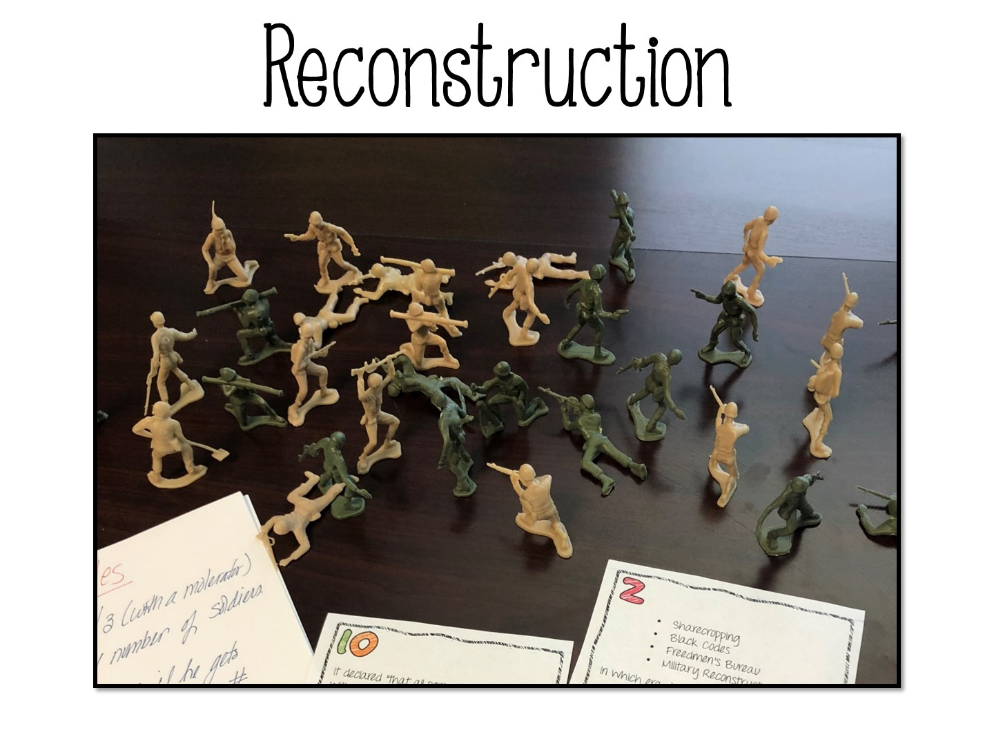
Notes:
Reconstruction Task Card Set
Toy Soldiers

Slide 56
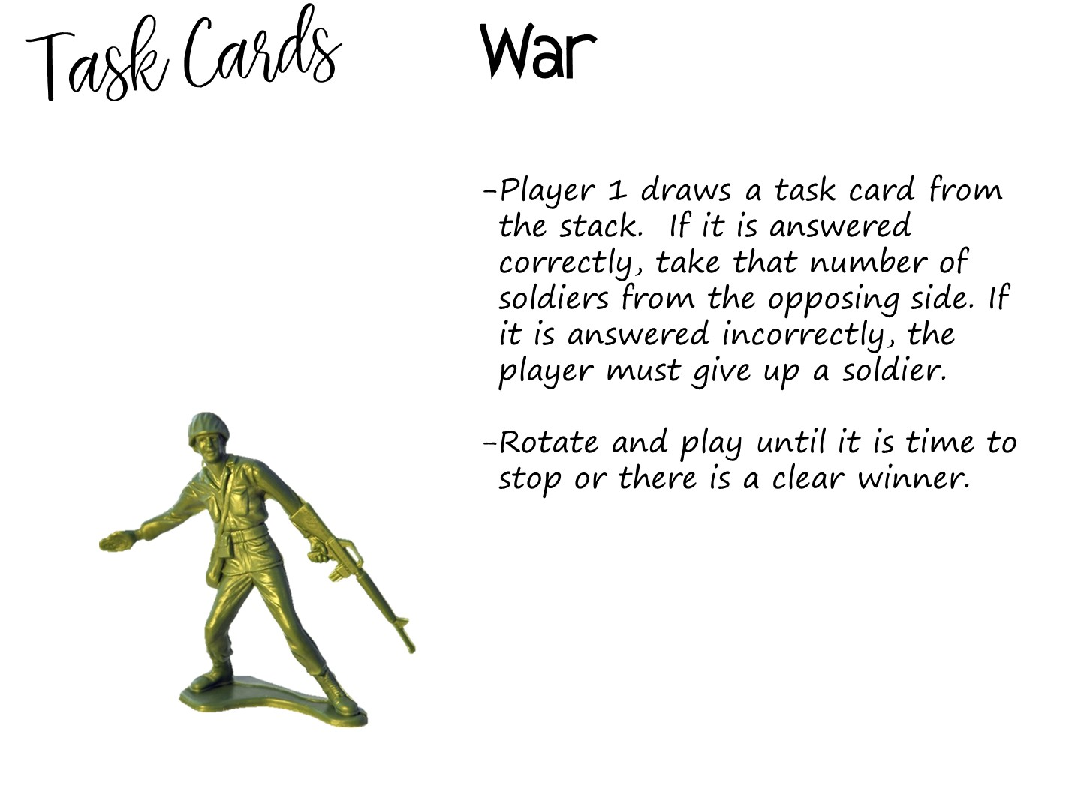

Slide 58


