Slide 1
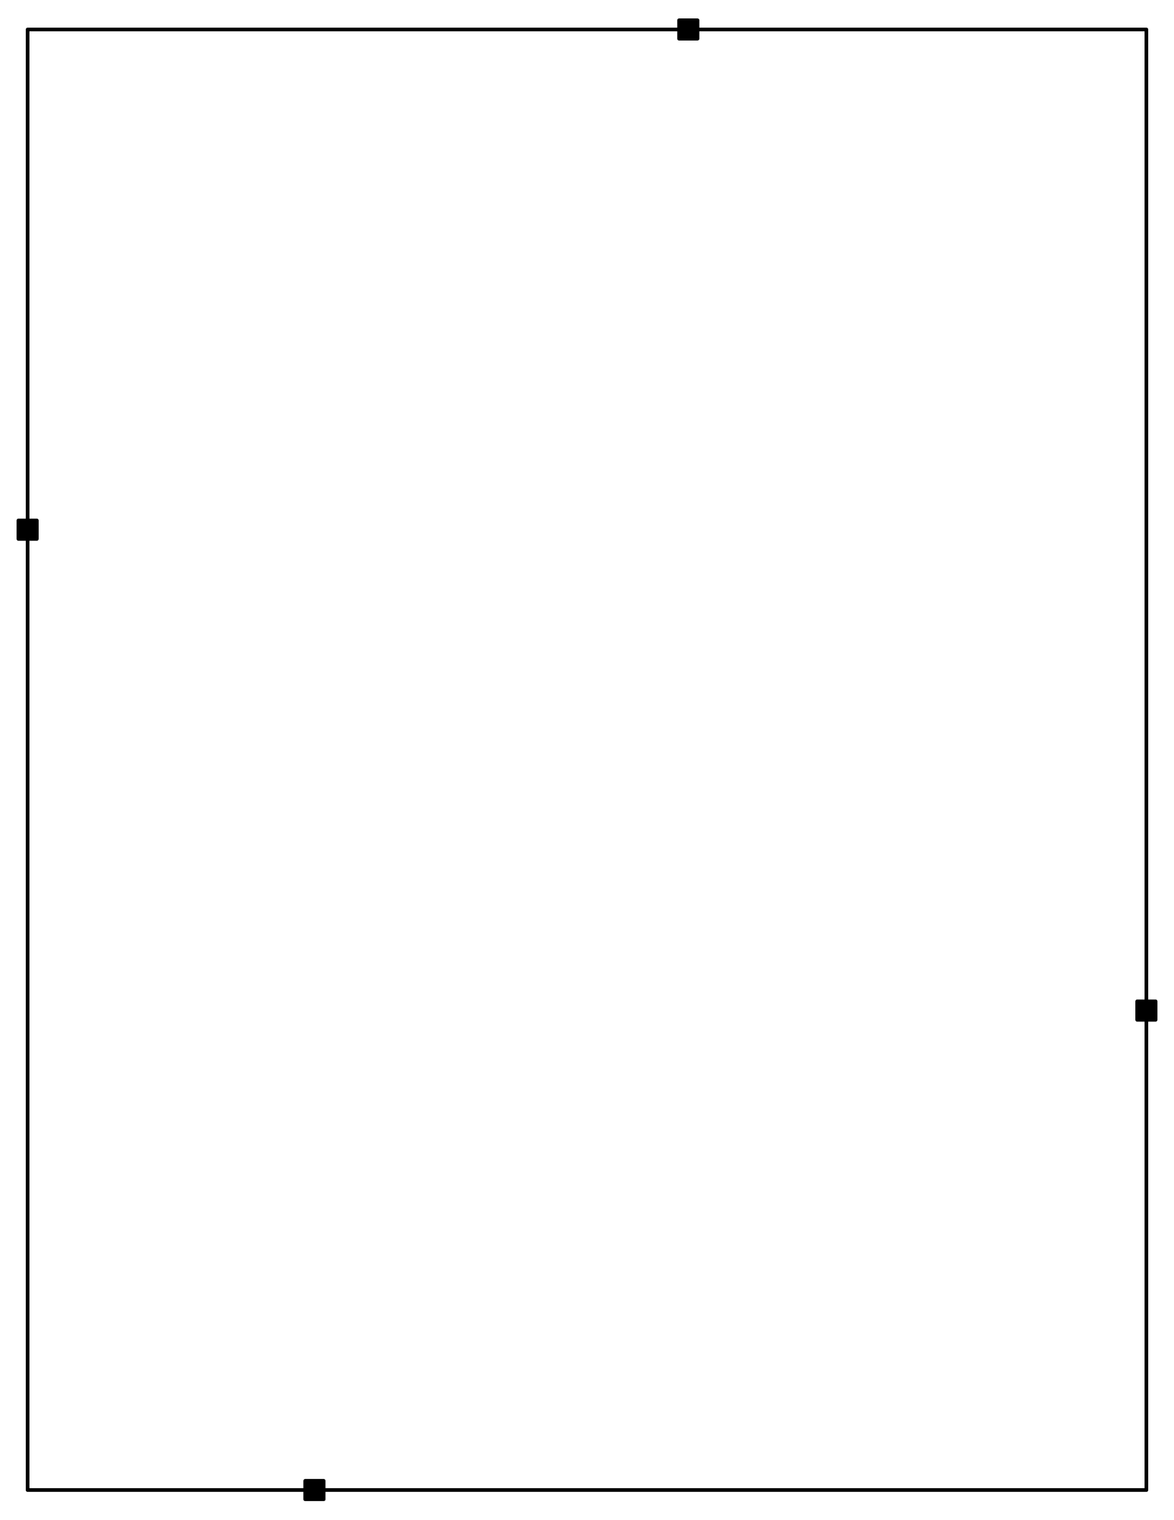
Midway ISD
Make sure you have the following supplies and copies for this workshop.
Materials
Copies Sent To Sponsor
socks
blue tape
crop it tools
4-Corner Signs
Texas Explorers Readings – Page one and Two and images in Restaurant Menus
Magnets for Word Walls on White Boards
Preview Puzzles
During Reading Placards
After Reading Scenarios
Texas Explorers Word Wall Terms
Reading Strategies Doodle Notes
Literacy Strategies Manual
Tips for Selecting Vocabulary Terms
Tips for Word Walls
Vocabulary Pyramid
Vocabulary Strategies Manual
Directions for Accessing Your Resources
Copies You Bring – print all in color
Texas Explorers Color-Coded Vocabulary
Texas Explorers Doodle Notes (7th)
Reading Strategies Manual
Vocabulary Strategies Manual
One original copy of each of the handouts above (print from here)

Slide 2
Midway ISD
Prepare the room
Place socks next to sign in sheet. Make sure you have matching pairs, but all scrambled up.
Reading Doodle Notes next to sign in sheet for teachers to pick up.
Post Latin America Word Wall Terms
Check your sponsor provided materials. If anything is missing, let them know you need it immediately!
colored pencils
post it notes
Highlighters
Markers
Chart paper

