Slide 1
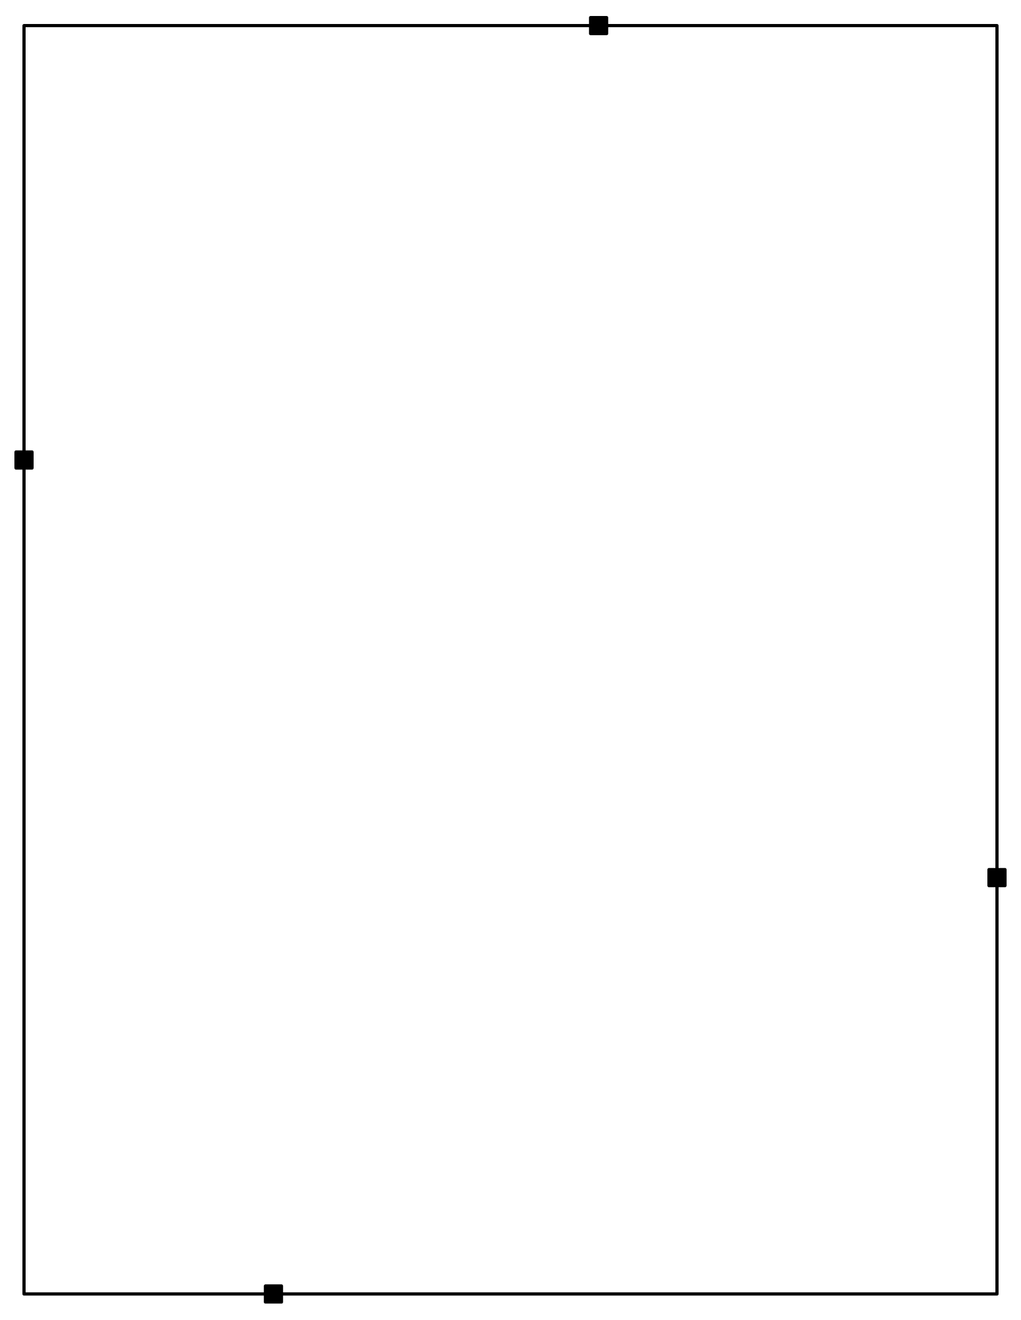
White Settlement ISD
Make sure you have the following supplies and copies for this workshop.
Materials
Copies Sent To Sponsor
socks
blue tape
crop it tools
4-Corner Signs
Columbus and Invasion Images - Latin America Readings – Page One
Magnets for Word Walls on White Boards
Latin America Word Wall Terms
Word Wall Connection Cards
Engagement Signs
Pick A Card set – you may have to make these, I am not sure if you have them
Question Dice Boxes
Texas Revolution Task Cards
Kaboom! Cards
Toy Soldiers
Causes of the TX Revolution Sorting Cards
Events Leading to the Texas Revolution Debrief Cards
Events Leading to the Texas Revolution Word Wall Terms
Station Directions – print 2-3 sets in color and place in plastic sleeves or laminate
Color Coded Vocabulary Activity for Latin America
Engagement Checklist
Doodle Notes for Engagement
Engagement Teaching Strategies
Engagement Tools Checklist
Handouts for the different stations
Copies You Bring – print all in color
Latin America Doodle Notes (6th)
Events to the TX Revolution Doodle Notes (7th)
One original copy of each of the handouts above (print from here)

Slide 2
White Settlement ISD
Prepare the room
Place socks next to sign in sheet. Make sure you have matching pairs, but all scrambled up.
Engagement Doodle Notes next to sign in sheet for teachers to pick up.
Post Texas History Word Wall Terms
Check your sponsor provided materials for the Make N Take. They should have all the supplies on the next page.
During lunch, set up the stations with the directions for each.

Slide 3

- craft (popsicle) sticks FOR POPSICLE STICK PEOPLE
- glue gun and glue sticks
- laminating pouches (I have two laminating machines I can bring, but if you also provide yours, that would be great) ALSO MAKE DRY ERASE BOARDS
- crayon boxes (the small ones from Wal-Mart or similar) 5-6 sets per participant FOR DISCUSSION DICE
- plastic toy soldiers (like from the Dollar Store) 4-5 sets per participant FOR WAR
- Jenga blocks (from the Dollar Store) 1 box per participant FOR LOGIC BOXES
- blank labels (size 8167 - Return Address) 1-2 sheets per participant FOR LOGIC BOXES
- dice (12-14 per participant)
- package of index cards (2 per participant) FOR QUICK WRITE ACTIVITIES
- post-it notes (2-3 packs per participant)
dry erase markers (1 pack per participant)
Binder clips or rubber bands
Supply List for Engagement Tool Kit
Laminators – either access to a large one or several small ones
Lamination sleeves – honestly, if we could give each teacher their own box, it would be amazing (https://www.amazon.com/AmazonBasics-Letter-Laminating-Pouches-100-pack/dp/B00BWU3HNY/ref=sr_1_6?dchild=1&keywords=lamination+sleeves&qid=1616686836&sr=8-6) or if we gave 50 to each teacher (https://www.amazon.com/Fellowes-Thermal-Laminating-Pouches-Pack/dp/B06XRLTJWM/ref=sr_1_15?dchild=1&keywords=lamination+sleeves&qid=1616687059&sr=8-15)
Paper clips (just have some available for the workshop)
Binder clips (just have some available for the workshop)
Scissors
Paper cutter (if we could have 1-2 of these available)
Sharpie markers (just available)
Rubber bands (just available)
Sandwich size Ziploc bags – just one box
Dice (each teacher would need 10) - https://www.amazon.com/SmartDealsPro-Assorted-Mini-Dice-Square/dp/B00H8M27S6/ref=sr_1_2?dchild=1&keywords=tiny+dice&qid=1616687258&sr=8-2 )
Army soldiers (each teacher would need 100) - https://www.amazon.com/RAINBOW-TOYFROG-Bucket-Soldiers-WWII-Over-Piece/dp/B07CSGKH4S/ref=sr_1_7?crid=3UWZHLQP03OZK&dchild=1&keywords=plastic+army+men&qid=1616687348&sprefix=plastic+army%2Caps%2C196&sr=8-7 )
Regular size envelopes (just need some available)
Colored craft sticks - https://www.amazon.com/Popsicle-Childrens-Handicrafts-Creative-Education/dp/B08Y5V42SW/ref=sr_1_8?dchild=1&keywords=colored+craft+sticks&qid=1625061706&sr=8-8
Large Craft (popsicle) sticks – each teacher will need 50 - https://www.amazon.com/Premium-Natural-Building-Creating-Projects/dp/B08R31HGXV/ref=sr_1_5?crid=3M4IEEW718DOF&dchild=1&keywords=craft+sticks&qid=1625061230&sprefix=craft+s%2Caps%2C198&sr=8-5
Glue guns (8) and glue sticks
Small plastic boxes – like crayon boxes – These will need to fit two dice, so if you buy smaller boxes, make sure you get smaller dice https://www.amazon.com/Plastic-Storage-Containers-Jewelry-Hardware/dp/B07VMVYKTS/ref=sr_1_2?crid=231V70E1KMSPX&dchild=1&keywords=small+plastic+boxes+for+jewelry&qid=1625061361&sprefix=small+plastic+box%2Caps%2C202&sr=8-2
A tub or basket for all of your teachers to keep these supplies in – like https://www.amazon.com/Ggbin-Quart-Storage-Handle-Latches/dp/B01DDGDT64/ref=sr_1_23?crid=108A4Q6LDDOVE&dchild=1&keywords=plastic+tub+with+handles+for+carrying&qid=1625062131&sprefix=plastic+tub+with+hand%2Caps%2C184&sr=8-23
I recommend shopping at the dollar store – items do not have to exactly match those listed.

