Slide 1


Understanding the
Interactive
Student Notebook
Kathleen Geraghty
Social Studies Success
Notes:
Place ISN samples around the room.

Slide 2



Slide 3

Who am i?
District Resource
Teacher
Trainer
Mom
Team Lead
Dept
Chair
Wife
Kathleen
Social Studies Success
Notes:
Introduce yourself

Slide 4
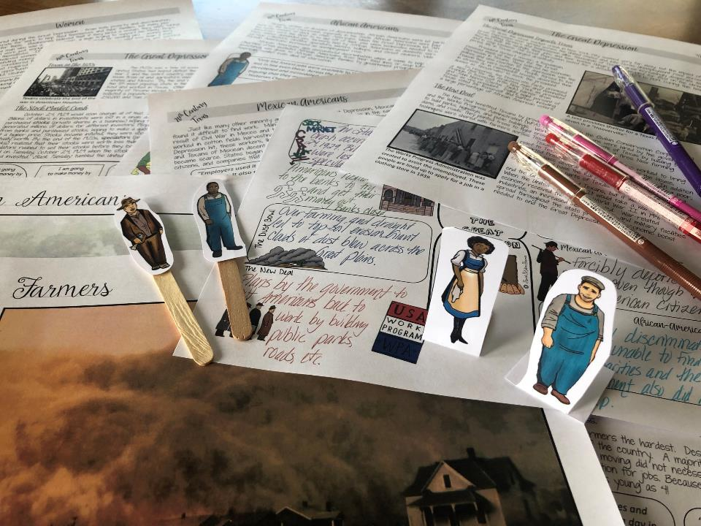
What do I believe about Social Studies instruction?
Students need to be engaged to learn.
-Schlechty’s Design Qualities of Engagement

Slide 5
What do I believe about Social Studies instruction?
Students need to be engaged to learn.
-Schlechty’s Design Qualities of Engagement
Students need to read in Social Studies – a lot! Like everyday!
-Kinsella’s Considerate Text

Slide 6
What do I believe about Social Studies instruction?
Students
are social – purposeful talk is crucial to learning.
-Walsh Quality Questioning
Students need to be engaged to learn.
-Schlechty’s Design Qualities of Engagement
Students need to read in Social Studies – a lot! Like everyday!
-Kinsella’s Considerate Text

Slide 7
What do I believe about Social Studies instruction?
Students
are social – purposeful talk is crucial to learning.
-Walsh Quality Questioning
Students need to be engaged to learn.
-Schlechty’s Design Qualities of Engagement
Students need to read in Social Studies – a lot! Like everyday!
-Kinsella’s Considerate Text
History can be fun and rigorous at the same time.
-Bower’s Bring Learning Alive!
Notes:
.

Slide 8
What do I believe about Social Studies instruction?
Students
are social – purposeful talk is crucial to learning.
-Walsh Quality Questioning
Students need to be engaged to learn.
-Schlechty’s Design Qualities of Engagement
Students need to read in Social Studies – a lot! Like everyday!
-Kinsella’s Considerate Text
All students can learn – we just need to support them in different ways.
-Seidlitz’s Seven Steps
History can be fun and rigorous at the same time.
-Bower’s Bring Learning Alive!

Slide 9
What do I believe about Social Studies instruction?
Students
are social – purposeful talk is crucial to learning.
-Walsh Quality Questioning
Students need to be engaged to learn.
-Schlechty’s Design Qualities of Engagement
Students need to read in Social Studies – a lot! Like everyday!
-Kinsella’s Considerate Text
All students can learn – we just need to support them in different ways.
-Seidlitz’s Seven Steps
History can be fun and rigorous at the same time.
-Bower’s Bring Learning Alive!
The
Interactive Student
Notebook is a powerful
teaching tool that allows you to differentiate instruction for students in a variety of ways.
-Wist’s Research on the Interactive Student
Notebook

Slide 10
What do I believe about Social Studies instruction?
Students
are social – purposeful talk is crucial to learning.
-Walsh Quality Questioning
Students need to be engaged to learn.
-Schlechty’s Design Qualities of Engagement
Students need to read in Social Studies – a lot! Like everyday!
-Kinsella’s Considerate Text
All students can learn – we just need to support them in different ways.
-Seidlitz’s Seven Steps
History can be fun and rigorous at the same time.
-Bower’s Bring Learning Alive!
The
Interactive Student
Notebook is a powerful
teaching tool that allows you to differentiate instruction for students in a variety of ways.
-Wist’s Research on the Interactive Student
Notebook
History should not be trivial pursuit – dig deeper and teach with essential questions and enduring understandings.
-Wiggins & McTighe Essential Questions

Slide 11
What do I believe about Social Studies instruction?
Students
are social – purposeful talk is crucial to learning.
-Walsh Quality Questioning
Students need to be engaged to learn.
-Schlechty’s Design Qualities of Engagement
Students need to read in Social Studies – a lot! Like everyday!
-Kinsella’s Considerate Text
All students can learn – we just need to support them in different ways.
-Seidlitz’s Seven Steps
History can be fun and rigorous at the same time.
-Bower’s Bring Learning Alive!
The
Interactive Student
Notebook is a powerful
teaching tool that allows you to differentiate instruction for students in a variety of ways.
-Wist’s Research on the Interactive Student
Notebook
History should not be trivial pursuit – dig deeper and teach with essential questions and enduring understandings.
-Wiggins & McTighe Essential Questions
Vocabulary instruction must be intentional and engaging.
-Marzano Academic Vocabulary

Slide 12
What do I believe about Social Studies instruction?
Students
are social – purposeful talk is crucial to learning.
-Walsh Quality Questioning
Students need to be engaged to learn.
-Schlechty’s Design Qualities of Engagement
Students need to read in Social Studies – a lot! Like everyday!
-Kinsella’s Considerate Text
All students can learn – we just need to support them in different ways.
-Seidlitz’s Seven Steps
History can be fun and rigorous at the same time.
-Bower’s Bring Learning Alive!
The
Interactive Student
Notebook is a powerful
teaching tool that allows you to differentiate instruction for students in a variety of ways.
-Wist’s Research on the Interactive Student
Notebook
History should not be trivial pursuit – dig deeper and teach with essential questions and enduring understandings.
-Wiggins & McTighe Essential Questions
Vocabulary instruction must be intentional and engaging.
-Marzano Academic Vocabulary
Writing is essential for learning, not just assessment.
-Daniels’ Content Area Writing

Slide 13
What do I believe about Social Studies instruction?
Students
are social – purposeful talk is crucial to learning.
-Walsh Quality Questioning
Students need to be engaged to learn.
-Schlechty’s Design Qualities of Engagement
Students need to read in Social Studies – a lot! Like everyday!
-Kinsella’s Considerate Text
All students can learn – we just need to support them in different ways.
-Seidlitz’s Seven Steps
History can be fun and rigorous at the same time.
-Bower’s Bring Learning Alive!
The
Interactive Student
Notebook is a powerful
teaching tool that allows you to differentiate instruction for students in a variety of ways.
-Wist’s Research on the Interactive Student
Notebook
History should not be trivial pursuit – dig deeper and teach with essential questions and enduring understandings.
-Wiggins & McTighe Essential Questions
Vocabulary instruction must be intentional and engaging.
-Marzano Academic Vocabulary
Writing is essential for learning, not just assessment.
-Daniels’ Content Area Writing
Kids need to continuously review content. All students need to participate in classroom activities.
-Himmele’s Total Participation Techniques

Slide 14
What do I believe about Social Studies instruction?
Students
are social – purposeful talk is crucial to learning.
-Walsh Quality Questioning
Students need to be engaged to learn.
-Schlechty’s Design Qualities of Engagement
Students need to read in Social Studies – a lot! Like everyday!
-Kinsella’s Considerate Text
All students can learn – we just need to support them in different ways.
-Seidlitz’s Seven Steps
History can be fun and rigorous at the same time.
-Bower’s Bring Learning Alive!
The
Interactive Student
Notebook is a powerful
teaching tool that allows you to differentiate instruction for students in a variety of ways.
-Wist’s Research on the Interactive Student
Notebook
History should not be trivial pursuit – dig deeper and teach with essential questions and enduring understandings.
-Wiggins & McTighe Essential Questions
Vocabulary instruction must be intentional and engaging.
-Marzano Academic Vocabulary
Writing is essential for learning, not just assessment.
-Daniels’ Content Area Writing
Kids need to continuously review content. All students need to participate in classroom activities.
-Himmele’s Total Participation Techniques
“Soft skills” of collaboration, communication, critical thinking, and creativity are essential to future success in the job market.
-Muir Reasons Millennials Get Fired

Slide 15
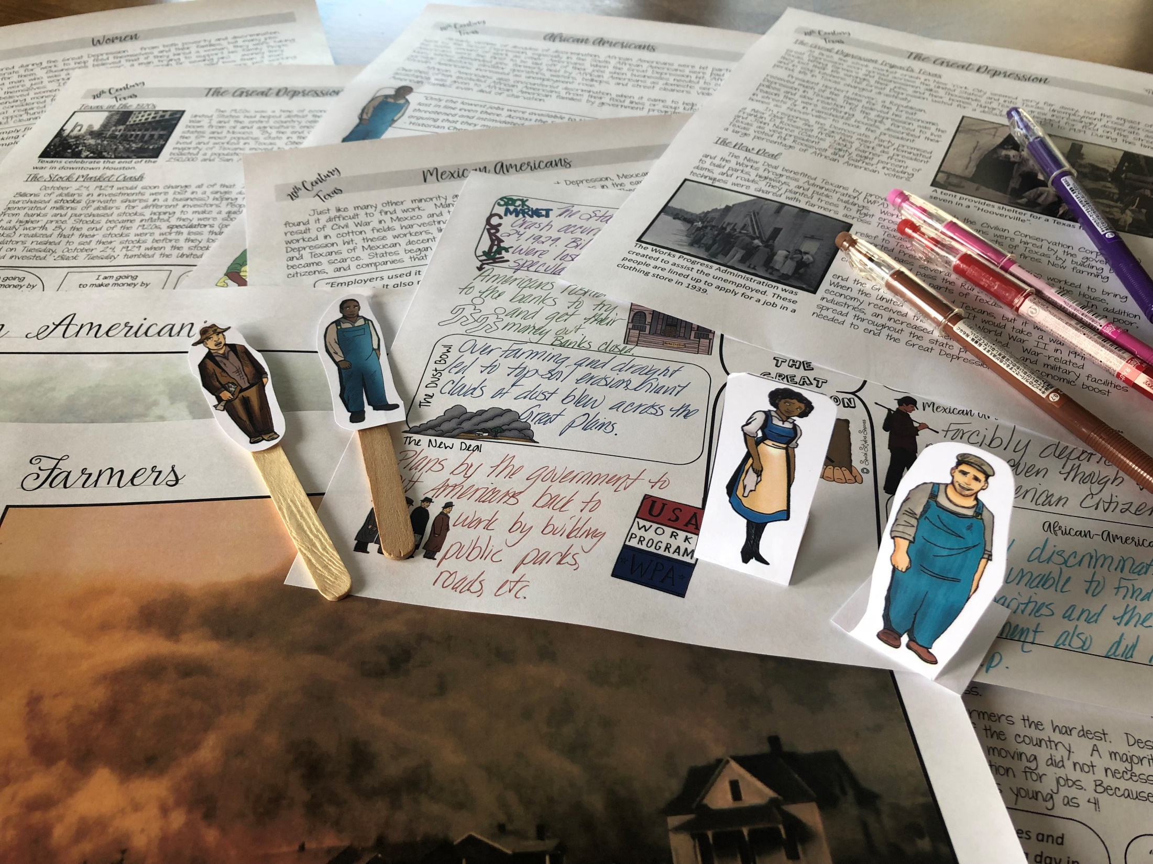
What do I believe about Social Studies instruction?
Students
are social – purposeful talk is crucial to learning.
-Walsh Quality Questioning
Students need to be engaged to learn.
-Schlechty’s Design Qualities of Engagement
Students need to read in Social Studies – a lot! Like everyday!
-Kinsella’s Considerate Text
All students can learn – we just need to support them in different ways.
-Seidlitz’s Seven Steps
History can be fun and rigorous at the same time.
-Bower’s Bring Learning Alive!
The
Interactive Student
Notebook is a powerful
teaching tool that allows you to differentiate instruction for students in a variety of ways.
-Wist’s Research on the Interactive Student
Notebook
History should not be trivial pursuit – dig deeper and teach with essential questions and enduring understandings.
-Wiggins & McTighe Essential Questions
Vocabulary instruction must be intentional and engaging.
-Marzano Academic Vocabulary
Writing is essential for learning, not just assessment.
-Daniels’ Content Area Writing
Kids need to continuously review content. All students need to participate in classroom activities.
-Himmele’s Total Participation Techniques
Heavy reliance on digital technology can weaken critical thinking, focus, and literacy – students learn best with pen and paper.
-Horvath The Digital Delusion
“Soft skills” of collaboration, communication, critical thinking, and creativity are essential to future success in the job market.
-Muir Reasons Millennials Get Fired
Notes:
Ask the teachers to discuss at their table – which ones of these do you agree with? Why? Call on a few to respond.

Slide 16

Do you agree with any of the ideas?
Notes:
Share with a partner.

Slide 17

Goals
What
are your
for this session?
goals
Notes:
Type response in chat box.

Slide 18

Explore the components of an Interactive Student Notebook.

Slide 19
Icebreaker
How well do you know the Interactive Student Notebook?
Line up on the spectrum
Never heard of it before!
I’m ready to teach it!
Notes:
5 min
Using the prompt listed below, have each individual stand on an imaginary spectrum in the front of the room. Fold the spectrum and place them with a partner. Have them sit down together and discuss the questions on the following slide.

Slide 20

Understanding
the
Interactive Student
Notebook

Slide 21

Examine
Interactive Student Notebooks
Notes:
Have teachers spend time examining the notebooks and discussing what they see.

Slide 22


Structure
Style
Notes:
We are going to look at what makes an ISN – Structure
and how we can personalize it in our classroom - Style

Slide 23

Structure

Slide 24

Hook, Line and Sinker
Notes:
This is the analogy we use for the ISN.

Slide 25

Use preview activities to prepare students for learning.
Activities
Preview
Tap into existing schema
Establish a purpose for the lesson
Prepares the brain to acquire new knowledge
Assess prior knowledge
Hook

Slide 26

Anticipation Guide
Identify the major concepts or big ideas you want students to learn.
Create four to six statements that support or challenge students' beliefs.
Ask students to agree or disagree with the statements and to be prepared to defend their opinions.
Conduct a class discussion.
Have students read to find evidence to support or disprove their responses.
After reading, students confirm or revise their responses.

Slide 27
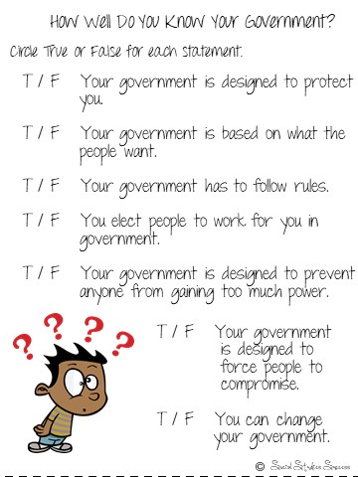
Anticipation Guide
Notes:
Sample for the 7 Principles of Government

Slide 28

Visual Discovery
Select key images that tell a story.
Ask student spiral questions that pull them into the image.
Challenge your students to read more about the topic.

Slide 29

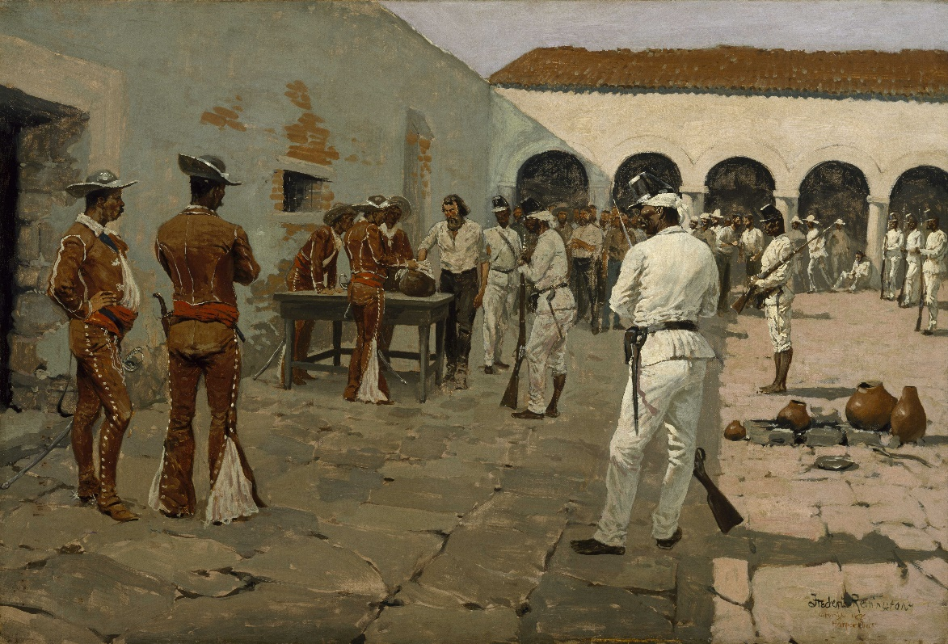
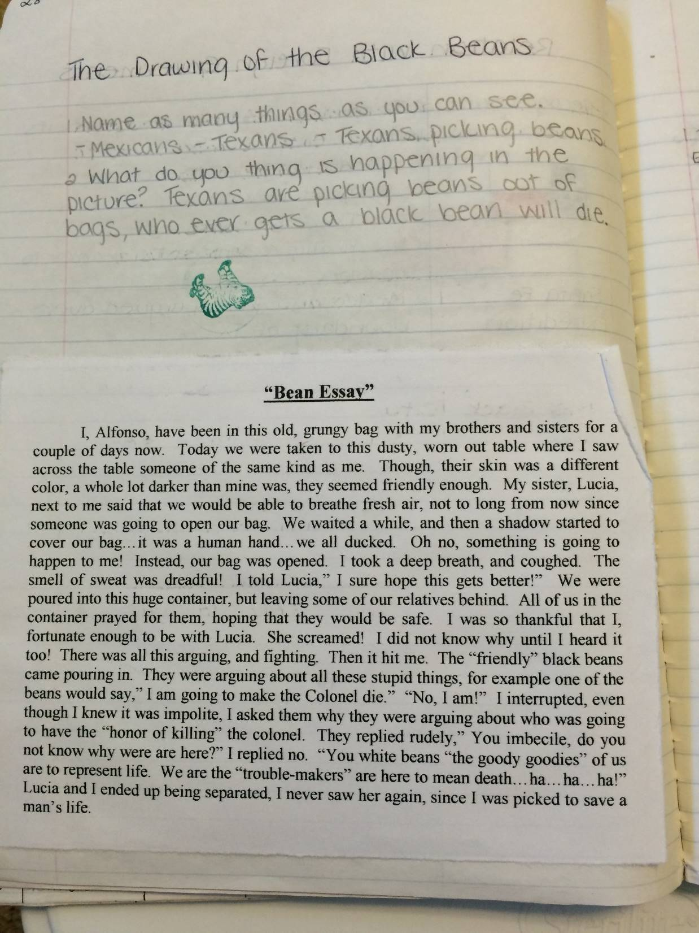
Visual Discovery
Notes:
Example for Texas History

Slide 30
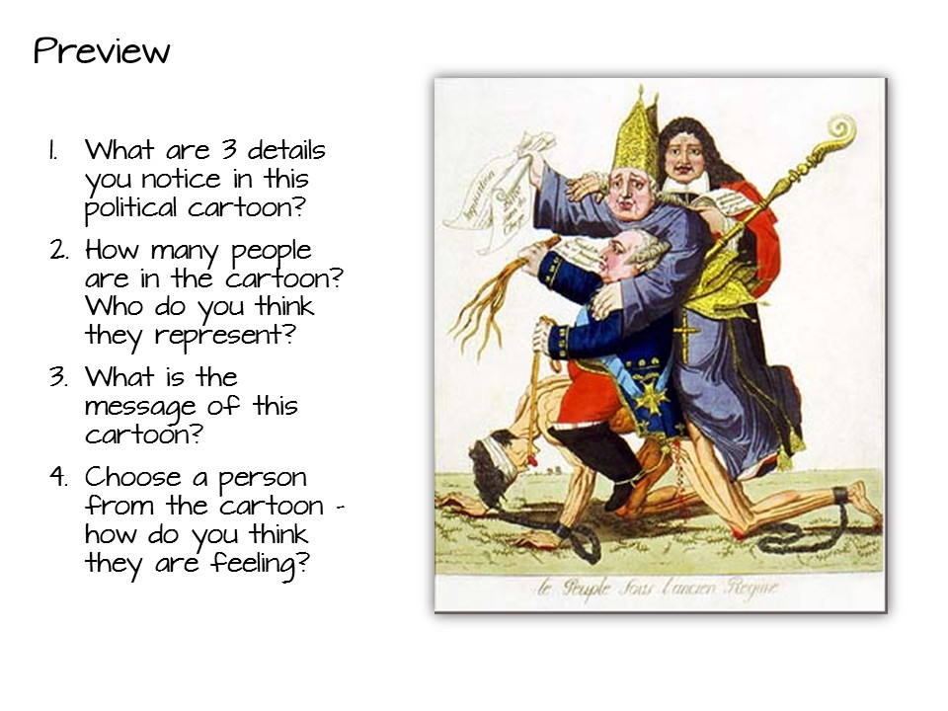
Visual Discovery
Notes:
Example for World History

Slide 31
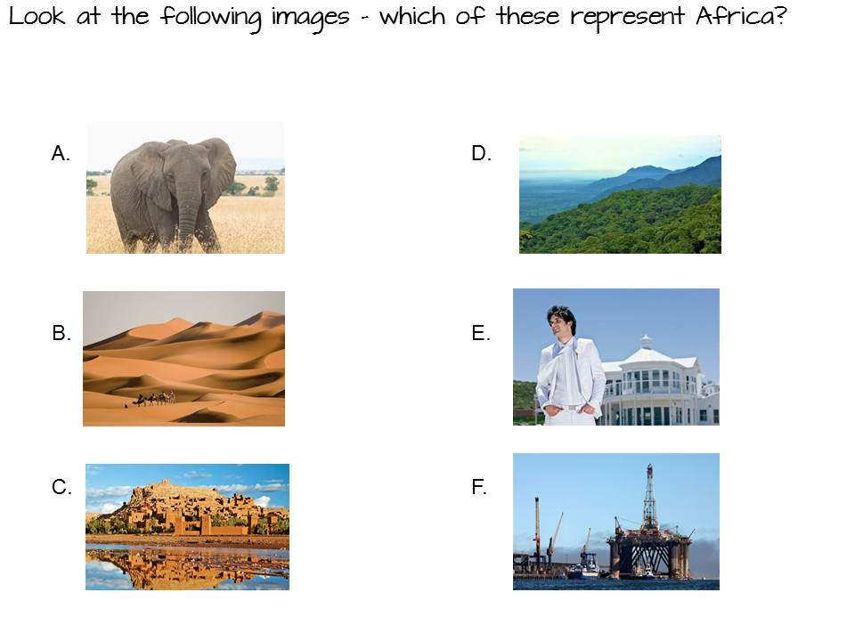
Comparison
Notes:
Example for Geography

Slide 32
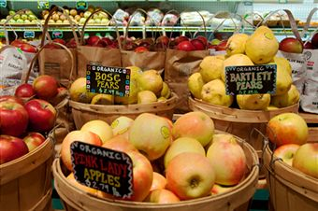
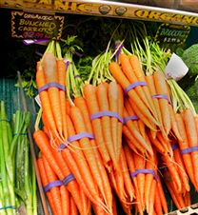

Relevant Example
You have the following items on your grocery list: apples, carrots, bread, milk, fish, steak, trash bags, chips, butter, cheese and paper towels.
You need to get in and out of the store as soon as possible.
How do you group these items to speed up your task?
Why did you group them the way they did?
Notes:
Geography

Slide 33


Preview Activities
Examine the preview strategies in the Interactive Student Notebook manual.
Choose one to read in depth – make sure everyone has a different strategy.
Discuss with your group which strategy you would use and why.
7 minutes
Notes:
Place teachers into a small group. Pass out the Interactive Student Notebook strategy manual and conduct this activity. They can be found by looking at the table of contents.

Slide 34

What preview strategy are you most likely to use and why?
Notes:
Debrief.

Slide 35
vs.
Taking Notes
Make Thinking Visible
Making Notes
Use graphic organizers to help students construct meaning as they read.
Create a visual summary of the content
Embed processing standards
Line

Slide 36
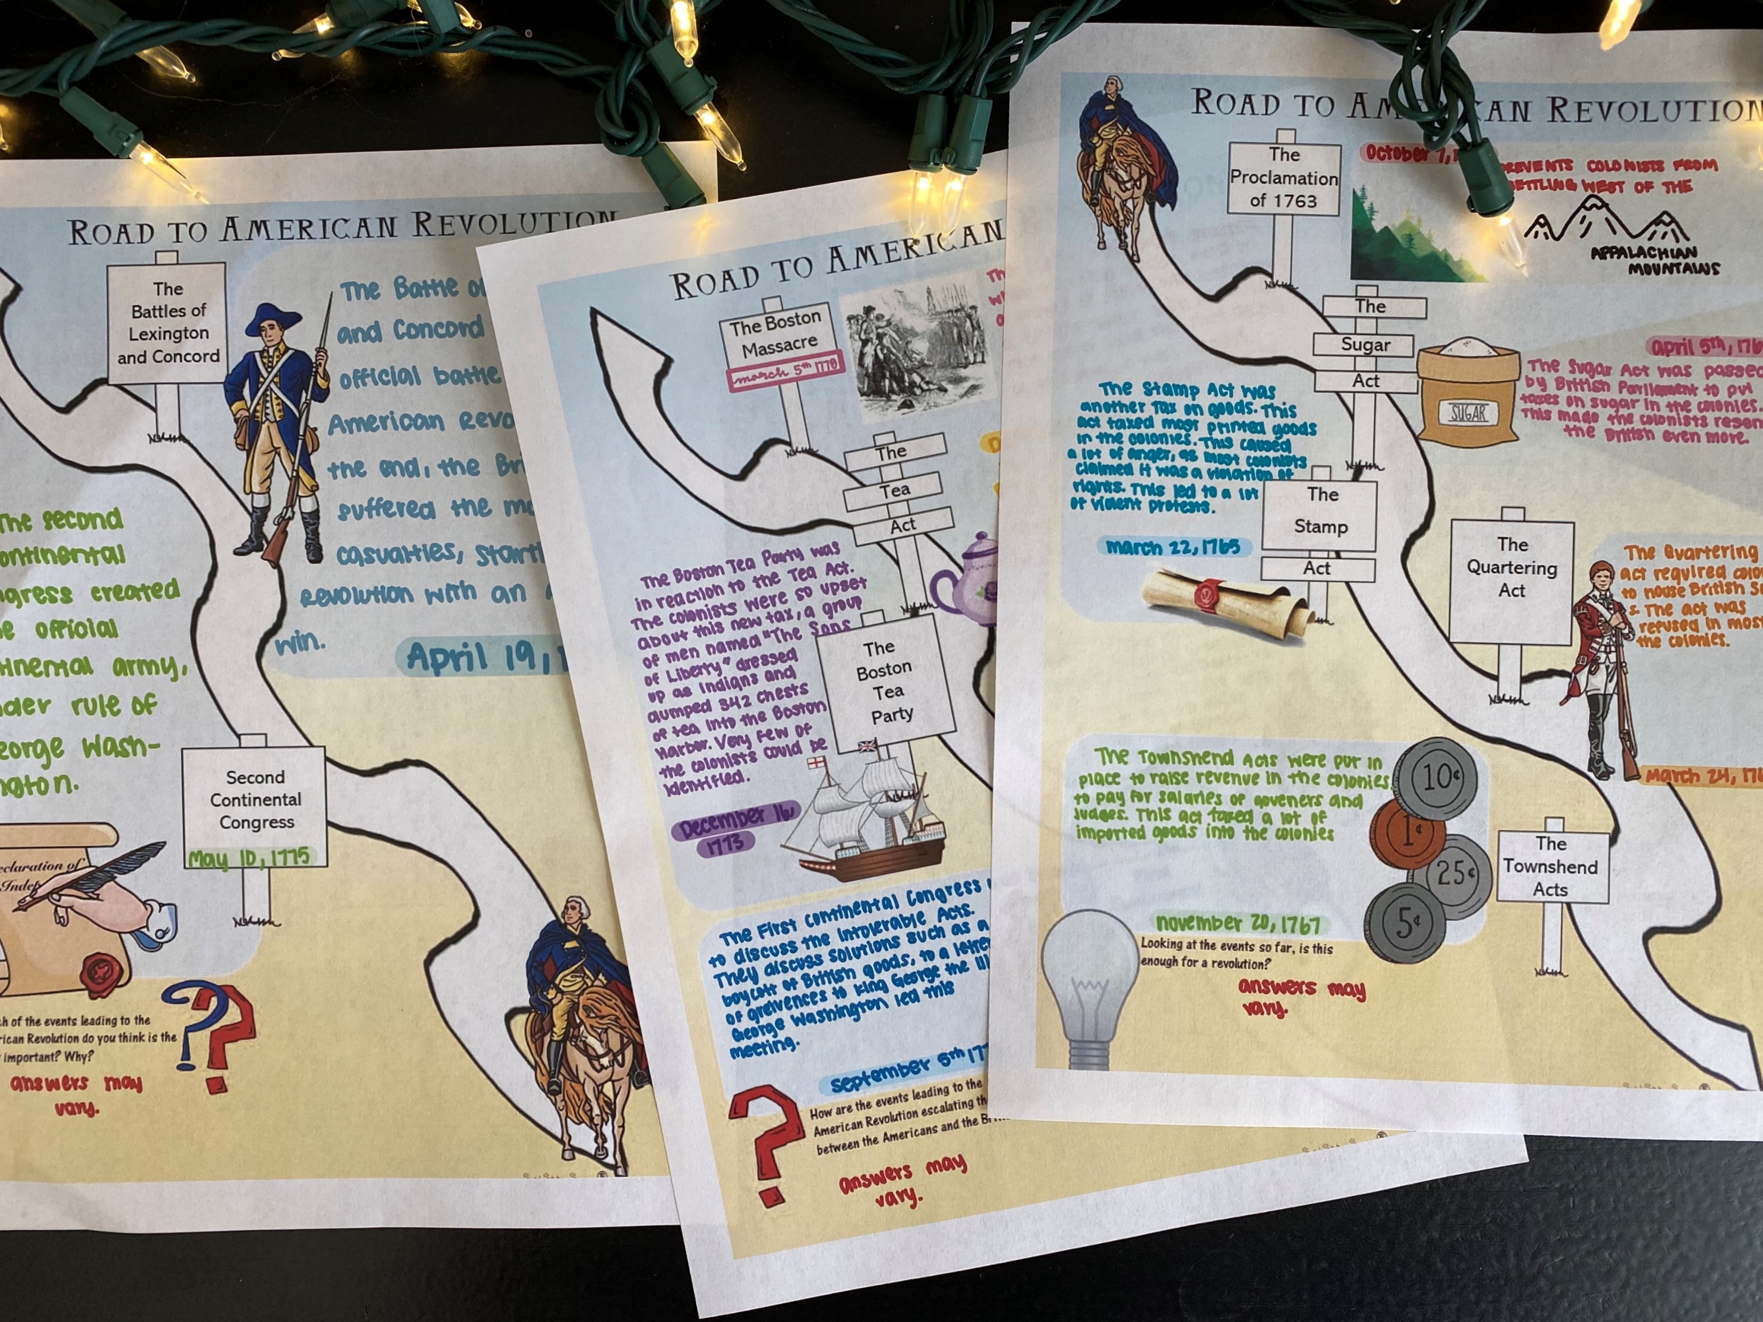
Graphic Organizers
Notes:
Graphic Organizers come in a variety of forms.

Slide 37
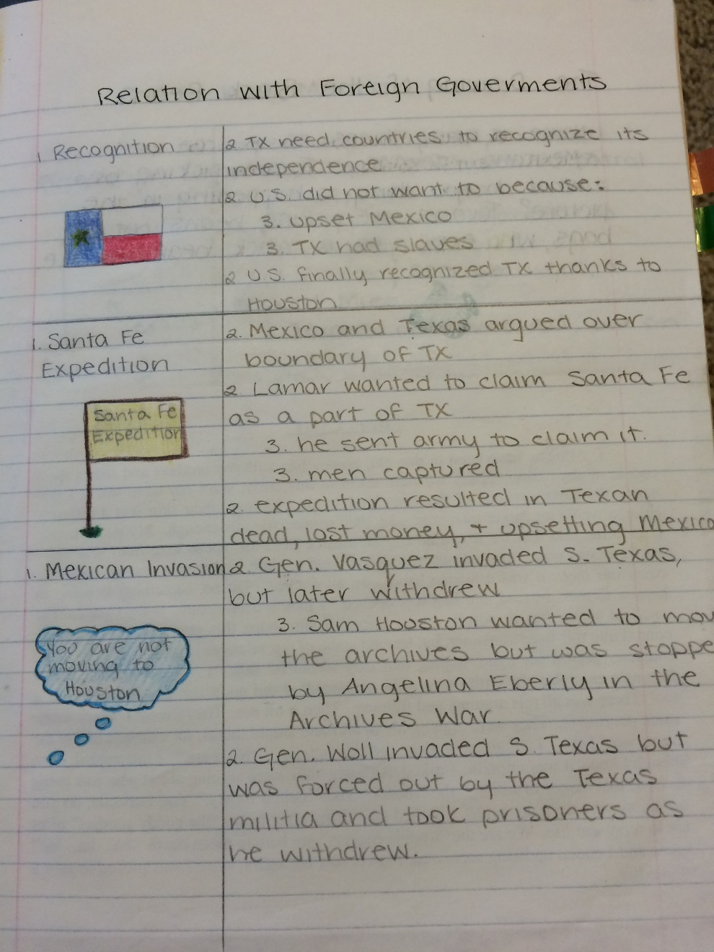
2 column Notes
Notes:
Other types of Graphic Notes include 2 –Column notes, with the topic and a summary.

Slide 38
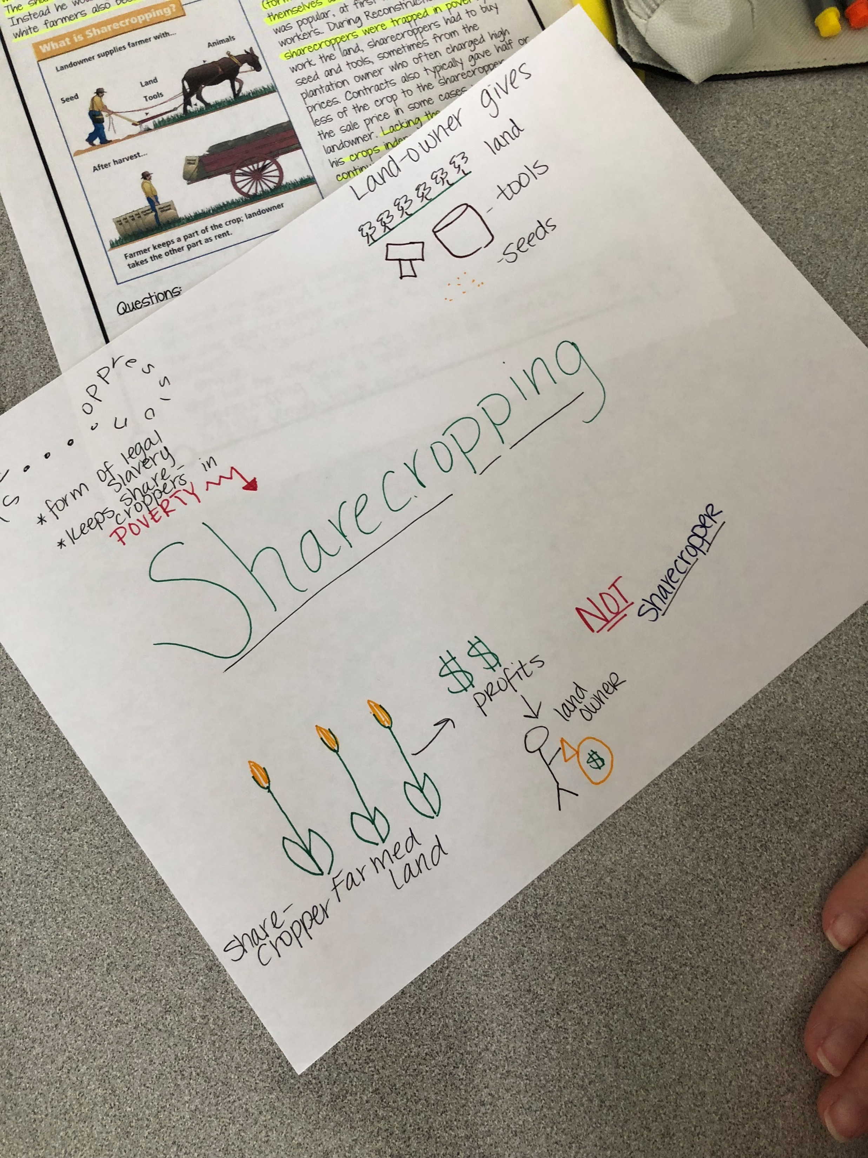
sketch Notes
Notes:
Sketch notes are created by students while they are reading.

Slide 39
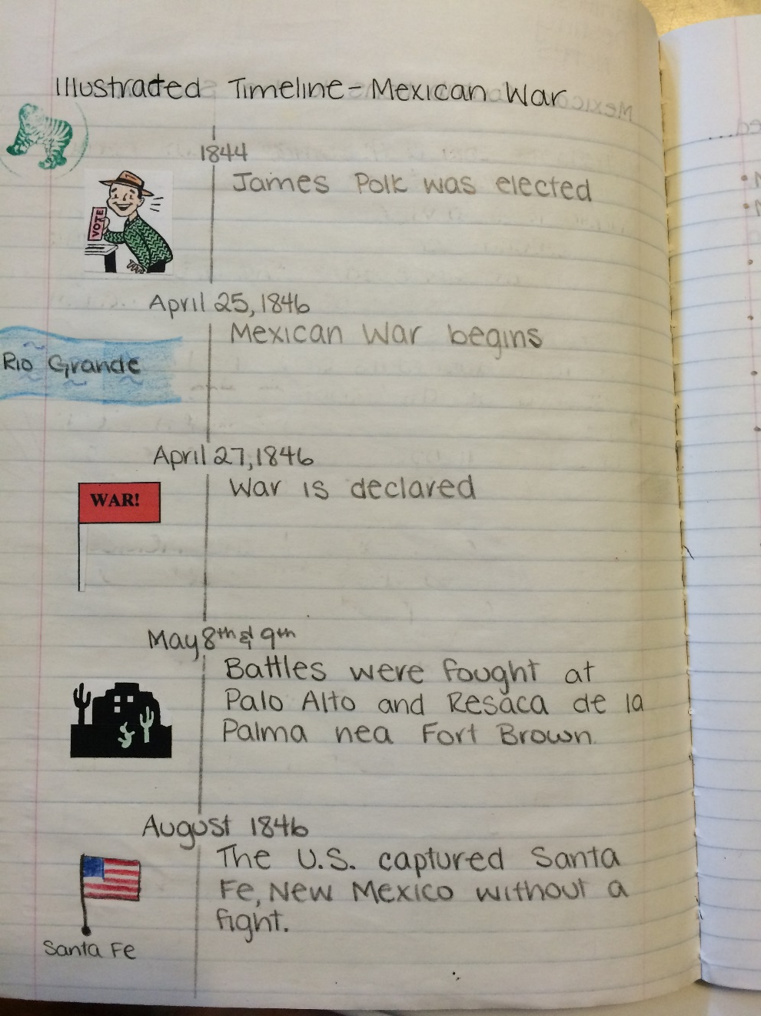
Illustrated timeline

Slide 40
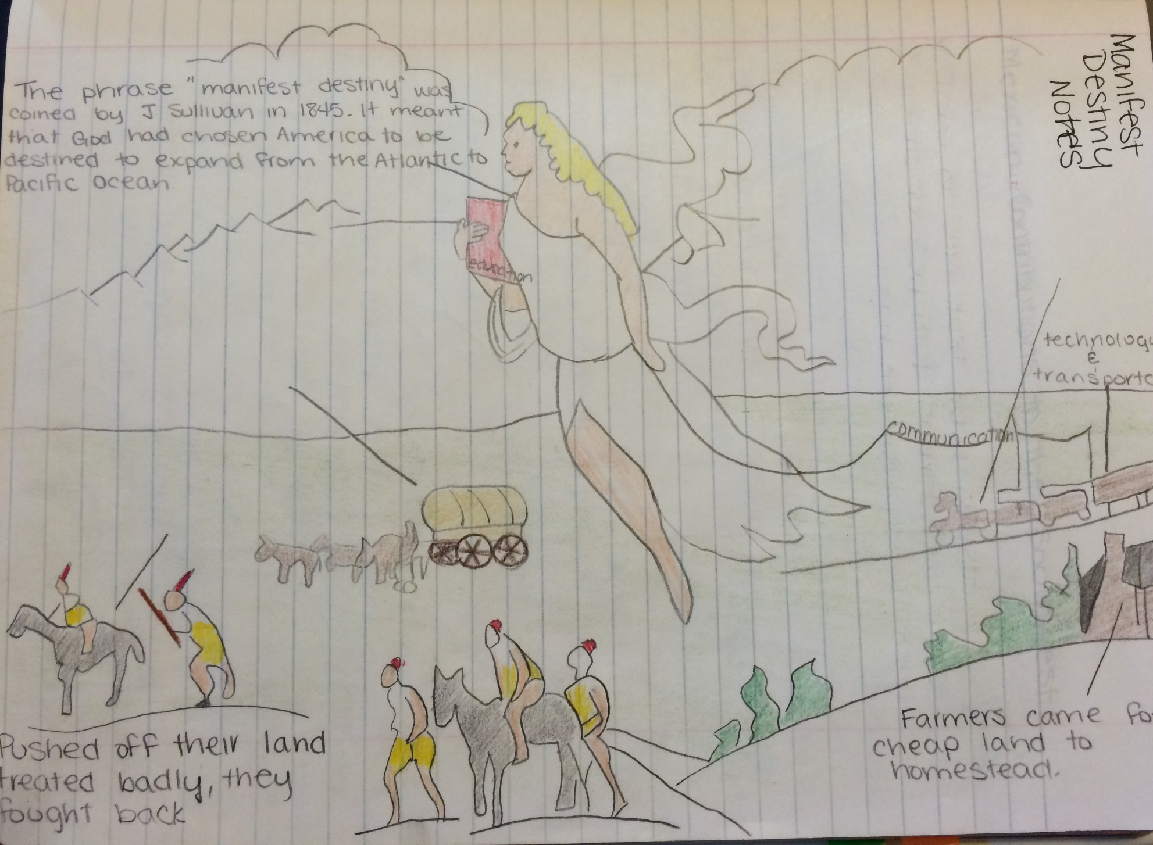
Annotated image

Slide 41
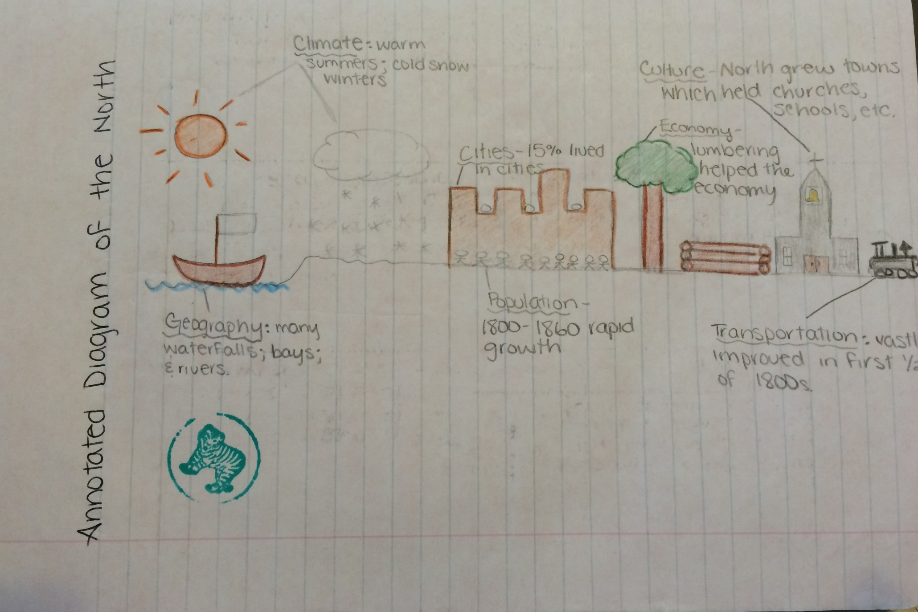
Annotated diagram

Slide 42
Doodle notes

Slide 43
Graphic organizers
Examine the graphic organizers in the Interactive Student Notebook manual.
Choose one to read in depth – make sure everyone has a different strategy.
Discuss with your group which strategy you would use and why.
7 minutes
Notes:
You will need to indicate which pages these are on – just flip through to find them.

Slide 44

What did you learn?

Slide 45
Use processing strategies that allow students to reflect, make connections, and apply learning.
Activities
Processing
make connections
extend the reading experience
lead students to a deeper analysis of the text
be able to apply new content
allows for Differentiated Learning
Sinker

Slide 46
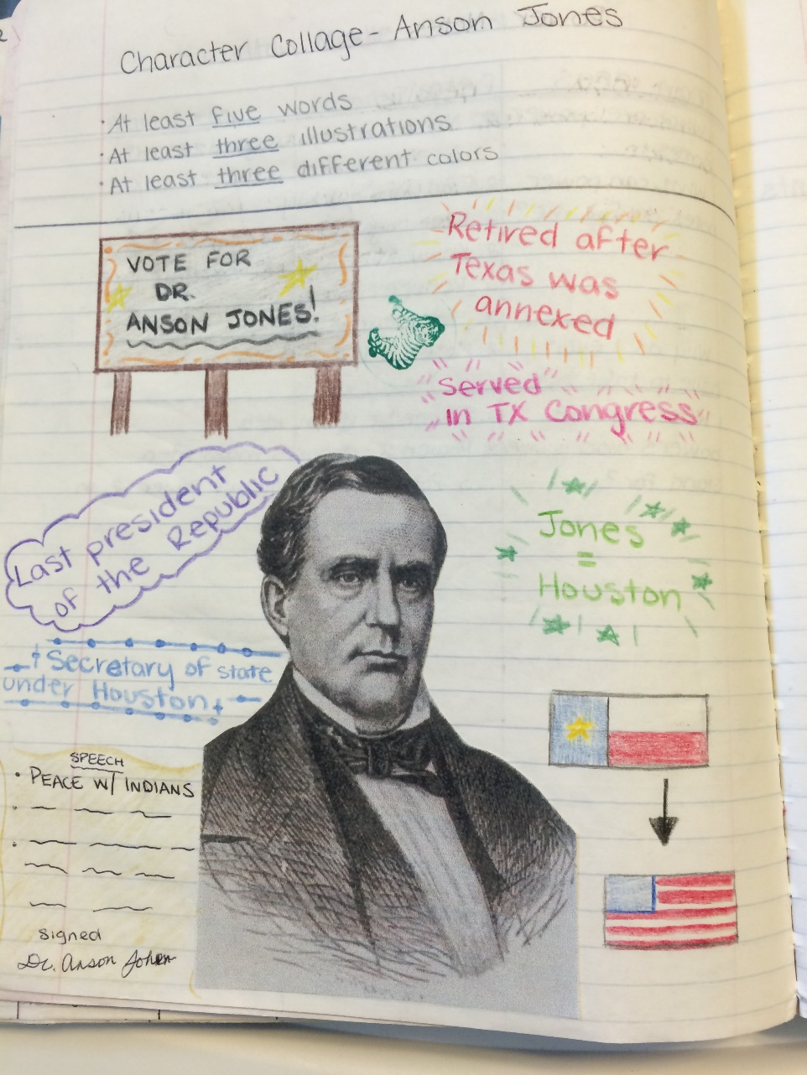
Character Collage
Notes:
Character collages allow students to process information about historical figures by adding images and quotes.

Slide 47
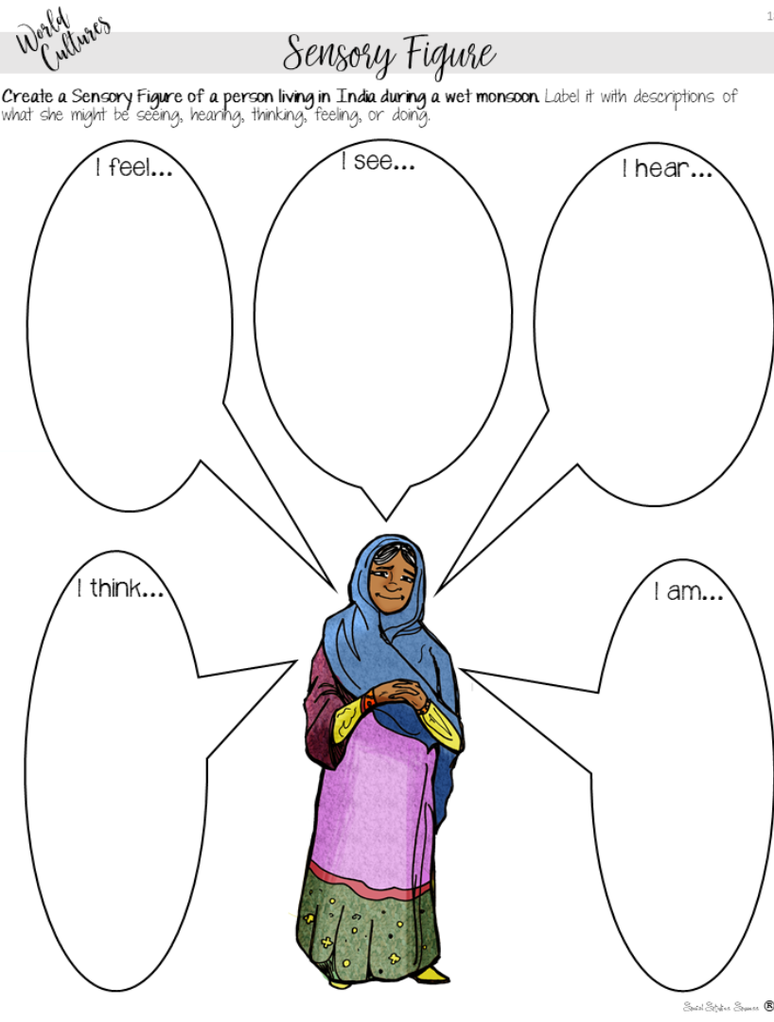
Sensory figure
Notes:
Sensory figures process by inferencing senses.

Slide 48
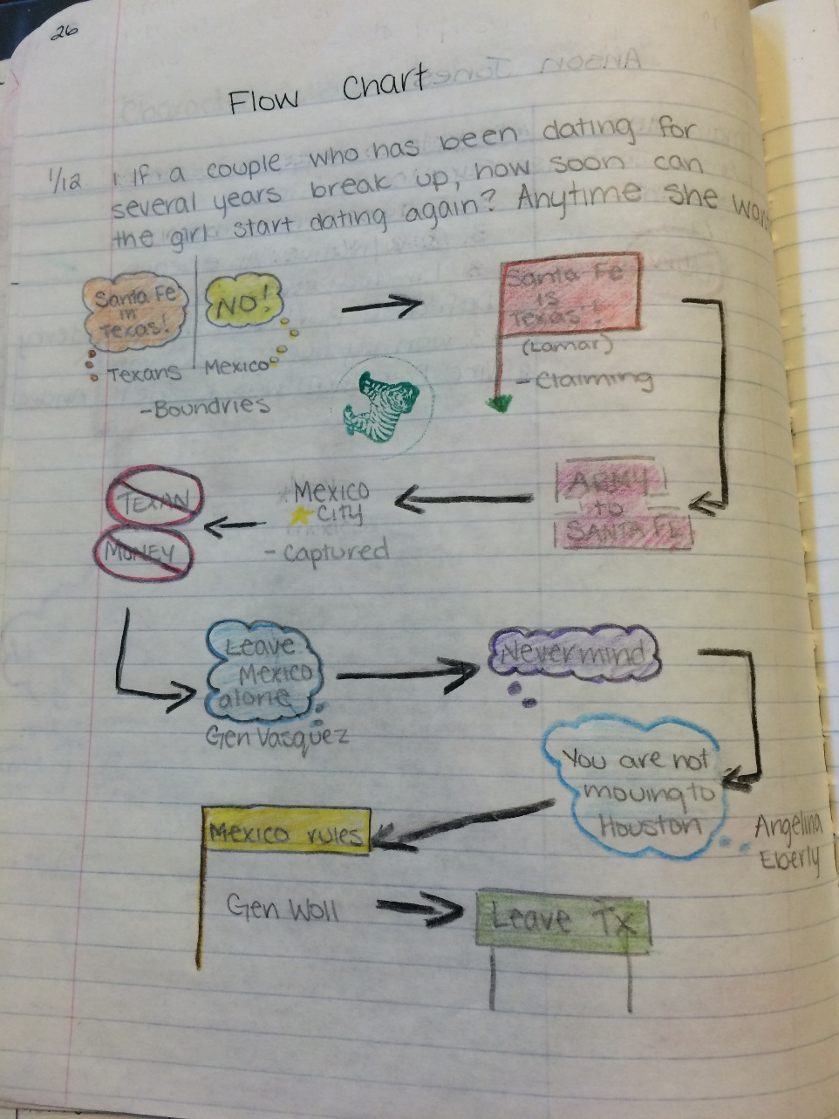
Flow Chart
Notes:
Flow charts show the movement of an idea.

Slide 49
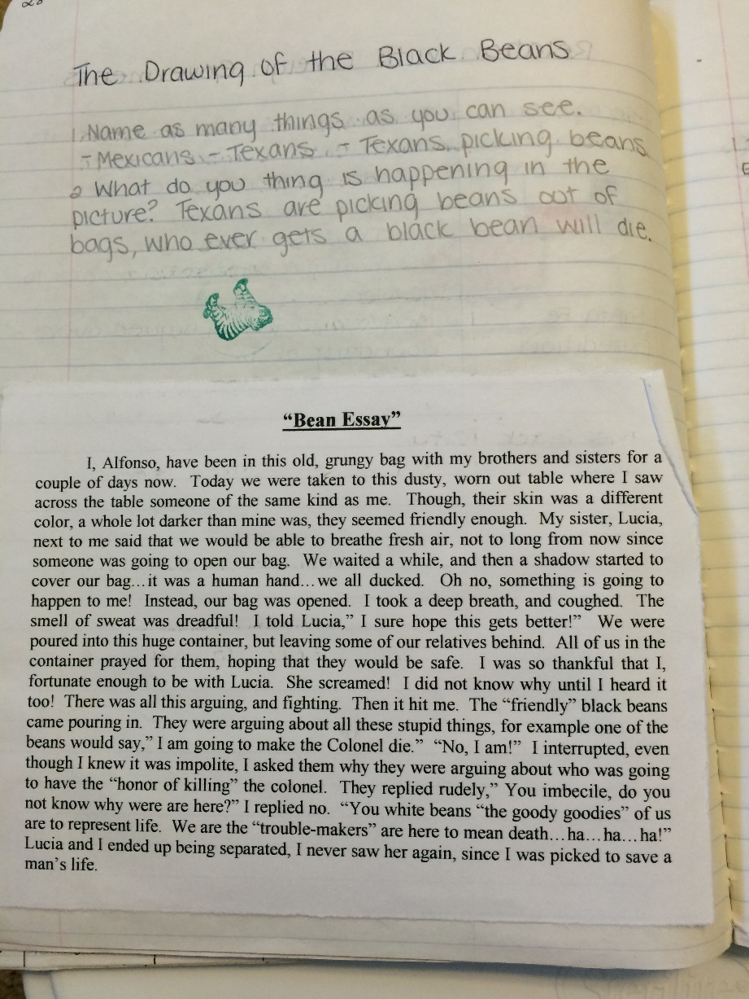
Point of view story
Notes:
Point of view stories are great for inferencing as well.

Slide 50
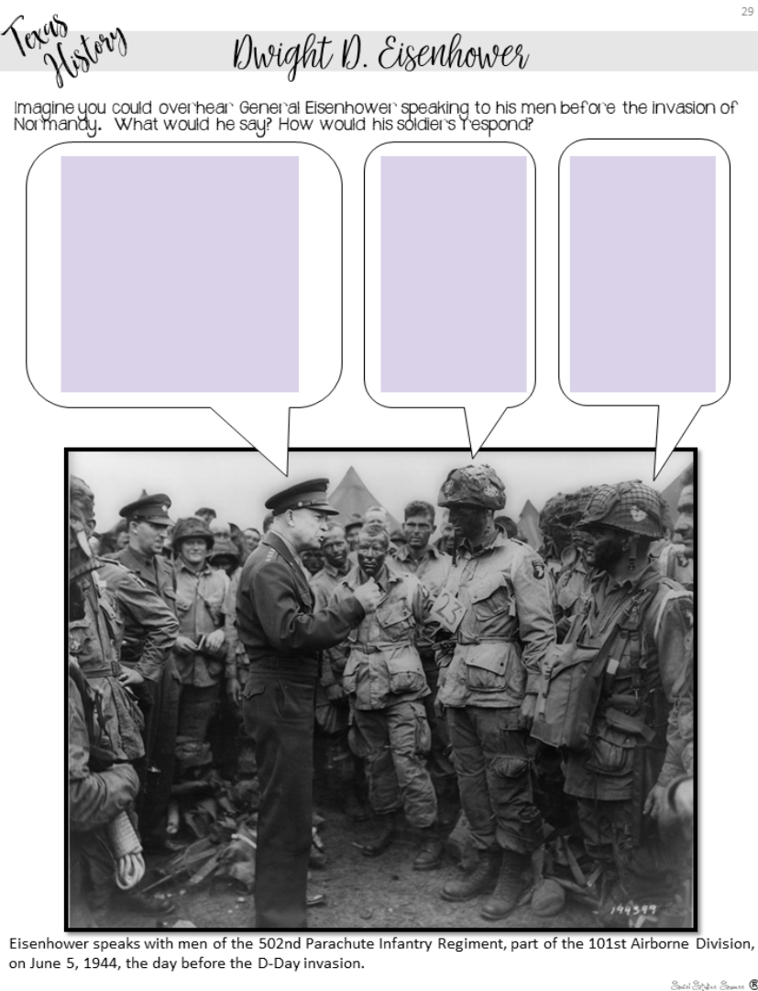
Annotated Image
Notes:
Students bring to life images by adding text.

Slide 51
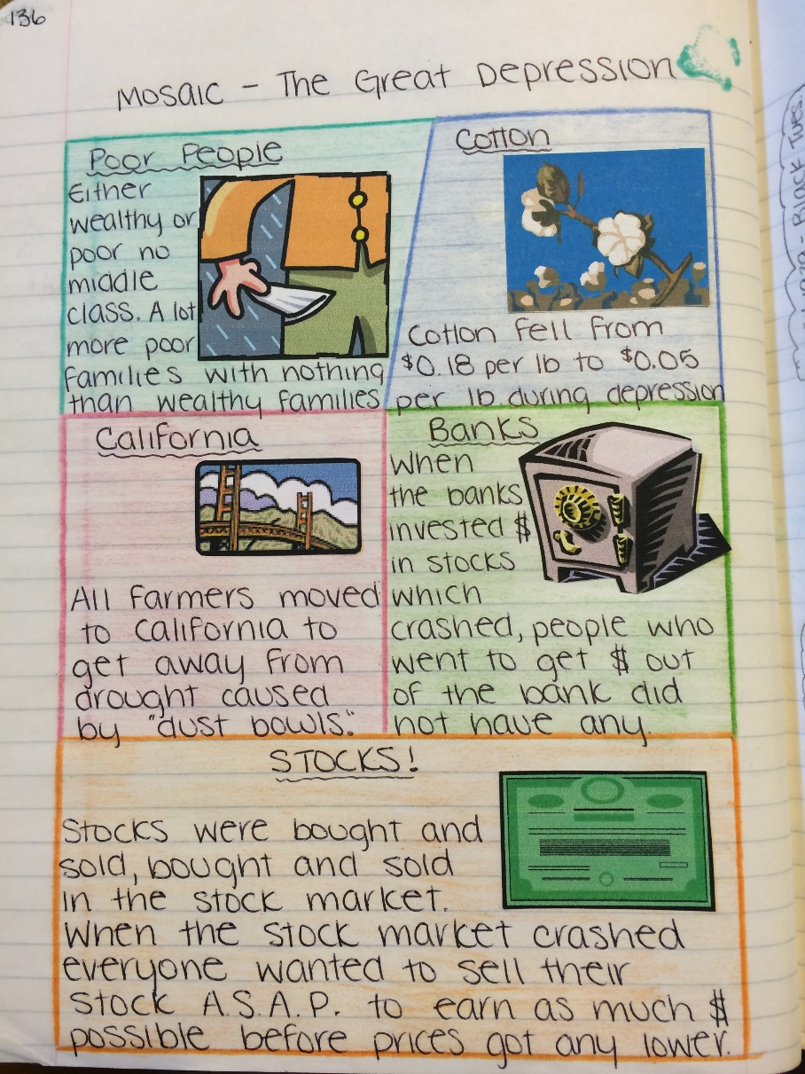
Mosaic
Notes:
A mosaic is great for showing the parts of a topic.

Slide 52
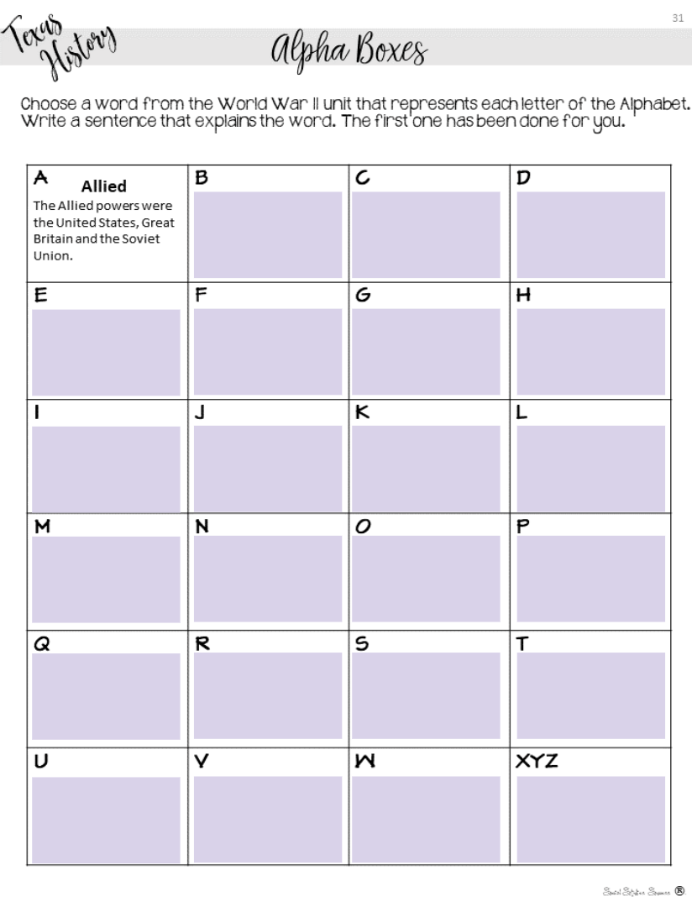
Alpha boxes
Notes:
Challenge students to create summaries for the topic with Alpha Boxes.

Slide 53
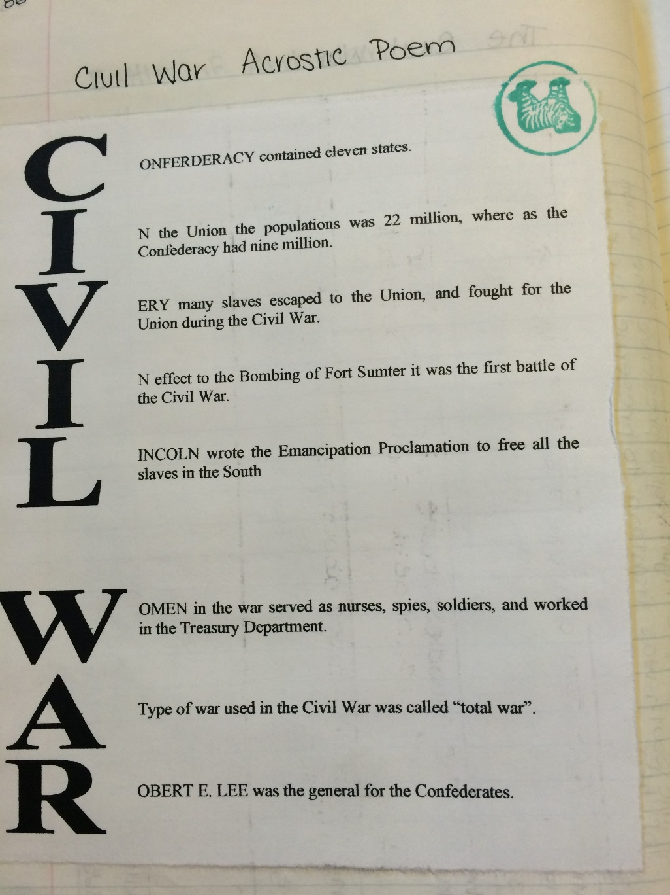
Acrostic poem
Notes:
Explain an acrostic poem.

Slide 54
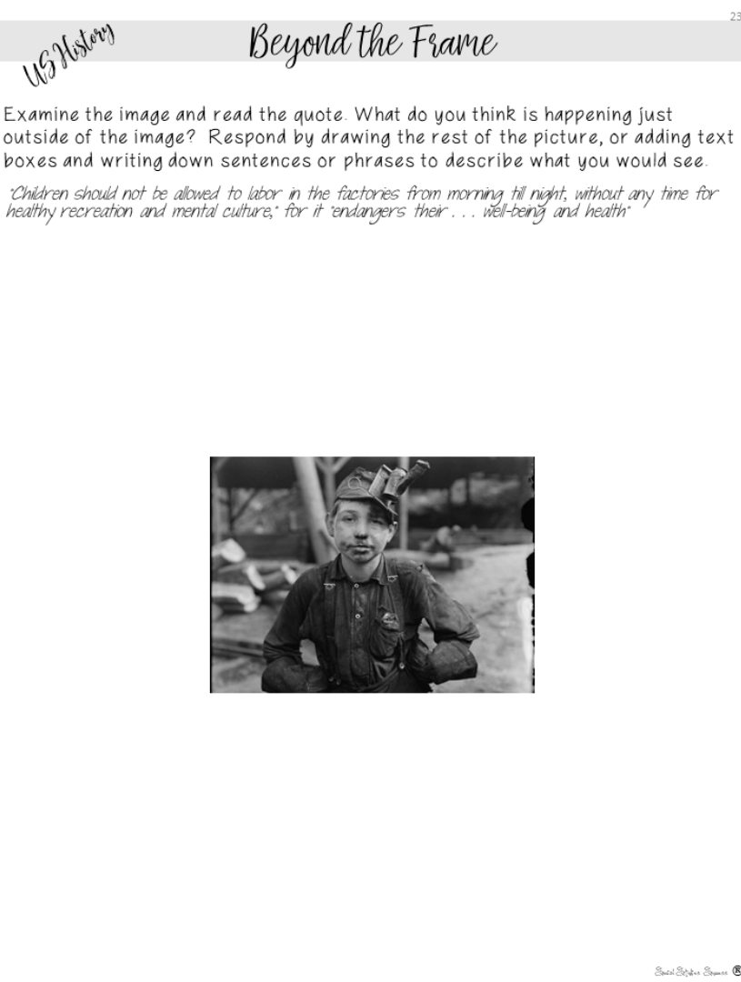
Beyond the frame
Notes:
Students write or draw what they would see beyond the picture frame.

Slide 55
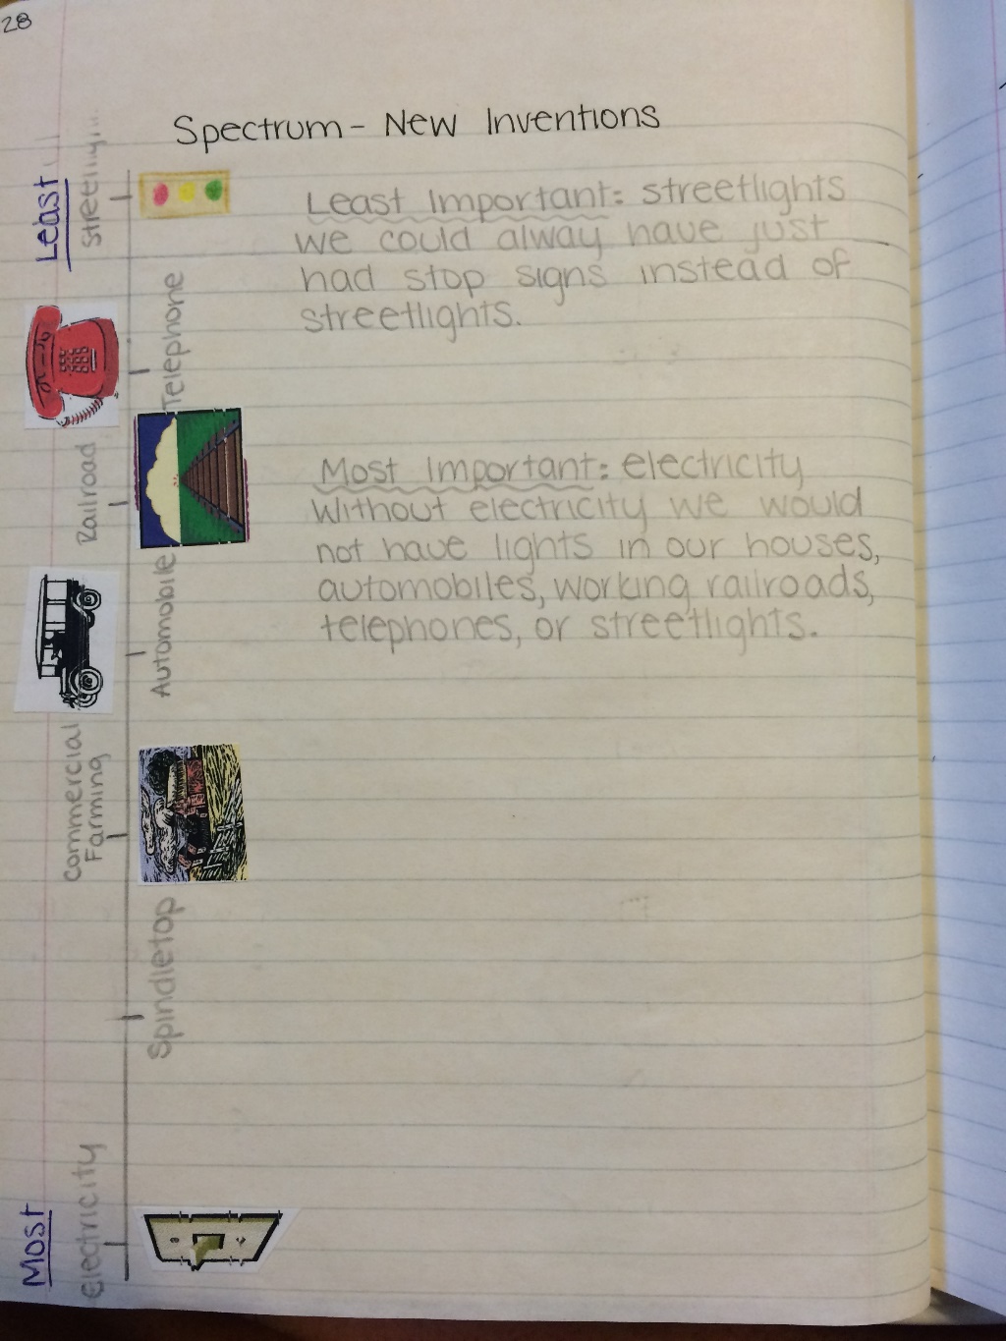
Spectrum
Notes:
Students rank the importance of certain events.

Slide 56
Processing activities
Examine the processing activities in the Interactive Student Notebook manual.
Choose one to read in depth – make sure everyone has a different strategy.
Discuss with your group which strategy you would use and why.
7 minutes
Notes:
These can be found in the table of contents.

Slide 57

Notebook Assignment
Gallery Walk
Examine the different notebook assignments.
Discuss new ideas with your partner.
Notes:
Have the teachers examine the different notebook placards

Slide 58

Now You Do -
Notes:
Gauge your time – do this portion if it looks like you have time.

Slide 59
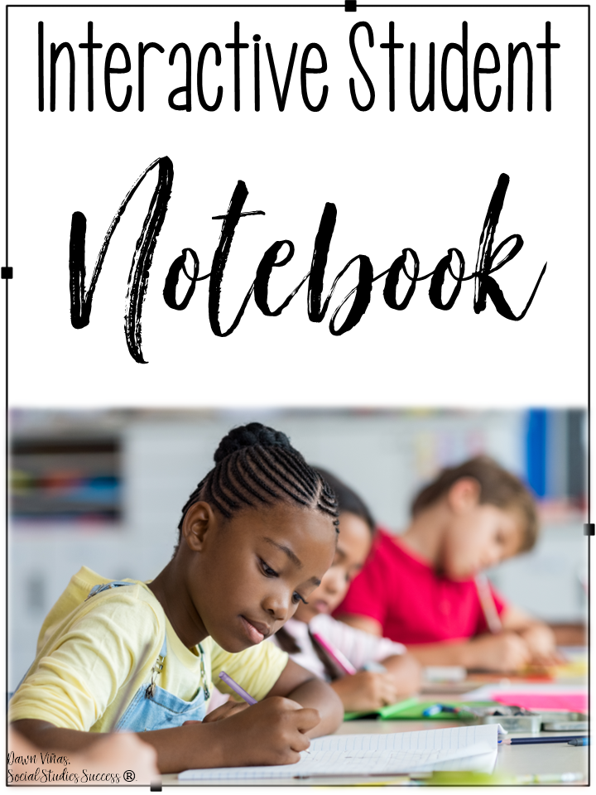
Strategy Practice
Review the standard and content.
Choose a preview, graphically organized notes, and processing assignment that fit the standard.
Jot these ideas down in your notebook.
Notes:
Refer to their lesson planning guides.

Slide 60

What part of this workshop was new information?
Notes:
Discuss

Slide 61

Style
Notes:
This is your personal choice in the classroom (share all your tips in this section).

Slide 62
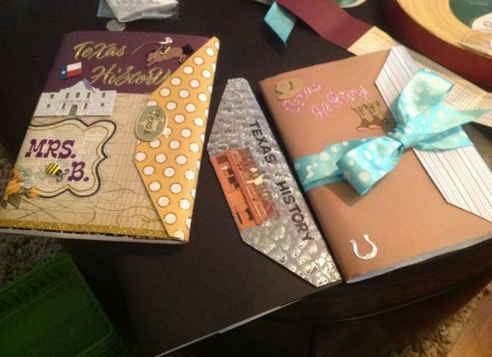
Personalization - Cover
Use magazines.
Cover with packing tape or contact paper.
Add special touches such as bookmarks and dividers.
Notes:
There are also things that you can do to individualize them. As you go over these, give your tips and experiences using notebooks.
For reduce the number of lost notebooks explain that the students have invested their time and personality into them, so they now have value to the kids.

Slide 63
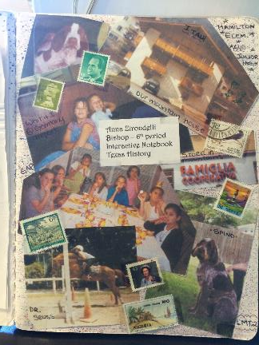
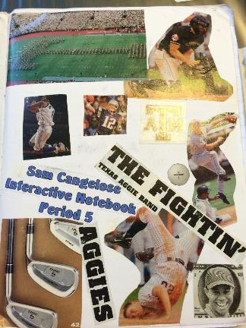
Personalization – Author Page
reflect content or individuals.
encourage students to take pride in their notebooks.
reduce the number of lost notebooks.
Notes:
There are also things that you can do to individualize them. As you go over these, give your tips and experiences using notebooks.
For reduce the number of lost notebooks explain that the students have invested their time and personality into them, so they now have value to the kids.

Slide 64
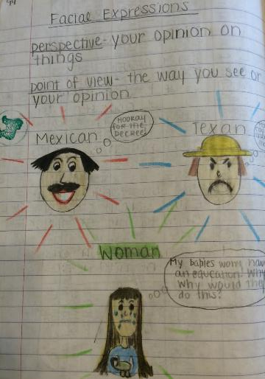
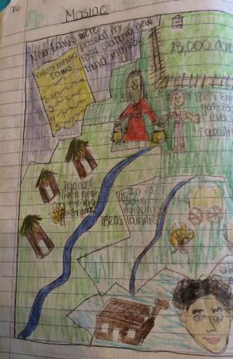
Organization - Pages
Interactive Student Notebook: Five Steps to Implementation
Have students put a title and date on each assignment.
Notes:
This will help kids know what the assignment is about and when it was done. This will help absent kids too.

Slide 65

Organization - Numbering
Interactive Student Notebook: Five Steps to Implementation
Show students how you want their pages numbered.
Number as you go
Number by activity
Use an A, B, C method with your numbers
Notes:
Discuss with participants how you can number pages. There are a variety of ways you can do this. Share the above with them and what you have done or tried in the past. You might need to explain that we are teaching without left-side/right-side if you have some folks who were taught the ISN by an old-schooler!
Number as you go - Explain to participants it is best to number as you go so if a kid messes up their whole notebook is not messed up.
Number by activity – each activity has a number
A,B,C method – Can use this with either. Preview is 2A, Notes 2B, Processing 2C or if you number as you go, if a kid needs more room than the page you gave them, they can make that A and move to page B.
Explain that all kids should be on the same number system and do not let them number on their own or their will be a lot of confusion when you want to grade or have the kids find something.

Slide 66
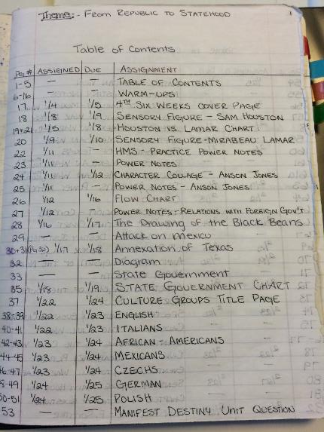
Organization – Table of Contents
Interactive Student Notebook: Five Steps to Implementation
Add a table of contents to help guide students.
Include page numbers and title.
May have the date you did the assignment.
Can include assignment grades.
Consider keeping a master table of contents in your room.
Notes:
I showed two examples, if you do something different, explain that to them.
I also share how I go to the teacher center and use a poster maker to make a big poster of the Table of Contents and laminate it. That way I can use dry erase markers on it and keep it up where the kids can see.

Slide 67
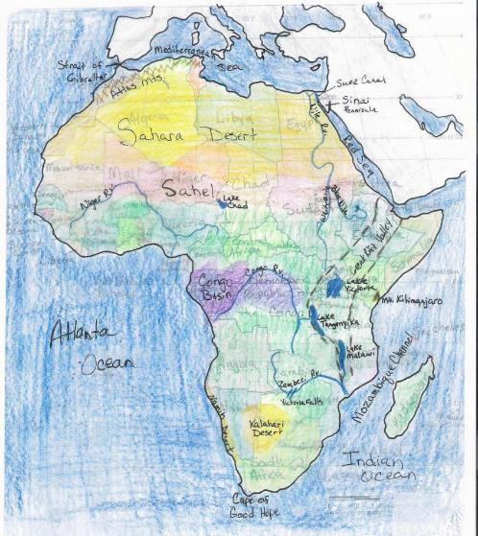
Organization – Resource Pages
Interactive Student Notebook: Five Steps to Implementation
Include lesson material with each unit such as:
vocabulary
maps
Notes:
You can include other things besides preview, notes, and processing in your notebooks as well. Vocabulary, maps are a few examples.

Slide 68
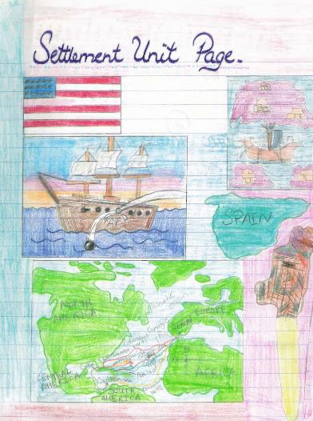
Organization – Unit Pages
Interactive Student Notebook: Five Steps to Implementation
Add unit title pages that echo the unit theme and contain:
the title of the unit.
pictures that represent the unit content.
a phrase that describes the unit.
Notes:
You can give the example of 5-5-5 5 terms, 5 phrases, 5 colors required for a unit page. This picture does not have it, but that is something they can require their students to do.

Slide 69

What are some ideas that you will use in your classroom?
I will use…
Notes:
Debrief with these stems.

Slide 70

Grading
the ISN
Notes:
There are rubrics for teachers to download on the website.

Slide 71

Is the Interactive Student Notebook
a Product or a Process?
Notes:
Turn and Talk
This decides how you grade the notebook – either looking for perfection or grading the learning process.

Slide 72
Inspect
What you Expect
Notes:
Monitor often at the beginning of the year.
Stamp, initial, or place stickers to indicate you have seen the item.
Write comments, especially positive comments or suggestions, on sticky notes.

Slide 73

Notes:
Allow students to use notebooks on a quiz
Helps students understand the importance of taking notes.
Encourages students to bring their notebooks daily.
Builds good work habits for the future.
z or test.

Slide 74

Peer
Review
Notes:
Have students look at other student examples.
Examples from previous years
Gallery walk
Peer Review

Slide 75

Grading

Slide 76
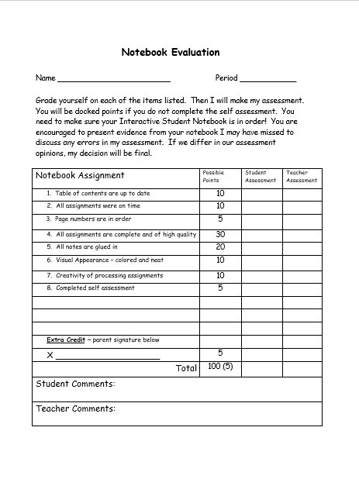
Explain to students the criteria used to grade notebooks.
Share rubric in advance
Stagger collection and grading
Notes:
Share any tips you have for grading. They will be receiving electronic copies of the rubrics from Vicki.

Slide 77

Improving
Quality

Slide 78
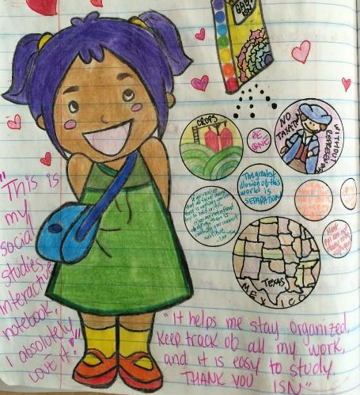
Require students to add color.
Show students how color improves notes and processing assignments.
Model what you expect to see in their notebooks.
Incorporate color for organizing into rubrics.
Notes:
Discuss by bullet points
Notes with highlighting key terms are easier to use to study for tests
Model when give notes use different color pens on overhead or in powerpoint.
Put color as part of the grade – stress color for organizing not for “prettiness”

Slide 79
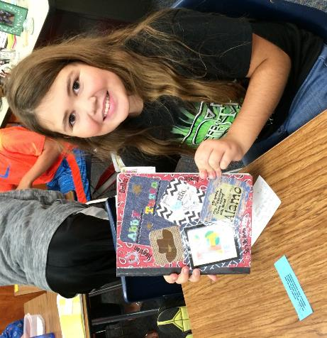
Encourage a sense of pride in notebooks.
Show students that their notebook has value and importance to them.
Provide evidence of students who have used their notebooks in future years.
Notes:
Discuss point
Can help them study; is a portfolio of evidence of learning
Help with test at state level; give story of student who kept and used their notebook

Slide 80


Questions?
Ideas?

Slide 81






Connect with me!
www.SocialStudiesSuccess.com
Notes:
Point out my blog on social studies success if they want to learn more.

