Slide 1

Notes:
Each teacher needs to use a spiral notebook.
You are modeling the use of an interactive student notebook. Glue all handouts into their spiral notebook as you work through the lessons.

Slide 2


Slide 3

Notes:
Introduce yourself

Slide 4
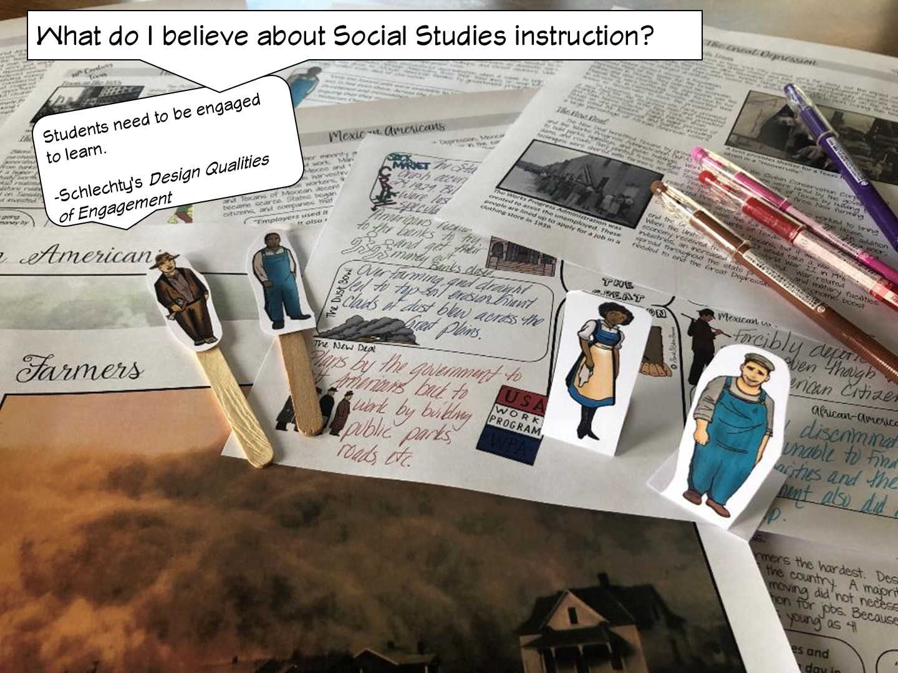

Slide 5
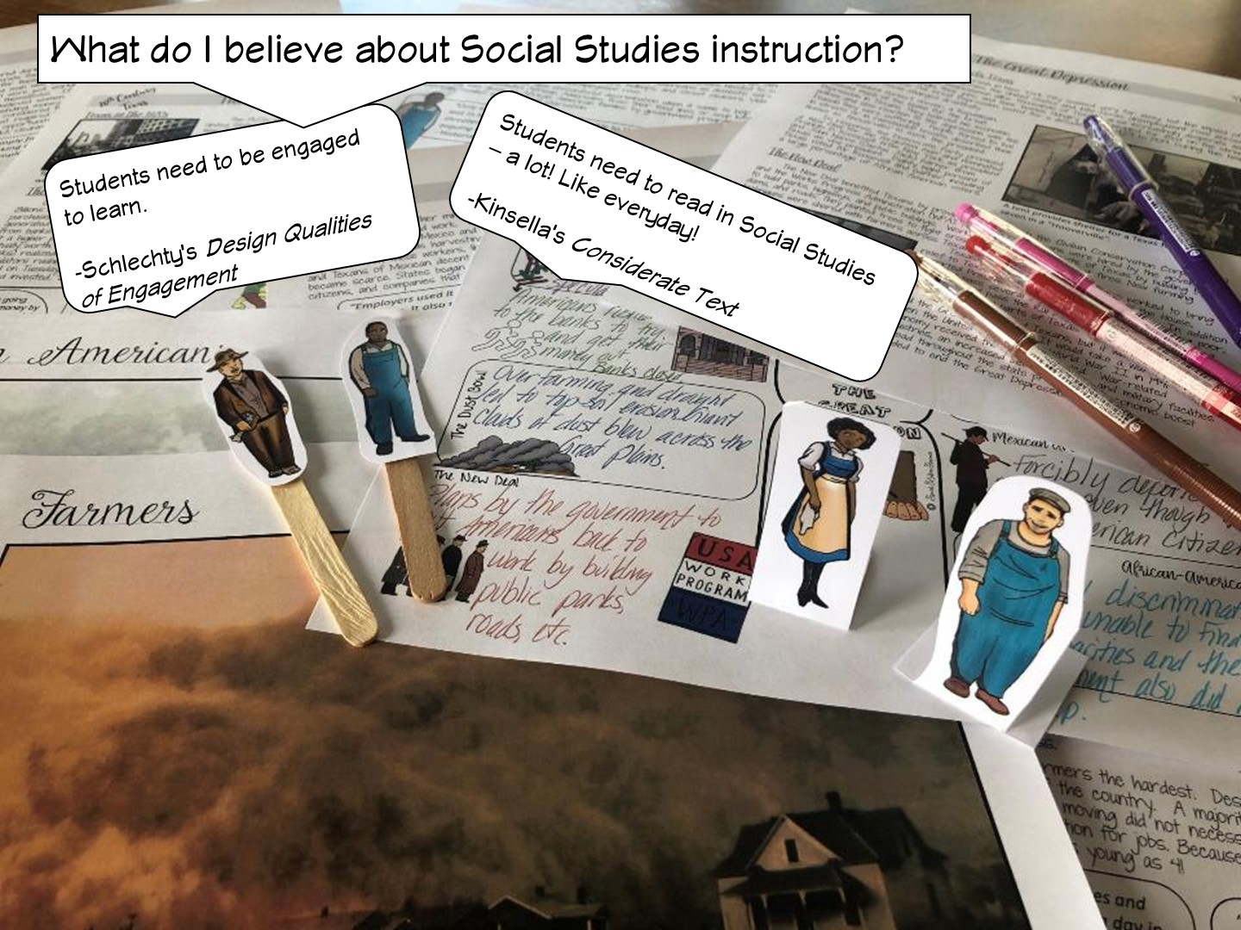

Slide 6
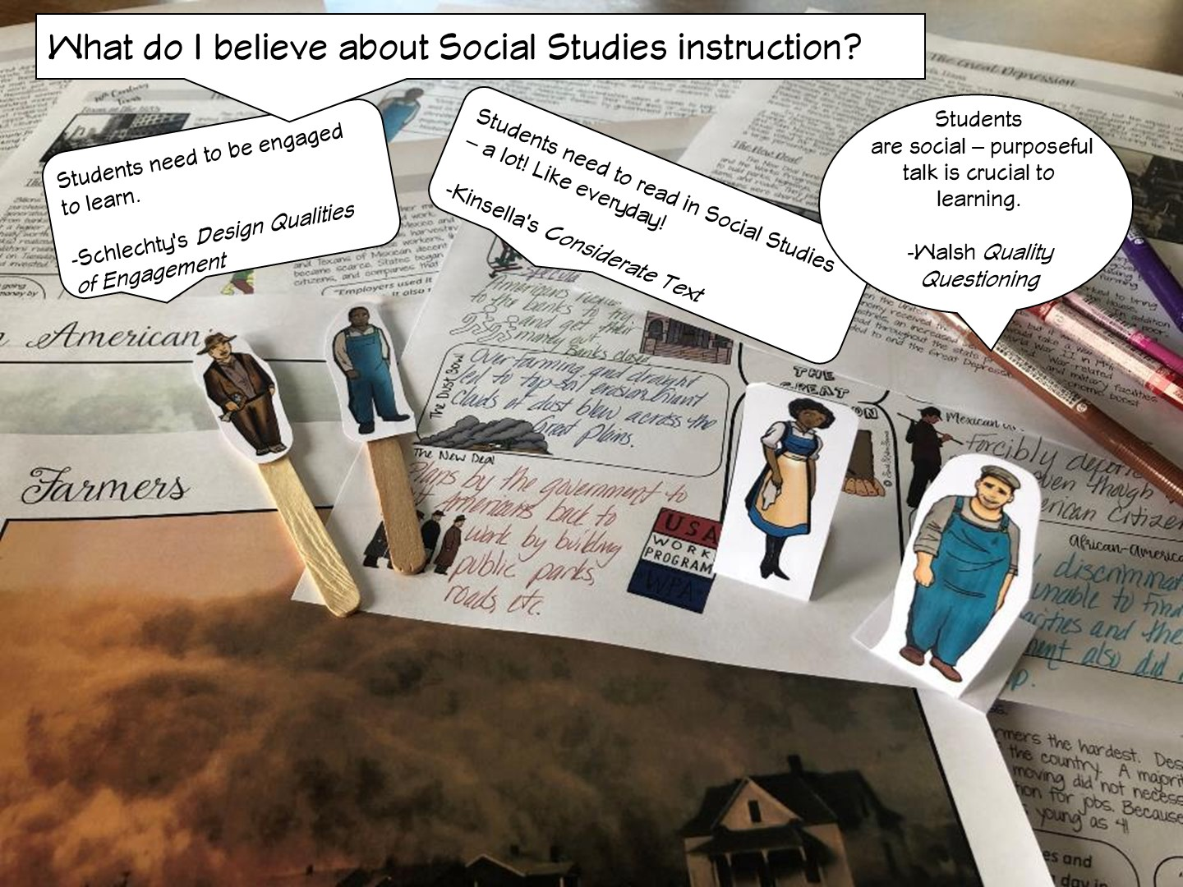

Slide 7
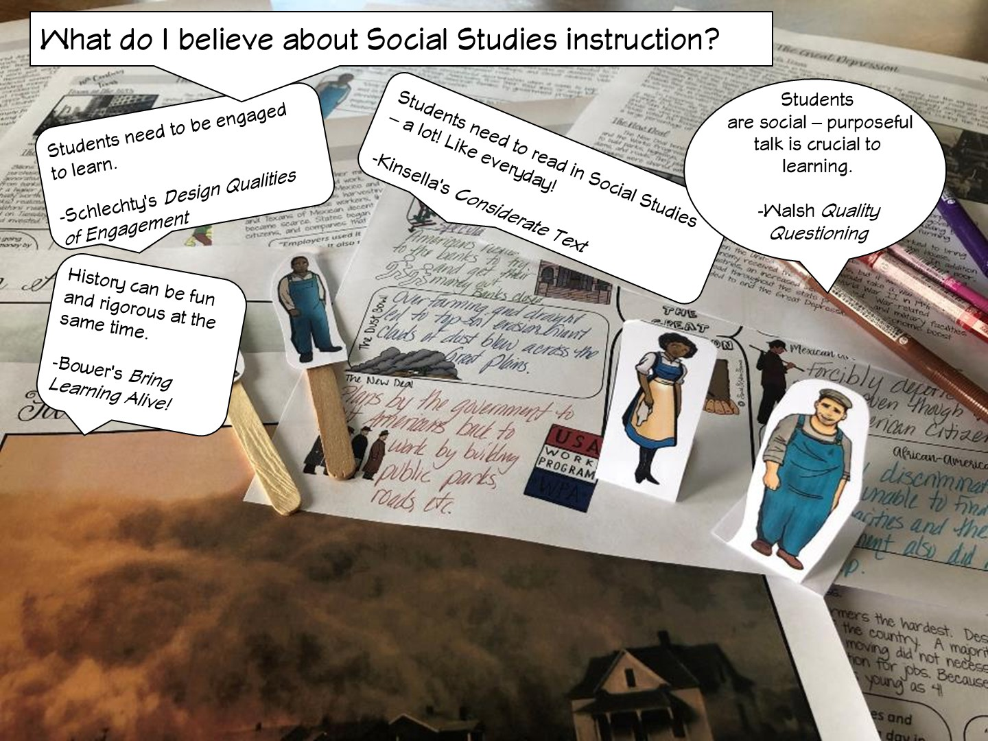
Notes:
.

Slide 8
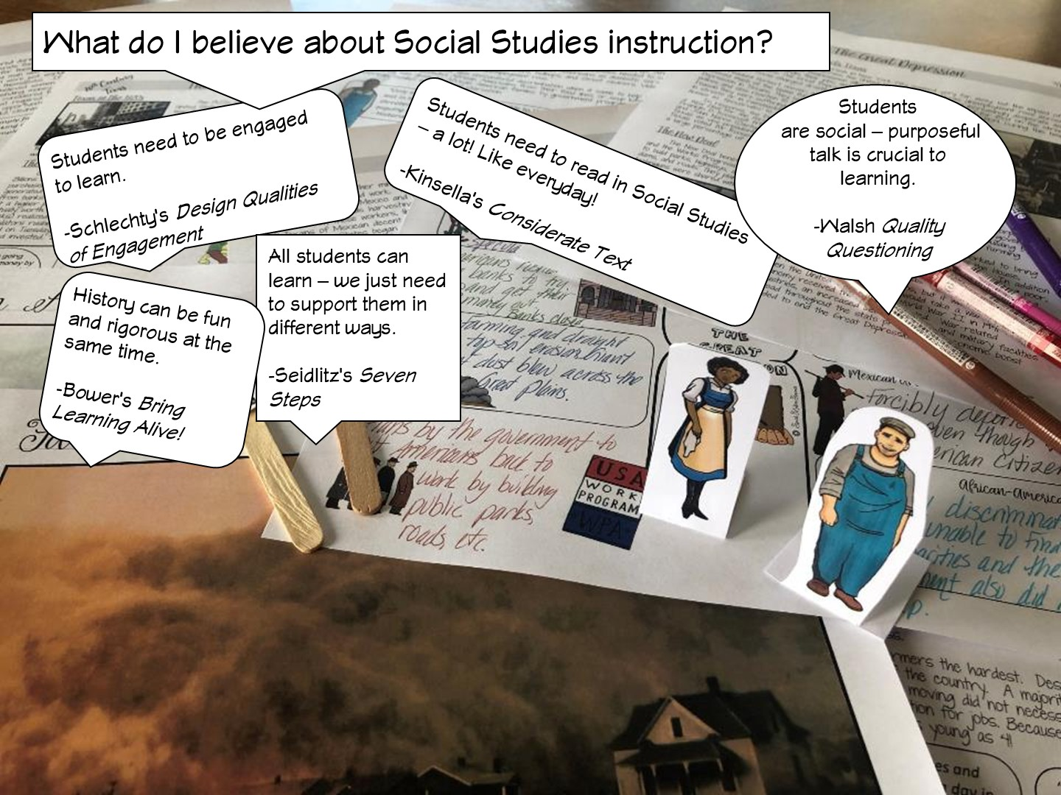

Slide 9
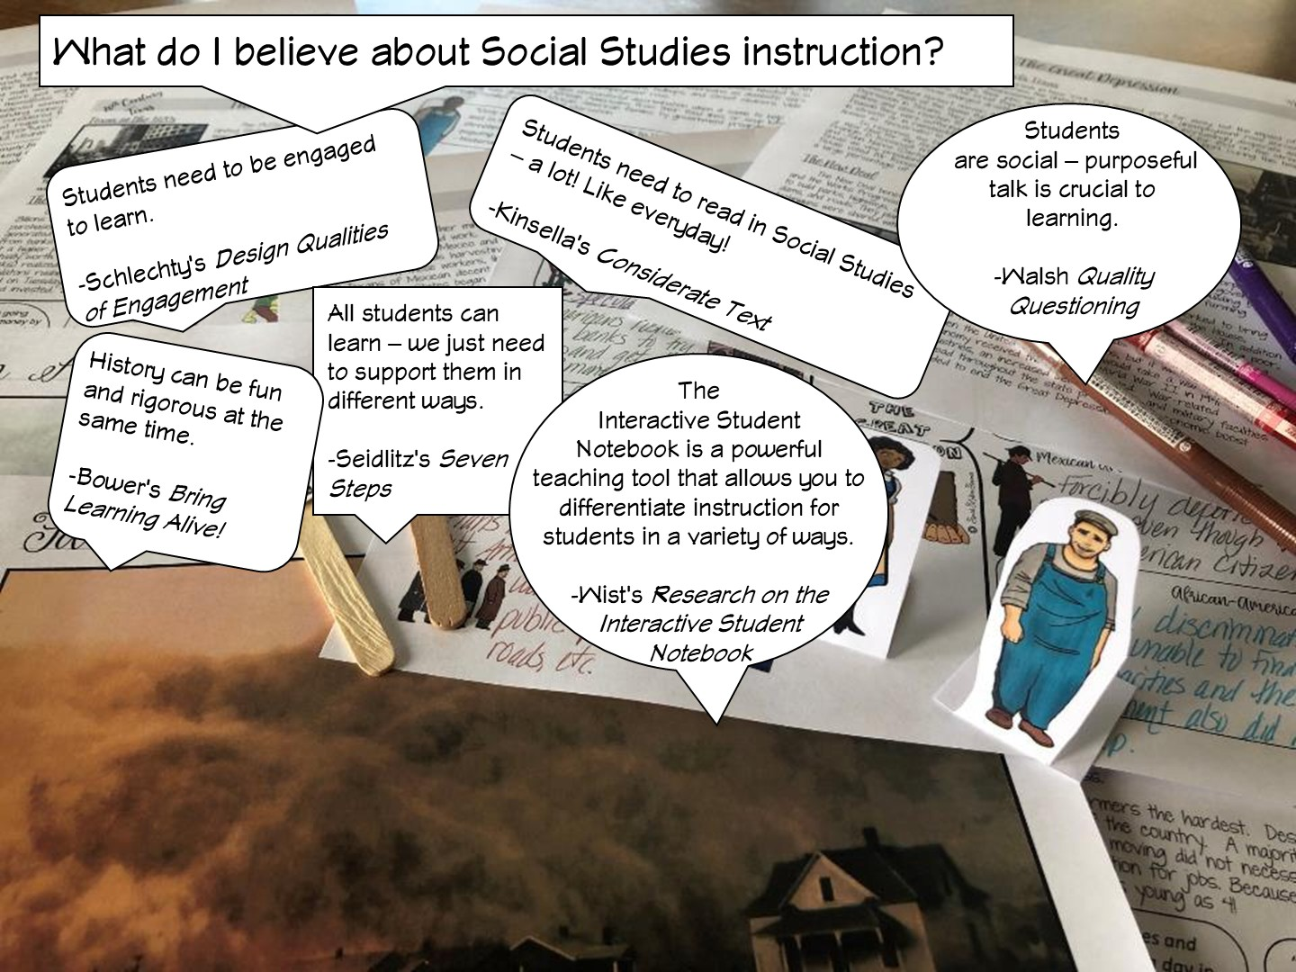

Slide 10
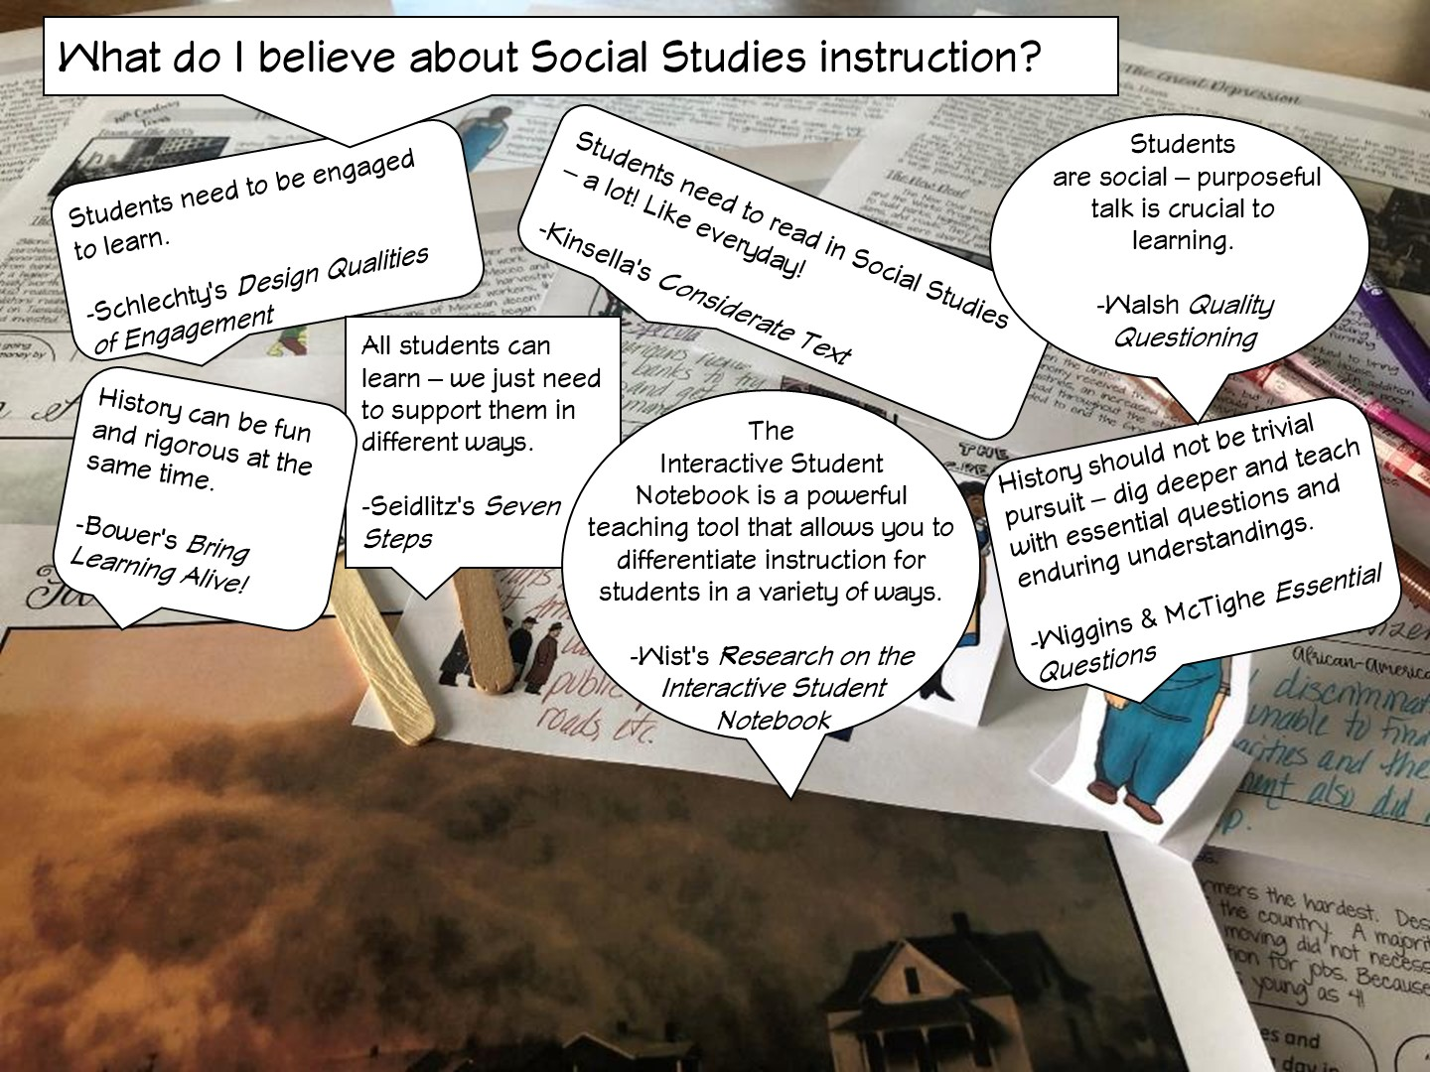

Slide 11
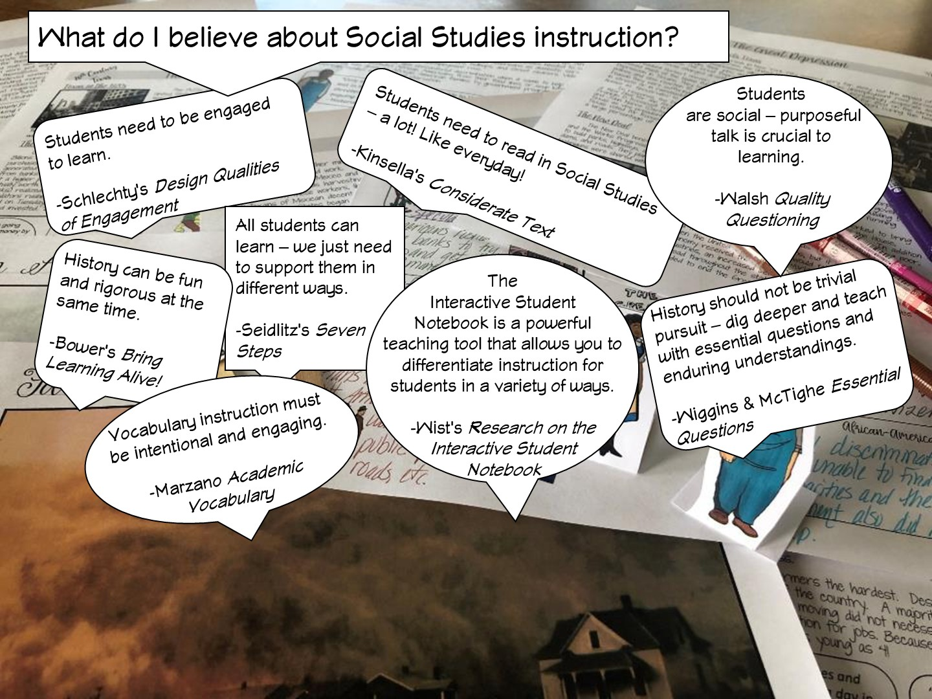

Slide 12
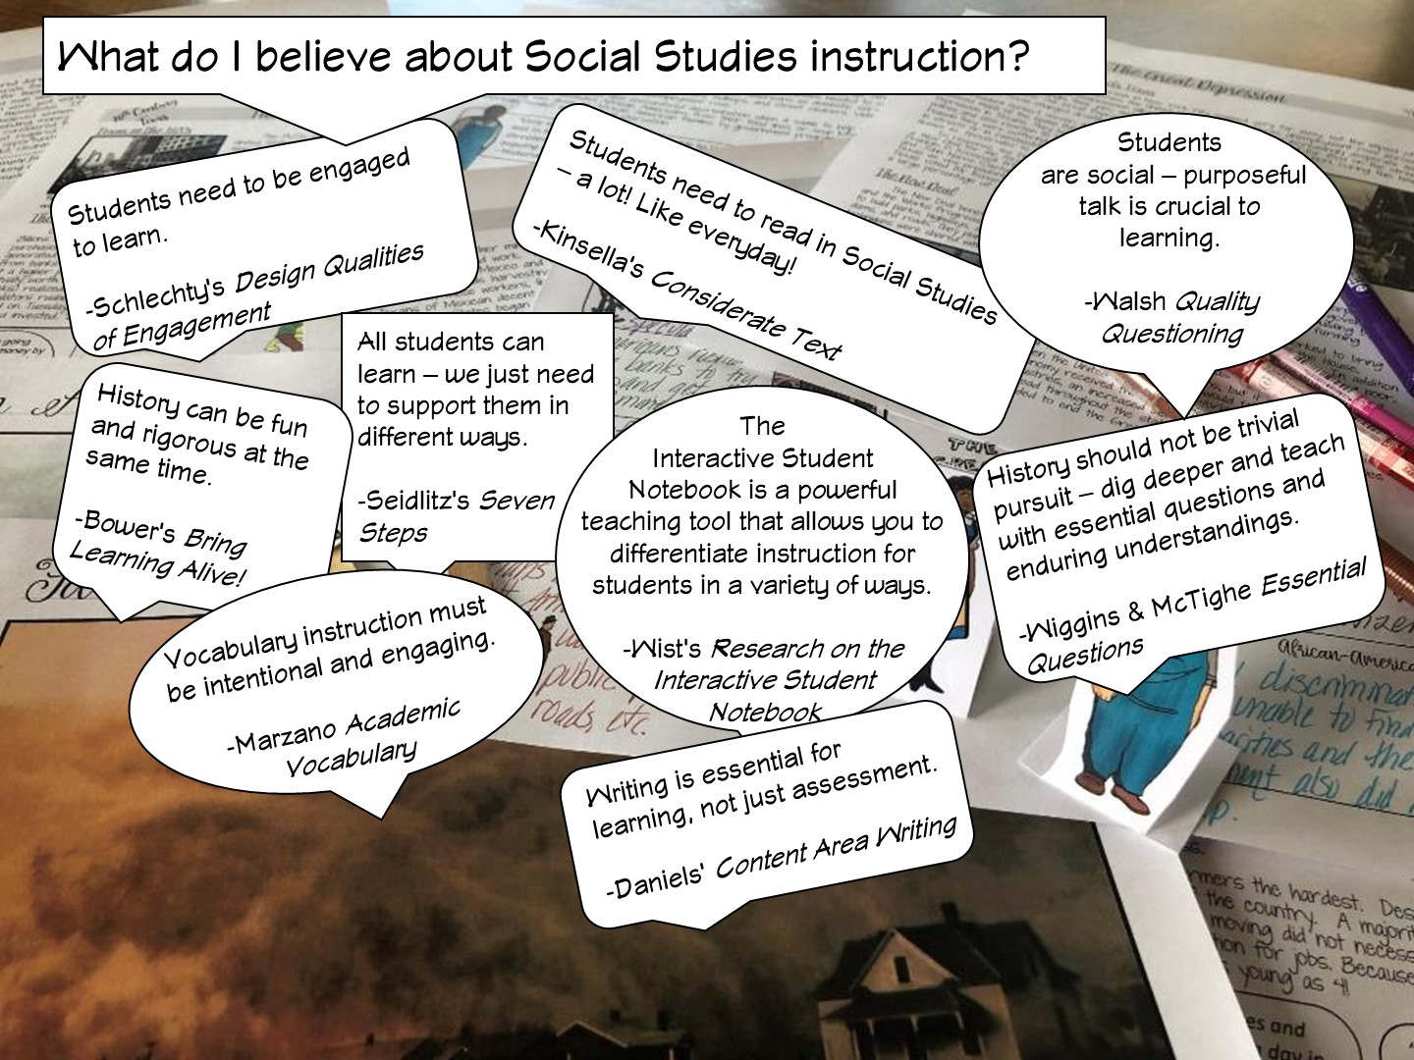

Slide 13
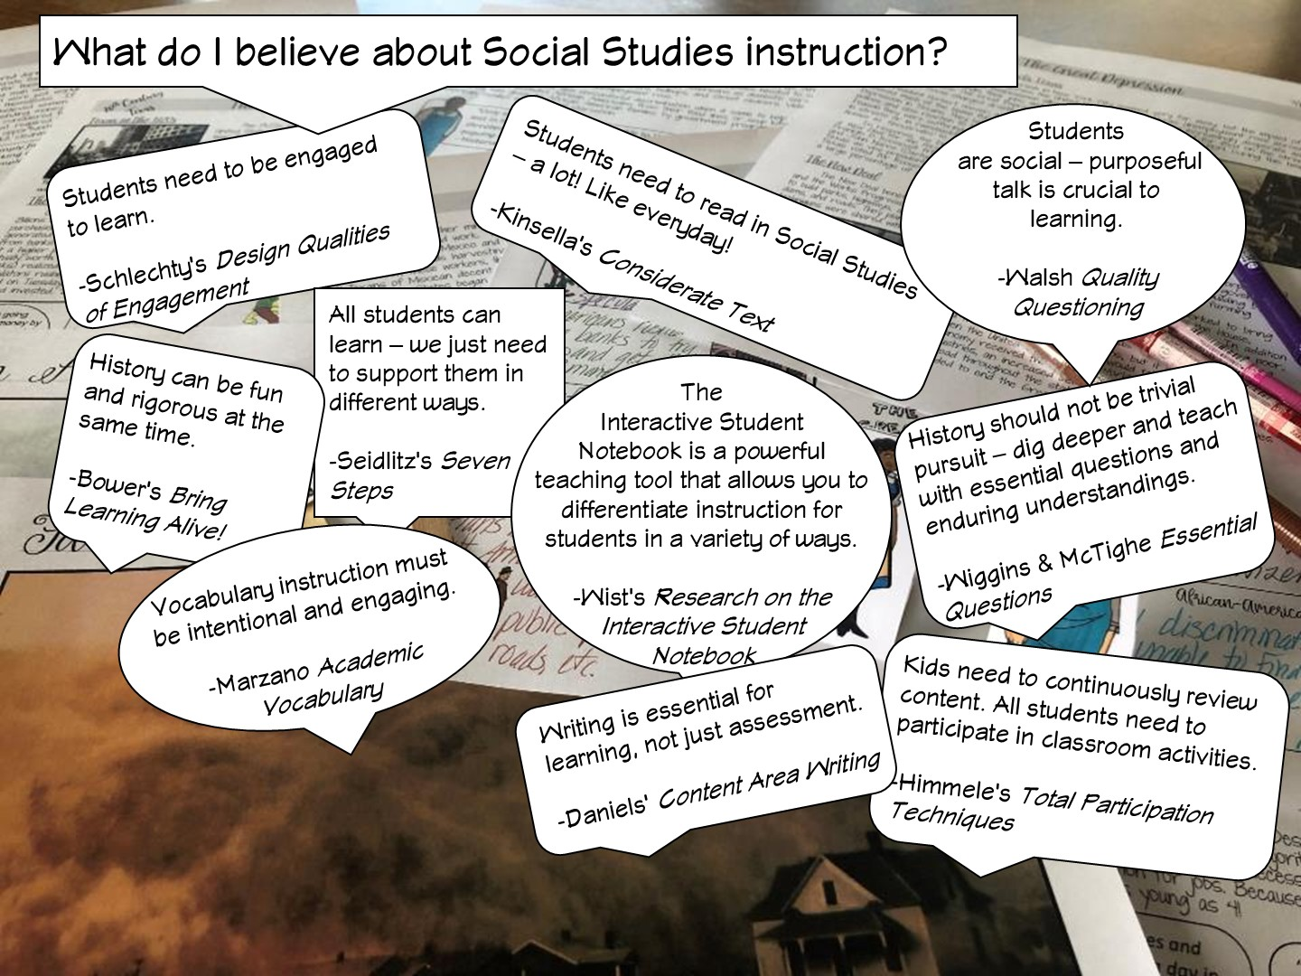

Slide 14
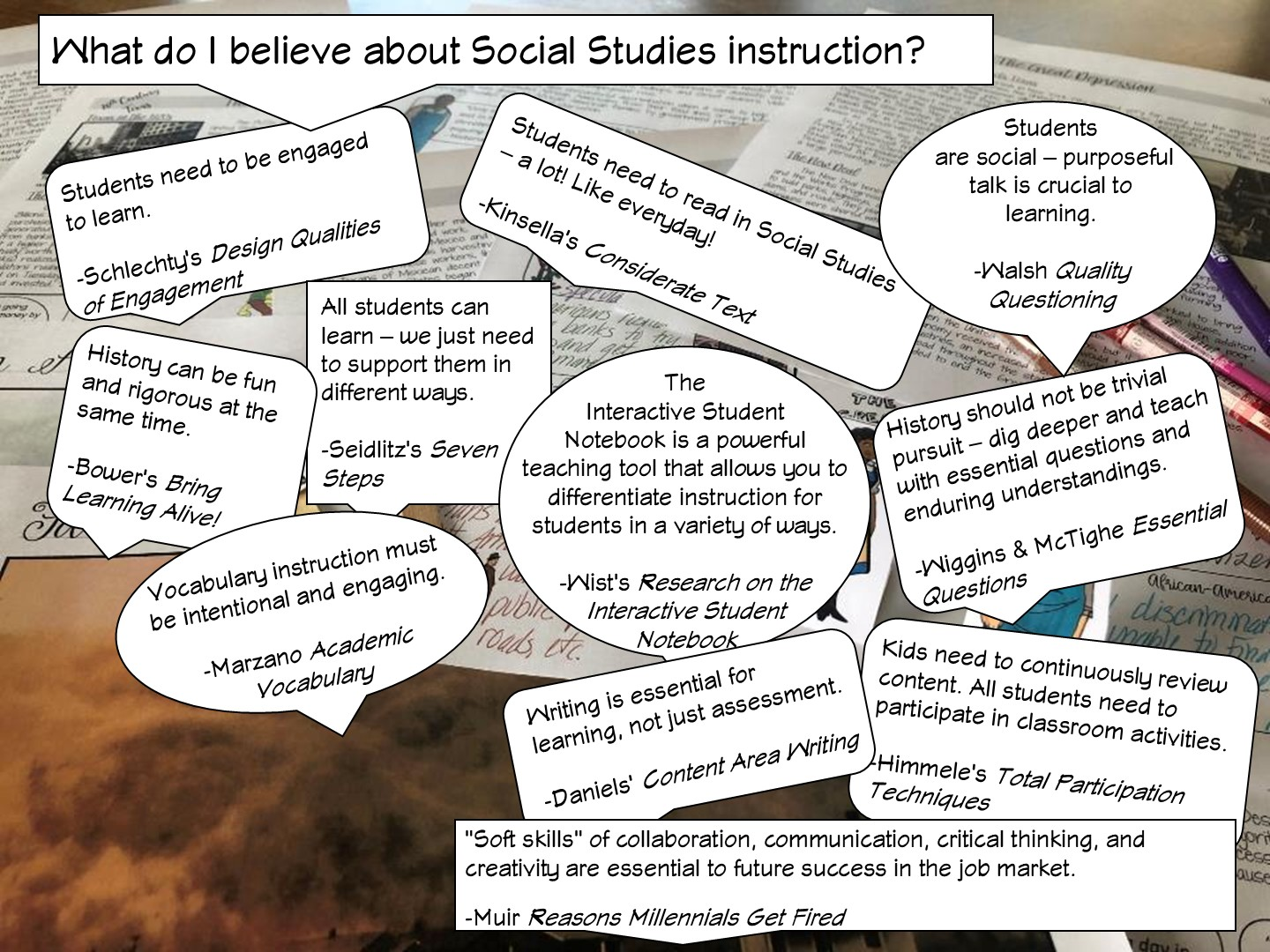

Slide 15
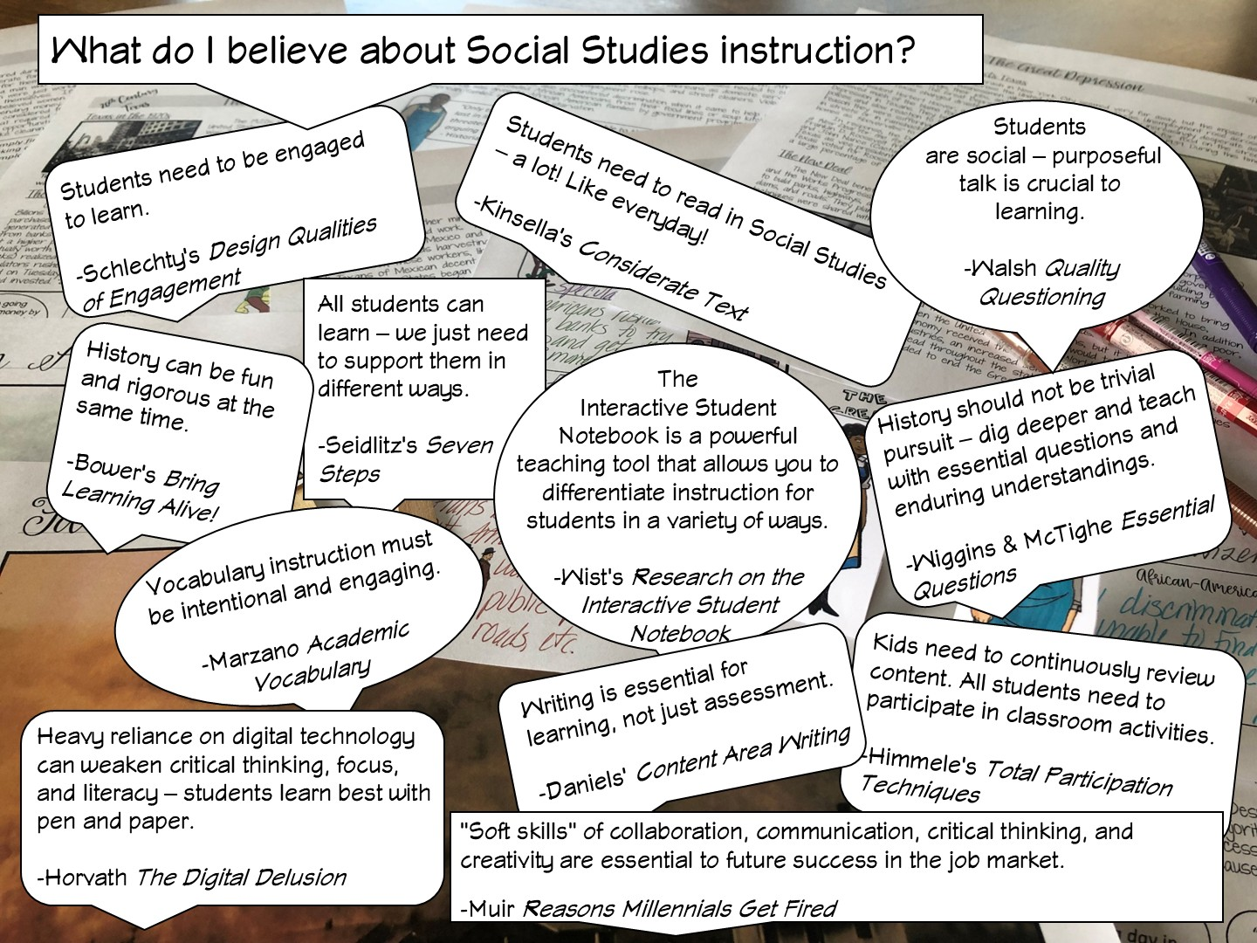
Notes:
Ask the teachers to discuss at their table – which ones of these do you agree with? Why? Call on a few to respond.

Slide 16


Slide 17
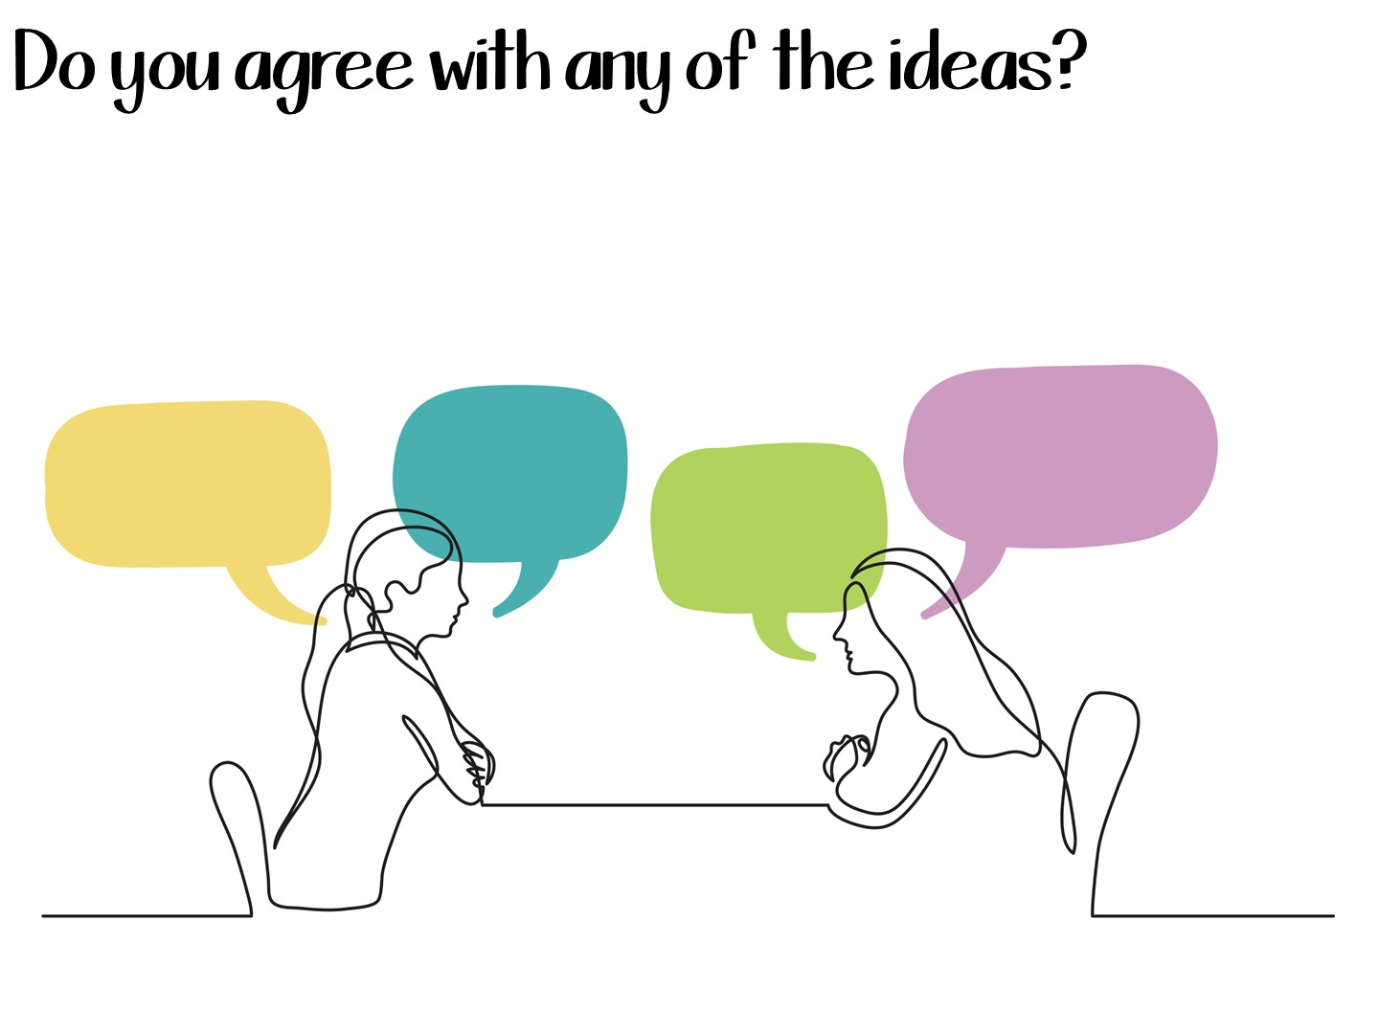
Notes:
Share with a partner.

Slide 18

Notes:
Type response in chat box.

Slide 19


Slide 20

Notes:
I share my rule of the socks:
They have never been on my feet
They are not a souvenir of the workshop
Put your cellphones away in the sock (model with your own)

Slide 21
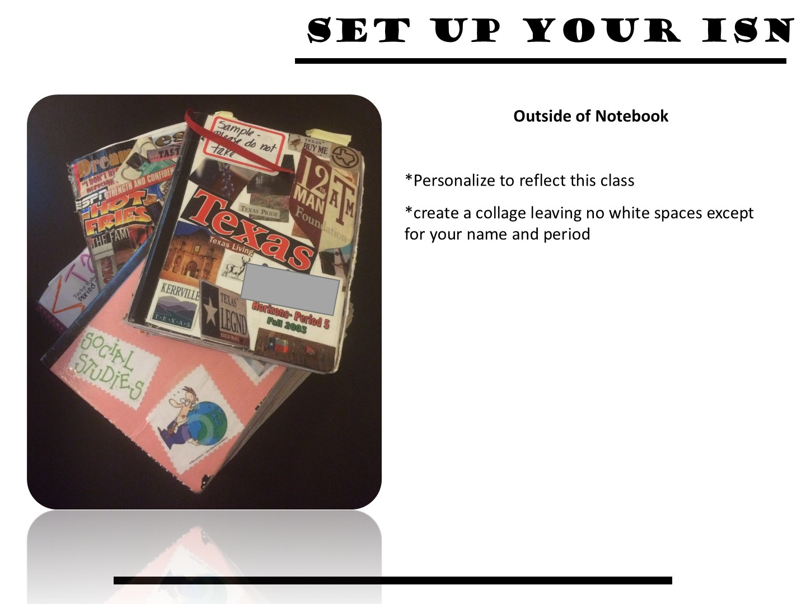
Notes:
Just show an example

Slide 22

Notes:
They can spend 5 minutes doing this

Slide 23
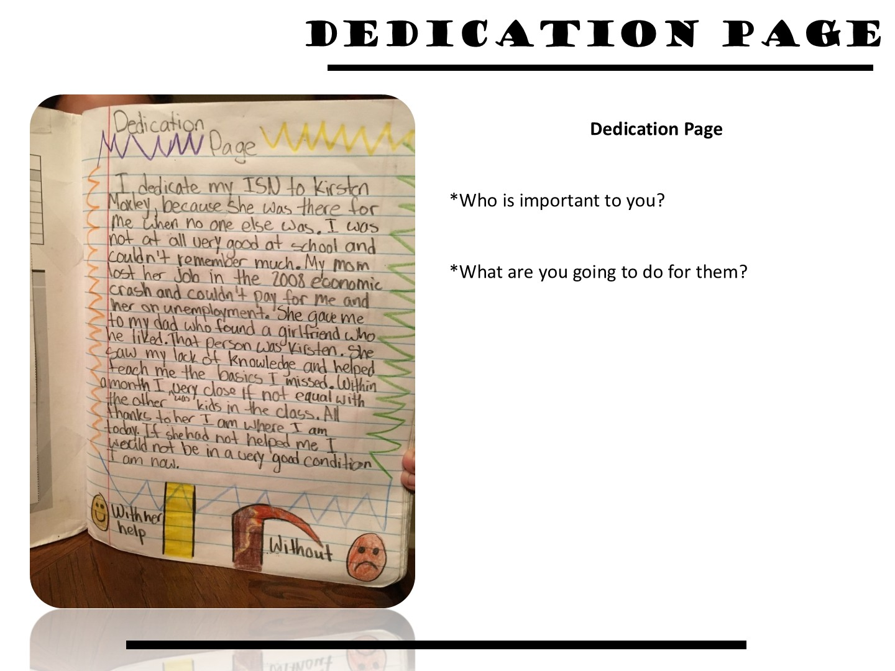

Slide 24
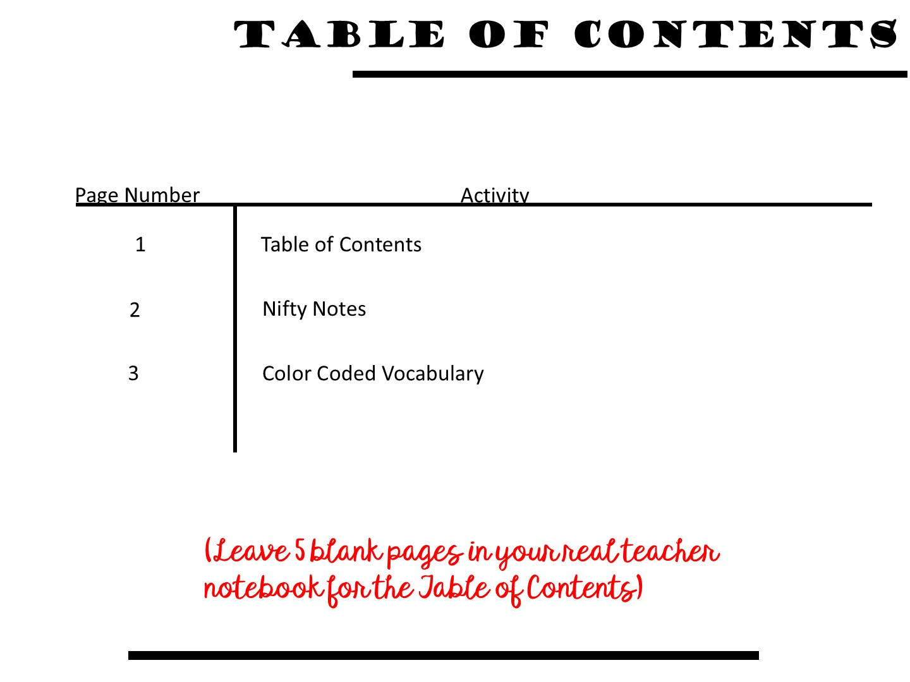
Notes:
24

Slide 25

Notes:
Let’s start with what you think about writing in the classroom with this 4 –Corner strategy. Take a look at these different statements regarding writing – which one do you agree with the most and why? Conduct a 4 Corner Activity
After this slide, you will move them into matching sock partners.

Slide 26

Notes:
Put them with their sock partner.

Slide 27

Notes:
Share with a partner

Slide 28
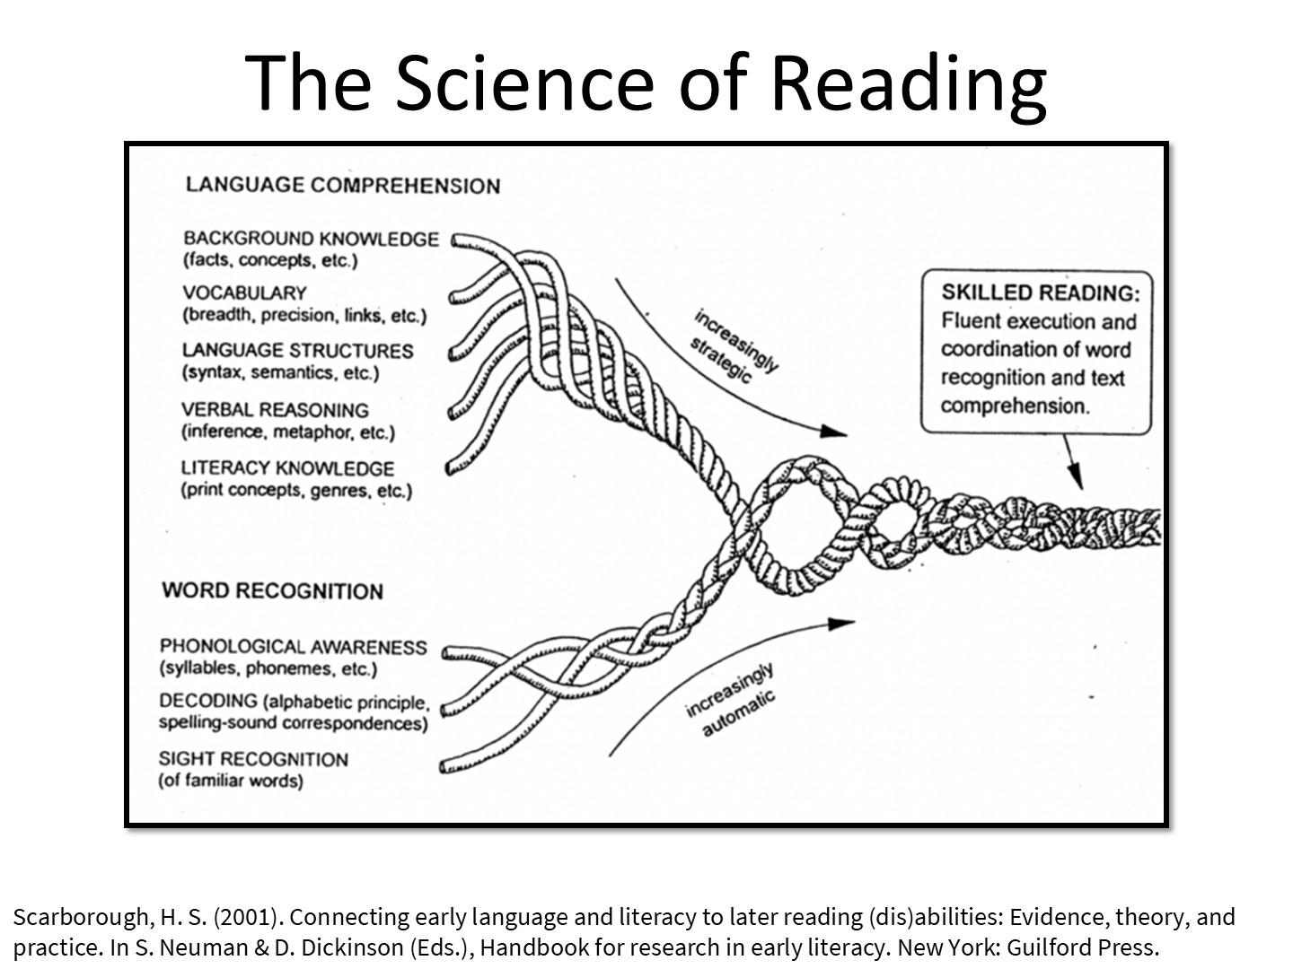
Notes:
What do you see in this image? Discuss with partner.
The Science of Reading is research into how we actually read, and what we need to do in order to create fluent readers.

Slide 29

Notes:
Most people think the ELA teacher is responsible for reading, but since so many vocabulary terms come from Social Studies, and we have so many opportunities to read informational text, we too are reading teachers.

Slide 30

Notes:
This is how we can contribute to building reading fluency in our students.

Slide 31

Notes:
Share that you are going to model a lesson based on the reading cycle – teachers need to look for what you do before, during, and after reading. You will be modeling several different strategies for each portion of the reading cycle.

Slide 32

Notes:
Now we are going to model what an interactive student notebook is like during a content lesson and how it features the ISN.

Slide 33

Notes:
Just read

Slide 34
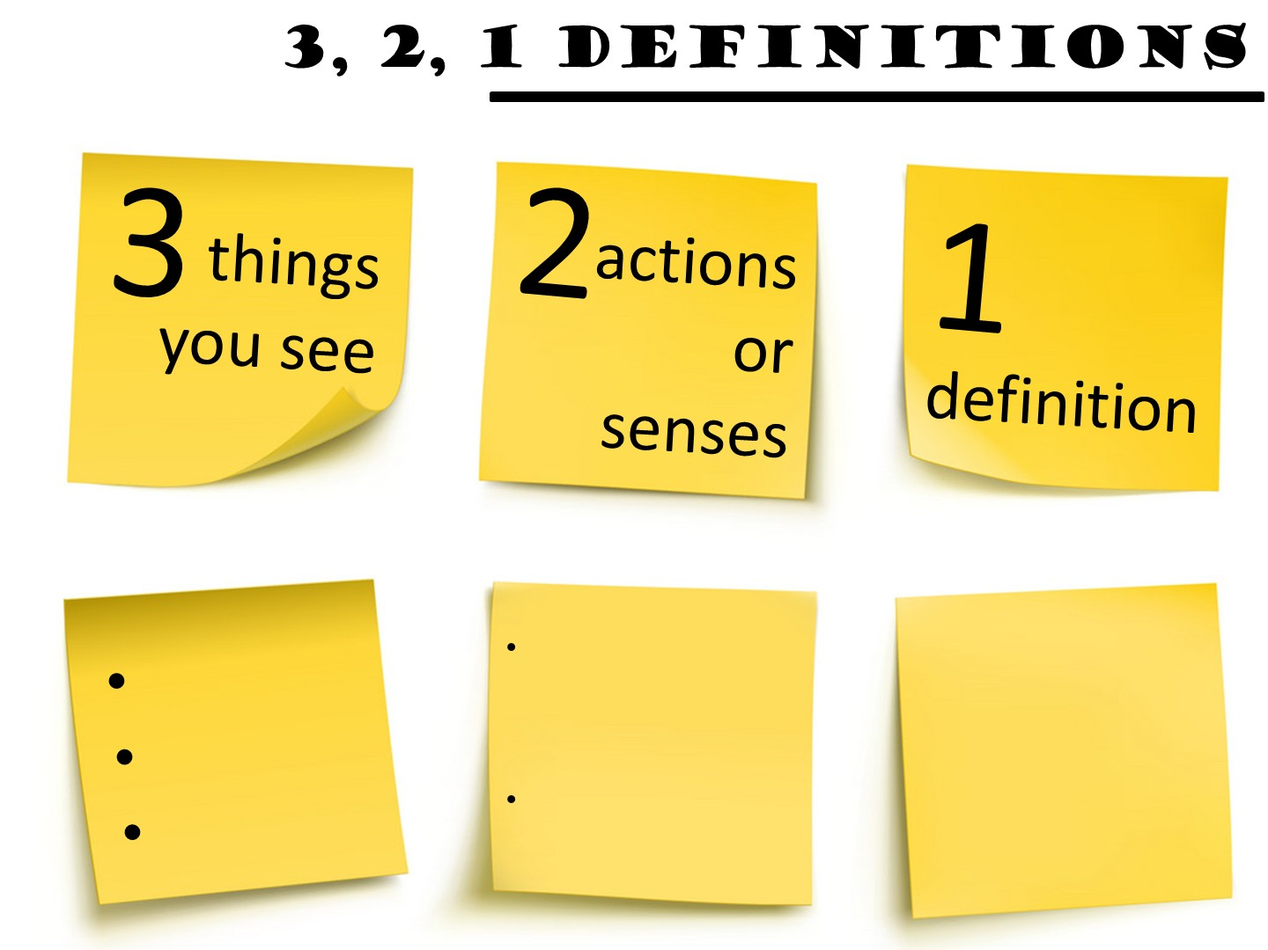
Notes:
Another method to teach vocabulary with images is the 3, 2, 1 Definitions – Allow students time to analyze an image to build their understanding of an image.
Allow them to pick a term with a partner and complete the 3, 2, 1 definition. I always bring the teachers close to word wall to get them out of their seats.

Slide 35


Slide 36


Slide 37


Slide 38

Notes:
Post the pictures of the earthquake damage and have them do a gallery walk – as they walk around, they add their thoughts to each of the images based on these questions. You don’t have to do all to get them to see what to do.

Slide 39
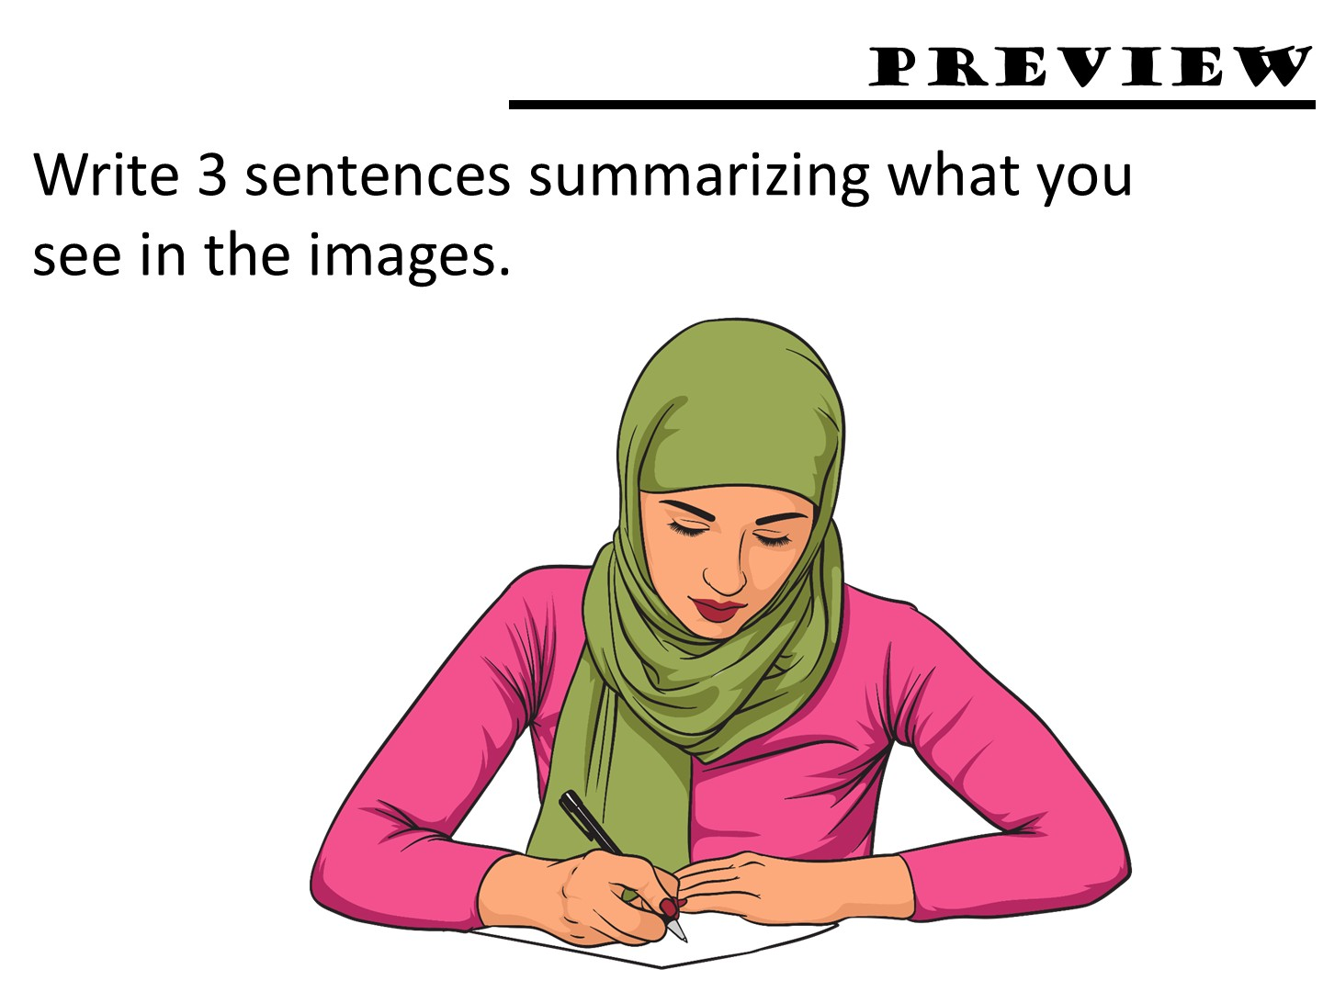
Notes:
Have them write this in their notebook as a preview.

Slide 40
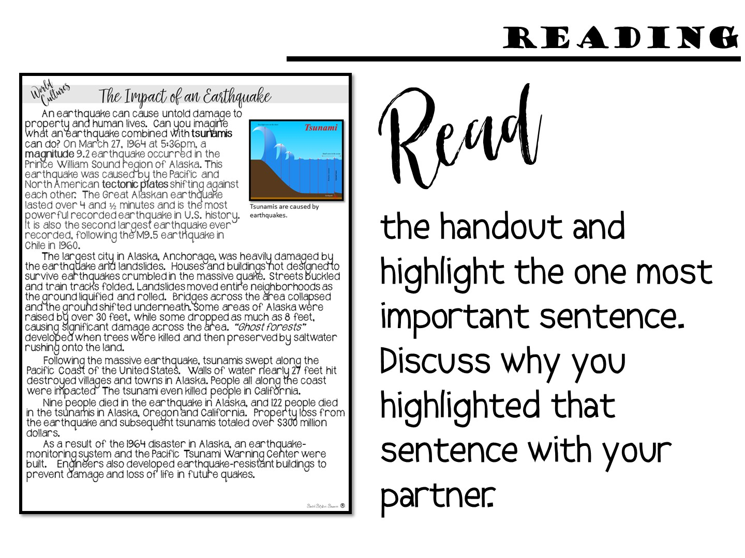

Slide 41
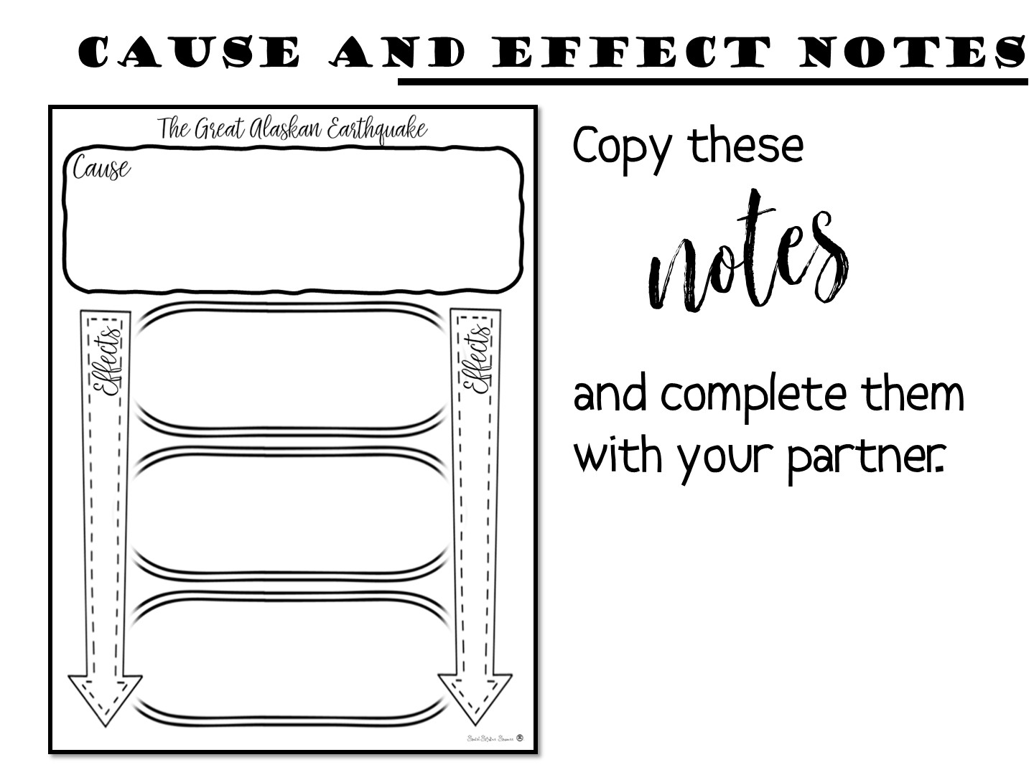
Notes:
Just give them a few minutes to do. They should copy this into their notebook – I want to avoid them gluing in so they don’t think everything has to be glued in.

Slide 42
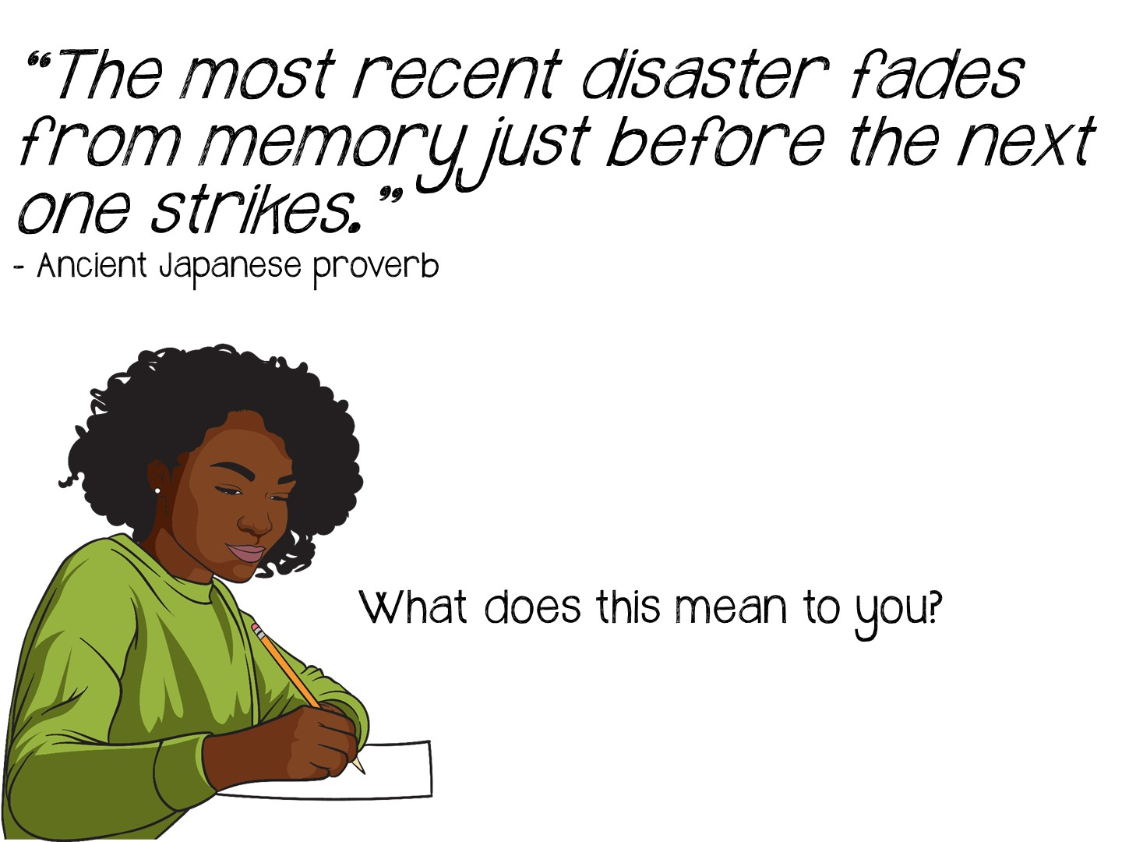
Notes:
This is their processing assignment.

Slide 43
Notes:
Remind them of the reading cycle and what they should be looking for…

Slide 44

Notes:
They should have seen:
PreReading: Vocabulary Instruction and Image Analysis
During Reading: Annotation with underlining and checking facts, choosing the most important sentence (main idea)
After Reading: Primary source quote and response

Slide 45
Notes:
Now you are going to review the reading cycle more in depth.

Slide 46

Notes:
Pass out the Reading Doodle Notes and encourage teachers to take notes on this handout. When you are done, they will glue it in their ISN.

Slide 47


Slide 48
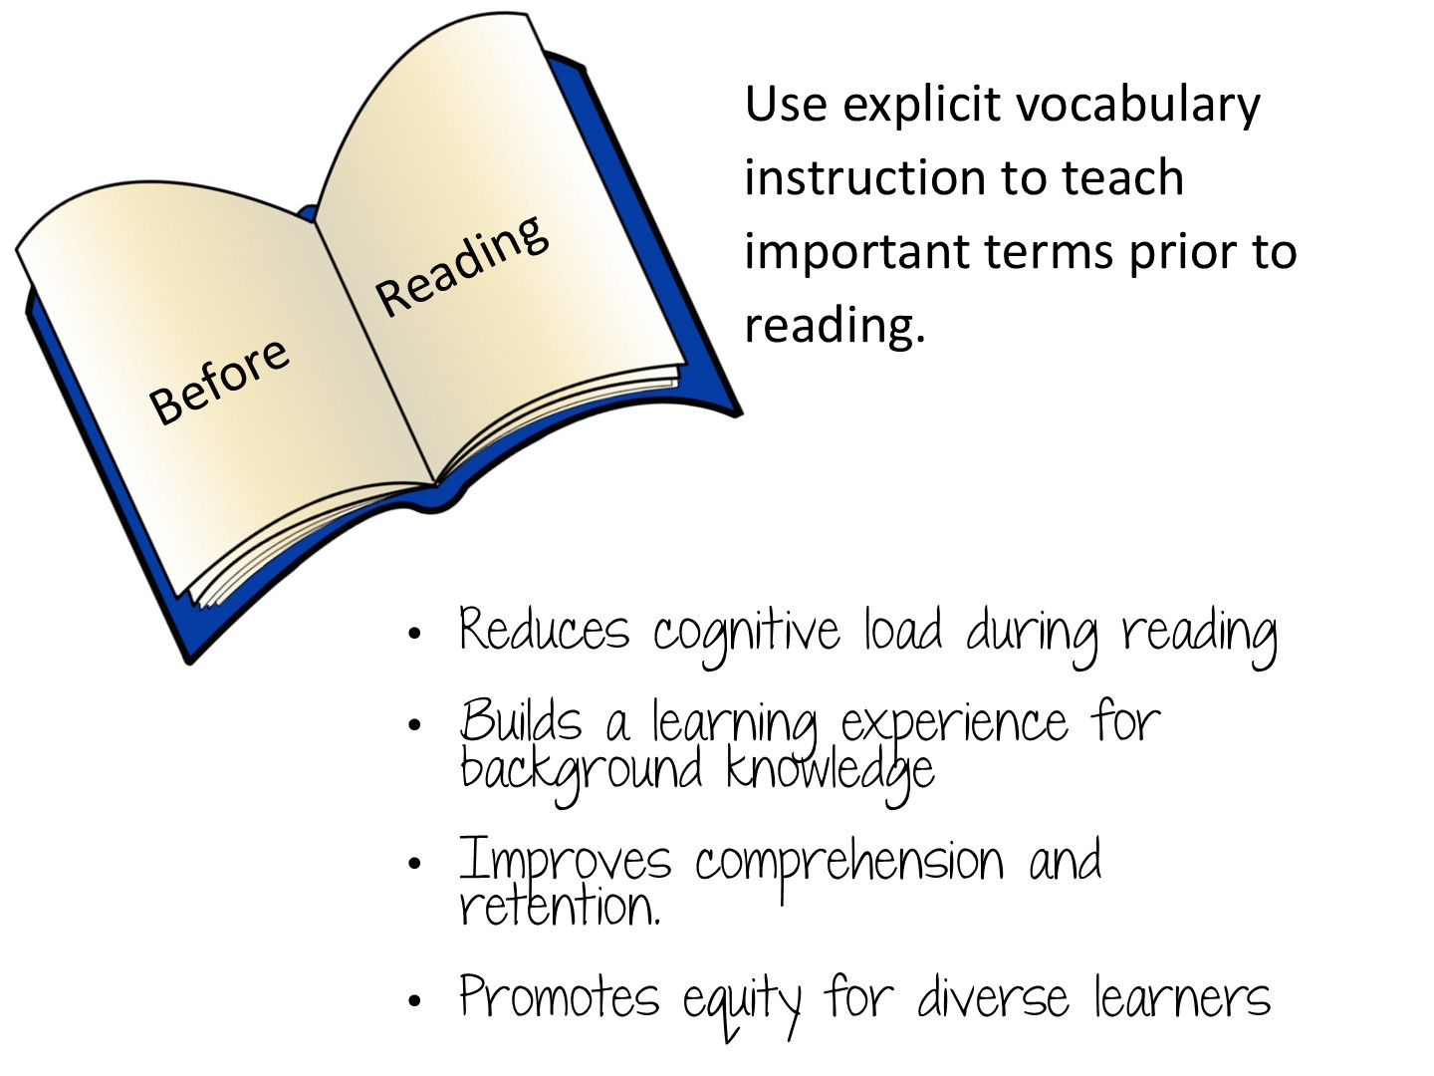
Notes:
Reduces cognitive load during reading. When students already know key terms, they can devote their mental energy to comprehending ideas and making connections rather than stopping to decode unfamiliar words, which keeps the flow of reading intact.
Builds the background knowledge needed to access the text. Content vocabulary often carries the core concepts of a subject (e.g., photosynthesis, democracy, denominator), so pre-teaching these terms gives students the conceptual hooks to understand what they read instead of encountering ideas cold.
Improves comprehension and retention. Research consistently links word knowledge to reading comprehension; students who understand the vocabulary going in are better able to grasp main ideas, follow arguments, and remember what they've read afterward.
Promotes equity for diverse learners. Pre-teaching levels the playing field for English language learners, struggling readers, and students with less prior exposure to academic language, ensuring they aren't shut out of the content before they even begin.

Slide 49


Slide 50
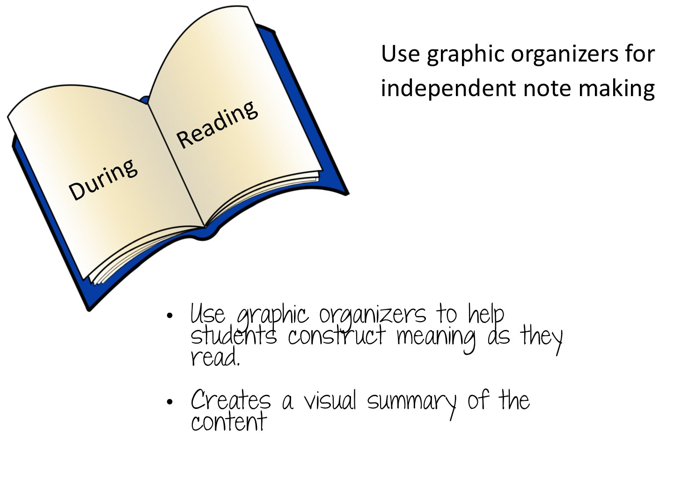
Notes:
Share that there are actually two different phases of During Reading in Social Studies – the second part includes independent note making.

Slide 51


Slide 52

Notes:
Stand on one foot and summarize what you have learned so far

Slide 53

Notes:
Give them 5 minutes to write down reflections on their Doodle Notes

Slide 54


Slide 55


Slide 56

Notes:
Pass out the bags with the Preview Puzzles – have your teachers match a title, description and picture.

Slide 57

Notes:
Debrief in chat box.

Slide 58
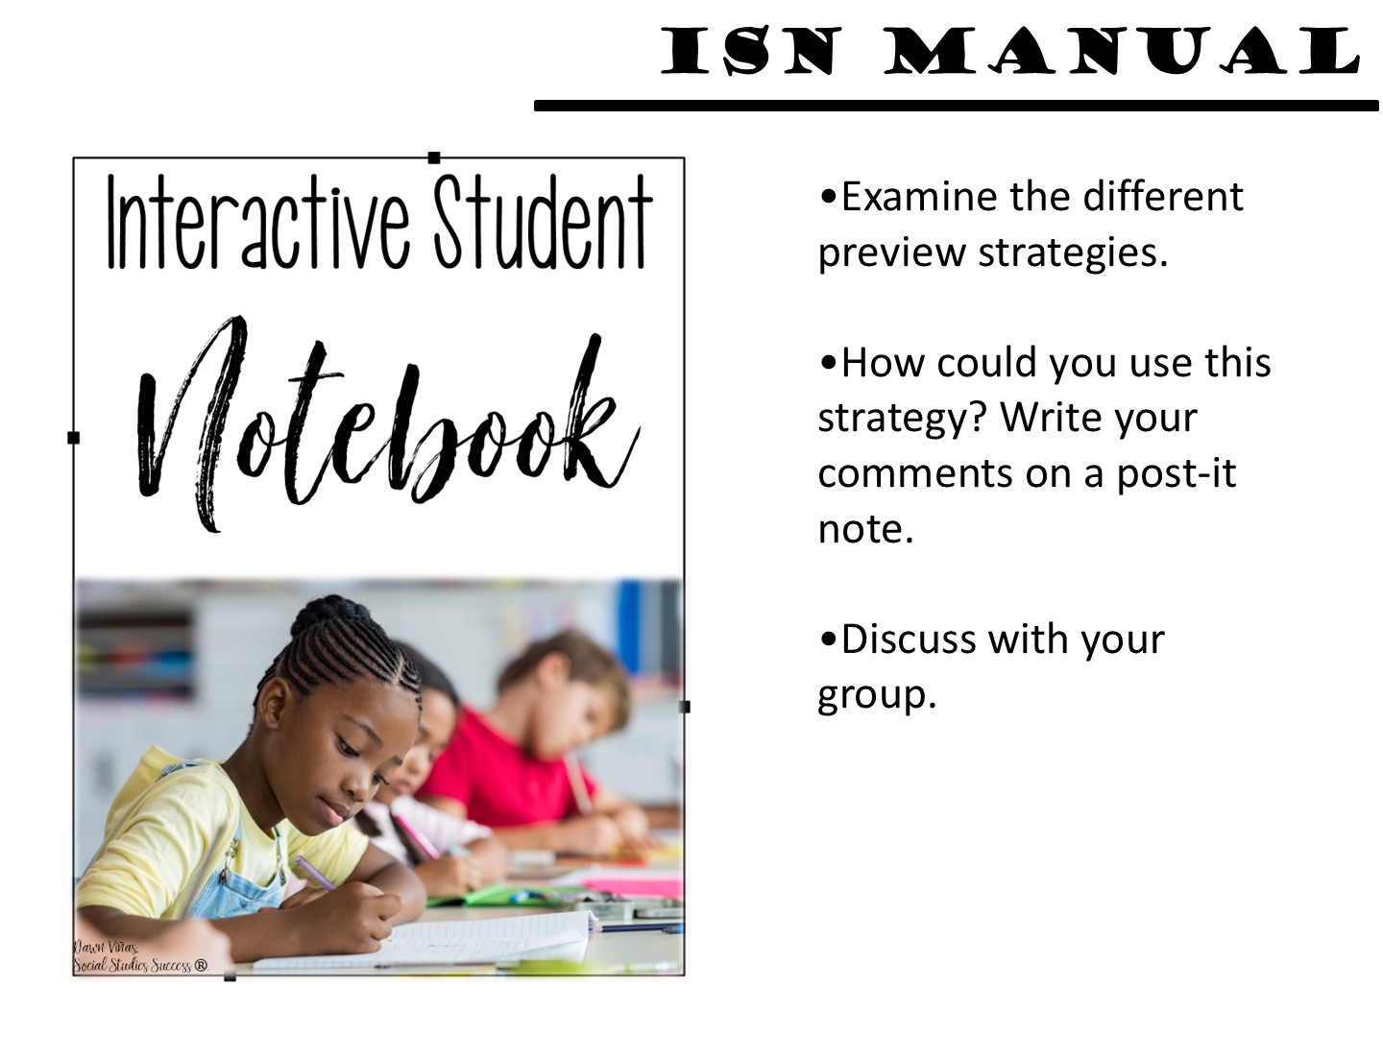

Slide 59

Notes:
Pat yourself on your back, then give me 5 new things you have learned so far. I have them count down on their fingers.

Slide 60
Notes:
Reduces cognitive load during reading. When students already know key terms, they can devote their mental energy to comprehending ideas and making connections rather than stopping to decode unfamiliar words, which keeps the flow of reading intact.
Builds the background knowledge needed to access the text. Content vocabulary often carries the core concepts of a subject (e.g., photosynthesis, democracy, denominator), so pre-teaching these terms gives students the conceptual hooks to understand what they read instead of encountering ideas cold.
Improves comprehension and retention. Research consistently links word knowledge to reading comprehension; students who understand the vocabulary going in are better able to grasp main ideas, follow arguments, and remember what they've read afterward.
Promotes equity for diverse learners. Pre-teaching levels the playing field for English language learners, struggling readers, and students with less prior exposure to academic language, ensuring they aren't shut out of the content before they even begin.

Slide 61

Notes:
Pass out the Vocabulary Doodle Notes and encourage teachers to take notes on this handout. When you are done, they will glue it in their ISN.

Slide 62

Notes:
Let’s take a look at explicit vocabulary instruction.

Slide 63

Notes:
Discuss

Slide 64

Notes:
We are now going to look at a variety of strategies to teach vocabulary. Remember, lack of vocabulary knowledge is one of the main reasons students struggle with reading and primary sources.

Slide 65

Notes:
First, we must start with the research. There are multiple books and articles written on how to teach vocabulary – but here are the key parts…

Slide 66
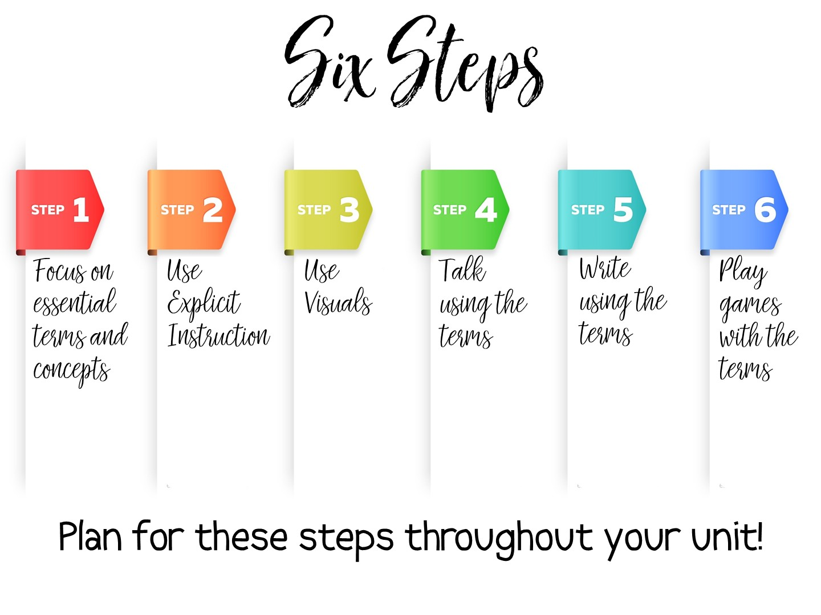
Notes:
I have taken the research and created my own 6 steps for practical vocabulary instruction. We will examine each of these steps in this workshop. Steps one and two need to be done in order, but the rest of the steps can be done at any point in the unit.
Some key points to remember:
Vocabulary instruction must be intentional, not just the initial instruction on the definition of the term, but included deliberately in subsequent lesson plans throughout the unit.
Vocabulary must be taught directly – students need to see the term, hear the term, and say the term in order to build their understanding of key content vocabulary.
Students need to encounter the vocabulary term in a meaningful way at least six times throughout the unit before it can be understood and applied.
One of the best ways for students to learn vocabulary is to associate an image with the term.
Students must participate in engaging activities for long term retention.

Slide 67


Slide 68


Slide 69

Notes:
Step One actually seems obvious – you need to know the terms that you will be teaching. In the discipline of Social Studies there are more than 26,000 terms – more than math, Language Arts, and Science combined. Social Studies vocabulary is actually the vocabulary needed most in college.
But there is actually more to just teaching a list of terms out of the textbook. What are the specific vocabulary terms students will need to master your daily lesson? The unit? You cannot teach too many vocabulary terms in one setting and expect immediate mastery. You need to carefully examine the terms you are given or you find for each unit and decide – is this a term that is essential for this lesson? For this unit? Can this term be introduced and master at a later point? Or does it need mastery now? Is this a term that has already been taught and just needs a refresher? Thoughtful planning needs to happen before instruction.

Slide 70
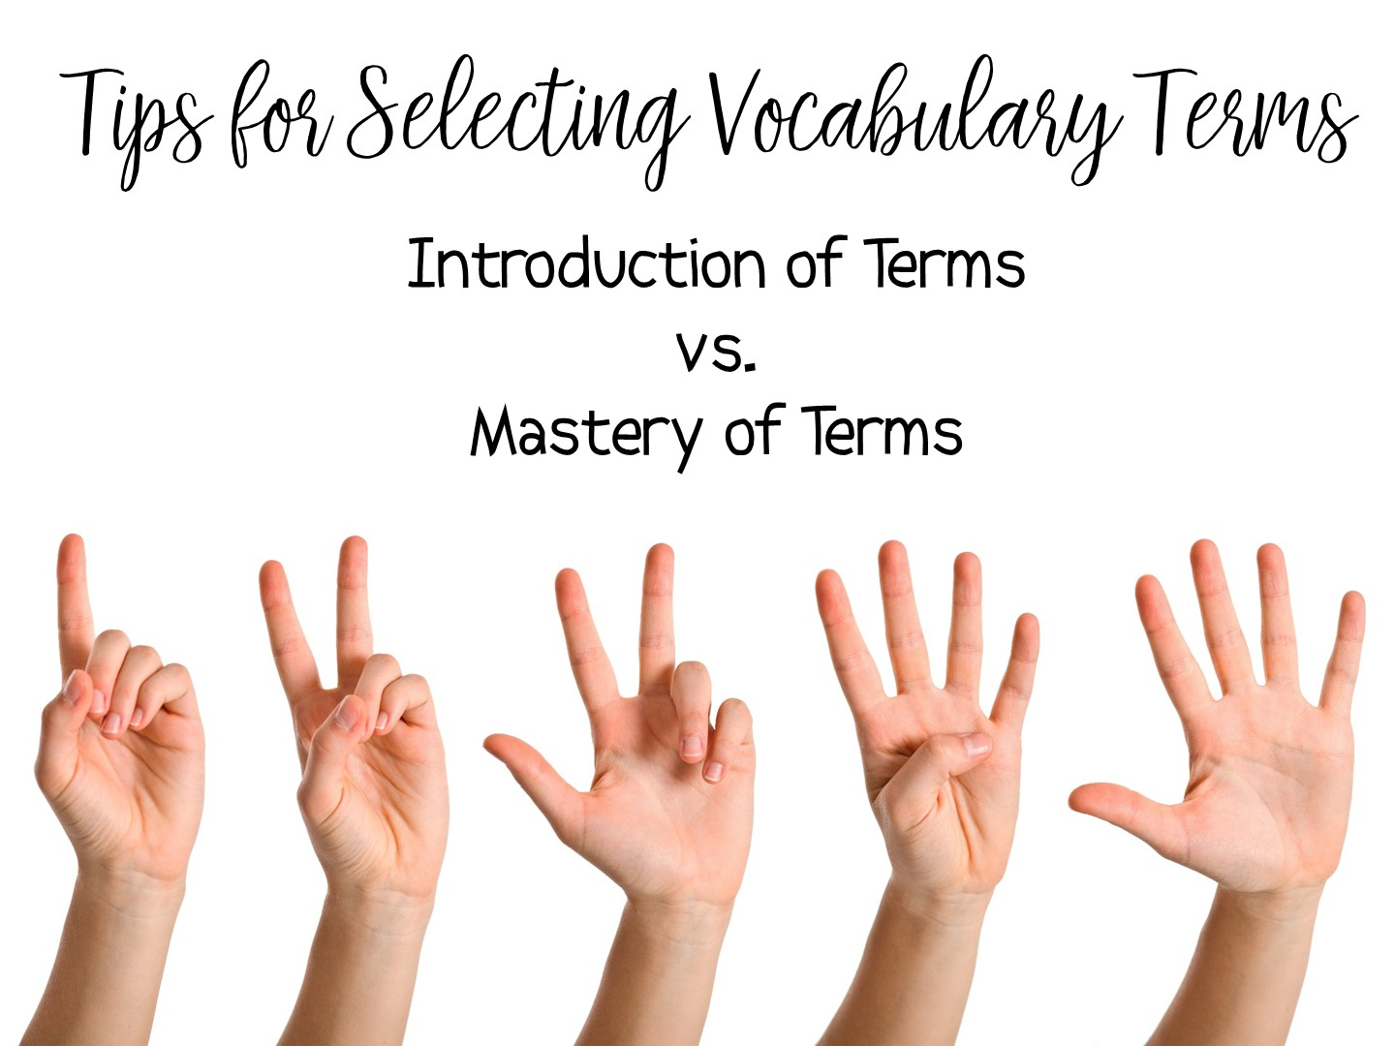
Notes:
Read the handout on Tips for Selecting Vocabulary Terms. When you have finished reading the Tips – jot down 1-2 new learnings or thoughts on your Doodle Notes.

Slide 71
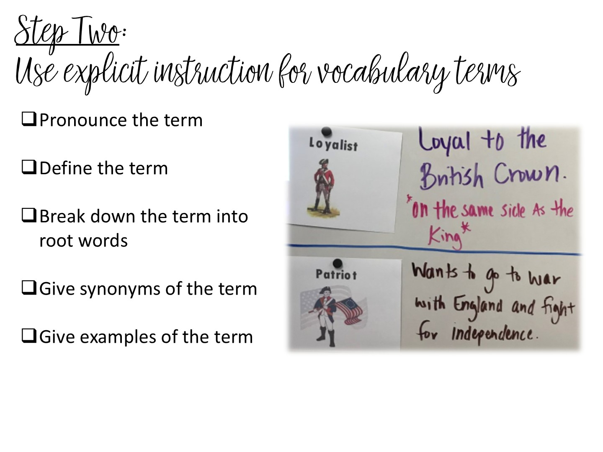
Notes:
Vocabulary instruction is active, it is not a passive activity to fill time. Assigning vocabulary out of the back of the book and having students copy the definition does not work. Just like you would plan for a lesson on teaching content, you need to plan how you will teach vocabulary.
The 2nd step involves explicit instruction. Pronounce the vocabulary terms to your students. Students must hear the word out loud to help build their understanding of the term. Many time students will understand a term more if they hear it first. Think of the term militia – the way it is pronounced and the way it is spelled can be confusing to your students. But if you pronounce the term first, they may already know the word, just not have experienced it in text.
The rest of the vocabulary instruction can differ depending on the term, but these activities are recommended when you are teaching vocabulary.
Define it, or help your students define the term. There is nothing more dangerous than asking kids to just “google” the definition. They will usually just choose the first definition rather than correct one.
Help students make connections to any root terms. This is important for transfer of knowledge – if they understand the root, they can understand the term.
Help students make connections with synonyms – many times, vocabulary on an assessment is actually a synonym of a term they were taught.
And finally, give concrete SOCIAL STUDIES examples of the term.

Slide 72

Notes:
Let’s do a quick check. What words in your course do you know students struggle with? Talk with your partner and list 5 terms that you know students will need to have explicit instruction for. Do these terms have any root words? What are their synonyms? What are Social Studies examples of these terms.

Slide 73
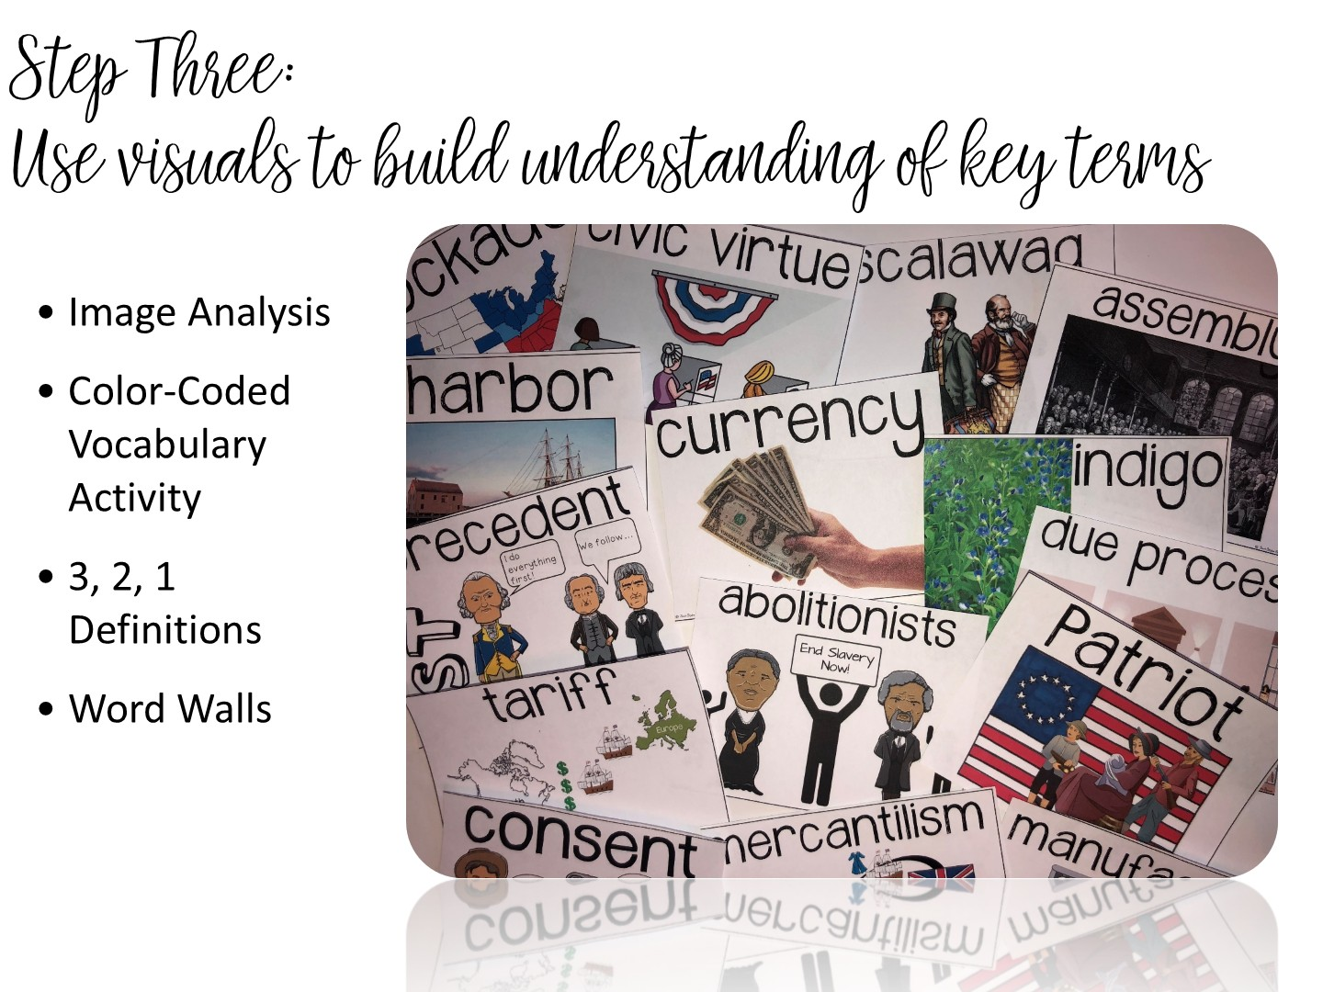

Slide 74
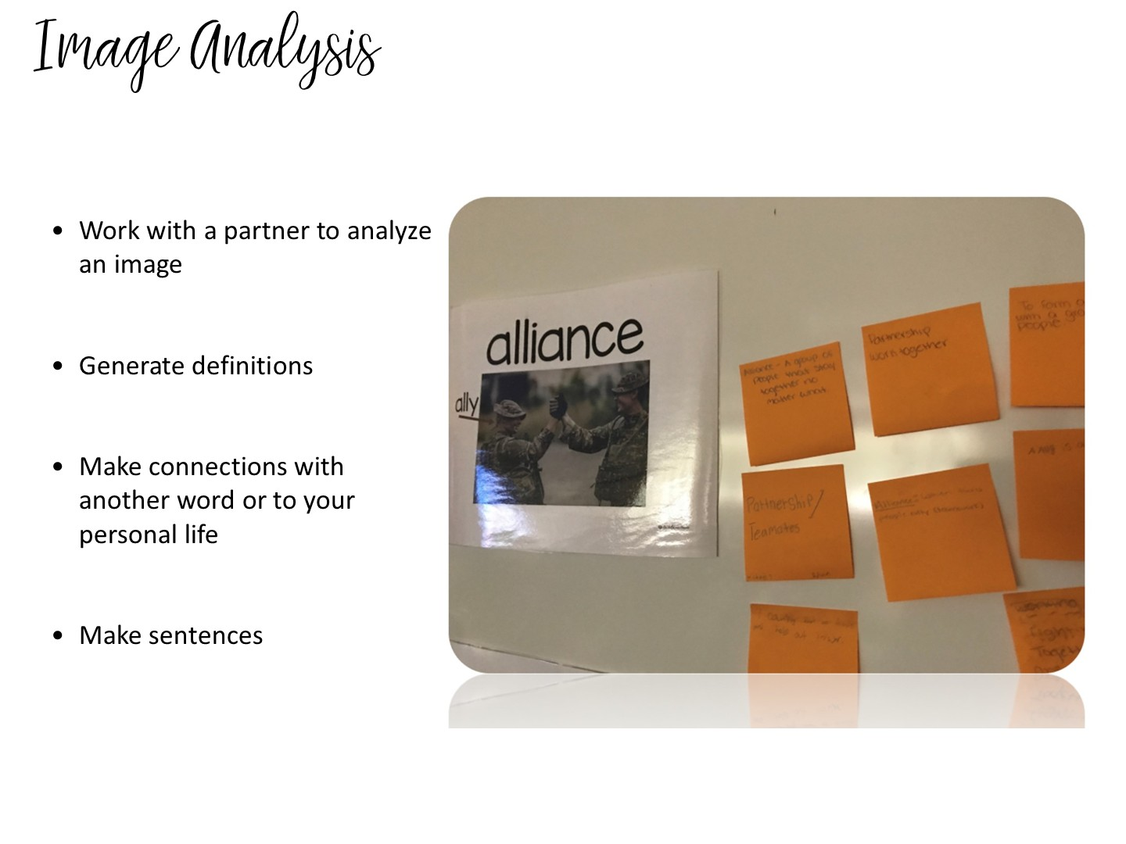
Notes:
One strategy for explicit instruction involves using planned visuals of the definition. Let’s look at a content example of this –…

Slide 75

Notes:
Take a quick look at this image -

Slide 76
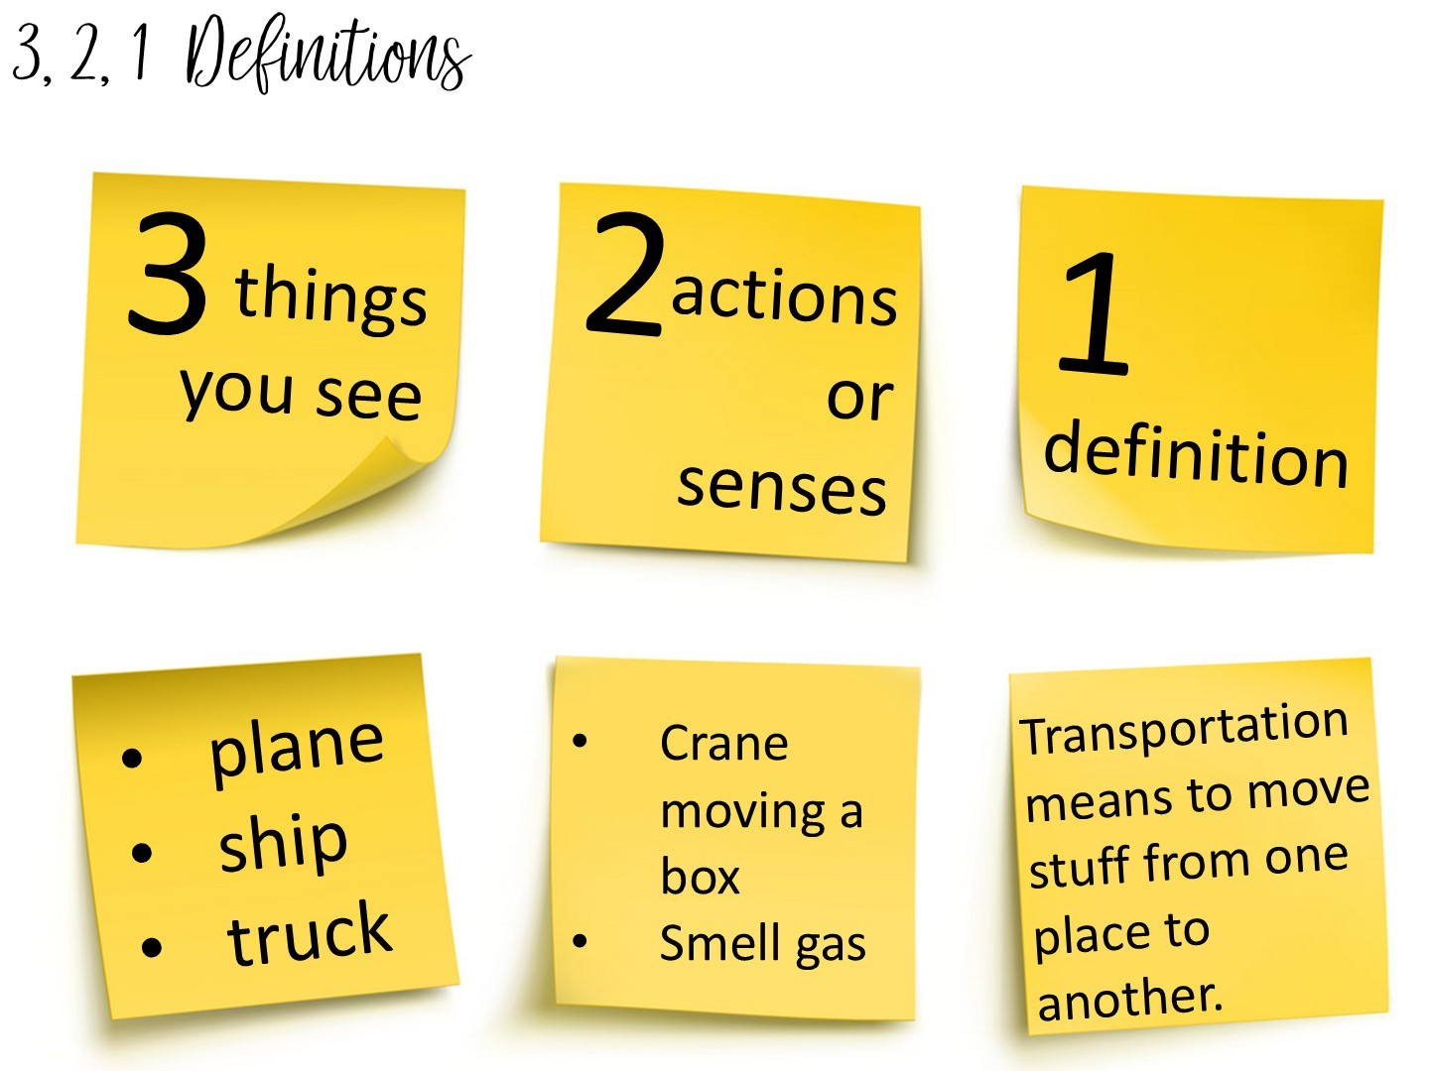
Notes:
Another method to teach vocabulary with images is the 3, 2, 1 Definitions – Allow students time to analyze an image to build their understanding of an image.

Slide 77
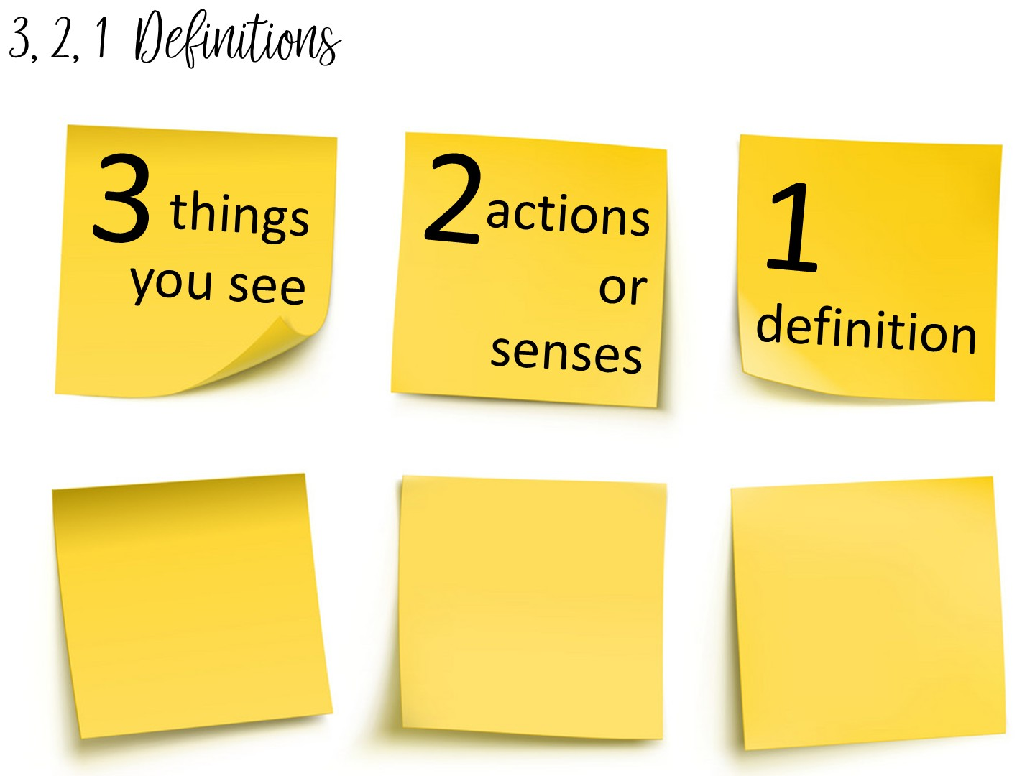
Notes:
Another method to teach vocabulary with images is the 3, 2, 1 Definitions – Allow students time to analyze an image to build their understanding of an image.

Slide 78
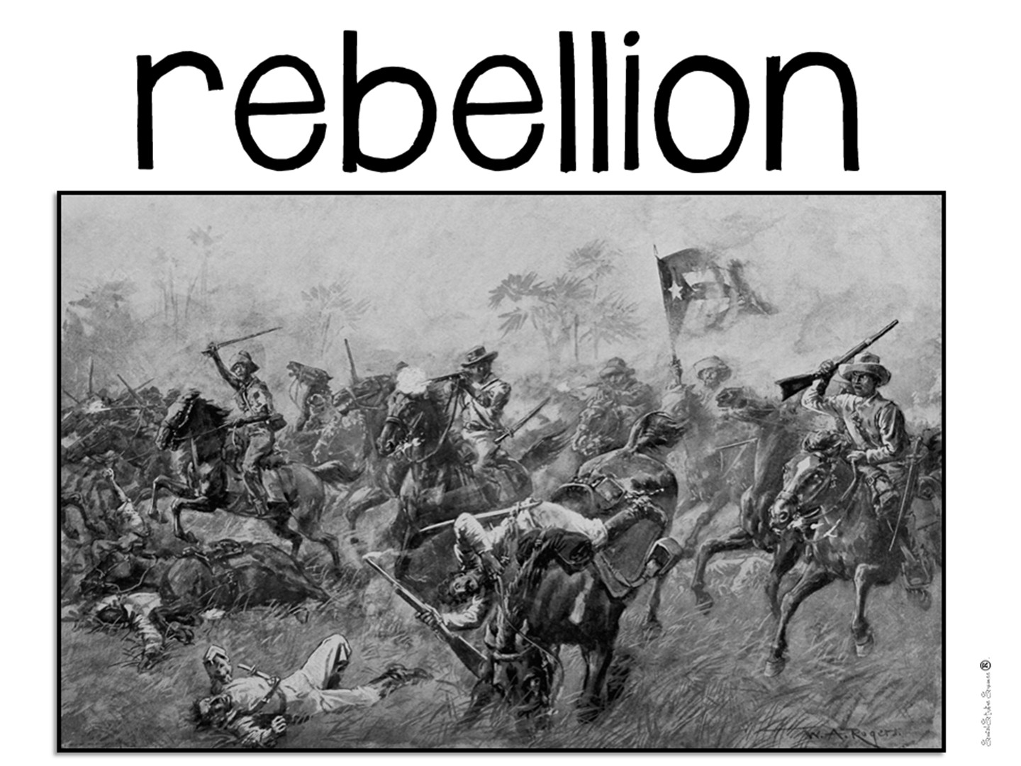
Notes:
Have them create a 3, 2, 1 definition on this image

Slide 79

Notes:
While you are learning about visuals to support vocabulary instruction – I want to take a quick time out to discuss Word Walls.

Slide 80

Notes:
Discuss with a partner

Slide 81


Slide 82

Notes:
Have you had instruction on how to use Word Walls, or was it just a district initiative you were told to follow? Let me tell you my own story with word walls….
Insert your own experience using word walls

Slide 83

Notes:
It's one thing to argue a strategy should help; it's another to measure it. A 2024 meta-analysis examining word walls across multiple schools found large effects on vocabulary learning, with effect sizes well above 1.0 at both the junior high and high school levels. For context, an effect size that large is the kind of result educators rarely see from a low-cost, low-tech intervention. Smaller studies echo the pattern across very different populations—including measurable vocabulary gains for students with hearing impairments learning science terms, and for English learners building academic language.
That breadth matters. The benefit isn't confined to one age group, subject, or learner profile. Word walls help your strongest readers and your most vulnerable ones alike.

Slide 84

Notes:
Word Walls work because of several different reasons – the first of which is episodic memory. Students begin to associate a certain space in your room with vocabulary terms, and if you have taken the time to teach the terms, they will associate the space with learning.
It is important that you put your current word wall in the focal point of your room – near where you teach.

Slide 85

Notes:
Word walls reinforce sight-word acquisition. When students recognize the terms on sight, their fluency increases. When their fluency increases, their comprehension increases. The goal is to build content literacy across grades and disciplines.

Slide 86
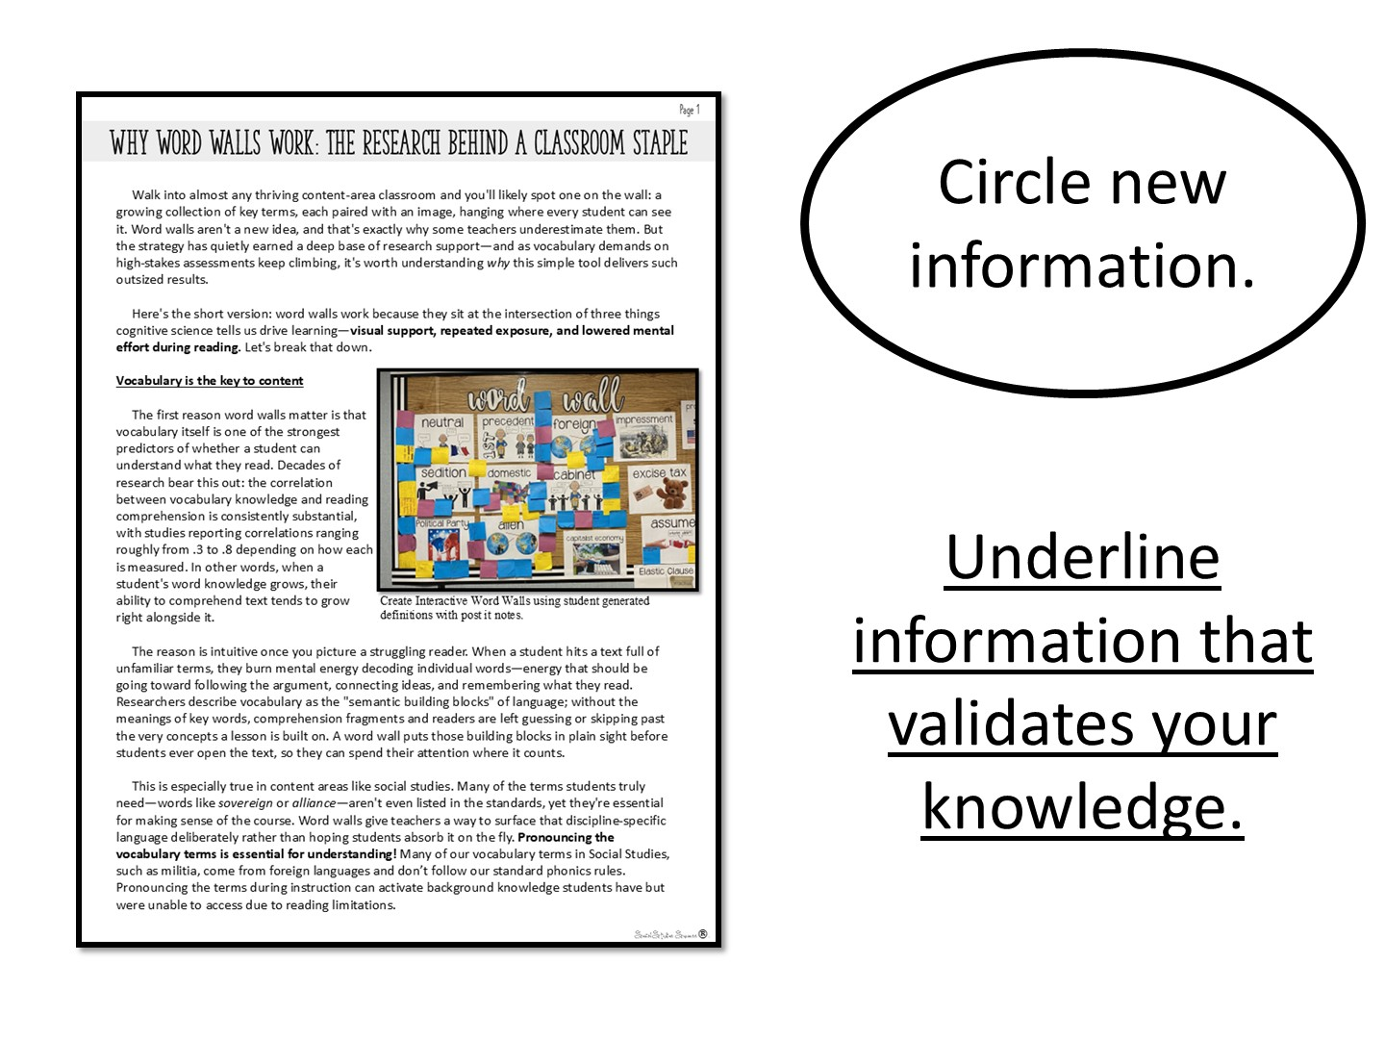
Notes:
Do you have extra time? You can pass out this handout and have them read it.

Slide 87

Notes:
Now you are going to share tips for making word walls work in the classroom.

Slide 88
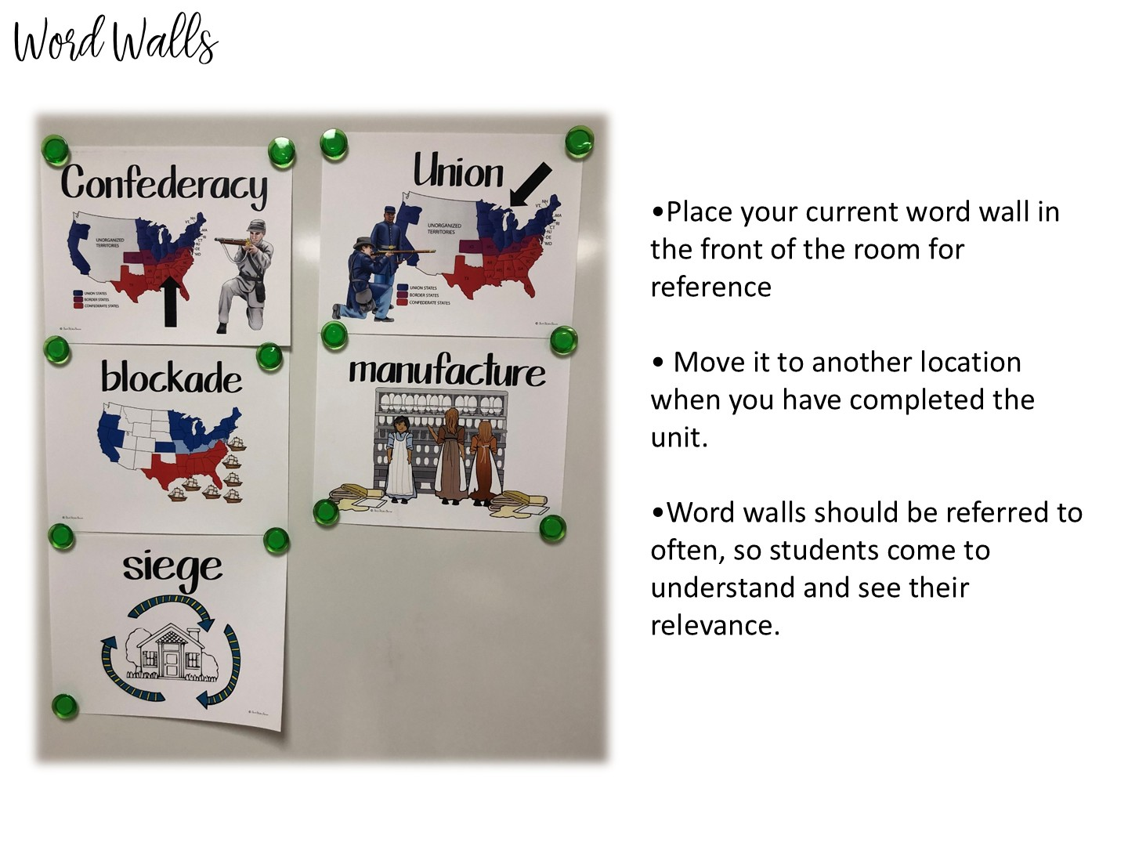
Notes:
See above

Slide 89
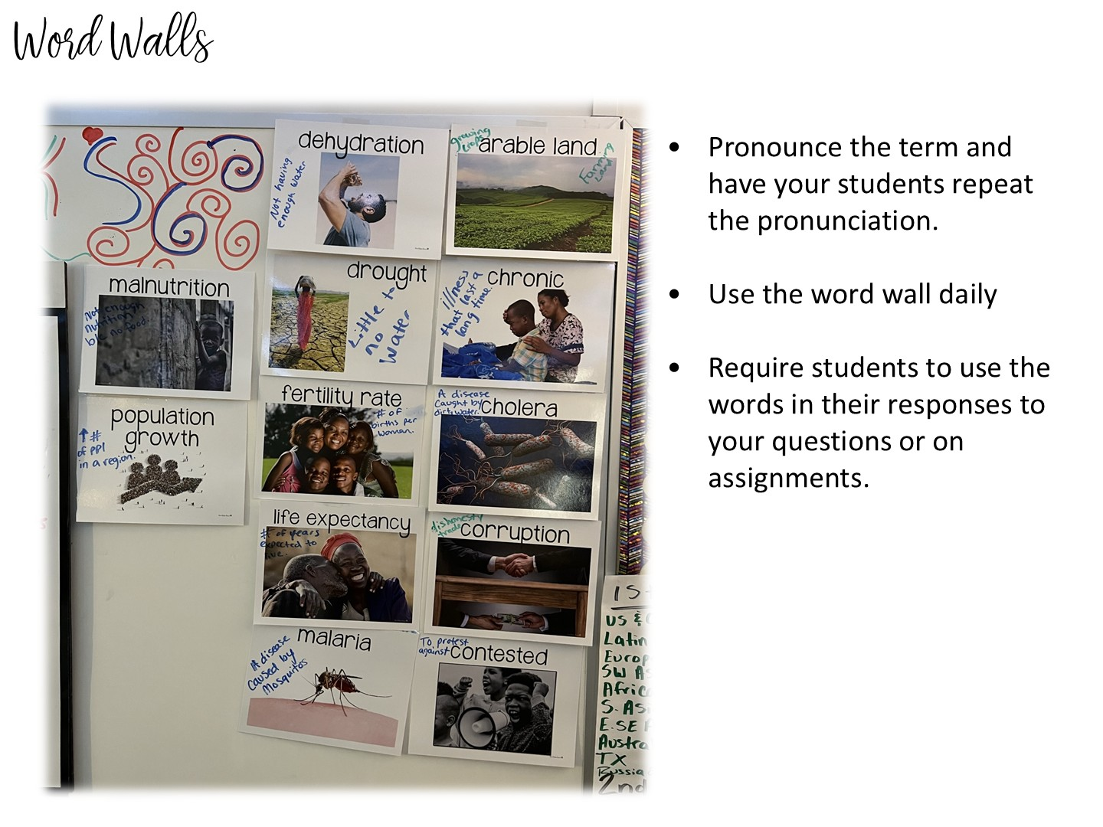
Notes:
See above

Slide 90
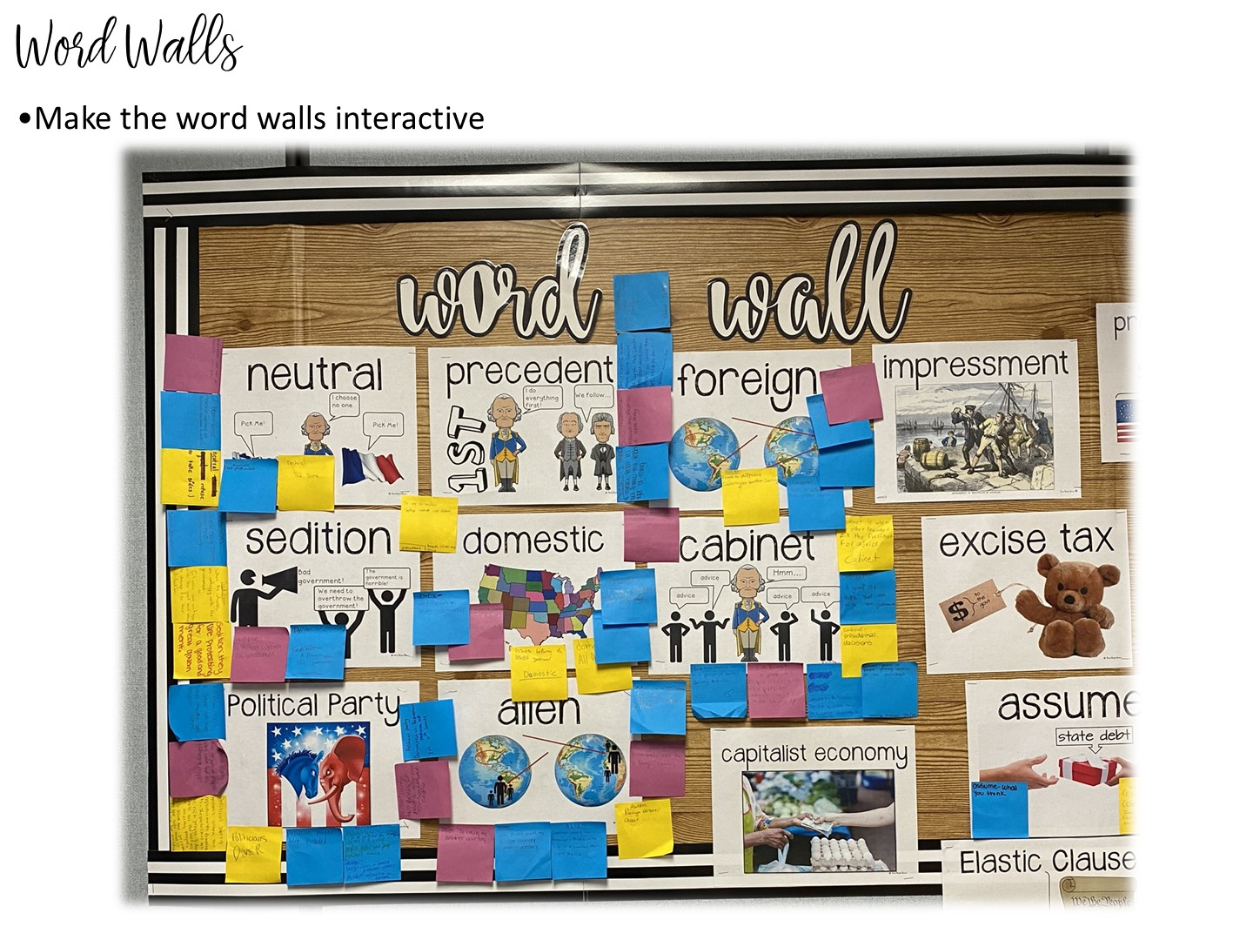
Notes:
You can use post-it notes to interact with the word walls.

Slide 91
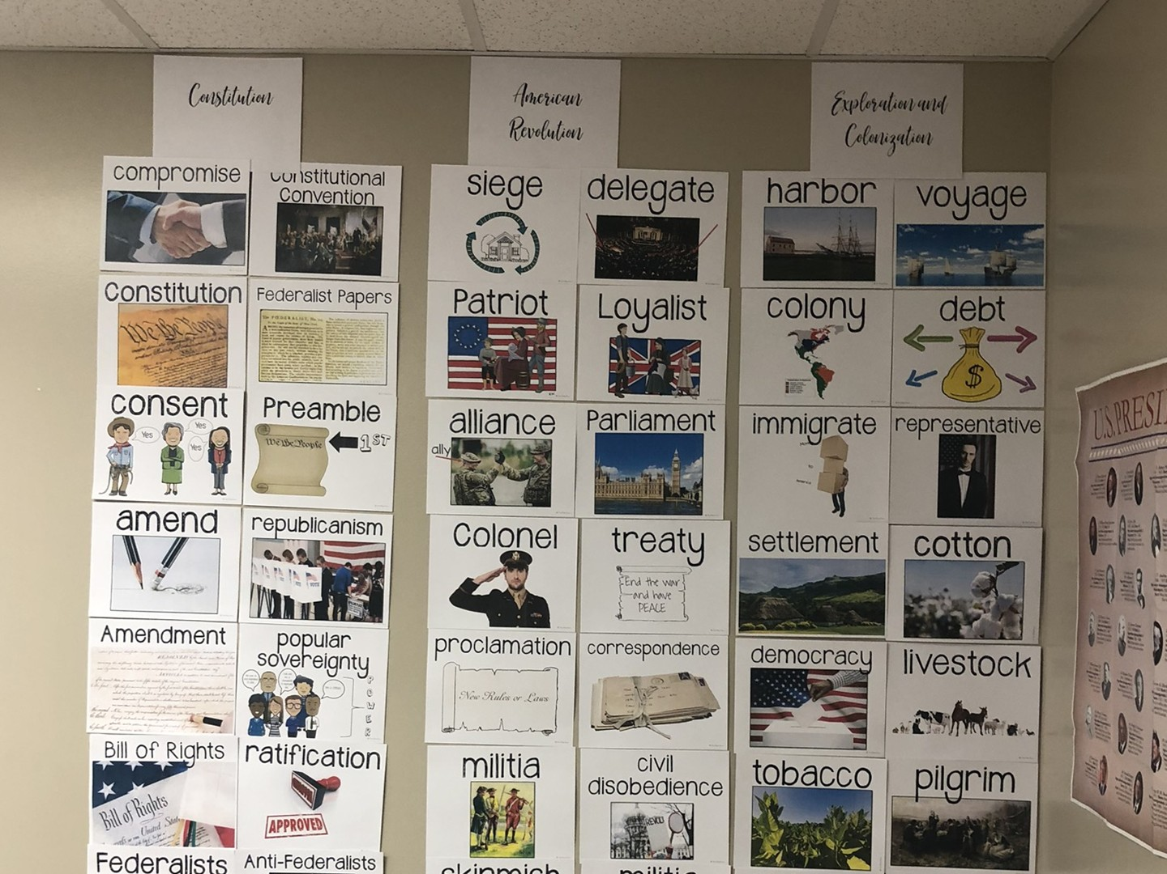
Notes:
When you finish with a unit, you can always take your word wall terms and put them in the back of the room. I recommend this for tested content areas.

Slide 92

Notes:
How to make your own word walls.

Slide 93

Notes:
Say-It-In-A-Word
Ask a question about your topic. After think time ask students to decide on one word that best expresses their response. Allow every student to share his or her word. Based on their responses, ask follow-up questions. Encourage students to ask questions of one another.

Slide 94
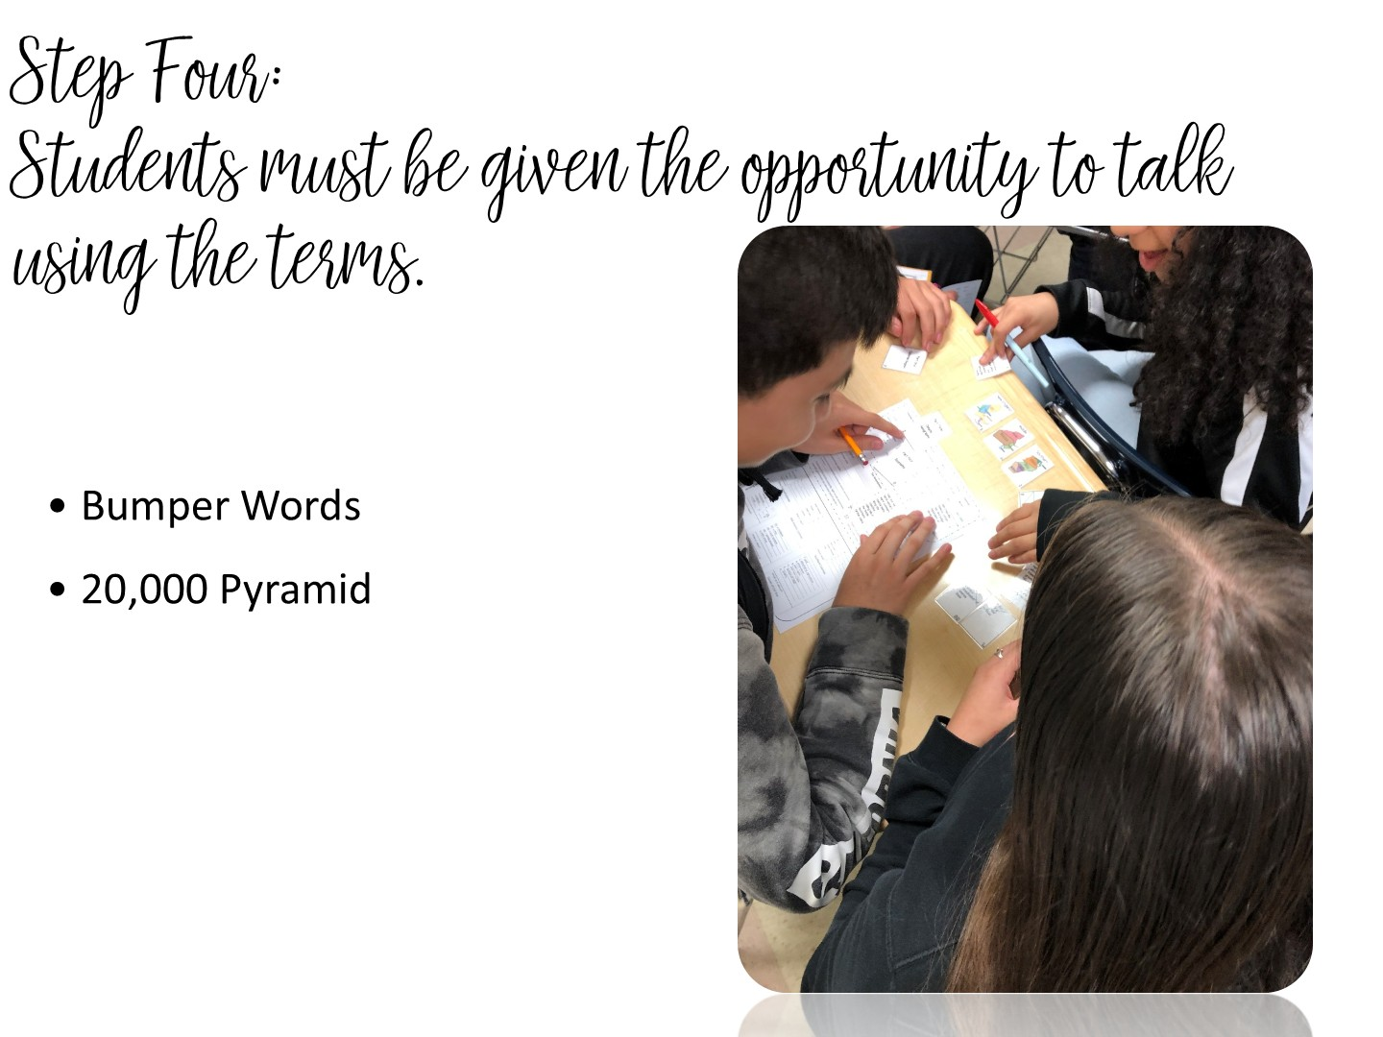
Notes:
See above

Slide 95
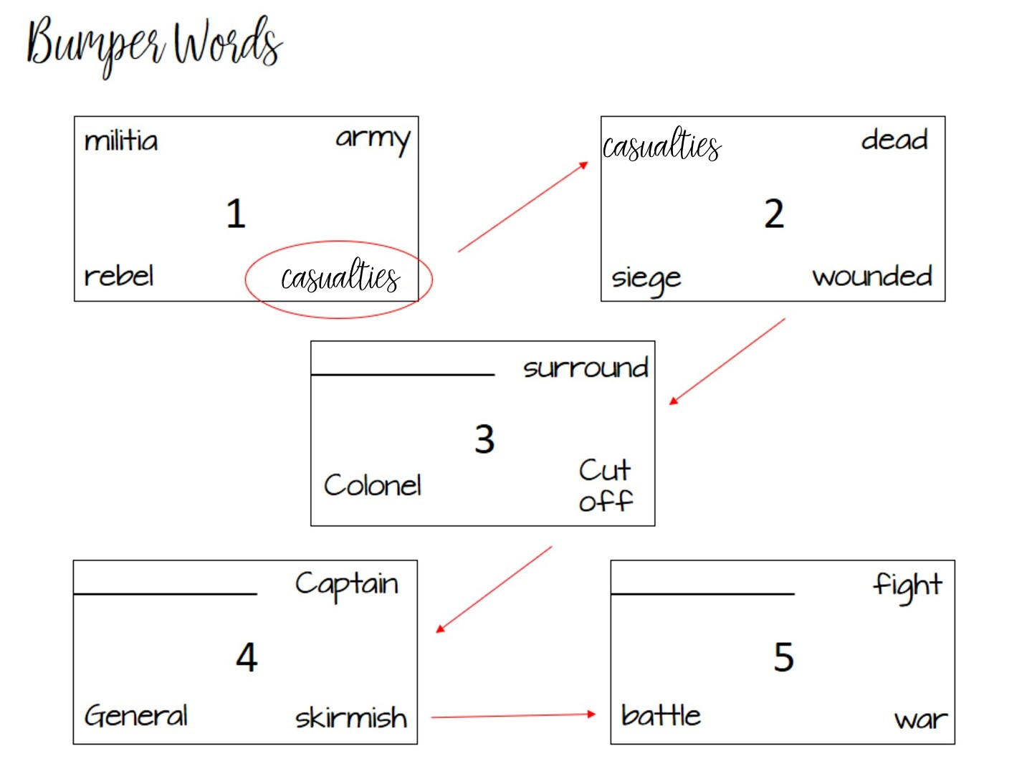
Notes:
Bumper words is a vocabulary strategy that is based on synonyms. In each box, you have a vocabulary term with synonyms. The student has to talk to a partner to determine which term does not fit. It gets bumped to the next box causing one of those terms to not fit. At the end, all of the terms in the box will go together.
Go over pattern – final answer is skirmish

Slide 96
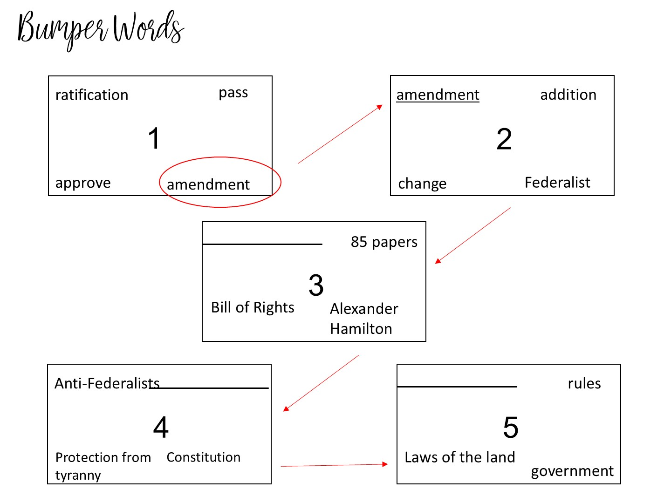
Notes:
Here is another example using both content and vocabulary terms. Final answer is constitution

Slide 97
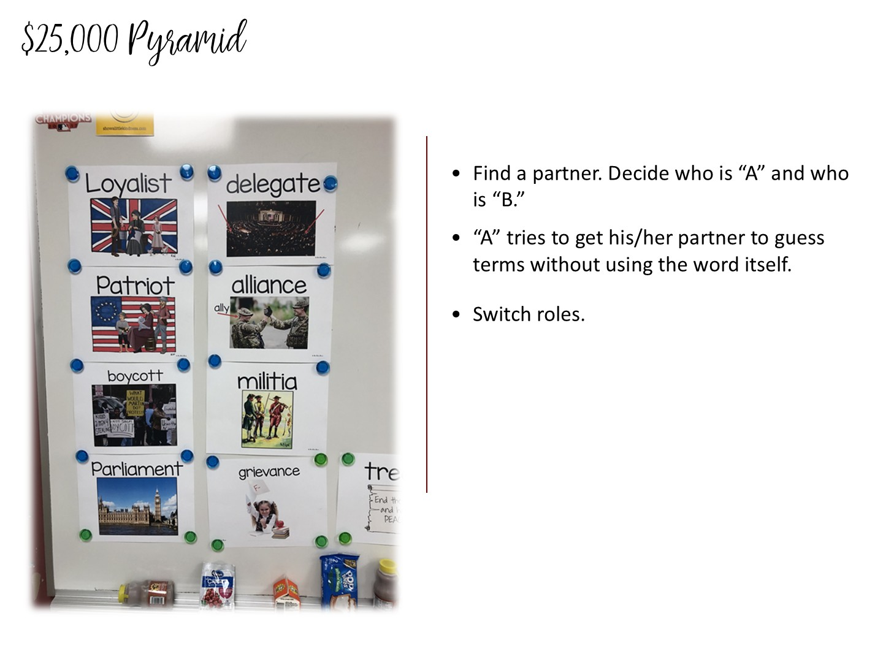
Notes:
5 minutes
Partner everyone – one person from each partner group needs to have their back to the screen (Partner B)
Put post it notes on certain terms – have partner A use definitions to try & get partner B to guess the term
Once all of the partner groups have finished – have the partners switch seats & duplicate the activity
Use the posted Latin America Vocabulary Terms to model this activity

Slide 98


Slide 99
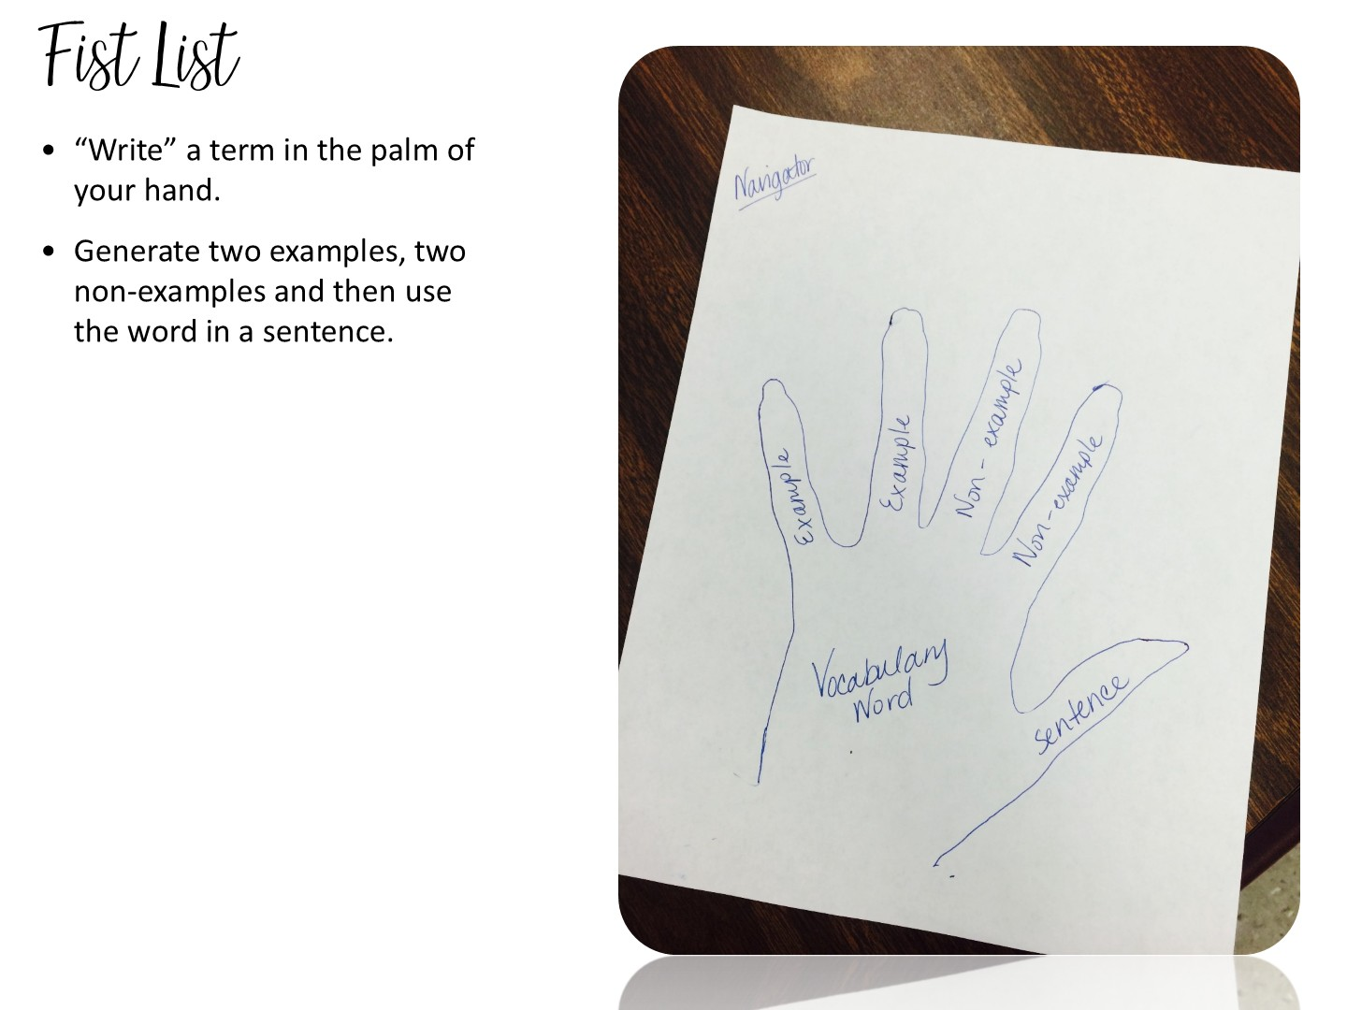
Notes:
5 minutes
Tell the participants to use the back of their pen to “write” the term in the palm of their hand or write the term on a slip of paper and put it into their closed fist.
Two of their fingers will be used for examples of the word, and two for non-examples. Their thumb would represent the word in a sentence.
5 minutes
An alternate way of doing this activity is for students to trace their hand on a sheet of paper. They then fill out the information on paper. Students can then cut the hands out & you can hang them up around the room.
EX:
Pretty
Examples – a flower, a model
Non examples – trash, pollution
Sentence – the girl wore a pretty dress to prom.

Slide 100
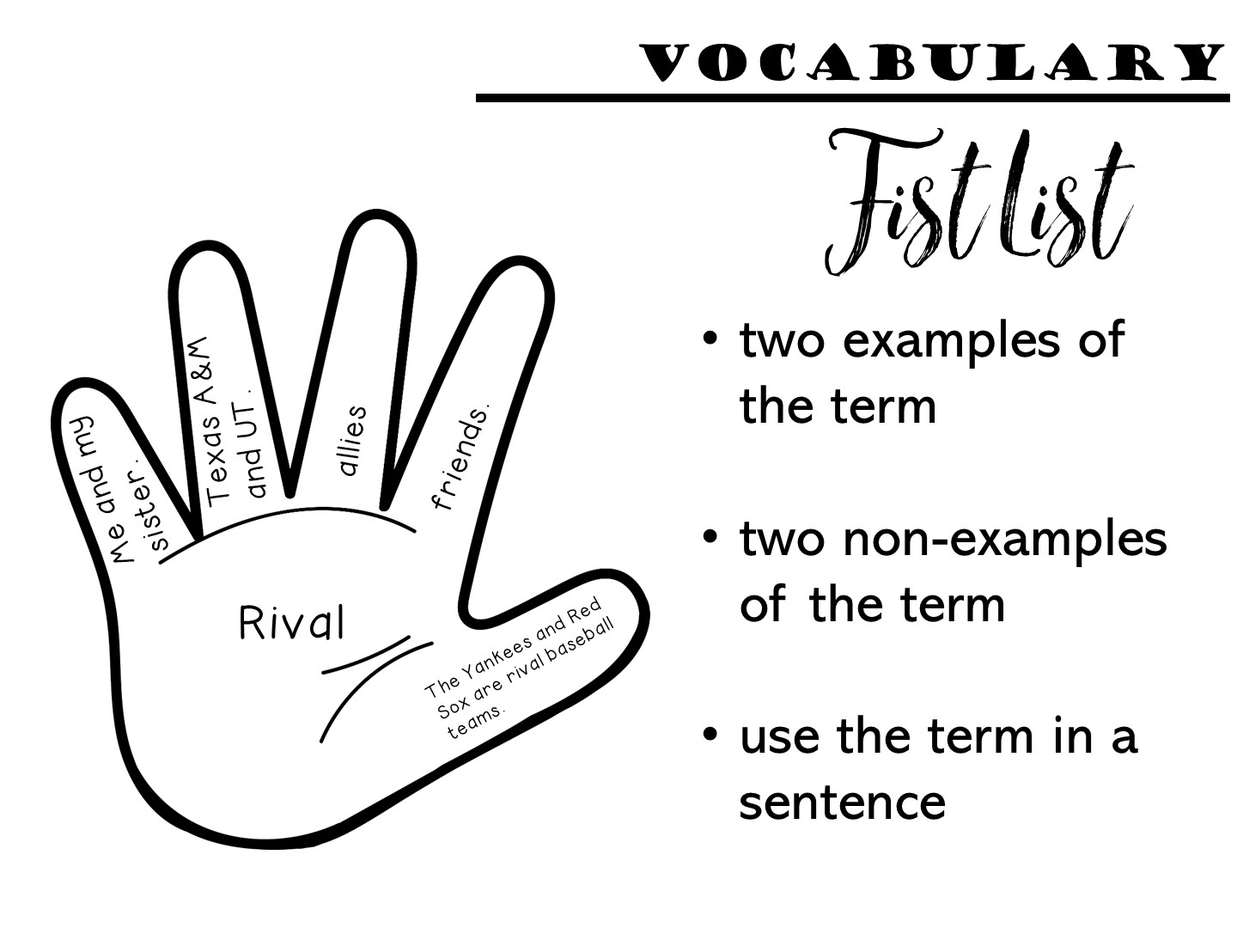
Notes:
If you have time, you can trace their hand on a sheet of white paper and choose a vocabulary word off of the word wall.

Slide 101
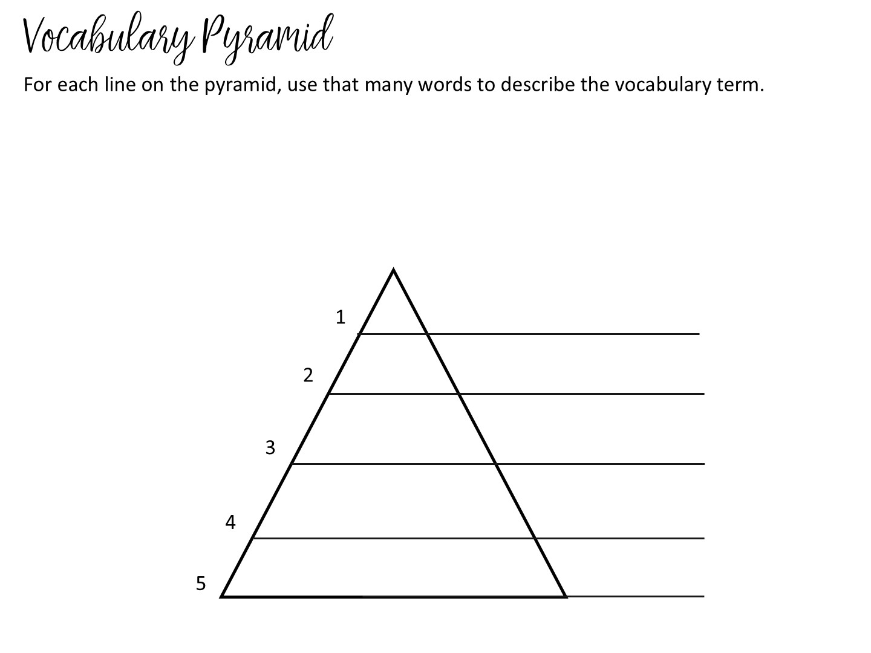

Slide 102
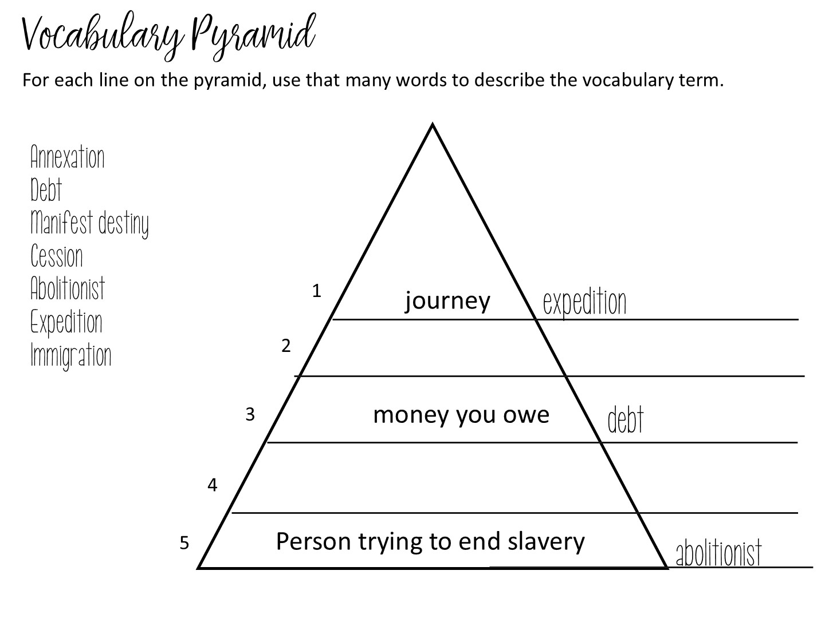
Notes:
Explain example

Slide 103
Notes:
Pass out Vocabulary Pyramid and use word wall to make.

Slide 104
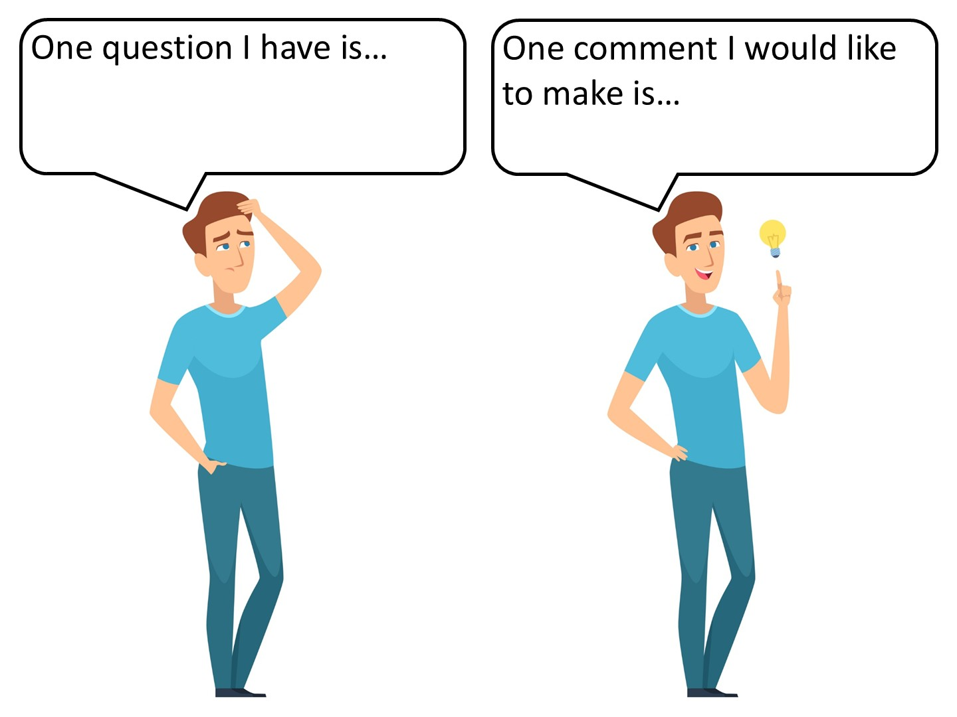
Notes:
Discuss one question this information brings to mind and one comment you would want to share with a colleague.

Slide 105
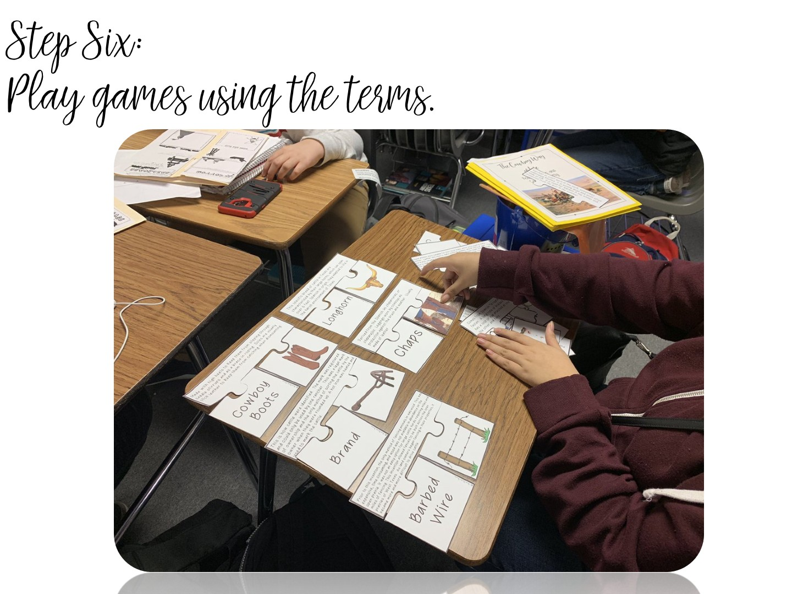
Notes:
Students LOVE games – I would like to share several different strategies for games with you.

Slide 106
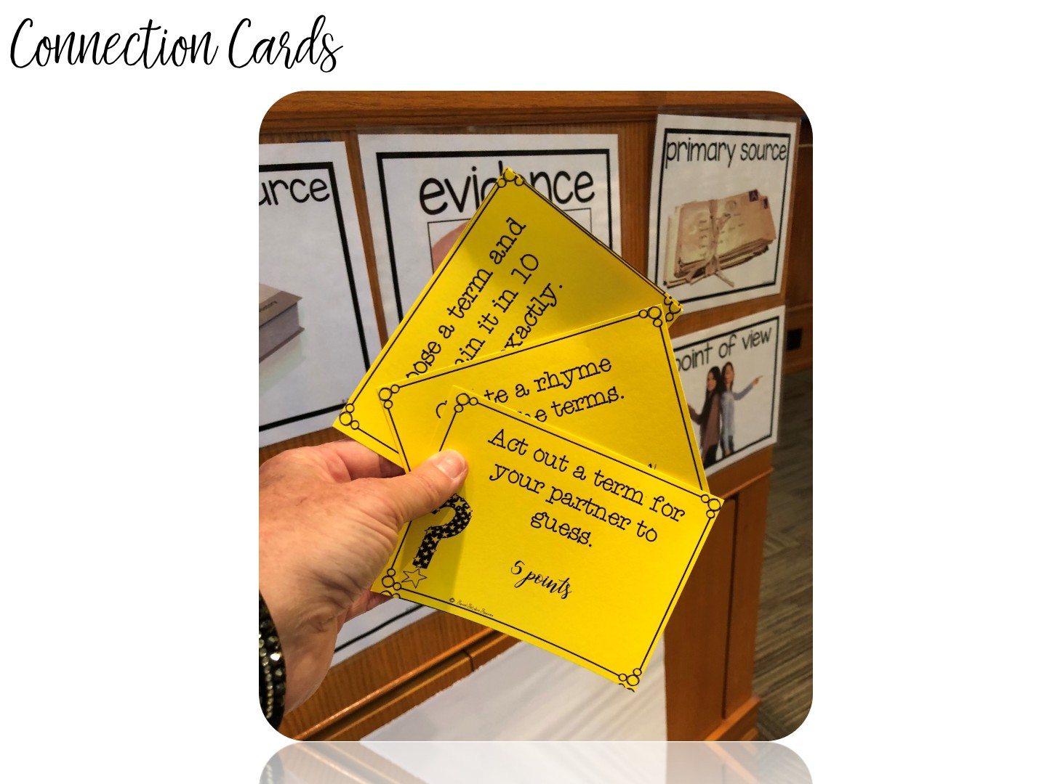
Notes:
explain

Slide 107
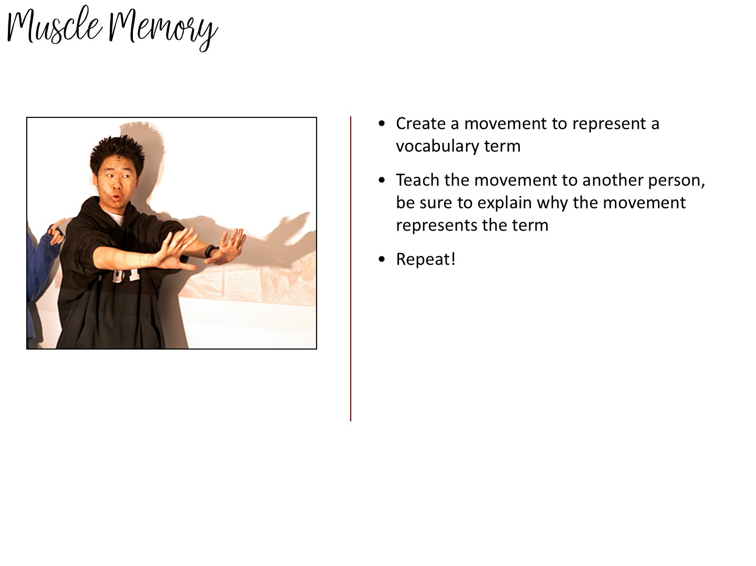
Notes:
explain
Have each group member act out or create a movement of the definition of the word – other group members guess the terms.

Slide 108

Notes:
With all those specific strategies you learned, there is only one addition – your students must read!

Slide 109

Notes:
Discuss

Slide 110


Slide 111

Notes:
Filler if you need time

Slide 112
Notes:
Give them 5 minutes to write down reflections on their Doodle Notes

Slide 113


Slide 114

Notes:
Just ask a few teachers as a warm-up question.

Slide 116

Notes:
Prep for this portion of the activity by taping different reading strategies on chart paper. Post the reading strategies around the room. Give teachers different colored markers and allow the teachers to visit and then write their thoughts on a post-it note next to each strategy.

Slide 117

Notes:
Debrief after chalk talk

Slide 118
Notes:
Give them 5 minutes to write down reflections on their Doodle Notes

Slide 119

Notes:
I want you to take a minute and think about the different types of notes you give in your class. (Share with a partner)

Slide 120
Notes:
Share that there are actually two different phases of During Reading in Social Studies – the second part includes independent note making.

Slide 121

Notes:
Graphic Organizers come in a variety of forms.

Slide 122

Notes:
Other types of Graphic Notes include 2 –Column notes, with the topic and a summary.

Slide 123

Notes:
Sketch notes are created by students while they are reading.

Slide 124


Slide 125


Slide 126


Slide 127


Slide 128


Slide 129
Notes:
Give them 5 minutes to write down reflections on their Doodle Notes

Slide 130


Slide 131

Notes:
Pass out the sinker scenarios. Give the teachers a moment to read the cards. You will be presenting a variety of different TEKS, and they will need to choose the best after reading assignment to go with the standard.

Slide 132


Slide 133


Slide 134


Slide 135

Notes:
Tell the teachers that these ideas came from the Literacy Strategy Manual – hold yours up. And that they are on the website at the top of the page.

Slide 136


Slide 137


Slide 138

Notes:
Pass out the ISN Doodle Notes and encourage teachers to take notes on this handout. When you are done, they will glue it in their ISN.

Slide 139

Notes:
We are now going to look at the interactive student notebook, using the Earthquake lesson as our reference model.

Slide 140

Notes:
We are going to look at what makes an ISN – Structure
and how we can personalize it in our classroom - Style

Slide 141


Slide 142

Notes:
This is the analogy we use for the ISN. Notice it parallels the reading cycle.

Slide 143


Slide 144

Notes:
This is your personal choice in the classroom (share all your tips in this section).

Slide 145

Notes:
There are also things that you can do to individualize them. As you go over these, give your tips and experiences using notebooks.
For reduce the number of lost notebooks explain that the students have invested their time and personality into them, so they now have value to the kids.

Slide 146

Notes:
There are also things that you can do to individualize them. As you go over these, give your tips and experiences using notebooks.
For reduce the number of lost notebooks explain that the students have invested their time and personality into them, so they now have value to the kids.

Slide 147

Notes:
This will help kids know what the assignment is about and when it was done. This will help absent kids too.

Slide 148

Notes:
Discuss with participants how you can number pages. There are a variety of ways you can do this. Share the above with them and what you have done or tried in the past. You might need to explain that we are teaching without left-side/right-side if you have some folks who were taught the ISN by an old-schooler!
Number as you go - Explain to participants it is best to number as you go so if a kid messes up their whole notebook is not messed up.
Number by activity – each activity has a number
A,B,C method – Can use this with either. Preview is 2A, Notes 2B, Processing 2C or if you number as you go, if a kid needs more room than the page you gave them, they can make that A and move to page B.
Explain that all kids should be on the same number system and do not let them number on their own or their will be a lot of confusion when you want to grade or have the kids find something.

Slide 149

Notes:
I showed two examples, if you do something different, explain that to them.
I also share how I go to the teacher center and use a poster maker to make a big poster of the Table of Contents and laminate it. That way I can use dry erase markers on it and keep it up where the kids can see.

Slide 150

Notes:
You can include other things besides preview, notes, and processing in your notebooks as well. Vocabulary, maps are a few examples.

Slide 151

Notes:
You can give the example of 5-5-5 5 terms, 5 phrases, 5 colors required for a unit page. This picture does not have it, but that is something they can require their students to do.

Slide 152

Notes:
Debrief with these stems.

Slide 153
Notes:
There are rubrics for teachers to download on the website.

Slide 154
Notes:
Turn and Talk
This decides how you grade the notebook – either looking for perfection or grading the learning process.

Slide 155
Notes:
Monitor often at the beginning of the year.
Stamp, initial, or place stickers to indicate you have seen the item.
Write comments, especially positive comments or suggestions, on sticky notes.

Slide 156
Notes:
Allow students to use notebooks on a quiz
Helps students understand the importance of taking notes.
Encourages students to bring their notebooks daily.
Builds good work habits for the future.
z or test.

Slide 157
Notes:
Have students look at other student examples.
Examples from previous years
Gallery walk
Peer Review

Slide 159
Notes:
Share any tips you have for grading.

Slide 161
Notes:
Discuss by bullet points
Notes with highlighting key terms are easier to use to study for tests
Model when give notes use different color pens on overhead or in powerpoint.
Put color as part of the grade – stress color for organizing not for “prettiness”

Slide 162
Notes:
Discuss point
Can help them study; is a portfolio of evidence of learning
Help with test at state level; give story of student who kept and used their notebook

Slide 164
Notes:
Give them 5 minutes to write down reflections on their Doodle Notes

Slide 165
Notes:
Point out my blog on social studies success if they want to learn more.

